Slide 1


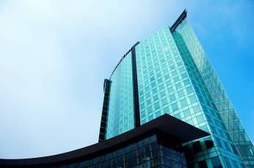
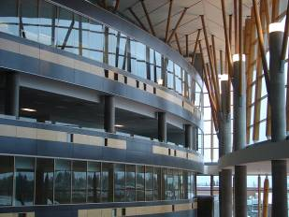
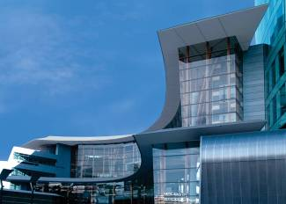
IAT 106
Spatial Thinking and Communicating
Fall 2020

Slide 2
ABM Sketch Submission
Final submission
OR
Work In Progress Submission?

Slide 3
Due by December 7th?
Sketches of ABM,
oral in-lab presentation
Onshape final model,
Video & Presentation

Slide 4
SIAT Showcase
☺
SIAT is running a digital showcase for the Fall 2020 semester and we are currently collecting project submissions by students to feature on the SIAT website and social media. The showcase will highlight the impressive work of student in SIAT and is a great opportunity to have your projects promoted and seen by industry professionals and others.
Projects can be submitted through the online form at the link below and are being accepted until December 8th.
http://www.sfu.ca/siat/fall2020-showcase-submission.html

Slide 5
This Monday (Nov 30th, 2020)?
Work on your ABM assemblies in groups of 5
Give feedback/suggestions to 4 of your group mates on their digital files
Receive feedback from the TA

Slide 6
OnShape Make-Up Quiz
Signup please!
☺
Date: Dec. 9th - Wednesday
Time: 11:30 AM - 12:30 PM

Slide 7
Final Exam Conflict
Early Final Exam sign up sheet on canvas!
Date: Dec. 10th - Thursday
Time: 10:30 AM - 1:30 PM

Slide 8
Final Exam Structure
Open book
3 hours exam
All drawing questions
(multi-views, x-sectional, auxiliary, isometric)
Date: Dec. 11th - Friday
Time: 7:00 PM - 10:00 PM

Slide 9
Weekly quizzes?
7 best out of 8 quizzes
Week 01 and 02 make-up quiz is up on canvas

Slide 10
Performers December 2nd,2020
Rohan – Sing ☺
Emily - ?
Alyssa and Olivia are sharing bird stories
Angela - painting
Hanmin – piano
Alex – piano,
Greg – sing + guitar ☺
Shallyn – cat + ski video

Slide 11
See you on Monday!
Thank you!
☺

