Slide 1
Fall 2020
REVIEW
Notes:
asdfa

Slide 2
Course Outline by Week
1.Nature of Spatial Thinking + Space, Objects and Operations
2.Sketching and Dimensioning
3.Multiview Projections - introduction
4.Multiview & Pictorial Projections; OnShape intro
5.Perspective; model-making
6.Auxiliary Views and Cross-Sections
7.Linkages
8.Project: A Beautiful Machine – Guest Lecture by Robert Woodbury
9.Project: Parts in OnShape
10.Project: Assemblies in OnShape; constraints
11.Project: Digital models
12. Course review & exam prep
13. Dec 11: Final Exam @7:00 PM

Slide 3
Spatial thinking as a universal mode of thinking
Accessible to everyone to different degrees in different contexts
As a means of problem solving
Three important elements of spatial thinking:
    concepts of space
    tools of representation
    processes of reasoning
Notes:
Accessible: Who uses spatial thinking? Graphic designers- Architects. What about your ABM?
Engineers use spatial thinking
Jobs in Entertainment, eg Animation, Games, …
Jobs in Design (Industrial, Engineering, Architecture)
Jobs in Business
Jobs in Science (Physics, Medicine, Biology, Engineering)
Jobs in Medicine
Problem Solving:
Three important elements:
Concepts of Space: Space: —how obj positioned wrt one another
Representation—for example, the relationships among views (e.g., plans versus elevations of buildings, or orthogonal versus perspective maps), the effect of projections (e.g., Mercator versus equal-area map projections), the principles of graphic design (e.g., the roles of legibility, visual contrast, and figure-ground organization in the readability of graphs and maps);
reasoning—for example, the different ways of thinking about shortest distances (e.g., as the crow flies versus route distance in a rectangular street grid), the ability to extrapolate and interpolate (e.g., projecting a functional relationship on a graph into the future or estimating the slope of a hillside from a map of contour lines), and making decisions (e.g., given traffic reports on a radio, selecting an alternative detour).
Tools of Representation:

Slide 4
Spatial thinking entails knowing about
Space:
  relationships among units of measurement, different ways of calculating distance, the basis of coordinate systems, the nature of spaces
  structuring problems, exploring solution alternatives, finding answers, expressing solutions.
Objects and Relationships
  Objects and …
  Assemblies: collections of objects and relationships
Representation:
  relationships among views, projections
  describe, explain, and communicate the structure, operation, and function of those objects and their relationships e.g. sketch, SW
Reasoning
  Answer questions about the operations of assemblies.
Notes:
Spatial thinking entails knowing about:
Objects: What are the spatial relationships between components? And constraints? For example, a gear on a vertical axis has a coincident mate to a similar gear on a horizontal axis.
Representation—for example, the relationships among views (e.g., plans versus elevations of buildings, or orthogonal versus perspective maps), the effect of projections (e.g., Mercator versus equal-area map projections), the principles of graphic design (e.g., the roles of legibility, visual contrast, andfigure-ground organization in the readability of graphs and maps);
Reasoning—for example, the different ways of thinking about shortest distances (e.g., as the crow flies versus route distance in a rectangular street grid), the ability to extrapolate and interpolate (e.g., projecting a functional relationship on a graph into the future or estimating the slope of a hillside from a map of contour lines), and making decisions (e.g., given traffic reports on a radio, selecting an alternative detour).

Slide 5
Functions of Spatial Thinking
Spatial thinking serves three purposes:
Descriptive function:
  capturing, preserving, and conveying the properties of
  and relations among objects
Analytic function:
  enabling an understanding of the structure of objects
Inferential function:
  generating answers to questions about the evolution and
  function of objects.
Notes:
Spatial thinking serves three purposes. It has
(1) a descriptive function, capturing, preserving,
and conveying the appearances of and relations among objects;
(2) an analytic function, enabling an
understanding of the structure of objects; and
(3) an inferential function, generating answers to
questions about the evolution and function of objects.

Slide 6
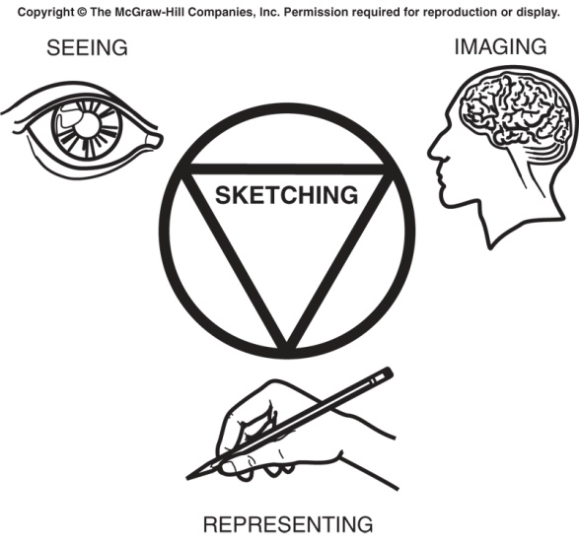
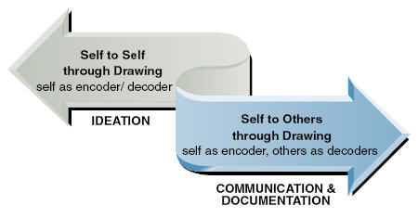
We Use Sketches to Communicate
To others:
To ourselves:
Communicate to ourselves---“Things that make us smart”
  Cannot keep all details in your head
  Put them on paper
  Adjust, refine
Communicate design ideas to others:
  Peers, other specialties
  technicians
  manufacturing
  marketing
  lawyers (why?)
  management(!)
Notes:
Things that make us smart: A book by Don Norman, discusses how we use ‘things in the world’ to help us with cognitively demanding tasks. Example: multiplying 5 x 9 in your head is easy. Multiplying 4,873 x 78,913 in your head is, for most of us, impossible.
We use ‘the world’, specifically pencil and paper, to help us with the process. Similarly when we design, we can only keep a rough idea in our head, and must work out details with pencil and paper … we are ‘communicating with ourselves’.

Slide 7
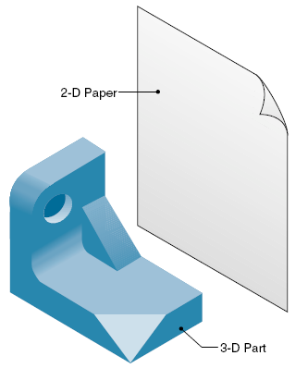
Graphical language: Object Representation
Object representation:
  How do we show a 3D object on 2D paper??
Notes:
We use a sketch as a form of representation in order to show a 3d object on 2d paperWe have to break the object down into planar views e.g. front, top, side…

Slide 8
Parts of a Sketching Language
Object representation:
  3D object on 2D paper?
Drawing layout
Line types: reduce ambiguity, increase clarity

Slide 9
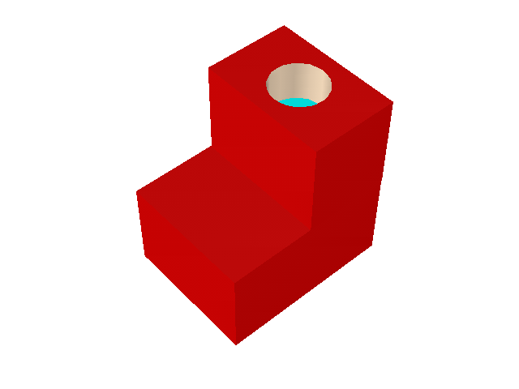
Object Representation
How show 3D object on 2D paper??
  standard projections
  orthographic views
  multiview drawing
  Isometric views
Views must be chosen carefully: if not enough, result is ambiguous!
Notes:
We have a set of conventions and techniques,
1.Standard projections that create othographic views,
2. Orthographics views which show us specific facets of the object e.g. front, top or plan, side view
2. We have multiviews which we can combine to discern a 3D object through a collection of 2D views.
Views: we see the top view, and the side view that shows the depth of the hole, In this case, we have discovered that two views are not enough.

Slide 10
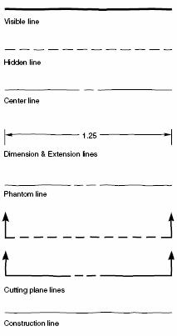
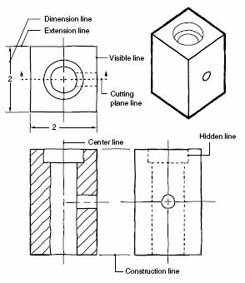
Line Types for Sketches
Both line weight and line “font” are used in the varying line types.
Line types in a design sketch
(hatching: “Cross Section”; we’ll cover in detail in later lecture)
Line “alphabet” for sketching
Notes:
Just as in any written or spoken language there are set rules to avoid error in communication.
Imagine if you use a visible line to draw the entire orthographic for your ABMs. How could anyone
Decipher the inner mechanisms from the exterior?
Here we see different styles and types of lines. You would not like to confuse a visible line with
A hidden line etc. A center line is distinguished by the distance between strokes vs. a center line.

Slide 11
What if Lines Overlap?
Use the Convention for Line Precedence:
  Visible
  Hidden & Cutting/section plane
  Center
  Break
  Dimension & extension
  Section
Notes:
There is a hierarchy of line types..

Slide 12
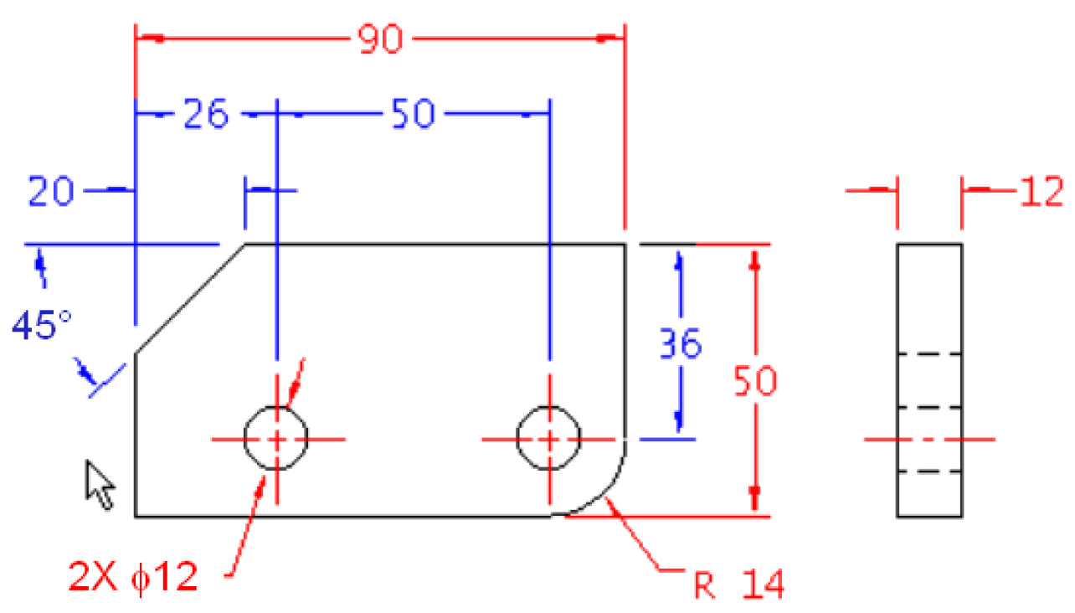
Dimensioning
Used to specify parts: Size, Location, Tolerances
All features of part must be dimensioned
Two types:
  Size (red): size of feature, e.g. of a hole
  Location (blue): location of features relative to baseline
Notes:
Question: What do we mean by overdimensioning??

Slide 13
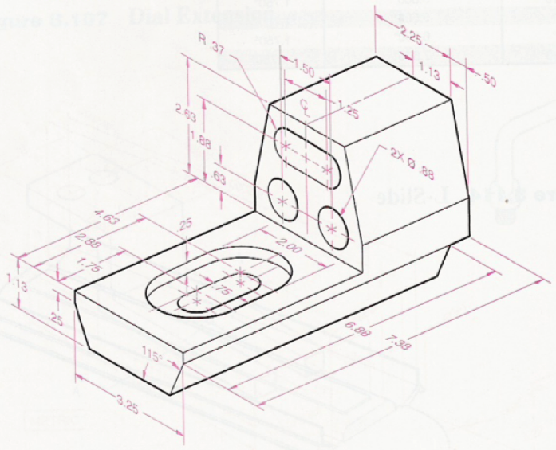
Dimensioned Object

Slide 14
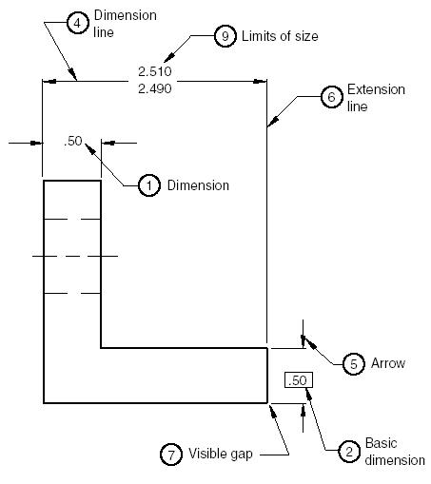
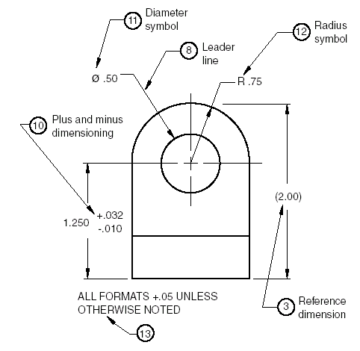
Dimensioning Terms

Slide 15
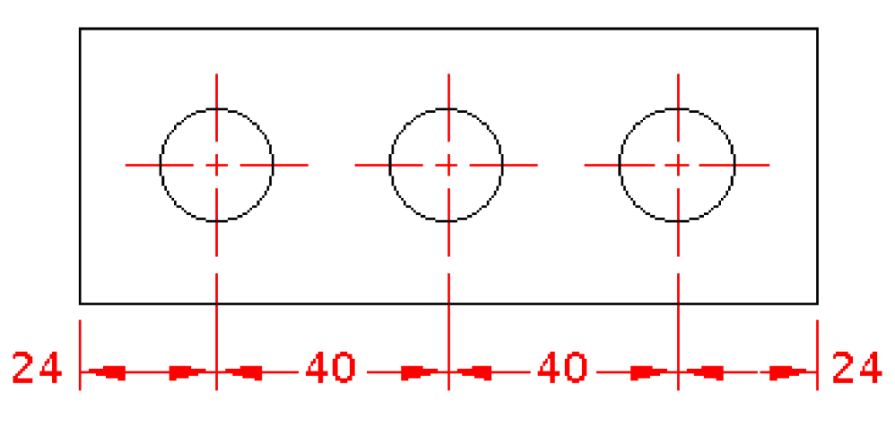
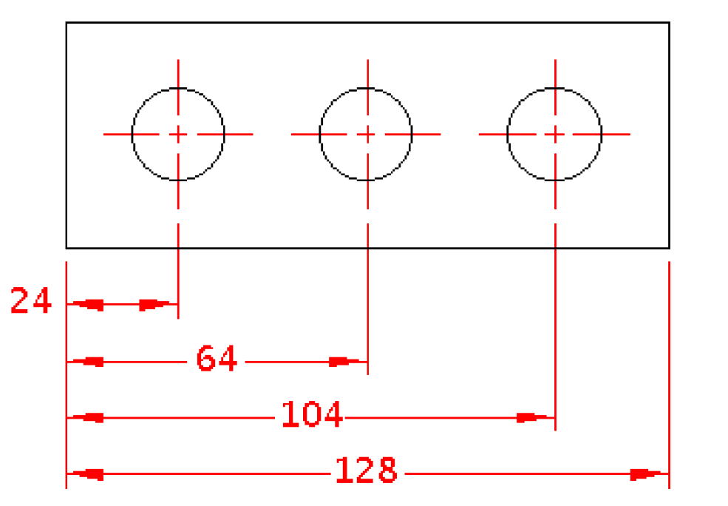
Location Dimensions: 2 Types
Relative:
locate features with respect to each other- there is no baseline for reference.
Use when separation distance between features is important
What is the drawback here?
Coordinate:
locate with respect to common baseline (also: Datum Line)
avoids tolerance buildup

Slide 16
Projections
Projection plane
object
Intersection points
projectors
“connect the dots”
Notes:
Projection Theory: based on “projectors” (rays or straight lines) from points or vertices on an object to a plane called the “Projection Plane”.
The projected view is formed on the projection plane by “connecting the dots”, ie by joining the points where projectors intersect the projection plane.
Note: clearly whether the projectors are all parallel or not makes a big difference! And the angle that the projectors make with the projection plane is also important. More on this later.

Slide 17
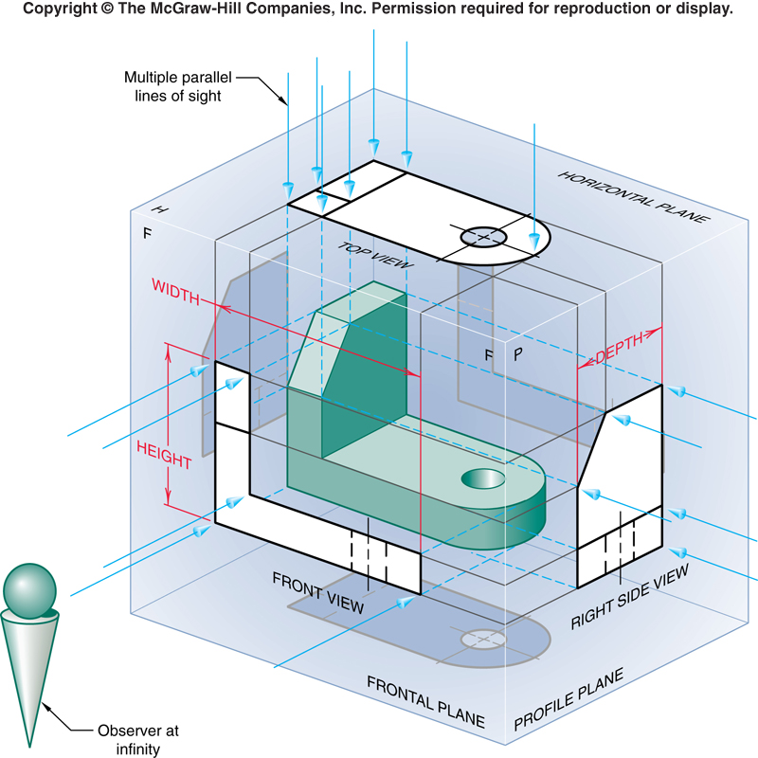
Principal Orthographic Views
So how many views can we have??
“Camera” can be anywhere:
  ∞ # views possible
  Only 6 “Principal Ortho Views”
Put object in “glass box”
Principal Views (6):
  those projected onto 6 faces of “glass box”

Slide 18
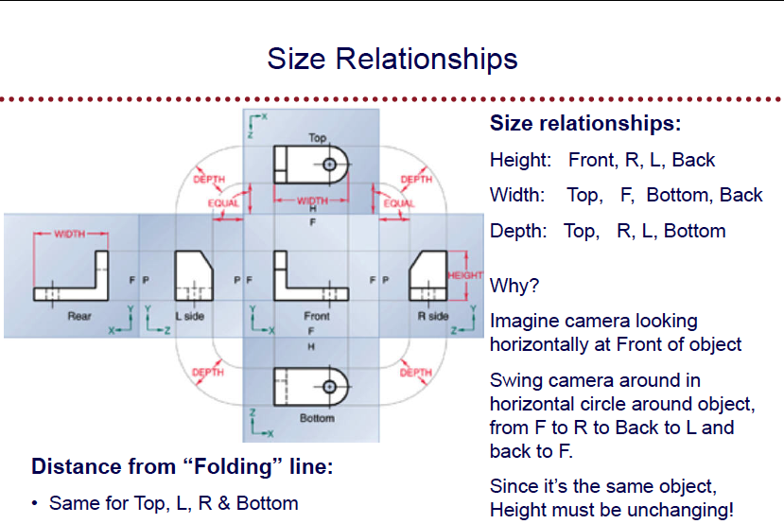

Slide 19
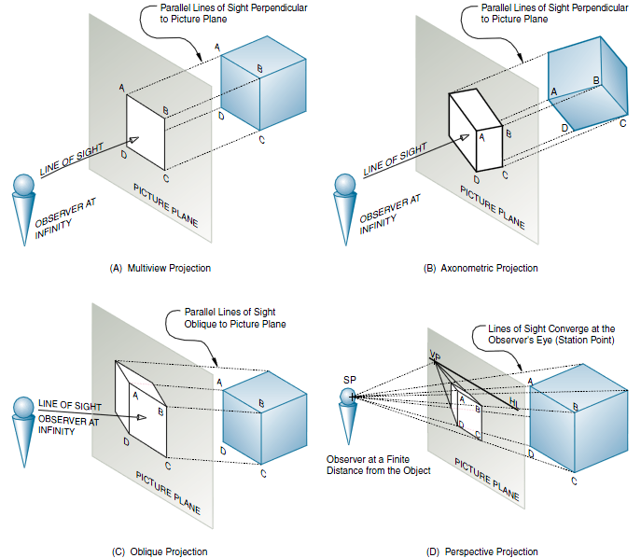
Kinds of Parallel Projection methods
Multiview/ortho
Axonometric
Perspective
Oblique
Notes:
Parallel: Projectors parallel
– from Viewpoint (infinite distance from object), through plane of projection, to object
Perspective: Projectors not parallel
- from viewpoint (finite distance from object) through plane of projection, to object
Remember the folding glass box example?
-The physiology of the human eye causes parallel edges or features to appear to converge at a distance.
-In orthographic views, projectors remain parallel

Slide 20
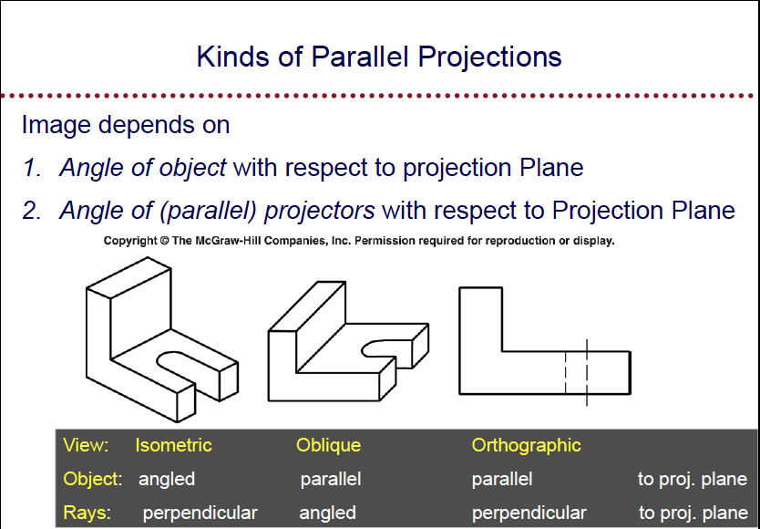
Notes:
-An oblique drawing is a type of pictorial with one face parallel to the PP (front view)
-The front view is shown in true shape and true size.
-The other views (e.g. sides) are parallel but can vary from 0 -90 degrees (arbitrarily).
- They can have a slanting position or direction; They are neither perpendicular nor horizontal, a non-right angle
There are any number of axonometric views. Simply by changing the angle of projection, we can get any image we want.
Oh, by the way, three of those are very popular and have been given a name by the number of angles that are the same.
They are available in your view menu in SW.

Slide 21
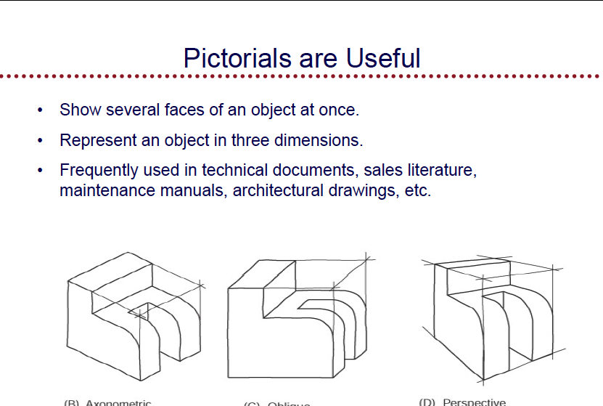

Slide 22
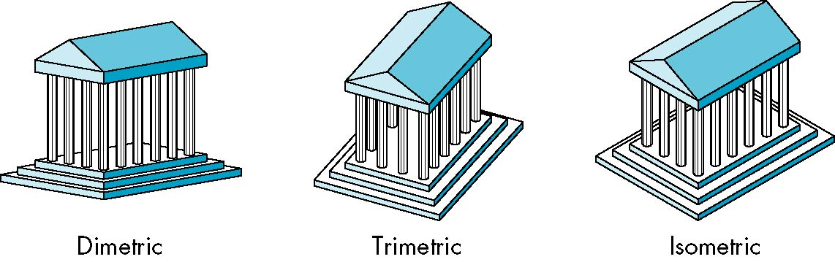
Review: Types of Axonometric Projections
There are the three most common types of axonometric projections. They can be distinguished by counting how many angles of a projected cube are similar
none= trimetric
Two= dimetric
Three= isometric
θ ₁
θ ₂
θ ₃
e.g. 60,60,60
Theta=angle
Notes:
Axonometric:
Axonometric projection is a type of parallel projection (orthographic projection is a more restricted type of parallel projection) used to create a pictorial drawing of an object, where the object is rotated about one or more of its axes relative to the plane of projection.^{[1]}
There are three main types of axonometric projection: isometric, dimetric, and trimetric projection.
These subclassifications or axonometric projections are determined by how many angles of a corner of a projected cube are the same? In the Dimetric, two angles are the same, in Trimetric, none are the same.
There are any number of axonometrics. Simply by changing the angle of projection, we can get any image we want.
Oh, by the way, three of those are very popular and have been given a name by the number of angles that are the same.
They are available in your view menu in SW.

Slide 23
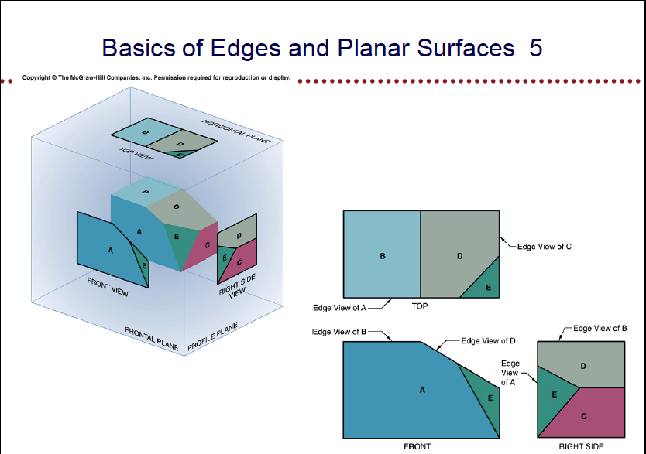

Slide 24
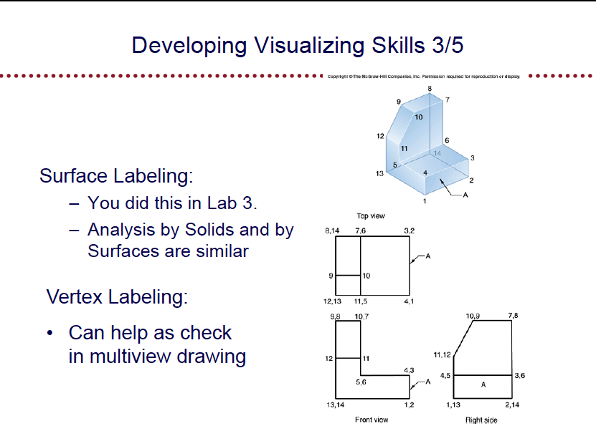

Slide 25
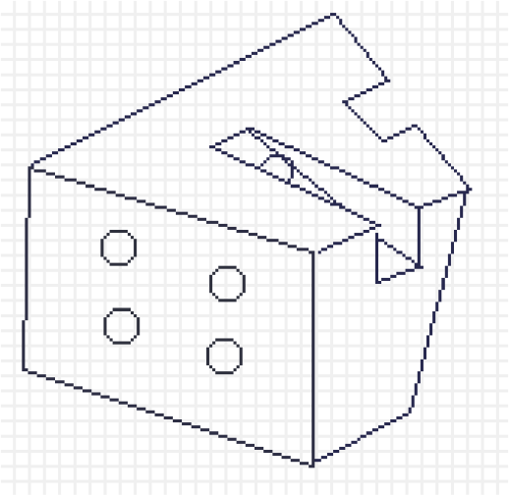
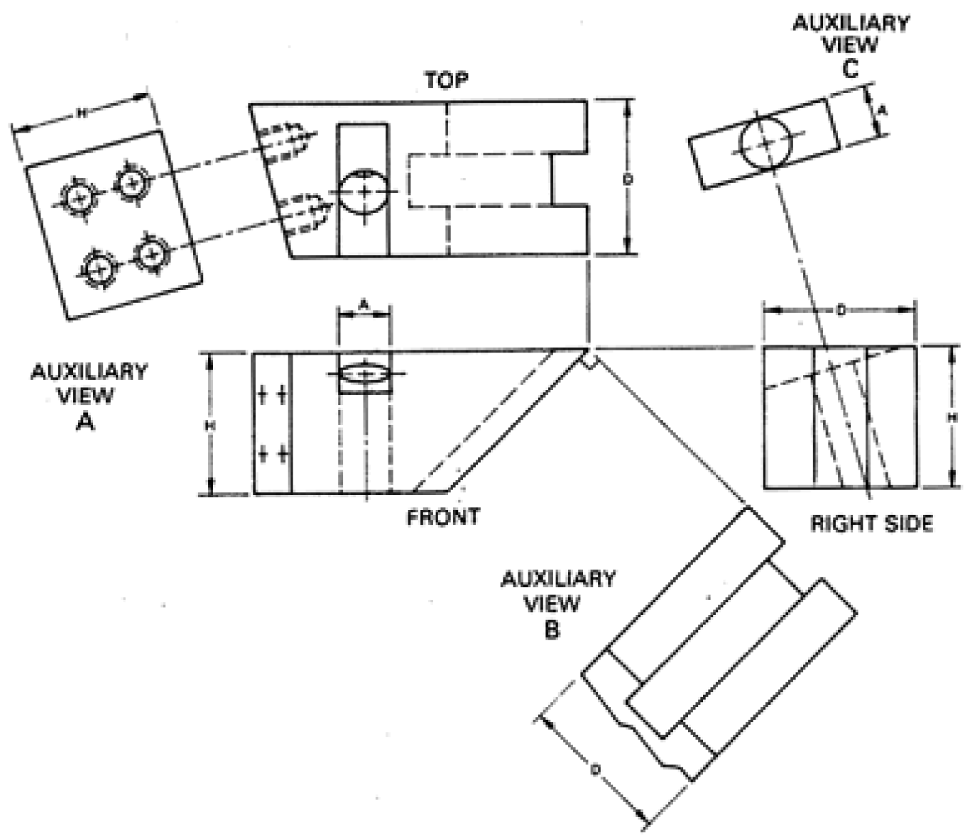
Auxiliary Views

Slide 26
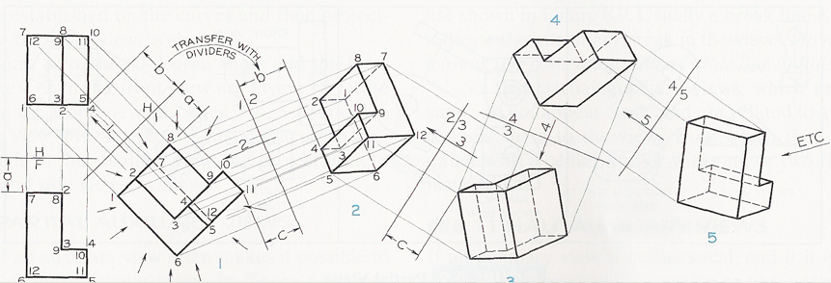
Types of Auxiliary Views
Primary Auxiliary View:
  projection from one of the six principle views
Secondary Auxiliary View:
  projected from a primary auxiliary view
Tertiary Auxiliary View:
  projected from a secondary or another tertiary auxiliary view

Slide 27
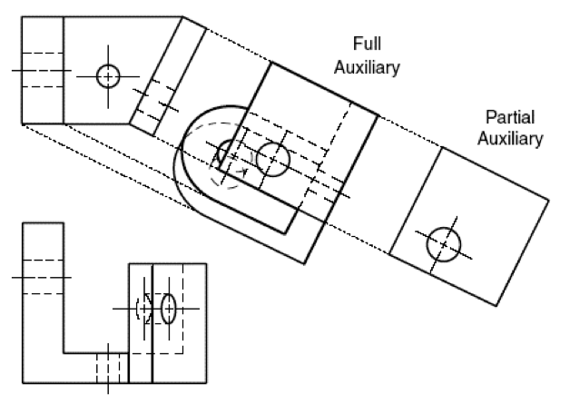
Partial Auxiliary View
Don’t show other features
Easier to draw
Easier to understand
Unless otherwise specified, we will create partial auxiliary views in IAT106
Notes:
-We will only add partial auxiliary views because they are easier to draw
-A full auxiliary view will show everything you see looking at that direction but there is more information than we need
- We are only looking at the face parallel to the auxiliary plane.

Slide 28
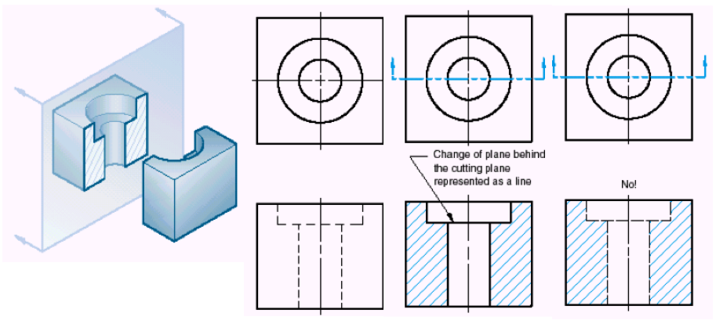
Creating a Cross-section
Normal
multiview
Correct
Cross-section
Incorrect
Cross-section
Notes:
When there are complicated internal features, they may be hard to identify in normal views with hidden lines. A view with some of the part "cut away" can make the internal features very easy to see, these are called section views.
In these views hidden lines are generally not used, except for clarity in some cases.
The cutting plane for the section is,
- shown with thick black dashed lines.
- has arrows at the end of the line to indicate the view direction
- has letters placed beside the arrow heads. These will identify the section
- does not have to be a straight line
sections can be lined to indicate,
- when the section plane slices through material
- two methods for representing materials. First, use 45° lines, and refer to material in title block. If there are multiple materials, lines at 30° and 60° may be used for example. Second, use a conventional set of fill lines to represent the different types of materials.

Slide 29
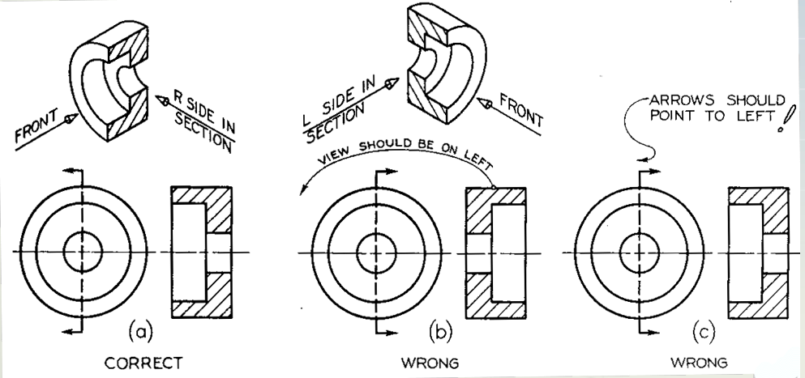
Orientation of Cutting Plane
Notes:
-Why is right side better?
-View should be on the opposite side of the arrows.
-You are removing all of the material to the right of the material and looking at it on the direction of the arrows.

Slide 30
Degrees of Freedom (For a Rigid Body)
The number of variables needed to describe the position and orientation of an object in space.
Divide movement into two types:
  Translational (moving along a line)
  Rotational (think of twirling or rotating)

Slide 31
Example of 1 Degree of Freedom
Consider a creature that lives on a number line in a 1 dimensional world
0
x
0
x
Creature can go forward and backward -> 1 degree of freedom
Notes:
An example of one degree of freedom, an object can move forwards and backwards on a line. It can change only one thing…it’s position on that line.

Slide 32
Example of 2 Degrees of Freedom
Consider a creature that lives in 2 dimensions.
y
If he can move along the x and y axis and cannot rotate, that is 2 DOF.
x
Move along the x and y axis
as well as rotate -> 3 DOF
Notes:
You can move the creature laterally up and down.

Slide 33
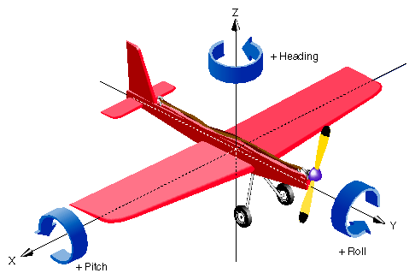
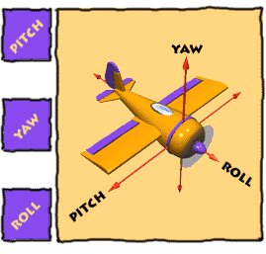
Example of 6 Degrees of Freedom
Now Consider three dimensions
3 “translational”: Translate in x, y, and z
y
Plus
3 rotational: Rotate about x, y, z
Gives a total of
6 DOF
x
z
Roll
Pitch
Yaw
http://www.nasm.si.edu/exhibitions/gal109/NEWHTF/ROLL.HTM

Slide 34
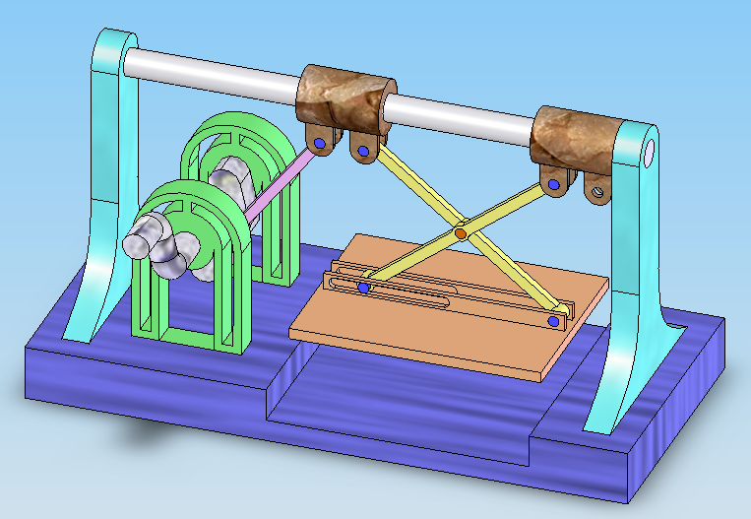
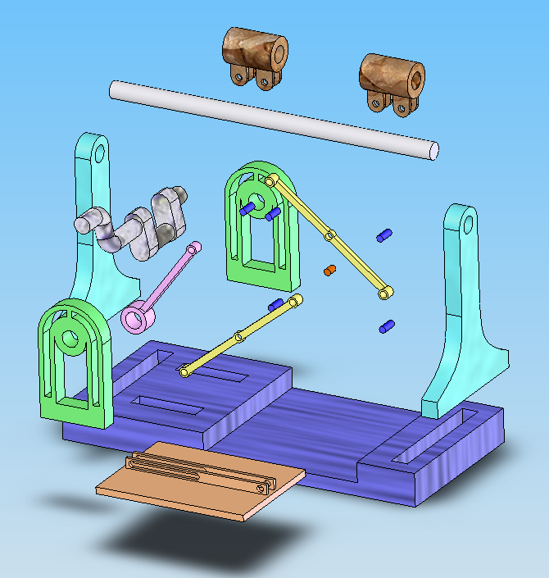
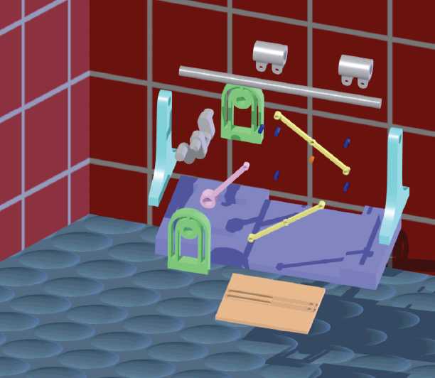
Examples of Mates

Slide 35
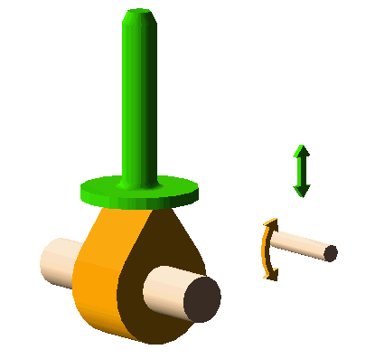
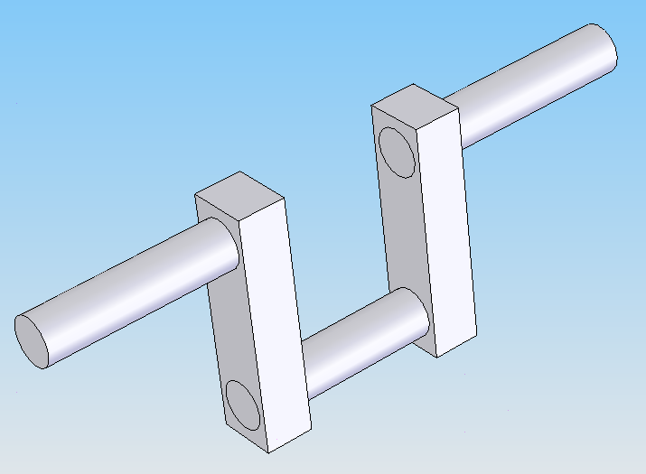
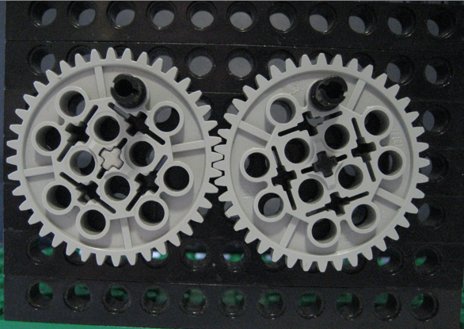

Mechanisms
Cam-follower
Crank-shaft
Gears
Belt drives

Slide 36
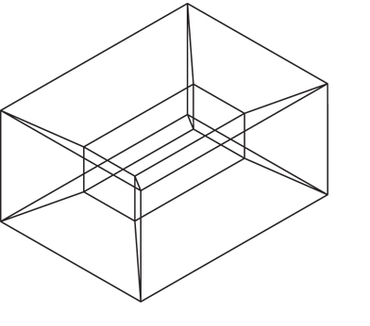
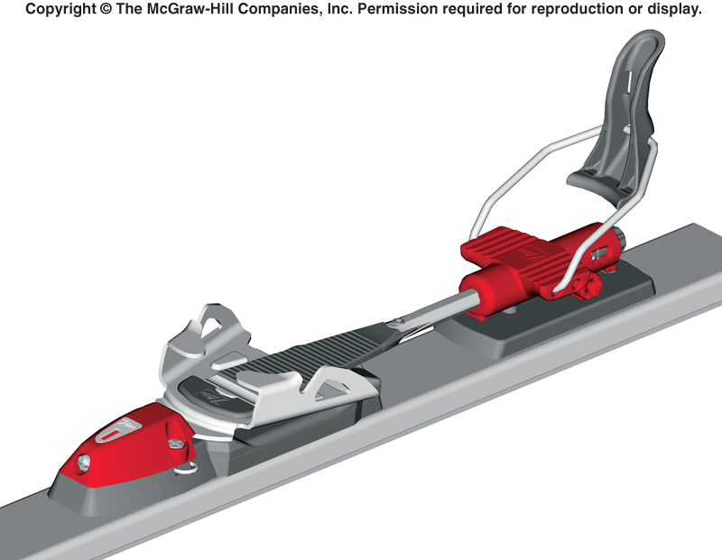
Wireframe vs Surface vs Solid Models
WireFrame: Edges + Vertices
ambiguous
Surface models: E + V + Faces
Incomplete Topological info
Solid Models
A true 3-D representation of objects. Typically constructed much like you would the physical object.
3-D Modelers, such as SolidWorks, create 3-D computer-based models of 3-D objects.
  Integrating computers into the design process (3-D CAD; available since early 1980s).
Solid Model of snow ski binding

Slide 37
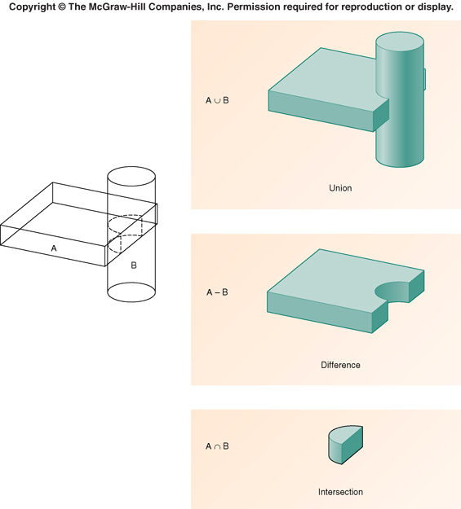
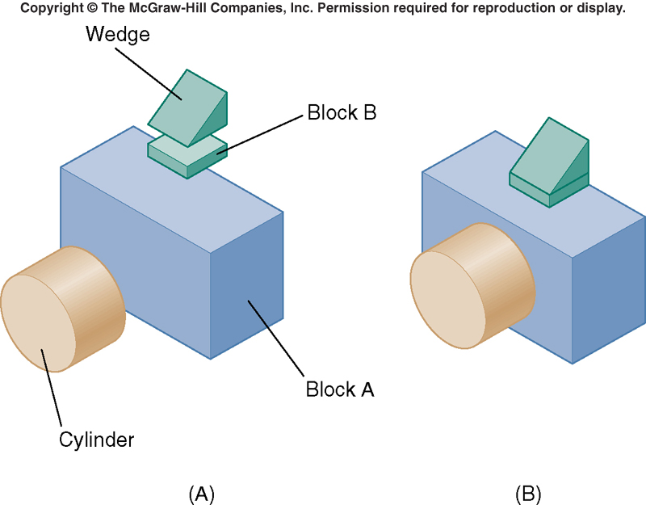
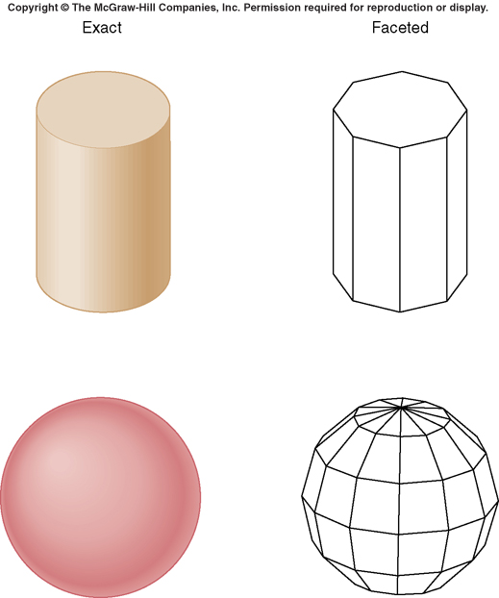
3D Solid Modeling Techniques
Primitive-Based
Constructive Solid Geometry
Boundary Rep (B-Rep)
Results in creation of different objects

Slide 38
OnShape
OnShape is an industrial-strength 3-D solid-model based computer-aided design (CAD) system.
Sketch ideas and experiment with different designs to create 3D models.
Produce simple and complex parts, assemblies, and drawings
Parametric
Feature-based
Associative

Slide 39
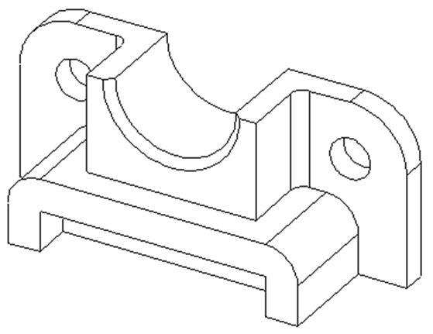
Feature-Based Modeling
Break down part geometry into set of smaller geometric elements that can be created with a single feature op in the modeler.
Begin building of the model with a base feature (sketching tool)
Constrain features: decide which geometry of the part will be constrained in each feature.
Using OnShape’s feature-based approach
Base feature: 1st feature created (foundation of the part).
The Base feature geometry:
  Extrusion (Blind, Through all, To Vertex, To Surface...)
  Sweep (need path and a close profile)
  Revolve (need an axis and a non-intersecting closed profile)
  Fillet, Chamfer, Mirror, Pattern etc.

Slide 40
Constraint-Based Modeling
Model defined as series of modifiable features.
  Feature’s geometry controlled via modifiable constraints.
Design model so it behaves as expected when features are modified.
  Behavior should reflect design intent of object being modeled.
Modifications to feature’s geometry reflected in both:
  part containing the feature, and
  assemblies containing this part.

Slide 41
Constraint-Based Modeling
The designer, in creating a 3-D solid model, starts by sketching components (i.e. features ). Consider:
Where should
the hole go?
Is this right?
Is this what the designer intended?
Based on given constraints,
it would go here
We don’t know; all we know is that the constraints indicating intent specify this.
Now, what if the designer had intended this:
Add new constraint:
Make circle’s center pt coincident with midpoint of diagonal

Slide 42
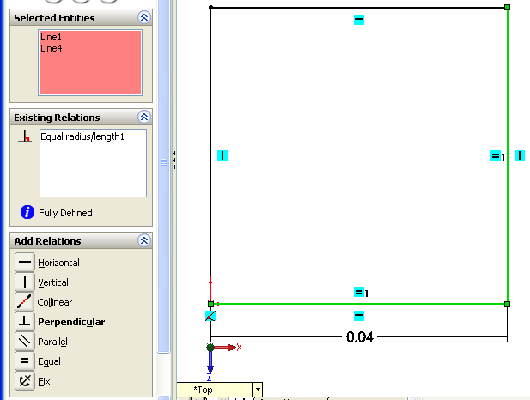
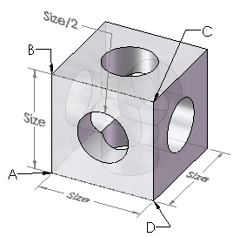
Types of Constraints
 | Size | Location | Orientation
Explicit defined by user | AD = AB R = AB / 4 | Center point on midpoint of diagonal | Angle AB and BC = 90°
Implicit selected by user | Equal | Concentric | Parallel

Slide 43
Implicit Constraints
Closure
Segment Overlap
Endpoint / Line
Overlap
Tangency
Parallelism
Perpendicular
Same Size
Concentric
Coincident

Slide 44
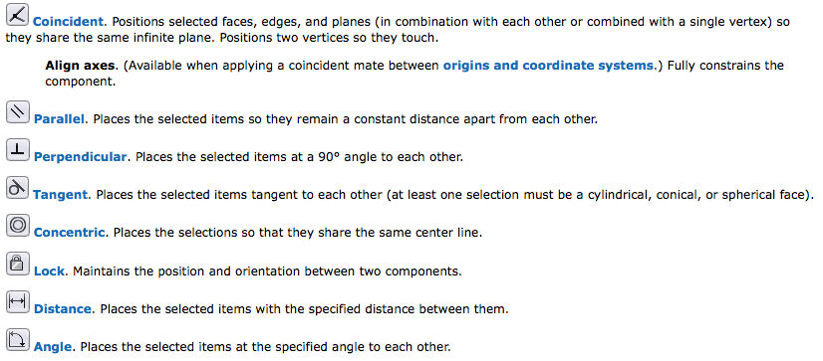
Constraints on Assemblies: Standard Mates

Slide 45
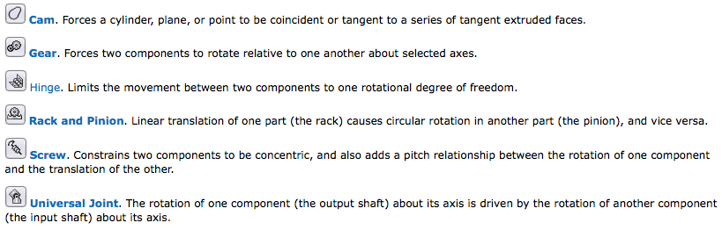
Constraints on Assemblies: Mechanical Mates

Slide 46
Final Exam Prep

Slide 47
Final Exam Coordinates
DEC 11, 2020, Friday
7:00 – 10:00 pm
Online: Zoom

Slide 48
Final Exam Coverage
Lecture notes and handouts.
Reading assignments.
Lab assignments, handouts and tutorials.
Project-related material (ABMs, mechanisms, etc).
OnShape
Covers entire semester.
Comprehensive

Slide 49
Types of Questions
Drawing questions.

Slide 50
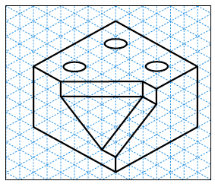
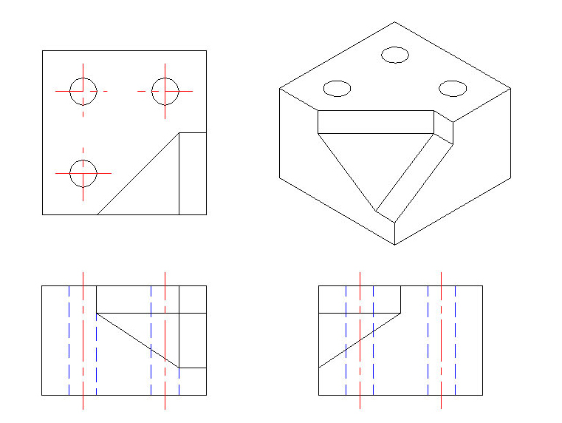
Types of Questions - 2
Example1: Given an isometric drawing of an object, sketch its orthographic views.

Slide 51
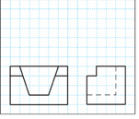
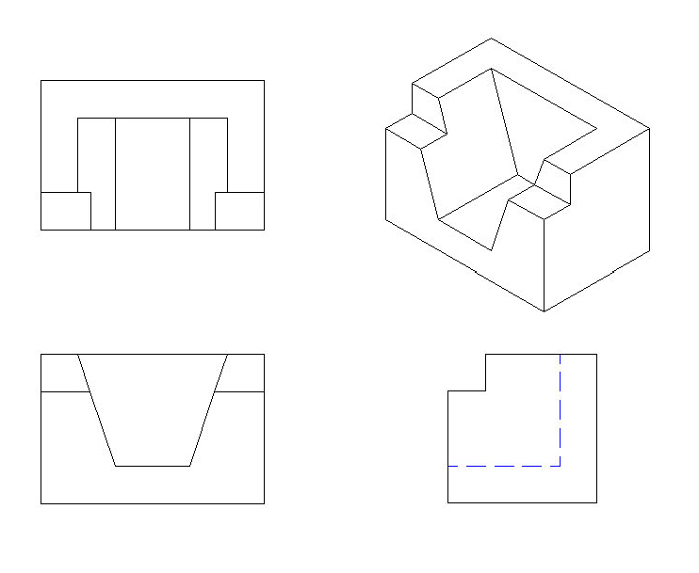
Types of Questions -3
Example2: Given two views of a multi-view drawing of an object, sketch the missing view (and its isometric drawing).

Slide 52
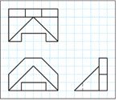
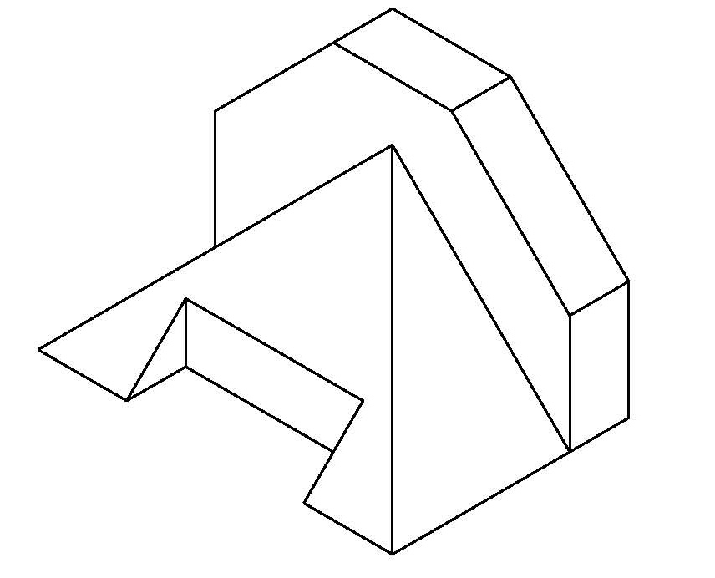
Types of Questions - 4
Example3: Given the orthographic views of an object, sketch its isometric drawing.

Slide 53

Types of Questions -5
Example5: Sketch a partial auxiliary view for the inclined surface.

Slide 54

Types of Questions - 6
Example6: Sketch a cross-section for the given cutting plane.

Slide 55
Comments, Advice, & Reminders
Previous examples represent possible exam questions only:
  Not exhaustive.
  e.g.: Dimensioning was not mentioned but is a possibility.
Exam Preparation:
  Review and read material covered in class.
  Review and read material covered in Labs.
  Review all reading assignments (your textbook).
  Practice lab assignments and tutorials (including SolidWorks).

Slide 56
Labs this week (FINAL):
100% of digital ABM completed
100% of ABM sketches
1 min. video
Best of Luck and see you in the labs ☺

Slide 57
Performers December 2nd,2020
Rohan – Sing ☺
Emily - ?
Alyssa and Olivia are sharing bird stories
Angela - painting
Hanmin – piano
Alex – piano,
Greg – sing + guitar ☺
Shallyn – cat + ski video

