Slide 1
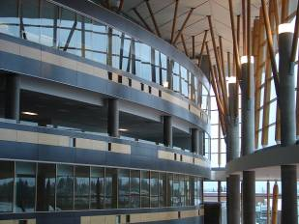
IAT 106
Spatial Thinking and Communicating
Spring 2021

Slide 2
Lecture 01 Quiz
The three important components within a 'concept of space' are?
Objects, Conventions, Operations
Objects, Coordinate Systems, Motions
Objects, Spaces, Operations
Names, Configurations, Directions
Domains, Spatial Configurations, Movements

Slide 3
Lecture 01 Quiz
The three important components within a 'concept of space' are?
Objects, Conventions, Operations
Objects, Coordinate Systems, Motions
Objects, Spaces, Operations
Names, Configurations, Directions
Domains, Spatial Configurations, Movements

Slide 4
Lecture 01 Quiz
2. $p=\left(3\sqrt{2}, 45, 4\right)$ is a point in a Cylindrical Coordinates system. Which one of these is its equivalent point in Cartesian coordinates using the x-axis and xy-plane as references?
(4, 3, 3)
(3, 3, 4)
($\sqrt{2}$ , 4, 4)
(3, 3, 3)
($\sqrt{2}$, 3, 3)

Slide 5
Lecture 01 Quiz
2. $p=\left(3\sqrt{2}, 45, 4\right)$ is a point in a Cylindrical Coordinates system. Which one of these is its equivalent point in Cartesian coordinates using the x-axis and xy-plane as references?
(4, 3, 3)
(3, 3, 4)
($\sqrt{2}$ , 4, 4)
(3, 3, 3)
($\sqrt{2}$, 3, 3)
z
y
x

Slide 6
Lecture 01 Quiz
2. $p=\left(3\sqrt{2}, 45, 4\right)$ is a point in a Cylindrical Coordinates system. Which one of these is its equivalent point in Cartesian coordinates using the x-axis and xy-plane as references?
(4, 3, 3)
(3, 3, 4)
($\sqrt{2}$ , 4, 4)
(3, 3, 3)
($\sqrt{2}$, 3, 3)
z
z
y
x
y
x

Slide 7
Lecture 01 Quiz
2. $p=\left(3\sqrt{2}, 45, 4\right)$ is a point in a Cylindrical Coordinates system. Which one of these is its equivalent point in Cartesian coordinates using the x-axis and xy-plane as references?
(4, 3, 3)
(3, 3, 4)
($\sqrt{2}$ , 4, 4)
(3, 3, 3)
($\sqrt{2}$, 3, 3)
z
z
y
x
y
x

Slide 8
Lecture 01 Quiz
2. $p=\left(3\sqrt{2}, 45, 4\right)$ is a point in a Cylindrical Coordinates system. Which one of these is its equivalent point in Cartesian coordinates using the x-axis and xy-plane as references?
(4, 3, 3)
(3, 3, 4)
($\sqrt{2}$ , 4, 4)
(3, 3, 3)
($\sqrt{2}$, 3, 3)
z
z
y
x
y
x

Slide 9
Lecture 01 Quiz
2. $p=\left(3\sqrt{2}, 45, 4\right)$ is a point in a Cylindrical Coordinates system. Which one of these is its equivalent point in Cartesian coordinates using the x-axis and xy-plane as references?
(4, 3, 3)
(3, 3, 4)
($\sqrt{2}$ , 4, 4)
(3, 3, 3)
($\sqrt{2}$, 3, 3)
z
z
y
x
y
x

Slide 10
Lecture 01 Quiz
2. $p=\left(3\sqrt{2}, 45, 4\right)$ is a point in a Cylindrical Coordinates system. Which one of these is its equivalent point in Cartesian coordinates using the x-axis and xy-plane as references?
(4, 3, 3)
(3, 3, 4)
($\sqrt{2}$ , 4, 4)
(3, 3, 3)
($\sqrt{2}$, 3, 3)
z
z
y
x
y
x

Slide 11
Lecture 01 Quiz
3. Spatial thinking is a very specialized skillset and is only applicable in a limited range of domains, i.e, only in medicine and engineering.
True
False

Slide 12
Lecture 01 Quiz
3. Spatial thinking is a very specialized skillset and is only applicable in a limited range of domains, i.e, only in medicine and engineering.
True
False

Slide 13
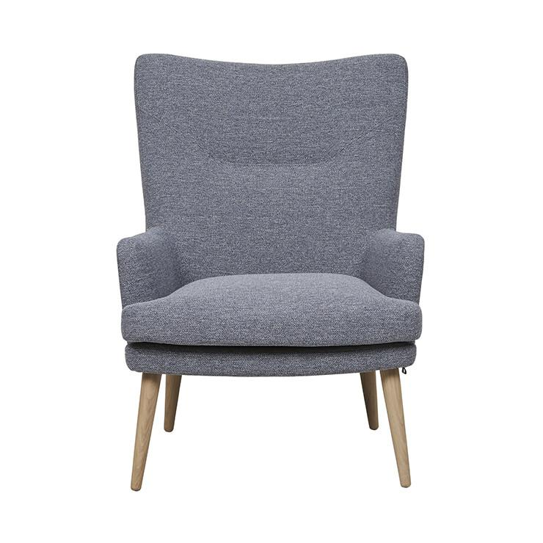
Sketch this chair on HALF of your paper

Slide 14
Sketch this chair on the other HALF of your paper, now using Bounding Box

Slide 20
What are we going to do in the Labs?

Slide 21
See you on Monday! Thank you!
☺

