Slide 1
Spatial Thinking Lab 2
Sketching & Dimensioning

Slide 2
Spatial Thinking Lab2
4 sets of exercises to be completed and handed in by start of your next lab session:
Surface identification
Sketching technique (draw sets of straight lines);
Sketching practice; and
Simple dimensioning exercises.
We’ll start with some “demo” spatial reasoning exercises and some examples of what we expect you to do.

Slide 3
Spatial Reasoning
There are many exercises to help you learn to “think” in 3D.
Let’s try a few …

Slide 4
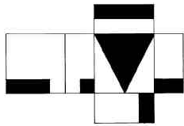
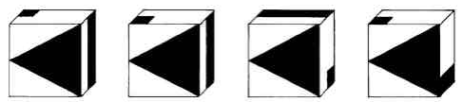
Spatial Reasoning—a folding exercise
The pattern can be folded into a 3D box.
Which of the 4 boxes could be made?
If you think none, choose “E”
A B C D E

Slide 5
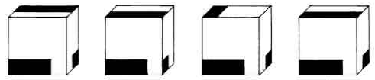
Spatial Reasoning—a folding exercise
The pattern can be folded into a 3D box.
Which of the 4 boxes could be made?
If you think none, choose “E”
A B C D E
A B C D E

Slide 6
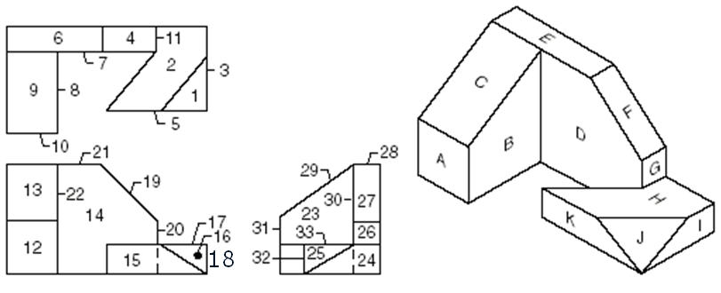
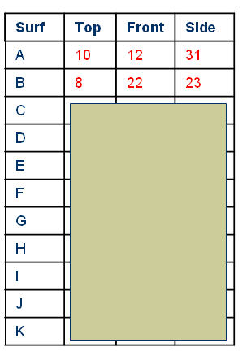
Surface Identification-practice/demo 1/2

Slide 7
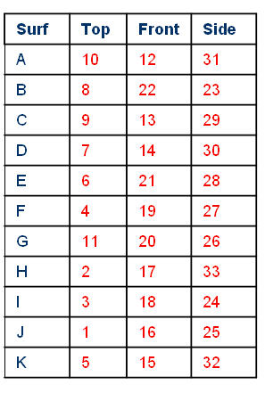
Surface Identification-practice/demo 2/2

Slide 8
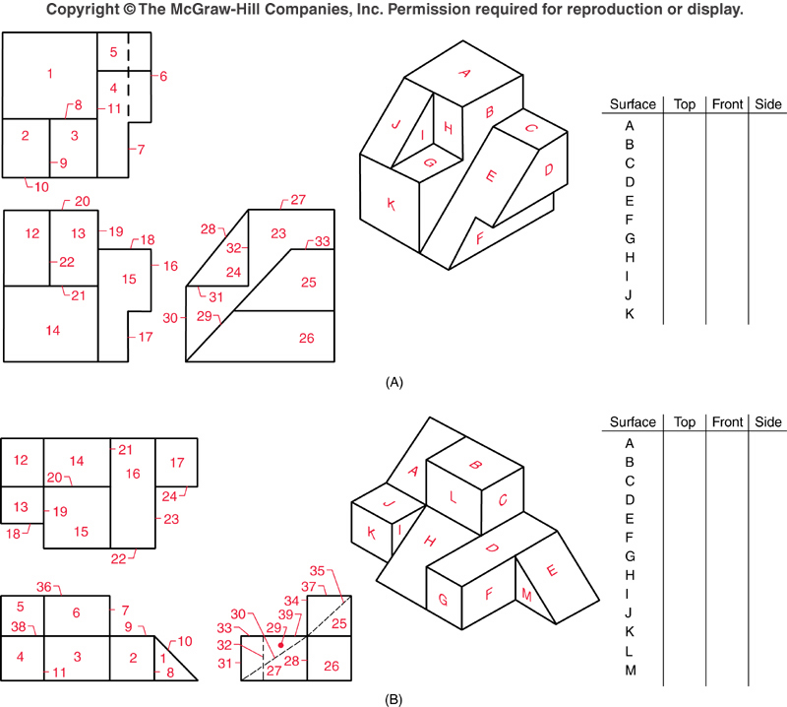
Surface Identification
As described in your assignment, draw the table and fill in the blanks. You have 10 min. If you don’t finish, you can complete outside the Lab

Slide 9
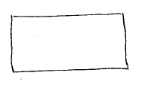
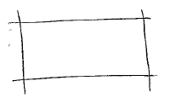
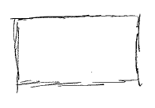
Styles of Sketching
X
Lines meet at endpoints,
“engineering-like”
Lines cross at endpoints
“architect-like”
Lines vague, ‘sketch-y’,
“expressive”, "art-like"

Slide 10
Sketching-Line Quality
You have 15 min to do the line quality exercise. Don’t worry if you don’t finish: you can complete this outside of Lab
As described in the assignment, prepare a sheet as shown, then sketch the lines shown.
Name
Student ID#
Date
Section #

Slide 11
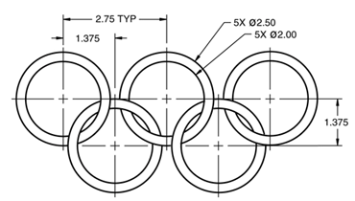



Sketching Exercises
Complete the exercises of section (c) in your assignment. Again if you don’t finish, you can complete as homework. You have 30 min.
N.B. -- units in centimetres

Slide 12
Dimensioning

Slide 13
Guideline for Dimensioning
Think of making an object—then dimension it in the most useful way.
Put in exactly as many dimensions as are necessary to make it: no more, no less.
You are “communicating spatially” with the person who will build your design (it may of course be you!)
Don’t put in redundant dimensions. They clutter the drawing (AND if "tolerances" included, redundant dimensions can lead to conflicts).

Slide 14
Drawing Scale (1 of 3)
Problem:
big objects cannot be drawn full size—too big to fit the paper.
very small objects similarly are too small to draw and to read.
Solution:
“Scale” or magnify the objects proportionately
Representative Fraction:
RF = Size on dwg / Actual size

Slide 15
Drawing Scale (2 of 3)
Scale -- just Representation Factor (R.F.), as a ratio
Eg object length = 1m,
We represent this on the drawing by a 10 mm line:
RF = 10 mm/ 1 m = 10 mm/ 1000 mm = 1/100
Scale = 1:100
Recommended Scales. (IS: 10713-1983)
Full Size Scale. Dwg size same as object size: full-size scale, i.e. 1:1.
Reduced Scale. Dwg smaller than objects, the reduced scales are used. Recommended scales 1:2, 1:5, 1:10, 1:20, 1:50, 1:100, etc.
Enlarged Scale. Dwg larger than actual objects, enlarged scales are used. Recommended scales 50:1, 20:1, 10:1, 5:1, 2:1, etc.

Slide 16
Drawing Scale (3 of 3)
Ø 1000 mm
Ø 3500 km
Ø 26.5 mm
Loonie
Truck Wheel
Moon
Scale: 1:1
Scale: 1:50
Scale: 1:132,000,000
N.B. – the Moon scale is "wrong" in two ways. First, it has commas. Real scales do not.
Second, it uses a non-conventional scaling factor.

Slide 17
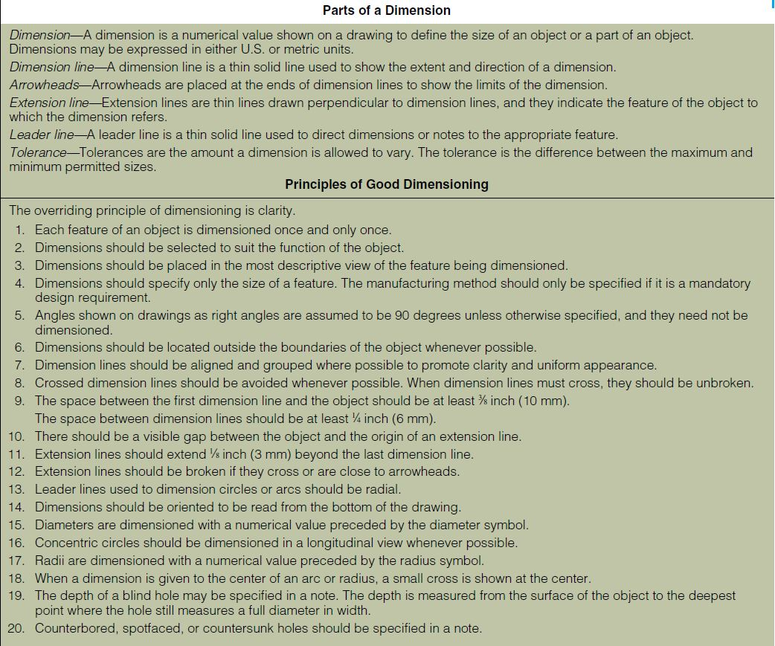

Slide 18
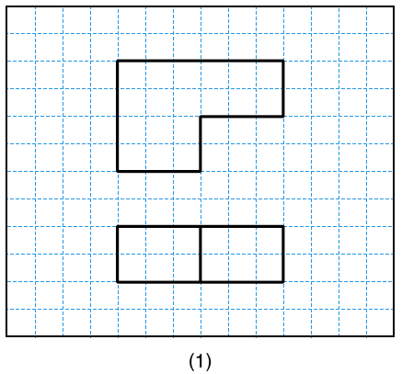
Dimensioning-TA Demo
Follow along with the TA. DO NOT hand in this exercise.
TA Demo: (from Fig 9.78 exercise #1, p 531, in full book).

Slide 19
Dimensioning Exercises
For each exercise listed, sketch the given views and completely dimension the drawing. Each square is 6mm. Use grid paper for these exercises. Each drawing should occupy half a page in the format shown on the last page of your assignment. The lettering for the dimensioning should be about 3mm high. (10 marks each)
In-class: See Lab overview doc:
Homework: See Lab overview doc:
Grading will be on placement and accuracy of dimensions, on completeness (enough dimensions but not over-dimensioned). Neatness and legibility of lettering will be taken into account as well.

