Slide 1



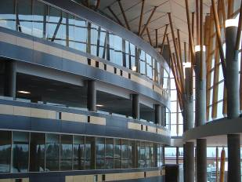

IAT 106
Spatial Thinking and Communicating
Spring 2021
Week 03
Multi-Views & Projections

Slide 2
Objectives for today
In today’s class, you’ll learn to
Understand the underlying theory of projections, including projection planes, the 6 standard views & how to generate them, & relations among them
Work with multi-view projections
Explore methods for solving multi-view problems
Create pictorial projections including axonometric
Readings:
Multi-view: Text Ch 5, ( 5.1-5.7, 5.8.1-5.8.4, 5.10-5.13)
Read-ahead for next week: Pictorials: Text Ch 7, (7.1 – 7.6, 7.14 - 7.19
Notes:
Are these objs for the lecture or the lab? BOTH
By the end of this lecture and lab you will be able to:
Explain…..
Describe
Explore the details
Produce …..
Practice???

Slide 3
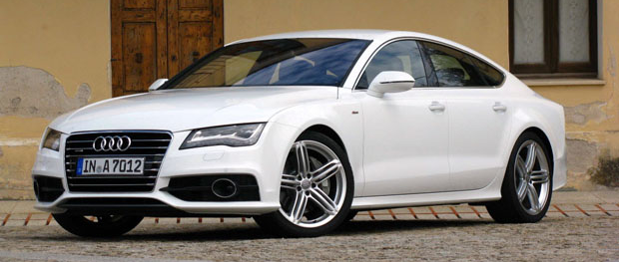
Projection of a Line
Problem: How do we represent a 3-Dimensional object in 2D?
Image: Audi A7 (www.driving.ca)
Notes:
What are examples of nonplanar/nongeometric projections?
Cartographic: (non geom, non planar)
Omnimax: (non geometric)

Slide 4
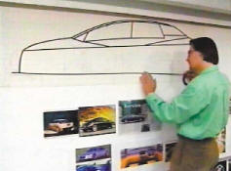

Ortho-2D in Car Design
Aside: this is a great blend of design and technology!
Very SIAT-like.
Right: Bill Buxton demonstrates method of bi-manual drawing
http://www.billbuxton.com/buxtonAliasVideos.html
http://www.youtube.com/watch?v=LvyzwN36PSw
IAT106 web
Notes:
This video demonstrates a novel 2-handed technique for drawing on large wall-sized displays. The technique exploits a method used in automotive design called Tape Drawing.
Traditionally, this was done by laying photographic tape on a wall in order to draw automobiles free-hand, full scale. Here, we mimic the traditional tape using computer graphics, but with enhancements, providing designers more powerful methods with which to apply their traditional skills.
Aside: this is a great blend of design and technology! Very SIAT-like. ☺

Slide 5
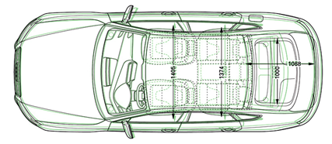
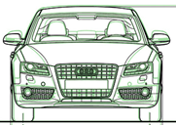
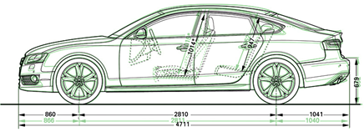
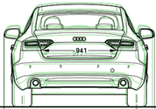
Projection of a Line
Answer: Projection
http://forums.audiworld.com
Notes:
What is wrong with the layout of these views?

Slide 6
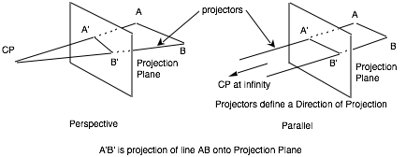
Basics: Projection of a Line
Projection
Linear map from 3D to 2D space or the image of a 3D geometric figure reproduced on a line, plane, or surface.
We only look at planar geometric projections
Straight lines (projectors) through object points, from Center Of Projection (can be at infinity)
Projection: intersection of projectors and Projection Plane
Notes:
Think of object points as the dots that make up the outline of an object, then connect the dots
-The projection is what you get when you intersect the projectors (straight lines) and the projection plane
Use the analogy of a screen.

Slide 7
Projections
Projection plane
object
Intersection points
projectors
“connect the dots”
Notes:
Projection Theory: based on “projectors” (rays or straight lines) from points on object to a plane called the “Projection Plane”. The projected view is formed on the projection plane by “connecting the dots”, ie by joining the points where projectors intersect the projection plane.
Note: clearly whether the projectors are all parallel or not makes a big difference! And the angle that the projectors make with the projection plane is also important. More on this later.

Slide 8
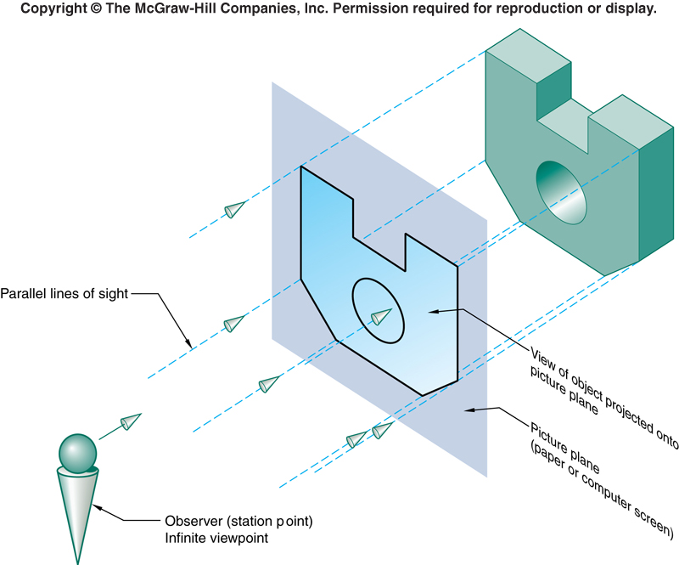
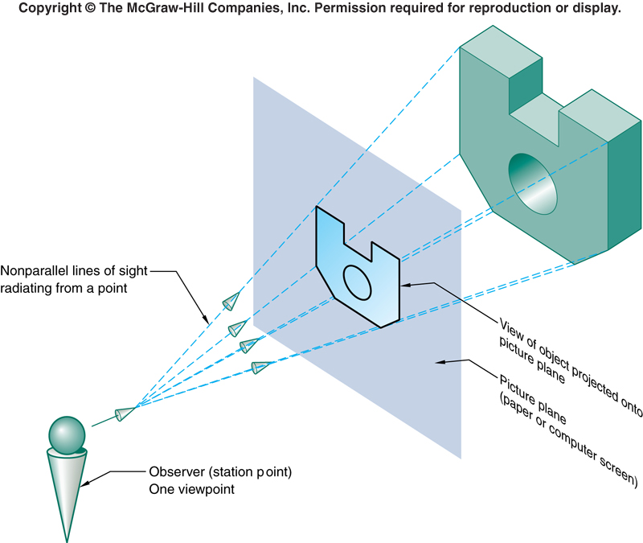
Parallel vs Perspective Projections
Perspective: Projectors are not parallel
- from viewpoint (finite distance from object) through plane of projection, to object
Parallel: Projectors are parallel
– from viewpoint (infinite distance from object), through plane of projection, to object

Slide 9
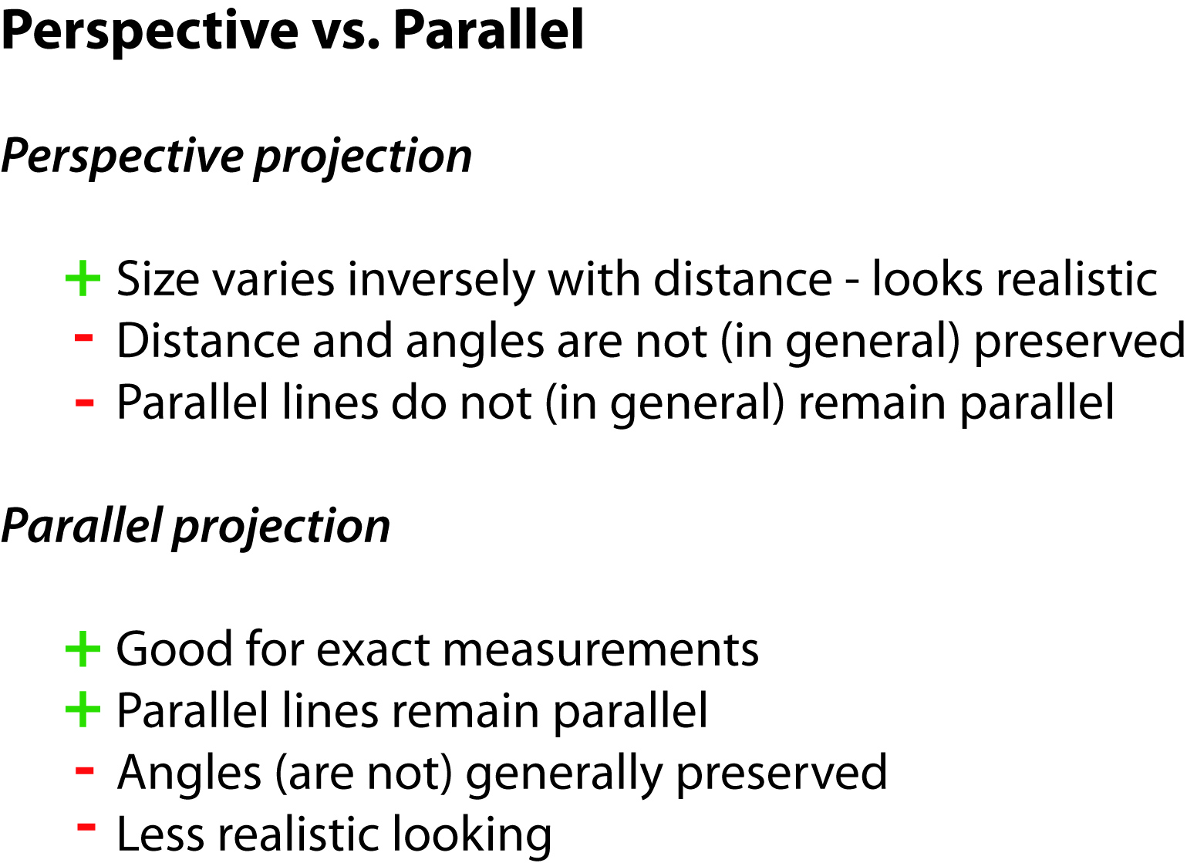
Parallel vs Perspective Projections
Notes:
Parallel projections have lines of projection that are parallel both in reality and in the projection plane. Parallel projection corresponds to a perspective projection with an infinite focal length (the distance from the image plane to the projection point), or "zoom".
Within parallel projection there is an ancillary category known as "pictorials". Pictorials show an image of an object as viewed from a skew direction in order to reveal all three directions (axes) of space in one picture.

Slide 10
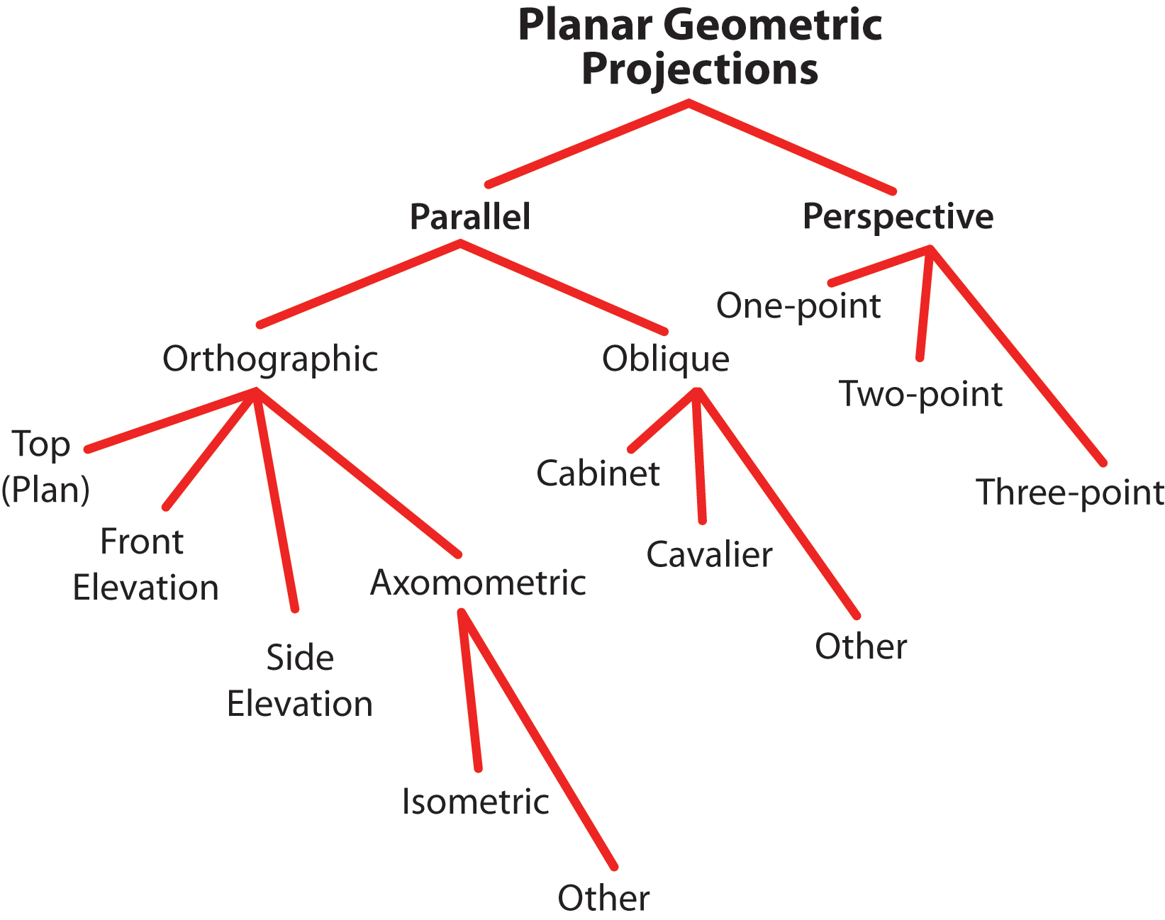
Taxonomy of Projection Types
Notes:
Are there projections which are NOT planar? Sure! Almost all map (geographic) projections (mercator, polar, …) are non-planar. So is the projection system used by IMAX

Slide 11
Taxonomy of Projection Types
Notes:
We are more concerned with the Parallel projections in this course rather than perspective

Slide 12
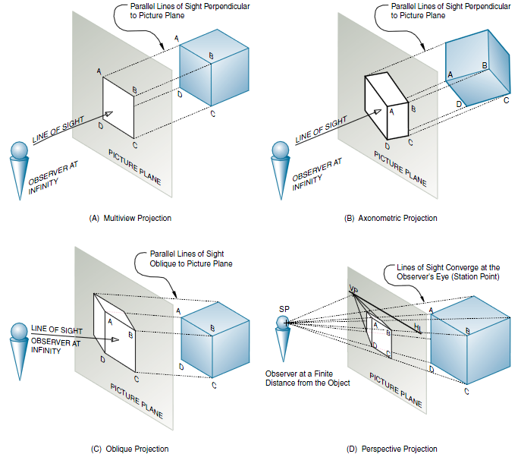
Kinds of Parallel Projection methods
Multiview/ortho
Axonometric
Perspective
Oblique
Notes:
To get different projections, you vary the projection method (orthographic, perspective), the orientation of the projection plane (oblique is not orthogonal to the projection rays) and/or the object orientation (the only difference between axonometric and, say, a top view.

Slide 13
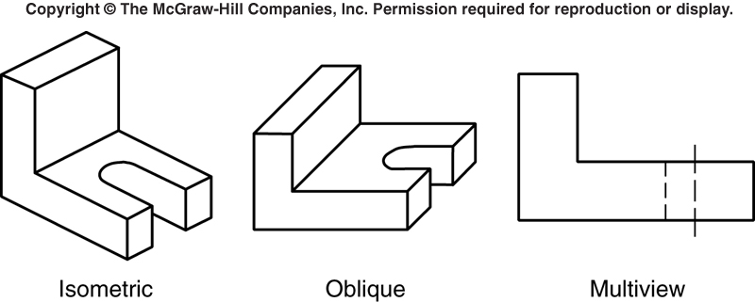
Kinds of Parallel Projections
Image depends on
Angle of object with respect to projection Plane
Angle of (parallel) projectors with respect to Projection Plane
View: Axonometric Oblique Orthographic
Object: angled parallel parallel to proj. plane
Rays: perpendicular angled perpendicular to proj. plane
*Rays=Projectors
Notes:
Notice how all of the projectors are parallel in each type

Slide 14
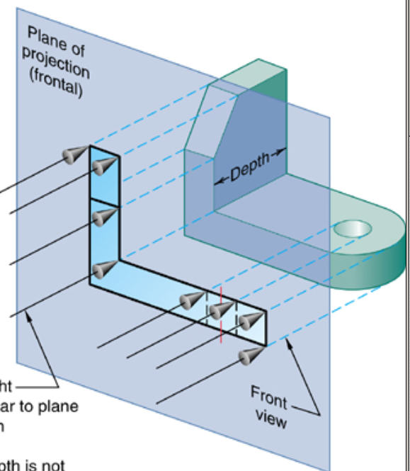
Orthographic Projection Plane
Orthographic: object oriented so only 2 of its 3 dimensions are seen
Object’s depth not represented in this (Front) view.
Projectors perpendicular to Proj. Plane
Notes:
Explain width, height and depth convention. We don’t use the term “length”.

Slide 15
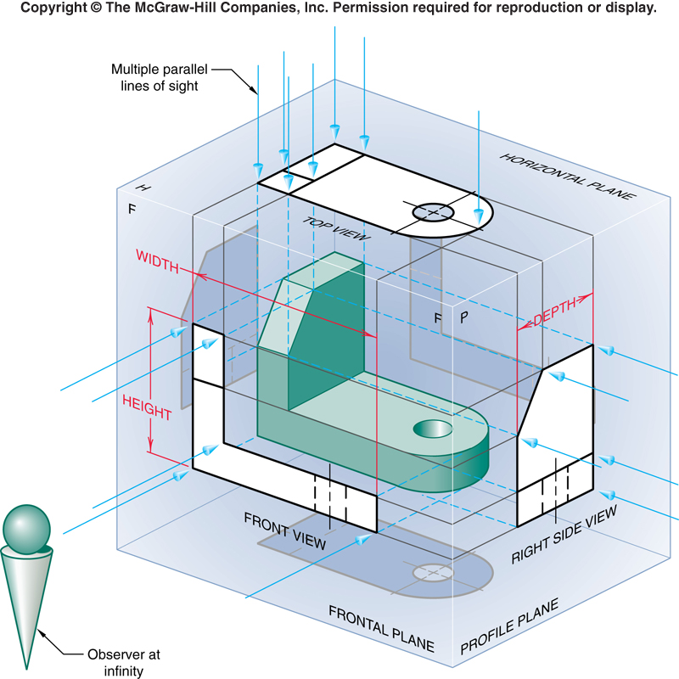
Principal Orthographic Views
So how many views can we have?
“Camera” can be anywhere:
∞ # of views possible
Only 6 “Principal Ortho Views”
Put object in “glass box”
Principal Views (6):
those projected onto 6 faces of “glass box”

Slide 16
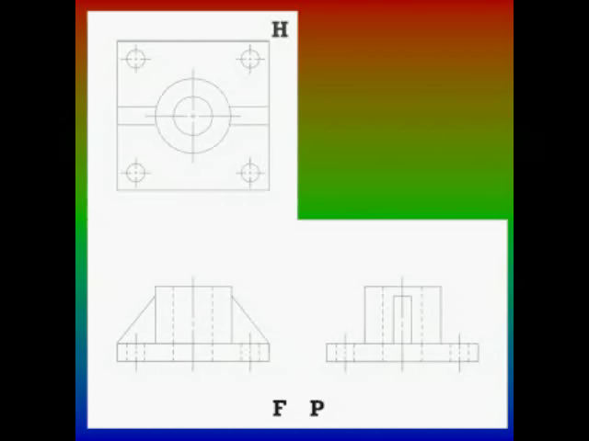
Multi-view Glass Box Animation
IAT 106 website

Slide 17
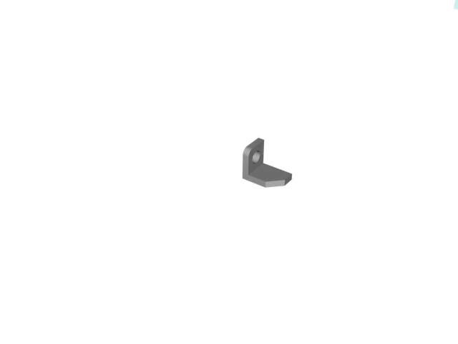
Glass Box: another example
IAT 106 website
Notes:
This animation is from
VISUALIZATION, MODELING & GRAPHICS FOR ENGINEERING DESIGN
By Dennis Kenmon Lieu, Sheryl Ann Sorby

Slide 18
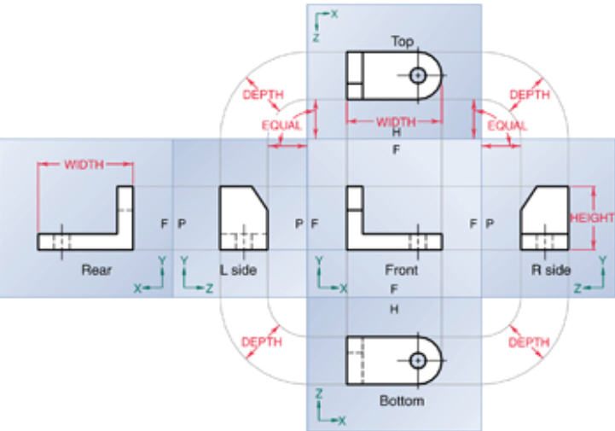
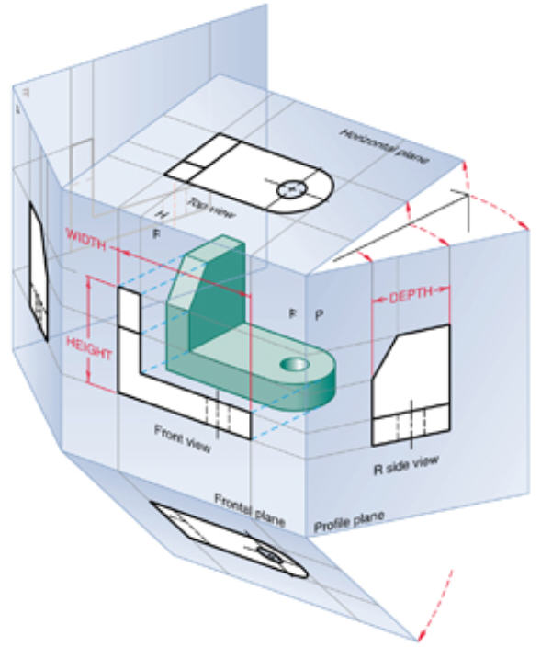
Unfolding the Glass Box for 6-view Sketch
Unfolding
Unfolded: note size relationships (i.e., depth in side/top/bottom)

Slide 19
Size Relationships
Size relationships:
Height: Front=R=L=Rear
Width: Top=F=Bottom=Rear
Depth: Top= R=L=Bottom
Why do these hold?
Imagine camera looking horizontally at Front of object
Swing camera around in horizontal circle around object, from F to R to Back to L and back to F.
Since it’s the same object, Height must be unchanging!
“Equal” Distance from “Folding” line:
Top, L, R & Bottom are all the same distance from fold
Why is this?
Notes:
SW demo to illustrate camera swinging

Slide 20
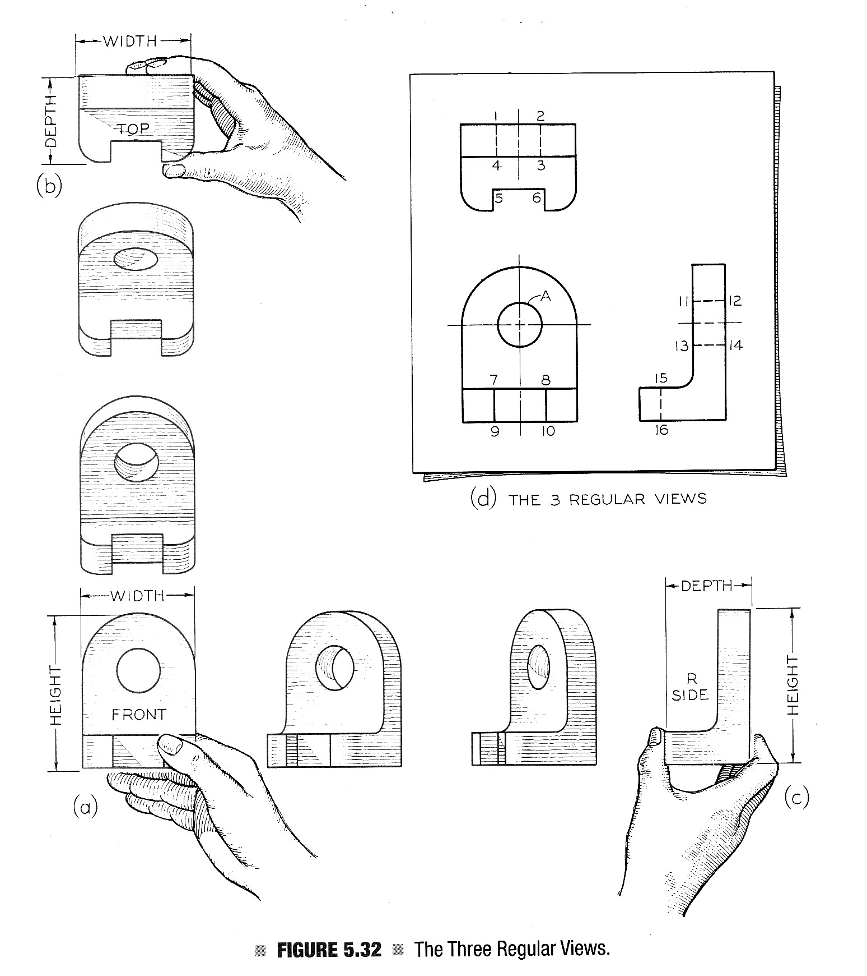
You Try It
Hold an object out at arms length,
Orient it so a major feature is perpendicular to your line of sight
Imagine the ortho projectors connecting the outline of the object
Rotate object 90 deg and imagine again,
This is the basic multi-view process.
NB: rotating obj is “equivalent” to swinging camera!

Slide 21
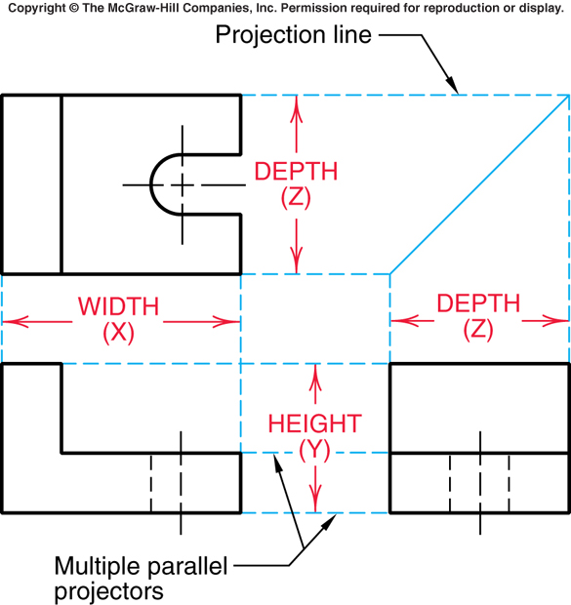
View Placement
Any single view of multi-view only shows 2 of object’s 3 dimensions
Remember there are 6 principal views
Mostly 3 are enough to completely describe
Top, Front, Right side
Observe:
Relative positioning
Alignment
Terms for overall size
Notes:
Note fix to R side view; this was from earlier edition of text and showed sides of slot as hidden whereas they should be visible

Slide 22
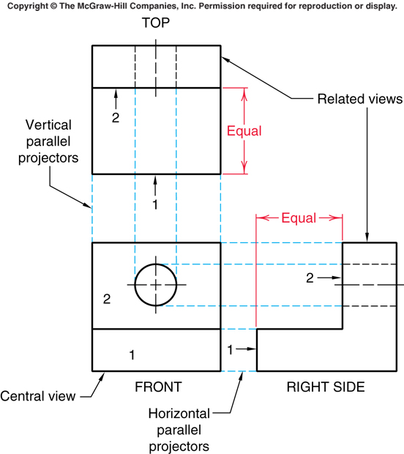
Principles of Ortho Projection: Rule 1
Rule 1: Alignment of features
Every corresponding/ matching point in given view must be aligned on a parallel projector in any adjacent view
Example:
A_{Front} to A_{Top}
A_{Front} to A_{Right}
A_{Top}

Slide 23
Principles of Ortho Projection: Rule 2
Rule 2: Distances in related views
Distances between any 2 pts of a feature in related views must be equal (if both are visible)
Related Views means:
2 views adjacent to same view
(e.g., T & R both adj to F,
so T&R are “related”)
Notes:
Notice use of “identify the face” method you did in lab!

Slide 24
Lines, Lines, Lines
Surfaces: Visible lines locate edge view of surface
Hidden lines (dashed) show hidden features
Holes: use lines to locate “key” elements
Notes:
How would this change if the circular hole were a square hole?

Slide 25
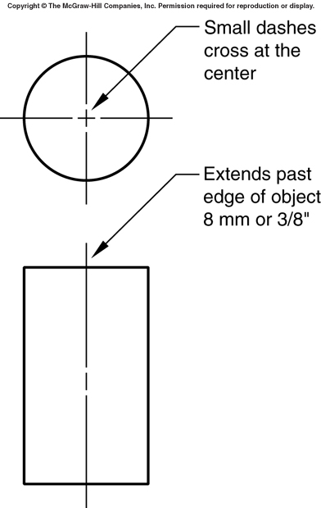
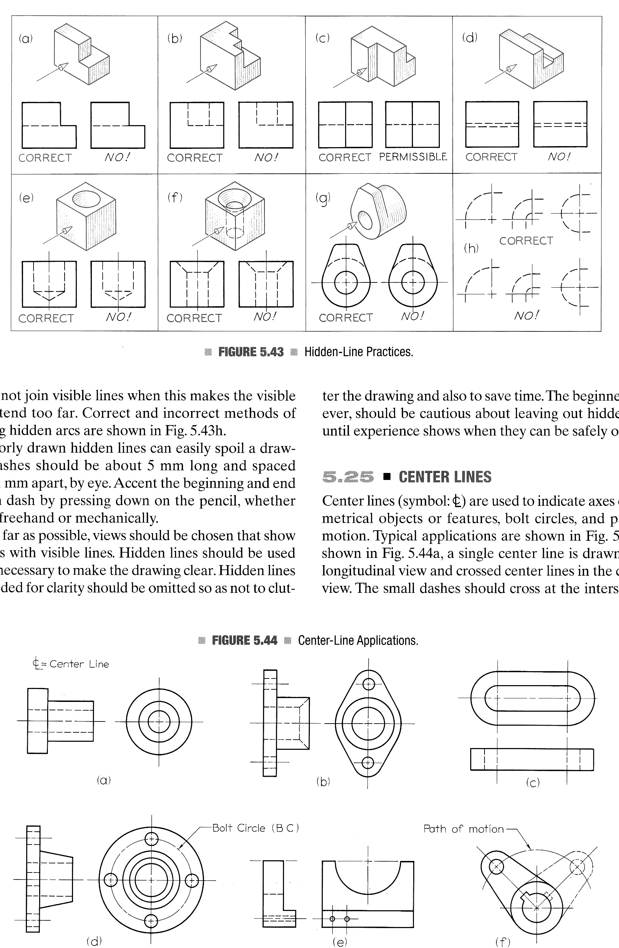
Lines, Lines, Lines
Center lines (long-short-long) show axes of symmetrical parts, features
Question: How come the cylinder only has two views? Top and front?

Slide 26
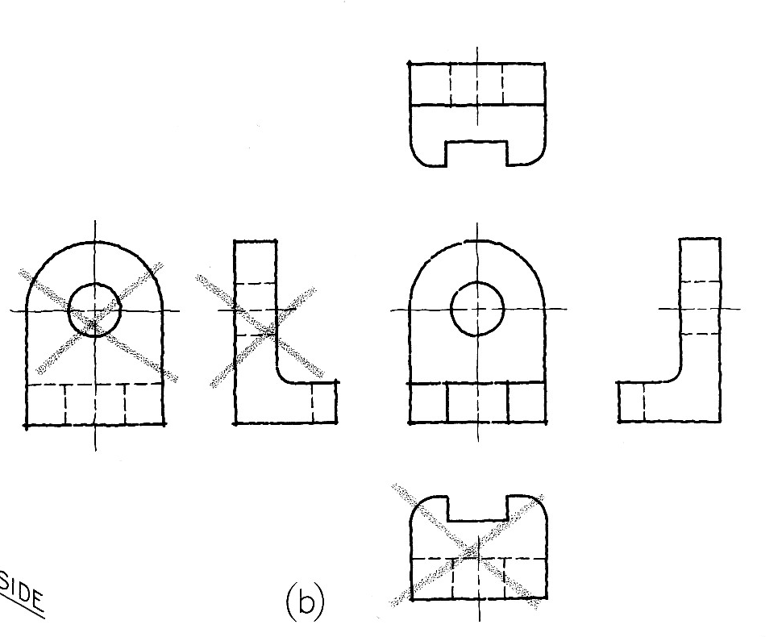
Multi-view Sketches
Q: How many (of the 6) views do we need?
A: Usually 3?

Slide 27
Multiview Sketches: How Many Views?
Is 1 enough?
Sometimes (not often)
Material: .025 brass

Slide 28
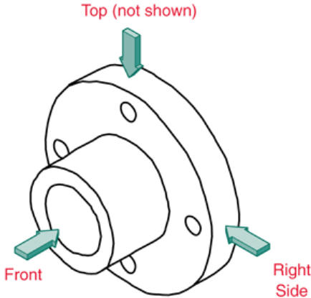
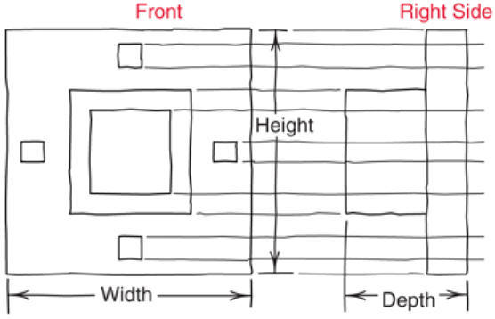
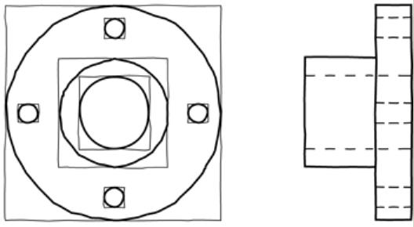
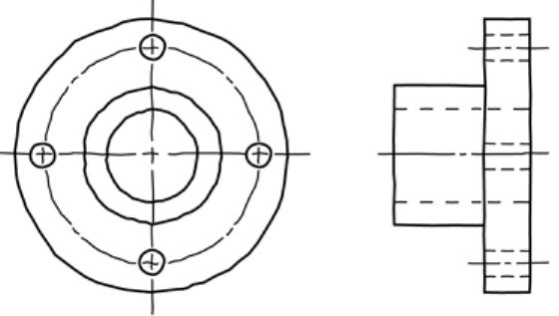
Multiview Sketches: How Many Views?
Is 2 enough?
Occasionally, when there’s some symmetry
Here, adding a top view would add no new information, and is not needed.
Rule: sketch min # views needed to completely define object

Slide 29
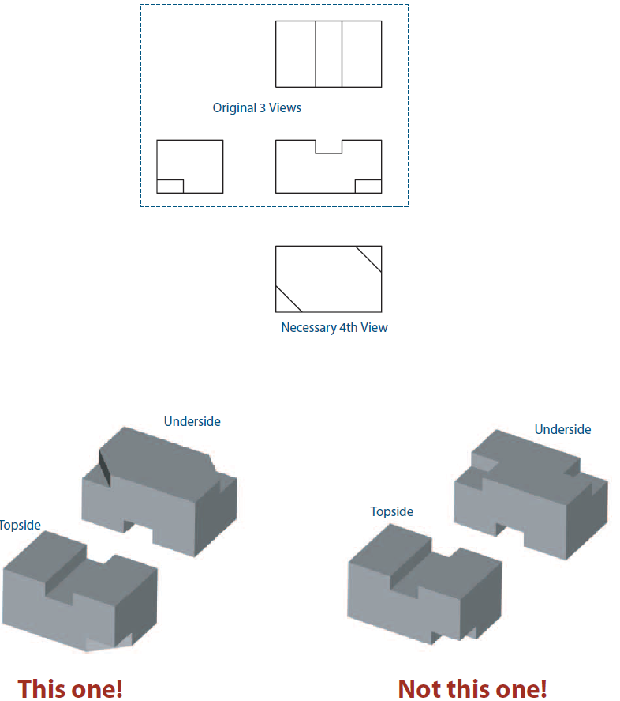
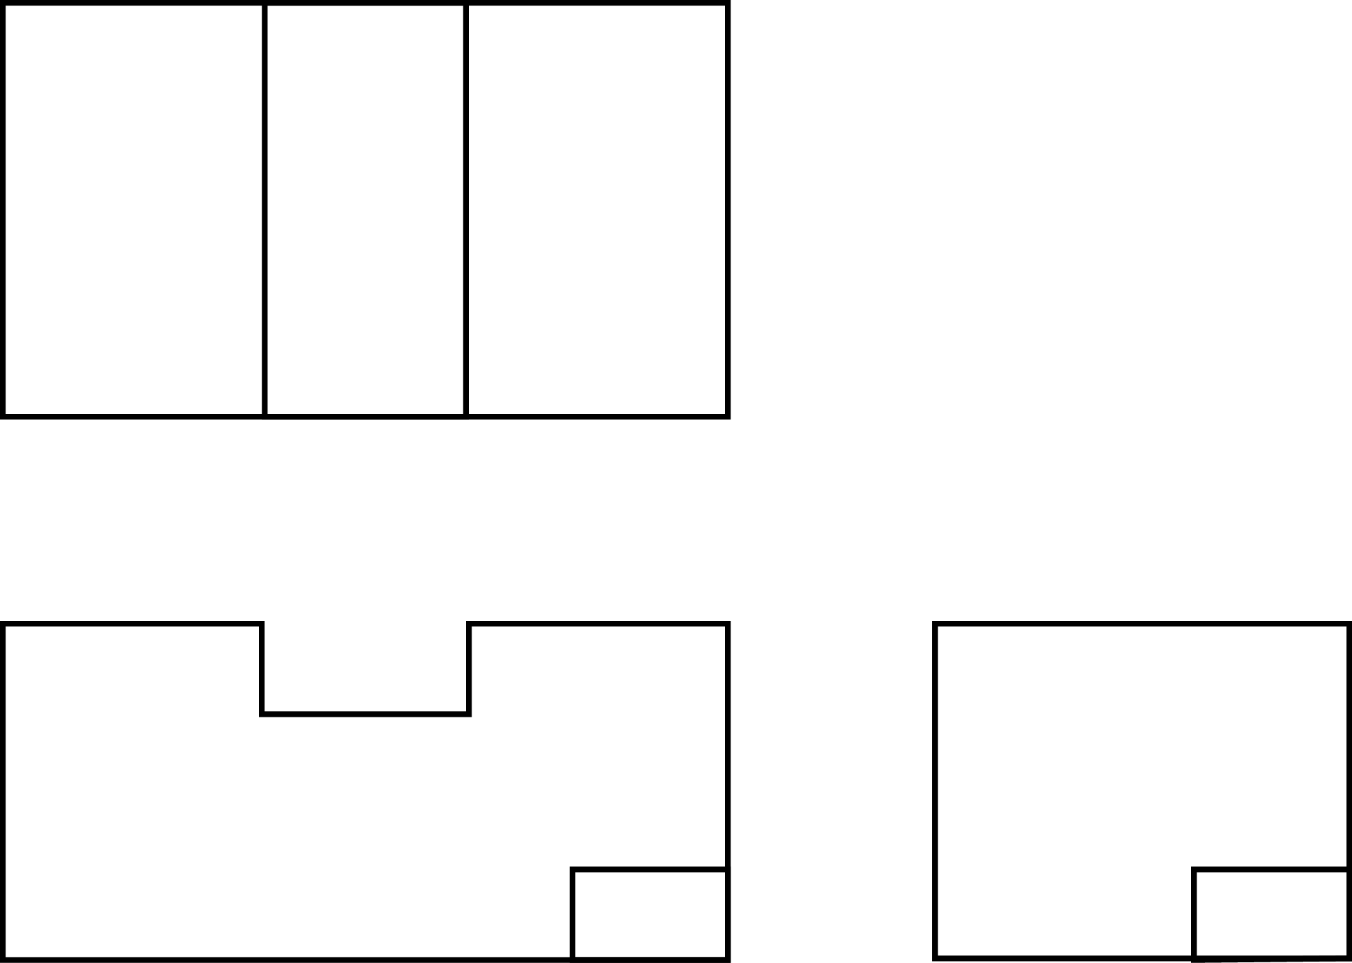
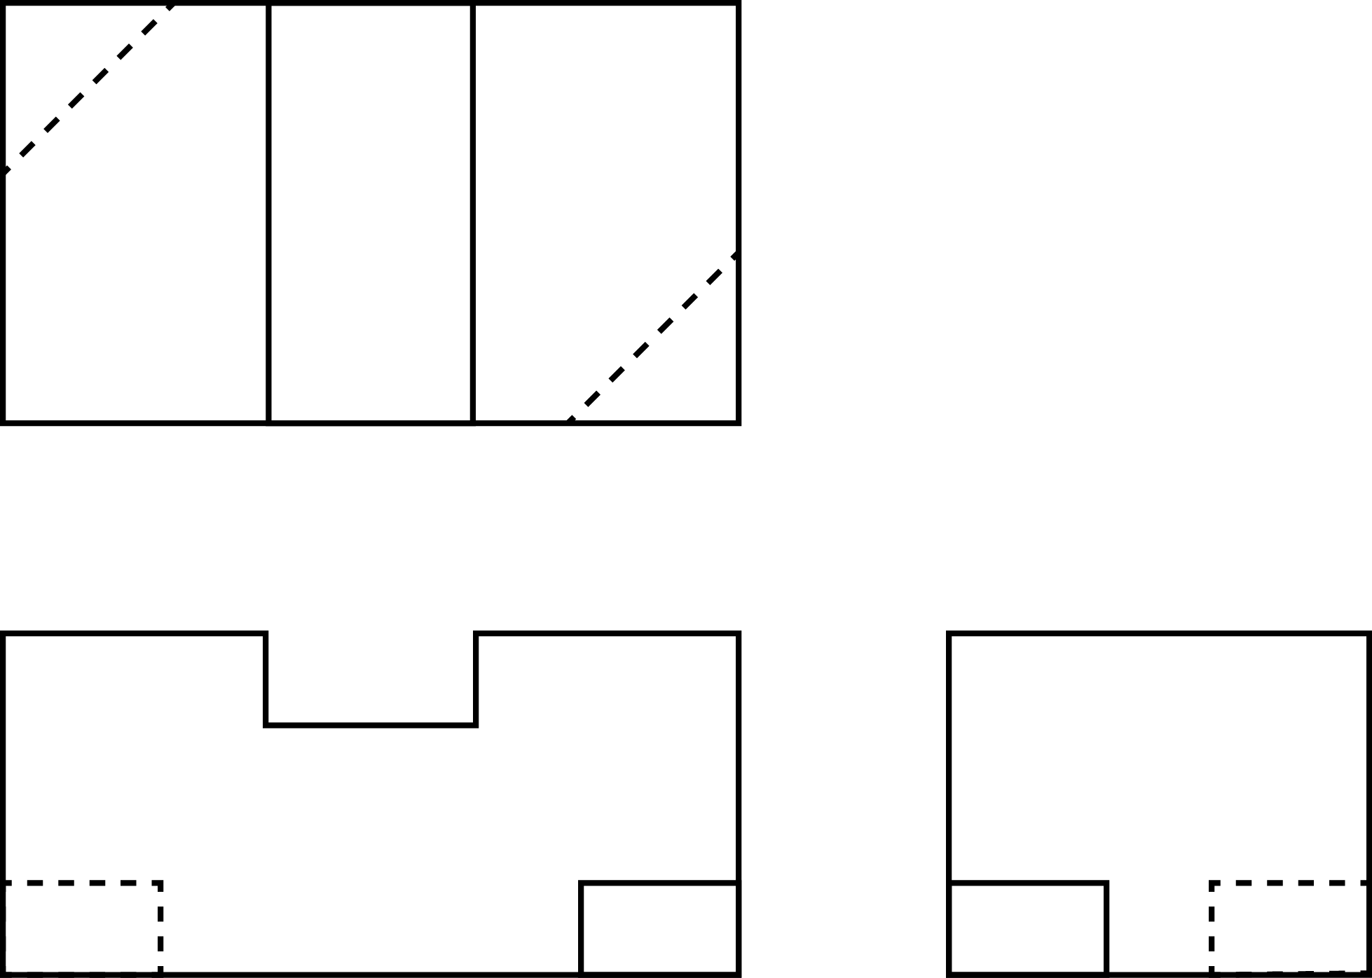
3 views not enough
What about the object shown by this 3-view? Are the 3 enough?
In absence of hidden lines, need 5 views to distinguish between these 2 parts.
Fourth and fifth views are needed to show cut-outs on underside as diagonal, not square!

Slide 30
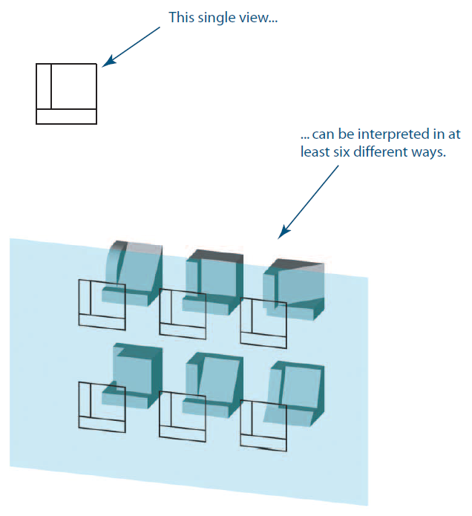
Not enough views leads to ambiguity
This draws“at least” 6.
Can you come up with another?

Slide 31
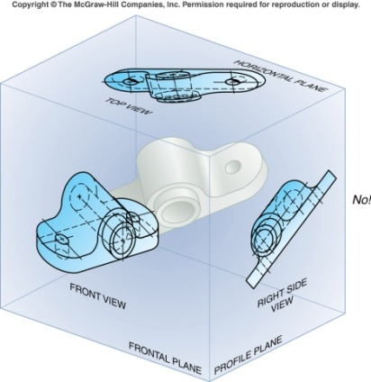
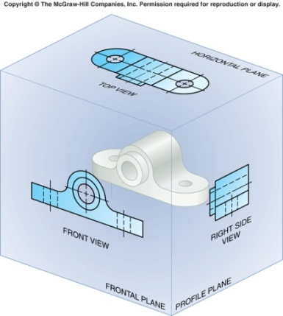
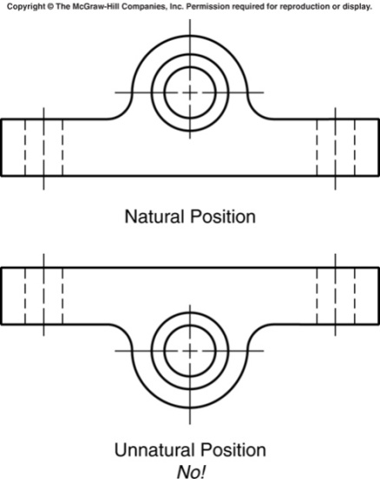
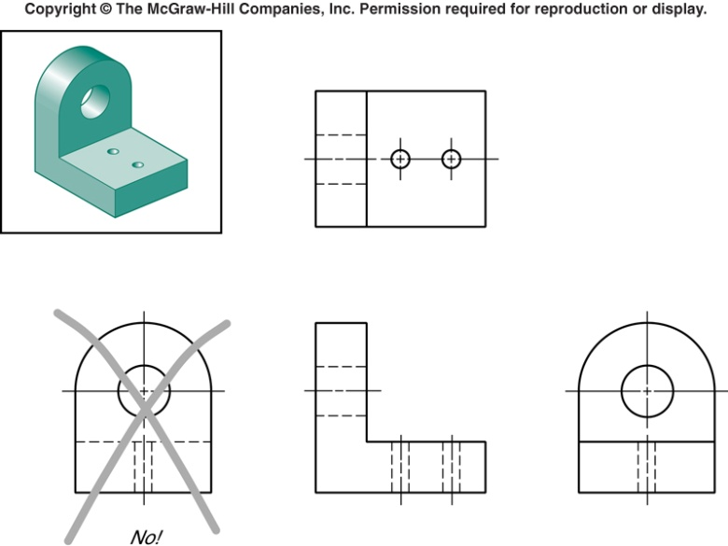
View Selection
Position in glass box so:
Major features perp. to or Parallel to sides
Minimize # hidden lines
Choose Front view to show object in ‘natural’ state
e.g., a car would be on its wheels
Decide on min # views
To completely define obj
Choose others to minimize Hidden Lines
NOT this
But This

Slide 32
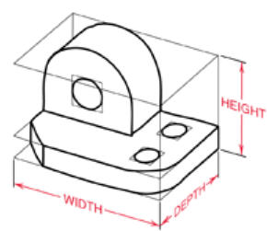
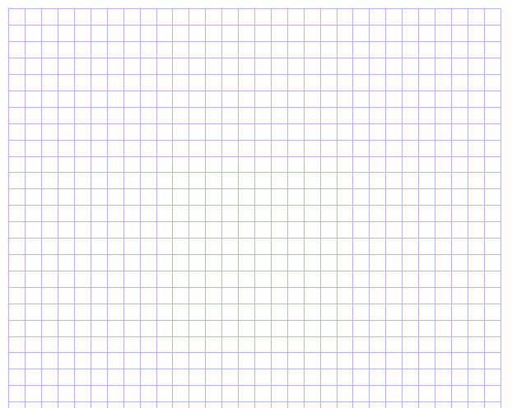
Multi-view Exercise: you do it
Width
Top view
Depth
Depth
Do 3-view sketch;
Use grid paper if you have it.
Right side view
Front View
Height
Remember: no rulers, triangles, compasses!
Do the sketch clearly yet quickly, grid paper helps.

Slide 33
Basics of Edges and Surfaces

Slide 34
Basics of Edges and Surfaces
True shape & True size View
Show edges of surfaces in True Length
Not foreshortened
Enables measuring length, angles
Edge: intersection of 2 surfaces
True Length Line:
Parallel to plane of projection
Notes:
Ref slide 6,13

Slide 35
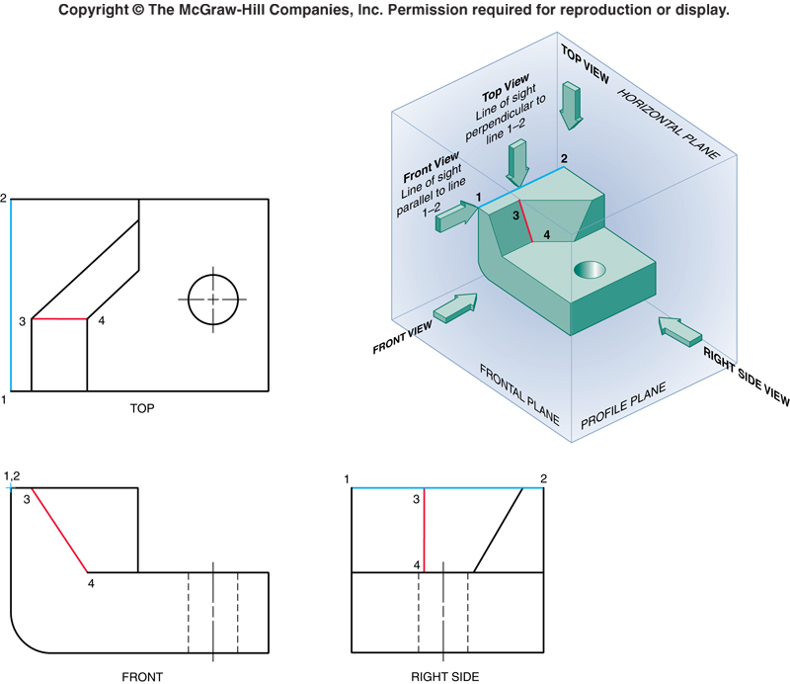
Basics of Edges and Surfaces
Edge (E) 1-2 is True Length (TL) in Top, Side, not in Front
E 3-4 is an inclined line, TL only in Front
True Length Line:
Parallel to plane of projection.
Notes:
Remember the camera analogy
Moving

Slide 36
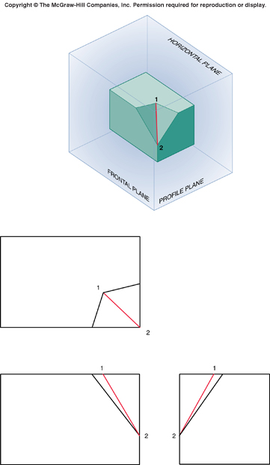
Basics of Edges and Surfaces
Oblique Edges
Edge 1-2 is oblique: not True Length in any principal plane of glass box.
It is not parallel to any plane of projection.
3
4
4
Quick quiz:
In which view(s) can you correctly see line 1-3 in TL?
Line 4-2?
3
3
3
4
Notes:
Think about how you would get a view in which Edge 1-2 could be seen in TL. Hint: look at the chapter on auxiliary views!

Slide 37
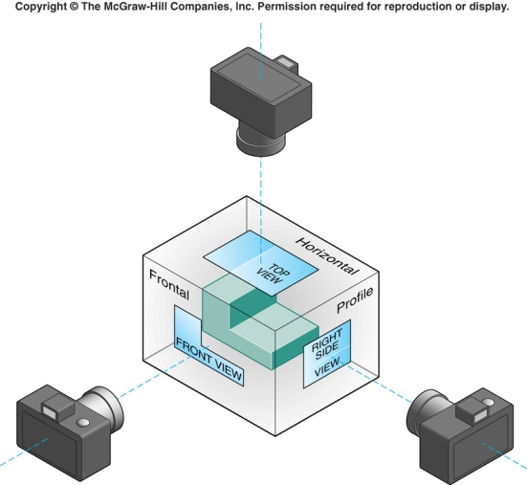
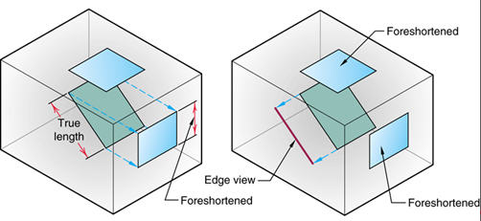
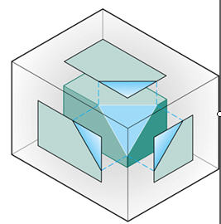
Basics of Edges and Surfaces
3 Types of Planar surface: Principal, Inclined or Oblique
Principal
Parallel to one of principal planes of projection
True Shape in view parallel to projection plane
Appears as line in adjacent views
Inclined
Perpendicular to 1 plane of projection
Inclined to others
True Shape not poss. in any standard view
Appears as TL Edge in view where perp. to plane of projection
Oblique
Does not appear as Edge in any standard view.

Slide 38
Basics of Edges and Surfaces
Principal Surface
Appears as a polygon in one view and a line in the other views.

Slide 39
Basics of Edges and Surfaces
Inclined Surface
Appears as a polygon in two view and a line in the other view.

Slide 40
Basics of Edges and Surfaces
Oblique Surface
Appears as a polygon in all three views.

Slide 41
Basics of Edges and Surfaces
Three Surface Types
Principal
Inclined
Oblique

Slide 42
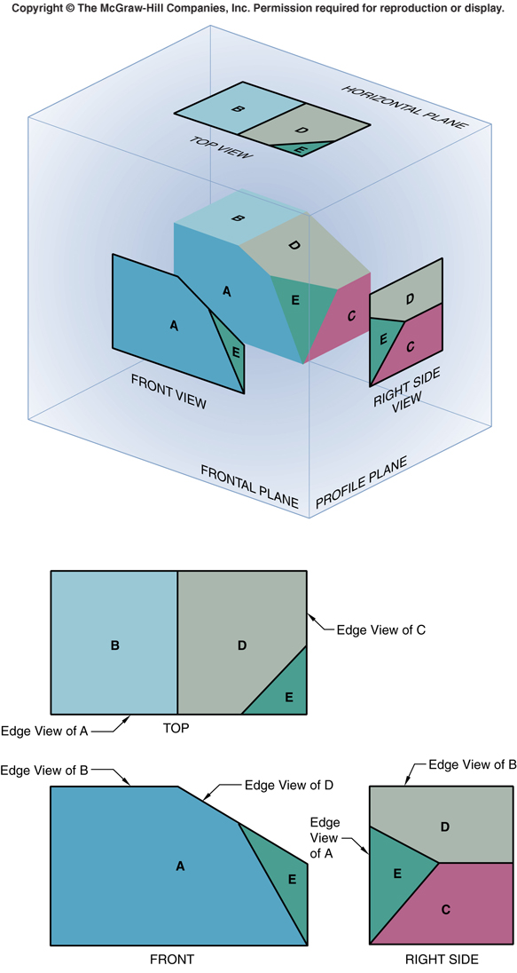
Basics of Edges and Planar Surfaces
Which surfaces are:
Principle?
Inclined?
Oblique?

Slide 43
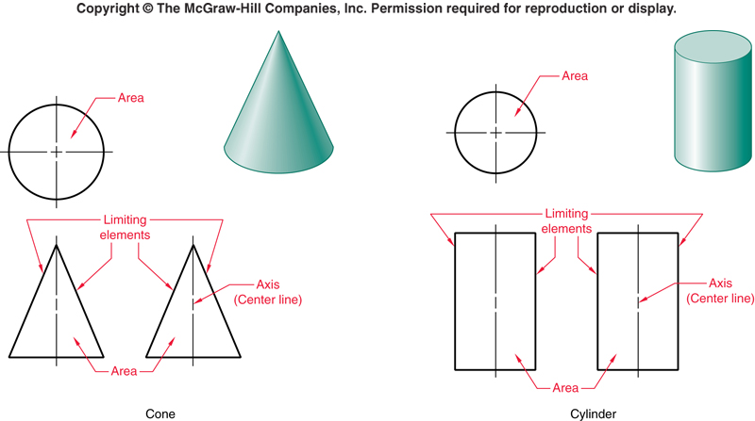
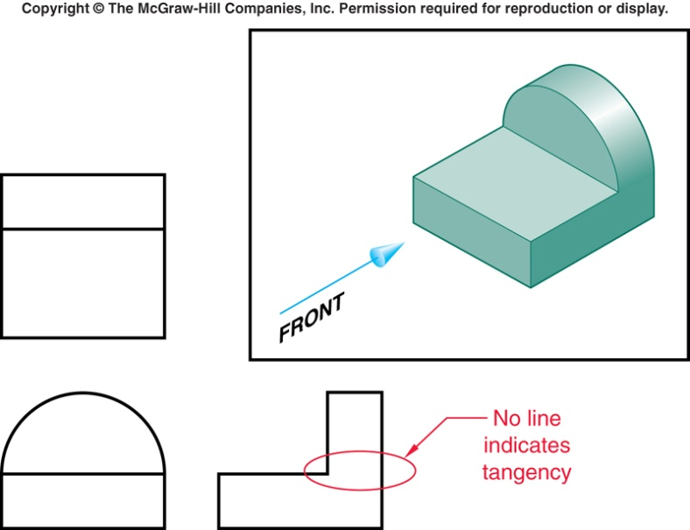
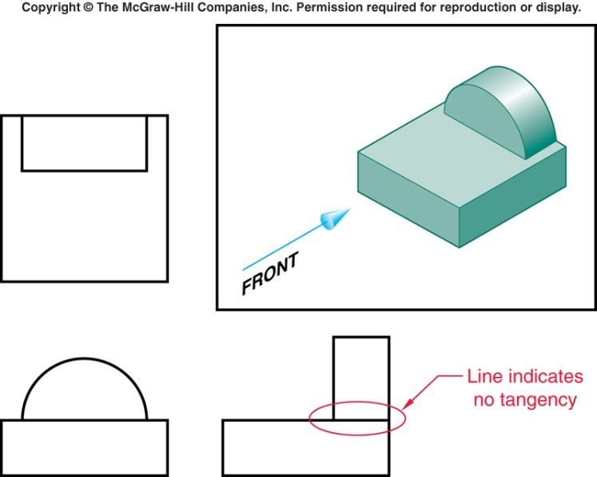
Representing Curved Surfaces
Key: only show limiting boundary
Cone & circle: base shown as circles when in a view perpendicular to projector.
Where rounded end tangent to plane, no line is shown

Slide 44
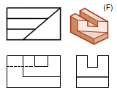

Developing Visualizing Skills
Important to develop skills for
Looking at multi-view and visualizing the object (or drawing a pictorial such as an isometric)
Looking at the object and being able to sketch a multi-view
Text: shows several ways to develop these skills:
Projection studies: look at examples of combined multi-view & iso (Recommended: study text fig 5-104, make sure you see the correspondence between iso and each ortho view)
Build sample physical models
Try these

Slide 45

Adjacent Areas: Developing Visualizing Skills
Adjacent areas: given a top view, sketch several possible objects
You Try It: Each of you sketch a possible 3-view OR isometric:
Visible lines show intersection between 2 adjacent planes; so …
Boundary between surfaces shows as a line indicating a change in planes
No two adjacent areas can lie in same plane (i.e. if there is a line, the 2 adjacent planes must not be co-planar)
Notes:
Show 2 student examples

Slide 46

Adjacent Areas: Developing Visualizing Skills
The problem: do 3-view or iso that matches the given top view:
Possible solutions:
What was yours?

Slide 47

Similar Shapes: Developing Visualizing Skills
Similar shapes:
apply rules 5 & 6: a surface will keep its basic configuration in all views (except of course on edge); so …
e.g. If it looks like an ‘ell’ in one view, it’ll look like an ell in ALL views
“L” shape “U” shape Inverted “T”
Notes:
Show 2 student examples

Slide 48

Developing Visualizing Skills
Another Technique is to apply Surface Labeling:
You will do this in Lab.
Analysis by Solids and by Surfaces are similar
Vertex Labeling:
Can help as check in multi-view drawing

Slide 49

Developing Visualizing Skills
Another technique: Missing Line exercises
What’s missing from this multi-view?

Slide 50

Developing Visualizing Skills
How to: Missing View exercises

Slide 51

Projection Between Views
Given two views of any point, the same point in any other orthographic view can be found
A 45º MITRE line is used to locate points and transfer depth dimensions between top and side views
Why does this work?
reflecting thru 45 deg line is equiv to rotation of 90 deg!
So reflection is like swinging camera 90 deg or
Rotating R side of glass box 90 deg
Notes:
Why does this work? See slide 17: reflecting thru 45 deg line is equiv to rotation of 90 deg!
So reflection is like swinging camera 90 deg or rotating R side of glass box 90 deg

Slide 52
Convention: Arrangement of Orthographic Views
Top View
Depth
Width
Right Side View
Front View
Height
Notes:
Note that the views are placed and aligned in the manner shown in the diagram. Remind the students that they have to follow the above convention for all their home work problems and exam problems.
It is crucial to maintain alignment and correct placement relative to each other.
Means line for top (and bottom) is straight across for both front view and right side view for example.
Same thing between front and top for sides.
Note : The following can be seen from the slide:
Top View and front view - same width
Front View and Right / Left side view - same height.
Depth of Top view is same as width of right/ left side view.

Slide 53

Align Bounding Boxes of each View
WIDTH
DEPTH
TOP
WIDTH
DEPTH
Mitre line at 45°
HEIGHT
HEIGHT
FRONT
RIGHT

Slide 54
Sketch Features – View Projection
TOP
Miter line at 45°
FRONT
RIGHT

Slide 55

Line Precedence
1. Visible
2. Hidden
3. Center
Notes:
From Bertoline: Figure 2.38 / Pg 42
In engineering and technical drawing, it is important that hidden features be represented, so that the reader of the drawing can clearly understand the object.
Thus we need hidden lines to emphasize that those features exist but are hidden in that particular view.
We also need center lines to understand how the features defined in the 2D views translate into 3D.
NOTE: hidden lines & center lines are used only on Orthographic projection drawings, never on isometric drawings
Q: Do we need a convention for what line to show if two lines fall on top of each other?
A: Yes! Otherwise features which are more important (eg: visible lines) would be overridden by less important features (eg: hidden lines) and the resulting drawing would be interpreted inaccurately. The next slide shows the convention followed.

Slide 56

Add missing view in indicated location

Slide 57
Add missing view in indicated location
Notes:
1 what is overall containing bounding brick? You can tell the W & D from top, W H from front!
2. What are basic components? Small block on large, chamfer on lg block. So do next level bbox
3. What are details?
a) divide into top & bottom
b) “notch out” top to small block
c) chamfer side of base

Slide 58

Add missing view in indicated location
Notes:
1 what is overall containing bounding brick? You can tell the W D from top, and W H from front!
2. What are basic components? An “Ell” shape. So do next level bbox
3. What are details?
a) corner off bottom
b) notch out of bottom
c) notch out of back of Ell
d) corner off back of Ell
4. Add these

Slide 59
Add missing view in indicated location
Notes:
1 what is overall containing bounding brick? You can tell the W D from top, and W H from front!
2. What are basic components? An “Ell” shape. So do next level bbox
3. What are details?
a) corner off bottom
b) notch out of bottom
c) notch out of back of Ell
d) corner off back of Ell
4. Add these

Slide 60

Add missing view in indicated location
Notes:
Do bounding box
Basic shape: 2 slabs about same thickness
Details
vertical slab smaller, off-center
vert slab: notched

Slide 61
Add missing view in indicated location
Notes:
Do bounding box
Basic shape: 2 slabs about same thickness
Details
vertical slab smaller, off-center
vert slab: notched

Slide 62
Reading
Reading:
Ch 5 ( 5.1 - 5.7, 5.8.1 - 5.8.4, 5.10 - 5.14)
Read-ahead for next week: Ch 7 (7.1 - 7.6, 7.14 - 7.19)
Bring plain paper and both regular and isometric grid paper to your lab.
Bring your textbook to your lab!!

Slide 63
See you in the labs!

