Slide 1



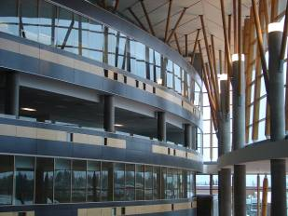

IAT 106
Spatial Thinking and Communicating
Spring 2021

Slide 2
Let’s do some POLLING. Shall we? 😉

Slide 3
Thank you for answering all the questions 👊🏽
We got this! We can make this course a much better experience than what it currently is.

Slide 4
Live Activity
Identify a simple household object (e.g., cup). Complete a 3-view sketch of the object, with dimensions. The views are to be placed and oriented correctly as shown in the lecture. Use a single sheet of grid paper.

Slide 5

Live Activity
Identify a simple household object (e.g., cup). Complete a 3-view sketch of the object, with dimensions. The views are to be placed and oriented correctly as shown in the lecture. Use a single sheet of grid paper.

Slide 7
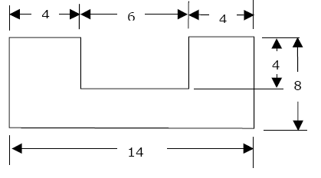
What wrong in this drawing?

Slide 8
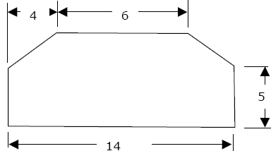
What wrong in this drawing?

Slide 9
See you on Monday! Thank you!
☺

