Slide 1



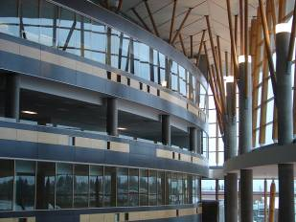

IAT 106
Spatial Thinking and Communicating
Week 04
Pictorial Projections & Intro to OnShape

Slide 2
Objectives for today
Review material from last week
Basics of edges & surfaces—i.e. where lines come from
Review of ortho/multiview techniques
Introduction to pictorial views, especially isometric/axonometric
Introduction to OnShape

Slide 3
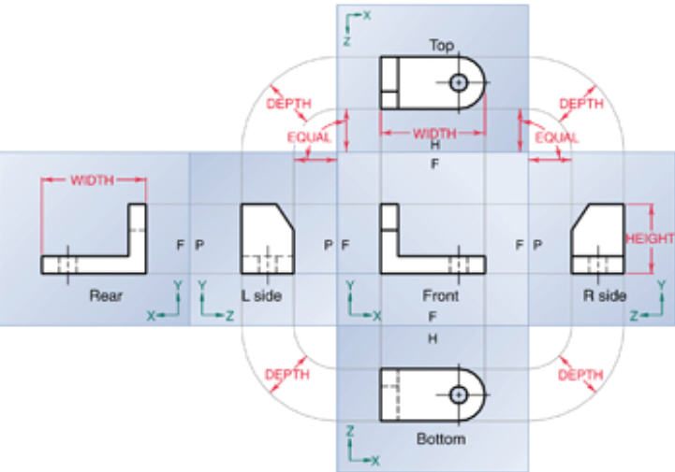
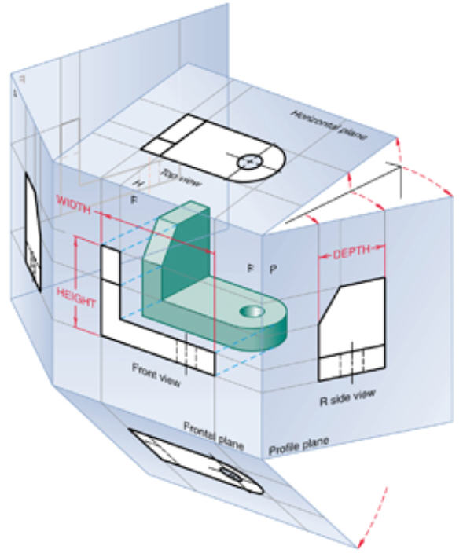
Review: Multi-view Glass Box method
put object in glass box
Project object out to sides of box
Unfold Box for multiview
Unfolding
Unfolded: note size relationships (i.e., depth in side/top/bottom)
Glass Box Demo: OnShape model of glass box.

Slide 4
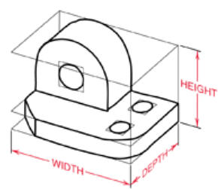
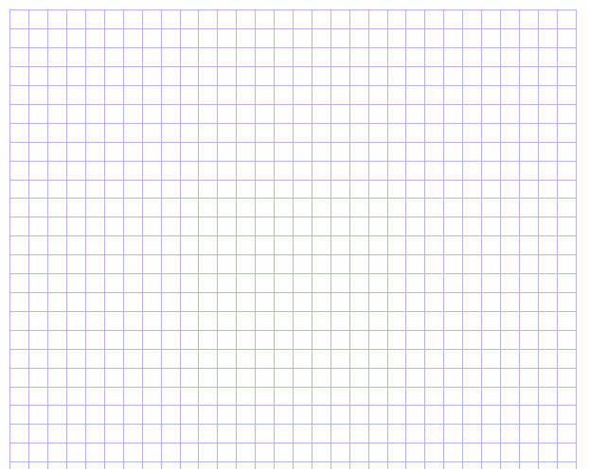
Review : Multi-view placement
Width
Top view
Depth
Depth
Right side view
Front View
Height
Notes:
Notice Top and Front are ALIGNED vertically (RULE 1)
Notice Front and Right are ALIGNED vertically (RULE 1)
Notice “depth” in Right is same as depth in Top (Rule 2 on “related views”)

Slide 5
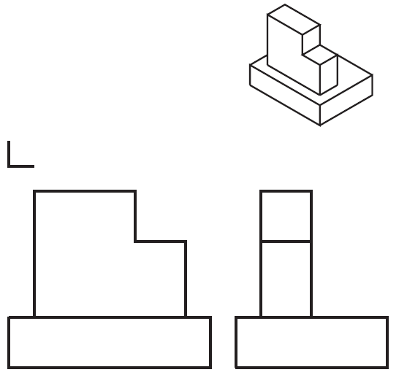
Review: multi-view & missing view
Notes:
Do bounding box
Basic shape: 2 slabs about same thickness
Details
vertical slab smaller, off-center
vert slab: notched

Slide 6
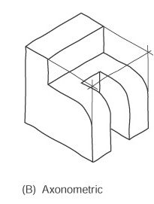
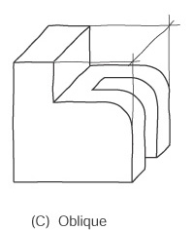
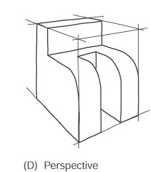
Pictorials are Useful
Show several faces of an object at once.
Represent an object in three dimensions.
Frequently used in technical documents, sales literature, maintenance manuals, architectural drawings, etc.

Slide 7
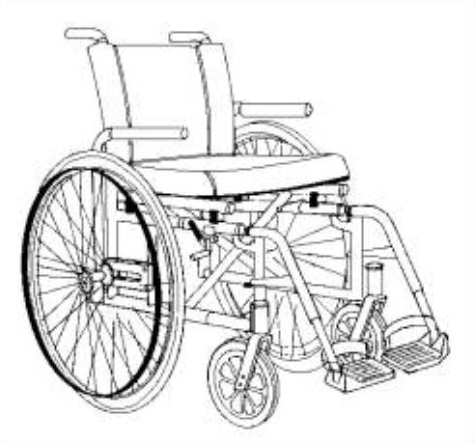
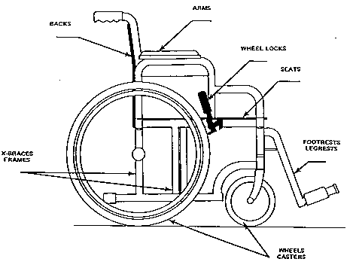
Pictorial vs Orthographic
Pictorial/perspective
Nice overview—looks “natural”
But not so good for exact geometry
Much harder to draw
Ortho
Sizes, proportions accurate
Not so good for visualization

Slide 8
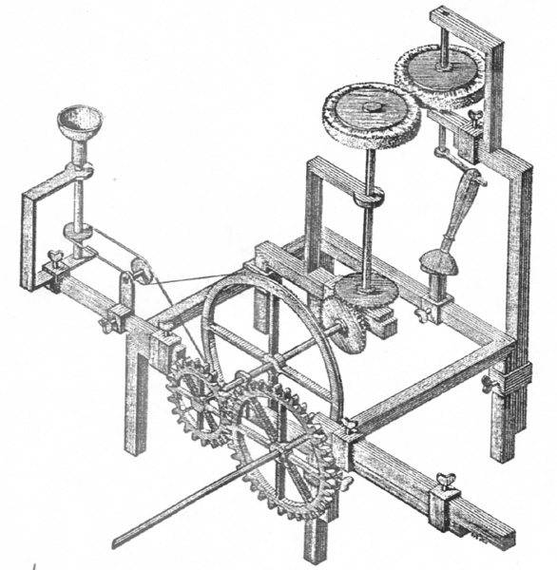
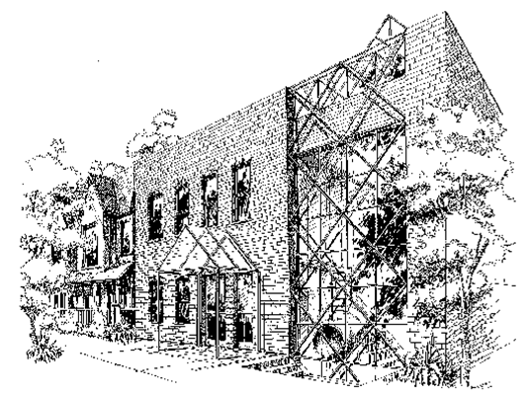
Examples
An Isometric Pictorial
A Perspective Pictorial

Slide 9
Objectives
Define axonometric projection and its three classes.
Create an isometric sketch.

Slide 10
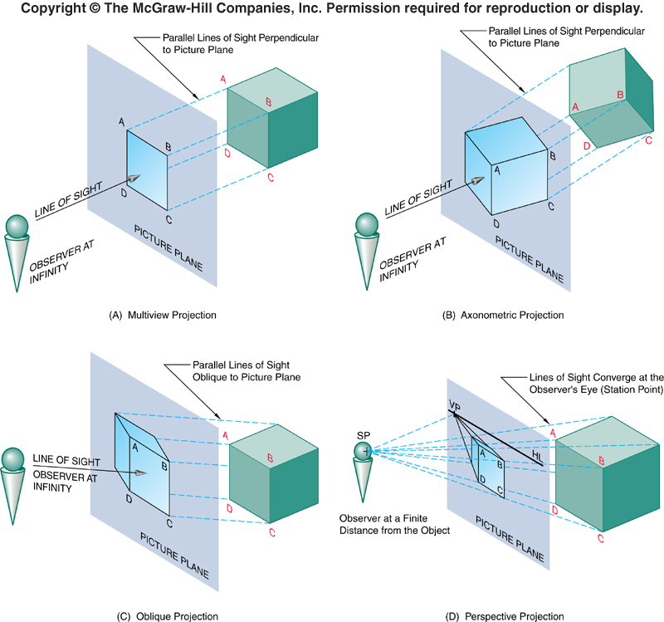
Axonometric Projection
One of four principal projection techniques.
Note position of observer and line of sight.
Orthographic projection (remember both multiview and axonometric are types of ortho projections).
Vanishing points
Only front face outlines are parallel, TL

Slide 11
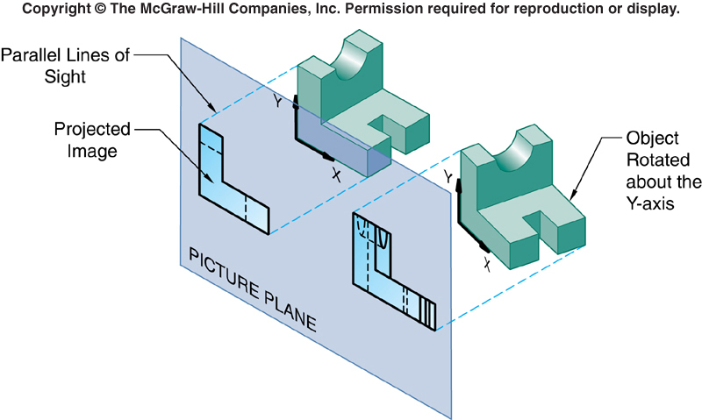
Axonometric Projection
Parallel projection technique.
Creates a pictorial drawing of an object by:
rotating the object on an axis relative to a projection, or picture plane.
Axonometric: From Greek, axon = axis; metric = to measure

Slide 12
Classifying Axonometric Projections
Based on angles between the axonometric axes.
There are three main types of axonometric projections:
Trimetric projections.
Dimetric projections.
Isometric (equal measure) projections..
The axonometric axes are axes (not faces!) that meet to form the corner that is nearest to the observer.

Slide 13
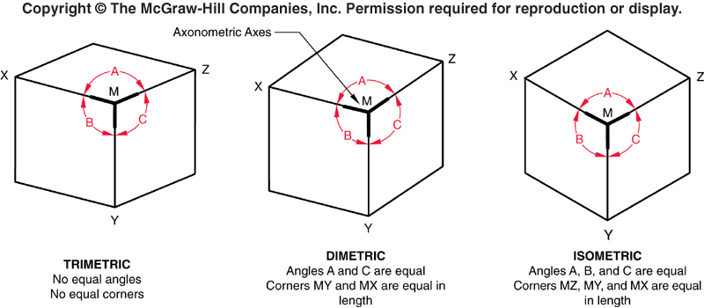
Types of Axonometric Projections
 | Trimetric | Dimetric | Isometric
Drawing | Most difficult | Easier | Easiest
Viewing | Most pleasing | Less pleasing | Least pleasing
Example: http://en.wikipedia.org/wiki/File:Axonometric_projections.png

Slide 14
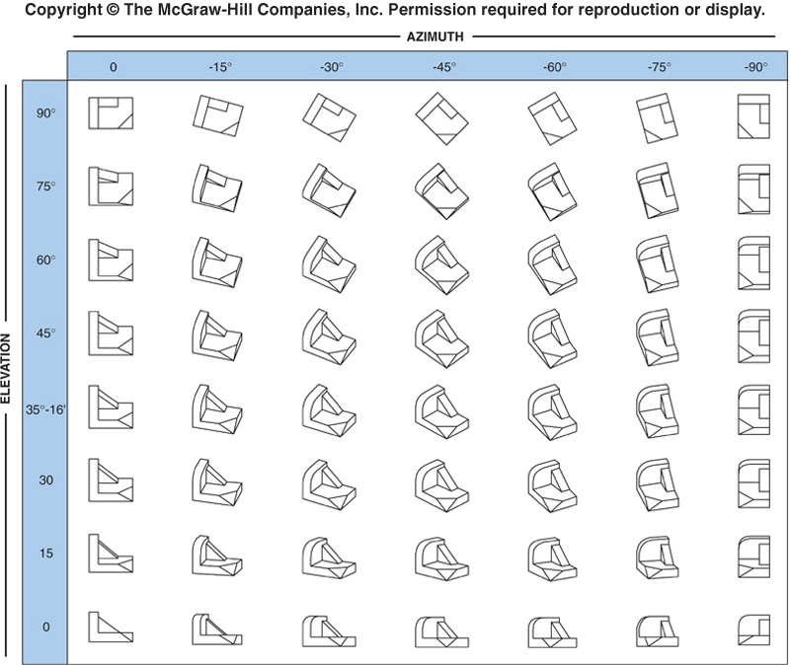
Axonometric Views
Infinite # views possible:
Obj can be inclined at any angle wrt proj. plane.
Only a few of the views are actually used.

Slide 15
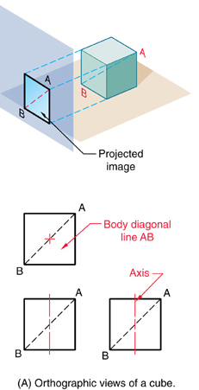
Isometric Projections
A true representation of the isometric view of an object.
Given a cube, its isometric view is created by:
Rotating it 45˚ about a vertical axis.
Then, tilting the cube forward until the body diagonal (AB) appears as a point in the front view (≅35˚16’).
The isometric axes meet at A,B and form equal angles of 120˚ in the isometric view.

Slide 16
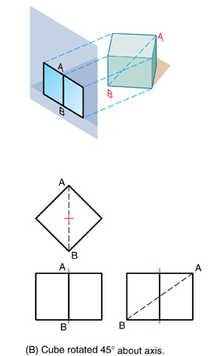
Isometric Projections
A true representation of the isometric view of an object.
Given a cube, its isometric view is created by:
Rotating it 45˚ about a vertical axis.
Then, tilting the cube forward until the body diagonal (AB) appears as a point in the front view (≅35˚16’).
The isometric axes meet at A,B and form equal angles of 120˚ in the isometric view.

Slide 17
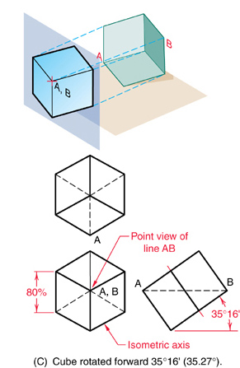
Isometric Projections
A true representation of the isometric view of an object.
Given a cube, its isometric view is created by:
Rotating it 45˚ about a vertical axis.
Then, tilting the cube forward until the body diagonal (AB) appears as a point in the front view (≅35˚16’).
The isometric axes meet at A,B and form equal angles of 120˚ in the isometric view.

Slide 18
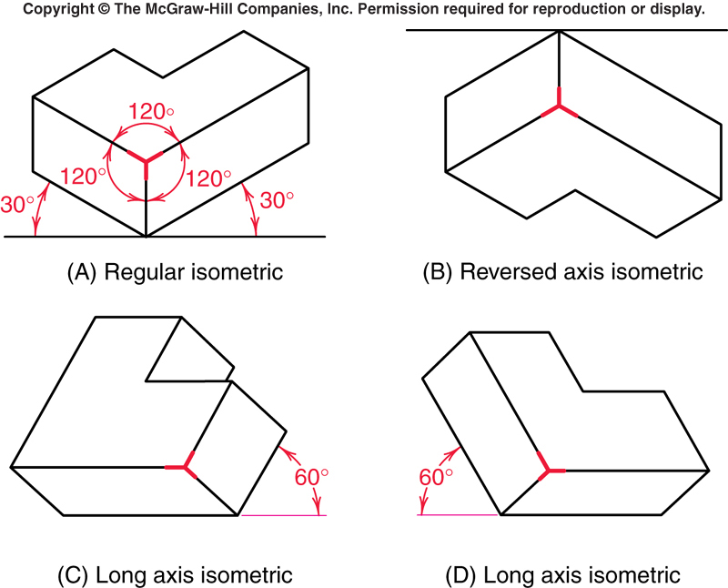
Isometric Drawings - Types
Isometric axes can be positioned in a number of ways to create different views of the same object:
Regular isometric.
Reversed axis isometric.
Long axis isometric.

Slide 19
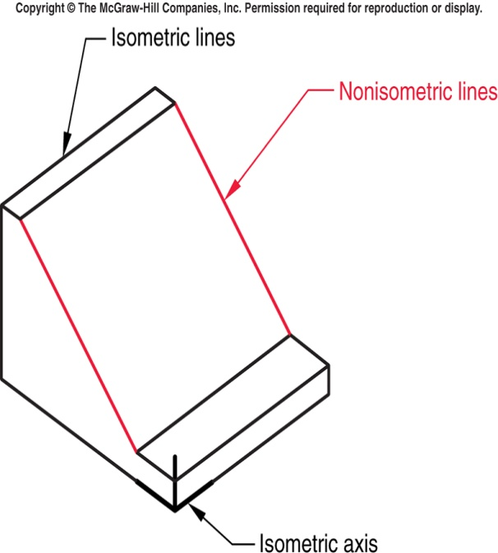
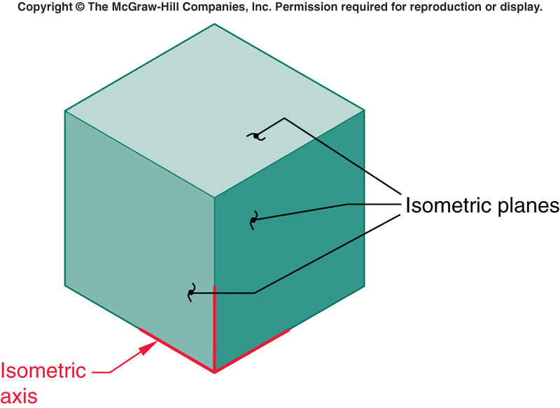
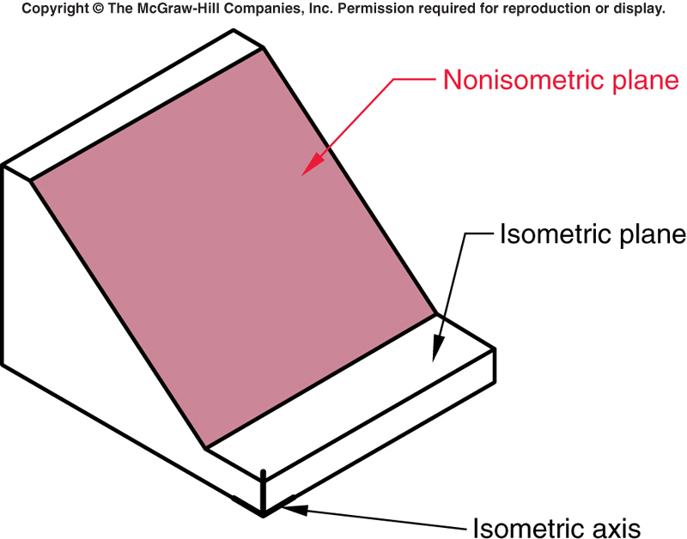
Isometric Drawings – Lines & Planes
Any line that is parallel (in the object – not the drawing) to one of the legs of the isometric axis is an isometric line. Else, it is a non-isometric line (e.g., inclined and oblique lines).
Any plane parallel to the isometric surfaces formed by any two adjacent isometric axes is an isometric plane.

Slide 20
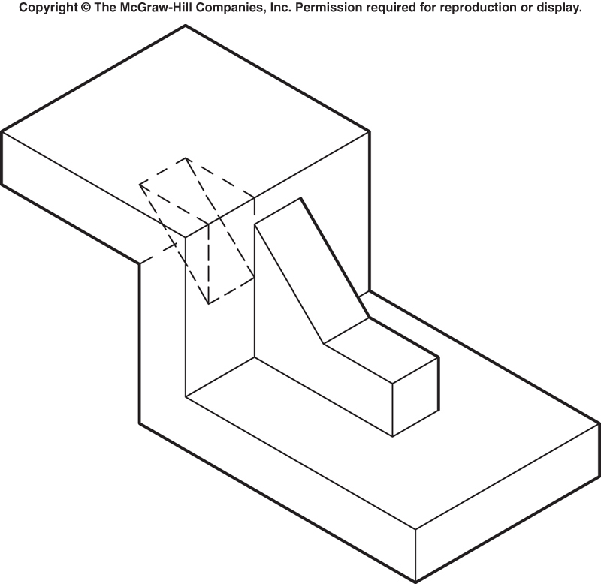
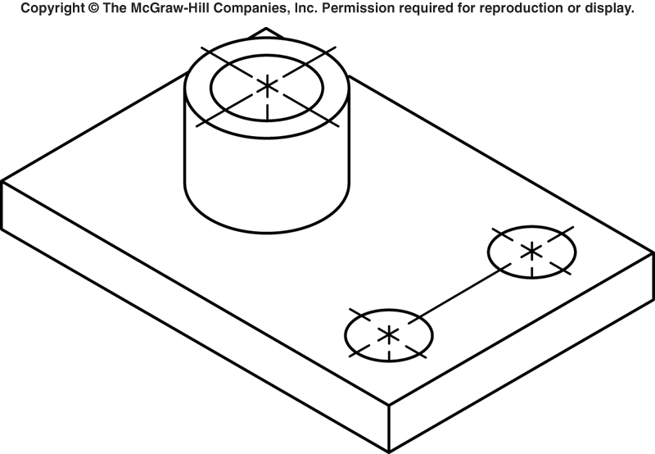
Hidden and Center Lines
Omit hidden lines unless absolutely necessary to completely describe the object:
Choose most descriptive viewpoint.
Center lines drawn only for showing symmetry or for dimensioning.

Slide 21
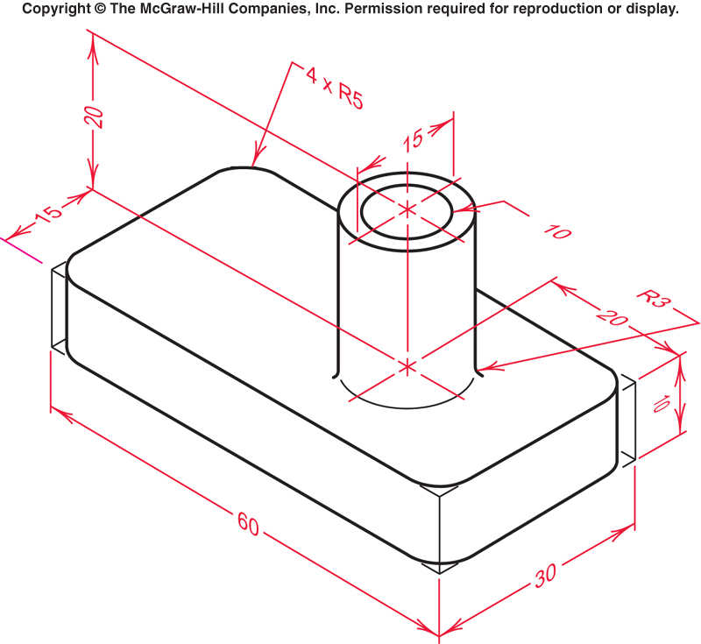
Dimensioning
For this class, if you must dimension then use the aligned method shown above:
Lines and lettering are drawn in the plane of one of the faces of the object (right image).

Slide 22
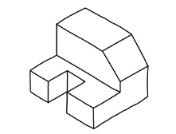
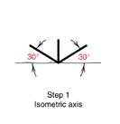
Activity: Let’s Create an Isometric Sketch – ermm but its too easy, so just watch this one out!
Grab a pencil and a sheet of plain paper.
Using boxing-in method (or bounding box), do isometric sketch of above object.
Start: draw iso axes (3 primary dimensions: w, h, and d).

Slide 23
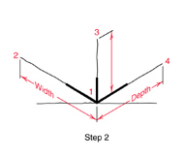
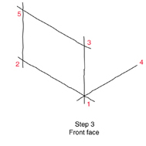
Isometric Sketch - 2
Step 2:
Extend isometric axes as shown: Draw 1 vertical line, 2 30-deg lines.
Label corner & end of construction lines as indicated.
Step 3 : Sketch in front face of object.
Sketch parallel (//) and equal length lines to width & height dimensions.
Label ends as indicated.

Slide 24
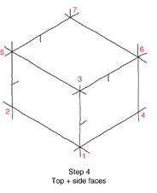
Isometric Sketch - 3
Step 4:
From pt 3, block in top face of object by sketching a line // to & equal in length to line 1-4.
aka 3-6
Label as line 3-6.
From pt 6, draw 6-7 similarly.
Repeat
Bounding box of the object, sketched as construction lines, is completed.

Slide 25
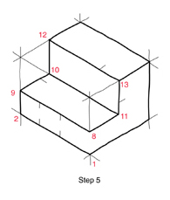
Isometric Sketch - 4
The Isometric Sketch
Step5: Locate object details on isometric planes.
Complete front cutout of block by estimating dimensions, marking points & sketching lines.
Begin darkening in some of the lines representing the final form.

Slide 26
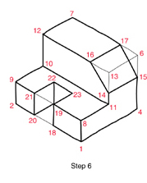
Isometric Sketch - 5
The Isometric Sketch
Step 6: Sketch angled surface by estimating distances & marking points.
Sketch notch (out of block front) following same approach.
Darken all visible lines to complete the isometric sketch.

Slide 27
Question
Is/are there any non-isometric line(s) in the just-completed isometric sketch?
2 nonisometric lines

Slide 28
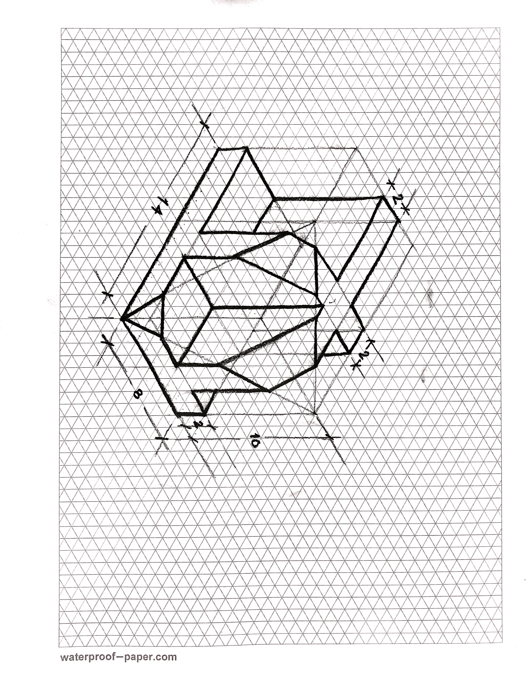
Let’s try a bit complex example! Shall we?
Onto your papers!
Now who can try the multi-views of this iso?
You got 5 minutes ☺

Slide 29
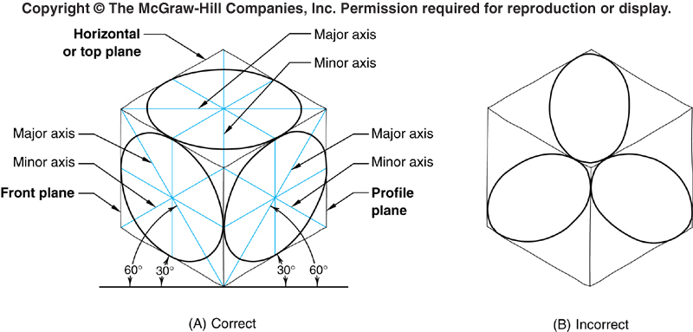
Isometric Ellipses
Special type of ellipse used to represent holes and ends of cylinders in isometric drawings:
Circles appear as ellipses in isometric sketches.
NB: take care to
put major and minor axes in proper positions &
orient ellipse correctly.

Slide 30
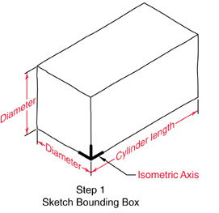
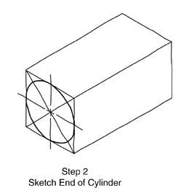
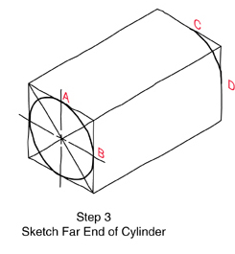
Activity: Sketching an Isometric Cylinder
In Step 3: After marking points A & B, sketch construction lines from them to back of bounding box & mark C & D. Then sketch arc between C and D.

Slide 31
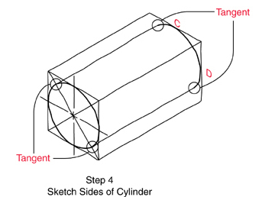
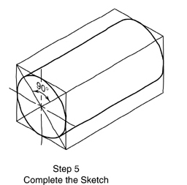
Isometric Cylinder - 2

Slide 32
Reading
Reading:
From last week: Ch 5 ( 5.1 - 5.7, 5.8.1 - 5.8.4, 5.10 - 5.13)
Ch 7 (7.1 - 7.6, 7.14 - 7.19)
In Section 5.4.2 there is an explanation of first- and third-angle projection. You may find the wikipedia article at http://en.wikipedia.org/wiki/Multiview_orthographic_projection to be a good explanation of the differences between the two.
Bring plain paper and both regular and isometric grid paper to your lab.
Bring your textbook to your lab!!

Slide 33
Lecture 4 – Part 2
Introduction to OnShape

Slide 34
OnShape
OnShape is an industrial-strength 3-D solid-model based computer-aided design (CAD) system.
In OnShape, you sketch ideas and experiment with different designs to create 3D models.
OnShape is used by students, designers, engineers, and other professionals to produce simple and complex parts, assemblies, and drawings.

Slide 35
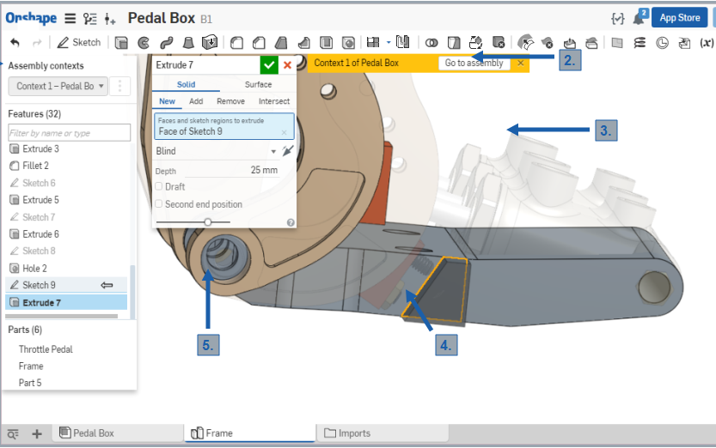
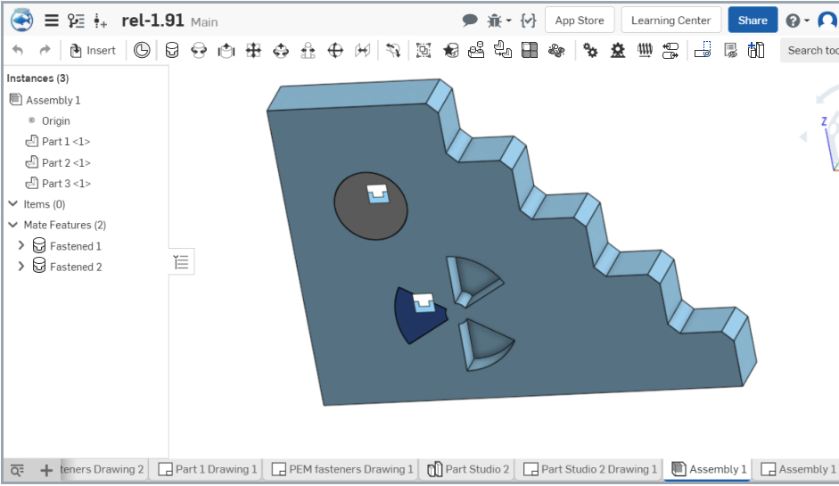
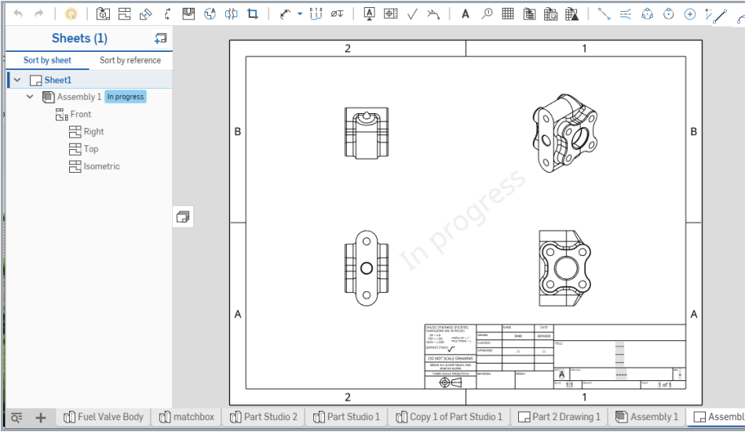
The OnShape Model: 3 Design Environments
Parts
Assemblies
Drawings

Slide 36
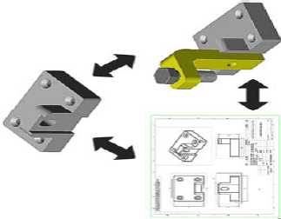
OnShape is ASSOCIATIVE
What’s it mean that OnShape is associative?
Parts, drawings & assemblies all use the same database.
So?
Any change made in any of the modes (i.e. Part, Assembly, or Drawing modes) is automatically reflected in the other modes immediately.

Slide 37
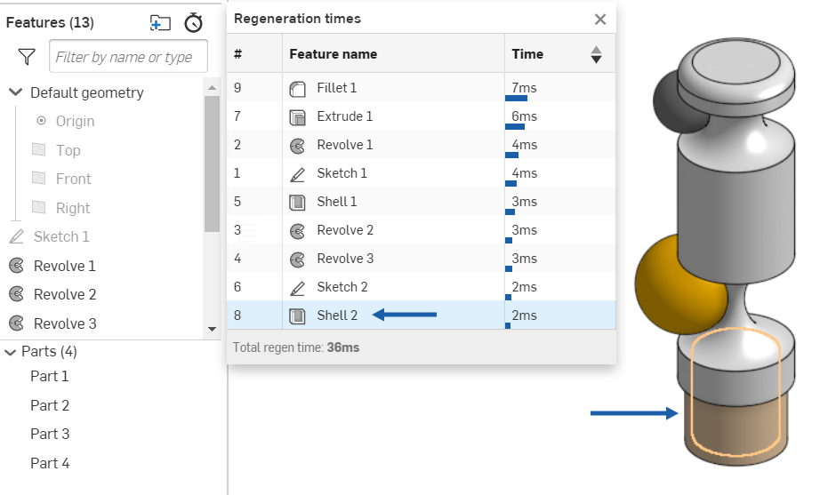

OnShape is FEATURE-BASED
Feature: smallest building block that can be modified individually.
Features are building blocks of the parts (shapes and operations).

Slide 38
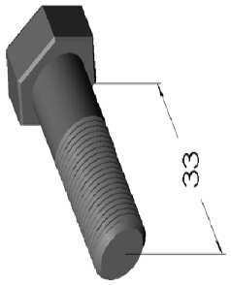
OnShape is PARAMETRIC
Dimensions in the model drive the geometry of the model.
Modifying the dimensions changes the model.
Dimensions and relations are stored in the model.

Slide 39
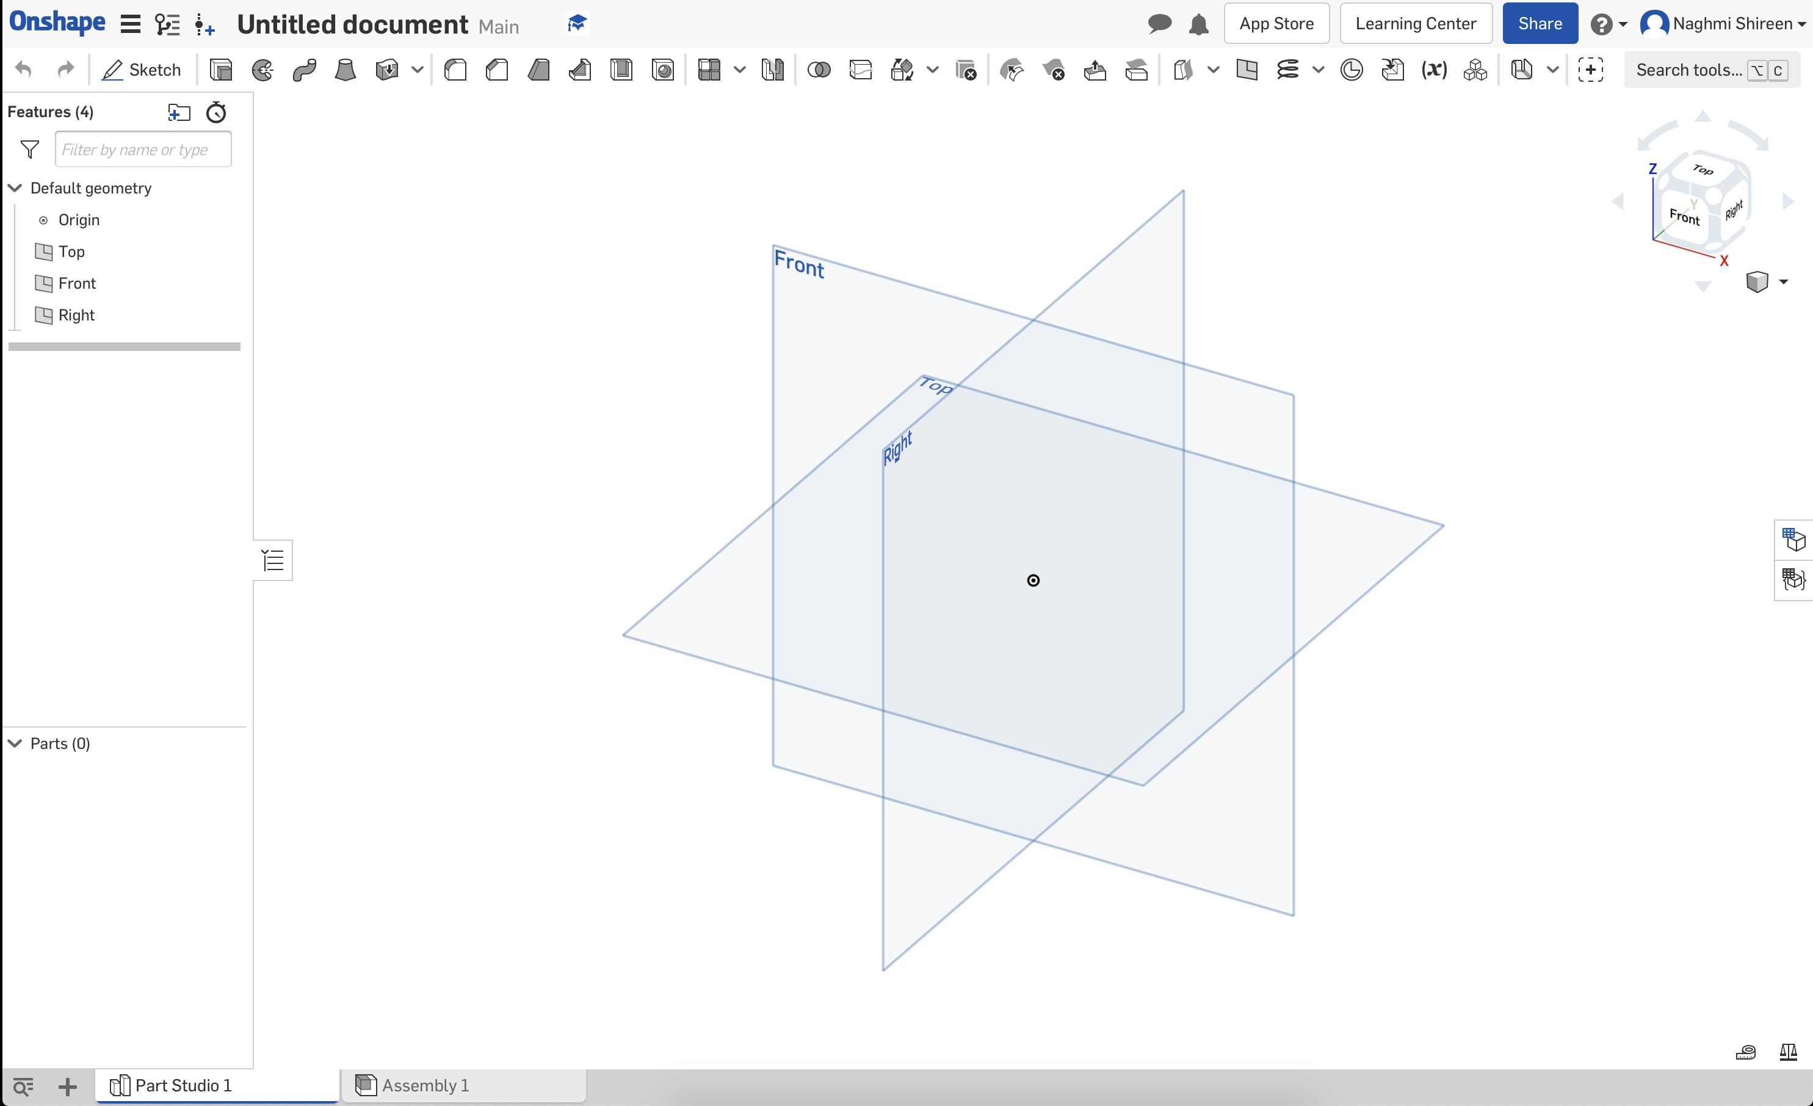

User Interface
Resources Pane
} Menu bar
“Document” subWindow
Feature Manager Pane
Graphics Area
} Tabs to switch between project files

Slide 40
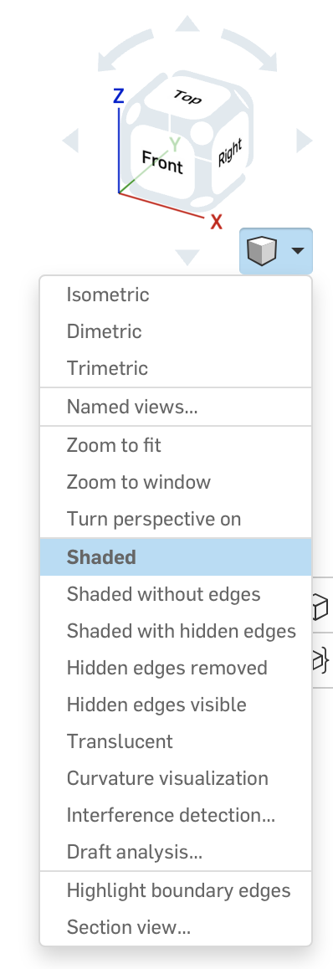
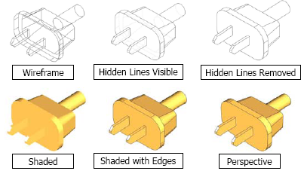
Display Modes

Slide 41
How do we actually build a Part?
Build parts by combining features
Ok how do I make a feature?
Build feature by drawing a 2D sketch and extruding it into the 3rd dimension:
Use familiar drawing tools.
The sketch does not need to be dimensionally accurate.
Just needs to represent basic shape (topology) of profile:
Number of sides
Relationships between elements (parallel, etc.)

Slide 42

Features
Features are the building blocks of parts.
Features are the shapes and operations that construct parts.

Slide 43


Shape Features
Base feature
First feature in part.
Created from 2D sketch.
Forms work piece to which other features are added.
Boss feature
Adds material to part.
Created from 2D sketch.
Must be attached to rest of part.
Two boss features here!

Slide 44


More Shape Features
Cut feature
Removes material from part.
Created from 2D sketch.
Must be attached to rest of part.
Hole feature
Removes material from part.
Works like intelligent cut feature
Usually corresponds to mfg process (eg countersink, thread, etc.)

Slide 45

Operation Features
Fillet features
Fillet feature
Used to round off sharp edges.
Can remove or add material.
Outside edge (convex) removes material.
Inside edge (concave adds material.
Chamfer feature
Similar to a fillet.
Bevels edge rather than rounding it.
Can remove or add material.

Slide 46
Feature attributes
Sketched Features
Shape features have sketches, are based on sketches
Sketched features are built from 2D sketches (profiles)
Operation Features
Do not have sketches
Applied directly to work piece by selecting edges or faces

Slide 47
See you in the Labs

