Slide 1



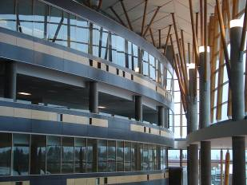

IAT 106
Spatial Thinking and Communicating
Spring 2021

Slide 2
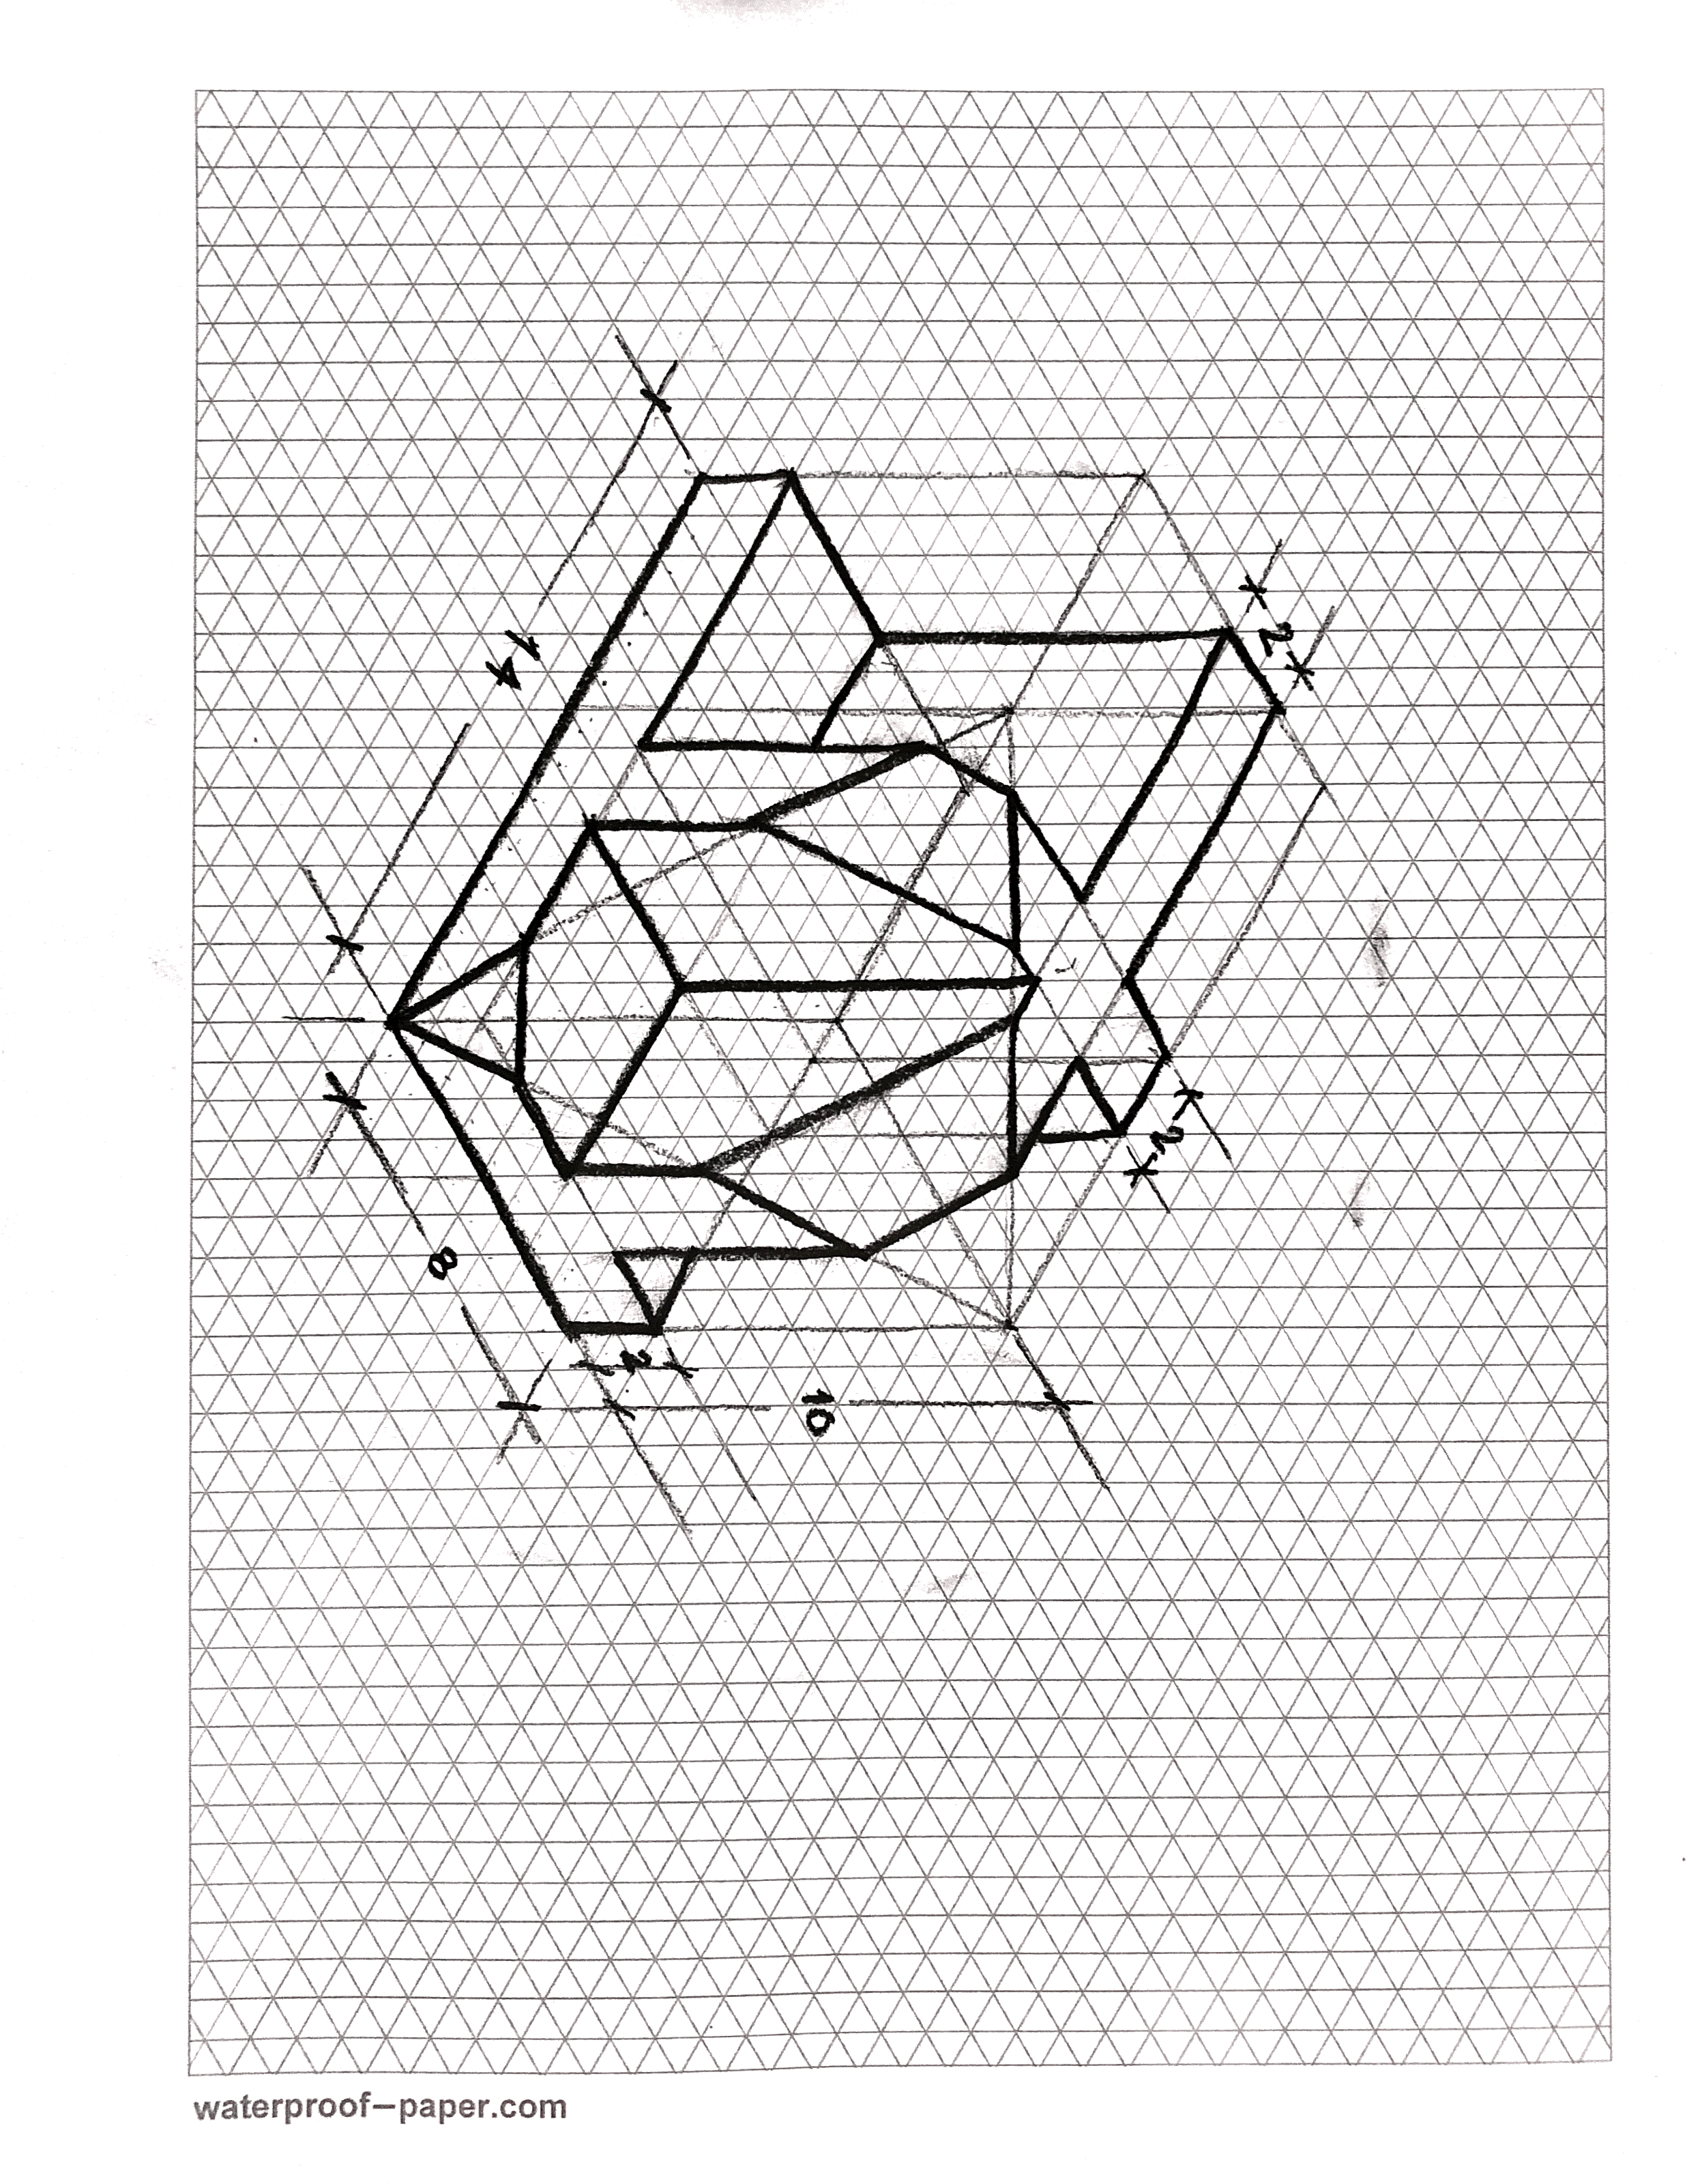

Slide 4
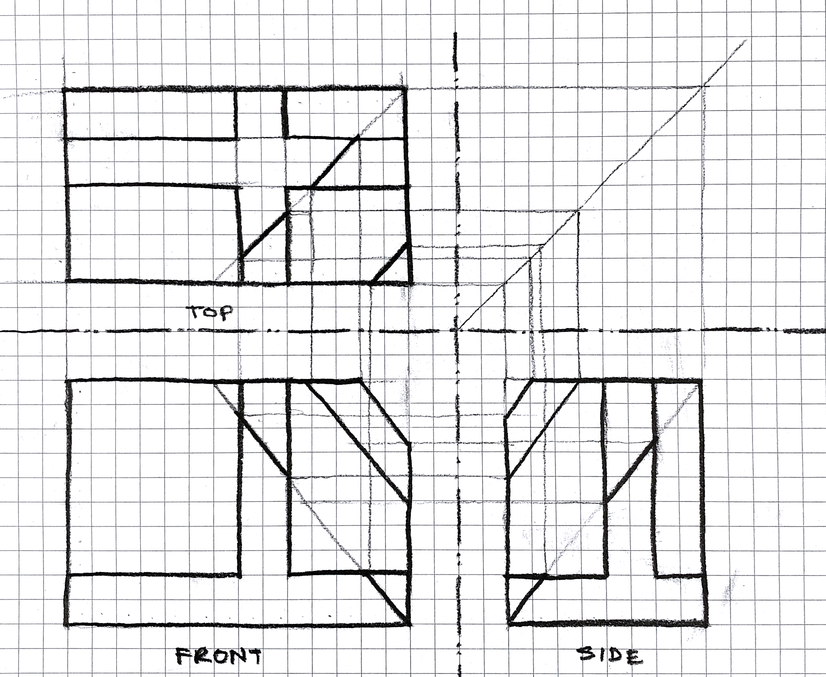

Slide 5
See you on Monday! Thank you!
☺

