Slide 1



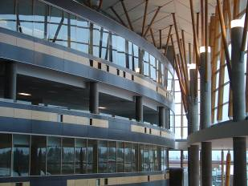

IAT 106
Spatial Thinking and Communicating
Fall 2020

Slide 2
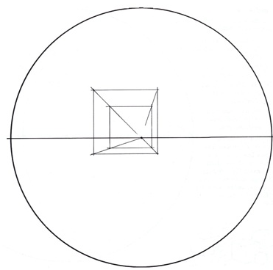
Class Exercise: Drawing Boxes in
One Point Perspective
Time: 5 minutes
Reproduce the following circle: including HL (horizon line)
Draw as many boxes as you can within the circle using the same VP.
Try drawing them with different sizes and from different views e.g. worm’s eye.
Use your eraser to remove any perspective lines (prevents confusion!)

Slide 3
Class Exercise: Drawing Boxes in
One Point Perspective
Sketch circle: & horizon line
Sketch several boxes using the same VP.(center of circle)

Slide 4
Pre-Lab 05

Slide 5
Design Scenario:
As a group, brainstorm (develop preliminary sketches of) a three-dimensional cube that can hold the much famous; first golf ball that was hit on the moon by Alan Shepard (first man in space) four decades ago. The ball has miraculously landed on Earth quite recently and you as a team are asked to design a fabulous casing for it.
Design Requirement:
The final design must be a cube of a size 120mm x 120mm x 120mm.
Should be taken apart into two halves. The two halves can be of different sizes.
The golf ball is 42.7mm diameter, you can round it off to 43mm including the tolerance. The placement of the ball does not have to be central.
The two halves should lock with each other, such that when the cube is held in hands and rotated around 360 degrees, it should not let the ball drop.
The final cube must have at least one of its internal surfaces an inclined surface.
The material given to develop this design will be single corrugated cardboard sheet.
Marking Criteria:
The final casing will be marked based on the creative design, workmanship and the proportional accuracy. The final case can be anything EXCEPT a box with a lid.

Slide 6
Digital Model
PART A
Technical Sketch
PART A
Physical
Prototype
PART A
Report
Ideate
Digital Model
PART B
Technical Sketch
PART B
Physical
Prototype
PART B
Report

Slide 7
Digital Model
PART A
Technical Sketch
PART A
Physical
Prototype
PART A
Report
Ideate
Digital Model
PART B
Technical Sketch
PART B
Physical
Prototype
PART B
Report

Slide 8
Digital Model
PART A
Technical Sketch
PART A
Physical
Prototype
PART A
Report
Ideate
Digital Model
PART B
Technical Sketch
PART B
Physical
Prototype
PART B
Report
Feb. 22
Feb. 24
Feb. 24
March. 01
March. 01

Slide 9
See you on Monday, Feb 22nd ! Thank you!
☺

