Slide 1

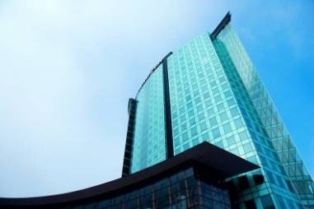
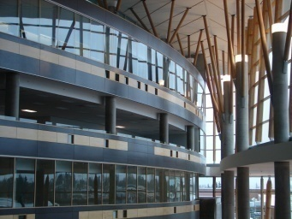

IAT 106
Spatial Thinking and Communication
Lab 5:
Model Making: Polyhedron
1.

Slide 2
Why are We Doing this Project?
Model making is fun!
Besides that …
In this lab you explore the relationship between 3 approaches to representing your ideas and see how each helps the others, and collectively how they assist you to improve your spatial thinking and communicating skills.
You will be given a simple isometric view of an object and, in teams of 2:
  (30 min) Sketch a full multiview drawing of the object
  (45 min) Build a Physical Model of the object
  (30 min) Build a digital model of the object.
Notes:
SW: will likely need more: complete as HW

Slide 3
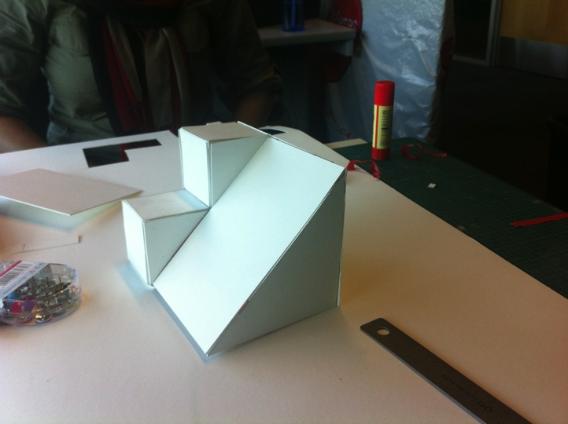
What & How
You will make:
Multiview drawings
Physical model
Digital model
Report
You bring in:
Square grid paper
Cardboard
Cutting board
Glue
Masking tape
Pencil
Metal ruler
X-acto knife or box cutter
Spatial Thinking power

Slide 4
Making the Polyhedron
Steps: Step 1:------------------------------------------------------------------- Sketch 6 orthographic views Step 2:------------------------------------------------------------------- Transfer the orthographic views to cardboard (use pins to locate points). Cut the faces of your model from the cardboard. Fabricate your physical model, using parts you just cut and tape/glue. Verify the physical model against the primary orthographic views Step 3:-------------------------------------------------------------------- Make a digital model of the same object using OnShape. Step 4:-------------------------------------------------------------------- Answer reflective questions relating to this project | Deliverables 6-view+inclined face multiview drawing Cardboard model of polyhedron SolidWorks model of polyhedron Word document with answers

Slide 5
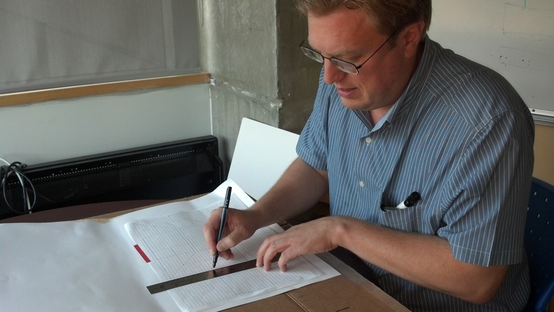
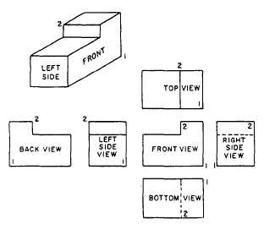
Step I: Sketching the Object (1/2)
sketch 6 ortho views of polyhedron
Use Square grid paper
Layout of the 6 views (6 principal orthographic projections):
Note:
  Place views so they fit on the grid paper.
  There is room for ONLY 1 grid unit between views!
  Your polyhedron has an inclined face: you will have to sketch this in addition to the 6 principal views.
    You will have to determine which of the principal views shows the width and which the length of this face!

Slide 6
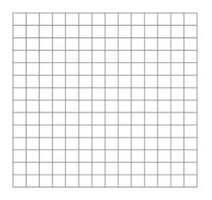
Step I: Sketching the Object (2/2)
Establish an appropriate scale.
Each 1 Sq = 5mm.
So 1:1 (for this exercise)

Slide 7
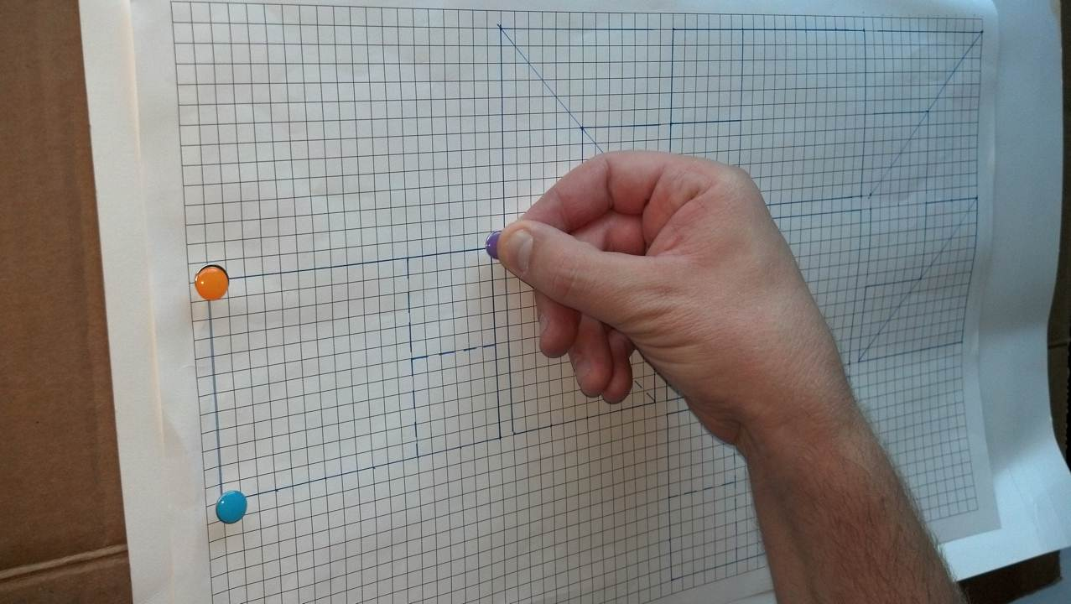
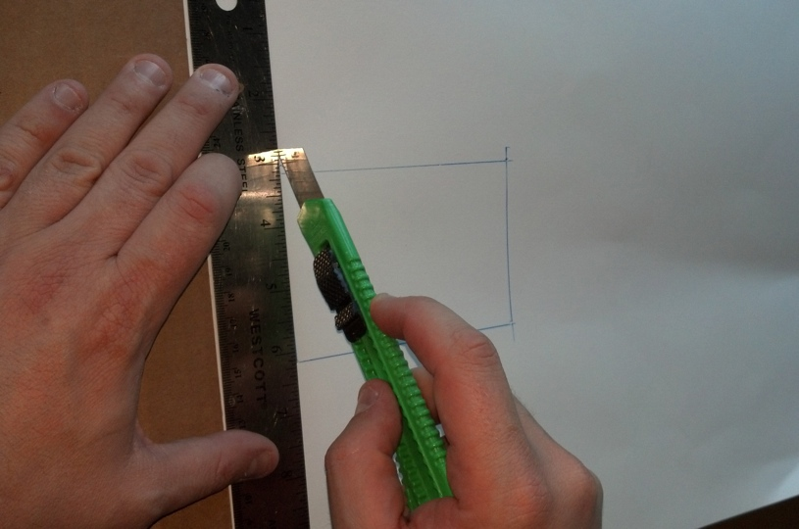
Step II: Building the Cardboard Model (45 min)
After drawing the six views:
  Align and Tape the grid paper directly on top of the cardboard (put tape along top edge to allow for lifting later)
  Using thumb tacks, press into the grid paper at all of the vertices to make a small hole in the cardboard.
  Flip the paper up and connect the dots (tack holes) to transfer the sketch onto the cardboard.
  Cut the cardboard with knife and ruler.
NB!
Keep the paper:
it will be needed in the marking process!
Also, if you make a mistake, you’ll need to redo one or more faces!
Notes:
Step 2 – 45 minutes

Slide 8
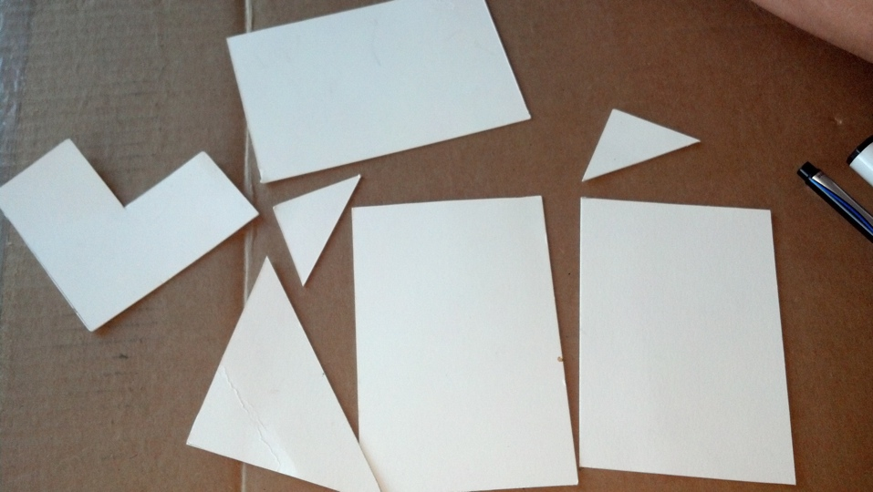
Step II: Building the Card Model
assemble the model using the faces you cut from the cardboard, using the scotch or masking tape, or glue.
Be careful with gaps and rough cuts:-)
These photos are from Fall 2012, where we used CardStock instead of cardboard.

Slide 9
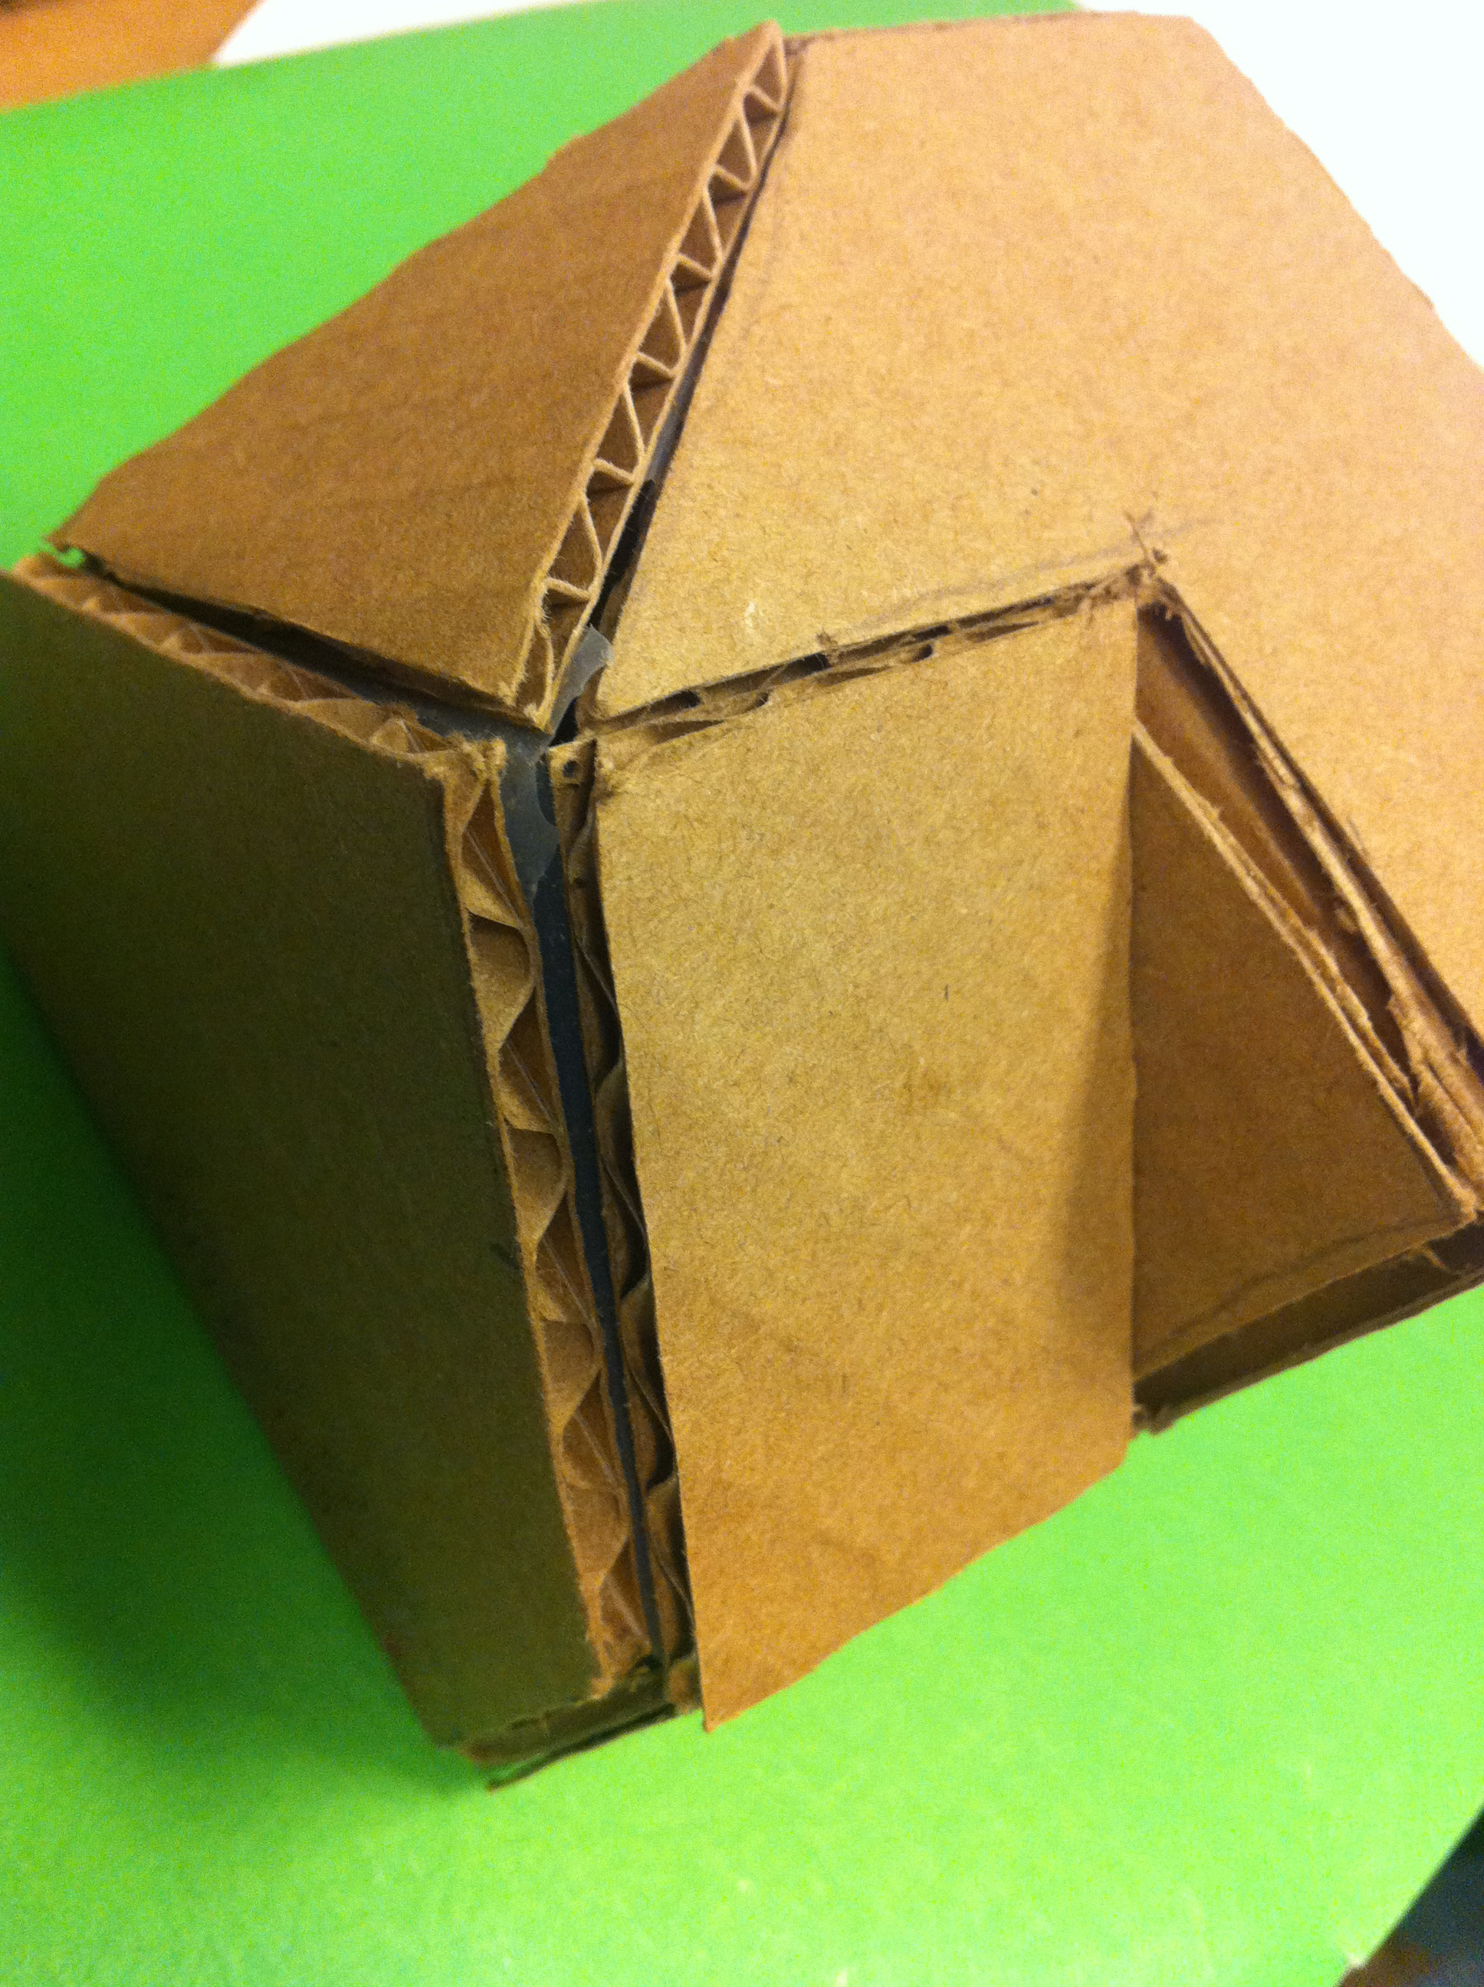
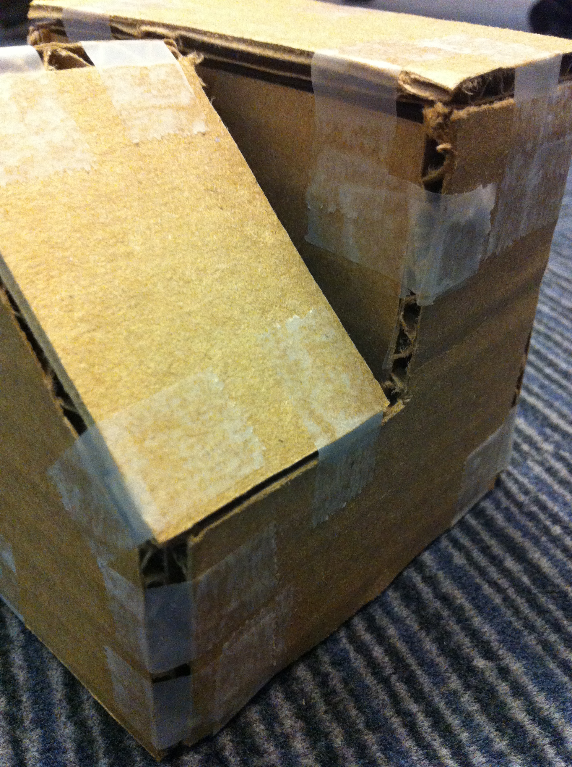
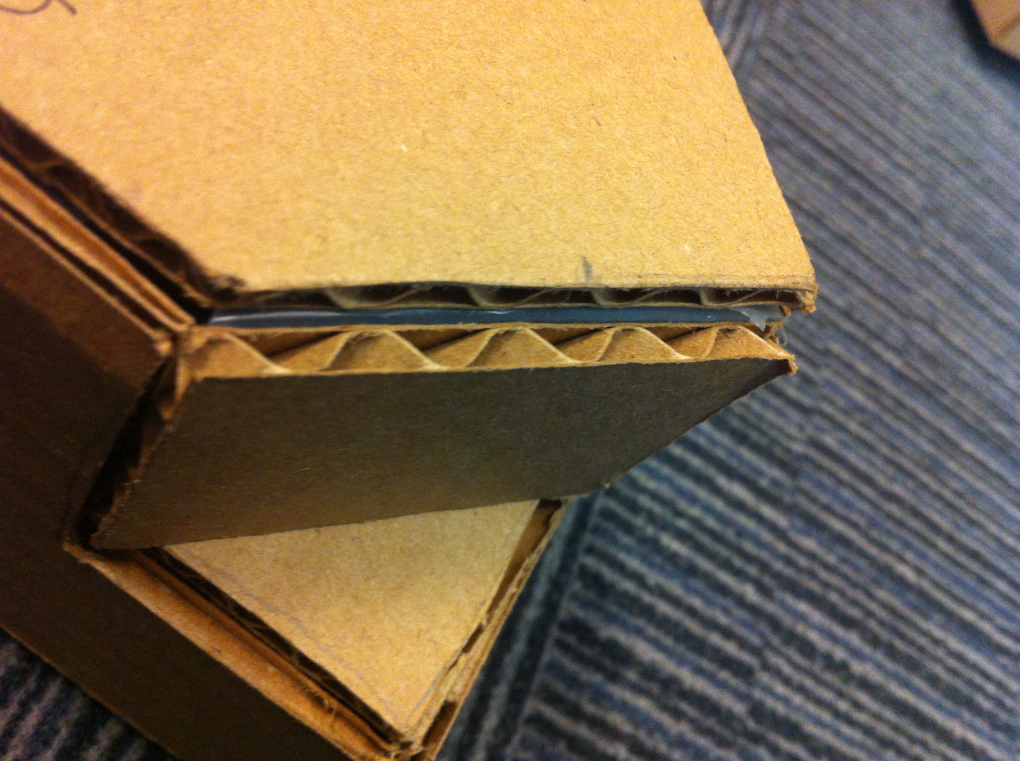
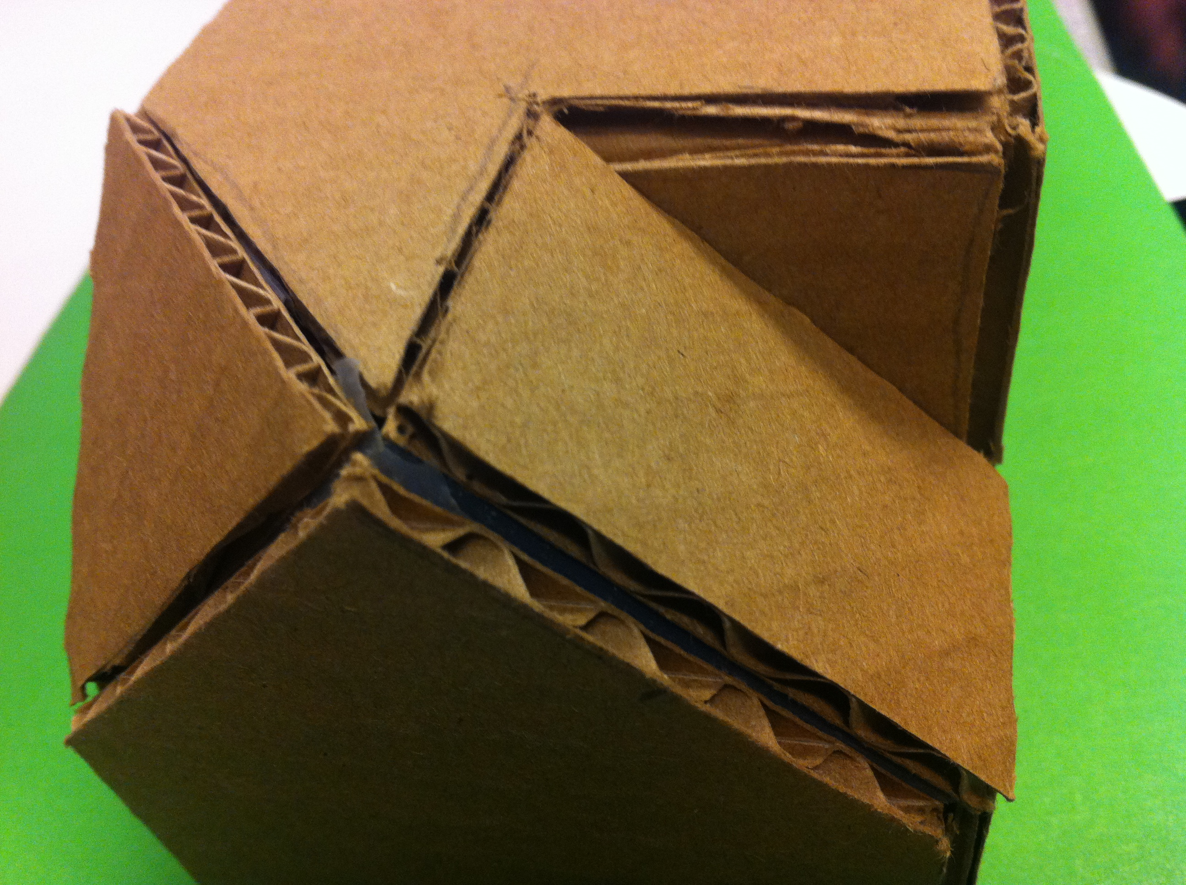
Step II: Building the Card Model:
Fall 2013 and Spring 2014 used Cardboard
Various problems and small mistakes are shown
Cardboard is thicker than cardstock! So thickness needed to be accounted for.

Slide 10

Step II: Building the Card Model:
Allowing for Material thickness
Task: build 6” x 3” x 4” box out of 1” thick material:
Box
Material
6”
1” thick
3”
4”
When we actually build the box, we must allow for the thickness of the material
Idealized: “Outline” suggests walls are zero thickness. So vertical “ends” are 3” high.
Height = 3” – 2 x thickness
= 1” (!)
Are they? What should be the dimension of the ends?

Slide 11
Step II: Building the Card Model:
Allowing for thickness of material
What other ways might we join top and side?
Butt joint with equal ‘shortening’ on all pieces.
Strong, but shows “inside” of material.
Partial cut and fold.
Easy, but ugly.
Mitre joint.
Difficult but nicest looking.
Two 45 deg cuts needed!

Slide 12

Allowing for Material Thickness
L
L
To make a cube of side “L”, only 2 of the 6 faces will be a full “L” in size!
C
L
t
A
B
L
L – 2t
L – 2t
L
A
B
C
L – 2t

Slide 13
Step III: Building the OnShape Model
Remember the usual method:
The polyhedron is just a OnShape “Part”; parts are collections of features, starting with a Base feature.
Shape Features are created using a 2D sketch that you extrude into 3D (boss extrude, cut extrude, etc.).
Save the file and share on OnShape.
Note: You might already have an OnShape model and if you don’t then complete this as Homework and share before the start of next week’s lab.
Notes:
Step 3 – 40 minutes

Slide 14
Step IV: Reflecting on the Representations
This is to be done individually
Write short but thoughtful, considered answers for each question and submit your answers as a Discussion through Canvas before the start of next week’s lab.
How did the sketches help with a) making the cardboard model and b) the OnShape model?
If you could change the order, what would this be and why?
Notes:
Step 4 – Reflections to be done individually

