Slide 1
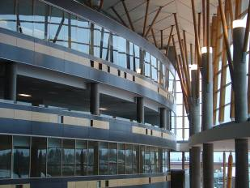
IAT 106
Spatial Thinking and Communicating
Spring 2021

Slide 2
Model Making Techniques

Slide 3
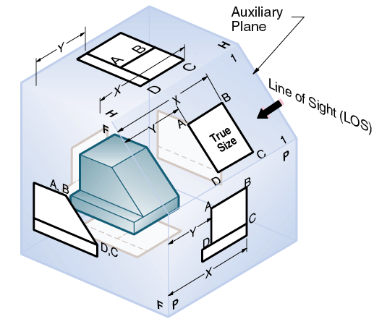

Slide 4
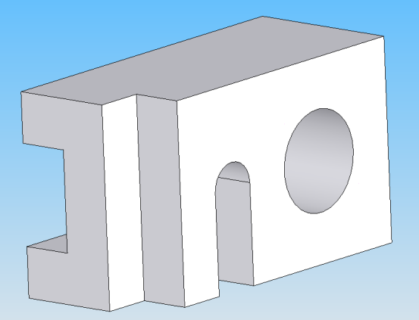
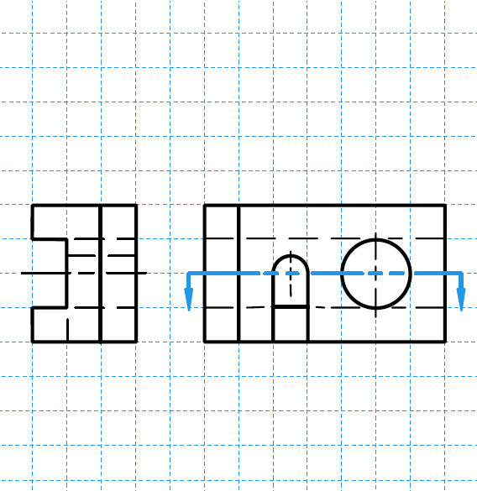
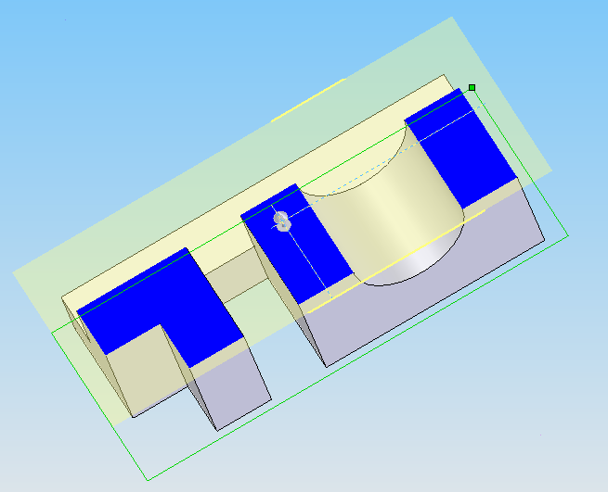
Creating a cross-section (3)
Notes:
The hatched lines is the cross-section

Slide 5
See you on Monday!
Thank you!
☺

