Slide 1
True Shape View of Oblique Face

Slide 2
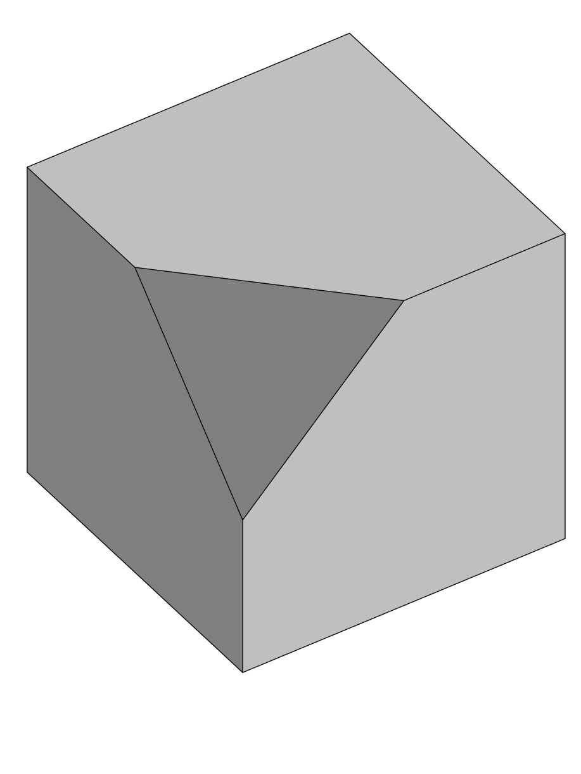
Object with oblique face
Would be better if face were scalene triangle

Slide 3
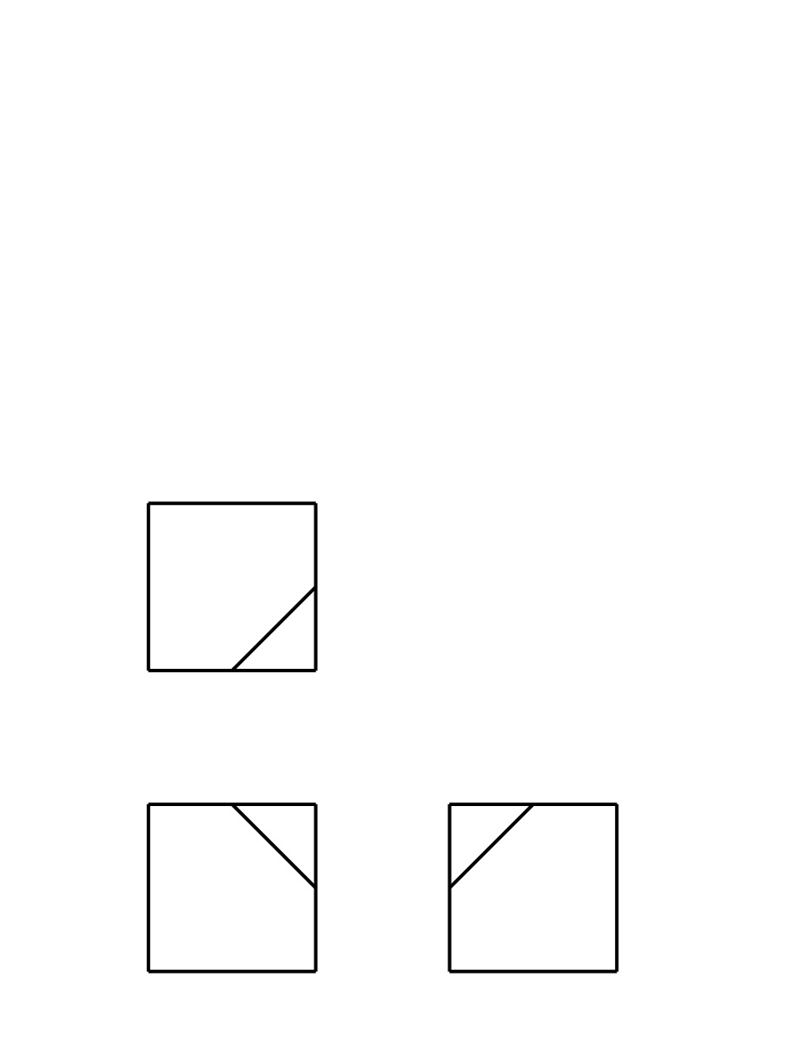
Normal Multiview

Slide 4
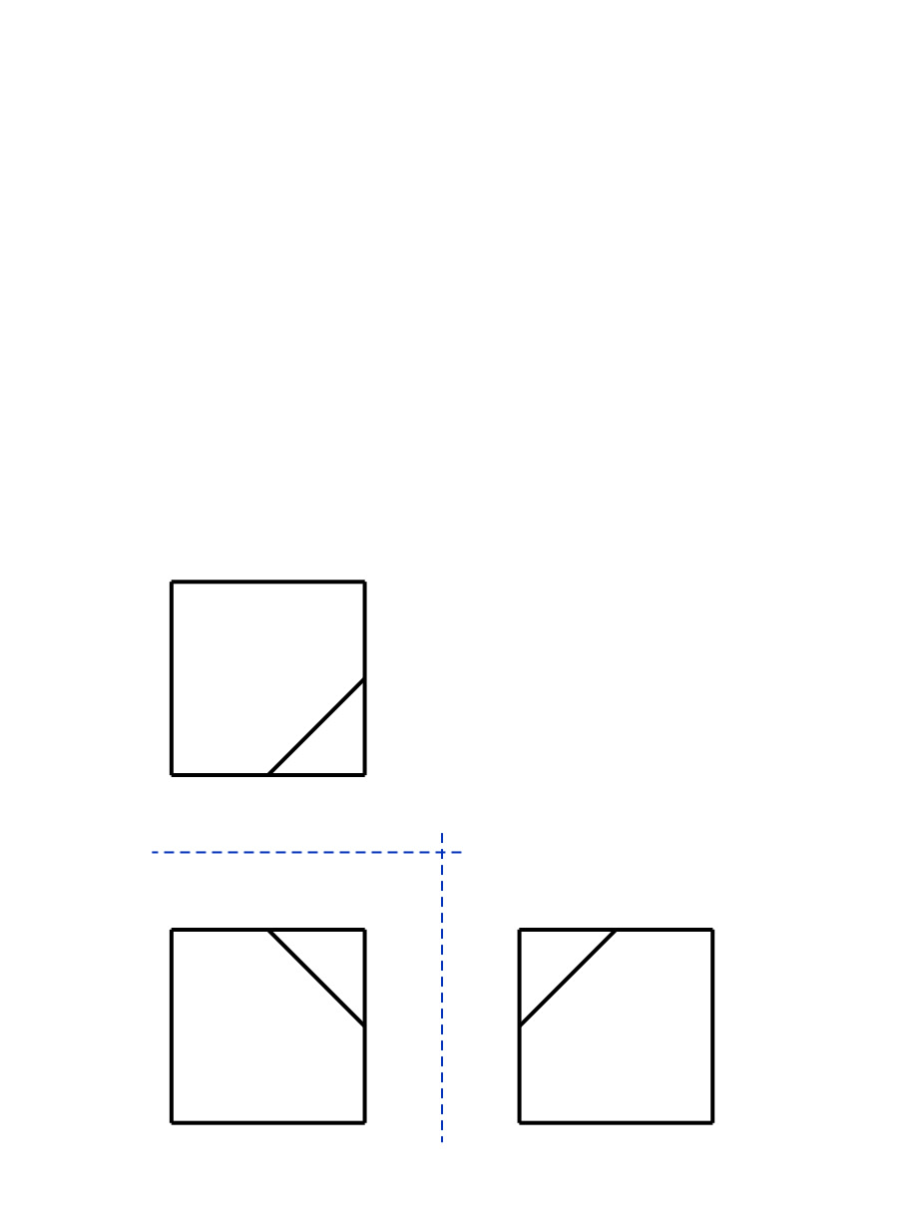
Multiview fold lines

Slide 5
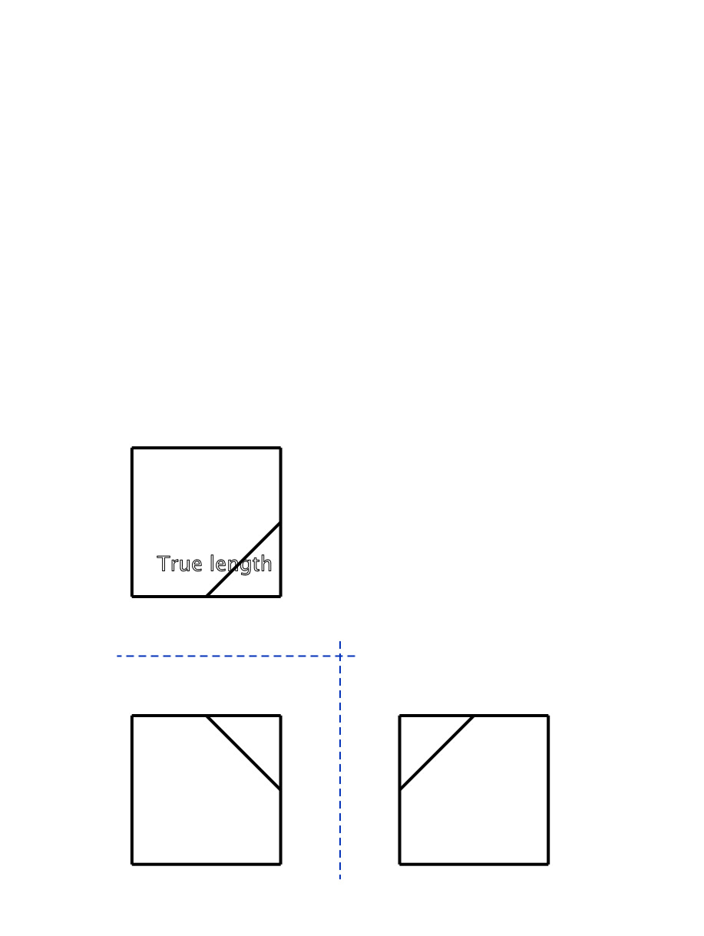
Edge appears in true length
Find a view in which an edge appears in True Length.
Why?
Because a projection from that view will show Face as Edge.
Why is that?
Need some theory of ortho projections for full answer but short answer is “TRY IT WITH A SMALL FACE!”
Why do I need to see Face on Edge?
Because, little one, you can then do just one more projection and then see it in glorious True SHAPE

Slide 6
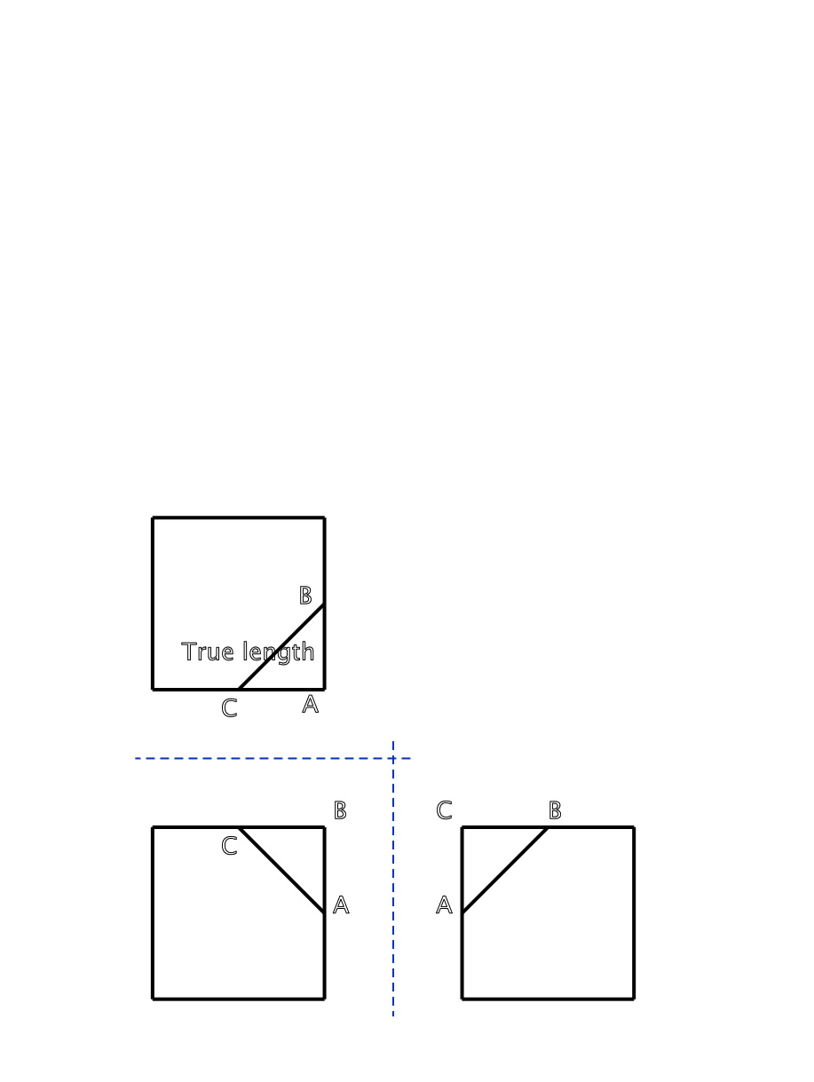
Multiview point labels
How do you know that Line is in True Length?
It lies in a plane parallel to one of the orthographic projection planes!

Slide 7
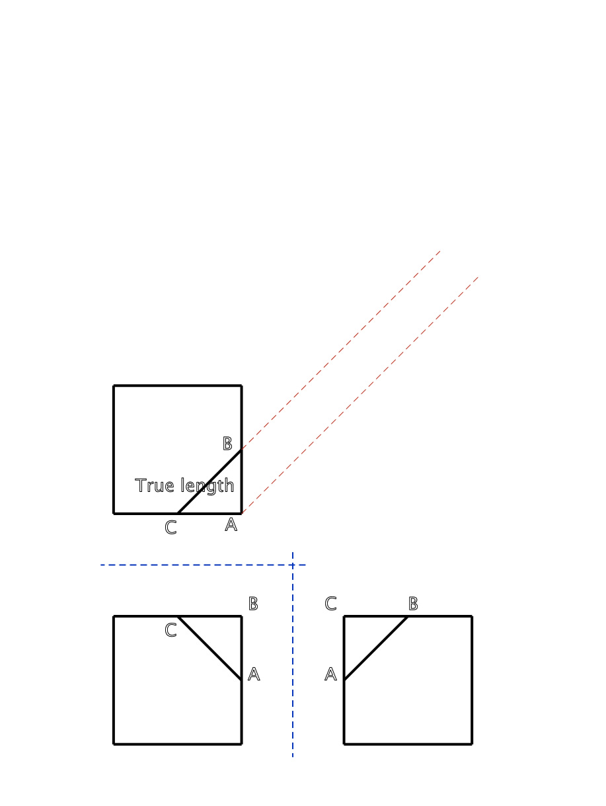
Primary projection lines
Why are lines in that direction? They could be in any direction, right?
Uh, no!
Projection has to be such that you see that True Length line as a POINT.
To do that, the projection direction must be parallel to the line.

Slide 8
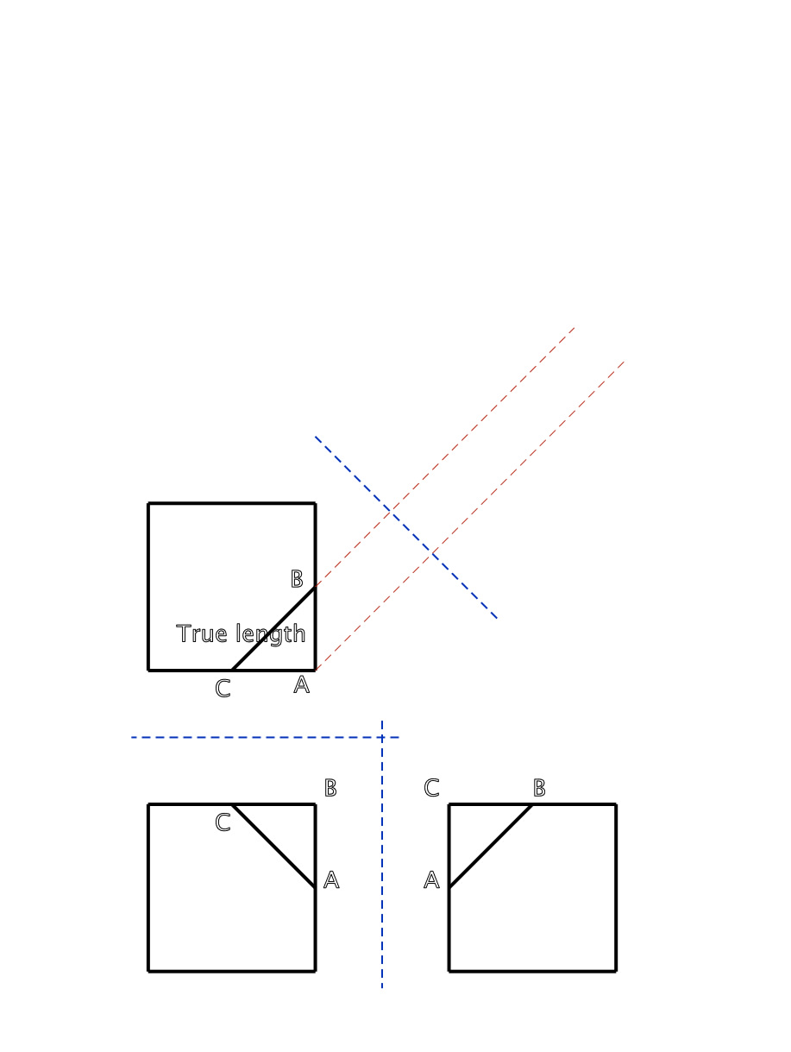
Primary fold line

Slide 9
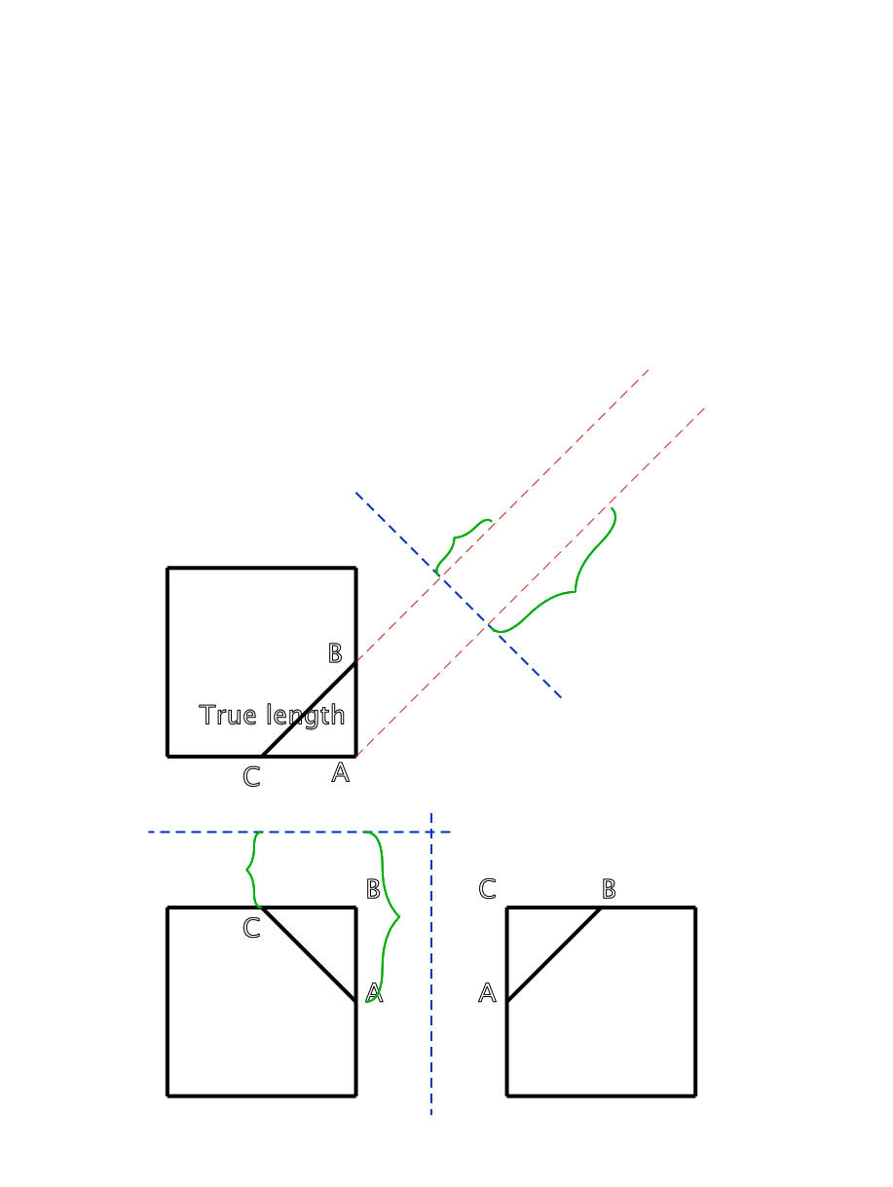
Primary distances

Slide 10

Primary point labels

Slide 11

Primary auxiliary view

Slide 12
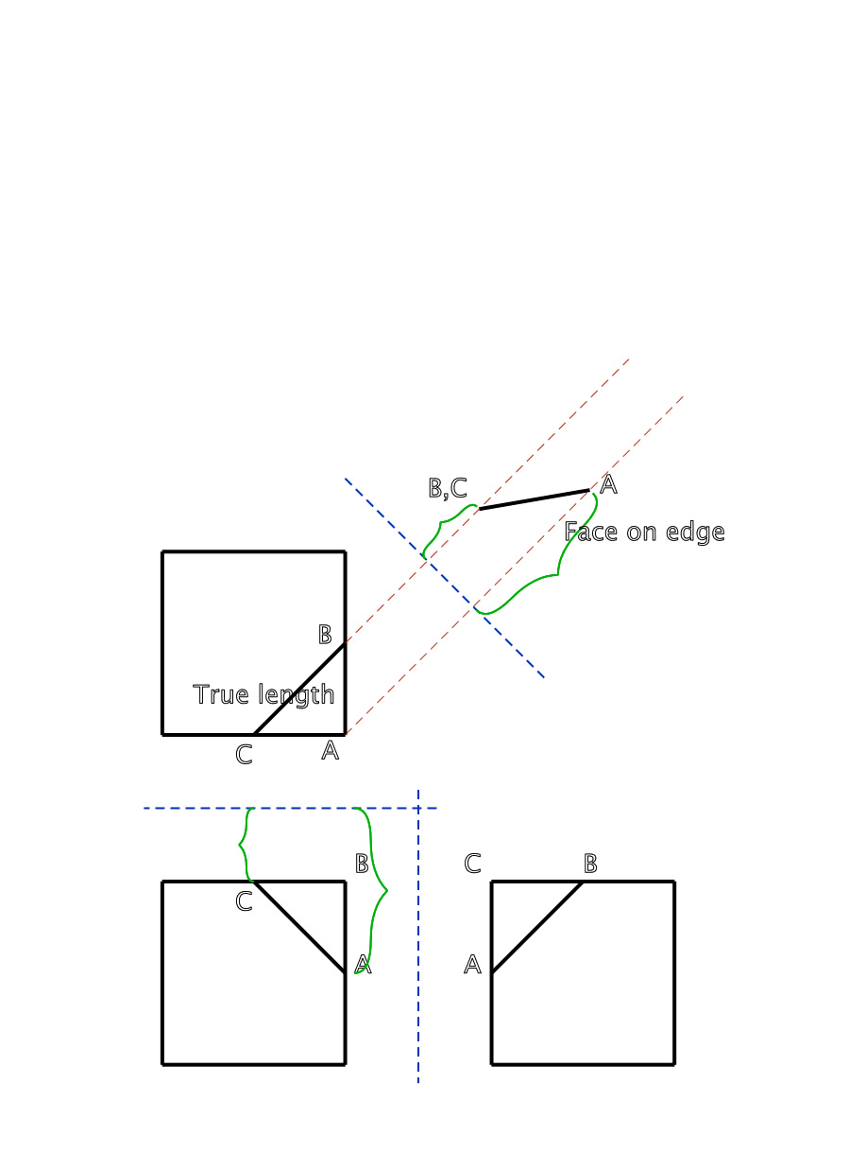
Face ABC appears on edge

Slide 13
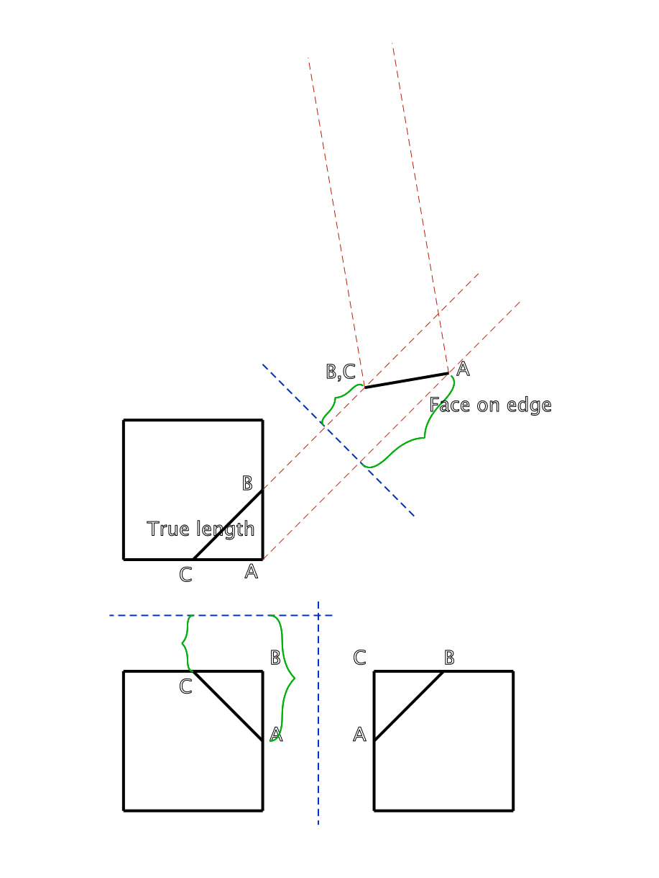
Secondary projection lines
Why projection lines in that direction?
b/c to see the True Shape, we have to look perpendicular to the face, thus perpendicular to the edge view of that silly face.

Slide 14
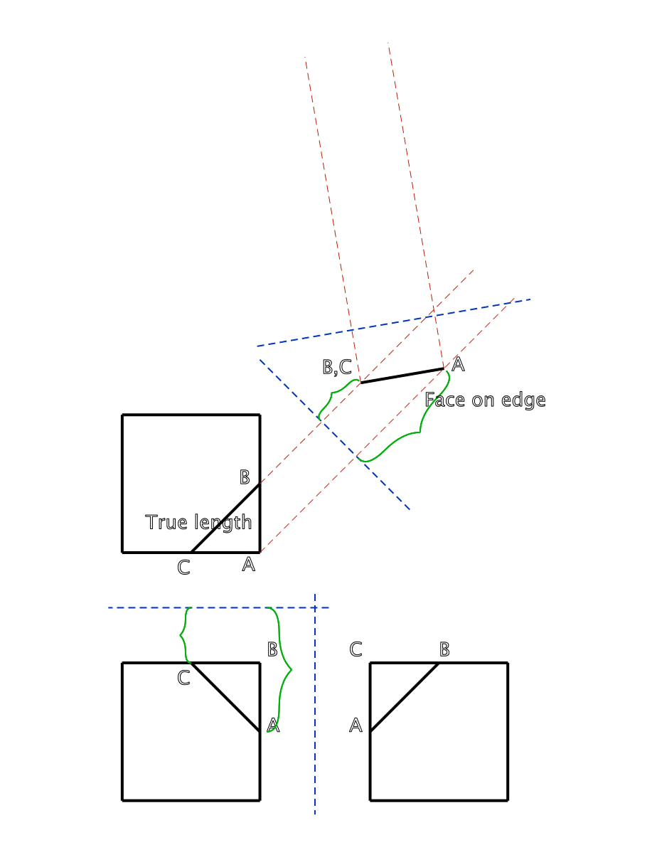
Secondary fold line

Slide 15
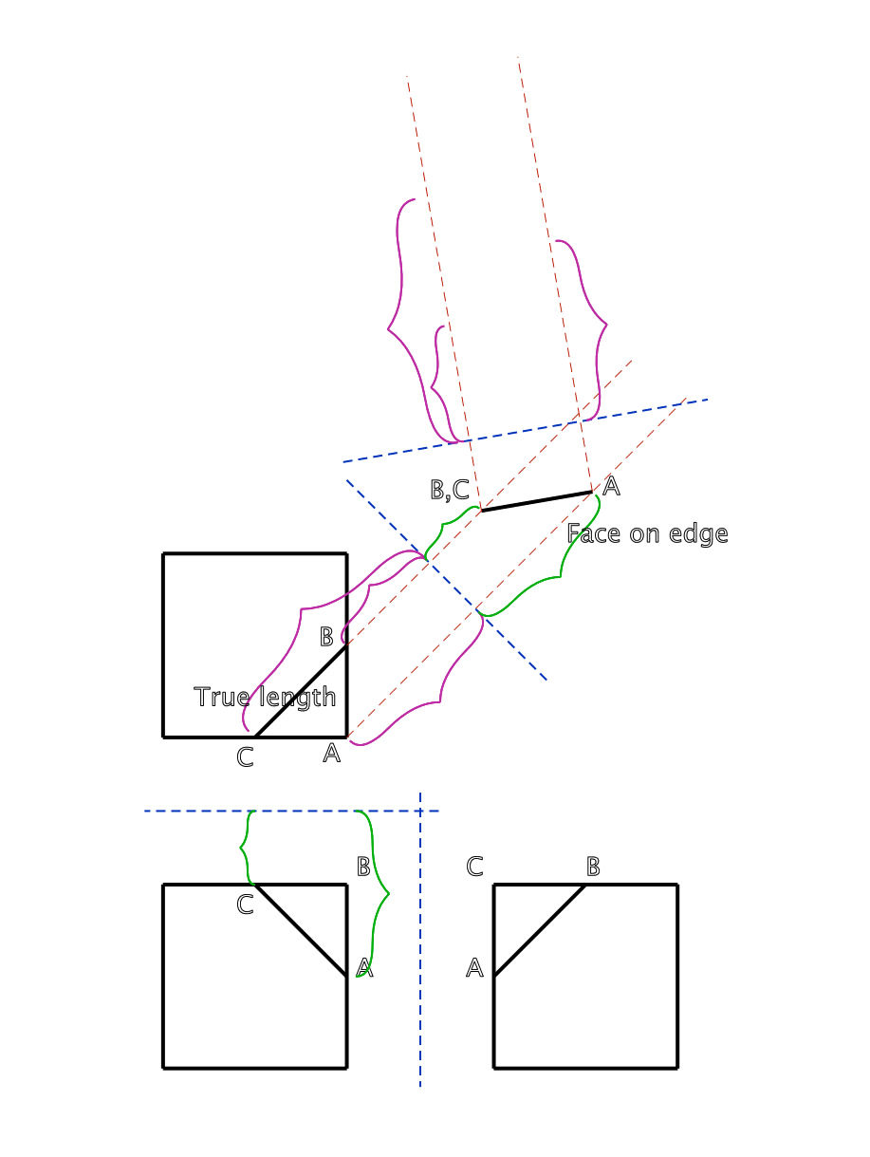
Secondary distances

Slide 16
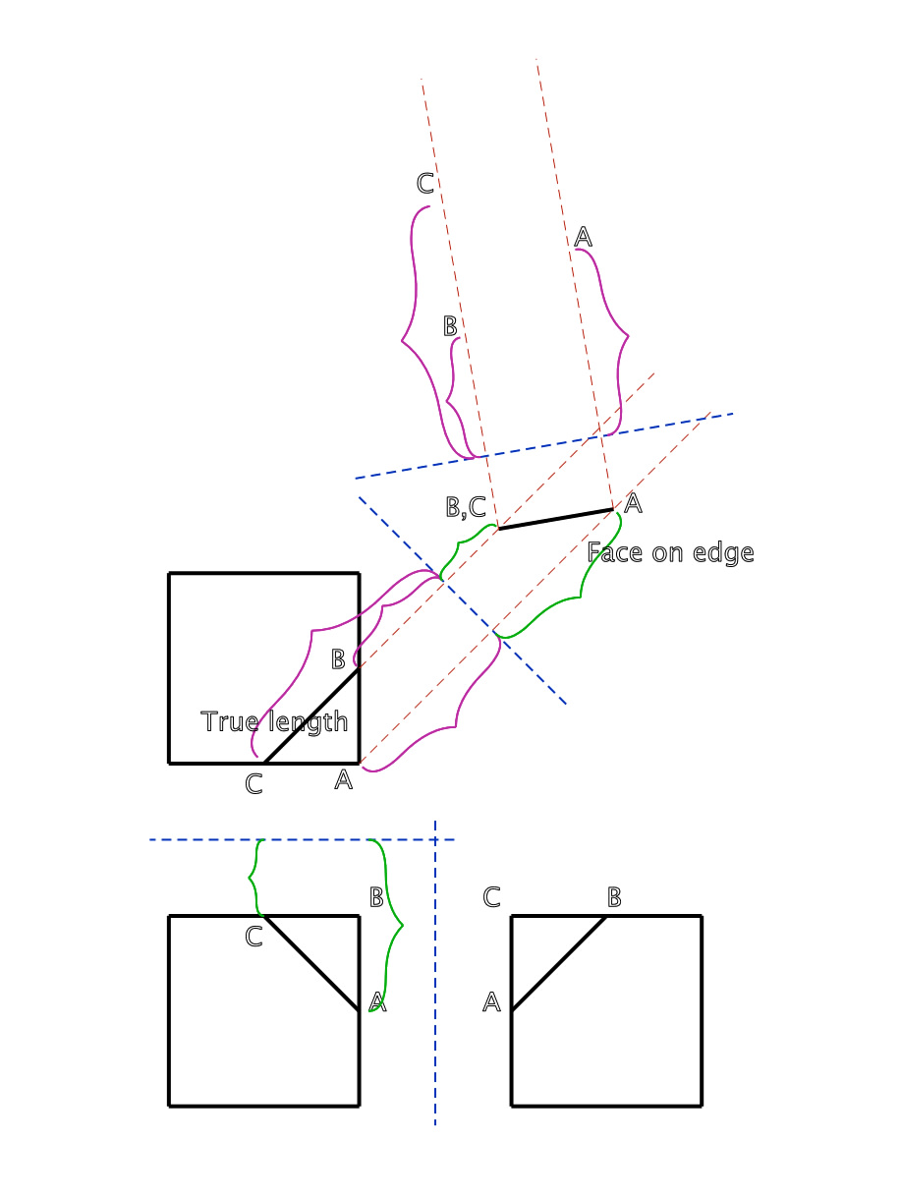
Secondary point labels

Slide 17
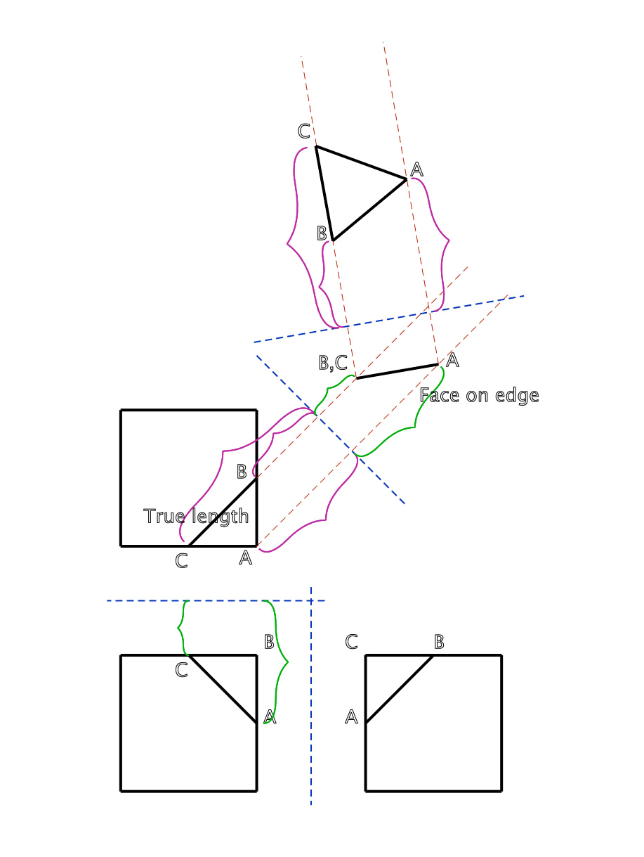
Secondary auxiliary view

Slide 18
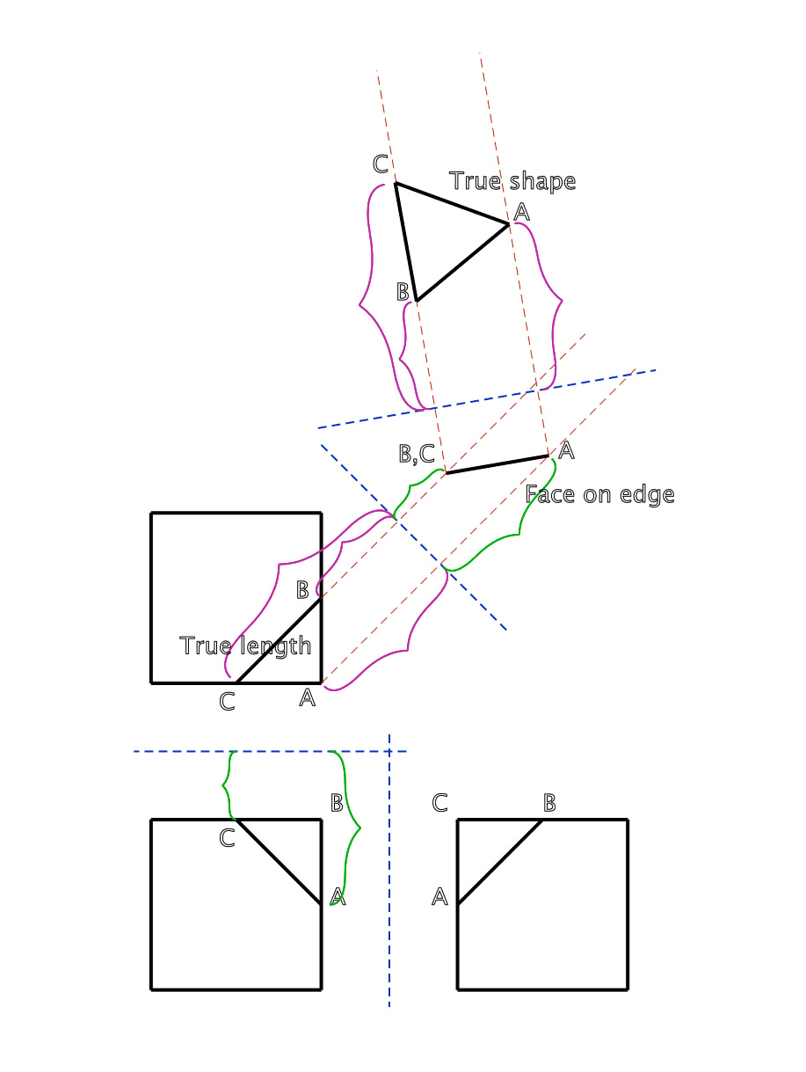
Face is in true shape

Slide 19
Object with oblique face

