Slide 1
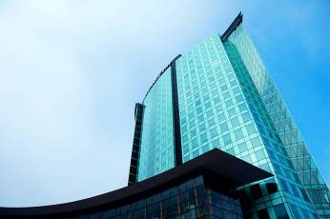
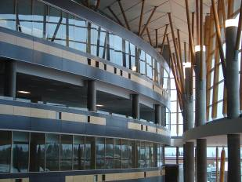
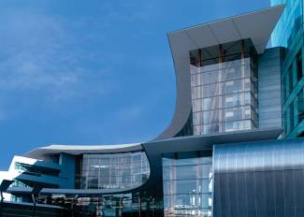
IAT 106
Spatial Thinking and Communicating
Spring 2021

Slide 2
OnShape Quiz
Monday March 15th, 2020
Keep your cameras on for the entire test
Exam will be on OnShape (auto-logs the last edits)
Canvas container will be used to distribute the exam, as well as to upload the URL of your file
Each person will get a different exam

Slide 3
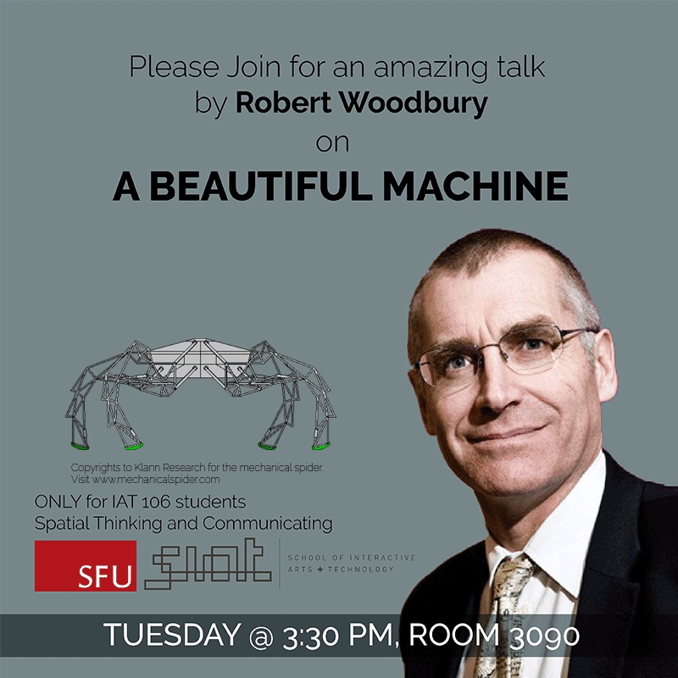
Guest Lecture

Slide 4
Final Course Project
Constraints
The machine must be under 40 cm length, 40 cm depth, 40 cm height. Smaller is better.
The resultant motion or output should be inspired by Nature (human, animals, wind, water, plants, etc.).
The ABM should be designed with an intention to be actuated by hand usually through a manual crank.
The ABM must have at least one kind of linkage mechanism (preferably 3+ linkage mechanisms).
The ABM must have at least two mechanically distinct motions (in other words, it cannot have same mechanical motion repeated multiple times to generate its overall effect, e.g., see dragon(ish) example in Lecture 07 slide-12).

Slide 5
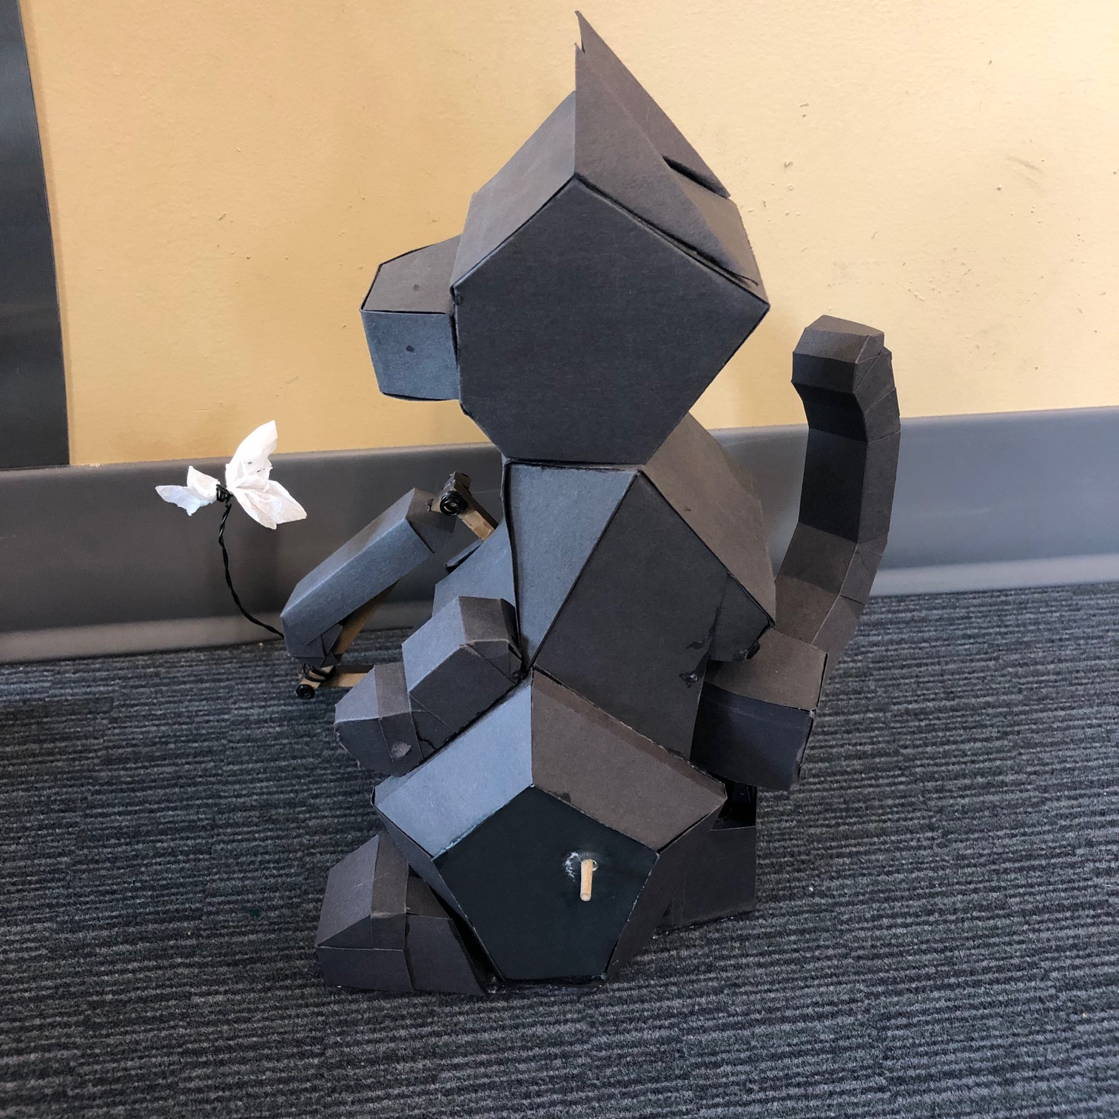
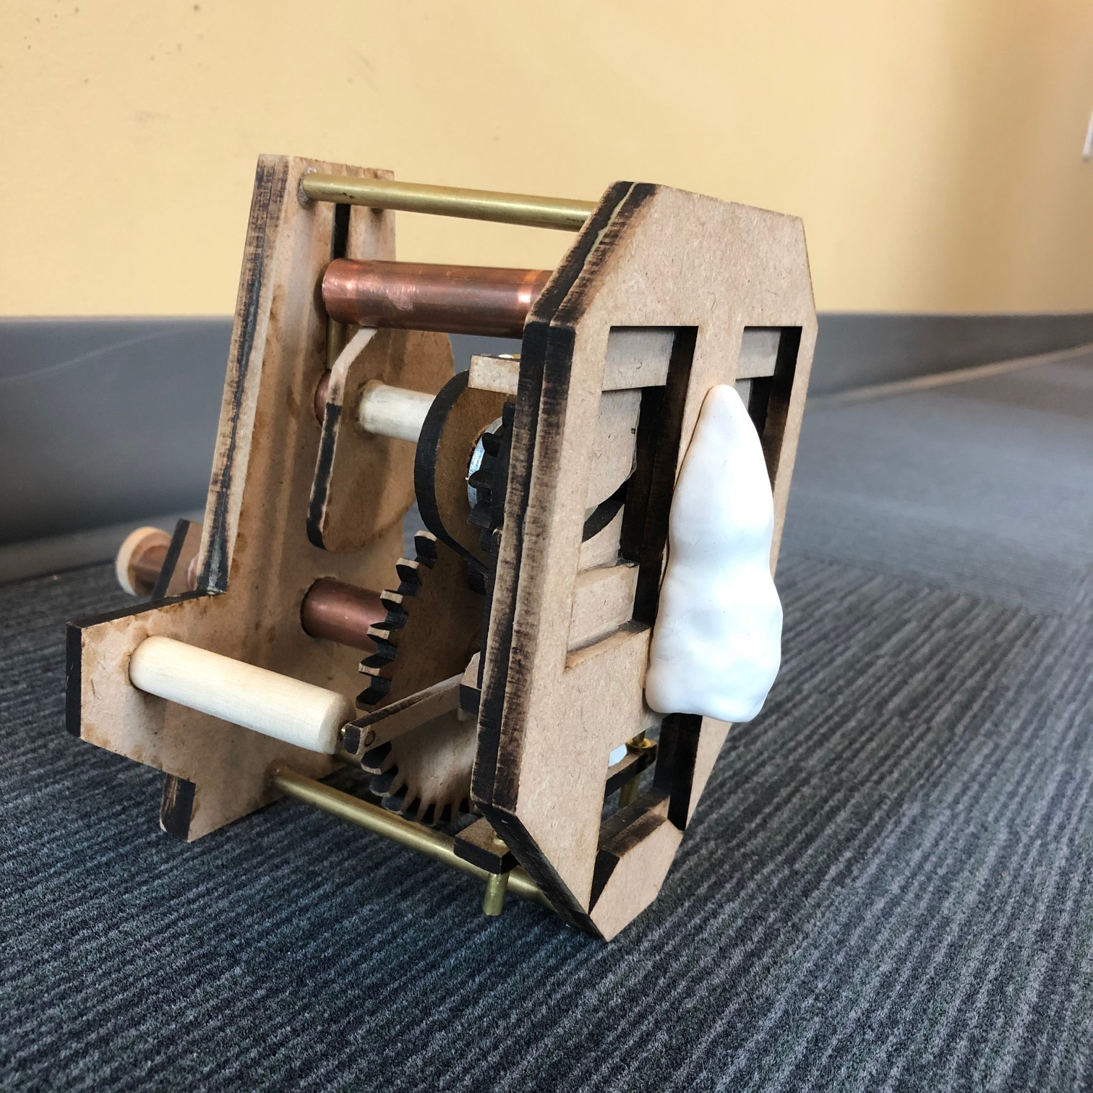
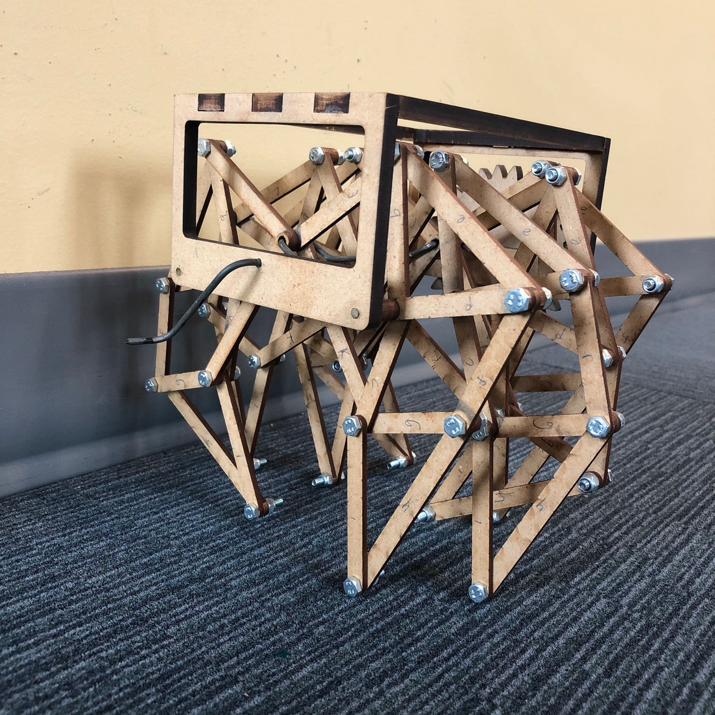
Final Course Project
ABM Introduction
Category 01 | Category 02 | Category 03
The housing is made beautiful (e.g. inspired by the art of origami – faceted figure), all mechanical parts are embedded inside it. The mechanical components connect different parts of the flexible housing to generate a beautiful motion | The mechanical parts are visible and are integrated with the housing such that they enhance the overall visual beauty of the machine and its motion. | The mechanical parts ARE the beautiful machine.

Slide 6
Final Course Project
ABM Grading (200)
We will assess your digital model according to the following criteria. Each will be equally weighted.
Mechanical Simplicity. We encourage individuals to use simple mechanisms. If the same output or resultant motion can be achieved using a simpler mechanism, then the students will be given fewer points. Unnecessarily adding complexity to a simple motion will have negative impacts.
Technical Appeal. Are all parts of the ABM carefully designed? Does your ABM have the technical appeal in terms of creatively using the simplest available mechanisms? Does the detailing of the parts and assemblies make sense as a whole?
Visual Appeal. The final ABM must be one of the three categories explained earlier. Visually it should appeal to the audience and be fun and surprising to the intended operator. We do understand that “visual beauty” is relatable but can be defined within a context, hence can be argued on. This assessment criteria may be graded in comparison with the other ABM submissions from your classmates.
Your descriptor. You provide to us an adjective or adjectival phrase that captures an important quality of your ABM. Here are some of the thousands of possible descriptors: cool, crisp, sharp, funny, ironic, spooky, silly, playful, modernist, baroque, medieval, ethereal, urban… This adjective or adjectival phrase MUST occur prominently in your presentation. We will evaluate your ABM based on how well it matches your descriptor.

Slide 7
Final Course Project
ABM Bonus Points
Badges
There are some extra bonus points that each one of you is eligible for. In order to receive these bonus points, you will have to earn one of the following badges.
The Prime Spatial Thinker → will the best ABM voted by majority of the class → 5 bonus points max.
The Ultimate Designer → one who cautiously designs the best solution, judged by the teaching team → 5 bonus points max.
The Truth Charmer → one who gives honest and constructive feedback on other student’s reflections/ideas. The person will be chosen by the instructor → 5 bonus points max.
The Best 3D Modeler → This category is for a person who spent good time on modelling the details of the ABM digital representation → 5 bonus points max.

Slide 8
Pre-Lab
Study and analyze existing ABMs, sketch your ABM individually in several ways, present your
design to the TA and later to the class.

Slide 9
See you on Monday!
Thank you!
☺

