Slide 1



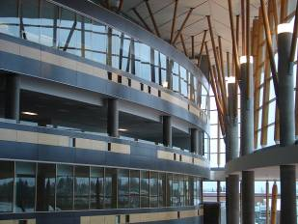

IAT 106
Spatial Thinking and Communicating
Spring 2021

Slide 2
ABM Pre-Lab Submission
And Feedback!
👍🏽

Slide 3
Quiz 07 – Answers/grades

Slide 4
Solid Modelling
Pure Primitive Instancing (PPI)
Constructive Solid Geometry (CSG)
Boundary Representation (B-Rep)

Slide 5
ABM Sketch Set examples

Slide 6
See you on Monday!
Thank you!
☺

