Slide 1
Celerity in the Courts An Application of Fuzzy Logic to Model Case Complexity in British Columbia’s Adult Criminal Court System
Math 800: Modeling of Complex Social Systems
November 30th, 2011
Andrew Reid
Richard Frank

Slide 2
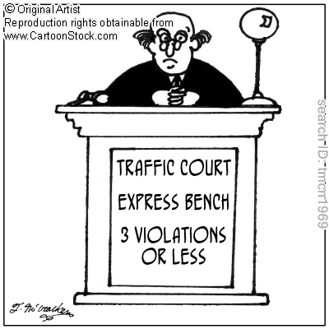
Table Of Contents
Introduction
Delay in the Courts
Fuzzy Logic
CourBC
Results
Based on ‘Theory’
Calibration of Model
Per Factor
Brute Force
Defuzzification methods
Discussion
Limitations
Future Directions

Slide 3



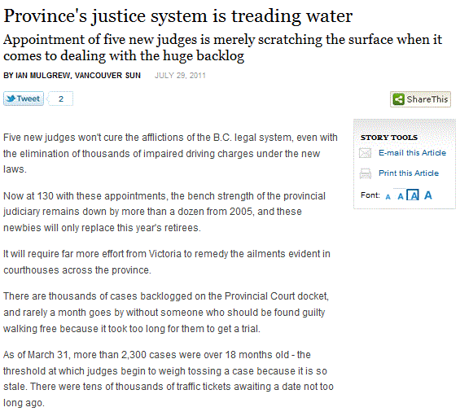
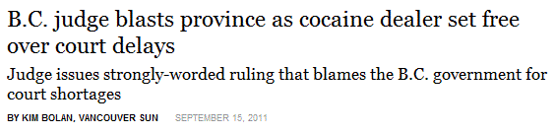
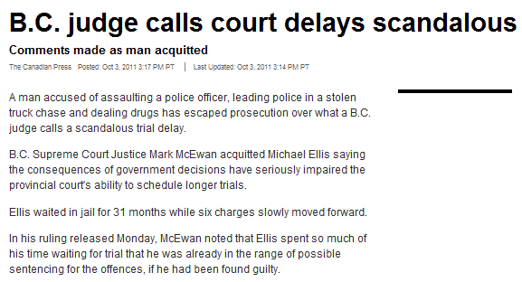
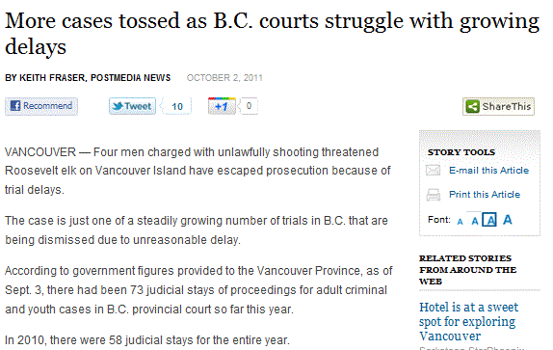
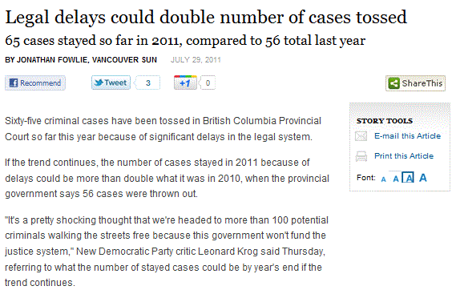

Slide 4
‘Justice delayed is ‘justice denied’
(William Gladstone)
Delay may lead to:
Undesirable conclusions to cases
Weakened cases by prosecution and defence counsels
Increased costs to the justice system
A breach of society’s interest in swift and fair justice
Infringements on the rights and freedoms of the accused

Slide 5
Legislative Framework
“Any person charged with an offence has the right to be tried within a reasonable time”
Canadian Charter of Rights and Freedoms, s. 11(b)
Interpretation set out in:
R. v. Askov [1990] ¹ and R. v. Morin [1992] ²
1 R. v. Askov, [1990] 2 S.C.R. 1199
2 R. v. Morin, [1992] 1 S.C.R. 771
> 50 000 charges withdrawn
Notes:
Discuss the USA context.

Slide 6
Reasonable vs. Unreasonable Delay
Caseflow procedures
Jurisdictional transfers
Expert/witness testimony
Legal interpretations/decisions
Judge unavailable for hearing
Shortage of court resources
Backlogs in courts

Slide 7
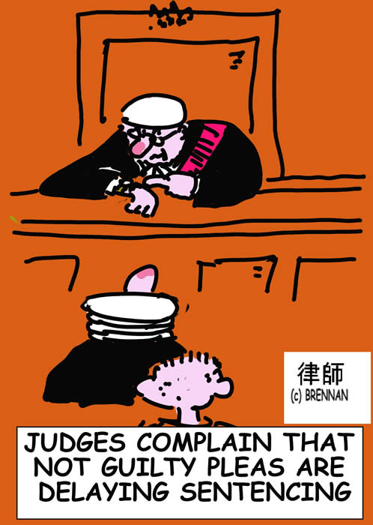
Where the line may become blurred
Delays initiated by accused/defence counsel
Scheduling practices

Slide 9
Where the line may become blurred
Delays initiated by accused/defence counsel
Scheduling practices
Circuit courts vs. sitting courts

Slide 10
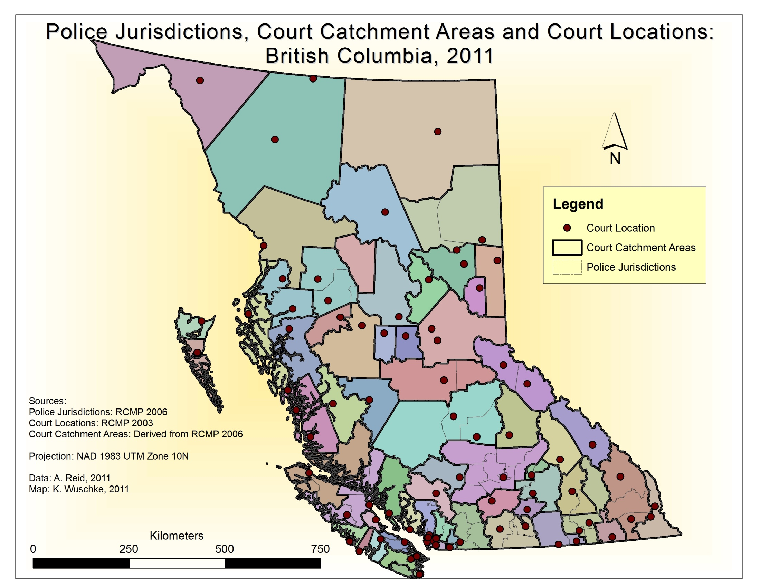

Slide 11
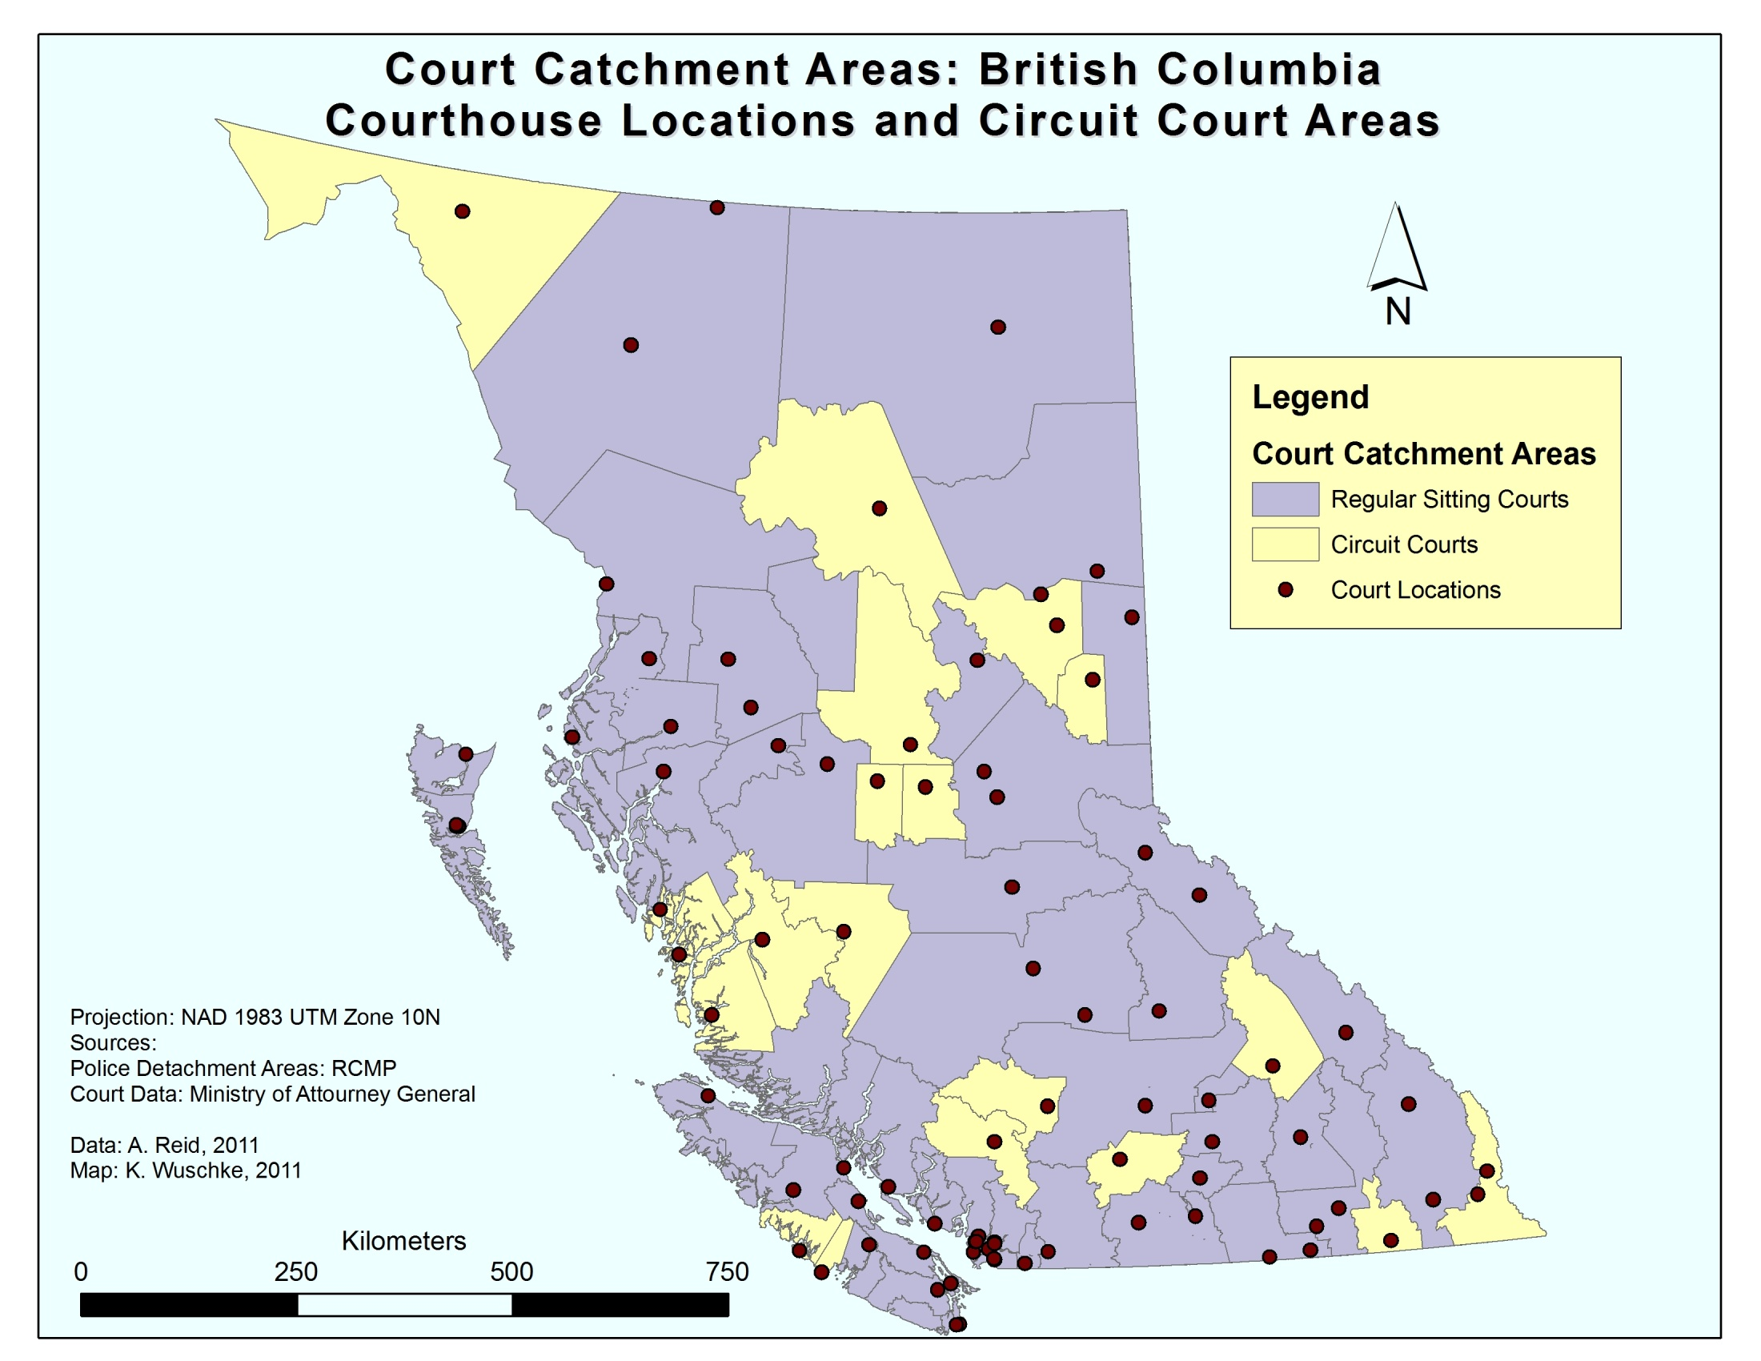

Slide 12
Initiatives to Reduce Delay
Police and prosecution linkages
Prosecutors counsel assist police in pre-charge legal advice
Early resolution mechanisms
Screening of cases by case management teams
Diversion and restorative justice
Prosecution to consider and promote the use of diversion programs where appropriate
Case Management Provisions
s. 625.1 of the Criminal Code permits pre-trial conferences
s. 482.1 of the Criminal Code allows courts to make rules that aid in effective and efficient case management

Slide 13
Current Trends in Case Processing Times
In Canada, median processing times increasing:
2000: 101 days to completion
2009: 124 days to completion
In British Columbia, the number of cases entering the courts has been decreasing yet:
Number of appearances has been on the rise
Time to disposition has been increasing
Cases in excess of 240 days shows increasing trend

Slide 14
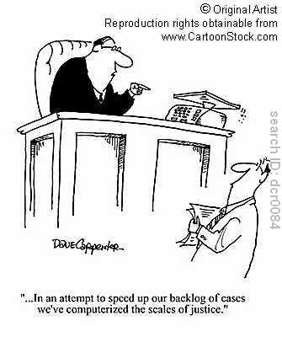
What Else May Help efficient Case Processing?
Understanding the complexity of cases a priori could allow for a series of early case consideration measures such as:
Effective case management, scheduling, and planning
But, there is no clear definition
of case complexity.

Slide 15
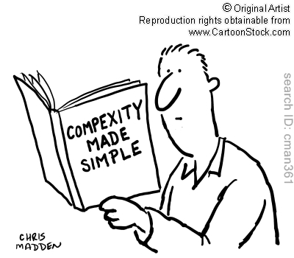
What Else May Help efficient Case Processing?
We propose an early case consideration tool that could be used to predict the complexity of cases before they enter the court system.

Slide 16
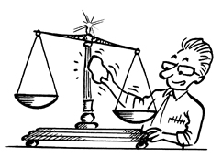
Data - CourBC
Scheduling and outcome data from all Adult Criminal Courts in British Columbia since April, 2007
Case characteristics that may be retrieved includes:
Number of accused
Number of charges
Types of charges

Slide 17
Data Description - Severity
Value | Category | Description
8 | Person | Crime against a person
7 | Property | Crime against a property or involving goods
6 | Drugs | Anything drugs related
5 | Weapon | Anything weapon related
4 | Driving | Anything driving related
3 | Administrative | Any offence that impedes the process of justice or resulted from an earlier offence
2 | Nuisance | Any form of nuisance or disturbance
1 | Animals | Anything involving animals
Average Severity | Number of Cases
1 | 1447
2 | 2708
3 | 4570
4 | 30703
5 | 3053
6 | 6933
7 | 18780
8 | 13833
Grand Total | 82027

Slide 18
Data Description - Charges
Number of Charges | Number of Cases
1 | 50169
2 | 26266
3 | 4445
4 | 899
5 | 188
6 | 43
7 | 11
8 | 6
Grand Total | 82027

Slide 19
Data Description - People
Number of People | Number of Cases
1 | 78921
2 | 2686
3 | 313
4 | 69
5 | 22
6 | 13
7 | 1
8 | 2
Grand Total | 82027

Slide 20
Data Description
Number Of Appearances | Number of Cases
1 | 3347
2 | 10906
3 | 10532
4 | 9432
5 | 8763
6 | 7588
7 | 6240
8 | 5129
9 | 4012
10 | 3177
11 | 2396
12 | 2012
13 | 1511
14 | 1262
15 | 891
16 | 782
17 | 602
18 | 545
19 | 388
20 | 382
21 | 290
Number Of Appearances | Number of Cases
22 | 247
23 | 192
24 | 181
25 | 149
26 | 130
27 | 110
28 | 90
29 | 76
30 | 77
31 | 64
32 | 49
33 | 34
34 | 46
35 | 32
36 | 45
37 | 30
38 | 25
39 | 19
40 | 24
40+ | 220
Grand Total | 82027

Slide 21
Model

Slide 22
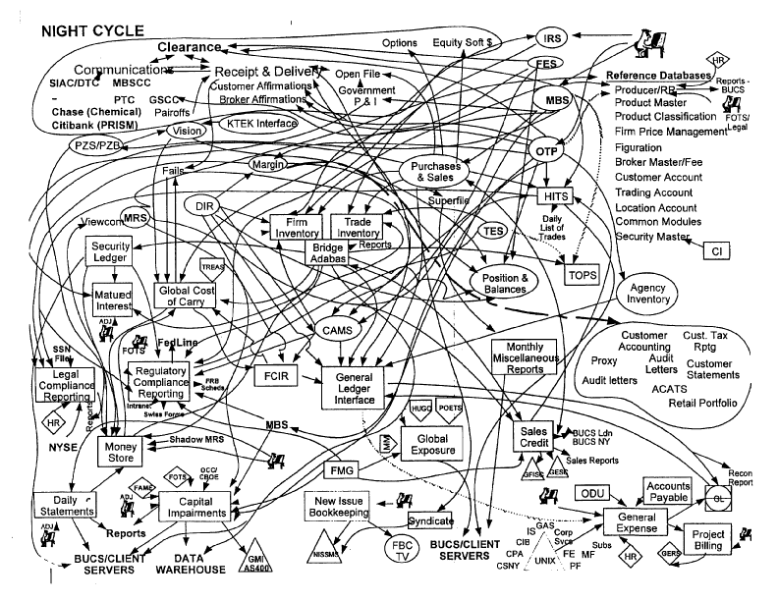
Complex Model – First Version

Slide 23

Complex Model – Second Version

Slide 24
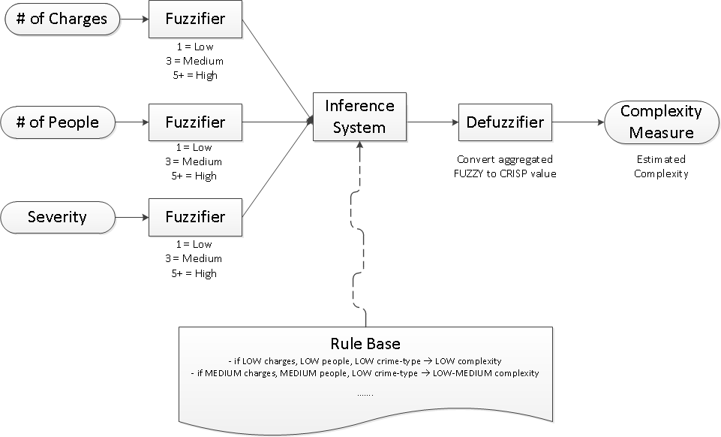
Complex Model – Fuzzy Logic

Slide 25
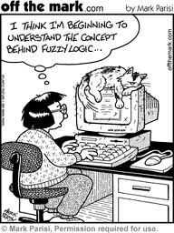
Fuzzy Logic

Slide 26
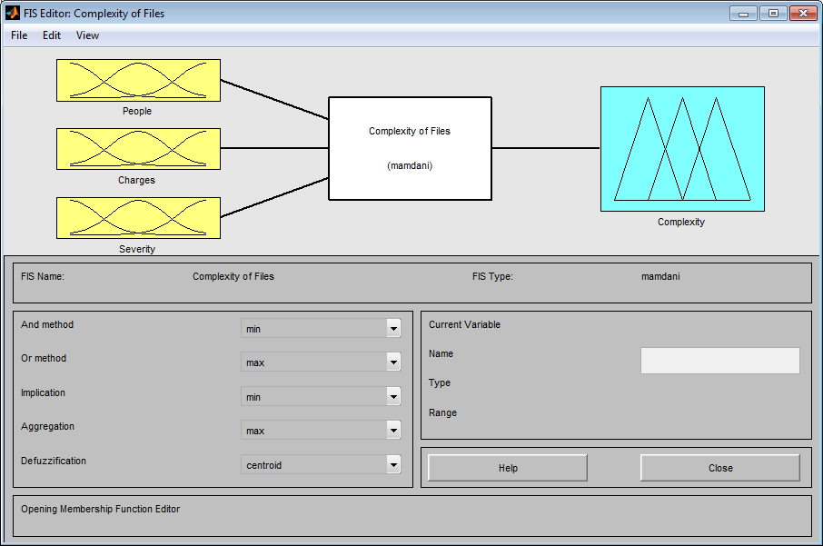
Methods

Slide 27
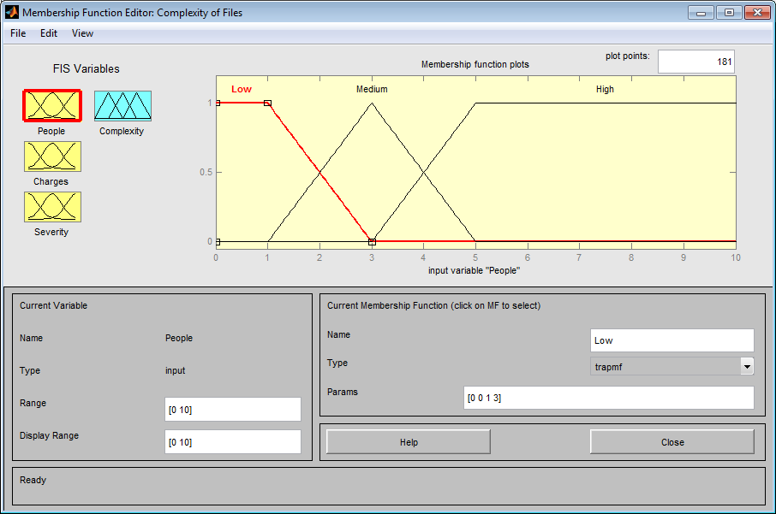
Methods

Slide 28
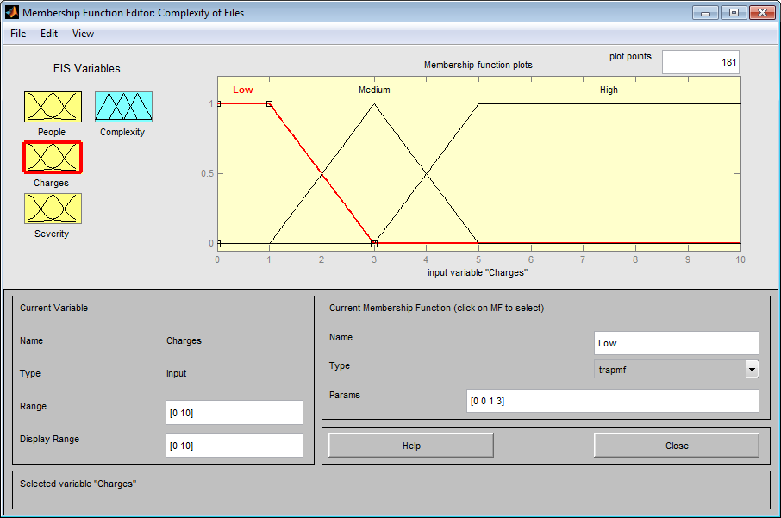
Methods

Slide 29
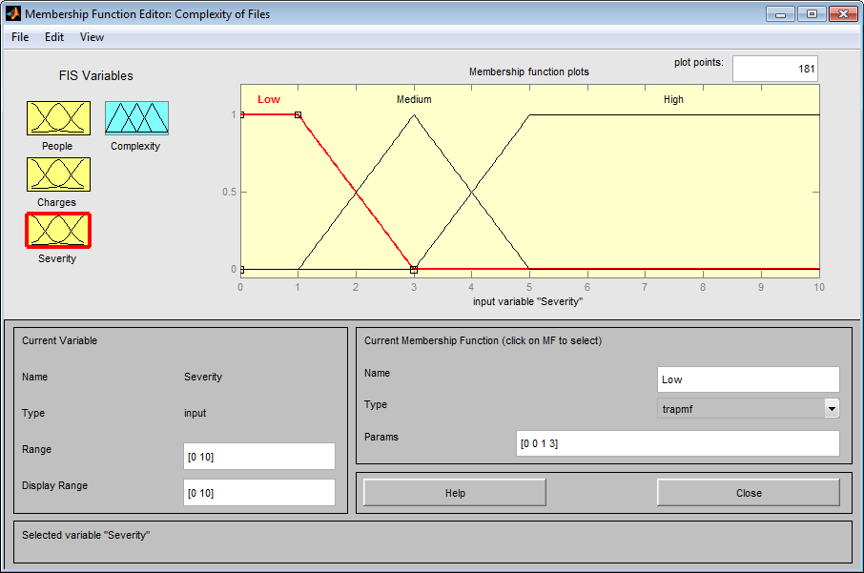
Methods

Slide 30
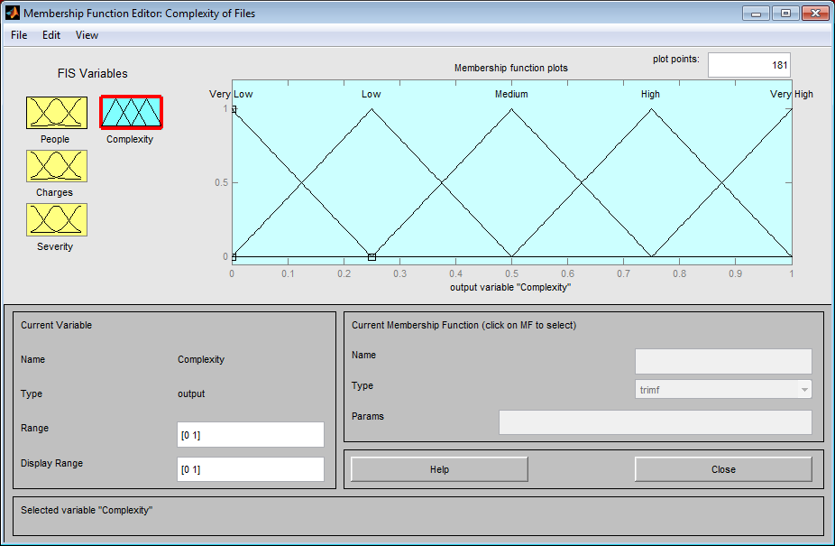
Methods

Slide 31
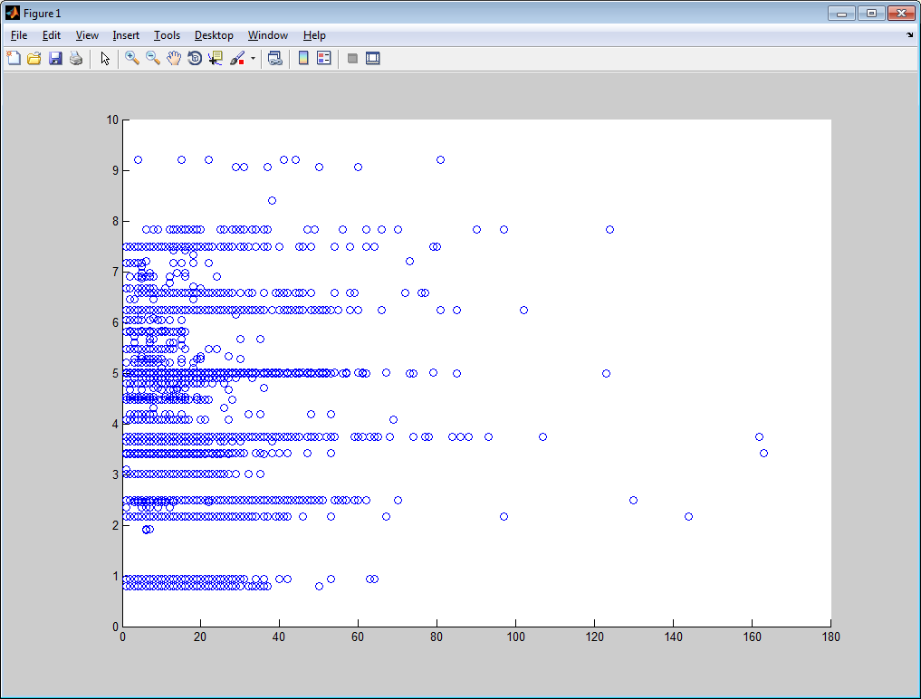
Results
Default model
Correlation of 0.226848
Weak correlation → Model is weak for prediction
Model predicted high ‘complexity’
Actually very low ‘complexity’
Model predicted high ‘complexity’
Actually very high ‘complexity’
Our predicted complexity
Model predicted low ‘complexity’
Actually very high ‘complexity’
Actual “complexity”

Slide 32
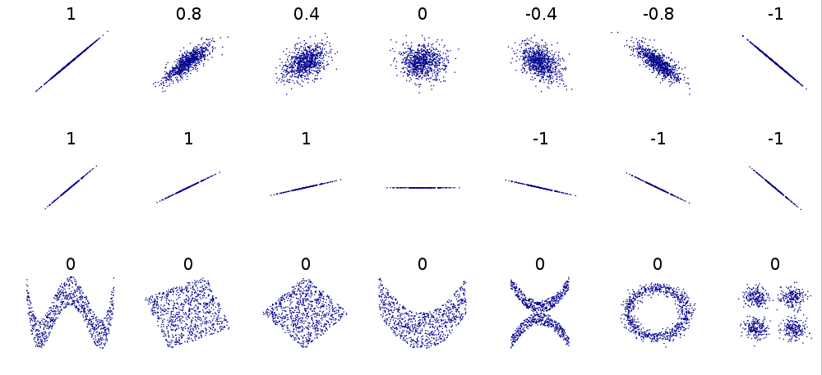
Results
Default model
Correlation 0.226848
Image from Wikipedia.org

Slide 33
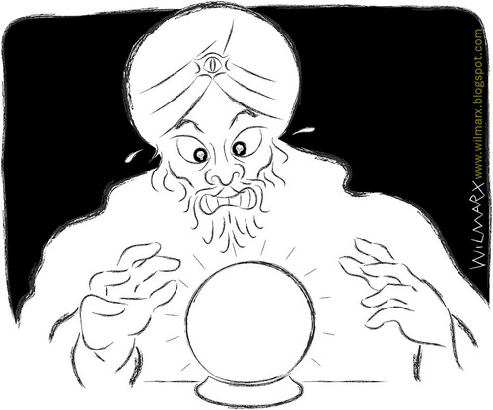
Calibration of Model

Slide 34
Optimization
Default model
Had a correlation of 0.226848.
Weak for prediction purposes
Perhaps our membership functions were not calibrated properly
Try to optimize by calibrating the model
Iterative
Brute Force
Various Defuzzification Methods

Slide 35
Calibrating the model
Calibrating the model
Training Dataset
Calibrate model using the training dataset
Evaluate model on the testing dataset.
Testing Dataset
CourBC

Slide 36
Calibration of Model 1) Iterative

Slide 37
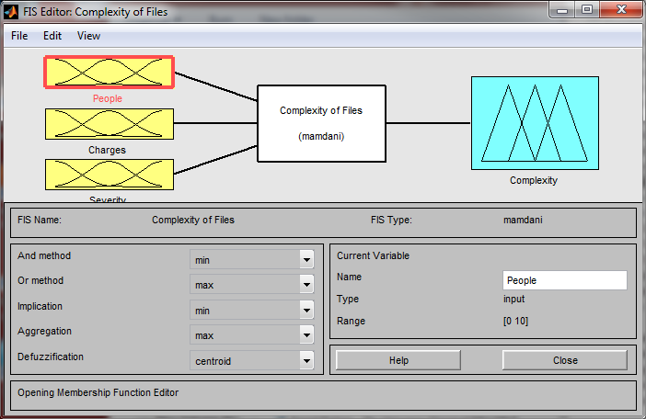
Optimize Variables
Default model:

Slide 38
Optimize Variables
4 variables to calibrate: 3 input & 1 output

Slide 39
Optimize Variables
People_Min + (People_Max - People_Min)
2
People_Min
People_Max

Slide 40
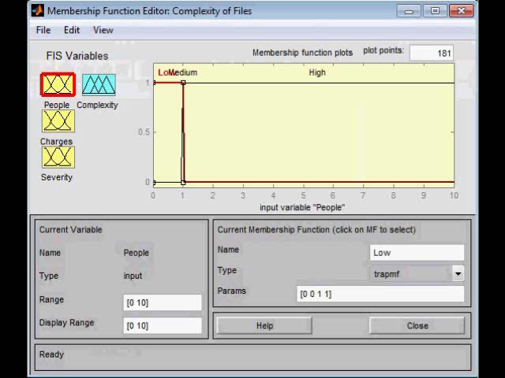
Optimize Variables
Search Process for one Input Variable

Slide 41

Optimize Variables
Have 4 variables in the system
Find optimal parameters for Variable #1
Try various parameters for each MF
Choose parameters such that correlation is MAX
Find optimal parameters for Variable #2
Try various parameters for each MF
Choose parameters such that correlation is MAX
Find optimal parameters for Variable #3
Try various parameters for each MF
Choose parameters such that correlation is MAX
Find optimal parameters for Variable #4
Try various parameters for each MF
Choose parameters such that correlation is MAX

Slide 42
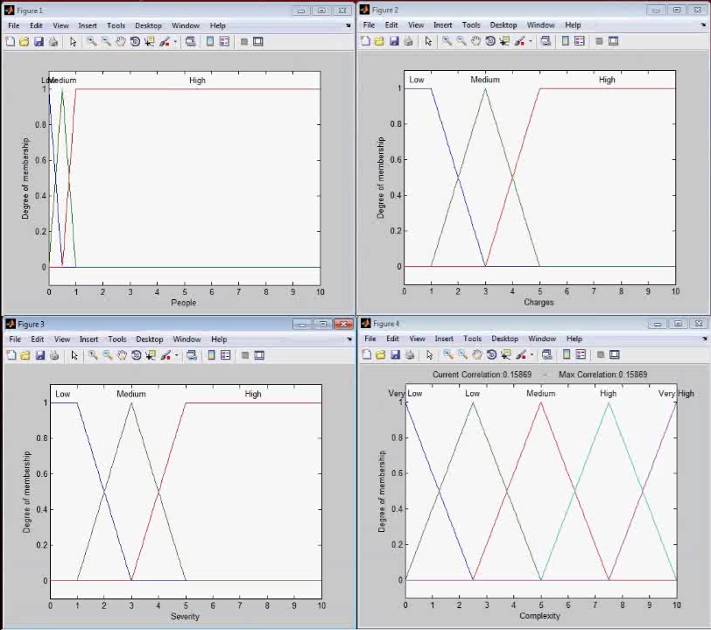
Optimize Variable

Slide 43
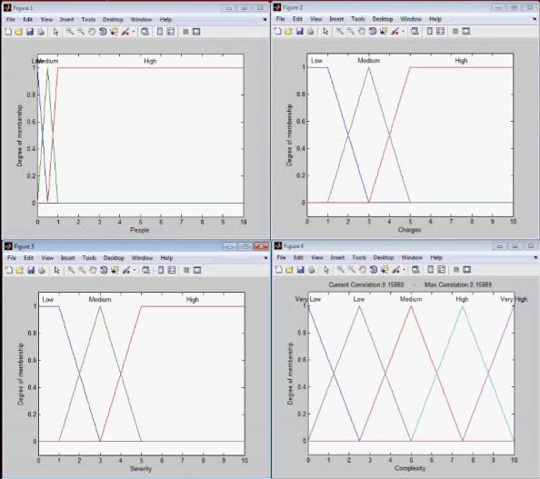
Optimize Variables
There are 4 variables
Which to optimize first?
Try all 24 permutations
{People, Charges, Severity, Complexity}
{People, Charges, Complexity, Severity}
{People, Severity, Complexity, Charges}
…
See which gives best correlation

Slide 44
Optimize Variables
Animation searches using an interval of 1
For experiments
searched using interval of 0.1
20604 evaluations of the FIS
24 permutations
494496 evaluation of the FIS
Single evaluation of the FIS takes ~3.2s
Total runtime ~18days

Slide 45
Optimize Variables – Results
Scenario | Correlation |  | Scenario | Correlation
{P, Ch, S, Co} | 0.3917 |  | {S, Ch, P, Co} | 0.3925
{P, Ch, Co, S} | 0.3862 |  | {S, Ch, Co, P} | 0.4071
{P, S, Ch, Co} | 0.3851 |  | {S, P, Ch, Co} | 0.4016
{P, S, Co, Ch} | 0.3854 |  | {S, P, Co, Ch} | 0.4051
{P, Co, S, Ch} | 0.3953 |  | {S, Co, P, Ch} | 0.3812
{P, Co, Ch, S} | 0.3924 |  | {S, Co, Ch, P} | 0.3729
{Ch, P, S, Co} | 0.3966 |  | {Co, P, S, Ch} | 0.3837
{Ch, P, Co, S} | 0.3957 |  | {Co, P, Ch, S} | 0.4023
{Ch, S, P, Co} | 0.4095 |  | {Co, S, P, Ch} | 0.3810
{Ch, S, Co, P} | 0.4092 |  | {Co, S, Ch, P} | 0.3718
{Ch, Co, P, S} | 0.3794 |  | {Co, Ch, P, S} | 0.4106
{Ch, Co, S, P} | 0.3612 |  | {Co, Ch, S, P} | 0.4108
P → People
Ch → # of Charges
S → Severity
Co → Complexity

Slide 46
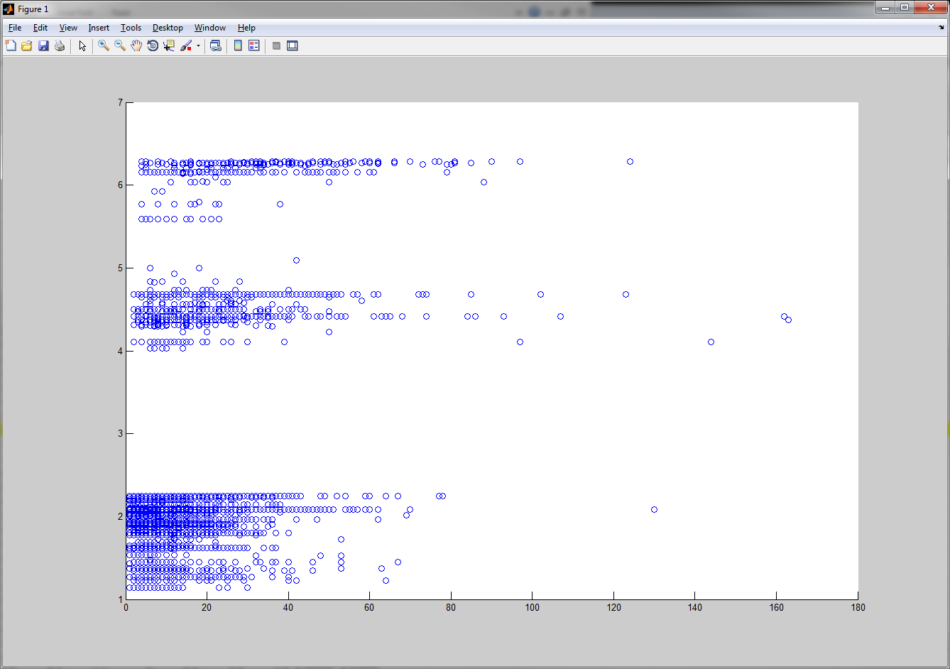
Optimize Variables – Results
Best correlation after optimization on testing dataset:
{Complexity, # of Charges, Severity, # of People} → 0.4173

Slide 47
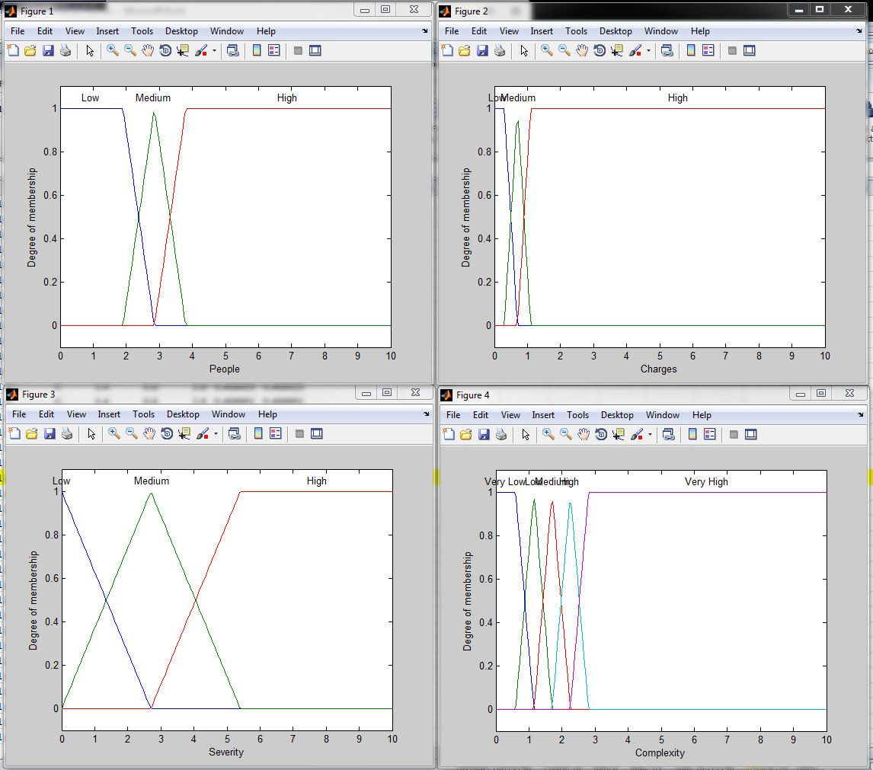
Optimize Variables – Results

Slide 48
Calibration of Model 2) Brute Force
"If brute force doesn't solve your problems, then you aren't using enough."

Slide 49
Optimize Variables
Previous section assumed independence of variables
What if there is dependence?
For example
# of People and Charges increases = Complexity increases
# of People or Charges increases ≠ Complexity increases
Previous method will not detect this

Slide 50
Optimize Variables – Brute Force
Brute Force
People input: Integer bounded between 0 and 10
Charges input: Integer bounded between 0 and 10
Severity input: Decimal bounded between 0 and 8
Complexity output: Decimal bounded between 0 and 10
Halfway between Min & Max
People_Min
People_Max

Slide 51

Results – Brute Force
For People_Min = 0 to 10
For People_Max = People_Min to 10
For Charges_Min = 0 to 10
For Charges_Max = Charges_Min to 10
For Severity_Min = 0 to 8
For Severity_Max = Severity_Min to 8
For Complexity_Min = 0 to 10
For Compexity_Max = Complexity_Min to 10
For each FIS variable
Try each possible value
Evaluate Correlation of calculated output to real output
9,150,625 evaluations of the FIS
~3.2s each evaluation → ~339 days
Infeasible
Halfway between Min & Max
People_Min
People_Max

Slide 52
Results – Brute Force
For People_Min = 0 to 10
For People_Max = People_Min to 10
For Charges_Min = 0 to 10
For Charges_Max = Charges_Min to 10
For Severity_Min = 0 to 8
For Severity_Max = Severity_Min to 8
For each FIS input variable
Try each possible value
Evaluate Correlation of calculated output to real output
166,375 evaluations of the FIS
~3.2s each evaluation → ~6.1 days
Feasible
Halfway between Min & Max
People_Min
People_Max

Slide 53
Results - Brute Force
Partition (People_Min) | Runtime | Hardware
0 | 28159 s | Intel Core i7 2600k @4.3GHz
1 | 25867 s
2 | 23597 s
3 | 21006 s
4 | 18536 s
5 | 15598 s
6 | 25200 s | Intel Core i7 860 @2.8GHz
7 | 19641 s
8 | 13583 s
9 | 7054 s
Total runtime without parallelization = ~55h
Total runtime with parallelization = ~8h
There are three kinds of lies: Lies, damned lies, and benchmarks.

Slide 54
Results - Brute Force
Maximum Correlation between Predicted Complexity and number of Appearances
Training Dataset: 0.401525
Testing Dataset: 0.405382
Not too great, but better than model based on ‘intuition’

Slide 55
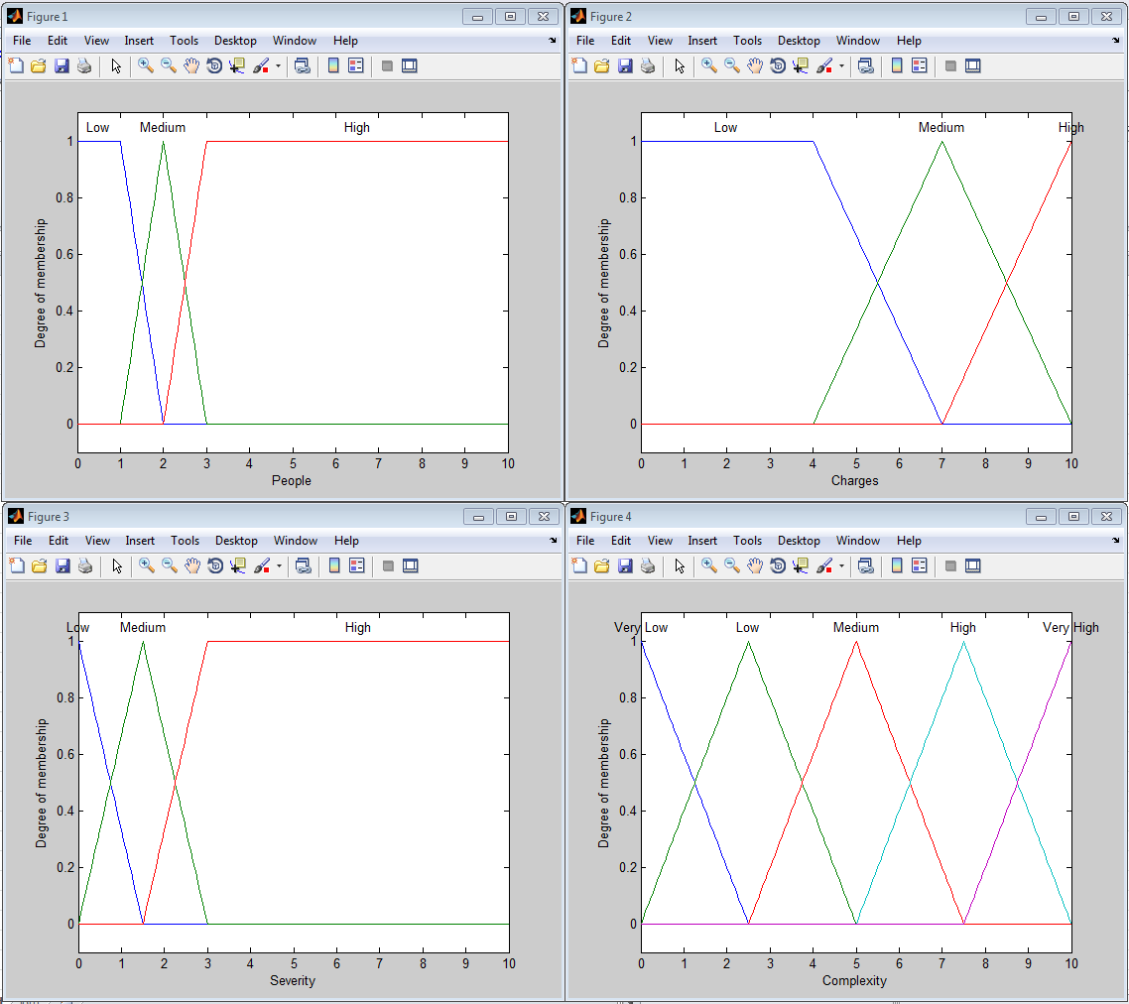
Results – Brute Force

Slide 56
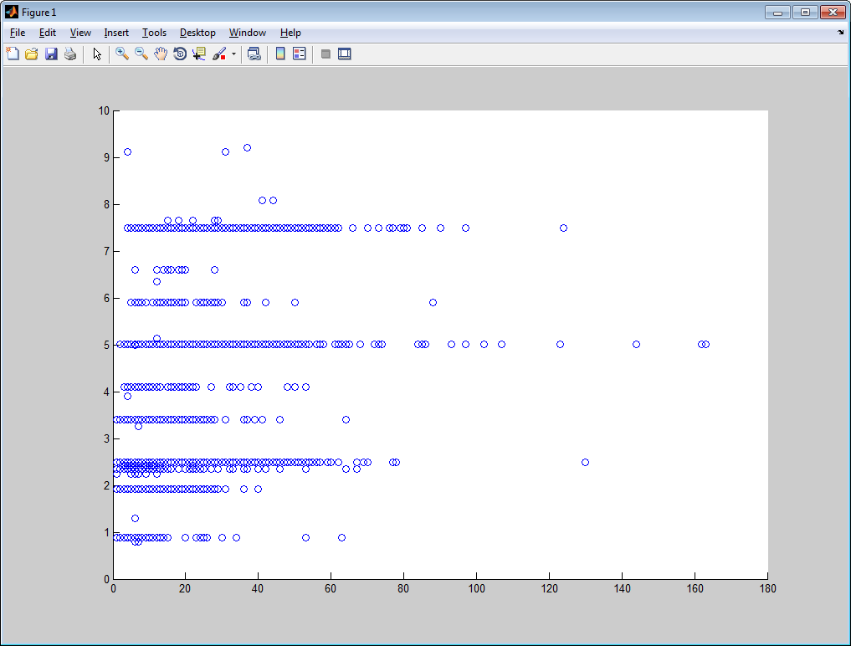
Results - Brute Force
Original
See some upward trend
Looks promising

Slide 57
Defuzzification

Slide 58
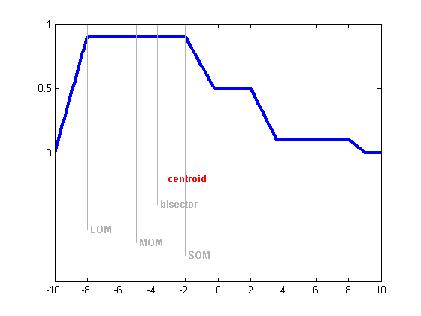
Various Defuzzification Methods
Evaluated FIS using:
Centroid
Bisector
LOM
MOM
SOM
No significant difference between any of the methods
Image from Mathworks.com

Slide 59
Discussion

Slide 60
Discussion
The criminal court system is very complex
Case processing is dependent on a number of factors including:
Legal procedures
Available resources
Interactions between branches of the criminal justice system
Interactions with outside individuals and organizations
Unpredictable human-behaviours
...and many more
Fuzzy logic provides sound structure for an early case intervention tool in the criminal court system
Optimization techniques further enhance the performance of the model

Slide 61
Discussion
Random “guess” would have resulted in a correlation of 0
Useless for prediction
Model based on intuition was not strong either
Correlation of 0.2
Optimization techniques further enhance the performance of the model
Correlation of 0.4
Preliminary results show that the model is capable of case complexity prediction
…but further refinement is necessary

Slide 62
Limitations
Considering 3 case characteristics
All 3 case characteristics are weighted equally
Including criminal offences from a variety of legal statutes
Considering the severity of all types of offences compared against each other
Using a single measure of time to completion (number of appearances)

Slide 63
Future Directions
Revisit the known limitations of the current work for model improvement
Discuss the model with professionals in the field to gain further insight
Consider further applications of the model that might work in different contexts

Slide 64
Celerity in the Courts An Application of Fuzzy Logic to Model Case Complexity in British Columbia’s Adult Criminal Court System
Thank you!
Math 800: Modeling of Complex Social Systems
November 30th, 2011
Andrew Reid
Richard Frank

