Slide 1
ENSC 427
Spring 2021 Group 10
Simulation Of
DDoS in 5G networks
Namsakhi Kumar (301336727) [namsakhi_kumar@sfu.ca]
Kwok Liang Lee (301326695) [leekwokl@sfu.ca]
Edwin Tam (301264849) [wailongt@sfu.ca]
Notes:
Hi everyone this is group 10. I am Lee and my teammates are Edwin and Namsakhi. Our project is about simulating DDoS in 5G network.

Slide 2
Roadmap
Introduction
Related Works
  DDoS Attack
  5G mmWave Module
Topology implementation
Simulation results
Conclusion
References
Notes:
As usual, we will start with introduction to give a brief idea about our project then related work, and topology we used in our simulation. After that, we will discuss about the results, conclusion, finally the references.

Slide 3
Introduction
Motive:
Higher bitrate and wider bandwidth that allow high-speed communication and more real time applications, such as autonomous vehicles and medical usage
However, if the network is under Distributed-Denial-of-Service (DDoS) attack, and device lose connection due to functional disruption of the server will contribute to accident or misstep
Objective:
Analysis of 5G Network under DDoS Attack Using ns-3 Simulator
Softwares:
  Wireshark
  ns3 - simulator
  Netanim
Notes:
Starting from 2019, more and more devices are capable to connect 5G, and from that time 5G networks begin to get more attention from the public. So why 5G, this might be the question asked most frequently. So to answer this, we first need to know that air interface 5G has two signals type, millimeter wave and sub-6 GHz wave. The millimeter wave has bandwidth of 50 MHz up to 400 MHz, while for sub-6 Hz is 100 MHz. These bandwidth are way larger than bandwidth in 4G which is around 1 MHz to 20 MHz. Therefore, what motivates us is that how well the 5G network can handle DDoS attack as misconnection from server might contribute to the happen of accident depends on application. The softwares we’re using in this project are Wireshark for reviewing the trace file, ns3 for simulation and Netanime for the animation.

Slide 4
Related Works
DDoS Attack
  A malicious attempt to disrupt the normal traffic of a targeted server, service or network by overwhelming the target or its surrounding infrastructure with a flood of Internet traffic
  Type of DDoS attacks:
    Volume Based Attacks (UDP floods, ICMP floods, and other spoofed-packet floods)
    Protocol Attacks (YN floods, fragmented packet attacks, Ping of Death, Smurf DDoS)
    Application Layer Attacks (GET/POST floods, attacks that target Apache, Windows or OpenBSD vulnerabilities, HTTP Flood)
  Type of DDoS methods:
    Direct Attack: sending a huge amount of packets from attacks to the victim. The type of packets can be of type Transmission Control Protocol (TCP), Internet Control Message Protocol (ICMP), UDP and mixture of all three
    Indirect Attack: attackers will use spoofed addresses to send reflectors to the packets that cause them to send replies to the victim

Slide 5
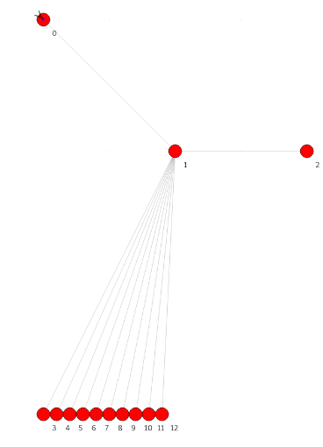
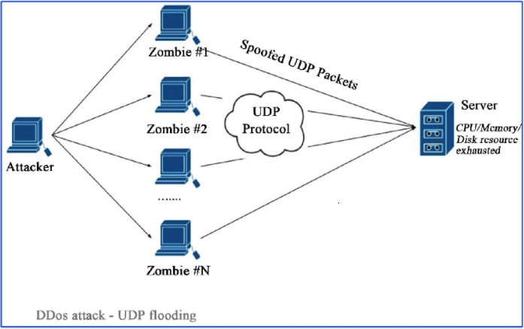
Related Works
We implemented Direct Attack method with UDP Flood type in our project
Legitimate user
eNodeB
Target
Attackers
Notes:
We implemented Direct Attack Method and UDP Flood type in our project

Slide 6
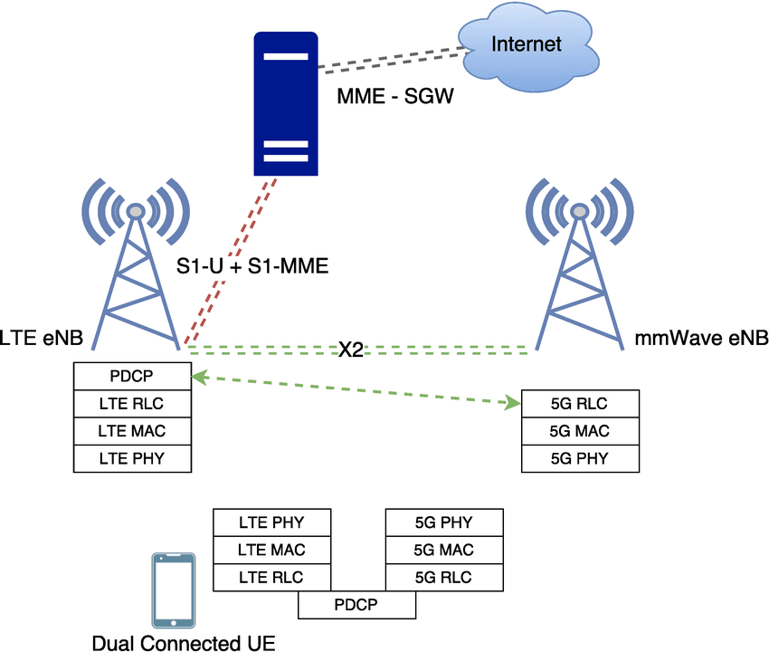
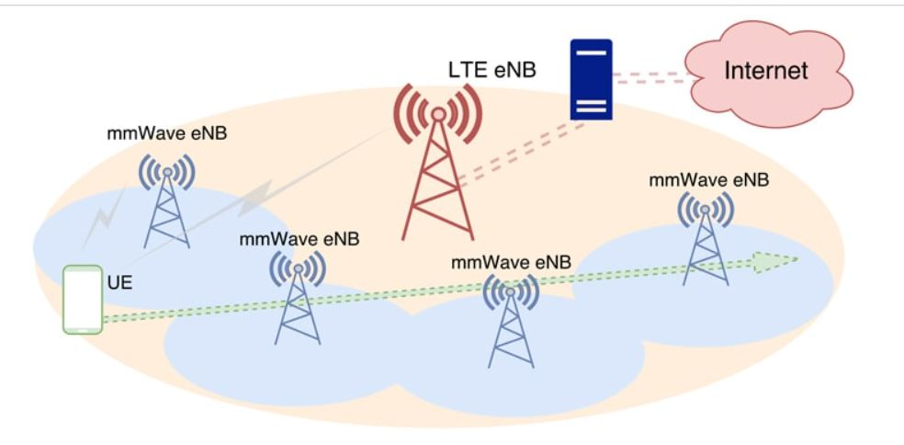
5G mmWave Module
5G Mmwave Module
  simulate 5G cellular networks at mmWave frequencies
  Built on top of the LTE (Long Transmission Evolution) module
  Simulation of core network elements (such as MME) (Mobility Management Entity)
  Modified Protocol full Stack
  Customizable Physical and Medium Access Control layers
Notes:
https://wireless.engineering.nyu.edu/multi-connectivity-handover/

Slide 7
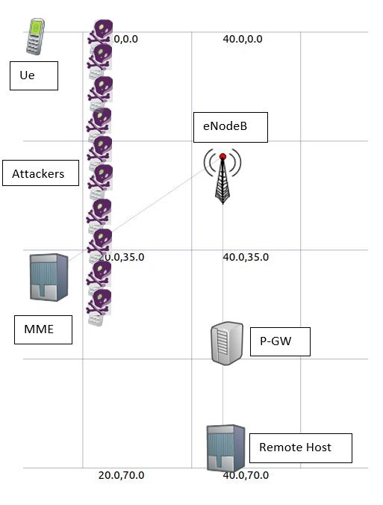
Topology
User Equipment (Ue):
user
Evolved Node B (eNodeB):
logical descendant of the
2G base station and the 3G Radio Network Controller
Packet Data Network Gateway (P-GW):
allocates IP addresses to the UEs and performs QoS
enforcement
Remote Host:
receive TCP/UDP packets and send ACKs to TCP users
Mobility Management Entity (MME):
performs connection and mobility management of UEs

Slide 8
Scenario Setup
Users: 1
Attackers: 10
eNodeB: 1
MME: 1
P-GW: 1
Remote Host: 1
User Data Rate: 0.5 Gbps
User Packet Size: 1000 bytes
Attacker Data Rate: Various (depends on the link capacity)
Attacker Packet Size: 1000 bytes
Attack Start Time: 0.4 seconds
Simulation Time: 1.5 Seconds
Notes:
For the topology setup, we created one user, 10 attackers, 1 eNodeB, 1 Mobility Management Entity, 1 Packet Data Network Gateway, and 1 Remote Host Server. In all scenarios, we set the user data rate to 0.5 Gigabits per second, both user and attacker packet size to 1000 bytes, but with the attacker data rate will be various and will depend on the link capacity. Such that we can fill up the data link between PGW and remote host with attackers packets. All of the simulations will be run for 1.5 simulation seconds and the attack time will be triggered at 0.4 seconds.

Slide 9
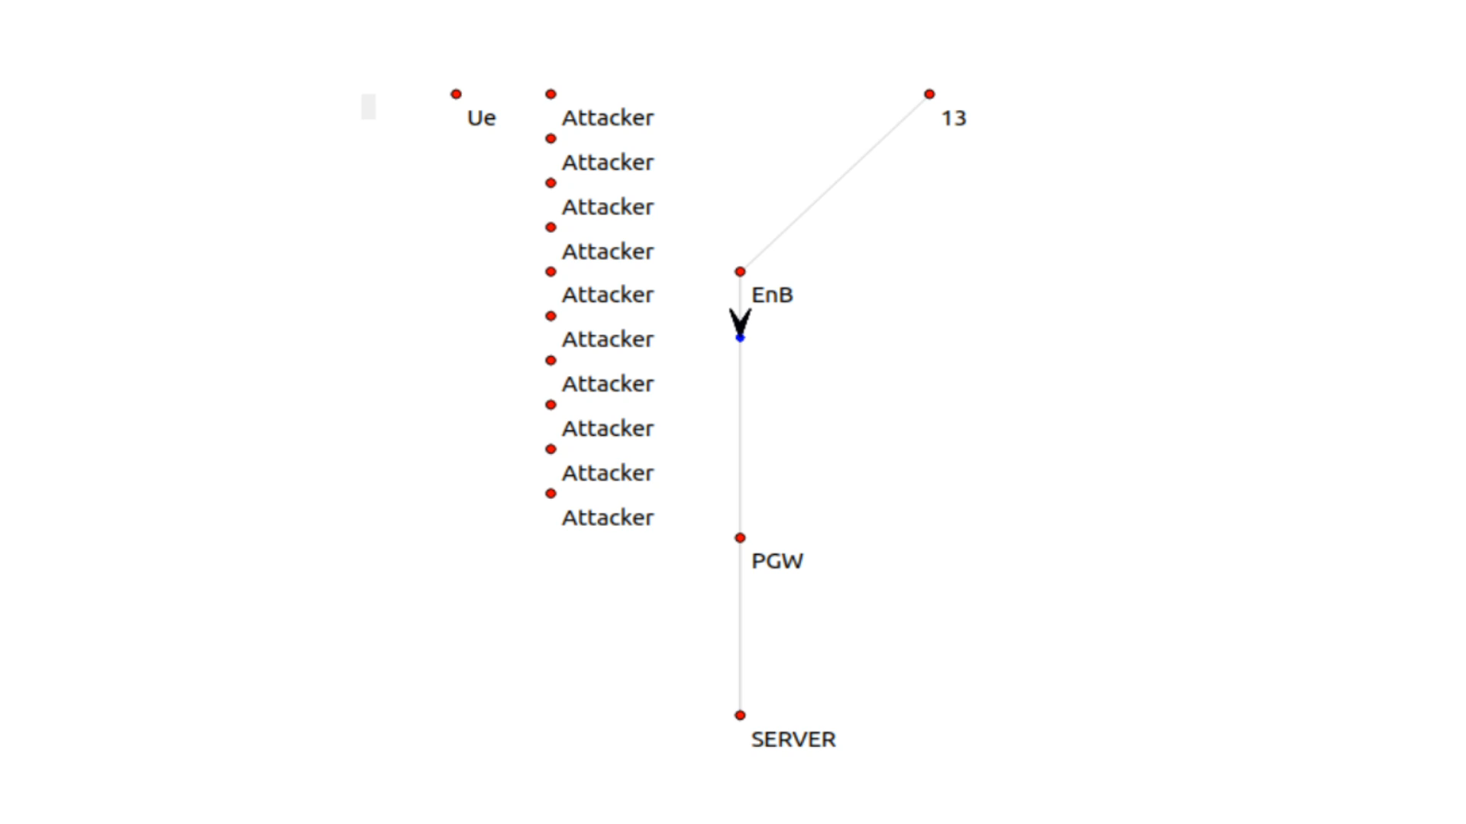
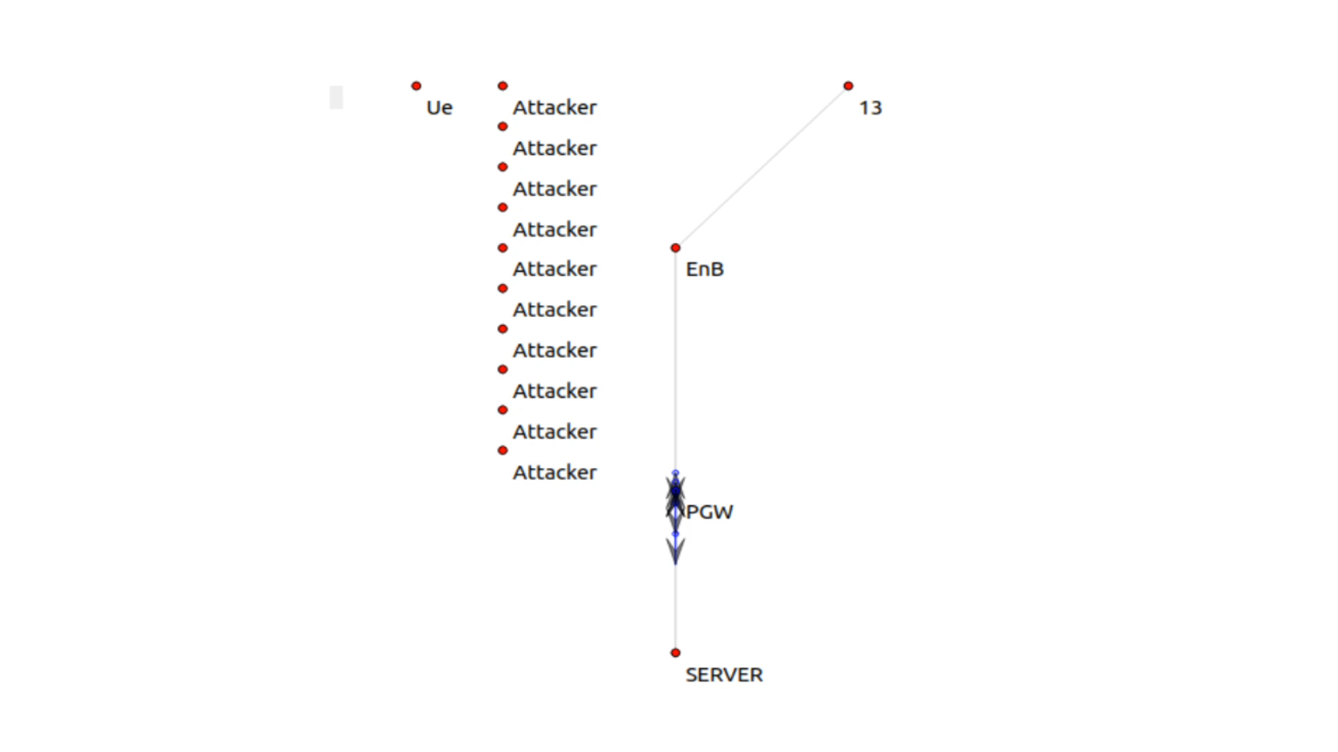
NetAnim Display
Notes:
Left video: Normal Scenario
Right video: DDoS occurs
The video on the left is the normal scenario. This is the scenario that does not have any DDoS attack. We can see there is a TCP packet sent from the ue node to the server via the enb node and the pgw. After the server receives the TCP packet from the user, the server will reply an ACK to the user to notify the packet is received.
On the other side, the server is under a ddos attack. We can see that all links are filled with the packets sent by the attackers. Since the packets sent by the attackers are UDP packets, the server will not reply with ACKs.

Slide 10
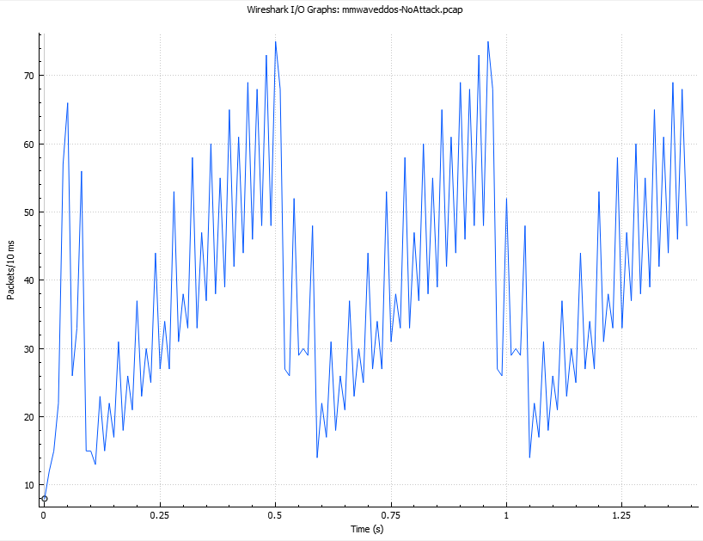
Simulation results
Scenario 1
  Normal behavior
  No attackers
  Full bandwidth
Notes:
In the first scenario, the network has only one user sending packets to the server, and this will be the behavior of normal transmission routine. No attacker will interrupt the transmission, and the user has the full bandwidth to send packets. Although the user has no interruption from the attackers, the user packets may drop during the transmission, and the server will have to request retransmission, which would cause a series of TCP Duplicate ACK. As a result, it will decrease the packet send rate for a moment.

Slide 11
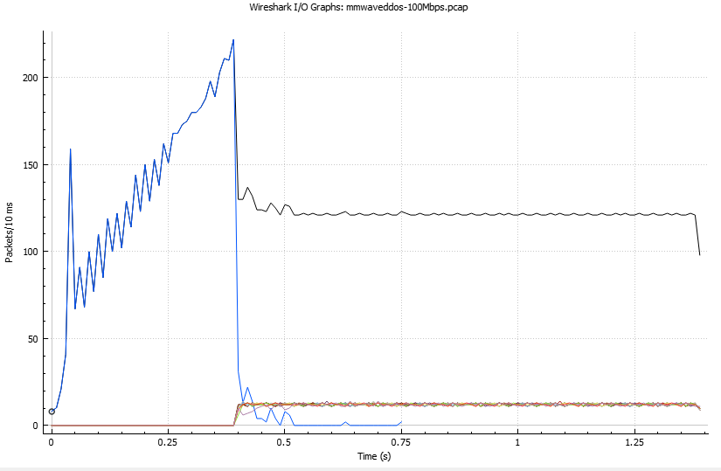
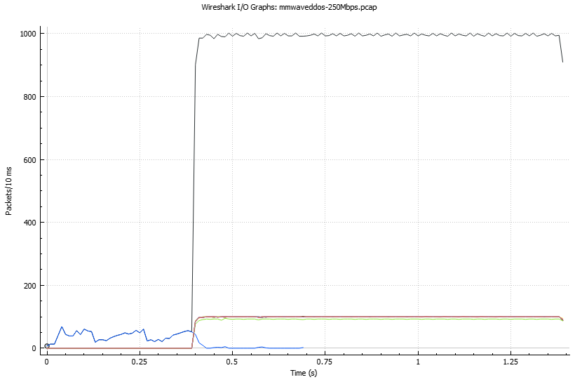
Simulation results
Total packet transmission in the network
User packet transmission
Attackers packet transmission
Scenario 2
  Link data rate: 100 Mbps
  Attacker send rate: 0.5 Gbps
Scenario 3
  Link data rate: 250 Mbps
  Attacker send rate: 0.5 Gbps
Notes:
For the next two scenarios, we have the link data rate set to 100 and 250 Megabits per second, which are higher than the 4G bandwidth, and both attackers send rate set to 0.5 Gigabits per second. In all the graphs, the blue line indicates the number packets per second of the legit user, black line means the total number of packets per second in the network, and other colors are the attackers number of packets over time. After the ddos attack occurs at 0.4 seconds, the transmission rate of the user, shown in blue line, has a significant drop to nearly zero, and the TCP transmission is stopped after around 0.7 seconds. This illustrates that the ddos attack works at low data rate scenarios. But how about high data rates like 5G?

Slide 12
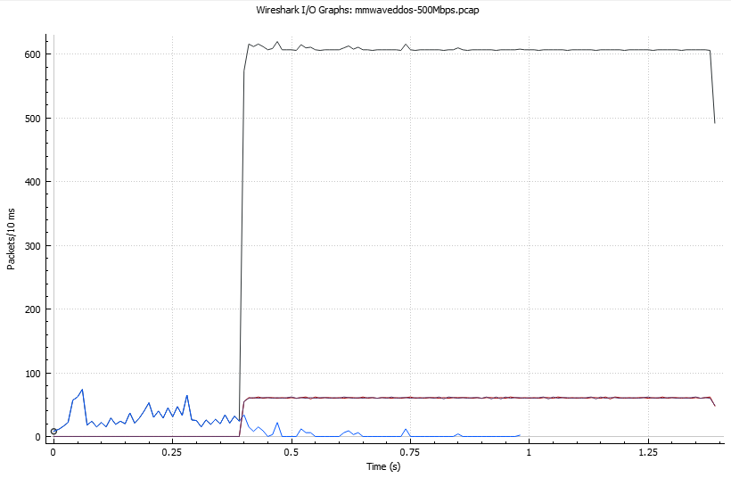
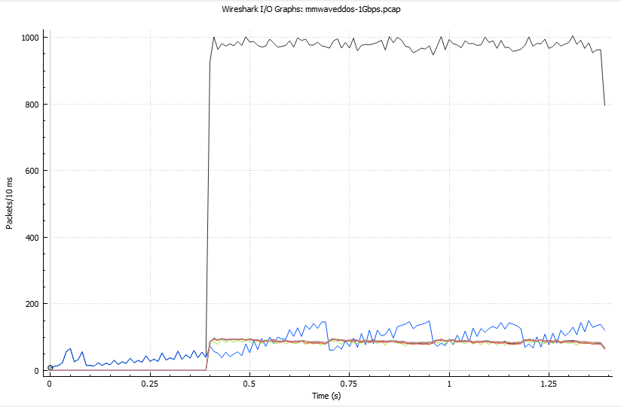
Simulation results
Scenario 4
  Link data rate: 500 Mbps
  Attacker send rate: 0.5 Gbps
Scenario 5
  Link data rate: 1 Gbps (5G rating)
  Attacker send rate: 1.5 Gbps*
  Attackers: 15*
*Different than other scenarios setting
Notes:
In scenario 4, this is simulating the 4G LTE-Advance data rate at 500 Megabits per second. Similar to other scenarios, the attacker starts at 0.4 seconds, and the user send rate fluctuates at around 10 to 20 packets per 10 milliseconds before the transmission ends at almost 1 second. This shows our model is still working in 4G LTE-Advance network. However, scenario 5 has the link data rate increased to 1 gigabit per second, which is the ideal 5G data rate, and the attacker send rate is changed from 0.5 Gigabits per second to 1.5 gigabits per second. Also, the attacker number is increased to 15, such that we can increase the traffic in the data rate. After the attack happens, the data rate of the user slightly drops for about 0.1 second, but it turns back to the normal routine pattern. It shows this ddos attack has no effect on the user.

Slide 13
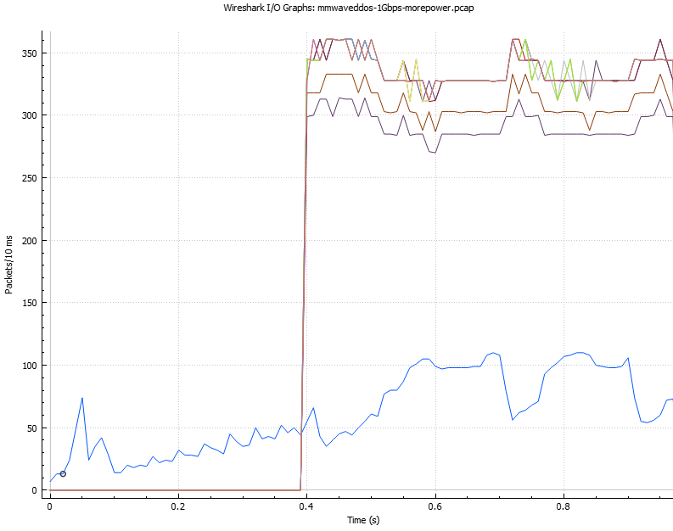
Simulation results
Senario 6
  More Attackers
    20 attackers
  More Powerful Attackers
    5Gbps attack rate
    350,000 packets/sec
  Ended at 0.9 simulation seconds
due to a system failure
Attackers
2
User
1
Notes:
In the last scenario, we increase the effect of the ddos attack by having 20 attackers in the network, and each attacker will have 5 gigabits per second data rate, which will generate about 350 thousand packets per second. At the beginning of the attack, the user data transmission has minor effect from the attacker, which we can see from the first interest point, the transmission rate slightly decreases. As the transmission rate of the attacker decreases, the user has some bandwidth to send data to the server, so the user packet received by the server increases. At point 2, the attackers send more packets to the server and make the legit user have less bandwidth to send packets. Hence, the number of packets received by the server decreases. This graph shows our model is possible to create a 5G ddos attack, but it requires more packets to send from the attackers to the server. However, the simulation ends after 7 hours of collecting data in real-time due to a system crash to the virtual box machine.

Slide 14
Conclusion
We have five scenarios with DDoS enable
  Scenario 1, 2 and 3 with link capacity of 100 Mbps, 250 Mbps and 500 Mbps
  Scenarios 4 and 5 with link capacity of 1 Gbps and XXX Gbps
The first three scenarios provided our topology work for DDoS
Last two scenarios didn’t successfully decrease the usage of user, the reasons can be:
  Not enough attacker
  The data rate is too low

Slide 15
Conclusion
Challenges and Limitations
  Gap observed after every burst of packets via NetAnim
  Long run time
  Cannot see packet flows of wireless transmission in NetAnim
  Difficulty in understanding mmwave module
Notes:
For the first challenges, it is the gap between the burst of packets when the attackers are sending packets. This make our attack not continuous. Next is the time for the simulation to complete. When the attack data rate goes up to Gbps, it takes about 1 to 2 hours to complete, but if both attack rate, user send rate and link capacity are in Gbps, the simulation takes up to 12 hours or even more. The third challenge is the animation we have in Netanim didn’t show the transmission in wireless connection. For the mmwave module we are using, we are having difficulty in understanding due to lack of description in the document.

Slide 16
Conclusion
Future work
  Have more understanding of ns-3 code
  Increase the link capacity between P-GW and remote host so it’s close to 5G set up
  Increase the number of attackers and users
  Implementation of different type of DDoS attacks in 5G module
Notes:
future work, we will dig deeper into mmwave module to have a better understanding of the provided functions. Second, we will have more scenario with the link capacity in 5G set up. Also, we should increase the number of attackers and user so it is more realistic. Finally, we can explore different types of DDoS attacks and compare them with our current results.

Slide 17
References
[1] B. Nagpal, P. Sharma, N. Chauhan and A. Panesar, "DDoS tools: Classification, analysis and comparison," 2015 2nd International Conference on Computing for Sustainable Global Development (INDIACom), New Delhi, India, 2015, pp. 342-346.
[2] M. K. Forland, K. Kralevska, M. Garau and D. Gligoroski, "Preventing DDoS with SDN in 5G," 2019 IEEE Globecom Workshops (GC Wkshps), Waikoloa, HI, USA, 2019, pp. 1-7, doi: 10.1109/GCWkshps45667.2019.9024497.
[3] S. U., “DDoS simulation in NS-3 [C++],” Medium, 07-Aug-2020. [Online]. Available: https://infosecwriteups.com/ddos-simulation-in-ns-3-c-12f031a7b38c. [Accessed: 10-Apr-2021].
[4] Nyuwireless-Unipd, “nyuwireless-unipd/ns3-mmwave,” GitHub. [Online]. Available: https://github.com/nyuwireless-unipd/ns3-mmwave. [Accessed: 14-Mar-2021].
[5] S. Alzahrani and L. Hong, “Generation of DDoS Attack Dataset for Effective IDS Development and Evaluation,” Journal of Information Security, vol. 09, no. 04, pp. 225–241, 2018.
[6] “Design Documentation,” Design Documentation - Model Library. [Online]. Available: https://www.nsnam.org/docs/models/html/lte-design.html#architecture. [Accessed: 14-Apr-2021].
[7] M. Mezzavilla et al., "End-to-End Simulation of 5G mmWave Networks," in IEEE Communications Surveys & Tutorials, vol. 20, no. 3, pp. 2237-2263, thirdquarter 2018, doi: 10.1109/COMST.2018.2828880.

