Slide 1
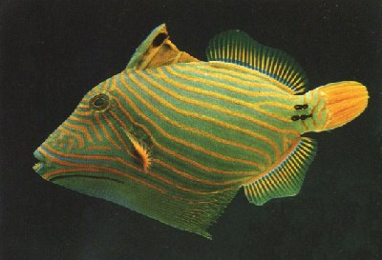
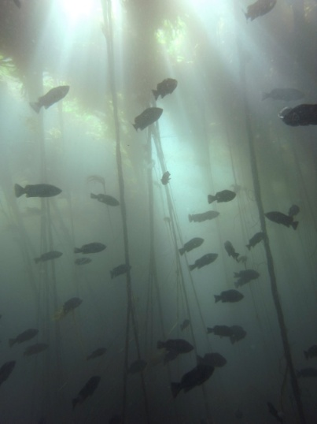
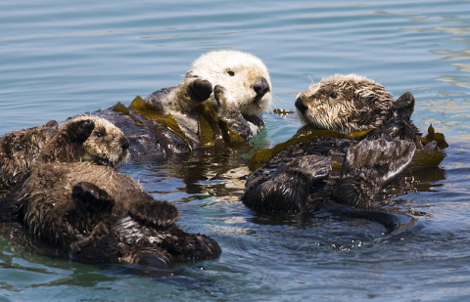
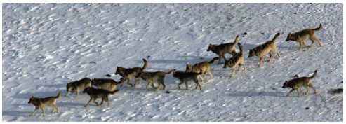
Keystone species and trophic cascades
BISC 830 Fall 2013
Nicholas Dulvy
dulvy@sfu.ca

Slide 2
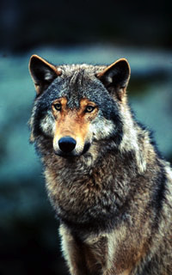
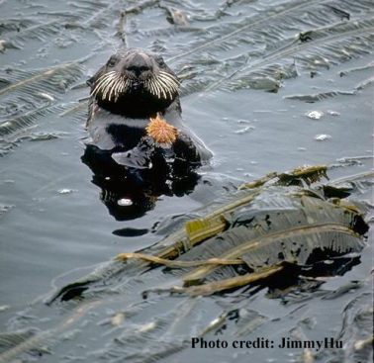
Roadmap for today
What is a keystone species?
What is a trophic cascade?
Allee effects and resource consumer dynamics
Four Case studies:
Fear and loathing in Shark Bay
Wolves/cougars, elk, aspen/cottonwood and rivers
Vertebrate predators, leaf-cutter ants, howler monkeys, and trees in tropical dry forest
Predatory fishes, starfish and coral reefs
www.panda.org
Notes:
Case studies – 2 marine and 2 terrestrial. All except the last include both keystones and cascades
Last one is a good eg of a cascade with no keystone
These case studies will intertwine keystones and cascades – as we’ll learn, the two concepts are inter-linked

Slide 3
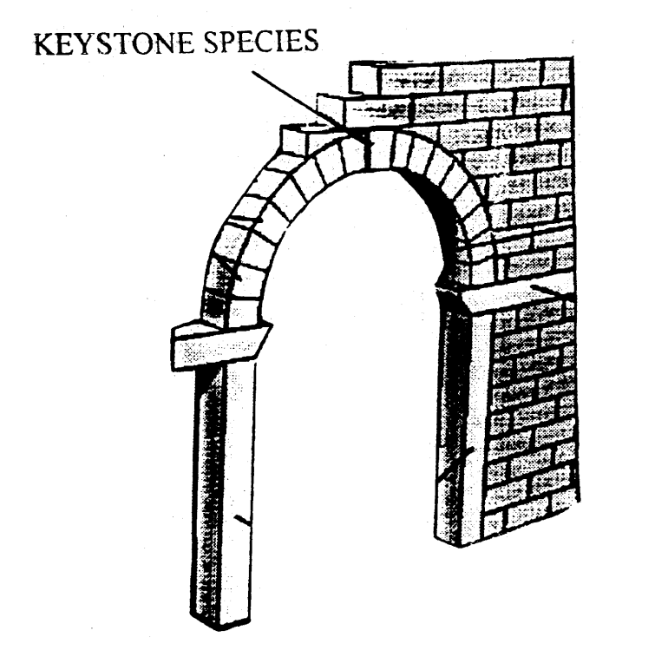
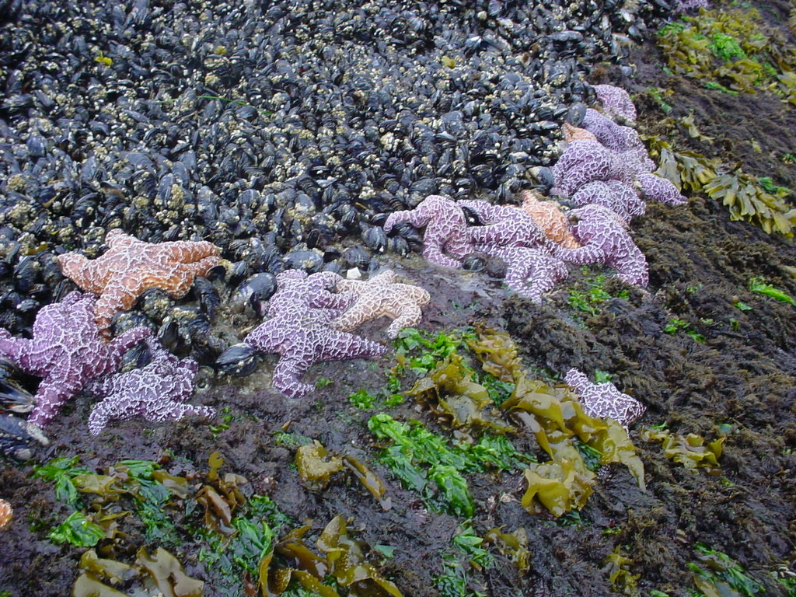
What is a keystone species?
“A species that has a disproportionate effect on its environment relative to its biomass”
Coined by Bob Paine (1969): Pisaster ochraeaus and Mytilus californianus
globalchange.umich.edu
www.wallawalla.edu
Notes:
Particularly apt description, because if you remove a keystone, the structure of the arch is pretty dramatically changed… and the route to rebuilidng the arch is likely to be more complex then just putting the keystone back.

Slide 4

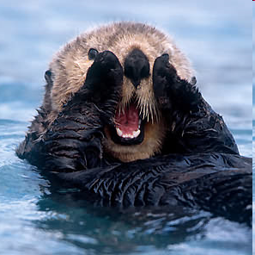
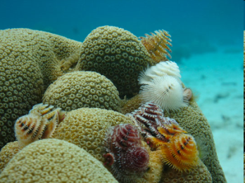
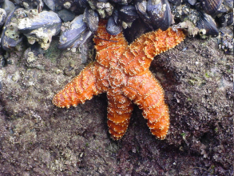
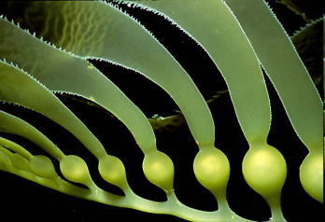
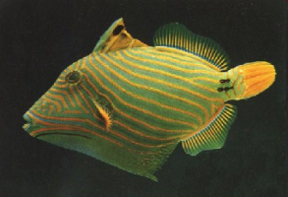
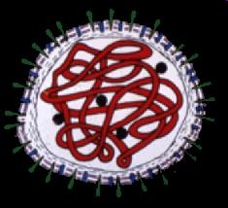
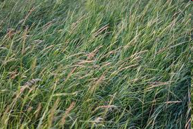
What is a keystone species?
Central idea: a non-abundant species that has a greater-than-expected impact on ecosystem functions via a chain of interactions
Keystone species
Dominant/
Foundation species
Impact on ecosystem
Rare species
Common species
Proportional biomass of species
Modified from Power et al. 1996
Notes:
Figure adapted from power that’s also in your text book. Useful way to think about it. Emphasise that it’s PER CAPITA influence, not just being an important species. Giant kelps, reef-building corals, forest trees etc all could fit in dominants, but not keystones. Viruses are relatively rare but some can have near keystone effects, such distemper impacts on lions and wild dogs

Slide 5
What a keystone isn’t (necessarily…)
Foundation species
a dominant primary producer in an ecosystem both in terms of abundance and influence
Kelp in kelp forests, coral on coral reefs, trees in a forest…
Umbrella species
Protecting it protects lots of other species too.
Amphibians, tigers, sea horses…
Flagship species
representative ‘poster’ species
Giant pandas, Orangutan, African elephants, manta ray, whale shark…
Indicator species
Indicative of ecosystem ‘health’, biodiversity or other properties of interest

Slide 6

Beware of spin over substance!

Slide 7
What sort of species are keystones?
Predators
Strong ‘top down’ effects on the structure of communities (Paine 1969)
Sea stars, sea otters , wolves, sharks…
Mutualists
Important nectary plants or pollinator insects
Ecosystem engineers
Bears & maggots – transport salmon nutrients
Beavers – transform river systems and mitigate flooding
Elephants - Mega-herbivores
Brittlestars - bioturbators
Notes:
NOT necessarily apex predators, though sometimes are. Today

Slide 8
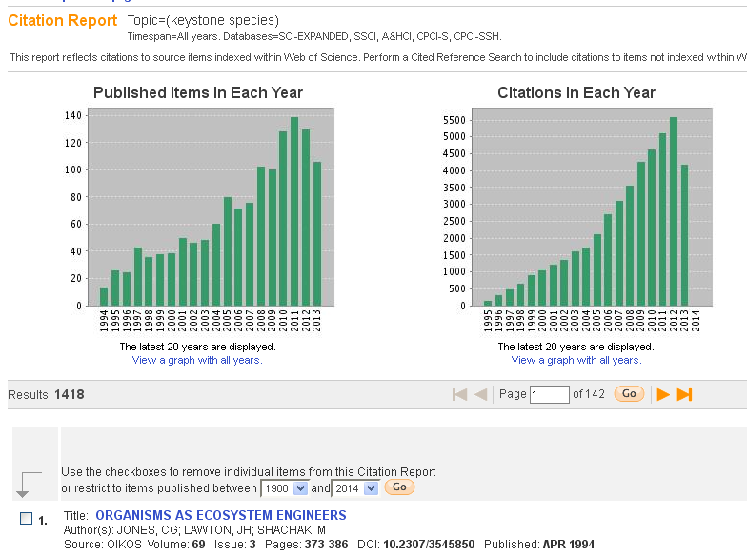

Slide 9


Slide 10
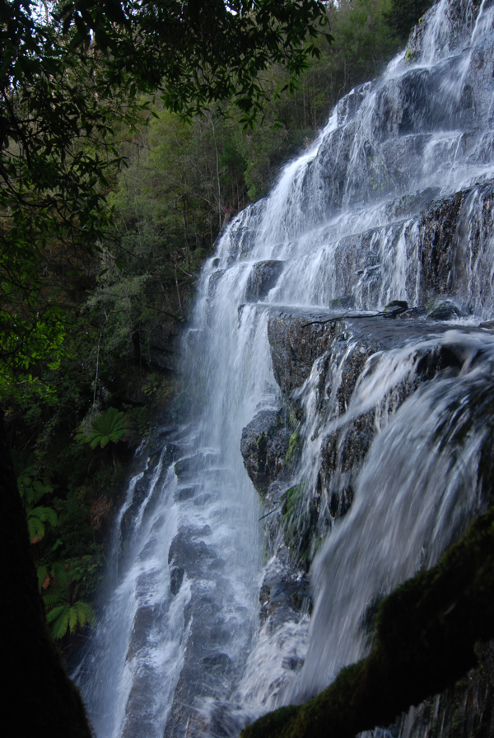
What is a trophic cascade?
Change in abundance that propagates between ≥3 trophic levels
Remember that keystones were non-abundant species with an outsized impact on ecosystem functions through a chain of interactions
Keystones and cascades often associated
Removing a keystone usually leads to a trophic cascade
Notes:
Waterfall is a nice way to think about it – not really a cascade until it tumbles over multiple levels

Slide 11
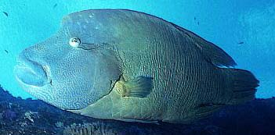
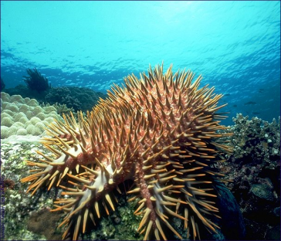
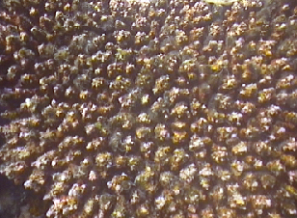
Trophic cascades can short-circuit a food web
predator
Strong direct
interactions
lead to
strong indirect
link from top to
bottom of food web
-
+
+
prey
-
+
resource

Slide 12
Top-Down vs. Bottom-up processes
Top down: Higher trophic levels control the abundance of those trophic levels below them, and /or overall ecosystem structure.
Bottom up: Nutrient supply and primary production determine ecosystem structure.
Trophic cascades are top-down processes.

Slide 13
Cascading effects of loss of top predators
Mesopredator release
Loss of top predators -> increase of mesopredators -> decline of mesopredator prey ->??
Trophic cascades
Loss of top predators -> increase in herbivores -> decline of plant populations ->??
Fisheries-Induced Trophic Cacades (FITCs): “the indirect effects of exploiting marine predators on the abundance, biomass, or productivity of species, or species assemblages, two or more trophic links below the exploited predator” (Salomon et al. 2010)

Slide 14
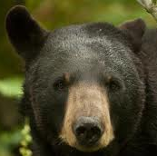

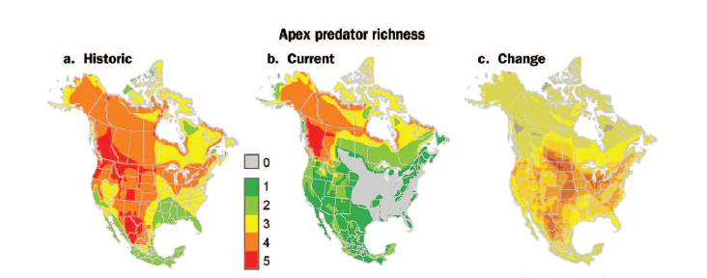
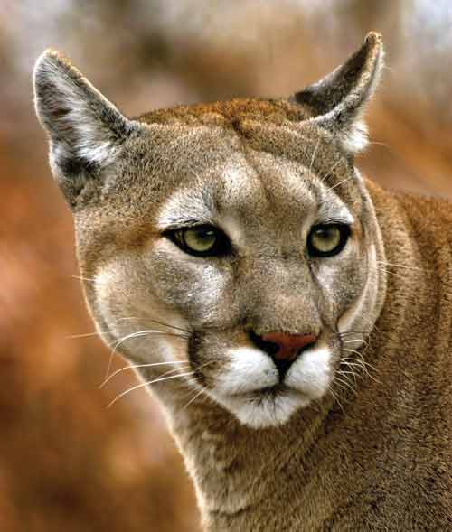
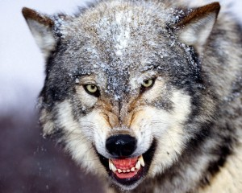
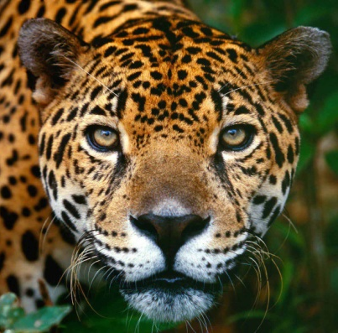
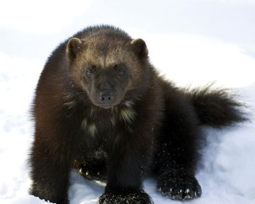
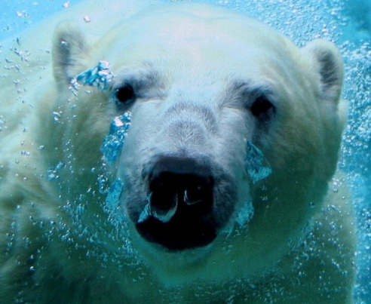
Loss of top predators

Slide 15
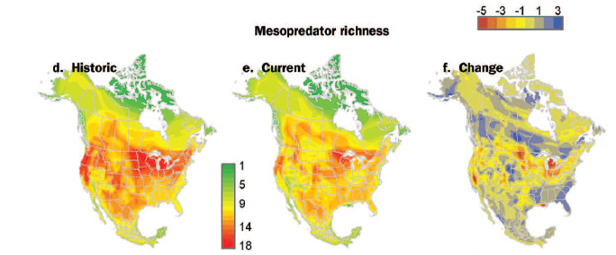
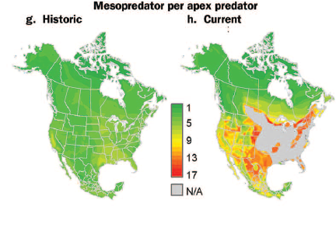
Rise of the mesopredators
Lynx
Mink
Marten
Otter
Fisher
Ferret
Racoon
Coati
Ringtail
Skunks
Badgers
Weasels
Coyote
Foxes
Ocelot
Jagurundi
Margay
Bobcat

Slide 16
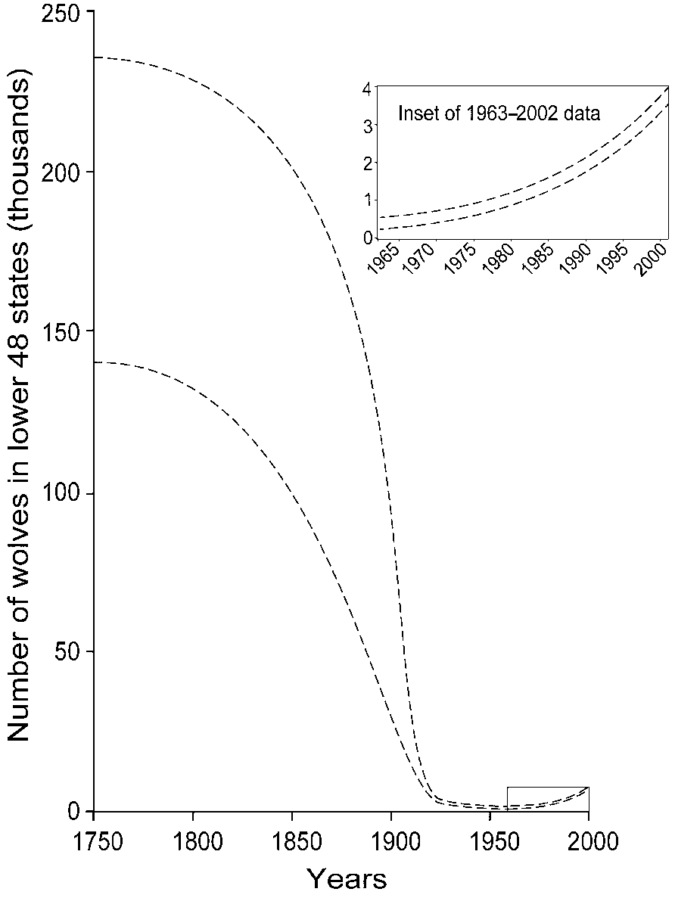
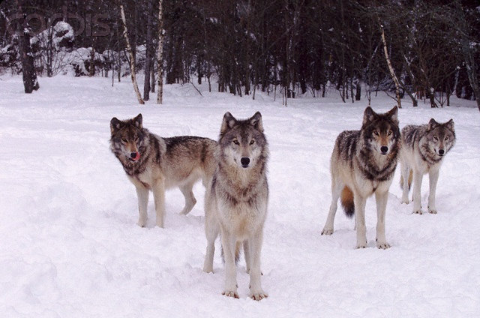
Historical and recent gray wolf population trends in the conterminous 48 United States
Ripple & Beschta 2005 Bioscience

Slide 17
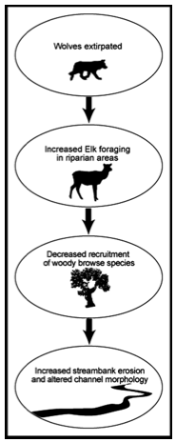
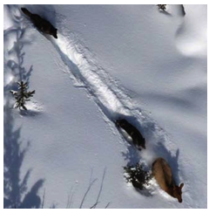
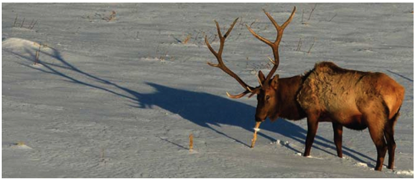
Case Study: Wolves
The Yellowstone Wolf Project Report 2008
Beschta and Ripple 2008

Slide 18
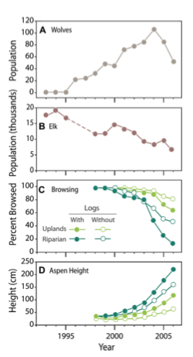
Case Study: Wolves in Yellowstone
Wolves extirpated in early 1900s
Re-introduced to Yellowstone in 1995-1996
Presence of wolves leads to broad changes in elk grouping, foraging behavior, habitat selection, diet, and nutrition (Creel and Christianson 2009)
Large decline in grazing of aspen, especially in riparian areas.
Combined density (predation) and behavioural effect
Elk less likely to graze in areas with poor escape routes or visibility with wolves around streams.
Ripple and Beschta 2007

Slide 19
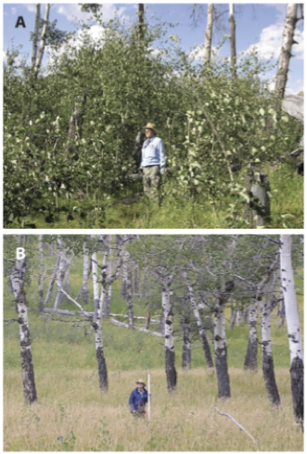
Case Study: Wolves in Yellowstone
Wolves extirpated in early 1900s
Re-introduced to Yellowstone in 1995-1996
Presence of wolves leads to broad changes in elk grouping, foraging behavior, habitat selection, diet, and nutrition (Creel and Christianson 2009)
Large decline in grazing of aspen, especially in riparian areas.
Combined density (predation) and behavioural effect
Elk less likely to graze in areas with poor escape routes or visibility with wolves around streams.
Wolves+
Wolves-
Ripple and Beschta 2007
Notes:
Also effects on poplar and willow, but less consistant.
Broadly consistant patterns in Olympic National Park in Washington, Yosemete, Zion and Wind cave national park.

Slide 20
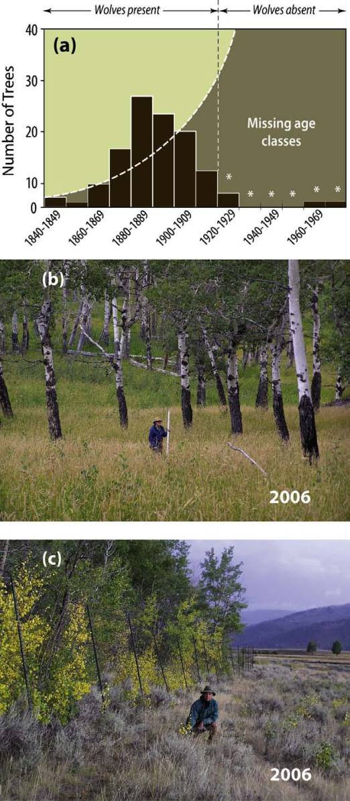
Case Study: Wolves in Yellowstone
Aspen age structure from 1840 to 2000
An aspen stand showing heavy bark damage from elk along the lower several meters of each tree and a long-term lack of recruitment (tall saplings and small diameter trees are missing)
Ongoing aspen recruitment within a fenced elk exclosure and an absence of recruitment outside the fence
Beschta & Ripple 2009 Biol. Con.
Notes:
Fig. 1. (a) Aspen age structure from 1840 to 2000, (b) an aspen stand showing
heavy bark damage from elk along the lower several meters of each tree and a longterm
lack of recruitment (tall saplings and small diameter trees are missing), and (c)
ongoing aspen recruitment within a fenced elk exclosure and an absence of
recruitment outside the fence (even though root sprouts are present); all in the
northern range of Yellowstone National Park. For the period following the
extirpation of wolves in Yellowstone, significant decreases (95% lower CI) in aspen
tree frequencies are indicated by ‘‘”. Source: adapted from (a) Larsen and Ripple
(2003).

Slide 21
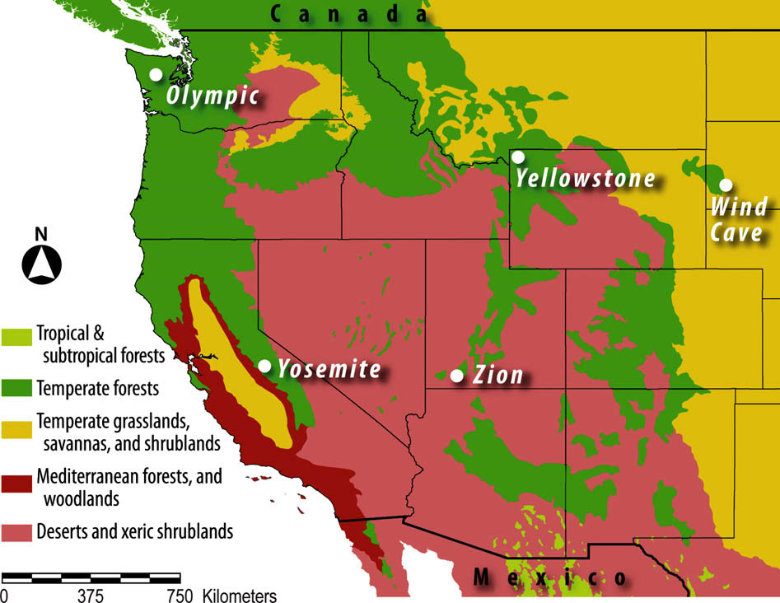
Predator-deer-tree cascade
Beschta & Ripple 2009

Slide 22
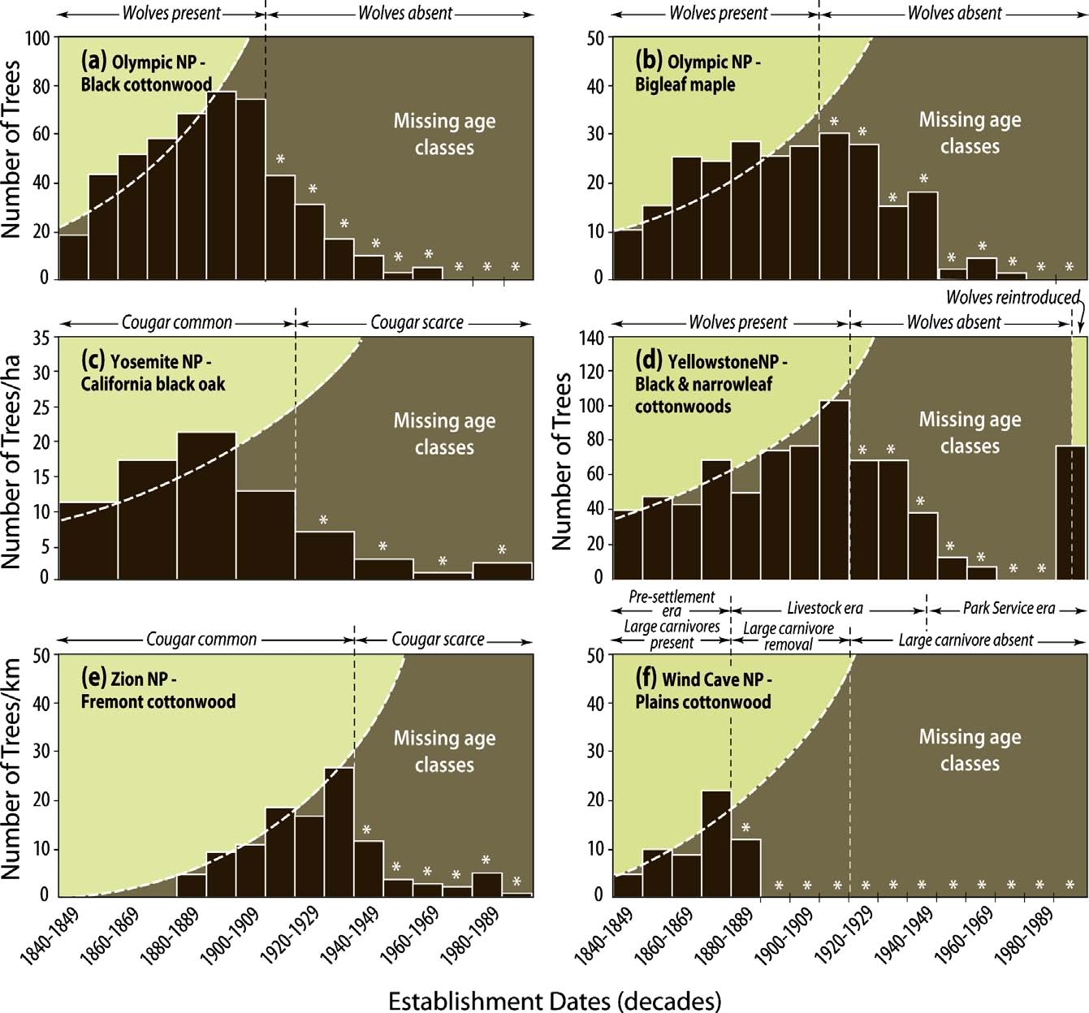
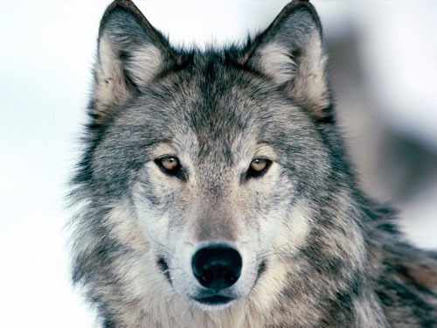
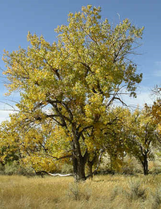
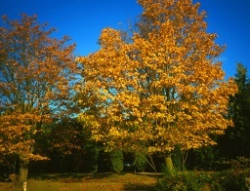
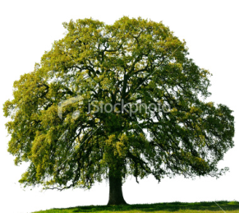
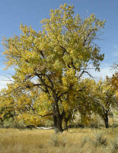
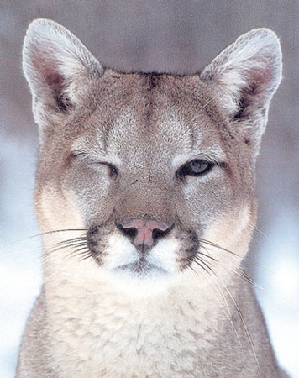
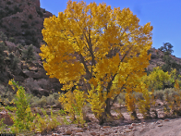
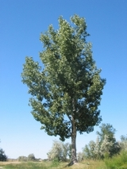
Beschta & Ripple 2009

Slide 23
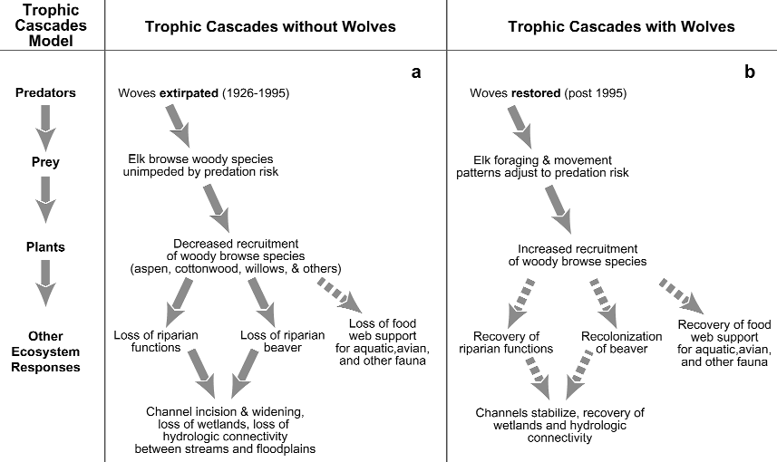
Trophic interactions due to predation risk and selected ecosystem responses in N Yellowstone

Slide 24
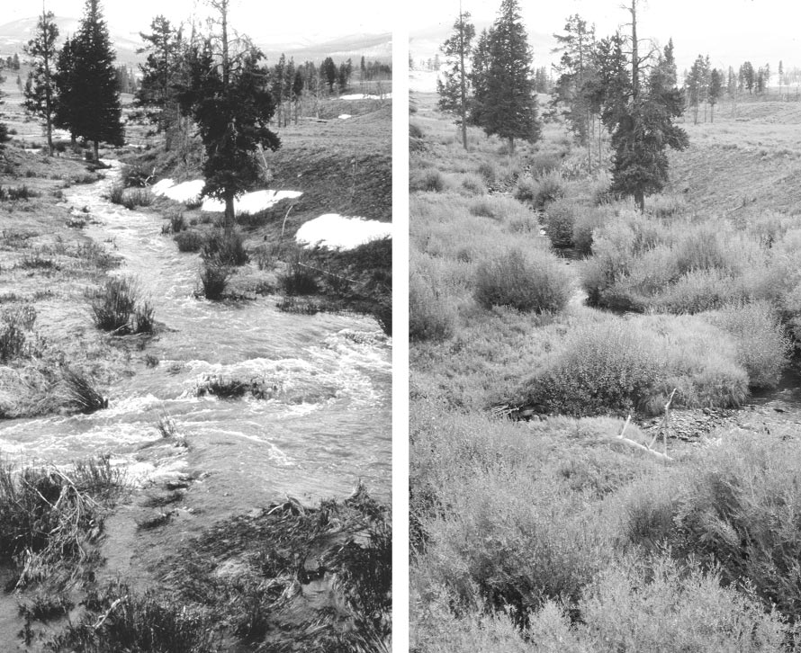
Following a 70-year
period of wolf extirpation, heavy browsing of willows and conifers is evident in the 1996 photograph.
In 2002, after 7 years of wolf recovery, willows show evidence of release from browsing pressure

Slide 25
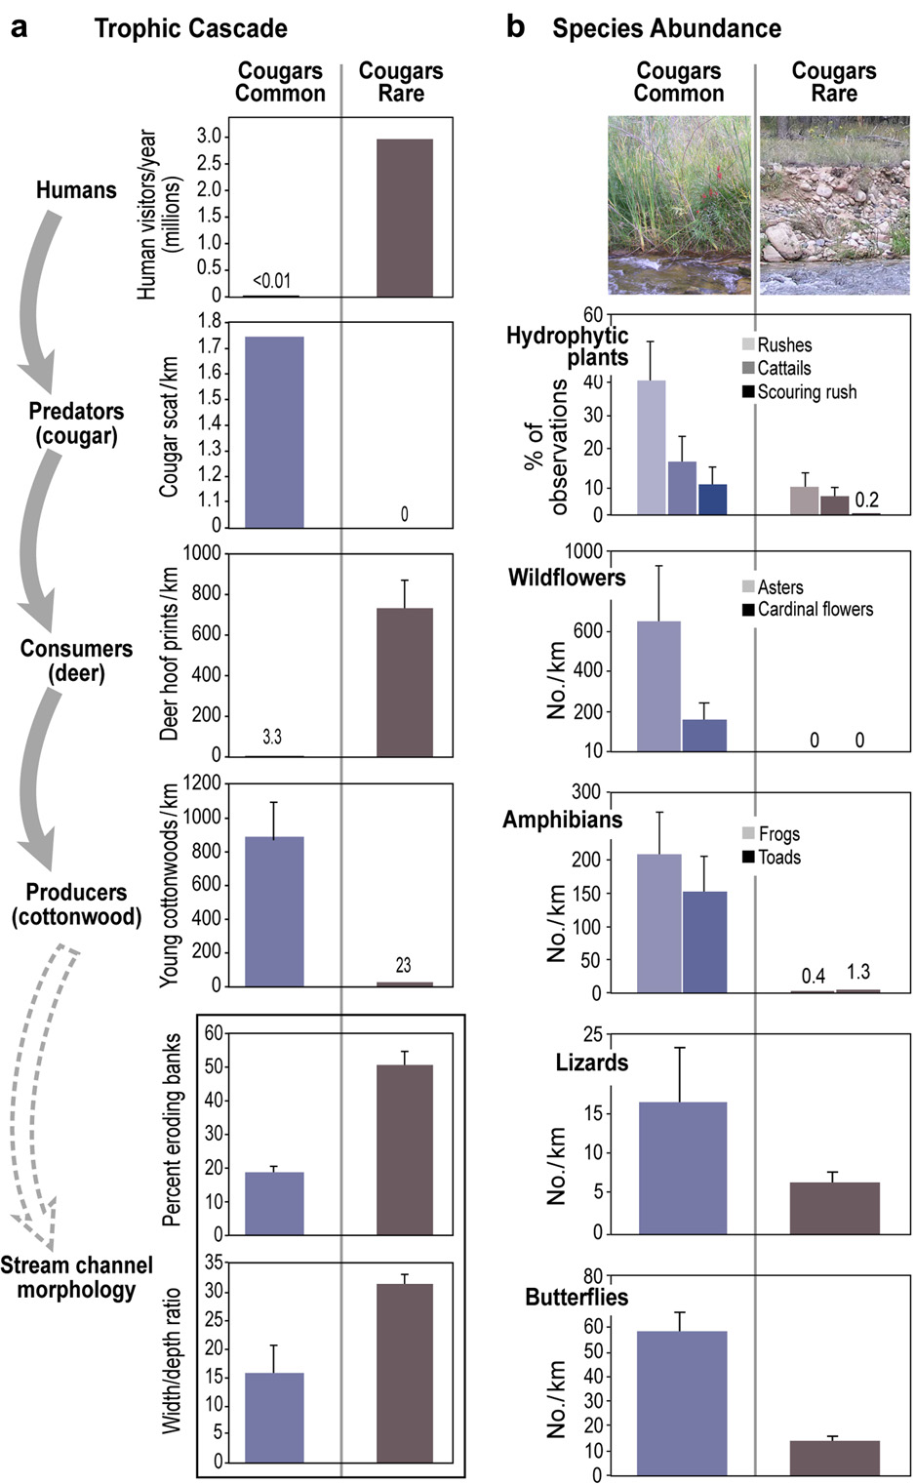

Slide 26


Direct consumptive versus indirect “ecology of fear” effects

Slide 27


Burkholder, D. A., Heithaus, M. R., Fourqurean, J. W., Wirsing, A. and Dill, L. M. (2013) Patterns of top-down control in a seagrass ecosystem: could a roving apex predator induce a behaviour-mediated trophic cascade? Journal Of Animal Ecology, DOI: 10.1111/1365-2656.12097

Slide 28




Slide 29

control
cage
Day 1
Day
600

Slide 30


Slide 31




Slide 32

Case study: Lago Guri, Venezuela (Terborgh et al 2001 and Terborgh et al 2006)
4300-km² hydroelectric impoundment, islands isolated by water since 1986
Semi-deciduous, tropical dry forest
Islands vary in size, some not large enough to support viable predator populations.
Faunal inventories in 1993/1994:
six “small” islands (0.25 to 0.9 ha)
four “medium” islands (4 to 12 ha)
two “large” islands (150 ha)
two sites on the mainland
Notes:
What would happen if you could exclude all predators from an area – large scale experiment:
Top down prediction:
Bottom up prediction:
Lake islands in Venezuela provided a natural experiment testing this.
measured the abundance at each site of all vertebrates and selected invertebrates.

Slide 33


Case study: Lago Guri, Venezuela
(Terborgh et al 2001 and Terborgh et al 2006)
Small and medium islands lacked 75% of the vertebrate species present on the mainland
The two large islands retained nearly all species
Consumers on small and medium islands hyper-abundant relative to large islands
35 times as many small rodents
10 times as many iguanas
50 times as many howler monkeys
100 times as many leaf cutter ants
All the major consumers feed on the foliage and leaves of trees.
Experiments showed that tree recruitment was depressed by herbivory and consumer abundance was controlled by predation
Notes:
What would happen if you could exclude all predators from an area – large scale experiment:
Top down prediction:
Bottom up prediction:
Lake islands in Venezuela provided a natural experiment testing this.
measured the abundance at each site of all vertebrates and selected invertebrates.

Slide 34


Case study: Lago Guri, Venezuela
“Mere numbers do not do justice to the bizarre condition of herbivore-impacted islets… There is almost no leaf litter, and the ground is bright red from the subsoil brought to the surface by leaf-cutter workers..”
(Terborgh et al. 2006)
Notes:
What would happen if you could exclude all predators from an area – large scale experiment:
Top down prediction:
Bottom up prediction:
Lake islands in Venezuela provided a natural experiment testing this.
measured the abundance at each site of all vertebrates and selected invertebrates.

Slide 35
Consumer-resource / Predator-prey dynamics and Allee effects
N_{t+1} = N_{t}+rN_{t}(1-N_{t}/K)
Per capita
population growth rate
dn/dt 1/N or N⁻¹
N_{t} Population size
Population growth rate
dn/dt
K
K
K
Time
Population size, N_{t}
Population size, N_{t}

Slide 36

Population growth + predation rate
May (1977)
Low
predation
High
predation
Intermediate
predation
Population growth rate
(dn/dt)
Prey consumption
Prey population size
Prey largely unaffected
Prey eliminated
Alternate
States
Lower prey carrying capacity
or extinction

Slide 37
Allee effects and outbreak dynamics emerge from simple predator-prey models
Population
growth rate (dn/dt)
0
Population size
Small prey populations < unstable equilibrium,
spiral to local extinction
Large prey populations exceed the unstable equilibrium point
resulting in outbreaks

Slide 38



Case study: Fijian coral reefs
Biomass
(g·m⁻²)
Abundance
(numbers·m⁻²)
81% biomass reduction
15
0.05
NS
10
0.025
5
0
0
53% biomass reduction
30
0.15
NS
20
0.1
10
0.05
0
0
39% biomass reduction
0.50
NS
75
50
0.25
25
0
0
0
10
100
0
10
100
Fishing intensity
persons·km reef front⁻¹
Dulvy, NK et al. 2004 CJFAS 61:466-475

Slide 39
Fishing out the biomass of largest predatory size fraction leads to numerical increases in small fishes
Biomass
Abundance
increase
decline
15
25
35
45
55
65
15
25
35
45
55
65
Change in B/A of Length class (cm) across fishing gradient
Net loss of biomass
30% higher abundance of small size classes in most heavily fished islands
Dulvy, N.K., Polunin, N.V.C., Mill, A.C., Graham, N.A.J. (2004) Size structural change in lightly exploited coral reef fish communities: evidence for weak indirect effects. Canadian Journal Of Fisheries and Aquatic Sciences 61, 466-475.

Slide 40

Predator removal associated with keystone starfish outbreaks
6
4
Density log₁₀ no km⁻²
2
0
e.g. starfish, urchins
0
20
40
60
Fishing intensity
persons·km reef front⁻¹
Dulvy et al. (2004) Ecology Letters

Slide 41
Starfish trajectory and primary production at one island
150,000
starfish
density
(#/km²)
100,000
50,000
0
80
Turf algae
% cover
40
Hard coral
0
Apr
1999
Nov
1999
Feb
2000

Slide 42
Starfish outbreaks modulated by Allee effect
3
2
Starfish
Per capita growth rate
1
0
-1
10²
10³
10⁴
10⁵
Starfish density (#/km²)
Dulvy, Freckleton & Polunin (2004) Ecology Letters 7:4210-416

Slide 43





Who are the starfish predators?
Negatively correlated with fishing and negatively correlated with starfish
All are known to feed on large morphologically-defended invertebrates,
congeners of urchin & starfish predators in other regions

Slide 44

Fishing induced trophic cascade
15
10
Predator biomass
(g m²)
5
0
10
100
Fishing intensity (persons·km reef⁻¹)
6
4
Starfish
(log₁₀# km⁻²)
2
0
0
20
40
60
Fishing intensity (persons·km reef⁻¹)
100
Calcifying benthos
Benthic cover %
50
Non-calcifying benthos
0
40
20
0
Predator density (g m²)

Slide 45
Wider Implications
Human exploitation, especially removal of keystone species may trigger mesopredator release and trophic cascades
Increasing acceptance that “top-down effects must be widely expected whenever entire functional groups of predators are de- pressed, as can occur with industrial fisheries” (Myers et al 2007).
Trophic cascades alter ecosystems, as well as the social and economic systems that depend on them
Often lead to altered ecosystem states, which can be long-lasting and difficult to reverse
“The take-home message is clear: the presence of a viable carnivore guild is fundamental to maintaining biodiversity” (Terborgh. et al 2006)

Slide 46
Problems for conservation
Shifting baselines
trophic cascades may have already occurred, keystones may have already been lost.
Effects are context-dependent
Productivity
Consumer efficiency
Diversity: High species diversity and foodweb complexity can reduce the trophic impact of predators and prevent strong cascading effects.
Notes:
Suggested that bottom-up effects are merely an artefact of pre-historic removals of predators and mega-herbivores.

Slide 47
What did we cover today
What is a keystone species?
Disproportionate effects relative to biomass
What is a trophic cascade?
Change in one species with indirect effects over 3 or more trophic levels
Allee effects and Consumer-resource dynamics
Examples
Wolves/Elk/Aspen
Lago Guri Islands
Predatory fishes/starfish/coral
Important implications for conservation

Slide 48
Suggested reading
Beschta, R. L., and W. J. Ripple. 2005. Linking Wolves and Plants: Aldo Leopold on Trophic Cascades. Bioscience 55:613-621.
Beschta, R. L., and W. J. Ripple. 2009. Large predators and trophic cascades in terrestrial ecosystems of the western United States. Biological Conservation 142:2401-2414.
Burkholder, D. A., Heithaus, M. R., Fourqurean, J. W., Wirsing, A. and Dill, L. M. (2013) Patterns of top-down control in a seagrass ecosystem: could a roving apex predator induce a behaviour-mediated trophic cascade? Journal of Animal Ecology, DOI: 10.1111/1365-2656.12097.
Dulvy, N. K., R. P. Freckleton, and N. V. C. Polunin. 2004. Coral reef cascades and the indirect effects of predator removal by exploitation. Ecology Letters 7:410-416.
Estes et al. (1998) Killer Whale Predation on Sea Otters, Linking Oceanic and Nearshore Ecosystems. Science, 282, 473-476
L. Scott Mills et al. (1993) The Keystone-Species Concept in Ecology and Conservation. BioScience, 43 (4), 219 (1993).
May RM (1977) Thresholds and breakpoints in ecosystems with a multiplicity of stable states. Nature 269:471-477
Myers, R.A. et al. (2007) Cascading effects of the loss of apex predatory sharks from a coastal ocean. Science, 315, 1846–1850.
Power, M. E., D. Tilman, J. A. Estes, B. A. Menge, W. J. Bond, L. S. Mills, G. Daily, J. C. Castilla, J. Lubchenco, and R. T. Paine. 1996. Challenges in the quest for keystones. Bioscience 46:609-620.
Prugh, L. R., C. J. Stoner, C. W. Epps, W. T. Bean, W. J. Ripple, A. S. Laliberte, and J. S. Brashares. 2009. The Rise of the Mesopredator. Bioscience 59:779-791.
Ripple, W. J., and R. L. Beschta. 2006. Linking a cougar decline, trophic cascade, and catastrophic regime shift in Zion National Park. Biological Conservation 133:397-408.
Ripple, W. J., T. P. Rooney, and R. L. Beschta. 2010. Large predators, deer and trophic cascades in boreal and temperate ecosystems. Pages 141-161 in J. Terborgh and J. A. Estes, editors. Trophic cascades. Island Press, Washington, DC.
Salomon AK, Gaichas SK, Shears NT, Smith JE, Madin EMP, Gaines SD (2010) Key features and context-dependence of fishery-induced trophic cascades. Conservation Biology 24:382-394
Terborgh, J. et al. (2001) Ecological Meltdown in Predator-Free Forest Fragments. Science 294, 1923-1926.
Notes:
All of these are nice, short and readable

Slide 49






Prugh et al. 2009

Slide 50
Predator removal associated with keystone starfish outbreaks
6
4
Density log₁₀ no km⁻²
2
0
e.g. starfish, urchins
0
20
40
60
Fishing intensity
persons·km reef front⁻¹
Dulvy et al. (2004) Ecology Letters

