Slide 1
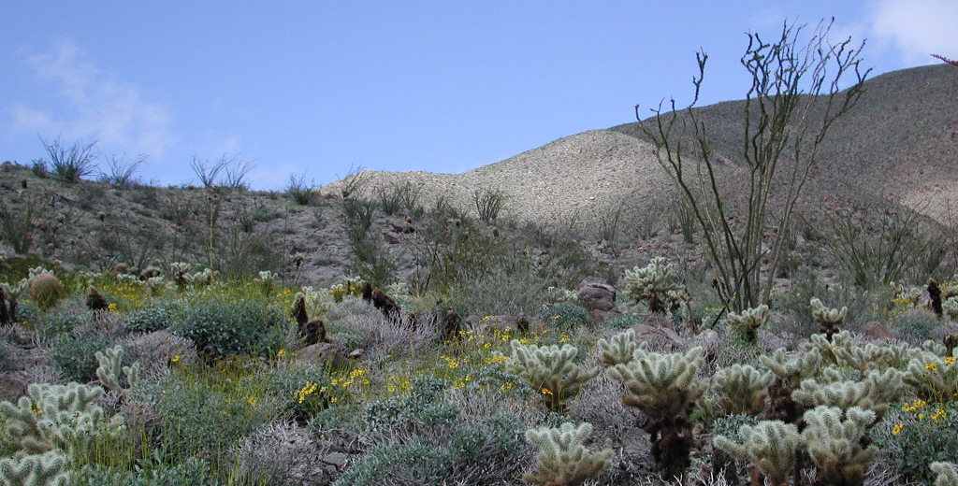
Community assembly and dis-assembly

Slide 2
Topics for today
Assembly Rules: concepts, conflicts
Early work: plant succession from the 1910’s (and relevance in the 2010’s)
Diamond’s biogeographical work in the 1970’s
Simberloff’s response and the null model approach
Current thinking about community assembly
Dis-assembly: predicting what we will lose
General principles of which species will go
Ecosystem consequences of species losses

Slide 3
Trivial examples of assembly
Predators cannot invade a habitat where there are no prey
Abiotic conditions limit species ranges (e.g. temperature, presence of soil, etc)

Slide 4
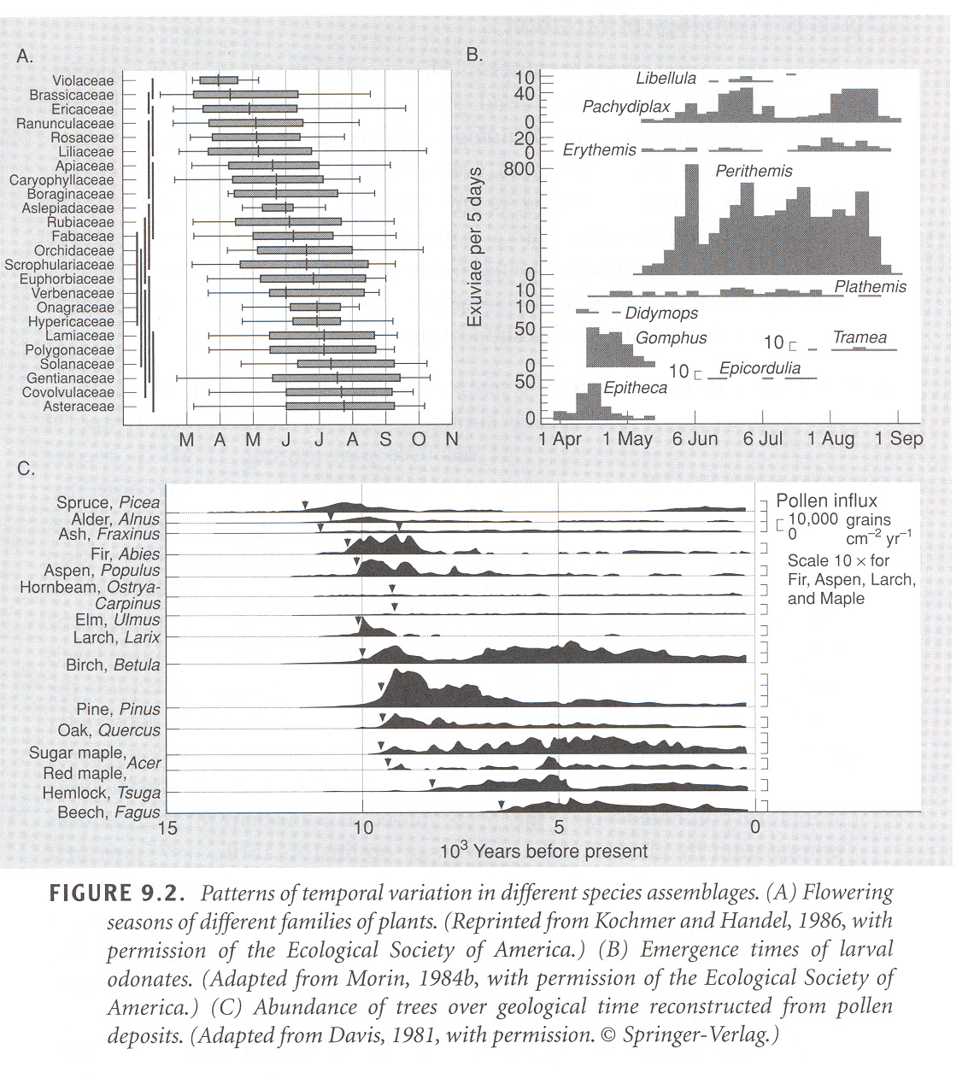
Temporal variation in assembly

Slide 5
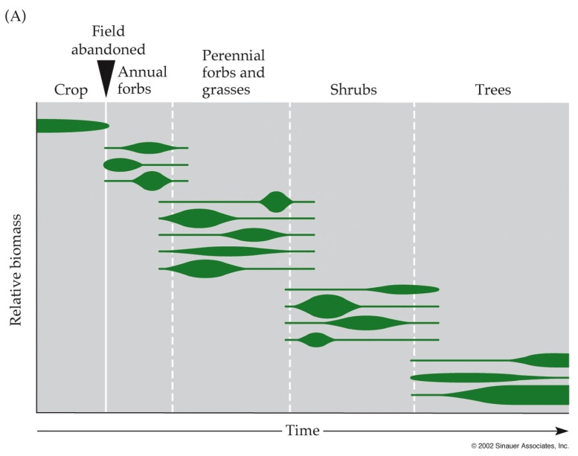
Successional change: directed or random?
Frederick Clements (1916, 1928)
“Organismal view”, or “super-organism concept” of communities
Each seral stage is discrete
Endpoint is predictable
Biotic interactions paramount

Slide 6
Successional change: directed or random?
Henry Gleason (1917, 1926, 1927)
“Continuum view”, or “individualistic concept”
Coincidence, dynamic processes important
Seral stages, like communities, intergrade
Endpoint is spatially variable; abiotic conditions and chance migration important

Slide 7
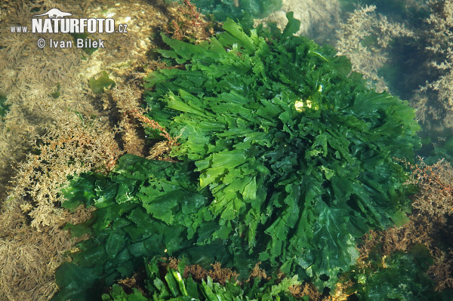
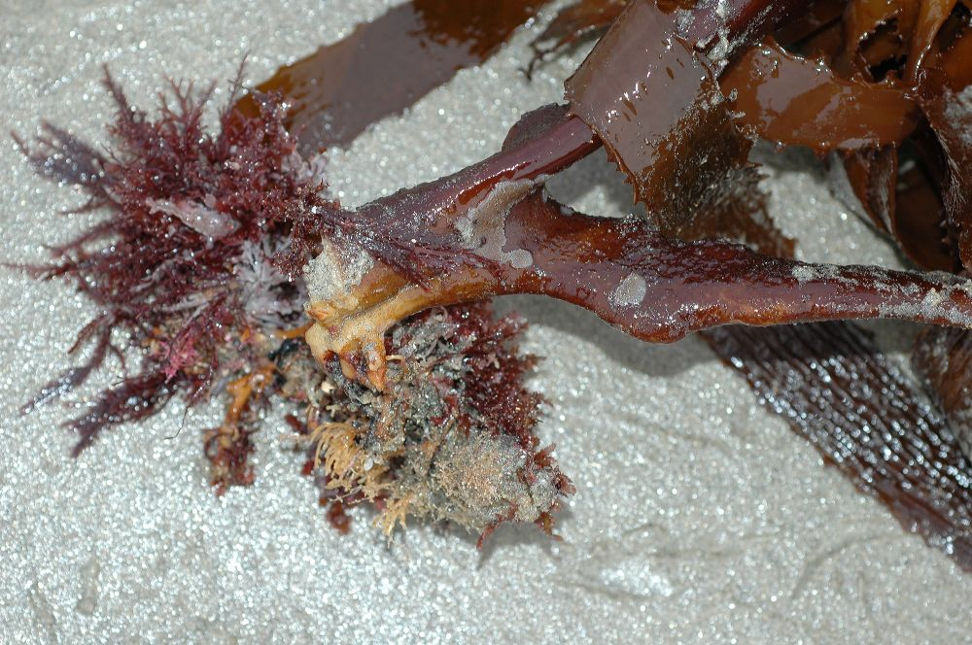
History matters
Priority rules: species that arrive first can potentially exclude later-arriving species

Slide 8
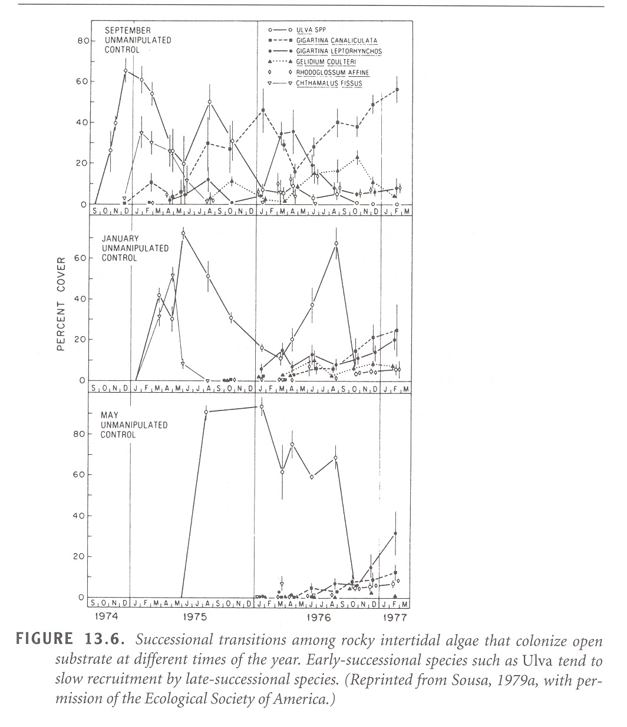
Successional sequence in rocky intertidal changes over the year, because of seasonal availability of recruits

Slide 9
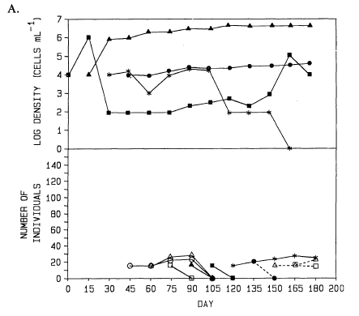
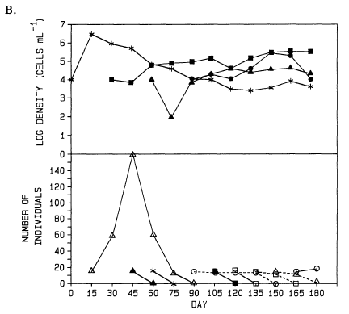

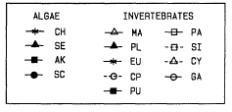
Outcome depends on order of assembly in experimental communities of algae and inverts
Drake 1991

Slide 10
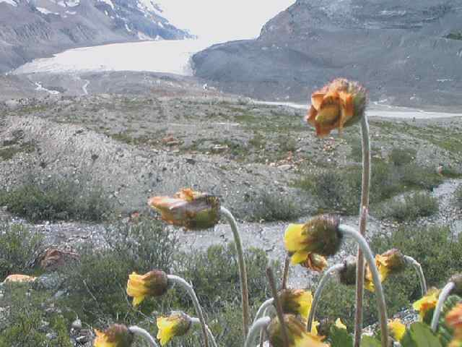
Species affect what comes later
Connell and Slatyer: mechanisms of succession
Facilitation
Inhibition
Tolerance

Slide 11
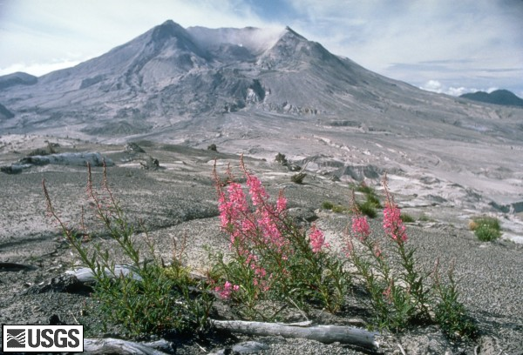
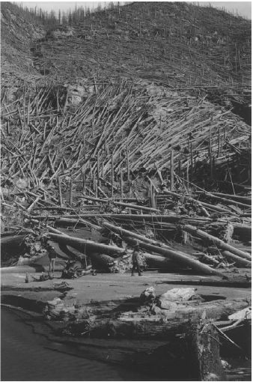
Mt. St. Helens and the importance of biological legacies and species traits

Slide 12
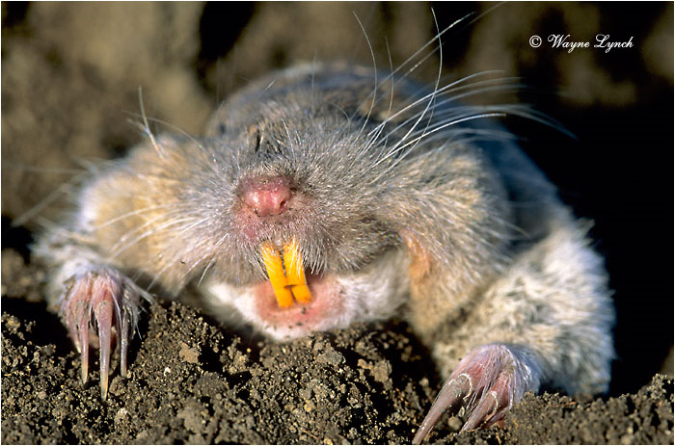
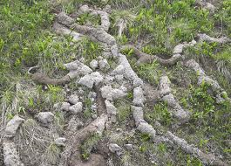
Pocket gophers survived underground; soil (including seeds, mycorrhizae) moved above ground by digging
Allen and MacMahon 1988

Slide 13

Self-pollinating, abiotically dispersed N-fixer Lupine an early colonist
Changes in soil N facilitated entry of other plants
Bare
Lupine
mg/kg soil
John Bishop

Slide 14
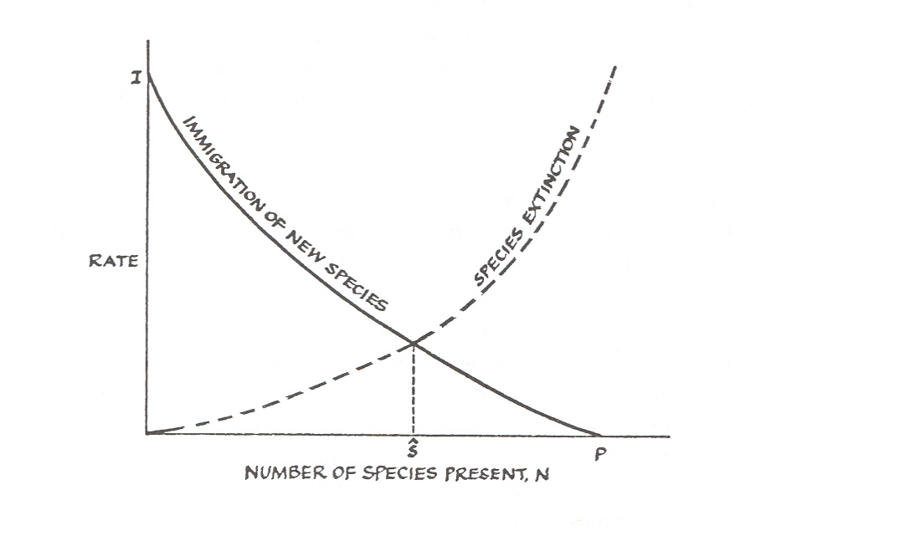
Community assembly: a reminder of Island Biogeography
MacArthur and Wilson, 1967

Slide 15
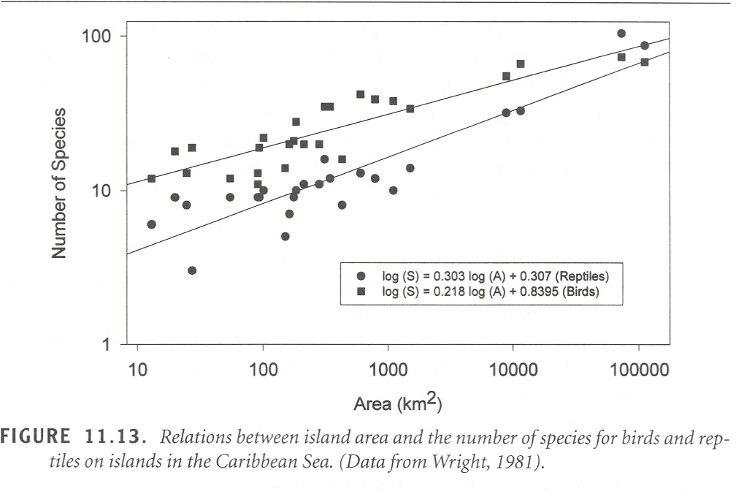

Slide 16
Jared Diamond, Assembly of Species Communities (1975)
“through diffuse competition, the component species of a community are selected, and coadjusted in their niches and abundances, so as to fit with each other and to resist invaders”

Slide 17
Species can be categorized
Islands vary in S (species richness)
J, the incidence of occurrence of particular species on a islands of a certain S-class
Incidence functions range from high-S species (only on most species-rich islands) through A-, B-, C-, and D-tramps (on species-rich islands and on increasing numbers of more species-poor-islands) and super-tramps (only on species poor-islands)

Slide 18
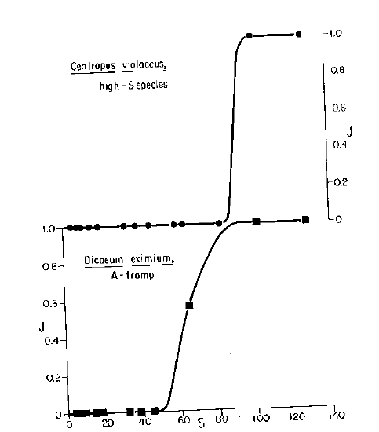
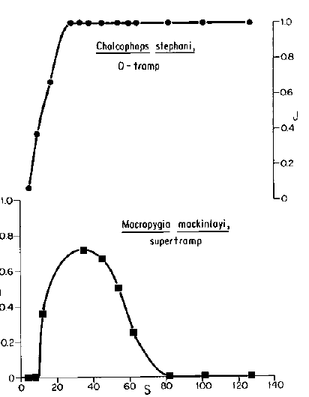
Example incidence functions

Slide 19
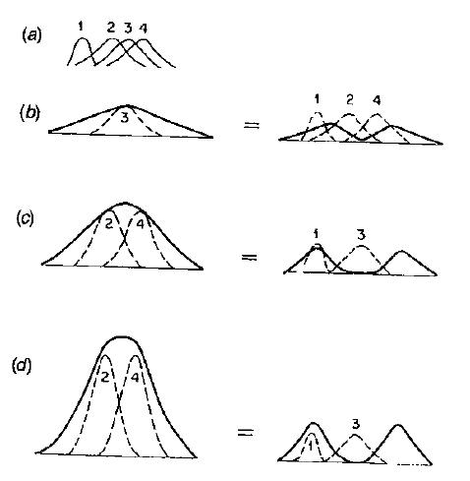
How competition structures community assembly
Tramps are r selected, outcompeted by high-S species
Resource usage (a) determines how many species can coexist (1, 2, or 3 in b, c, d respectively)

Slide 20
Assembly Rules
Only some combinations exist, some never do
Permissible combinations resist invaders
Stable combination types vary between island sizes
(there were more)

Slide 21
The debate
Connor and Simberloff 1979: “we show that every assembly rule is either tautological, trivial, or a pattern expected were species distributed at random”

Slide 22
C&S built null models to test whether species distributions differ from simulations based on:
islands have a particular (observed) S
species occur on a given number of islands (observed)
species restricted to islands of particular size
Differences of opinion (between C&S and others) regarding whether species within guilds could be considered equivalent, on the importance of geographic range, and on exact test statistics used
Main (and valid) complaint: that even should a pattern be shown, it does not mean that there was competition

Slide 23
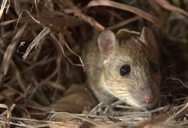
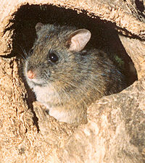
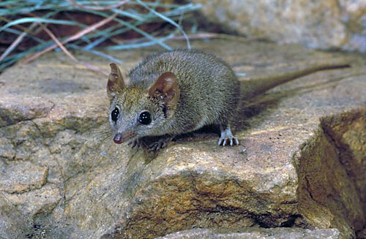
Examples of some rules with at least some support (depending on who you ask)
Fox 1987 (also Fox and Brown): there is a higher probability that each species entering a community will be drawn from a different group/genus/guild until each group is represented, before the rule repeats
Notes:
Rat, mouse (Pseudomys), dasyurid (Antechinus)

Slide 24
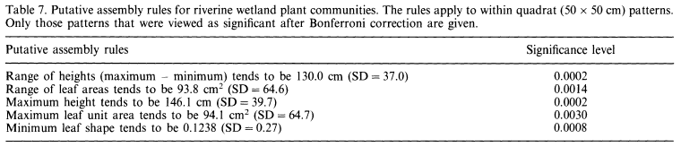
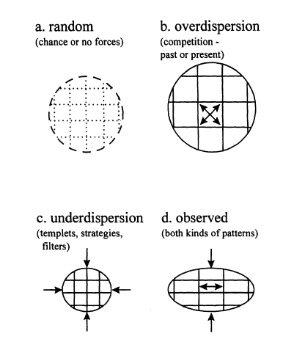
Assembly of wetland communities depends on a series of morphological traits
“The rules are clearly not very compelling....[they] may be no more than simple descriptive expectations on the morphology of species that reflect the particular environmental constraints of the wetlands...”
Weiher et al. 1998

Slide 25
Are assembly rules useful?

Slide 26
Community dis-assembly
The non-random process of species declines and losses
Which species are likely to be lost? (see examples in Zavaleta et al 2009)
Small geographic range
Large body size (animals) or small size (plants)
Slow population growth, late maturation, etc
Specialists

Slide 27
Community dis-assembly
Species lost will impact future losses (eg if a keystone species or obligate mutualist is lost)
Trajectory depends on timing, ie if there is time for compensation after an interactor is lost
Which species are lost depends on extinction drivers at the local scale

Slide 28
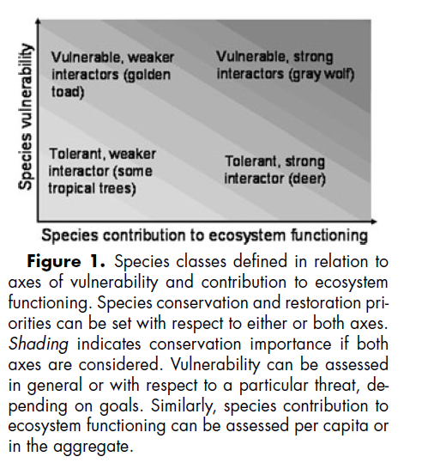
Are vulnerability and functioning associated?
Large size (eg large trees, carbon storage; some large predators that are keystone)
Specialization (eg pollinators)
Zavaleta et al 2009

Slide 29
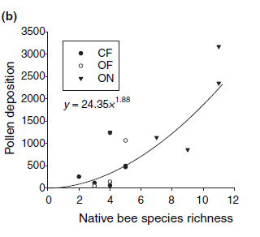
Body size and ecosystem function
Large-bodied bees lost first
More speciose communities have greater pollen deposition (right)
Larsen et al 2005

Slide 30
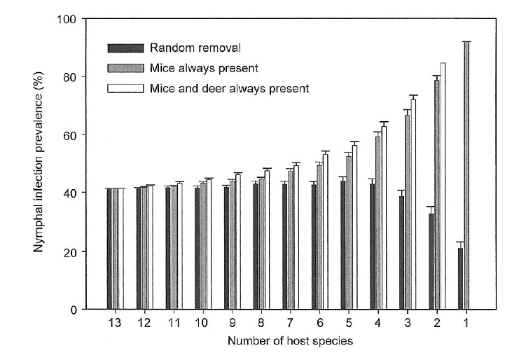
Loss of species diversity associated with higher risk of Lyme disease transmission (a simulation based on field data)
Disease risk depends on species identities lost
Ostfeld & LoGuidice 2003

Slide 31
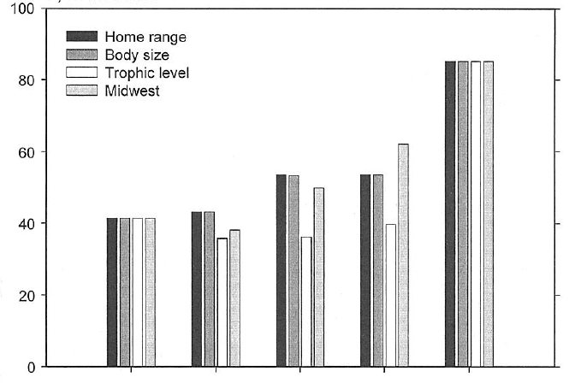

Simulations based on likely order of losses
Results depend on the order of loss
Species removed in decreasing order of body size, home range size, trophic level, or based on data from fragmented habitat in midwestern US

Slide 32
Are there rules in community ecology?
Lawton 1999: Community Ecology is a Mess
McGill et al 2002 suggest we consider:
Functional traits (rather than species identities)
Environmental gradients (rather than just biotic interactions)
The interaction milieu (not just pairs of species)
Performance currencies (rather than population increase)
...to return to the concepts of fundamental and realized niche

Slide 33
Are there rules in community ecology?
Lawton 1999: Community Ecology is a Mess
Vellend 2010 suggests a process approach borrowed from population genetics:
Selection (where species identity can be considered the target)
Drift (aka the neutral theory)
Speciation (incorporate biogeographic context)
Dispersal (island biogeography, metapopulation and metacommunity dynamics)
...to allow more rigorous theory to be developed

Slide 34
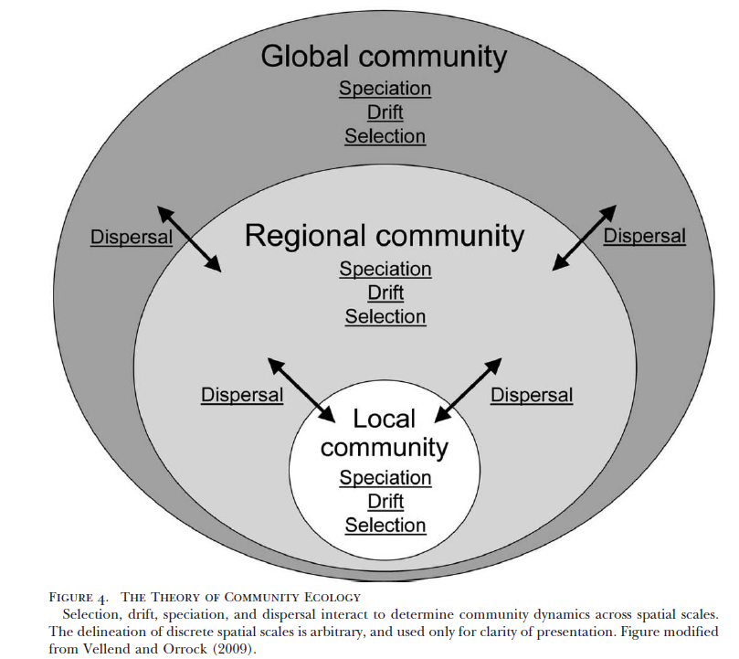

Slide 35
The oft-cited recalcitrance of community ecology to generally applicable theory seems like a fair assessment if the goal is to be able to make general predictions about how particular processes have shaped real ecological communities. If the goal is to make general statements about the fundamental processes that can underlie community dynamics and the possible ways in which these can interact, then community ecology appears to be in excellent shape.
Vellend 2010

Slide 36
Reading for next week
Simberloff, D. S. and E. O. Wilson. 1969. Experimental zoogeography of islands: the colonization of empty islands. Ecology 50: 278-296.
NO write up or modern papers—brief discussion of Simberloff and Wilson, and then discussion of your outlines!

Slide 37
As always: Morin, P. J. 1999. Community Ecology. Blackwell Publishing
Weiher, E. and P. A.Keddy, eds. 1999. Ecological Assembly Rules: Perspectives, advances, retreats. Cambridge University Press.
Allen, M. F. and J. A. MacMahon 1988. Direct VAM mycorrhizal inoculation of colonizing plants by pocket gophers (Thomomys talpoides) on Mount St. Helens. Mycologia 80:754-756.
Connor, E. F. and D. Simberloff. 1979. The assembly of species communities: Chance or competition? Ecology 60: 1132-1140.
Diamond, J. M. 1975. Assembly of Species Communities. Pp. 342-445 in M. L. Cody and J. M. Diamond, eds. Ecology and Evolution of Communities. Harvard University Press.
Drake, J. A. 1991. Community assembly dynamics and the structure of a n experimental species ensemble. Am Nat 137: 1-126
Fox, B. J. 1987. Species assembly and the evolution of community structure. Evolutionary Ecology 1: 201-213.
Fukami, T. 2010. Community assembly in space. Chapter 4 in H. A. Verhoef and P. J.Morin . Community Ecology: Processes, Models, and Applications.
Larsen, T.H., M.N.Williams & C.Kremen. 2005. Extinction order and altered community structure rapidly disrupt ecosystem functioning. Ecol. Lett. 8: 538– 547.
Lawler, S. P. and P. J. Morin. 1993. Temporal overlap, competition, and priority effects in larval anurans. Ecology 74: 174-182
McGill, B. J., GB.J. Enquist, E. Weiher, M. Westoby. 2006. Rebuilding community ecology from functional traits. Trends in Ecology and Evolution 21: 178-185
Memmott, J., N. M. Waser, and M. V. Price. 2004. Tolerance of pollination networks to species extinctions. Proc. R. Soc. Lond. B 271, 2605–2611
Ostfeld, R. S. and K. LoGuidice. 2003. Community Disassembly, Biodiversity Loss, and the Erosion of an Ecosystem Service. Ecology 84 1421-1427.
Vellend, M. 2010.Conceptual synthesis in community ecology. Quarterly Review of Biology 85:183-206.
Weiher, E., G.D.P. Clarke. P. A. Keddy. 1998. Community Assembly Rules, Morphological Dispersion, and the Coexistence of Plant Species. Oikos 81: 309-322
Zavaleta, E., J.Pasari, J. Moore, D. Hernandez, K. B. Suttle, and C. C. Wilmersa. 2009. Ecosystem responses to community disassembly. Ann. N.Y. Acad. Sci. 1162: 311–333.

