Slide 1
Exploitation
Positive effect on eater, negative on eatee
Includes predation, parasitism, herbivory
+

Slide 2
Topics for today
Patterns arising from exploitation
Models of exploitation: Lotka-Volterra equations and predator-prey cycles
  When are cycles stable?
Food webs as a way of thinking about interactions in communities
  Chain length, connectance, modularity, and what they mean for stability

Slide 3
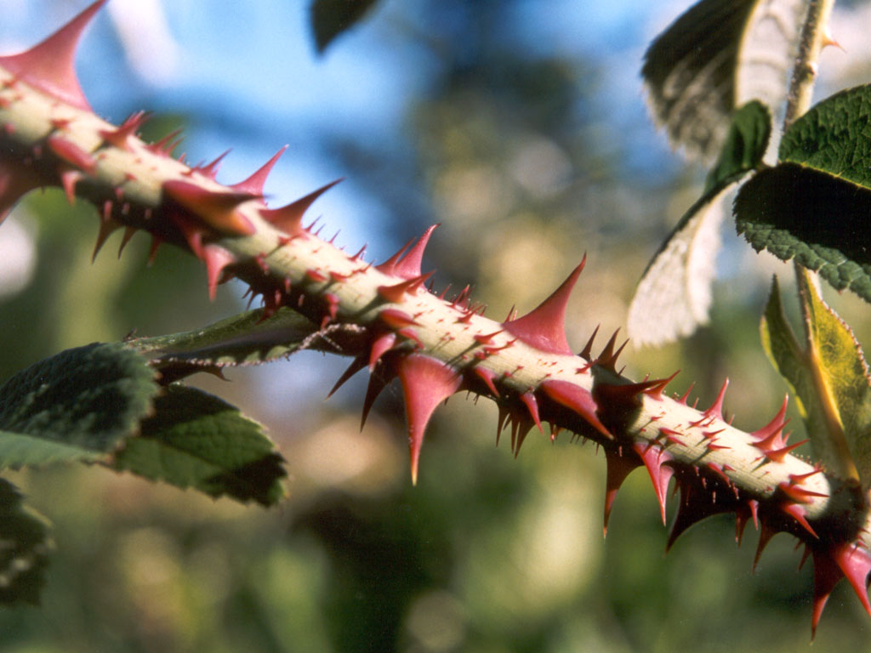
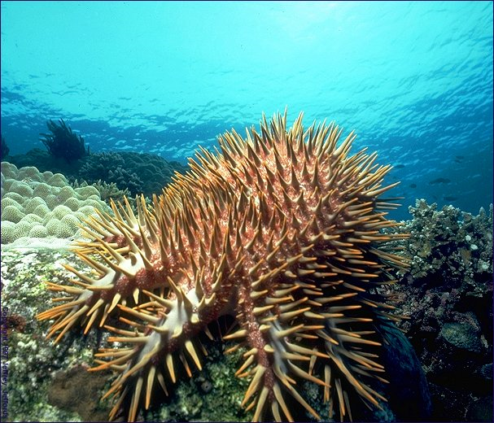
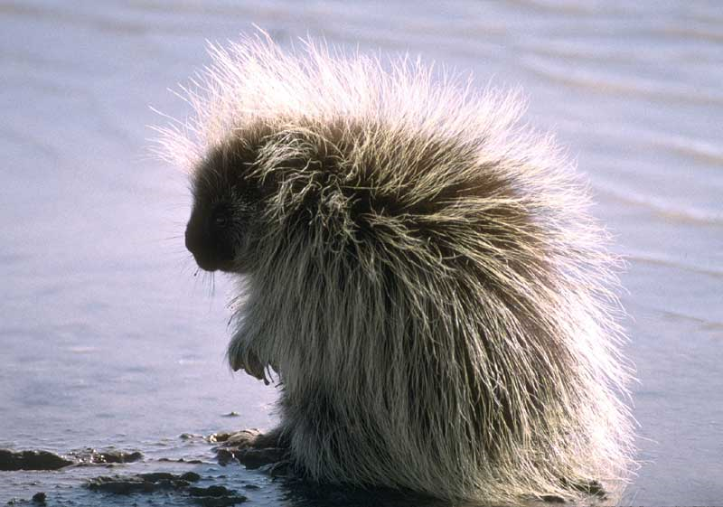

Slide 4
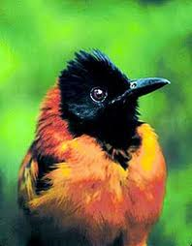
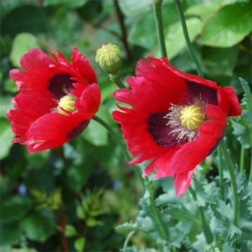
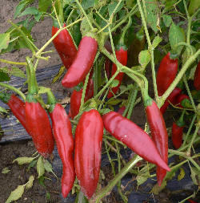
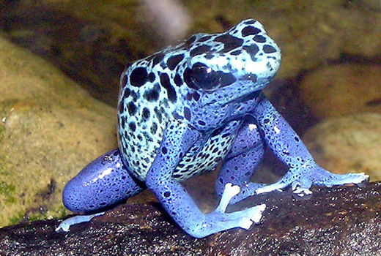

Slide 5
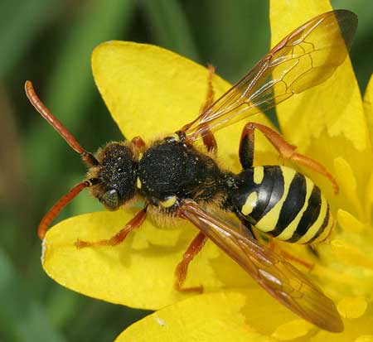
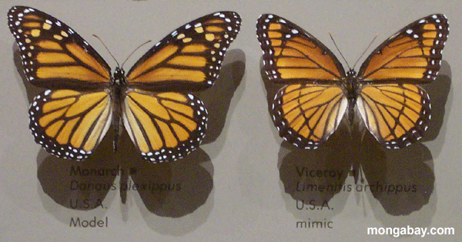
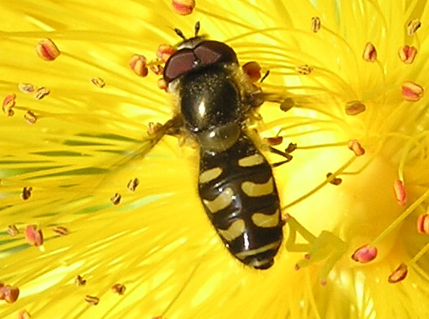
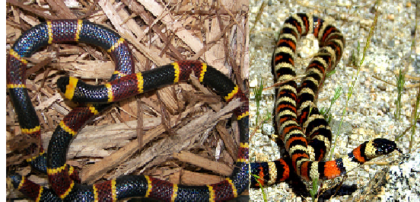
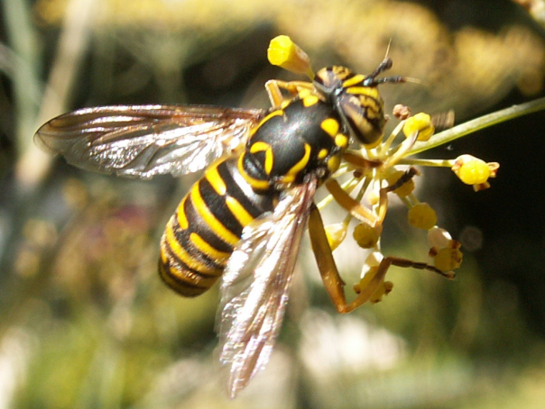

Slide 6
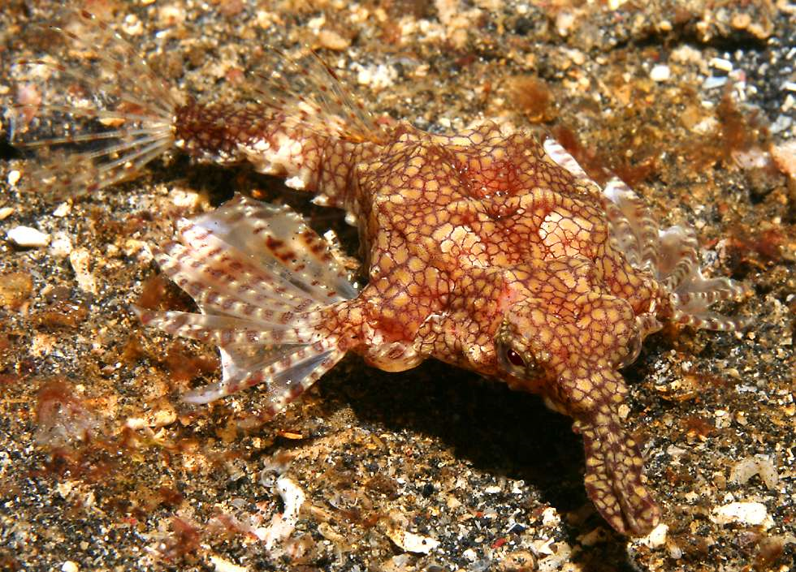
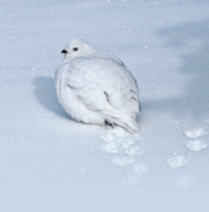
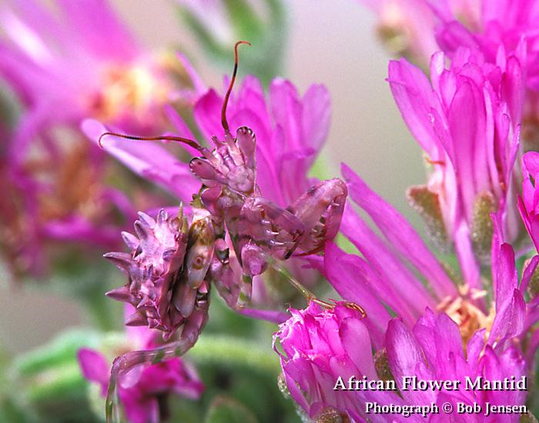
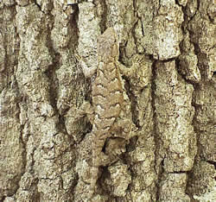

Slide 7
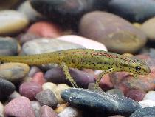
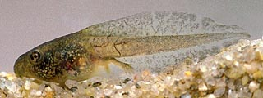
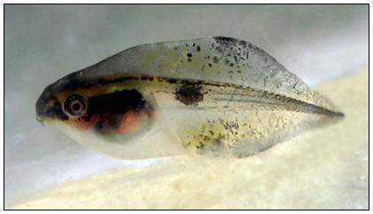
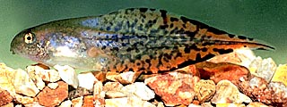
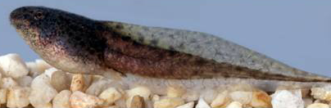
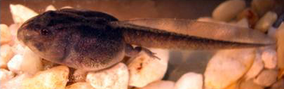
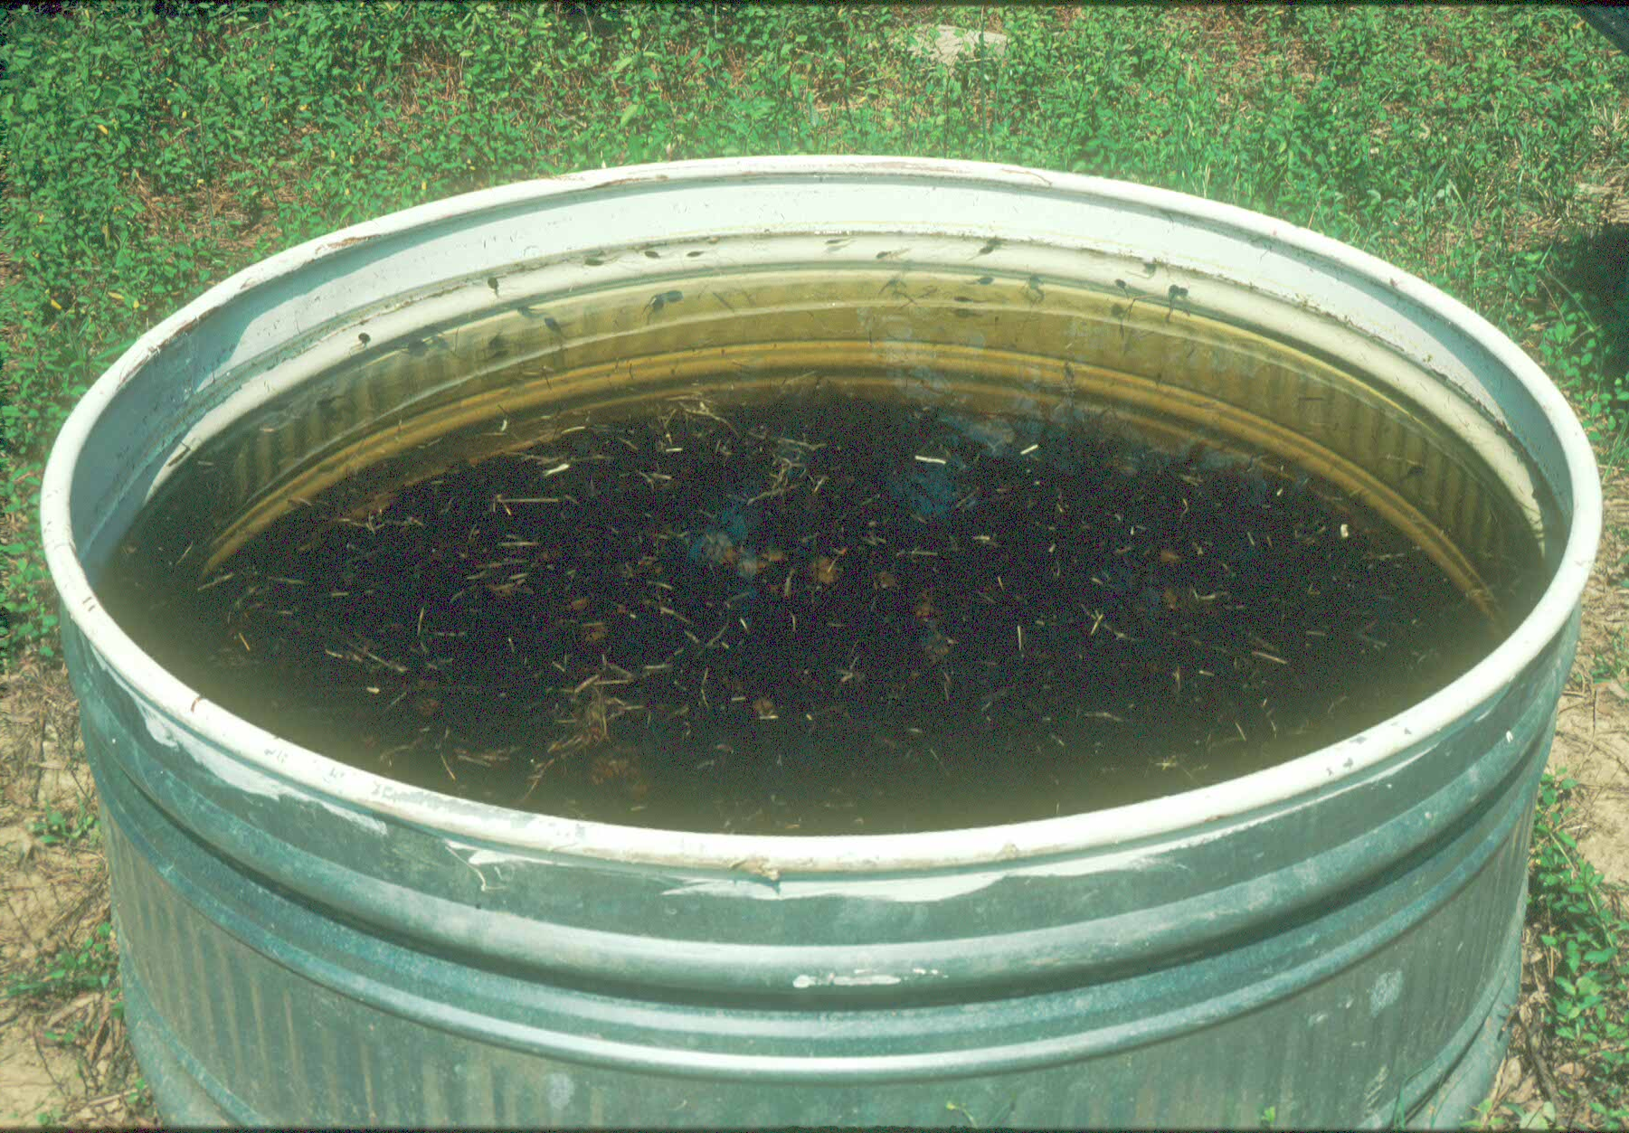
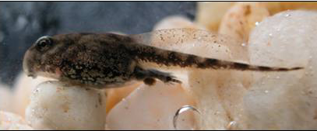
How does predation affect diversity and abundance of prey?
Notophthalmus viridescens dorsalis
Pseudacris crucifer
Scaphiopus holbrooki
Hyla gratiosa
Rana sphenocephala
Bufo terrestris
Hyla chrysoscelis
Morin 1983

Slide 8
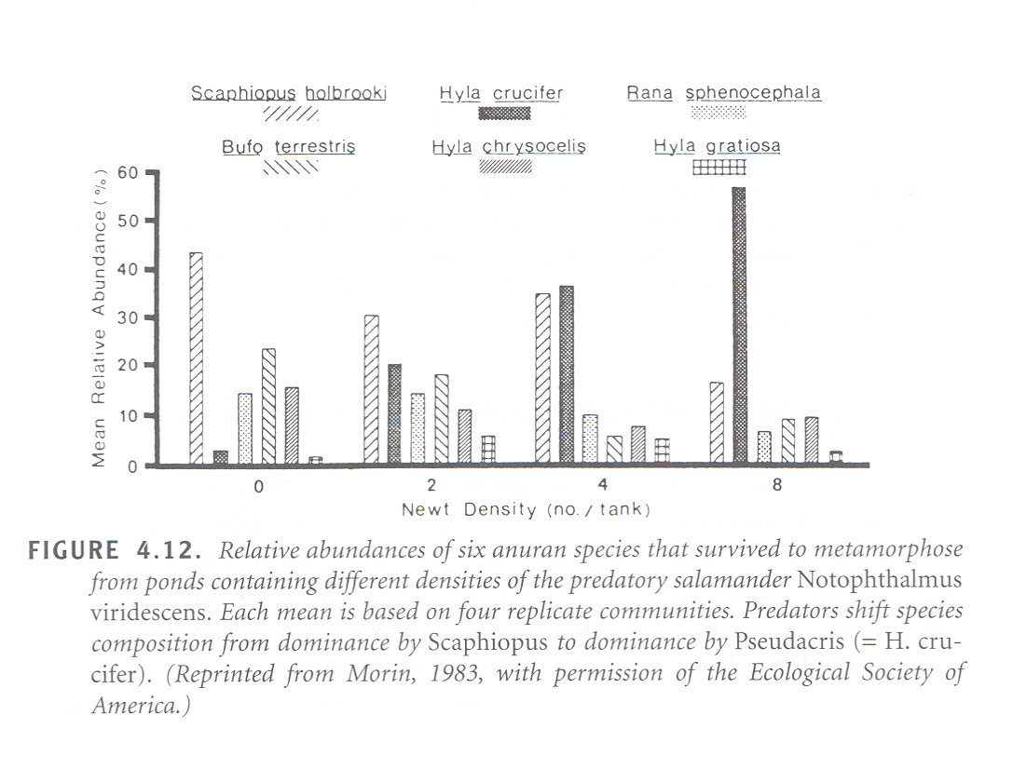

Slide 9
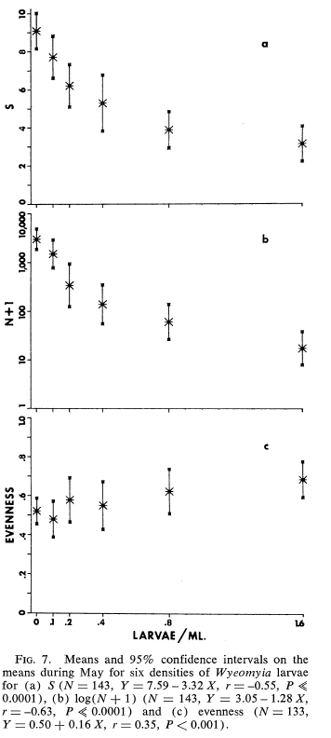
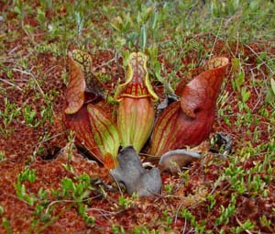
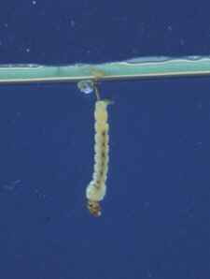
Richness
Abundance
Mosquito larvae as predators on protists in pitcher plants
Evenness
Addicott 1974

Slide 10
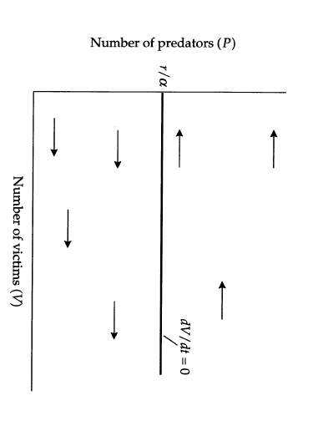
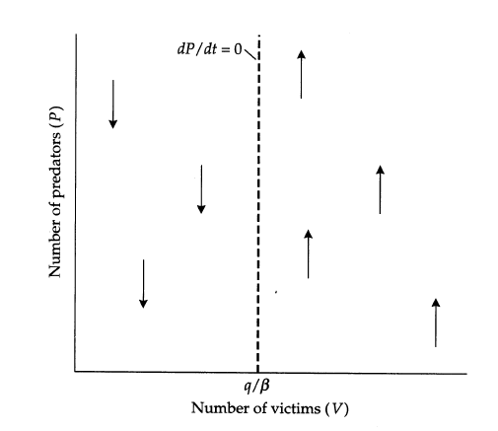
Lotka volterra approach to predation
r is victim growth rate
α is capture efficiency of predators
q is per capita death rate of predators
β is conversion efficiency of predators (to per capita growth)

Slide 11
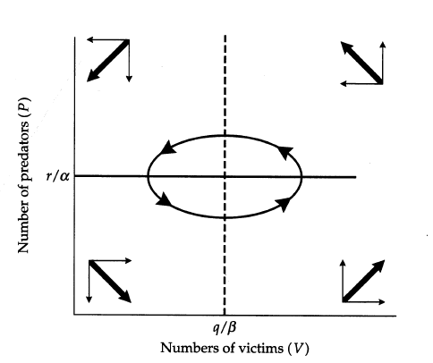
Lotka volterra approach to predation

Slide 12
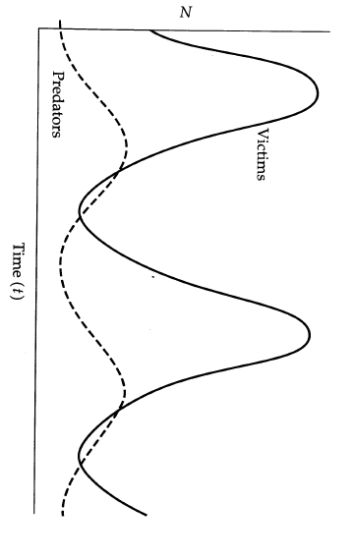

Slide 13
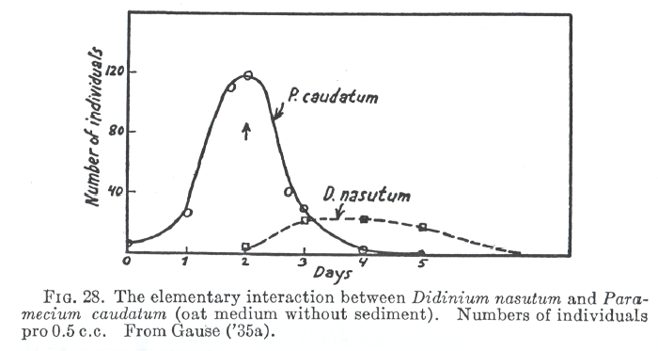
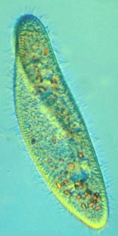
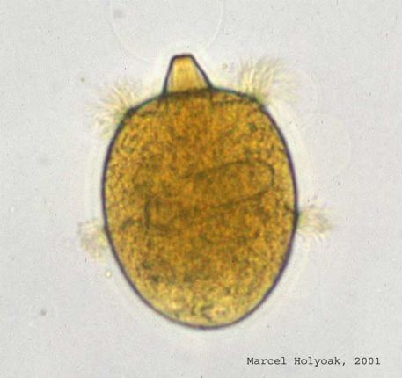
Predator-prey cycles: Gause showed extinction

Slide 14
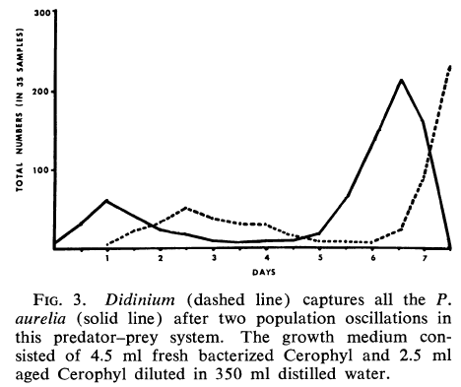
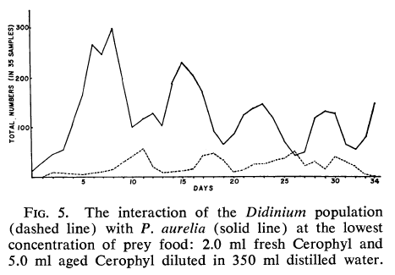
Coexistence (and cycles) possible when:
Refuges exist (space or physical hiding places)
Prey are food limited
Luckinbill 1974

Slide 15
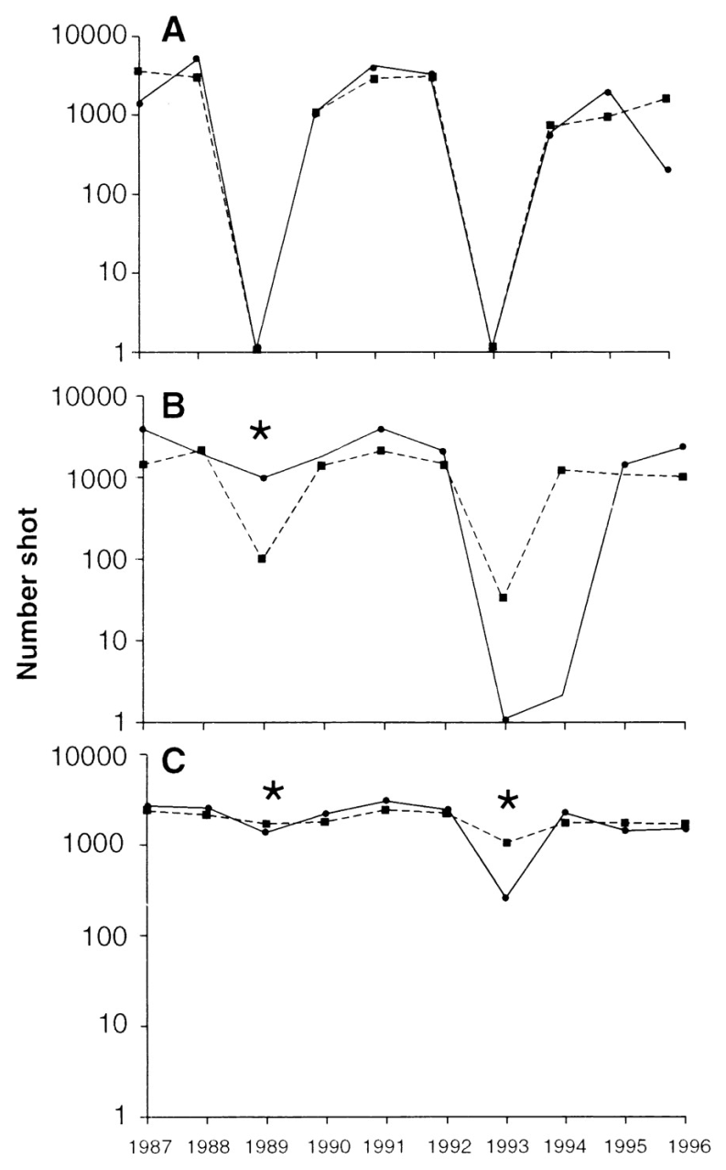
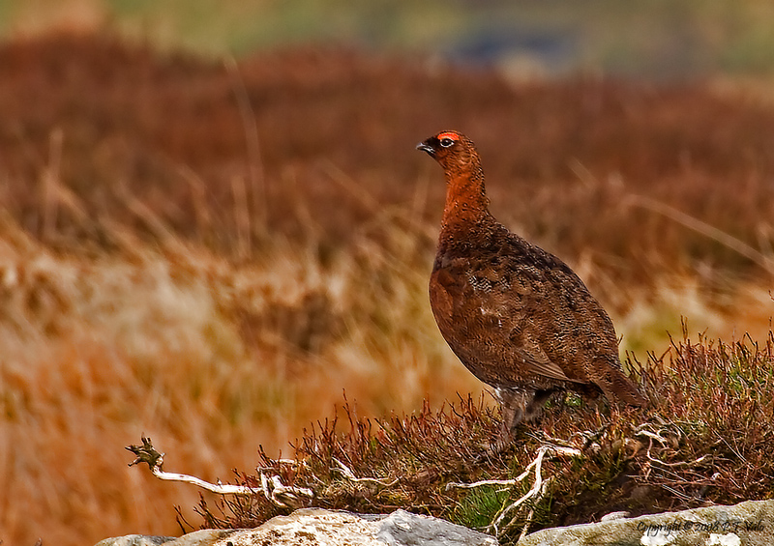
Red Grouse and parasites
control
* = treatments to remove worms
Hudson et al 1998

Slide 16
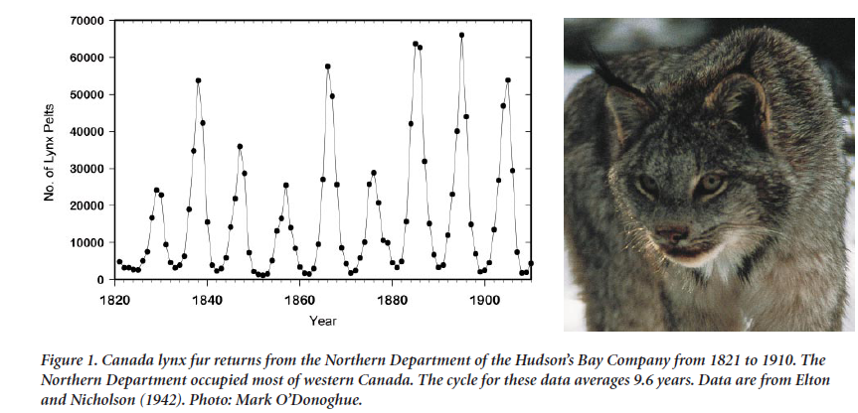
Predator-prey cycles: hare and lynx
Krebs et al 2001

Slide 17
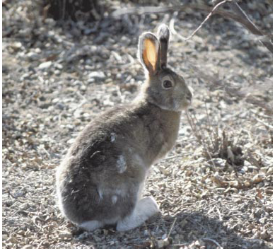
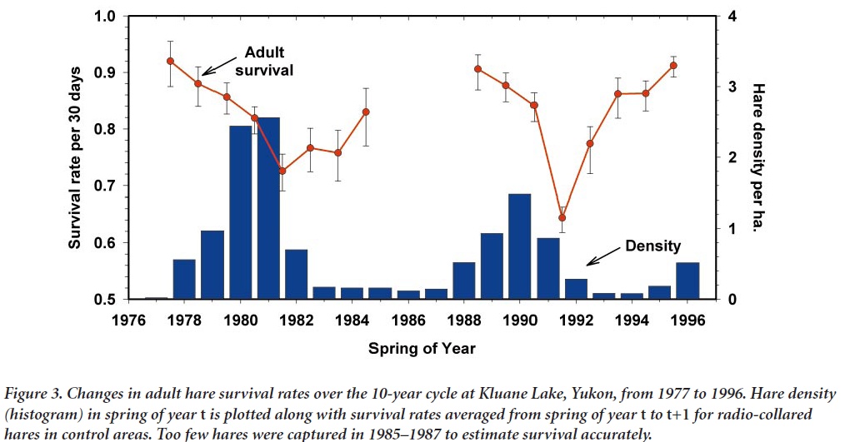

Slide 18
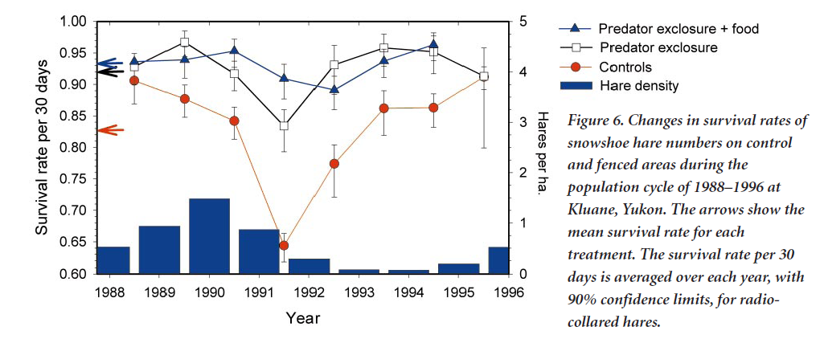
Cycles due to a combination of predator and food effects

Slide 19
Basic predator-prey…questions?

Slide 20
Why the world is green: Hairston, Smith, and Slobodkin 1960
With likely regulating factor indicated for each trophic level
competition
Predators
predation
Herbivores
Decomposers
competition
competition
Producers

Slide 21
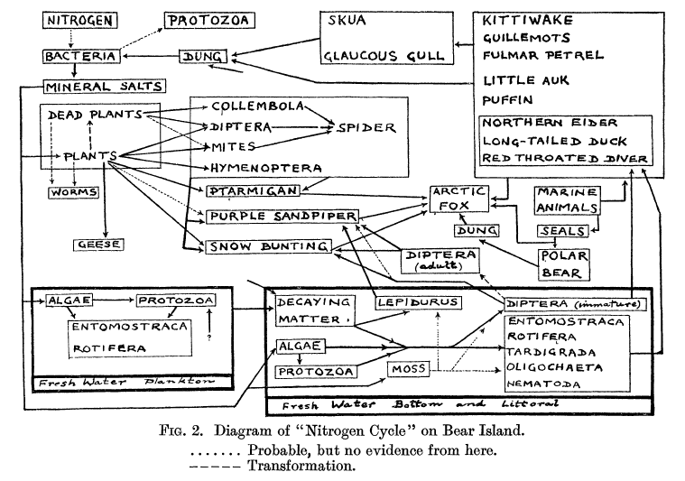
Food web of Bear Island: Summerhayes and Elton 1923, Journal of Ecology, 11, 214-286

Slide 22
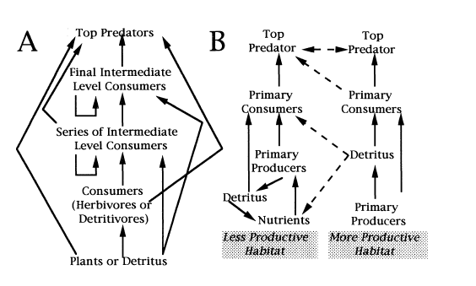
Omnivory and spatial subsidies are probably fairly common
Polis and Strong 1996

Slide 23
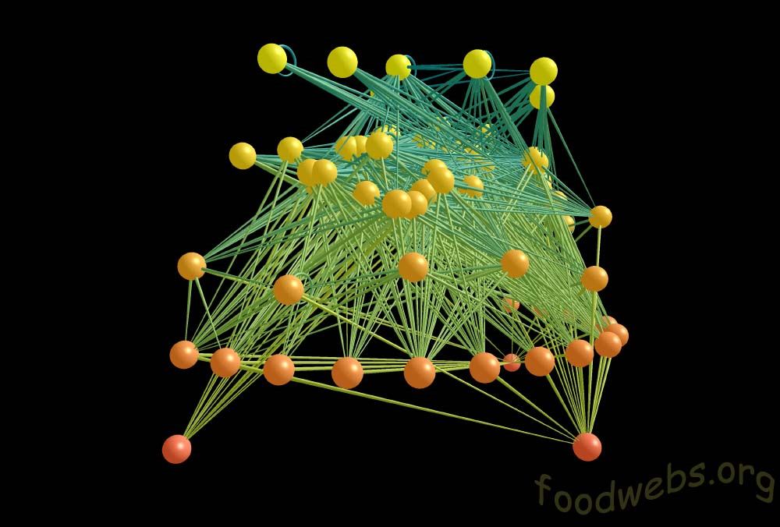
Caribbean reef trophic web

Slide 24
Source web: species that feed on Pine
Richards, 1926.
Sink web: species fed on by Pisaster.
Paine, 1966.
Community web: Morgan’s Creek.
Minshall, 1967.
Examples from Morin 1999

Slide 25
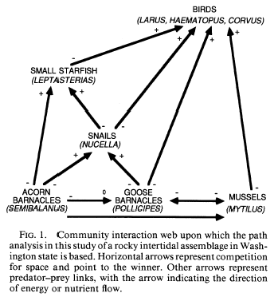
Interaction web: includes type of relationship (+/-), and often interaction strength
Wooton

Slide 26
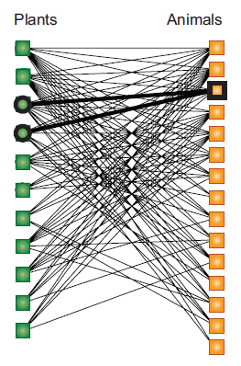
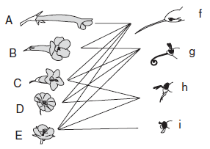
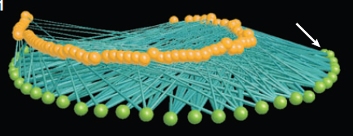
Mutualist webs: bipartite web, where currency in one direction is food, but in the other it’s some benefit (pollination, dispersal)
Bascompte and Jordano 2007

Slide 27
Most webs are inaccurate
Missing links/species
No indication of interaction strength or abundance

Slide 28


A North Atlantic Web

Slide 29
Complexity and stability
Food chains tend to be short, especially in two-dimensional habitats (grasslands; vs. 3-d habitats like lakes and forests)
Chains are longer in more productive environments

Slide 30

Chains longer in more productive environments
Figure 6.14. Number of species, number of links, and food chain length in tree hole communities subjected to different levels of nutrient inputs for 48 weeks. Different levels of productivity, denoted high, med, and low, correspond to 1x, 0.1x, and 0.01x of normal levels. (Reprinted from Jenkins et al. (1992), with permission from Oikos).

Slide 31




Longer food chains have less stable population dynamics in experimental communities
Notes:
But note that these microcosms are still very short chains!!

Slide 32

Species richness and temporal variability in communities negatively related
In general, the skew in distribution of interaction strengths (e.g. few strong, many weak interactions) is thought to provide stability to more complex communities ….a recent meta-analysis.
Jiang and Pu 2009

Slide 33
Patterns in Food Webs
Connectance in webs declines with species richness
  Where connectance is the proportion of possible links that are realized: L/[S(S-1)/2]
  L = # links, S = # species
  [S(S-1)/2] is the number of possible links, excluding cannibalism
More connected = more stable

Slide 34
Patterns in Food Webs
Webs in variable environments tend to be less connected
Briand 1983

Slide 35
Patterns in Food Webs
Nestedness: the tendency for a core group of interactors to occur within a web; generalists that interact with specialists for instance.
More nested = more stable

Slide 36

Patterns in food webs
Nested
Random
Modularity and nestedness
Bascompte and Jordano 2007

Slide 37
Patterns in food webs
Compartments or Modules: subgroups of strongly interacting species within larger food webs
More modular = more stable

Slide 38

Figure 1 Graphical display of the results for the Chesapeake Bay food web with 45 taxa
and weighted by interaction strength. Circles indicate compartment boundaries and numbers
identify taxa (yellow, within compartment A; blue, within compartment B). Arrows indicate
interactions between taxa (solid red, within compartment; dashed green, between
compartments; thickness indicates rank of associated interaction strength) and point from
predator to prey
Krause et al 2003

Slide 39



Trophic vs.mutualistic webs trophic webs more modular (compartmentalized), less nested; connectance decreases slower with increased richness
Thebault and Fontaine, 2010

Slide 40

Different web features stabilize different types of webs
Size of arrow is “strength” from path analysis
Black is positive,
Red is negative
Thebault and Fontaine, 2010

Slide 41
Applications of food webs
Agroecosystems (biocontrol)
Fisheries (trophic cascades)
Lakes (water quality, fisheries)
Toxicology (bioaccumulation, remediation)
Conservation (biological invasions)

Slide 42
Main points: what food webs can tell us
Productivity can impact food web stability
The structure of webs also impacts stability and resilience
Complexity of interactions within webs can inform management decisions

Slide 43
Reading for next week
Brooks & Dodson, 1965. On the impact of predation on lake communities.

Slide 44
Additional figs and references from:
Mittlebach, G. G. 2012. Community Ecology. Sinauer Publishing.
Morin, P. J. 1999. Community Ecology. Blackwell Publishing
Polis, G. A. And K. O Winemiller, eds. 1996. Food webs: Integration of Patterns and Dynamics. Chapman and Hall.
Addicott J. F. 1974. Predation and prey community structure: an experimental study of the effect of mosquito larvae on the protozoan communities of pitcher plants. Ecology 55: 475-492
Bascompte, J. And P. Jordano. 2007. Plant-animal mutualistic networks: the architecture of biodiversity. Ann. Rev. Ecol. Evol. Syst. 38: 567-593.
Carson W. P. and R. B. Root. 2000. Herbivory and plant species coexistence: Community regulation by an outbreaking phyophagous insect. Ecological Monographs 70: 73-99.
Cohen, J. E., T. Jonsson, and S. R. Carpenter. 2003. Ecological community description using the food web, species abundance, and body size. PNAS 100: 1781-6.
deRuiter, P.C., A-M Neutel, and J. C. Moore. 1995. Energetics, Patterns of Interaction Strengths, and Stability in Real Ecosystems. Science 269: 1257-60.
Elle, E., S. L. Elwell, G. A. Gielens. 2012. The use of pollination networks in conservation. Botany 90: 525-534.
Elton C. and M. Nicholson. 1942. The Ten-Year Cycle in Numbers of the Lynx in Canada. J. Anim. Ecol. 11: 215-244.
Hairston, N. G. Jr., F. E. Smith and L. B. Slobodkin. 1960. Community structure, population control, and competition. Am Nat 94: 421-425
Hudson, P. J., A. P. Dobson and D. Newborn. 1998. Prevention of population cycles by parasite removal. Science 282: 2256-2258
Kaunzinger, C. M. K. and P. J. Morin. Productivity controls food chain properties in microbial communities. Nature 395: 495-497.
Krause AE, Frank KA, Mason DM, Ulanowicz RE, TaylorWW. 2003. Compartments revealed in food-web structure. Nature 426:282–285.
Krebs, C. J., R. Boonstra, S. Boutin, A. R. E. Sinclair. 2001. What drives the 10-year cycle of snowshoe hares? Bioscience 51: 25-35.
Luckinbill, L. S. 1973. Coexistence in Laboratory Populations of Paramecium aurelia and Its Predator Didinium nasutum. Ecology 54: 1320-1327.
Luckinbill, L. S. 1974. The effects of space and enrichment on a predator-prey system. Ecology 55: 1142-1147.
Morin, P. J. 1983. Predation, competition, and the composition of larval anuran guilds. Ecol. Monogr. 53: 119-138.
Polis, G. A.and D. R. Strong. Food web complexity and community dynamics. Am Nat 147: 813-846.
Raghu, S. and C. Walton. 2007. Understanding the ghost of Cactoblastis past: historical clarifications on a poster child of classical biological control. Bioscience 57: 699-705.
Thebault, E. And C. Fontaine. 2010. Stability of ecological communities and the architecture of mutualistic and trophic networks. Science 329: 853-856.
Yoshida, T., L. E. Jones, S. P. Ellner, G. F. Fussmann, and N. G. Hairston Jr. 2003. Rapid evolution drives ecological dynamics in a predator–prey system. Nature 424: 303-6.

