Slide 1
Community Ecology
The study of how abundance, diversity, and distributions of species vary due to interactions with other organisms and variation in abiotic conditions

Slide 2
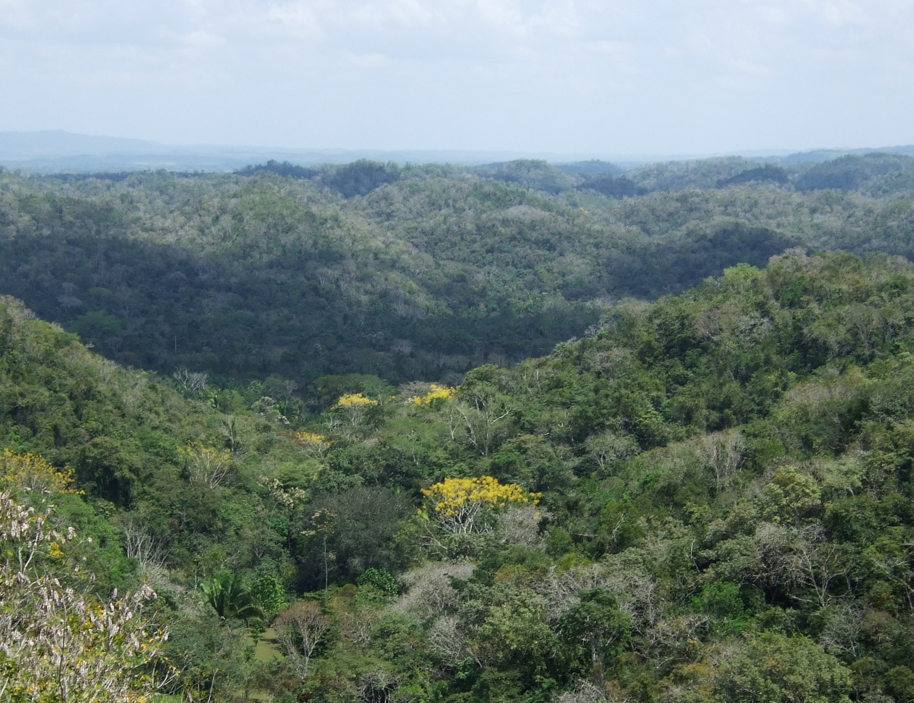
A traveler should be a botanist,
for in all views plants form
the chief embellishment
Charles Darwin,
The Voyage of the Beagle
Belize

Slide 3
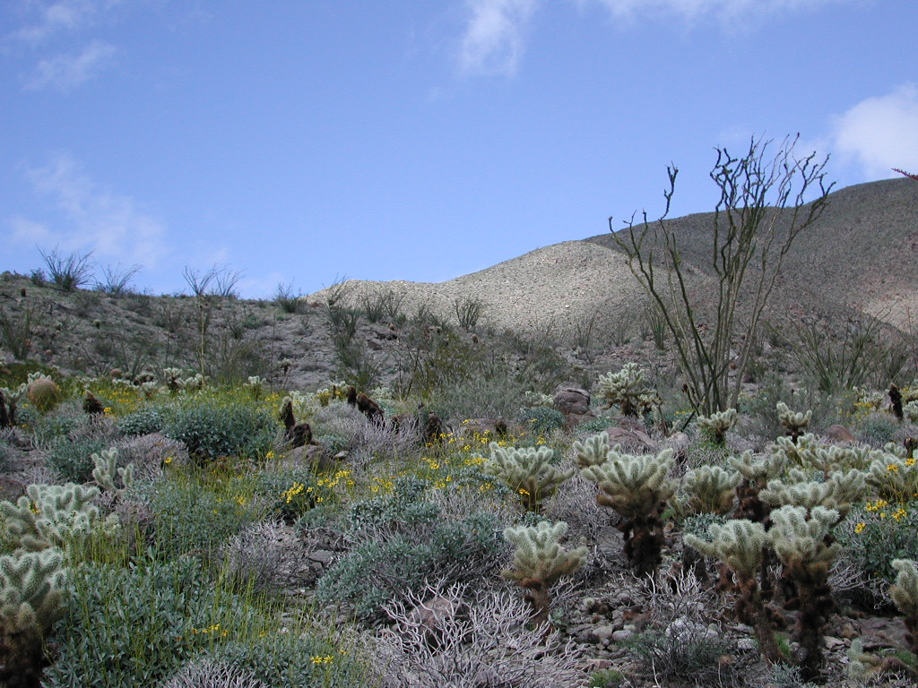
Anza-Borrego Desert,
California

Slide 4
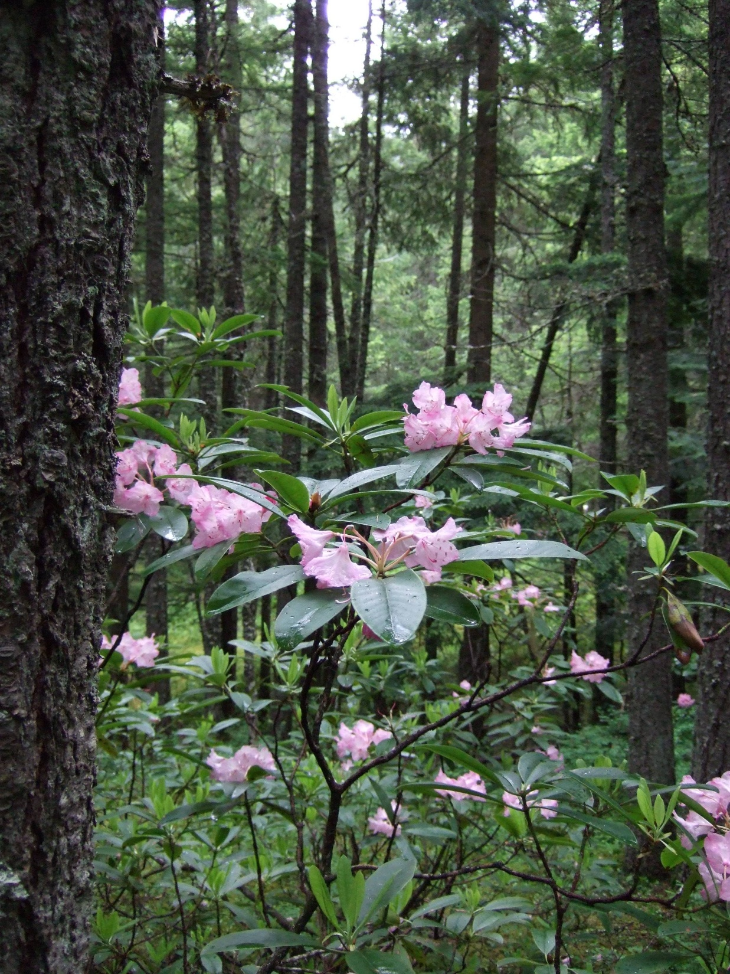
Manning Park
Rhododendron Flats

Slide 5
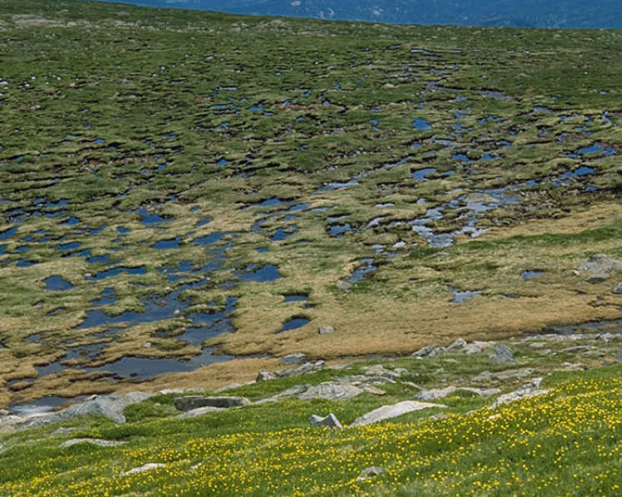
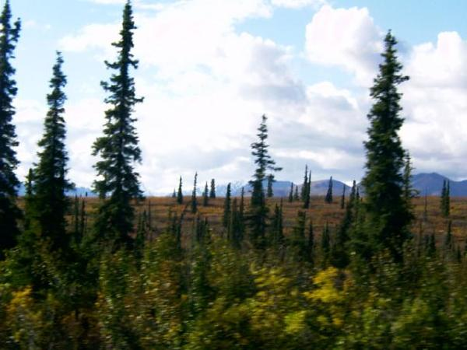
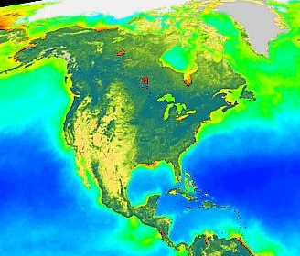
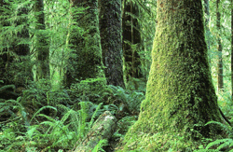
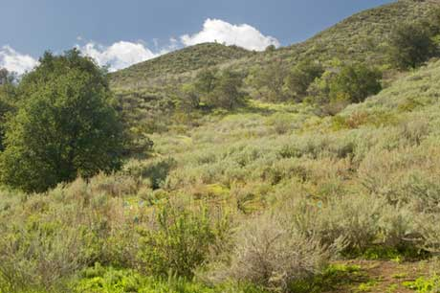
ARCTIC TUNDRA
BOREAL FOREST
TEMPERATE EVERGREEN COASTAL RAINFOREST
TEMPERATE SCLEROPHYLLOUS WOODLAND AND SHRUBLAND

Slide 6
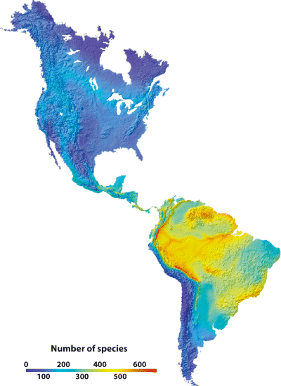
Bird species richness in the Western Hemisphere (Hawkins et al. 2006)

Slide 7
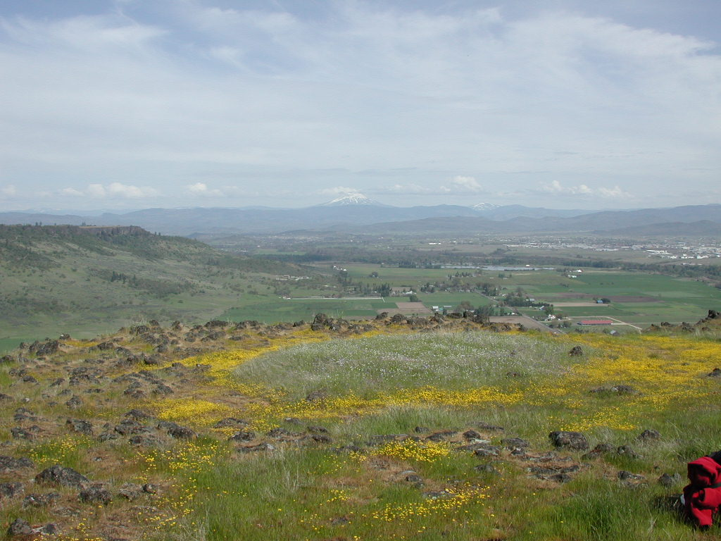
Table Rock, Oregon

Slide 8
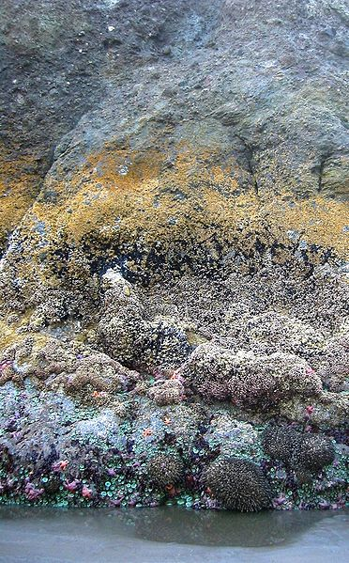
www.wildiaries.com

Slide 9
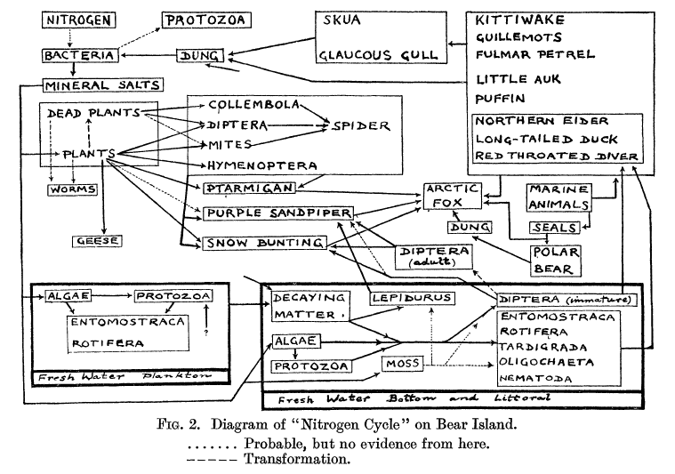
Food web of Bear Island: Summerhayes and Elton 1923, Journal of Ecology, 11, 214-286

Slide 10
Questions in Community Ecology
Why are some species more common than others?
What causes spatial and temporal patterns of community change?
What are the consequences of diversity patterns for community processes?
Can we explain patterns of organization by invoking some universal laws?

Slide 11
A cautionary tale: body size
Hutchinson’s “Homage to Santa Rosalia” (1959)posited that coexisting animals (at the same level in a food web) tend to differ in size by a ratio of roughly 1.3 (hypothetically due to character displacement after competition).
With thanks to Peter Morin

Slide 12
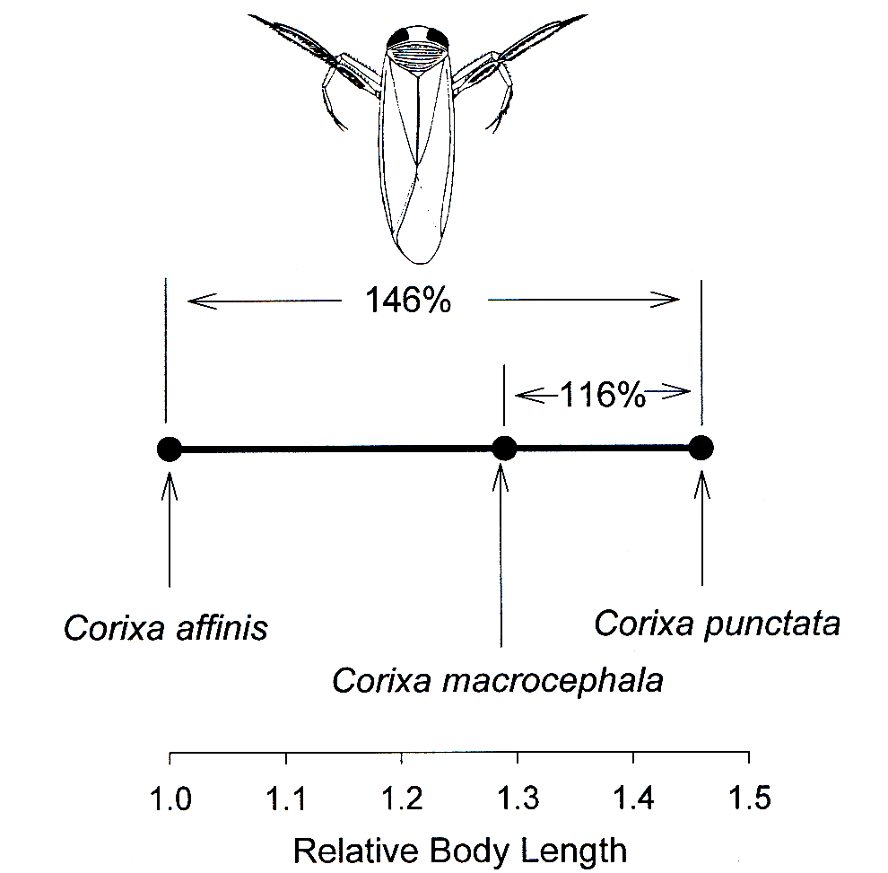
Largest species (puncata) can occur with others (affinis and macrocephala), but two small spp shouldn’t coexist—due to competitive exclusion.
Notes:
But affinis and macrocephala differ by 125%, so clearly within 1.3 rule!

Slide 13
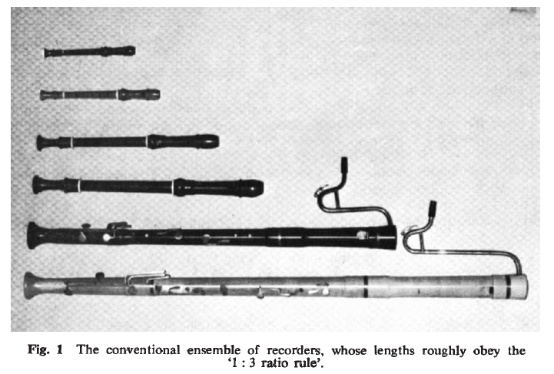
Horn and May (1977) showed that the “1.3 rule” also held for non-biological communities

Slide 14
Simberloff and Boecklen (1981) suggested true statistical tests needed (the beginning of the null model movement), and found many reported 1.3 ratios not significant

Slide 15
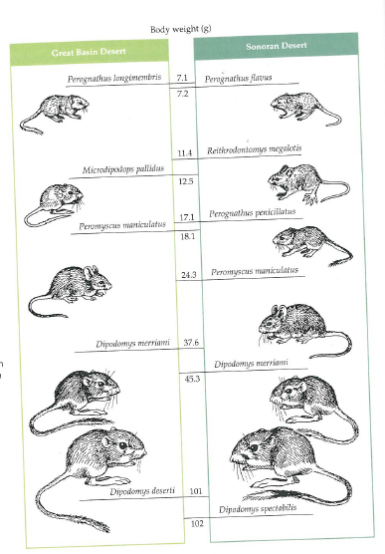
In some cases, depending on the model, body sizes WERE found to be “overdispersed”
Sonoran Desert Rodent “Hutchinsonian ratios”
Brown 1975
Bowers and Brown 1982
Notes:
This is a good example of how controversy and the process of competing ideas being aired in the literature can lead to greater care in how we do science and in more robust results in the end

Slide 16
Approaches
Community ecology often asks: how do interactions lead to the pattern of organisms/traits?
Experiments, models, observation/inference, often small spatial scales
Macroecology asks: what can we infer about processes from the distribution of organisms/traits?
Statistical patterns, usually large spatial or temporal scales

Slide 17
Figure 1.9. The species composition of a local community at any time is a consequence of many factors interacting in a hierarchical fashion. The composition of the species pool of potential community members depends on past evolutionary and historical events, as well as physiological constraints. Dispersal ability and habitat selection influence which members of the species pool arrive in a particular location. Interspecific interactions among those species that manage to arrive in a particular place further inhibit or facilitate the inclusion of species in the community.
Morin 1999

Slide 18
Course Topics
Competition
Predation (incl. trophic cascades)
Mutualisms/indirect effects
Macroecology
Diversity (and neutral theory)
Metabolic theory
Community Assembly

Slide 19
Types of interactions
Direct effects are indicated by solid lines, with signs corresponding to the signs of interactions between the species. Net indirect effects are indicated by broken lines.
Morin 1999

Slide 20
Interaction Strength
Interaction strength (IS) often measured by species deletions, with varying response metrics
experiment length important (time for interactions to manifest), as are density and species composition.
Details on metrics in Laska and Wooton, 1998, and Berlow et al, 1999; more recent review in Wooton and Emerson, 2005

Slide 21
Interaction Strength
IS as per-capita impact (short term impact of one individual on an individual of another species)
There are also several modelling approaches; one popular group is perturbation models (impact of one individual on a population of another species)

Slide 22
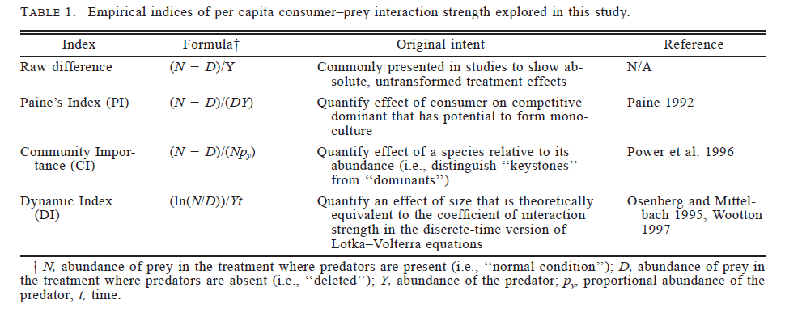
Empirical IS indices (Berlow et al)

Slide 23
How can interaction strength be measured?
Or, a short primer on how to do community ecology

Slide 24
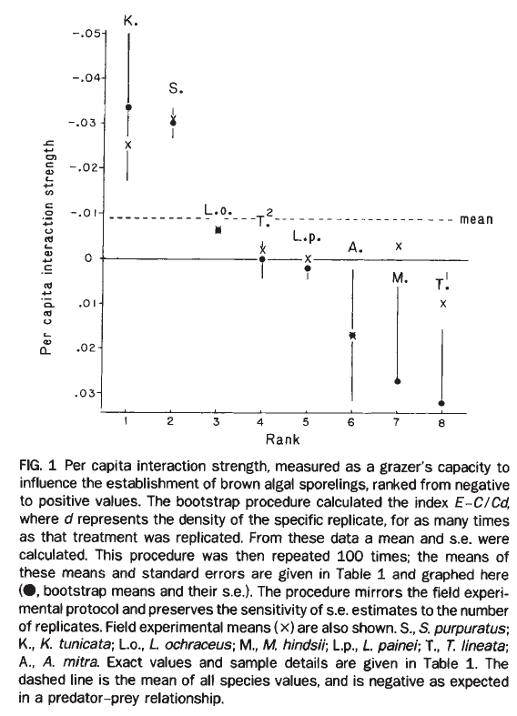
Field experiments 1
Paine 1992; removed herbivores from intertidal, measured impact on algae
(E-C)/CM
Few strong negative impacts of consumers; positive impacts due to indirect interactions
Chiton
Sea urchin
Limpets and chitons
E = Experimental
C = Control
M = density of manipulated species

Slide 25
Field Observations
Wooton 1997; uses methods of dynamic food web models to measure per capita consumption and assimilation in birds
Estimated population sizes, consumption rates, took into account time spent searching or sleeping vs. feeding, and time at low tide (when intertidal species available)—observational impact similar to estimates from experiments

Slide 26
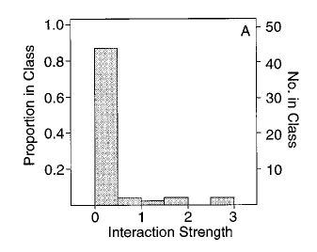
Wooton analyzed feeding patterns of 17 species of birds, same island as Paine

Slide 27
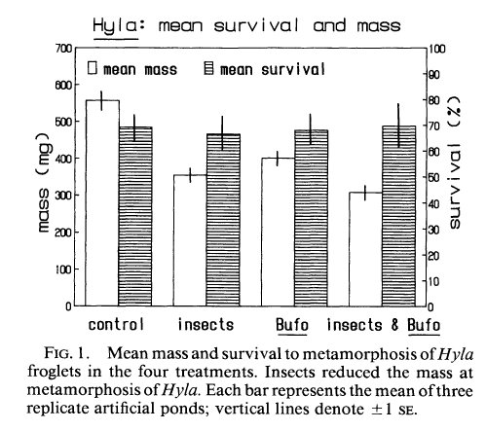
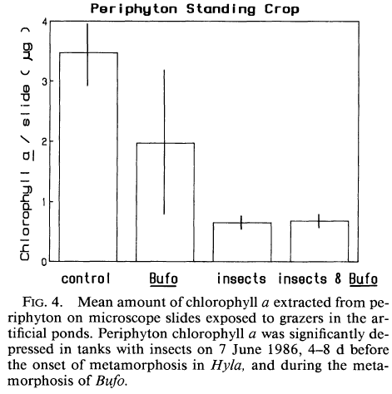
Lab experiments 1
Morin et al 1988 measured interaction strength for competitors in experimental ponds: frogs and aquatic insects

Slide 28
Lab experiments 2
Schmitz 1997; studied old field food webs (grasshoppers, plants, nitrogen)using field and lab experiments
Lab experiments manipulated top-down (herbivore) and bottom-up (nitrogen) factors separately for each plant species; compared with field experiment manipulating both simultaneously for the community.

Slide 29
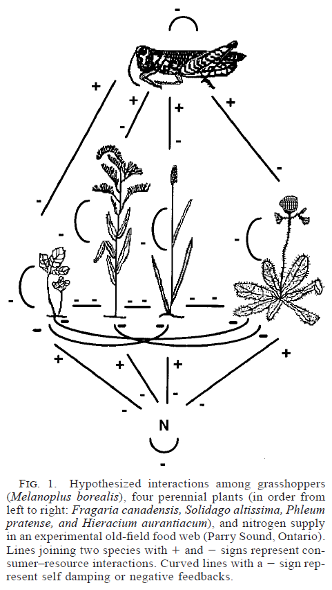
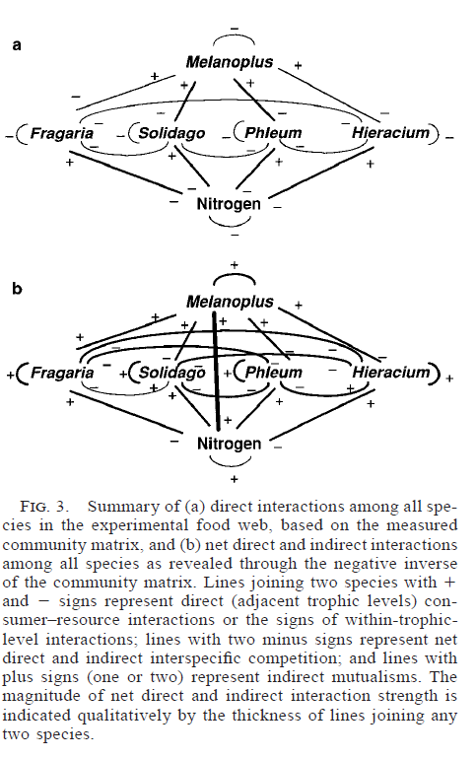

Slide 30
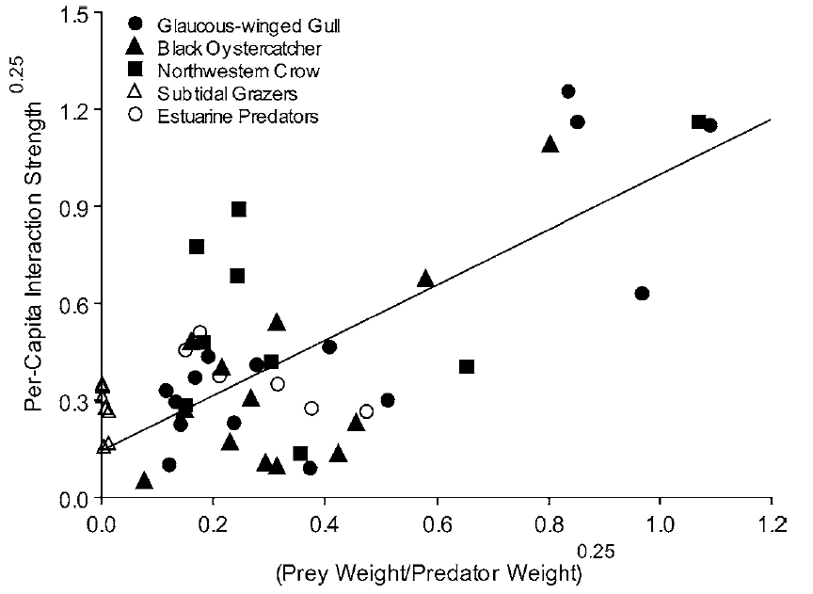
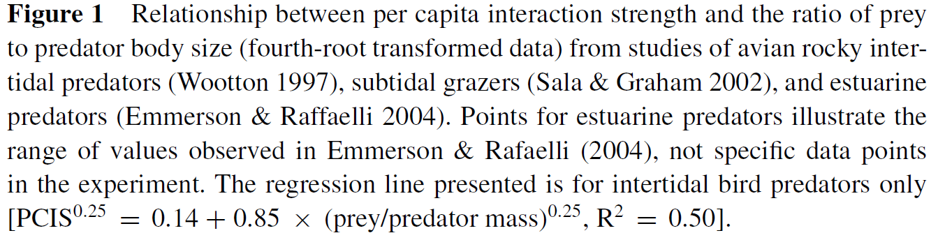
Inference based on species traits (e.g. relative body sizes of predators and their prey)
Wooton Emerson 2005
Notes:
Data from several studies suggest an allometric relationship; but taxa differ

Slide 31
Pros and cons of different methods
Removals assume equilibrium, do not always effectively estimate indirect effects, and Paine’s index does not work well for rare species—otherwise is practical
Dynamic index (Wootton) best when community is far from equilibrium (better for comparing short-term results) or when both positive and negative effects occur
Observational approaches good when experimentation is not feasible, but require validation

Slide 32
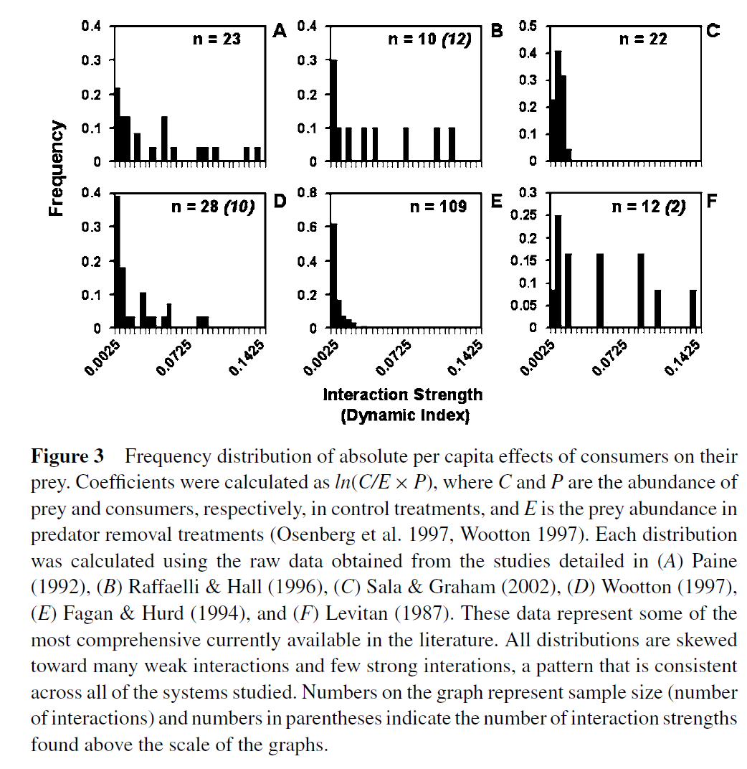
Interaction-strength distributions
Usually many weak and few strong
Notes:
Does the skewed nature of interaction strengths promote coexistence? Perhaps due to assembly processes?
Some suggestion that mutualist and competitive interactions also skewed

Slide 33
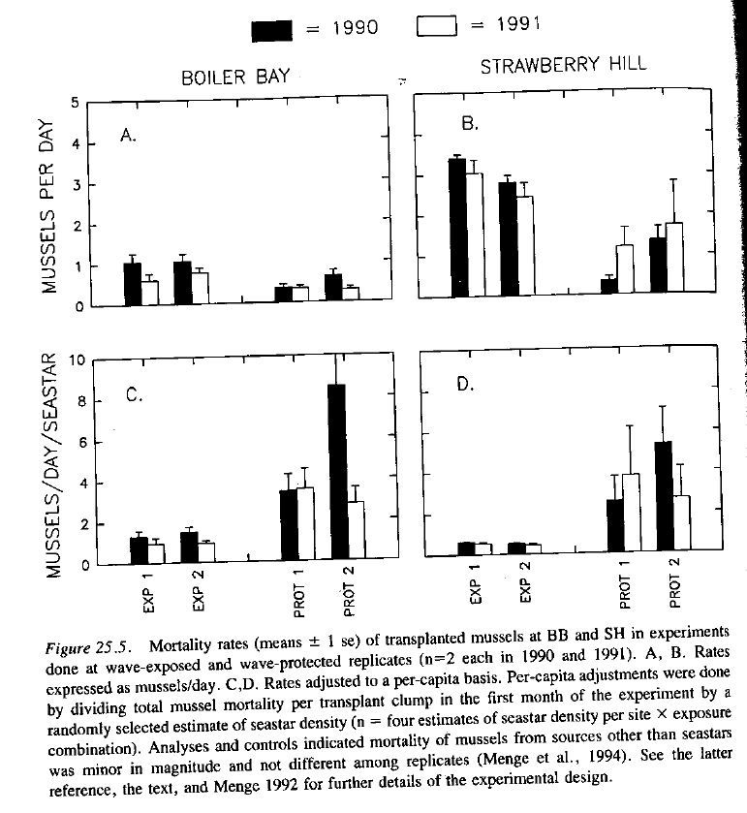
Abiotic conditions and interaction strength
Menge et al 1996: compared predation on mussels in wave exposed vs protected

Slide 34
Lawton 1999: “Community ecology is a mess”
“The rules are contingent in so many ways….as to make the search for patterns unworkable”

Slide 35
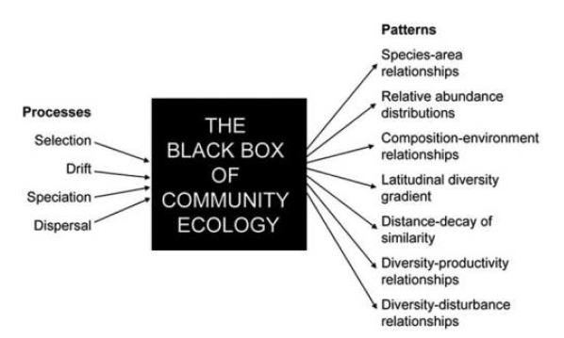
Selection: processes determining relative success (competition, predation, disease)
Drift: changes in abundance to due random effects
Speciation: generation of diversity in regional species pools
Dispersal: movement in and out of local communities
Vellend 2010

Slide 36
To Read for next time:
Two Papers from TREE, posted on web page, for a discussion of format (mostly) but ideas in the paper are cool too!

Slide 37
Abrams, P. A. 2001 Describing and quantifying interspecific interactions: a commentary on recent approaches. Oikos 94: 209-218.
Berlow, E. L., S. A.Navarrette, C. J. Briggs, M. E. Power, and B. A. Menge. 1999. Quantifying variation in the strengths of species interactions. Ecology 80: 2206-2224.
Bowers, M. A. and J. H. Brown. 1982. Body size and coexistence in desert rodents: Chance or community structure? Ecology 63: 391-400.
Brown, J. H. 1975. Geographical ecology of desert rodents. Pages 315-341 in M. L. Cody and J. M. Diamond, eds, Ecology and Evolution of Communities
Horn, H.S and R. M. May. 1977. Limits to similarity among coexisting competitors. Nature 270: 660-661.
Hutchinson, G. E. 1959. Homage to Santa Rosalia, or, why are there so many kinds of animals? Am Nat 870: 145-159.
Laska, M. S. and J. T. Wootton. 1998. Theoretical concepts and empirical approaches to measuring interaction strength. Ecology 79: 461-476.
Lawton, J. H. 1999. Are there general laws in ecology? Oikos 84: 177-192
Lewin., R. 1983. Santa Rosalia was a goat. Science 221(4611): 636-639.
Menge, B. A., B. Daley, and P. A. Wheeler. 1996. Control of interaction strength in marine benthic communities. pp. 258-274 in G. A. Polis and K. O. Winemiller (eds) Food Webs: Integration of patterns and dynamics. Chapman and Hall.
Morin, P. J., S. P. Lawler, and E. A. Johnson. 1988. Competition between aquatic insects and vertebrates: interaction strength and higher order interactions. Ecology 69:1401–1409.
Paine, R. T. 1992. Food-web analysis through field measurement of per capita interaction strength. Nature 355: 73-75.
Pajunen, V. I. 1982. Replacement analysis of non-equilibrium competition between rock-pool corixids. Oecologia 52: 153-155.
Power, M. E., et al. 1996. Challenges in the quest for keystones. BioScience 46:609-620.
Sala, E. and M. H. Graham. 2002. Community-wide distribution of predator-prey interaction strength in kelp forests. PNAS 99:3678-3683.
Schmitz O.J. 1997. Press perturbations and the predictability of ecological interactions in a food web. Ecology 78:55–69
Simberloff, D. S., and W. Boecklen. 1981. Santa Rosalia reconsidered: Size ratios and competition. Evolution 35:1206-1228.
Summerhayes, V. S. and C. S. Elton. 1923. Contributions to the ecology of Spitsbergen and Bear Island. Journal of Ecology 11: 214-286.
Travis, J. 1996. The significance of geographical variation in species interactions. Am Nat 148: S1-S8.
Vellend, M. 2010. Conceptual synthesis in community ecology. Quarterly Review of Biology 85: 183-206
Wooton, J. T. 1997. Estimates and tests of per capita interaction strength: diet, abundance, and impact of intertidally foraging birds. Ecological Monographs 67: 45-64.
Wooton, J. T. and M. Emmerson. 2005. Measurement of interaction strength in nature. Annu. Rev. Ecol. Evol. Syst. 36: 419-444.

