Slide 1
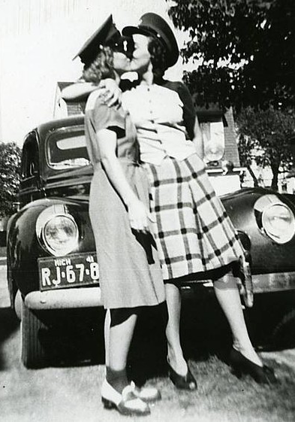
Riverview Lesbians

Slide 5
Riverview Lesbians
Sane vs. Crazy
Sanctioned vs. Forbidden
Sacred vs. Perverse
Safe vs. Dangerous
Private vs. Public
Out vs. Closeted
Horror vs. Love
Staged or Outed?
Who are these people?
Who was the photographer?
Why a picture of the audience?

Slide 7
Riverview Lesbians

