Slide 1
Finance Program Chart of Accounts/FINS 9.2 Project
September, 2016

Slide 2
Agenda
Topic | Est Time
The Finance Program | 5 minutes
Who is impacted and key dates? | 10 minutes
Impacts of the New Chart of Accounts Object Fund Department Program Project | 10 minutes
What support will be in place? Finance Program website Chart of Accounts website Online Training FAST | 15 minutes
Recap questions/action items | 5 minutes
Wrap up
Agenda
Notes:
 say…
Read the Agenda aloud and indicate the estimated time for each topic
Inform the attendees whether they are to ask questions as you go or if they should save them until you call for questions..

Slide 3
What is the Finance Program?
The goal…
Successfully implement a number of SFU Finance strategic initiatives that will improve service to the community through clearer, simplified financial processes, streamlined business processes and the automation of workflow for many existing manual processes.
Notes:
 Read the program goal aloud.
Say:
The program will occur over 18 – 24 months and we are just finishing the first year.
This first year was to lay a foundation on which we can build. This included upgrading FINS to the latest version of PeopleSoft software and redesigning our chart of accounts so our financial data is structured in a way that we can move towards better reporting and analytics and implementing a more robust budget system.

Slide 4
What is the Finance Program?
Phase 1
New Chart of Accounts
Upgrade to
FINS 9.2
Phase 2
Planning in progress
New Budget System (Hyperion Planning)
Initial scope identified
Will begin in November 2016
Replace FAST
Automate Workflows/improve processes
Improve Procurement Integration
Consolidate document imaging (i.e. invoices)
Notes:
Read Phase 1 bullets aloud.
Say…
Phase 1 is laying the foundation and as just mentioned focuses on 3 projects:
Implementing a new chart of accounts. A chart of accounts is the way an organization structures its financial information (assets, liabilities, expenses and so on). Our current COA (chart of accounts) is more than 25 year old and no longer meets SFU’s financial reporting needs and work began 2 years ago to redesign ours. BPS
Upgrading FINS to the newest version of software. FINS screens will look slightly different going forward using something called WorkCentres but gives us enhanced functionality for implementing automated workflows in the next phase.
Implementing Oracle’s Hyperion Planning software to replace IFPBS. Hyperion Planning is a web based budget planning system configured specifically for SFU.
Read Phase 2 bullets aloud.
Say…
Some of the highlights of phase 2 include replacing FAST with a better tool for reporting and analytics, automating workflows to streamline work between the Faculties and Admins areas with Finance and improve our procurement practices.

Slide 5
Who is impacted by new the Chart of Accounts?
Those who uses financial information such as:
Funds
Departments
Account/Object codes
Projects
Those who use FINS to process:
Requisitions
Cash Advances
Expense Reports
Journal Entries
Those who monitor financial information in:
FAST or
the Budget System
Notes:
Say…
Let’s focus on the new chart of accounts and who is going to impacted by this change on Oct 3, 2016.
 Read the contents of each bubble aloud

Slide 6
Key Dates
October 3, 2016
FINS 9.2 – new navigation and processes
New chart of accounts:
New structure and values
New department codes
Programs introduced
Funds are consolidated
Accounts (now objects) revised
HAP and SIMs – use new departments and programs
3rd party systems revised to use new chart of accounts
FAST revised to use new chart of accounts
October 11
Hyperion Planning System opens for orientation and familiarization of the system. Training begins.
November 14
Hyperion Planning System Budget Planning functionality opens
Notes:
Say:
There are three dates to be aware of in Phase 1.
 Read the slide aloud.

Slide 7
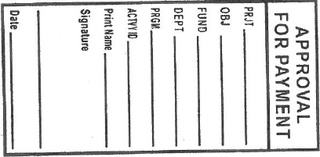
Chart of Accounts Impacts
The new structure
New Stamps
Revised forms
Notes:
Say…
For the rest of the presentation we are going to focus on how the new chart of accounts impacts us.
There is a new structure for the COA seen here. And the values within each of the chartfields are also changing.
This means how we code transactions using stamps, complete forms, and/or enter info into systems will also change.

Slide 8
New Object Codes
What’s Changing?
The number of object codes are being rationalized and reduced
Object codes are being renumbered
Object codes defined
See the Top 50 Translated Object Codes Quick Reference Sheet
Notes:
Say…
Lets look at the new values in each of the chartfields. We’ll start with Object codes. These used to be called “account codes” but it was confusing. Some people call the entire chartfield string (object, fund and department) the account code while others only mean what will call objects.
Over time, our object codes have become very “bloated” so the project has worked with us to rationalize and reduce the number of codes.
The object codes have been renumbered and they have been more clearly defined. The definitions can be found on the Chart of Accounts website that we will look at later in this session.
Handout the Top 50 Translated Account Codes Quick Reference
Say…
This is a Quick reference of the top 50 most commonly used object codes (old to new) for you to refer to.

Slide 9
Fund Codes
What’s Changing?
Some funds are being merged:
Funds 11 and 12
Ancillary funds consolidated in Fund 40
The endowment-funded projects of Fund 23 and 24 are being combined into a new fund: Fund 62 Endowment Support
Notes:
Read the slide aloud
Clarify any changes that impact your audience

Slide 10
Departments
What’s Changing?
Department codes now 4 digits
Departments are true organizational units
Some departments are being converted into Programs
Notes:
Say..
One of the most significant COA change is to department id’s (names and numbers).
Departments will only be four digits when they used to five.
Department ID’s and names have been significantly reduced and renamed and are meant to represent organizational units. Departments in HAP and SIMS and many other systems will also change.
However, because some Departments may want to further breakdown costs, a new chartfield has been created called Program.
Let’s look at our new department structure.

Slide 11
Our new Department Codes
Code | Description
6010 | VPR Administration
6020 | VPR Major Projects Office
6030 | VP Research Centre/Facilities
6050 | VPR Research Services Office
6060 | Ethics Policy Admin
6070 | VPR Innovation Office
6110 | VPR Animal Care
6210 | SFU International
6610 | Library Administration
6660 | Library Systems
6670 | Library Equipment Operations
6675 | Library Acquisitions Serials
6680 | Library Cataloguing
6700 | Library Access Services
6705 | Library ILL and Media
6710 | Library Learning Instruction
6715 | Library Research Commons
6720 | Library Student Learn Commons
6725 | Library Special Collections
6760 | Library Collections 100 Rebate
6770 | Library Collections Reg Rebate
6785 | BC ELN Operation
6790 | BC ELN Cost Recovery
6795 | eHLbc Cost Recovery
Insert your codes
1. Go to the COA website:
http://www.sfu.ca/finance/COA-Landing-pg.html
2. Go to Department Listing:
Locate your department and copy and paste the department codes to this slide
3. Delete the ‘example’ and ‘Insert your codes’ text boxes.
example
Notes:
Read the new department codes and descriptions.
Say…
Some departments also use program codes (either specific to our department) or university-wide shared programs to help us break down costs.

Slide 12
Programs
What’s Changing?
New chartfield to further segment information.
Used where departments are the organizational units, programs are the services that they deliver
Notes:
Read the bullets aloud
NOTE: If your department does not use programs – skip the next slide.

Slide 13
Our Department Specific Programs
VPR Admin
 | 60012 | VP Research - Special Projects
 | 60014 | VP Research - Contingency
VP Research Centre/Facilities
 | 60302 | VP Research Centres
 | 60304 | IRMACS
 | 60306 | MITACS
 | 60308 | VP Research - CL3 Labs
Insert your codes
1. Go to the COA website:
http://www.sfu.ca/finance/COA-Landing-pg.html
2. Go to Program Listing:
Locate your department and copy and paste the department codes to this slide
3. Delete the ‘example’ and ‘Insert your codes’ text boxes.
example
Notes:
Say…
These are our department specific program codes.
Read the program codes and descriptions aloud.
Say…
The chart of accounts also includes a number of University wide or global programs we can use. Let’s look at those.

Slide 14
Global Programs
Code | Description | Definition
00000 |  | Default program when no other program is applicable.
90010 | Communications & Marketing | Communications activity, except where a more specific Global Program is more appropriate to use
90020 | Departmental Initiatives | Specific projects or programs undertaken to achieve specific objectives in the near-term. This Global program can be used as a value to aggregate a set of initiatives that fall below the bar for creation of a Project ID, or can be used in combination with Project IDs.
90110 | Recruiting - Faculty | All costs associate with recruitment of faculty (advertising, meals, travel, etc.)
90112 | Recruiting - Students | Expenditures related to identification of potential students, informing them of the opportunities available at SFU and provision of materials and activities to assist them in making a decision as to whether to enroll at SFU (aka "Getting students in the door")
90120 | Program Development | (a) Activities around the creation of planned curriculum, pedagogy, instruction, and delivery methods for guiding student learning; (b) Activities related to development of academic and administrative programs
90130 | Technology Support | IT support, equipment purchased for general IT support plus all salaries
90140 | Research Support | Equipment purchase and maintenance, renovations, start up grants, annual research grants, staff hired to work in research labs
90150 | Instructional Delivery | Anything related to teaching - materials and supplies, TAs, Sessional Instructors, equipment maintenance and renovations in teaching space
90152 | External Examiner | Expenditures/Activity associated with the provision of External Examiners for Graduate and Postdoctoral Studies
90160 | Student Affairs | Expenditures/Activity associated with supporting students once they are enrolled. The objective for these activities is to promote student growth and success both inside and outside of the classroom. This includes the provision of financial support for students, clubs and events.
90170 | Conference Funding | Support for academic conferences (internal and external)
90172 | Seminar Series | Ongoing lectures, seminars and colloquia. Includes travel, hosting expenses, honoraria, room rental, AV and catering expenses
90180 | External Review | All costs associated with cyclical departmental external reviews
90182 | Accreditation | Any costs associated with the accreditation process (but not expenses to bring the area up to code to meet accreditation requirements)
90210 | Advancement | Expenses for materials, supplies and time related to fundraising
90220 | Alumni Services | Initiatives, events and support for alumni that are not specifically for the purpose of fundraising
90230 | Community Engagement | All outreach events, regardless of the nature of the target audience (children, families, adults, schools, etc.). Transactions would include expenditures for staff, materials, room, food and specialized equipment; These events may include SFU community celebrations, outreach events and government relations activities.
90240 | Employer Relations | Activities and programs related specifically to engaging with Employers for the purpose of organizing and enabling access to students
Notes:
Say…
The slide is a little crowded but as you can see there are some of the programs that apply to many departments at SFU so rather than us each having our own – we will code transactions to our department and one of these generic programs.
An example is: select one appropriate to your department.
Note: that there is a code 00000 which is a default program. When filling out forms, or completing authorization stamps or entering a transaction online, and no other program is applicable, we will use 00000.

Slide 15
Projects
What’s Changing?
Project costing module will be implemented
Projects will have an leading alpha character to identify the type.
Legacy project IDs will remain the same except with a leading alpha character.
Projects are now allowed in Fund 11
Notes:
Say…
There are also changes to project ID’s. SFU is implementing a new PeopleSoft module called Project Costing which will help us better manage project costing in future but we will take advantage of some of the basic features with phase 1.
 Read the remaining bullets aloud.

Slide 16
How are we making the change happen?
FINS
Converting 5 years of history + current year to date
Applying new chart of accounts
SIMS
Updating all Chart of Account references to the new values
HAP
Inserting new records to move jobs, positions and people to new departments and programs
Additional communication will outline other changes
3rd Party Systems using financial information
Working with each system owner/IT to align with the new chart of accounts
Notes:
Say…
The Chart of Accounts impacts every SFU system that uses or references accounting information. This slide shows the approach to the majority of systems,
 Read the bullets aloud

Slide 17
What support will be in place?
Finance Program website
Chart of Accounts website
BETA FAST
Online training
Go Live Response Team
Notes:
Say…
A number of tools have been put in place to help us transition to using the new chart of accounts.
Read the bullets aloud
Note: if you have any internal processes you are providing – add them to the slide.

Slide 18
Finance Program Website
http://www.sfu.ca/finance/financeprogram.html
Notes:
Say ….
The first tool is the program website that contains all the communication the projects have issued (see the Stakeholder Communication Library) and provides a gateway to the Online Knowledge Centre where you can find online training.
 Demo the site.

Slide 19
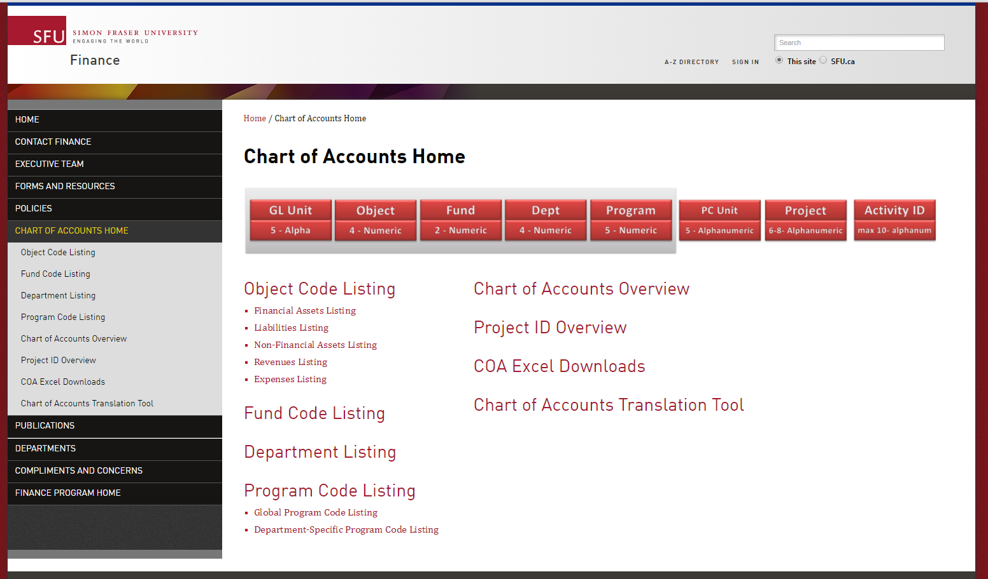
Chart of Accounts Website
http://www.sfu.ca/finance/COA-Landing-pg.html
Key points
You can see definitions of the codes and examples of when to use them
You can download the listings to Excel
Use the Translation tool
Notes:
Say…
Another tool is the Chart of Accounts website.
This allows you to view all the code listings online or you can download excel spreadsheets that you can edit to see only your most commonly used codes.
It also provides a link to the Chart of Accounts Translation tool. This tool can be downloaded and used to convert old codes to new codes.
 Demo the website and translation tool.

Slide 20
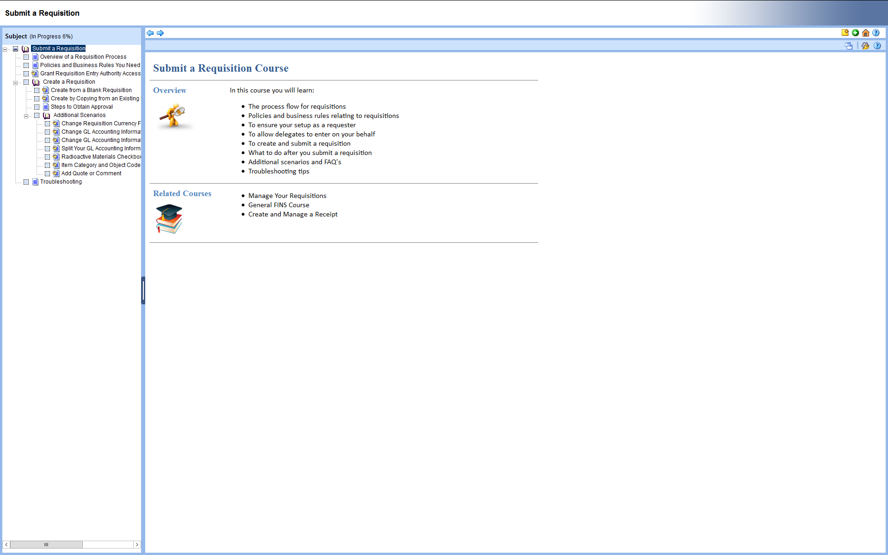
Online Training
www.sfu.ca/UPKtraining
Key points
You can see all the courses available based on your security access
The systems tells you which courses you have completed
Use the Feedback or Ask the Expert icons to provide feedback or ask questions about the course
Notes:
Say…
Training has been built online is accessed through the online knowledge centre. The courses are organized into Knowledge Paths and the one labelled All SFU employees offers courses for requisitions, travel and expense/cash advance claims using FAST and many more.
The training has been designed so that you can start at the first course and work your way through all the topics or if you need a quick refresher after go live, the topics all short and quick providing you with a demo (called See It) or allow you to simulate a function (called Try It).
Take a few moments to familiarize yourself with the viewing controls at the bottom of the window to fast forward or repeat topics.
 Demo accessing the online knowledge centre and how to navigate to the All SFU Employees Knowledge path.

Slide 21
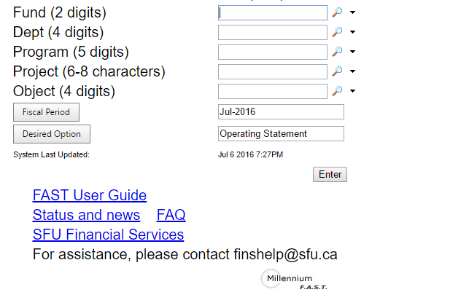
FAST https://fast-tst.its.sfu.ca
Key points
If you need access please contact FPINFO@sfu.ca with your computing ID
Notes:
Say…
FAST will also be updated to reflect the new chartfields. You can see that the new landing page has been changed to show Fund, Department, Program and Project. User 1 and 2 fields have been removed.
When drilling down on a Fund 11 or Fund 40, FAST will display a department report.
For all other funds, FAST will display a project report.
If you have access to BETA FAST you can demo the system but warn people this is a beta site and not all functionality is working as expected but it does give viewers an opportunity to see how the new chart of accounts impacts our financial data.
Note that after go live on Oct 3rd, this site will be irrelevant and our regular FAST system will be updated to show the new chart of accounts.

Slide 22
Discussion/Parking Lot
Notes:
Say…
Ask if there are questions. If you are unable to answer questions let everyone know about FPInfo@sfu.ca
or if you will find the answers and get back to them.

