Slide 1
KUALI RESEARCH:
INTRO TO PROPOSAL DEVELOPMENT
Notes:
FONT:
Impact, uppercase
Do not extend text outside of red section.
SUBHEADS / DAY MONTH YEAR:
Trebuchet MS, bold, uppercase

Slide 2
OBJECTIVES
Describe Kuali Research (KR)
Provide training on how KR will manage proposal pre-approval workflows in KR Proposal Development
Clarify roles, responsibilities and processes
Provide training on researcher / proxy related actions
Highlight next steps in implementation roadmap
GOAL: BUILD A COMMUNITY OF EARLY ADOPTERS

Slide 3
WHAT IS KUALI RESEARCH?
Notes:
On-brand bullet points
* copy and paste to reuse *
FONT:
Header:
Impact, uppercase
Subheads and Table:
Trebuchet MS, bold, uppercase
Body:
Times, sentence-case

Slide 4
Current “Signature Sheet” – Manual, Fragmented
Email, GTR
Chair / Dean / SFU Approved
GTR, PS
Signature Sheet
Email, GTR
Sponsor Approved
Email, GTR, PS
$$
Budget attached ?
Award Setup
Account
Expenses
Compliance
Agreements
Proposal attached ?
Special Req approved ?
CAM
Where is sig sheet?
Where is sig sheet ?
Where is my money?
    Challenges:
    Back and forth email communications
    Supporting Documents sent through email (paper-based)
    Manual Entry
    Fragmented data
    Lack of clarity and visibility
    Access limitations

Slide 5
KUALI ”Signature Sheet” – Electronic Workflow
External Submission to Sponsor*
Proposal
Budget
Internal Submission in Kuali Research*
SFU Specific Info
Supporting Info
External Documents as Attachment
Approvals
Available & Together
* Formally known as the “Signature Sheet” process
*No change
    Solution:
    One source of truth
    Comprehensive record
    Access by relevance

Slide 6
Why “SIGNATURE SHEET” Process?
Keeps info/docs together, gets things on radar
Helps resource assignments
Reminds of important to dos (ethics, COI)
Ensures approvals are in place “pre-agreement”
Provides status
Streamlines account setup
Informs eligibility and compliance check
Notes:
The purpose of the Signature Sheet / Kuali Proposal is to provide high level information to SFU approvers (Chair, Dean and Research Services) about the proposed activities so they can confirm SFU is eligible, compliant, and ready to undertake the research if funded under the parameters described in “Proposal Development” – aka signature sheet information.

Slide 7





PRE-AWARD WORKFLOW TIMELINE
 | APPROVER | PI | KUALI |  |  |  | PI or ORS
 | 1-4 weeks | 1-4 weeks | 1-5 workdays | 2-5 workdays | 2-5 workdays | 2-3 workdays | Fixed Deadline
Special Approvals
Proposal & Budget Development
Proposal Info - PI
Chair Approval
Dean Approval
SFU (ORS) Approval
Submission to Sponsor
Notes:
If special requirements are part of the research proposal (e.g., PI fees, release time, renovations, special equipment, letter of support or other SFU commitments), those must be negotiated and approved prior to starting the Kuali Proposal since evidence of decisions regarding these special approvals need to be part of the Kuali Proposal for the decision makers to be able to approve the activities. Please start special approvals early enough (2-4 weeks depending on complexity) to allow negotiations, justification, and approvals prior to creating Kuali Proposals.

Slide 8
PRE-KUALI CHECKLIST FOR SPECIAL APPROVALS
    Release Time, Teaching Release, Course Buy Out
    PI Fee, Additional Compensation, Salary Recovery
    Graduate Fellowship
    VPR / Dean Cash or In-Kind Contribution
    Letter of Support
    Space, Renovation, Facility, Retrofitting, Equipment
    Commitment from SFU Co-Applicant
    Overhead
    Partner Consent, Attestation
    Mapping Relevant Compliance, Certificate, Training, Permit Liability and Insurance Requirements
Note: Special Requirements Need Time! These tasks need to be considered and negotiated before starting the approval workflow in Kuali to help streamline the internal approval process.

Slide 9


PI RESPONSIBLITIES & ACCOUNTABILITIES
Responsibilities
Ensure that the proposal is accurate and complete before submitting;
Prepares a proposal budget that considers all financial elements associated with the research: one-time costs, incremental costs, capital costs, renovations, matches and institutional (indirect) costs
Identifies any personal or project compliance, certification or training needs: COI, Human Ethics, Biohazards, Radiation, etc.
Provides explanations or supporting attachments where required; e.g. Conflict of Interest (COI) or Release Time Stipends (RTS); matching funds; letters of support or commitment
Is familiar with, and adheres to, the provisions of SFU’s Policies, and related procedures, as well as the requirements of external funding sponsors;
Accountabilities
As per SFU policy R10.01: Acceptance of the terms; willingness to carry out the work within the budget and the availability / sufficiency of resources identified. It is the responsibility of the PI to make arrangements for payment for over-expenditures.
It is the accountability of the PI to make sure all relevant certifications, permits, insurance, licenses are in good standing before work commences
Workflow is triggered upon user clicking submit
1
PI
** Entry Delegation ** The PI may delegate the preparation of the proposal, but must review and submit the proposal into workflow to start the approval process; cannot delegate approval and submission to the delegate or the reviewer.
SIMON FRASER UNIVERSITY 9

Slide 10
KUALI PROPOSAL TERMS TO REMEMBER
Kuali Proposal Term | Equivalent
Proposal, Proposal Development | Signature Sheet
Proposal Approval | Signature Sheet Approval
Proposal Budget | High-Level Signature Sheet Budget
Institutional Proposal | Approved Signature Sheet Waiting for Funder Decision
F&A (Facilities and Administration) | Overhead, Indirect Cost
Submission | Submission for Internal Approval
Sponsor | Funder, funding agency, partner, granting agency, contractor, vendor
Sponsored Research | Research funding, grant, contract, funded research
Sponsor Program | Funding Program
Questionnaire | Special Requirements and Sig Sheet questions

Slide 11

HOW DO I LOG INTO KUALI RESEARCH?
Most users will be pulled through the HR system and use SSO to sign-in.
Some users may need to request access, please contact ors@sfu.ca.

Slide 12
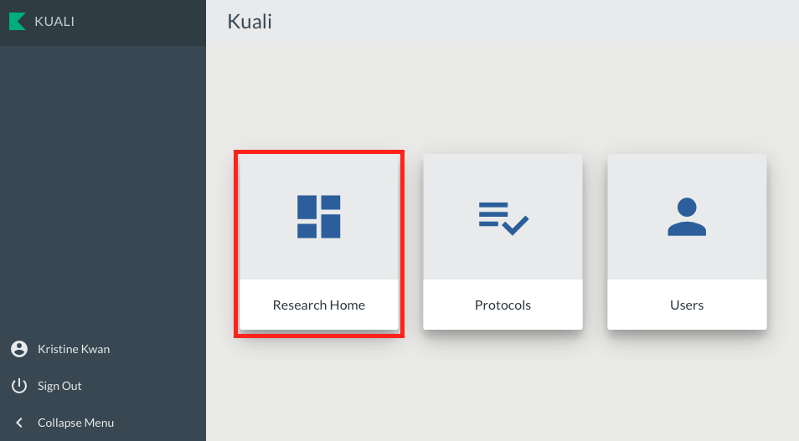
KUALI RESEARCH HOME

Slide 13
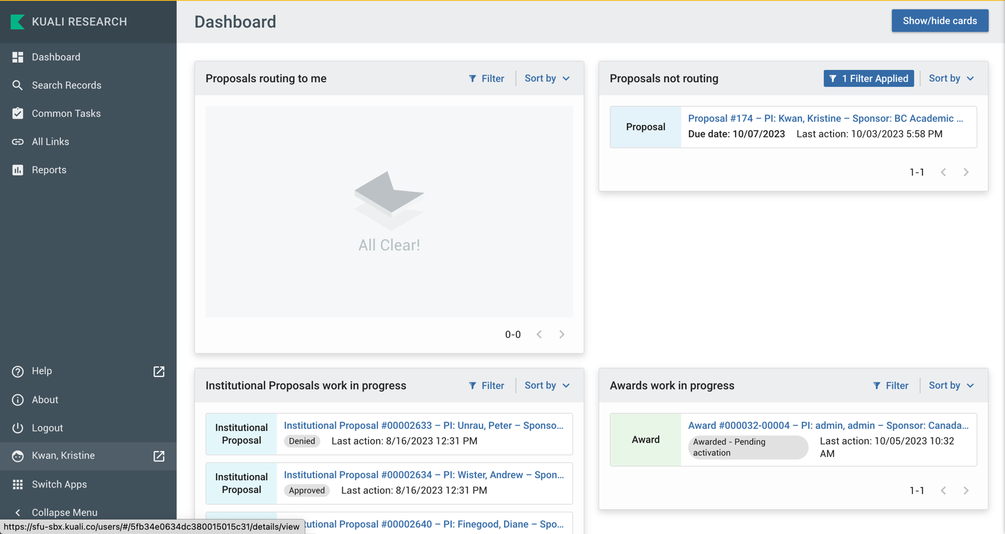
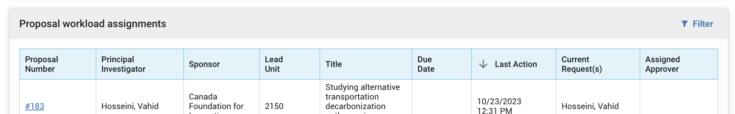
KUALI RESEARCH DASHBOARD
Notes:
Proposals Routing to Me: This card will allow Reviewers/Approvers to easily monitor proposals that are queued up for their approval and watch for proposals they will soon have to approve. If you are not an approver , you will not see any records in this card and may choose to hide the card if preferred. Approvers (which includes PIs) will see proposals in the Proposals Routing to Me card when the proposal is submitted for review. It will display how many steps away the proposal is from needing approval. In the case of PIs, since they will have access to their own proposals, they will see the proposals in progress in that card if a proxy created the file in their name.
Proposals Not Routing
This card will allow proposal creators to monitor which proposals they are still working on and have not been submitted for internal approval yet. To open a proposal to view or edit, click on the entry. If you are a Proposal Creator with edit rights in the Proposal’s Lead unit, you will be placed in edit mode after clicking on the entry.
Proposal Workload Assignments
This card allows anyone with Proposal view access to see which proposals are still currently in the process of being approved across all routing steps. Unlike the “Proposals Routing to Me” card, you will see each proposal listed throughout the entire approval process once it has been submitted for approval.
Institutional Proposals Work in Progress
This card will allow proposal creators to monitor which proposals have been submitted for internal approval yet. To open a proposal to view or edit, click on the entry.
Awards Work in Progress
This card will allow proposal creators to monitor which institutional proposals have been awarded and are in the progress of account set-up in the finance system. Once approved for account setup, the award is no longer whon in awards work in progress
Left Bar Navigation:
This is a menu bar where you can find the common tasks. Common tasks is a place where you can easily access your most common tasks whether that's searching, creating new records, or other actions. Also available is the search option at the top to give easy access to any system action. More information can be found here.

Slide 14
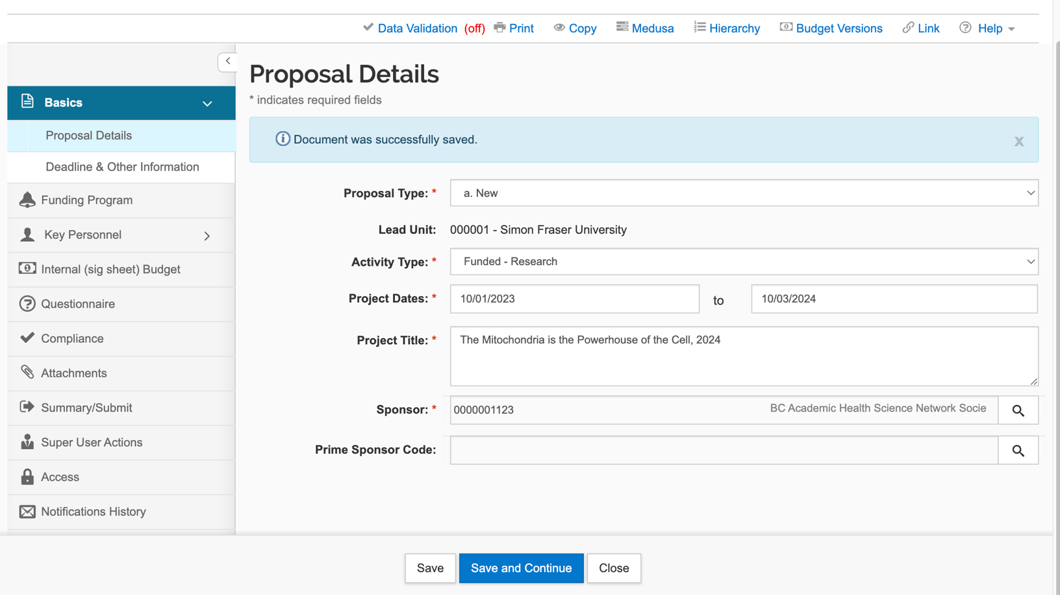
SHORTCUTS: COPYING A PROPOSAL
Open any proposal an ORS provided template

Slide 15
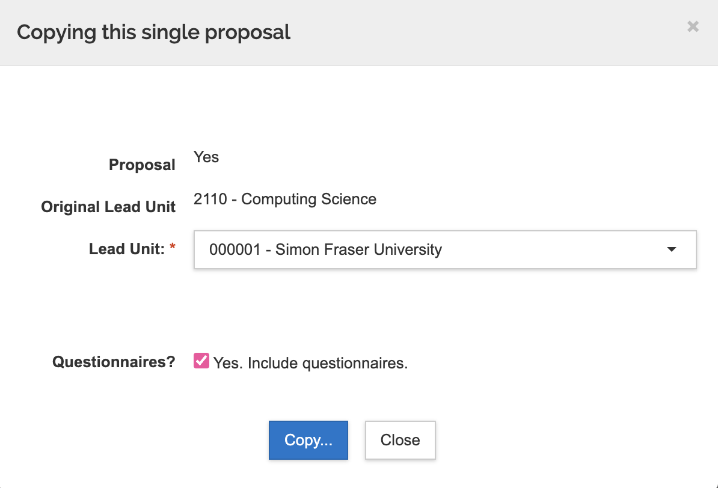
SHORTCUTS: COPYING A PROPOSAL
Chose appropriate unit
Chose to include questionnaire
Review carefully and update as necessary!
Will have sample proposals as templates for new proposals (e.g. Tri-agency, NIH, Funded Contracts with special approvals, etc.)

Slide 16
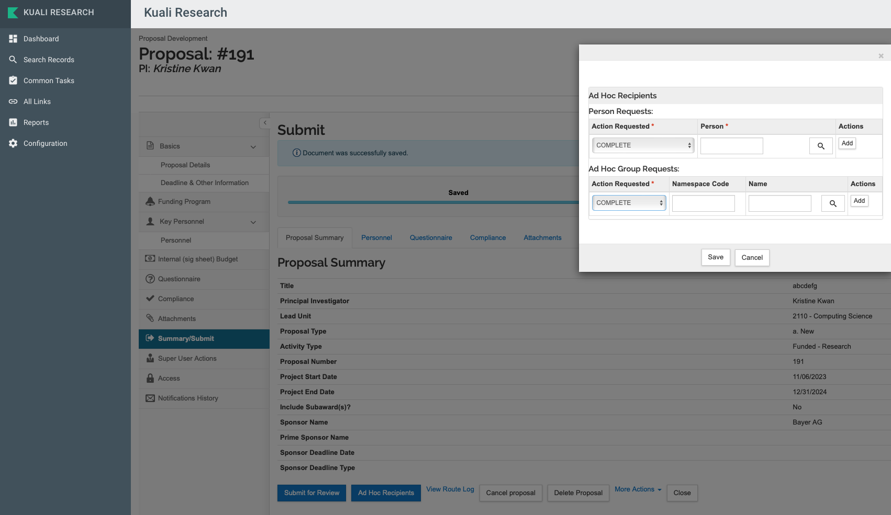
SHORTCUTS: WORKING WITH A PROXY
If Proxy already has KR access, they can create proposal simply by selecting the appropriate PI.
- Routing will pull PI with appropriate Chair / Director and Dean
- Proxy cannot submit to workflow without PI approval
- Direct submission by PI does not require PI approval
Proxies can also be invited to a proposal for editing of an existing proposal.
Summary Page
Ad Hoc Recipients
Note that ”ad hoc” approval cannot replace workflow approval

Slide 17
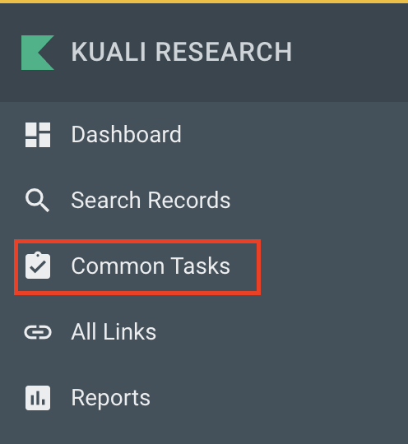
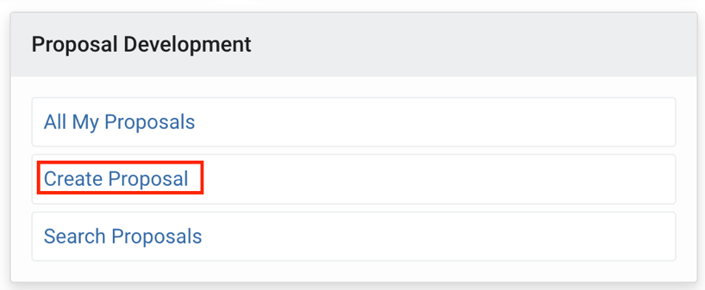
CREATING A NEW PROPOSAL
Notes:
A place where you can easily access your most common tasks whether that's searching, creating new records, or other actions. Also available is the search option at the top to give easy access to any system action.

Slide 18
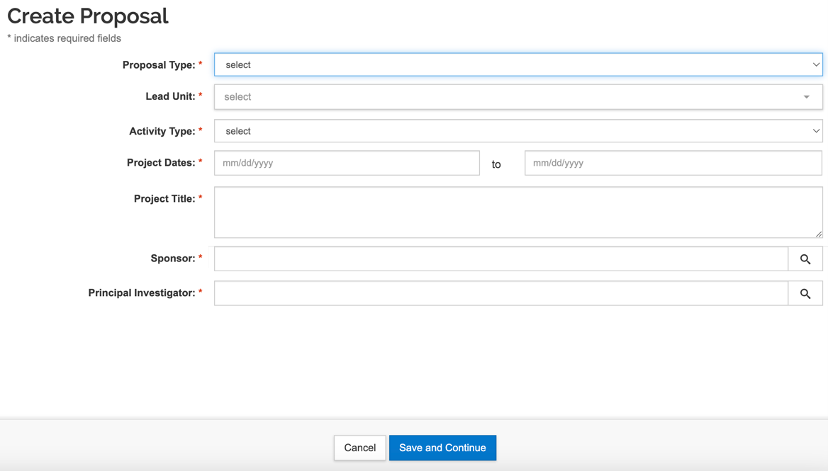
CREATING A NEW PROPOSAL
Use predictive typing including abbreviations with * as wild card
No predictive typing available, use magnifying glass and search fields
Tip: Use SFU email linked to computing ID; firstname_lastname@sfu.ca alias will not work.
Tip: Username is equivalent to SFU employee ID in KR
Tip: Use employee’s preferred name in KR
Required fields in Proposal Details must be filled in to save a draft. After saving the Proposal Details, the Kuali Proposal can be updated any time.
Notes:
If the sponsor does not exist in the drop-down list:
Please search for *not* in the sponsor name box of the search function (magnifying glass).
Select “sponsor not found” from the search results. This will let ORS know to onboard the sponsor.
The new sponsor will be activated in the system within 48 hours. You do not need to wait 48 hours with your signature sheet information, you can proceed with the rest of the proposal.

Slide 19
CREATING A NEW PROPOSAL
Lead Unit cannot be changed once saved
Do not use
New Proposal Number created, available on Dashboard
Notes:
Kuali Proposal has a data validation option that is off by default at the start of a new Kuali Proposal. It is better practice to keep it off and turn it on when closer to internal submission to validate the data entry. This will minimize too much and irrelevant feedback as you are working through drafts.

Slide 20
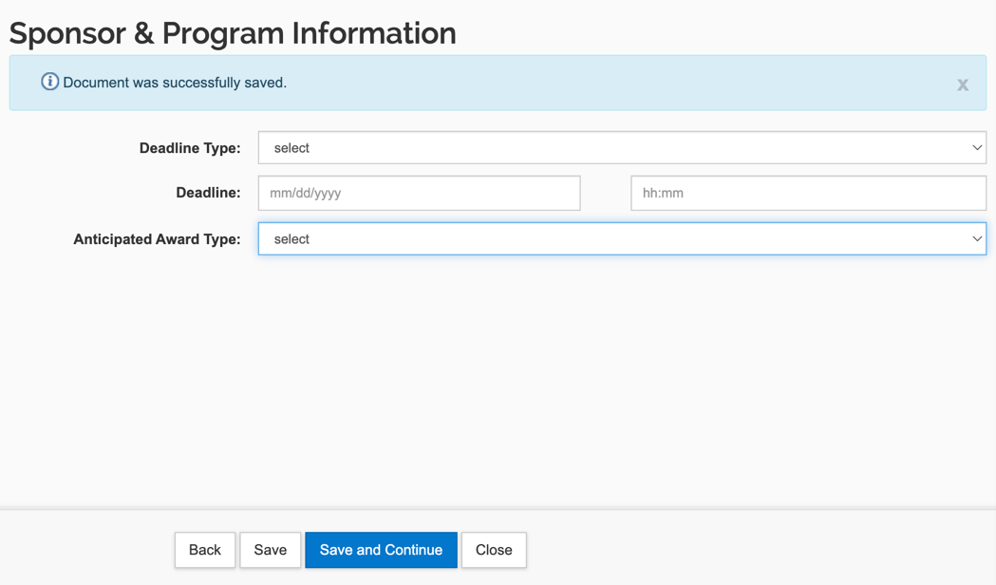
EXTERNAL DEADLINE AND AWARD TYPES
Anticipated Award Type:
- G-Grant
- C-Contract
Deadline:
If funder’s deadline is known, please add so approvers can sort by urgency!
NOTE: Completion of this section is not mandatory.
Notes:
Anticipated Award Type: The list is created in PeopleSoft and is important for ORS to be able to set awards up properly. At the proposal stage, only the grant versus contract types are tracked.
* Please select G-Grant if the funding opportunity is through a granting agency whose mandate is to fund research (NSERC, NIH, MITACS, etc).
* Please select C-Contract if the funding (or non funded agreement) is from a non-profit or from private industry for a specific research project.
NOTE: If unsure, please select the best match. ORS will update the Award type at the time of funding based on the award letter and terms and conditions around the funding.

Slide 21
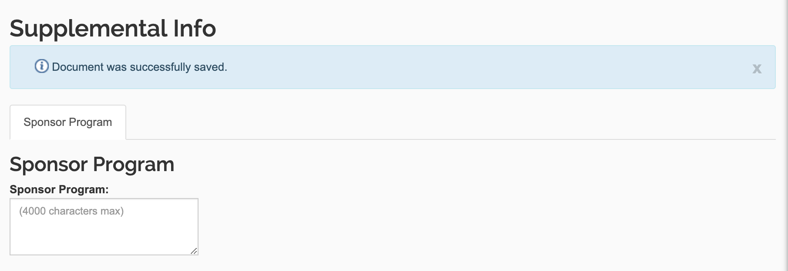
FUNDING / SPONSOR PROGRAM
Mandatory to enter text, type “none” if not applicable
Please provide the sponsor program to your best understanding in this field for the reviewers and approvers to know what you are applying for. ORS will update the information.
Please note we cannot configure “programs” in Kuali like sponsors. Supplemental Info is the only place we can collect this information!
Notes:
During the pre-approval stage in the Kuali Proposal Development workflow the exact program name is not always available. ORS will fill in the exact program based on the award letter in Kuali Awards to maintain consistency and accuracy in the records.
NOTE: If the funder (sponsor) has several streams of funding opportunities, they provide a name to each new program (e.g. NSERC Alliance and NSERC Discovery; or SSHRC Insight and SSHRC Partnership Development).

Slide 22
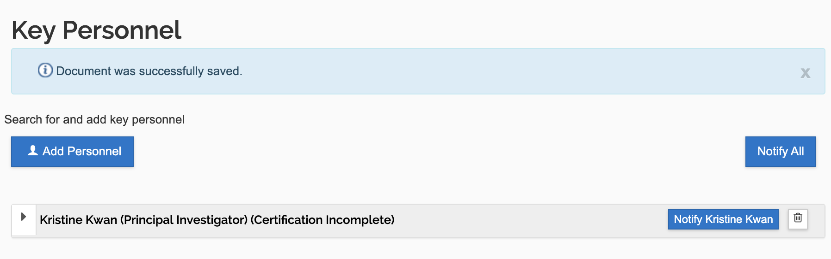
KEY PERSONNEL
PI Automatic
1.If you have a co-investigator from SFU who is promising resources towards your project, please enter the co-PI and answer the related questions in the questionnaire.
2. If you are applying for NIH funding, list all your co-PIs to comply with FCOI requirements and training.
Key personnel is not a required field; you may leave it blank unless 1 or 2 applicable.

Slide 23
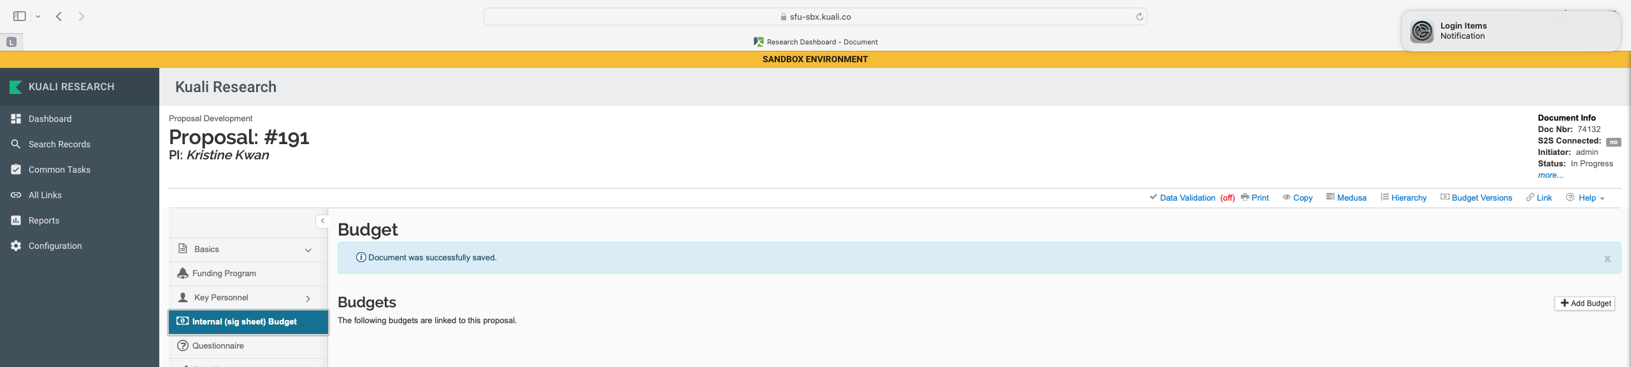
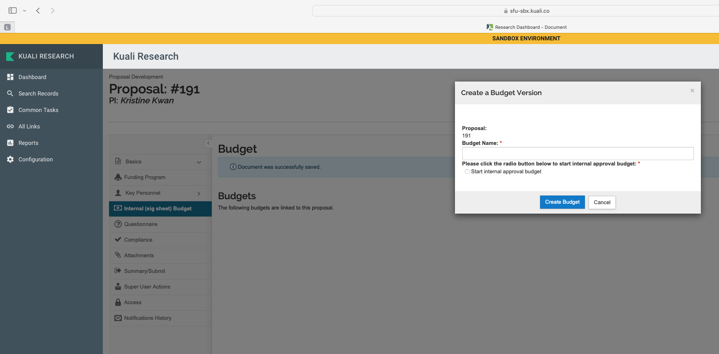
INTERNAL (SIG SHEET) BUDGET
CREATE BUBDGET:
- Option for scenarios
- Budgets cannot be deleted
- Only one can enter workflow
Notes:
The detailed budget you are creating for the funder will be an attachment to the Kuali Proposal and will provide details, when applicable.

Slide 24
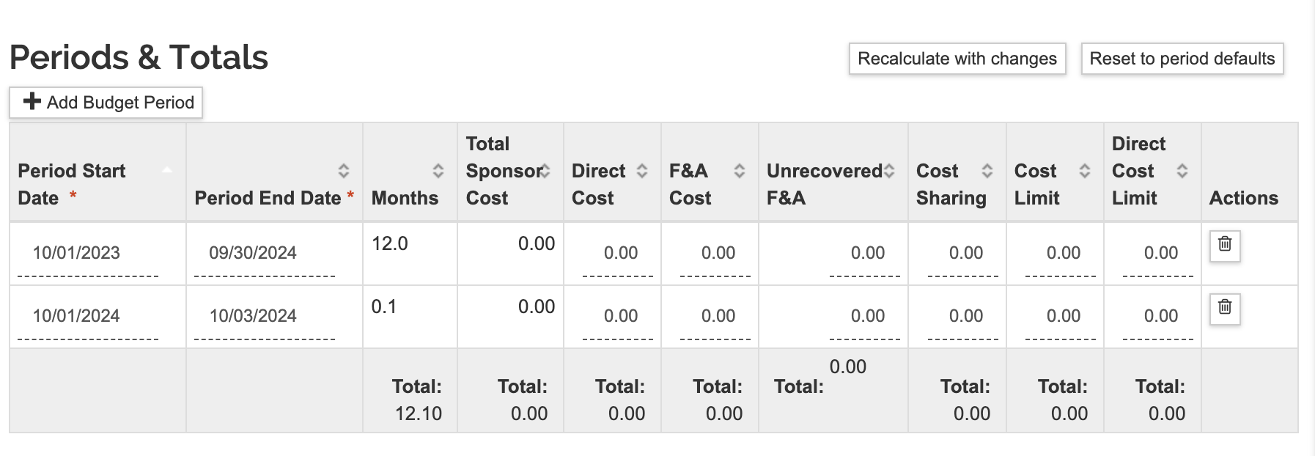
INTERNAL (SIG SHEET) BUDGET
- Periods and months automatic from proposal dates
- Total sponsor calculates by pressing “recalculate with changes”
- Only fill direct costs and F&A (a.k.a overhead)
SFU policy is 25% F&A on direct costs or funder’s set rate. Provide justification in Budget Question related to F&A. Contact ata26@sfu.ca for overhead related questions.
TIP: to calculate 25% F&A rate correctly with an upper limit to funding, divide funder total by 1.25 to get “direct cost” and subtract “direct cost” from funder total to get the “F&A cost” (e.g. for a $100,000 grant the direct costs will be $100.000/1.25 = $80,000 and the F&A $100,000 - $80,000 = $20,000). If there is no upper limit, ask for $125,000 from the funder and enter $100,000 to direct and $25,000 to F&A.

Slide 25
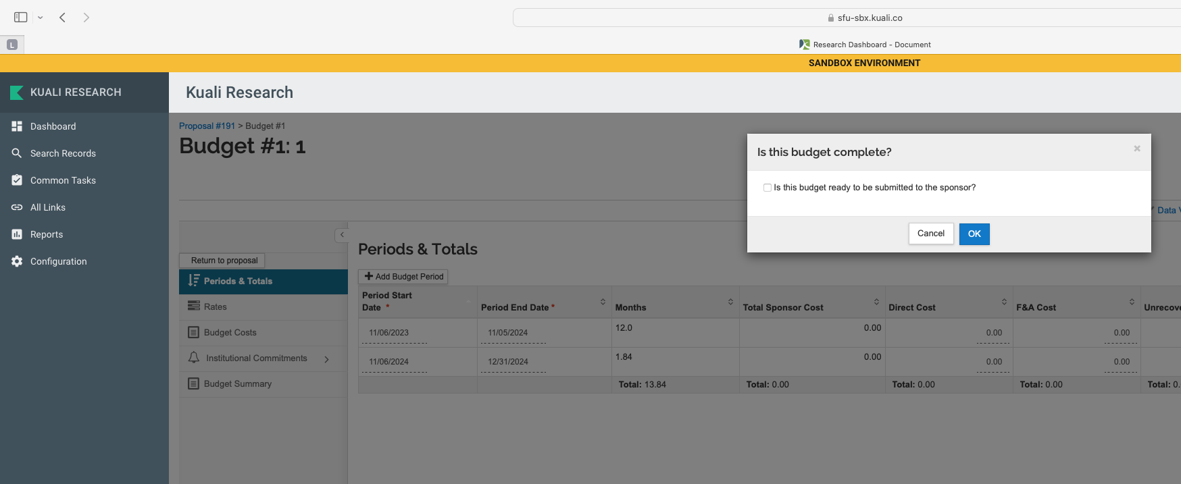
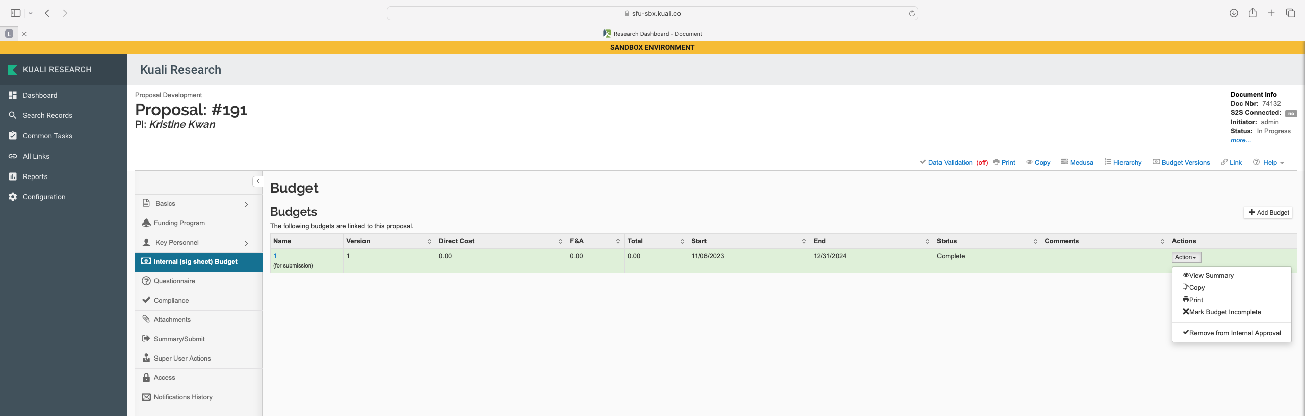
INTERNAL (SIG SHEET) BUDGET
i.e. to workflow!
One budget must be selected for submission to internal approval

Slide 26
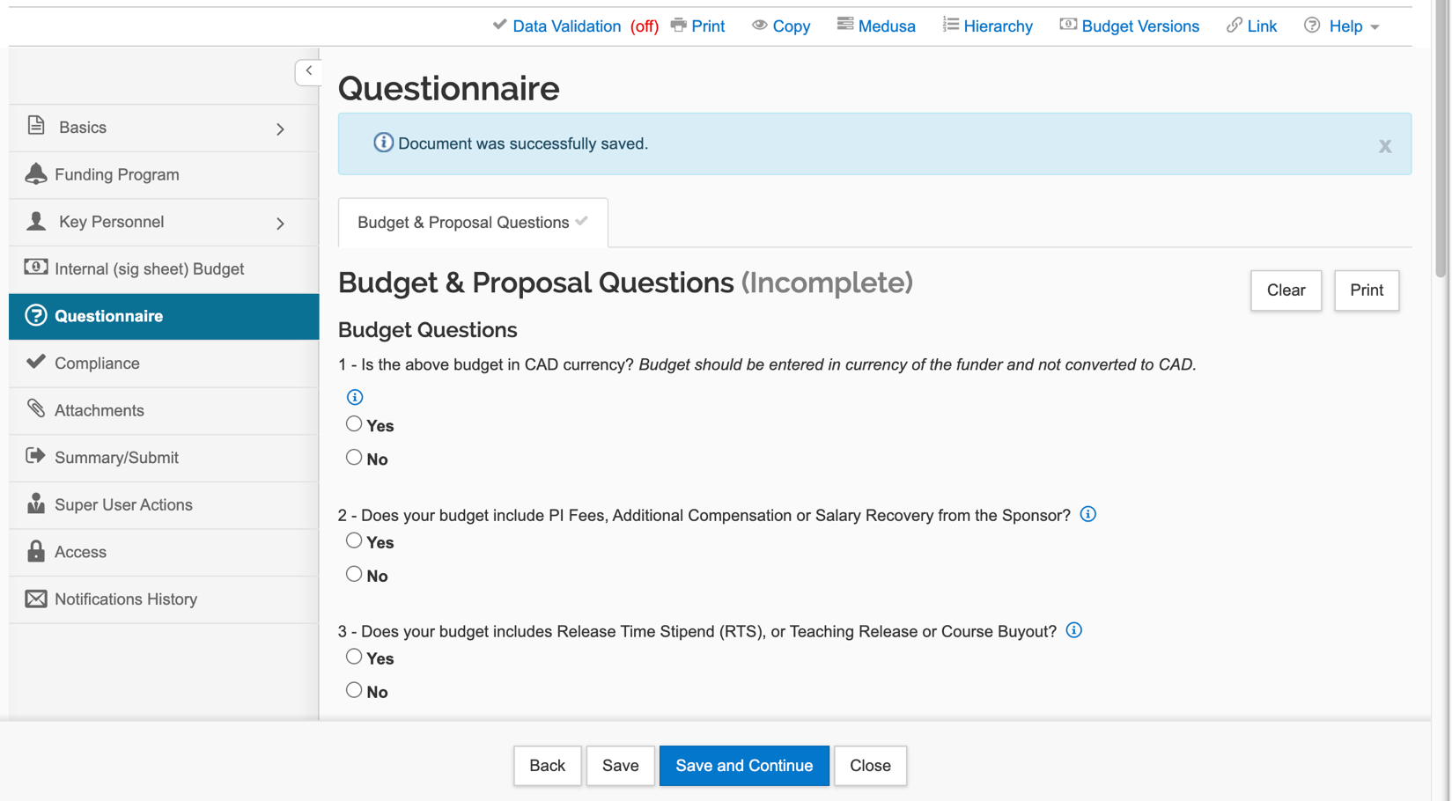
QUESTIONNAIRE
If you do have items that require special approval, this section will take time to complete. Some questions (e.g. PI Fee, Release Time) will require that you secured approval or agreement already. You will be asked to upload evidence of the agreement as per Chair / Director / Dean process in your unit.
Other items will generate to-dos for action when you receive the funding decision (e.g. field activity plan, etc). To speed up access to funds, make sure you have these as well as items marked in the Compliance section ready before account setup.
Notes:
In Kuali, the Questionnaire replaces the “special requirements” and some of the follow up questions on the former signature sheet. These items are all important to make sure Chair / Director / Dean and SFU are agreed to the proposed activities and parameters and can track promises made.
Most research proposals will not require special requirements. In this case you will not be asked for additional detail or documentation, but to just select the appropriate response and move on. If you – in the future – will apply to the same or similar program, you can utilize the “copy” function and copy a previous “proposal” in Kuali where you only need to update information that has changed.

Slide 27
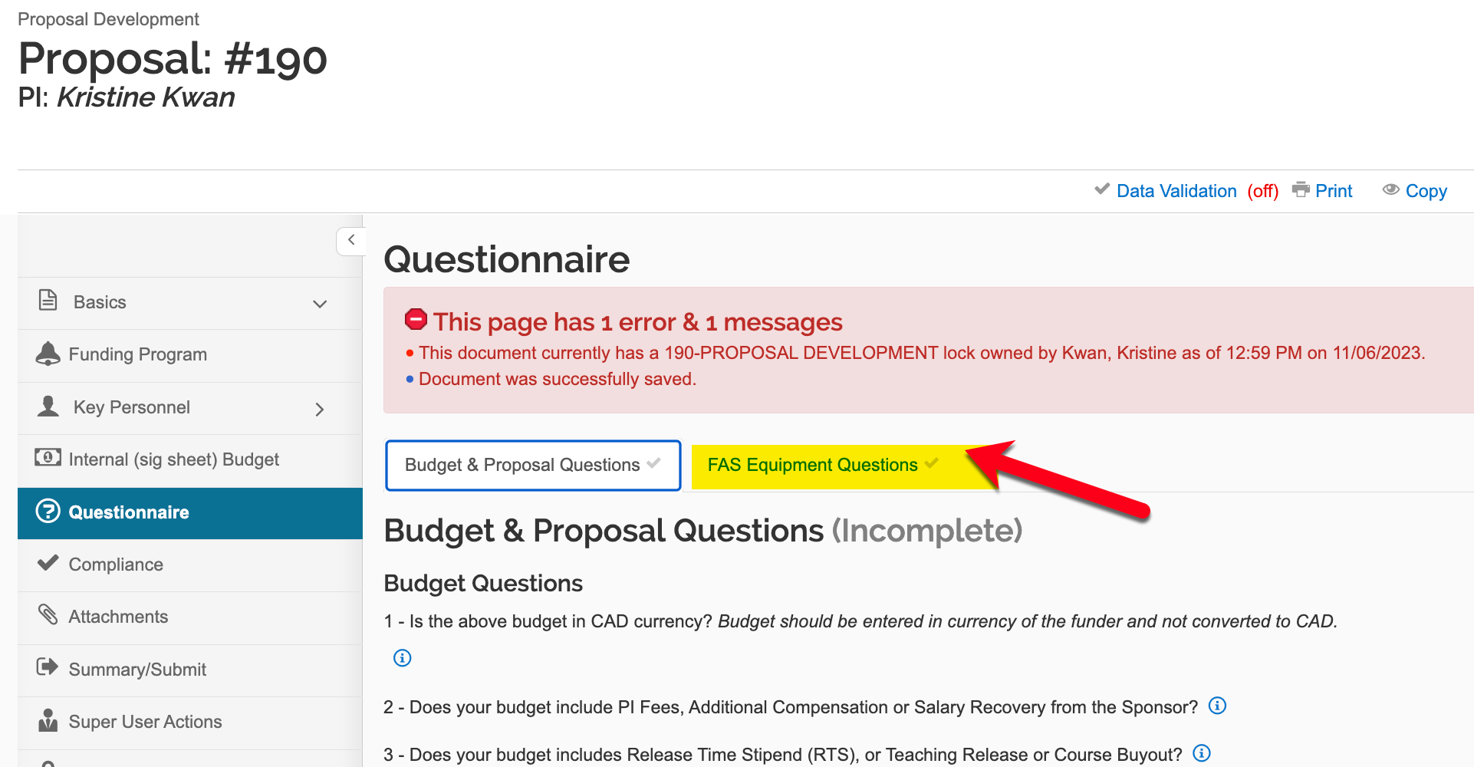
QUESTIONNAIRE – FAS TAB

Slide 28
BUDGET QUESTIONS
Question 1 (Budget): Budget should be entered in currency of the funder (drop down)
Question 2 (Budget): PI Fees, Additional Compensations, or Salary Recovery: If “yes”, amounts per period as approved by Dean outside of Kuali must be listed and email or form to verify the approval must be uploaded to KR Attachments.
If you answered “no”, no further action
Question 3 (Budget): RTS, Teaching Release, or Course Buy out: same process as Q2.
Question 4 (Budget): Does the Applied F&A follows SFU policy: If “yes”, no further action. If “no” include justification. It is the responsibility of ORS to verify if overhead policy is properly followed.
Examples for F&A justification: Funder is Tri Agency, no overhead was applied; OR Funder is NIH and 8% overhead was applied on modified direct costs; OR Funder only allows line-item budget for indirect cost $x was included in the budget…). If there is a special agreement on overhead, please add a note and attach the relevant documents. Please contact ata26@sfu.ca for all overhead related questions.
NOTE: If the additional commitments towards the proposed research are not paid from the funder’s money but provided by department, faculty or SFU, information will not be entered here.
Notes:
Approver training includes that if the funds you are applying for will be in part used for PI fees, RTS, etc, for you, it needs to be approved by Chair and Dean before you enter Kuali Proposal information
This question is to confirm that SFU’s overhead policy is properly followed. If you included 25% indirect costs (F&A in Kuali) on total direct costs in the internal budget section, please select “yes” and there is no further action. If the funder has a policy different than the SFU one, please select “no” and enter a link to the funder policy regarding indirect cost or overhead or facilities and admin costs or explain variance

Slide 29
PROPOSAL QUESTIONS
Question 5: International Collaboration: For stats, select all applicable
Question 6: Will you Conduct the Research Only on SFU premises
- If “yes”, no action.
- If “no” Question 6.1: Will you conduct the proposed research at SFU’s Affiliates? To comply with Affiliate Agreements with institutes listed, please select Institute as applicable
Question 6.2: Will you conduct the proposed research at the premises of any other organization (e.g. leased space, partner organization, industry partner lab)?
- If ”no” move to next sub-question.
- If ”yes” name of the organization and/or the location must be provided for Approver to follow appropriate internal process.
Question 6.3: Does the proposal include field work?
- If ”no” move to next question.
- If ”yes” you must describe where the field activities will take place and start Field Activity Plan https://www.sfu.ca/srs/work-research-safety/research-safety/field-safety.html
NOTE: PIs receive reminder in KR that all applicable permit, license, compliance, security, certificate, training, etc. requirements must be met before proposed activities commence.
Notes:
If all proposed activities are at SFU campuses or working from home, there is no further action. This includes SFU office and lab space, not businesses, services, or leased facilities happening to be on SFU campuses like institutes, elementary school, and daycare.
If PI conducts work at facilities of an SFU affiliate, or other external organization including leased space, partner organization, industry partner facility or doing field work, will have follow up questions to answer depending on proposed research
SFU has a finite list of Affiliation Agreements that govern our relationship and requires that we track research activities we perform on their premises. If you have questions about SFU’s Affiliates, please contact ors@sfu.ca
BC Cancer Agency (including BC Cancer Research Centre)
First Nations Health Authority
Fraser Health Authority
Providence Health Care Society (including B.C. Centre for Excellence in HIV/AIDS, St. Paul’s Hospital, and the Canadian HIV Trials Network)
The Occupational Health & Safety Agency for Healthcare in British Columbia
Provincial Health Services Authority (PHSA)
Vancouver Coastal Health (VCH
If you PI is planning to conduct research in the field, will select “yes” and describe in the text box where will the field work take place.
Principal investigators training includes that they must submit annual Field Activity Plans at least 2 weeks ahead of any fieldwork. While this is a proposal and it is uncertain whether or when the activities will start until a funding decision is made, completing the plan and related paperwork can be time consuming, they are asked to become familiar with the requirements to ensure they have everything in place by the time project activities start. Field Activity Safety Guidelines and relevant forms are available from the Safety & Risk Services Field Activities webpage. https://www.sfu.ca/srs/work-research-safety/research-safety/field-safety.html.

Slide 30
PROPOSAL QUESTIONS
Question 7: Indigenous Research (engaging with or studying people, culture or their wisdom)
- if “no” no action
- if “yes” you must provide 1) List of indigenous groups involved 2) description of how you have or will secure indigenous groups’ approval for the proposed activities.
Question 8: Are you seeking any of the following Physical Resources
1) additional space, 2) additional facilities, 3) renovations, 4) retrofitting, 5) new equipment, or 6) other resources.
- if “no” no action
- if “yes” select ALL applicable items and provide approval through Attachments
Question 9: SFU Core Facilities
- if “no” no action
- if “yes” select ALL that applies
Big Data Hub
4D labs
BIO3 Lab
eBRAIN Lab
ImageTech Lab
WearTech Lab
Public Knowledge Project PKP
Library
Animal Care Facility
Supercomputer CEDAR
Research Data Centre
Digital Research Alliance Canada
Notes:
Conducting indigenous research in the context of this questionnaire is defined as: Research in any field or discipline that is conducted by, grounded in or engaged with First Nations, Inuit, Métis or other Indigenous nations, communities, societies or individuals, and their wisdom, cultures, experiences or knowledge systems, as expressed in their dynamic forms, past and present. Indigenous research can embrace the intellectual, physical, emotional and/or spiritual dimensions of knowledge in creative and interconnected relationships with people, places, and the natural environment. Canada specific, not international.
If you are indigenous and working in your own community, this is not applicable.
NOTE: Special requirements need to be approved before routing KR Proposal for Chair and Dean approval. Each Dean has their own process for approval, please make sure you are familiar with the requirements of your faculty. Please note that if there is a special requirement, the attachment of a supporting document is mandatory in Kuali to proceed.
SFU has 8 core facilities and 4 other central and faculty-based facilities (e.g., 4D labs, Big Data Hub, Digital Research Alliance Canada) and several extra Departmental Units. These units provide services to researchers and it is important to track what research activities are utilizing their services. PI will select ALL THAT APPLY
Big Data Hub
4D labs
BIO3 Lab
eBRAIN Lab
ImageTech Lab
WearTech Lab
Public Knowledge Project PKP
Library
Animal Care Facility
Supercomputer CEDAR
Research Data Centre
Digital Research Alliance Canada

Slide 31
PROPOSAL QUESTIONS
Question 10: Does your proposal include Co-applicants
- if “no” no action
- if “yes” all co-PIs (SFU or external) should be listed in the attached proposal.
Question 10.1 Are any of your co-applicants from SFU?
- if “no” no action
- if “yes”, answer Question 10.1.1 Are any of your SFU Co-Applicants providing additional resources?
- if “no” no action
- if “yes” check that you have verification that approvals were secured, or that you acknowledges that approvals must be secured before project start. Please follow internal process for verification, follow up and tracking.
Question 11: Institutional support letter or contributions by the OVPRI
- if “no” no action
- if “yes” provide please select support letter and/or contribution and upload signed letter or provide 3-digit ISA identifier.
NOTE: Question 11 will not track commitments made within Department, School and Faculty at go live. Only commitments tracked by ISA are listed.
Notes:
Similarly to tracking special approvals for physical resources in your Faculty, if co-PI made promises towards these activities from a different Sfu department, they need to be approved by their Dean and evidence need to be communicated here.
Institutional support letter or contributions committed by the Office of the Vice-President Research and International (OVPRI): e.g., Graduate Fellowships, cash or in-kind support
Note: commitments and support letters take time and are processed by Institutional Strategic Awards, contact isa@sfu.ca for more information and please allow ample time to secure these commitments.

Slide 32
QUESTIONNAIRE – FAS EQUIPMENT QUESTIONS
Question 1: Are you seeking new equipment and/or use of existing equipment?
Question 2: Does the equipment have modular components that require service, repair or replacement? Please list component and frequency of service/repair/replacement for each.
Question 3: Does the equipment require additional resources?
Question 4: Please provide technical data sheet specific to model number of for each equipment.
Question 5: Provide information about electrical, plumbing, heating, cooling, ventilation, dimensions (W.H,D) and weight of equipment and any other special requirements?

Slide 33
REVIEWING THE PROPOSAL – FYI COMPLIANCE
No account will be authorized until ORS verified all bold typeset compliance requirements are met.
Human Ethics
Animal Care
Biohazard
Conflict of Interest Management Plan*
Radiation
Cannabis
*COI Management Plans are processed and approved in the Faculties. Please use internal process to make sure all required documentation and approval are in place for COI Management Plan Approval. KR will only hold the plan as approved by the Dean.
NOTE: there are several other certification and compliance requirements that could be applicable to a proposed project. It is the responsibility of the PI to make sure they do their diligence in exploring what is applicable and completing it before starting the funded project. Please contact ors@sfu.ca for a list of most common requirements.
NOTE: PIs cannot procced without choosing a compliance entry. If you have none, you must select “none” for compliance type and “not applicable” for approval status before you can proceed.

Slide 34
ATTACHMENTS
In the Attachments tab, this is where documents for the proposal, budget, and internal approval attachments are uploaded to be part of the submission.
Attachment Type | Description
Sponsor Proposal | Mandatory
Sponsor Budget | Mandatory
Letter of Support | If selected on the questionnaire
Approver-Requested Justification | As applicable
CFI Approved line-item budget | Mandatory
Outside Activity Report | FAS only
Dean Approval | For PI fees/additional compensation/salary recovery – if selected in the questionnaire
Conflict of Interest (COI) Management Plan Approved by the Dean | If applicable
Statement of Work (SOW) for Contracts | If applicable
Course Release Paid by SFU | If applicable
RTS/Course Release | If applicable
Approver Attachment | If applicable
Other | If applicable

Slide 35
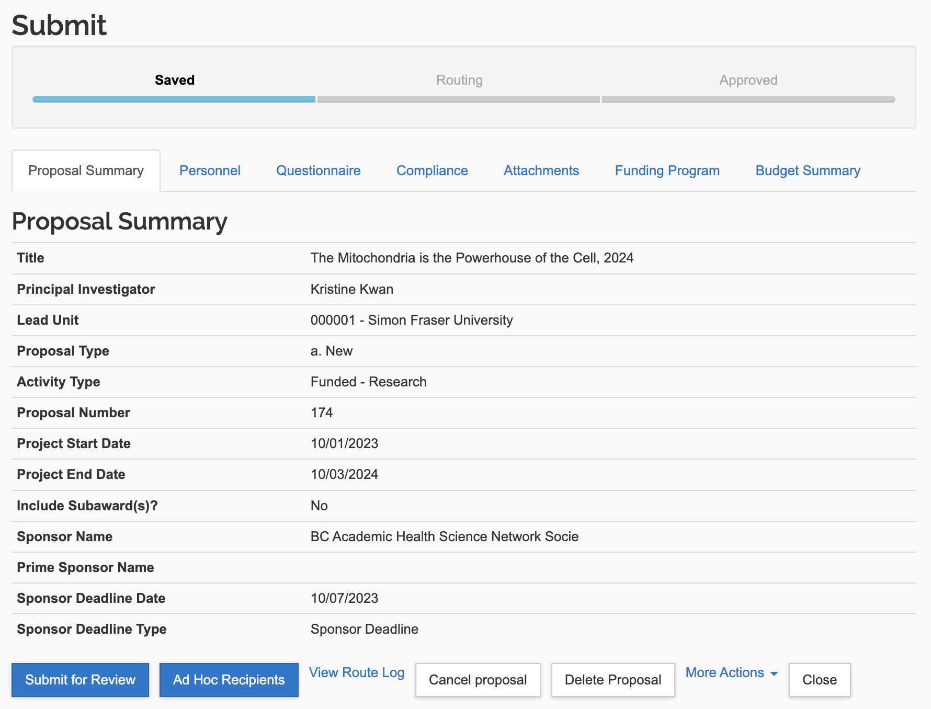
Summary/Submit Tab

Slide 36


APPROVAL WORKFLOW STEPS IN KR
Proposal Approved
Dept/Faculty
Proposal Approved
SFU
PI
Reviewer
(optional)
Approver
Reviewer
(optional)
Approver
Delegated
Signing Official
SFU Signing Official
Risk?
Departments/Schools
Faculty
Institution
- Approves when working with proxy
- Automatic routing when filling out own KR Proposal
- Follows Dept/ School process
- Approver can act without reviewer action
- Chair or Director
- No formal deputy, contact ors@sfu.ca if alternate needed
- Follows Faculty process
- Approver can act without reviewer action
- ADR is Primary,
Dean Secondary
- Primary to notify secondary when not available
- Grants Officer, Director ORS
SIMON FRASER UNIVERSITY 36

Slide 37
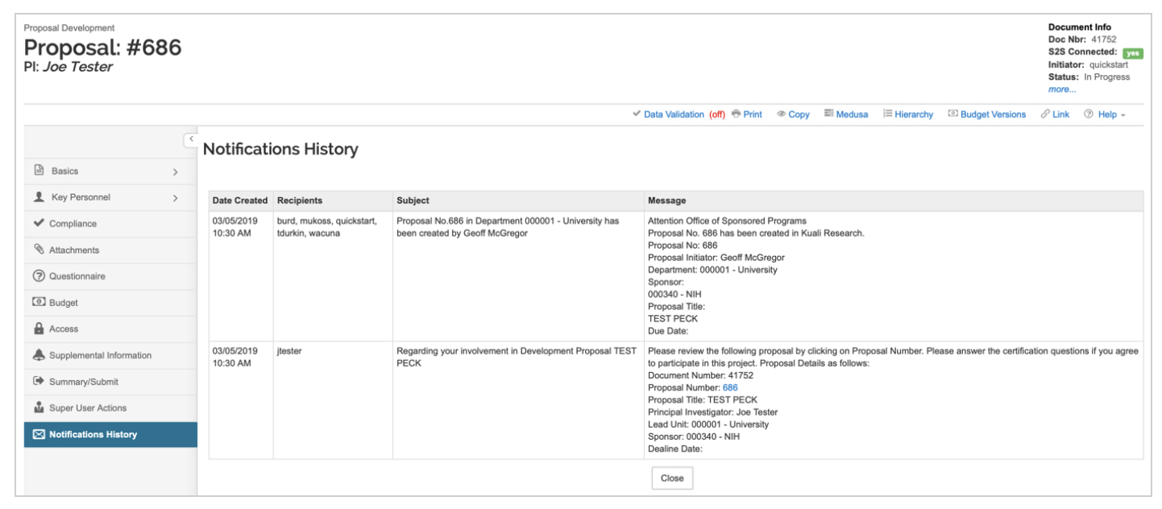
Notifications History

Slide 38
SPECIAL CONSIDERATIONS
KR approval workflow will not change how proposals are submitted to external funder
KR approval workflow will not change how SFU negotiates and signs contracts for research
KR approval workflow will not copy detailed budget info
KR approval workflow will not be used for commitment tracking
Approval of Contract Approval Memo will not be in KR at the time of go live
KR full reporting configuration will not be available at go live

Slide 39
WHAT IS NEXT?
Finalizing Manual and Sandbox
  inline help text
  role based access
Invitation to test Sandbox, UAT
Make minor adjustments to KR if necessary, before go live
Follow on training January 2024
Work on modules, integration and migration for back office
Go Live March 2024
Continue adjusting KR as necessary

Slide 40
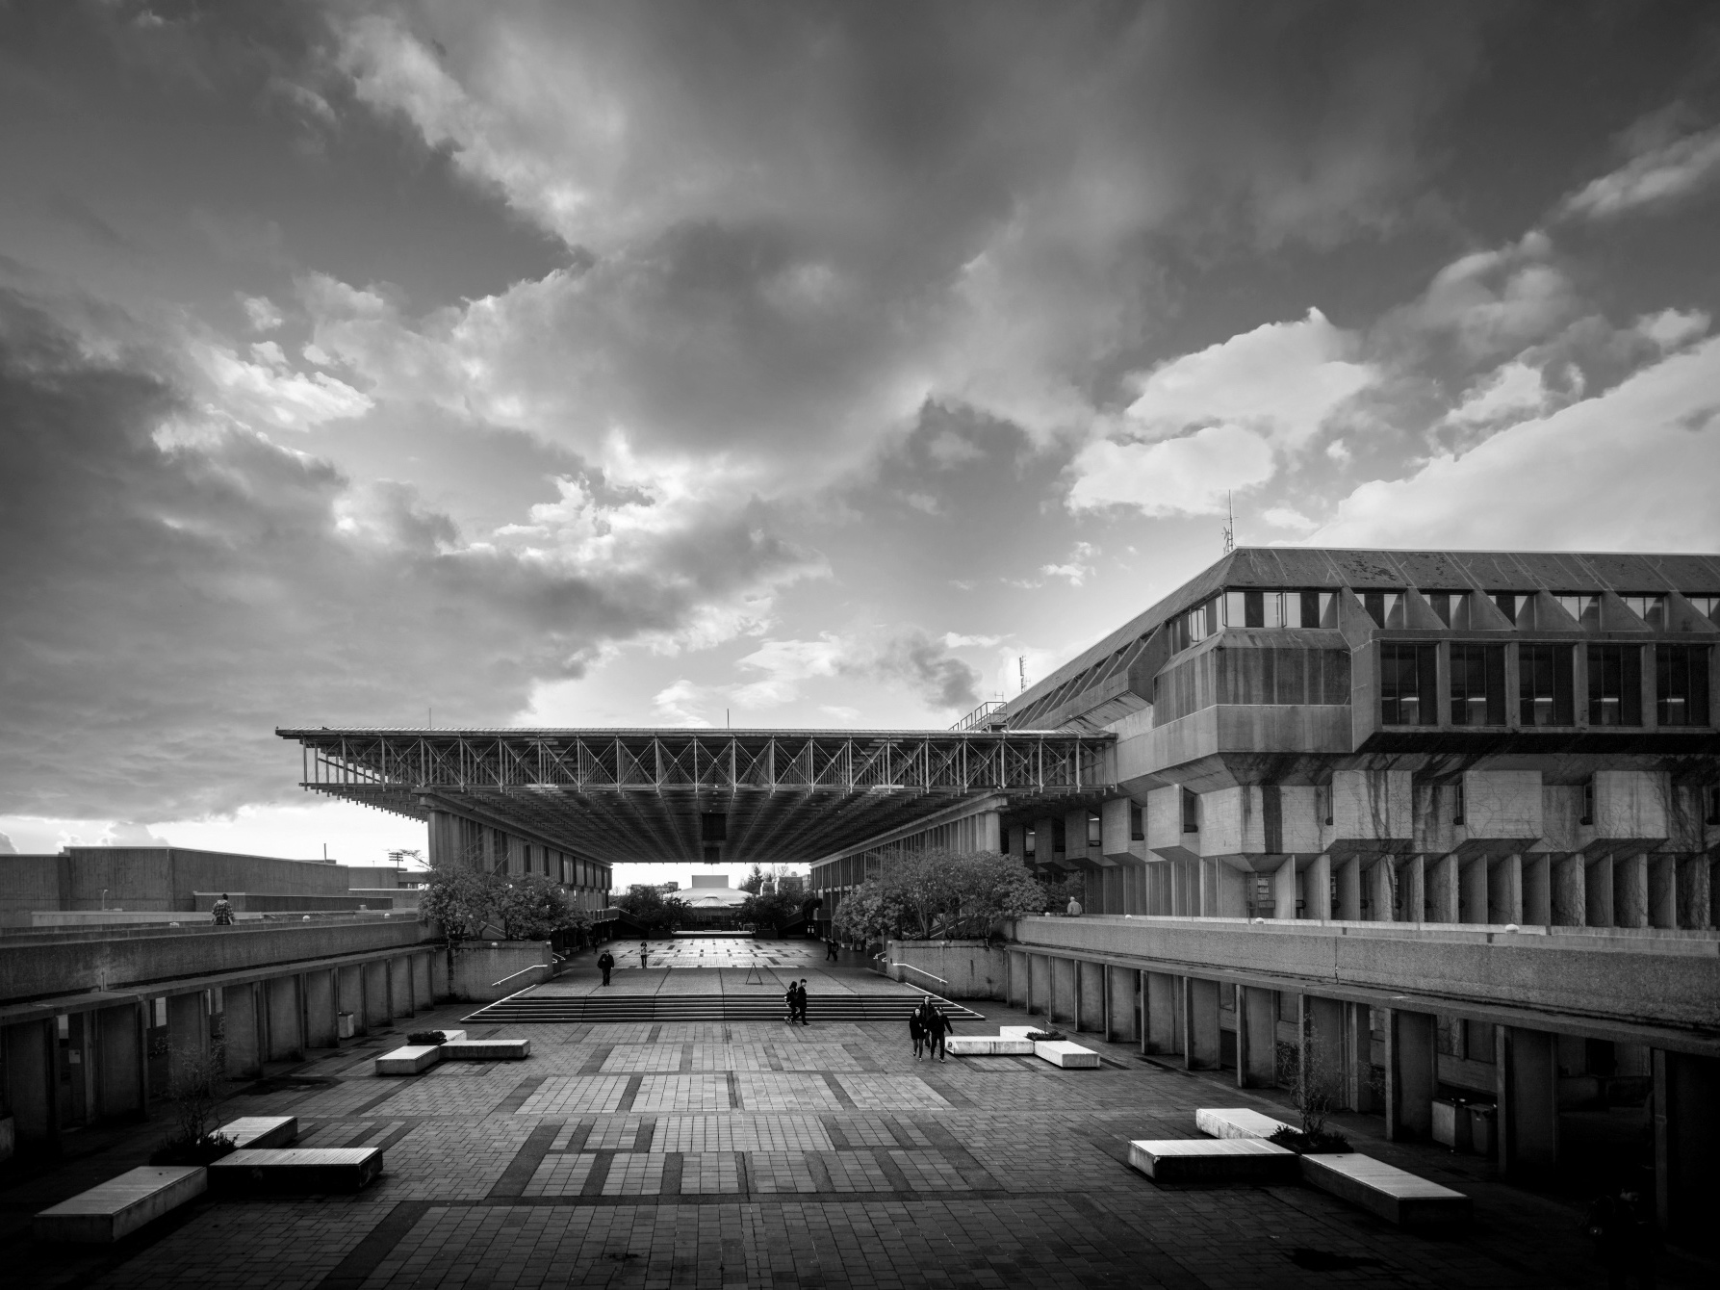
Notes:
HOW TO CHANGE IMAGE:
Click on image box.
Go to “Picture Format” tab
Click “Change Picture”

