Slide 1
KUALI RESEARCH:
INTRO TO THE APPROVAL WORKFLOW
Notes:
FONT:
Impact, uppercase
Do not extend text outside of red section.
SUBHEADS / DAY MONTH YEAR:
Trebuchet MS, bold, uppercase

Slide 2
OBJECTIVES
Describe Kuali Research (KR)
Provide training on how KR will manage proposal pre-approval workflows in KR Proposal Development
Clarify roles, responsibilities and processes
Provide training on reviewer and approver related actions
Highlight next steps in implementation roadmap
GOAL: BUILD A COMMUNITY OF EARLY ADOPTERS

Slide 3
WHAT IS KUALI RESEARCH?
Notes:
A “Proposal” in Kuali Research is the equivalent of the current Signature Sheet (internal approval workflow for externally funded research as per policy R.10.01) and is not to be confused by the (research) proposal the PI is submitting to the funder, which will form an attachment to this approval workflow.
The purpose of the Kuali Proposal is to provide high level information to SFU approvers (Chair, Dean and Research Services) about the proposed activities so they can confirm SFU is eligible, compliant, and ready to undertake the research if funded under the parameters described in “Proposal Development” – aka signature sheet information.

Slide 4



APPROVAL WORKFLOW ROUTING STEPS
Proposal Approved
Dept/Faculty
Proposal Approved
SFU
PI
Reviewer
(optional)
Approver
Reviewer
(optional)
Approver
Delegated
Signing Official
SFU Signing Official
Risk?
Departments/Schools
Faculty
Institution
SIMON FRASER UNIVERSITY 4

Slide 5
APPROVAL WORKFLOW STEPS IN KR
Proposal Approved
Dept/Faculty
Proposal Approved
SFU
PI
Reviewer
(optional)
Approver
Reviewer
(optional)
Approver
Delegated
Signing Official
SFU Signing Official
Risk?
Departments/Schools
Faculty
Institution
- Approves when working with proxy
- Automatic routing when filling out own KR Proposal
- Follows Dept/ School process
- Approver can act without reviewer action
- Chair or Director
- No formal deputy, contact ors@sfu.ca if alternate needed
- Follows Faculty process
- Approver can act without reviewer action
- ADR is Primary,
Dean Secondary
- Primary to notify secondary when not available
- Grants Officer, Director ORS
SIMON FRASER UNIVERSITY 5

Slide 6

KUALI APPROVERS
PERSON BASED LOG ON!
NO ROLE ACCOUNTS:
Legal Accountability
Knowing who signed
No signing off on own submission as PI
Dean as secondary approver and Associate Dean as primary approver configured on Faculty Level in KR.
Chair / Director on School / Department Level configured in KR.
One-up approval rule applies if PI is Chair or Dean! Please contact ORS if this is the case!
List provided by Department, School and Faculty Offices and to be maintained by ORS.
Please inform changes without delay!

Slide 7

KUALI REVIEWERS
ROLE ACCOUNT LOG ON - no central maintenance of vacation scheduling!
NO PERSONAL EMAIL:
People in roles change, role accounts remain in system
Cannot integrate with HR system, manual updates impossible
Easy to delegate
Faculty Level: Role emails provided by Dean’s offices where applicable
School and Department Level: Role email provided by Chair/ Director offices where applicable
Up to date list of role accounts to be maintained by ORS. Please inform changes without delay!

Slide 8

PI RESPONSIBLITIES
Responsibilities
ensure that the proposal is accurate and complete before submitting;
prepares a proposal budget that considers all financial elements associated with the research: one-time costs, incremental costs, capital costs, renovations, matches and institutional (indirect) costs
identifies any personal or project compliance, certification or training needs: COI, Human Ethics, Biohazards, Radiation, etc.
provides explanations or supporting attachments where required; e.g. Conflict of Interest (COI) or Release Time Stipends (RTS); matching funds; letters of support or commitment
is familiar with, and adheres to, the provisions of SFU’s Policies, and related procedures, as well as the requirements of external funding sponsors;
Accountabilities
As per SFU policy R10.01: Acceptance of the terms; willingness to carry out the work within the budget and the availability / sufficiency of resources identified. It is the responsibility of the PI to make arrangements for payment for over-expenditures.
It is the accountability of the PI to make sure all relevant certifications, permits, insurance, licenses are in good standing before work commences
Workflow is triggered upon user clicking submit
1
PI
** Entry Delegation ** The PI may delegate the preparation of the proposal, but must review and submit the proposal into workflow to start the approval process; cannot delegate approval and submission to the delegate or the reviewer.
SIMON FRASER UNIVERSITY 8

Slide 9

REVIEWER RESPONSIBLITIES
“Pre-screen” the proposal submission ensuring it meets all the requirements for the approver. NOTE: Reviewer function is optional, the Approver (Department as well as Faculty) can review and approve in one step.
Responsibilities
verify that the proposal is accurate and complete; including any supporting info and attachments;
verify the initiator’s eligibility to apply (start/end date and position)*;
verify any Department/Faculty resource (money, people or facilities) commitments identified can be met
validates budget cost estimates;
Accountabilities
ongoing tracking of RTS, PI fees and other commitments
has sufficient knowledge of applicable SFU policy, procedures and high-level sponsor requirements;
ensure transactions are processed in a timely manner.
* Note that eligibility to funder terms is accountability for ORS. Reviewers to consult with ORS with all funder related questions
Reviewer
a second set of “eyes”
Can qualify, troubleshoot, consult and recommend for approval; but no approval rights.
SIMON FRASER UNIVERSITY 9

Slide 10
DEPT./SCHOOL APPROVER RESPONSIBLITIES
Individuals who “authorize” the proposal are committing to the School or Department’s ability to support the research if the proposal is awarded. This is the School Director or the Chair.
Responsibilities
ensures COI action items are/will be met as per COI Management Plan
ensures the PI’s proposed time commitment can be met
Agrees to proposed PI fees, recommends for Faculty approval
Agrees to proposed RTS, recommends for Faculty approval
ensure facilities, space or other department or school resources identified in the proposal will be available to support the research
ensure people identified in proposal will be made available
ensure transactions are processed in a timely manner.
Accountabilities
committing to the School or Department’s ability to support the research if the proposal is awarded.
1
Approver
SFU Policy R10.01: “The Department Chair or Director: acknowledges the availability in the department of facilities, space, and resources required to carry out the project (in a non-departmentalized Faculty, the Dean’s signature is required)”
SIMON FRASER UNIVERSITY 10

Slide 11
FACULTY APPROVER RESPONSIBLITIES
Individuals who “authorize” the proposal are committing to the Faculty’s ability to support the research if the proposal is awarded. This is the Associate Dean-Research or the Dean.
Responsibilities
Approves COI, RTS, PI fees
Commits the Faculty to providing the facilities, space, or other resources identified in the proposal
Commits the Faculty to providing the people identified in the proposal to be made available as identified in the proposal
Commits to any Faculty funding commitments identified in the proposal if awarded
Accountabilities
committing to the Faculty’s ability to support the research if the proposal is awarded.
2
Approver
SFU Policy R10.01: “The Dean of the Faculty (or delegate): confirms the Dean’s approval regarding allocation of infrastructure or other resources within the Faculty for performance of the proposed research, approval of the proposed time commitment including teaching releases, teaching buyouts and outside activities, and indicates awareness of any declared Conflicts of Interest.”
SIMON FRASER UNIVERSITY 11

Slide 12
INSTITUTIONAL APPROVER RESPONSIBLITIES
The Director, Research Services, or appropriate delegate, is committing the institution’s ability to support the research if the proposal is awarded.
Responsibilities
Review the proposal for accuracy and completeness
Verify initiator and proposal eligibility for submission
Verify the high-level budget including RTS, PI Fee, Overhead
Verify all funding commitments, documentation and approvals
Provide institutional signoff (sponsor dependent)
Commit the institution to commitments made on behalf of VPR
Consult PI, Department, Faculty if changes are necessary or if terms and conditions for external submission are binding before money is awarded
Submit proposals via portals on PI’s behalf (in most cases)
Track any compliance commitments (e.g. COI, Ethics, Animal Care, Biohazard)
Accountabilities
SFU Policy R10.01 Through delegated authority from the Vice-President, Research and International: “indicates that the University will encourage the prosecution of the research to the extent that available facilities and resources permit, and that the University is prepared to administer funds received on behalf of the Project Leader”
3
Approver
SIMON FRASER UNIVERSITY 12

Slide 13





PRE-AWARD WORKFLOW TIMELINE
 | APPROVER | PI | KUALI |  |  |  | PI or ORS
 | 1-4 weeks | 1-4 weeks | 1-5 workdays | 2-5 workdays | 2-5 workdays | 2-3 workdays | Fixed Deadline
Special Approvals
Proposal & Budget Development
Proposal Info - PI
Chair Approval
Dean Approval
SFU (ORS) Approval
Submission to Sponsor
Notes:
If special requirements are part of the research proposal (e.g., PI fees, release time, renovations, special equipment, letter of support or other SFU commitments), those must be negotiated and approved prior to starting the Kuali Proposal since evidence of decisions regarding these special approvals need to be part of the Kuali Proposal for the decision makers to be able to approve the activities. Please start special approvals early enough (2-4 weeks depending on complexity) to allow negotiations, justification, and approvals prior to creating Kuali Proposals.

Slide 14
PRE-KUALI CHECKLIST FOR SPECIAL APPROVALS
    Release Time, Teaching Release, Course Buy Out
    PI Fee, Additional Compensation, Salary Recovery
    Graduate Fellowship
    VPR / Dean Cash or In-Kind Contribution
    Letter of Support
    Space, Renovation, Facility, Retrofitting, Equipment
    Commitment from SFU Co-Applicant
    Overhead
    Partner Consent, Attestation
    Mapping Relevant Compliance, Certificate, Training, Permit Liability and Insurance Requirements
Note: Special Requirements Need Time! These tasks need to be considered and negotiated before starting the approval workflow in Kuali to help streamline the internal approval process.

Slide 15

HOW DO I LOG INTO KUALI RESEARCH?
Most users will be pulled through the HR system and use SSO to sign-in.
Some users may need to request access, please contact ors@sfu.ca.

Slide 16
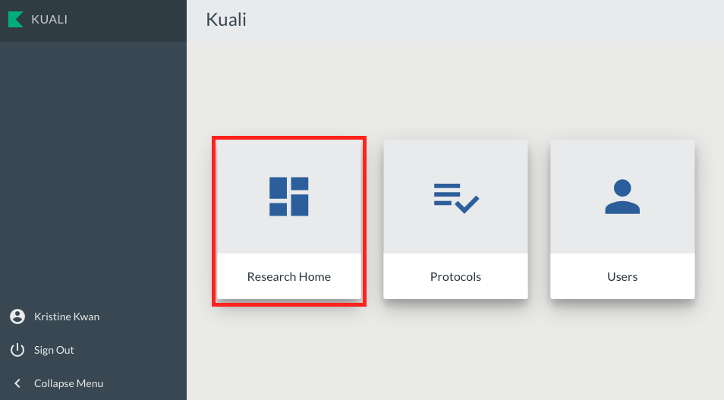
KUALI RESEARCH HOME

Slide 17
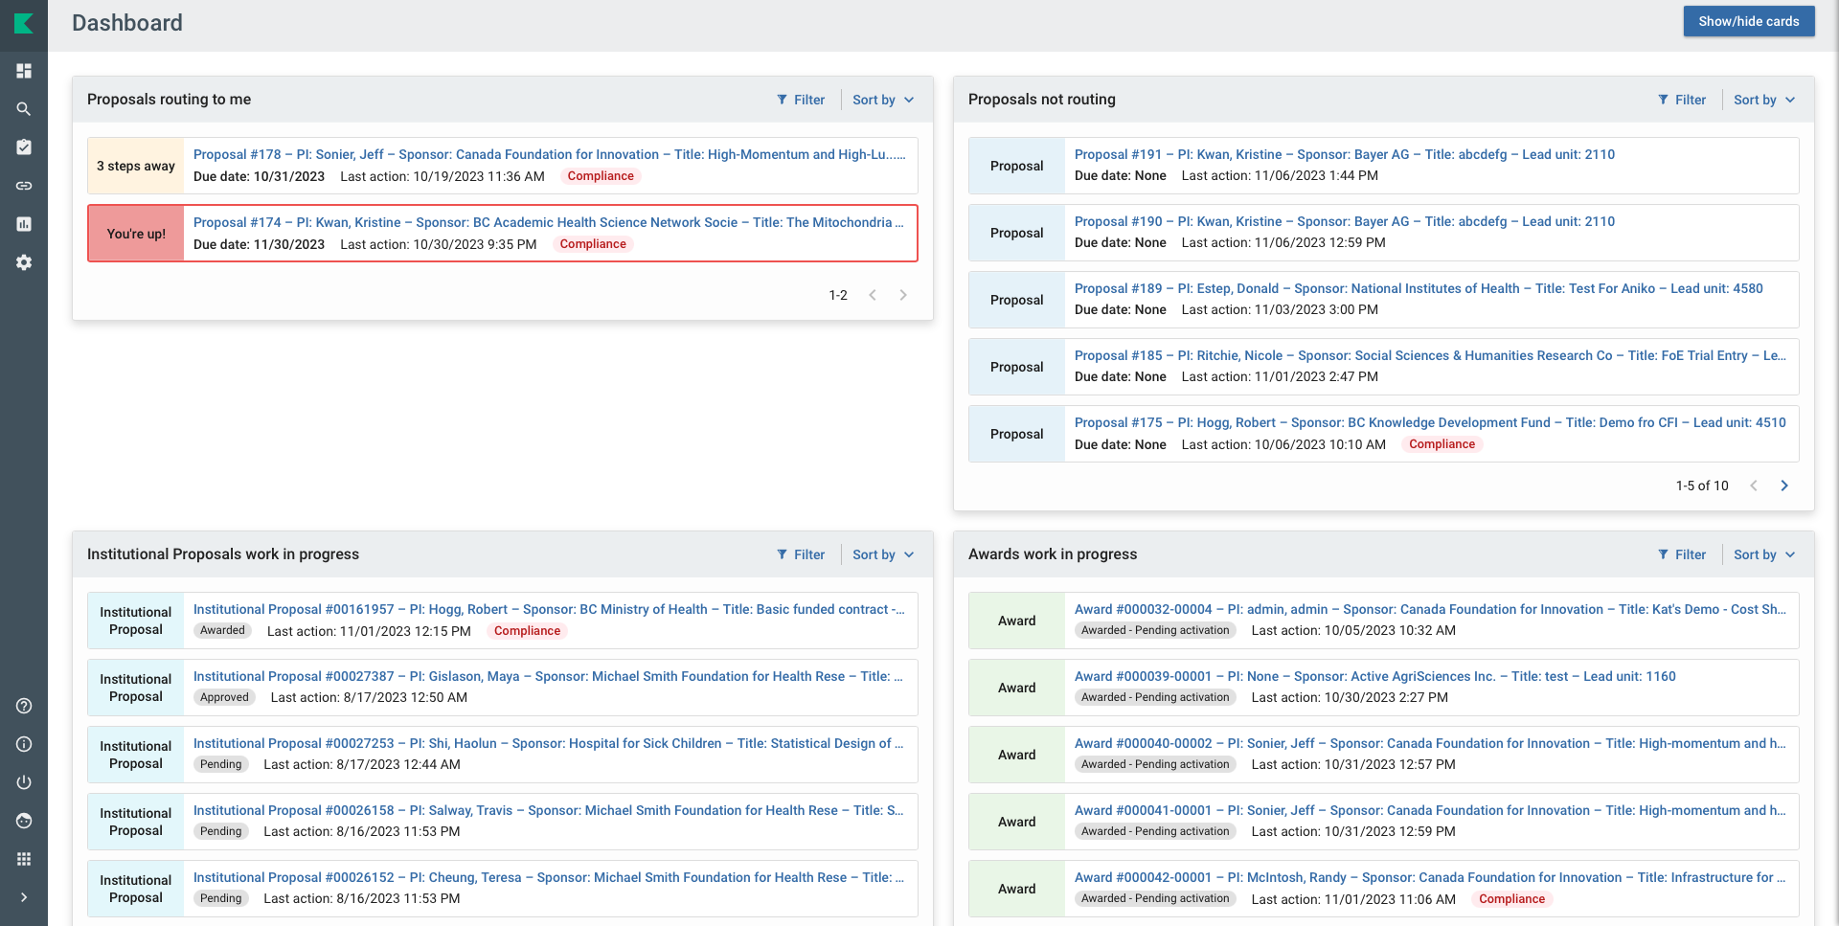
KUALI RESEARCH DASHBOARD
Notes:
The Proposals Routing to Me Card on the dashboard home page allows reviewers and approvers to easily monitor proposals that are queued up for their approval and watch for proposals they will soon have to approve. The colored “steps” tab shows you proposals that are available for your immediate approval, or if it’s one or more steps away. The details for each entry shows a summary of information along with the proposal’s due date (deadline) and who when the last action was taken.
Currently the deadline in the proposal development is not a mandatory filed for PIs because not all opportunities have a fixed deadline. We emphasize in training that if the PI knows the external deadline, they must write it in because then the Chair / Dean / ORS can filter according to deadline and act on proposals closer to deadlines. No deadline will go to the bottom if others are more urgent. Chairs and Deans need local process for workflow planning and prioritizing proposal approval.

Slide 18
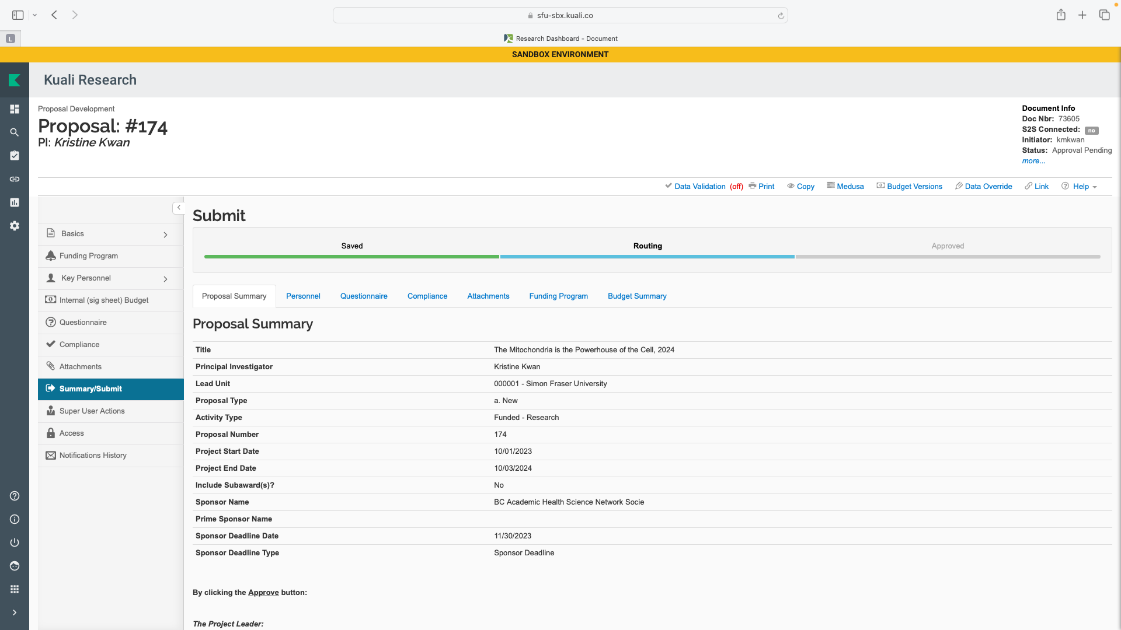
PROPOSAL SUMMARY - TOP
Note that Compliance “to dos” are an ORS responsibility. No account will be authorized until ORS verified that all applicable compliance requirements are met.

Slide 19
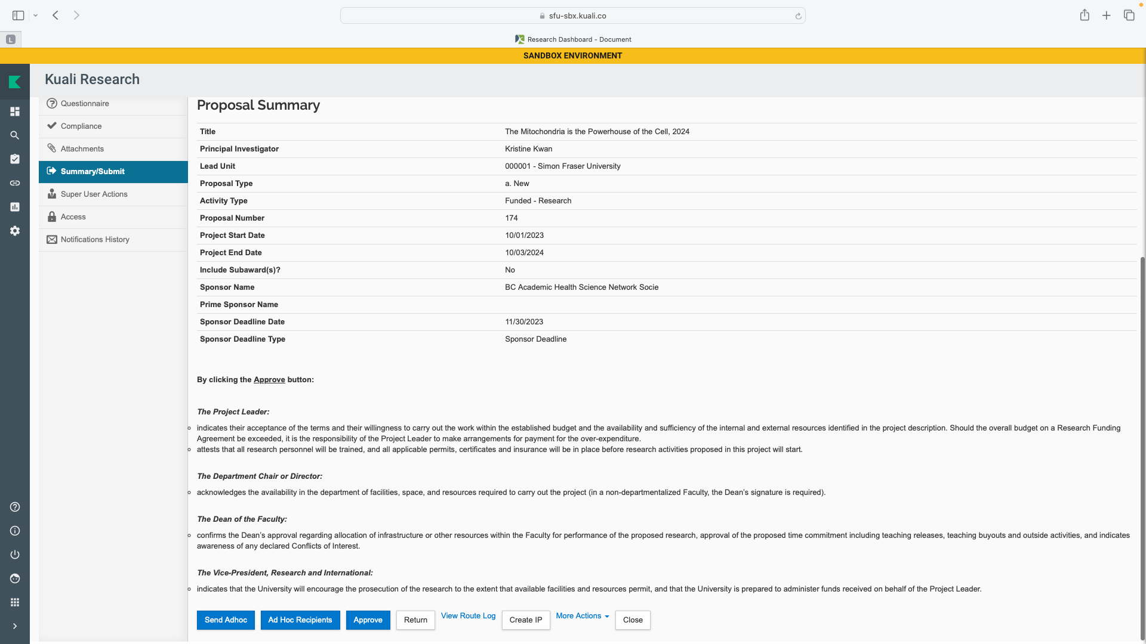
PROPOSAL SUMMARY - SCROLL

Slide 20
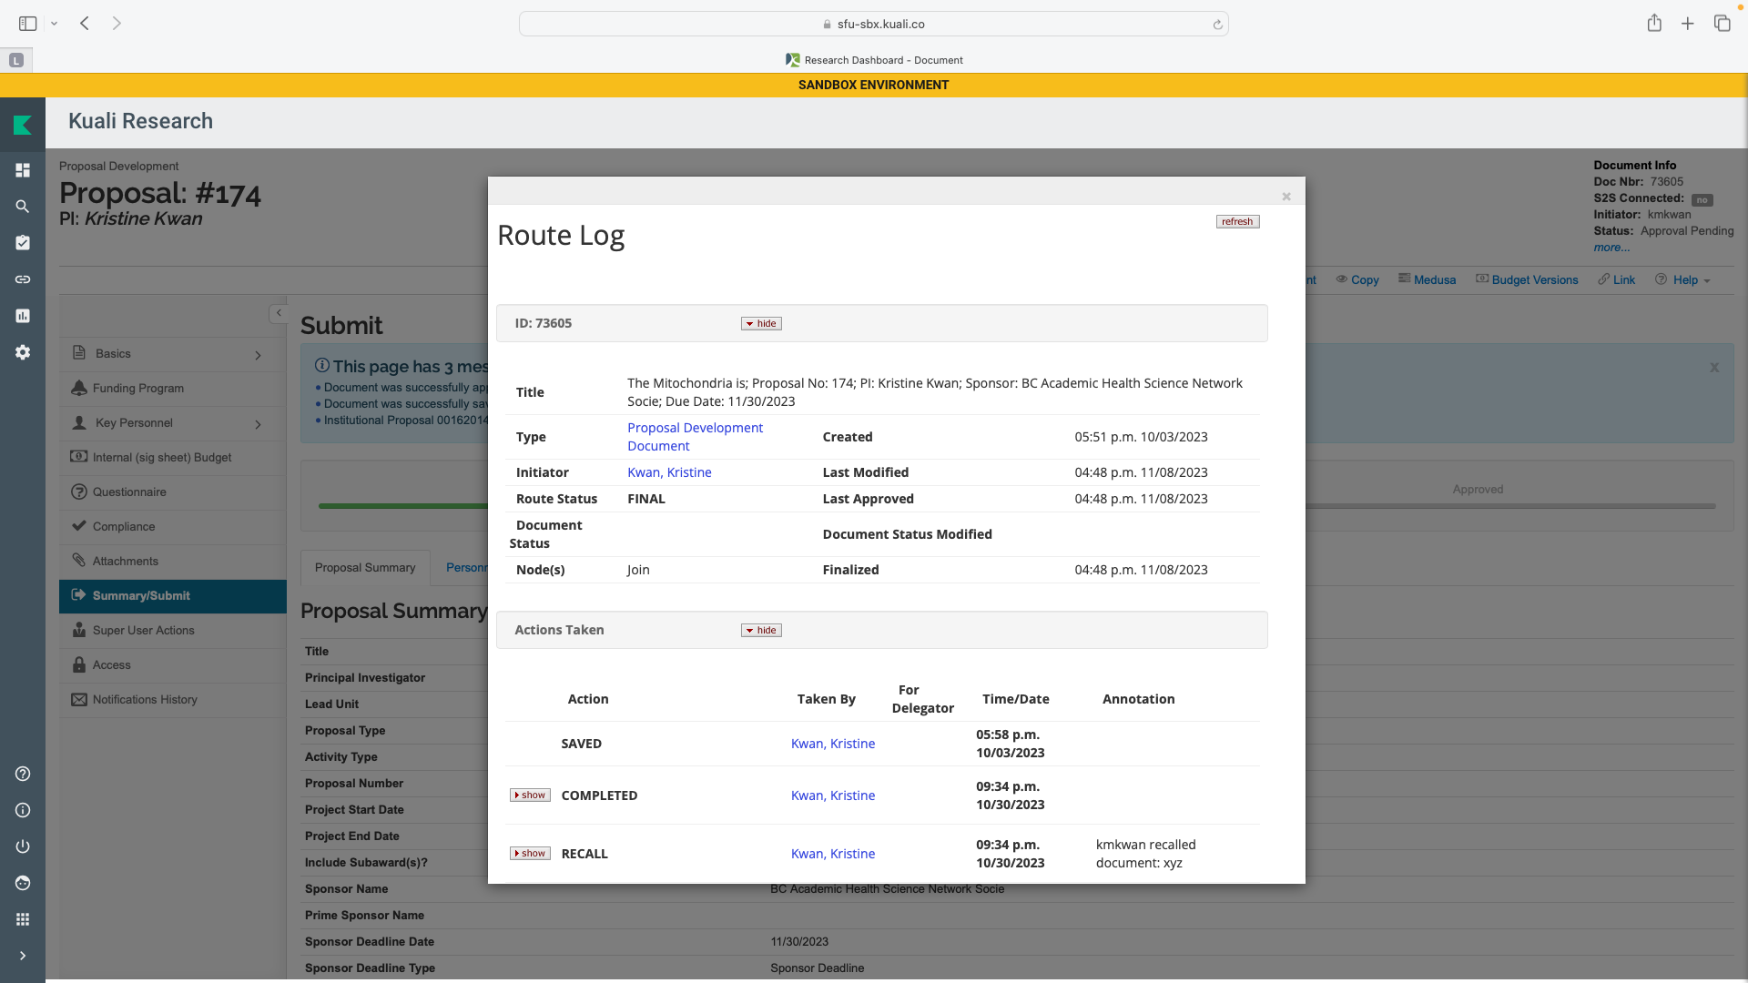
APPROVAL ROUTE LOG

Slide 21
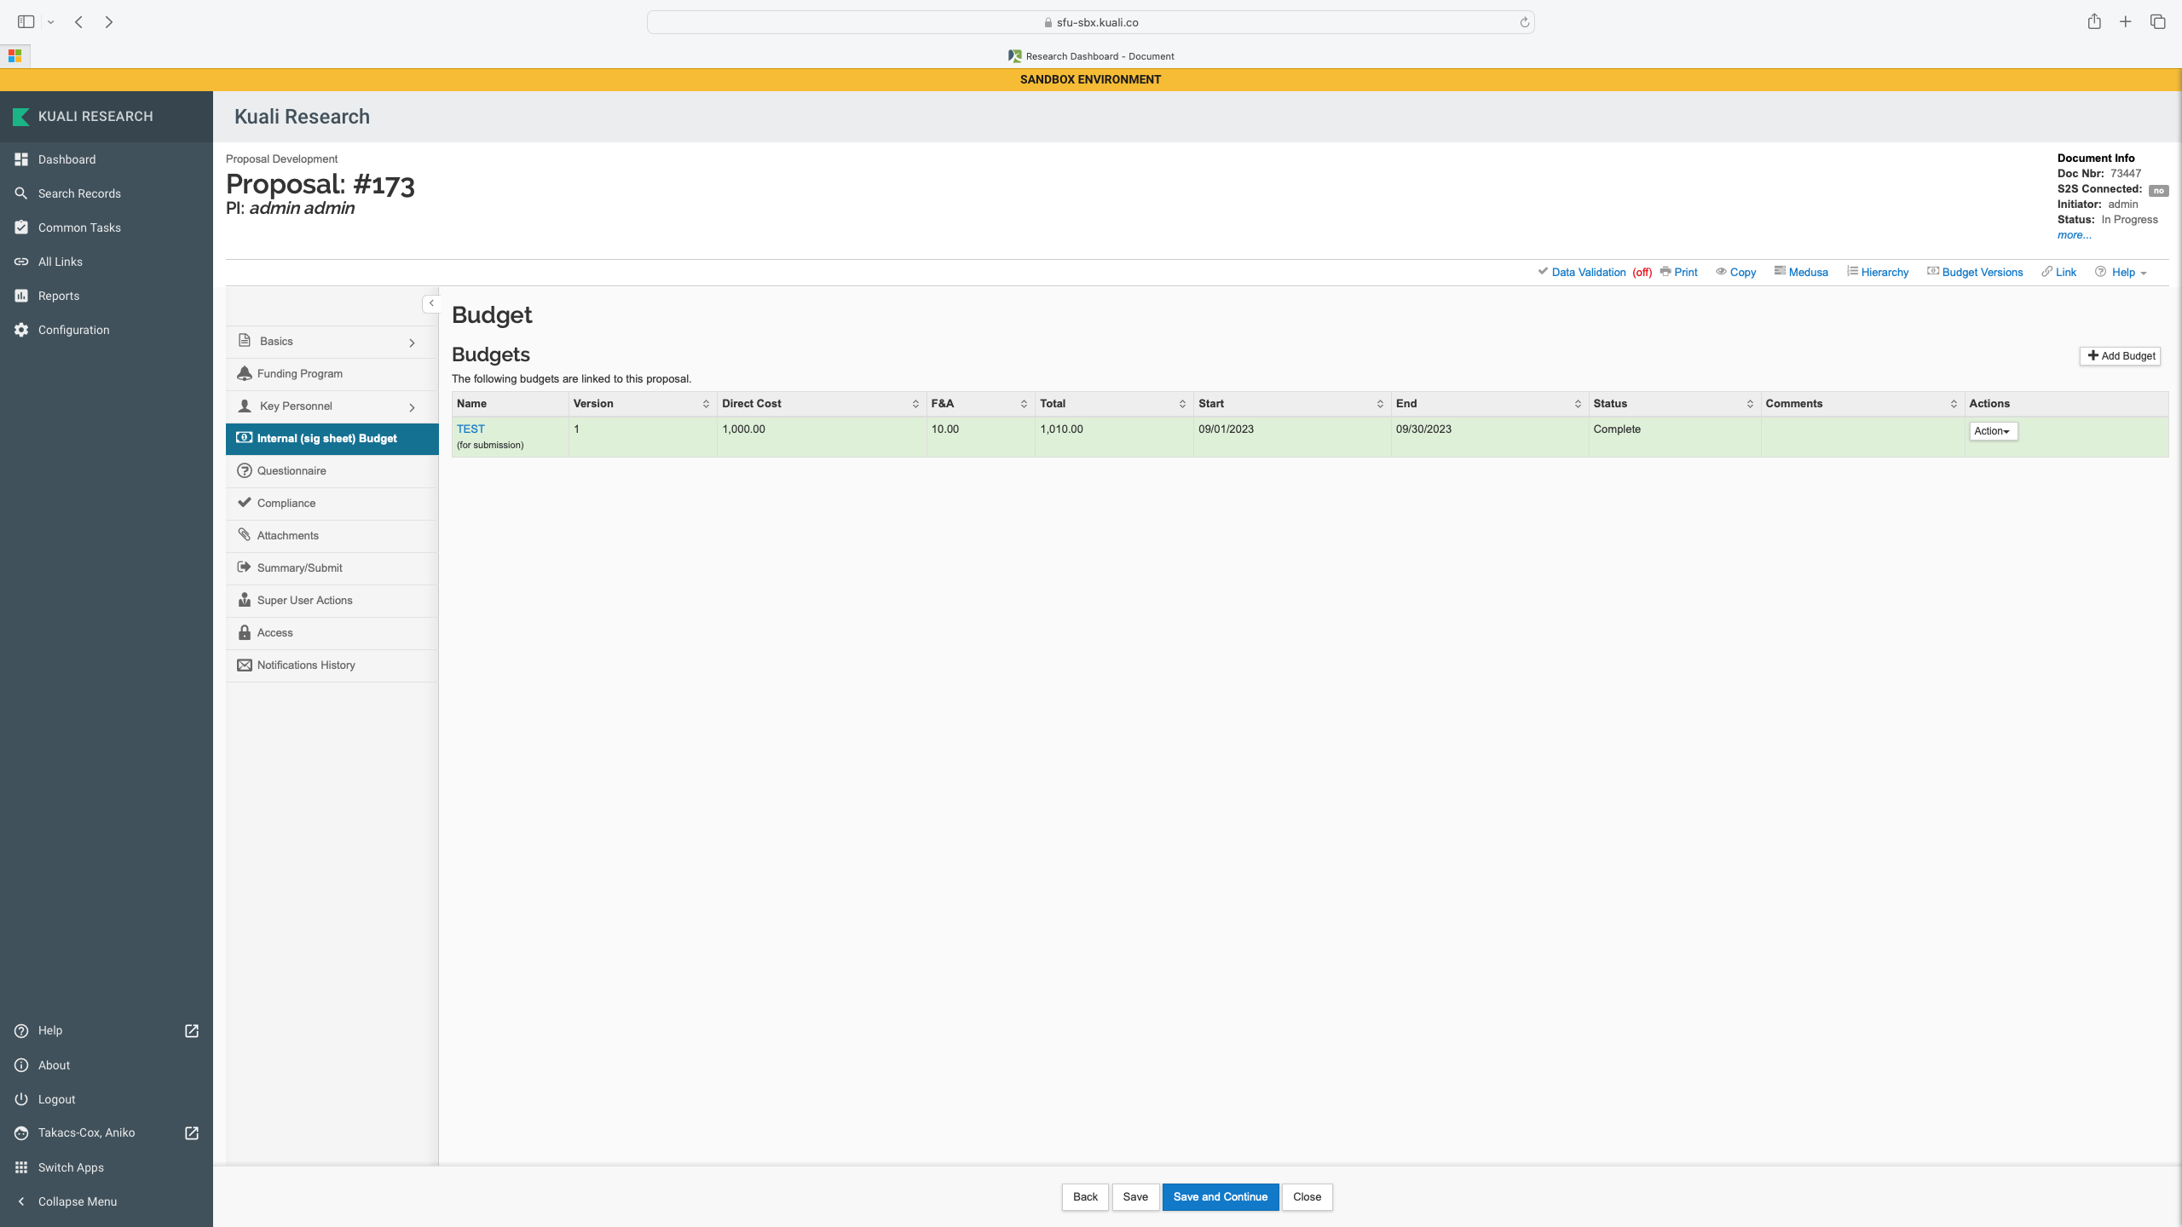
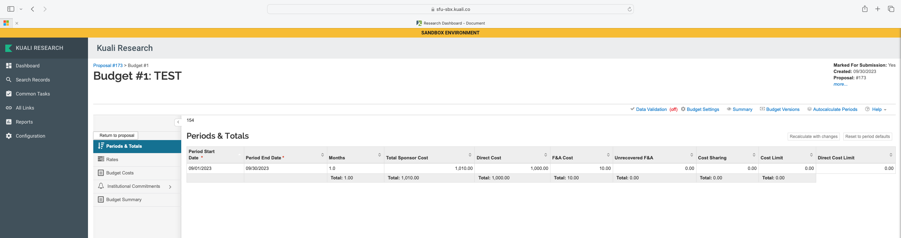
REVIEWING THE PROPOSAL - BUDGET
Periods, direct costs and F&A (overhead) only!
Details in budget questions (questionnaire) and budget document (attachments).
Note that Kuali is made for system-to-system submission that SFU does not use. It important to know differences in terminology (e.g. budget for submission versus internal (sig sheet) budget.

Slide 22
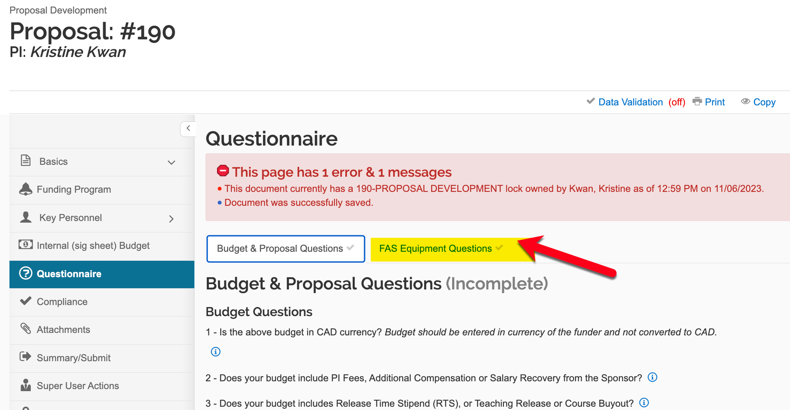
REVIEWING THE PROPOSAL - QUESTIONNAIRE

Slide 23
REVIEWING THE PROPOSAL – BUDGET QUESTIONS
Question 1 (Budget): Budget should be entered in currency of the funder
Question 2 (Budget): PI Fees, Additional Compensations, or Salary Recovery: If “yes”, amounts per period as approved by Dean outside of Kuali will be listed and email or form to verify the approval will be uploaded to KR Attachments.
If you answered “no”, no further.
Question 3 (Budget): RTS, Teaching Release, or Course Buy out: same process as Q2.
Question 4 (Budget): Does the Applied F&A follows SFU policy: If “yes”, no further action. If “no” PI will include rationale. It is the responsibility of ORS to verify if overhead policy is properly followed. Please contact ORS with questions.
NOTE: If the additional commitments towards the proposed research are not paid from the funder’s money but provided by department, faculty or SFU, information will not be entered here.
Notes:
PI training includes that if the funds they are applying for will be in part used for PI fees, RTS, etc, for them, it needs to be approved by Chair and Dean before they enter Kuali Proposal information
This question is to confirm that SFU’s overhead policy is properly followed. If PI included 25% indirect costs (F&A in Kuali) on total direct costs in the internal budget section, please select “yes” and there is no further action. If the funder has a policy different than the SFU one, please select “no” and enter a link to the funder policy regarding indirect cost or overhead or facilities and admin costs or explain variance (e.g. Funder is Tri Agency, no overhead was applied; OR Funder is NIH and 8% overhead was applied on modified direct costs OR Funder only allows line item budget for indirect cost $x was included in the budget…). If there is a special agreement on overhead, please add a note and attach the relevant documents. Please contact ata26@sfu.ca for all overhead related questions.

Slide 24
REVIEWING THE PROPOSAL – OTHER QUESTIONS
Question 5: International Collaboration: No action, for stats only
Question 6: Will you Conduct the Research Only on SFU premises
- If “yes”, no action.
- If “no” skip Question 6.1: Will you conduct the proposed research at SFU’s Affiliates? For back-office use, no action, move to next sub-question.
Question 6.2: Will you conduct the proposed research at the premises of any other organization (e.g. leased space, partner organization, industry partner lab)?
- If ”no” move to next sub-question.
- If ”yes” name of the organization and/or the location will be provided for Approver to follow appropriate internal process.
Question 6.3: Does the proposal include field work?
- If ”no” move to next sub-question.
- If ”yes” you can review where the field activities will take place.
NOTE: PIs receive reminder in KR that all applicable permit, license, compliance, security, certificate, training, etc. requirements must be met before proposed activities commence.
Notes:
If all proposed activities are at SFU campuses or working from home, there is no further action. This includes SFU office and lab space, not businesses, services, or leased facilities happening to be on SFU campuses like institutes, elementary school, and daycare.
If PI conducts work at facilities of an SFU affiliate, or other external organization including leased space, partner organization, industry partner facility or doing field work, will have follow up questions to answer depending on proposed research
SFU has a finite list of Affiliation Agreements that govern our relationship and requires that we track research activities we perform on their premises. If you have questions about SFU’s Affiliates, please contact ors@sfu.ca
If you PI is planning to conduct research in the field, will select “yes” and describe in the text box where will the field work take place.
Principal investigators training includes that they must submit annual Field Activity Plans at least 2 weeks ahead of any fieldwork. While this is a proposal and it is uncertain whether or when the activities will start until a funding decision is made, completing the plan and related paperwork can be time consuming, they are asked to become familiar with the requirements to ensure they have everything in place by the time project activities start. Field Activity Safety Guidelines and relevant forms are available from the Safety & Risk Services Field Activities webpage. https://www.sfu.ca/srs/work-research-safety/research-safety/field-safety.html.

Slide 25
REVIEWING THE PROPOSAL – OTHER QUESTIONS
Question 7: Indigenous Research (engaging with or studying people, culture or their wisdom)
- if “no” no action
- if “yes” you can review 1) List of indigenous groups involved 2) description of how PI has or will secure indigenous groups’ approval for the proposed activities.
Question 8: Are you seeking any of the following Physical Resources
1) additional space, 2) additional facilities, 3) renovations, 4) retrofitting, 5) new equipment, or 6) other resources.
- if “no” no action
- if “yes” review all selected items and verify approval through Attachments
Question 9: SFU Core Facilities
- if “no” no action
- if “yes” will be reportable for tracking, no approver related action
Notes:
Conducting indigenous research in the context of this questionnaire is defined as: Research in any field or discipline that is conducted by, grounded in or engaged with First Nations, Inuit, Métis or other Indigenous nations, communities, societies or individuals, and their wisdom, cultures, experiences or knowledge systems, as expressed in their dynamic forms, past and present. Indigenous research can embrace the intellectual, physical, emotional and/or spiritual dimensions of knowledge in creative and interconnected relationships with people, places, and the natural environment. Canada specific, not international.
If you are indigenous and working in your own community, this is not applicable.
NOTE: Special requirements need to be approved before routing KR Proposal for Chair and Dean approval. Each Dean has their own process for approval, please make sure you are familiar with the requirements of your faculty. Please note that if there is a special requirement, the attachment of a supporting document is mandatory in Kuali to proceed.
SFU has 8 core facilities and 4 other central and faculty-based facilities (e.g., 4D labs, Big Data Hub, Digital Research Alliance Canada) and several extra Departmental Units. These units provide services to researchers and it is important to track what research activities are utilizing their services. PI will select ALL THAT APPLY
Big Data Hub
4D labs
BIO3 Lab
eBRAIN Lab
ImageTech Lab
WearTech Lab
Public Knowledge Project PKP
Library
Animal Care Facility
Supercomputer CEDAR
Research Data Centre
Digital Research Alliance Canada

Slide 26
REVIEWING THE PROPOSAL – OTHER QUESTIONS
Question 10: Does your proposal include Co-applicants
- if “no” no action
- if “yes” all co-PIs (SFU or external) should be listed in the attached proposal.
Question 10.1 Are any of your co-applicants from SFU?
- if “no” no action
- if “yes”, see answer to Question 10.1.1 Are any of your SFU Co-Applicants providing additional resources?
- if “no” no action
- if “yes” check that PI either has verification that approvals were secured, or that PI acknowledges that approvals must be secured before project start. Please follow internal process for verification, follow up and tracking.
Question 11: Institutional support letter or contributions by the OVPRI
- if “no” no action
- if “yes” review PI response to support letters and contributions.
NOTE: Question 11 will not track commitments made within Department, School and Faculty at go live. Only commitments tracked by ISA are listed.
Notes:
Similarly to tracking special approvals for physical resources in your Faculty, if co-PI made promises towards these activities from a different Sfu department, they need to be approved by their Dean and evidence need to be communicated here.

Slide 27
REVIEWING THE PROPOSAL – FYI COMPLIANCE
No account will be authorized until ORS verified all bold typeset compliance requirements are met.
Human Ethics
Animal Care
Biohazard
Conflict of Interest Management Plan*
Radiation
Cannabis
*COI Management Plans are processed and approved in the Faculties. Please use internal process to make sure all required documentation and approval are in place for COI Management Plan Approval. KR will only hold the approved plan.
NOTE: there are several other certification and compliance requirements that could be applicable to a proposed project. It is the responsibility of the PI to make sure they do their diligence in exploring what is applicable and completing it before starting the funded project. Please contact ors@sfu.ca for a list of most common requirements.
NOTE: PIs cannot procced without choosing a compliance entry. If they have none, they must select “none”.

Slide 28
ATTACHMENTS
Attachment Type | Description
Sponsor Proposal | Mandatory
Sponsor Budget | Mandatory
Letter of Support | If selected on the questionnaire
Approver-Requested Justification | As applicable
CFI Approved line-item budget | Mandatory
Outside Activity Report | FAS only
Dean Approval | For PI fees/additional compensation/salary recovery – if selected in the questionnaire
Conflict of Interest (COI) Management Plan Approved by the Dean | If applicable
Statement of Work (SOW) for Contracts | If applicable
RTS/Course Release | If applicable
Approver Attachment | If applicable
Other | If applicable

Slide 29
PROPOSAL SUMMARY - SCROLL

Slide 30
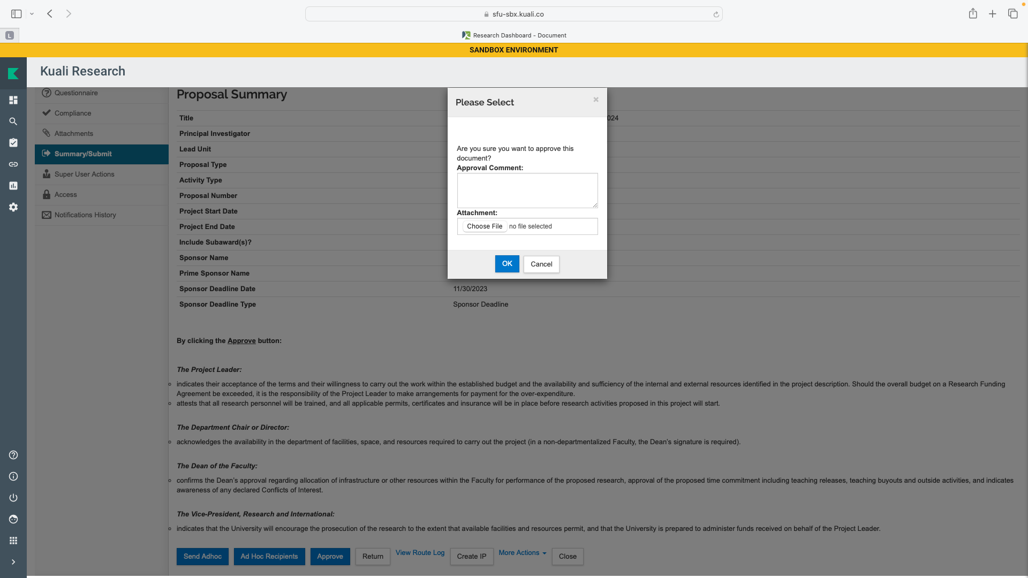
APPROVING THE PROPOSAL

Slide 31
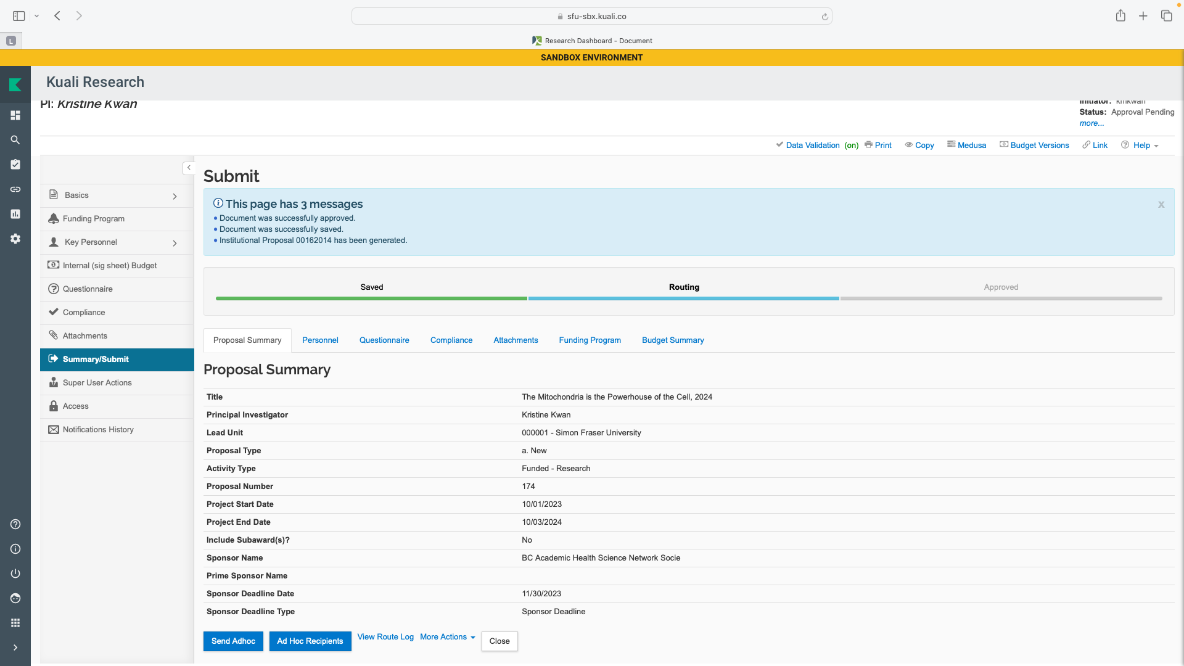
APPROVING THE PROPOSAL
NOTE: Institutional Proposal will only be generated after ORS approval

Slide 32
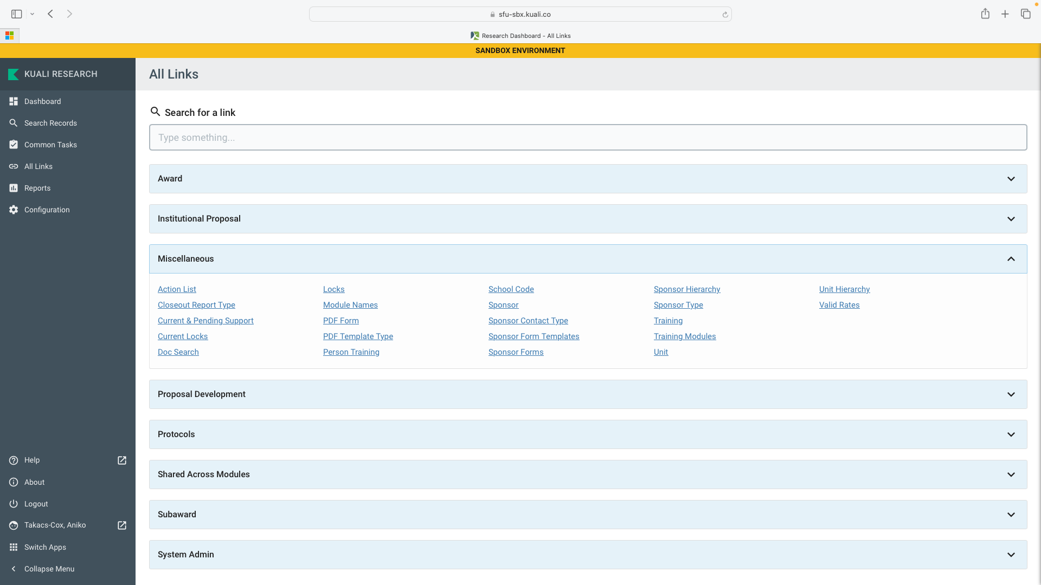
NOTIFICATION OF SECONDARY APPROVER

Slide 33
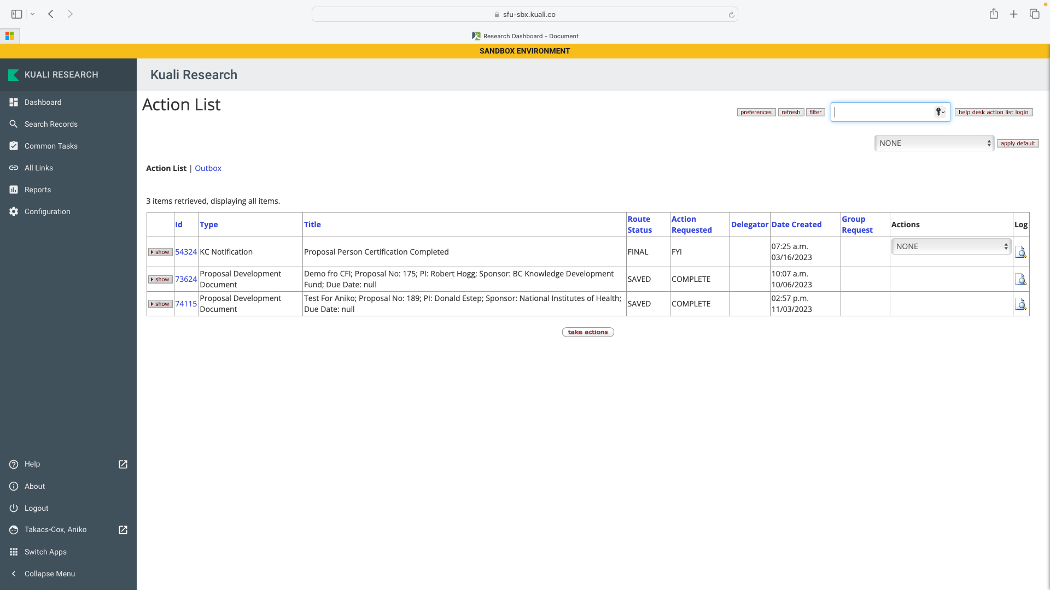
NOTIFICATIONS OF SECONDARY APPROVER

Slide 34
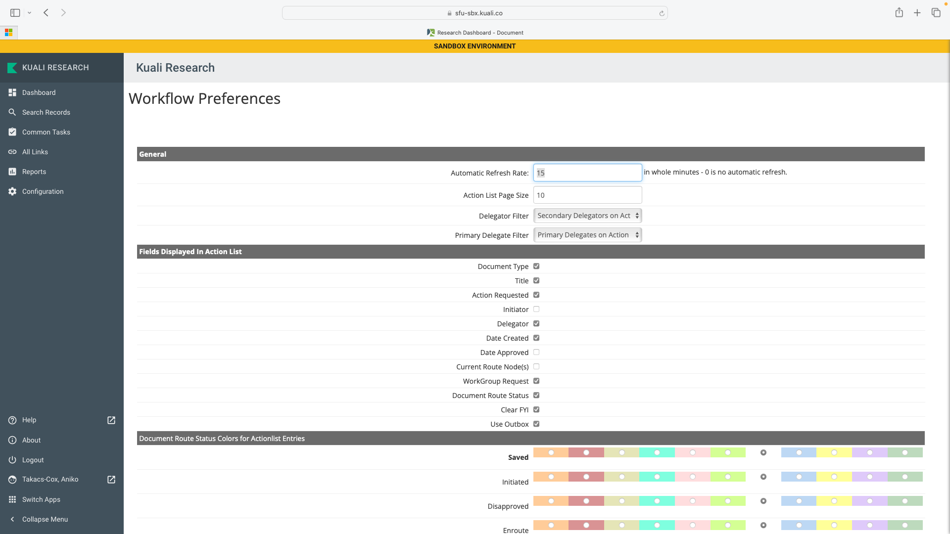
NOTIFICATION OF SECONDARY APPROVER
Scroll Down

Slide 35
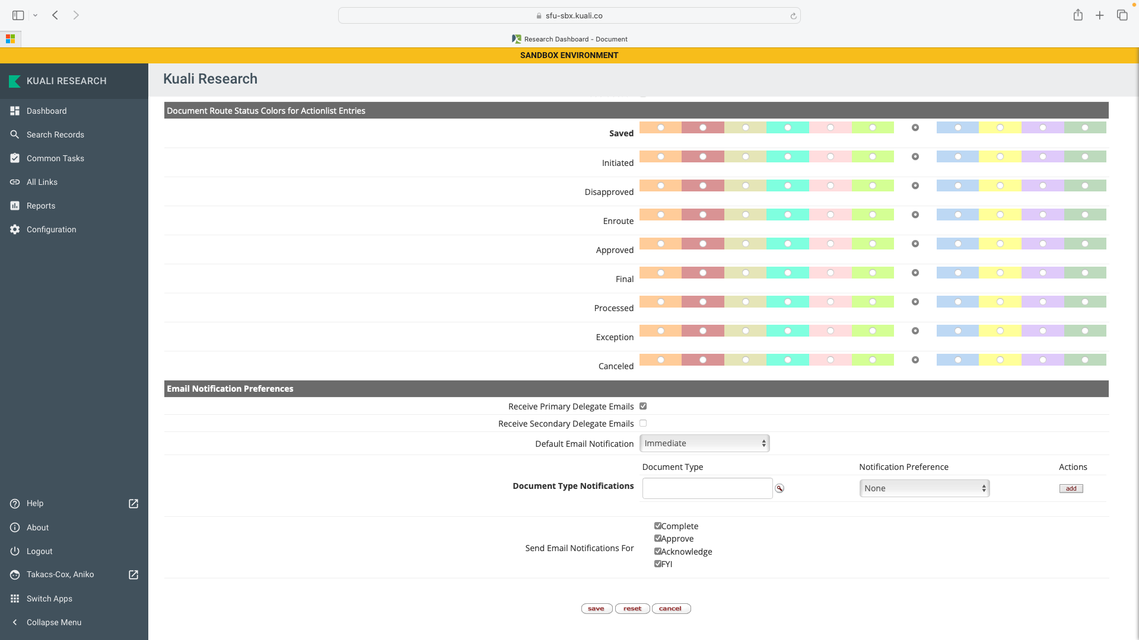
NOTIFICATIONS OF SECONDARY APPROVER

Slide 36
APPROVING / REVIEWING SPECIAL CONSIDERATIONS
KR approval workflow will not change how proposals are submitted to external funder
KR approval workflow will not change how SFU negotiates and signs contracts for research
KR approval workflow will not copy detailed budget info
KR approval workflow will not be used for commitment tracking
Approval of Contract Approval Memo will not be in KR at the time of go live
KR full reporting configuration will not be available at go live

Slide 37
WHAT IS NEXT?
Finalizing Manual and Sandbox
  inline help text
  role based access
Invitation to test Sandbox, UAT
Make minor adjustments to KR if necessary, before go live
Follow on training January 2024
Work on modules, integration and migration for back office
Go Live March 2024
Continue adjusting KR as necessary

Slide 38
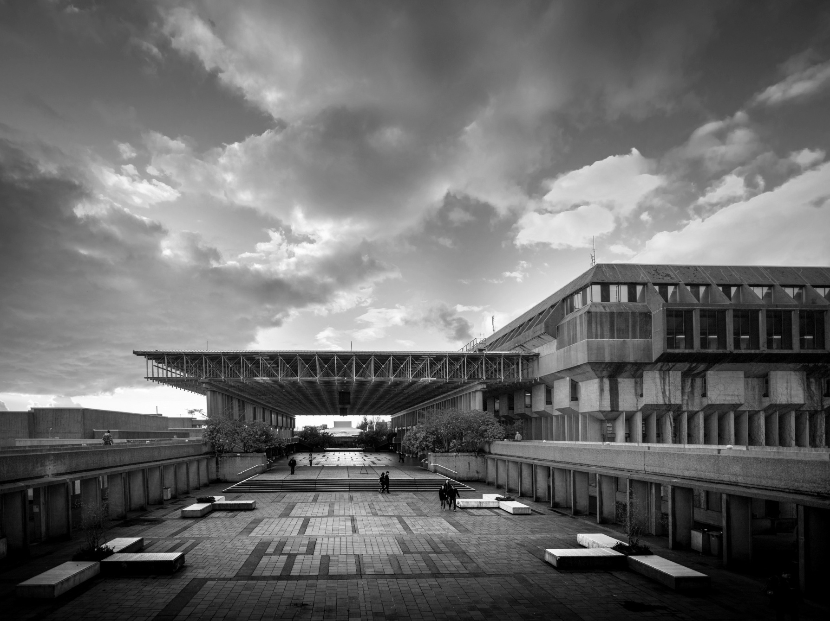
Notes:
HOW TO CHANGE IMAGE:
Click on image box.
Go to “Picture Format” tab
Click “Change Picture”

