Slide 1
Research Enterprise System (RES) Program: Project 1 (Project Costing) FAST Training February 2022

Slide 2
Agenda
Background
Objective
Project Costing Changes
New FAST view
Questions/Feedback
Next Steps

Slide 3
Background

Slide 4
Background
Project Costing introduced new data elements that needed to be displayed in FAST
Current FAST reports (views) could not display some of this data without changes
Workshopped the look and data presented in a new report (view) for research community
Created new Award List report to display this information for fund 30s projects
See the entire project, broken down by project budget year (e.g., Oct 1 – Sept 31)
Different from current FAST reports, which are all about current SFU fiscal year

Slide 5
To Date…
From January 2021-present, we met with key stakeholders (RES Champions, PIs, Research Accounting, ISA) to workshop a new FAST report with these objectives:
to provide the research community with a view of their direct spending balance (“how much project money do I have remaining?") that is as up to date and complete as possible
to maintain the existing set of FAST reports used today (Operating Statement, Research Expense Report, etc.)
Stakeholders provided key feedback and suggestions
Reviewed with project team members to ensure Project Costing requirements were met

Slide 6
Objective
To provide training on the new FAST Award List report ahead of Project Costing go-live on February 28, 2022

Slide 7
Housekeeping
Walkthrough will:
Cover layout of the new Award List report
Cover the data presented through this view
Not cover all the nuances of the converted project data
Training Session will be recorded for reference
Quick Guides will be provided to supplement training

Slide 8
What is Project Costing Delivering?
Award demographics
project title, start/end date, total awarded, status, PI name, etc.
Project Budget years calculated against project’s unique FY
(e.g., Sept 1– Aug 31), not bound to SFU’s FY (Apr 1 – Mar 31)
Encumbrances calculated against project’s current and future FY, not bound to SFU’s FY
Encumbrances calculated for both salaried and hourly resources and employee-level payroll detail
Project attachments (Notice of Award, amendments, etc.)
New FAST report called the Award List created to show the above information for fund 30s projects

Slide 9
New FAST Award List Report

Slide 10
Award List 101
What can I find in the new Award List report?
Fund 30s Research Projects
View entire project’s financial info
past, current, and future
View the project according to its unique project fiscal year
E.g., Sept 1 - Aug 31
View project’s non-financial information
PI, Sponsor/Program, Start/End Date, Status, Project Title
Access key project supporting documents
Notice of Award, Contract, Amendments, Certificates
View Payroll Encumbrances calculated for salaried and hourly employees
Projects listed in this report will be determined by your current FAST access

Slide 11
What’s Not Changing?
No current FAST reports are going away, the Award List is just an additional new report to use
How frequently FAST data is updated (nightly)
How frequently FAST is updated with payroll information (actuals and encumbrances) (i.e., every 2 weeks)
Your access to FAST based on your account, including drill-to-payroll ability

Slide 12
Award List – Level 1
Let’s go into FAST now and check it out!
Notes:
At this level, we’ll:
Walk through what each column header means
You will see all the fund 30s projects you have access to (as a PI, then as a dept manager, then as a director)
Can export this list to excel to sort/filter further
Some converted projects will appear to have a total award of zero, these are how PI fees, RTS, etc. were managed (as separate projects spawned from the main project) and were converted as such.

Slide 13
Award List – Level 1
Column Header | Definition (hover over column header)
Project | Project number assigned by SFU
Status | Used to communicate where the project is at in its lifecycle
PI | Principle Investigator
Sponsor | Sponsor as indicated on Award Letter or Fully Executed Contract
Program | Sponsor Program, if applicable, as indicated on Award Letter or Fully Executed Contract
Project Title | Title PI submitted with Project’s proposal
Notes:
Note: where today you see the old project description (concatenated title), that’s been replaced by the actual proposal title
This impacts the other FAST reports as well

Slide 14
Award List – Level 1
Column Header | Definition (hover over column header)
Award Start Date | Project start date indicated on Notice of Award or fully executed contract
Award End Date | Project end date indicated on Notice of Award or fully executed contract, or as determined by an approved amendment (i.e., an extension)
Auto Extension Date | 1-year auto-extension date as defined by the Tri-Agency Guide on Financial Administration. If there is an Auto-Extension as part of the award, then the Auto-Extension field in FAST will mirror the award end date.

Slide 15
Award List – Level 1
Column Header | Definition
Total Awarded | Total amount awarded to PI indicated on Notice of Award or fully executed contract
Approved Total Spending Budget | Total direct and indirect (overhead) budget approved for spending
Approved Total Overhead Budget | Total overhead budget approved for allocation
Direct Spending Balance | Balance available for spending (approved total spending budget less actual direct expenditures, payroll and non-payroll encumbrances, overhead actuals, and overhead cost remaining)

Slide 16
What is a Project Status?
Status | Meaning | When would it happen? | Can PI spend? | Can PI encumber?
A | Proposal Awarded | RS processes Notice of Award info in system | No | No
E | Partially Released Budget | RS releases part of year 1 budget | Yes, partial budget for protocol dev. | Yes
O | Project Open | RS releases full year 1 budget | Yes | Yes
H | On Hold | RS asks RA to put on hold due to an issue* with the project | No, except for committed payroll** | No
S | Closeout Started | Project has reached end date | Only expenses incurred prior to end date | No
F | Closeout Final | Sponsor financial reporting has been completed | No | No
C | Closed – No Further Activity | Final reporting has been received and accepted by sponsor | No | No
Note: all converted projects will initially be in status ‘O’ after go-live
Notes:
All statuses will be visible in new FAST views
Not all projects will necessarily move through all the statuses
Status E is if PI requests some funding to develop an ethics proposal
*Potential reasons for H status: Changes in certificate (doesn’t happen often), lapse in COI, employment change (quickly flip), change in Compliance, or change in eligibility
**Could be a commitment in the system already, or PI has committed to employee but hadn’t submitted PAF paperwork yet

Slide 17
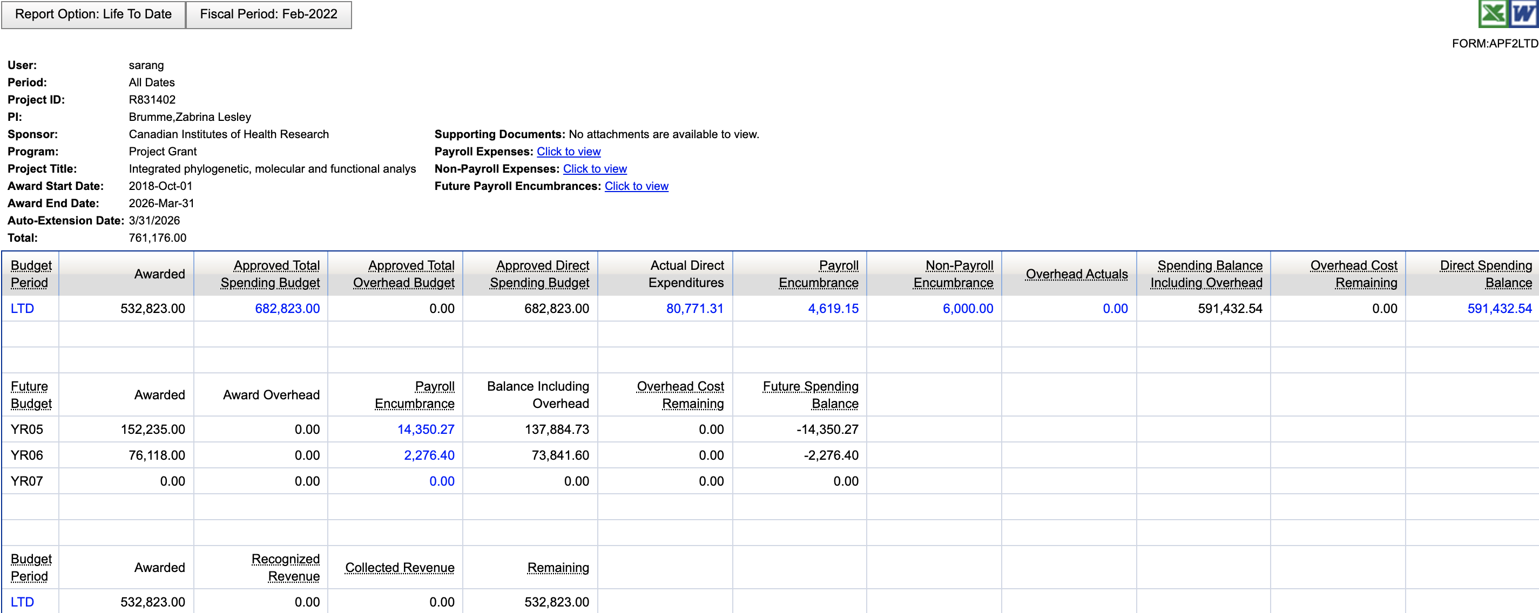
Award List – Level 2 “Project View”
Note: This is a test “new” project
Note: Project View defaults to LTD
Notes:
At this level, we’ll:
Take a look at some of these new columns
Drill into LTD to show the project years broken out
Drill into Approved Total Spending Budget
Drill into Actual Direct Expenditures
Drill into Payroll Encumbrances, all the way to employee details
Drill into Non-Payroll Encumbrances
Drill into Direct Spending Balance to show what a Sub-Out will look like going forward
Drill into Payroll Expenses, Non-Payroll Expenses, and Future Payroll Encumbrances (what’s left of current project year + future years’ encumbrances)
Show how you can select LTD through to a period, or select a date range

Slide 18
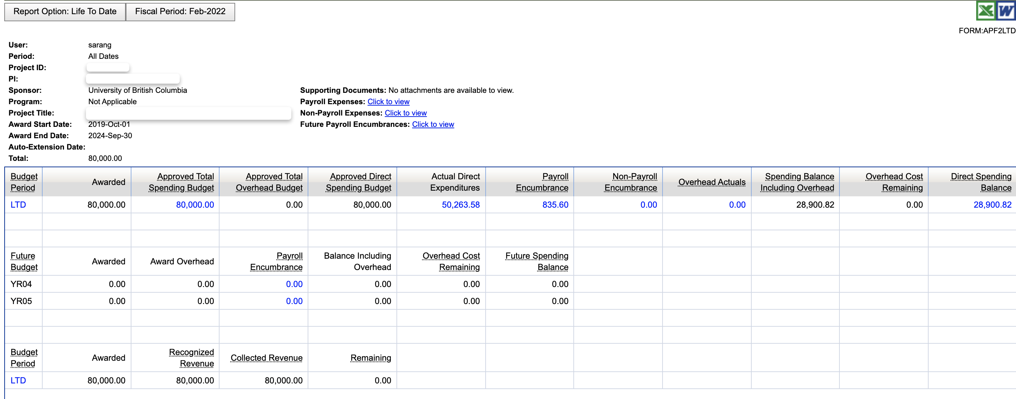
Award List – Level 2 “Project View”
Note: This is a real converted project
Note: Project View defaults to LTD

Slide 19
Award List – Level 2 “Project Year View”
Note: For converted projects that align with SFU’s Fiscal Year (most tri-agency projects that run April 1-March 31) , there should be no value for past years’ payroll encumbrances.
For those that do not align with SFU’s FY (like this example, Oct 1-Sept 30) there may be a value for past years due to past encumbrances being calculated on a SFU FY basis.
The payroll encumbrance reflected in the current project year is accurate.
Note: For converted projects, recognized and collected revenue were all posted to the current project budget year and Approved Total Spending Budget will all be posted to the conversion month (Feb 2022)

Slide 20
Award List – Level 2 “Project View”
Note: Supporting Documents for converted projects won't automatically be uploaded after go-live (far too many to manually upload). Requests to upload the supporting documents for converted projects can be made to Research Services on a case-by-case basis.

Slide 21
Award List – Level 2 “Project View”
Column Header | Definition
Budget Period | Segregation of total awarded amount by period(s) as defined by Sponsor
LTD (Life to Date) | All transactions related to the current and prior budget periods
Approved Direct Spending Budget | Approved total spending budget less approved total overhead budget
Payroll Encumbrance | Salary encumbrance commitments not yet expensed
Non-Payroll Encumbrance | Non-salary encumbrance commitments not yet expensed (e.g., purchase orders and requisitions)
Notes:
Note: Approved total spending budget – long description can be updated beyond generic “direct cost exp"

Slide 22
Award List – Level 2 “Project View”
Column Header | Definition
Overhead Actuals | Overhead amount incurred to date
Spending Balance Including Overhead | Spending Balance including overhead costs remaining (approved total spending budget less actual direct expenditures, payroll and non-payroll encumbrances, and overhead actuals)
Overhead Cost Remaining | Amount of overhead costs remaining related to the current budget period
Future Budget | Sponsor commitment for providing funding beyond the current budget period

Slide 23
Award List – Level 2 “Project View”
Column Header | Definition
Recognized Revenue | Revenue that has been recorded in the system (when the project earns the revenue not necessarily when it is received, and that is based on costs that are incurred, which is the accounting practice SFU follows)
Collected Revenue | Revenue that has been received and posted in the system (i.e., the actual cash the sponsor has paid)
Remaining | Awarded Amount less collected revenue
Note: For Project Costing go-live, recognized and collected revenue will be the same, the difference will come into effect once the A/R and Billing project goes live.
Note: Anyone with access to the project will see the recognized revenue table, including the PI, which is a change

Slide 24
Award List – Level 3
Column Header | Definition
Source Type | Only used for CFI, represents the CFI line item number.
Activity | New fund 30s chart field value that is required. Default value for all transactions will be SPN001. Where additional activities (Sub Out, CFI funding source) have been defined they would be SPN002, etc.
Note: Most Level 2 drill downs go to the object code level > detailed transactions, with the exception of the Direct Spending Balance drill down, which drills to expense grouping level > object code > detailed transaction
Notes:
Will use project R5831401 to show how PI fees will be reflected going forward

Slide 25
Award List Tips
Before you fill out a PAF: Ensure project is in status O or E
Export Award List to Excel to sort/refine information further
Use Award List report for current and future financials
Use the existing FAST reports to reference historical direct spending balances
Awarded amount will always display as the most current value
LTD view (default) will automatically calculate any prior roll forward amounts

Slide 26
Award List Recap
What can I find in the Award List report?
Fund 30s Research Projects
View entire project’s financial info (past, current, and future)
View the project according to its unique project fiscal year (Sept 1 - Aug 31)
View project’s non-financial information (PI, Sponsor/Program, Start/End Date, Status, Project Title)
Access key project supporting documents (Notice of Award, Contract, Amendments, Certificates)
View Payroll Encumbrances calculated for salaried and hourly employees
Project view will be determined by your current FAST access

Slide 27
Questions?

Slide 28
Next Steps
FAST training will be provided for faculty and department administrative staff, and PIs, Research Accounting, Financial Reporting, ISA, and Research Services
New Award List report in FAST will be available after go-live on February 28, 2022
Send any questions to ask_res@sfu.ca
Notes:
- PI sessions are drop in sessions, this Wednesday, Thursday, and Friday

Slide 29
Thank you!

