Slide 1
Some simple, useful, but seldom taught statistical techniques
Larry Weldon
Statistics and Actuarial Science
Simon Fraser University
Nov. 27, 2008

Slide 2
Outline of Talk
Some simple, useful, but seldom taught statistical techniques
Why simple techniques overlooked
Simplest kernel estimation and smoothing
Simplest multivariate data display
Simplest bootstrap
Expanded use of Simulation
Conclusion

Slide 3
Evolution of Good Ideas in Stats
New idea proposed by researcher (e.g. Loess smoothing, bootstrap, coplots)
Developed by researchers to optimal form (usually mathematically complex)
Considered too advanced for undergrad
Undergrad courses do not include good ideas

Slide 4
What new techniques can undergrad stats use?
Simplest kernel estimation and smoothing
Simplest multivariate data display
Simplest bootstrap
Expanded use of Simulation

Slide 5
What new techniques can undergrad stats use?
Simplest kernel estimation and smoothing
Simplest multivariate data display
Simplest bootstrap
Expanded use of Simulation

Slide 6
Kernel Estimation
Windowgrams and Non-Parametric Smoothers

Slide 7
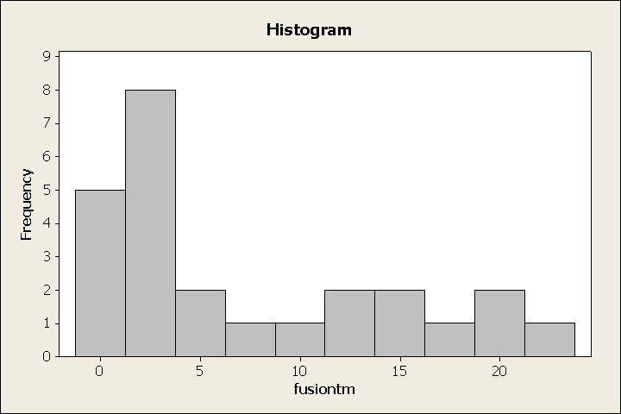
Histogram

Slide 8
Primitive “Windowgram”
Notes:
windowgram.demo()

Slide 9
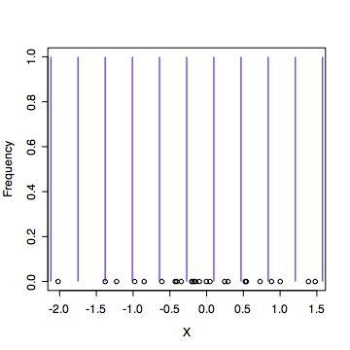
Estimate density at grid points
d
Notes:
grid.demo()

Slide 10
Windowgram
Just records frequency withing “d” of grid point.
Like using rectangular “window”
d
1
Weight Function
0
Grid point

Slide 11
Primitive “Windowgram”
Count at grid
Join grid counts
Rescale to area 1
go to R
Notes:
my.density(rnorm(50))
hist(rnorm(50))

Slide 12
Extension to “Kernel”
1
Weight Function
0
Grid point
Simple Concept?
Weighted Count?

Slide 13
Advantage of Kernel Discussion
Bias - Variance trade off - can demonstrate.
(Too wide window - high bias, low var
Too narrow window - low bias, high var )
Idea extends to smoothing data sequence

Slide 14
Concept Transition: Count -> Average
Count of local data -> Average of local data (X data only) (X,Y data)
Simplest Example: Moving Average of Ys (X equi-spaced)

Slide 15
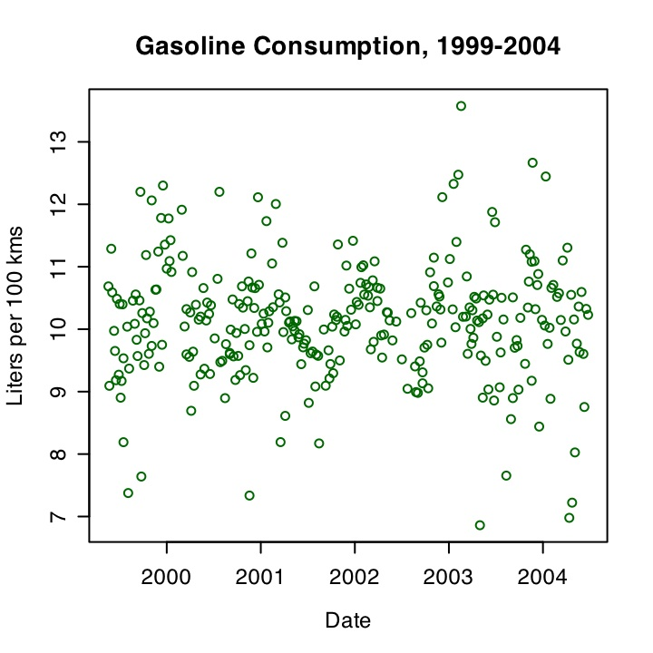
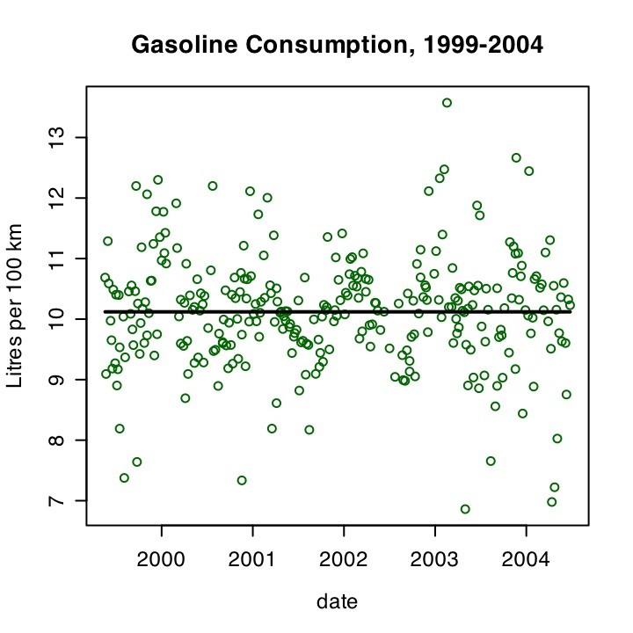
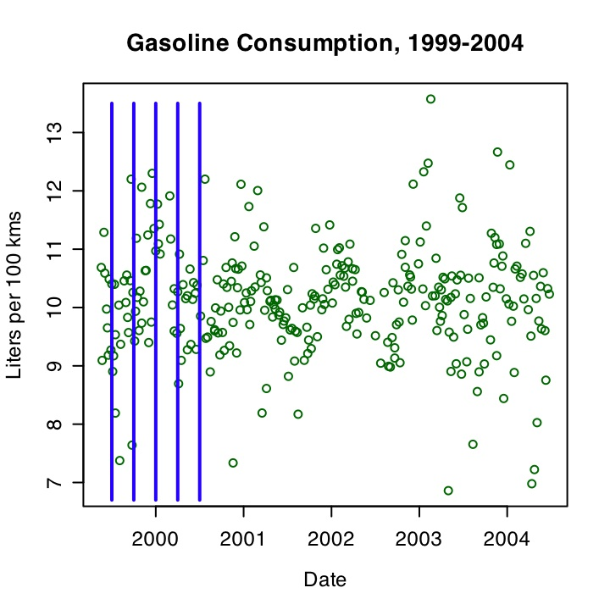
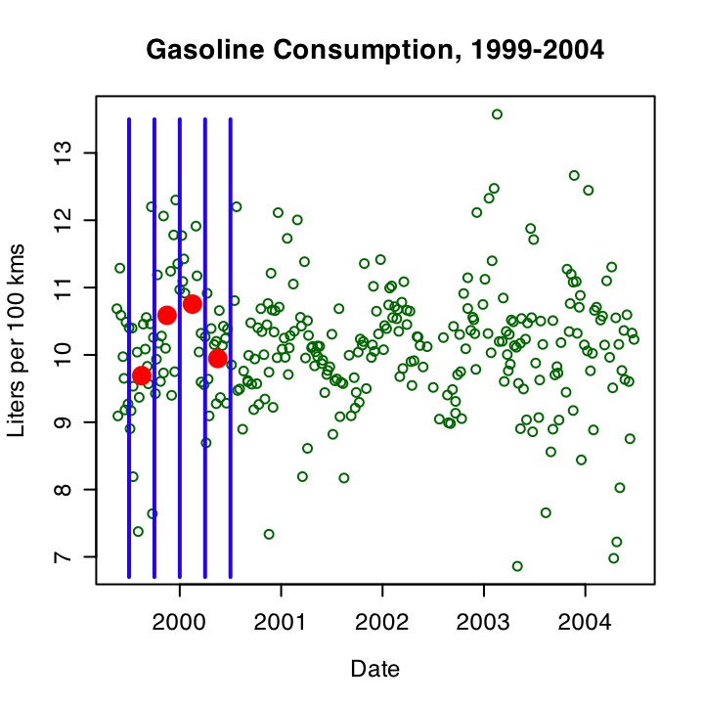
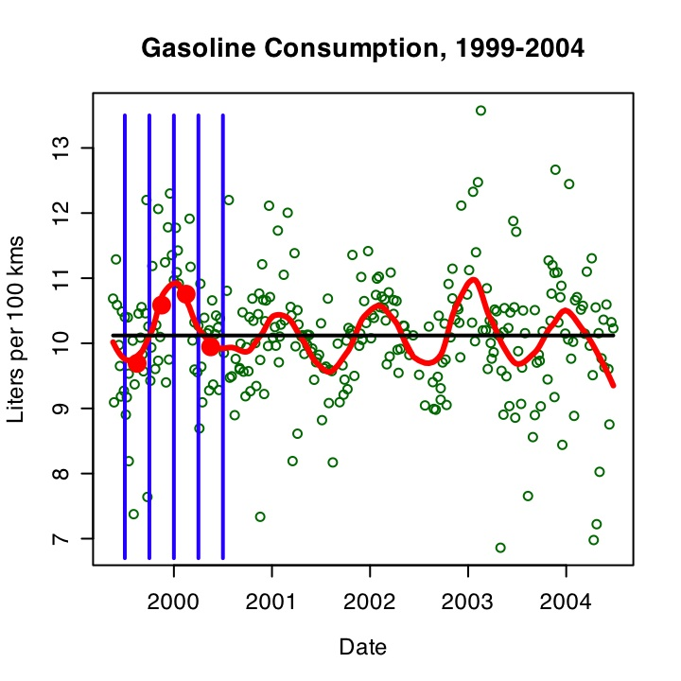
Gasoline Consumption
Each Fill - record kms and litres of fuel used
Smooth
--->
Seasonal
Pattern
….
Why?
Notes:
Lots of variability in spite of regular pattern of commuting. Pattern?
If fit a line, or even a polynomial, get straight line.
But proper way to assess is to look at vertical strips …

Slide 16
Pattern Explainable?
Air temperature?
Rain on roads?
Seasonal Traffic Pattern?
Tire Pressure?
Info Extraction Useful for Exploration of Cause
Smoothing was key technology in info extraction
Notes:
Not sure of main reason. But in Winnipeg, wave has larger amplitude ….
Anyone else have such data?

Slide 17
Recap of Non-Parametric Smoothing
Very useful in data analysis practice
Easy to understand and explain
More optimal procedures available in software
Good topic for intro course

Slide 18
What new techniques can undergrad stats use?
Simplest kernel estimation and smoothing
Simplest multivariate data display
Simplest bootstrap
Expanded use of Simulation

Slide 19
Multivariate Data Display
Profile Plots
Augmented Scatter Plots
Star Plots
Coplots

Slide 20
Profile Plot
[1] "Density" "Age"
[3] "Wgt" "Hgt"
[5] "Neck" "Chest"
[7] "Abdomen" "Hip"
[9] "Thigh" "Knee"
[11] "Ankle" "Biceps"
[13] "Forearm" "Wrist"
Notes:
[1] "Density" "Age"
[3] "Wgt" "Hgt"
[5] "Neck" "Chest"
[7] "Abdomen" "Hip"
[9] "Thigh" "Knee"
[11] "Ankle" "Biceps"
[13] "Forearm" "Wrist"

Slide 21
Augmented Scatter Plot

Slide 22
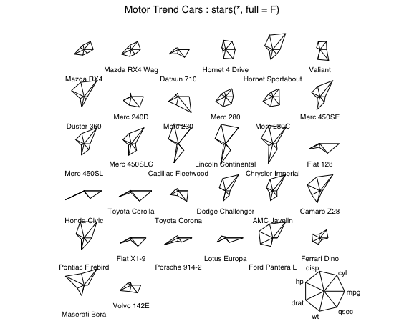
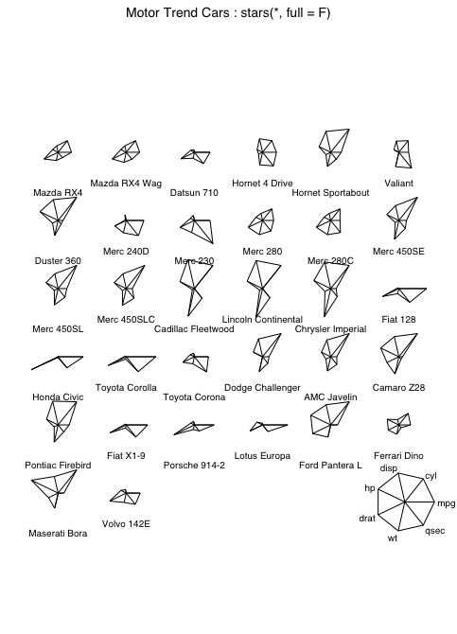
Star Plot (for many variables)

Slide 23
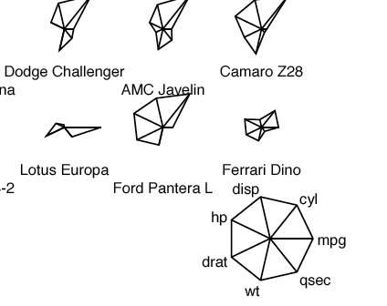
Star Plot - More Detail

Slide 24
Coplot (3 Variables here)
low hardness
medium hardness
high hardness
Fig. 7 Coplots of Abrasion Loss vs Tensile Strength Given Hardness
Interaction?

Slide 25
Ethanol Example (Cleveland)
Shows how graphical analysis sometimes more informative than regression analysis.

Slide 26
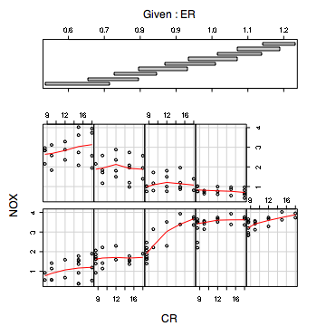
Coplot:
Visualizing an
Interaction
Notes:
attach(ethanol.df)
coplot(NOX~CR|ER,data=ethanol.df,given.values=co.intervals(ER,number=9,overlap=.5),rows=2,panel = function(x, y, ...) panel.smooth(x, y, span = .8, ...))

Slide 27
Exercise for 4rth-yr Students
Use regression analysis to model interaction in the Ethanol data.
Tough to do!
After many modeling steps (introducing
powers and interactions of predictors and
checking residual plots) ….--->

Slide 28
Call:
lm(formula = log(NOX) ~ ER + CR + ER.SQ + CR.SQ + ER.CB + ER.QD +
ER * CR)
(Intercept) 2.080e+01 8.011e+00 2.597 0.011202 *
ER -1.456e+02 3.776e+01 -3.856 0.000232 ***
CR 1.665e-01 4.023e-02 4.139 8.56e-05 ***
ER.SQ 3.066e+02 6.545e+01 4.684 1.13e-05 ***
CR.SQ -1.633e-04 1.455e-03 -0.112 0.910937
ER.CB -2.530e+02 4.944e+01 -5.116 2.09e-06 ***
ER.QD 7.201e+01 1.374e+01 5.243 1.26e-06 ***
ER:CR -1.425e-01 2.137e-02 -6.667 3.07e-09 ***
---
Signif. codes: 0 ‘***’ 0.001 ‘**’ 0.01 ‘*’ 0.05 ‘.’ 0.1 ‘ ’ 1
Residual standard error: 0.1456 on 80 degrees of freedom
Multiple R-Squared: 0.957, Adjusted R-squared: 0.9532
F-statistic: 254.3 on 7 and 80 DF, p-value: < 2.2e-16

Slide 29
As ER increases,
NOX slope against CR
decreases.
→
Interaction Negative

Slide 30
Why “Plots of Multivariate Data?”
Allows novice to see data complexity
Correct “Model” not an issue
Easy to understand and explain

Slide 31
What new techniques can undergrad stats use?
Simplest kernel estimation and smoothing
Simplest multivariate data display
Simplest bootstrap
Expanded use of Simulation

Slide 32
Resampling
The bootstrap
General resampling strategies

Slide 33
The Bootstrap
Population: Digits 1-500
R. Sample of 25.
335 214 57 35 243 32 497 111 270 32 495 294 471 484 169 163 9 389 267 147 204 463 29 205 21
Sample Mean is 225.4
Precision?

Slide 34
Resample!
Resample without replacement
Take mean of resample
Repeat many times and get SD of means
SD of means is 32.8
What did theory say? Sample SD = 167.0 n=25 so …..
Est SD of means = Sample SD/√n = 33.4
Go to R
Notes:
my.boot(rnorm(25))
my.boot.test()

Slide 35
Try a harder problem
90th percentile of population?
Data men’s BMIs 22.1 23.8 26.8 28.2 24.8 24.6 29.9 23.2 32.0 29.3 27.1 26.7 20.1 20.3 22.7 33.5 23.9 20.0 25.4 21.2 29.4 26.5 20.8 21.6 27.0
Estimate 90th percentile = 29.7 Precision?
Resample SD of sample percentiles is 1.4
Easy, useful.
Notes:
my.boot.90(rnorm(25))
my.boot.90.test()

Slide 36
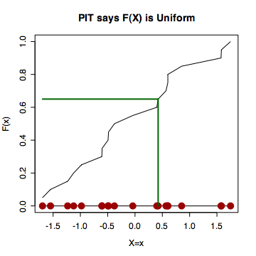
Why does bootstrap work?
Notes:
ecdf.demo()

Slide 37
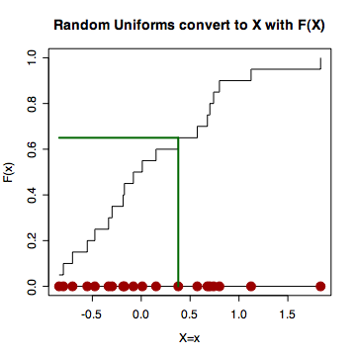
Why does the bootstrap work?

Slide 38
The Bootstrap
Easy, Useful
Should be included in intro courses.

Slide 39
What new techniques can undergrad stats use?
Simplest kernel estimation and smoothing
Simplest multivariate data display
Simplest bootstrap
Expanded use of Simulation

Slide 40
Expanding the Use of Simulation
Bimbo Bakery Example
Data: 53 weeks, 6 days per week
Deliveries and Sales of loaves of bread
Question: Delivery Levels Optimal?
Additional Data needed: cost and price of loaf, cost of overage, cost of underage

Slide 41
Data
Mondays for 53 weeks
deliveries / sales
142 / 101
113 / 113
94 / 86
112 / 112
111 / 111
and 48 more pairs.
Also: Economic Parameters
cost per loaf = $0.50
sale price per loaf = $1.00
revenue from overage?
cost of underage?
Profit each day

Slide 42
Method of analysis – step 1
Guess demand distribution for each day
Simulate demand, use delivery to infer simulated sales each day (one outlet)
Compute simulated daily sales for year
Compare with actual daily sales (ecdf)
Adjust guess and repeat to estimate demand

Slide 43
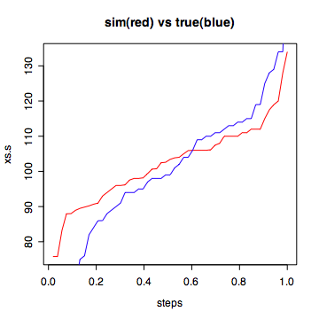
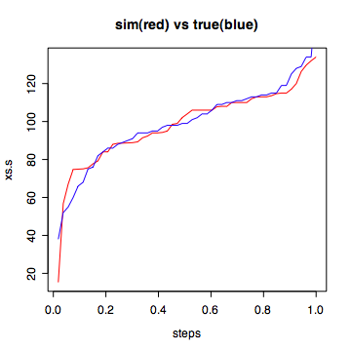
Compare simulated (red) and actual(blue) sales
m=110, s=20
m=110, s=30
Notes:
attach(bimbo.adj.df)
bimbo.test(m=110,s=30,xs=ms,xd=md)
bimbo.profit.graph(110,30,xd=md)

Slide 44
Method of analysis –step 2
Use estimated demand to compute profit
Redo with various delivery adjustments (%)
Select optimal delivery adjustment

Slide 45
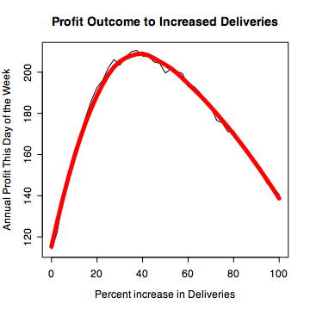
Use fitted demand m=110, s=30 to compute profit (many simul’ns)
Max Profit if 38%
increase in deliveries
Notes:
bimbo.profit.graph(110,30,xd=md)

Slide 46
Methods Used?
common sense
ecdf
simulation
graphics

Slide 47
Summary
Software ease suggests useful techniques
e.g. nonparametric smoothing, multivariate plots, bootstrap.
Simulation – a simple tool useful even for for complex problems
Simple tools in education –> wider use
Better reputation for statistics!

Slide 48
The End
More info on topics like this
www.stat.auckland.ac.nz/~iase
www.icots8.org
www.ssc.ca/
weldon@sfu.ca
Notes:
stats
r9q9xpz7

