Slide 1
Some Uses of the Freeware, R, for Studying Financial Phenomena
K.L. (Larry) Weldon
Simon Fraser University
R Development Core Team (2008). R: A language and environment for
statistical computing. R Foundation for Statistical Computing, Vienna,
Austria. ISBN 3-900051-07-0, URL http://www.R-project.org.
Notes:
Greetings from Sunny Tsawwassen, 6700 km west of here (as the crow flies). The only other place I would choose to live other than Halifax! >30 years ago ….
I am here to sell the software R – pity that it is free – I could make a fortune!

Slide 2
“Financial Applications”
Equities & Bonds in Long Term Risk
Assessing Mutual Fund Performance
Robustness of Large Companies
Management of a Hospital System
Notes:
I am not expert in finance
Neither is anyone else! (viz. – current markets)
my background is in probability and stats
my experience is as a “data analyst”
I was led to explore nonparametric approaches – including simulation & graphics

Slide 3
Counterfactual Inference Approach
Observe complex real-world phenomenon
Use parametric models for “noise”
Simulate complex model, graph outcomes
Calibrate model with global outcome data
Use model to predict unobserved behavior

Slide 4
I. Equities & Bonds in Long Term Risk
Portfolio Variability ≠ Risk (=Prob’y of Loss)
Canada: 50 years experience: Bonds ROR is 7% Equities ROR is 10%, Abs. daily change mean .6% sd .67% Prob (positive daily change) = .53 → suggests random walk
How long ‘til Equity Advantage Realized?
Go to R: tse() (and tse.run())

Slide 5
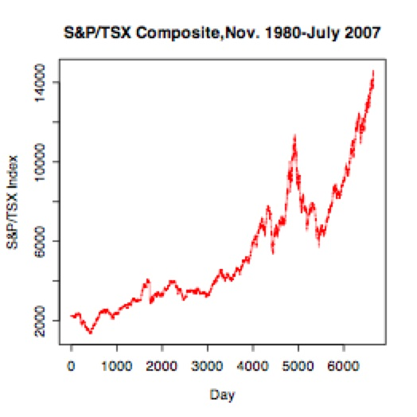
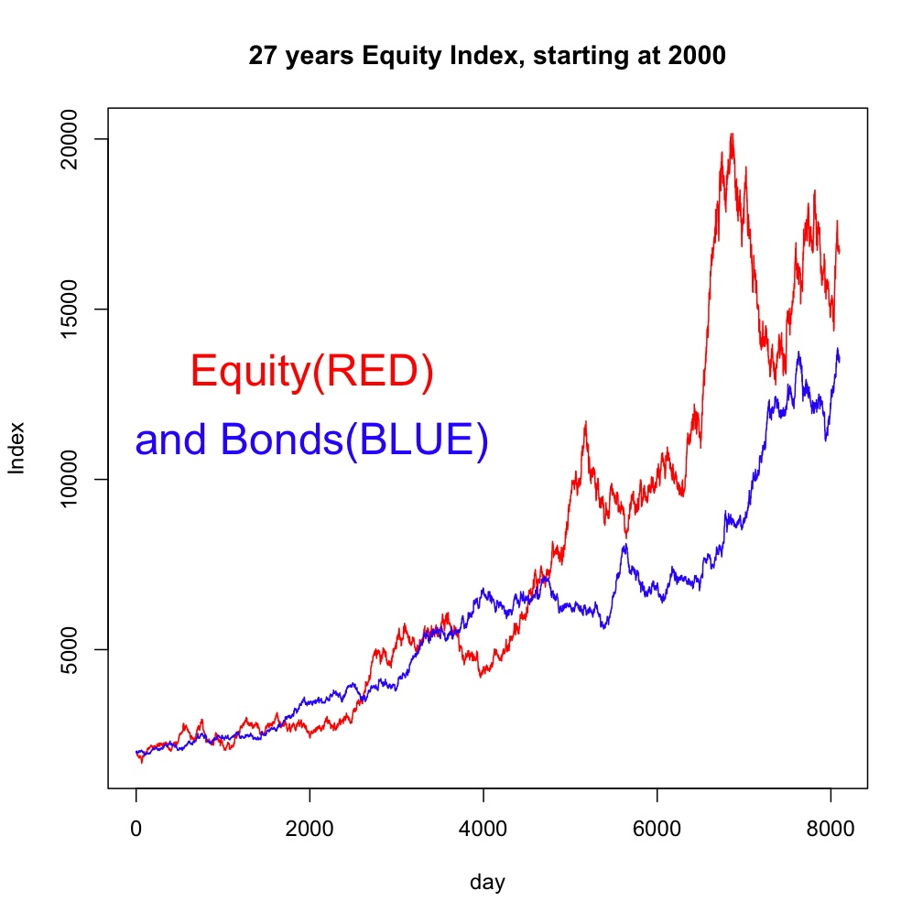
Go to R: tse() (and tse.run())

Slide 6
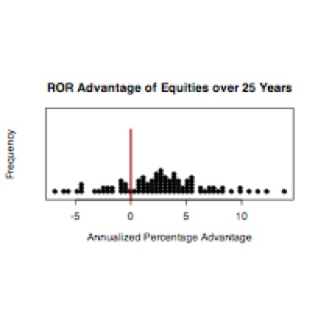
100, 25-years experiences

Slide 7
Observations from “tse” programs
long term ROR for equities exceeds ROR for bonds 80% of time.
when bonds better, not much better
typical shocks are not large enough to affect long term trends.
long term “risk” is inverse to short term variability
Q: What is “long term”

Slide 8
Waiting for Equities …

Slide 9
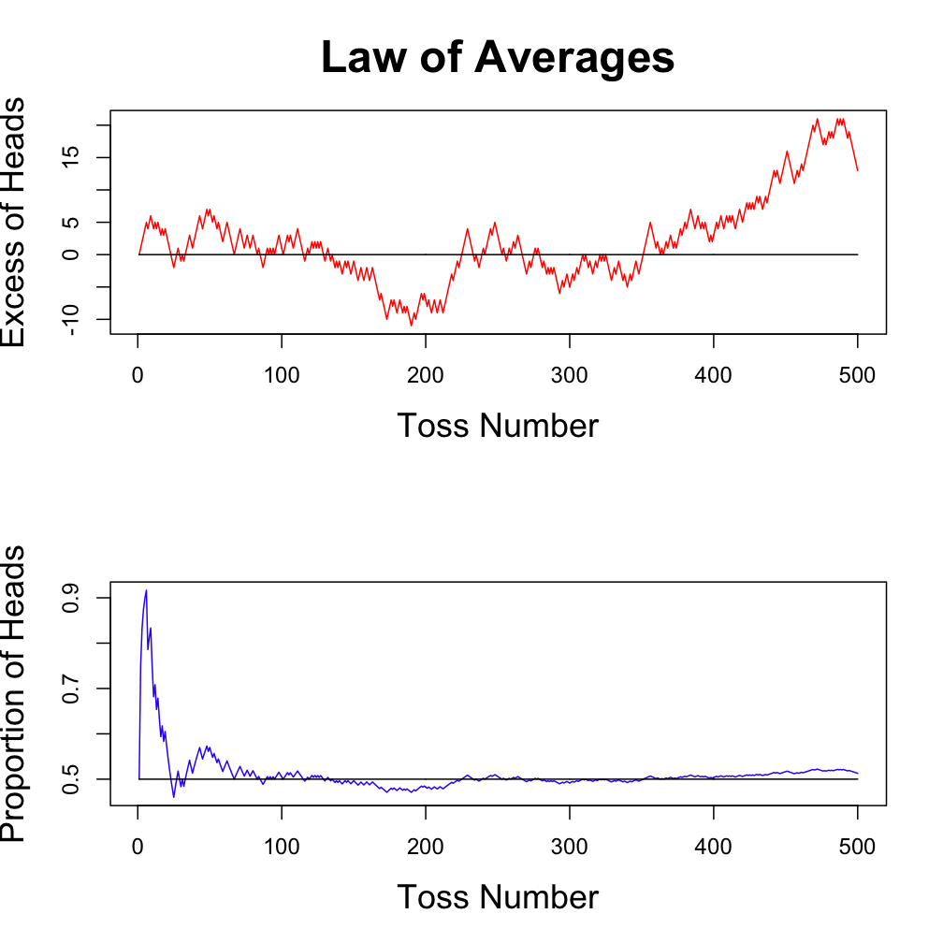
Technical Analysis Illusions
Apparent trends may be useless for prediction
Go to R: rwalk()

Slide 10
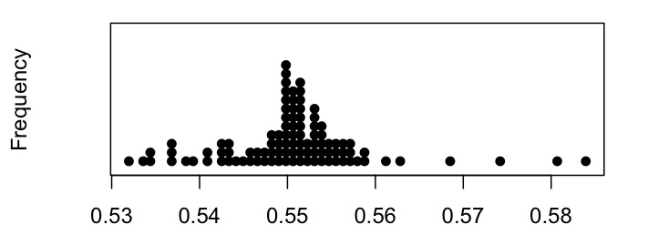
II. Assessing Mutual Fund Performance
Asymmetric random walk: P(+.3)=p, P(-.3)=1-p
models % daily changes
p is selected from a distribution like

Slide 11
Effect of p in this range .54-.56

Slide 12
Simulation of Fund Managers
p=.54 models a poor fund manager
p=.56 models a good fund manager
We simulate 100 managers 5-year experience
Variety of p values.
Pick the “best” (top 15% in ROR) managers
Follow them for 5 more years
How do we do?

Slide 13
R program is fund.walk.run()

Slide 14
Summary of result
Managers of various qualities were simulated for 5 years to observe RORs
The managers that appeared to do best were selected (top 15%)
These same selected managers were followed for 5 more years, assuming same “quality”
We compare the select group with the riff-raff: not much better!
Conclusion: past performance has little useful quality info.

Slide 15
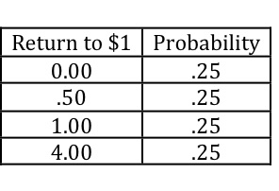
The diversification role of funds
If Risk=P(Loss), and
If P(loss) of 50% or so in one year is considered “risky”
How risky is a portfolio of “risky” investments?
E.G. One year returns to a $1 investment

Slide 16
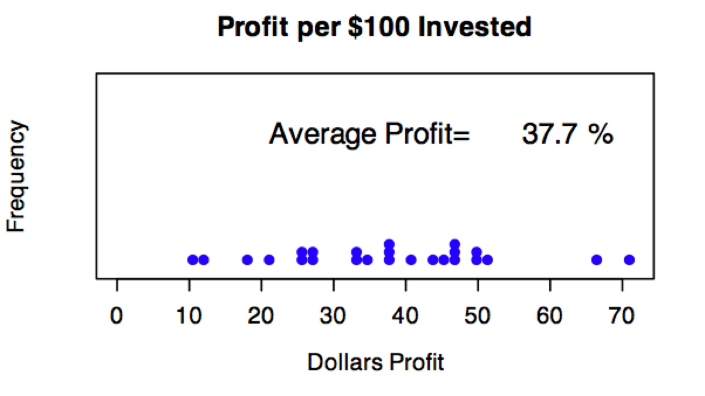
Hypothetical Portfolio
25 such companies have one-year returns that are independent.
portfolio of the 25 “risky” companies
what are typical one-year portfolio returns?
goto R: risky(m=25)
Phenomenon survives
lack of independence

Slide 17
III. Robustness of Large Companies
Insurance Scenario
Casualty Insurance
Assume:
Cost of Claim = $6000
Poisson Stream of Claims p = .2/year
Premium – start at $1460 per year
Expected gross profit = $260
actual variability depends on no. of policies
go to R program insce()

Slide 18
Small Company Can Lose

Slide 19
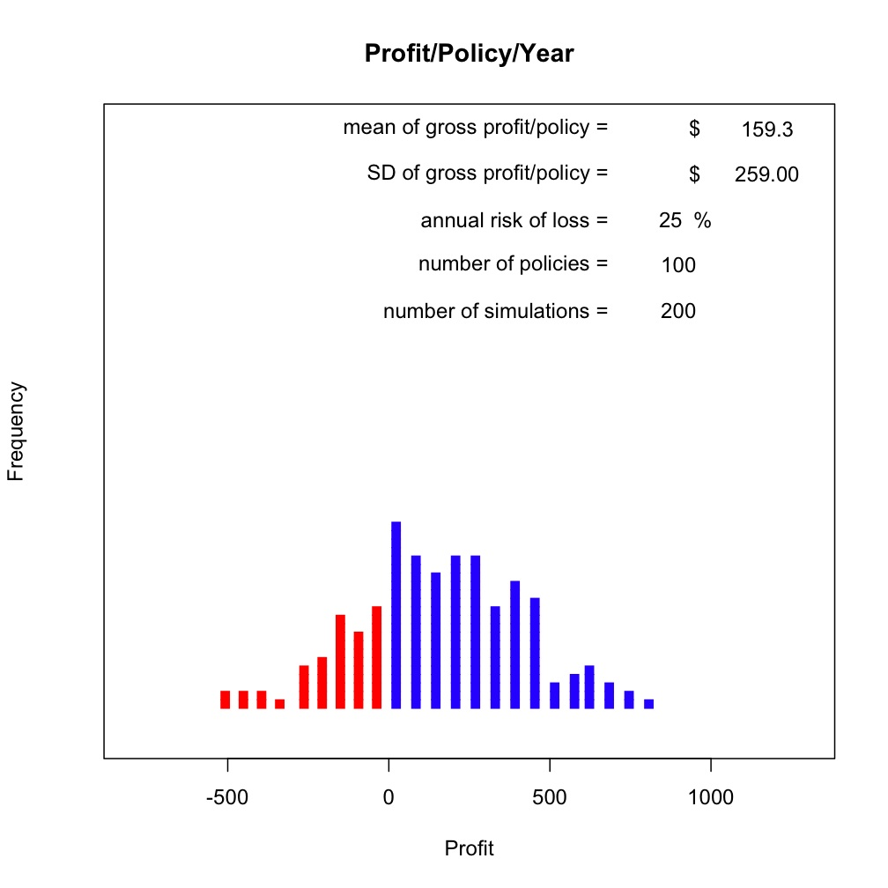
Big Company Pressures Small One
Suppose Premium Reduced to $1350
100 policies
Chance of Loss = 25%
1000 policies
Chance of Loss = 2%
100 policies
1000 policies

Slide 20
Summary
Big insurance companies are less likely to have a loss than small insurance companies
Big Insurance companies can drive smaller ones into bankruptcy by reducing premiums. (not news, but the specifics are useful)

Slide 21
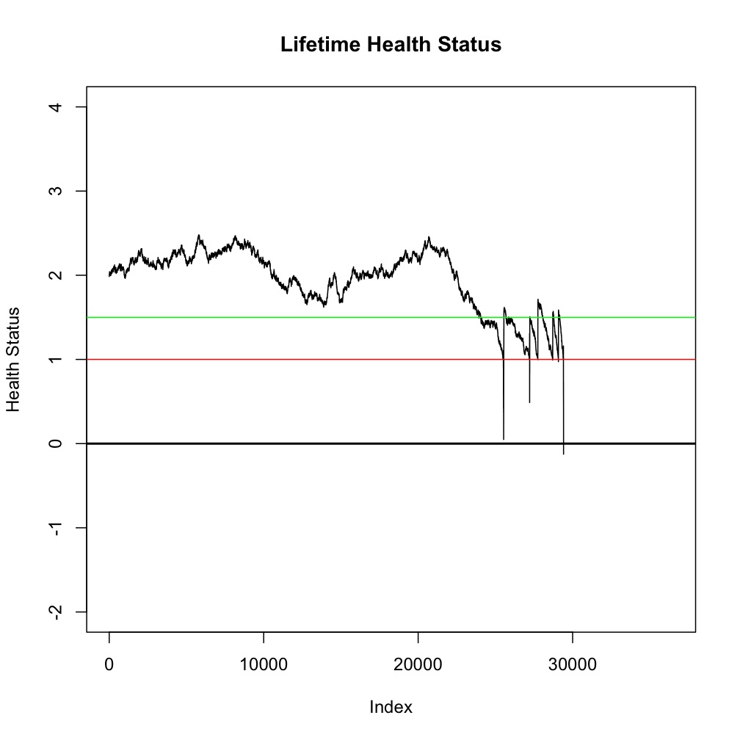
IV. Management of a Hospital System
Idea: Simulate “health status” for an entire lifetime (a life process)
Define status for hospital admission and discharge, and death
Calibrate the life process with public health data
Use model to study alternative mgt. policies

Slide 22
Typical Life: Health Status History
---Admission
---Discharge
---Death
Day Number
make.life(plt.final=T)

Slide 23
Hospital Cure Process
Fig 12
Distribution of Daily changes in Health Status while in the Hospital. Mean is
about +0.02, and SD is about 0.2.

Slide 24
Outcomes from Pop’n of 10,000

Slide 25
Age at Hospitalization

Slide 26
Number of Hospitalizations

Slide 27
Calibration OK?
Hospital admission rate: .3/1000
Length of stay: median 10 days
Age in hospital: mostly >70, some young
Age at death: median 80 yrs
Number of lifetime hospitalizations: mean 6
All resulting from random walk!

Slide 28
Process
Use Theory to Construct Model
Use Outcome Data to Calibrate Model
Use Model to Run Counter-Factual Scenarios such as ….

Slide 29
Ways to use the simulation
Suppose current hosp beds available = .3/1000
How often will capacity be breached?
Expand beds to .35/1000
Same Question …
If avg. length-of-stay decreased by 10% Impact on bed occupancy?
If admission rules liberalized (admission line ) Impact on bed requirements?

Slide 30
Summary
R capable of producing simulation programs of practical relevance to finance and mgt.
Programs can be run by anyone with internet access
Software is free and has international support www.r-project.org/
Info re these particular programs weldon@sfu.ca and www.stat.sfu.ca/~weldon

