Slide 1
Authentic Content in Statistics Courses
Adapting Content to Modern Practice
Larry Weldon
Simon Fraser University
Canada

Slide 2
Overview of Issue
How can we arrange to have statistics courses evolve with modern statistical practice?

Slide 3
What are “the basics”?
Histograms, measures of center and spread
Probability models
Estimation
Hypothesis testing
Regression and Anovar
But are these the most commonly used techniques?

Slide 4
Some tools of practice (data analysis)
descriptive measures and indexes
data screening methods
graphs of data distributions
smoothes and their graphs
simulation to study variability, robustness, and the influence of missing data.
sensitivity to apparent outliers

Slide 5
How does a student learn these practical strategies?
Through live data analysis projects with expert statistical advice
What is theory vs practice?
Theory: Generally-applicable strategies
Practice: Context-specific strategies
What do students find more instructive?
Practice -> Theory or Theory -> Practice ????

Slide 6
Demographic Split
Theory first preferred 1%
Practice first preferred 99 %
(Based on proportions choosing to major in Math vs major in Math Sciences and Engineering.(Stats, computing sci, natural science, ecology, management science, ….)

Slide 7
Applied Math?
STATS= APPLIED MATH ?
STATS= APPLYING MATH ?
STATS= INFO EXTRACTION (Applying Math whenever useful)
MATH-STAT ≠ STAT THEORY
HOW DOES MATH SUPPORT TEACHING OF STAT THEORY?

Slide 8
Role of Math in Stat Ed?
Clarification of Ideas Already Internalized
Taxonomy of Tools Already Used
Simplification of Complex Methods
Note: Math Follows Stat Learning

Slide 9
Undergrad Stats Ed Proposal
Immersion in Data Analysis,
with Guidance and Feedback,
will promote
a more Useful Knowledge of Statistics
than a Logical Sequence of Technique Presentations
A return to Apprenticeship Education,
but making use of modern resources
(statistical software and electronic communication.)

Slide 10
Outline
Pedagogy Reform
Obstacles to Implementation
Experience & Tools
Technology Support
New Role of Textbooks
New Role of Math
Simulation Metaphor
Implications for Stat Ed

Slide 11
Outline
Pedagogy Reform
Obstacles to Implementation
Experience & Tools
Technology Support
New Role of Textbooks
New Role of Math
Simulation Metaphor
Implications for Stat Ed

Slide 12
Good Ideas from ICOTS2 (1986)
"Using the practical model [of teaching statistics] means aiming to teach statistics by addressing such problems in contexts in which they arise. At present this model is not widely used." (Taffe 1986)
“Experiential Education”

Slide 13
Good Ideas from ICOTS2 (1986)
"The interplay between questions, answers and statistics … if students have a good appreciation of this interplay, they will have learned some statistical thinking, not just some statistical methods." (Speed 1986)

Slide 14
Quotes from ICOTS2 (1986)
… while most statistics professors like statistics for its own sake, most students become interested in statistics mainly if the subject promises to do useful things for them. …. Only then do most students seem to become sufficiently intrigued with statistics to want to learn about statistical theory." (Roberts 1986)

Slide 15
Quotes from ICOTS2 (1986)
"The development of statistical skills needs what is no longer feasible, and that is a great deal of one-to-one student-faculty interaction ..." (Zidek 1986)

Slide 16
Implications from ICOTS2
Use Context to teach theory (Taffe)
Whole process of data-based Q&A (Speed)
Abstractions do not motivate (Roberts)
Teacher-student interaction needed for useful learning of statistics (Zidek)

Slide 17
Status in 1996
In discussing what helps students learn, [David Moore (1996)]
listed the following:
Hands-on activities
Working in small groups
Frequent and rapid feedback
Communicating results
Explaining reasoning
Computer simulations
Open questions real settings
Learning to work co-operatively
Do we incorporate
all these features???
Phillips - ICME 8

Slide 18
Outline
Pedagogy Reform
Obstacles to Implementation
Experience & Tools
Technology Support
New Role of Textbooks
New Role of Math
Simulation Metaphor
Implications for Stat Ed

Slide 19
Obstacles to Implementation
Overcoming These Obstacles
Domination of Old-Math Culture in Stat Ed
Math eliminates context, stats incorporates it
Math appeals to minority, stats needed by many
Confusion of Math-Stat = Stat Theory
Administrative Control of Stats by Math Dept
Stat Theory:
Strategies for Information Extraction From Data With Context
Academic Disincentives to Curriculum Change
Promote Data Analysis Courses - Instructor Is Guide
Publishers Reluctance to Innovate
Find a new role for existing textbooks - evolve

Slide 20
Context vs Abstraction
Which is more interesting to students?
Example of a new item of stat theory
“Zipf’s Law” chosen for obscurity!

Slide 21
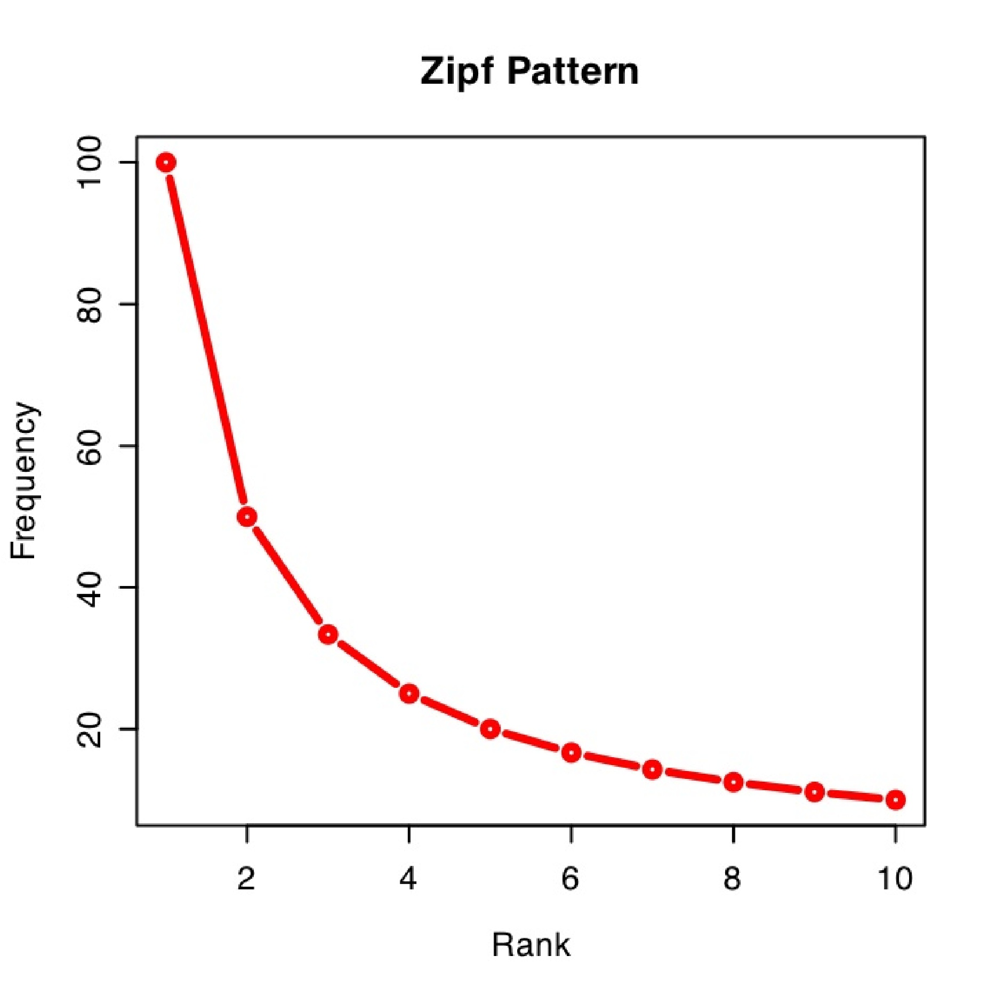
“Theory”: Zipf’s Law
An empirical finding of relative sizes of things
Frequency * rank = constant
Total Freq = 300
Constant=100

Slide 22
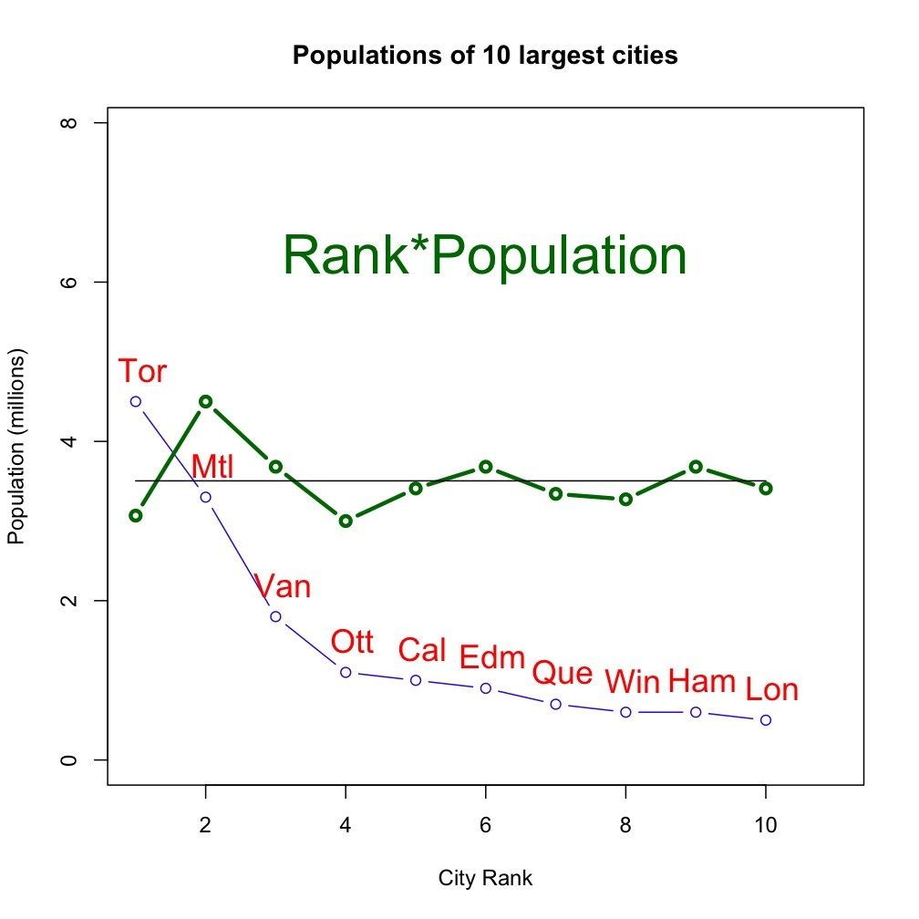
Population*Rank = Constant?
CANADA

Slide 23
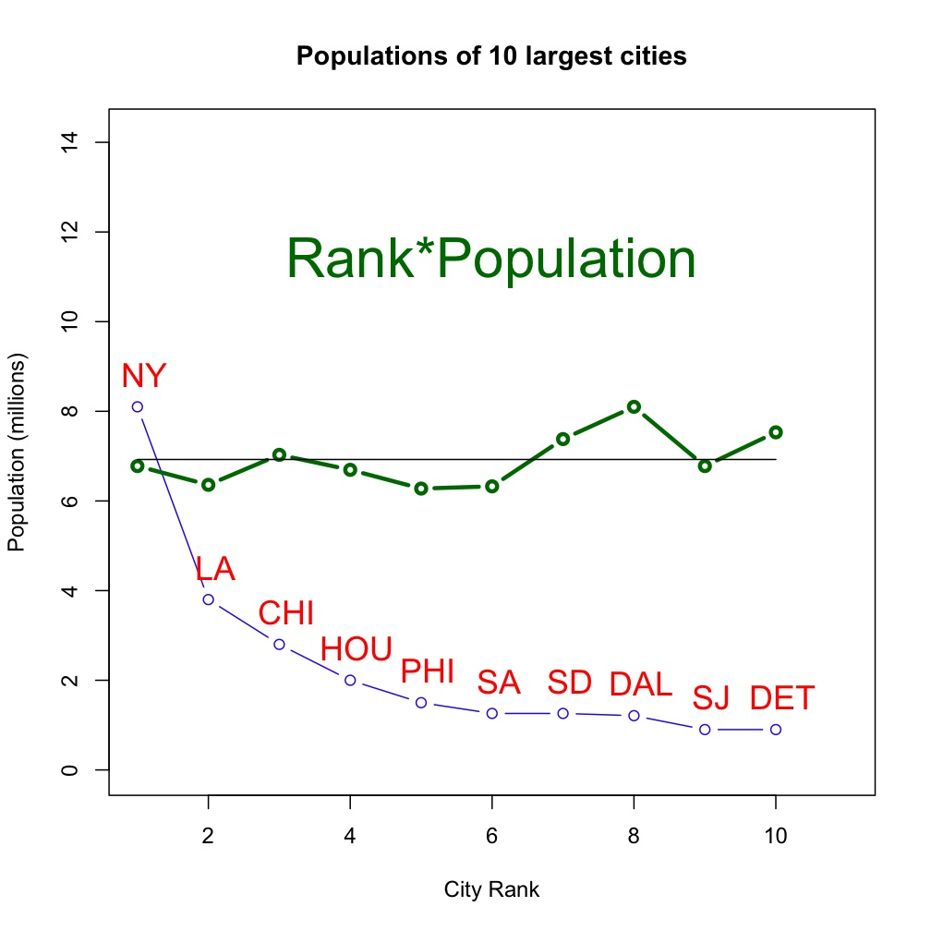
Population*Rank = Constant?
CANADA
U.S.

Slide 24
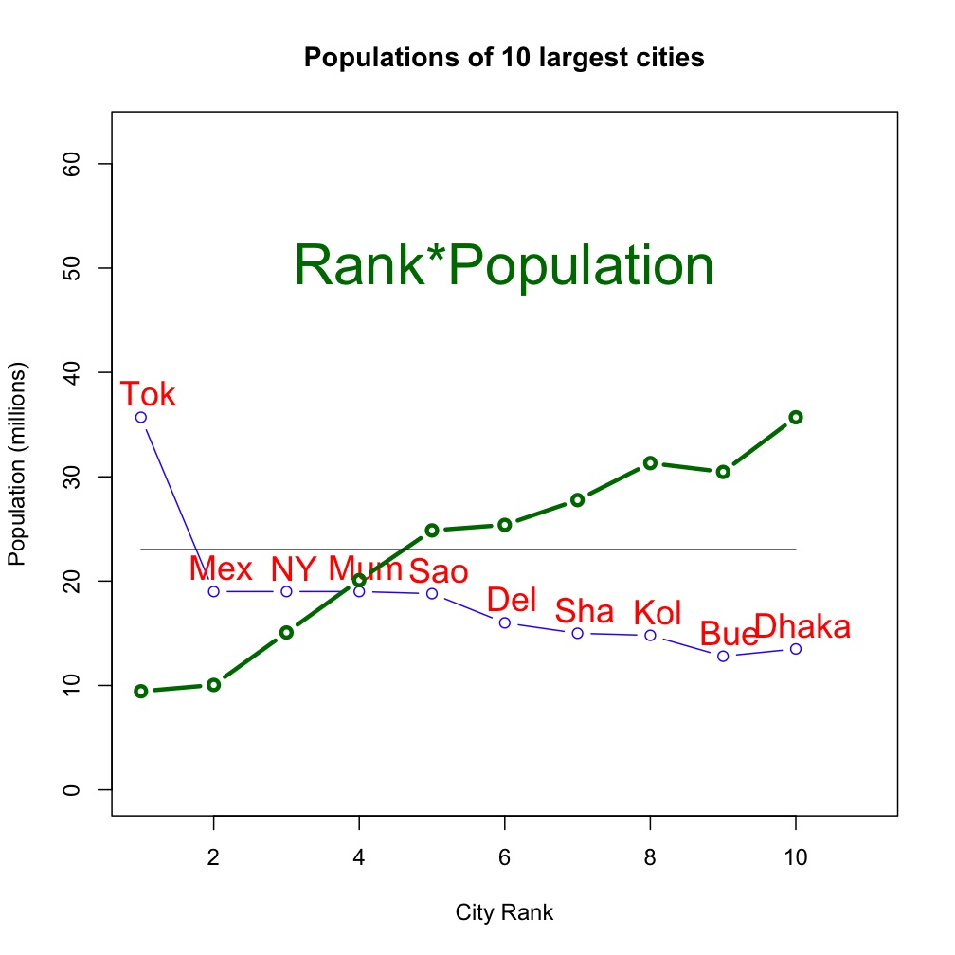
Population*Rank = Constant?
CANADA
WORLD
CANADA

Slide 25
Suggests Follow-up
Why is WORLD different?
To which kinds of counts does Zipf’s Law apply?
Point is:
Contextual Introduction conveys understanding of theory
wheras
Theory alone conveys ‘theory’ but not understanding
(Even with confirming example)

Slide 26
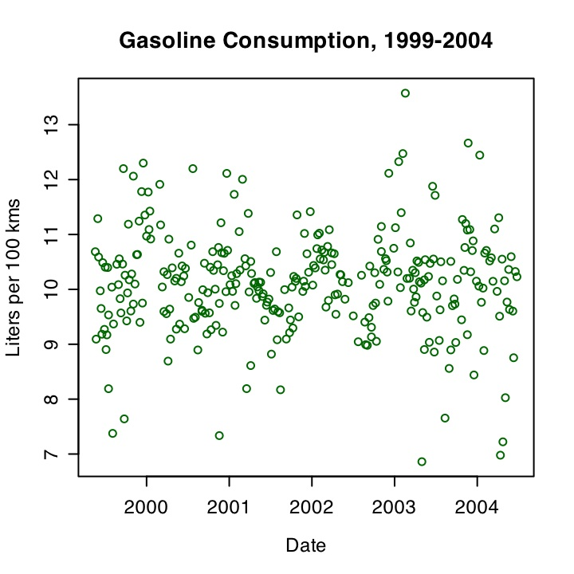
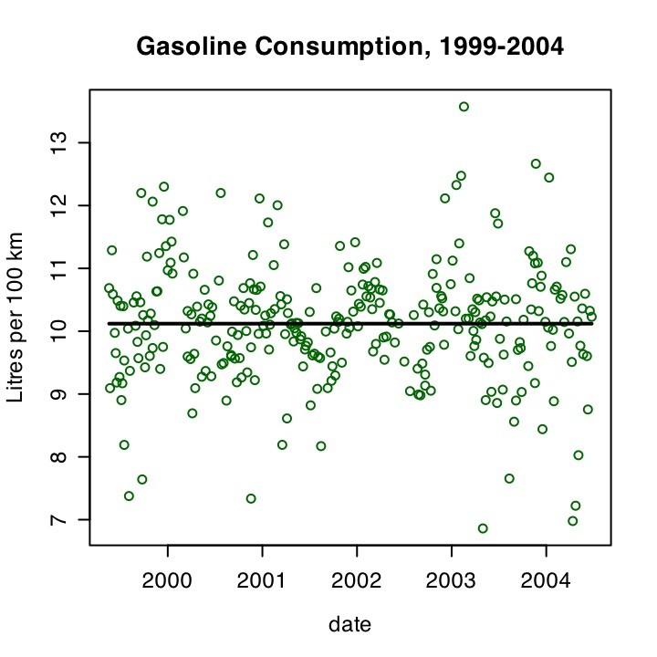
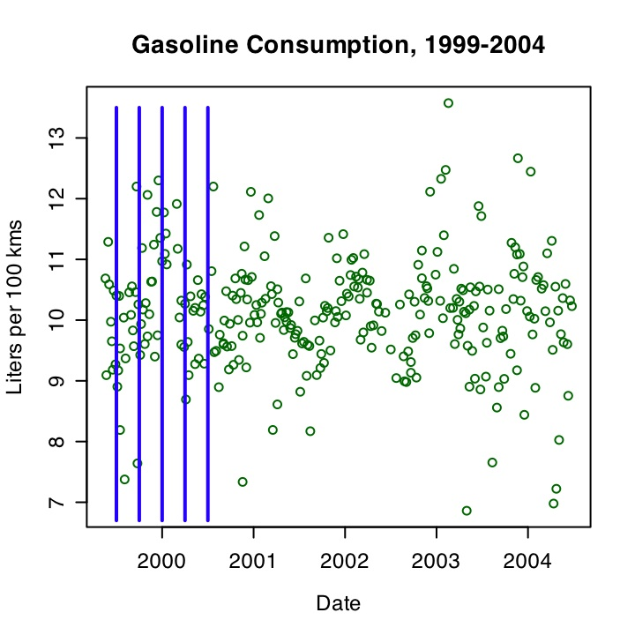
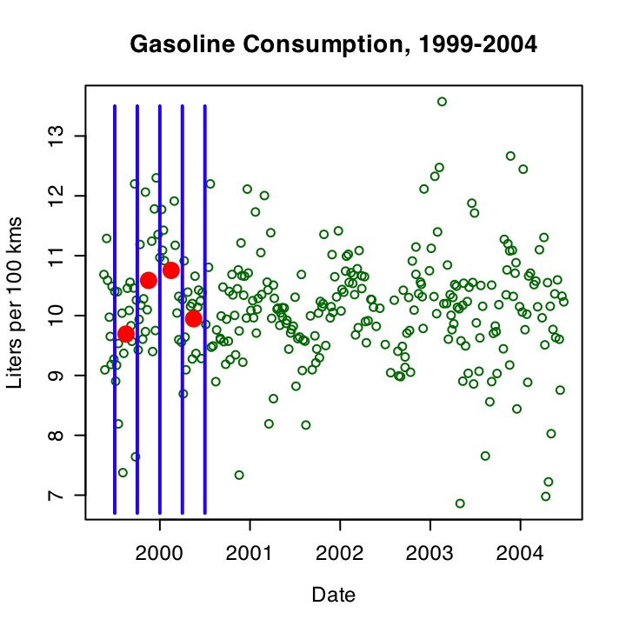
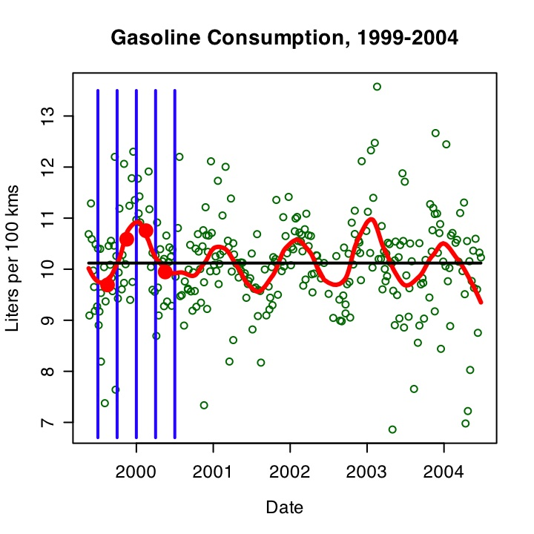
Another Example: Gasoline Consumption
Each Fill - record kms and litres of fuel used
Smooth
--->
Seasonal
Pattern

Slide 27
Suggests follow-up
1. How do you choose the amount of smoothing to produce useful information?
2. Why does a seasonal pattern occur?
Again, Point is …
New theory is best introduced through data exploration.

Slide 28
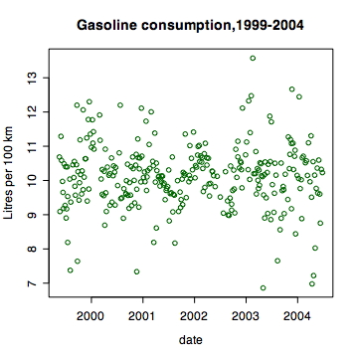
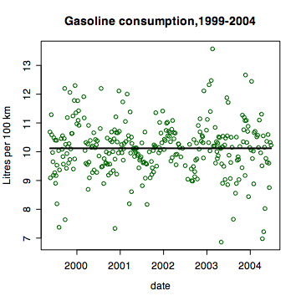
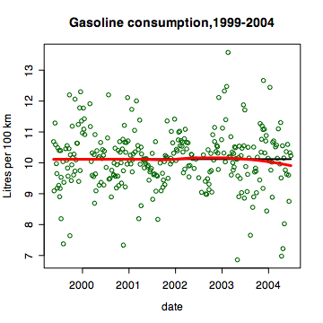
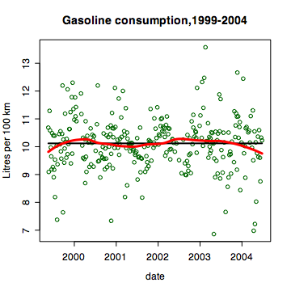
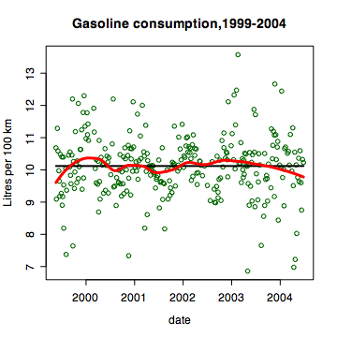
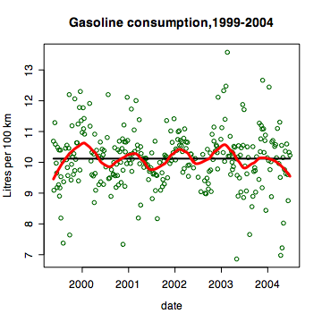
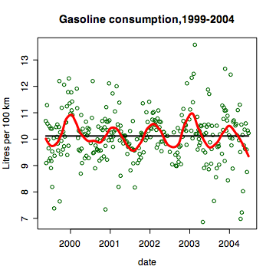
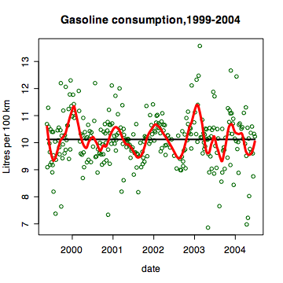
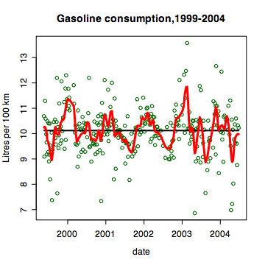
Intro to smoothing with context …

Slide 29
Role of Context?
Necessary for the extraction of useful information
Necessary for arousing student interest in statistical theory

Slide 30
Old Math Culture inhibits the joy of data analysis in learning stats
And so retards pedagogic reform in statistics

Slide 31
A More Traditional Intro to Theory of Smoothing
Smoothing amplifies signal
but introduces bias
by cutting off peaks and valleys

Slide 32
Theory Intro
Moving Average
Exponential Smoothing
Loess
Kernel Windows

Slide 33
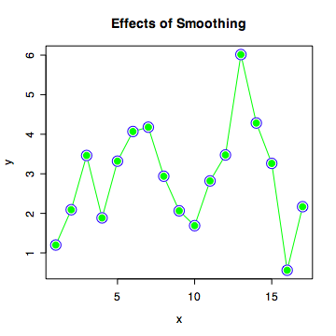
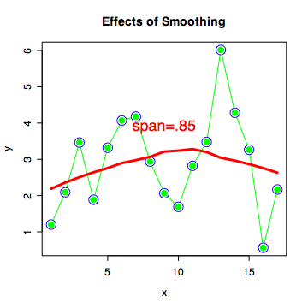
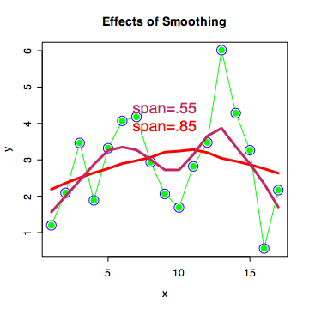
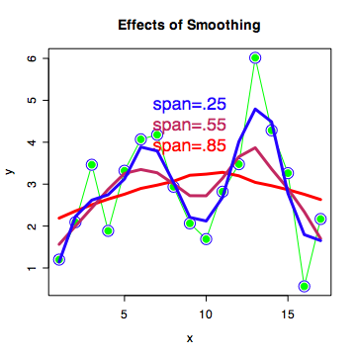
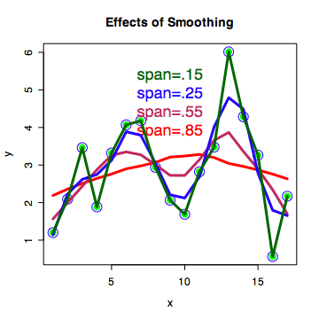
Illustration of Effect

Slide 34
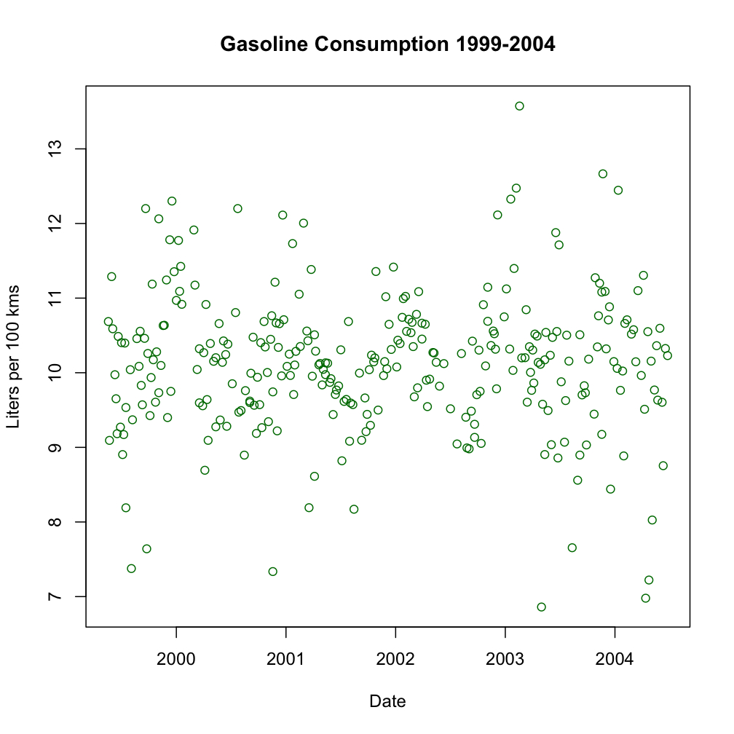
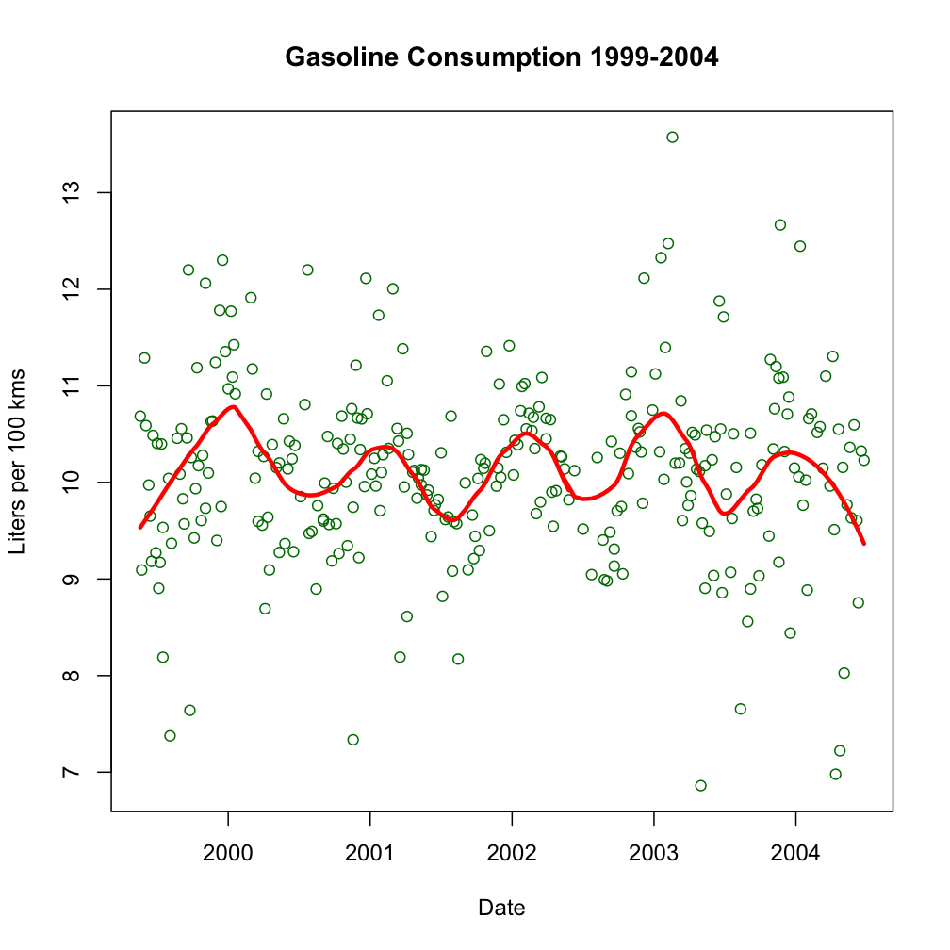
Real Data Example

Slide 35
Outline
Pedagogy Reform
Obstacles to Implementation
Experience & Tools
Technology Support
New Role of Textbooks
New Role of Math
Simulation Metaphor
Implications for Stat Ed

Slide 36
Data Analysis -> Stat Theory
Using applications to illustrate theory
(is common approach)
Using applications to construct theory
(is proposal here)
Best Approach for undergraduate stats?

Slide 37
Sports League - Football Success = Quality or Luck?

Slide 38
Leading Questions
Does Team Performance (as represented by league points) reflect Team Quality (as represented by the probability of winning a game)?
What would happen if every match 50-50?
“Equal Quality” Teams
Coin Toss (or computer) simulation ….

Slide 39
Stat Theory?
Understanding of “illusions of randomness”
Opportunity for Hypothesis Test (via simulation)
Need for measures of variability
….(more in paper)
Notes:
a better understanding of "better than and even chance"
a realization that current rankings are, at least in part, subject to "luck" or "random variation"
an opportunity to test a hypothesis by observing data
consideration of conditional probability
an appreciation that randomness can deceive and often does
an opportunity for answering a question via simulation (by coin or computer)
a need to define a measure of variability (in point status)

Slide 40
Arms and Hands Exercise
Ways to cross arms and to fold hands
(MacGillivray (2007))
Related?
Related to Gender?
Theory Learned?
Formulation of Data-Based Question
Summary of Categorical Variable Relationships
Illusions of Randomness
…. (more)

Slide 41
Examples of Experiential Learning Courses (SFU)
STAT 100 - Statistics Appreciation Course
Survival analysis, Randomized Response, …
STAT 300 - Statistics Communication
Verbal explanations of stat theory and practice
Oral presentation of summary of official data
STAT 400 - Data Analysis
Data exploration by graphics and simulation
Comparison of parametric and non-par methods
Rescue of (almost) hopeless cases
More details at www.stat.sfu.ca/~weldon

Slide 42
Experiential learning has potential to
Motivate student inquiry into stat theory at all undergraduate levels
Encourage authentic learning of stat theory

Slide 43
Objections to Experiential Learning
1. Chaotic collection of techniques
(No general framework for applications)
2. Lack of complete coverage of basics
Some New Technologies can help

Slide 44
Outline
Pedagogy Reform
Obstacles to Implementation
Experience & Tools
Technology Support
New Role of Textbooks
New Role of Math
Simulation Metaphor
Implications for Stat Ed

Slide 45
Rodney Carr
Deakin U
Rodney Carr
Demo in PP

Slide 46
Outline
Pedagogy Reform
Obstacles to Implementation
Experience & Tools
Technology Support
New Role of Textbooks
New Role of Math
Simulation Metaphor
Implications for Stat Ed

Slide 47
Textbook as Reference
Textbook for topic sequence?
Textbook for reference, cases for sequence
Electronic textbooks particularly useful here
(e.g. Stirling(2002) CAST - Computer Assisted Statistics Teaching.)

Slide 48
Outline
Pedagogy Reform
Obstacles to Implementation
Experience & Tools
Technology Support
New Role of Textbooks
New Role of Math
Simulation Metaphor
Implications for Stat Ed

Slide 49
Teaching Future Practitioners
"A very limited view of statistics is that it is practiced by statisticians. … The wide view has far greater promise … ” Cleveland (1993)
Math-Stat Not the Target for Undergraduates

Slide 50
Math as an “simplifier”
Identify Common Approaches (e.g. regression, residual plots, conditioning, …)
Compare and Contrast Methods (e.g. hypoth tests vs CIs, parametric vs non-parametric, …)
Discuss role of models (simpler than reality, simulation role, independence, …)
…
Anything that clarifies and reduces ambiguity

Slide 51
Outline
Pedagogy Reform
Obstacles to Implementation
Experience & Tools
Technology Support
New Role of Textbooks
New Role of Math
Simulation Metaphor
Implications for Stat Ed

Slide 52
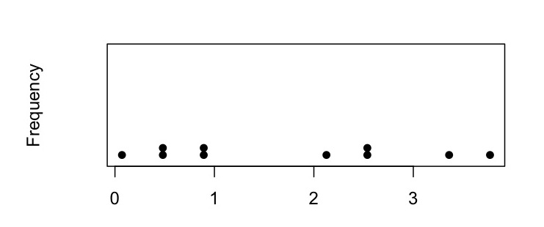
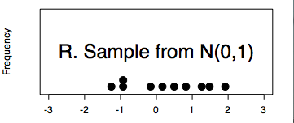
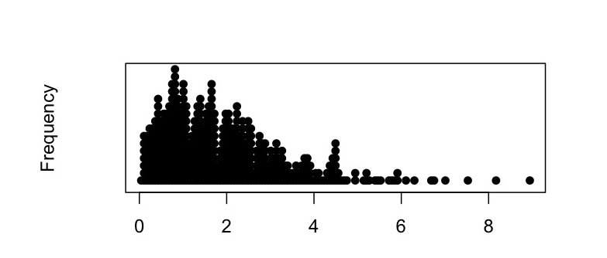
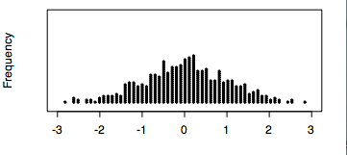
Statistics for the Practitioner
Experiential Immersion provides Authentic Target
Simulation Metaphor:
Random Sample from ?
(Empirical)

Slide 53
Metaphor Revealed!
sample from known distribution | example illustrating theory
known distribution | theory thought basic
sample from unknown distribution | data from application context
unknown distribution (real life) | technique required for real life practice

Slide 54
The aggregate of guided data analysis experiences
is what practitioners actually need to learn
Experiential learning is Authentic Learning

Slide 55
Outline
Pedagogy Reform
Obstacles to Implementation
Experience & Tools
Technology Support
New Role of Textbooks
New Role of Math
Simulation Metaphor
Implications for Stat Ed

Slide 56
Teaching vs Learning
Teachers can encourage authentic learning
Difficult to arrange in conservative depts
Difficult to do with large classes
Difficult for teachers without practical exp’ce
Nevertheless, a worthwhile goal.

Slide 57
Thanks for listening.
The End
Follow-up (weldon@sfu.ca)
www.stat.sfu.ca/~weldon

