Slide 1
Experiential Learning in Statistics: Expanding its role
Larry Weldon Simon Fraser University

Slide 2
Outline
Math Roots and Course Taxonomy
Calls for Change 1986 and 2009
Examples of Experiential Teaching
Features of Experiential Teaching and Learning
Implementation Issues

Slide 3
Influence of Math Roots
Statistics as a Logical sequence of Techniques
e.g.
1 var -> 2 var -> 3 var -> multivariate
descriptive -> models -> sampling -> estimation -> hypoth testing
probability -> stochastic processes -> time series

Slide 4
Where do these fit in?
Smoothing
Graphics
Resampling
Research Design
Nonparametrics
Time Series
Measurement Model
Quality Control
Computer Intensive Techniques
These are not really
“advanced” topics

Slide 5
Influence of Math Roots
Have we let our desire for mathematical thinking limit our service to statistics students?
Why do we omit useful, simple techniques so that we can cover the traditional inference methods that students find so confusing?
Are math students our primary target for stats instruction?

Slide 6
Mainstream Teaching Target for Statistics Courses?
Stat majors?
Science/Engineering Majors?
Future Stat Practitioners?

Slide 7
Traditional Course Taxonomy
Appreciation Courses for Liberal arts
Service Courses for Practitioners
“Mainstream” Courses for Stat Majors
Proportion of students
Appreciation 5%
Service 80%
“Mainstream” 15%
More Math

Slide 8
Main Target of Stats Education?
Practitioners! (Really the “Mainstream”?)
Should stat majors take practitioners’ courses?
Perhaps stat majors need more, not different
Appreciation -> Practice -> Expert (New Taxonomy?)

Slide 9
Many Levels – One Process
The big ideas of statistics can be explained at any level: appreciation, practice, expert
Averaging
Distribution
Randomness
Simulation
Sampling
....
But the mastery of real world
application takes experience
and “practice”.
Appreciation -> Practice -> Expert

Slide 10
Proposal
Define courses by level of experience instead of level of mathematics.
Not a new idea!

Slide 11
Calls for Change – ICOTS2 - 1986
Jim Zidek (Canada)
“The development of statistical skills needs what is no longer feasible, and that is a great deal of one-to-one student-faculty interaction”
Terry Speed (USA)
“…if students have a good appreciation of this interplay
[between questions, answers and statistics],
they will have learned some statistical thinking,
not just some statistical methods.”

Slide 12
More ICOTS2 - 1986
John Taffe (Australia)
“Using the practical model [of teaching statistics] means aiming to teach by addressing such problems in contexts in which they arise. At present this model is not widely used.”

Slide 13
Teleport to 2009
Meng (Harvard) re STAT 105 there …
“The central feature of this course is that the materials are organized by real-life topics instead of statistical ones ... The statistical topics are covered whenever they are needed …”
= Experiential Learning

Slide 14
More 2009
Brown and Kass (Harvard)
“The net result is that at every level of study, gaining statistical expertise has required extensive coursework, much of which appears to be extraneous to the compelling scientific problems students are interested in solving.”

Slide 15
Another recent quote (2007)
Nolan and Temple-Lang (Berkeley and Davis)
“We advocate broadening and increasing this effort to all levels of students and, importantly, using topical, interesting, substantive problems that come from the actual practice of statistics.”

Slide 16
Decades of Advice Leading to ….
How far have we advanced? Do we still teach statistics as a sequence of techniques, or do we introduce these techniques as they arise in real-world statistical problems?
Time to explore experiential teaching (and learning) – even within an undergraduate program.

Slide 17
Examples of Experiential Teaching
Example 1: Sports Leagues
Example 2: Melanoma Incidence
Example 3: Bimbo Bakery
(From my SFU courses STAT 100 and STAT 400)

Slide 18
Example 1: Sports League - Football Success = Quality or Luck?

Slide 19
Leading Questions
Does Team Performance (as represented by league points) reflect Team Quality (as represented by the probability of winning a game)?
What would happen if every match 50-50?
“Equal Quality” Teams
Coin Toss (or computer) simulation ….

Slide 20
Creativity Needed
Measurement of League Point Variability?
Allowance for quality gradient?
Which comparisons most useful?
Information Useful?

Slide 21
Stat Theory?
Understanding of “illusions of randomness”
Opportunity for Hypothesis Test (via simulation)
Need for measures of variability
Probability useful for occurred events
Invention of Indices sometimes necessary
….more in OZCOTS paper Weldon (2008)
Notes:
a better understanding of "better than and even chance"
a realization that current rankings are, at least in part, subject to "luck" or "random variation"
an opportunity to test a hypothesis by observing data
consideration of conditional probability
an appreciation that randomness can deceive and often does
an opportunity for answering a question via simulation (by coin or computer)
a need to define a measure of variability (in point status)

Slide 22
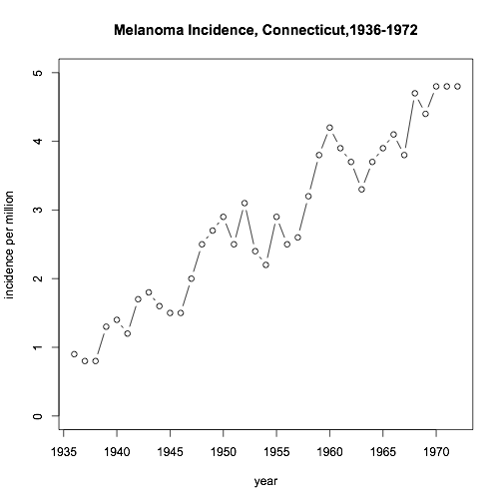
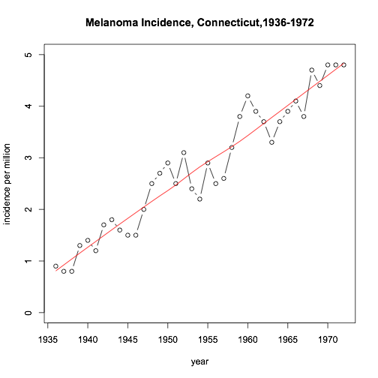
Example 2: Melanoma Incidence
Loess Smooth

Slide 23
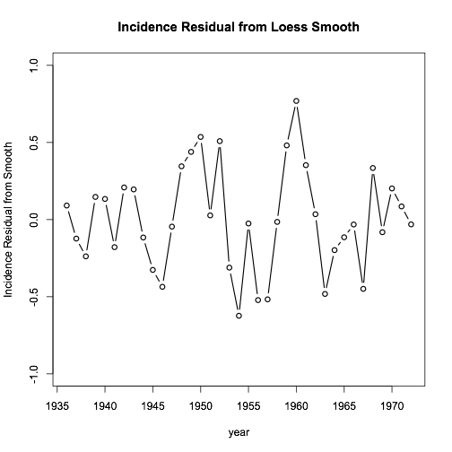

Slide 24
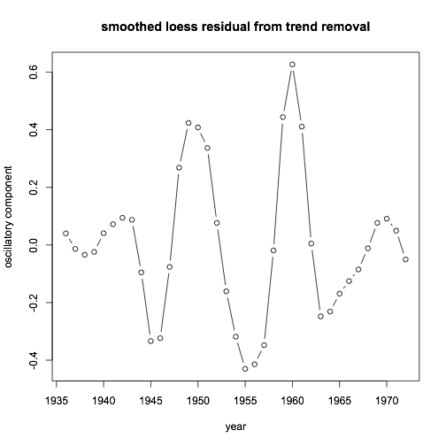
Analysis of Melanoma Data
Remove trend
Oscillation (Smoothed Residual)
cf Sunspot Cycle (3 yr lag)

Slide 25
What tools and concepts learned?
de-trending of time series
role of residual plots that have patterns
iterative nature of curve-fitting, choice of smoothing level
value of general knowledge for data analysis
the importance of aspect ratio in graphical displays
comparison of two time series
the value of exploratory data analysis
convenience of loess as a smoothing method
the use of timing in relating causation to correlation

Slide 26
Example 3: Bimbo Bakery
Bimbo Bakery
Multi-national Mexican Company
(Orowheat, Bobili, and many other brands)
Baked goods – time value
How many to deliver daily to this retail outlet?
sample data: one product, one retail outlet, deliveries and sales for one year (53 x 6 days)

Slide 27
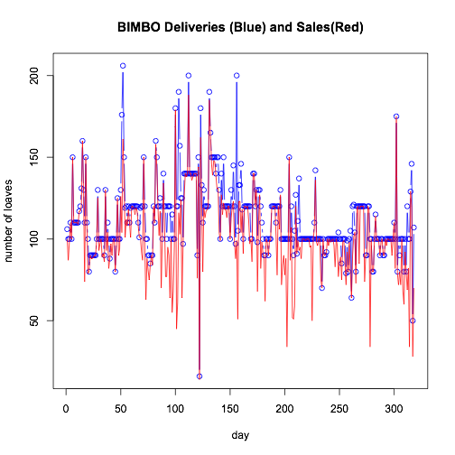
One Year, One product, One Outlet

Slide 28
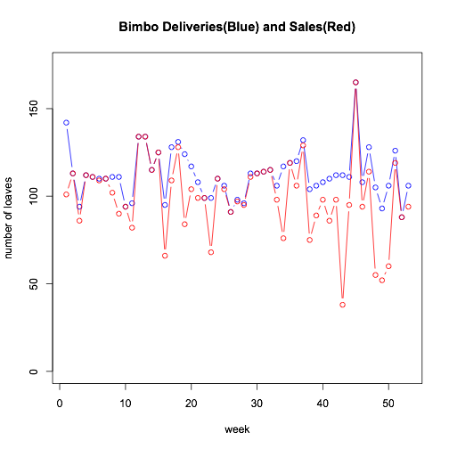
Mondays Only, Seasonally adjusted

Slide 29
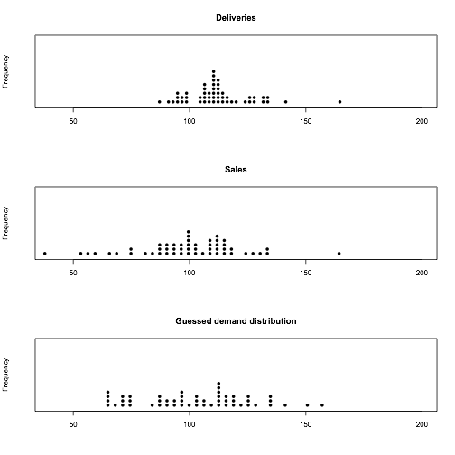
Try N(100,25):

Slide 30
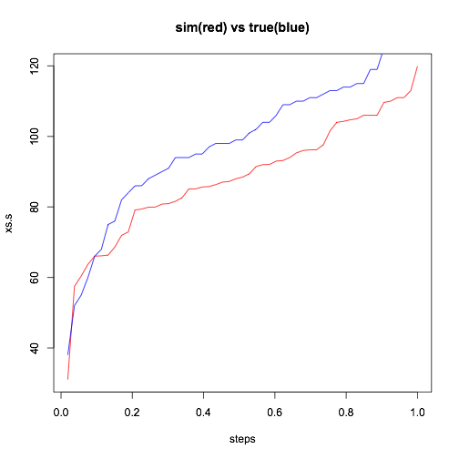
Compare Guess vs Actual
mean=100, SD=25 ?

Slide 31
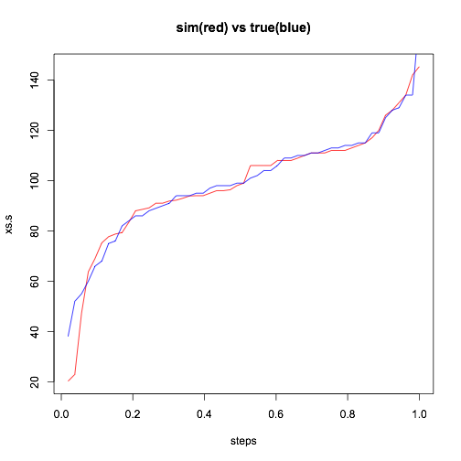
Improved Fit
mean=117, SD=40

Slide 32
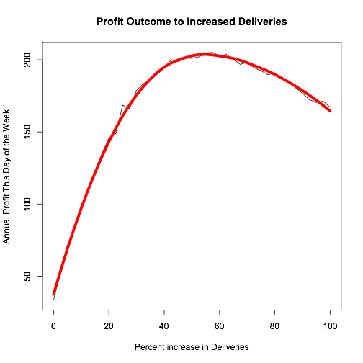
Optimize Delivery Percentage
Assumes N(117,40) and certain
economic parameters for overage
and underage.

Slide 33
Criteria for Projects
Subject Matter of Interest
Context Known or Easily Learned
Info Accessible with Next Level Techniques

Slide 34
Features of Experiential Projects
Of Interest to Students
Using Modern Techniques for Analysis
Opportunity for Student Creativity
Wide Variety of Techniques Required
Linkage of Theory and Context
Involving Techniques Useful for Practice
(“Authentic Content”)

Slide 35
Implementation Issues
3hrs/wk schedule
No textbook, Any textbook
Assessment
Instructor Workload
Large Classes
Experiential Background of Instructors
User Department Requirements
Choice of Project Contexts
Course Content Coverage Requirement (Rodney Carr “Roadmaps” – next slide)

Slide 37
Conclusion
(My conclusion!)
Experiential Teaching and Learning may
enable students to be better prepared for statistics practice,
may provide a more stimulating way to learn, and
may change negative attitudes to statistics
is feasible now, for small classes (<25)

Slide 38
Comments?
Larry Weldon
weldon@sfu.ca
www.stat.sfu.ca/~weldon

