Slide 1
The Magic of Randomness
How to explain statistics to your uneducated friends
Larry Weldon, Simon Fraser University
Notes:
Thanks …jorge rodriguez
Instructions: ” We ask the professors not to give a technical talk but rather something that can be easily followed by the audience and that you think is something students in Statistics and Actuarial Sciences should know about but it is not usually taught in courses.” I have been retired for a few years now, and I have had an increased interest in non-course statistics.
What I like to do is to program simulations that allow study of a real world phenomenon. This produces some surprising results, and I think they help to convince “everyday people” that statistics is a worthwhile discipline.

Slide 2
Language of Statistics?
Significance
Normal
Standard Deviation
Mean
Expected Value
Error
Greek Symbols!
Suggests a discipline that is out-of-touch with Reality!
Notes:
Significance – but not importance
Normal – but not “normal” in the usual sense
Standard Deviation – the amount of error that is OK
Mean – but not doing anyone any harm
Expected Value – that is rarely an expected value
Error – that is not a mistake
Greek Symbols – to keep the common people from understanding stats

Slide 3
The Skeptical Public
Skeptical Public – “Show me the benefit”
Stat Inference in Research (Drug Trials, Survey Summaries)
“Will ignorance cost me? I don’t do research.”
“Is it always so complicated? I’m too busy to re-train”
“Is it de-humanizing? I’m a people person”

Slide 4
Applications from the Real World
Sports
Investment
Fuel Consumption
Lotteries
Peer Review
Traffic
Notes:
A few things that “everyday people” are concerned about.

Slide 5
Sports
from the internet
NBA Pacific Division of Western Conference 2010 data
Pacific W L PCT GB CONF DIV HOME ROAD L 10 STREAK
L.A. Lakers 38 17 0.691 0.0 21-11 8-3 19-8 19-9 6-4 L 1
Phoenix 26 26 0.500 10.5 15-16 6-5 15-12 11-14 6-4 L 1
L.A. Clippers 20 34 0.370 17.5 13-21 7-4 16-14 4-20 3-7 L 2
Golden State 24 29 0.453 13.0 14-20 4-8 18-11 6-18 5-5 W 1
Sacramento 13 38 0.255 23.0 8-23 3-8 7-22 6-16 4-6 W 1
pacific.nba=c(.73, .64, .55, .33, .27)
Proportions of games Won (in approx 11 games)
Are the LA Lakers demonstrably better than Sacramento?
(There had to be “top” team even if no quality difference.)
Notes:
A typical sports league – and we might get the usual impression that, for example, the LA Lakers are a team that is superior to Sacramento:
8-3 win-loss vs 3-8. But does this much difference demonstrate the apparent superiority? Can we talk about the winning quality of a team to be the probability of winning P(Win).
How much difference in the observed Win rate would occur if every team was the same quality P(Win)=0.5?
Important if you are trying to predict who will win a future game. Are there better teams????

Slide 6
NBA example - continued
What would happen in this division if every team had a 50% chance of winning every game?
Would the win rate vary as much?
Let’s simulate what would happen …
go to R:
lg.win.index(pacific.nba,m=11)
lg.win.index(northwest.nba,m=11)
Notes:
The simulation simply records the results of many tosses of a fair coin.
After the demo’s we ask “Is it common to under-appreciate the effects of randomness’?
After watching this actual series of basketball games, it might be very hard for a fan to believe EQ, and yet it is a tenable hyp.

Slide 7
Sports Leagues Demo: So what?
We argued that the effects of randomness (or luck) in sports is under-appreciated.
Simulation enables us to allow for luck in assessing sports outcomes
The smart money would back the underdog, with good odds (at least in Pacific Division).
Notes:
If a team deemed to be a loser by many, then anyone betting it to win will expect a larger payoff if successful. Odds …

Slide 8
Stock Prices and Random Walks
Symmetric Random Walks produce patterns that suggest predictability go to R:
simple.walk() shows accumulation heads
rwalk.run(avg=F) shows illusionary trends
But the stock market varies like a random walk fund.walk() realistic fund price generator fund.walk.test() shows parameter control fund.walk.run() use of past performance?
Notes:
This topic may not seem to relevant to students, but anyone with an RRSP or a TFSA (which is a lot of people) will be.
So if you are explaining the charm of statistics, its lessons for investing will be of interest to your audience.
Symmetric Random Walks are very simple to describe – again, as simple as tosses of a fair coin.
In the rwalk.run(avg=F), notice how often the accumulation crosses the zero line.
Stock market has positive bias (upward over long run) but unpredictability still like symmetric random walk since p close to ½.
10% per year is realistic for the Toronto Stock Exchange Index, which we simulate with p=.55.
Now consider the following experiment: We will simulate 100 funds for 5 years, and make sure that the funds are assigned qualities of .55 + or - .2 so there is a good distribution of
qualities. If we consider how to choose a fund manager for the next 5 years, we might base our decision on how they did in the first five years. Lets use the managers that were in the top 15% of managers in the first five years, and see how we do in the second five years.

Slide 9
Random Walks & Funds: So what?
Fund price trends display apparent patterns that are not real trends (not predictive)
Past fund price trends are very poor predictors of future prices, even when mgr quality varies.
Knowing how much apparent trend is due to chance allows real trends to be identified.
Notes:
first item is because fund prices are like a random walk with illusory trends
second item is because variability swamps quality of mgr over short (5 year) time periods.
need a huge advantage to show in a short time (or many unrelated funds simultaneously)

Slide 10
Diversification of Investments
Portfolio with Independent Components
Components need not be stable
Consider “Risky Company”
Risky Company
1 Year Outcome Probability
$0.00 0.25
$0.50 0.25
$1.00 0.25
$4.00 0.25
1 Yr NET Outcome Probability
-$1.00 0.25
-$0.50 0.25
$0.00 0.25
$3.00 0.25
[1] -1.0 -0.5 0.0 -1.0 -1.0 -0.5
[7] -1.0 0.0 3.0 3.0 0.0 0.0
[13] 0.0 -1.0 -1.0 -0.5 3.0 3.0
[19] -0.5 3.0 -0.5 -0.5 -1.0 3.0
[25] 3.0

Slide 11
Simulations for “Risky” Portfolio
Go to R
risky.sample(prt.tables=F) experience for 1 co.
risky() showing experience for 25 companies.
Notes:
shows big chance of losing money – hence high “risk” (for 1 company)
But for portfolio of 25 INDEPENDENT companies, almost 0 chance of losing money. (Because >0 on average).

Slide 12
Risky Company Portfolio: So What?
A variable return is not necessarily a risky return. Variability is NOT risk. SD does not measure risk.
Risk is the chance of loss.
If a portfolio has companies which are profitable on average, and if the success of the companies have a measure of independence, then the portfolio will very likely be profitable.

Slide 13
Gasoline Consumption Example
_{Uncovering hidden information}
_{through modern graphics}

Slide 14
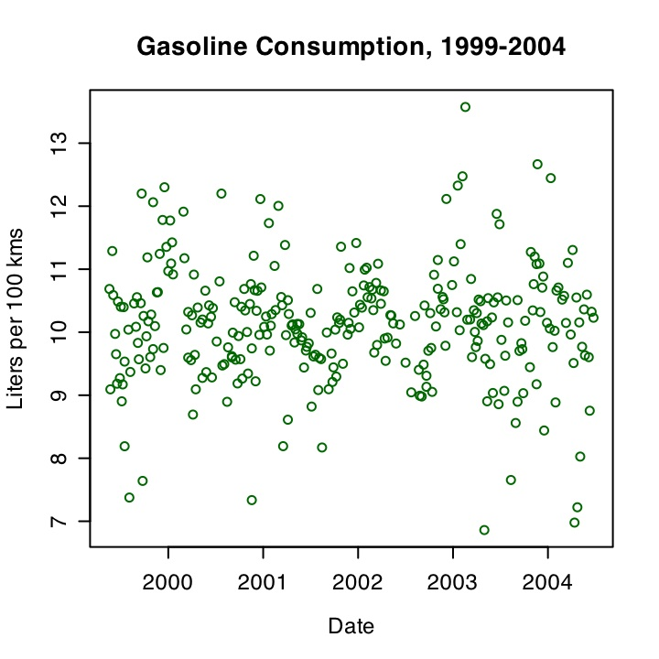
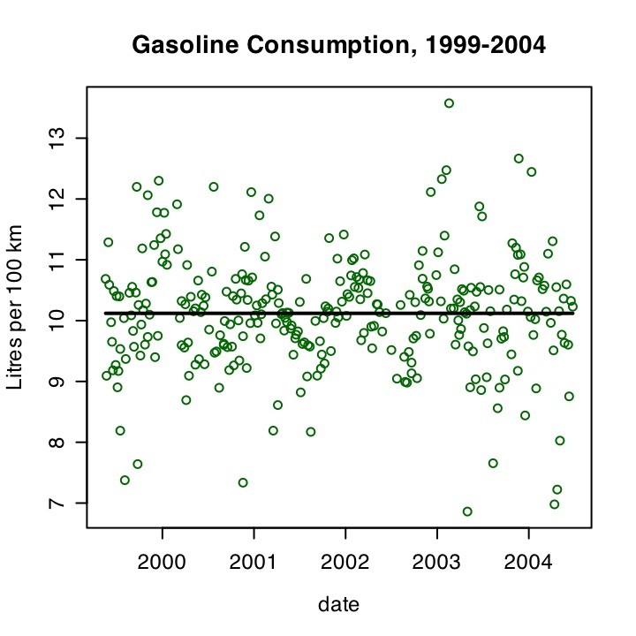
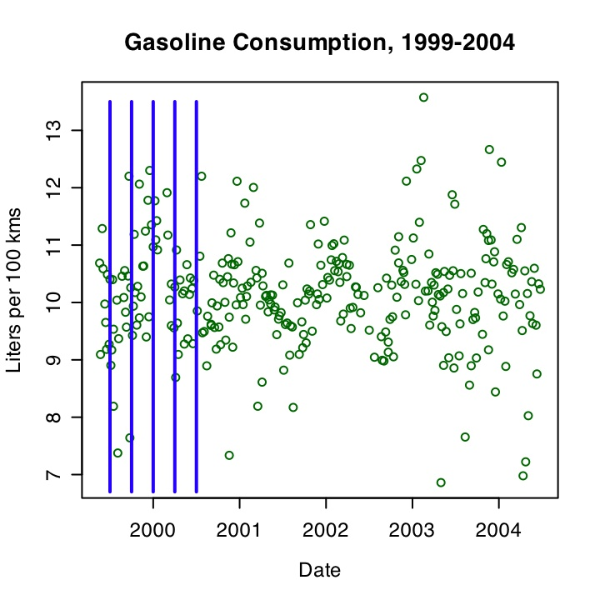
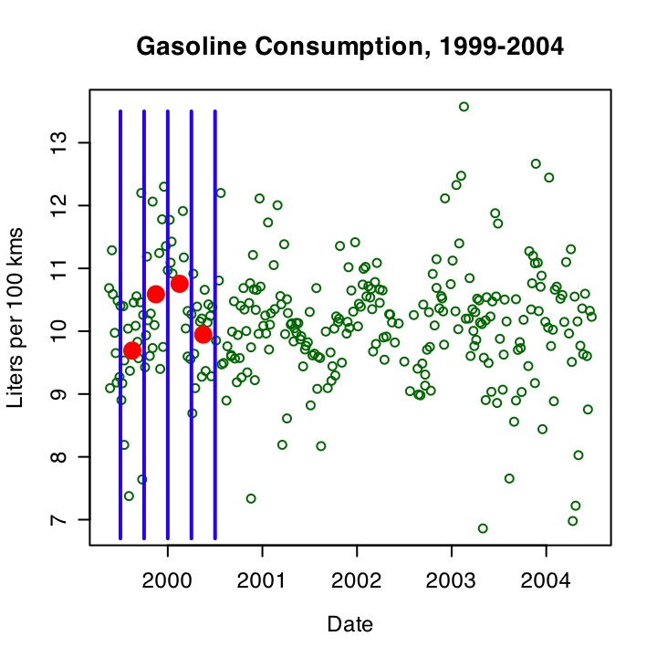
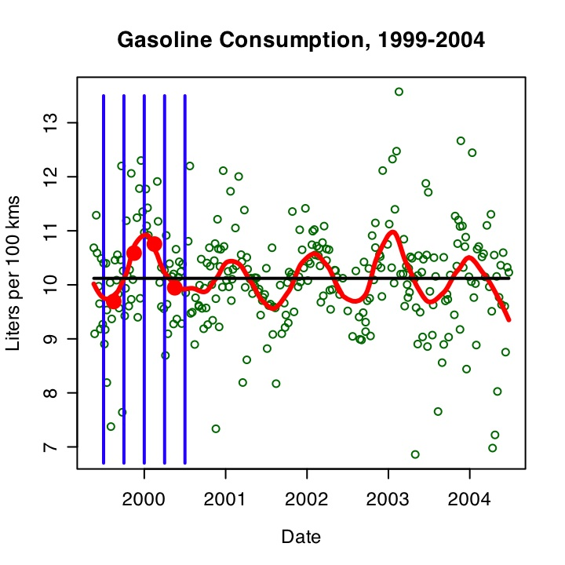
Gasoline Consumption
Each Fill - record kms and litres of fuel used
Smooth
--->
Seasonal
Pattern

Slide 15
Smoothing amplifies signal
but introduces bias
by cutting off peaks and valleys

Slide 16
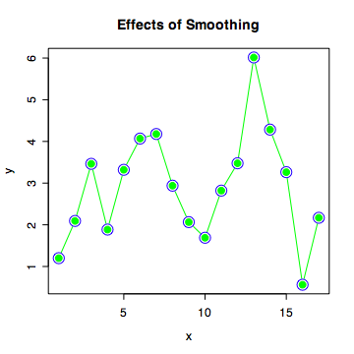
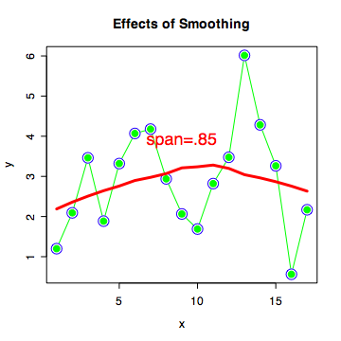
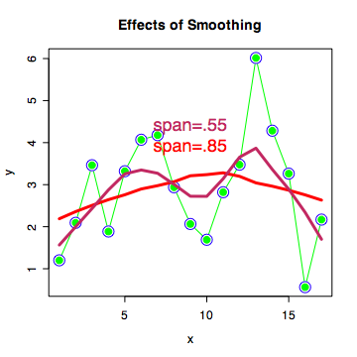
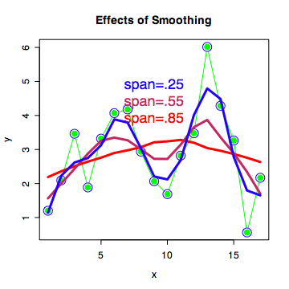
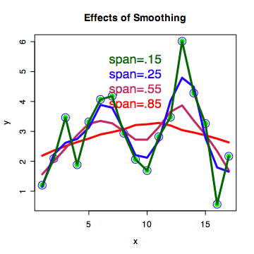
Illustration of Effect – Artificial Data

Slide 17
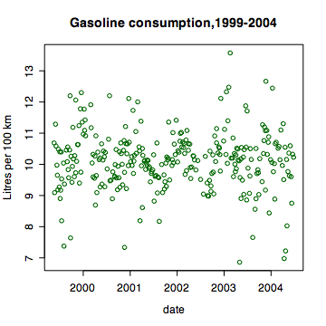
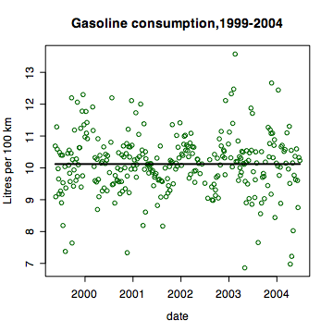
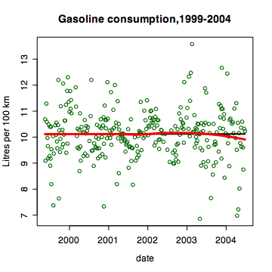
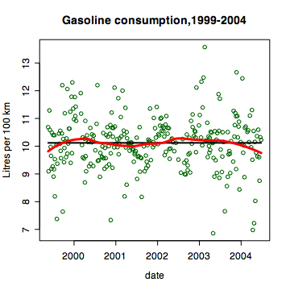
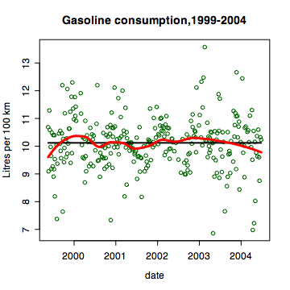
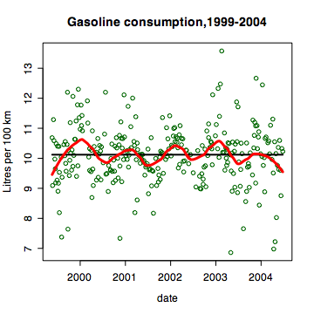
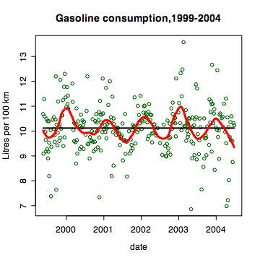
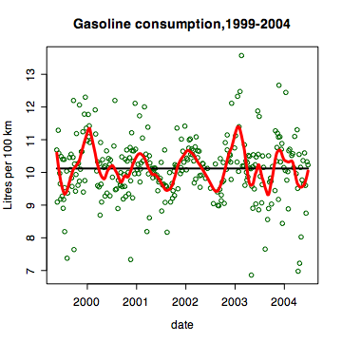
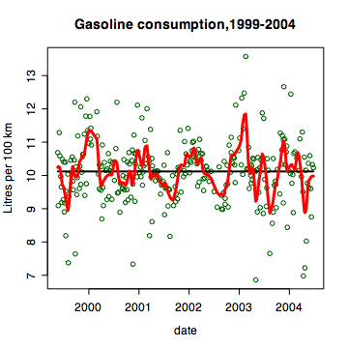
Intro to smoothing with context …

Slide 18
Gas Consumption Example: So What?
1. Smoothing can reveal info not otherwise observable.
2. Use of the technique combines the technique of averaging with real-world common sense.
3. Subjectivity is a necessary part of good data analysis.

Slide 19
Public Lotteries
(like 6/49)
Cash flow
Ticket proceeds in (100%)
Prize money out (50%)
Good causes (35%)
Administration and Sales (15%)
$1.00 ticket worth 50 cents, on average
Typical lottery P(jackpot) = .0000007

Slide 20
How small is .0000007?
Buy 10 tickets every week for 60 years
Cost is $31,200.
Chance of winning jackpot is = ….
1/5 of 1 percent!

Slide 21
Lottery Example – So What?
1. Lottery is not a good investment from financial perspective.
2. Long participation is no guarantee of a big win.
3. Almost always, long participation results in a big loss.
Notes:
Unless “hope” is valued a lot, not a good investment!

Slide 22
Peer Review – Motivating Example
“Motherhood” Procedure?
SFUs “Diverse Qualifications Admissions”
2 referees, each assign 0,1,2,3 to case
rank applicants and accept best ones
problem: referees vary drastically in toughness
Admission depended on referee assignment
Luck!
Corrected Problem by forcing calibration of refs

Slide 23
Peer Review – More General
Submissions to publishers (popular press or academic journals)
How sensitive to referee choice?
Assume 2 refs. If agree yes -> publish 95%
If agree no -> reject 100%
If disagree -> publish 20%
Consider processing of 100 submissions

Slide 24
Simulation of Peer Review Process
Assume refs approve 0-50% (avg 20%)
Assume “quality” varies over 0-1 (avg 0.5)
Modulate ref approval pct by quality
(Paper quality must influence approval -
this is built in to the model – more later).
Go to R: peer()

Slide 25
Combining Quality & Ref. Toughness
an example:
Ref averages 25% approval, say
Particular paper has quality 0.8, say
Refs % approval for this paper is 25% + (0.8-0.5)/0.5 * (100%-25%) = 70%
peer() again – ask why good papers are not often published
Notes:
need more assessors, randomly chosen, for fairness
The graph shows that
1. Higher Quality of a paper will give it a better chance of being published, but
2. The papers that are published have had to had a lucky assignment of referees.

Slide 26
Peer Review: So What?
Procedures that appear “fair” can become very “unfair” because of randomness
Any system in which a small number of assessors are selected from a larger group of assessors can be flawed for this reason. (e.g. university grades!)

Slide 27
Traffic
Q: What causes the accordion effect in heavy, one-lane, automobile traffic?
Go to R: traff.run()
Notes:
watch speed of last car in line. Order is fixed, so no passing. and last car is slowed when car in front is slowed.

Slide 28
Traffic – So What?
Complex Behavior can sometimes have a simple explanation once randomness is accounted for.

Slide 29
Overall Take-away Message?
An education in statistics allows one to understand many aspects of daily life, not merely the arcane detail of data-based research, and we should share this awareness widely.

Slide 30
The End
Thank you for listening
Questions? Comments?
These slides are posted at
www.stat.sfu.ca/~weldon
R programs available: email weldon@sfu.ca

Slide 32
Sports Again: Hockey
Can we tell from a game which team is the better team?
Define team quality as Prob‘y(get next goal)
How often does A win if quality A = 0.6?
(As of Feb 22, Canucks were 38/61 = 0.62 for games. What does this imply for quality?)
go to R:
hockey(ngames=100,ateam=.6)
hockey.game(ateam=.6)

Slide 33
Zipf’s Law
plotzipf(CANcitypops,CANcitynames)
plotzipf(UScitypops,UScitynames)

