Slide 1
TEACHING STATISTICS CONCEPTS THROUGH STOCK MARKET CONTEXTS
Larry Weldon
Simon Fraser University
Notes:
Thank organizers Talk motivated by experience as Pension Trustee of my university. Much talk of Controlling RISK
by minimizing variability of returns, and I felt this was due to some confusion about basic stats.
I want to say more about this but first let me explain that this whole talk is just an example of a larger topic.

Slide 2
Big Picture: Real Life Experiences Inform Curriculum Choice in Stats
Stock Market Experience
  Stock Price Trends
  Stock Price Variability
Notes:
Melbourne 2008 project-based teaching would keep the curriculum current and relevant.
Techniques required for Current applications are the ones we should be teaching
This is example of how experience informs course content.
Trends – of interest because possible profit if predictive
Variability - of interest because they are used to measure risk

Slide 3
Typical Stock Price Time Series
IBM Share Price April 2013 – April 2014
Notes:
Typical stock price data – one year IBM –daily - and there does seem to be a trend. Click.
Can see a fairly regular variability around the trend. A potential investor might ask:
How much RISK is there in buying this stock in April 2014? Is it measured by the observed Variability???? What is RISK in this context? FIRST let’s consider stability of TREND.

Slide 4
STOCK PRICE DEVIATIONS FROM TREND
SD = $2.30, Proportion Positive = .50
Notes:
A couple of larger spikes but we ignore these for now and use the summary to suggest a kind of random walk for this stock.

Slide 5
Study TREND and DEVIATIONS with Simulation?
Similar Deviations ?
Similar Trend ?
Try RANDOM WALK with same mean and SD
A CUMULATION of
Independent Normal Deviations with mean 0
→ NO TREND ???

Slide 6
Random Walk with same mean & variability as IBM data
Simulate with norm.walk()
Notes:
Surprising Trend? Not really. SEE simulation.

Slide 7
Typical Stock Price Time Series
IBM Share Price April 2013 – April 2014
Notes:
Typical stock price data – one year IBM – and there does seem to be a trend. Click.
Can see a fairly regular variability around the trend. A potential investor might ask:
How much RISK is there in buying this stock in April 2014? Is it measured by the observed Variability???? What is RISK in this context? FIRST let’s consider stability of TREND.

Slide 8
Is the apparent trend typical?
Simulation Runs Confirm ….
Inference?
Past trends are no hint of future trends
(in real stock data as well as simulation)
Notes:
The simulations suggest that the trend in the IBM stock price will not be useful for predicting future trends. (since symmetric random walk has same apparent trends)
This is not something that is well-understood by either students or graduates.

Slide 9
Conclusion so far?
Stock Price Trends from the past do not predict trends in the future.
Next: Variability
How does it relate to Risk?

Slide 10
Investment Risk
What is it?
Chance of a non-trivial loss, when you are
forced into the loss within your time horizon
How can it be measured?
Stock Price Variability?
Notes:
Does Stock Price Variability Measure Stock Investment Risk?

Slide 11
Determinants of Stock Market Risk
General Level of Stock Prices
Competition in the Industry
World Upheavals (War, Bank Collapse, Sunamis, etc)
Technological Change
Capability & Ethics of Management
Etc. (Things that might happen in Future)
Stock Price Variability does not measure RISK!

Slide 12
To Repeat ….
Risk is Probability of Loss
Stock Price Variability Does Not Measure RISK
Notes:
A big jump in stock price increases variability but does not represent a risky result.

Slide 13
What use for measurement of
Stock Price Variability?
Day Traders
Options Holders
Portfolio Variability
Notes:
There are three uses in this context ….
Its something that statisticians can do!

Slide 14
What is an option?
An opportunity to force a purchase or sale at a pre-specified price during a pre-specified time interval. (But no obligation to do anything).
This opportunity costs money.
The price of the option depends on the stock price variability
More variability implies a higher option price.
Option holders want increasing variability!
Notes:
An option holder is not afraid of variability of stock prices.

Slide 15
What use for measurement of
Stock Price Variability?
Day Traders
Options Holders
Portfolio Variability

Slide 16
Stock Portfolio Variability
Although Variability is not RISK, we might still want to reduce it in some situations.
Expect to need money soon
Unknown timing of future need
Can achieve Variability Reduction:
High Variability Stocks, but
a Conservative Portfolio
Notes:
Run “Risky()”

Slide 17
Risky Company
For each $1 invested:
Return is $0 after one year with prob 25%
$1/2 ..…………………………………25%
$1 ..…………………………………25%
$4 ..…………………………………25%
RUN RISKY()
Notes:
Very good chance of wasting money! 75% no profit. Do simulation RISKY before next click.
On AVERAGE, positive. ROLE of INDEPENDENCE.

Slide 18
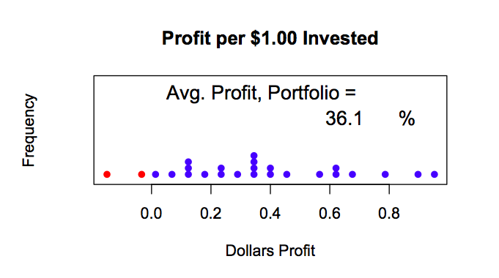
Simulation Outcome, 25 trials

Slide 19
Stock Variability vs Portfolio Variability
Stock variability can be accommodated in a well diversified portfolio (not all eggs ….)
More variable investments tend to be those with higher returns on average
A diversified portfolio of variable stocks can produce stable returns
Notes:
Well-diversified = not too dependent

Slide 20
Lessons from this Exercise
Measuring Risk
Illusion of Trends
Role of Independence in SEM
SD vs Time Series Variability
All useful topics given little time in standard course

Slide 21
Big Picture?
Life experience provides important input to the selection of statistics curriculum items
Evolution of the curriculum should make continual use of life experience inputs
→ a way to keep course modern
Notes:
Thank you for your attention. Questions? Comments?

Slide 22
Thank you!
Questions?

