Slide 1
Analysis by Simulation and Graphics
Some Examples
Larry Weldon
Statistics, SFU
Notes:
What would the life of a statistician be like if he did not understand Stat 101 inference: Cis and HTs, Regression and Anova. I hope my analysis examples will convince you that the other stuff you learn in stats courses is more fun and just as useful! I used to teach this stuff at SFU but as soon as I retired they deleted the course! The course notes are still available at http://people.stat.sfu.ca/~weldon/stat400-05-3.html

Slide 2
The Examples
Smoothing – Auto Gasoline Consumption
Bootstrapping – SEM and Body Mass Index
Simulation for Missing Data – Bimbo Bakery
The Problem with Panel Reviews – SFU entry

Slide 3
Gasoline Consumption
Commute many years Tsawwassen <-> SFU
Similar route, similar traffic
Measure km and liters each fill-up

Slide 4
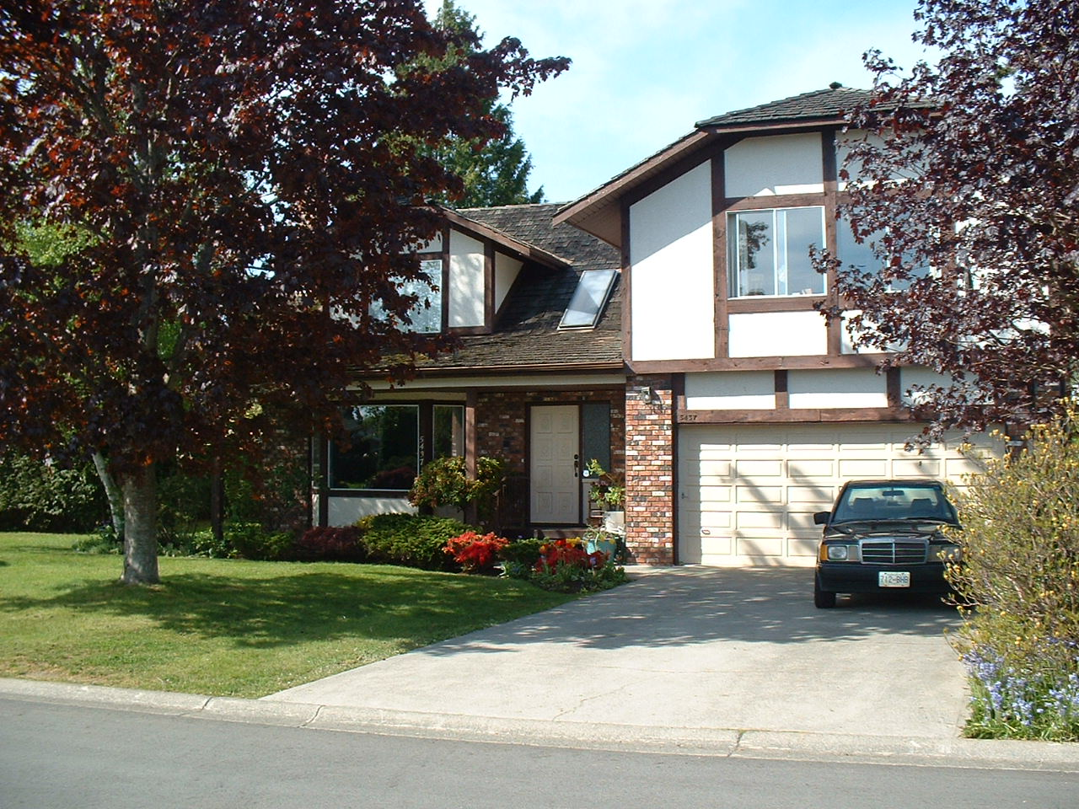

Slide 5
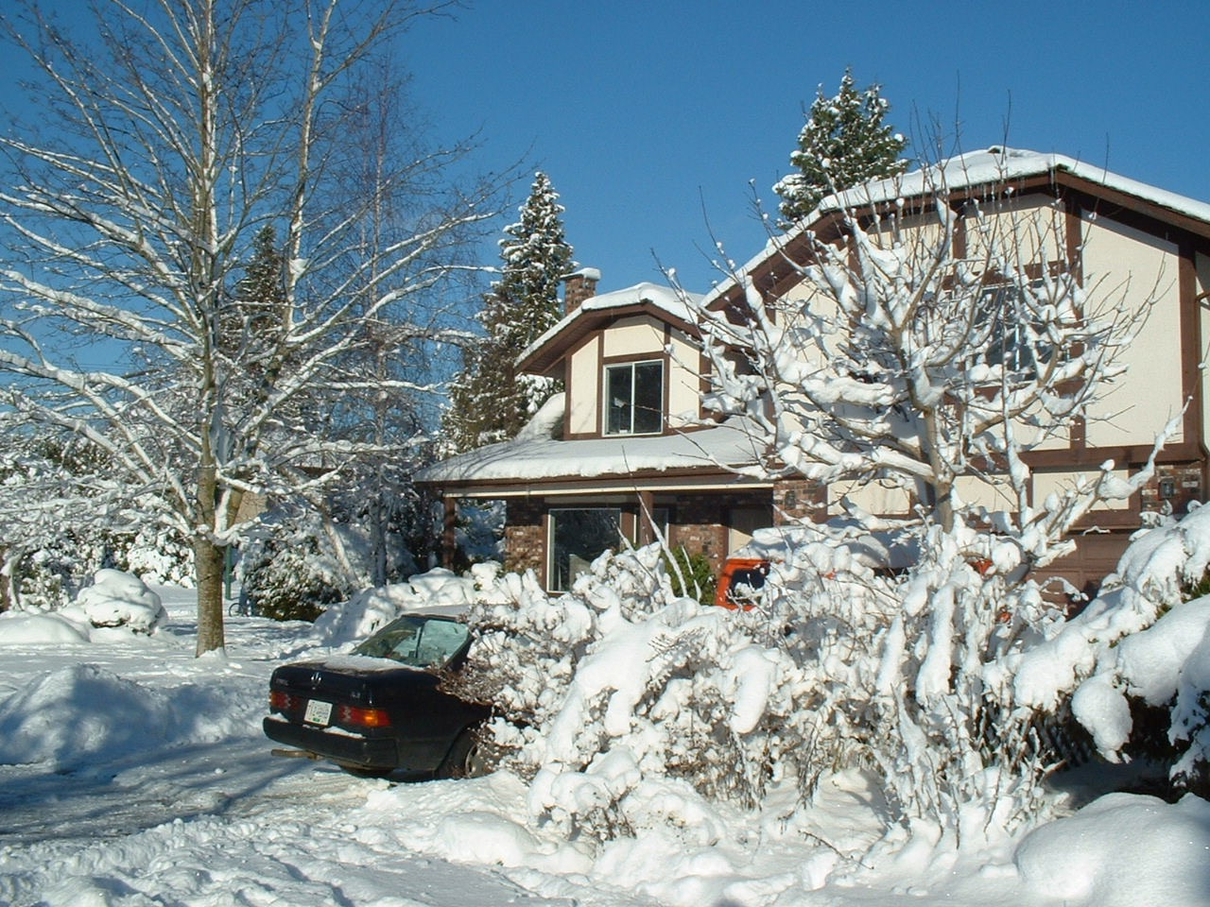

Slide 6
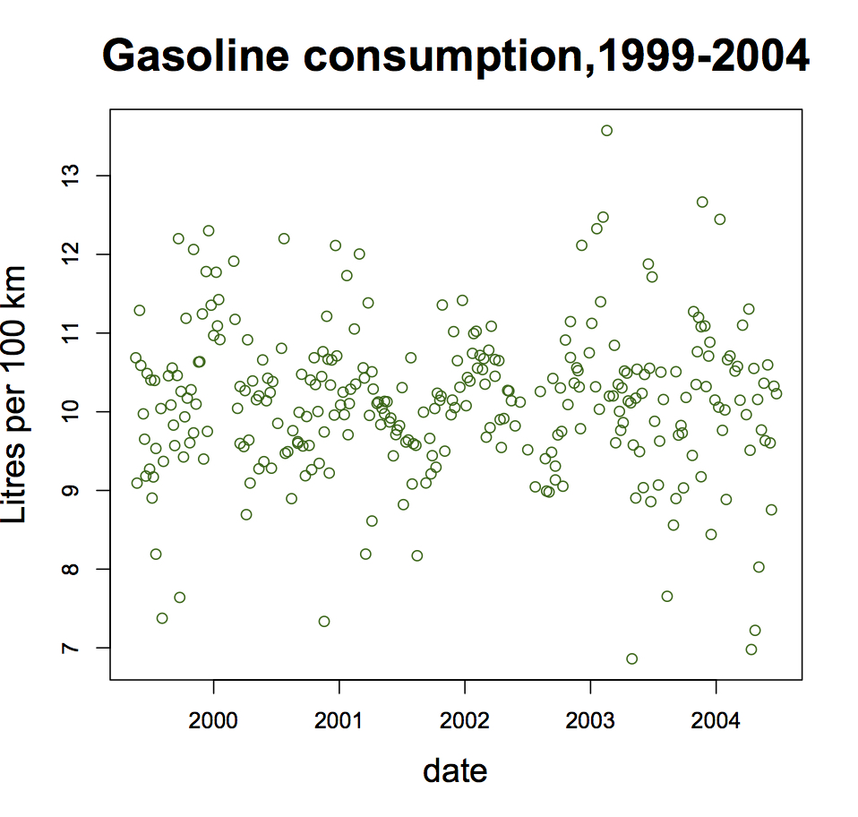
A Graphics Application
Notes:
Tell the story of driving to and from SFU – about 80 km per day. An expense I have escaped in retirement! Note the variability – 7 l/100km to 13 l/100km - ±30%
The variability is large but there does not seem to be a trend up or down – no suggestion that my 18-year old car was deteriorating. Lets fit the trend with a regression line.

Slide 7
Notes:
Note that this is a time series, and the time-order of the points from left to right is of interest. In this situation, it is worth remembering that regression attempts to use averages in vertical strips to estimate any trends. Use gasplot() in R to show the next steps. Does anyone here collect this info routinely? Works for predictive relationships, not just time series …

Slide 8
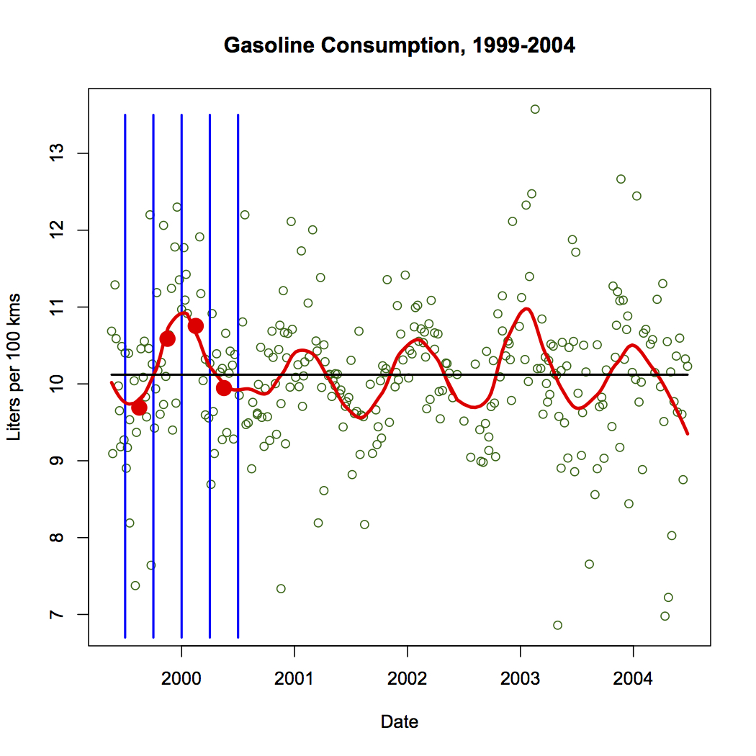
Notes:
Note that the key to uncovering the hidden trend was the simple operation of taking the average. But note that the width of vertical strips was chosen subjectively. How can we tell which width is best? Use gas.v.run()

Slide 9
Notes:
The strips were too narrow here, and the trend is chaotic.

Slide 10
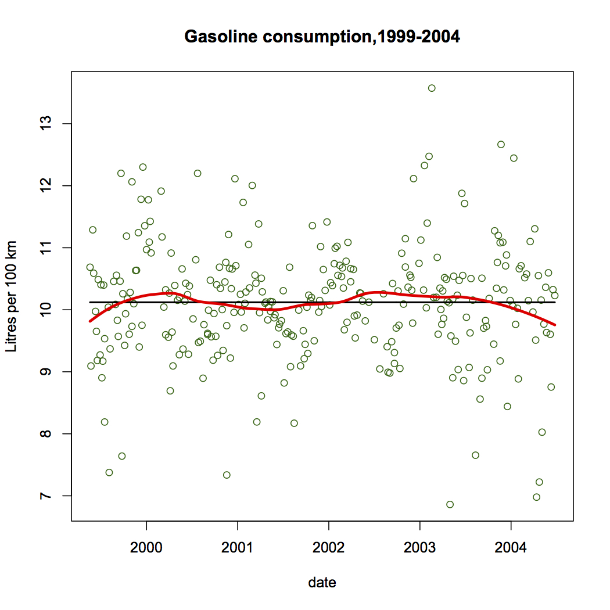
Notes:
In this one the strips were too wide, so the time-dependence is smoothed over. Too much smoothing. The choice of interval width is determined from knowledge of the context of the data. Five almost identical trends over five years is not an random event! A good statistical analysis does not always use objective methods ….Statistics is not Mathematics.

Slide 11
Point of the Example?
Smoothing can detect trends otherwise missed
Graphical presentation is the best way to show the result
Knowledge of data context is an important input to data interpretation
Subjectivity can be a useful trait in data analysis (e.g. in degree of smoothing)

Slide 12
Next Example …
Use of Bootstrapping
to Provide the Precision
of an Estimator
Notes:
When we use a statistic to estimate a parameter, we usually like to know how accurate our estimate is. Note that in this case the “statistic” can be the result of quite a complex process, and theoretical formulae for the accuracy of our estimate may not be known. In this situation the bootstrap can be used to bypass the theoretical lack. To illustrate this, and to assure you that the method really works, I will take a situation where we do know the formula, but we will temporarily pretend we do not have it, and use the bootstrap.

Slide 13
Bootstrap Sampling for Estimator Variation?
Just resample the one given sample, with replacement, and repeat with this one given sample many times.
Values are the same but with varying multiplicity.
Compute value of estimator for each bootstrap sample
Compute variability of estimator

Slide 14
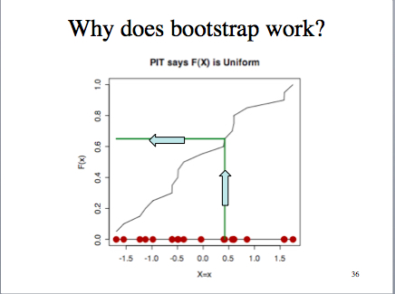
Notes:
So, if you reverse the arrows, you get a way to generate a random sample from the population with this CDF.
What if we replace the CDF by the best estimate ECDF?

Slide 15
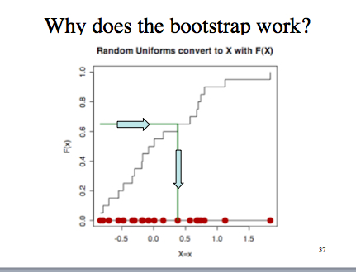
Bootstrap Sampling is ECDF Sampling

Slide 16
Bootstrapping - SEM
Imagine that you have never seen
SEM = 𝜎 / √n, or its estimate s / √n
to estimate the precision of the sample mean,
as an estimator of the population mean.
Notes:
You have wanted to estimate the average BMI among stats students. You take a random sample of stats students and record their BMI.
Then you compute the mean BMI. How precisely does this estimate the population mean?

Slide 17
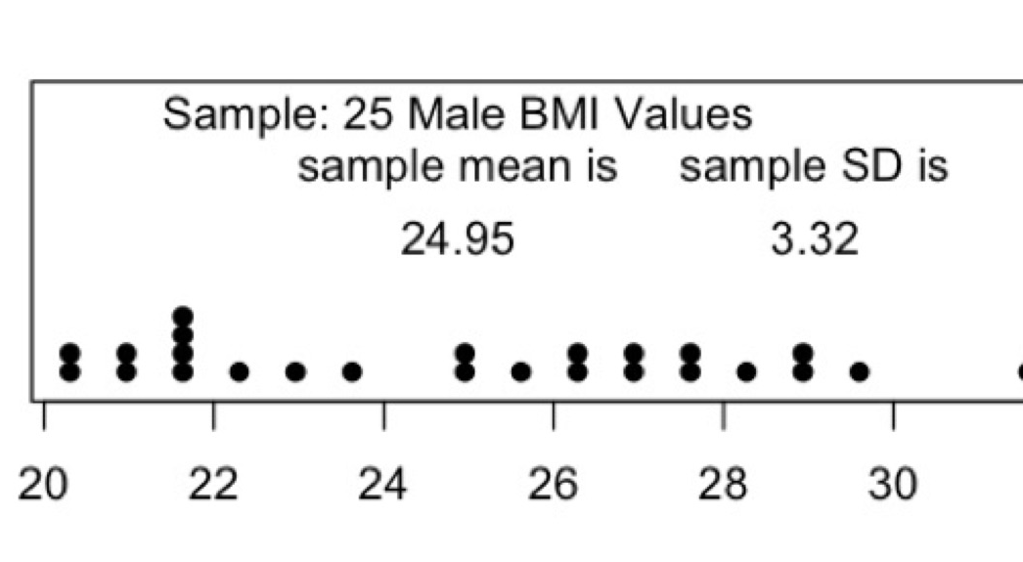
Sample Data - BMI
Notes:
Usual estimate of SEM is 3.32/sqrt(25) = .66 but in this experiment we know the population so we can find out true SEM .

Slide 18
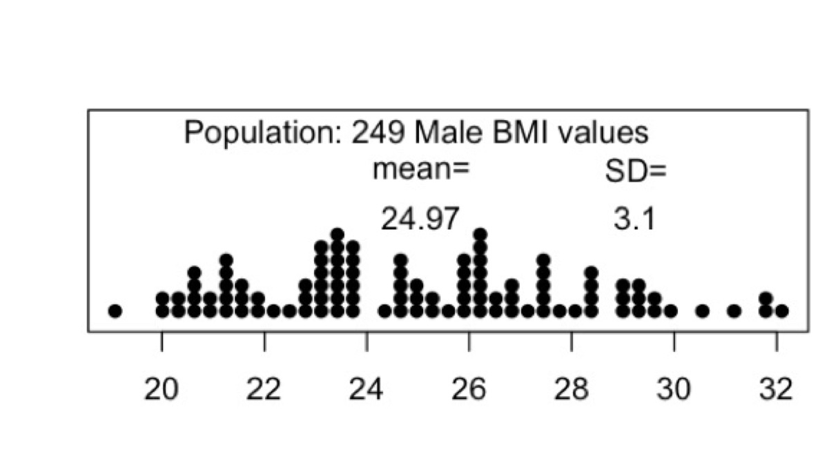
BMI Population
Notes:
True SEM is 3.1/5=0.62. But we can suppose we do not know the square root law and use bootstrap instead ….

Slide 19
SEM and its estimates
True SEM = 3.1/√25 = 0.62
Usual Estimate = 3.32/√25 = 0.66
Bootstrap Estimate = 0.60
But these estimates are sample-sensitive.
Re-do with simulation …
Notes:
use boot.demo.slow() with the BMI data
And boot.SEM.demo() but in this case I just use N(0,1) as the population

Slide 20
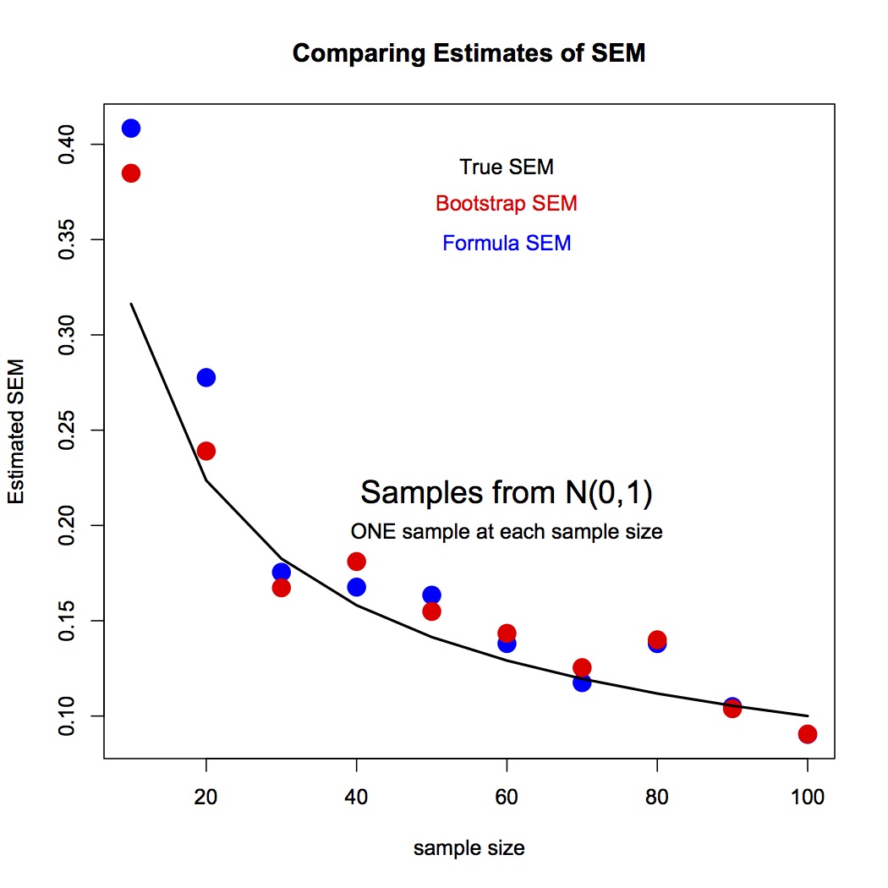
Notes:
This shows the relationship of the bootstrap estimate of SEM to the usual formula estimate for various sample sizes – again a simulation but the graph is typical.

Slide 21
Point?
We have found the variability of an estimator without knowing the mathematical result.
Can we use for more complicated examples?

Slide 22
Estimating 90th percentile
New Population N(0,1)
Estimate 90th percentile in n=30 by 4rth largest value
Variability of this estimate?
Notes:
Use my.boot.90.test() and
Use boot.90pct.demo()

Slide 23
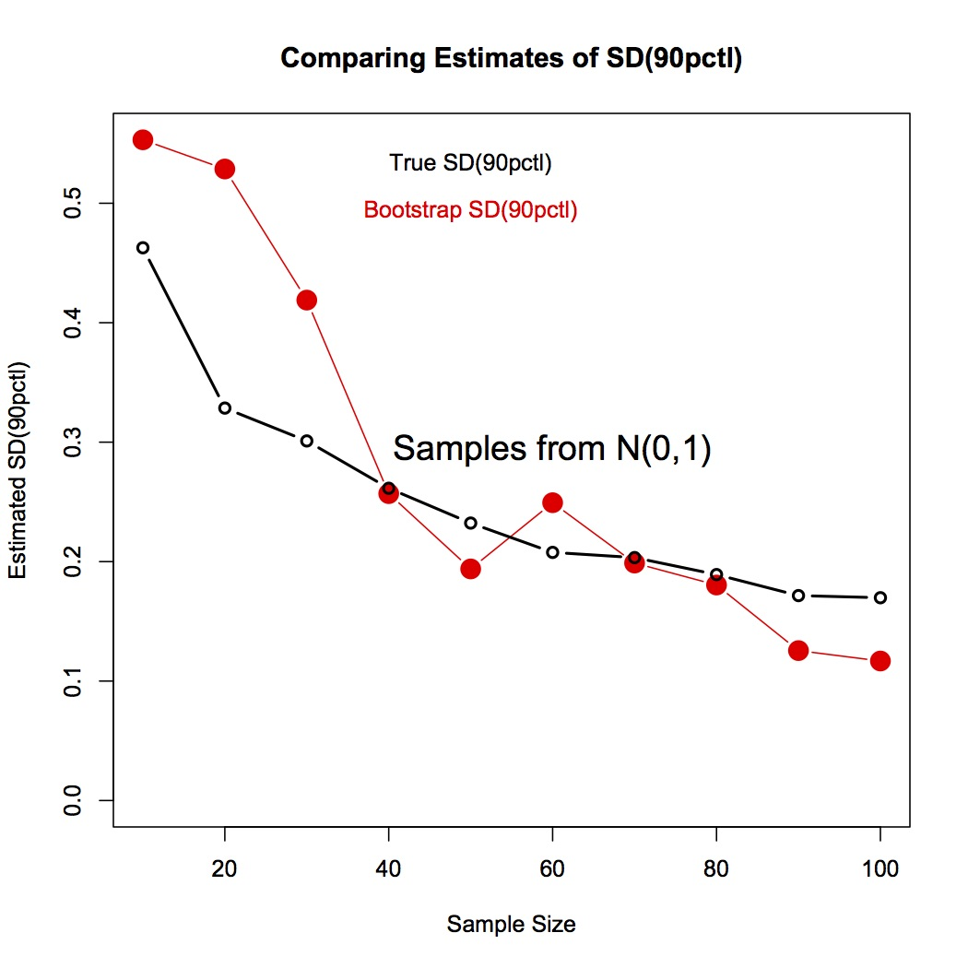

Slide 24
Point of this example?
In situations where a complex estimator is used,
the bootstrap can estimate precision
without mathematical gymnastics.

Slide 25
Bimbo Bakery
Using Simulation And Graphics
We explore the use of simulation and graphics for a commercial optimization task.
Available Data:
Daily deliveries and sales of loaves of bread
at one retail location, over 53 weeks.

Slide 26
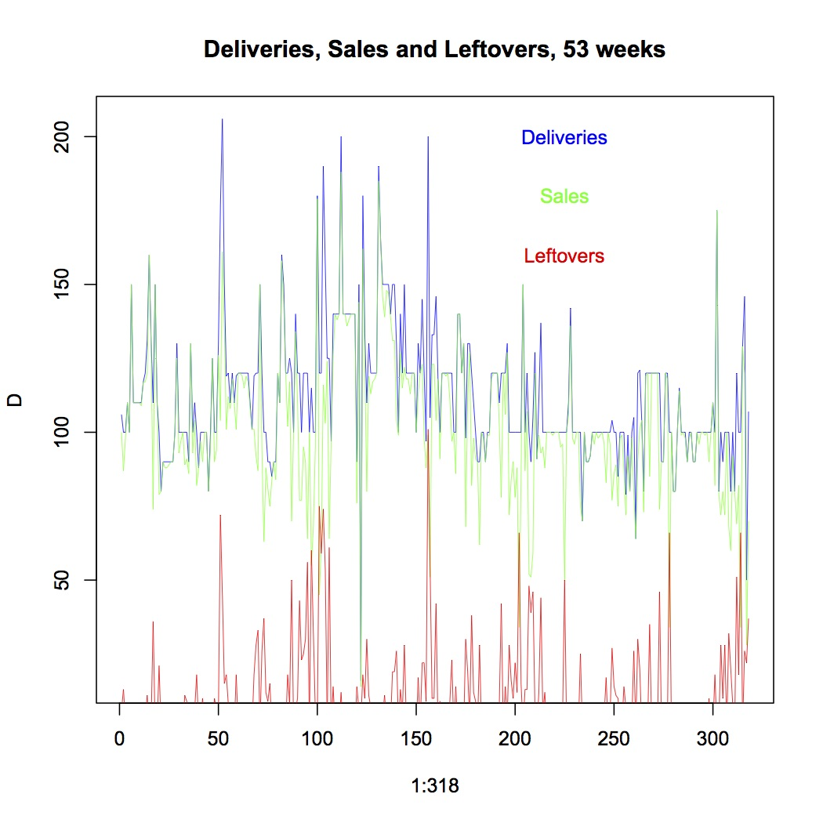
Notes:
I work with seasonally adjusted version of this data – only slightly different.

Slide 27
Question …
Are delivery amounts profit maximizing?
Need costs & profits parameters
Profit per loaf sold $0.50
Unsold loaf cost $0.25 per loaf
Out of stock cost $2.00 per loaf demanded

Slide 28
Problem…
Demand is unknown when it Exceeds Deliveries
Demand=Sales when Sales < Deliveries
Demand ≥ Sales when Sales ≥ Deliveries
But we need Demand Distribution
to maximize Profit

Slide 29
Solution?
Guess the Demand Distribution (T &A)
Construct Simulated Sales: Use the Actual Sales with simulated Demand to estimate simulated (delivery-limited) sales
Compare Simulated Sales with Actual Sales and redo Guess if necessary.

Slide 30
There is a weekly pattern
We use Wednesday data only – 53 days data

Slide 31
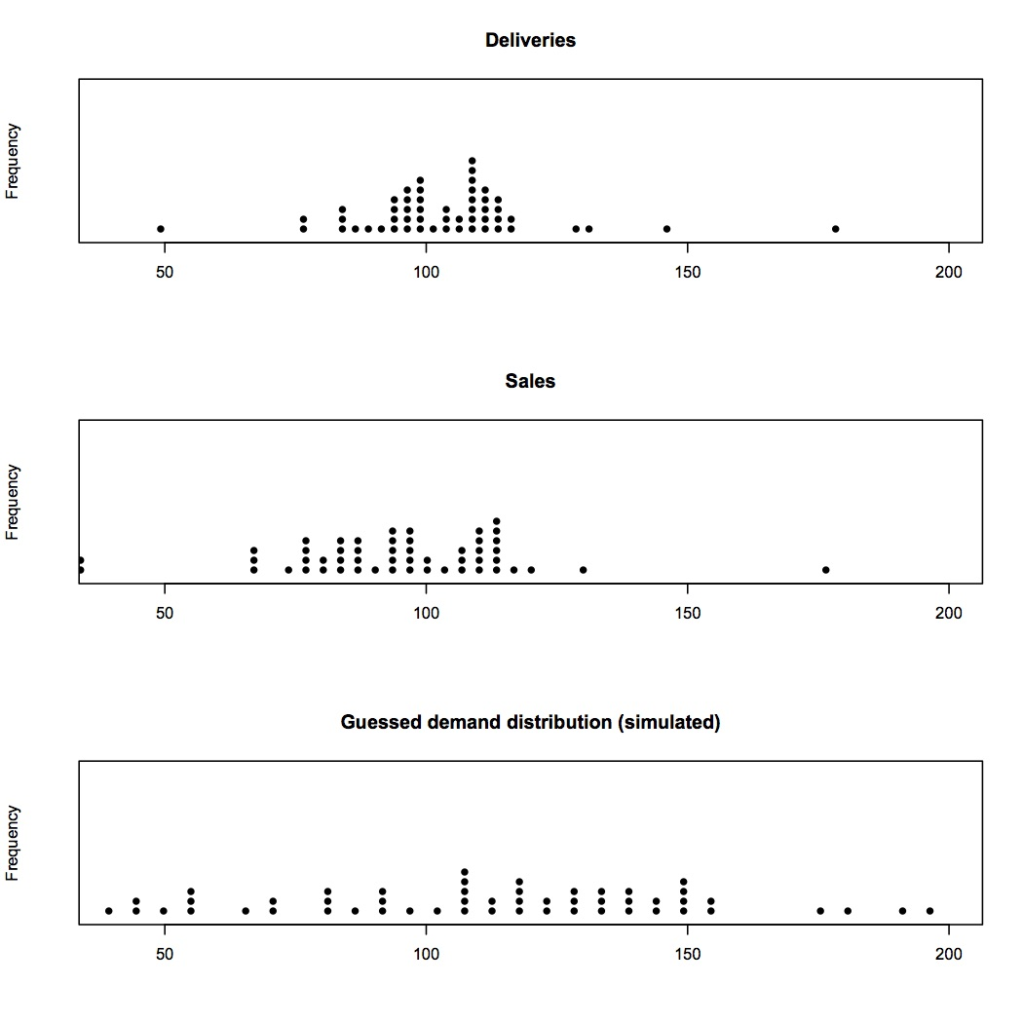
Notes:
Use bimbo.guess.plots(115,35,xd=wd,xs=ws) and try a few other means and sds. Hard to assess. But try ecdf … Use bimbo.test() a few times.

Slide 33
Know we know Demand Dist’n
N(115,35)
Apply Demand with Actual Deliveries
and Cost Parameters
Let D be replaced by D * (1+%)

Slide 34
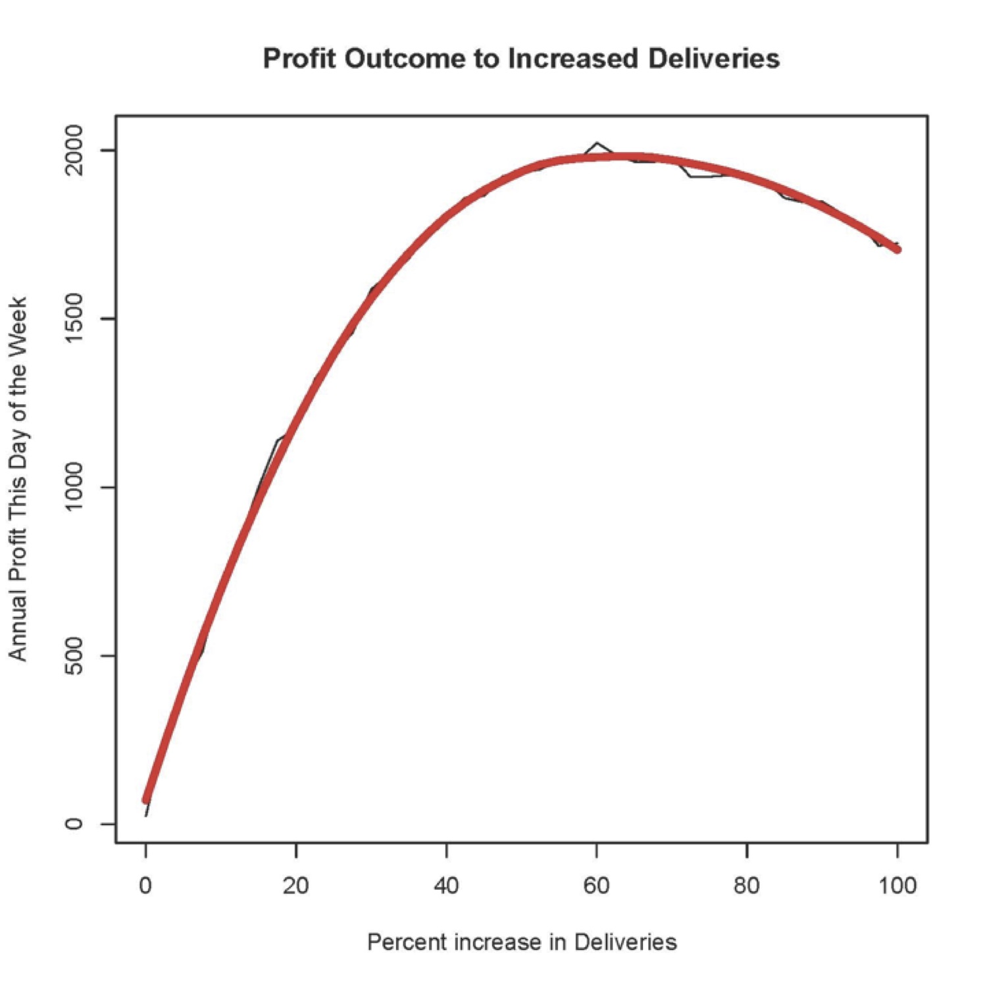
Using our best guess of Demand
Notes:
bimbo.profit.graph(115,35,wd) Looks like 60% increase in deliveries would provide a huge increase in profit.

Slide 35
Practical?
Could use same process for every Bimbo product and every retail outlet!
Notes:
But my source got interested in politics and did not pursue this problem, unfortunately.

Slide 36
Point of the Bimbo Example?
Trial and Error is a useful technique when there is a way of checking the outcome.
In real-world applications of statistics, the best methods use information from the application expert as well as from the statistician.
Simulation is useful even when the population of interest is unknown.
Graphical methods are a good way to judge a distribution fit.
Notes:
T&E – suggesting demand distribution Use % change rather than absolute change Population was demand distribution ecdf comparisons

Slide 37
Panel Review – Like Peer Review
More Simulation and Graphics …
Diverse Qualifications Admissions to SFU
Committee Reviews – 2 primary reviewers
Assign case with 0,1,2,3
3= best prospect
0=worst prospect
Problem: Reviewer Rigour Variability
Notes:
Admission was dependent on reviewer assignment luck ….

Slide 38
Impact?
Does the process guarantee that the applicants with the best cases will be admitted, and the ones with the worst cases will be rejected?
We do a simulation of this situation to assess.
Notes:
Use peer.mod()

Slide 39
How are quality and rigor combined?
Example
Applicant quality = 0.7
Two Reviewers Prob of acceptance = 0.15, 0.4
Modify Reviewer probs
0.15 -> 0.15 +(0.7-0.5)/0.5 * (1-0.15) = 0.49
0.40 -> 0.40 +(0.7-0.5)/0.5 * (1-0.40) = 0.64

Slide 40
How are quality and rigor combined?
Another Example
Applicant quality = 0.3
Two Reviewers Prob of acceptance = 0.15, 0.4
Modify Reviewer probs
0.15 -> 0.15 +(0.3-0.5)/0.5 * (0.15-0) = 0.09
0.40 -> 0.40 +(0.3-0.5)/0.5 * (0.40-0) = 0.24
Notes:
So the paper quality is a strong determinant of acceptance, as should be. However, we will see that the impact of reviewer quality is still quite surprising. Use peer.mod().

Slide 41
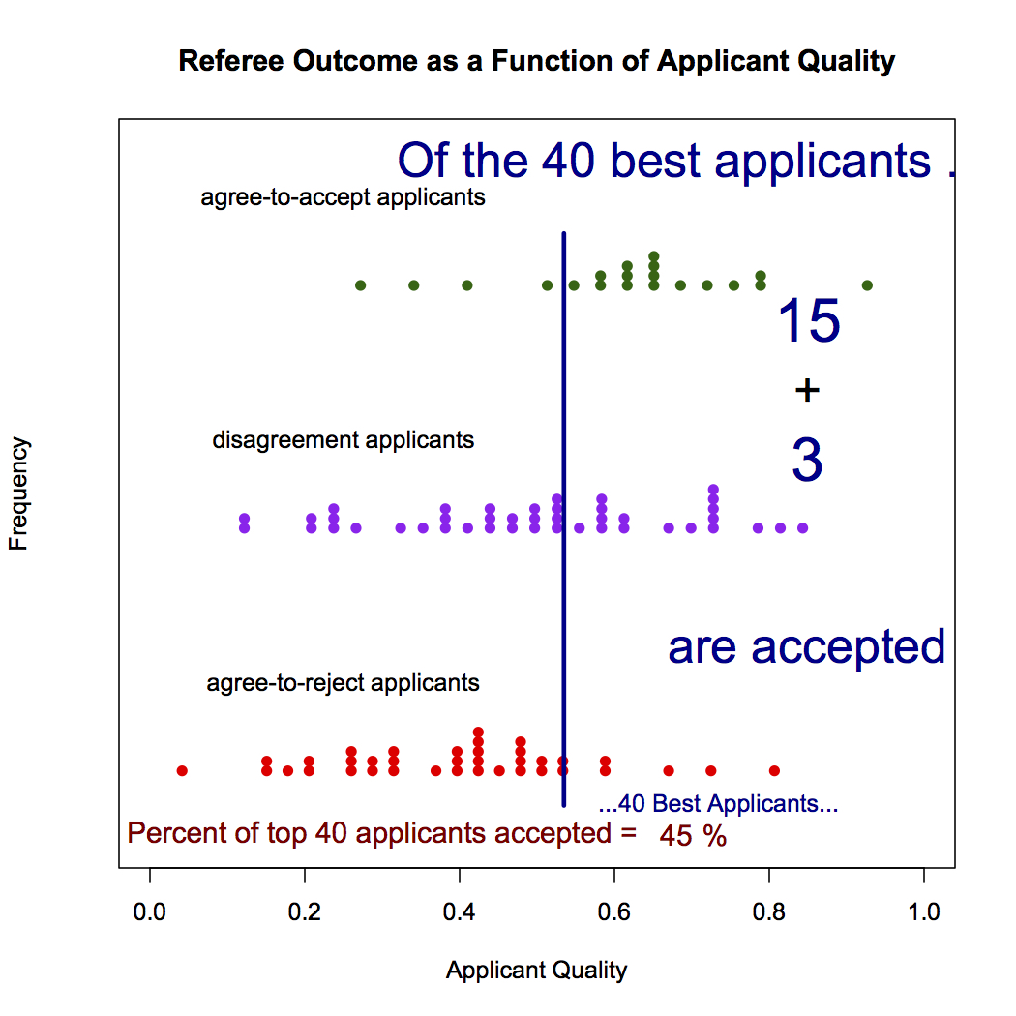
Notes:
Note that many high quality applicants are rejected, and many poor quality applicants are accepted. This phenomenon also applies to peer review of research papers. SFU has fixed the problem by requiring all reviewers to submit ranks rather than absolute quality assessment.

Slide 42
Outcome of this example?
Panel Reviews (like peer review of research papers) is “best practice” but is not very good!
Good applicants get rejected
Poor Applicants get accepted
But panel reviews can easily be fixed, while peer reviews cannot .

Slide 43
Conclusion?
Simulation and graphics are not just for fun!
They provide powerful tools for data analysis, and a new scope for creativity in applied statistics.
Thank you for listening!

