Slide 1
Analysis by
Simulation and Graphics
Some Examples
Larry Weldon
Statistics, SFU
Notes:
Thanks to Farouk Nathoo for scheduling me in this time spot and to Mary Lesperance who agreed to give me her allocated spot. I imagine many of you have made use of graphics and simulation in your studies or research. I wonder how many have been introduced to the power of these methods in undergraduate courses, perhaps not too many. What I want to demonstrate today is that there are many techniques using simulation and graphics that are easy-to-teach & easy-to-learn at the undergraduate level and at the same time very useful for practicing statisticians. Can we say the same thing for Anova, P-values and confidence intervals?
I had been teaching courses at SFU: STAT 100, 300, 400 and todays examples are just selections from the topics of these courses. The course notes are still available at http://people.stat.sfu.ca/~weldon/stat400-05-3.html

Slide 2
The Examples
Smoothing – Automobile Gasoline Consumption
Bootstrapping – SEM and Body Mass Index
Simulation for Missing Data – Bimbo Bakery
Randomness in Sport – Premier League Football
Programming – R – a temporary problem
Notes:
Many examples I use require programming (I use R) for implementation. This might be a limitation for students who do not learn this skill in other courses or jobs. You need to keep this in mind as I claim simplicity for my techniques.

Slide 3
Gasoline Consumption
A Graphics Application
Commute many years Tsawwassen <-> SFU
Similar route, similar traffic
Measure kms and liters each fill-up
Data from One car – One Driver
Notes:
Not your typical statistics data set …

Slide 4
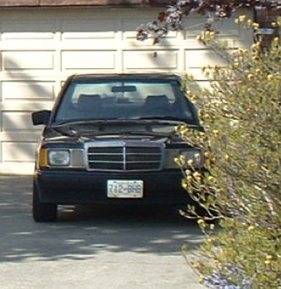
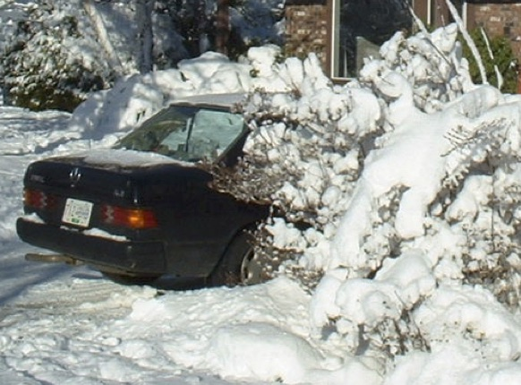
Notes:
I looked for photos of the car – this is what I found. From 20 years ago. 1986 Mercedes 110E. Even Sunny Tsawwassen gets snow!. But most of the time, roads are clear, though sometimes wet.

Slide 5
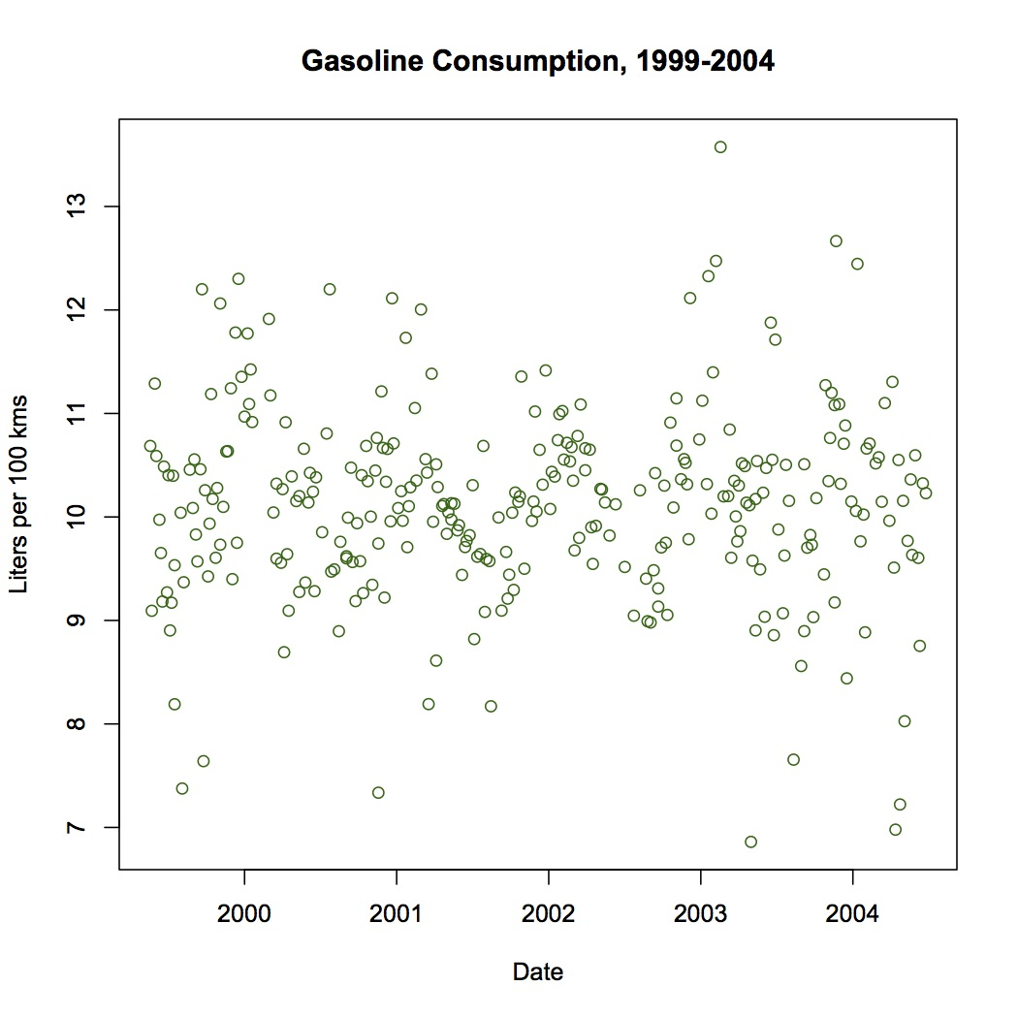
Notes:
Tell the story of driving to and from SFU – about 80 km per day. An expense I have escaped in retirement! Note the variability – 7 l/100km to 13 l/100km - ±30%
The variability is large but there does not seem to be a trend up or down – no suggestion that my 18-year old car was deteriorating. Lets fit the trend with a regression line.

Slide 6
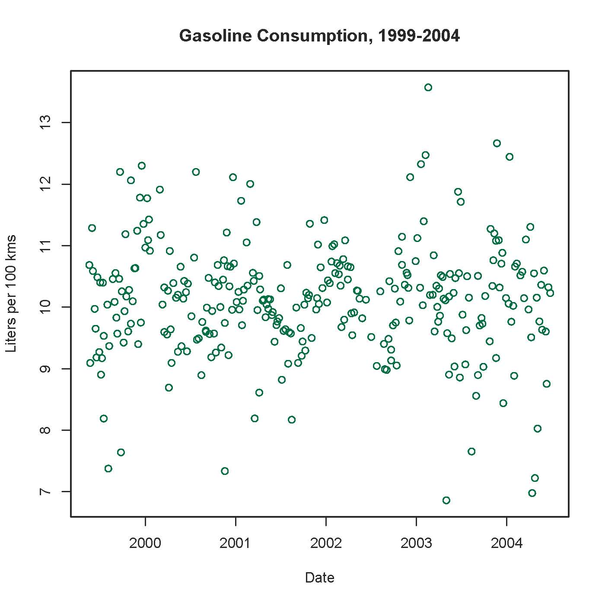
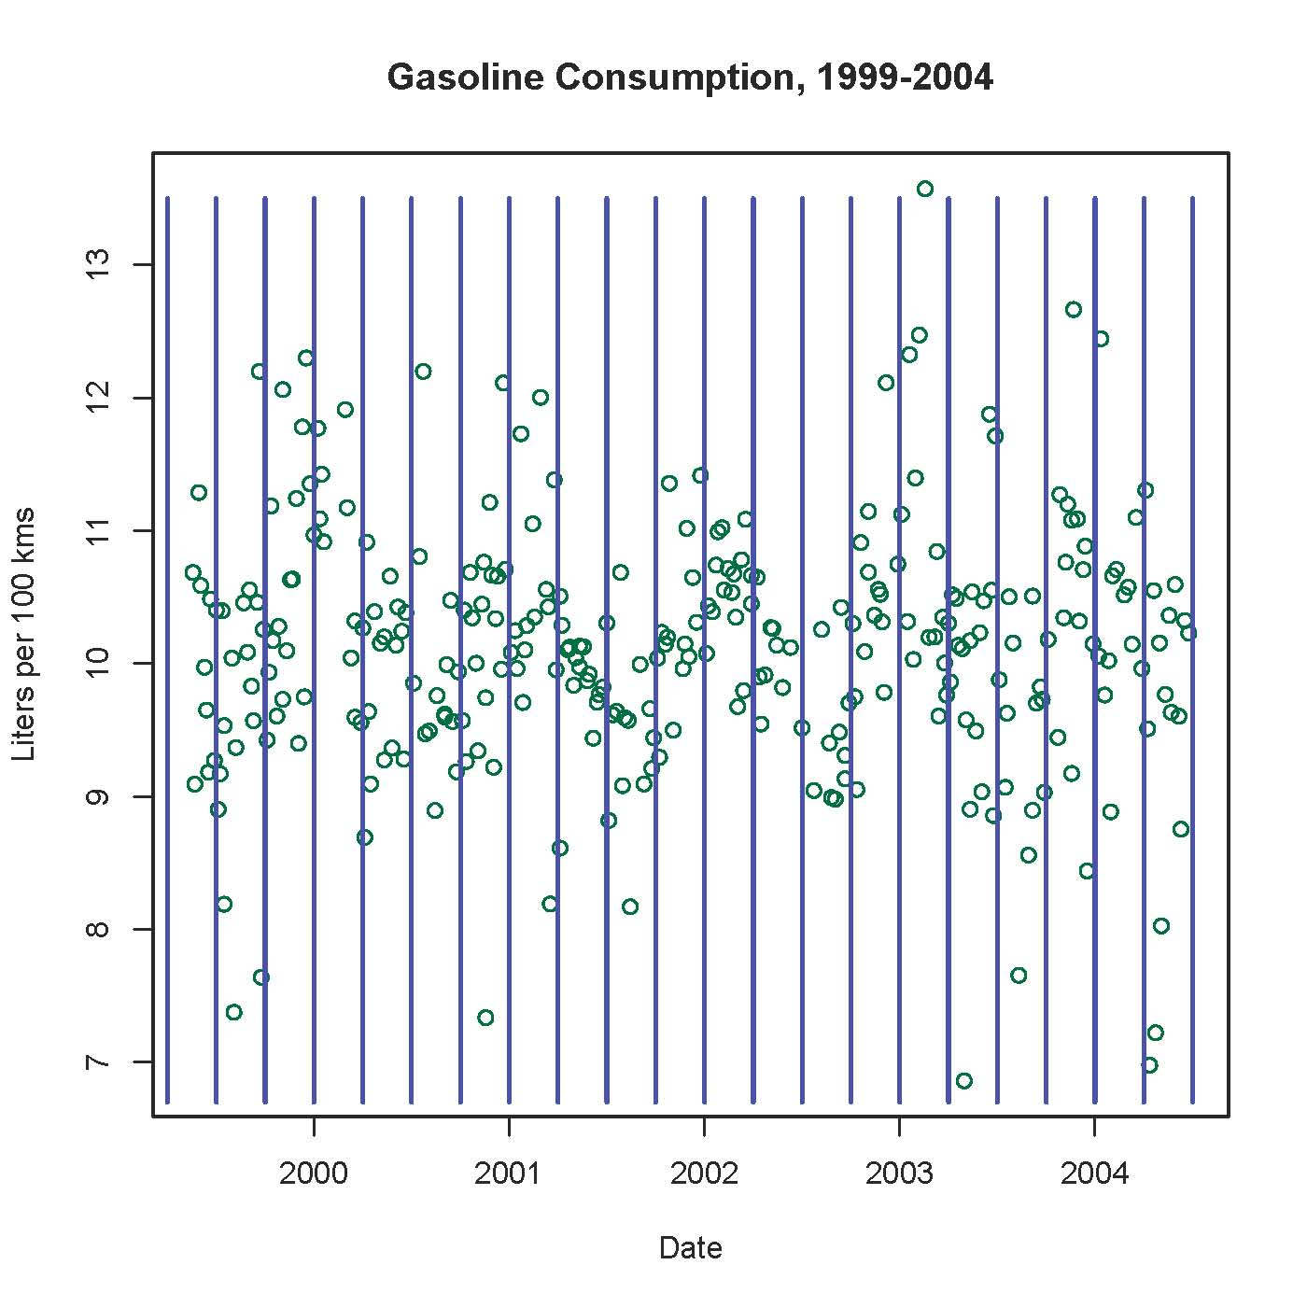
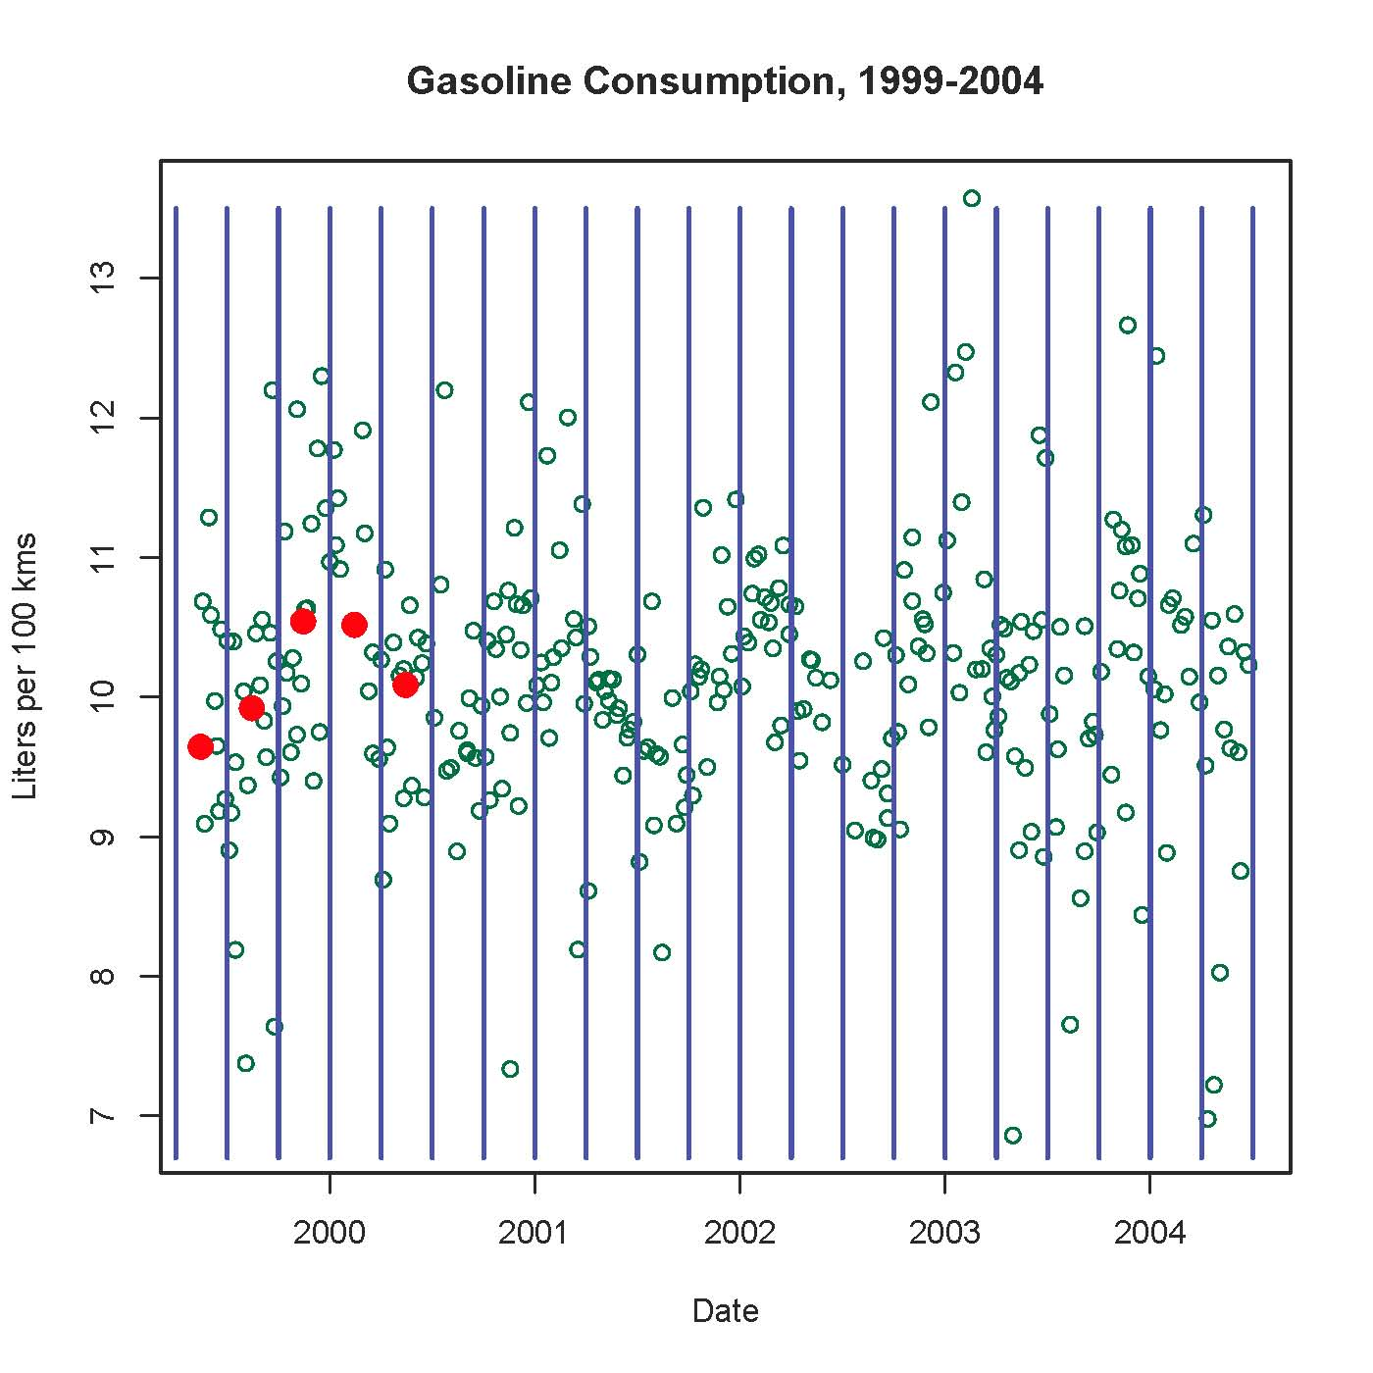
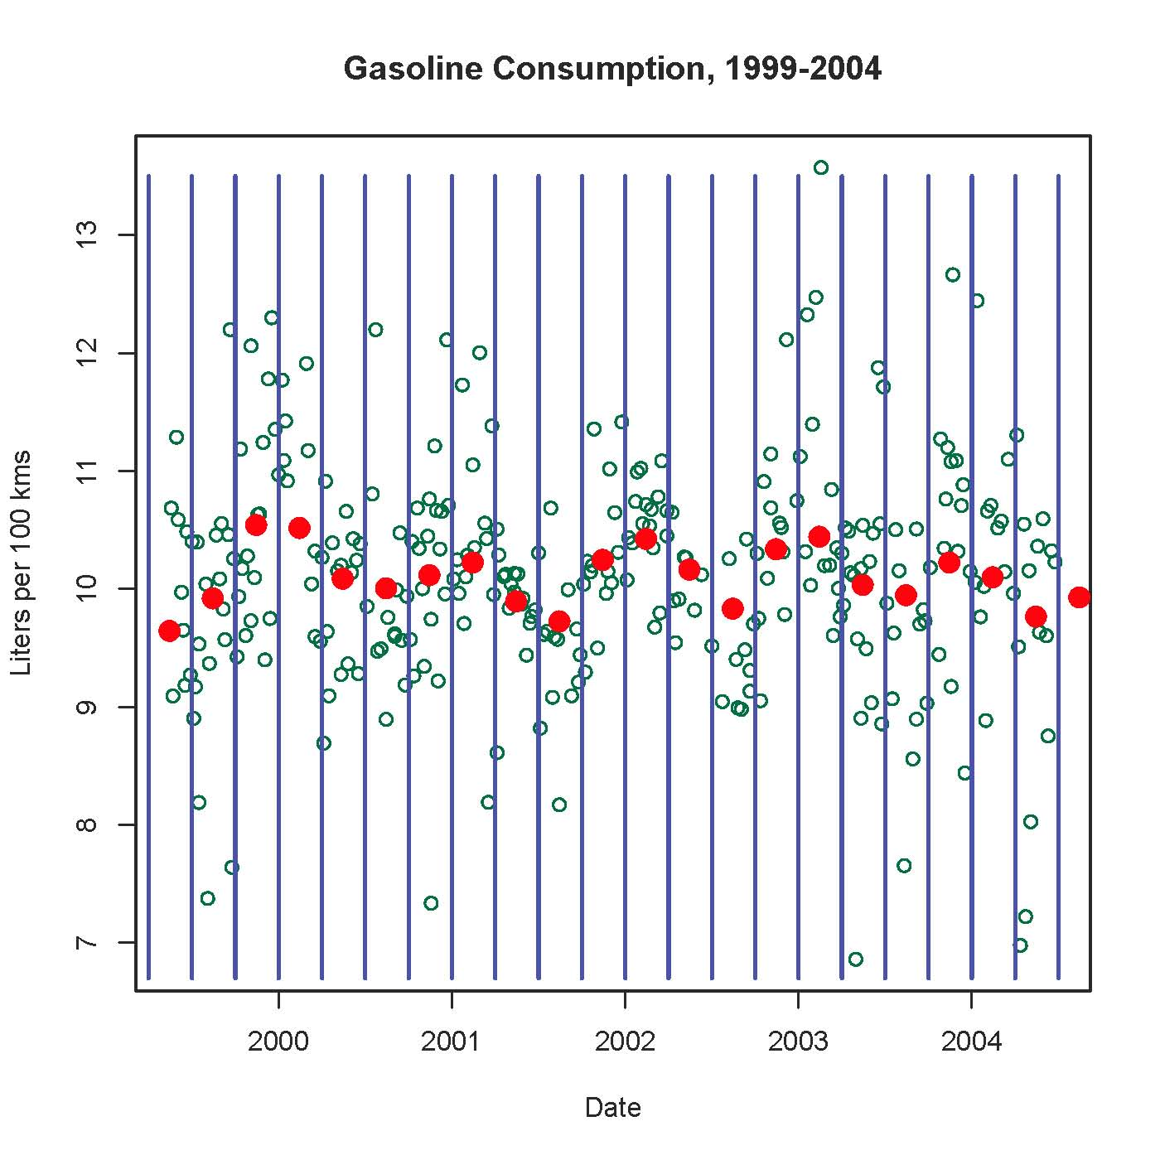
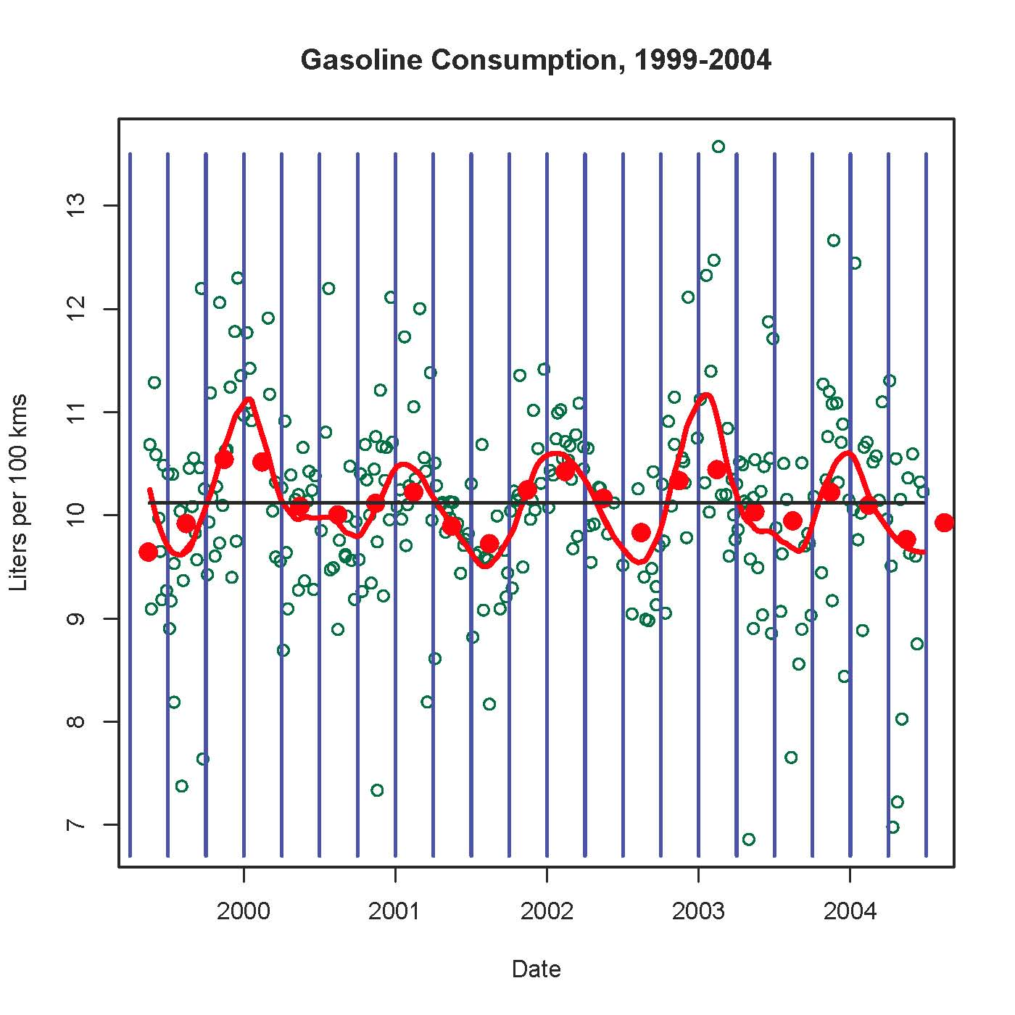

Slide 7
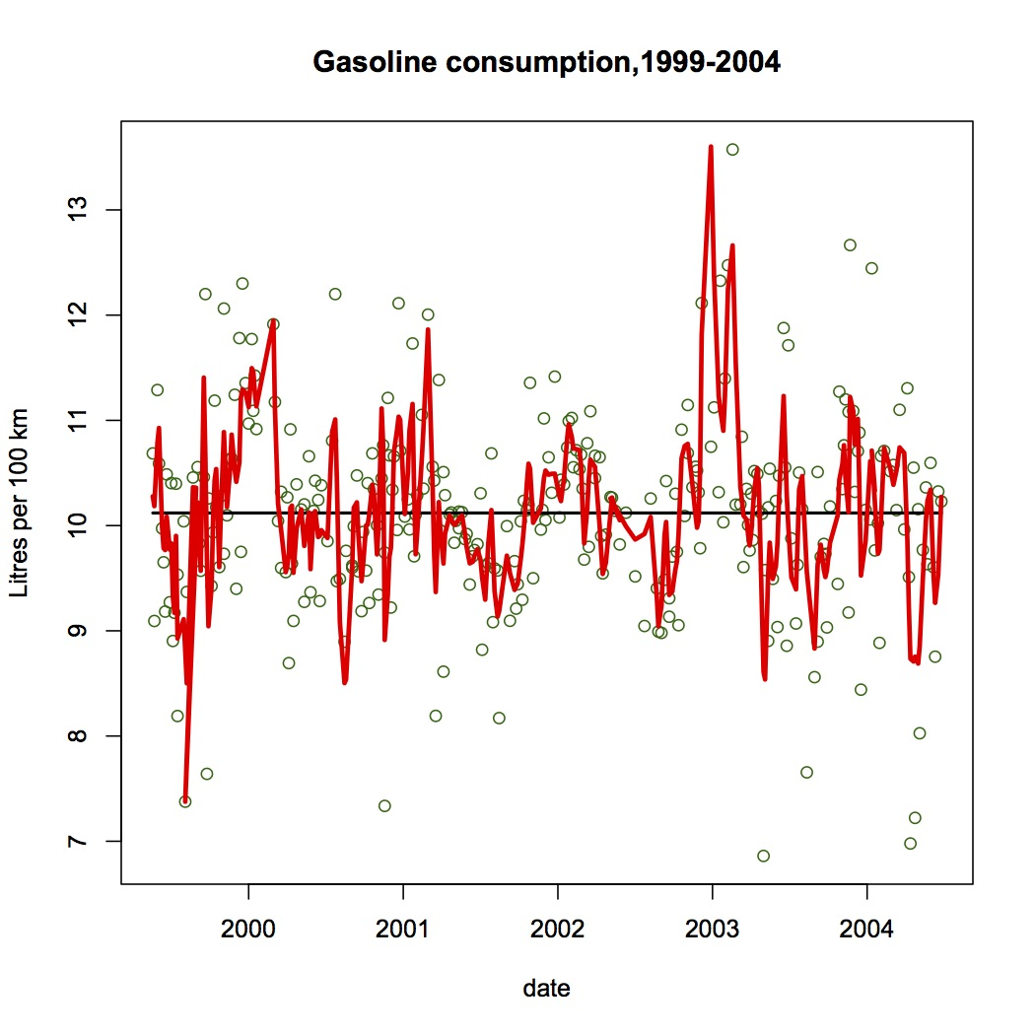
Notes:
The strips were too narrow here, and the trend is chaotic. Go to gas.v.run(). Trial and Error OK if a way to check result.
----- Meeting Notes (17-03-26 13:21) -----
To wide vertical strips obliterates the annual pattern.

Slide 8
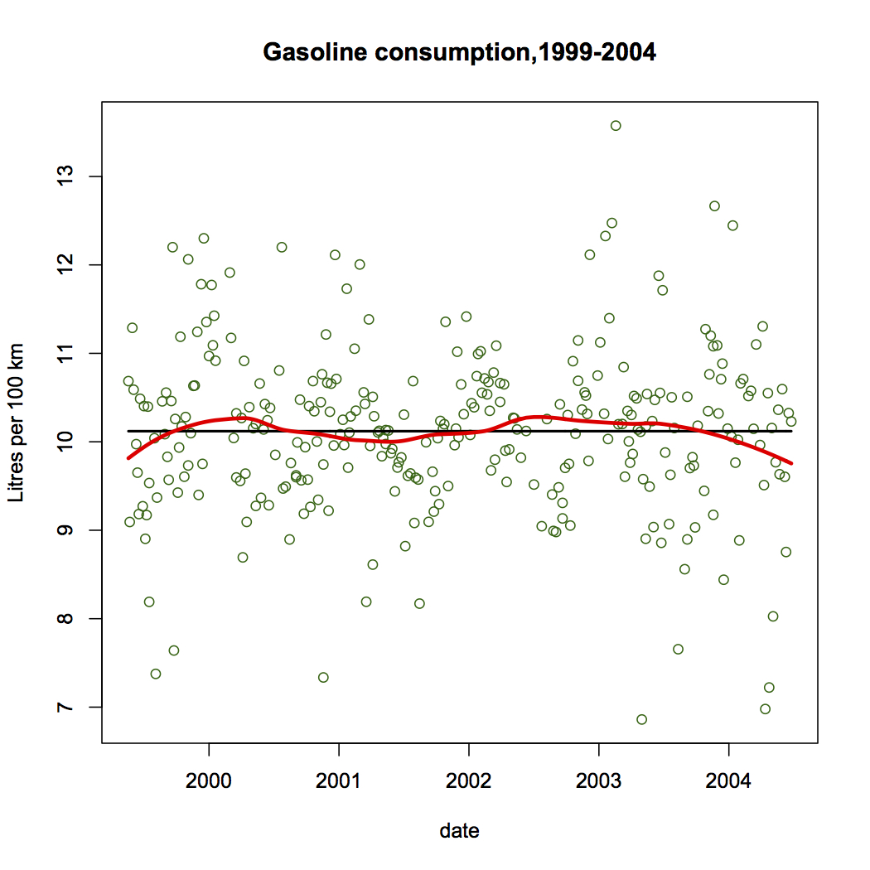
Notes:
In this one the strips were too wide, so the time-dependence is smoothed over. Too much smoothing. The choice of interval width is determined from knowledge of the context of the data. Five almost identical trends over five years is not an random event! A good statistical analysis does not always use objective methods ….Statistics is not Mathematics.

Slide 9
Point of the Example?
Averaging in vertical strips is smoothing
Smoothing can detect trends otherwise missed
Graphical presentation is the best way to show the result
Knowledge of data context is an important input to data interpretation (example of non-mathematical input to analysis).
Simple techniques!
Notes:
Subjectivity because seasonality idea might not have been part of the prior info but is needed for interpretation.

Slide 10
A Simulation Example, with a bit of graphical explanation …
Use of Bootstrapping
to Provide the Precision
of an Estimator
Notes:
When we use a statistic to estimate a parameter, we usually like to know how accurate our estimate is. Note that in this case the “statistic” can be the result of quite a complex process, and theoretical formulae for the accuracy of our estimate may not be known. In this situation the bootstrap can be used to bypass the theoretical lack. To illustrate this, and to assure you that the method really works, I will take a situation where we do know the formula, but we will temporarily pretend we do not have it, and use the bootstrap.

Slide 11
Consider this Situation
Random Sample, 25 observations
Compute Sample Mean
Precision of Estimate?
Imagine that you have never seen
SEM = 𝜎 / √n, or its estimate s / √n
Are you stuck?

Slide 12
Bootstrap Sampling: for
Estimator Variation?
Start with a random sample from a population
Resample, with replacement, many times
Same sample values, but varying multiplicity.
Compute estimator, each bootstrap sample
Compute variability of estimator (i.e. SD)
Notes:
First of all, here is a reminder of what the bootstrap estimator of variability is …Aside: Why do I use SD, and not Variance ? Units.

Slide 13
Data from 249 Men - BMI
BMI is Body Mass Index
BMI = weight/height² In Metric Units (kg, m)
For example, 165 pounds = 75 kg
70 inches = 1.77 m
BMI = 75/1.77² = 23.9

Slide 14
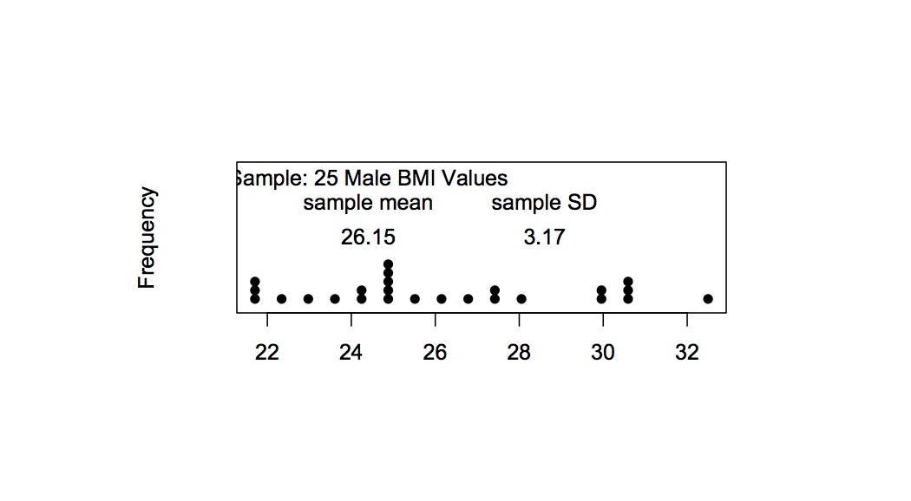
Sample Data - BMI
Notes:
You have wanted to estimate the average BMI among stats students. You take a random sample of stats students and record their BMI.
Then you compute the mean BMI. How precisely does this estimate the population mean?
Usual estimate of SEM is 3.32/sqrt(25) = .66 but in this experiment we know the population so we can find out true SEM . So we can check how good the sqrt law works.

Slide 15
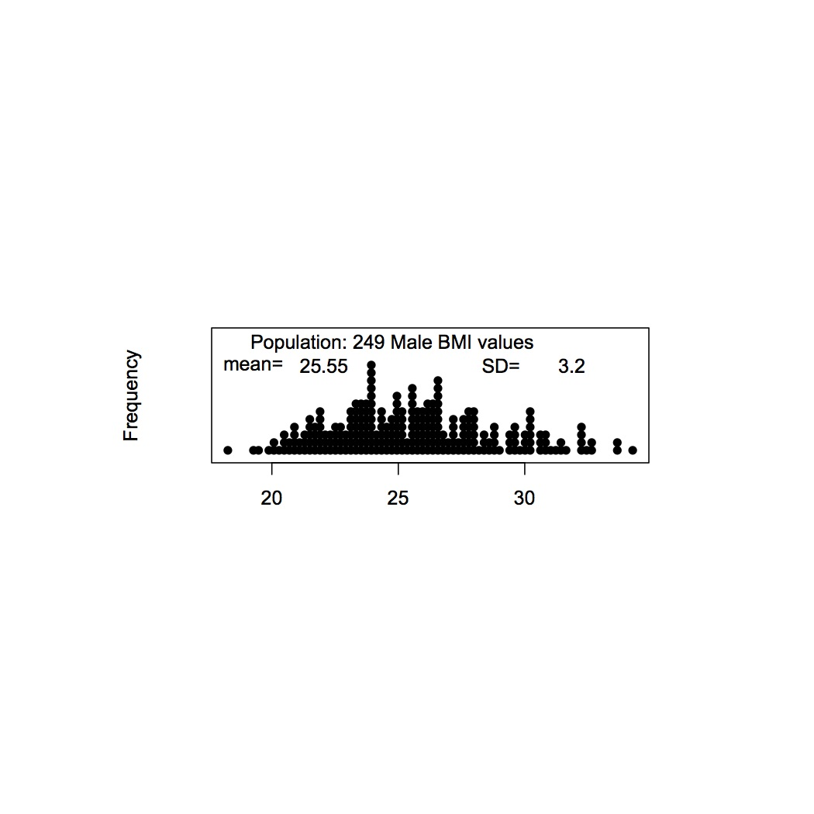
BMI Population
Notes:
True SEM is 3.1/5=0.62. But we can suppose we do not know the square root law and use bootstrap instead ….

Slide 16
SEM and its estimates
True SEM = PopSD/√n = 3.2/√25 = 0.64
Usual Estimate = SampleSD/√n=3.17/√25 = 0.63
Bootstrap Estimate = 0.63
But these estimates are sample-sensitive.
Were we just lucky?
Re-do with simulation …
Notes:
Use my.boot.BMI() to show simulations of comparison

Slide 17
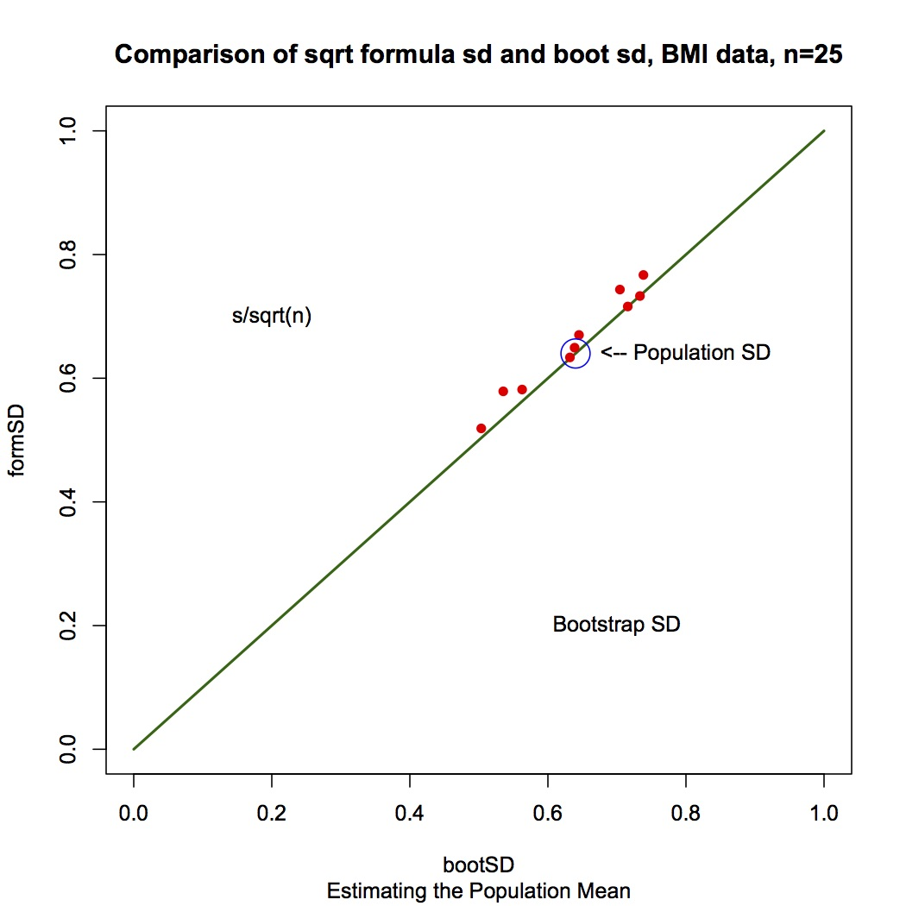
Notes:
Use my.boot.BMI() to show this for several different samples of n=25..

Slide 18
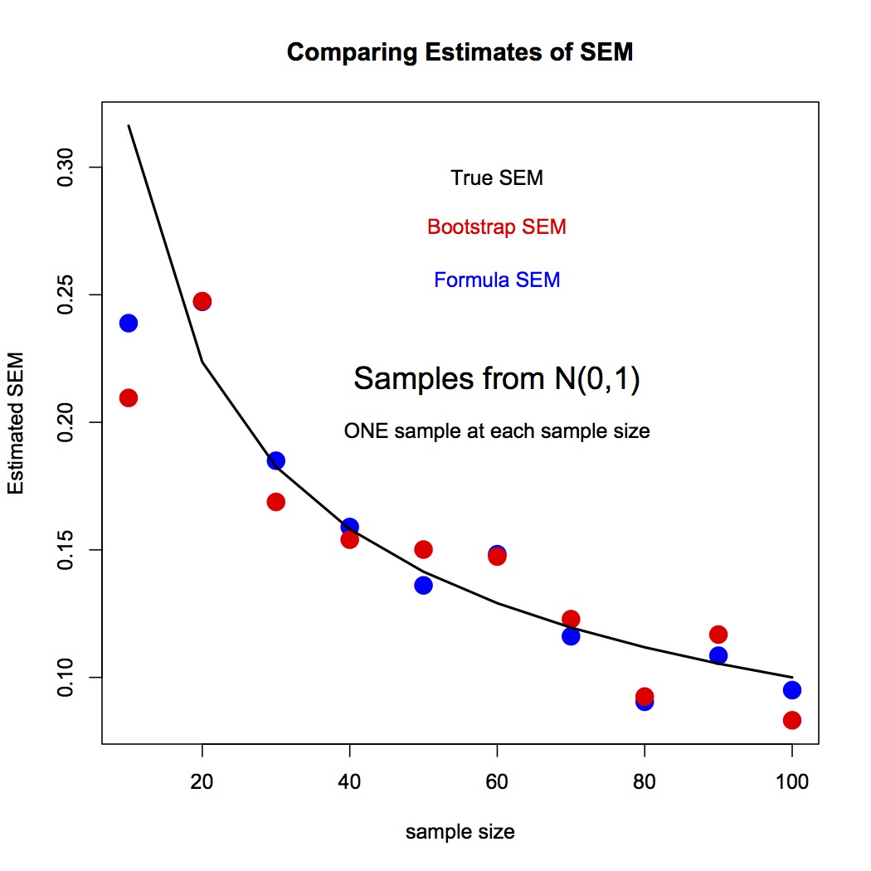
Does it work for other distributions and sample sizes?

Slide 19
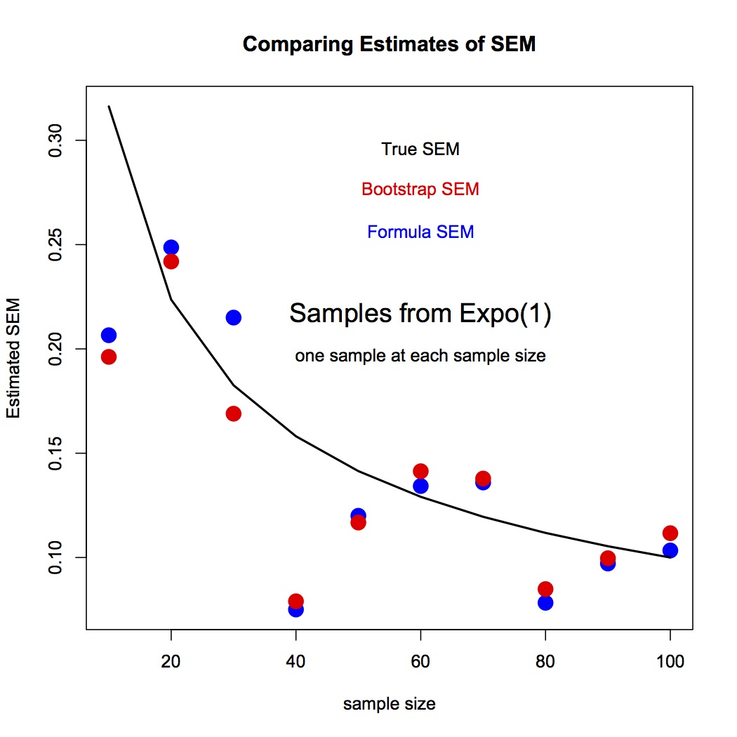

Slide 20
Point?
We have found the variability of a sample mean without knowing the square root law
Can we use it for more complicated examples?
We show for the variability of the 90th percentile … But first …
Notes:
But first, why does the bootstrap work?

Slide 21
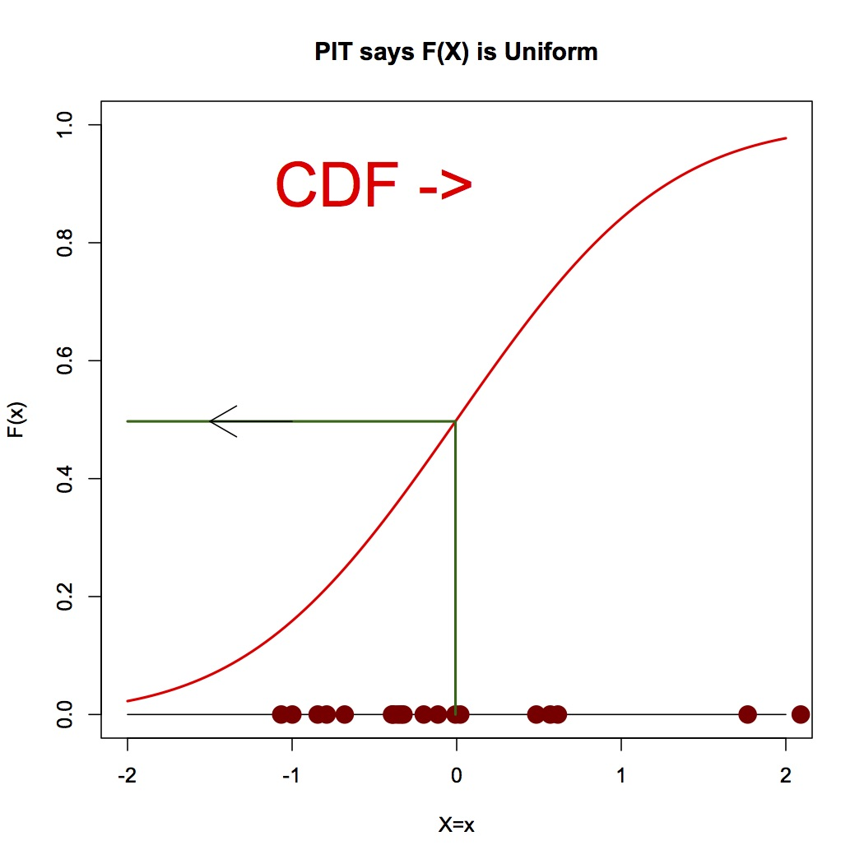
Why does the Bootstrap Work?
P[F_{X}(X) < t] = P[X<F⁻¹(t)]
= F[F⁻¹(t) = t
So F_{X}(X) ~ U[0,1]
t
Notes:
Define X as the rv with CDF = F(x), and then look at F(X), a new Random Variable.

Slide 22
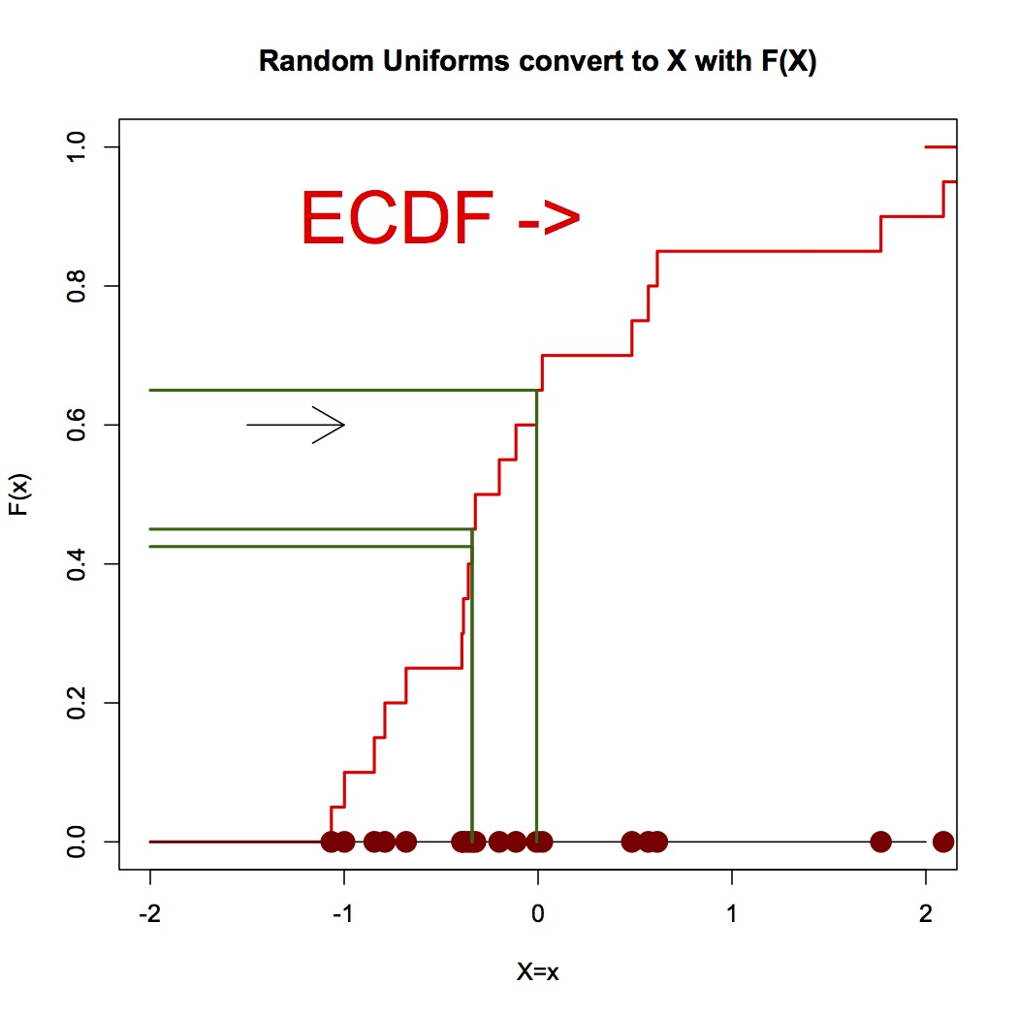
Notes:
Bootstrap samples are samples that would be generated using the ecdf as if it were the true cdf of the underlying distribution. Some values are selected multiple times, some once, and some are omitted in each sample of n data points.

Slide 23
Estimating 90th percentile
BMI population again
Estimate 90th percentile in n=30 by 4rth largest value
Variability of this estimate?
In this experiment, true 90th percentile = 30.1
And true SD of 4rth largest value is 1.1 or about 3.6%
Lets see how close Bootstrap gets to this …
Notes:
Use my.boot.90.test.BMI() and

Slide 24
Typical Bootstrap Outcome for estimating 90th percentile BMI?
[1] "True SD of 90th sample percentile"
TrueSD= 1.1 TrueSD as Pct = 3.6
[1] "Bootstrap estimates of SD of 90th sample percentile"
BootSD = 1.1 BOOTSD as pct = 3.6
BootSD = 1.2 BOOTSD as pct = 3.8
BootSD = 1 BOOTSD as pct = 3.3
BootSD = 1.6 BOOTSD as pct = 5.4
BootSD = 1.2 BOOTSD as pct = 4.2
BootSD = 0.8 BOOTSD as pct = 2.6
BootSD = 1.1 BOOTSD as pct = 3.6
BootSD = 0.9 BOOTSD as pct = 3.2
BootSD = 1.1 BOOTSD as pct = 3.6
BootSD = 1 BOOTSD as pct = 3.3
And this was for a sample of size 30
Notes:
What about other sample sizes. Can we do better with a larger sample size?

Slide 25
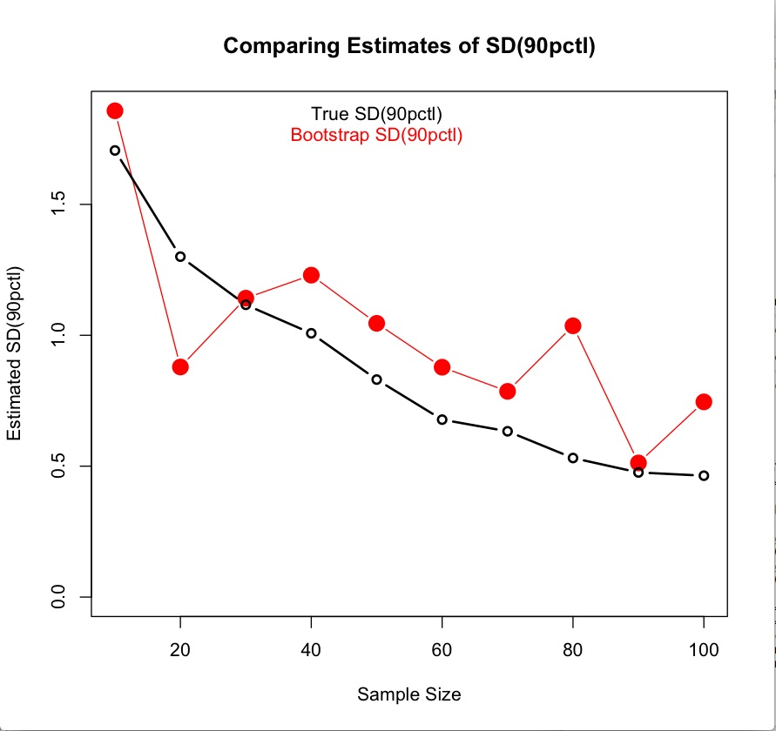
Notes:
`Use boot.90pct.demo.BMI()
Not bad – note the scale.

Slide 26
Point of this example?
In situations where a complex estimator is used,
the bootstrap can estimate precision
without mathematical gymnastics.
Simple and Useful?
Notes:
Programming needed – but this is not statistics per se ….

Slide 27
Bimbo Bakery
Using Simulation And Graphics
We explore the use of simulation and graphics for a commercial optimization task.
Available Data:
Daily deliveries and sales of loaves of bread
at one retail location, over 53 weeks.
Notes:
We had graphics with smoothing, and simulation with the bootstrap. Now ….

Slide 28
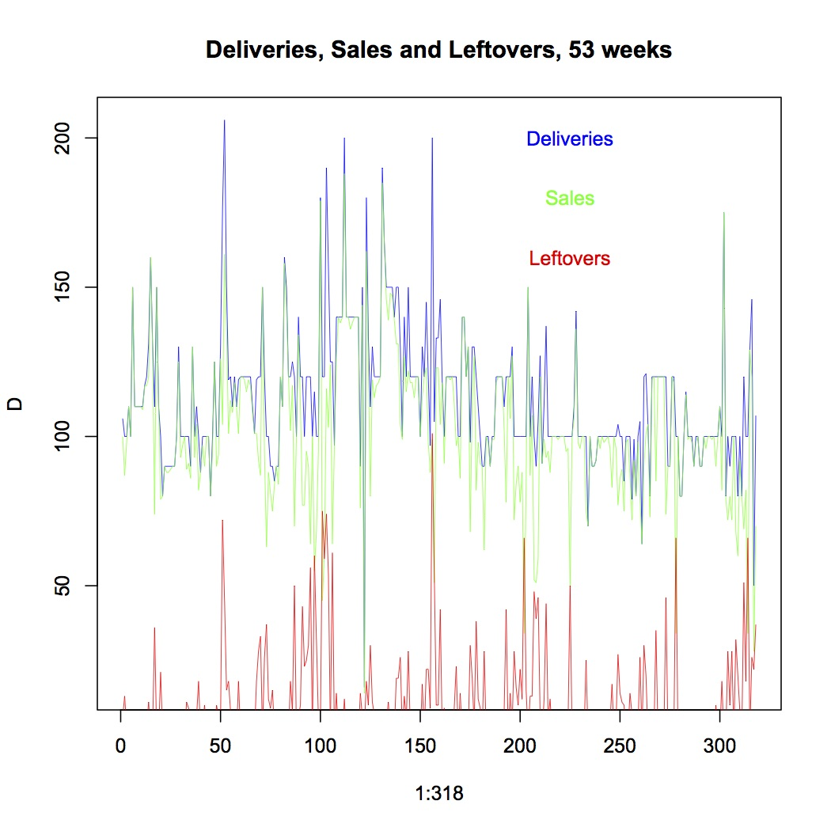
Notes:
I work with seasonally adjusted version of this data – only slightly different.
Red measures how far the green is below the blue.

Slide 29
Question …
Are delivery amounts profit maximizing?
Need costs & profits parameters – Assume …
  Profit per loaf sold $0.50
  Unsold loaf cost $0.25 per loaf
  Out of stock cost $2.00 per loaf demanded
Notes:
We can see what different economic coefficients would do later.

Slide 30
There is a weekly pattern
We use Wednesday data only – 53 days data

Slide 31
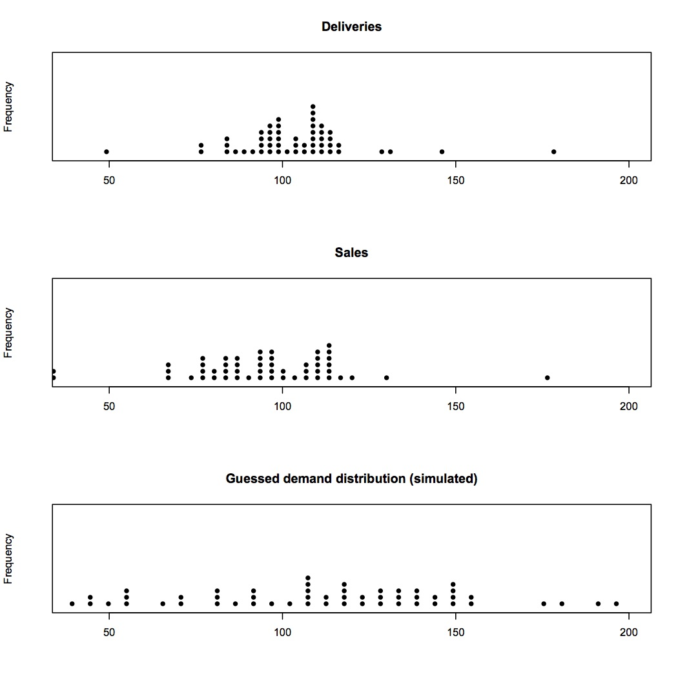
Notes:
Shows demand distribution cut off by deliveries.

Slide 32
Problem…
Demand is unknown when it Exceeds Deliveries
  Demand=Sales when Sales < Deliveries
  Demand ≥ Sales when Sales = Deliveries (no leftovers)
But we need Demand Distribution to choose new Deliveries that will maximize Profit
Notes:
One way to estiimate demand would be to deliver too much every day! But not feasible if we are to extend to all products …

Slide 33
Solution?
Guess the Demand Distribution (Trial & Error)
Construct Simulated Sales: Use the Actual Deliveries with simulated Demand to estimate Simulated (Delivery-limited) Sales
Compare Simulated Sales with Actual Sales and redo Guess if necessary.
Notes:
Do for each day of the year. We use the simulated demand with the actual deliveries … How do we compare simulated sales dist with actual sales dist?

Slide 34
Notes:
Possibly Use bimbo.guess.plots(115,35,xd=wd,xs=ws) and try a few other means and sds. Hard to assess. But try ecdf … Use bimbo.test(115,35,xs=ws,xd=wd) a few times. Invite guesses of mean and SD
Show bimbo.test(125,25,xs=ws,xd=wd) not as good as bimbo.test(115,35,xs=ws,xd=wd)

Slide 35
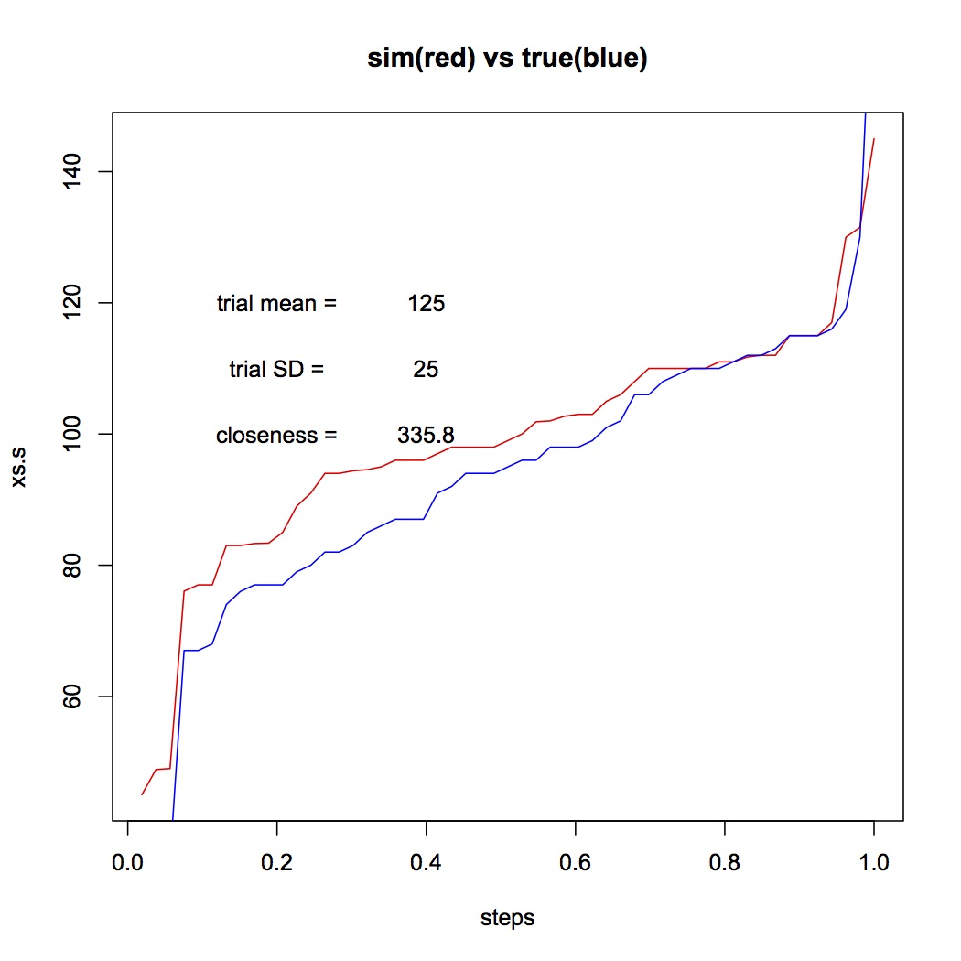
Notes:
Sorry to use sideways ECDF! S curve is sideways. Variable on y-axis, steps on x-axis.
The ecdf for this guess is not too good. Need to increase SD (vertical stretch) and decrease mean (move red down). Try mean = 115 and SD = 35.

Slide 36
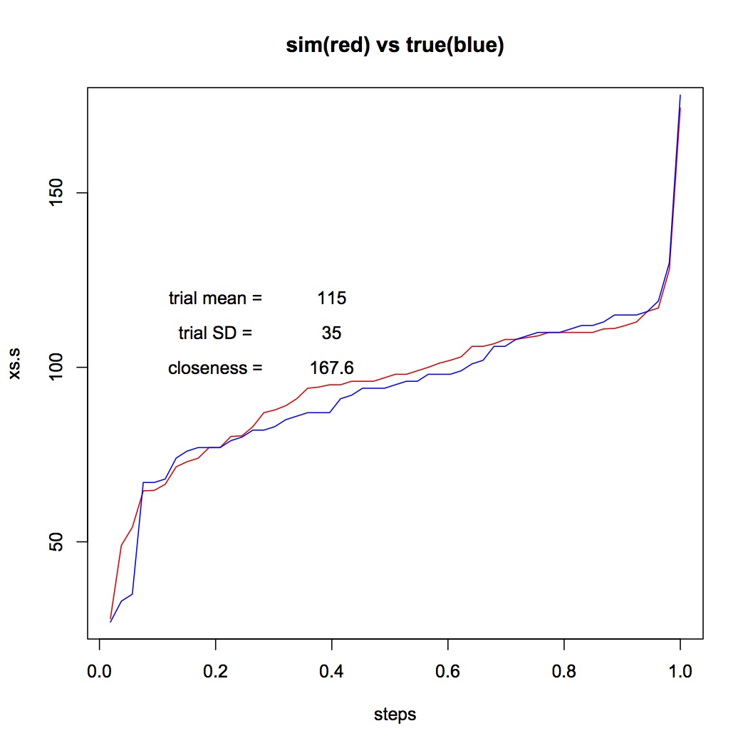
Notes:
Much better. But note this will vary each simulation. Try a few more times.

Slide 37
A Good Guess - Demand Dist’n
D ~N(115,35)
Apply Demand (D) with Actual Deliveries
and Cost Parameters to simulate Sales
Let D be replaced by D * (1+%)
Notes:
Assume delivery decisions in data done with local expertise, and consider modulations of those (%).

Slide 38
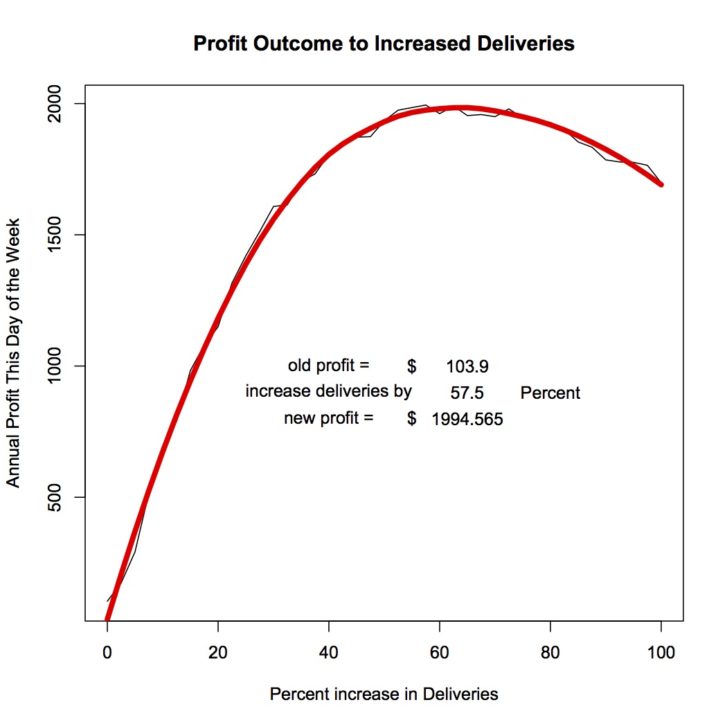
Using our best guess of Demand
Notes:
bimbo.profit.graph(115,35,wd) Looks like 60% increase in deliveries would provide a huge increase in profit. Try other cost parameters …Try bimbo.profit.graph(115,35,wd,sc=.50,uc=1,lc=.25) If uc lower, expect optimal delivery amounts to be smaller.

Slide 39
Notes:
Indeed we see delivery increase of 52% would be optimal, rather than 60% increase.

Slide 40
Practical?
Could use same process for every Bimbo product and every retail outlet!
Notes:
But my source got interested in politics and did not pursue this problem, unfortunately.

Slide 41
Point of the Bimbo Example?
Trial and Error is a useful technique when there is a way of checking the outcome.
Use application-context expertise ..
Known population not a requirement for Simulation utility.
Graphical methods are a good way to judge a distribution fit.
Notes:
T&E – suggesting demand distribution Use % change rather than absolute change Population was demand distribution ecdf comparisons

Slide 42
Another example of the use of simulation and graphics
The Premier Football League
Twenty Teams compete each Year
We examine quality vs luck

Slide 43
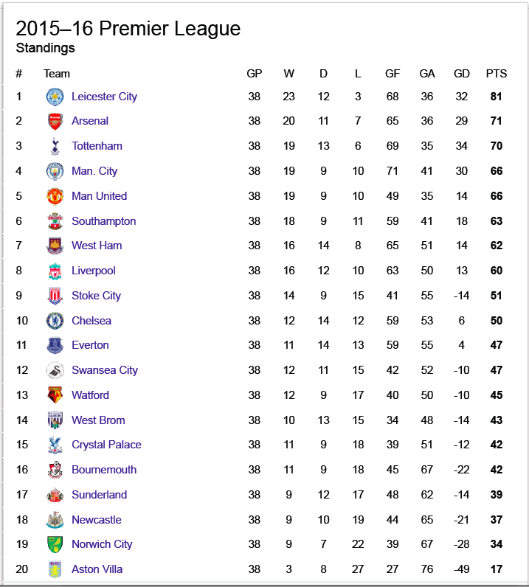
Notes:
Note the spread of league points at the end of the season, and that a middling team has about 50 points.

Slide 44
The Premier Football League
38 games for each team (Home + Away)
League Points
  0 for Loss
  1 for Tie (about 25% of games end tied)
  3 for Win
Avg. points assigned per game = 2.75 (2 teams)
Avg. points per team per season = 38*2.75/2 = 52.25

Slide 45
Annual Changes to Teams?
There is no draft system to equalize teams
Most fans believe in existence of superior teams
Suggests an investigation of “Luck”
First Attempt – All teams equal
  Prob(Win) = 0.5
  Prob(Loss) = 0.5
  Use lgz.round(ha=0,tie=0)
Notes:
League history suggests a two tier league. Lets assume not …

Slide 46
[,1] [,2] [,3] [,4] [,5] [,6] [,7] [,8] [,9] [,10]
[1,] 75 72 81 72 72 69 75 69 84 72
[2,] 72 72 75 66 66 69 75 69 75 72
[3,] 72 69 69 63 63 69 66 66 69 69
[4,] 66 63 66 63 63 63 66 66 66 69
[5,] 63 63 66 63 60 63 66 66 66 63
[6,] 60 63 63 63 60 63 66 66 63 63
[7,] 60 63 60 60 60 63 63 60 60 63
[8,] 60 60 57 60 60 60 63 60 60 60
[9,] 57 60 57 60 57 60 63 60 60 60
[10,] 57 60 57 60 57 57 60 57 57 57
[11,] 54 57 54 57 57 54 60 57 54 57
[12,] 54 57 54 57 57 54 57 54 54 54
[13,] 54 54 54 54 54 54 54 54 54 54
[14,] 51 54 51 51 54 51 48 51 51 54
[15,] 51 51 51 51 54 51 48 51 51 48
[16,] 51 51 48 48 51 51 45 51 48 48
[17,] 48 48 48 48 51 48 45 51 48 48
[18,] 48 48 48 48 48 48 42 45 42 48
[19,] 45 45 42 48 48 48 39 45 42 45
[20,] 42 30 39 48 48 45 39 42 36 36
Use lgz.round.hilo(ha=0,tie=0)

Slide 47
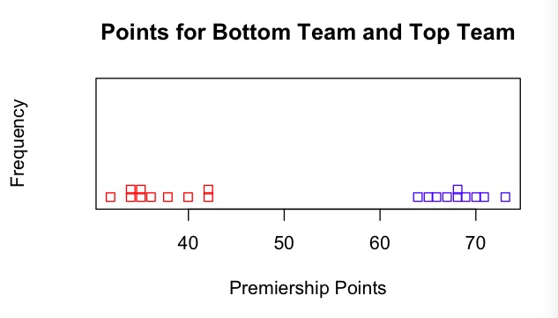
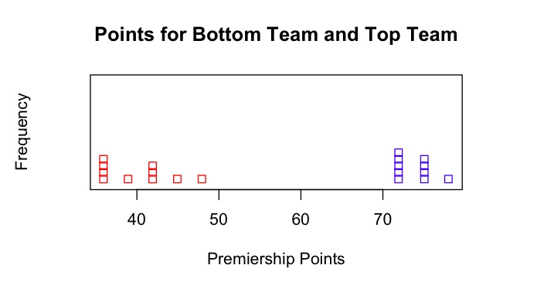
Notes:
If the extreme ranks are within the simulated range, suggests luck not quality.

Slide 48
Notes:
Note the spread of league points at the end of the season, and that a middling team has about 50 points.

Slide 49
What does this suggest?
Leicester City result slightly better than “luck”
Aston Villa definitely inferior
Rest about the same, except “luck”
Suggests a need for more information, some history …

Slide 50
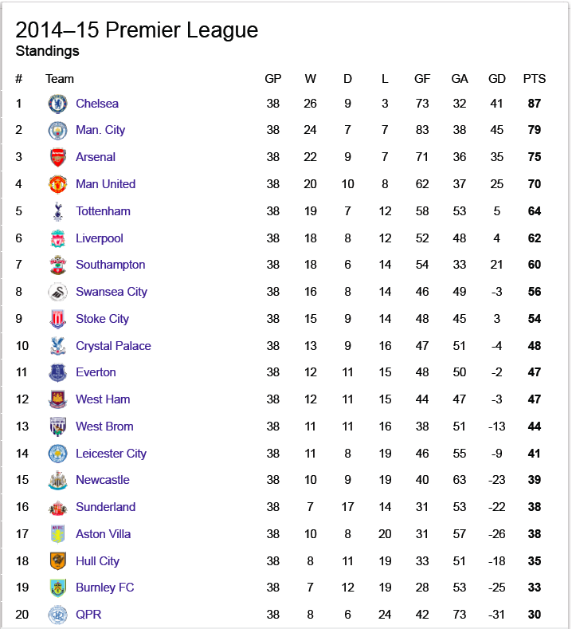
Notes:
Previoius Year: Look at Leicester City! Also Look at top 6 teams.

Slide 51
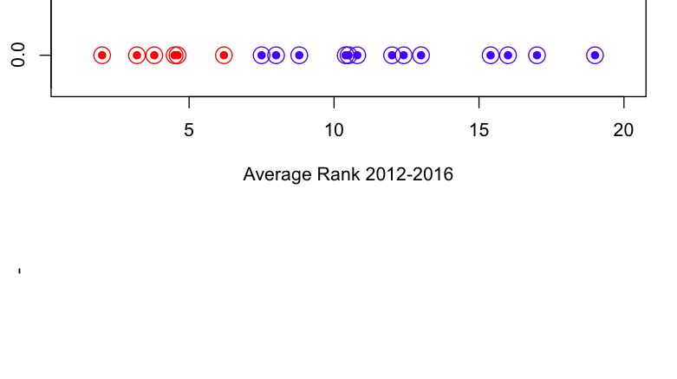
5 past years – Average Ranks
Avg. Ranks ----->
5 years
Red = Six Elite, Better financed teams

Slide 52
Notes:
Note the spread of league points at the end of the season, and that a middling team has about 50 points.

Slide 53
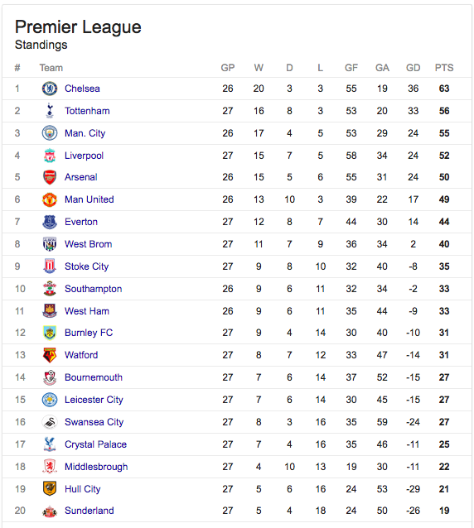
Current Unfinished Season
Look at top
Six teams!
Look again! ->
Notes:
Only 27 games so far. Same six teams that had top average ranks from previous 5 games. A genuine aristocracy in the league! More detailed look confirms – not much evidence of consistency within each tier.

Slide 54
Better Simulation Possible?
6 Superior teams – 60% win against 14 inferior teams
Home team advantage needs to be allowed
(increase of win prob by .10)
Ties in 25% of games
Redo Simulation
Use lgz.round(ha=.1,nsup=6,hi=1.5,m=10,tie=.25)

Slide 55
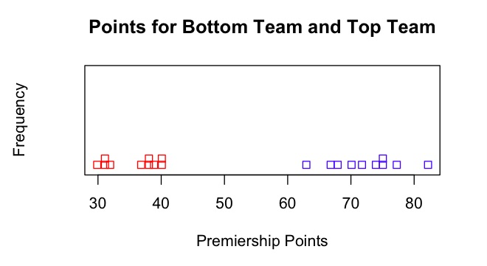
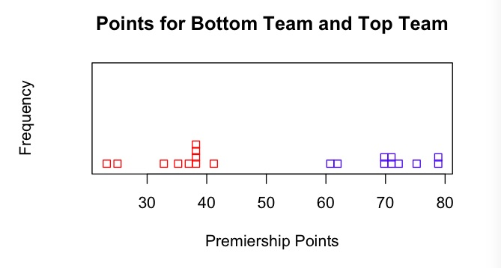

Slide 56
Inference?
Leicester City anomaly still surprising
Historically Superior teams exist (top 6)
Dominating role of Luck not appreciated

Slide 57
More inference?
There are two tiers in the Premier League
Within each tier, luck determines outcome!
Fans believe in quality performance, not luck
Fans’ odds biased to past performance (NYT)
Advice to gamblers: Back the underdog (best odds for big payoff amount.)
Note: All we used was tossing a coin, averaging,
and plotting a simple graph.
Notes:
If luck determines outcome, and fans perceive it is quality based on recent data, then likely good odds for an apparent underdog.

Slide 58
The Examples
Smoothing – Automobile Gasoline Consumption
  Smoothing using means
Bootstrapping – SEM and Body Mass Index
  Assessing precision without Math
Simulation for Missing Data – Bimbo Bakery
  Using Trial and Error and ECDF for Missing Data
Randomness in Sport – Premier League Football
  Using Fair-Coin-Tossing to Assess Randomness (or Luck)
Notes:
Did I show that simulation and graphics were simple & useful? Examples only, but I hope suggestive. And I accept the need for some programming skills, but, like language and interpersonal skills, need to be learned by statisticians elsewhere.

Slide 59
Conclusion from Four Examples
Simulation and graphics are not just for fun.
Powerful tools for data analysis, easy to explain to students.
Opens up the discipline to creativity, and may appeal to a wide audience.
Methods do not have to be “exact” to be useful.
Notes:
Note the contrast between determining optimal procedures (math approach to inference) and determining widely applicable procedures, like trial and error, subjective graphical assessment, context-specific smoothing (a broader approach for stat education).

Slide 60
A Suggestion
Classical Inference is hard to teach, and hard to use without making mistakes
Techniques like graphics and simulation are inherently simpler to understand and apply
Let’s not keep these techniques a secret from undergraduates.
Thanks for listening!
Notes:
More examples on my web page …www.stat.sfu.ca/~weldon

