Slide 1
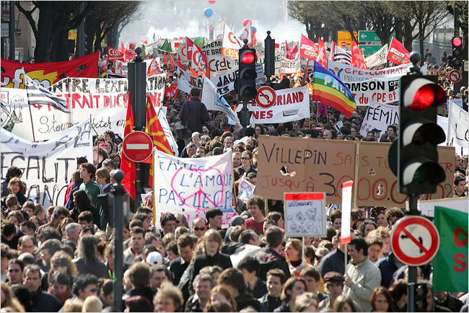

Social Power
Gerardo Otero
Sociology/Anthropology and International Studies

Slide 2
Outline
Premises and definitions
Power organizations
Interstitial emergence
Empowerment

Slide 3
Premises
societies are not totalities or systems
No theoretical primacy (economy or ideology)

Slide 4
Premises, cont’d
Four sources of power (ideological, economic, military and political relationships)
Organizations or institutional means of attaining goals.

Slide 5
Multicausality
social events or trends have multiple causes

Slide 6
Humans are social in that
they are able to achieve goals only by cooperation

Slide 7
Primacy
Not ends but means give us our point of entry into the question of primacy

Slide 8
Power
A exercises power over B when A affects B in a manner contrary to B’s interests.

Slide 9
Social Power
General sense: ability to attain mastery of one’s environment:
mastery over other people
Collective aspect: persons in cooperation enhance joint power over third parties or over nature

Slide 10
Social Power, cont’d
distributive
collective
exploitative
functional
All aspects operate simultaneously in most social relations

Slide 11
Leaders
occupy supervisory and coordinating positions
immense organizational superiority over others

Slide 12
Why masses comply
lack collective organization
embedded within collective and distributive power organizations controlled by others

Slide 13
Society: a unitarian whole?
Marxists: “levels of society”, privilege economic subsistence
Weberians: “dimensions”, privilege meaning
but organizations function as both ends and means

Slide 14
For Michael Mann society is
“a network of social interaction at the boundaries of which is a certain level of interaction cleavage between it and its environment” (Man 1986:13)

Slide 15
Underneath stable networks:
“human beings are tunnelling ahead to achieve their goals, forming new networks . . .” (16)

Slide 16
Sources and organizations of power
Ideological
Economic
Military
Political

Slide 17
Ideology as organization
Monopolizing meaning (requires concepts and categories of meanings imposed on perceptions)
norms (necessary for sustained social cooperation)
aesthetic-ritual practices

Slide 18
Economic organization
Circuits of praxis
Classes
States (perform both economic and political functions)

Slide 19
Circuits of praxis are modes of
Production
Distribution
Exchange and
Consumption
(no primacy of production is implied)

Slide 20
Why no primacy?
“Whereas production is high on intensive power,mobilizing local social cooperation to exploit nature, exchange may occur extremely extensively” (Mann 1986:25)

Slide 21
Class are formed thus:
“Economic power derives from the satisfaction of subsistence needs through the social organization of the extraction, transformation, distribution, and consumption of the objects of nature.” (Mann 1986:24)

Slide 22
Dominant class:
can obtain general collective and distributive power in societies

Slide 23
Economic organization
extraction
transformation
distribution
consumption of the objects of nature
➔ Circuits of praxis

Slide 24
Military power
concentrated-coercive
intensive
➔ militarism has yielded disproportionate results

Slide 25
Political power = state
centralized
institutionalized
territorialized regulation of social relations
➔ geopolitical power is essential in social stratification

Slide 26
Tracklaying vehicles (Weber)
set the route for train tracks
“interstitial emergencies” or generalized means of history making (Mann)
empowerment, or what I would call “generative interstitial emergence”

Slide 27
Model of organized power (Mann)
Original motor
Humans pursuing goals
Creation of multiple social networks

Slide 28
Major sources of social power
Organizing means
Institutional networks
Interstitial networks

Slide 29
Ideology—Transcendence
Economy—Circuits of praxis
Concentrated-coercive—Military
Centralized-territorial—state
Geopolitical-diplomatic—states

Slide 30
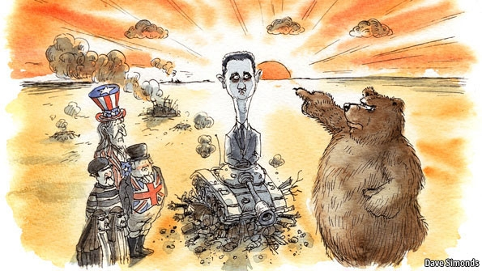
Geopolitics

Slide 31
Empowerment or Political-Cultural Formation
Class structural processes
Mediations
Political outcomes

Slide 32
Class structural processes
Relations of production
between exploiters-exploited,
Relations of reproduction
among the exploited
and oppressed

Slide 33
Political-cultural formation: Mediating determinations
Political outcomes
Regional cultures
State intervention
Leadership types

Slide 34
Political outcomes
Bourgeois-hegemonic
Oppositional
Popular-democratic

