Slide 1
Crim 860 Building a Likert Scale: Next Steps

Slide 2
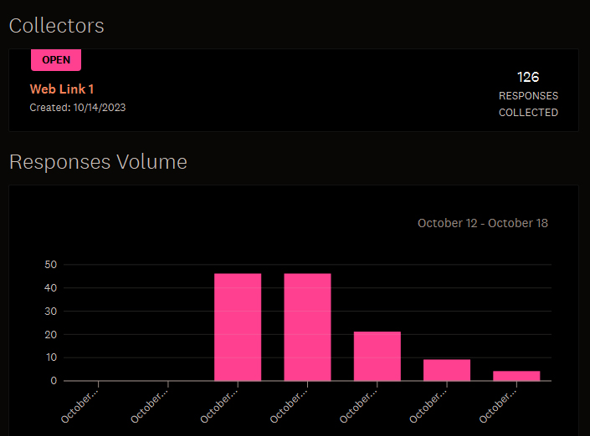

Slide 3
Next Steps
You’ve done the first steps by creating a balanced set of statements and asking numerous people to respond
One thing we always should consider is who exactly it is we have, which is why a few demographic items were included

Slide 4
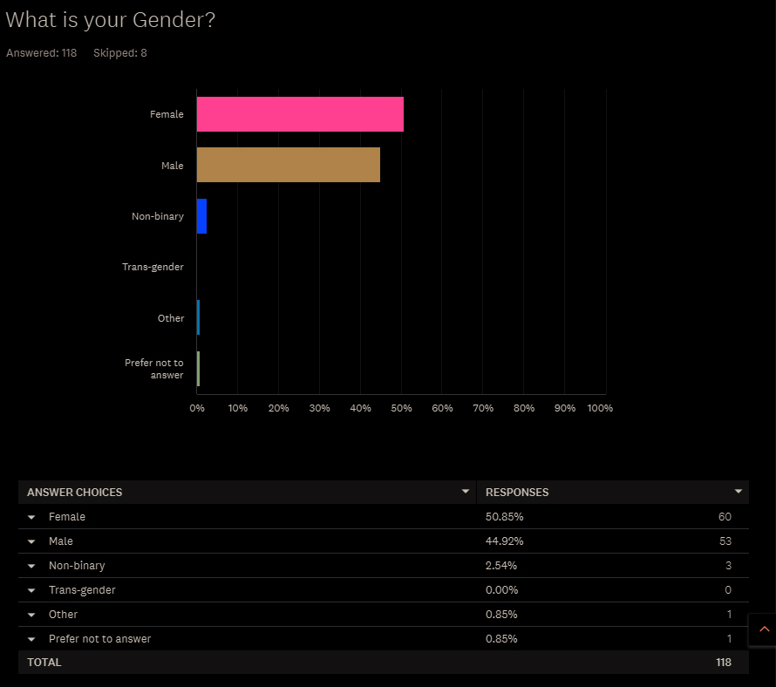

Slide 5
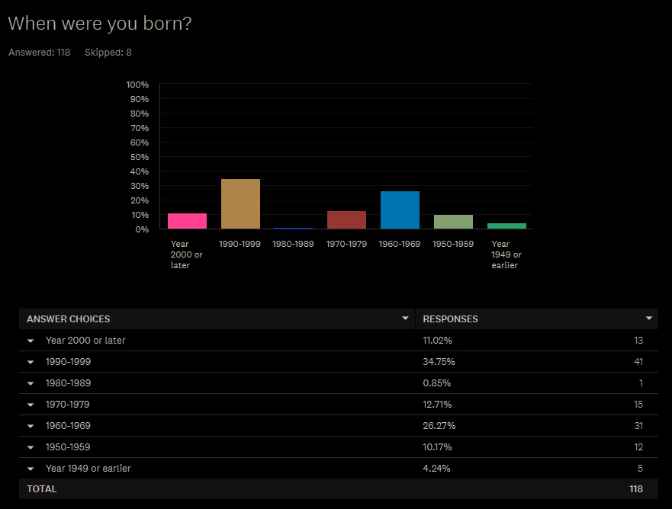

Slide 6
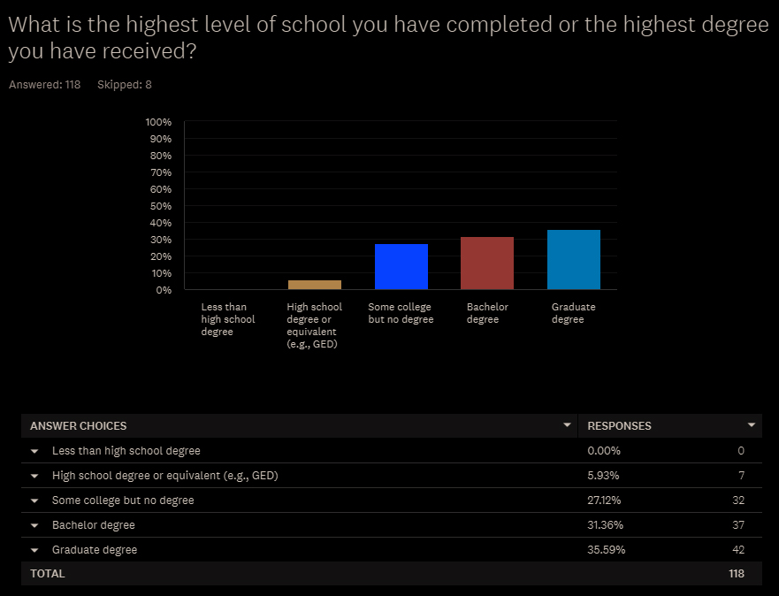

Slide 7
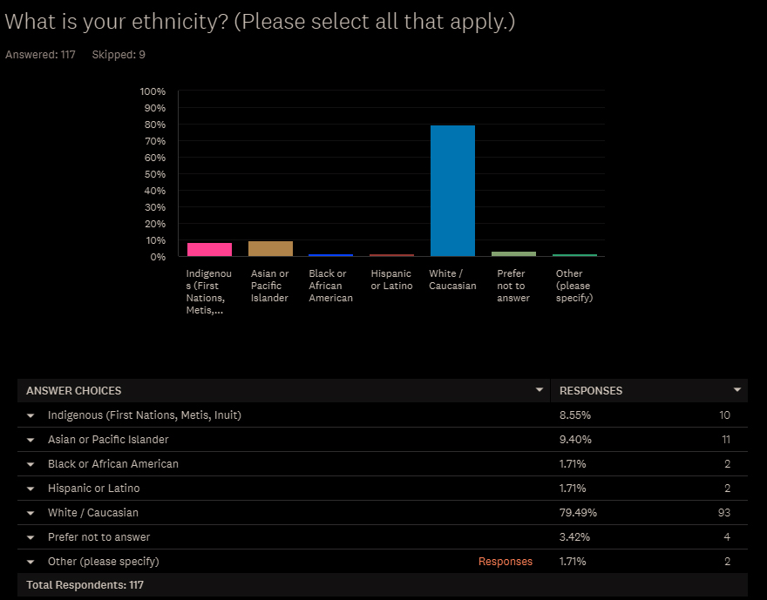

Slide 8
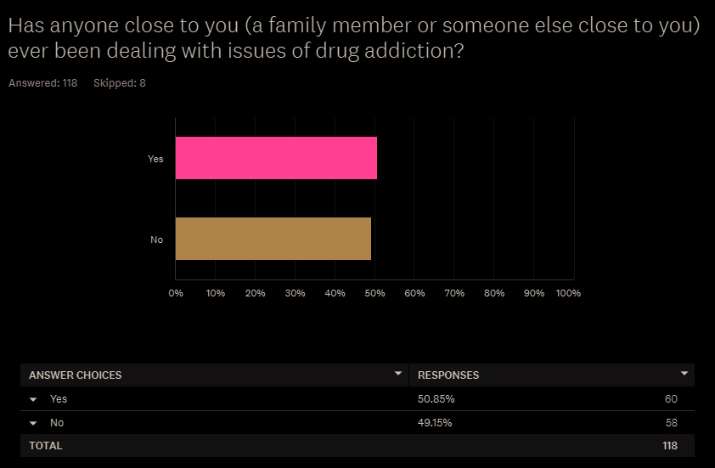

Slide 9
Next Steps
Next on the list is to look at our distributions to see if there’s any we should probably rule out
The items that are LEAST likely to be useful are those on which it seems everyone pretty much agrees, or agrees to disagree

Slide 10
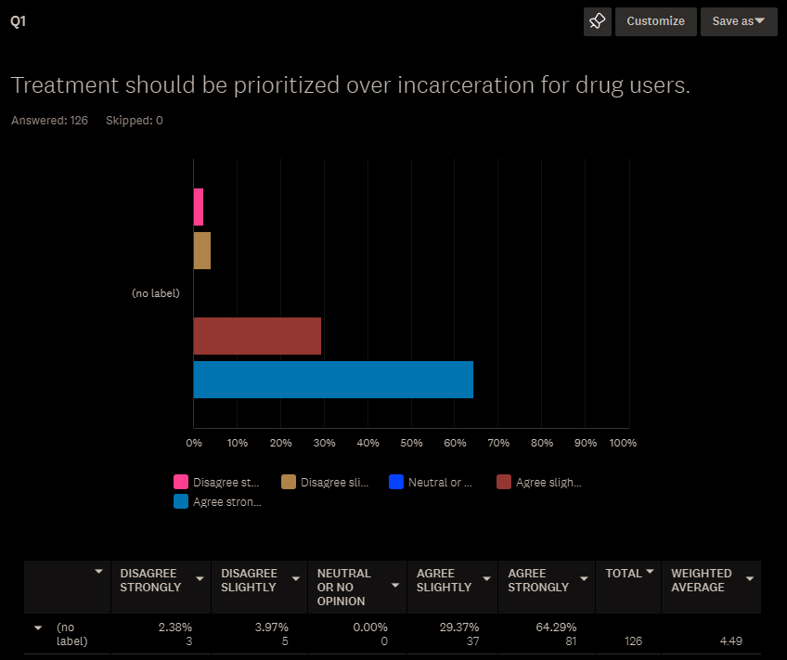

Slide 11
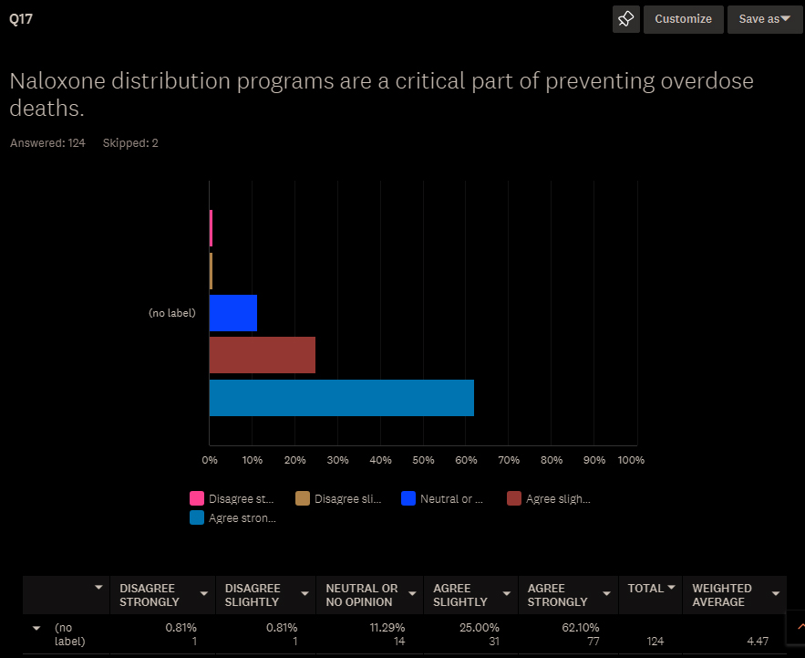

Slide 12
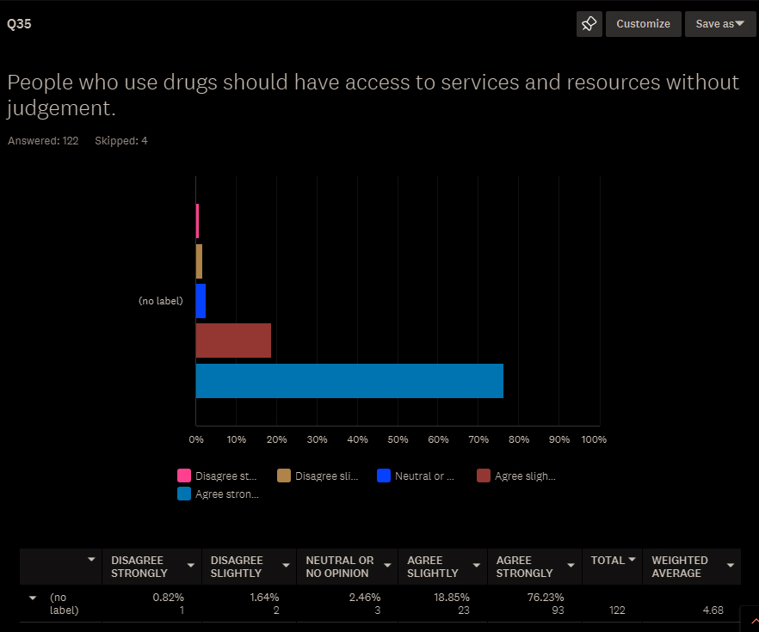

Slide 13
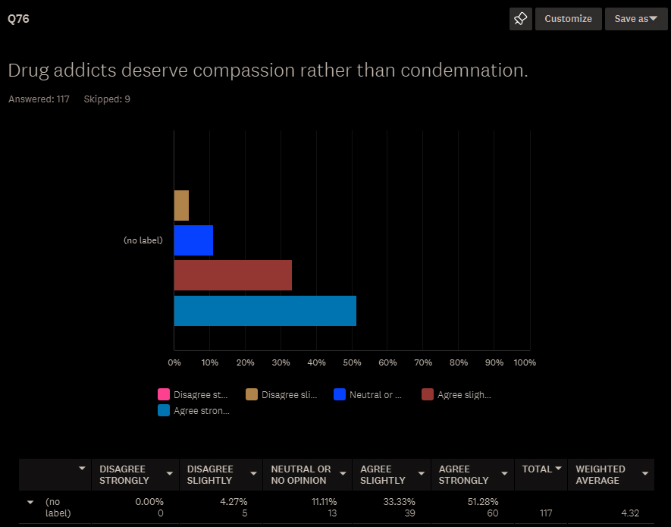

Slide 15
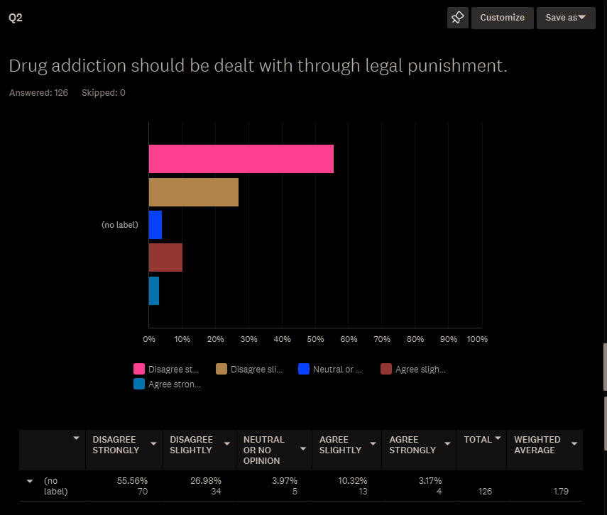

Slide 16
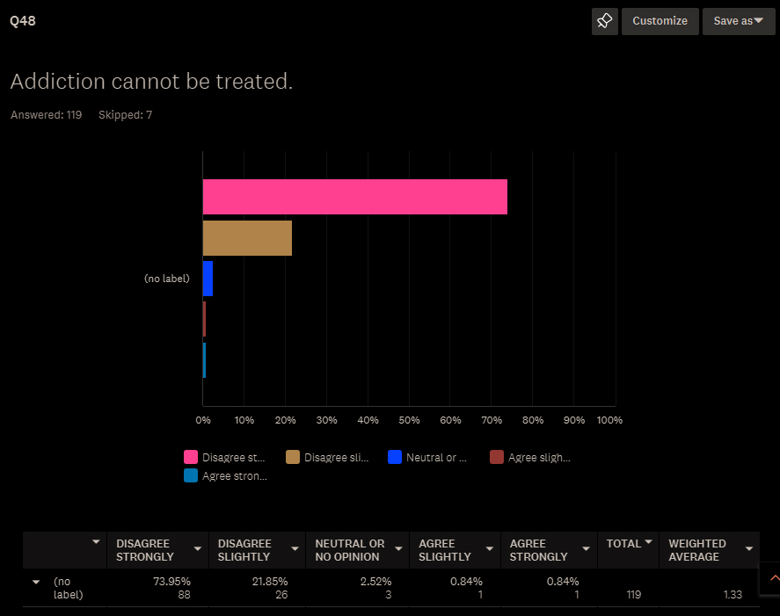

Slide 17
Next Steps
The items that are MOST likely to be useful are those where you have people spreading themselves across the distribution of positive and negative responses

Slide 18
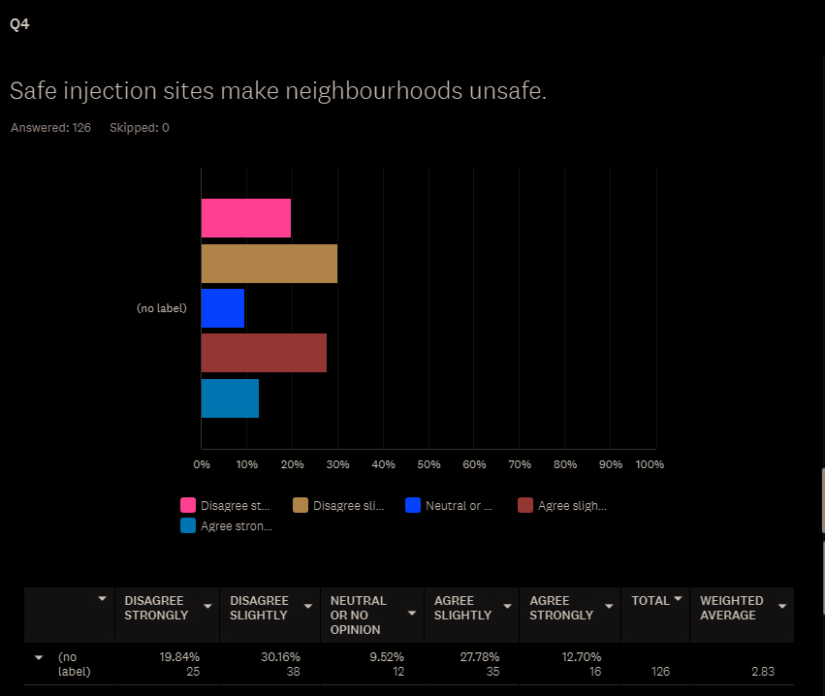

Slide 19
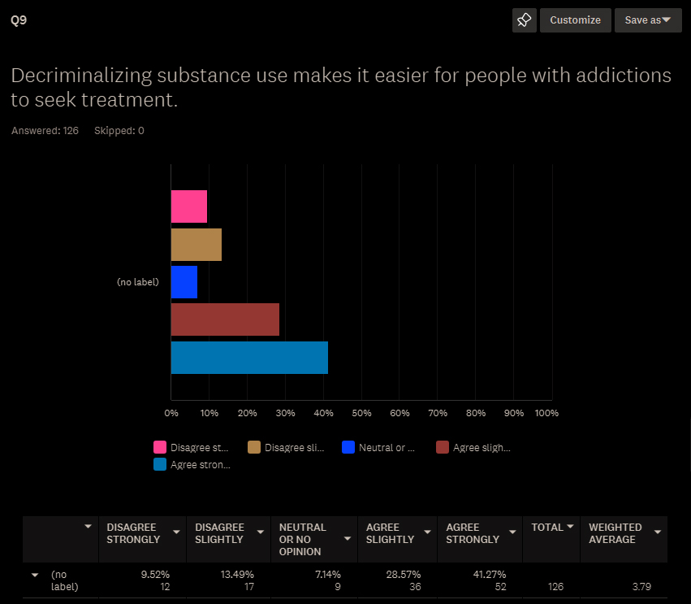

Slide 20
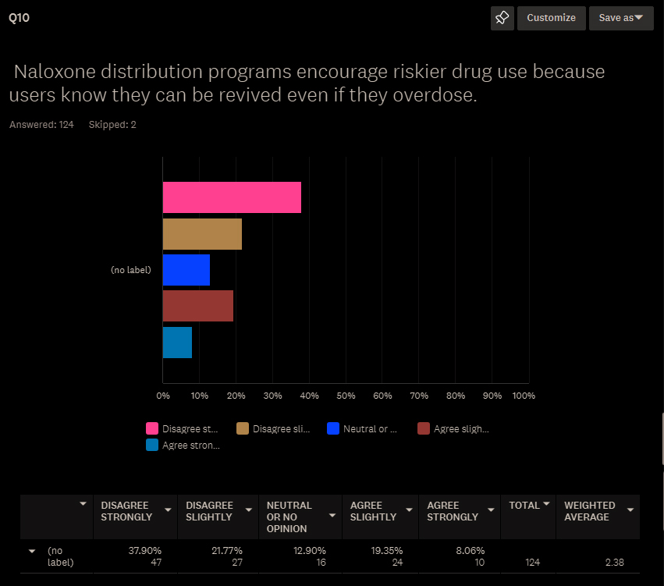

Slide 21
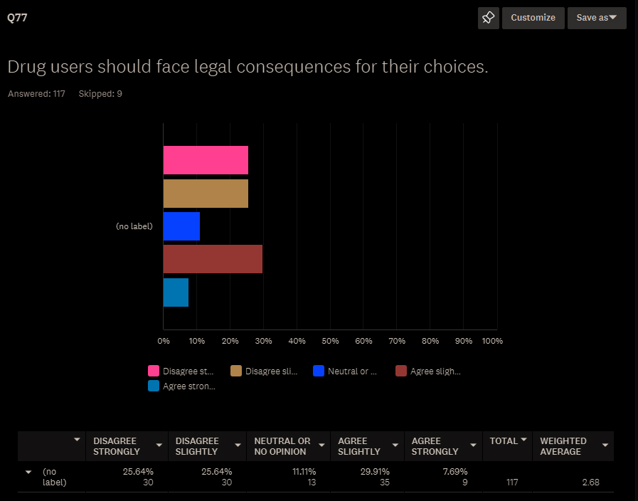

Slide 22
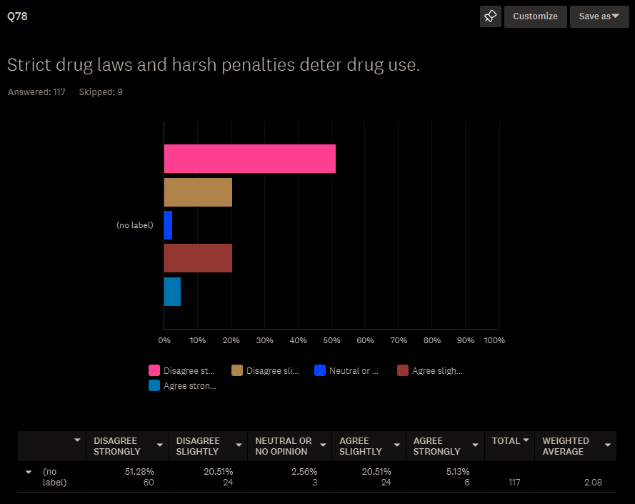

Slide 23
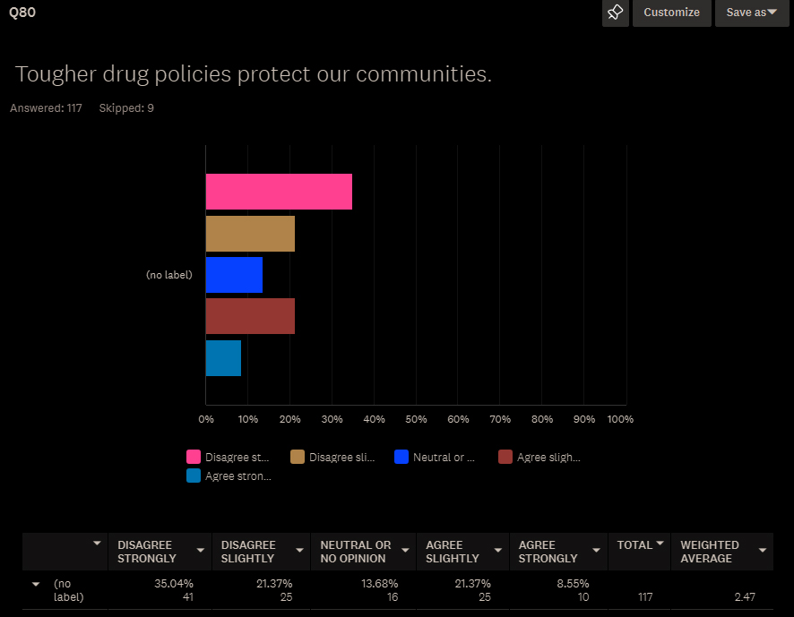

Slide 24
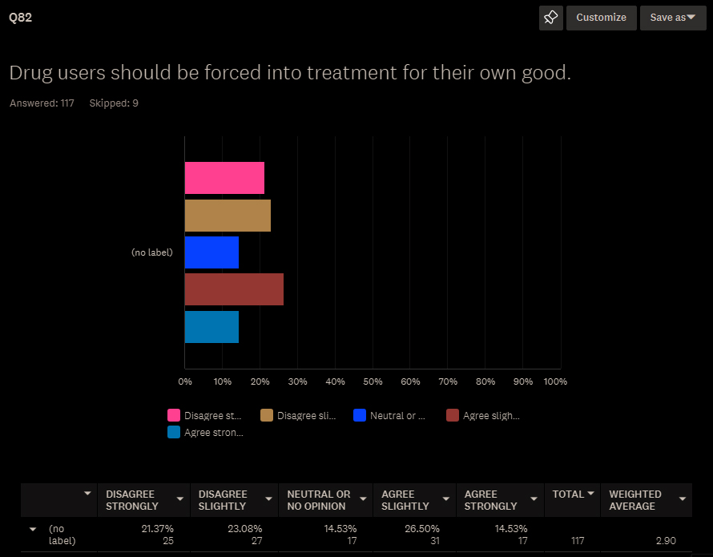

Slide 25
Next Steps
This is a good time to re-consider whether you have sampled adequately, or whether you should look for a more diverse sample of respondents
Our sample is quite white, educated, but decent age and sex variability
Biggest limitation is too pro-harm reduction

Slide 26
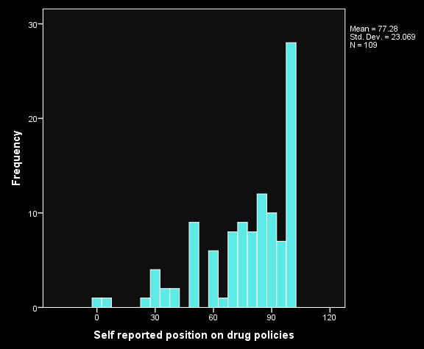

Slide 27
Next Steps
After this comes the item analysis via SPSS
Getting ready
Clean your data
Decide what you will do with missing data
Decide what direction you want to code in
Recode relevant items so that higher numbers reflect that direction

Slide 28
Next Steps
After that:
Compute total score #1
Compute item-whole correlations
Eliminate items not significantly correlated
Repeat 1-3 until you have a set of items that all hang together reasonably well
Now look through and see you are adequately “sampling the domain of interest” and have a “balanced set of items”

Slide 29
Next Steps
And then:
Compute split half reliability, correcting for length with the Spearman-Brown formula
Compute Cronbach’s Alpha for internal consistency (above .80 considered “good”)
Consider test-re-test reliability where possible
Once you have a set of items you feel comfy with, do validity assessments
Some proxy possibilities for now

Slide 32
Assignment 3 Constructing a Likert Scale

