Slide 1

BUS 417 - Global Gadgets
Apple (AAPL)
Microsoft (MSFT)
Google (GOOG)
Jerry Yang
Allen Man
Casey Huang

Slide 2

The Industry Overview

Slide 3
Gadgets are:
Small electronic tools that are widely used
Uses include information access, online media, games, and health (i.e. Apple Health App, Google Fit, etc.)
Benefits provided through the use of application software

Slide 4
Where the Profit Comes From
Sales of gadgets (cell phones, laptops, etc.)
Additional services provided by company
Downloadable software (app purchases)

Slide 5
Normal Gadgets
Useful devices that have been substantially integrated into our everyday lives
Examples - Cell phones, laptops, GPS’s, eBooks

Slide 6
Novelty Gadgets
Refers to gadgets that change the way users conduct daily activities
Examples - Virtual reality, smart watches, Google Glasses, game consoles

Slide 7
Services:
Softwares:
E-commerce
Mobile networking
Advertising
Telecommunication service
Customer support
Internet
App stores
Other applications
Social Media
Open Source/Closed Environment

Slide 8
Structure of the Gadget Industry
Engineers, designers marketers, salespeople, customer service reps, and finance personnel all work on existing familiar products to help improve them
Low labour cost countries assist in reducing expenses
Traditional categorizations are blurred: hardware, consumer electronics, telecommunications etc.
Complex value chain involving multiple players, such as suppliers, manufacturing, marketing, etc.

Slide 9
Trends in the Gadget Industry
Convergence:
Price Competition:
Players in the industry of electronics, hardware, and telecommunications are increasingly competing head-to-head
Turmoil (fluctuations in profit and mergers/acquisitions) will occur in each of these industries over time
Reliance on the semiconductor industry
Moore’s Law requires industry be competitive in price/performance for market share
Short life span of new products, recycle and move on to the next model

Slide 10
Modern Day Gadget Industry
Rapidly changing and growing
Under consumer electronics industry
Consumer electronics sector approaches US$400 billion in annual revenues (according to the Consumer Technology Association report in 2019)
Exciting new developments in recent years

Slide 11
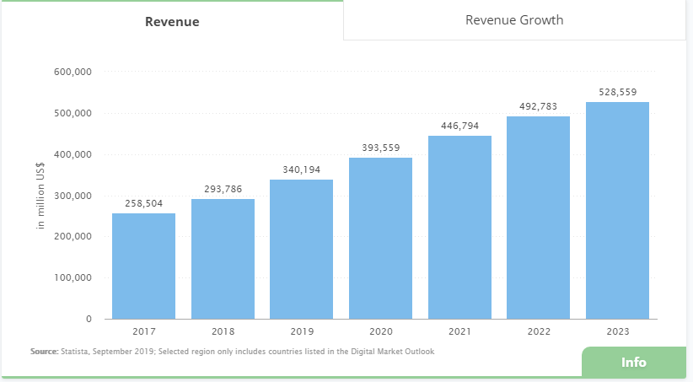

Slide 12
Challenges of the Industry
High capital expenditure
Constant changes in trends
Global supply chains
Shortening product life-cycle
Slim operating margins

Slide 13
Competition in the Industry
Market dominance by small number of large companies
  Profits are extremely high for those companies
Need for new innovations and reduction in production costs
Rapid changes in market shares

Slide 14
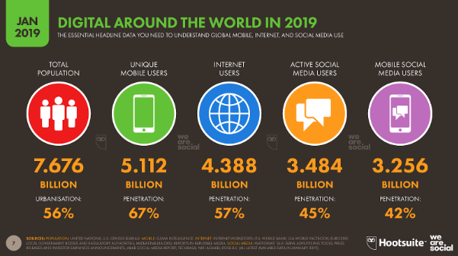

Slide 15
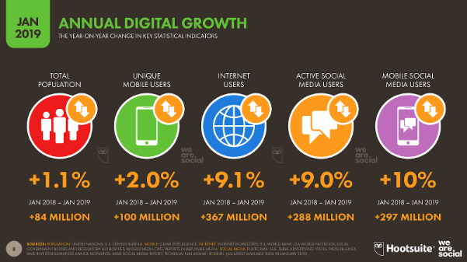

Slide 16
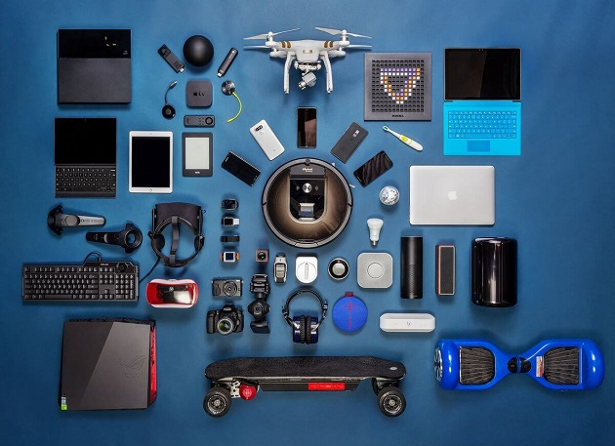
Main Aspects of Industry
Internet
Computers
Laptops
Smartphones
Smart watches
Operating Systems
Cloud Computing
VR

Slide 17

What is the Internet
Huge network of networks
Connects billions of people worldwide, enabling communication and other various activities

Slide 18
Internet History
1969 The original Internet (US Dept. of Defence)
1971 First Email sent
1990 First search engine (Archie) created
1991 Internet available for commercial use
1996 "BackRub" search engine (Stanford)
1997 Google (Googol)
2004 Facebook begins...

Slide 19
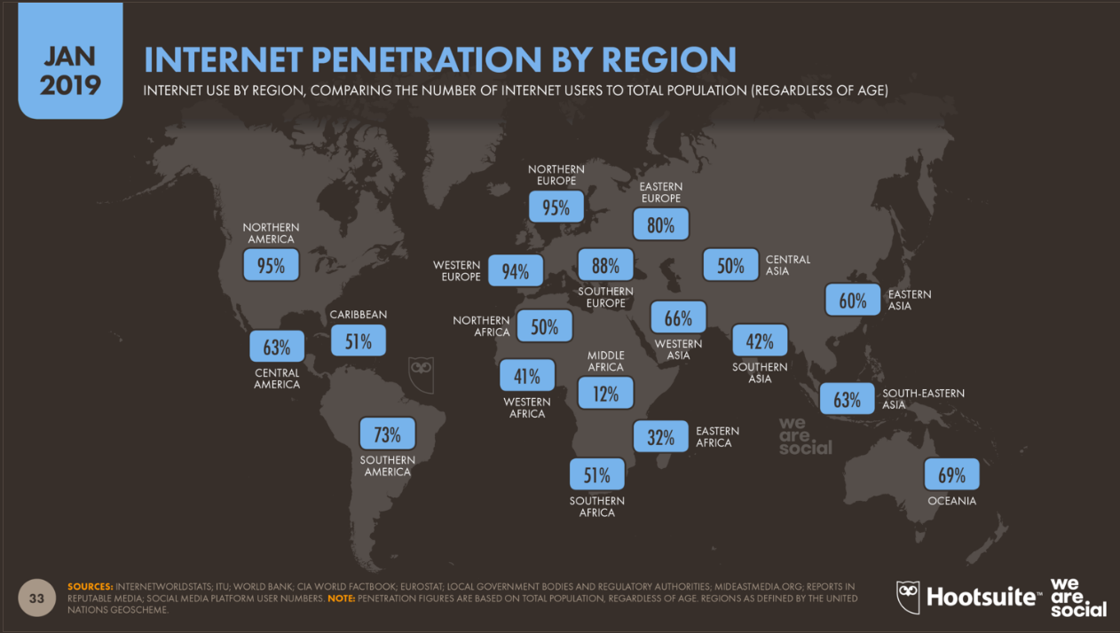

Slide 20
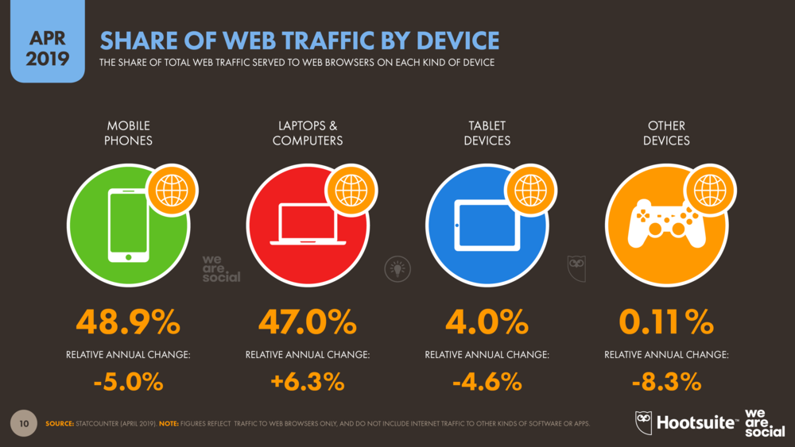

Slide 21
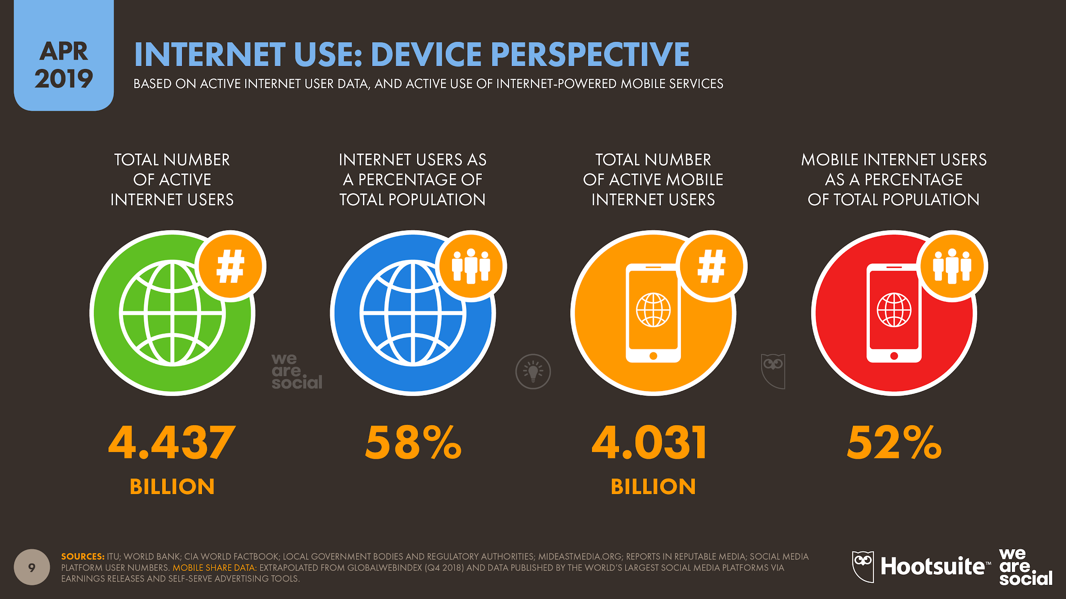

Slide 22
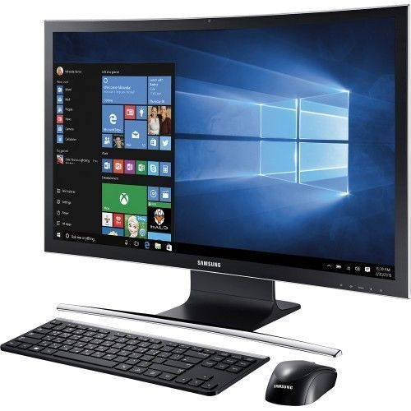
Computers
A device which can do a multitude of tasks:
  processing and storing data
  doing set tasks based on the software it is operating on

Slide 23
History of the Computer
1936 First freely programmable computer
1951 First commercial computer released
1974 First consumer computers (IBM)
1976 Apple I & II
1984 Apple Macintosh
1985 Microsoft Windows

Slide 24
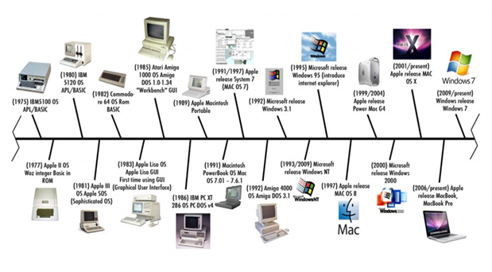
Timeline

Slide 25
Smartphones
All in one multi-media device that can be used as a cell phone with computing functions
Variety of applications available (both free and purchased from application store)
High Speed Data Access
Essential in the 21st century

Slide 26
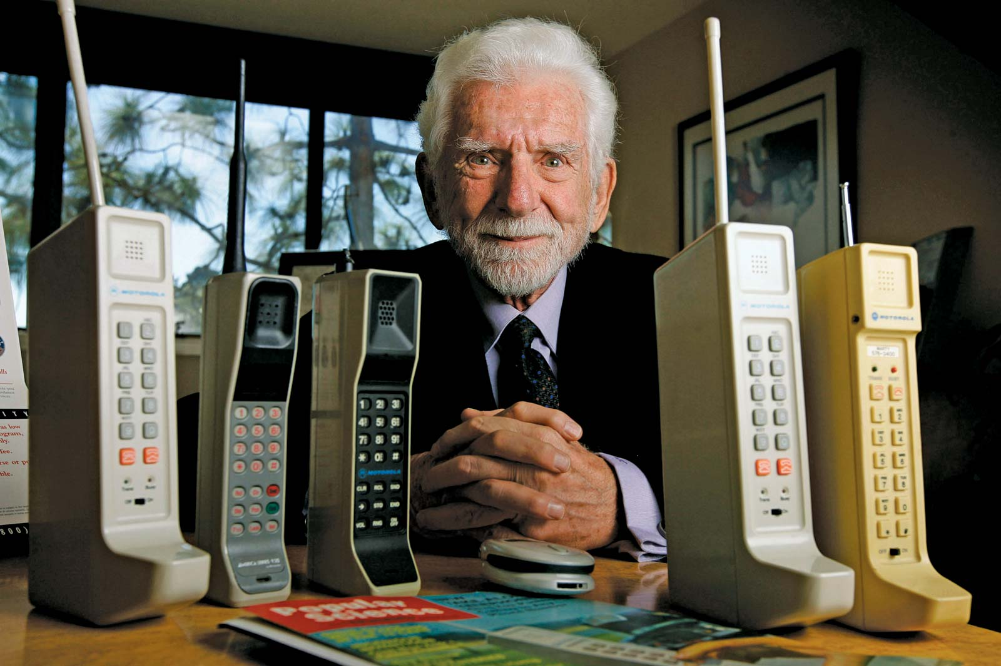
History of the Mobile Phone
1973 Motorola cell phone created by Martin Cooper
1973 First cell phone call made
1982 First instance of a smart watch created (Pulsar NL C01)
1983 First consumer cell phone available
1994 First smartphone
1999 First mobile watch phone
2001 First Commercial 3G Network
2007 First iPhone released
2008 First Android phone released
2010 First LTE Network
2019 Samsung Galaxy Fold released

Slide 27
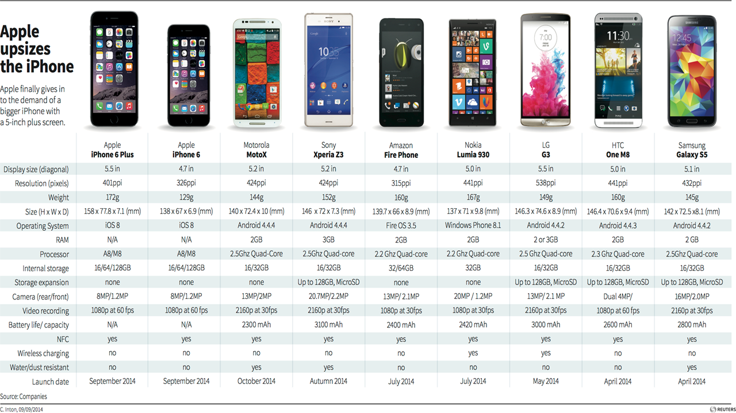

Slide 28
4G LTE Networks
LTE - Long Term Evolution
The standard for high-speed wireless communication for mobile devices and data terminals
Peak download rates up to 299.6 Mbit/s and upload rates up to 75.4 Mbit/s
Very low (5 ms) data transfer latencies

Slide 29
5G - Network of the Future
Estimated to be up to 50% faster
Energy saving
Higher system capacity
Reduce latencies (1 ms)
Target high data rate 1 GB/s

Slide 30
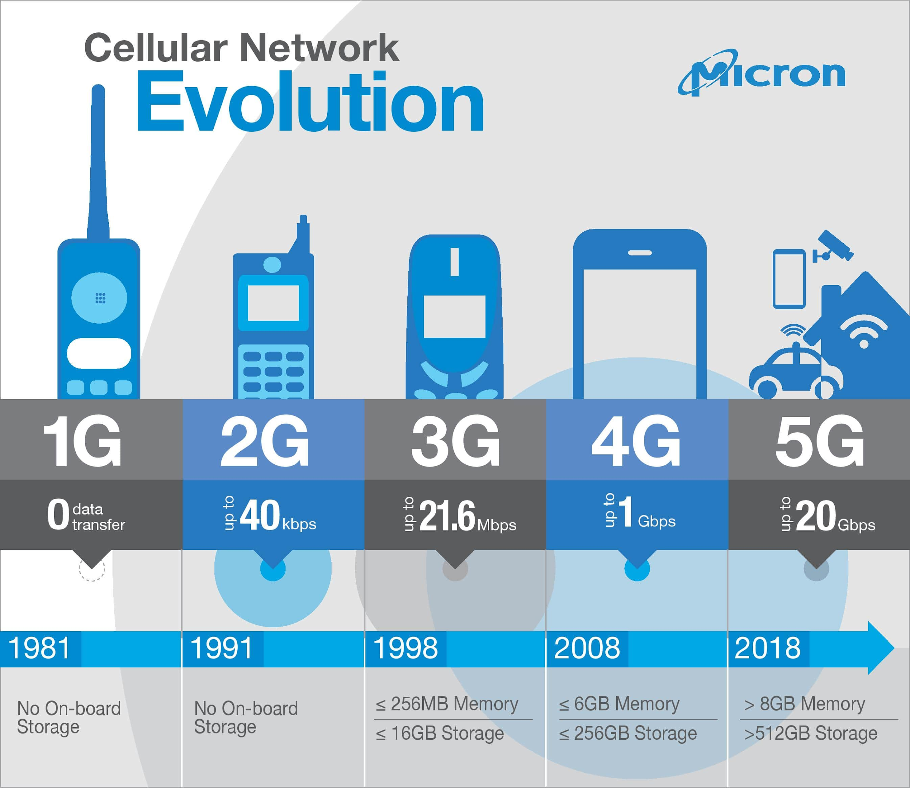

Slide 31
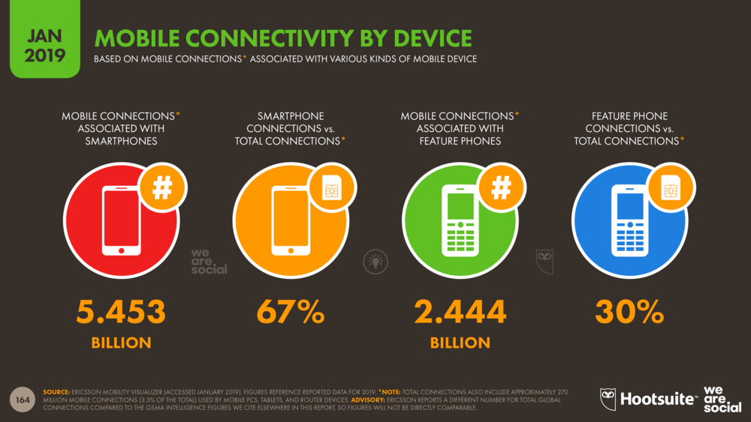

Slide 32
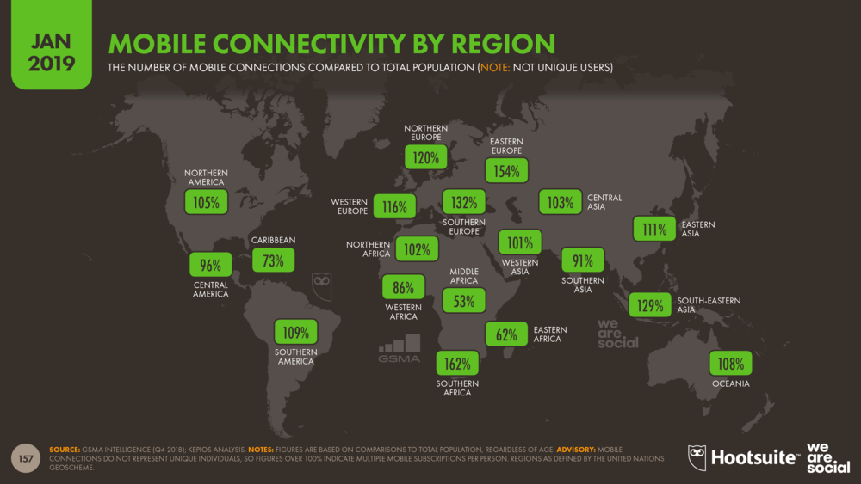

Slide 33
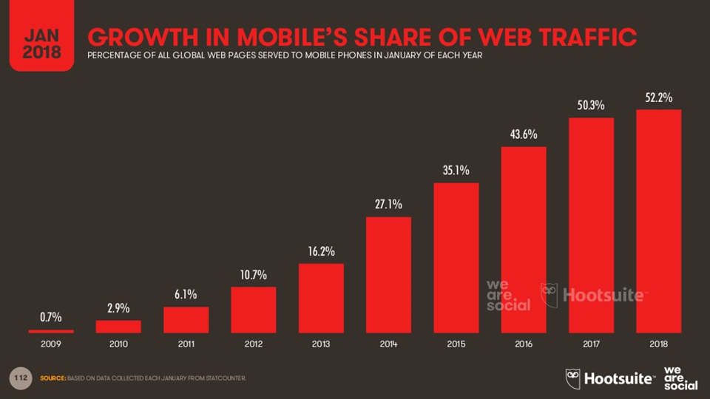

Slide 34
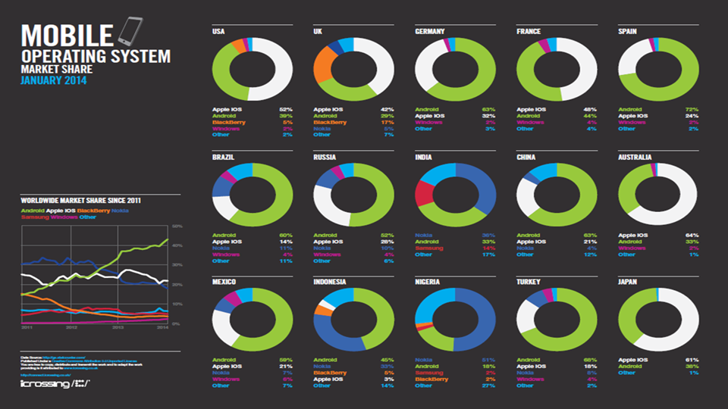

Slide 35
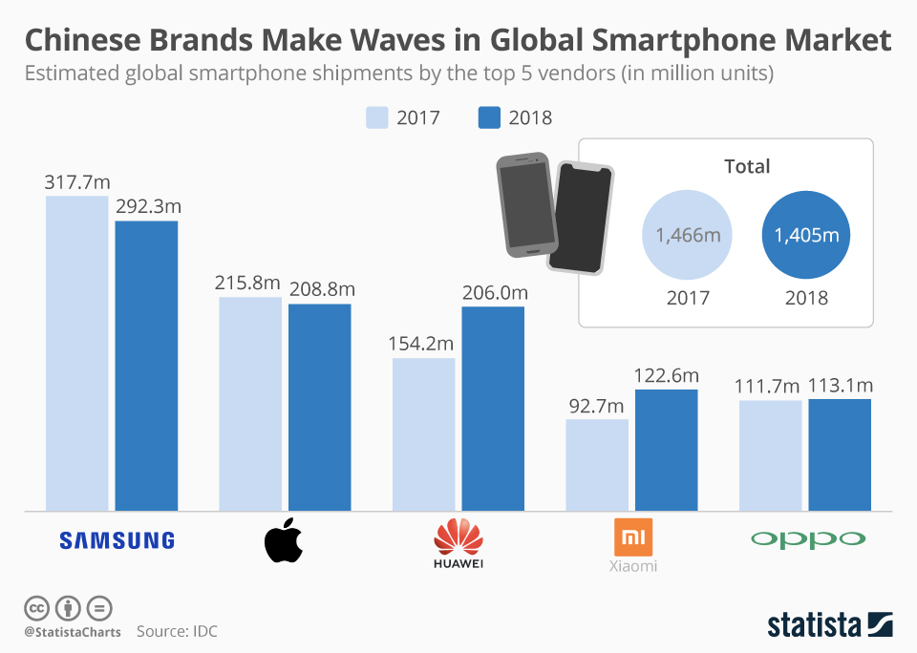

Slide 36
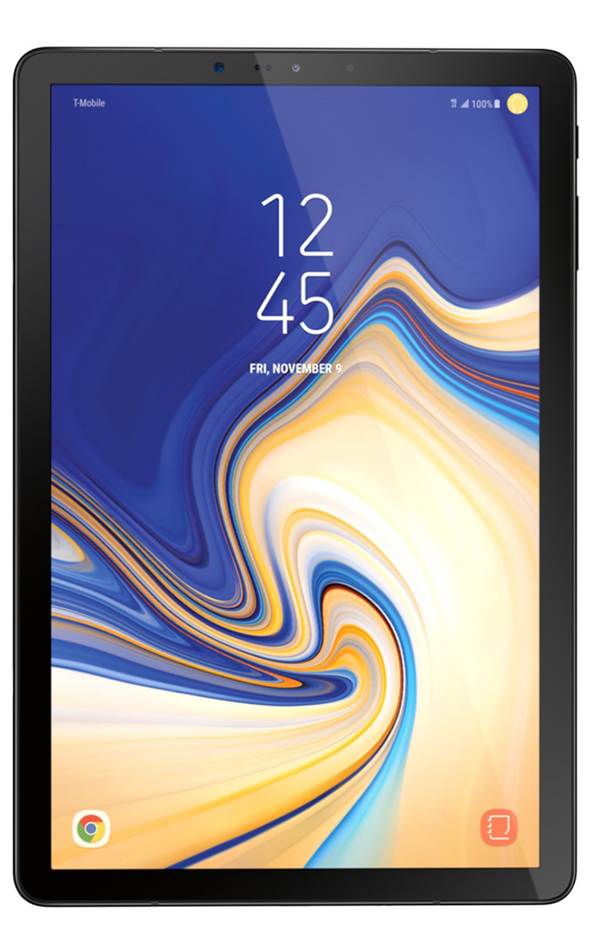
Tablets
Similar features to a smartphone but larger in size
Web browsing, software applications, social media, etc.
Usually no cell phone calling features
Usually has a camera

Slide 37
Tablet History
1971 Allan Kay describes a tablet computer at Xerox PARC
1983 Apple and AT&T work on a tablet prototype
1991 IBM markets a tablet computer but fails
1993 Apple Newton launches but fails
1996 NewsPad debuts (considered one of the first serious prototypes)
2009 Various computer manufacturers release tablets to market
2010 Apple iPad launched

Slide 38
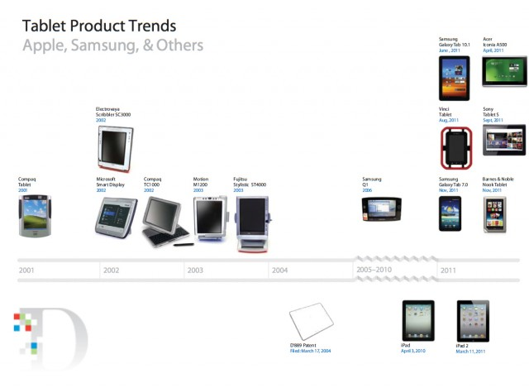

Slide 39
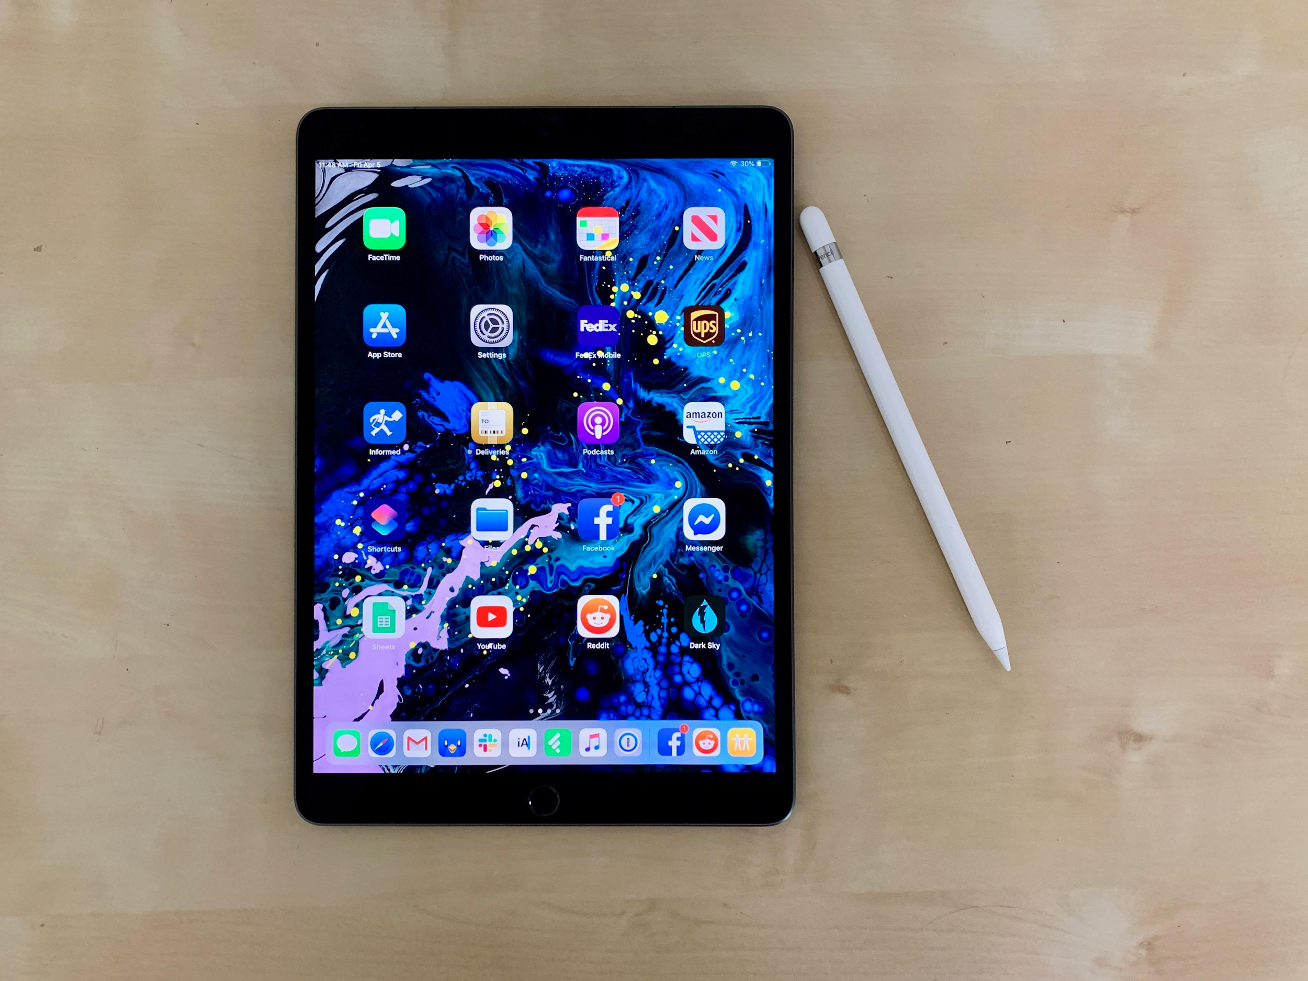
2019 Tablets
Apple iPad Air 2019
iPad Mini 2019
Microsoft Surface Pro 7
Samsung Galaxy Tab S6
Amazon Fire HD 8
Lenovo Tab 4
Microsoft Surface Pro X

Slide 40
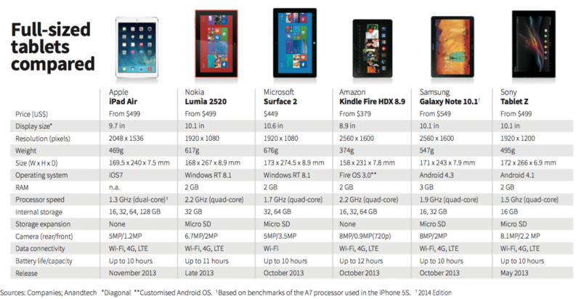

Slide 41
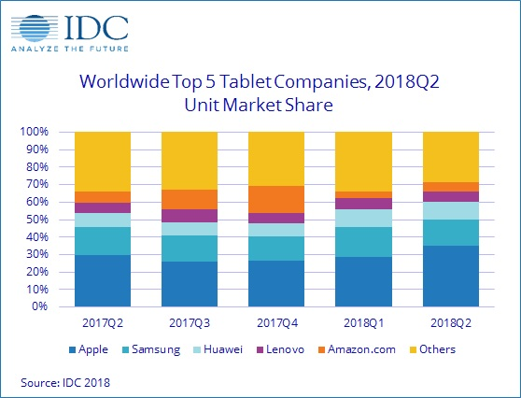

Slide 42
Smart Watches
A computerized wristwatch with functionality that is enhanced beyond timekeeping, and is often comparable to a personal digital assistant device
Some, like the Apple Watch, can monitor heart rates

Slide 43
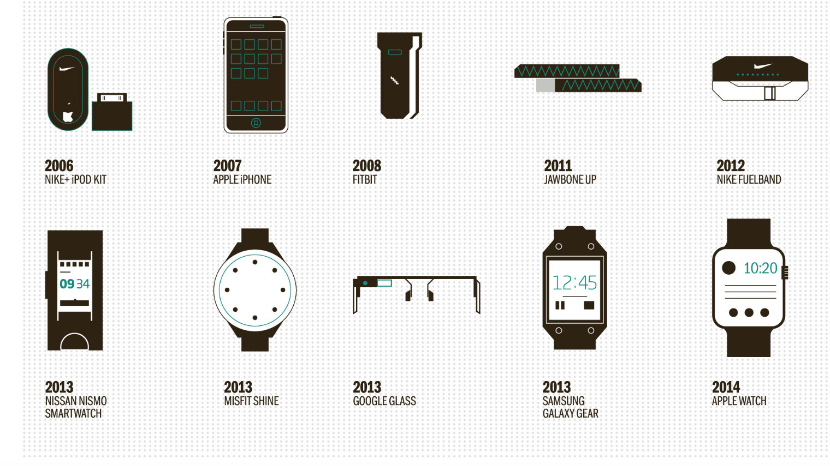

Slide 44
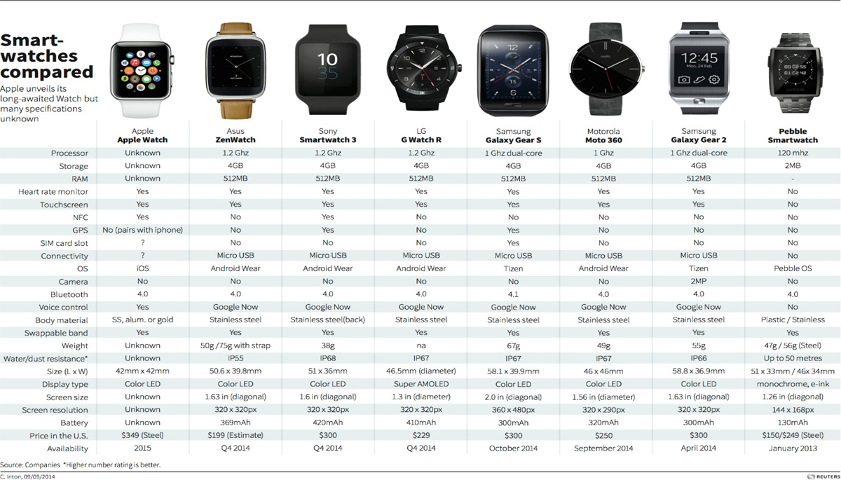

Slide 45
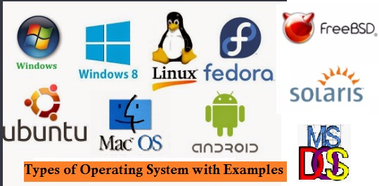
Operating Systems
Software that manages computer hardware resources
Provides services for computer programs
Windows 10, Mac OS, Etc

Slide 46
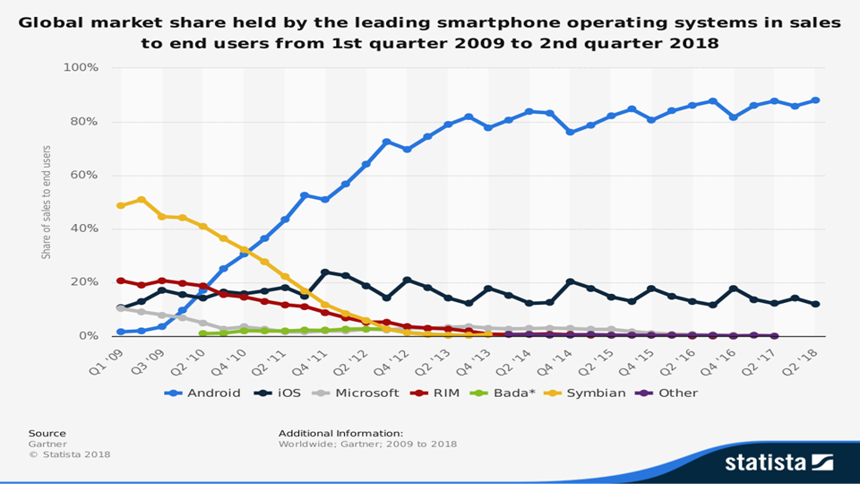

Slide 47
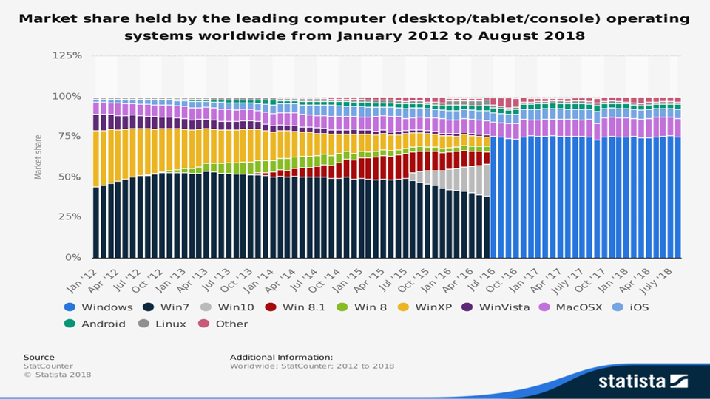

Slide 48
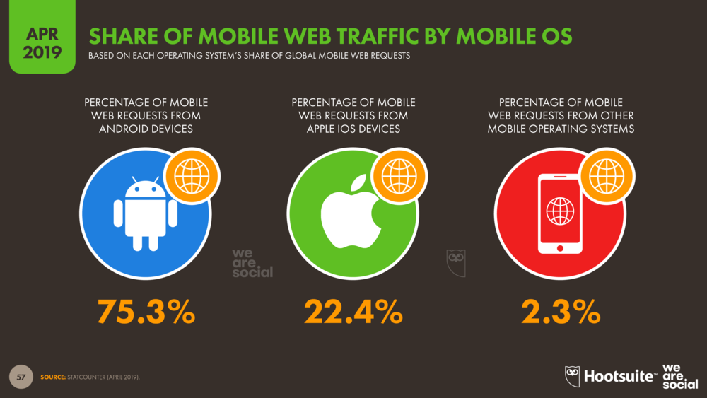

Slide 49
Cloud Computing
A server is used to run programs and applications rather than locally on the computer
Data is saved outside the local server
Ease of accessibility of data

Slide 50
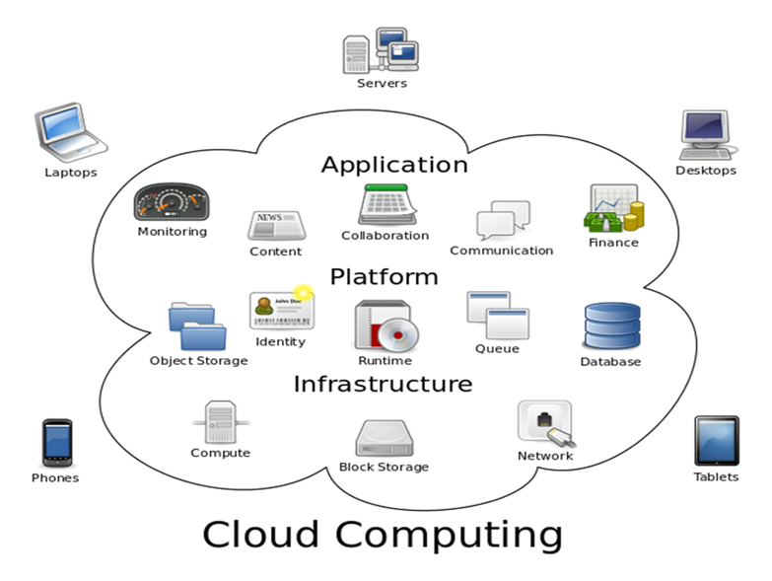
Cloud Computing

Slide 51
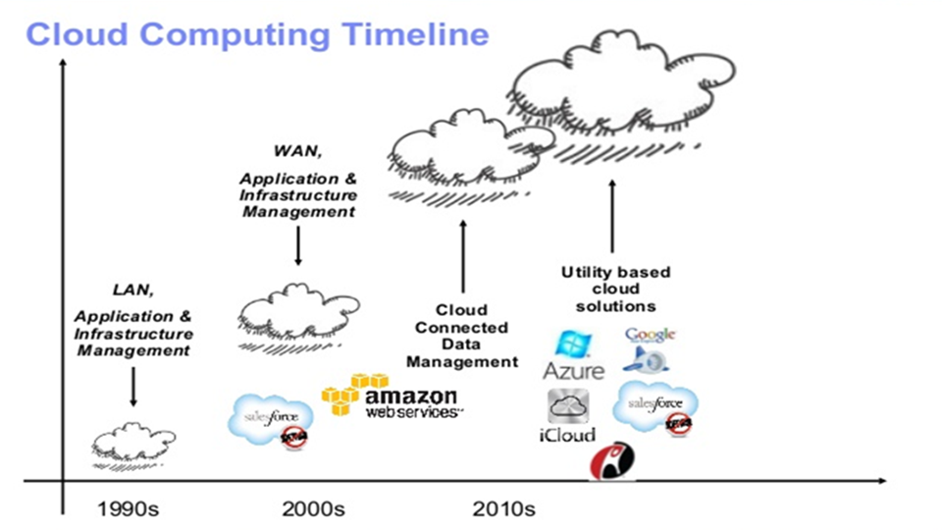

Slide 52
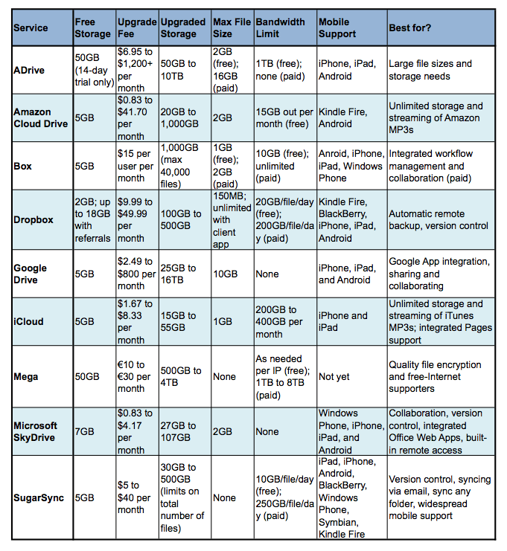
Cloud Computing

Slide 53

App Stores
OS specific application stores that allow you to download free and paid software to your device
Apps can be used for entertainment, education, or lifestyle

Slide 54
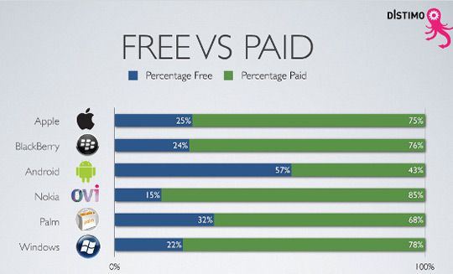
App Stores

Slide 55
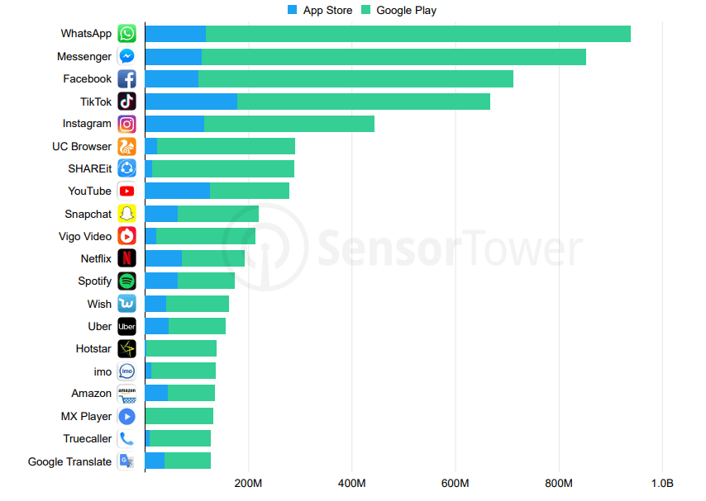

Slide 56
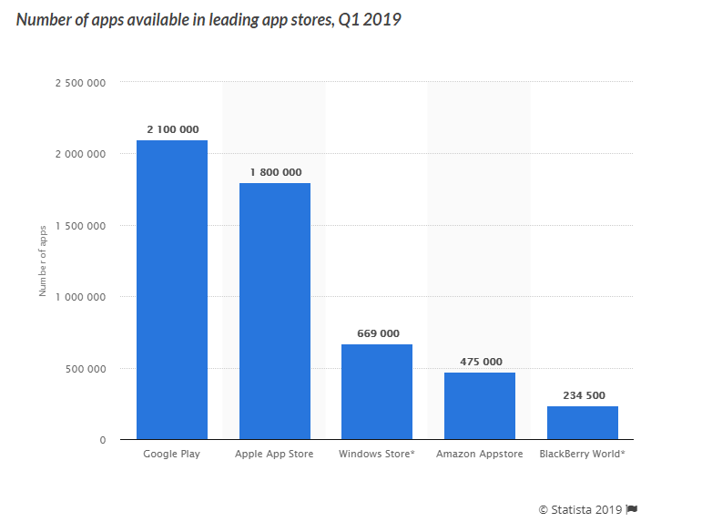

Slide 57
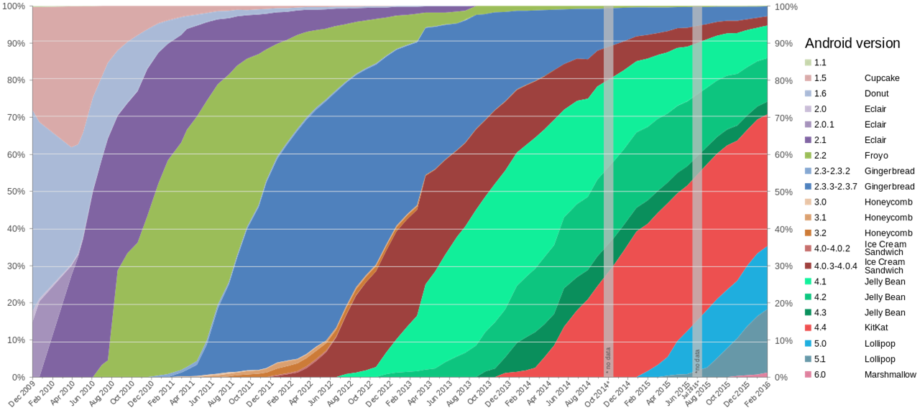

Slide 58
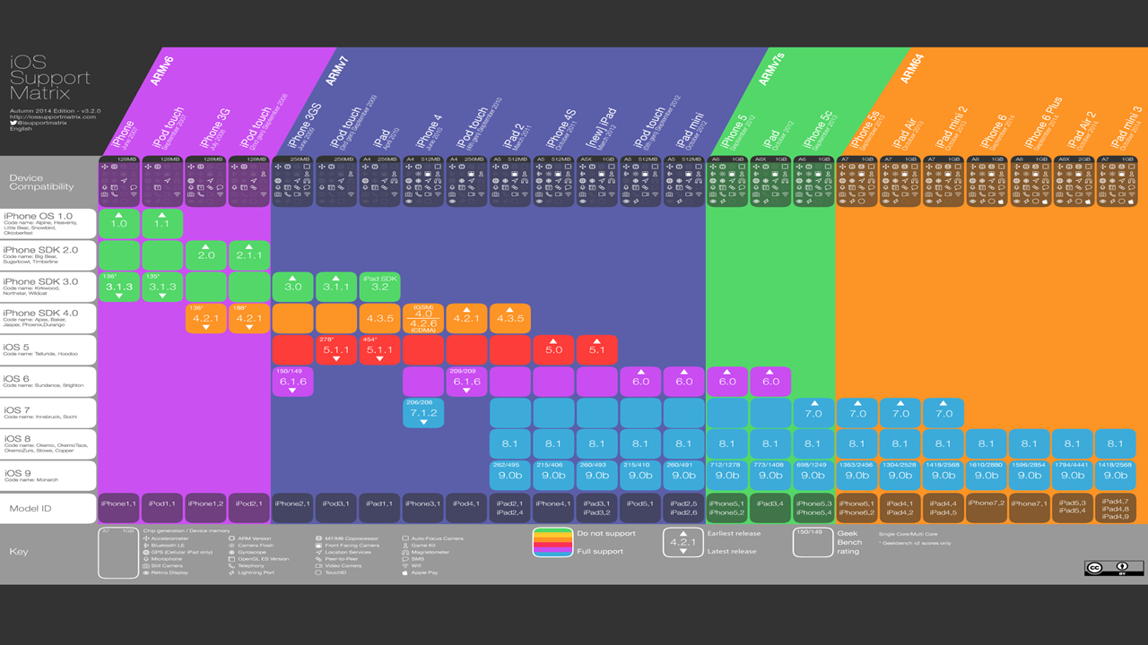

Slide 59


Slide 60

Stock Overview

Slide 61
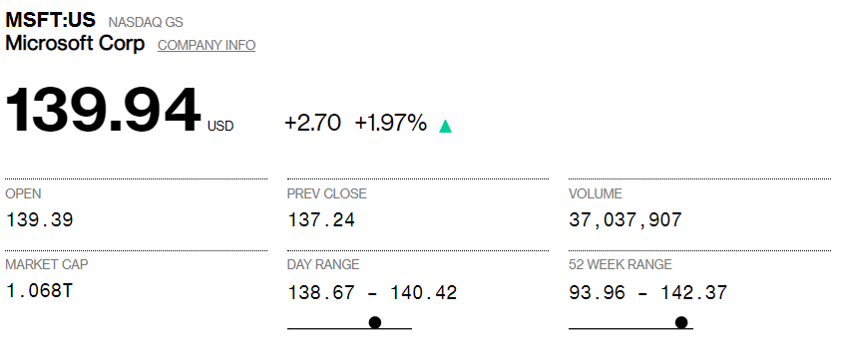
Stock Information

Slide 62
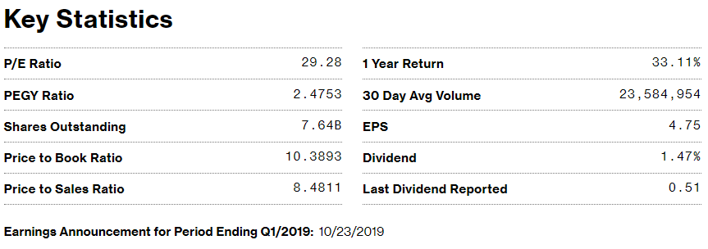
Stock Information

Slide 63
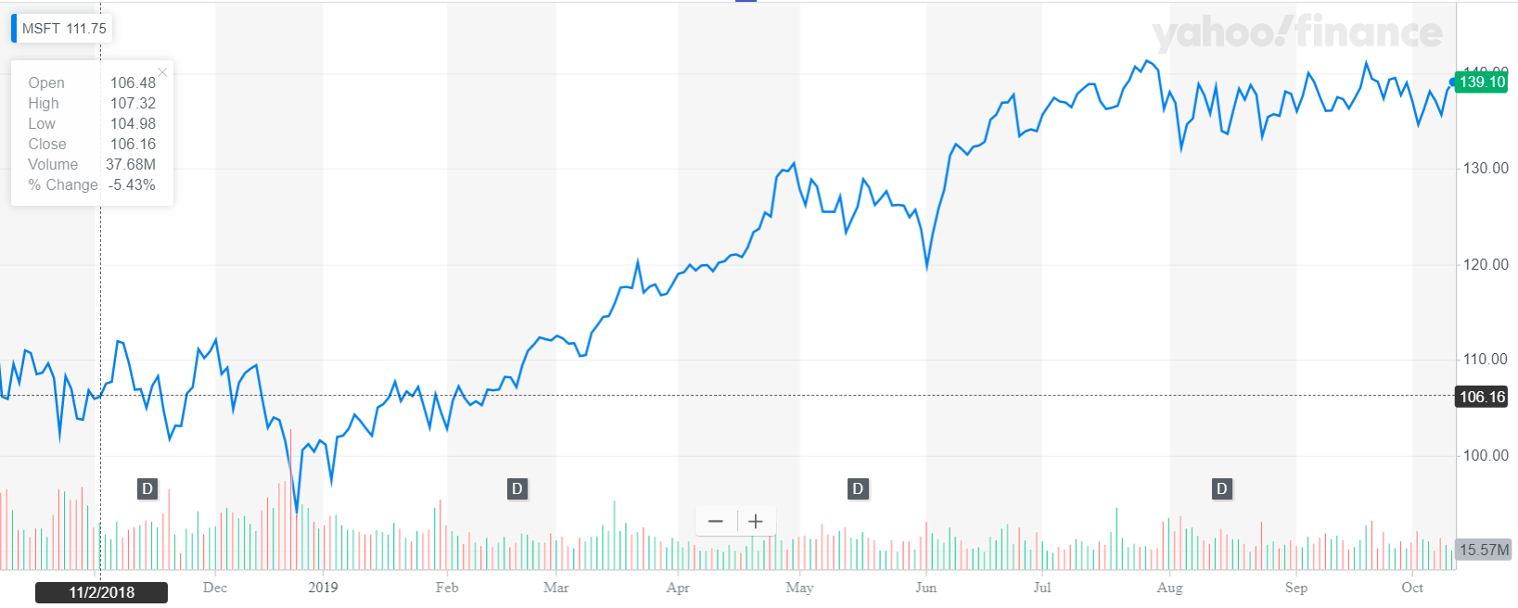
Stock 1 Year Performance

Slide 64
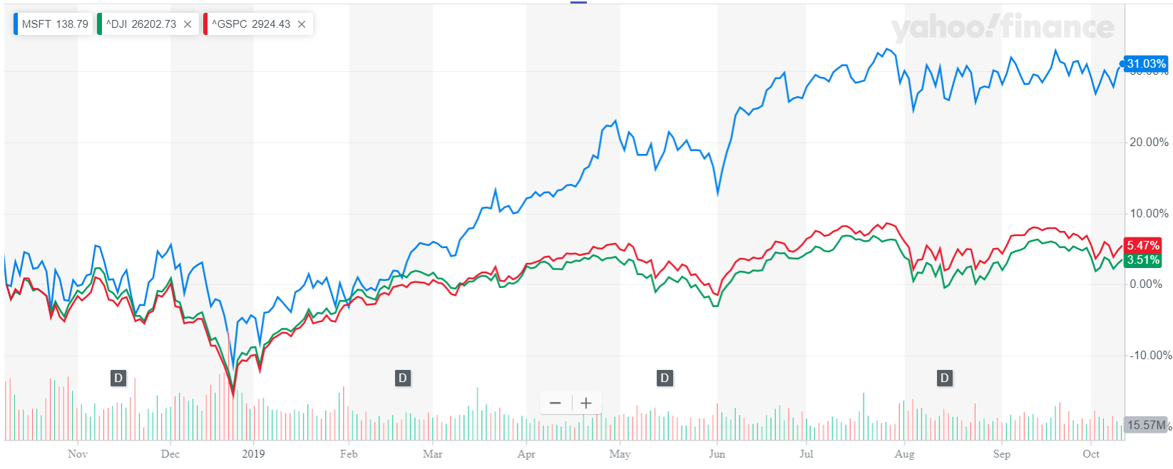
Stock 1 Year Comparison

Slide 65
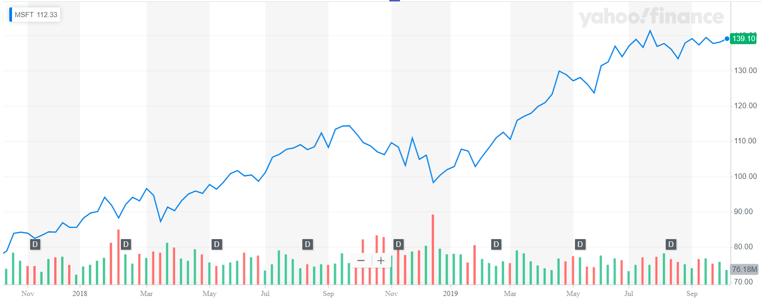
Stock 2 Year Performance

Slide 66
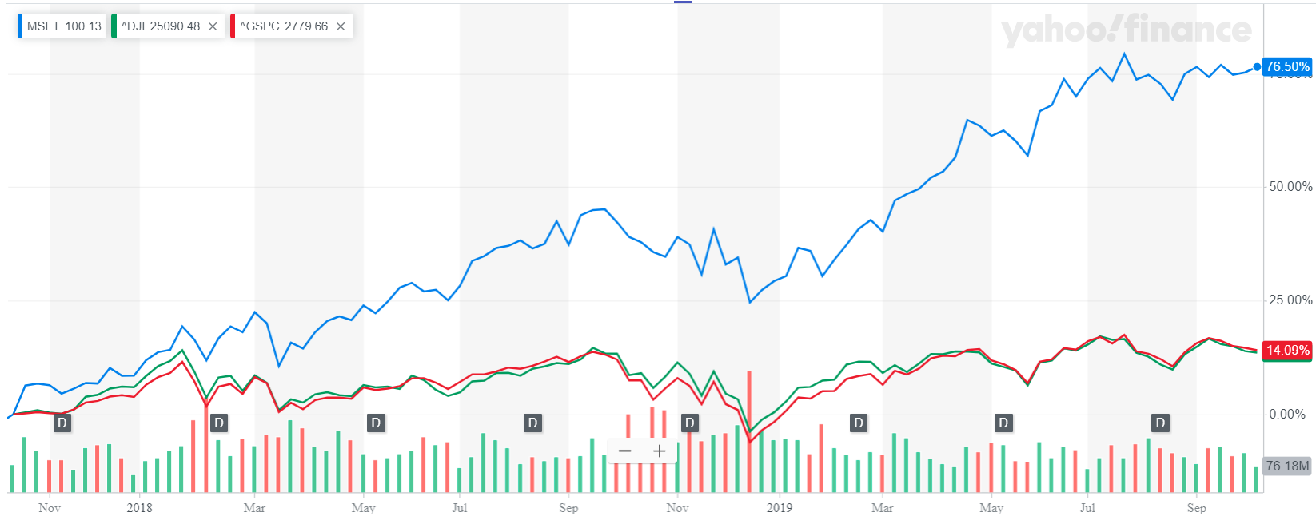
Stock 2 Year Comparison

Slide 67
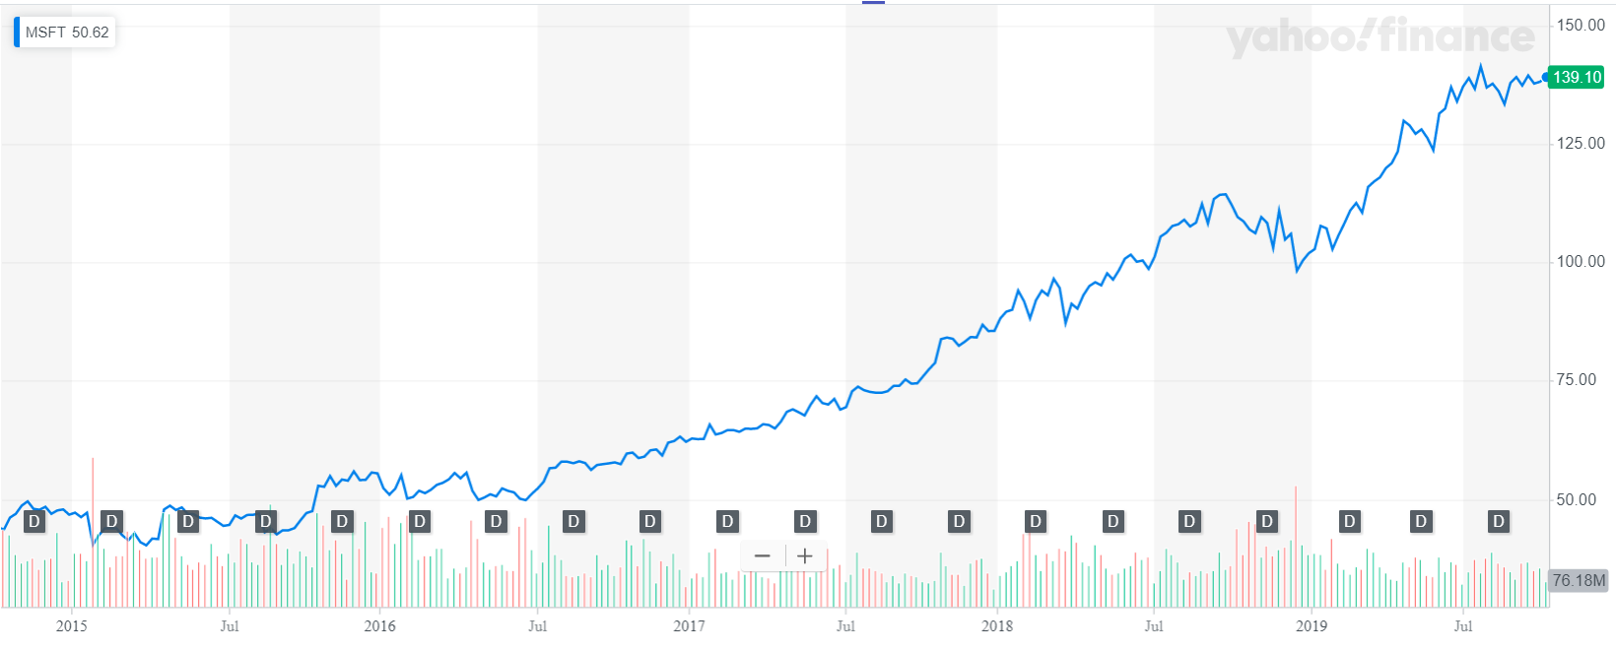
Stock 5 Year Performance

Slide 68
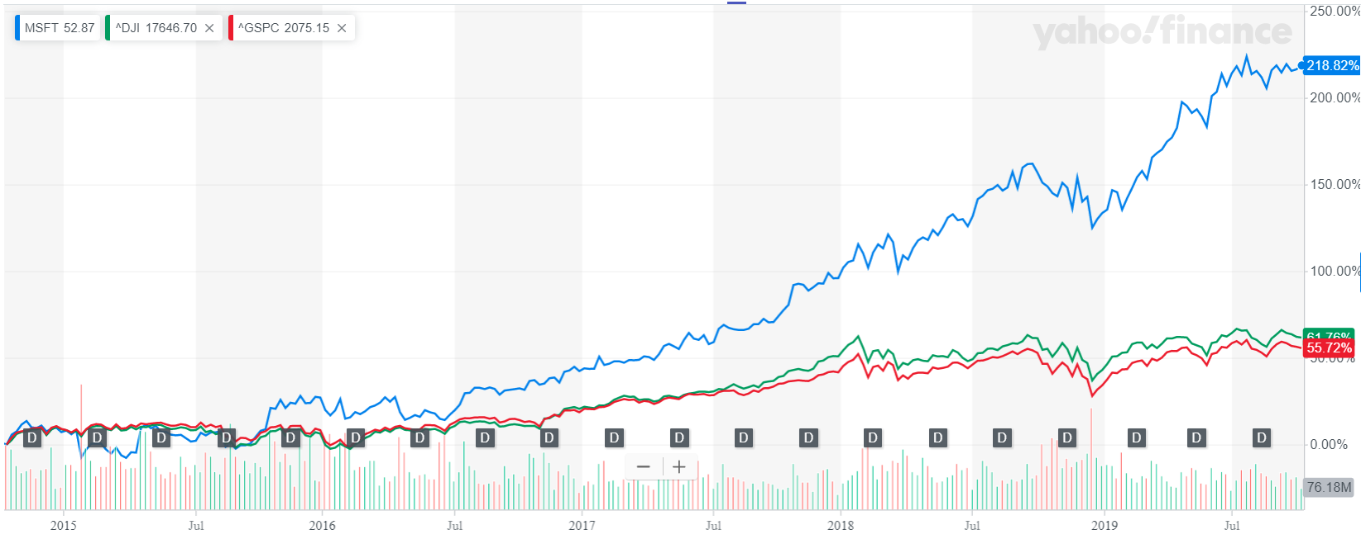
Stock 5 Year Comparison

Slide 69
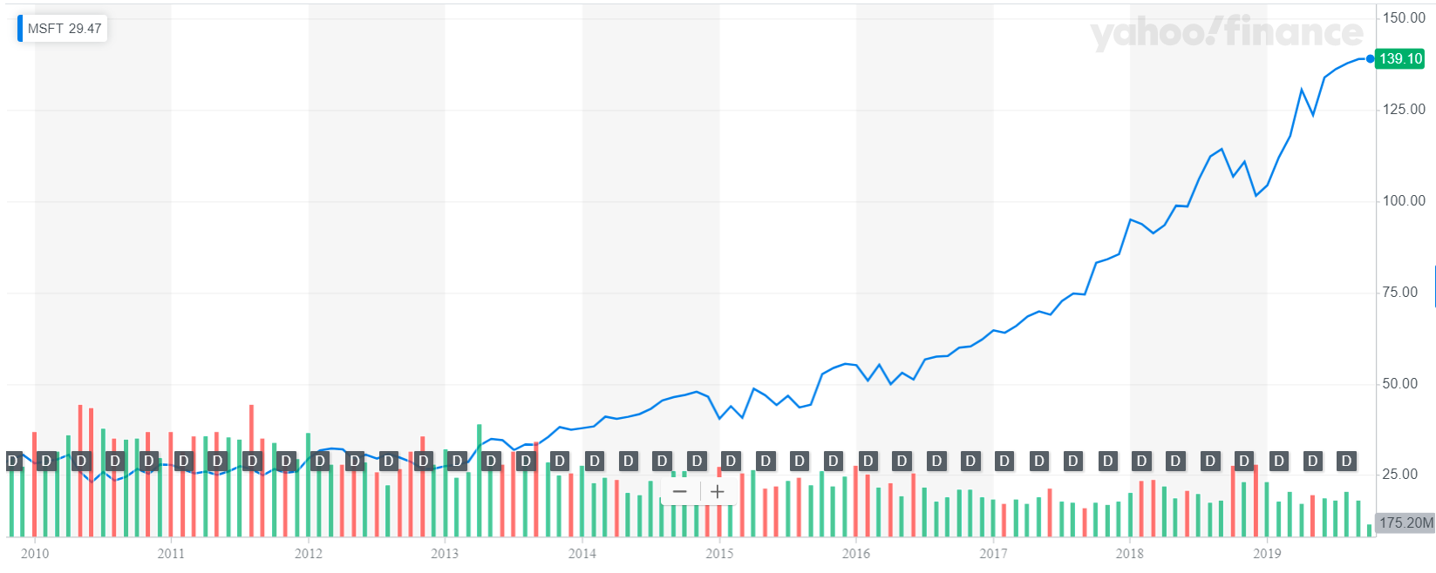
Stock 10 Year Performance

Slide 70
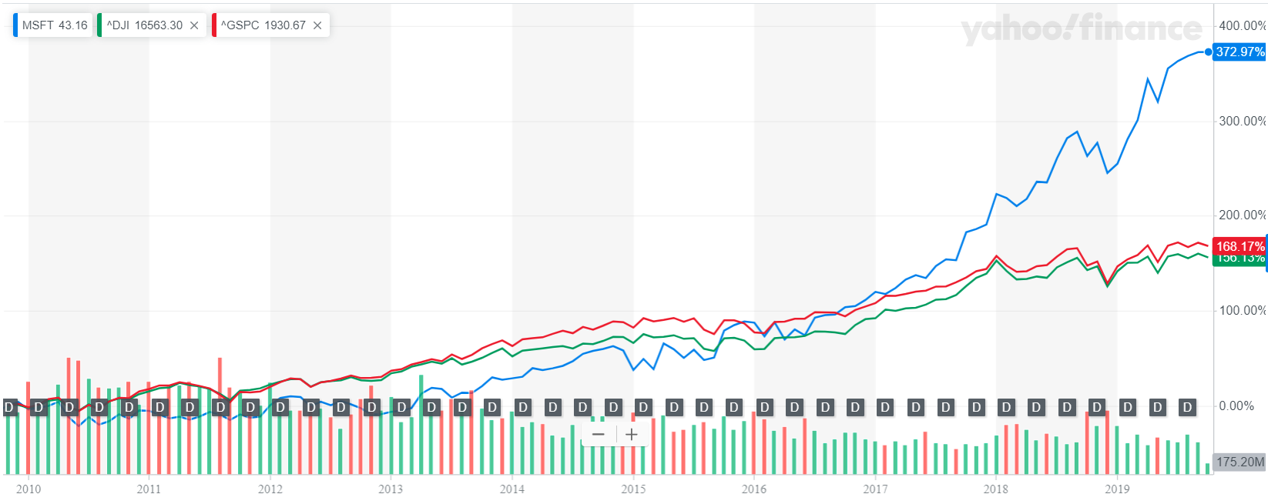
Stock 10 Year Comparison

Slide 71
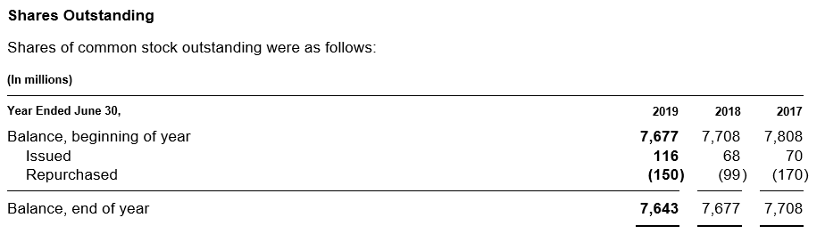
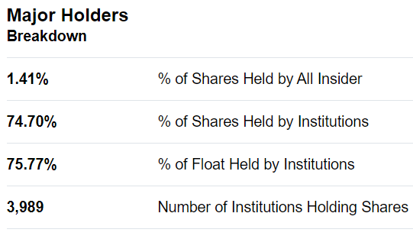
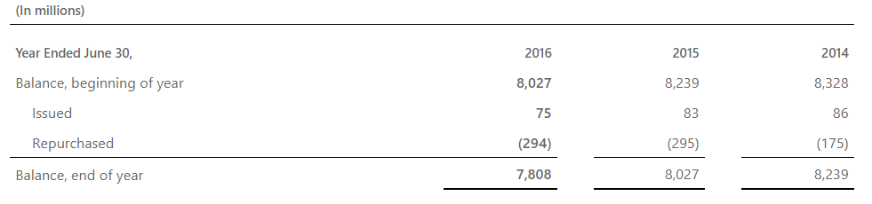
Share Structure

Slide 72
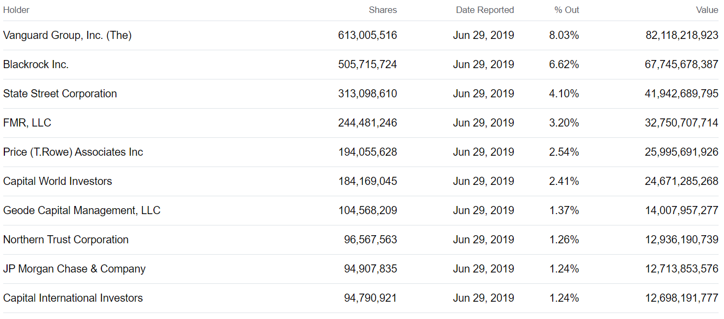
Top Institutional Holders

Slide 73

Share Repurchases

Slide 74


Dividends

Slide 75
Company Overview

Slide 76
Mission and Strategy
Mission
Empower every person and every organization on the planet to achieve more
Strategy
Reinvent productivity and business processes
Build the intelligent cloud and intelligent edge platform
Create more personal computing

Slide 77
Company History
1975
Bill Gates and Paul Allen found Microsoft
1985, 1986
Releases Microsoft Excel
Launches Windows 1.0
Microsoft goes public at $21/share
1995
Launches Windows 95
1981
IBM Personal Computer launches with MS-DOS
1990
Releases Windows 3.0
and Microsoft Office
1998
Releases Windows 98
Launches Indian Headquarters

Slide 78
Company History
2000
Bill Gates hands over CEO position to Steve Ballmer
2005
Launches Xbox 360
2009
Launches Windows 7
Unveils Microsoft Bing
2011
Launches Office 365
2001
Releases Windows XP
Launches Xbox
2007
Releases Windows Vista
2010
Launches Microsoft Azure
Launches Xbox Kinect
Launces Windows Phone

Slide 79
Company History
2013
Launches Xbox One
Launches Outlook.com
2015
Releases Windows 10
Opens first Microsoft Store in New York City
2018
Announces Project Mu
Announces open source implementation of Windows Forms and Windows Presentation Foundation
2012
Launches Windows 8
Launches Microsoft Surface
2014
Satya Nadella succeeds Steve Ballmer as CEO
2016
Announces Surface Studio and Surface Dial
Launches Microsoft Teams
Joined Linux Foundation as a Platinum member
2019
Announces end of support for Windows 10 Mobile

Slide 80
Key Acquisitions
1987 - Forethought
  Founded in 1983, then later be known as Microsoft PowerPoint
1997 - Hotmail
  Acquired for $500 million
2000 - Visio Corporation
  Acquired for $1.375 billion
2002 - Navision
  Purchased for $1.33 billion; turned into a new division as Microsoft Business Solutions (now Microsoft Dynamics)
2011 - Skype Technologies
  Purchased for $8.5 billion; 32 times larger than its value
2013 - Nokia (Hardware Division)
  Formerly developed phones for Microsoft; highlights Microsoft’s move into hardware

Slide 81
Key Acquisitions
2015 - Metanautix
  Metanautix helps big companies to navigate their data
2015 - Mobile Data Labs
  An intelligent productivity solutions for mobile professionals
2016 - Swiftkey
  A start-up company that makes keyboard apps for Android and iOS devices
2016 - Xamarin
  Allows developers to build fully native apps across several platforms from a single shared code base
2016 - Linkedln
  Acquired for $26.2 Billion
2017 - Cloudyn
Israeli cloud startup that helps customers manage their cloud billing across multiple clouds
2018 - GitHub
  Acquired for $7.5 billion

Slide 82

Company Management
Satya Nadella (CEO, 2014 – present)
Led Microsoft’s move to cloud computing and the development of one of the largest cloud infrastructures in the world as President, Server and Tools
Emphasized openness to working with Microsoft’s competitors (e.g. Apple, IBM, Linux)
Lead a series of high-profile acquisitions (e.g. Mojang, Linkedin, Github)
Also serves on the Board of Directors of Starbucks Corporation
Education
  Earned a bachelor’s degree in electrical engineering from Mangalore University, a master’s degree in computer science from the University of Wisconsin – Milwaukee and a master’s degree in business administration from the University of Chicago

Slide 83

Company Management
Chris Capossela (Executive VP of Consumer Business, CMO, 2014 - present)
Led Microsoft business for Microsoft’s EMEA region in 1999
Assumed leadership of Microsoft Project in 2001
Promoted to corporate Vice President of Microsoft Office division in 2003
Oversees marketing across all Microsoft product, services, research, brand, advertising, and corporate communications
Education
  Holds a bachelor’s degree in computer science and economics from Harvard University

Slide 84

Company Management
Jean-Philippe Courtois (Executive VP & President, Microsoft Global Sales, Marketing and Operations, 2016 - present)
Promoted to general manager of Microsoft France in 1994
Corporate Vice President, Worldwide Customer Marketing from 1998 to 2000
Senior Vice President and President, Microsoft EMEA from 2000 to 2003
Chief Executive Officer, Microsoft EMEA from 2003 to 2005
President of Microsoft International from 2005 to 2016
Education
  holds a DECS (diplôme des études commerciales supérieures, diploma in advanced business studies) from Skema Business School

Slide 85

Company Management
Kathleen Hogan (Executive VP, Human Resources, 2014 – present)
Management consultant for McKinsey & Company until 2003
Joined Microsoft in 2003
Corporate Vice President of Customer Service and Support from 2005
Corporate Vice President of Microsoft Worldwide Services from 2009
Education
  graduated Harvard University in 1988 with a bachelor's degree in applied mathematics and economics

Slide 86

Company Management
Amy Hood (Executive VP, Chief Financial Officer, 2013 – present)
Worked in Goldman Sachs’ investment banking and capital market’s group
Joined Microsoft in 2002
General Manager, Microsoft Business Division Strategy from 2006 to 2009
Chief Financial Officer of the Microsoft Business Division from 2010 to 2013
Also serves on the Board of Directors of 3M Corporation
Education
  holds a bachelor's degree in economics from Duke University in 1994 and an MBA from Harvard University

Slide 87

Company Management
Peggy Johnson (Executive Vice President, Business Development, 2014 – present)
24 years at Qualcomm in leadership positions across engineering, sales, marketing and business development
Served as Executive Vice President of Qualcomm Technologies, Inc before joining Microsoft in 2014
Also serves on the Board of Directors of BlackRock, Inc
Education
  BS degree in Electrical Engineering from San Diego State University

Slide 88

Company Management
Brad Smith (President and Chief Legal Officer, 2015 – present)
Led Microsoft’s Legal and Corporate Affairs team in Europe, then five years as deputy general counsel since joining in 1993
Senior Vice President, General Counsel, and Secretary from 2001 to 2011
Served as Executive Vice President, General Counsel, and Secretary from 2011 to 2015
longest serving member of Microsoft's top leadership
Education
  Attended Princeton University. Earned his J.D. from Columbia University Law School and studied international law and economics at the Graduate Institute in Geneva, Switzerland

Slide 89





Products and Services
Productivity and Business Process
Intelligent Cloud
More Personal Computing

Slide 90
Productivity and Business Process
Office Commercial (volume licensing, subscriptions to Office 365 commercial for products: Office, Exchange, SharePoint, and Skype for Business, and related Client Access Licenses)
Office Consumer (Office 365 consumer subscription, Skype, Outlook.com, Linkedin, and OneDrive)
Dynamics business solutions (Dynamics ERP products, Dynamics CRM on-premises, and Dynamics CRM Online)

Slide 91
Intelligent Cloud
Server products and cloud services (Microsoft SQL Server, Windows Server, Visual Studio, System Center, related CALs, and Azure)
Enterprise Services (Premier Support Services and Microsoft Consulting Services)

Slide 92
More Personal Computing
Windows (Windows original equipment manufacturer licensing, other non-volume licensing of the Windows operating system, volume licensing of the Windows operating system, patent licensing, Windows Embedded, MSN display advertising, and Windows Phone licensing)
Devices (Surface, phones, and PC accessories, and other intelligent devices)
Gaming (Xbox hardware, Xbox Live, comprising transactions, subscriptions, and advertising, video games, and third-party video game royalties)
Search advertising (Bing, Bing Ads, and MSN)

Slide 93

Revenue By Segments

Slide 94

Revenue by Product and Service Offerings

Slide 95

Revenue By Geography

Slide 96

World Market Share of Cloud Service Providers (Q2, 2019)

Slide 97

Office Suites Market Share (July 2019)
Source: Datanyze

Slide 98

Global Computer Operating System Market Share (2015 to 2019)

Slide 99
Financial Analysis

Slide 100

Balance Sheet 10-Q

Slide 101


Slide 102

Balance Sheet 10-K

Slide 103


Slide 104

Income Statement 10-Q

Slide 105

Income Statement 10-K

Slide 106

Comprehensive Income 10-K

Slide 107

Cash Flow Statement 10-Q

Slide 108

Cash Flow Statement 10-Q

Slide 109

Cash Flow Statement 10-K

Slide 110

Cash Flow Statement 10-K

Slide 111

Shareholders’ Equity Statement 10-Q

Slide 112

Shareholders’ Equity Statement 10-K

Slide 113

Earnings Per Share 10-Q

Slide 114

Earnings Per Share 10-K

Slide 115

Q4 2019 Share Repurchases

Slide 116

Q1 2020 Share Repurchases

Slide 117

Market Risks

Slide 118

Sales Forecast
Source: CNN Money

Slide 119

Earning Forecasts
Source: CNN Money

Slide 120

Stock Price Forecast
Source: CNN Money

Slide 121



Analyst Recommendations
Source: CNN Money

Slide 122
BUY

Slide 123

Apple

Slide 124



Stock Overview

Slide 125




Share Information
Source: Bloomberg

Slide 126

Key Statistics
Share Information
P/E Ratio | 19.35 | 1 Year Return | 0.46%
Shares Outstanding | 4.519B | 30 Day Avg Volume | 27,622,276
Price to Book Ratio | 10.5421 | EPS | 11.74
Price to Sales Ratio | 4.0735 | Dividend | 1.37%
Earnings Announcement for Period Ending Q4/2019 | October 30, 2019 | Last Dividend Reported | 0.770 (August 9, 2019)
Source: Bloomberg

Slide 127
FY 19 Fourth Quarter Results
Apple’s conference call to discuss fourth fiscal quarter results is scheduled for Wednesday, October 30, 2019 at 2:00 p.m. PT / 5:00 p.m. ET.

Slide 128

Share Structure
Shares Outstanding
2015 | 2016 | 2017 | 2018 | 2019 Q2
5.793B | 5.5B | 5.252B | 5B | 4.601B
5.6% decline from 2014 | 5.05% decline from 2015 | 4.52% decline from 2016 | 4.79% decline from 2017 | 6.6% Decline from YOY
Apple Stock Buybacks (Quarterly):
16.95B for June 30, 2019
Source: Macrotrends, Y Charts
Notes:
https://www.macrotrends.net/stocks/charts/AAPL/apple/shares-outstanding
Shares outstanding can be defined as the number of shares held by shareholders (including insiders) assuming conversion of all convertible debt, securities, warrants and options. This metric excludes the company's treasury shares.
$9.22
$8.31
$9.21
$11.91

Slide 129


Share Structure
↑ 29.32%
Source: Macrotrends
Apple 2018 annual EPS was $11.91, a 29.32% increase from 2017.
$9.22
$9.21
$8.31
$6.31
$6.45
$5.68
Notes:
Apple 2018 annual EPS was $11.91, a 29.32% increase from 2017.

Slide 130


1 Year Performance
Source: Yahoo! Finance

Slide 131


5 Year Performance
Beta (S&P500) 3 Years, Monthly
1.24
Source: Yahoo! Finance

Slide 132


10 Year Performance
Beta (S&P500) 10 Years, Monthly
Source: Yahoo! Finance

Slide 133


Maximum Stock Chart

Slide 134

Shareholders’ Analysis
Top 10 Owners of Apple Inc
Source: CNN Business
Stockholder | Stake | Shares owned | Total value ($) | Shares bought / sold | Total change
The Vanguard Group, Inc. | 7.27% | 328,525,375 | 73,579,828,239 | -3,317,083 | -1.00%
Berkshire Hathaway, Inc. (Investm... | 5.52% | 249,589,329 | 55,900,522,016 | 0 | 0.00%
BlackRock Fund Advisors | 4.28% | 193,179,452 | 43,266,401,864 | -3,811,227 | -1.93%
SSgA Funds Management, Inc. | 4.14% | 187,085,416 | 41,901,520,622 | -3,564,861 | -1.87%
Fidelity Management & Research Co... | 2.01% | 90,635,159 | 20,299,556,561 | -2,699,602 | -2.89%
Geode Capital Management LLC | 1.37% | 61,746,765 | 13,829,422,957 | +682,953 | +1.12%
Northern Trust Investments, Inc.(... | 1.31% | 58,966,400 | 13,206,704,608 | -311,739 | -0.53%
Norges Bank Investment Management | 1.05% | 47,548,836 | 10,649,512,799 | -3,236,761 | -6.37%
Invesco Capital Management LLC | 0.90% | 40,767,482 | 9,130,692,944 | -119,048 | -0.29%
BlackRock Investment Management (... | 0.68% | 30,830,410 | 6,905,086,928 | -369,899 | -1.19%

Slide 135

Dividend Payments
Declared | Amount
July 30, 2019 | $ 0.77
Apr 30, 2019 | $ 0.77
Jan 29, 2019 | $ 0.73
2019* | $ 2.27
Nov 1, 2018 | $ 0.73
Jul 31, 2018 | $ 0.73
May 1, 2018 | $ 0.73
Feb 1, 2018 | $ 0.63
2018 | $ 2.82
Nov 2, 2017 | $ 0.63
Aug 1, 2017 | $ 0.63
May 2, 2017 | $ 0.63
Jan 31, 2017 | $ 0.57
2017 | $ 2.46
Oct 25, 2016 | $ 0.57
Jul 26, 2016 | $ 0.57
Apr 26, 2016 | $ 0.57
Jan 26, 2016 | $ 0.52
2016 | $ 2.23

Slide 136
Company Overview

Slide 137
Company Background
In 1976, Steve Jobs, Steve Wozniak and Ronald Wayne founded Apple Computer, Inc. (Today’s Apple, Inc.)
Headquartered in Cupertino, California
Designs, manufactures, and markets:
  Mobile communication and media devices;
  Personal computers;
  Portable digital music players
  Related software, services, peripherals, networking solutions, and third-party digital content and applications
Sold worldwide through its online stores, retail stores, third-party cellular network carriers, wholesalers, and resellers

Slide 138
Apple’s Mission
Bring users the best experience through its innovative hardware, software and services
Unique ability to design and develop its own operating systems, hardware, application software
Provide its customers products and solutions with innovative design, superior ease-of-use and seamless integration
Supporting third-party software and hardware development which can complement their products and services
Investment in R&D, marketing, and advertising to encourage the sale of innovative technology

Slide 139


Products and Services
Accessories i.e. AirPods
Other Software: watchOS, tvOS
Desktop
MacBook Air
MacBook
MacBook Pro
And More…
Internet Services
iCloud
AppleCare
Apple Pay (Apple Card)

Slide 140




Product: iPhone
Smartphone, the user interface is built around the device’s multi-touch screen including a virtual keyboard
Shoot video, take pictures, download apps, play music, send/receive text messages and e-mail
First released in June, 2007
More than 2.2 b iPhones had been sold (November, 2018)
Latest models: iPhone 11, iPhone 11 Pro, iPhone 11 Max

Slide 141


Product: iPhone New 2019 iPhone Model

Slide 142




Product: iPhone (Other Models)

Slide 143


Product: iPad
Multimedia tablet computers
  User Interface and Capabilities similar to the iPhone
Most recent releases are 10.2” 7th generation iPad (September, 2019)
Includes Siri, Touch ID and Face ID
Consists of accessories i.e. Apple Pencil, Smart Keyboard, etc.

Slide 144


Product: Macintosh
Line of notebook and desktop computers based on the MacOS operating system
Current desktop models (iMac) include 27-inch LED-backlit Retina 5K display, 5.0GHz, 2TB SSD,
Long battery life, fast storage, beautiful display, thin and lightweight

Slide 145

Product: Apple Watch
Smartwatch for health, fitness-tracking and other connections with the iPhone for calling functions, etc.
First released in April, 2015
Current desktop models (Series 5) include 1.78-inch, 32GB, 30.8g weight
Now featuring LTE cellular connectivity, allowing independence from iPhone, energy saving, magnetomerter

Slide 146



Service: Apple Pay
Offers an easy, secure, fast and private way for payment
Payment service available in certain countries through Apple devices i.e. iPhone, Apple Watch, Touch ID on MacBook.
Allows payment within apps i.e. subscription to Apple Music
Digitalizes and replace physical cards with the chip, pin or magnetic stripe
Wireless communication with point of sale by using NFC antenna, secure element

Slide 147

Service: iCloud
Apple’s cloud storage service which stores music, photos, contacts, calendars, mail, notes and files
Safe, up to date and available whenever you are
Works across devices (iPhone, Mac, Windows System)
Provides means to back-up important personal data directly through iCloud Backup and Restore
5GB of free storage space with storage plan: 50GB C$1.29/month, 200GB C$3.99/month, 2TB C$12.99/month

Slide 148



Other Services
Apple Music, Apple TV+ and Apple Podcasts (Formally iTunes) allows to purchase, rent, and download entertainment to be played
App Store allows customers to download and purchase applications for their iOS devices,
Apple Books (Formally iBooks) features e-books reading across iOS devices and Mac and store application from major and independent publishers for customers to purchase
Apple Card: Credit Card primarily used with Apple Pay on Apple devices, developed by Goldman Sachs

Slide 149

Sales by Segment and Products

Slide 150

Sales by Segment and Products
Sales by Segment and Products

Slide 151

Sales by Segment and Products
Sales by Segment and Products

Slide 152




Source: Apple and Statista

Slide 153
Apple’s Current Business Strategy
Product Differentiation: Provide simple, yet attractive design and advanced functionality products and services
3 Cores
Focus on design and functionality of products: introduction of iPad, Macintosh
Strengthening Apple ecosystem: perform vertical integration through its rich expertise in software, hardware and services
Decrease dependence on the sales of iPhones: Apple’s services division generated US$10.9b in 2019 1Q, record revenues, 19% increase YOY

Slide 154
Company History

Slide 155


Slide 156



Company History
1976
-Founded in Cupertino by Steve Jobs, Ronald Wayne and Steve Wozniak
-Apple I sells for $666.66 (200 units)
1977
-Apple II released at $1,300
-Incorporated in the state of California
1979
- First app unveiled: VisiCalc
1980
December 12: IPO launched at $22M, selling $4.6M shares
Release of Apple III
Apple I
VisiCalc
1983
LISA (Local Integrated System Architecture) released at $9,995, one of the first personal computers to offer a GUI in a machine; sells only 10,000 units
1984
Launch of the Macintosh 128K with initial price of $2,495. Including beige case, keyboard and mouse
1985
-Steve Jobs leaves Apple and starts NeXT
1993
-The Newton released (early PDA model)
1987
-Apple registered the Apple.com domain name
Newton

Slide 157
Company History
1994
-Apple releases its first Power Macintosh, PC -based desktop computers
1997
-Apple acquires NeXT and its OS, NeXTSTEP
-Steve Jobs returns as advisor; interim CEO
-Intro of Apple Store
-Company faces financial trouble, as share price hits 12-year low
1998
-iMac launched
1999
-iBook release
2001
-Mac OS X
-Opening of Apple Retail Stores
-First iPod
2002
-iMac G4
2003
-iTunes Music Store launch
2004
-Release of iMac G5 and iPod Mini
2005
- Release of iPod Shuffle and iPod Nano
2006
-MacBook Pro
2007
-iPhone 3G
-iPod Touch
-Apple TV
2008
-MacBook Air
-Launch App Store
2010
-iPad and iPhone 4

Slide 158
Company History
2011
-iCloud
-Steve Jobs resigns as CEO due to illness, replaced by Tim Cook
-Apple passes Exxon to become the most valuable company in the world
2012
-iPhone 5 and iPad Mini released
-Apple Maps launched
2013
-iPhone 5S/5C
2014
-Apple Pay launched
2015
-iPhone 6 and 6S Plus released
-iPad Pro
-Apple Watch
-Apple Music
2016
-iPhone SE
-MacBook (Rose Gold, Space Grey, Silver, Gold)
2017
-New iPhone 8
-iPhone X
- iOS 11 Released
- latest versions of the iPad, Apple Watch, and Macs
2018
- iOS12
-iPhone XS and XR
-MacBook Air
-iPad Pro
-Apple Watch 4
2019

Slide 159
Apple in 2019
January 29, 2019: First decline in revenues and profits in a decade
March, 2019: Introduction of new iPad Air, iPad Mini, iMac, AirPods, Apple Card and other services i.e. Apple TV+, Apple News+ and Apple Arcade
May, 2019: Introduction of new MacBook Pro and iPod Touch
July, 2019: Introduction of new MacBook Air, acquired Intel’s smartphone modem business for US$1 billion
September, 2019: Introduction of Apple Watch Series 5, iPhone 11, new iPad and upgrade iPhone 8 to 128GB

Slide 160

Key Acquisitions
1997 | NeXT (Computer programming services) ▪Derived Products: OS X and iOS ▪$404 million
2000 | SoundJam MP (Software) ▪Derived Products: iTunes ▪2005: Fingerworks ▪Derived Product: Multi-touchscreen
2008 | P.A. Semi (Semiconductors) ▪Derived Products: Apple A4 and A5 chips ▪$278 million
2009 | Lala.com (Music streaming) ▪Derived Products: iCloud, iTunes Match ▪$80 million

Slide 161



Key Acquisitions
Key Acquisitions II
2010 | Siri (Voice control software) ▪Derived Products: Siri ▪$200 million
2012 | Chomp (App search engine) ▪Derived Products: App store ▪$50 million AuthenTec (PC and mobile security) ▪Derived Products: Touch ID ▪$356 million
2014 | Beats Electronics ▪Derived products: Apple Music ▪$3 Billion
2015 | linX (Camera) Derived products: iPod, iPhone, iPad $20 Million

Slide 162
Key Acquisitions III
2016 | Flyby Media (Augmented reality software) Acquired to aid Apple’s in developing for virtual reality
2017 | Lattice Data (Artificial Intelligence) Acquired to aid Apple’s Development in AI $200 Million Workflow (Automation and scripting app)
2018 | Akonia Holographics (Augmented Reality Goggle) Shazam (Music and Image Recognition) $400 Million Dialog Semiconductor (Chip Development)
2019 | Stamplay (Backend Development) $5.6 Million Drive.ai(Autonomous Vehicles) Intel Mobile Communications (Smartphone Modem) $1 Billion

Slide 163
Management Team

Slide 164

Steve Jobs
Apple’s Key People
Co-founder (with Steve Wozniak) and former CEO
Pioneer of the microcomputer revolution
Education: Reed College (dropped out)
Left the company in 1985, worked in: NeXT and PIXAR
Returned to Apple in 1997
Collaborate with Jony Ive, overseeing the development of iMac, iTunes, iPhone iPad on the service side and Apple retail stores
Diagnosed with a pancreatic neuroendocrine tumor in 2003
Died in 2011 of respiratory arrest due to the tumor

Slide 165


Apple’s Organization Chart
*
Source: CB Insights
Source: Philip Elmer‑DeWitt
Notes:
https://www.ped30.com/2019/03/05/information-apple-org-chart/

Slide 166
Apple’s Board Updates
Angela Ahrendts (known for previously worked at Burberry) resigned her role as Senior Vice President of Retail in February 2019.
Jonathan Ive, Chief Design Officer resigned in June, 2019. A spin off design company will be launched to work on projects with Apple. A new Chief Design Officer is yet to be named. The announcement was made after the launch of 3 services including Apple TV+ but nothing on hardware.
Bob Iger, the long-time Disney CEO, resigned from Apple's board of directors. Apple made the announcement in an SEC filing, where it revealed that Iger stepped down on September 10th -- which happens to be the day the company shared launch details for Apple TV+
Notes:
https://www.cnbc.com/2019/09/13/bob-iger-resigns-from-apple-board.html

Slide 167

Executive Team
Tim Cook
Chief Executive Officer (Since August 2011, Joined in 1998)
Formerly the COO; responsible for worldwide sales and operations, end-to-end supply chain, sales activities, service and support in markets across the globe Head of Macintosh division; led development of reseller and supplier relationships to meet increasing demands Previous served roles with Compaq, IBM, and Intelligent Electronics Education: BS in Industrial Engineering from Auburn (1982); MBA from Duke (1988)

Slide 168

Executive Team
Jonathan Ive
Chief Design Officer (Joined in 1992)
Responsible for the designs at Apple, including the hardware, user interface, packaging, architectural projects Will depart the company as an employee later this year An independent design company formed by Jony will have Apple among its primary clients and work closely on a range of projects Holder of over 5000 patents and recipient of numerous awards for his design work Education: Bachelor of Arts from Newcastle Polytechnic, also holds honorary doctorates from 3 other institutions

Slide 169

Executive Team
Angela Ahrendts
Senior Vice President, Retail (Since February, 2019) and People
Focus on the connection between customers and Apple’s employees Replace Angela Ahrendts’ role, when she previously resign in 2019 Veteran of Apple for over 30 years Education: Bachelor’s degree in Operations Management from Michigan State University and an MBA from San Jose State University.

Slide 170

Executive Team
Eddy Cue
Senior Vice President, Internet Software and Services (Joined in 1989)
Oversees Apple Pay, Siri, Maps, iAd, iCloud services, and Apple’s productivity and creativity apps Created the Apple’s online store in 1998, iTunes store in 2003, and App Store in 2008 Played a key role in the development of the iLife: various programs for media creation, organization, editing and publishing i.e. GarageBand Education: Bachelors’ in Computer Science and Economics from Duke

Slide 171

Executive Team
Craig Federighi
Senior Vice President, Software Engineering (Return in 2009)
Oversees the development of Apple's operating system engineering teams Responsible for the software of the products – interface, applications, and frameworks Previously worked at NeXT and Ariba where he was the CTO Education: MS in Computer Science and BS in in Electrical Engineering and Computer Science from UC Berkeley

Slide 172

Executive Team
Luca Maestri
Senior Vice President and Chief Financial Officer (Joined in 2013)
Oversees accounting, business support, financial planning and analysis, merger and acquisition and investor relations Promoted from Vice President of Finance and Corporate Controller Previously served as CFO at Xerox and Nokia Siemens Networks and GM’s European operations Education: Master’s degree in Science of Management from Boston University and Bachelor’s in Economics from Luiss University

Slide 173

Executive Team
Dan Riccio
Senior Vice President, Hardware Engineering (Joined in 1998)
Leads the Mac, iPhone, iPad and iPod engineering teams Promoted from VP of Product Design and in 2010 was named VP of iPad of Hardware Engineering Key contributors to the iPad and other Apple’s hardware Prior to Apple, he worked at Compaq as a Mechanical Engineering manager Education: Bachelor’s in Mechanical Engineering from University of Massachusetts Amherst

Slide 174

Executive Team
Katherine Adams
Senior Vice President and General Counsel (Joined in 2017)
Overseas legal matters, including corporate governance, intellectual property, litigation and securities Joined Apple from Honeywell, where she worked for 14 years Bachelor’s degree in Comparative Literature from Brown University and law degree from University of Chicago Law School

Slide 175

Executive Team
Phillip W. Schiller
Senior Vice President, Worldwide Marketing (Return in 1997)
Helped the company create the best computers in the world with the Mac Lead the digital music revolution with iPod and iTunes Reinvent mobile phones with iPhone and the App Store Define the future of mobile computing with iPad Various roles in marketing management positions including Nolan, Norton and Company and Mass. General in Boston) Education: BS in Biology from Boston College (1982)

Slide 176

Executive Team
Johny Srouji
Senior Vice President, Hardware Technologies (Joined in 2008)
Lead development of the A4 (first Apple-designed chip) Built strong and innovative teams of silicon and technology engineers, overseeing hardware technologies including batteries, application processors, storage controllers, sensors silicon, and chipsets across Apple’s entire product line Johny previously held senior positions in processor development and design at Intel and IBM Education: Bachelor’s and Master’s degree in Computer Science from Technion, Israel’s Institute of Technology

Slide 177

Executive Team
Jeff Williams
Chief Operating Officer (Joined in 1998)
Oversees the development of Apple Watch Drives the company’s health initiatives including ResearchKit Oversee Apple’s worldwide operations for supply chain, service and support and social responsibility initiatives since 2010 Played a key role when Apple launch the iPhone mobile market Previously worked at IBM in operations and engineering Education: Bachelor's degree in Mechanical Engineering from North Carolina State University and an MBA from Duke

Slide 178
Financial Analysis

Slide 179

Trend Analysis- Balance Sheet
As of September 28, 2018
Current Assets: Cash and cash equivalents, Short-term marketable securities, Accounts receivables, Inventories
Non-Current Assets: Long-term marketable securities, Property, Plant and Equipment (PP&E)
Source: Stock Analysis on Net

Slide 180

Balance Sheet -10-K (2018)

Slide 181

Balance Sheet -10-K (2018)

Slide 182

Balance Sheet -10-Q (2019)

Slide 183

Balance Sheet -10-Q (2019)

Slide 184

Trend Analysis- Income Statement
Gross Margin TTM | 38.34%
Operating Margin TTM | 26.69%
Net Profit Margin TTM | 22.98%
Return on Investment TTM | 23.32%
Source: Stock Analysis on Net and Investing

Slide 185

Statement of Income - 10-K (2018)

Slide 186

Statement of Income - 10-Q (2019)

Slide 187
Sales by Segment and Products

Slide 188

Shareholder Equity - 2018

Slide 189


Trend Analysis- Cash Flow Statement
Source: Investing
Notes:
https://www.investing.com/equities/apple-computer-inc-financial-summary

Slide 190

Statement of Cash Flow - 10-K (2018)
Statement of Cash Flow - 10-K (2018)

Slide 191

Statement of Cash Flow - 10-K (2018)
Statement of Cash Flow - 10-K (2018)

Slide 192

Statement of Cash Flow - 10-Q (2019)
Operating Cash Flow - 10-Q (2019)

Slide 193

Statement of Cash Flow - 10-Q (2019)

Slide 194
Risk Factors
Global and regional economic conditions i.e. Trade War in China and America, Exchange rate volatility
Products are highly competitive and subject to rapid technological changes
  Must manage frequent introductions and transitions of offerings
Performance depends on carriers, wholesalers, retailers and other resellers.
Depends on manufacturing and logistic services from outsourcing partners
  Manufacturing defects and ability to obtain components
Relied on access to third-party intellectual property and support from third-party developers
  Legal proceedings and intellectual property rights infringement
New business strategy and acquisitions
Reputational damage from system failures, defects, disruptions and unauthorized access to confidential info
Notes:
Macroeconomic effects (high inflation, decline in economic conditions )
Aggressive price competition and rapid tech changes

Slide 195


Stock Price Forecasts
Source: CNN Money

Slide 196

Stock Price - 11 October 2019
Source: Bloomberg

Slide 197



Analyst Recommendations
Source: CNN Money

Slide 198

Sales Forecasts
Reported Sales in Q3, 2019 is 53.8B
Q4 2019 Sales forecasts range from 61.1B to 65.8B with a consensus estimate of 62.9B (16.90% growth)
Reported Sales in 2018 is 265.6B
2019 Sales forecasts range from 256.7B to 261.2B with a consensus estimate of 259.0B (2.49% decline)
Source: CNN Money

Slide 199
Earnings Forecasts
Reported EPS in Q3, 2019 is 2.18
Q4 2019 EPS forecasts range from 2.72 to 2.95 with a consensus estimate of 2.83 (29.59% growth)
Reported EPS in 2018 is 11.91
2019 EPS forecasts range from 11.50 to 11.80 with a consensus estimate of 11.67 (2.04% decline)
Source: CNN Money

Slide 200

BUY

Slide 201


Slide 202

Stock and Company Overview

Slide 203



Stock Price
Stock Price

Slide 204

Stock Price - Key Statistics
Stock Price- Key Statistics
Stock Price - Key Info

Slide 205

Stock Price - 1 Year Performance
Stock Price- 1 Year Performance
Stock Price - 1 Year Performance

Slide 206

Stock Price - 5 Year Performance
Stock Price- 5 Year Performance
Stock Price - 5 Year Performance

Slide 207

Stock Price - Maximum Performance
Stock Price- Maximum Performance
Stock Price - Max Performance

Slide 208
Share Structure I- Google Share Outstanding
Google - Shares Outstanding
Shares Outstanding
2015 | 2016 | 2017 | 2018 | 2019 Q2
687.34M | 691.23M | 694.78M | 695.56M | 693.398M

Slide 209
Share Structure II
Share Structure II
Shares Structure Cont’d
Common shares outstanding - 693,398,350‬ (as of July 19, 2019)
  Class B Shares - Google Insiders only, not publicly traded, ten votes each
  Anyone who owned Google stock before the split got one share of the voting GOOGL stock and one share of the non-voting GOOG stock
Class A (GOOGL) 299,531,683 shares of the registrant’s Class A common stock outstanding
  1 vote per share
  Listed on the NASDAQ Global Select Market since August 19, 2004
Class B 46,522,084 shares of the registrant’s Class B common stock outstanding
  10 votes per share
  Available only to Google Insiders and Executives
Class C 347,344,583 shares of the registrant’s Class C common stock outstanding
  No voting rights; maintain control of Google’s direction
  Since April 3, 2014, listed on the NASDAQ Global Select Market
Class A (GOOGL) | Class B | Class C (GOOG)
299,531,683 Shares | 46,522,084 Shares | 347,344,583 Shares
1 vote per share | 10 vote per share | No voting rights Maintain control of Google’s direction
Listed on the NASDAQ Global Select Market since August 19, 2004 | Available only to Google Insiders and Executives | Listed on the NASDAQ Global Select Market since April 3, 2014

Slide 210

Top Institutional Shareholders (GOOG)
Top Institutional Shareholders (GOOG)
Source: CNN Money

Slide 211

Top Institutional Shareholders (GOOGL)
Top Institutional Shareholders (GOOGL)
Top Institutional Shareholders (GOOGL)
Source: CNN Money

Slide 212

Net Income Per Share Class
Net Income Per Share Class

Slide 213


Revenue by Geographic Region
Revenue by Geographic Region

Slide 214

Revenue by Geographic Region
Revenue Growth

Slide 215

Revenue By Segments
Revenue by Segment (10-K)
Notes:
Executive Overview of Results Here are our key financial results for the fiscal year ended December 31, 2016 (consolidated unless otherwise noted): •
Revenues of $90.3 billion and revenue growth of 20% year over year, constant currency revenue growth of 24% year over year.
• Google segment revenues of $89.5 billion with revenue growth of 20% year over year and Other Bets revenues of $0.8 billion with revenue growth of 82% year over year. • Revenues from the United States, the United Kingdom, and Rest of the world were $42.8 billion, $7.8 billion, and $39.7 billion, respectively. •
Cost of revenues was $35.1 billion, consisting of traffic acquisition costs of $16.8 billion and other cost of revenues of $18.3 billion.
Our traffic acquisition costs as a percentage of advertising revenues was 21%. •
Operating expenses (excluding cost of revenues) were $31.4 billion. • Income from operations was $23.7 billion.
• Effective tax rate was 19%.
• Net income was $19.5 billion with diluted net income per share of $27.85. •
Operating cash flow was $36.0 billion. •
Capital expenditures were $10.2 billion. •
Headcount increased to 72,053 as of December 31, 2016.

Slide 216
History and Management

Slide 217

Google History
1996
Larry and Sergey create search engine BackRub, operates on Stanford servers, featuring algorithm, “PageRank”
1998
Bechtolsheim first investors invested $100,000
Google Files incorporate
2000
Google AdWords Launched
Google Toolbar released
Website in 10 languages
2002
Google Labs, Scholar Released
AdWords becomes cost-per-click
Google News Launched
1997
September 15, the domain Google.com was registered. The name is a play on the word "googol"
1999
Venture capital firms invested $25 million;
Website officially launched
2001
Eric Schmidt becomes CEO and Chairman of the Board
Patent granted for PageRank
First International Office in Tokyo, Japan

Slide 218
Google History
2003
Acquire Blogger Pyra Labs
Launch Google AdSense, Google Grants and Google Print
2005
Google Maps with satellite views and directions launched
Google Earth, Mobile Web Search and Analytics released
2007
Share prices reach $700
2011
Larry Page took over as CEO
Erich Schmidt becomes executive chairman
Android reached 10B app download, growth at 1b/ month
Google Drive Launched
2004
Google Local (today’s Maps), Gmail released
IPO for Class A Shares raised
Acquire Kehole for developing Google Earth
2006
Google Finance launched
2009
Google Voice released
Google Ventures announced

Slide 219
Google History
2012
Chrome launches on Android and iOS
Google has 88.8% market share as search engine, most visited website
Unveiled Project Glass
2014
Self-driving car prototypes revealed
Motorola Mobility sold to Lenovo for $2.91B
Launched VR media, Google Cardboard
2016
Google Station announced in India, providing public Wi-Fi
Released hardware devices i.e. Pixel Smartphone
2019
Announce Google Stadia, cloud gaming platform
2013
Released Google Play Music
Android passed 1B devices activations
Announced Calico, company focuses on health and well-being
2015
Alphabet, Inc. was found as the parent company of Google
2017
James Damore was fired due to alleged memo distributed
Google enabled new “personal” tab in Google Search

Slide 220




Key Acquisitions
Key Acquisitions
April 2003: Applied Semantics (AdSense and AdWords) - 102m
October 2004: Keyhole Corp. (Google Maps/ Google Earth)
August 2005: Android 50m – Mobile Software
October 2006: YouTube - 1.65B – Video sharing
April 2007: Double Click - 3.1B – Online Advertising
November 2009: AdMob - 750m – Mobile Advertising
August 2011: Motorola 12.5B – Mobile Device Manufacturer
September 2011: Zagat 151m – Restaurant reviews
During 2012:
  Meebo: Web-based instant messaging service ($100M)
  Sparrow: Email client for iOS and OSX devices ($25M)
  Wildfire: Social marketing software developer ($450M)
  Quickoffice: Productivity suite for Google Docs and smart devices.
March 2013: DNNresearch Inc. 5m – Neural Networks
May 2013: Makani Power 30m – Clean Energy

Slide 221




Key Acquisitions (Cont.)
Key Acquisitions
June 2013: Waze 966m –Navigation Software
December 2013: Boston Dynamics 500m - Robotics
January 2014: DeepMind Technologies 650m – Artificial Intelligence
February 2014: Nest 3.2B – Home Automation
April 2014: Titan Aerospace 60m – Drones and UAVS
June 2014: Skybox Imaging – 500m - Satellite
July 2014: Dropcam – 517m – Home Monitoring
September 2016: Apigee for $625M (Google Cloud Platform)
September 2017: HTC Design Team for $1.1B (Google Pixel)
December 2018: Sigmoid Labs for $40M
January 2019: Superpod for $60M (Google Assistant)
June 2019: Looker for $2.6B (Google Cloud Platform)
As of June 2019 , Google as acquired 227 companies.

Slide 222
Company Overview
Company Overview
Focused on improving the ways people connect with information
Organize the world’s information and make it universally accessible and useful.
Innovations in web search and advertising have made their website a top internet property and their brand one of the most recognized in the world.
Revenues primarily by delivering relevant, cost-effective online advertising.
Google’s AdWords program and AdSense program to promote their products and services with advertising

Slide 223

Products and Services – For All
Products and Services for all
Android Auto
Android OS
Android One
Android Pay
Android Phones
Android Tablets
Android Wear
Calendar
Cardboard
Chrome
Chrome Web Store
Chromebook
Chromecast
Google Play
Google Play Apps
Google Play Games
Google Play Movies & TV
Google Play Newsstand
Google Store
Google Sync
Google Wi-Fi
Google for Education
Google+
Hangouts
Inbox by Gmail
Keep
Maps
News
Nexus
Nik Collection
OnHub
Photos
Pixel
Project Fi
Scholar
Search
Sheets
Sites
Slides
SmartBox
Tango
Tilt Brush
Translate
Voice
Waze
YouTube
YouTube Gaming
YouTube Kids
Zagat

Slide 224

Products and Services – For All
Products and Services for all

Slide 225

Products and Services: For Business
Products and Services for Business
AdMob
AdSense
AdWords
AdWords Express
Analytics
Android for Work
Blogger
Chrome for Work
DoubleClick by Google
G Suite
Google Cloud Platform
Google Domains
Google Maps Business View
Google Maps for Work
Google Merchant Center
Google My Business
Google Search for Work
Google Shopping Campaigns
Google Surveys
Google Tag Manager
Google Trends
Google Trusted Stores
Google Web Designer
Google+ Brands
Local Inventory Ads
Search Console

Slide 226

AdWords
Product: AdWords
Advertisers create ads to show alongside Google search results
Advertisers “bid” in an auction to have their ads displayed alongside certain specific keywords
  Pay per click
  Cost-per-thousand
Advertisers create ads to show alongside Google search results
  Consists of 1 headline, 25 characters
  2 text lines, 35 characters each
Advertisers may bid on certain specific keywords to have their ads displayed alongside
  Cost-per-impression (CPM)
  Cost-per-click (CPC)

Slide 227

AdSense
Product: AdSense
Google partnerships with publishers within Google Network Members, who sell the ad space of their websites
Ads are shown on publishers’ websites in terms of relevancy to their products
Google shares profits with the website publishers
  Per click
  Per impression

Slide 228

Products : Google Search Engine
Product: Google Search Engine
Most popular and widely used search engine in the world
More than 2.3 million google searches a minute.
Uses over 200 factors into account before delivering your results in 1/8th of a second.
About 80% of the search engine market share is taken by Google

Slide 229

Products : Google Chrome
Product: Google Chrome
A free web-based web browser
First released in 2008 for windows then later ported to Linux, macOS, iOS and Android
Google Chrome accounts for a 62% share of the worldwide usages of web browsers
Most popular browser for smartphones
Google Chromes success has led to an expansions of the brand name “Chrome” to various products

Slide 230


Products: Android
Product: Android
Mobile operating system designed primarily for touchscreen mobile devices
Further developed for televisions, cars and wrist watches
Captured 86.7% of the market share for mobile OS in 2019
9 out of 10 smartphones run Android OS
List of Android Versions
  Cupcake, Donut, Éclair, Froyo
  Gingerbread, Honeycomb, Ice Cream Sandwich
  Jelly Bean, KitKat, Lollipop, Marshmallow
  Nougat, Oreo, Pie, Android 10 (September, 2019)
  Android 10 (September, 2019)

Slide 231

Services: YouTube
Product: YouTube
The standard for online video watching
Has over 1 billion users – almost one-third of all internet users
9% of U.S small businesses use YouTube for marketing purposes
Google aims to monetize video content by leveraging partnerships in the mobile space

Slide 232

Alphabet INC
Alphabet, Inc
Introduced in 2015
Same founders as Google
Alphabet is the parent company of Google (introduced in 2015)
Same founders as Google
Includes other companies:
  Access, Calico, CapitalG, GV, Nest, Verily, Waymo, X

Slide 233

Executive Team
Executive Team
Lawrence Edward Page, Chief Executive Officer & Director at Alphabet Inc. (since October 2015, Co-founded Google in 1998)
Directors of Google Inc., since its inception in 1998.
Formally CEO of Google Inc. from September 1998 to July 2001.
Served as President of Products at Alphabet Inc. from July 2001 to April 2011
Member of the National Advisory Committee (NAC) for the University of Michigan College of Engineering.
Previous served roles with Chips & Technologies Inc.
Education: Bachelors in Computer Engineering from University of Michigan; Masters in computer science from Stanford University.

Slide 234

Executive Team
Executive Team
Eric E. Schmidt, Executive Chairman of Google Inc. (since April 2011, joined company in 2001)
Executive Chairman of Alphabet Inc. since October, 2015
Responsible for the external matters of Google: building partnerships and broader business relationships, government outreach and technology thought leadership.
Also advising the CEO and senior leadership on business and policy issues.
Formerly the CEO from July 2001 to April 2011.
Previous served roles with Novell, Sun Microsystems, and Apple.
Education: Bachelors in Electrical Engineering from Princeton (1982); Masters and PHD in Computer Science from University of Berkley (1988)

Slide 235

Executive Team
Executive Team
Sergey Mikhaylovich Brin, President & Director of Alphabet Inc. (since October 2015, co-founded Google in 1998)
Director of Google Inc. since 1998
Formally President of Google Inc. from September 1998 to July 2011.
Then served as Google’s President of Technology from July 2001 until April , 2011
Published more than a dozen academic papers
Research interests include search engines, information extraction from unstructured sources and data mining of large text collections and scientific data.
Education: Bachelors in Mathematics and Computer Science from University of Maryland; Masters in Computer Science from Stanford.

Slide 236

Executive Team
Executive Team
Sundar Pichai, Chief Executive Officer of Google Inc. (since August 2015, joined Google in April 2004)
Previously the Senior Vice President of products at Google from 2008 to August 2015.
Originally worked on the Google search toolbar, Google Gears and Google Pack
Convinced Google to launch its own browser, Google Chrome, in 2008. It became the No.1 browser in the world.
Previous served roles with Applied Materials Inc., McKinsey & Company and Jive Software Inc.
Education: Bachelors in Metallurgical Engineering at Indian Institute of Technology Kharagpur; Masters in Business administration at the Wharton School of the University of Pennsylvania; Masters of Science degree in materials, science and engineering from Stanford.

Slide 237

Executive Team
Executive Team
Ruth M. Porat, Chief Financial Officer & Senior Vice President at Alphabet Inc. (since October 2015, joined company in 2015)
Chief Financial Officer and Senior Vice President at Google Inc. since May, 2015.
Lead Banker on numerous milestone technology financing rounds, including for Amazon, eBay, Netscape, Priceline and Verisign as well as for The Blackstone Group, GE and the NYSE.
Member of the U.S. Treasury's Borrowing Advisory Committee
Previous served roles with Morgan Stanley, Financial Sponsors Group, and Speyer Properties LP
Education: Bachelors of Economics and Internal relations from Stanford; Masters in Business Administration from the Wharton School at the University of Pennsylvania; Masters in Economics from the London School of Economics.

Slide 238

Executive Team
Executive Team
David C. Drummond, Secretary, Chief Legal Officer & Senior Vice President of Alphabet, Inc. (since August 2015, joined Google in April 2004)
Leads Google’s global teams for legal, government relations, corporate development and new business development.
Worked with co-founders of Google to incorporate the company and secure its initial round of financing.
Brought his expertise of working with technology companies on complex mergers, acquisitions and initial public offerings
Previous served roles with SmartForce PLC, Wilson Sonsini Goodrich and Rosati PC
Education: Bachelors of Arts at Santa Clara University; JD from Stanford Law School.

Slide 239
Financial
Analysis

Slide 240

Balance Sheet:10-Q (Assets)
Balance Sheet: 10-Q (Assets)

Slide 241

Balance Sheet: 10-Q(Liabilities and Shareholder Equity)
Balance Sheet: 10-Q (Liabilities and Shareholder Equity)

Slide 242

Balance Sheet:10-K (Assets)
Balance Sheet: 10-K (Assets)

Slide 243

Balance Sheet: 10-K(Liabilities and Shareholder Equity)
Balance Sheet: 10-K (Liabilities and Shareholder Equity)

Slide 244

Income Statement: 10-Q
Income Statement: 10-Q

Slide 245

10-K Income Statement
Income Statement: 10-K

Slide 246

Cash Flows: 10-Q (Operating)
Operating Cash Flow: 10-Q

Slide 247

Cash Flows: 10-Q (Investing and Financing)
Cash Flow (Investing and Financing): 10-Q

Slide 248

Cash Flows: 10-K (Operating)
Operating Cash Flow: 10-K

Slide 249

Cash Flows: 10-K (Financing & Investing)
Cash Flow (Investing and Financing): 10-K

Slide 250

Sales Forecast
Sales Forecast
Reported Sales in Q2, 2019 is 38.9B
Q3 2019 Sales forecasts range from 39.0B to 41.7B with a consensus estimate of 40.3B (3.47% growth)
Reported Sales in 2018 is 136.8B
2019 Sales forecasts range from 160.2B to 165.3B with a consensus estimate of 162.4B (18.73% growth)
Source: CNN Money

Slide 251


Earnings Forecast
Earnings Forecast
Reported EPS in Q3, 2019 is 14.21
Q3 2019 EPS forecasts range from 10.83 to 14.42 with a consensus estimate of 12.31 (13.37% decline)
Reported EPS in 2018 is 43.70
2019 EPS forecasts range from 46.13 to 52.18 with a consensus estimate of 48.77 (11.59% growth)
Source: CNN Money

Slide 252

Stock Forecast
Stock Price Forecast
Source: CNN Money

Slide 253


Analyst Recommendations
Analyst Recommendation
Source: CNN Money

Slide 254
Recommendation
Recommendation
BUY

