Slide 1



Social Media
BUS 417 - Group 2

Slide 2





Presenters:
Nick Chen
Nina Wong
Lewis Chiang
Erica Ku
John Wei
Industry Overview
Industry Overview
Twitter
Facebook
Weibo

Slide 3


Slide 4
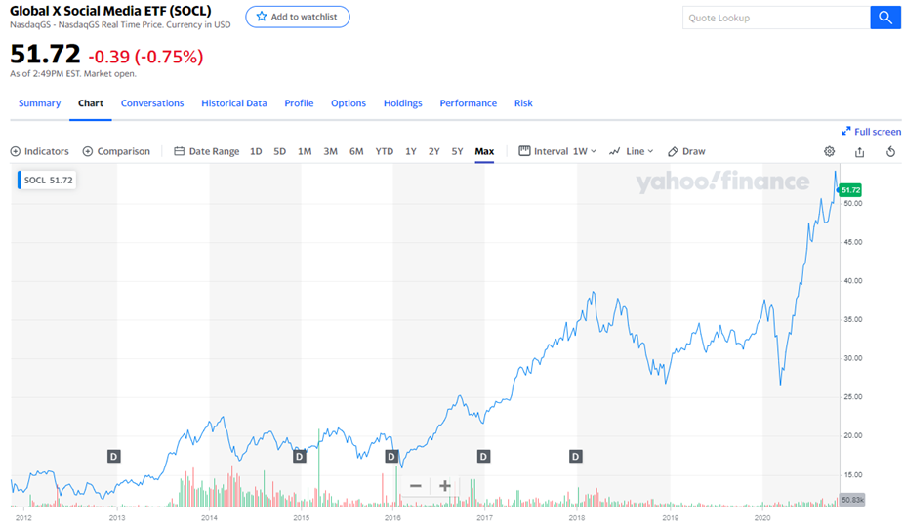
Social Media Index

Slide 5
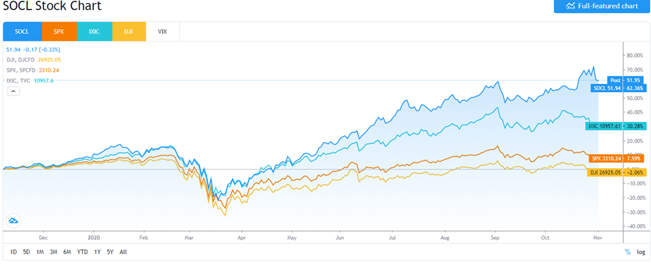

Slide 6
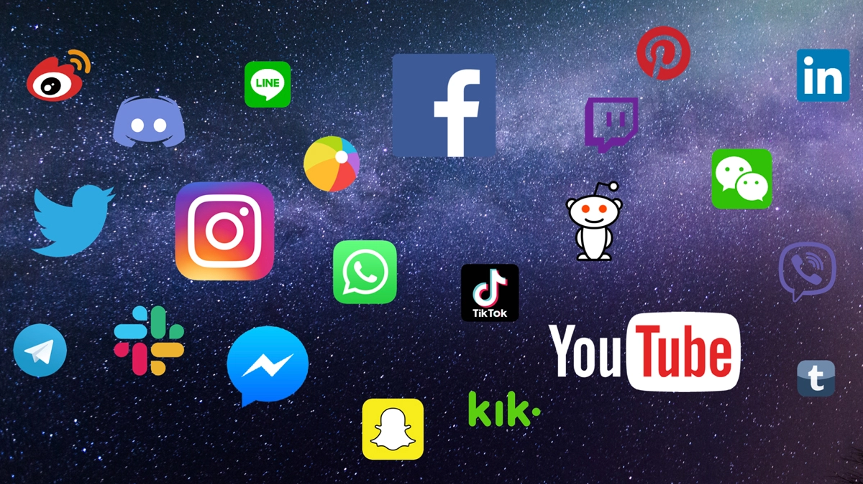
What is social media?
● collective of online communications channels
● dedicated to community-based input, interaction, content-sharing and collaboration

Slide 7
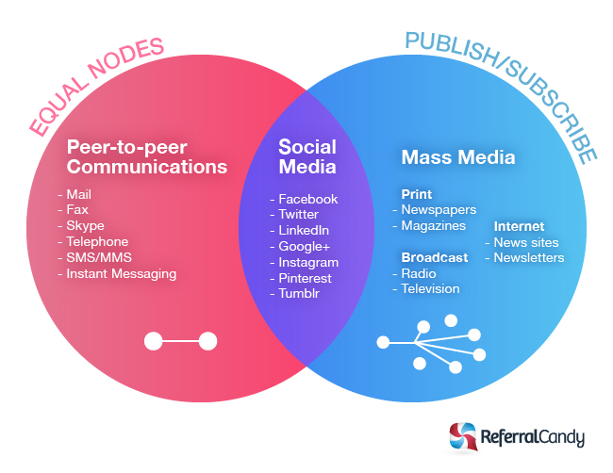
Social Media or Social Networking?
Social Networking
New Social Media
Publishing

Slide 8
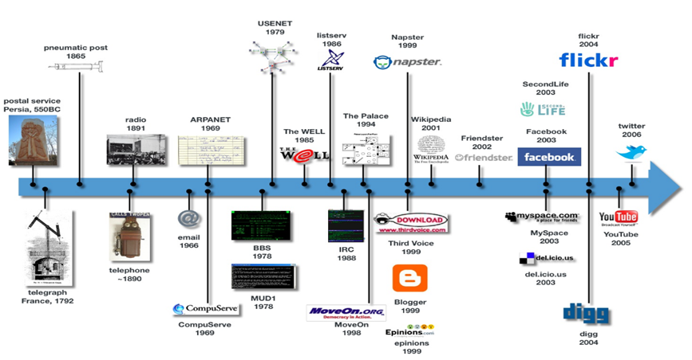
Evolution of Social Media

Slide 9
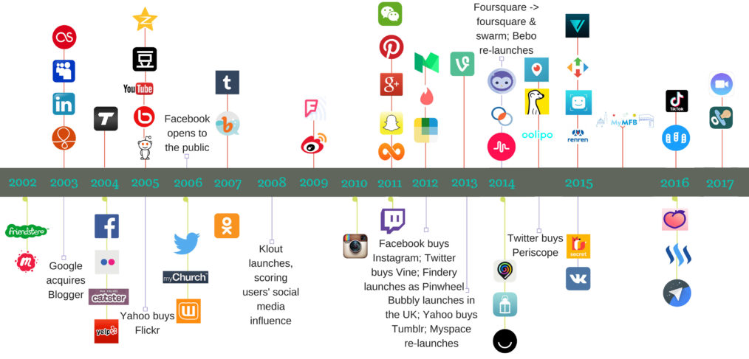

Slide 10
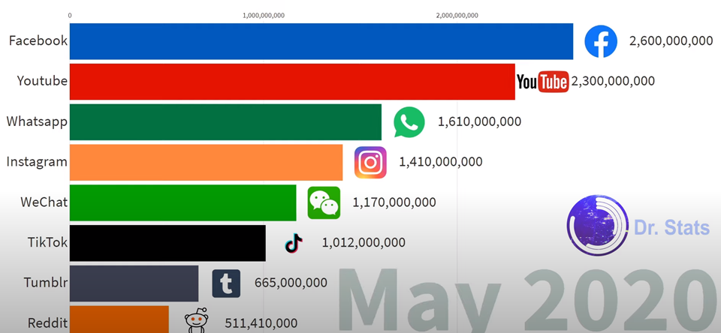
Prominent examples of Social Media

Slide 11
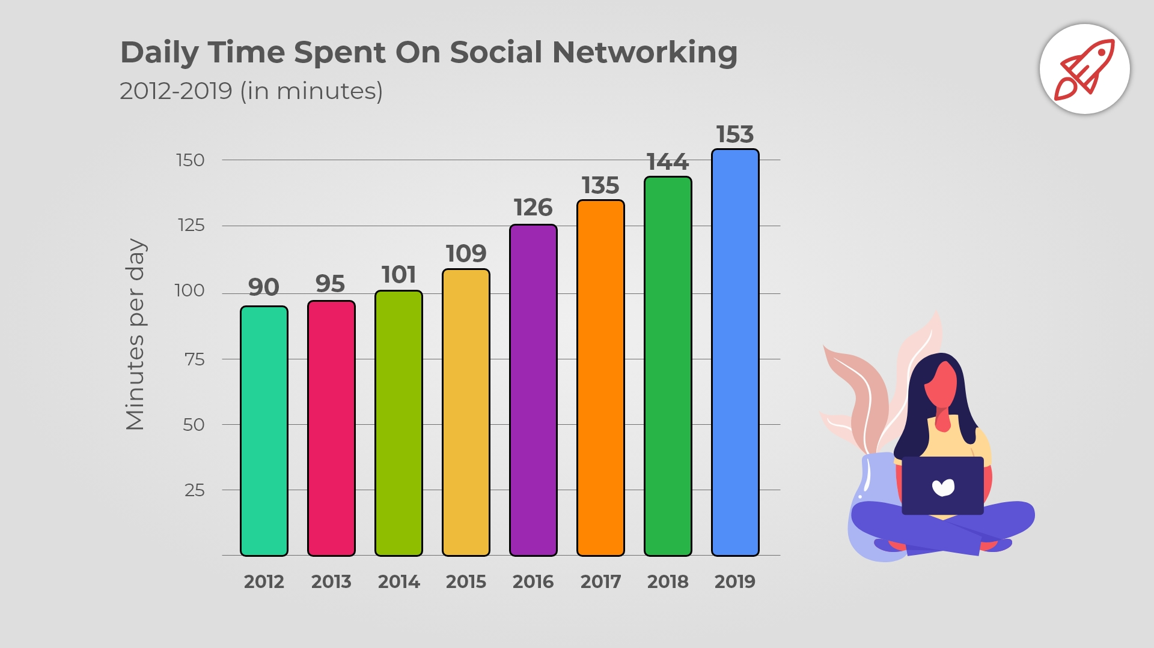
Why you should care Social Media?

Slide 12
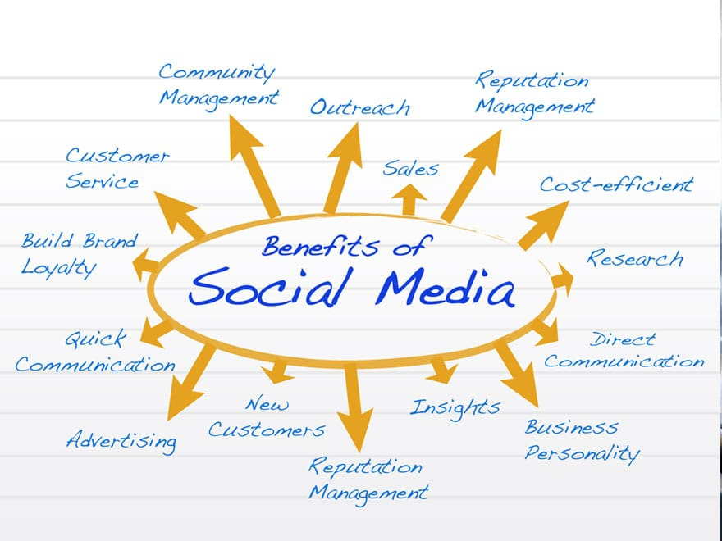
Benefits of Social Media
Promote open communication between employees and management.
Enable employees to share project ideas and work in teams effectively, which helps in sharing knowledge and experiences.
Social media also promotes better content, such as webcast and videos, than just simple text.
Helps to communicate collaboratively between current and potential customers, in receiving feedback, product definition, product development, or any forms of customer service and support
.

Slide 13
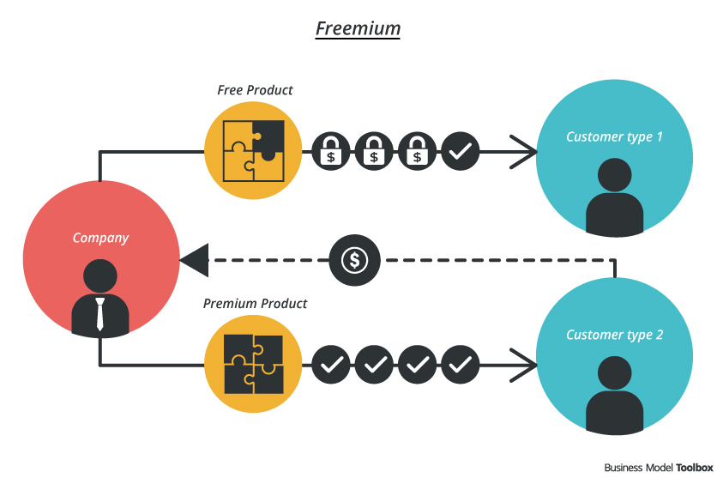
Primary Revenue Model
Freemium Model:
offering a basic service for free, while charging for a premium service with advanced features to paying members.

Slide 14
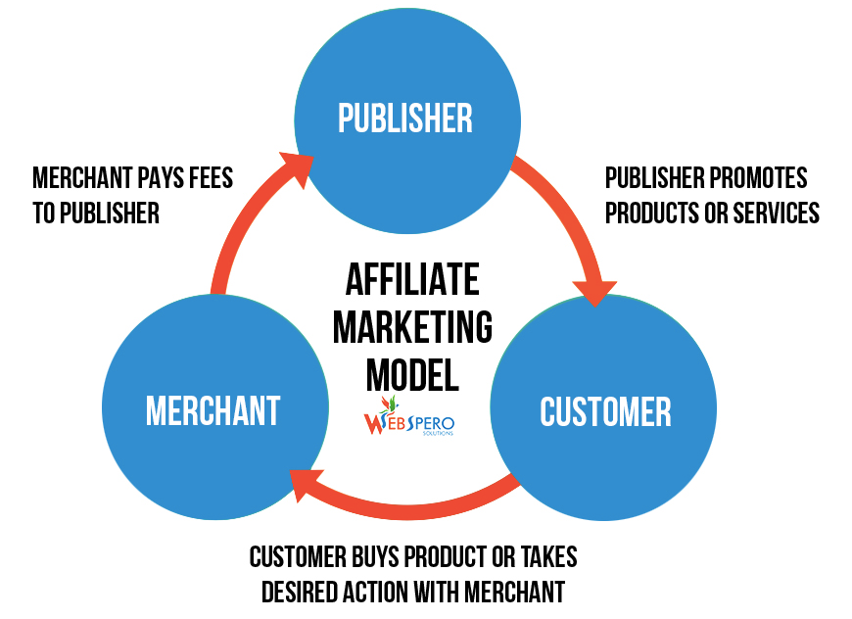
Primary Revenue Model
Affiliate Model:
business makes money by driving traffic, leads, or sales to another, affiliated company's website. Businesses that sell a product, meanwhile, rely on affiliated sites to send them the traffic or leads they need to make sales.

Slide 15
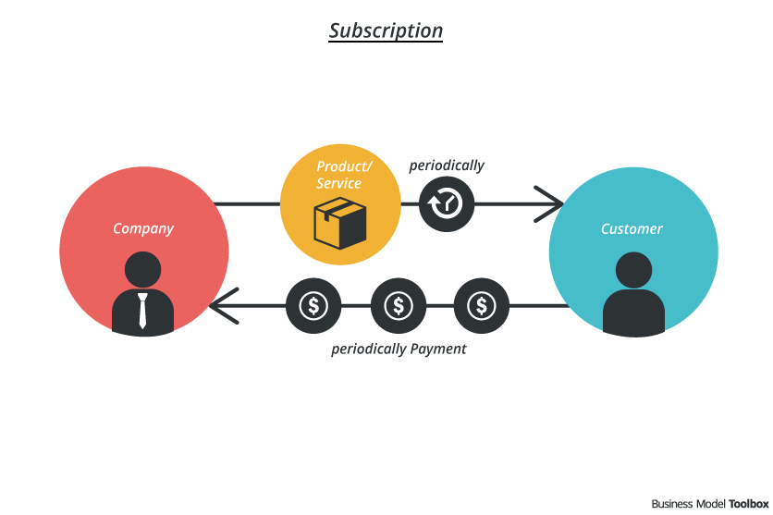
Primary Revenue Model
Subscription Model:
Sites using the subscription model require users to pay a fee (generally monthly or yearly) to access a product or service.

Slide 16
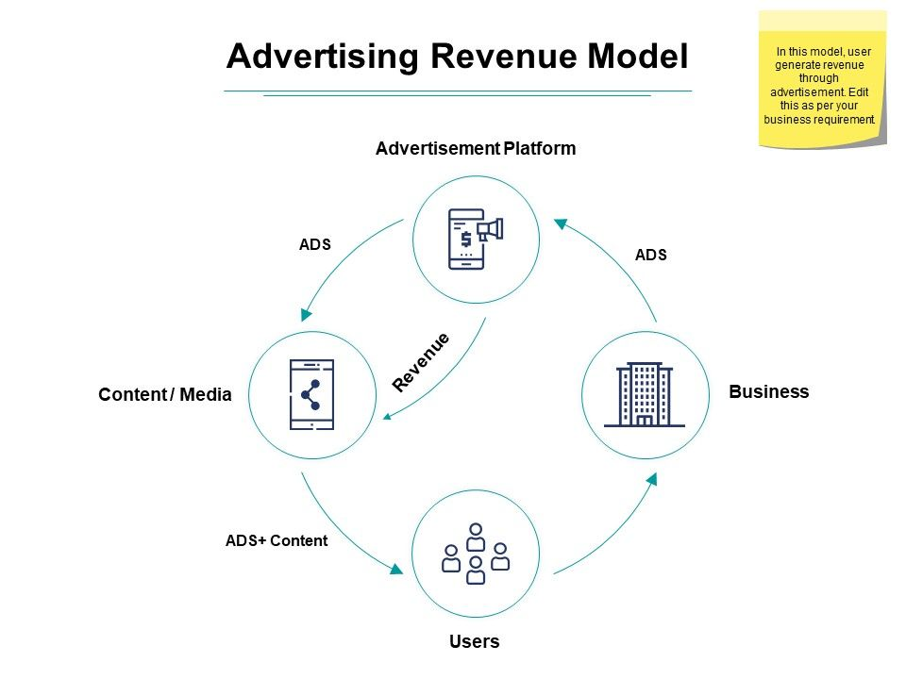
Primary Revenue Model
Advertising Model:
Sites that rely on advertising, sell advertisements against their traffic. In basic terms: the more traffic you have, the more you can charge for ads (additional demographics about your site's visitors, such as age, gender, location, or interests, also affects the amount you can charge advertisers to place ads on your site).

Slide 17
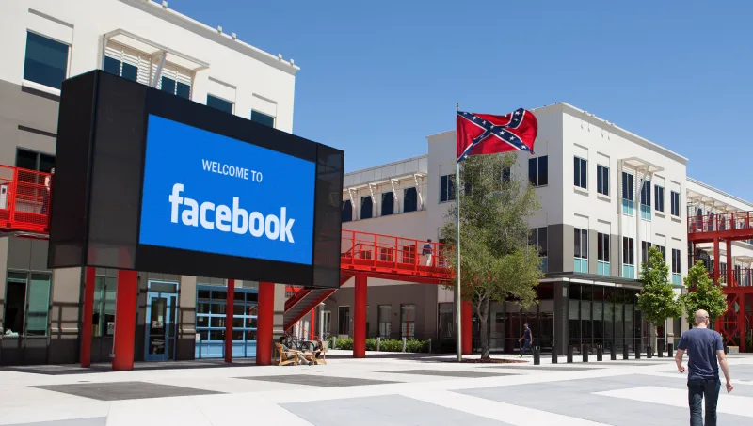
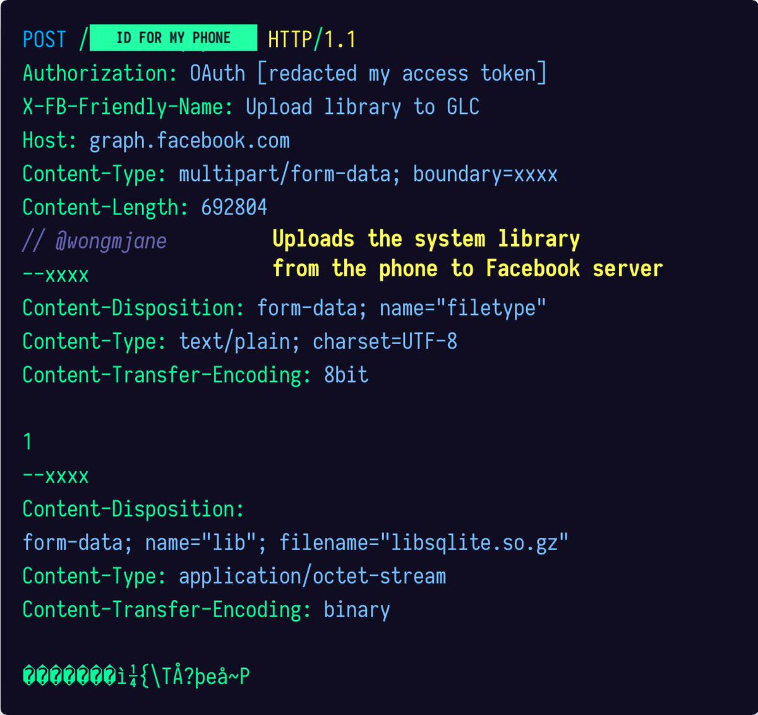
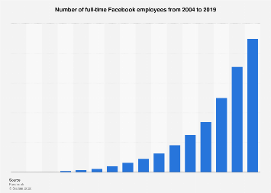
Cost Structure
Fixed Cost:
Headquarters for operation
Severs
Other hardwares
Variable Cost :
Salaries for employees
Branding cost
Marketing cost
Developing and maintaining system
Innovating new model

Slide 18
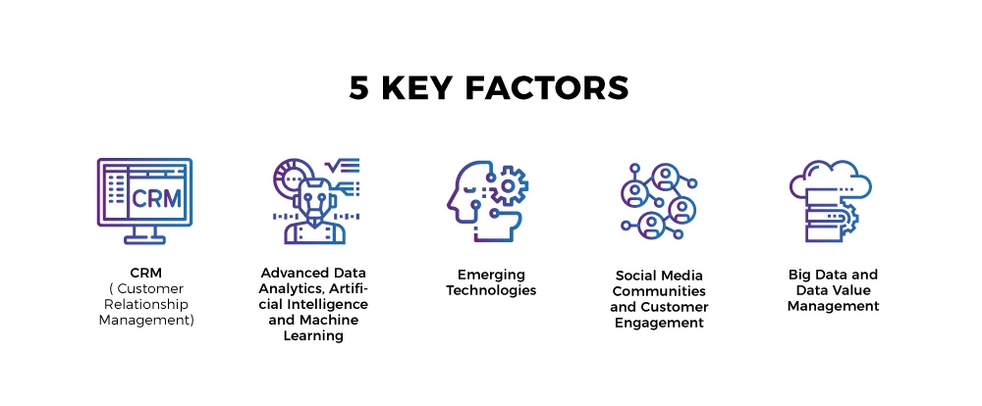
Key Success Factors
The ability to compete effectively depends on:
●Ability to innovate.
●Security, updates, and support are critical factors
●Reputation and Brand Strength relative to competitors
●Offer a user-friendly interface to consumers.
●Compatibility and ubiquity are important.

Slide 19
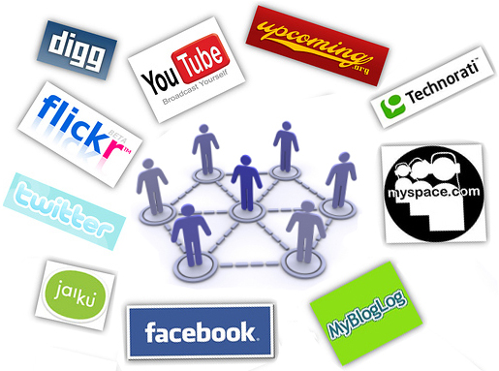
Key Success Factors
●The frequency, size, format, quality and prominence of advertisements.
●Ability to attract, retain, and motivate talented employees.
●Ability to keep costs low and maintain gross/operating margins.
●Ability to comply with complex and evolving laws and regulations.

Slide 20
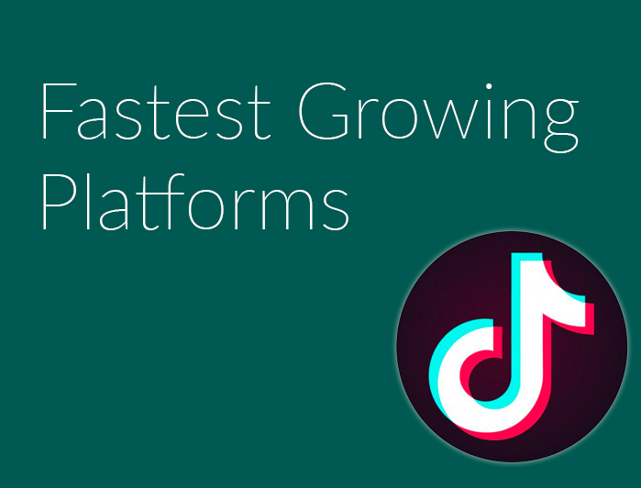
Fastest growing social media platform in 2020
Why TikTok so successful?
What is the future of social media?
What is the risk of social media?

Slide 21
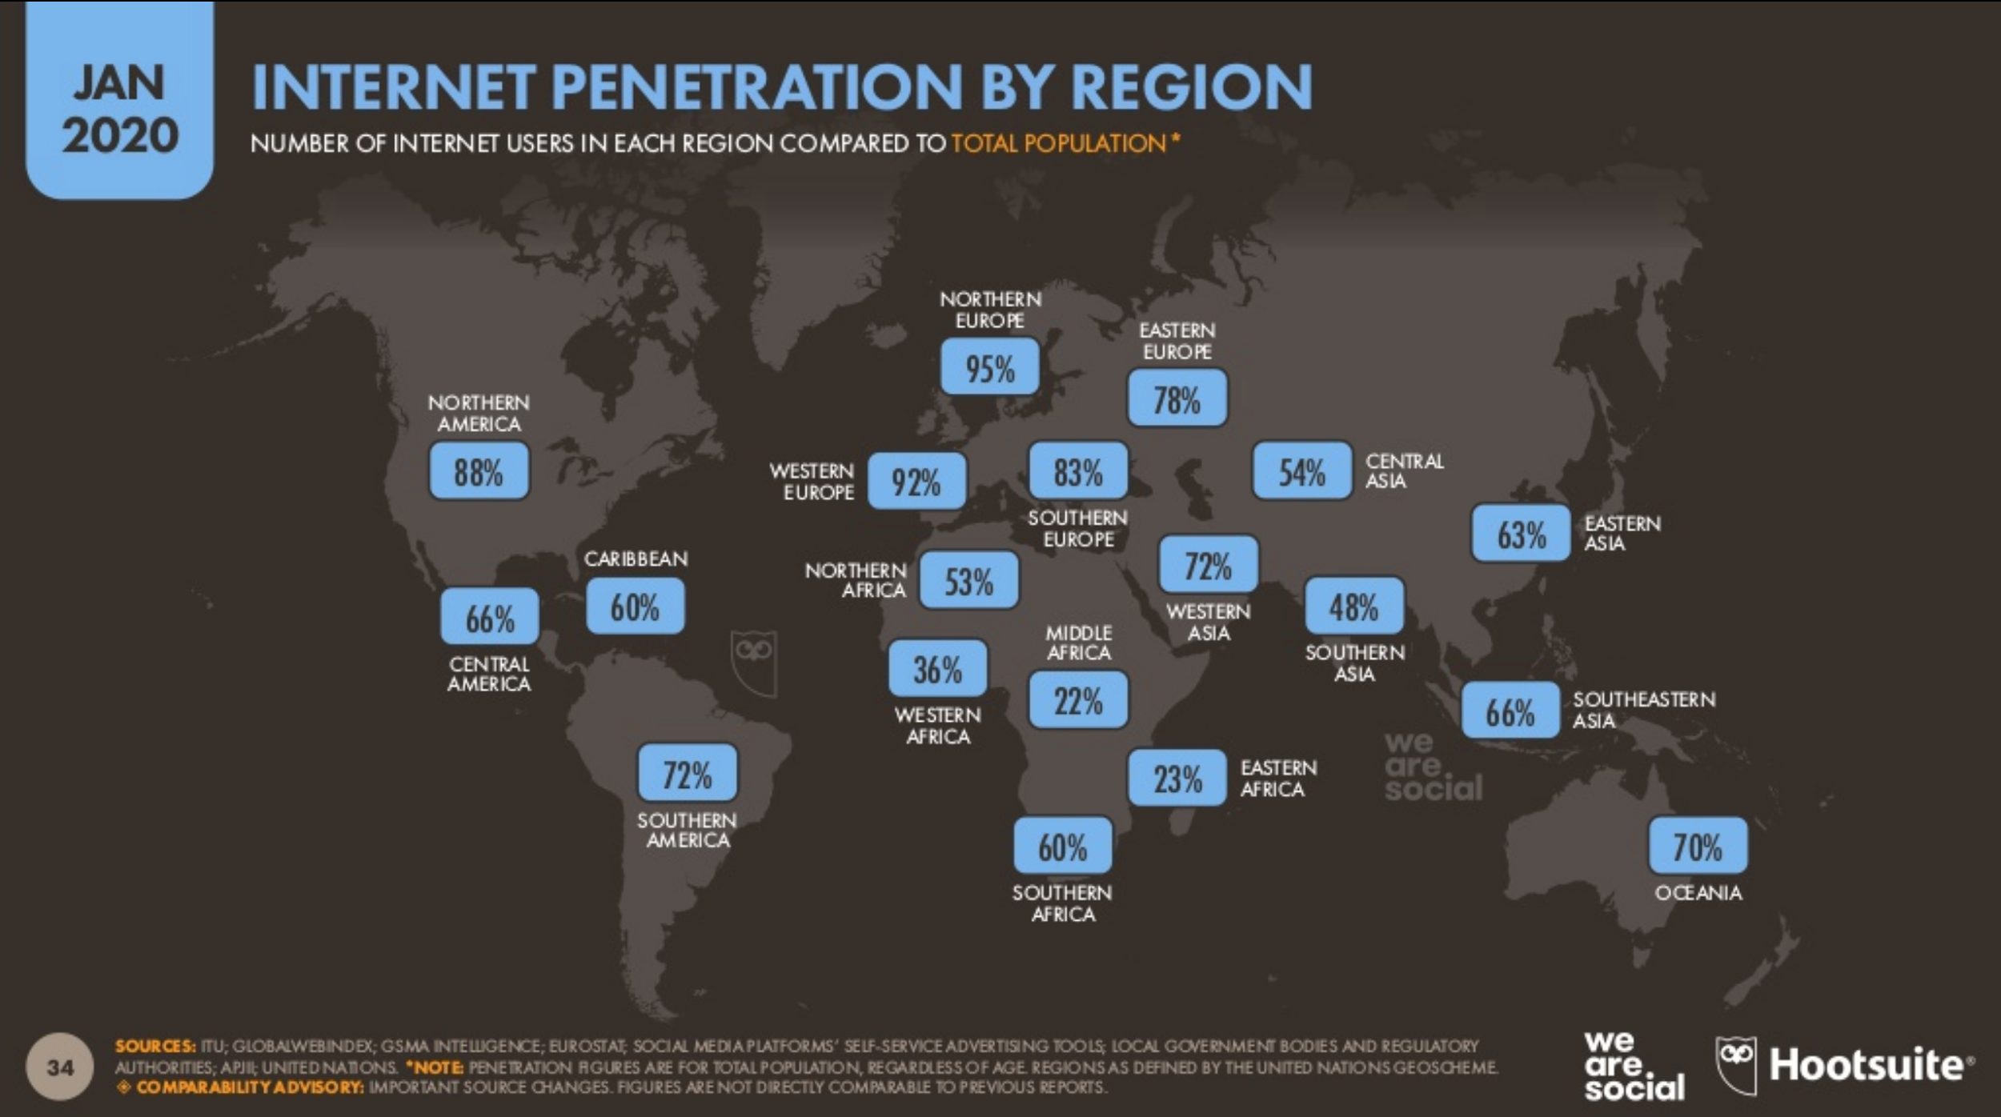
Notes:
This graph shows the percentage of internet users by region relative to its total population. Northern Europe has the highest amount at 95% and Western Europe has the second highest amount at 92%.

Slide 22
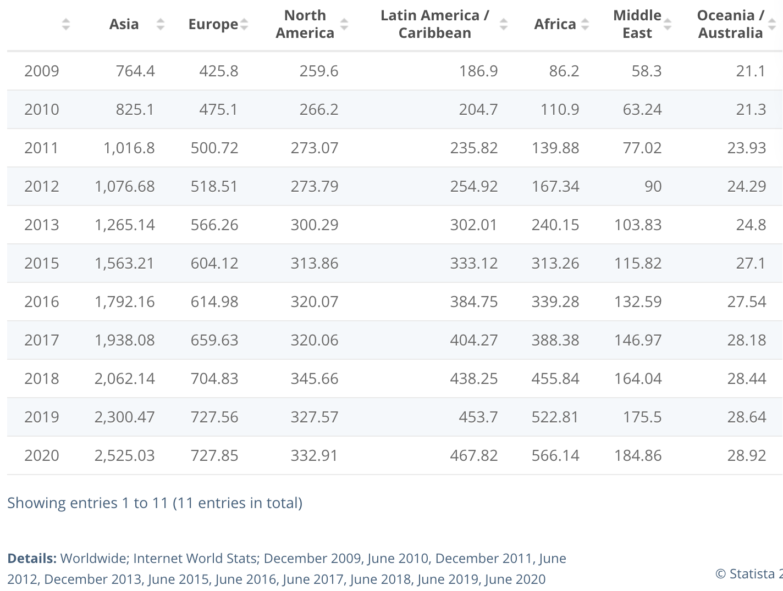
Number of Worldwide Internet Users from 2009-2020 by region (in millions)
Notes:
This table shows the growth in the numbers of worldwide internet users from 2009-2020. As of June 2020, Asia accounts for the highest amount of internet users with over 2.5 billion users.

Slide 23
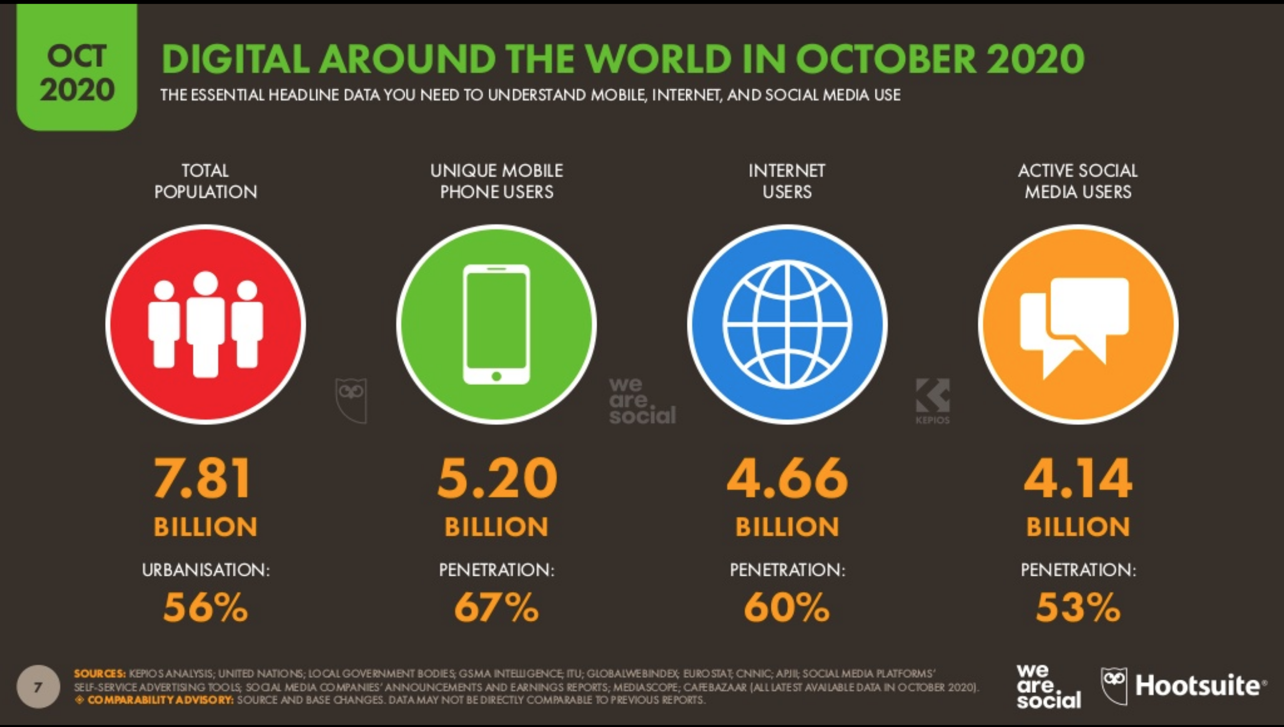
Notes:
As of October 2020, this figure shows and compares the total global population, the number of individual mobile phone users, the number of internet users, and the number of active social media users

Slide 24
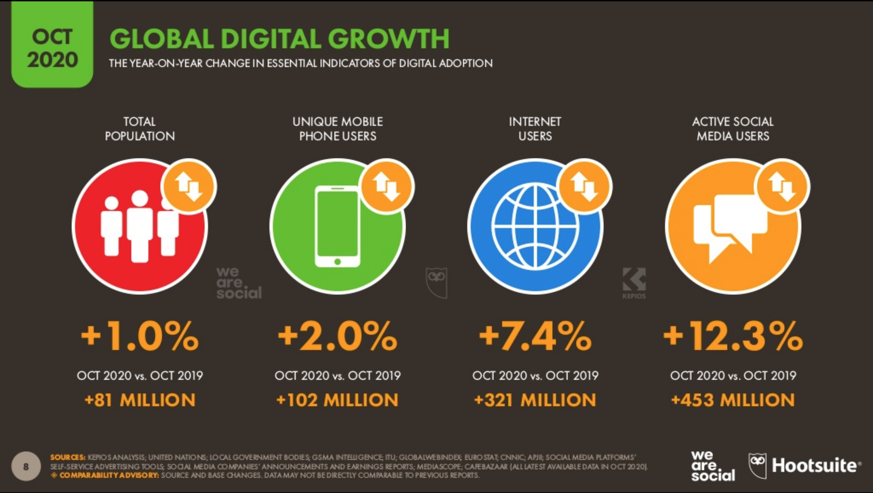
Notes:
This figure shows the one year growth in the number of the total population compared to the growth of individual mobile phone users, internet users, and active social media users. As you can see, all have increased.

Slide 25
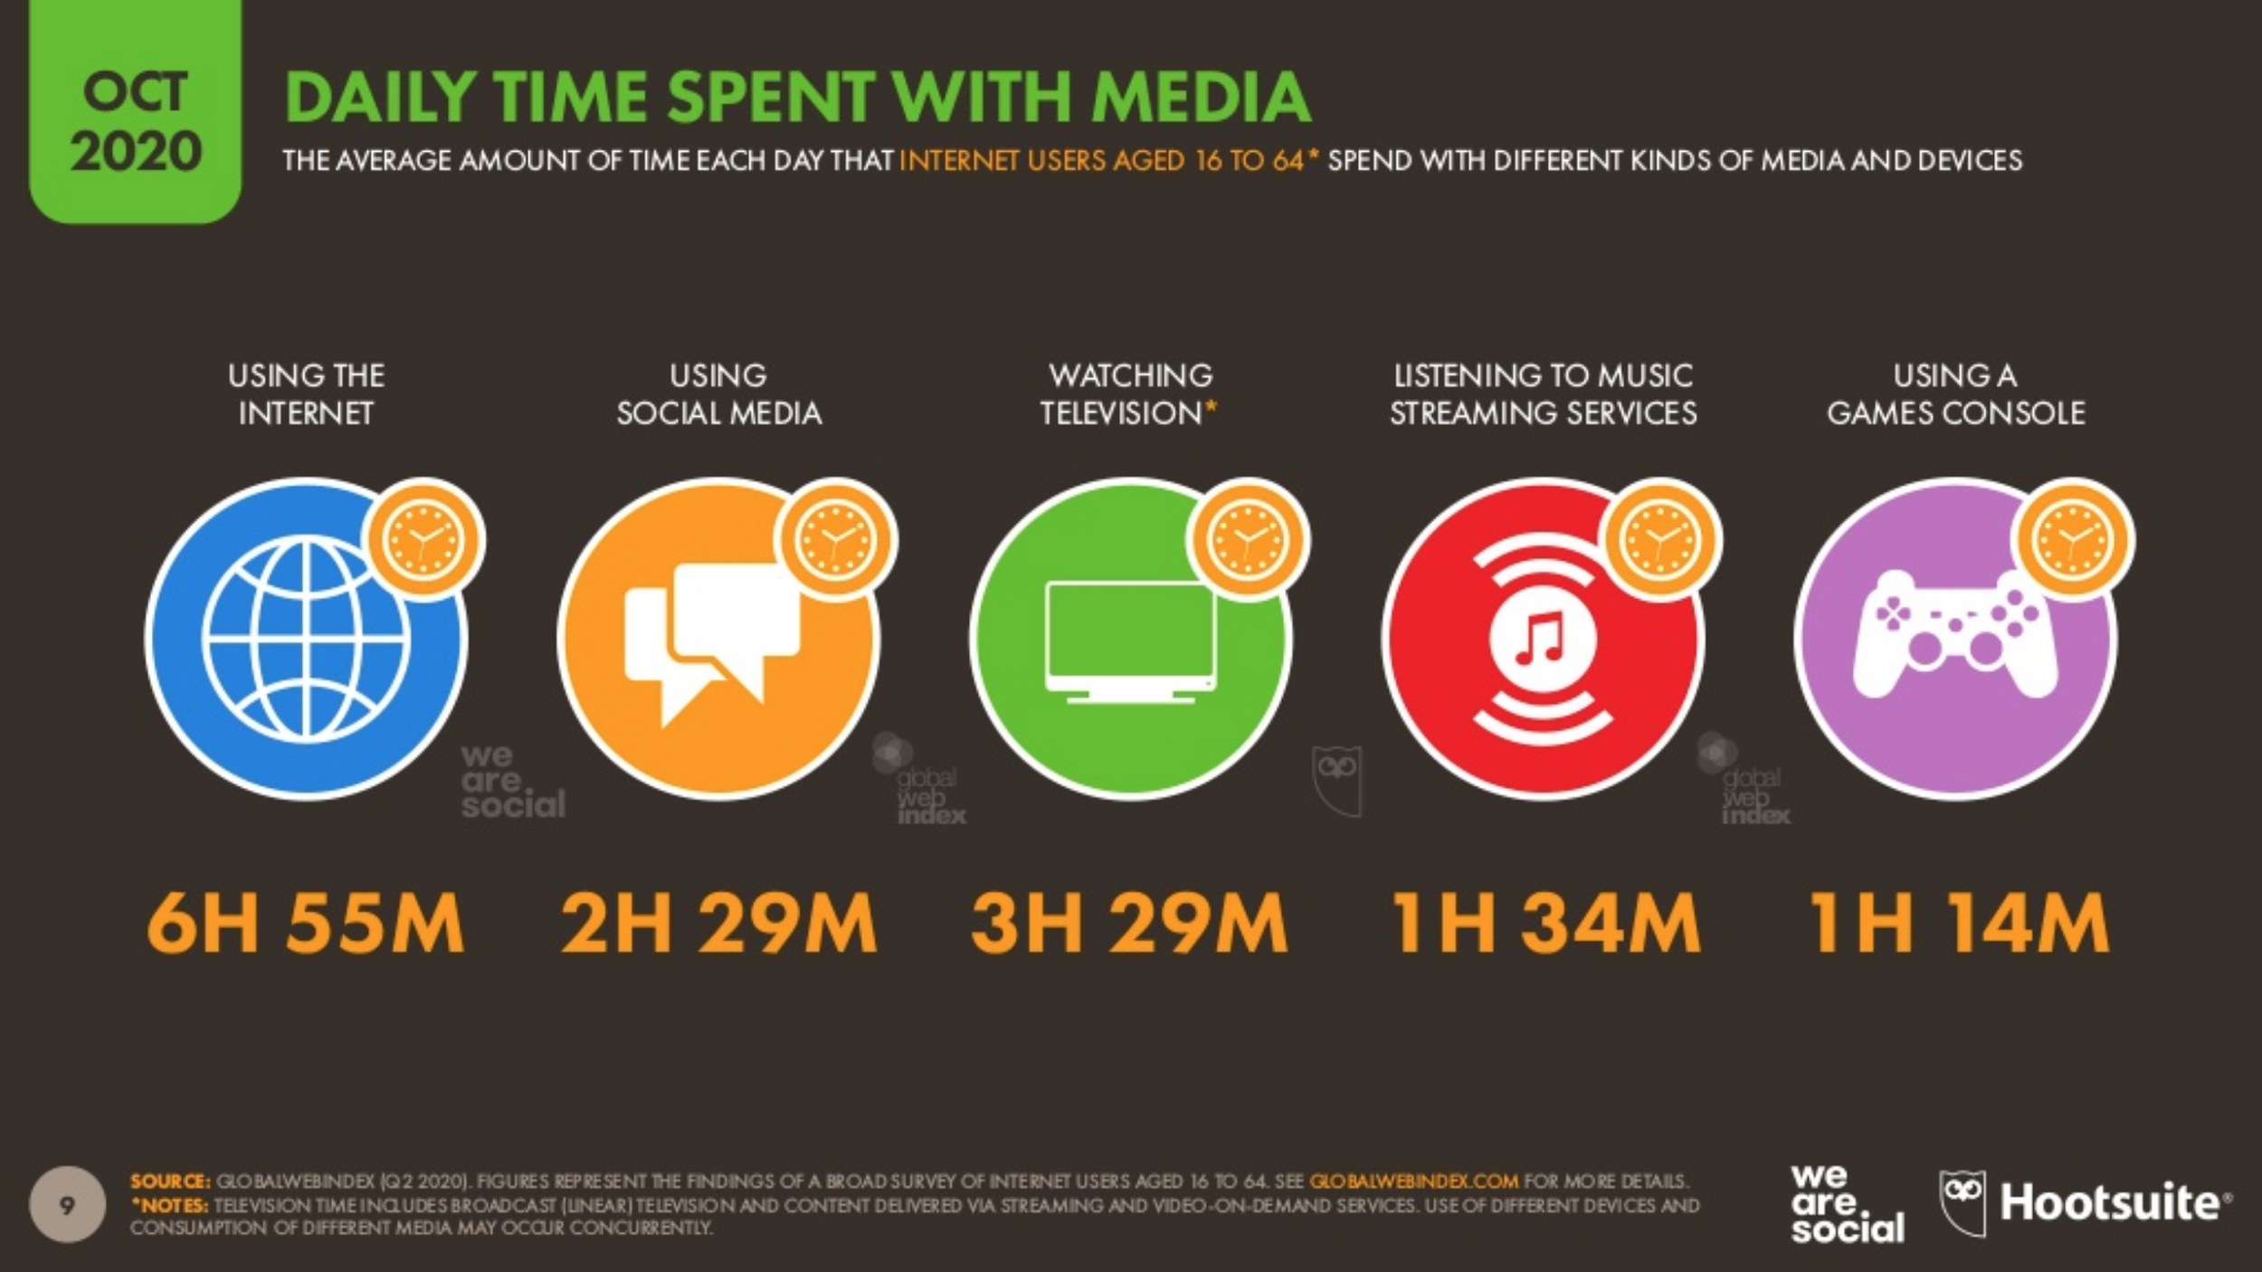
Notes:
This figure shows the average amount of time per day that internet users age 16 to 64 spend on different social media platforms.
As shown, people spent an average of 6 hours and 55 minutes using the internet and 2 hours and 29 minutes using social media.

Slide 26
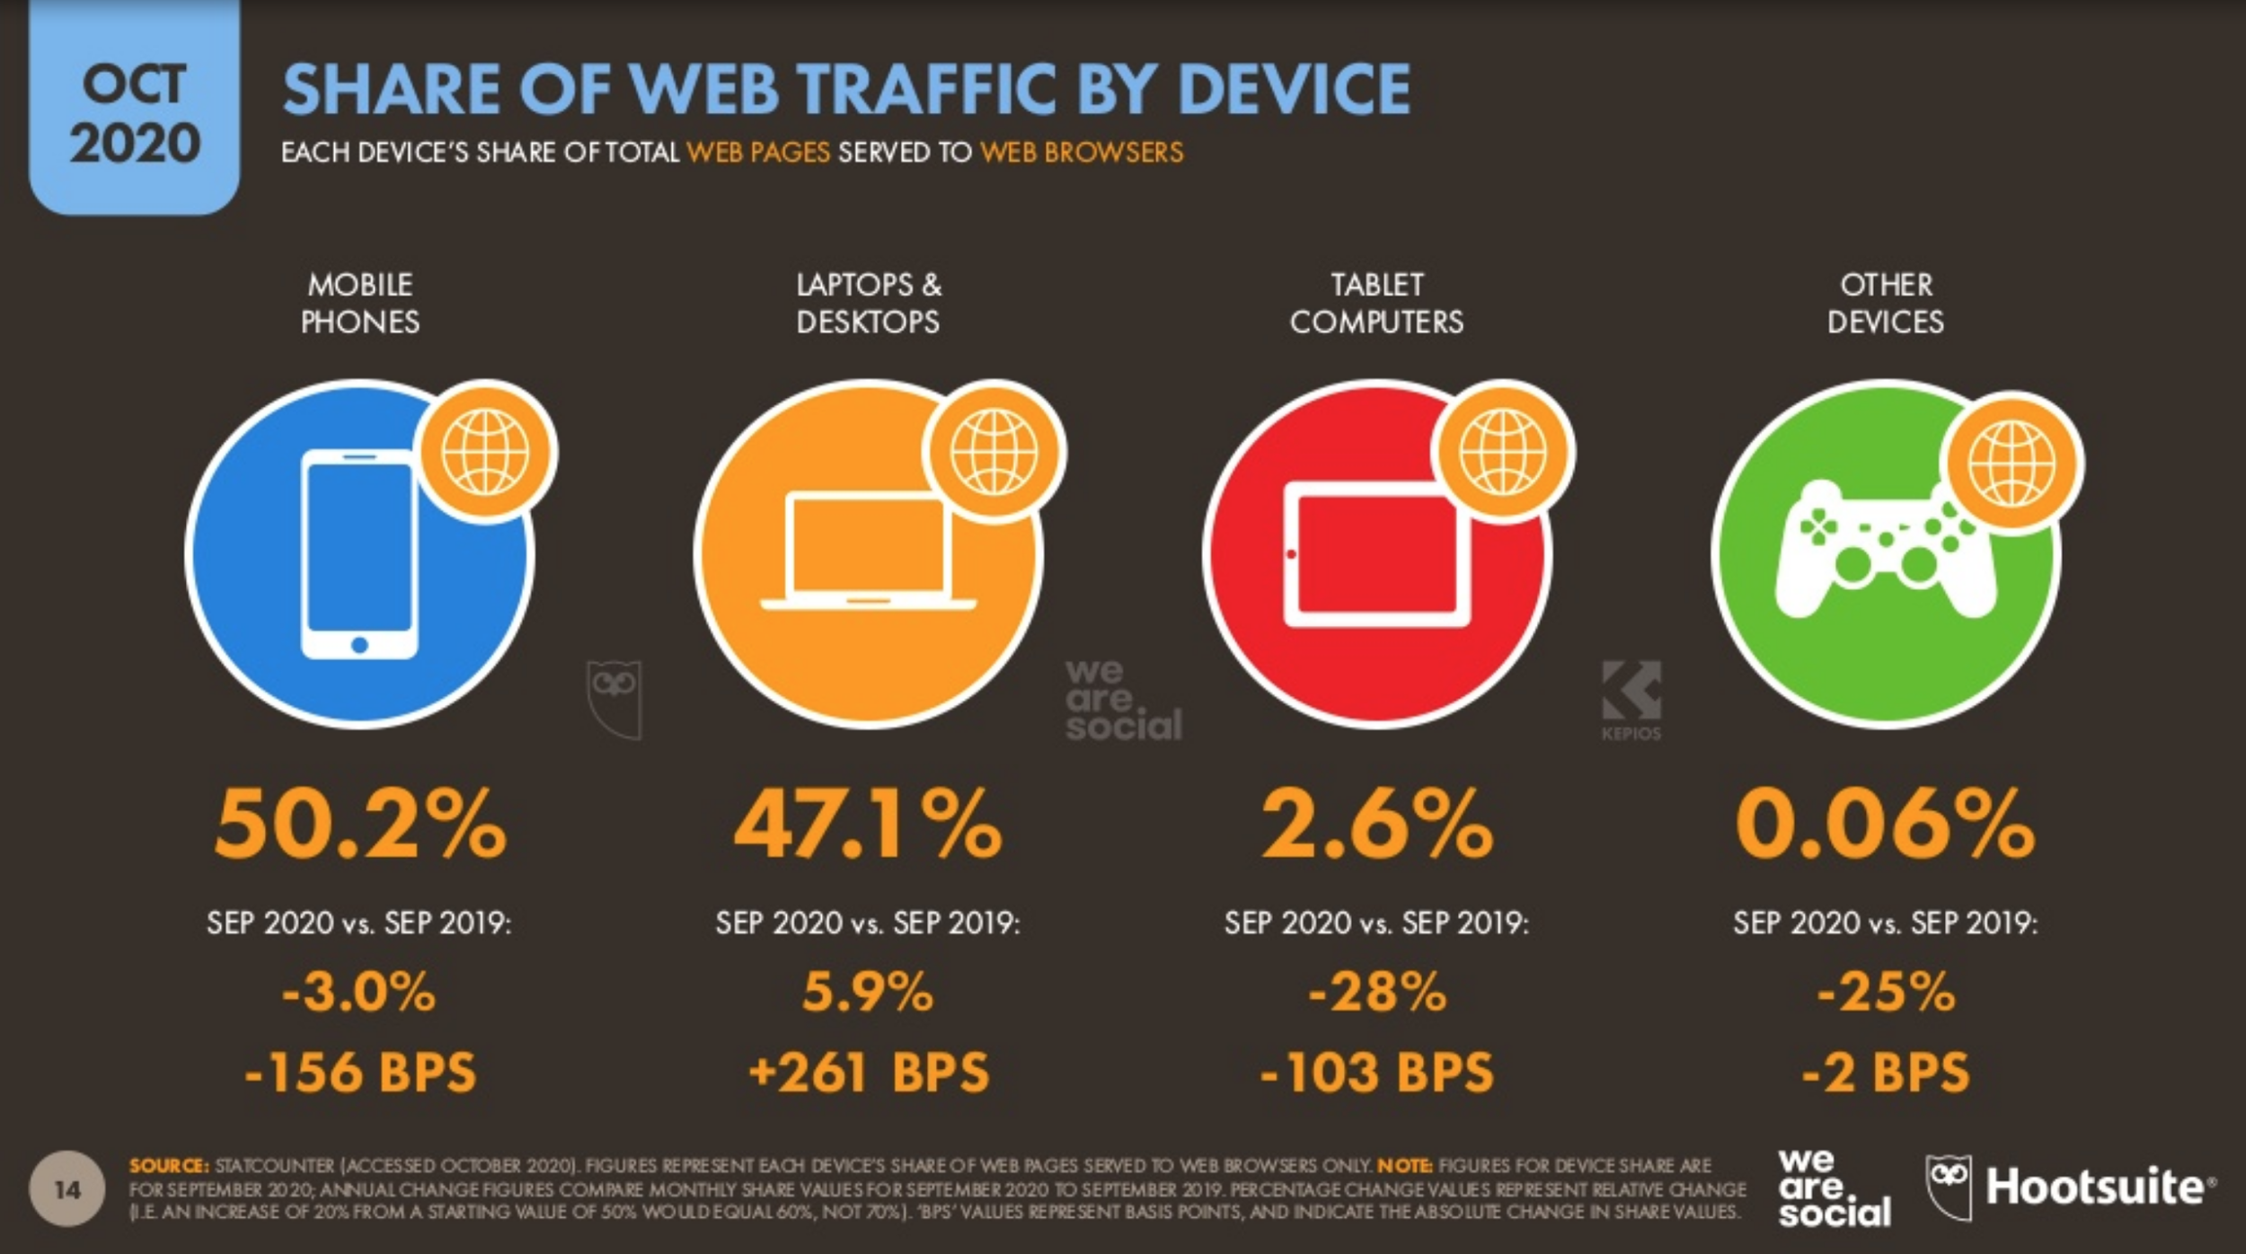
Notes:
This shows the share of web traffic by device, as in, the total number of web pages served to an individual device.
You can also see that the mobile phone users’ share of web traffic has decreased by 3% since last year, and tablet users’ share of web traffic has decreased by 28%, while users of other devices like game consoles have decreased by 25%
Only laptops and desktop users’ share of web traffic increased, specifically by 5.9%

Slide 27
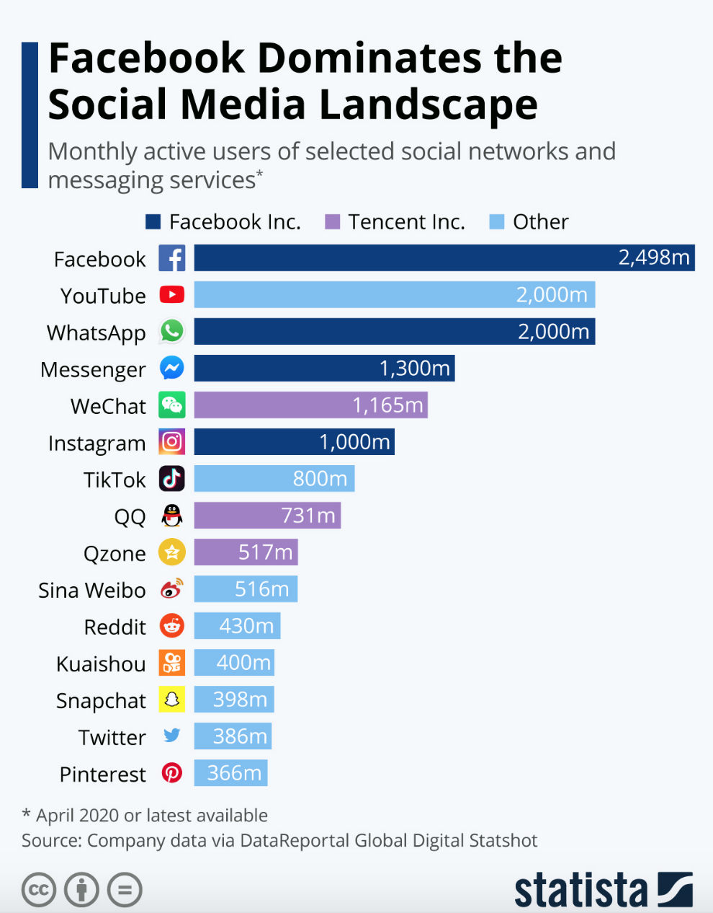
Facebook is the most used social media platform with almost 2.5 million users alone
Facebook owns three other largest social media/messaging services (Messenger, WhatsApp, and Instagram)
Tencent, a Chinese company, owns WeChat, Qzone and QQ
Notes:
Here is a more detailed look at the top social media platforms and messaging services

Slide 28
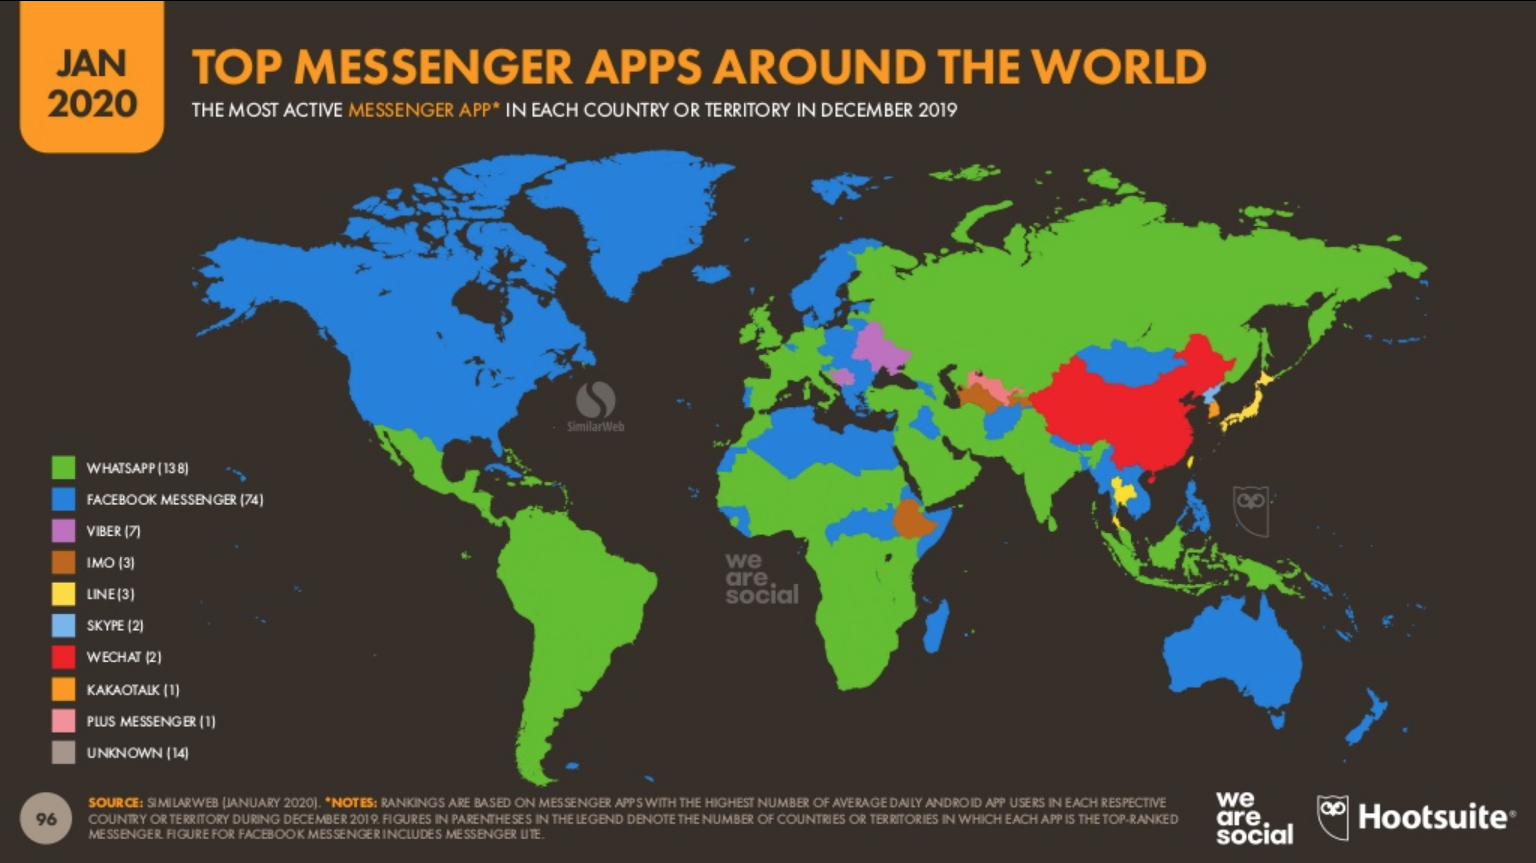
Notes:
As of Jan, 2020, this shows a further breakdown of the most active messenger apps by region. As shown in the previous slide, facebook and whatsapp are the most popular.

Slide 29
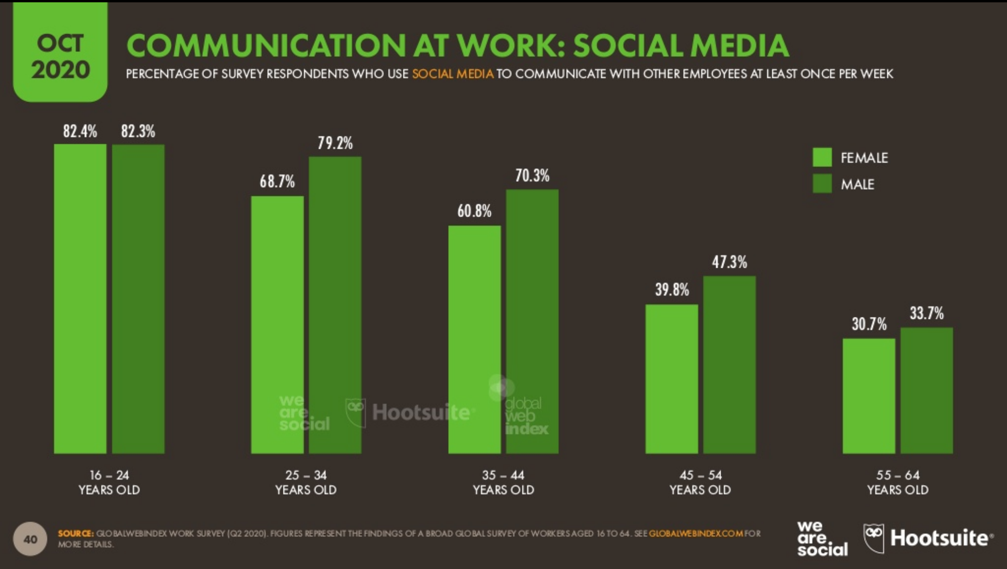
Notes:
This shows the percentage of survey respondents who are using social media platforms to communicate for work at least once a week, and it’s further split into age groups and gender.

Slide 30
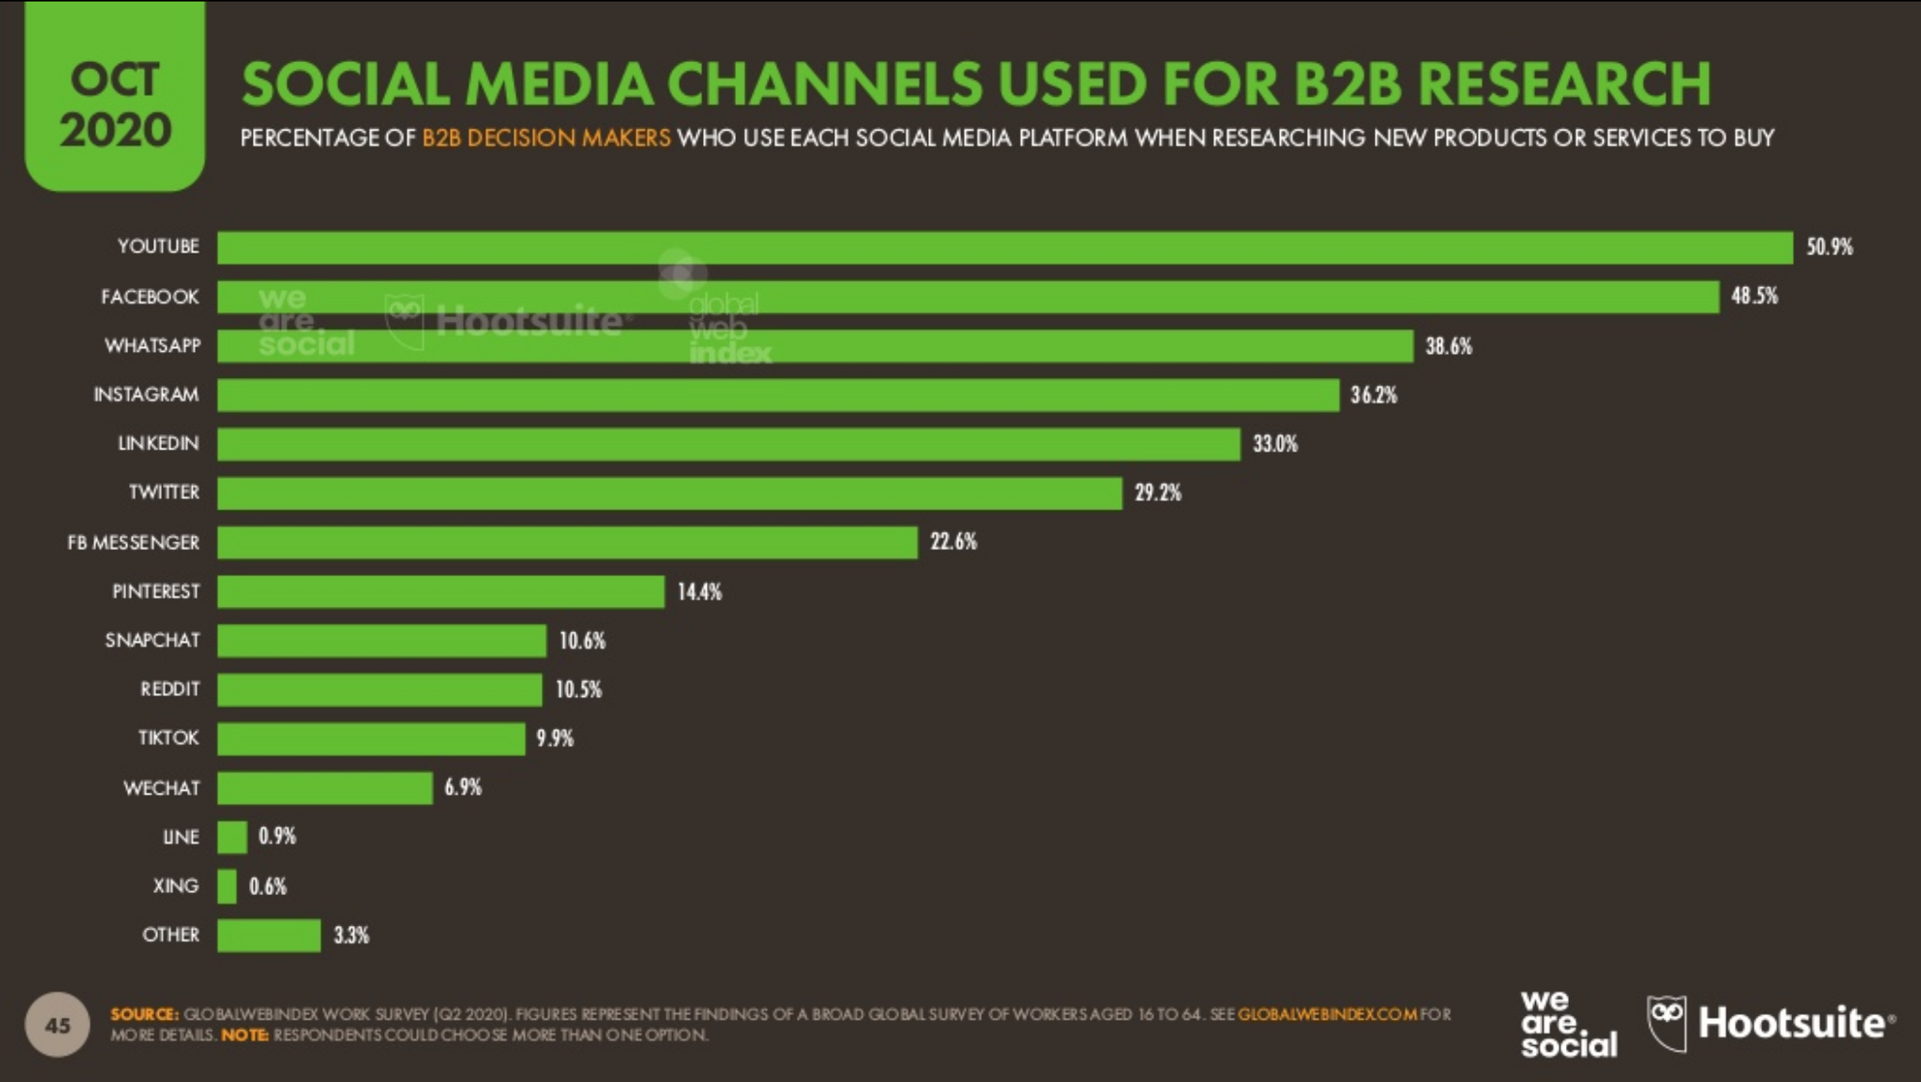
Notes:
Here we can see the percentage of B2B decision makers who use social media platforms when researching new products or services to buy. Youtube, facebook, and whatsapp are in the top 3.

Slide 31
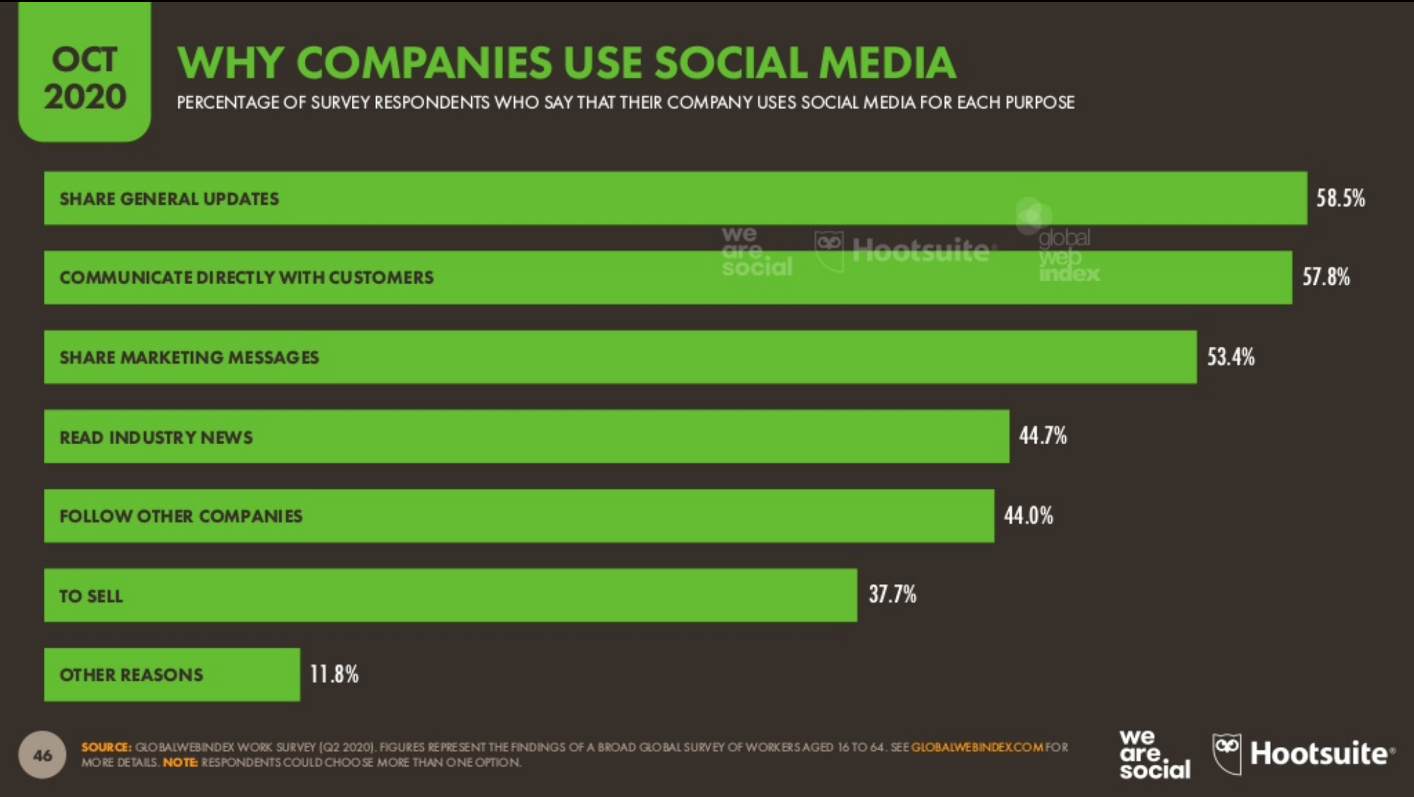
Notes:
Here we can see the main purposes of using social media according to survey respondents. The top 3 reasons are to share general updates, to directly communicate with customers, and to share marketing messages.

Slide 32
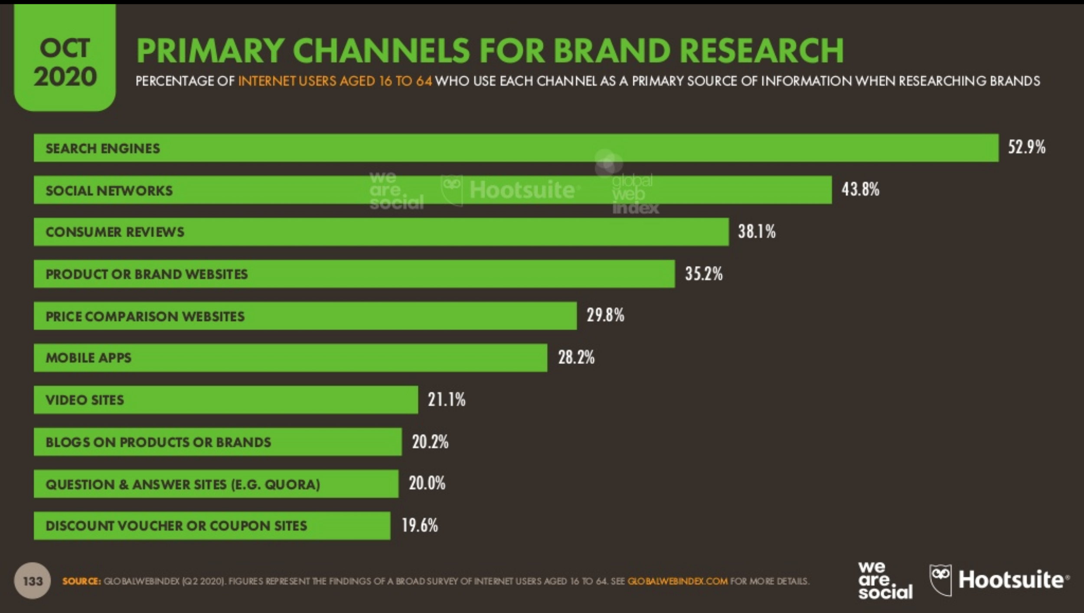
Notes:
This shows the primary channels for brand research through a survey of internet users aged 16 to 64. We can see that search engines are the most popular option and social networks come in second

Slide 33
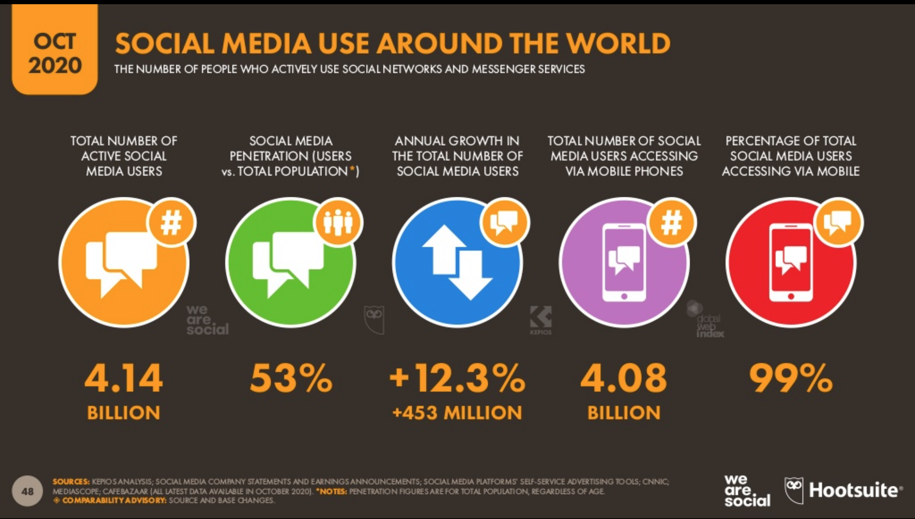
Notes:
This figure shows the number of people who actively use social networks and messenger services.
It shows that there are 4.14 billion active social media users which represents 53% of the total global population. This indicates a growth of 12.3% since October 2019. Of those active users, 99% access social media with their phones.

Slide 34
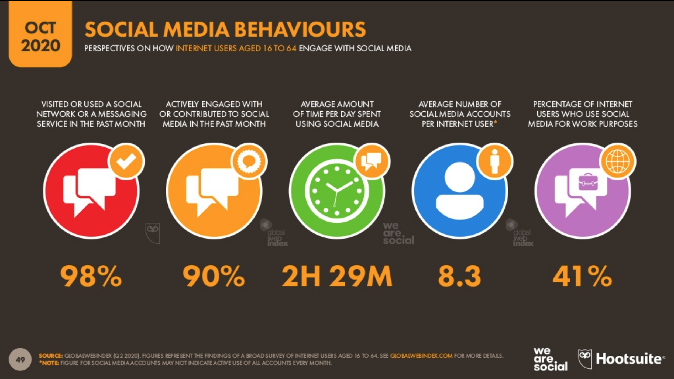
Notes:
This shows how internet users aged 16 to 64 engage with social media. 98% of users have visited a social network or messaging service in the past month with 90% actively engaging. We also see that an internet user has an average number of 8.3 social media accounts.

Slide 35
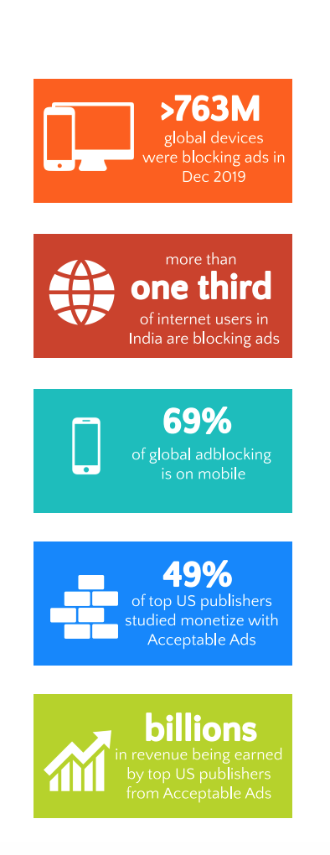
Ad Block
According to the 2020 PageFair Adblock Report, as of the end of December 2019:
Approx. 527 million people were using mobile browsers that block ads by default which is a 64% increase from December 2016
Approx. 236 million people were blocking ads on desktops which is a 16% decline from December 2016 because users spend more time on their mobile devices
Total of over 763 million global devices blocking ads
69% of global ad blocking is on mobile phones
Billions in revenue is generated by top US publishers from Acceptable Ads
With Acceptable Ads, many mainstream ad blockers are using “ad filters” which allow publishers to show light, more respectful ads to users who opt-in
Notes:
https://s3.amazonaws.com/media.mediapost.com/uploads/2020-PageFair_Blockthrough-Adblock-Report.pdf

Slide 36
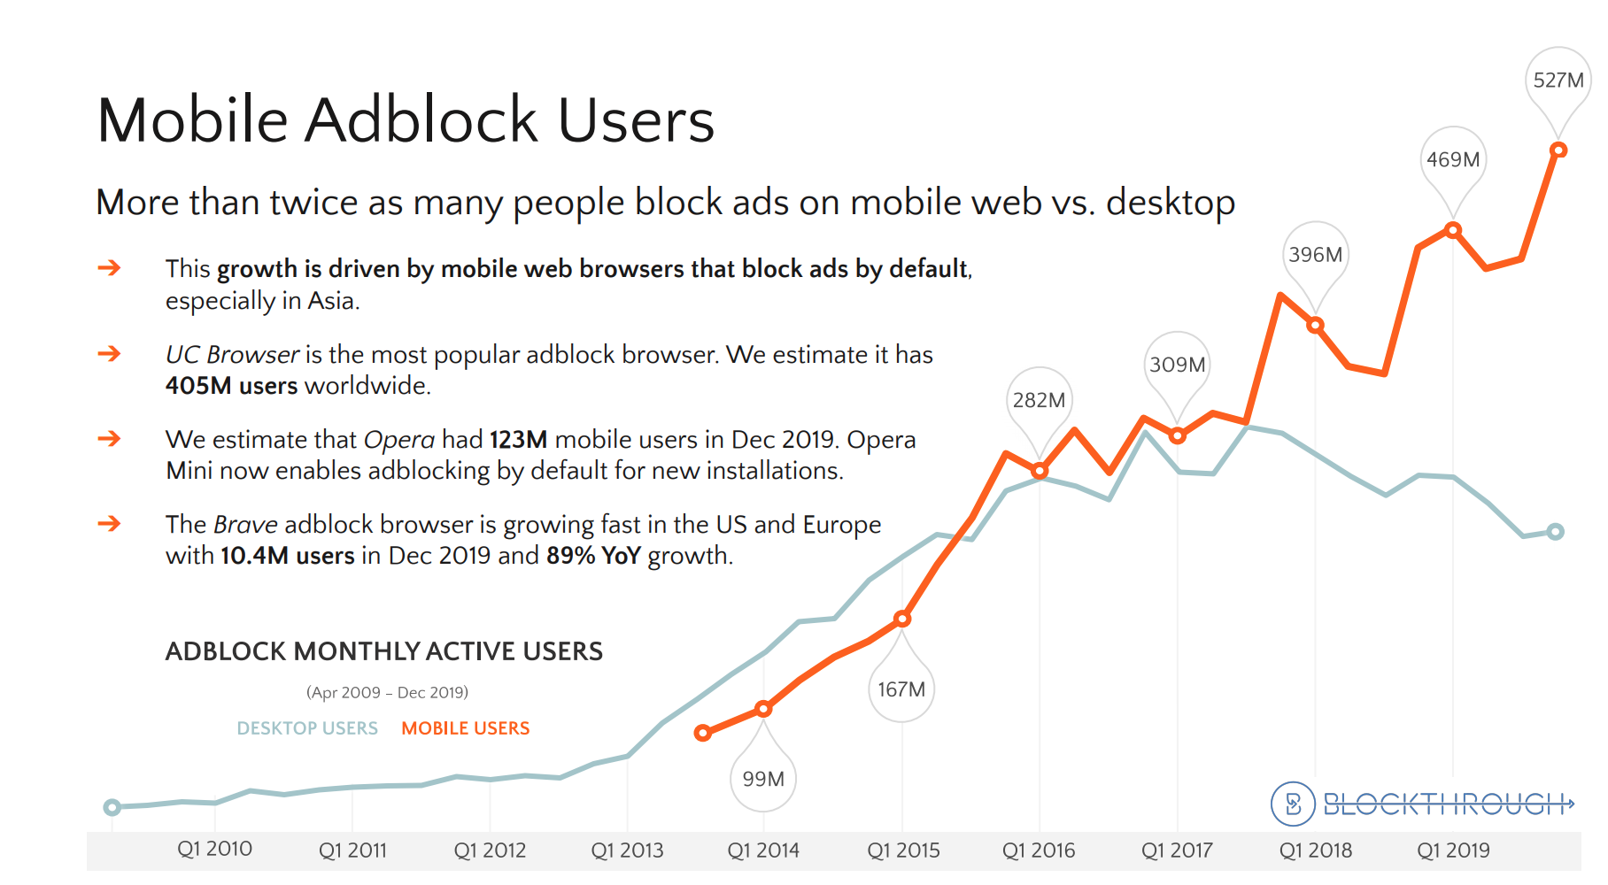
Mobile Ad Block Users
Over twice as many people are using adblock on mobile devices than desktop users
Growth is due to mobile web browsers that block ads by default particularly in Asia
Notes:
https://s3.amazonaws.com/media.mediapost.com/uploads/2020-PageFair_Blockthrough-Adblock-Report.pdf
This shows the increase in monthly active adblock users from 2010-2019

Slide 37
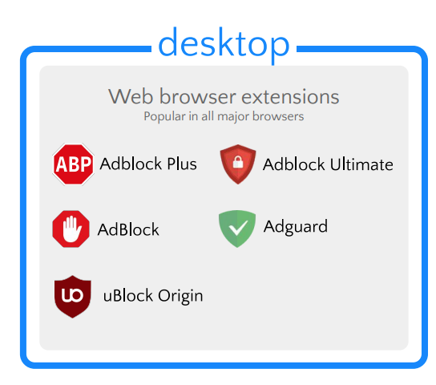
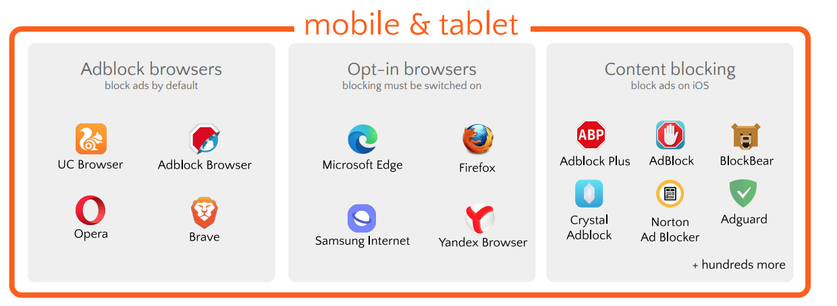
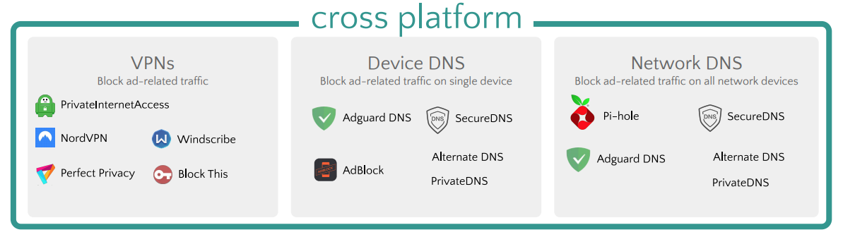
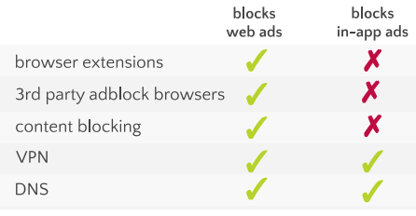
Notes:
https://s3.amazonaws.com/media.mediapost.com/uploads/2020-PageFair_Blockthrough-Adblock-Report.pdf
You can see the different adblocks on desktop and mobile and tablet
-ad blocking is expanding since web browser extensions like adblock on chrome are becoming more popular
-VPNs and DNS (Domain Name System) are emerging because browser extensions are only able to block web ads
-VPNs and DNS are able to block in-app ads
-The ad block browser, UC Browser, is highly popular in Asia and is a major factor in the growth of ad block on mobile web

Slide 38
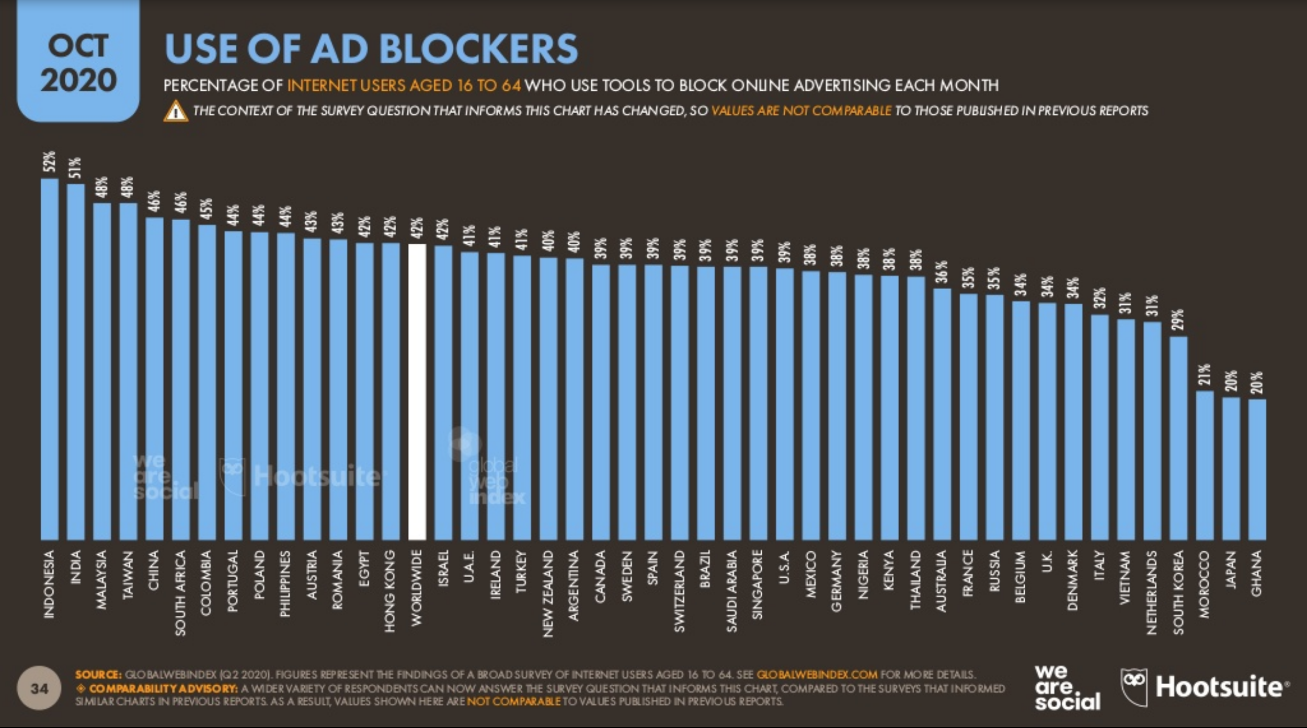
Notes:
This graph shows the percentage of internet users who also use ad blockers each month, by region. The worldwide average is 42%.

Slide 39
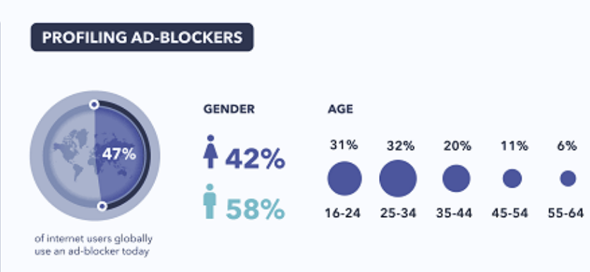
Ad Blocker User Demographics
Notes:
https://www.impactplus.com/blog/ad-blocker-trends-for-2019
In 2019, 42% of adblock users were female and 58% of adblock users were male.
The largest percentage of adblock users were in the 25-34 age range while the second largest is the 16-24 age category

Slide 40
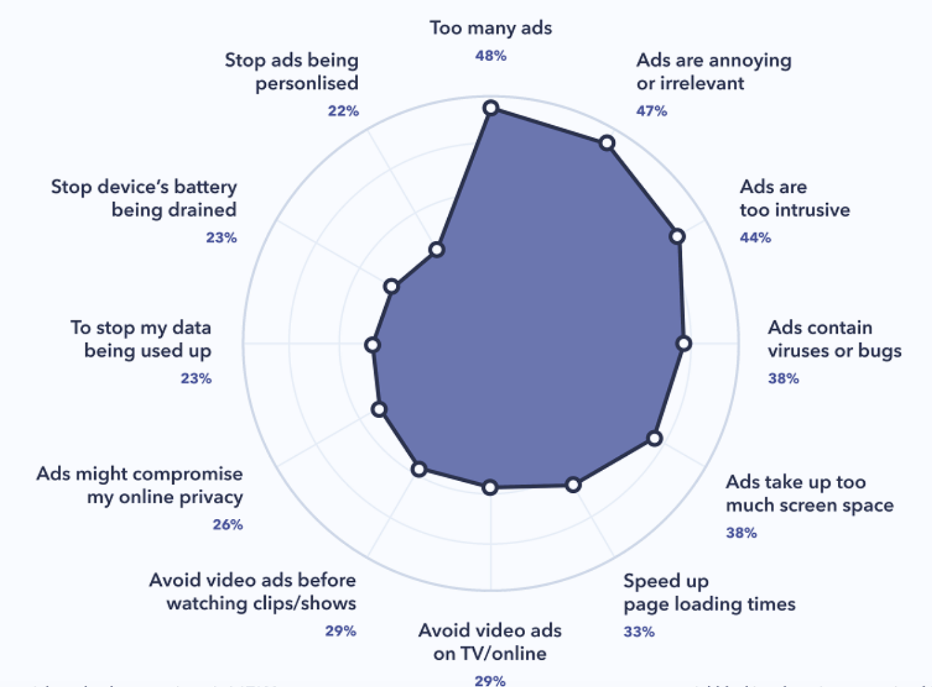
Top Motivations for Ad Blocking
Notes:
https://www.impactplus.com/blog/ad-blocker-trends-for-2019
This shows the top motivations for ad blocking from a 2019 survey
- a few top motivators for using adblock include too many ads shown, the ads being annoying or irrelevant, and the ads being too intrusive

Slide 42
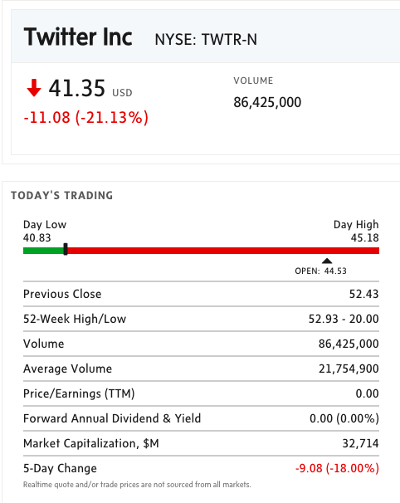
Stock Data and
Ratios
* Data as of Market Close October 30th 2020

Slide 43
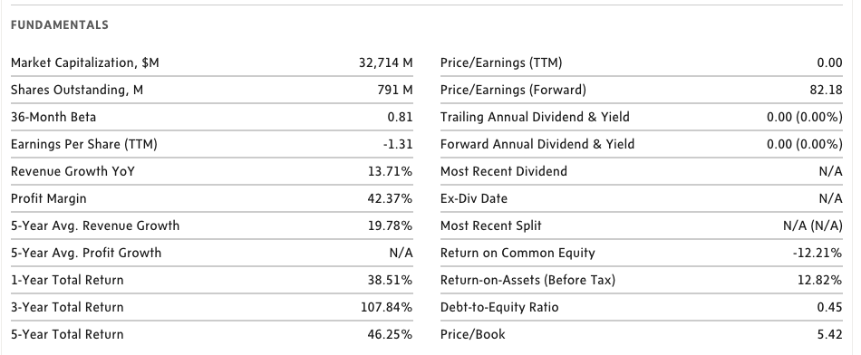
Stock Data and Ratios

Slide 44
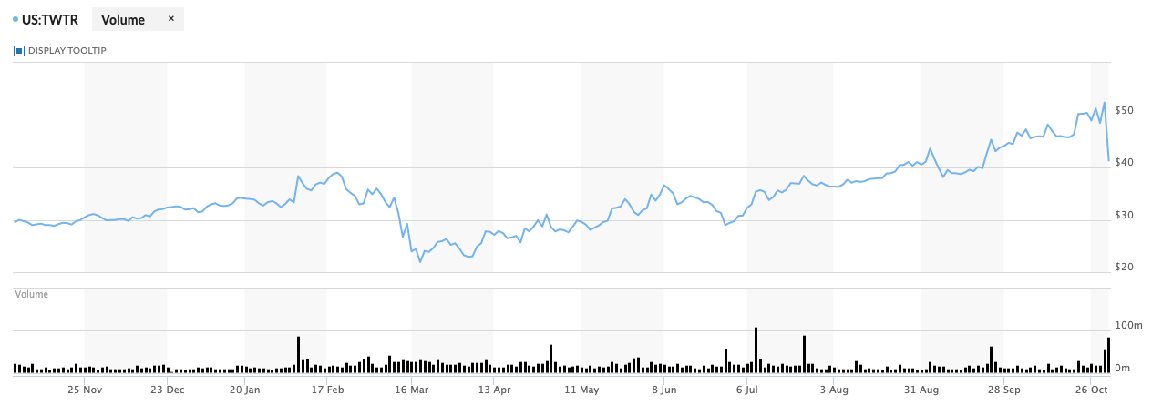
Twitter 1-year Performance

Slide 45
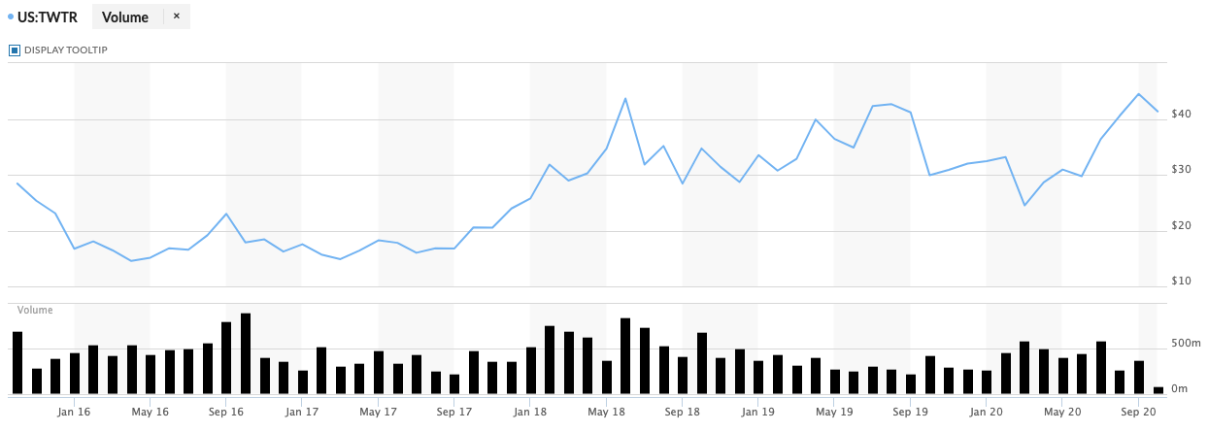
Twitter 5-year Performance

Slide 46
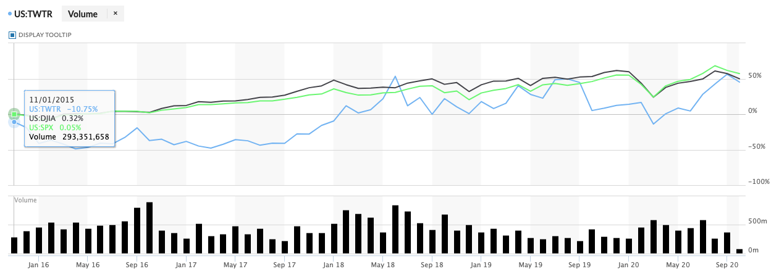
Twitter Comparison to Dow Jones and S&P 500

Slide 47
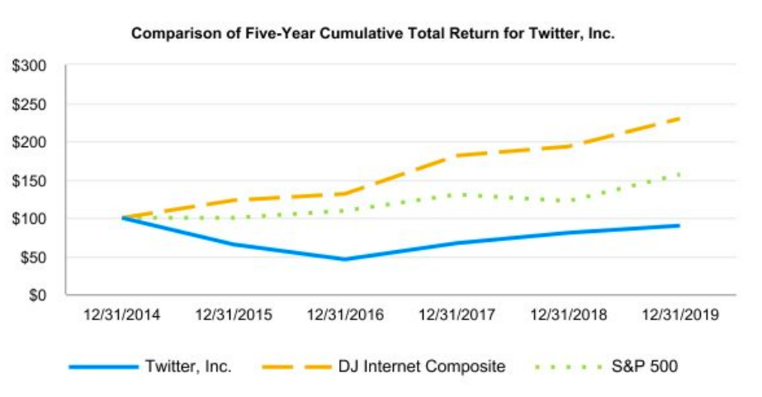

Slide 48

Company Overview
Founded in 2006
An American social media company that allows users to interact with one another through the use of posts and messages called “Tweets”
Have over 330 million active users
35+ offices worldwide in over 19 countries
4,900+ employees around the world
Mission: “to give everyone the power to create and share ideas and information instantly without barriers”

Slide 49
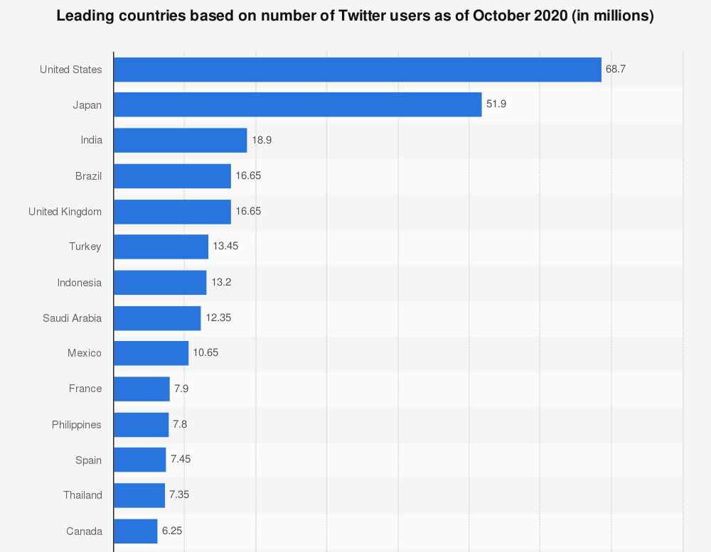
Countries with the Most Twitter Users

Slide 50
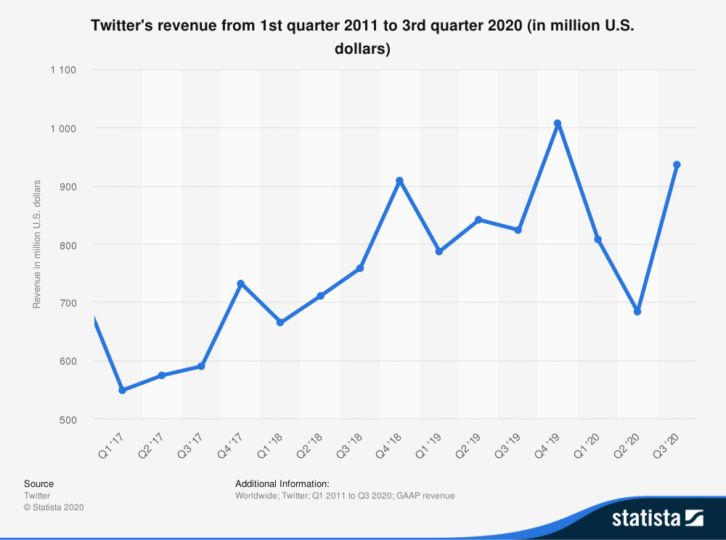
Quarterly Revenue Comparison
Notes:
Revenue beat estimates of $777 million
14% increase YoY, 37% increase QoQ

Slide 51

Constant Ad Engagement Growth and Cost Reduction

Slide 52

Flat-lining mDAUs
Notes:
Forecasts expected close to 195 million users
Struggling to make Twitter a must buy for advertisers
“mDAU growth slowed sooner than expected” - BMO Capital Markets analyst Daniel Salmon
“...the Bull case screeches to a halt for the time being and we remain comfortable on the sidelines until greater visibility can be gained."
Twitter stopped reporting its overall monthly active users last year, choosing instead to focus on the mDAU metric,

Slide 53

Flat-lining mDAUs

Slide 54

Monetization and Revenue
Generated 86% of total revenue from advertising and 14% from Data licensing and their mobile ad exchange

Slide 55



Breakdown of Revenue Generation & Sources
Promoted Tweets
Promoted Accounts
Promoted Trends

Slide 56


Breakdown of Revenue Generation & Sources
Periscope
A mobile application that lets people broadcast and livestream videos
MoPub Exchange
Mobile-focused advertising exchange
Enables buyers and sellers of ad inventory to be matched

Slide 57
Privacy Concerns
Multiple privacy breaches the past few years
CEO Jack Dorsey’s account getting hacked in August 2019
Inappropriate use of phone numbers and emails from their Two-factor Authentication system in October 2019
Hacking of various high profile accounts such as Barack Obama, Bill Gates, Elon Musk in July 2020
Notes:
Those information became part of a marketing and advertising database (wasn’t intended)
Hacking: as part of scam instructing followers to transfer cryptocurrency,

Slide 58

Jack Dorsey (CEO)
Co-founded Twitter in 2006
Took over Interim CEO after Dick Costolo’s departure on June 10th 2015
Became permanent CEO on October 5th 2015
Also the CEO and Co-founder of Square
Notes:
Recently kept his spot as CEO,

Slide 59

Ned Segal (CFO)
CFO since August 2017
Previously worked as Senior VP: Finance at Intuit
Spent 17 years working for Goldman Sachs in roles such as Managing Director: Global Software Investment Banking and COO: Tech Banking

Slide 60

Leslie Berland (CMO)
CMO and Head of People since February 2016
Previously the Executive VP: Global Advertising, Marketing, and Digital Partnerships at American Express
Focused on both the marketing and HR aspects at Twitter

Slide 61

Kayvon Beykpour (Product Head)
Product Head since June 2018
CEO and Co-founder of Periscope which was acquired by Twitter in 2015
Prior to Periscope, he co-founded Terriblyclever Design LLC which was sold to Blackboard Inc.

Slide 62

Dantley Davis (CDO)
CDO since June 2019
Previously served as Director of Product Design for Facebook and Design Director at Netflix
This year, he is placing a stronger emphasis on creating a more inclusion platform

Slide 63

Management Ownership

Slide 64

Executive Compensation Breakdown

Slide 65


Slide 66

Share Structure

Slide 67

Balance Sheet (10Q part 1)

Slide 68

Balance Sheet (10Q part 2)
Notes:
Will be looking to repurchase shares soon, about $2billion worth of shares

Slide 69

Balance Sheet (10K part 1)
Notes:
New accounting rule that began after end of 2018

Slide 70

Balance Sheet (10K part 2)

Slide 71

Consolidated Statement of Operations (10K)

Slide 72

Consolidated Statement of Operations (10Q)
Notes:
Negative net income comes from 2nd quarter ending June 30th 2020 where revenue fell substantially yet costs and expenses went up

Slide 73

Cash Flow Statement (10K part 1)
Notes:
Relatively constant stock-based compensation

Slide 74

Cash Flow Statement (10K part 2)

Slide 75

Cash Flow Statement (10Q Part 1)

Slide 76

Cash Flow Statement (10Q Part 2)

Slide 77
Recommendation:
HOLD

Slide 79


Stock Data and Ratios

Slide 80

Facebook Market Cap Growth 2012 - 2020

Slide 81

Facebook 1 Year Performance

Slide 82

Facebook IPO to Present

Slide 83

Company Overview
Facebook is a social network that allows users to interact with others, connect with friends and family, and share photos, video, and information
It's a platform primed for sharing every kind of content, from articles and ads to live video, memes and more
2.7 billion monthly active users as of June 2020
Available in 100+ languages

Slide 84


Timeline
Newsfeed

Slide 85


Facebook Page
A free opportunity for businesses to increase brand awareness and generate sales on Facebook
A public profile specifically created for businesses, brands, celebrities, causes, and other organizations
Keep customers updated
Reach more people with page promotions and boost posts
Promote an event or share an offer

Slide 86


Facebook Marketplace and Group
Facebook Marketplace was introduced in 2016 as a place for people to buy and sell within their communities
In June 2018, Facebook announced the option for businesses to place ads in Marketplace
B2C and C2C platform
A Facebook Group is a place for group communication and for people to share their common interests and express their opinion

Slide 87


Facebook Messenger
A messaging app and platform developed by Facebook in 2011
Originally developed as Facebook Chat in 2008
Users can send messages and exchange photos, videos, stickers, audio, and files, as well as react to other users' messages and interact with bots
Supports voice and video calling
After being separated from the main Facebook app, Messenger now has 1.3 billion active users

Slide 88

Ad Products
Facebook is creating an easier experience for small and medium-sized businesses to create a web presence, instead of a traditional website, they can create a Facebook profile
Choose a goal
Get more calls
Get more website visitors
Get more messages
Simple and inexpensive ad buying experience and impression tracking for businesses

Slide 89

Timeline

Slide 90

Instagram
A photo and video sharing platform
Instagram now has 1 billion active users
Facebook bought Instagram for around $1 billion in 2012
Instagram makes its money from advertising
Brought in $20 billion in advertising revenue in 2019
Ads show up on Instagram in between Stories, and within the feed

Slide 91

Whatsapp
A free cross platform messaging application
Whatsapp now has 2 billion active users
Facebook bought Whatsapp in February 2014
WhatsApp makes money by charging registered businesses for slow replies
Also makes money through Click to WhatsApp ads, which are not ads shown on Facebook, not WhatsApp, but these ads redirect users from Facebook to WhatsApp

Slide 92


Oculus
A virtual reality technology company
Produces Oculus Rift and Gear VR
Acquired by Facebook in 2014 for 2.3 billion U.S. dollars in cash and stock
Oculus is creating a virtual reality platform for all consumer media
More than 1 million people are using Oculus software through Gear VR partnership with Samsung

Slide 93

Number of Daily Active Facebook Users Worldwide
(In millions)
1785
372

Slide 94

Facebook Daily Active Users ( By Region)
(In millions)

Slide 95

Number of Monthly Active Users: US and Canada
(In millions)

Slide 96

Facebook Monthly Active Users (By Region)
(In millions)

Slide 97

Countries with the Most Facebook Users 2020
(In millions)

Slide 98

Number of Users Worldwide 2017 - 2025, By Region
(In millions)

Slide 99

Number of Users in Canada from 2017 - 2020
(In millions)

Slide 100

Device Usage of Facebook Users Worldwide

Slide 101

Distribution of Top 100 Stories on Facebook Worldwide

Slide 102

Annual Revenue 2009 - 2019

Slide 103

Revenue (In millions)

Slide 104

Revenue By Facebook User Geography

Slide 105

Facebook Average Revenue Per User (ARPU)

Slide 106

Other revenues are generated through the delivery of consumer hardware devices and net fees Facebook receives from developers using its payments infrastructure, as well as from various other sources

Slide 107

Diluted Earnings Per Share

Slide 108

Capital Expenditures
(In millions)

Slide 109

Mark Zuckerberg (CEO)
The founder, chairman, and CEO of Facebook
Founded Facebook in 2004
Responsible for setting the overall direction and product strategy for the company
Today the social media platform has a market capitalization of more than $500 billion, and Zuckerberg is worth more than $70 billion
Studied Computer Science at Harvard University

Slide 110

David Wehner (CFO)
Leads the finance, facilities, and information technology teams
Became CFO in June 2014
Before 2014, David served as Facebook’s vice president of Corporate Finance and Business Planning
Holds a B.S. in Chemistry from Georgetown University
M.S. in Applied Physics from Stanford University

Slide 111

Sheryl Sandberg (COO)
Became COO in March 2008
Oversees the firm’s business operations
Responsible for helping Facebook scale its operations and expand its presence globally and also managed sales, marketing, business development, legal, HR, public policy, privacy and communication
Previously VP of Global Online Sales and Operations at Google
She led Facebook from a $56 million loss in 2008 to $18.5 billion in profits in 2019
Holds a B.A. in Economics from Harvard University

Slide 112

Chris Cox (CPO)
Chris joined Facebook in 2005 as a software engineer and helped build the first versions of key Facebook features, including News Feed
Then became director of human resources, setting the tone for Facebook’s culture
In 2008, he became Facebook’s vice president of product, where he built the initial product management and design teams
Promoted to chief product officer in 2014
B.A. in Symbolic Systems from Stanford University

Slide 113

Shareholder Ownership

Slide 114

Condensed Consolidated Balance Sheet (10Q)
(Assets)

Slide 115

Condensed Consolidated Balance Sheet (10Q)
(Liabilities and Stockholders’ Equity)

Slide 116

Consolidated Balance Sheet (10K)
(Assets)

Slide 117

Consolidated Balance Sheet (10K)
(Liabilities and Stockholders’ Equity)

Slide 118

Income Statement (10K)

Slide 119

Income Statement (10Q)

Slide 120

Cash Flow Statement (10Q)

Slide 121

Cash Flow Statement (10Q) Con’t

Slide 122

Cash Flow Statement (10K)

Slide 123

Cash Flow Statement (10K) Con’t

Slide 124
Recommendation
BUY

Slide 125
Weibo

Slide 126

Stock Price

Slide 127

Stock Information

Slide 128

Weibo 6 month (NASDAQ)

Slide 129

Weibo 1 Year (NASDAQ)

Slide 130

Weibo 5 Year (NASDAQ)

Slide 131

IPO to November 3, 2020

Slide 132

Weibo vs Dow Jones vs S&P 500

Slide 133


Company Profile
* As of June 2020
Notes:
Weibo is a leading social media for people to create, share and discover content online. It combines the means of public self-expression in real time with a powerful platform for social interaction, content aggregation and content distribution. Any user can create and post a feed and attach multi-media and long-form content. User relationships on Weibo may be asymmetric; any user can follow any other user and add comments to a feed while reposting. This simple, asymmetric and distributed nature of Weibo allows an original feed to become a live viral conversation stream.
Weibo enables its advertising and marketing customers to promote their brands, products and services to users. Weibo offers a wide range of advertising and marketing solutions to companies of all sizes. The Company generates a substantial majority of its revenues from the sale of advertising and marketing services, including the sale of social display advertisement and promoted marketing offerings. Weibo has developed and is continuously refining its social interest graph recommendation engine, which enables its customers to perform people marketing and target audiences based on user demographics, social relationships, interests and behaviors, to achieve greater relevance, engagement and marketing effectiveness.

Slide 134
History
Oct 2017
Completed the offering of USD900 Million Convertible Senior Notes due 2022
Dec 2016
Monthly active users (MAUs) exceeded 300 million
Sep 2015
Average daily active users (DAUs) reached 100 million
Apr 2014
IPO on NASDAQ under symbol “WB”
Mar 2011
Registered users reached 100 million
Aug 2009
Launched SINA Weibo
Sep 2005
First portal website to launch blogging service
Dec 1993
Stone Rich Sight was founded (Predecessor of SINA)

Slide 135

Monetization

Slide 136

Monetization
Advertising and marketing

Slide 137

Monetization
Advertising and marketing

Slide 138

Monetization
Advertising and marketing

Slide 139

Monetization
Value-Added service
Subscription fee: ¥15 monthly or ¥108 annually

Slide 140


Slide 141


Slide 142


Slide 143
Decreasing active users
Unacceptable customer services
Over aggressive advertising strategy
Users are forced to follow accounts automatically without being notified
Increasing number of alternatives such as TikTok
Bad reputation

Slide 144

Management Team
Chairman of the board of directors since inception
Position in SINA
Chairman of the board of directors(2012 – )
CEO of SINA ( May 2006 – )
President (September 2005 – February 2013)
Chief Financial Officer (February 2001 – May 2006)
Co-Chief Operating Officer (July 2004 – September 2005)
Executive Vice President ( April 2002 – June 2003)
Vice President, Finance (September 1999 – January 2001)
B.A. in Journalism from Fudan University in Shanghai, China
M.A. in Journalism from the University of Oklahoma
Master of Professional Accounting degree from the University of Texas at Austin
Charles Guowei Chao
COB

Slide 145

Management Team
Director (August 2020 – )
Chief Executive Officer (February 2014 – )
Since inception, Mr. Wang has had various product and business development roles at Weibo
Promoted to General Manager in December 2012
Joined SINA in August 2000 and worked in the product development department
Transferred to the SINA Mobile division in 2004
General Manager of SINA Mobile (November 2006 – November 2012)
B.S. degree in Computer Science from Peking University
EMBA degree from Guanghua School of Management of Peking University
Gaofei Wang
Chief Executive Officer
Director

Slide 146

Management Team
Vice President, Finance (August 2017 – )
Vice President of SINA ( January 2017 – July 2017)
Overseeing SINA’s finance department
Joined SINA in 2005
Corporate Controller for more than ten years
Prior to joining SINA, she was an audit manager at the PricewaterhouseCoopers in Beijing
B.S. in engineering and an EMBA degree from Shanghai Jiaotong University
Certified public accountant in China
A member of the China Institute of Certified Public Accountants
Fei Cao
Vice president, Finance

Slide 147

Management Team
Joined Weibo in September 2009
Senior Vice President, Operation (April 2018 – )
Chief Editor (October 2017 – March 2018)
Vice President of Operation (April 2015 – September 2017)
General Manager of Operation (April 2013 – March 2015)
Director of Operation (September 2009 – March 2013)
Joined SINA in September 2002
Chief Editor and other roles in SINA Technology Channel (September 2002 – August 2009)
Prior to joining SINA, Mr. Cao worked at Sohu
B.S. in Electrical Engineering and Automation from Hebei University of Technology
Zenghui Cao
Senior Vice President, Operation

Slide 148

Management Team
Independent director (January 2016 – )
Director of SINA (March 1999 – December 2015)
Chief Executive Officer, Founder, President and Chairman of the board of
BroadVision Inc. (May 1993 – )
Vice President of Multimedia Technology at Sybase, Inc. (1992 – 1993)
Founder and President of Gain Technology (1989 – 1992)
Board of director of Asian Art Museum
B.S. in Computer Science from National Taiwan University
M.S. in Computer Science from Indiana University
Ph.D. in Computer Science from the University of California at Berkeley
Pehong Chen
Independent director

Slide 149


Shareholder Ownership

Slide 150

Shareholder Ownership

Slide 151

Shareholder Ownership

Slide 152

Shareholder Ownership

Slide 153
Financial Reports

Slide 154

Balance Sheet – 6-K 2020 Q2

Slide 155

Balance Sheet – 20-F

Slide 156

Balance Sheet – 20-F cont.

Slide 157

Income Statement – 20-F

Slide 158

Income Statement – 20-F cont.

Slide 159

Income Statement– 6-K
2020 Q2

Slide 160

Cash Flow Statement – 20-F

Slide 161

Cash Flow Statement – 20-F cont.

Slide 162
Recommendation
Hold

