Slide 1



US Entertainment
Notes:
hello welcome to our presentation, we are group 5 and we'll be presenting on the US entertainment industry

Slide 2




Agenda
Industry
Shayne LaRochelle
Netflix
Jeremy Effendy
AMC Networks
Will Kinnaird
The Walt Disney Company
Madison Park
Agenda
History
Industry Overview
Business Model Overviews
Trends

Slide 3
Agenda
History of the Industry
Industry Overview
Business Model Overviews
Trends
Netflix
AMC
Walt Disney
Agenda
History
Industry Overview
Business Model Overviews
Trends

Slide 4
History: Industry Origins
Origins can be traced to photography exhibits in New York
USA has been prominent industry leader since industry inception
New York was original dominant market, later switching to Hollywood around the start of WW1
Agenda
History
Industry Overview
Business Model Overviews
Trends
Notes:
origins late 19th century
Origins can be traced to photography exhibits in New York 19th century
USA has been prominent industry leader since industry inception
New York was original dominant market, later switching to Hollywood around the start of WW1
switched to hollywood for more favourable weather conditions

Slide 5
History: Industry Boom
1930’s – 1940’s was golden age of industry
11th largest industry in the US, 2/3 of Americans went to the theatre weekly
Antitrust legislation such as USA v Paramount (1948) led to dismantling of industry monopolies
Theatre attendance has drastically declined since 1945 and has been flat since the mid 1960’s
Agenda
History
Industry Overview
Business Model Overviews
Trends
Notes:
anti trust legislation
in combination with the rise of television led to a drastic decline in attendance which has declined since 1945 and been flat since the mid 1960s

Slide 6
History: Development of New Technology and Origins of Television
Rise of Television greatly contributed to the downfall in movie attendance
Anti-trust suits, notably USA vs. Technicolor, greatly decreased the cost of technology in the industry
Due to these suits, Kodak was able to release Eastmancolor, the first affordable color film production option
Led to a more than 416% increase in the number of color films released from late 1940’s to 1954
20th Century Fox creates wide angle film
Agenda
History
Industry Overview
Business Model Overviews
Trends
Notes:
1950-1960
rise of tv was largely made possible due to anti trust legislation that greatly decreased the cost of producing content and also allowed more players to enter the market
Technicolor suit mandated that the then sole patent holder for color film was required to license all of its current patents and any patent it acquires within 5 years to any applicant at a reasonable royalty
Eastmancolor is a trade name for a number of related film production technologies
416% - more than 50% of films were color in 1954, 12% were color in the late 1940s
https://www.justice.gov/atr/page/file/1145156/download

Slide 7
History: Liberalization of Film, Beginnings of Film as Business
Rise of the Hollywood blockbuster concept
Studios began to commit to significantly larger and fewer products
Significant increase in film advertising and promotion
Rise of special effects
Rise of the “knock-off”
Beginnings of movie themed merchandise
Beginnings of the wide release distribution style
Agenda
History
Industry Overview
Business Model Overviews
Trends
Notes:
70-80s
this is really wehre the modern film entertainment begins to take shape. The idea of media as a business really takes
rise of sex and violence in film
increased sophistication of film as a business
at this time, studios begin to commit to fewer but larger projects
advertising up
film strategy up
monetization strategies greatly enhanced and become increasingly sophisticated
Wide release as opposed to gradual release where they would test films in individual markets and role out gradually later
Movies had larger advertsiign budgets (TV, Radio) so they favoured an all at onve style of relaeaase
due to the increased expense in making the films we see rise of knock offs and sequels

Slide 8
History: Present
Rise of the independent film
Improved special effects and immersive technologies (Sound, 3D, etc)
Rise of home video
Rise of Over-The-Top Video (OTT)
Agenda
History
Industry Overview
Business Model Overviews
Trends

Slide 9
Industry Overview: Major Sectors
Cinema
Television
Over-The Top Video
Video Games
Agenda
History
Industry Overview
Business Model Overviews
Trends
Notes:
Were focused on film, TV and OTT for this presentation

Slide 10
Industry Overview: Major Players
1. Comcast (Globally: 1)
2. Disney (Globally: 2)
3. Charter Communications (Globally: 3)
4. Viacom (Globally: 4)
5. Netflix (Globally: 6)
6. DISH (Globally: 9)
7. 20th Century Fox (Globally: 10)
Agenda
History
Industry Overview
Business Model Overviews
Trends
Notes:
global entertainment market is domainated by us companeis with 7 companies being in the global top 10
you see the american ranking on th left followed by the global ranking on the far right
The U.S. filmed entertainment sector enjoyed a trade surplus of $16.3 billion[6] in 2014 (latest available data), 11th largest sector contribution in the usa
Key Players US with global ranking:

Slide 11
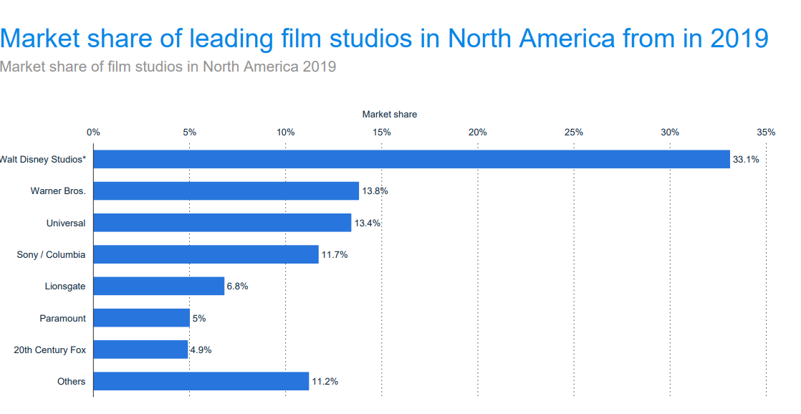
Industry Overview: Market Leaders
Agenda
History
Industry Overview
Business Model Overviews
Trends
Notes:
Top film studios control a huge amount of the market
top 7 companies control close to 90% of the north american market
huge barriers to entry under a traditional wide release blockbuster style releases structure (cost structure shown later)
PRE disney fox merger

Slide 12
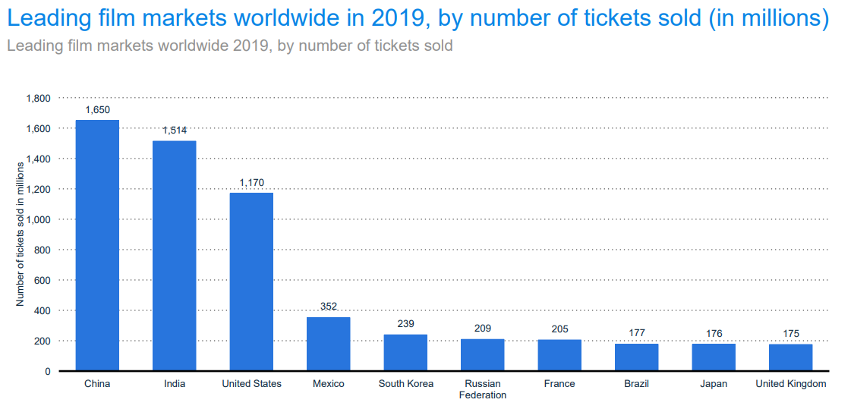
Industry Overview: Top Global Markets
Agenda
History
Industry Overview
Business Model Overviews
Trends
Notes:
opportunities in other markets notable china india
China largely captured by Hong Kong based firms and chinese firms. US still has sizeable presence but is not dominant
Bollywood scene is dominant in India

Slide 13
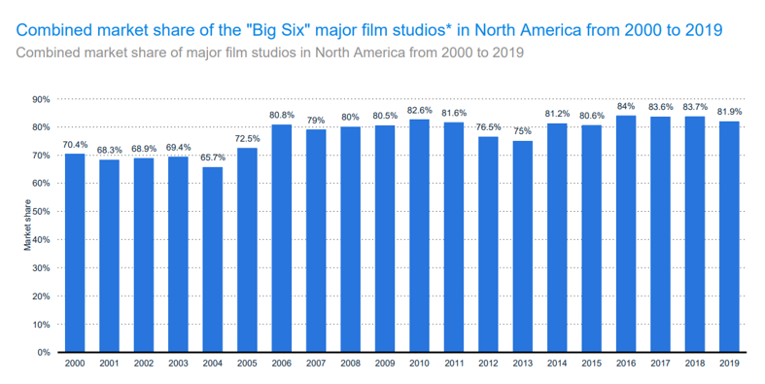
Industry Overview: Market Share of Largest Studios
Agenda
History
Industry Overview
Business Model Overviews
Trends
Notes:
BIG SIX are:
Disney
Warner
Paramount
Sony/Columbia
Universal
now a big 5 after disney fox merger
Trend of market consolidation in previous years
largest studios continue to increase in size
PRE disney fox

Slide 14
Industry Overview: Market Share of Largest Studios
USD
CAGR
Subscription TV
$200 million
$94.2B
-2.90%
Cinema
Growth rate of Market Share
$3.5B
-69.29%
Growth rate of Market Share
OTT Video
$15.21B
+12.70%
Agenda
History
Industry Overview
Business Model Overviews
Trends
Notes:
Some key figures from 2020:
decline in subscription tv revenue
huge decline in cinema revenue
continued growth in OTT video
Mostly due to effects of covid 19
OTT revenue increasing partly due to covid 19 and also just due to its own growth
cinema expected to be -2.40 % 5 year growth rate

Slide 15
Industry Overview: Other Notable Metrics
CAGR
TV Advertising Revenue
$200 million
+11.60%
Streaming Surpasses Cable
Agenda
History
Industry Overview
Business Model Overviews
Trends
Notes:
growth in TV advertising revenue
Percentage of people owning at least one streaming service surpasses percentage of people with cable TV in the usa

Slide 16
Industry Overview: Producing Content: Process
Capital Intensive
Development
Pre Production
Pre-script work and costs
Building a team, writing a script
Production
Post Production
Shooting the movie
Editing, effects etc.
Actual production costs for films are not revealed
Agenda
History
Industry Overview
Business Model Overviews
Trends
Notes:
tremendously capital intensive to produce a major film. Both a huge time and financial commitment to shoot a movie or TV show. Due to this, studios are less willing to try new creative concepts than in the past. these factors played into the rise of copycat movie concepts, sequels, spinoffs and acquisition driven growth(acquire proven IP)
actual production costs are not revealed. this is done:
attempts to make the film seem more successful than it was
Downplay the amount of advertising that was done

Slide 17
Industry Overview: Producing Content: Costs
Marketing – 81% of a major film’s budget. Can be significantly more than double the budget for small films
Prints – development of the physical copies of the films sent to cinema
Residuals – profits mandated for film union workers
Financing costs
Overhead
Physical delivery of units to consumers (less of a modern issue)
Agenda
History
Industry Overview
Business Model Overviews
Trends
Notes:
In 2005, Dreamworks overestimated the number of Shrek 2 DVDs they would sell in the US by 5 million units. This caused the studio to missing their quarterly earnings target by 25% and their shares fell as a result.

Slide 18
Industry Overview: Key Revenue Drivers
Theatrical
Home Entertainment
Television
Streaming
Soundtrack Sales
Merchandising
Product Placement
Agenda
History
Industry Overview
Business Model Overviews
Trends
Notes:
Tons of ways to monetize films
name of the game is increase avenues of exposure for the end consumer:
disney does this well: toys, theme parks, other merch, soundtrack sales, spin offs
Theatrical - ticket sales, cinema revenue can be 50/50 for smaller films as much as 90/10 for blockbusters
home ent is dvd, home video rentals etc
television is obvious - licensing etc
Streaming rihgts - licensing
soundtrakc sales
mercahdisnig
product placement

Slide 19
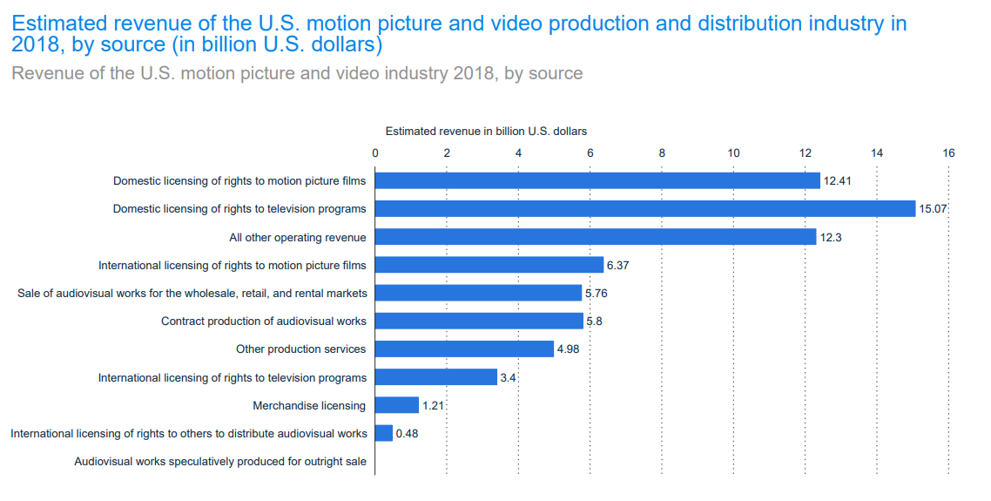
Industry Overview: Breakdown of Revenue Drivers
Agenda
History
Industry Overview
Business Model Overviews
Trends
Notes:
greatest percentage of revenue comes from licencing. things with replay value ( TV shows) contribute greatly to revenue. Shows the huge importance of owning and monetizing a companies IP. A succesful product can be monetized for years or even decades

Slide 20
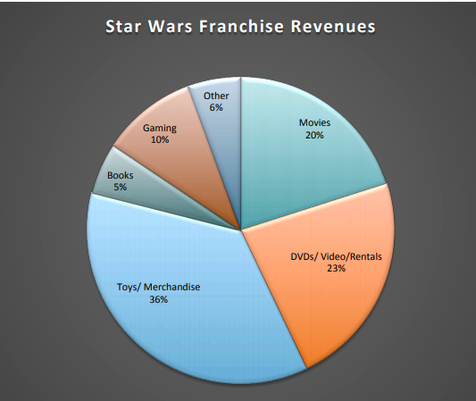
Industry Overview: Star Wars Franchise Breakdown
Agenda
History
Industry Overview
Business Model Overviews
Trends
Notes:
goal is to maximize mediums of consumption
star wars franchise has earned 36% of its total revenue from toy and merch sales
only 20% from the theatre

Slide 21
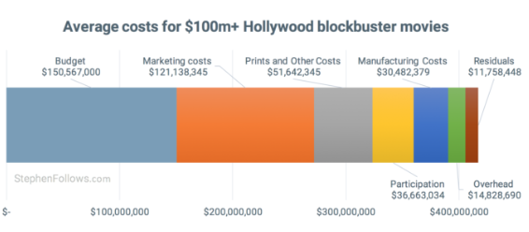
Industry Overview: Producing Content
Agenda
History
Industry Overview
Business Model Overviews
Trends
Notes:
marketing costs are a huge contribution to a films expense, another reason that studios prefer to make large expensive films so as the marketing costs make up a lower percentage of the total cost of the project
it's another reason that we see that studios prefer to make sequels and spinoffs as it does not require as much marketing to make the audience familiar with the show/movie

Slide 22
Industry Overview: Film Release Cycle
Theatrical
Airlines, Premium Hospitality, PPV
Home Entertainment Release
Streaming Licensing
Television Licencing
Agenda
History
Industry Overview
Business Model Overviews
Trends
Notes:
In 2015, the average release window between theatrical and Home Entertainment was 3 months and 23 days.

Slide 23
Industry Overview: Television
Traditionally
Newer Styles
Pilot
Shows released constantly throughout the year
Straight-to-series
full order immediately
Pilots released en masse
Allow for viewers to vote for their favourite shows or analyze viewer information for the pilots over a specified time period to determine which shows are picked up
Agenda
History
Industry Overview
Business Model Overviews
Trends
Notes:
Amazon does this
https://christopherming.com/2018/05/how-television-pilots-are-mad
Straoight to series benefits
They Give Creatives More Time To Do Their Thing – no pressure to make a cheesy or flashy opener to appease network critics
2. They Attract the Big Stars – stars more willing to commit to guaranteed 10-13 show season. Don’t want to waste time learning a role for a to be failed pilot
Save money on pilots
Darawbacks more risk obisoulsy
notable straight to series shows cancelled
THE MICHAEL J. FOX SHOW on NBC, which was cancelled after 15 of its scheduled 22 episodes aired, in large part because of low ratings and waning interests.
Fox’s sci-fi drama TERRA NOVA, an expensive investment reportedly costing around 100 million pounds (more than $171 million)⁶… canceled after one season.
Fox’s highly anticipated Ancient Egypt drama HIEROGLYPH, which was cancelled before it even made it on air due to “creative issues during development.”

Slide 24
Industry Overview: Trends in Revenue Sourcing
Content is key
Control of intellectual property is key
Push towards content creators owning OTT services (CBS All Access Disney + etc)
Additional licencing of content to major OTT carriers for smaller markets
Agenda
History
Industry Overview
Business Model Overviews
Trends
Notes:
https://www.strategy-business.com/article/The-Revenue-Stream-Revolution-in-Entertainment-and-Media?gko=94f4f
Goal is to maximize the monetization of core brands either through existing mediums of consumption or new ones (OTT, home DVD purchase, re-runs, licencing, merchandising etc)
as touched on earlier, creating conent is exrtremley expensive both from a time and ifnancial standpoitn. because of this studios would rather aquire proven IP or develope a spin off series with proven characters or a sequel for an already succesful show/movie.
The payoff for owning succesful IP is huge and can lead to a cash flow for years or even decades into the future. Seinfeld has brought in an estimated 3 billion to sony and NBC through its ongoing syndication deals through 2020 and seinfeld debuted in 1989
this is especially true in the streaming age as OTT video providers seek to build large catalogs of content. some notable large aquisitions of IP
netflix: Friends 450m, the office 500m, Seinfeld rumoured “Significantly more’ than 500m paid for office for 5 year licencning rights beginning in 2021
CBS licences content CBC all access content through amazon prime in select global markets where demand for CBC products as a whole is not deemed to be high enough. More exposure through largest players make up for loss of direct revenue

Slide 25
Industry Overview: Trends in Revenue Sourcing Cont
Merchandising
New ways to brand IP video games etc
Agenda
History
Industry Overview
Business Model Overviews
Trends
Notes:
Ultimate takeaway, ip is expensive to make or acquire. Goal is to increase return by maximizing ways (forms) in which we can deliver the IP to consumers.

Slide 26
Industry Overview: Streaming Models
Transaction VOD
Typical pay per view structure
Content behind paywall
Pay for individual items of content
Download to own or download to rent options
Agenda
History
Industry Overview
Business Model Overviews
Trends
Notes:
Benefits
no monthly subscriptions
only pay for what they want
for company
able to specifically target consumer groups allowing for higher prices to be charged and a decreased marketing expense
enables you to carry a smaller library of content
easier to communicate offering to consumers as they are not flooded with long line of unwanted content
exampled
itunes, pay per view sports(UFC)

Slide 27
Industry Overview: Streaming Models
Subscription VOD
Standard Monthly Subscription Model
Large Access to Catalog
Cancel Anytime
Agenda
History
Industry Overview
Business Model Overviews
Trends
Notes:
Benefits
large catalog
cancel anytime
for company
constant revenue stream
examples netlfix hulu spotify

Slide 28
Industry Overview: Streaming Models
Ad-Supported VOD
Video on Demand Supported by Ads
Free to end user
Agenda
History
Industry Overview
Business Model Overviews
Trends
Notes:
Youtube
spotify not video but same idea free version

Slide 29
Industry Overview: Streaming Models
Hybrid
Any combination of preceding
Common models are combination of TVOD and SVOD (Amazon Prime) as well as Ad-Supported version of SVOD (YouTube)
Agenda
History
Industry Overview
Business Model Overviews
Trends

Slide 30
Future: Trends
Continued push toward OTT
licencing continuing to play a large part in total revenue
Decreased focus on product delivery (virtual)
Fight to acquire rights to IP
Expansion in new markets
Agenda
History
Industry Overview
Business Model Overviews
Trends

Slide 31
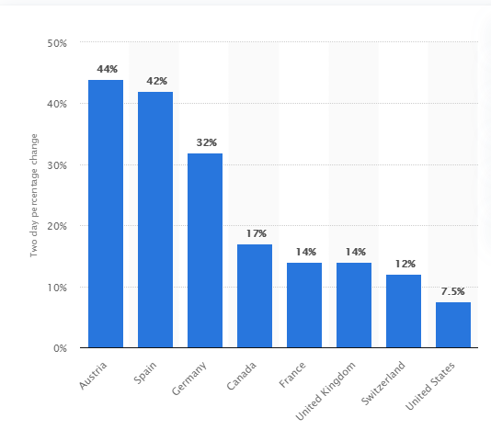
Future: Increase in Streaming due to COVID-19
Agenda
History
Industry Overview
Business Model Overviews
Trends
Notes:
2 day change in streaming march 15th covid year

Slide 32
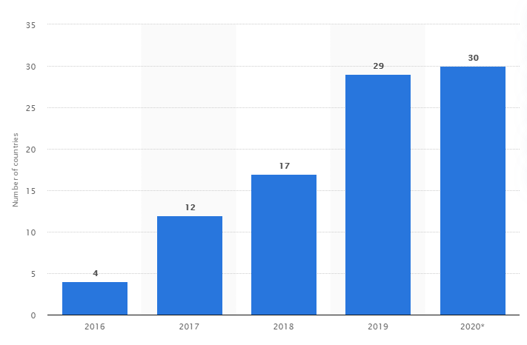
Future: Number of Countries in Which SVoD has Overtaken Cable
Agenda
History
Industry Overview
Business Model Overviews
Trends
Notes:
by user count
estimate midway through 2020 post covid

Slide 33
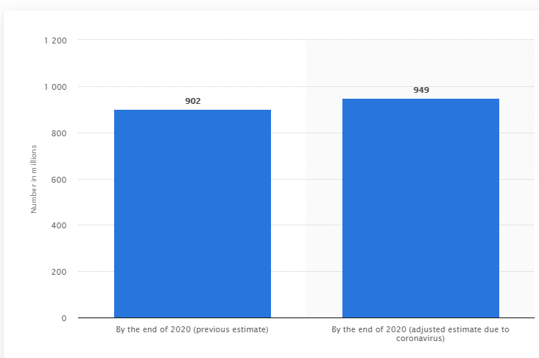
Future: SVoD growth Attributable to COVID-19
Agenda
History
Industry Overview
Business Model Overviews
Trends
Notes:
COVID impacts on SVOD users Globally by end of 2020 (millions)
5.21% higher than originally projected

Slide 34
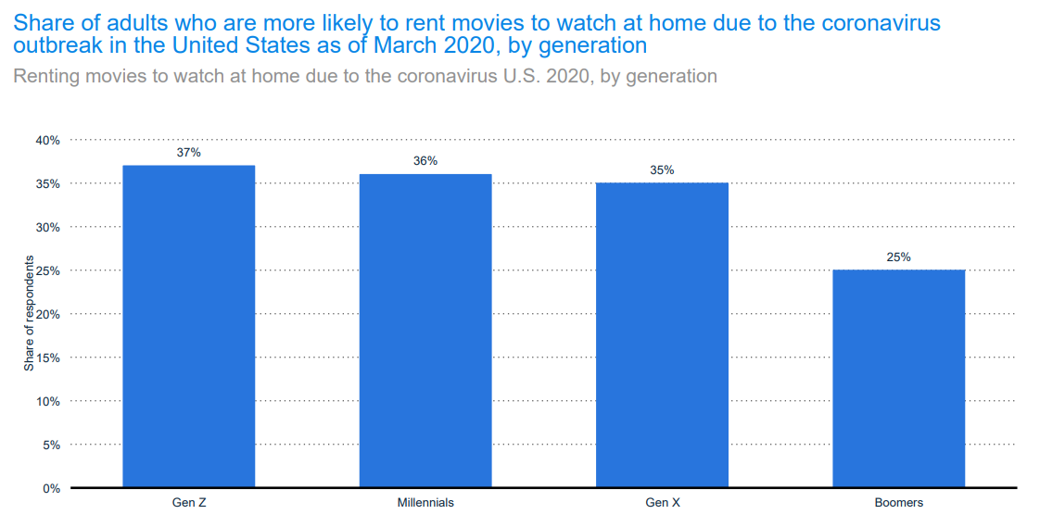
Future: Will Consumers Return to Cinema?
Agenda
History
Industry Overview
Business Model Overviews
Trends

Slide 35

Ticker: NFLX
Exchange: NASDAQ
Overview
Stock Performance
Company Information
Strategy
Leadership Team
Financials
Recommendation

Slide 36
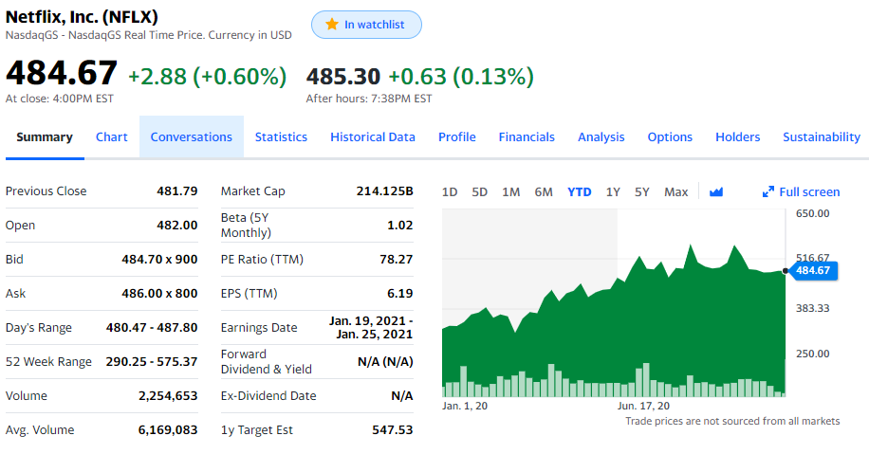
Stock Overview: NFLX
Overview
Stock Performance
Company Information
Strategy
Leadership Team
Financials
Recommendation
Notes:
First company of the day: Netflix
Done very well year to date, started off in January at the bottom 300’s, and they’ve gone over the 500 dollar mark 3 times since the mid-march rally
YTD return almost 50%

Slide 37
Stock Performance
1Y Stock Performance
Overview
Stock Performance
Company Information
Strategy
Leadership Team
Financials
Recommendation
Notes:
Mid-march sell off to below 300
Surge in Q3 after strong earnings report

Slide 38
Stock Performance
5Y Stock Performance
Overview
Stock Performance
Company Information
Strategy
Leadership Team
Financials
Recommendation

Slide 39
Stock Performance
Stock Performance Since IPO
Overview
Stock Performance
Company Information
Strategy
Leadership Team
Financials
Recommendation
Notes:
IPO’d at just $1 in 2002 as a DVD rental company

Slide 40
Stock Performance
5Y Peer Comparison
Overview
Stock Performance
Company Information
Strategy
Leadership Team
Financials
Recommendation
Notes:
Done very well compared to the other companies in the presentation, 300% return over the past 5 years

Slide 41
Stock Performance
5Y Market Comparison
Overview
Stock Performance
Company Information
Strategy
Leadership Team
Financials
Recommendation
Notes:
Done very well compared to GSPC, the only go-to video streaming service for quite a period of time before a lot of networks started to build their own platforms
FAANGM stocks pulling the index, would be in the red otherwise

Slide 42
Stock Performance
1Y P/E Ratio Peer Comparison
Overview
Stock Performance
Company Information
Strategy
Leadership Team
Financials
Recommendation
Notes:
1Y P/E ratio, Disney is the only one close to or over NFLX’s in the industry

Slide 43
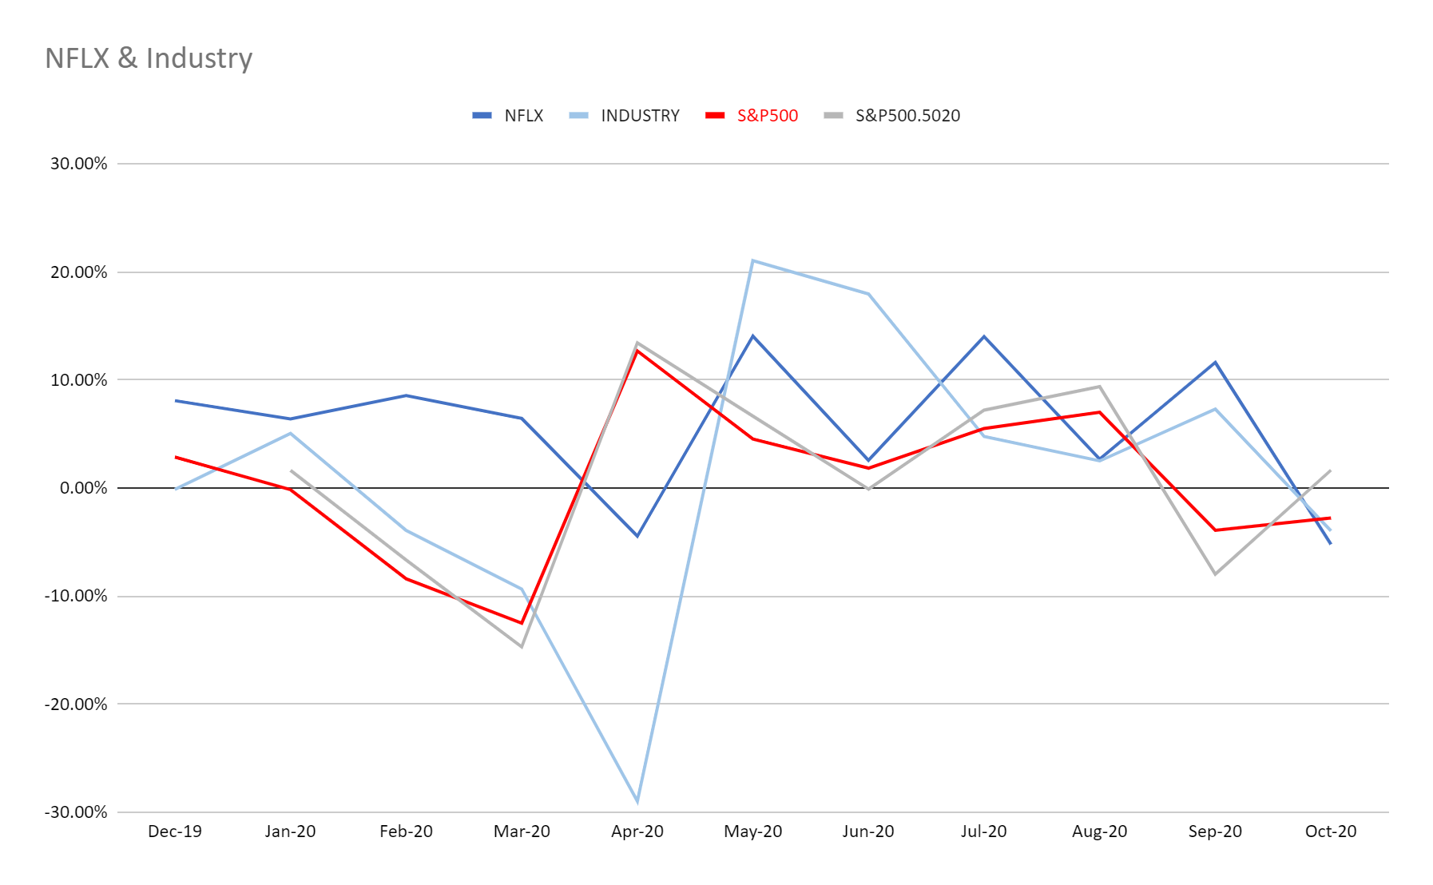
MoM Growth
NFLX vs. Custom Index vs. GSPC
Overview
Stock Performance
Company Information
Strategy
Leadership Team
Financials
Recommendation
Notes:
Custom index of 119 companies: includes indirect competitors
Friday night moments of truth
Competitors not only other streaming services, but everything that you might do to occupy your free time

Slide 44
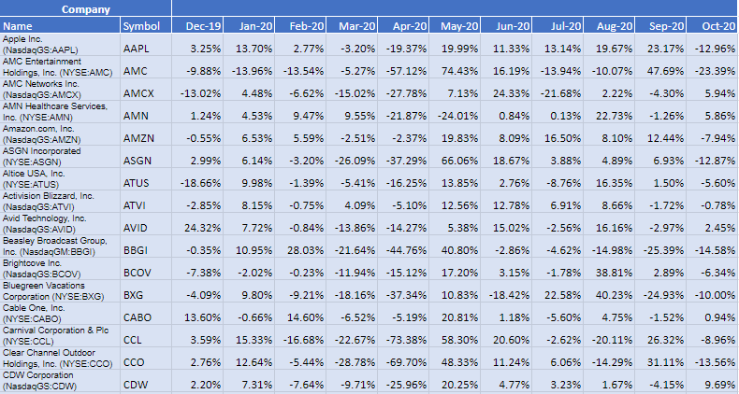
Custom Index Constituents
Index includes indirect competitors
Overview
Stock Performance
Company Information
Strategy
Leadership Team
Financials
Recommendation
Notes:
Activision Blizzard – video game company
This is their month-to-month growth rate from 2019 to October 2020

Slide 45
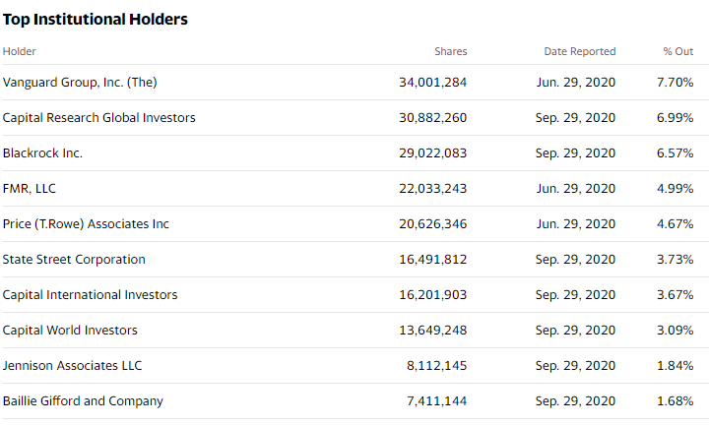
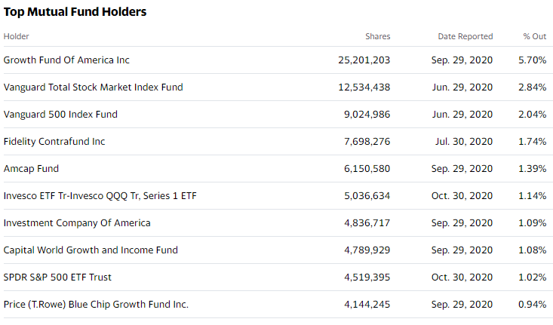
Company Analysis
Top Holders
Overview
Stock Performance
Company Information
Strategy
Leadership Team
Financials
Recommendation
Notes:
Institutional Holders – some passive investors in Vanguard, Blackrock, Fidelity, SPDR – big part of SP ETFs

Slide 46
Company Profile
About
Key Metrics
Media streaming and production company
Founded in 1997 by Reed Hastings and Marc Randolph as a DVD rental
Headquarters: Los Gatos, California
167M paid members
190 countries
13,900+ titles
Regions: UCAN, EMEA, LATAM, APAC
Overview
Stock Performance
Company Information
Strategy
Leadership Team
Financials
Recommendation
Notes:
Almost bankrupted blockbuster: which by the way isn’t bankrupt, there’s still one store left in Oregon
DVD rental model – instead of going to the stores, DVDs would be mailed to customers’ homes
Monthly fee varies depending on how many DVDs they want to have on hand, they’d have to return existing ones to get new ones
Online titles dwarfed by DVD
Still 2M DVD subscribers, a lot of them in rural areas without enough bandwith
Movie enthusiasts wanting access to more content; DVD doesn’t have license expiry

Slide 47
Historical Timeline
1997
1999
2000
2002
Netflix started as a DVD-rental-by-mail firm
Netflix subscription service debuts, offering unlimited DVD rentals without due dates, late fees, or monthly rental limits
Personalized movie recommendation system introduced
NFLX IPO at $1/share
Overview
Stock Performance
Company Information
Strategy
Leadership Team
Financials
Recommendation

Slide 48
Historical Timeline
2005
2006
2007
2010
NFLX launches profile feature, allowing members to create different “playlists”
NFLX members reach 5M
Streaming is introduced
Netflix arrives in Canada
Streaming launches on mobile devices
First dedicated kids experience debuts on streaming
Overview
Stock Performance
Company Information
Strategy
Leadership Team
Financials
Recommendation

Slide 49
Historical Timeline
2012
2014
2016
2017
Membership reaches 25M
NFLX expands to UK, Ireland, and Nordic Countries
Membership surpasses 50M+
Netflix reaches 190 countries
Membership reaches 100M globally
Overview
Stock Performance
Company Information
Strategy
Leadership Team
Financials
Recommendation

Slide 50
Historical Timeline
2018
2019
NFLX is the most nominated studio at the Emmys, winning 23 awards
Original content production coming to fruition
NFLX wins 4 Academy Awards
Production hubs open in London, Madrid, New York, and Toronto
Overview
Stock Performance
Company Information
Strategy
Leadership Team
Financials
Recommendation

Slide 51
Strategy
Viewership
Customer retention through binge-culture
Straight-to-series strategy is a double-edged sword
Content
Recent shift to in-house production
Netflix Originals: exclusive licensing
Content localization → South Asia (India) and East Asia (Japan & Korea)
Overview
Stock Performance
Company Information
Strategy
Leadership Team
Financials
Recommendation
Notes:
One of the reasons of success: customers spend long periods of time going through the whole series
After they’re done, they become attached to NFLX since they spent so much time
2018 case studies, they were struggling to generate new content at the pace customers are going through them
Content Strategy
Recent shift to in-house production, they’ve invested a lot in producing their own content
Just opened a production house at South Surrey
Netflix Originals: encapsulates both external content exclusively available on NFLX, or their in-house content
Focused on acquiring local content in recent years, especially in Asia

Slide 52
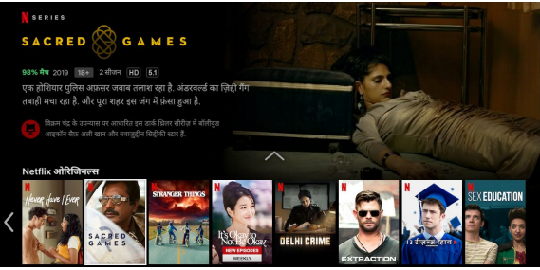
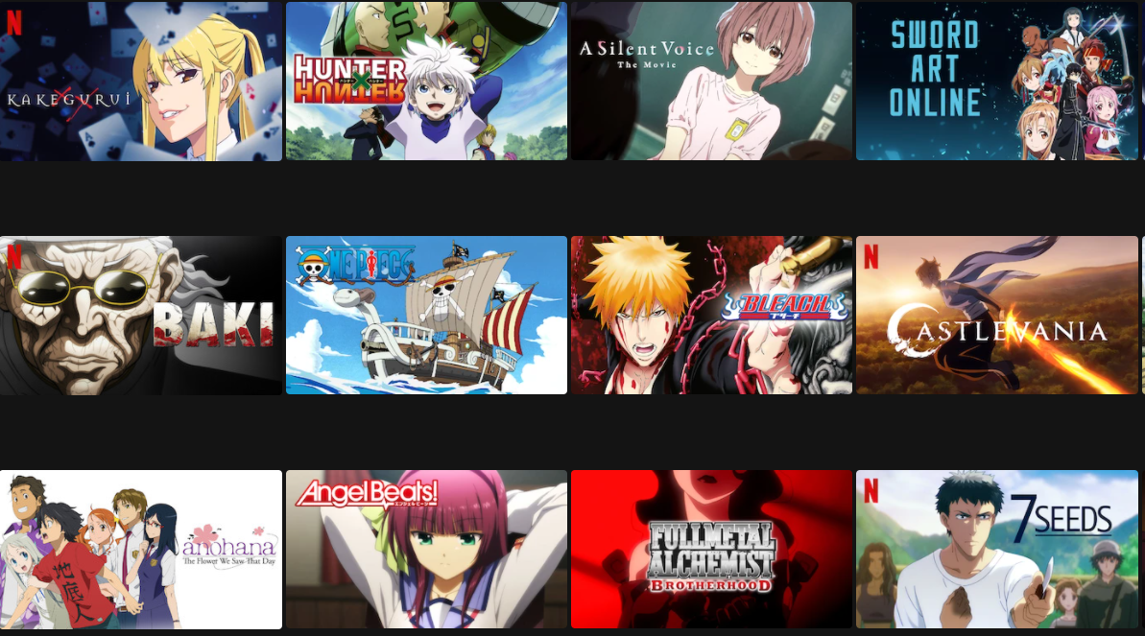

Content Localization
Netflix in Hindi
Japanese Content
Korean Content
Overview
Stock Performance
Company Information
Strategy
Leadership Team
Financials
Recommendation
Notes:
Cater to more audiences, a lot of their competitors in Asia are focused on local content
Netflix generally viewed as a platform to access Western media content, they’re changing that

Slide 53
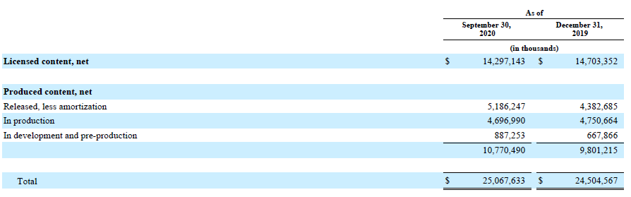
Value of Content
Overview
Stock Performance
Company Information
Strategy
Leadership Team
Financials
Recommendation

Slide 54
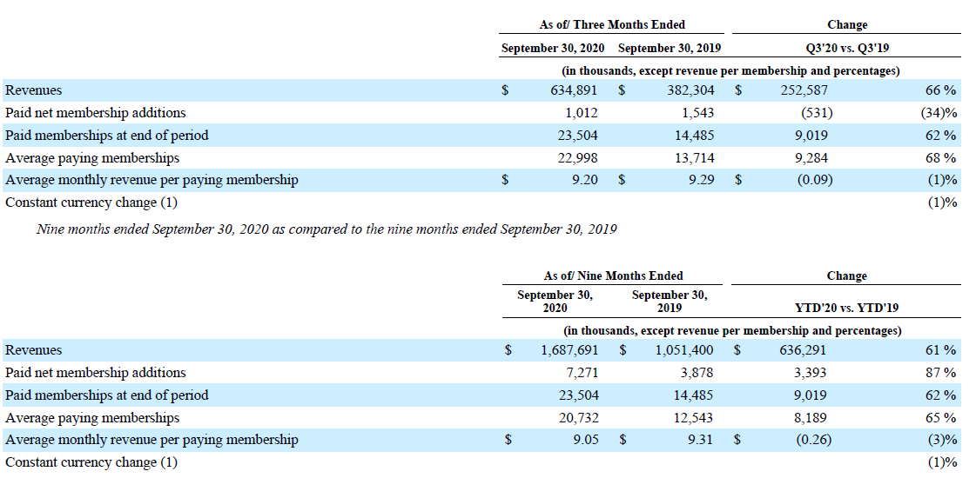
COVID Impact - NFLX Demonstrates Strong Growth in APAC
Overview
Stock Performance
Company Information
Strategy
Leadership Team
Financials
Recommendation
Notes:
Strong growth in Asian Market, 87% change in subscriber numbers YTD this year compared to last year

Slide 55




The APAC Ceiling
Technological Limitations
Competition
Mobile-centric market
Lower-cost subscription fees
Not a lot of people have access to technology with enough bandwidth except for their phone
Japan and Korea have some of the best internet speeds in the world
Intense competition specializing in localized content
AVIA study on consumers accessing pirated content:
Philippines: 49% of consumers
Indonesia: 63% of consumers
Malaysia: 51% of consumers
Overview
Stock Performance
Company Information
Strategy
Leadership Team
Financials
Recommendation
Notes:
Wouldn’t hope for too much growth in Asia
Hotstar → owned by Disney

Slide 56
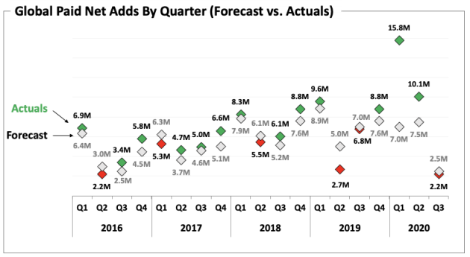
COVID Impact – Q2 2020 Pull-Forward
126% of forecast
Overview
Stock Performance
Company Information
Strategy
Leadership Team
Financials
Recommendation

Slide 57
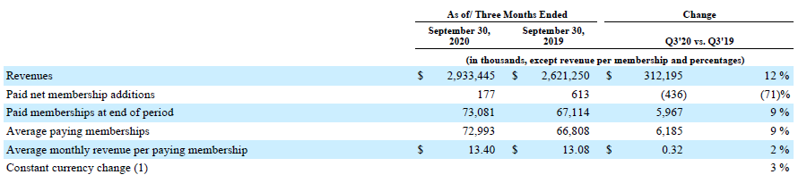
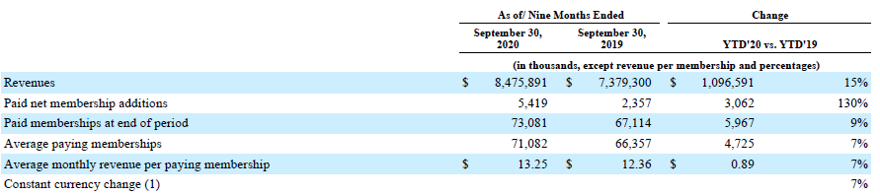
COVID Impact – UCAN Growth
Overview
Stock Performance
Company Information
Strategy
Leadership Team
Financials
Recommendation

Slide 58
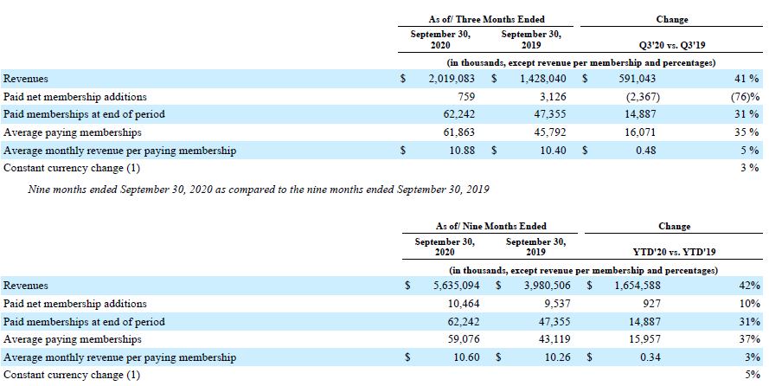
COVID Impact – EMEA Growth
Overview
Stock Performance
Company Information
Strategy
Leadership Team
Financials
Recommendation

Slide 59
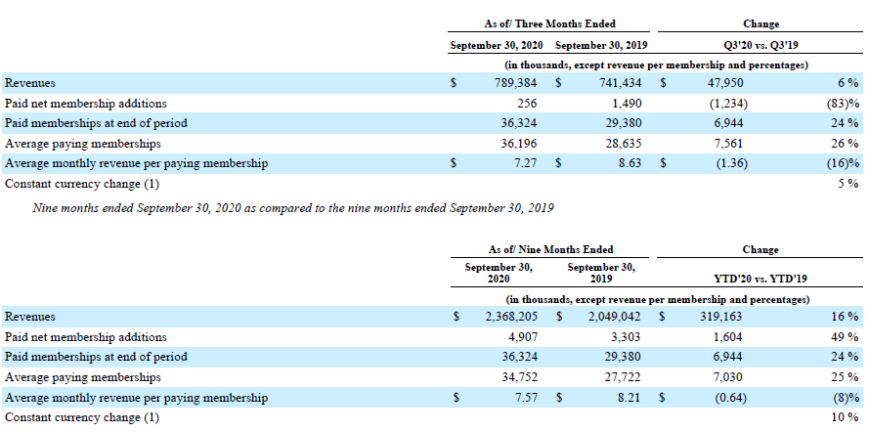
COVID Impact – LATAM Growth
Overview
Stock Performance
Company Information
Strategy
Leadership Team
Financials
Recommendation

Slide 60



Strong Leadership Team Guides NFLX
Founder & Co-CEO – Reed Hastings
CFO – Spencer Neumann
COO & CPO – Greg Peters
Founded Pure Software in 1991
Active philanthropist
Served on the California State Board of Education (2000-2004)
Current board of:
KIPP
Pahara
The City Fund
Joined in 2019
Previously CFO at Activision Blizzard
CFO and executive VP of Global Guest Experience of Walt Disney Parks and Resorts (2012- May 2017)
Private equity background
Executive VP of ABC (2001-2004)
BA in Economics, Harvard
MBA, Harvard
Joined in 2008
Previously International Development Officer
Previously Senior VP of Rovi Corporation
BS in physics and astronomy, Yale
Overview
Stock Performance
Company Information
Strategy
Leadership Team
Financials
Recommendation
Notes:
Spencer Neumann

Slide 61


Strong Leadership Team Guides NFLX
Co-CEO & CCO – Ted Sarandos
Chief Legal Officer – David Hyman
Joined in 2000
Oversees the team responsible for the acquisition and creation of all Netflix content
Responsible for a lot of Netflix’s successful content – ROMA, Money Heist, The Witcher, Stranger Things, House of Cards
Joined in 2002
Responsible for all legal and public policy matters
Previously General Counsel of Webvan (online retailer)
Practiced law at Morrison & Foerster and Arent Fox
JD and BA from University of Virginia
Overview
Stock Performance
Company Information
Strategy
Leadership Team
Financials
Recommendation
Notes:
Money Heist – responsible for massive subscriber growth in Spain
One of the few Spanish shows that gained notoriety all over the world that isn’t a telenovela

Slide 62
Balance Sheets
Overview
Stock Performance
Company Information
Strategy
Leadership Team
Financials
Recommendation

Slide 63
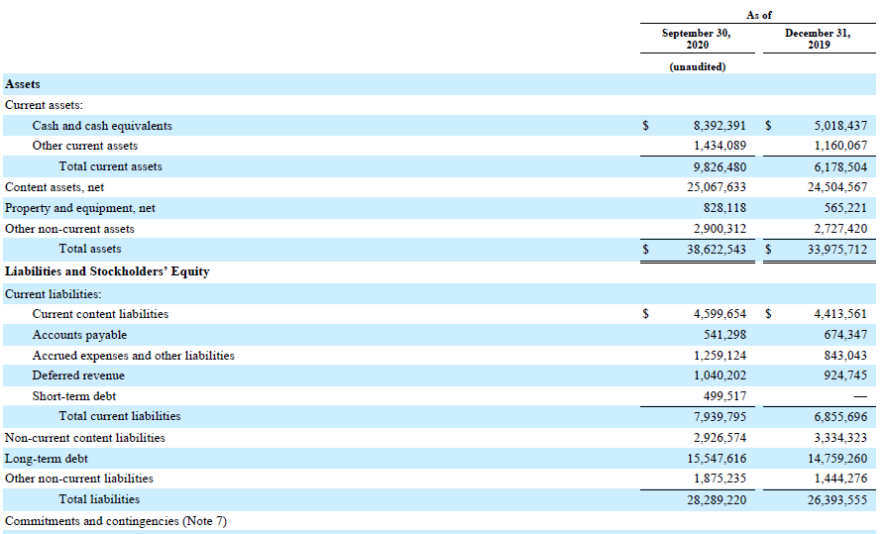
10-Q Balance Sheet (1)
Overview
Stock Performance
Company Information
Strategy
Leadership Team
Financials
Recommendation
Notes:
Continued growth in PPE and content
Their content acquisition has halted a bit since COVID, a lot of content are stuck in pre-production or in-production

Slide 64
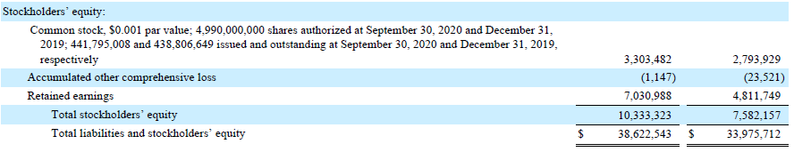
10-Q Balance Sheet (2)
Overview
Stock Performance
Company Information
Strategy
Leadership Team
Financials
Recommendation

Slide 65
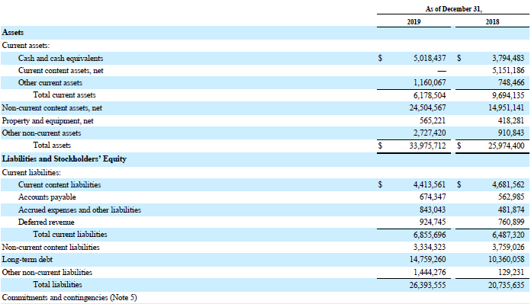
10-K Balance Sheet (1)
Overview
Stock Performance
Company Information
Strategy
Leadership Team
Financials
Recommendation
Notes:
Increased cash balance to improve liquidity, pretty prevalent in companies in the industry
In-development and LT content licensing
Non-current assets → production facilities (US, Mexico, Canada, Spain, India, Singapore, UK, Netherlands, Korea)

Slide 66
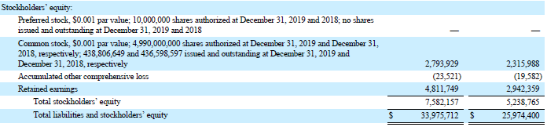
10-K Balance Sheet (2)
Overview
Stock Performance
Company Information
Strategy
Leadership Team
Financials
Recommendation
Notes:
Makes sense to lever up at this period, the rates are so low and they can use the accumulated capital for content production once restriction subsides

Slide 67
Income Statements
Overview
Stock Performance
Company Information
Strategy
Leadership Team
Financials
Recommendation

Slide 68
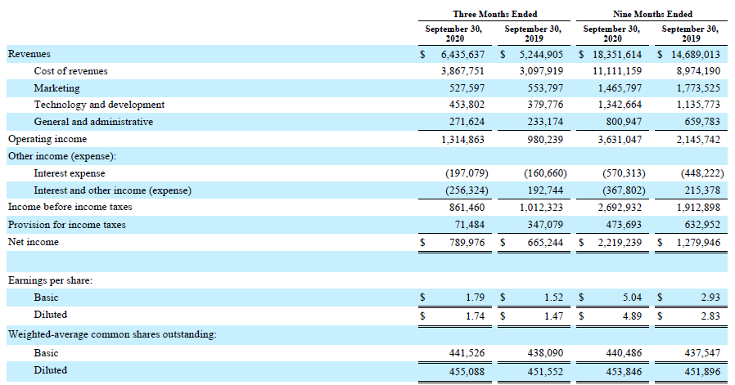
10-Q Income Statement
Overview
Stock Performance
Company Information
Strategy
Leadership Team
Financials
Recommendation
Notes:
YTD Net Income in Q3 almost double that of last year’s → really emphasizes how well COVID has played into their hands in the short term

Slide 69
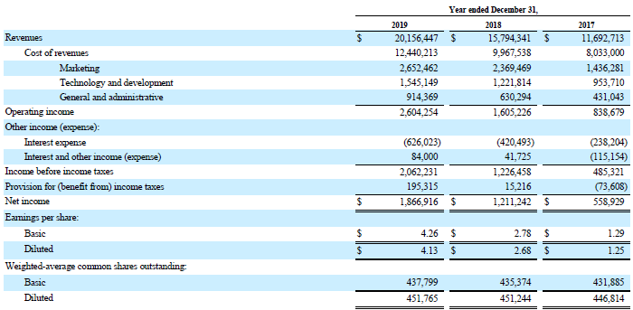
10-K Income Statement
Overview
Stock Performance
Company Information
Strategy
Leadership Team
Financials
Recommendation

Slide 70
Statement of Cash Flows
Overview
Stock Performance
Company Information
Strategy
Leadership Team
Financials
Recommendation

Slide 71
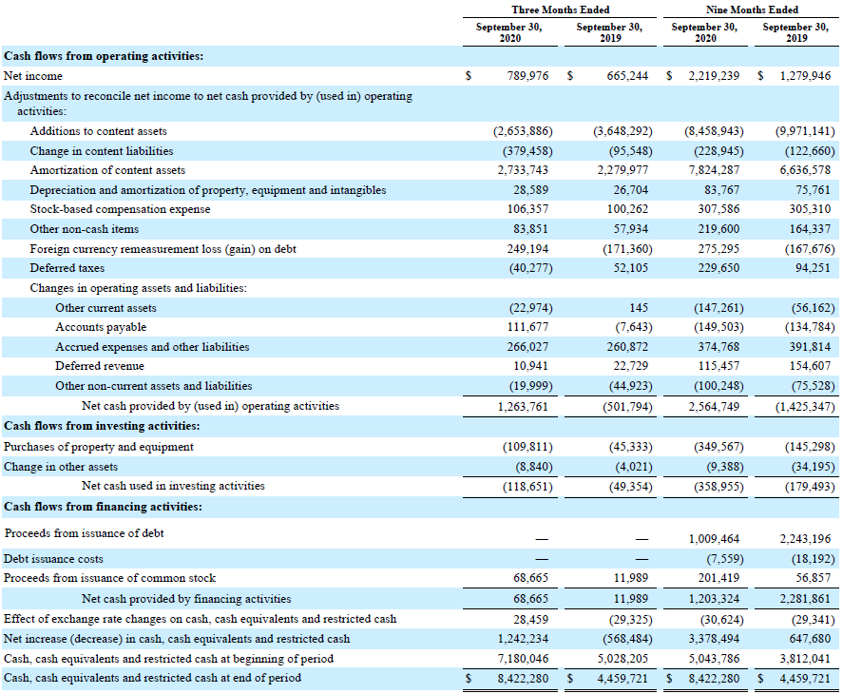
10-Q Cash Flows (1)
Overview
Stock Performance
Company Information
Strategy
Leadership Team
Financials
Recommendation
Notes:
Slowed down content production → COVID restrictions
Global presence in both offices, payments, and production makes them exposed to forex risks
USD weakened over the year

Slide 72

10-Q Cash Flows (2)
Overview
Stock Performance
Company Information
Strategy
Leadership Team
Financials
Recommendation
Notes:
Scale down on buying production equipment
Cash balance a lot more → might be to produce something big or just a glut (content production halt)
Had to sell off some PPE to increase cash balance and overall liquidity

Slide 73
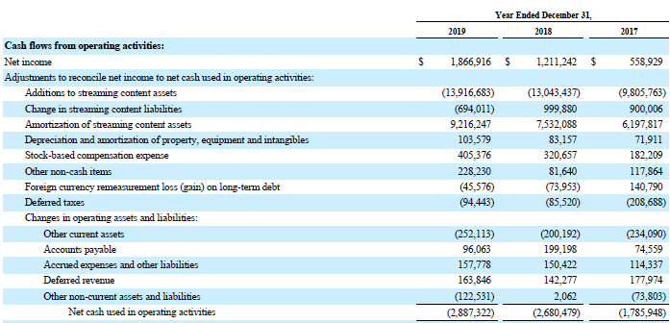
10-K Cash Flows (1)
Overview
Stock Performance
Company Information
Strategy
Leadership Team
Financials
Recommendation
Notes:
Net Income over the years
Growth in amortization expense because they’re adding more and more

Slide 74
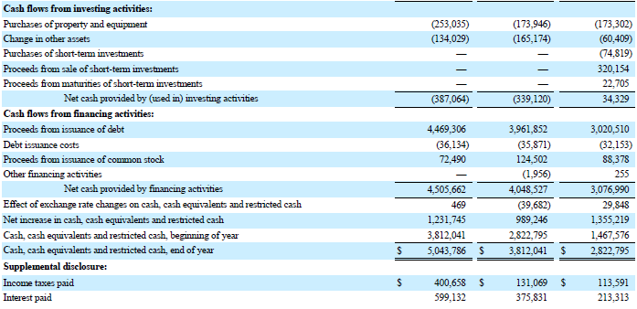
10-K Cash Flows (2)
Overview
Stock Performance
Company Information
Strategy
Leadership Team
Financials
Recommendation

Slide 75
Stockholder’s Equity
Overview
Stock Performance
Company Information
Strategy
Leadership Team
Financials
Recommendation

Slide 76
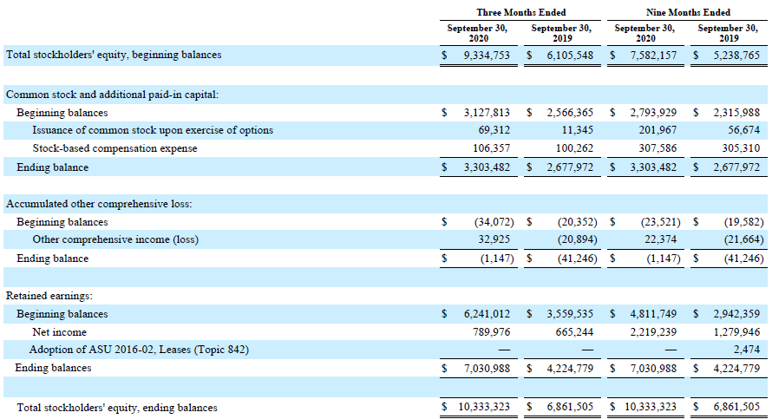
10-Q Stockholder’s Equity
Overview
Stock Performance
Company Information
Strategy
Leadership Team
Financials
Recommendation

Slide 77
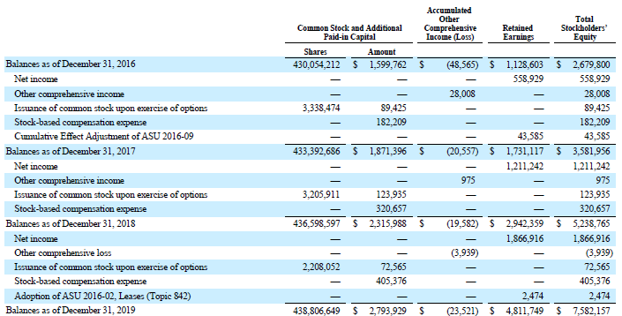
10-K Stockholder’s Equity
Overview
Stock Performance
Company Information
Strategy
Leadership Team
Financials
Recommendation

Slide 78
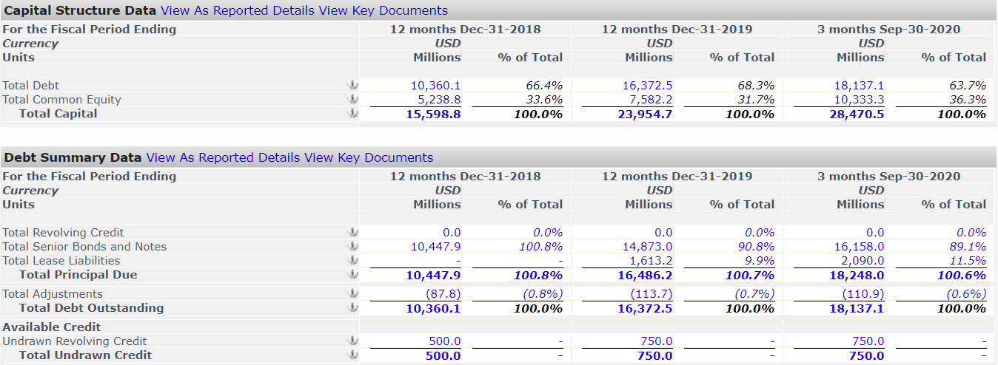
Capital Structure
Overview
Stock Performance
Company Information
Strategy
Leadership Team
Financials
Recommendation
Notes:
A lot of maturity are LT, most of them in 2025
All debt is at a fixed rate, compared to AMC which has over 20% in variable rates which my teammate will later touch on

Slide 79
Profitability & Margin Comps
 | LTM Gross Margin | LTM EBIT Margin | LTM Net Income Margin | LTM Net Income, 1Y Growth | LTM ROA | LTM ROE
DIS | 5.8% | 5.8% | (4.38%) | - | 1.2% | (2.4%)
VIAC | 38.3% | 15.6% | 5.22% | (75.92%) | 6.7% | 15.5%
AMC | 53% | 25.8% | 4.85% | (70.35%) | 8.3% | 15.6%
Mean | 32.4% | 15.7% | 1.90% | (73.13%) | 5.4% | 9.5%
NFLX | 38.8% | 17.2% | 11.78% | 98.48% | 7.3% | 32.6%
Overview
Stock Performance
Company Information
Strategy
Leadership Team
Financials
Recommendation
Notes:
Monster profitability compared to the other companies
Included Viacom as we find it similar (SHOWTIME, Nickelodeon, CBS)

Slide 80
Trading Multiple Comps
 | EV/Revenue | EV/EBITDA | EV/EBIT | P/E (Diluted) | P/BV | EV/Forward Revenue | EV/Forward EBITDA | Forward P/E
DIS | 4.8x | 31.7x | 69.9x | NM | NM | 4.45x | 28.64x | 64.94x
VIAC | 1.5x | 8.9x | 10.0x | 15.5x | NM | 1.46x | 7.97 | 7.85
AMC | 1.3x | 4.1x | 4.9x | 11.6x | NM | 1.25x | 5.72x | 3.84x
Mean | 2.5x | 14.9x | 28.2z | 13.6x | - | 2.39x | 14.11x | 25.54x
NFLX | 9.4x | 52.1x | 54.7x | 78.3x | NM | 7.88x | 37.41x | 55.93x
Overview
Stock Performance
Company Information
Strategy
Leadership Team
Financials
Recommendation
Notes:
Bubble territory, who knows?
Expensive stock

Slide 81
Recommendation
Rating: BUY
Strong balance sheet allows continuation of in-house content production post-COVID restrictions
NFLX’s large content-base has positioned themselves to capitalize on a halting industry
Success of exclusive/in-house content:
Strong content acquisition strategy
24 Oscars nominations in 2020 alone
Awards nominated: 432
Awards won: 203
Overview
Stock Performance
Company Information
Strategy
Leadership Team
Financials
Recommendation
Notes:
Buy but would wait for Q4 results, see if the subscriber growth is faltering

Slide 82

Ticker: AMCX
Exchange: NASDAQ

Slide 83
Stock Overview

Slide 84

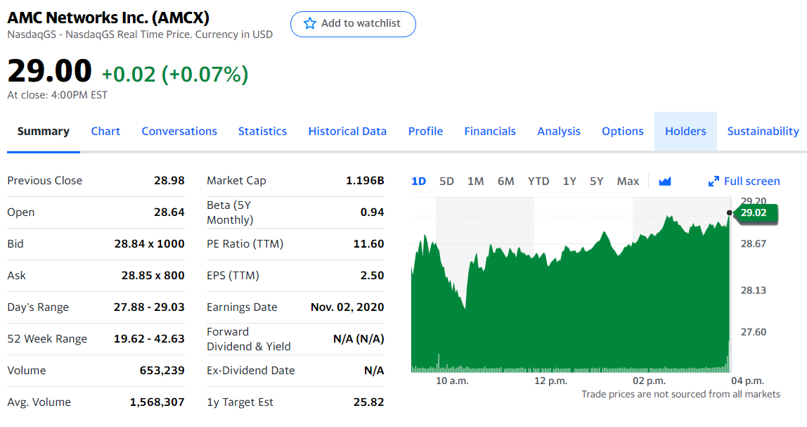
Stock Overview
Stock Overview
Company Overview
Corporate Strategy and Risk
Management Overview
Financial Statements
Industry Comparison
Recommendation
Notes:
[Talk about year performance, market cap, PE]

Slide 85
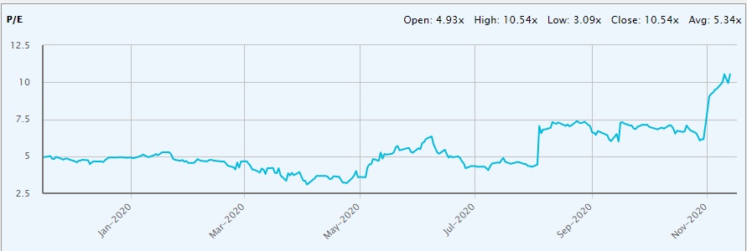
Stock Overview
Price to Earnings
Stock Overview
Company Overview
Corporate Strategy and Risk
Management Overview
Financial Statements
Industry Comparison
Recommendation
Notes:
[Talk about PE ratio]

Slide 86
Stock Overview
Earnings per Share
Stock Overview
Company Overview
Corporate Strategy and Risk
Management Overview
Financial Statements
Industry Comparison
Recommendation
Notes:
Large goodwill impairment of -98 million in Q4 2019 caused large EPS drop from a recalculation in the Fair value of AMCNI, The decrease in the estimated fair value was in response to current and expected trends across the International television broadcasting markets, as well as a decrease in the financial multiples used to estimate the fair value using the market approach.

Slide 87
Stock Overview
Dividends Paid and Stock Splits
Dividends
Stock Splits
AMCX is a non-dividend paying stock
There have been no stock splits
Stock Overview
Company Overview
Corporate Strategy and Risk
Management Overview
Financial Statements
Industry Comparison
Recommendation

Slide 88
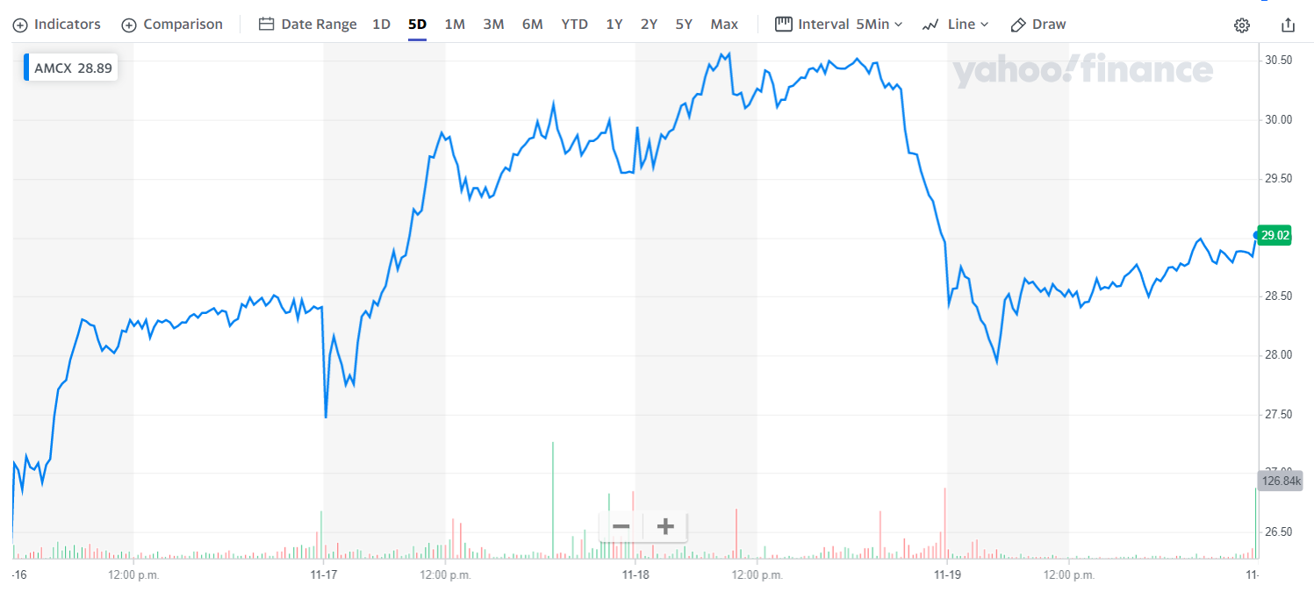
Stock Performance
5 Day
Stock Overview
Company Overview
Corporate Strategy and Risk
Management Overview
Financial Statements
Industry Comparison
Recommendation

Slide 89
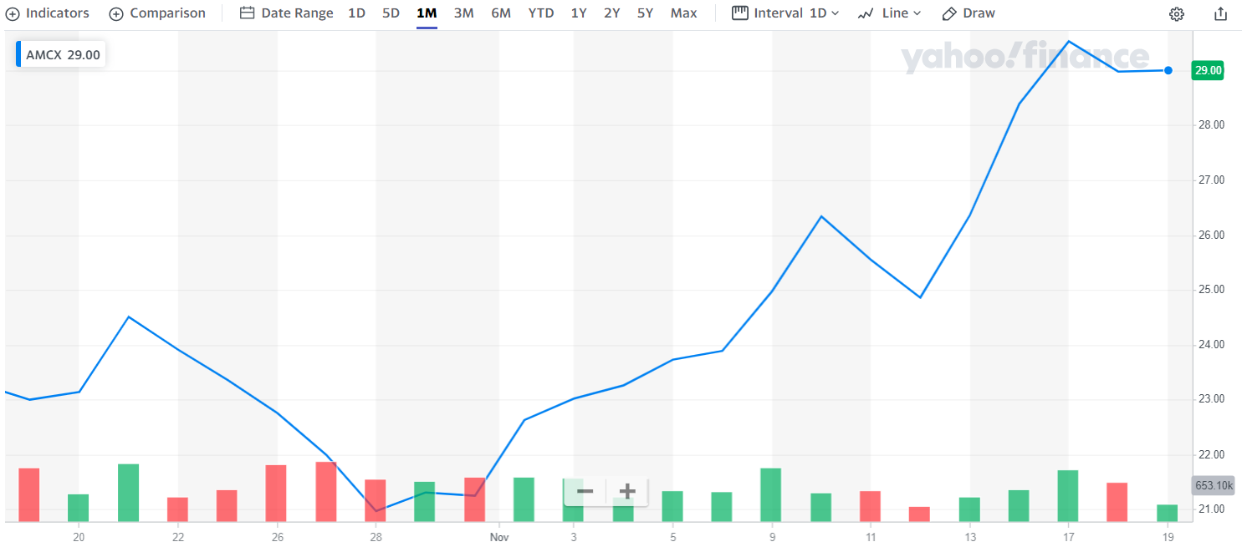
Stock Performance
1 Month
Stock Overview
Company Overview
Corporate Strategy and Risk
Management Overview
Financial Statements
Industry Comparison
Recommendation
Notes:
The large increase in share price in November comes from AMCX beating both revenue and earnings estimates

Slide 90
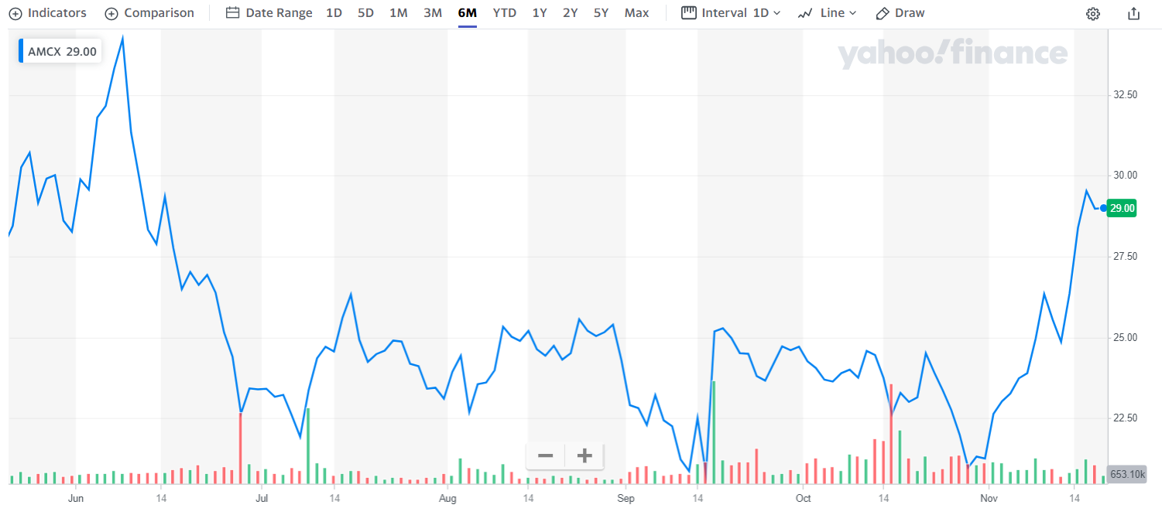
Stock Performance
6 Month
Stock Overview
Company Overview
Corporate Strategy and Risk
Management Overview
Financial Statements
Industry Comparison
Recommendation
Notes:
[Large fluctuations]

Slide 91
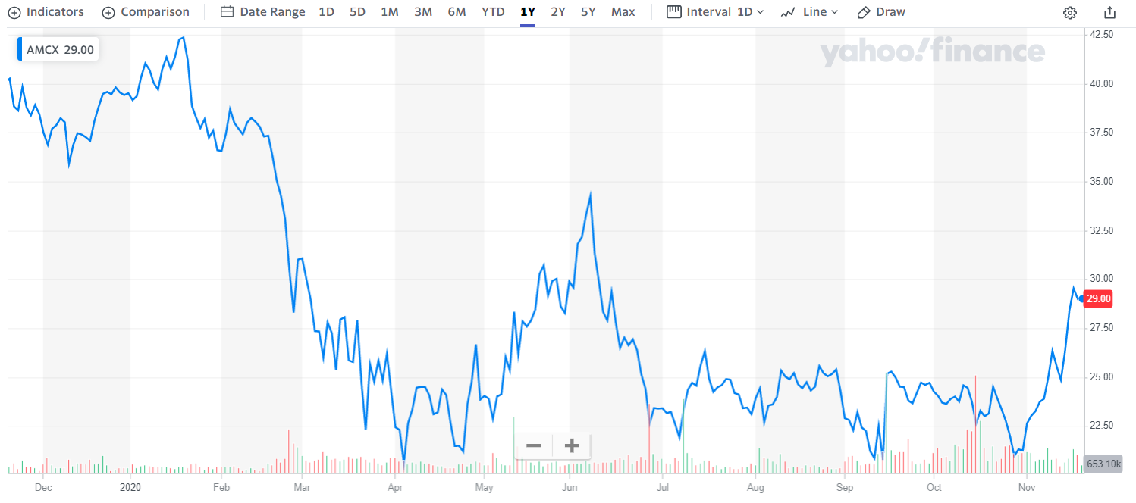
Stock Performance
1 Year
Stock Overview
Company Overview
Corporate Strategy and Risk
Management Overview
Financial Statements
Industry Comparison
Recommendation

Slide 92
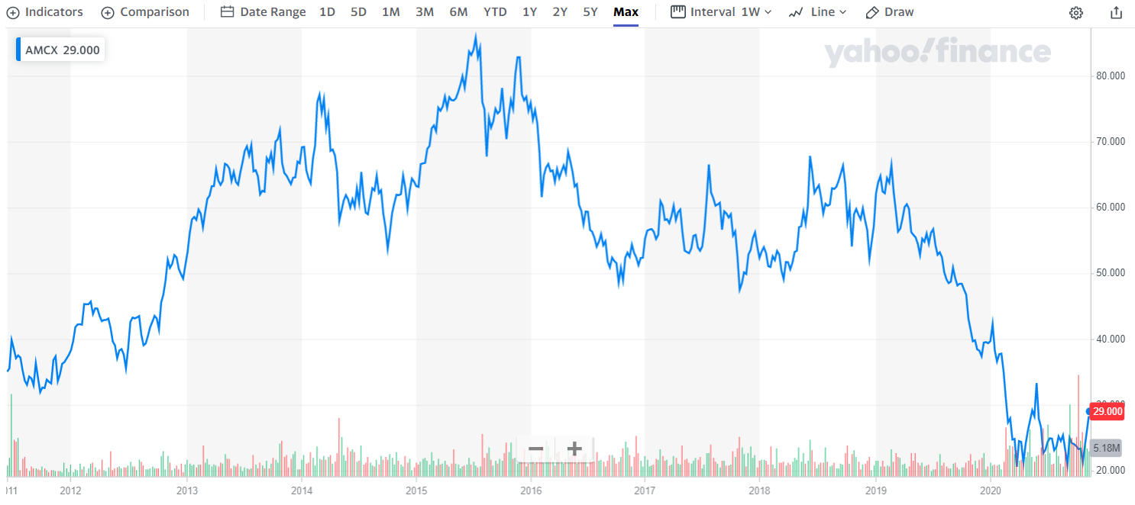
Stock Performance
Max (IPO 2011)
Stock Overview
Company Overview
Corporate Strategy and Risk
Management Overview
Financial Statements
Industry Comparison
Recommendation

Slide 93
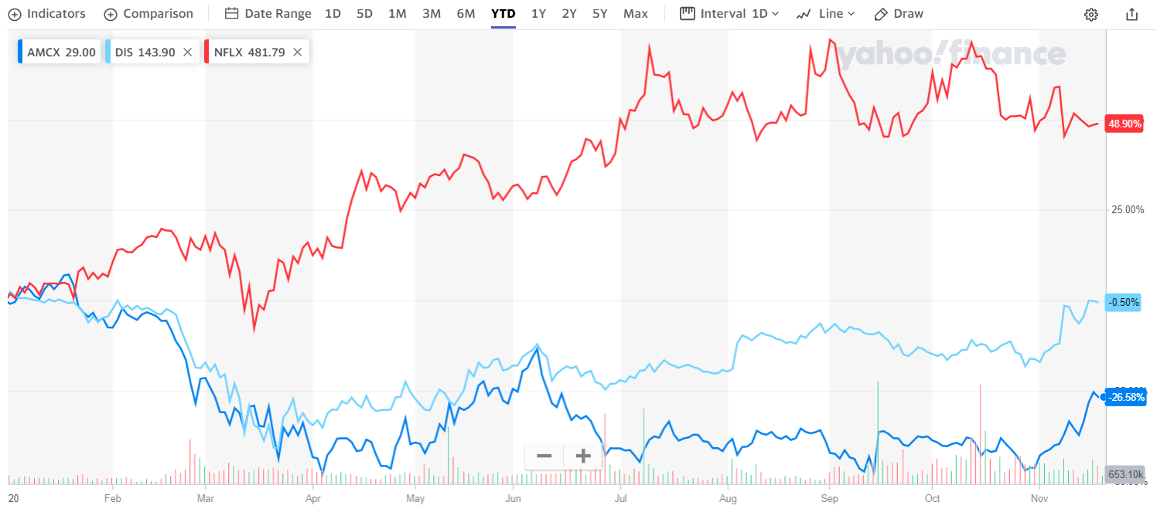
Stock Performance
Peer Comparison
Stock Overview
Company Overview
Corporate Strategy and Risk
Management Overview
Financial Statements
Industry Comparison
Recommendation

Slide 94
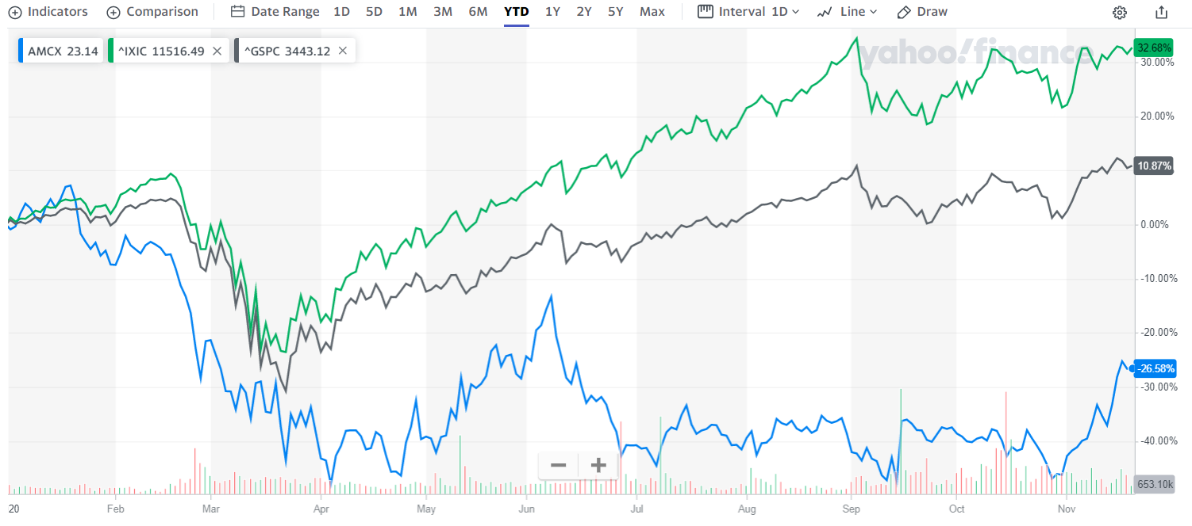
Stock Performance
Market Comparison
Stock Overview
Company Overview
Corporate Strategy and Risk
Management Overview
Financial Statements
Industry Comparison
Recommendation

Slide 95
Company Overview

Slide 96
Company Overview
AMC Networks is a Global Entertainment Company
Known for producing award-winning content
Own and operate multiple SVOD platforms
Programming is both created in-house and acquired externally
Mainly creates and programs adult-oriented television friendly content, both scripted and unscripted
Current programming includes Dramas, Anthologies, Docuseries, Reality Shows, Variety Shows, and Acquired Shows
Stock Overview
Company Overview
Corporate Strategy and Risk
Management Overview
Financial Statements
Industry Comparison
Recommendation
Notes:
[Different SVOD platforms]

Slide 97
Company Overview
Award Winning Programming
AMC has many award winning shows, including:
Mad Men
Breaking Bad
The Walking Dead
Turn: Washington Spies
Hell on Wheels
The Killing
Stock Overview
Company Overview
Corporate Strategy and Risk
Management Overview
Financial Statements
Industry Comparison
Recommendation

Slide 98
Company Overview
Timeline
1973
1980
1982
1983
CableVision is formed by Charles Dolan with systems serving New Jersey and surrounding areas
Rainbow Media is formed as a subdivision of CableVision
Formed the PlayBoy Channel with PlayBoy
Acquired Philadelphia’s Regional sports channel with Washington Post Company
Stock Overview
Company Overview
Corporate Strategy and Risk
Management Overview
Financial Statements
Industry Comparison
Recommendation

Slide 99
Company Overview
Timeline
1988
1994
2005
2011
CableVision merges cable networks with NBC, NBC now owns a 50% stake
Launch of the Canadian Music Channel MuchMusic
Initial thoughts of spinning RainbowMedia into a public company, plan withdrawn
Rainbow Meia spins off into AMC Networks and becomes a publicly traded company
Shares initially traded at $43.50
Stock Overview
Company Overview
Corporate Strategy and Risk
Management Overview
Financial Statements
Industry Comparison
Recommendation

Slide 100
Company Overview
Timeline
2013
2014
2016
2018
2020
AMC acquires ChelloMedia from Liberty Global
Purchase of a 49.9% stake in BBC America for $200 million
Partnership with RLJ Company for use of programming and distribution to benefit Acorn and UMC
Purchase of remaining RLJ shares for $59 million
Charles Dolan retires from his position, his son James is appointed Chairman
Stock Overview
Company Overview
Corporate Strategy and Risk
Management Overview
Financial Statements
Industry Comparison
Recommendation

Slide 101
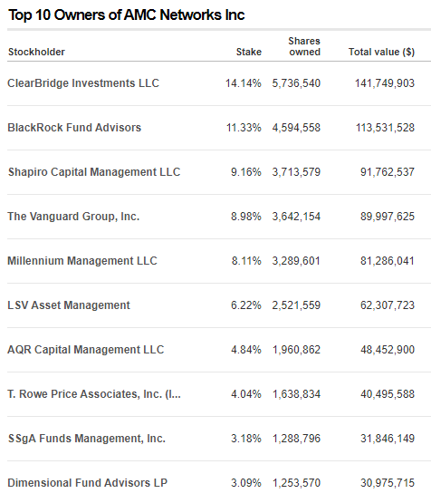
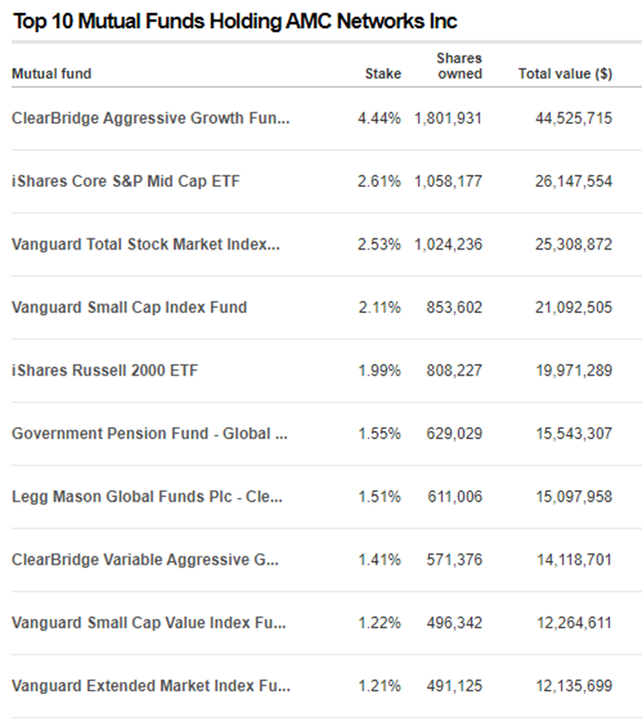
Company Overview
Institutional Ownership
Stock Overview
Company Overview
Corporate Strategy and Risk
Management Overview
Financial Statements
Industry Comparison
Recommendation

Slide 102
Company Overview
Revenue Streams
AMCX has two revenue streams
Distribution of Programming
Sale of Advertising
Accounts for 68% of consolidated revenues
Includes subscription revenue and content licensing revenue
Accounts for 32% of consolidated revenues
Sell advertising on both and upfront and scatter bassis
Upfront = Pre-sale in advance of season screening
Scatter = Purchase closer to the time of the commercial airing
Stock Overview
Company Overview
Corporate Strategy and Risk
Management Overview
Financial Statements
Industry Comparison
Recommendation
Notes:
[Revenue streams and their main sources of income, focus more on domestic market]

Slide 103





Company Overview
Subsidiaries
Levity Entertainment Group
WeTV
IFC Films and Entertainment
SunDanceTV
ChelloMedia
Stock Overview
Company Overview
Corporate Strategy and Risk
Management Overview
Financial Statements
Industry Comparison
Recommendation
Notes:
[Talk about content on each platform]

Slide 104
Company Overview
Business Segments
Business is managed through two operating segments
National Networks
International and Other
Activities of five national programming networks
AMC, WE tv, BBC America, IFC, SunDanceTC
Domestic (US-Based) subscribers to SVOD
Includes AMCNI (international programming business)
International subscribers to SVOD
Stock Overview
Company Overview
Corporate Strategy and Risk
Management Overview
Financial Statements
Industry Comparison
Recommendation

Slide 105
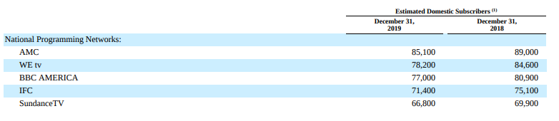
Company Overview
Domestic Subscribers (2019 10K)
February 26, 2020
2020 Year End Estimate
Passed 2 million streaming subscribers worldwide
Across all 4 streaming platforms
Agreement with DISH Network includes launch of targeted SVOD services
Estimate of roughly 4 million subscribers worldwide by year end
Subscriber base alone valued at $1 billion
Stock Overview
Company Overview
Corporate Strategy and Risk
Management Overview
Financial Statements
Industry Comparison
Recommendation
Notes:
[Future outlook with the estimated increase in subscriber base and valuation]

Slide 106
Corporate Strategy and Risks

Slide 107
Corporate Strategy and Risks
Corporate Strategy
AMC’s corporate strategy focuses on:
Continued development of high-quality original programming
Increase ownership and control of content and IP
Develop and grow new target direct-to-consumer offerings and brands
Innovation in content, format, distribution, and products
Growth and innovation in advertising
Stock Overview
Company Overview
Corporate Strategy and Risk
Management Overview
Financial Statements
Industry Comparison
Recommendation
Notes:
[Expand on strategy – 10K]

Slide 108
Corporate Strategy and Risks
Business Risks
The risks AMC is exposed to are:
Unpredictable/Volatile Industry
Change in distributors and decline in subscribers
Inability to secure quality programming
Increased programming costs
Theft of content and digital copyright infringement
Distributors have large bargaining power
Intense competition
Ability to adapt to new tech and changing consumer behaviour
Inability to attract and retain SVOD subscribers
Adverse Advertising Market condition
Stock Overview
Company Overview
Corporate Strategy and Risk
Management Overview
Financial Statements
Industry Comparison
Recommendation
Notes:
[Expand on points]

Slide 109
Corporate Strategy and Risks
Impact of COVID-19
The impact of COVID-19:
Adverse advertising sales impacts
Suspended content production, leading to delays in creation and availability of programming
Comedy venues closed temporarily
Cannot reasonably predict the impact of the virus on financials, but there can be declared a material impact on operations
Stock Overview
Company Overview
Corporate Strategy and Risk
Management Overview
Financial Statements
Industry Comparison
Recommendation
Notes:
[Expand on covid impacts]

Slide 110
Corporate Strategy and Risks
Stock Repurchase Program
Stock repurchase programs have been put into place
Repurchased 10.8 million shares for $251 million on October 21, 2020
Board authorized Modified Dutch Auction Tender program to repurchase up to $1.5 billion of outstanding common shares
No pre-established closing date and may be suspended or closed at any time
Stock Overview
Company Overview
Corporate Strategy and Risk
Management Overview
Financial Statements
Industry Comparison
Recommendation
Notes:
[Combine the dutch auction tenders and talk about that]

Slide 111
Management Overview

Slide 112
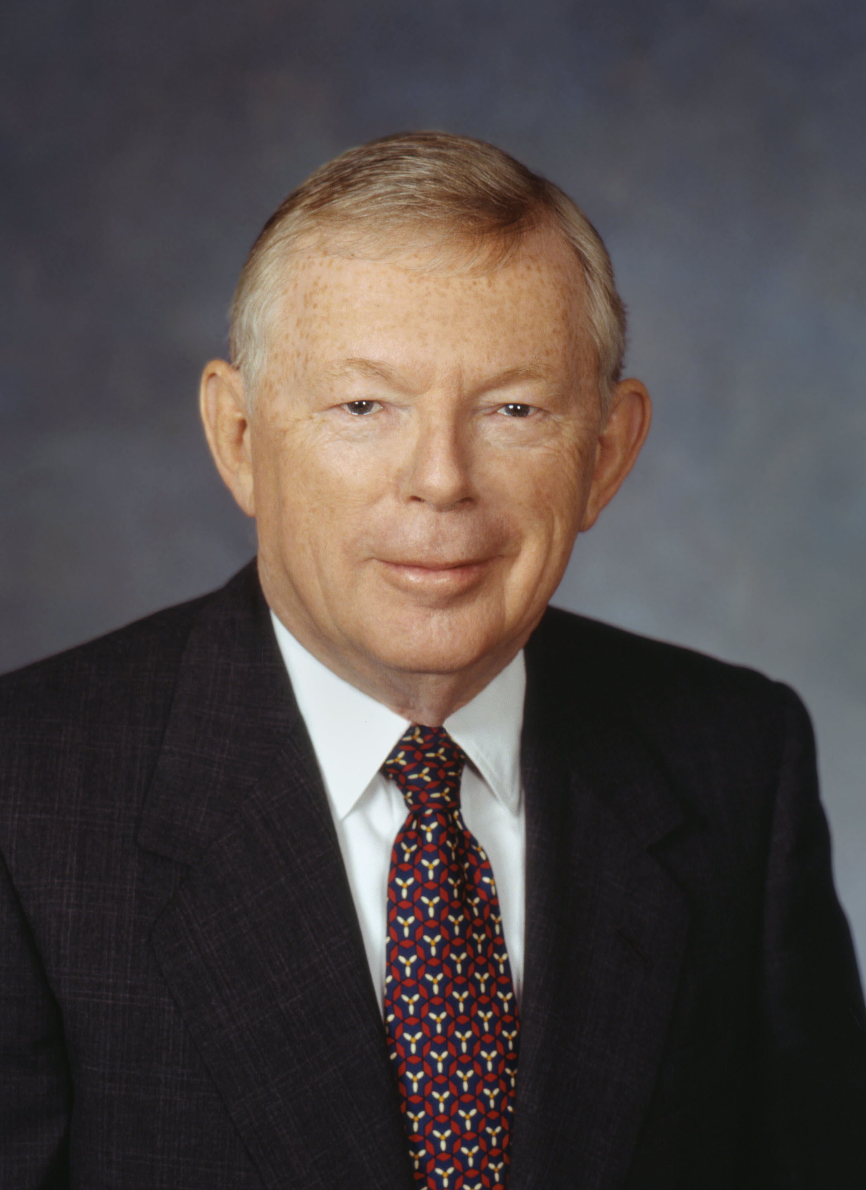

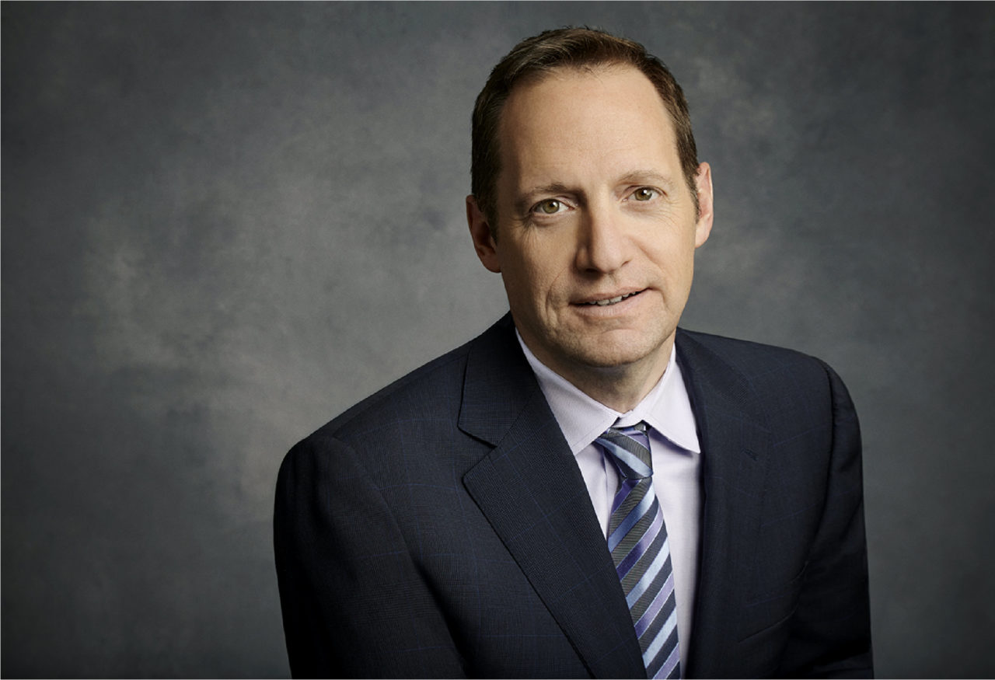
Corporate Leadership
Chairman Emeritus & Founder
Charles Dolan
President & CEO
Joshua Sapan
COO
Edward Carroll
Founded Cablevision Systems Corp.
Serves on the board of Madison Square Garden Entertainment, Networks, and Sports
President, CEO 1995 to present
Led Successful spinoff from Cablevision Systems Corp in 2011
Earlier in career, spearheaded development of Bravo Network
Serves on several other boards, including American Film Institute, Paley Center for Media, and more
Oversees all operations for AMC Network’s television networks, advertising sales, and AMC Networks International
Prior to COO position, he was AMC Network’s President of Entertainment Services
28 Year veteran with AMC
Stock Overview
Company Overview
Corporate Strategy and Risk
Management Overview
Financial Statements
Industry Comparison
Recommendation
Notes:
[Expand a bit on the people]

Slide 113


Corporate Leadership
Interim CFO
Donna Coleman
Non-Executive Chairman
James Dolan
Previously was the Executive Vice President, Finance at the Madison Square Garden Company
Has held several executive finance positions with MSG, Cablevisions Corp
Executive Chairman of the Madison Square Garden Company
CableVision CEO 1995 to 2016
Owner of the New York Knicks, New York Rangers, New York Liberty
Stock Overview
Company Overview
Corporate Strategy and Risk
Management Overview
Financial Statements
Industry Comparison
Recommendation
Notes:
[Expand on people]

Slide 114

Corporate Leadership
Executive Compensation
Stock Overview
Company Overview
Corporate Strategy and Risk
Management Overview
Financial Statements
Industry Comparison
Recommendation
Notes:
[Main sources of executive comp]

Slide 115
Financial Statements

Slide 116

2020 Q3
Balance Sheet
Stock Overview
Company Overview
Corporate Strategy and Risk
Management Overview
Financial Statements
Industry Comparison
Recommendation
Notes:
Program Rights Obligations means all obligations in respect of the purchase, use, license or acquisition of programs, programming materials, films and similar assets that relate to the utilization of the Program Rights.

Slide 117

2019 10K
Balance Sheet - Assets
Stock Overview
Company Overview
Corporate Strategy and Risk
Management Overview
Financial Statements
Industry Comparison
Recommendation

Slide 118

2019 10K
Balance Sheet – Liabilities and Shareholder’s Equity
Stock Overview
Company Overview
Corporate Strategy and Risk
Management Overview
Financial Statements
Industry Comparison
Recommendation

Slide 119

2019 10K
Consolidated Income Statement
Stock Overview
Company Overview
Corporate Strategy and Risk
Management Overview
Financial Statements
Industry Comparison
Recommendation

Slide 120

2020 Q3
Income Statement
Stock Overview
Company Overview
Corporate Strategy and Risk
Management Overview
Financial Statements
Industry Comparison
Recommendation

Slide 121

2019 10K
Statement of Cash Flows - Operating
Stock Overview
Company Overview
Corporate Strategy and Risk
Management Overview
Financial Statements
Industry Comparison
Recommendation

Slide 122
2019 10K
Statement of Cash Flows – Investing and Financing
Stock Overview
Company Overview
Corporate Strategy and Risk
Management Overview
Financial Statements
Industry Comparison
Recommendation

Slide 123

2020 Q3
Statement of Cash Flows - Operating
Stock Overview
Company Overview
Corporate Strategy and Risk
Management Overview
Financial Statements
Industry Comparison
Recommendation

Slide 124

2020 Q3
Statement of Cash Flows – Investing and Financing
Stock Overview
Company Overview
Corporate Strategy and Risk
Management Overview
Financial Statements
Industry Comparison
Recommendation

Slide 125

2020 Q3
MD&A
Consolidated Results of Operations
Stock Overview
Company Overview
Corporate Strategy and Risk
Management Overview
Financial Statements
Industry Comparison
Recommendation

Slide 126

2019 10K
MD&A
Consolidated Results of Operations
Stock Overview
Company Overview
Corporate Strategy and Risk
Management Overview
Financial Statements
Industry Comparison
Recommendation

Slide 127

2019 10K
MD&A
Stock Overview
Company Overview
Corporate Strategy and Risk
Management Overview
Financial Statements
Industry Comparison
Recommendation

Slide 128

2019 10K
MD&A
Stock Overview
Company Overview
Corporate Strategy and Risk
Management Overview
Financial Statements
Industry Comparison
Recommendation

Slide 129


2019 10K
MD&A
Stock Overview
Company Overview
Corporate Strategy and Risk
Management Overview
Financial Statements
Industry Comparison
Recommendation

Slide 130


Capital Structure
Stock Overview
Company Overview
Corporate Strategy and Risk
Management Overview
Financial Statements
Industry Comparison
Recommendation

Slide 131

Capital Structure
Additional Notes
Current Debt
Operations
$2,894,800 in debt due in 2025 or before
93.07% of total debt due in next 5 years
Operations have historically been funded through operating cash flows
Revolving credit may be put under duress from current economic situation
Interest rate risk managed by entering into interest rate swap contracts to fix borrowing rates
Stock Overview
Company Overview
Corporate Strategy and Risk
Management Overview
Financial Statements
Industry Comparison
Recommendation

Slide 132
Industry Comparison

Slide 133
Industry Comparison
Monthly Growth
NOTE: “INDUSTRY” is a compilation of 119 companies consisting of both direct and indirect competitors to AMCX, DIS, and NFLX to use as a comparison.
Stock Overview
Company Overview
Corporate Strategy and Risk
Management Overview
Financial Statements
Industry Comparison
Recommendation

Slide 134

Industry Comparison
From 2019 10K
Stock Overview
Company Overview
Corporate Strategy and Risk
Management Overview
Financial Statements
Industry Comparison
Recommendation

Slide 135
Industry Comparison
Company Comparisons
 | LTM Gross Margin | LTM EBIT Margin | LTM Net Income Margin | LTM Net Income, 1Y Growth | LTM ROA | LTM ROE
DIS | 5.8% | 5.8% | (4.38%) | - | 1.2% | (2.4%)
VIAC | 38.3% | 15.6% | 5.22% | (75.92%) | 6.7% | 15.5%
NFLX | 38.8% | 17.2% | 11.78% | 98.48% | 7.3% | 32.6%
Mean | 32.4% | 15.7% | 1.90% | (73.13%) | 5.4% | 9.5%
AMC | 53% | 25.8% | 4.85% | (70.35%) | 8.3% | 15.6%
Stock Overview
Company Overview
Corporate Strategy and Risk
Management Overview
Financial Statements
Industry Comparison
Recommendation
Notes:
[Talk about AMC standpoint with competitors]

Slide 136
Industry Comparison
Company Comparisons
 | EV/Revenue | EV/EBITDA | EV/EBIT | P/E (Diluted) | P/BV | EV/Forward Revenue | EV/Forward EBITDA | Forward P/E
DIS | 4.8x | 31.7x | 69.9x | NM | NM | 4.45x | 28.64x | 64.94x
VIAC | 1.5x | 8.9x | 10.0x | 15.5x | NM | 1.46x | 7.97 | 7.85
NFLX | 9.4x | 52.1x | 54.7x | 78.3x | NM | 7.88x | 37.41x | 55.93x
Mean | 2.5x | 14.9x | 28.2z | 13.6x | - | 2.39x | 14.11x | 25.54x
AMC | 1.3x | 4.1x | 4.9x | 11.6x | NM | 1.25x | 5.72x | 3.84x
Stock Overview
Company Overview
Corporate Strategy and Risk
Management Overview
Financial Statements
Industry Comparison
Recommendation
Notes:
[Talk about AMC standpoint with competitors]

Slide 137
Recommendation
HOLD
Notes:
[Expand on why it’s a hold]

Slide 138

Disney
Ticker: DIS

Slide 139

Stock Overview
Overview
Stock Performance
Company Overview
Notable Events
Management Overview
Financial Statements
Recommendation

Slide 140

Stock Performance
DIS

Slide 141

1Y Stock Performance
Select
Select
Select
Overview
Stock Performance
Company Overview
Notable Events
Management Overview
Financial Statements
Recommendation

Slide 142

5Y Stock Performance
Select
Select
Select
Overview
Stock Performance
Company Overview
Notable Events
Management Overview
Financial Statements
Recommendation

Slide 143

20Y Stock Performance
Select
Select
Select
Overview
Stock Performance
Company Overview
Notable Events
Management Overview
Financial Statements
Recommendation

Slide 144

1Y Industry Comparison
Select
Select
Select
Overview
Stock Performance
Company Overview
Notable Events
Management Overview
Financial Statements
Recommendation

Slide 145

Peer Comparison
Select
Select
Select
Overview
Stock Performance
Company Overview
Notable Events
Management Overview
Financial Statements
Recommendation

Slide 146

P/E Ratio
Select
Select
Select
Overview
Stock Performance
Company Overview
Notable Events
Management Overview
Financial Statements
Recommendation

Slide 147

EPS
Select
Select
Select
Overview
Stock Performance
Company Overview
Notable Events
Management Overview
Financial Statements
Recommendation

Slide 148

5Y Dividends
Select
Select
Select
Overview
Stock Performance
Company Overview
Notable Events
Management Overview
Financial Statements
Recommendation

Slide 149

Institutional Ownership
Select
Select
Select
Overview
Stock Performance
Company Overview
Notable Events
Management Overview
Financial Statements
Recommendation

Slide 150

Top Mutual Fund Holders
Select
Select
Select
Overview
Stock Performance
Company Overview
Notable Events
Management Overview
Financial Statements
Recommendation

Slide 151

Company Overview
DIS

Slide 152




Company Overview
A diversified worldwide entertainment company headquartered in Burbank, California
Operations in four business segments:
Media Networks
Parks, Experiences, and Products
Studio Entertainment
Direct-to-Consumer & International (DTCI)
Overview
Stock Performance
Company Overview
Notable Events
Management Overview
Financial Statements
Recommendation

Slide 153

Revenue by Segment, Fiscal Year 2019
Overview
Stock Performance
Company Overview
Notable Events
Management Overview
Financial Statements
Recommendation

Slide 154






Media Networks
About
Deals with Disney’s array of television networks, cable channels, associated production and distribution companies, and owned and operated television stations
Two divisions–Walt Disney Television and ESPN
Overview
Stock Performance
Company Overview
Notable Events
Management Overview
Financial Statements
Recommendation
Notes:
https://www.retailcouncil.org/wp-content/uploads/2018/12/RCC-Canadian-Shopping-Centre-Study-2018_EN_Final-Rev1.pdf for mall traffic and rent numbers
https://ca.finance.yahoo.com/news/17-chick-fil-minimum-wage-090000722.html wage info

Slide 155




Parks, Experiences, and Products
About
The global hub that brings Disney’s stories, characters, and franchises to life through theme parks and resorts, cruise and vacation experiences, and consumer products
From toys to apparel, and books to video games
Overview
Stock Performance
Company Overview
Notable Events
Management Overview
Financial Statements
Recommendation
Notes:
https://www.retailcouncil.org/wp-content/uploads/2018/12/RCC-Canadian-Shopping-Centre-Study-2018_EN_Final-Rev1.pdf for mall traffic and rent numbers
https://ca.finance.yahoo.com/news/17-chick-fil-minimum-wage-090000722.html wage info

Slide 156

Parks, Experiences, and Products
Walt Disney World Resort
Disneyland Resort
Disneyland Paris
Hong Kong Disneyland Resort
Shanghai Disneyland Resort
Walt Disney World Resort
Disneyland Resort
Disneyland Paris
Hong Kong Disneyland Resort
Shanghai Disneyland Resort
Overview
Stock Performance
Company Overview
Notable Events
Management Overview
Financial Statements
Recommendation

Slide 157



Studio Entertainment
About
Encompasses Disney, Walt Disney Animation Studios, Pixar Animation Studios, Disneynature, Marvel Studios, Lucasfilm, 20th Century Studios, Searchlight Pictures, and Blue Sky Studios
Walt Disney Records, Hollywood Records, and Disney Theatrical Productions
Overview
Stock Performance
Company Overview
Notable Events
Management Overview
Financial Statements
Recommendation
Notes:
https://www.retailcouncil.org/wp-content/uploads/2018/12/RCC-Canadian-Shopping-Centre-Study-2018_EN_Final-Rev1.pdf for mall traffic and rent numbers
https://ca.finance.yahoo.com/news/17-chick-fil-minimum-wage-090000722.html wage info

Slide 158

Direct-to-Consumer & International
About
Comprises of Disney’s international business units and direct-to-consumer streaming services
Mission is to provide entertainment to consumers around the world with convenience and personalization
Overview
Stock Performance
Company Overview
Notable Events
Management Overview
Financial Statements
Recommendation
Notes:
https://www.retailcouncil.org/wp-content/uploads/2018/12/RCC-Canadian-Shopping-Centre-Study-2018_EN_Final-Rev1.pdf for mall traffic and rent numbers
https://ca.finance.yahoo.com/news/17-chick-fil-minimum-wage-090000722.html wage info

Slide 159

History of Disney
1923
1929
Beginning of the Walt Disney Company, first known as Disney Brothers Cartoon Studio, by signing a contract with M.J. Winkler to produce a series of Alice Comedies
Partnership replaced by 4 companies: Walt Disney Productions, Ltd.; Walt Disney Enterprises; Liled Reality and Investment Company; Disney Film Recording Company
1928
Debut of Steamboat Willie, the first animated film that starred Mickey Mouse, at the Colony Theatre in New York
Overview
Stock Performance
Company Overview
Notable Events
Management Overview
Financial Statements
Recommendation

Slide 160


History of Disney
1932
1940
Disney’s first full-colour cartoon, Flower and Trees, and first Academy Award Winner for Cartoon Shorts debuts
First stock issued by Walt Disney Productions
Disney Studio moves to Burbank, California
1937
Snow White and the Seven Dwarfs premiers at Carthay Circle Theatre in Los Angeles
First feature-length animated film
Overview
Stock Performance
Company Overview
Notable Events
Management Overview
Financial Statements
Recommendation

Slide 161


History of Disney
1950
1955
Disney’s first live-action, Treasure Island, opens in theatres
Disney’s first Television show, One hour in Wonderland, airs
Disneyland opens
1952
WED Enterprises established
Overview
Stock Performance
Company Overview
Notable Events
Management Overview
Financial Statements
Recommendation

Slide 162


History of Disney
1971
1982
1983
Walt Disney World opens
EPCOT Centre opens
Disney’s first international park, Toykyo Disneyland, opens
The Disney Channel begins broadcasting
Overview
Stock Performance
Company Overview
Notable Events
Management Overview
Financial Statements
Recommendation

Slide 163

History of Disney
1984
1986
1987
Michael Eisner and Frank Wells named chairman and president of Walt Disney Productions respectively
The first Touchstone film Splash opens in theaters
Walt Disney Productions renamed to The Walt Disney Company
The first Disney Store opens in Glendale, California
Overview
Stock Performance
Company Overview
Notable Events
Management Overview
Financial Statements
Recommendation

Slide 164


History of Disney
1996
2005
2006
Stockholders approve of Disney merger with Capital Cities/ABC
Robert A. Iger becomes Chief Executive Officer
Disney purchases Pixar Animation Studios
Overview
Stock Performance
Company Overview
Notable Events
Management Overview
Financial Statements
Recommendation

Slide 165



History of Disney
2009
2015
Completion of Marvel Entertainment acquisition
Release of Star Wars: The Force Awakens; the first Lucasfilm title released from The Walt Disney Company
2012
Completion of Lucasfilm acquisition
Overview
Stock Performance
Company Overview
Notable Events
Management Overview
Financial Statements
Recommendation

Slide 166



History of Disney
2016
2018
Shanghai Disney resort opens
Disney launches ESPN+
2019
Completion of 21st Century Fox acquisition
Overview
Stock Performance
Company Overview
Notable Events
Management Overview
Financial Statements
Recommendation

Slide 167

History of Disney
2020
Bob Chapek becomes Chief Executive Officer and Bob Iger becomes Executive Chairman
Overview
Stock Performance
Company Overview
Notable Events
Management Overview
Financial Statements
Recommendation

Slide 168

Effects of Covid-19 on Operations
Initial Impact
Parks closed mid-March or operating at reduced capacity
Cruise ships and guided tours suspended
Closed retail stores
Delayed or cancelled theatrical releases
Overview
Stock Performance
Company Overview
Notable Events
Management Overview
Financial Statements
Recommendation
Notes:
https://www.retailcouncil.org/wp-content/uploads/2018/12/RCC-Canadian-Shopping-Centre-Study-2018_EN_Final-Rev1.pdf for mall traffic and rent numbers
https://ca.finance.yahoo.com/news/17-chick-fil-minimum-wage-090000722.html wage info

Slide 169

Effects of Covid-19 on Operations
Revenue by Segment
Estimation on the net adverse impact of Covid-19 on quarter 4 income is $3.1 billion and $7.4 billion on full year segment operating income
Overview
Stock Performance
Company Overview
Notable Events
Management Overview
Financial Statements
Recommendation
Notes:
https://www.retailcouncil.org/wp-content/uploads/2018/12/RCC-Canadian-Shopping-Centre-Study-2018_EN_Final-Rev1.pdf for mall traffic and rent numbers
https://ca.finance.yahoo.com/news/17-chick-fil-minimum-wage-090000722.html wage info

Slide 170

Effects of Covid-19 on Operations
Overview
Stock Performance
Company Overview
Notable Events
Management Overview
Financial Statements
Recommendation
Notes:
https://www.retailcouncil.org/wp-content/uploads/2018/12/RCC-Canadian-Shopping-Centre-Study-2018_EN_Final-Rev1.pdf for mall traffic and rent numbers
https://ca.finance.yahoo.com/news/17-chick-fil-minimum-wage-090000722.html wage info

Slide 171

Streaming
Shift in Focus
Centralizing media business into a single organization
Responsible for content distribution, ad sales, and Disney+
Studios segment focused on creating content for theatrical release, Disney+ and Hulu
Kareem Daniel leads the new Media and Entertainment Distribution group
Overview
Stock Performance
Company Overview
Notable Events
Management Overview
Financial Statements
Recommendation
Notes:
https://www.retailcouncil.org/wp-content/uploads/2018/12/RCC-Canadian-Shopping-Centre-Study-2018_EN_Final-Rev1.pdf for mall traffic and rent numbers
https://ca.finance.yahoo.com/news/17-chick-fil-minimum-wage-090000722.html wage info

Slide 172

Streaming
Disney+
Launched November 19, 2019
$8.99/month
$89.99/year
Disney
Pixar
Marvel
Star Wars
National Geographic
Overview
Stock Performance
Company Overview
Notable Events
Management Overview
Financial Statements
Recommendation
Notes:
https://www.retailcouncil.org/wp-content/uploads/2018/12/RCC-Canadian-Shopping-Centre-Study-2018_EN_Final-Rev1.pdf for mall traffic and rent numbers
https://ca.finance.yahoo.com/news/17-chick-fil-minimum-wage-090000722.html wage info

Slide 173
Disney/Fox Merger
Major Points
Purchase
Remaining Major Studios
Notes
$71.3 billion purchase of film and TV assets held by 21st Century Fox
Gained 20th Century Fox and Fox Searchlight
Gains 33% stake in Hulu (results in 67% ownership)
Disney
Warner Bros.
Sony
Universal
Paramount
Notable shows Disney now owns: FX’s American Horror Story, Deadpool, X-Men
Completed March 20, 2020
Overview
Stock Performance
Company Overview
Notable Events
Management Overview
Financial Statements
Recommendation
Notes:
https://www.statista.com/statistics/302200/primetime-tv-cost-commercial-usa/ - ~$105,000 to produce a 30 second ad
https://fitsmallbusiness.com/tv-advertising/#:~:text=For%20local%20television%20stations%2C%20advertisers,for%20upward%20of%20%245.25%20million. (Wack source, but a lot of this data is locked behind paywalls) - ~$15,500 to run 1 ad. Total cost at 2 runs per day for 30 days = $1,415,000

Slide 174

Streaming
Hulu
Fully controlled and majority-owned by Disney
33% owned by Comcast
FX on Hulu
Over 30 million subscribers
Overview
Stock Performance
Company Overview
Notable Events
Management Overview
Financial Statements
Recommendation

Slide 175

Number of Paid Subscribers
Overview
Stock Performance
Company Overview
Notable Events
Management Overview
Financial Statements
Recommendation

Slide 176

Average Monthly Revenue Per Subscriber
Overview
Stock Performance
Company Overview
Notable Events
Management Overview
Financial Statements
Recommendation

Slide 177

Streaming
Overview
Stock Performance
Company Overview
Notable Events
Management Overview
Financial Statements
Recommendation

Slide 178

Management Overview
DIS

Slide 179


Management Overview
Robert A. Iger
Bob Chapek
CEO from 2005 - 2020; Executive Chairman since Feb 2020
Previously Chairman of ABC Group
Graduate of Ithaca College and Western State College of Law
CEO since Feb 25, 2020
Chairman of Disney since 2015
Degree in Microbiology from Indiana University Bloomington; MBA from Michigan State University
Overview
Stock Performance
Company Overview
Notable Events
Management Overview
Financial Statements
Recommendation

Slide 180


Management Overview
Alan Bergman
Alan F. Horn
Co-Chairman: Studios Content
Joined Disney in 1996 as Director in the corporate controllership group
Bachelor’s degree in business economics from UCLA
Co-Chairman: Studios Content
Previously President and Chief Operating Officer of Warner Bros. and Twentieth Century Fox Film Corporation
MBA from Harvard Business School
Overview
Stock Performance
Company Overview
Notable Events
Management Overview
Financial Statements
Recommendation

Slide 181


Management Overview
Rebecca Campbell
Josh D’Amaro
Chairman of International Operations and Direct-to-Consumer
Previously employed at ABC
Graduate of Bloomsburg University
Chairman of Disney Parks, Experiences and Products
With Disney since 1998 at Disneyland Resort
Bachelor’s degree in business administration from Georgetown University
Overview
Stock Performance
Company Overview
Notable Events
Management Overview
Financial Statements
Recommendation

Slide 182


Management Overview
Kareem Daniel
James Pitaro
Chairman of Media and Entertainment Distribution
Joined Disney as an intern
Bachelor of Science degree in Electrical Engineering; MBA from Stanford University
Chairman of ESPN and Sports Content since October 12, 2020
Joined Disney in 2010
Bachelor of Science degree in economics from Cornell University in 1991
Overview
Stock Performance
Company Overview
Notable Events
Management Overview
Financial Statements
Recommendation

Slide 183

Company Overview
DIS

Slide 184

Balance Sheet Assets – 10Q
Overview
Stock Performance
Company Overview
Notable Events
Management Overview
Financial Statements
Recommendation
Notes:
https://www.retailcouncil.org/wp-content/uploads/2018/12/RCC-Canadian-Shopping-Centre-Study-2018_EN_Final-Rev1.pdf for mall traffic and rent numbers
https://ca.finance.yahoo.com/news/17-chick-fil-minimum-wage-090000722.html wage info

Slide 185

Balance Sheet Assets – 10Q
Overview
Stock Performance
Company Overview
Notable Events
Management Overview
Financial Statements
Recommendation
Notes:
https://www.retailcouncil.org/wp-content/uploads/2018/12/RCC-Canadian-Shopping-Centre-Study-2018_EN_Final-Rev1.pdf for mall traffic and rent numbers
https://ca.finance.yahoo.com/news/17-chick-fil-minimum-wage-090000722.html wage info

Slide 186

Income Statement – 10K
Overview
Stock Performance
Company Overview
Notable Events
Management Overview
Financial Statements
Recommendation
Notes:
https://www.retailcouncil.org/wp-content/uploads/2018/12/RCC-Canadian-Shopping-Centre-Study-2018_EN_Final-Rev1.pdf for mall traffic and rent numbers
https://ca.finance.yahoo.com/news/17-chick-fil-minimum-wage-090000722.html wage info

Slide 187

Income Statement – 10K
Overview
Stock Performance
Company Overview
Notable Events
Management Overview
Financial Statements
Recommendation
Notes:
https://www.retailcouncil.org/wp-content/uploads/2018/12/RCC-Canadian-Shopping-Centre-Study-2018_EN_Final-Rev1.pdf for mall traffic and rent numbers
https://ca.finance.yahoo.com/news/17-chick-fil-minimum-wage-090000722.html wage info

Slide 188

Income Statement – 10Q
Overview
Stock Performance
Company Overview
Notable Events
Management Overview
Financial Statements
Recommendation
Notes:
https://www.retailcouncil.org/wp-content/uploads/2018/12/RCC-Canadian-Shopping-Centre-Study-2018_EN_Final-Rev1.pdf for mall traffic and rent numbers
https://ca.finance.yahoo.com/news/17-chick-fil-minimum-wage-090000722.html wage info

Slide 189

Cash Flows– 10K
Overview
Stock Performance
Company Overview
Notable Events
Management Overview
Financial Statements
Recommendation
Notes:
https://www.retailcouncil.org/wp-content/uploads/2018/12/RCC-Canadian-Shopping-Centre-Study-2018_EN_Final-Rev1.pdf for mall traffic and rent numbers
https://ca.finance.yahoo.com/news/17-chick-fil-minimum-wage-090000722.html wage info

Slide 190

Cash Flows– 10K
Overview
Stock Performance
Company Overview
Notable Events
Management Overview
Financial Statements
Recommendation
Notes:
https://www.retailcouncil.org/wp-content/uploads/2018/12/RCC-Canadian-Shopping-Centre-Study-2018_EN_Final-Rev1.pdf for mall traffic and rent numbers
https://ca.finance.yahoo.com/news/17-chick-fil-minimum-wage-090000722.html wage info

Slide 191

Cash Flows– 10Q
Overview
Stock Performance
Company Overview
Notable Events
Management Overview
Financial Statements
Recommendation
Notes:
https://www.retailcouncil.org/wp-content/uploads/2018/12/RCC-Canadian-Shopping-Centre-Study-2018_EN_Final-Rev1.pdf for mall traffic and rent numbers
https://ca.finance.yahoo.com/news/17-chick-fil-minimum-wage-090000722.html wage info

Slide 192

Cash Flows– 10Q
Overview
Stock Performance
Company Overview
Notable Events
Management Overview
Financial Statements
Recommendation
Notes:
https://www.retailcouncil.org/wp-content/uploads/2018/12/RCC-Canadian-Shopping-Centre-Study-2018_EN_Final-Rev1.pdf for mall traffic and rent numbers
https://ca.finance.yahoo.com/news/17-chick-fil-minimum-wage-090000722.html wage info

Slide 193

Capital Structure
Overview
Stock Performance
Company Overview
Notable Events
Management Overview
Financial Statements
Recommendation
Notes:
https://www.retailcouncil.org/wp-content/uploads/2018/12/RCC-Canadian-Shopping-Centre-Study-2018_EN_Final-Rev1.pdf for mall traffic and rent numbers
https://ca.finance.yahoo.com/news/17-chick-fil-minimum-wage-090000722.html wage info

Slide 194
Profitability & Margin Comps
 | LTM Gross Margin | LTM EBIT Margin | LTM Net Income Margin | LTM Net Income, 1Y Growth | LTM ROA | LTM ROE
NFLX | 38.8% | 17.2% | 11.78% | 98.48% | 7.3% | 32.6%
VIAC | 38.3% | 15.6% | 5.22% | (75.92%) | 6.7% | 15.5%
AMC | 53% | 25.8% | 4.85% | (70.35%) | 8.3% | 15.6%
Mean | 32.4% | 15.7% | 1.90% | (73.13%) | 5.4% | 9.5%
DIS | 5.8% | 5.8% | (4.38%) | - | 1.2% | (2.4%)
Overview
Stock Performance
Company Overview
Notable Events
Management Overview
Financial Statements
Recommendation
Notes:
https://www.retailcouncil.org/wp-content/uploads/2018/12/RCC-Canadian-Shopping-Centre-Study-2018_EN_Final-Rev1.pdf for mall traffic and rent numbers
https://ca.finance.yahoo.com/news/17-chick-fil-minimum-wage-090000722.html wage info

Slide 195
Profitability & Margin Comps
 | EV/Revenue | EV/EBITDA | EV/EBIT | P/E (Diluted) | P/BV | EV/Forward Revenue | EV/Forward EBITDA | Forward P/E
NFLX | 9.4x | 52.1x | 54.7x | 78.3x | NM | 7.88x | 37.41x | 55.93x
VIAC | 1.5x | 8.9x | 10.0x | 15.5x | NM | 1.46x | 7.97 | 7.85
AMC | 1.3x | 4.1x | 4.9x | 11.6x | NM | 1.25x | 5.72x | 3.84x
Mean | 2.5x | 14.9x | 28.2z | 13.6x | - | 2.39x | 14.11x | 25.54x
DIS | 4.8x | 31.7x | 69.9x | NM | NM | 4.45x | 28.64x | 64.94x
Overview
Stock Performance
Company Overview
Notable Events
Management Overview
Financial Statements
Recommendation
Notes:
https://www.retailcouncil.org/wp-content/uploads/2018/12/RCC-Canadian-Shopping-Centre-Study-2018_EN_Final-Rev1.pdf for mall traffic and rent numbers
https://ca.finance.yahoo.com/news/17-chick-fil-minimum-wage-090000722.html wage info

Slide 196
Recommendation
BUY
Overview
Stock Performance
Company Overview
Notable Events
Management Overview
Financial Statements
Recommendation
Notes:
https://www.retailcouncil.org/wp-content/uploads/2018/12/RCC-Canadian-Shopping-Centre-Study-2018_EN_Final-Rev1.pdf for mall traffic and rent numbers
https://ca.finance.yahoo.com/news/17-chick-fil-minimum-wage-090000722.html wage info

Slide 197
Our Rankings
Notes:
https://www.retailcouncil.org/wp-content/uploads/2018/12/RCC-Canadian-Shopping-Centre-Study-2018_EN_Final-Rev1.pdf for mall traffic and rent numbers
https://ca.finance.yahoo.com/news/17-chick-fil-minimum-wage-090000722.html wage info

