Slide 1

E-Commerce Industry
Eunbee
Liam Friesen
Tyler Halverson
Vanessa

Slide 2



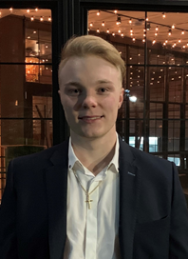
Presenters
Liam Friesen
Vanessa Lian
Eunbee Kang
Tyler Halverson
Market
Shopify
Wayfair
Amazon

Slide 3
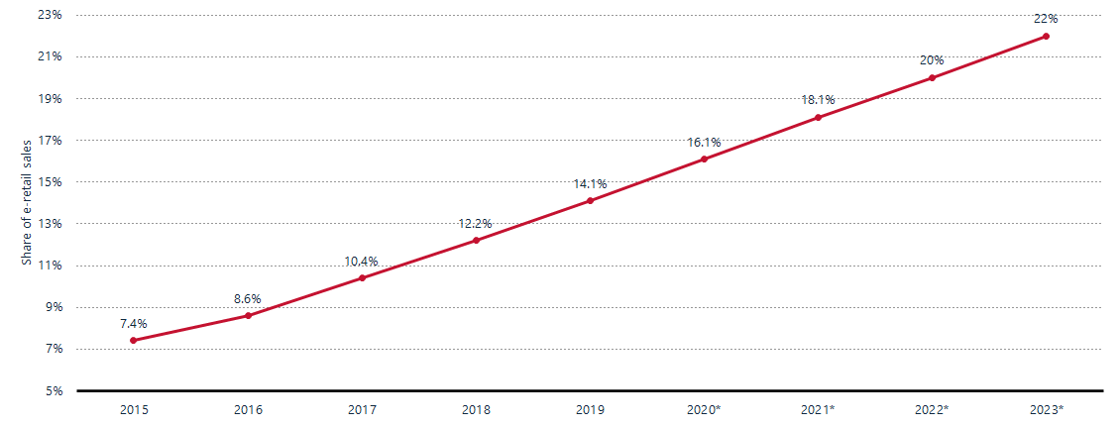
E-Commerce
Aka. Electronic Commerce
E-Commerce is the purchase or selling of goods and services using the internet.
Notes:
E-commerce is one of the fastest growing sectors globally each year.

Slide 4
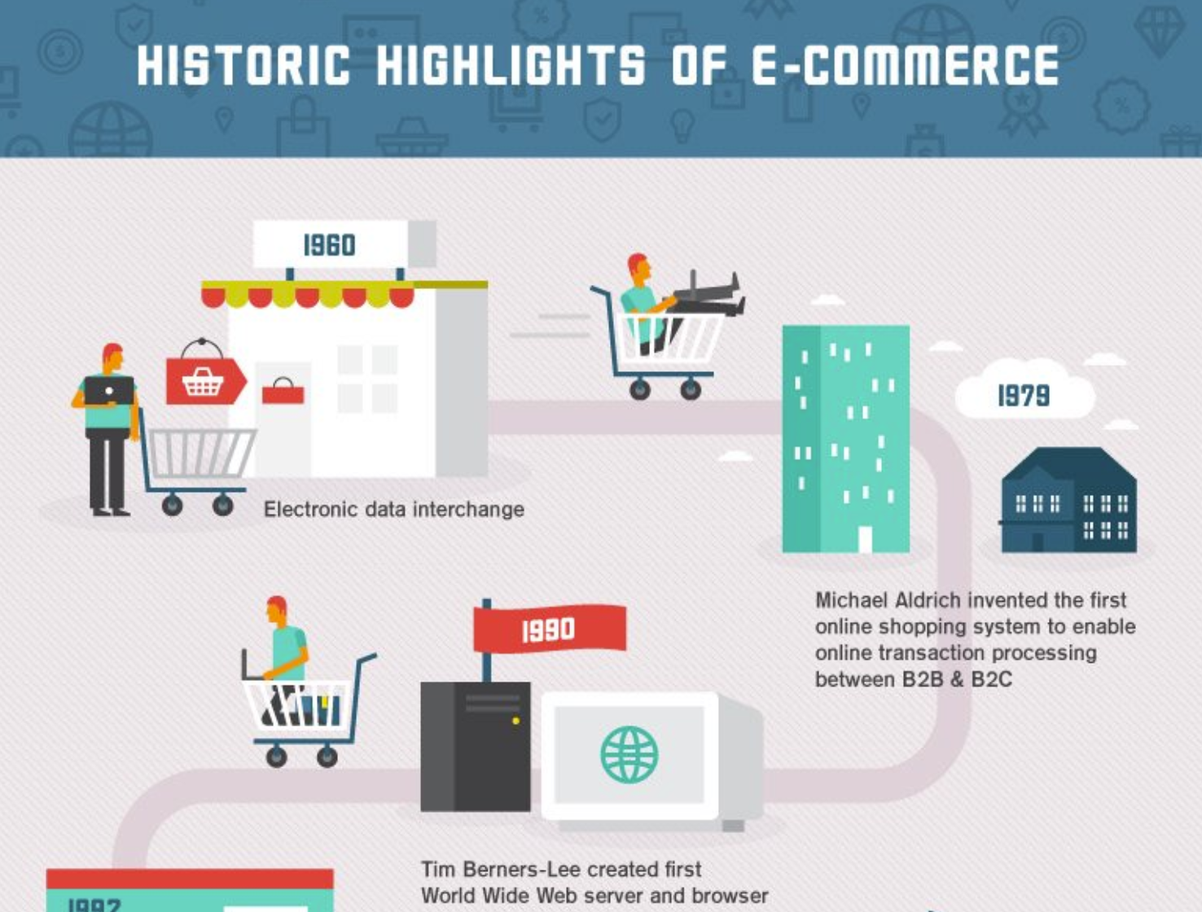

Slide 5
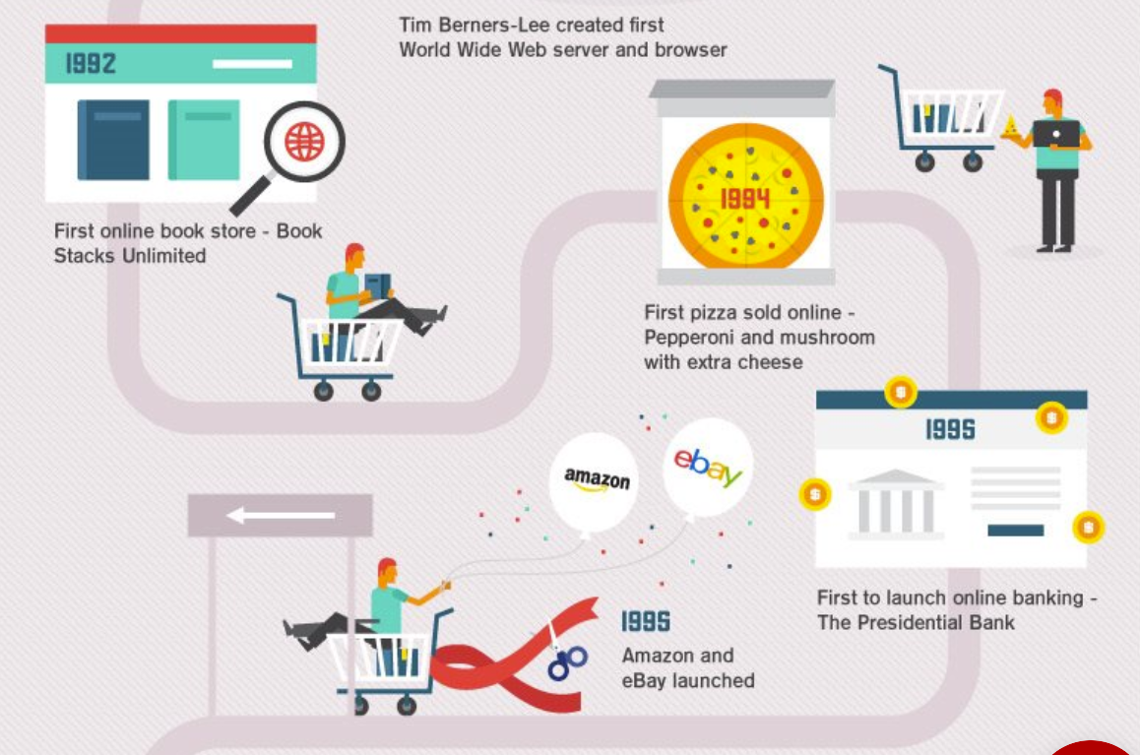

Slide 6
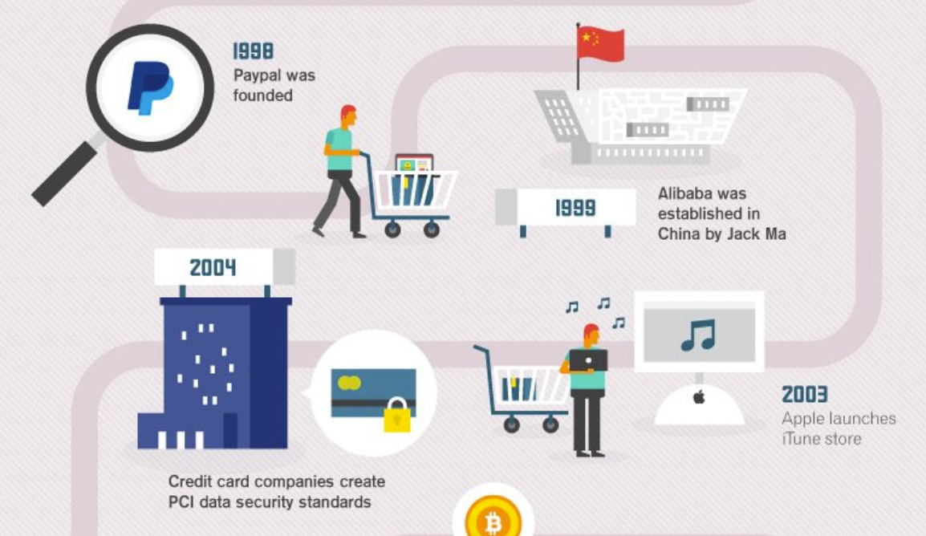

Slide 7
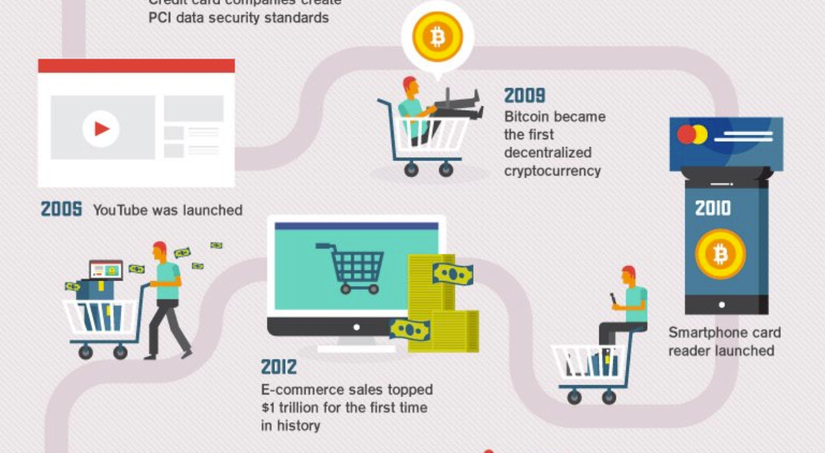

Slide 8
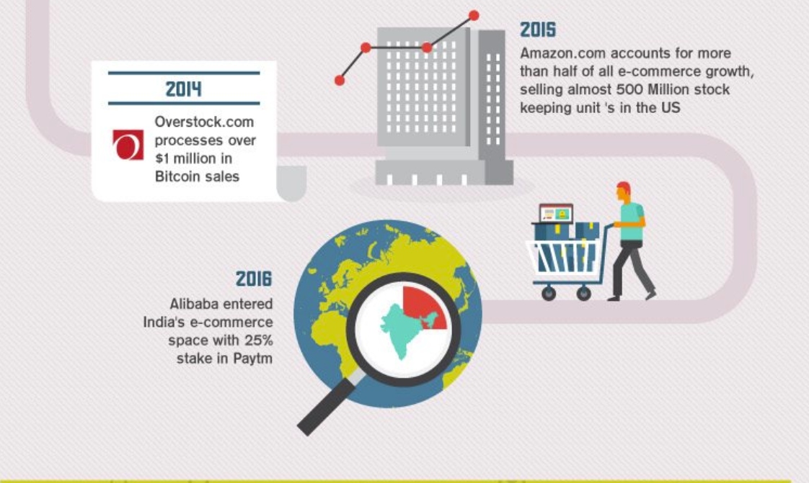

Slide 9
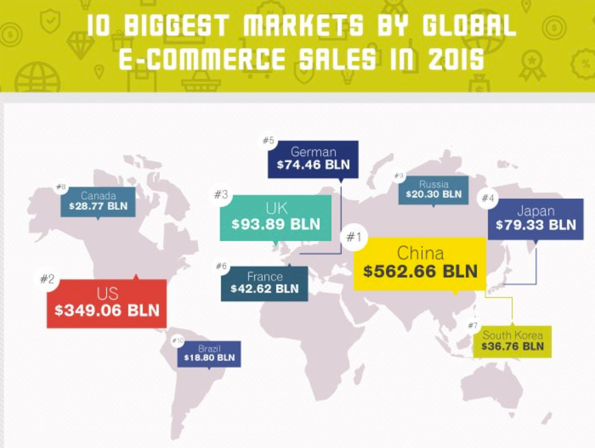

Slide 10
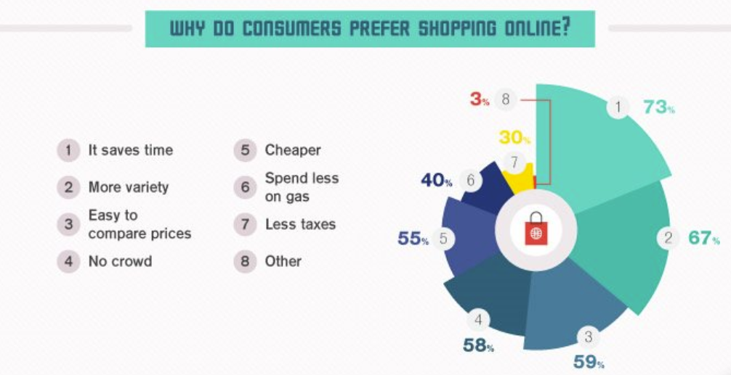

Slide 11






Examples of E-Commerce you didn’t know...
When you think of e-commerce you think of: Amazon, and that’s about it.

Slide 12
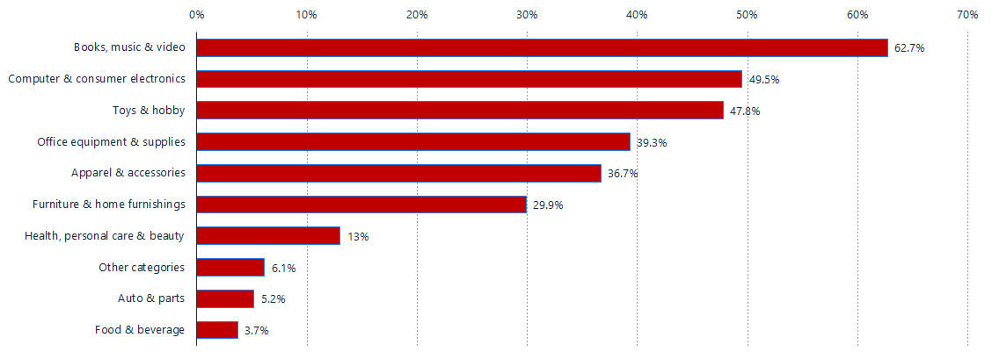
E-commerce share of total retail revenue in the United States as of May 2020, by product category

Slide 13
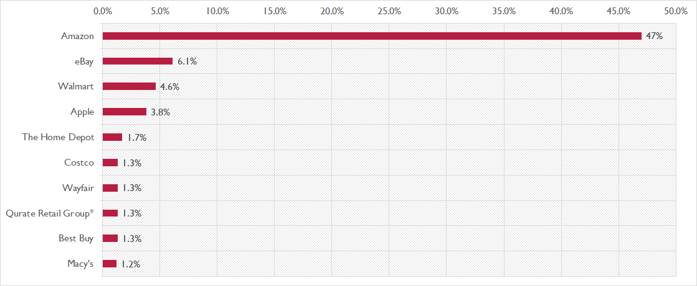
2019 - U.S. leading e-commerce retailers by market share

Slide 14
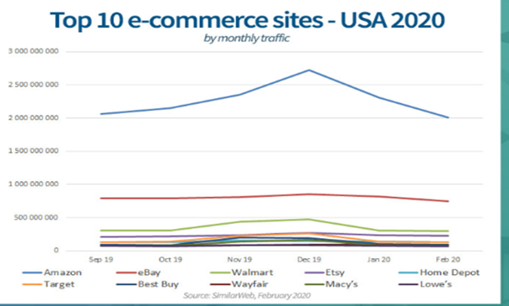

Slide 15
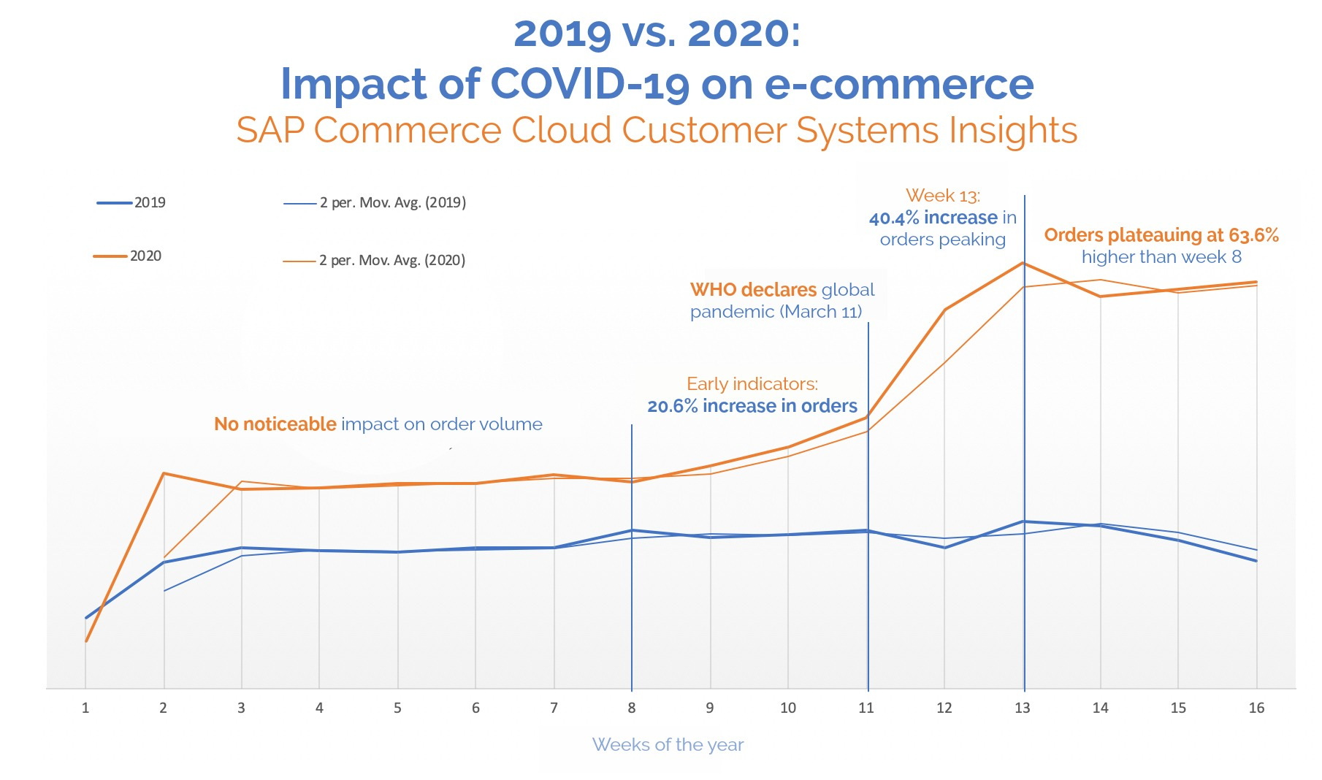

Slide 16
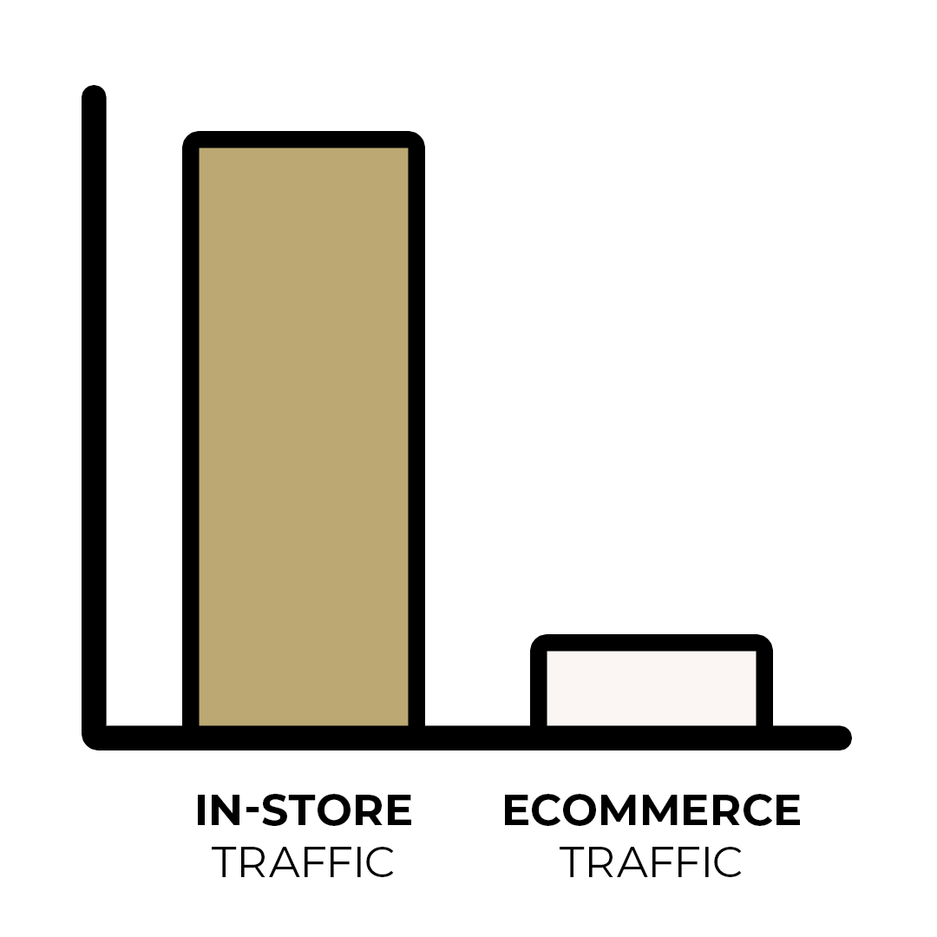
3 Biggest E-Commerce Business Models
B2B
B2C
C2C

Slide 17
Business-to-Business (B2B)
E-Commerce B2B sales are the purchases or selling of platforms, goods, services that help other businesses operate.
B2B sales made up 23.6% of all E-Commerce U.S. sales in February, 2020.
Examples: Alibaba, Shopify
B2B

Slide 18
Business-to-Business (B2B)
Pros: - High Revenue - Less labour needed needed physical retail stores - Less physical space needed (ex. Store front) - Ability to sell in bulk to businesses = cheaper shipping
Cons: - Barriers to entry are high (Lots of competition) - E-commerce Regulations (We will look at later) - Customs/Duties

Slide 19
Business-to-Consumer (B2C)
E-Commerce B2B sales are the purchases or selling of goods and services to consumers.
B2C sales made up 33.7% of all E-Commerce U.S. sales in February, 2020.
Example: Amazon, Shopify, and Wayfair
B2C

Slide 20
Business-to-Consumer (B2C)
Pros: - High Revenue - The entire market is transitioning to purchasing everything online. - Less labour needed compared to a physical store
Cons: - High barriers to entry - E-commerce Regulations (we will look at later) - Selling in bulk won’t be applicable, therefore, shipping 1 item at a time can be expensive.

Slide 21
Consumer-to-Consumer (C2C)
C2C e-commerce sales is the sale of a good or service between two consumers using an third party platform.
Examples: Ebay, Craigslist, Etsy, AirBnb.
C2C

Slide 22
Consumer-to-Consumer (C2C)
Cons: - Low revenue (Mostly from ads) - Need to be the biggest C2C business in the area (ex. You only use Craigslist, and Facebook marketplace, because it has the most traffic)
Pros: - Low operating costs - Low start-up costs - Payroll is very low

Slide 23
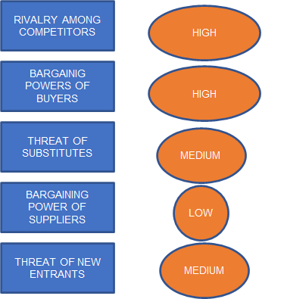
Industry Analysis

Slide 24
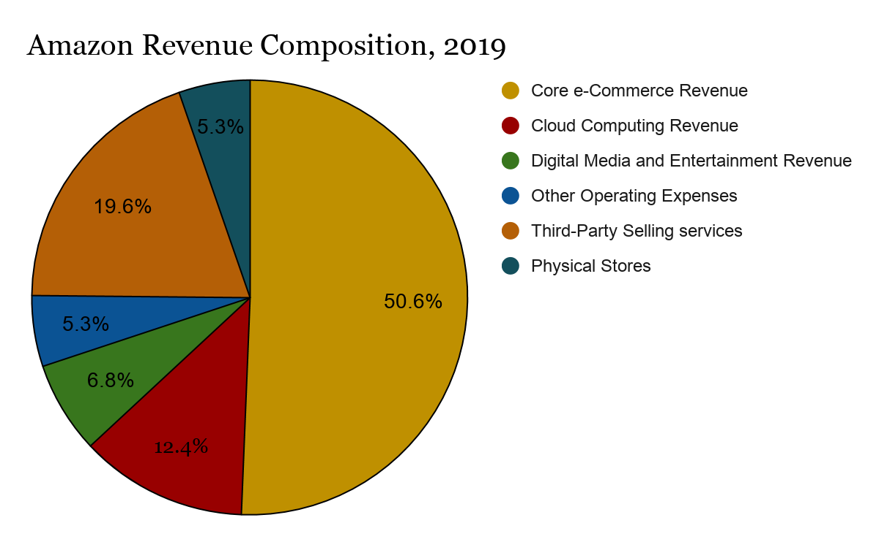
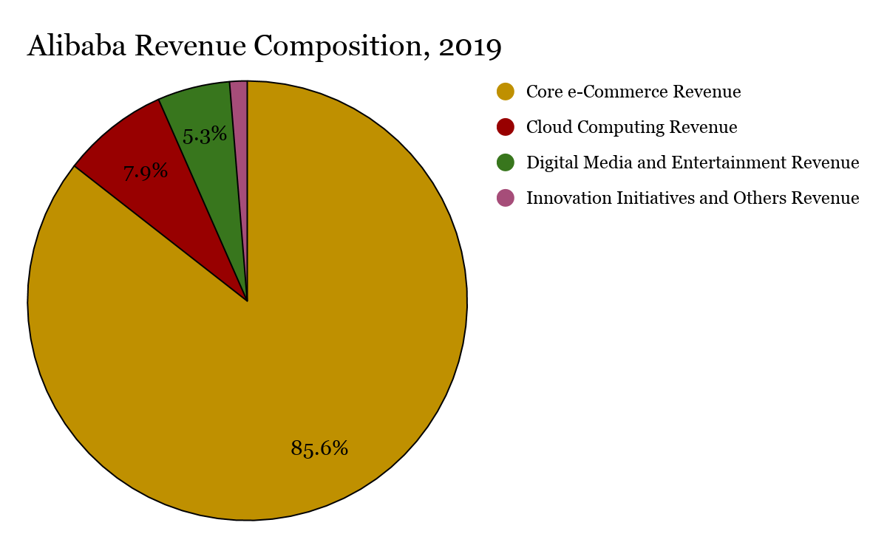
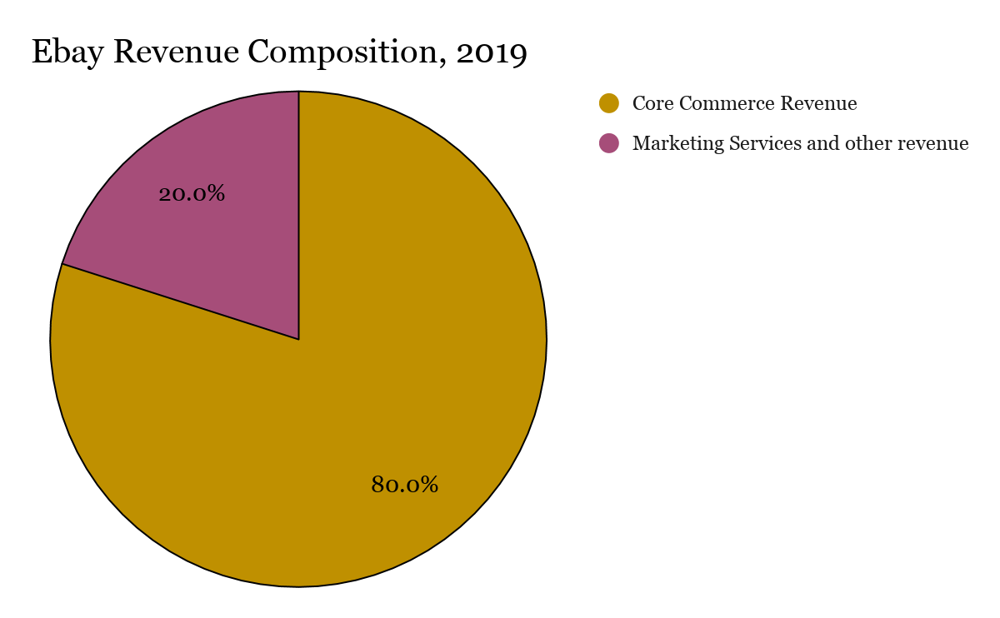
Retail Firm Revenue Composition
Core commerce Revenue (ex. Product sales, membership fees)
Digital Media and Entertainment (Ex. Amazon Prime video)
Cloud Computing Revenue (Ex. Big data analytics, cloud storage)
B2C
C2C
B2B

Slide 25
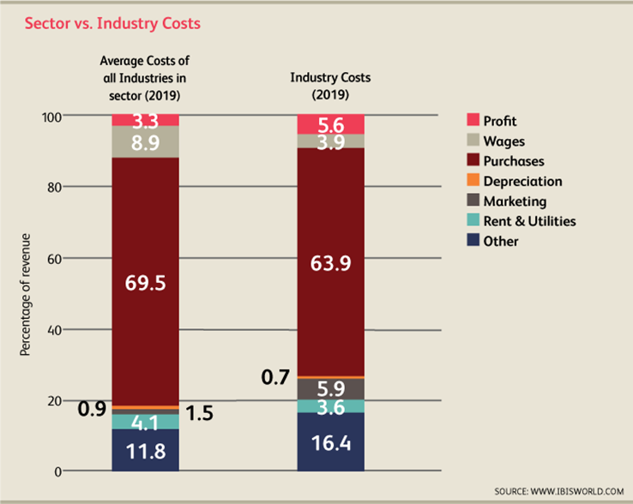
Cost Structure
Biggest differences
-Wages
-Marketing
Notes:
As we can see, Payroll is obviously takes up a lot less with e-commerce businesses, allowing for the company to put more towards marketing and r&d expenses

Slide 26



E-commerce firm strategy
Subscription/membership model

Slide 27


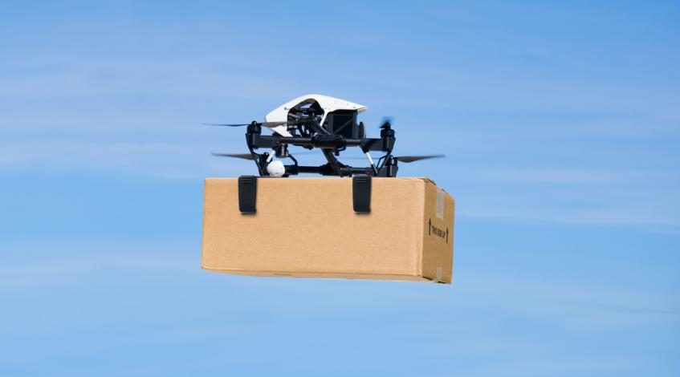

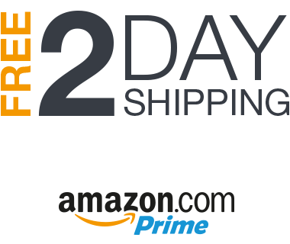
E-commerce firm strategy
Faster shipping than their competitors

Slide 28
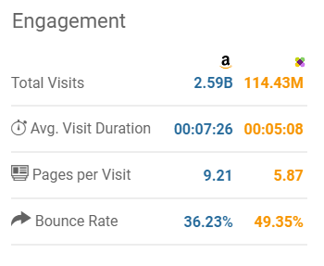
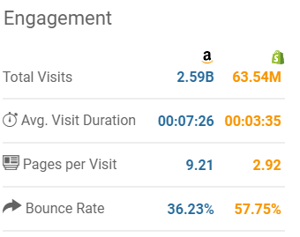
E-commerce firm strategy
Increasing website traffic & website searchability

Slide 29
E-commerce Regulations
A LOT
Notes:
There are a lot of regulations governing the sale of goods, and consumer protection. We will say the ones that are specifically for e-commerce firms.

Slide 30

E-commerce Regulations
Notes:
A registered customs broker is the most important link in ensuring your products reach your customers, quickly and efficiently.
Each product you sell needs to be classified, and the correct documentation has to be completed in order to pass through customs.

Slide 31
E-commerce Regulation
Advertisement Regulations
Mass Marketing Fraud
Misleading advertising and labelling
Multi-level marketing and pyramid selling

Slide 32

E-commerce Regulation
PIPEDA - Personal Information Protection and Electronic Documents Act
Businesses must have consent to collect, use, or disclose personal information.
You must protect the information against unauthorized access, theft, copying or alteration

Slide 33

E-commerce Regulation
Canada’s anti-spam law (CASL)
Businesses cannot: send electronic messages (emails, social media messages, or cell phone messages) without customer consent
All messages must have an unsubscribe function

Slide 34


Slide 35
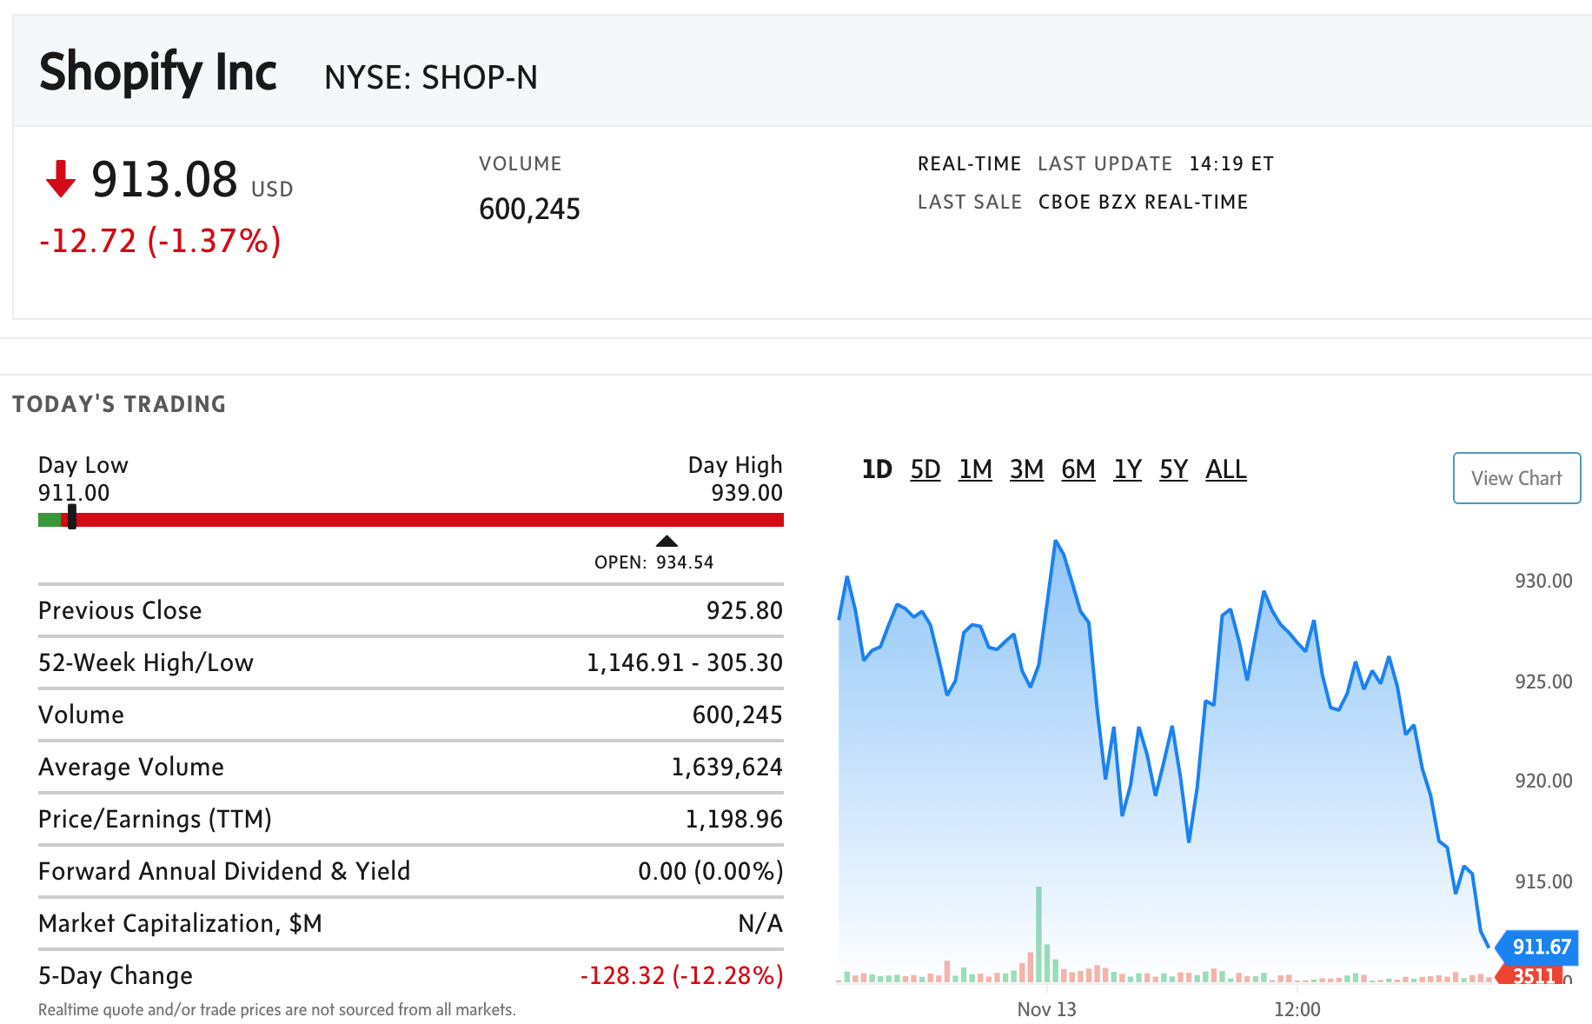

Slide 36
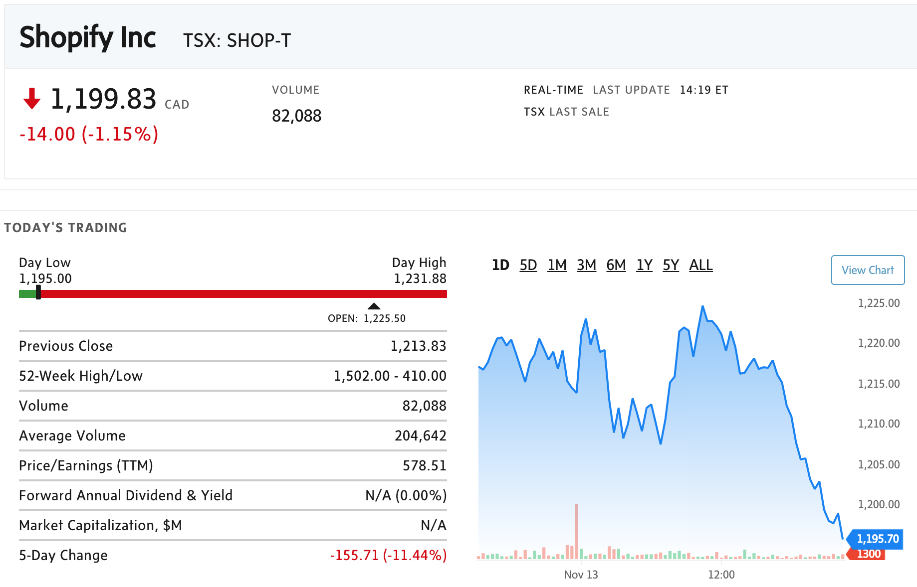

Slide 37
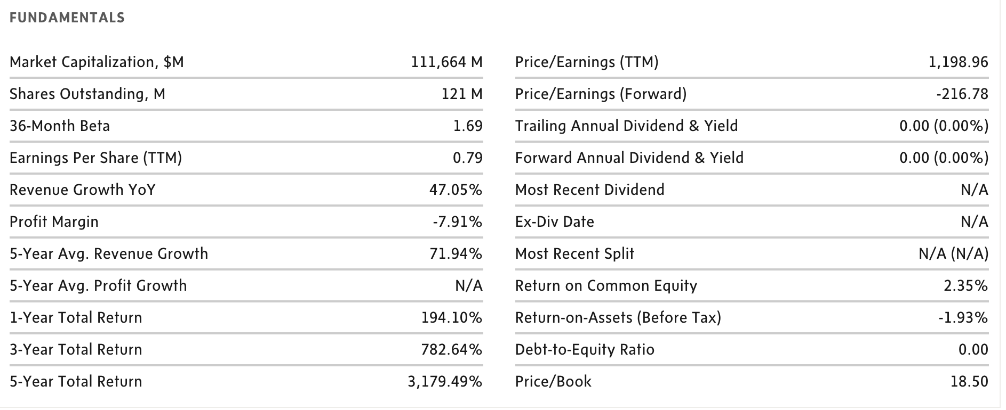
Key Statistics (USD)

Slide 38
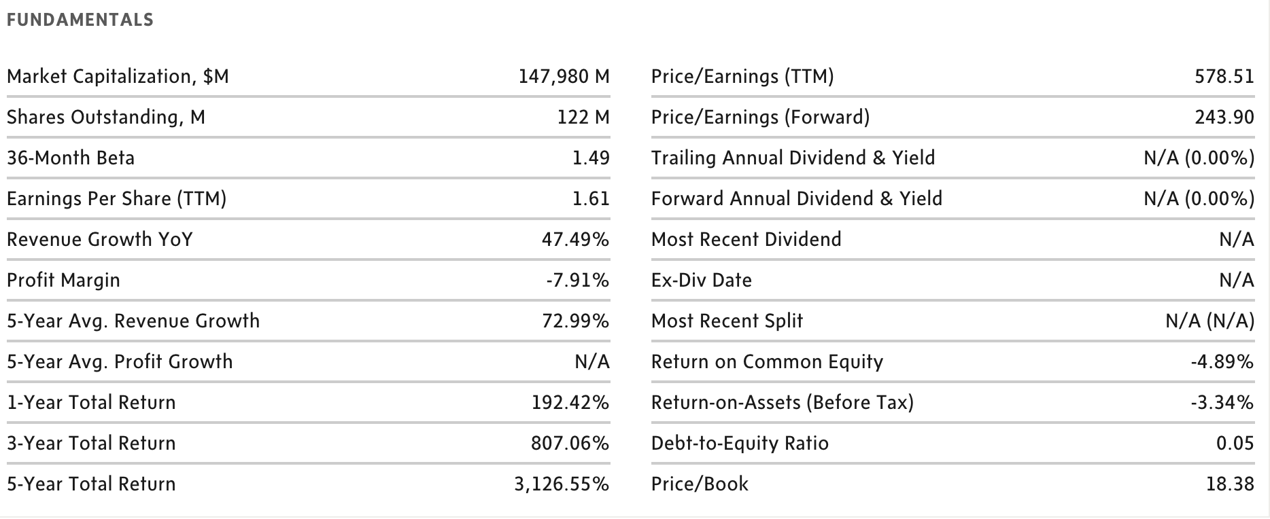
Key Statistics (CAD)

Slide 39
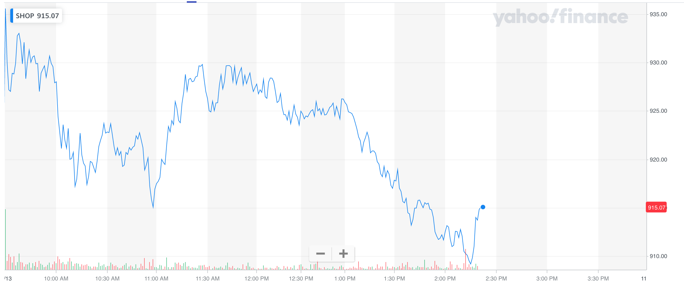
1 Day Performance

Slide 40
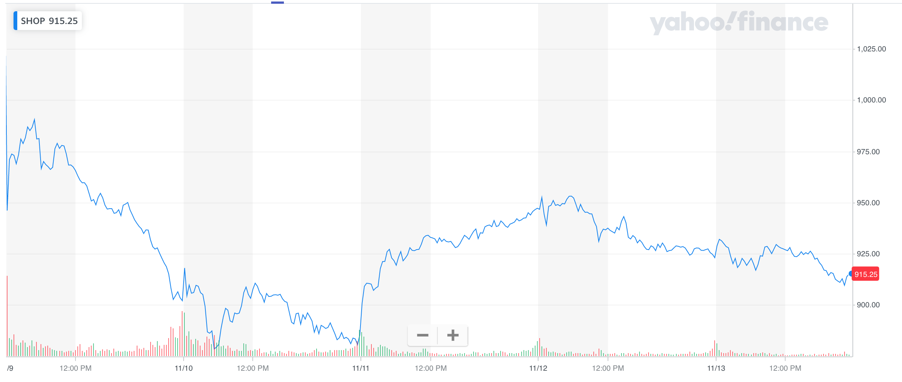
5 Day Performance

Slide 41
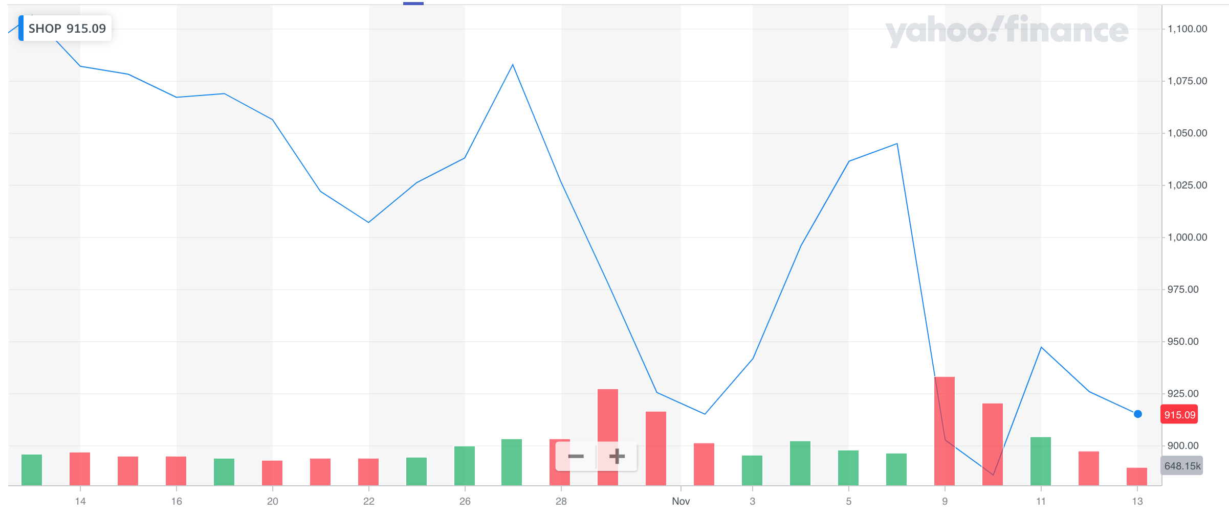
1 Month Performance

Slide 42
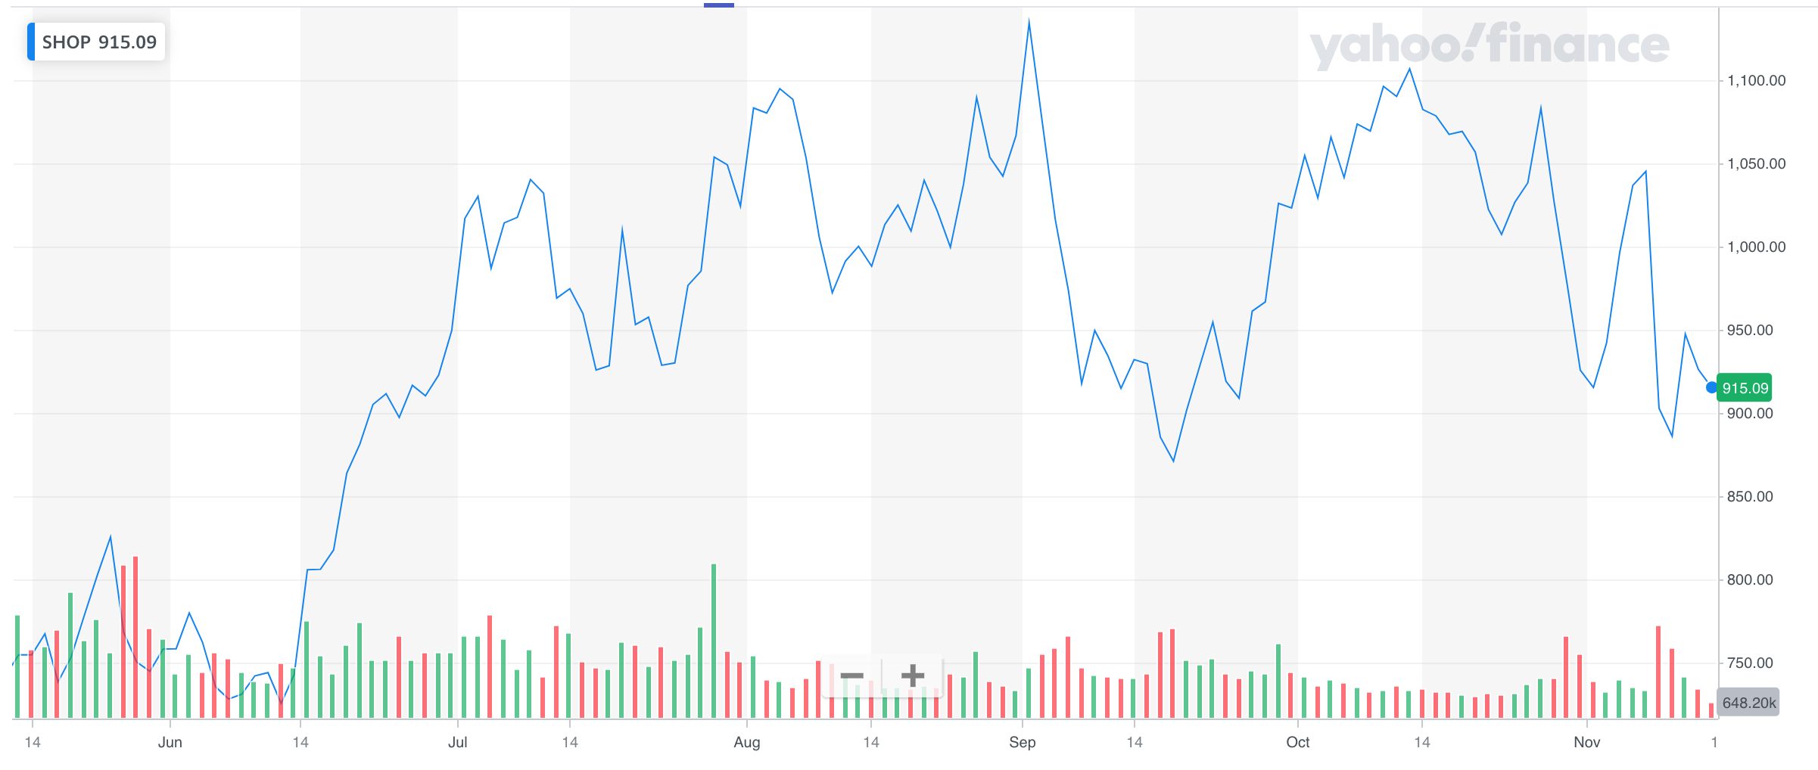
6 Month Performance

Slide 43
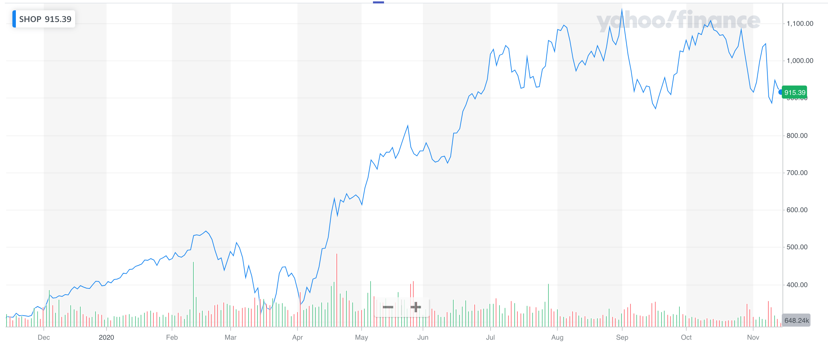
1 Year Performance

Slide 44
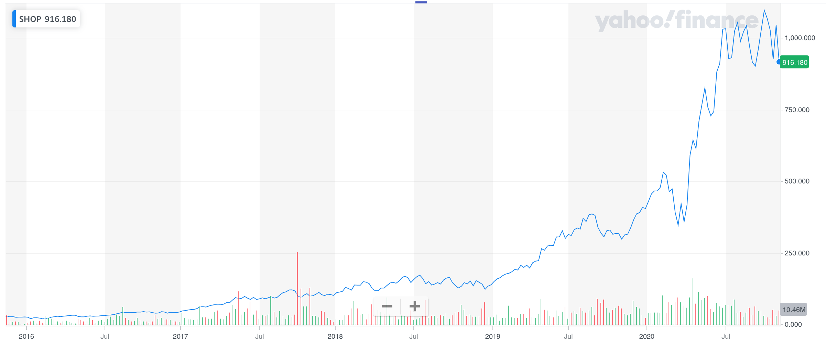
5 Year Performance

Slide 45
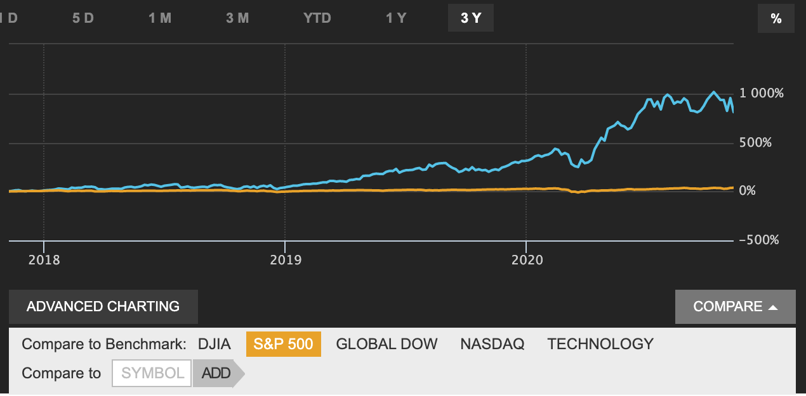
Shopify Comparison to S&P 500

Slide 46
Shopify History
•Shopify was founded in 2004, and started with selling snowboards online
•A Canadian multinational e-commerce company headquartered in Ottawa, Ontario
•Merchants use Shopify to design, set up, and manage their stores
•A powerful back-office and a single view of their business, from payments to shipping
•Powers over 1,000,000 businesses in around 175 countries
•Number of employees: 4000+
•Over $100 billion in sales
•The initial public offering (IPO) on New York Stock Exchange and Toronto Stock Exchange with “SHOP” and “SH” on April 14, 2015
Mission -- Making commerce better for everyone.

Slide 47
History Continue...
2009
•Shopify launched an application programming interface (API) platform and APP store. The developers can create applications for Shopify online stores and sell them on the Shopify APP Store.
2010
•Shopify launched a free mobile app on the Apple Store. It started its Build-A-Business competition, in which participants create a business using its commerce platform.
•The company received $7 million from an initial series A round of venture capital financing.

Slide 48
History Continue...
2011
•Later year, Shopify raised another $15 million from a Series B round of venture capital financing.
•By the end of year, 15,000 active stores across 80 countries.
2012
•Profit Magazine named Shopify “Canada’s Smartest Company”. By the end of the year, Shopify had grown to 40,000 stores across 90 countries selling $740 million worth of product.

Slide 49
History Continue...
2013
•Shopify Payments allowed merchants to accept credit cards without a third party payment gateway, and point of sale system was launched. The point of sale system can use iPad to accept payments from debit and credit.
•Shopify acquired Jet Cooper, a designer and user experience agency based in Toronto.
•Shopify received $100 million in Series C funding.

Slide 50
History Continue...
2014
•Shopify platform hosted around 120,000 online retailers, and it was listed as #3 in Deloitte’s Fast 50 in Canada, as well as #7 in Deloitte’s Fast 500 of North America.
•It earned $105 million, twice as much as it raised the previous year.
2015
•Shopify’s initial public offering filled for in April on NYSE and TSX (under the symbols "SHOP" and "SH" respectively), and it went public in May, raising more than $131 million.
•Shopify generated $45 million during the first quarter as a public offering, doubled from the year-ago quarter.

Slide 51
History Continue...
2017
• January 2017, Shopify announced integration with Amazon, allowing merchants to sell on Amazon from their Shopify stores. Shopify's stock rose almost 10% upon this announcement.
2018
• Shopify opened their first physical space in Los Angeles. The space offered classes, a "genius bar" for companies that use Shopify software and workshops.

Slide 52
History Continue...
2019
• Shopify announced an integration with Snapchat to allow Shopify merchants to buy and manage Snapchat Story ads directly on the Shopify platform. The company had previously secured similar integration partnerships with Facebook and Google.
• Shopify acquired Handshake, a business-to-business e-commerce platform for wholesale goods.
• Shopify announced the acquisition of 6 River Systems, a Massachusetts-based fulfillment solutions company.

Slide 53
History Continue...
2020
• On March 11, 2020, Shopify announced it is going fully remote, over 5000 employees will start working from home, in response to rapid spread of Coronavirus disease 2019.
• Shopify announced the launch in the US of the Shop app for Android (operating system) and iOS that enables shoppers to browse and purchase products online from stores using Shopify.
• Shopify announced the launch of Shopify Balance, a new form of business bank account that allows business owners a new way to manage their finances. The suite of products offered are Shopify Balance Account, Shopify Balance Card, and Rewards.

Slide 54
Main Revenue Streams
Subscription Solutions
oA recurring subscription component
Merchant Solutions
oA merchant success-based component

Slide 55
Revenue Streams Continue...
Subscription Solutions
•Principally through the sale of subscriptions to the platform
•Offer different plans for different prices (USD)
Basic Shopify - $29/month
Shopify - $79/month
Advanced Shopify - $299/month
Shopify Plus (High Volume Businesses) - $2000/month
•Subscription terms automatically renew and subscription fee are non-refundable
•Additional subscription solutions revenue from the sale of themes and apps, the registration of domain names, and the collection of variable platform fees

Slide 56
Revenue Streams Continue...
2. Merchant Solutions
Providing additional services to merchants to increase their use of the platform
•Majority of revenue is from fees earned from merchants based on their customer orders processed through Shopify Payments
•Generates revenue which relating to Shopify Shipping, Shopify Capital, other transaction services and referral fees, as well as from the sale of Point-of-Sale (POS) hardware

Slide 57










Acquisitions
An acquisition is when one company purchases most or all of another company's shares to gain control of that company. Purchasing more than 50% of a target firm's stock and other assets allows the acquirer to make decisions about the newly acquired assets without the approval of the company’s shareholders.

Slide 58
Acquisitions Continue...
6 River Systems
•Shopify completes acquisition of 6 River Systems in October 2019.
•6 River Systems is flexible and scalable warehouse automation powered by collaborative robots and artificial intelligence. The solution engages associates, keeps them on task and boosts productivity by 2-3x.
•Tobi Lütke, CEO of Shopify, said “With 6 River Systems, we will bring technology and operational efficiencies to companies of all sizes around the world.”

Slide 59
Acquisitions Continue...
Solutions Alveo Inc.
•Shopify completed the acquisition of Solutions Alveo Inc. on June 22, 2018, accounted for as a business combination.
•Solutions Alveo Inc. provides a platform for commerce return solution, and it was founded in 2016 in Montreal.
•The operations of Solutions Alveo Inc. have been consolidated into Shopify.

Slide 60

New Partnerships

Slide 61
New Partnerships Continue...
Walmart Partnership 2020
•Goal: Bring small businesses from Shopify to Walmart’s Marketplace
•An estimated 1200 Shopify users will be able to display their products to Walmart’s 120 million monthly visitors.

Slide 62
Management Team

Slide 63

Tobi Lütke
Founder & Chief Executive Officer
•In 2004, built software to launch an online snowboard store called Snowdevil.
•He and his founding team launched the Shopify platform in 2006.
•He is proficient in computer literacy, and an advisory board commissioned by the federal government to provide recommendations on how to turn Canada into a digital leader.

Slide 64
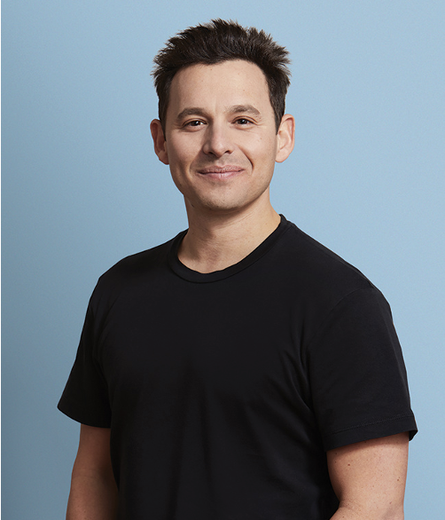
Harley Finkelstein
Chief Operating Officer
•He has been with Shopify since 2010.
•Serves on the board of the CBC and is an advisor to Felicis Ventures.
•Holds a Bachelor degree in Economics from Concordia University and a J.D./M.B.A. joint degree in Law and Business from the University of Ottawa.

Slide 65
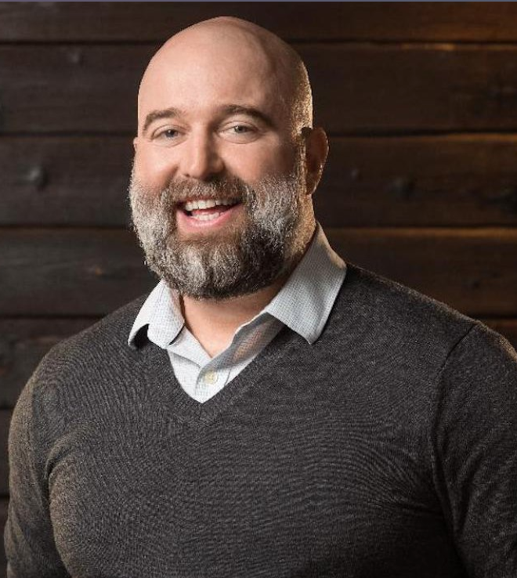
Toby Shannan
Chief Support Officer
•He founded Social Fabric Creative Ltd.
•In the past he occupied the position of Chief Executive Officer for Social Fabric Creative Ltd. and Vice President-Sales & Marketing of DNA Genotek, Inc.

Slide 66
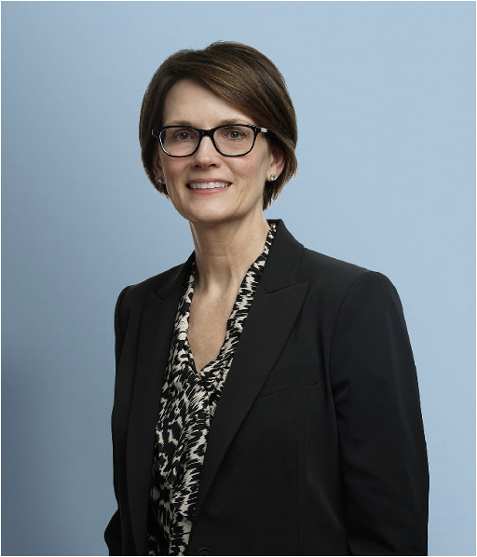
Amy E. Shapero
Chief Financial Officer
•In her past career she was Chief Financial Officer of Betterment Holdings, Inc., Chief Financial Officer for Spot Trading LLC, Chief Financial Officer for Sailthru, Inc., Manager for Ernst & Young LLP and SVP-Strategy, Development & Communications at DigitalGlobe, Inc.
•She received an undergraduate degree from the University of Illinois and an MBA from The University of Chicago Booth School of Business.

Slide 67
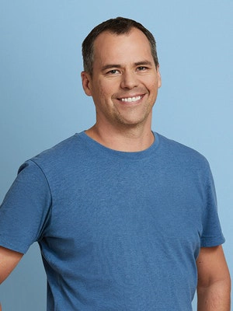
Jean-Michel Lemieux
Chief Technology Officer
•In his past career he occupied the position of Software Developer at HP, Inc., Software Developer at Object Technology International, Inc., Software Developer at ObjecTime Ltd, Chief Architect at IBM Software Group and Vice President-Engineering for Atlassian Pty Ltd.
•Mr. Lemieux received an undergraduate degree from the University of Ottawa.

Slide 68
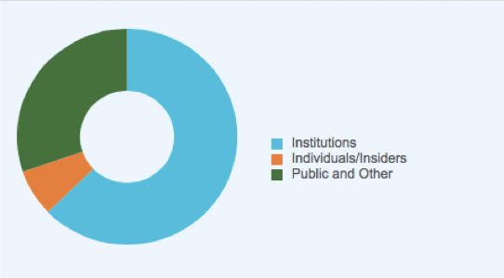
Ownership Structure
30.23%
62.75%
7.02%

Slide 69
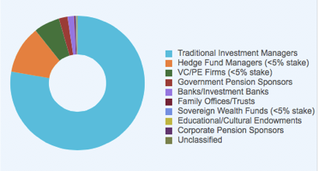
Ownership Structure Continue...
6.24%
11.54%
77.74%

Slide 70
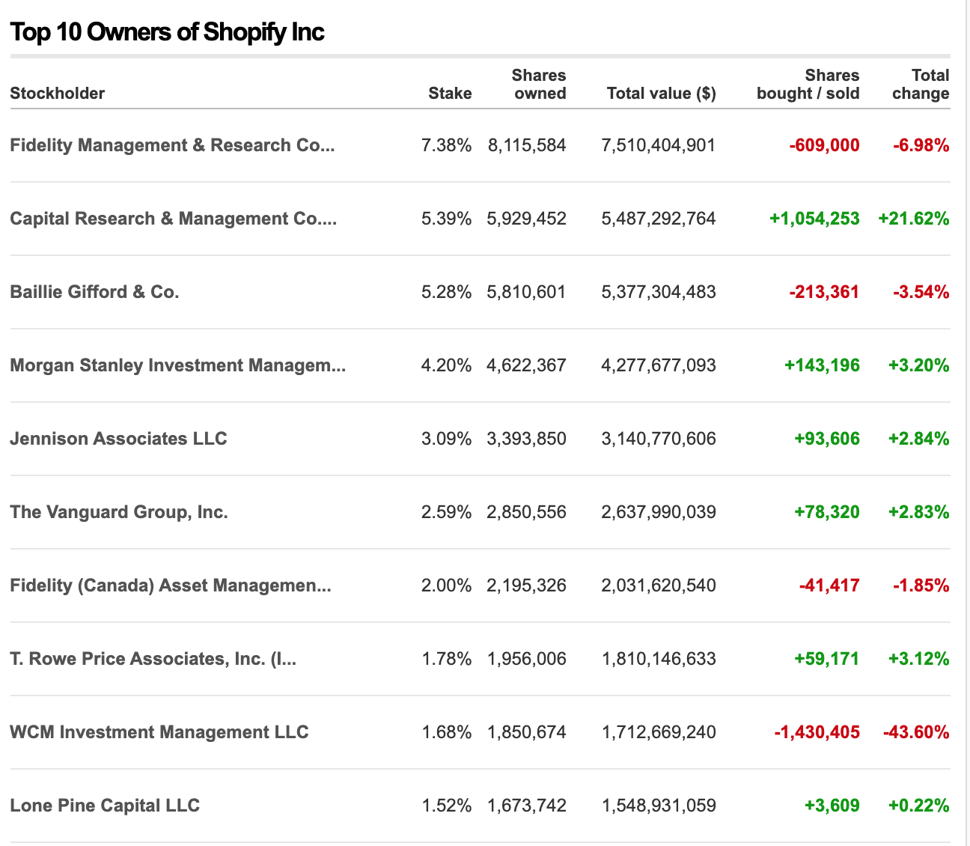
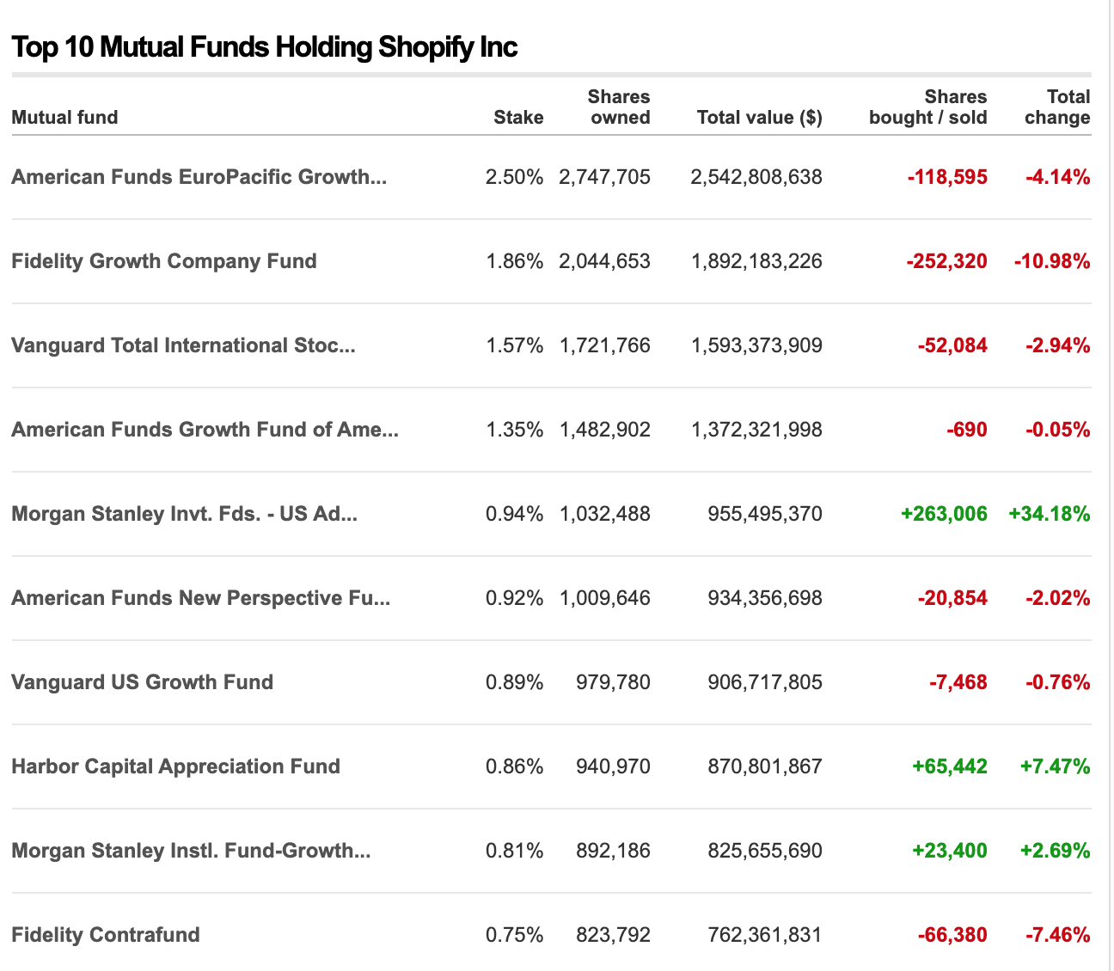
Ownership Structure Continue...

Slide 71
Financial Statements

Slide 72
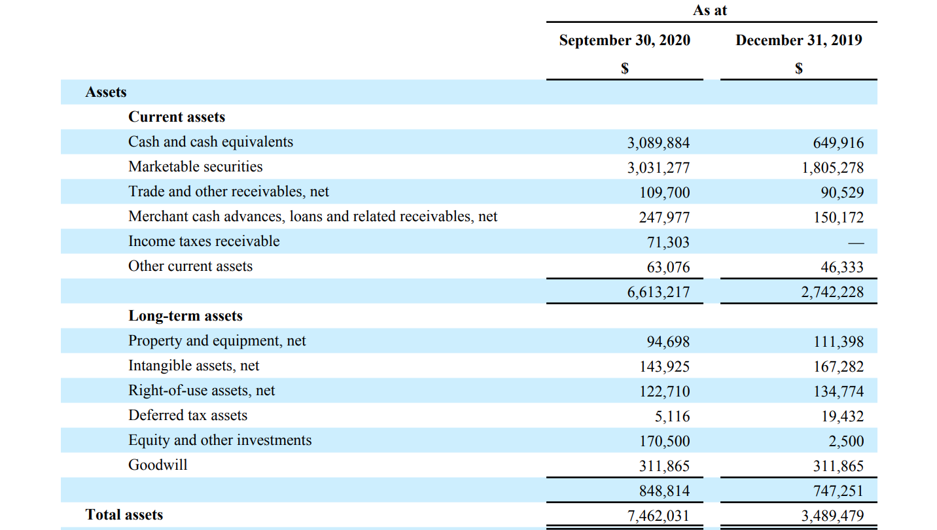
Balance Sheet: Assets (10-Q)

Slide 73
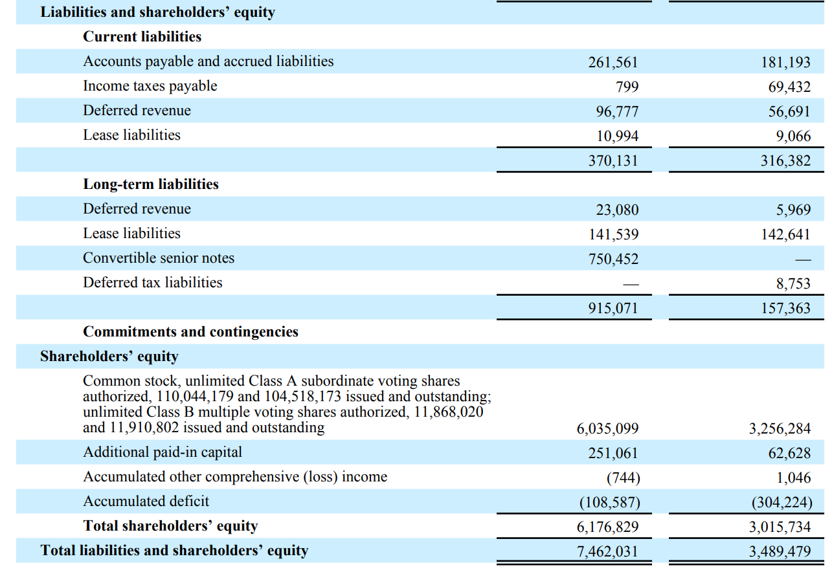
Balance Sheet: Liabilities & Equity (10-Q)

Slide 74
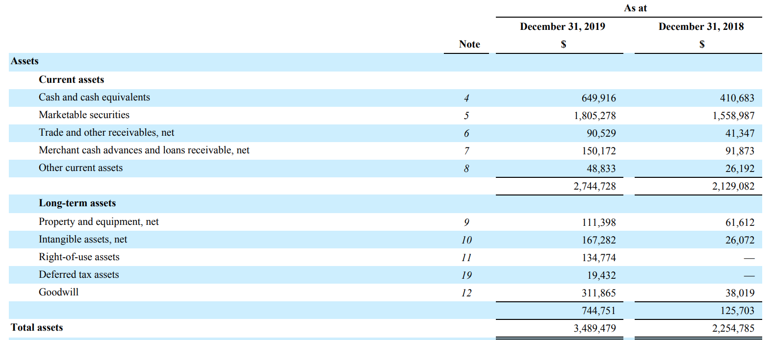
Balance Sheet: Assets (10-K)

Slide 75
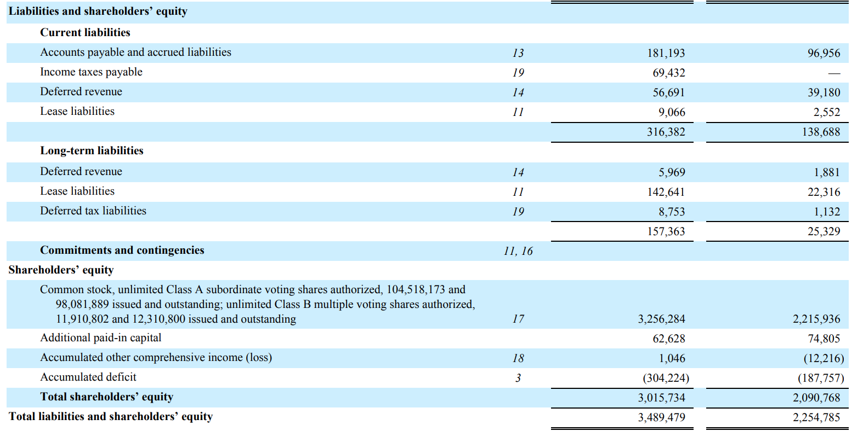
Balance Sheet: Liabilities & Equity (10-K)

Slide 76
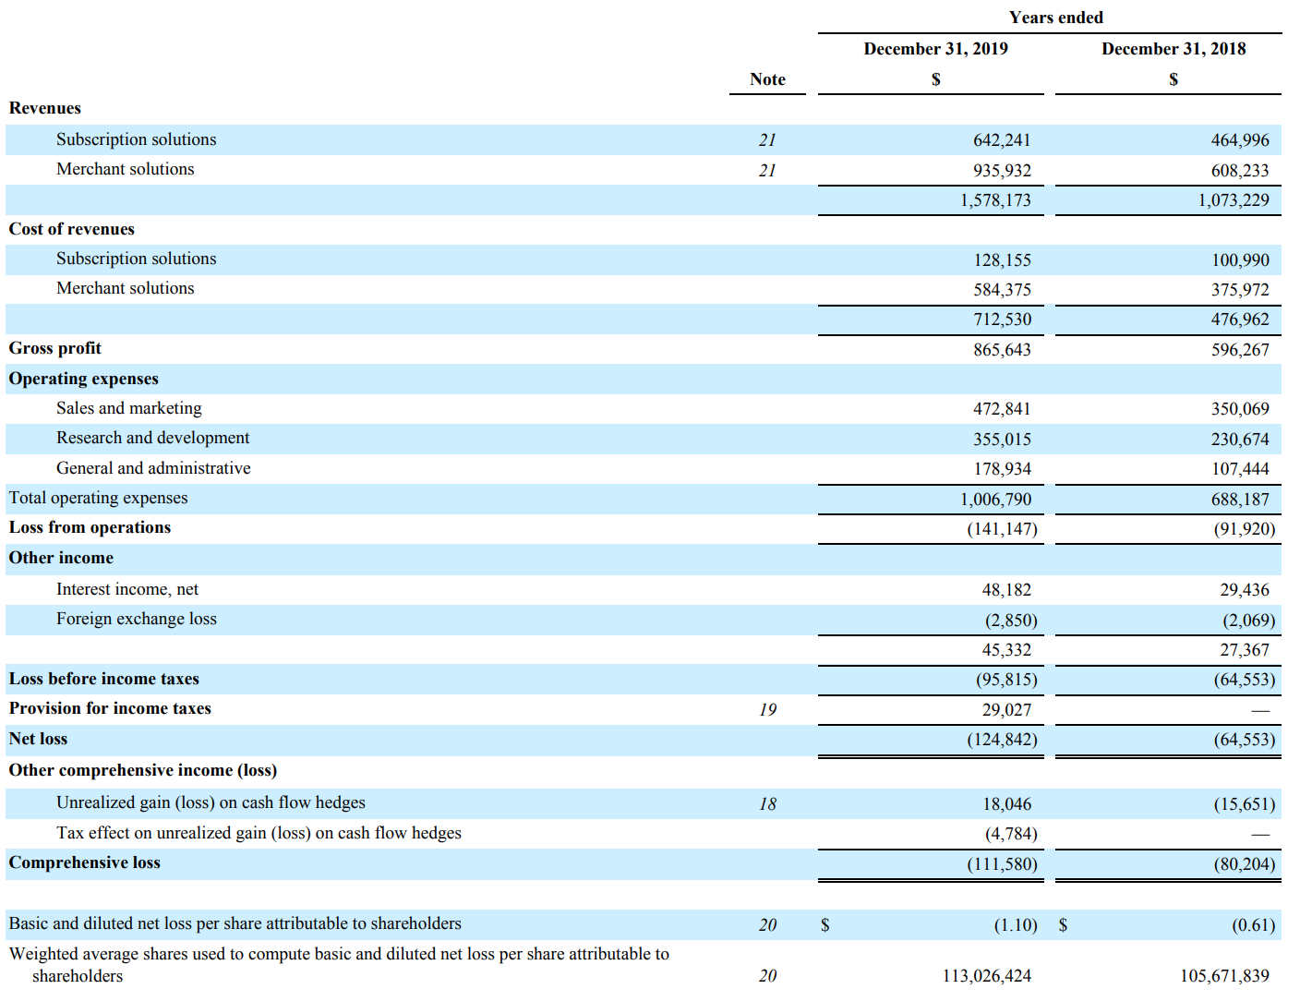
Income Statement (10-K)

Slide 77
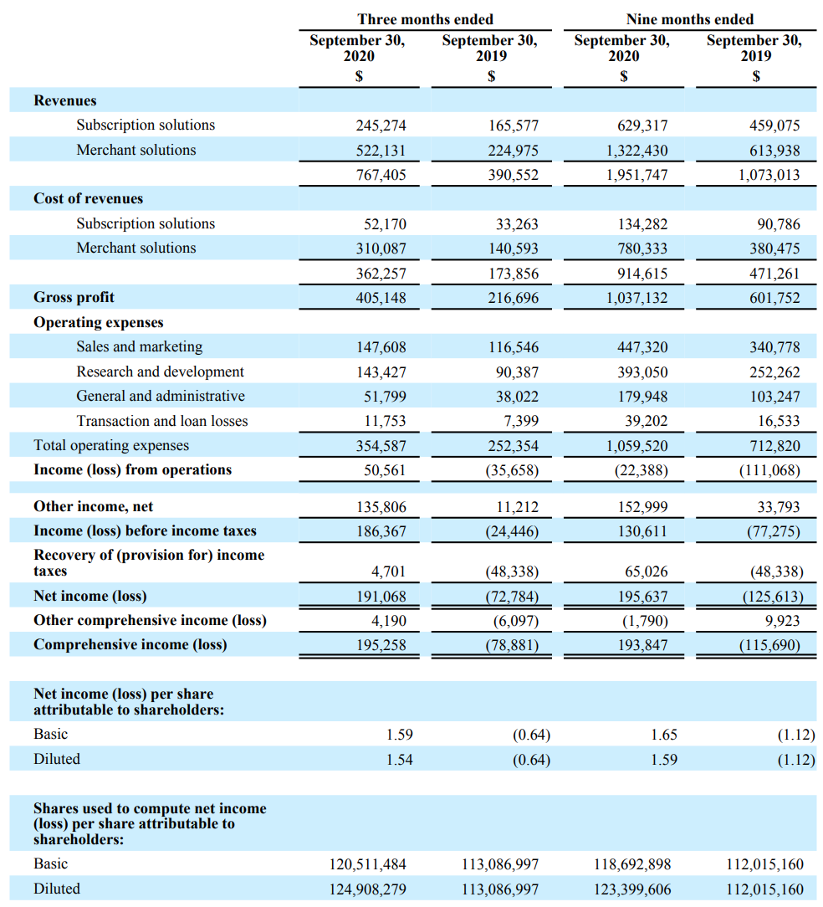
Income Statement (10-Q)

Slide 78
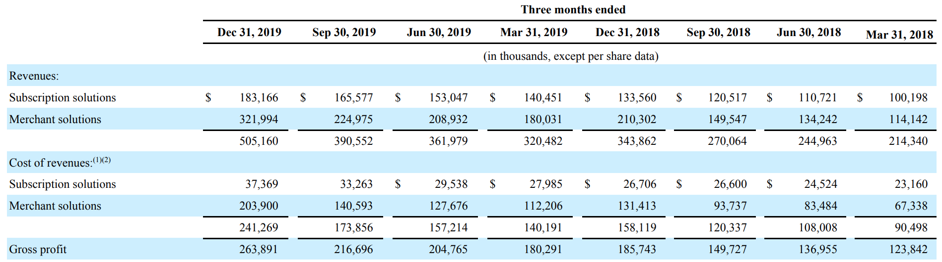
Breakdown of Revenue

Slide 79
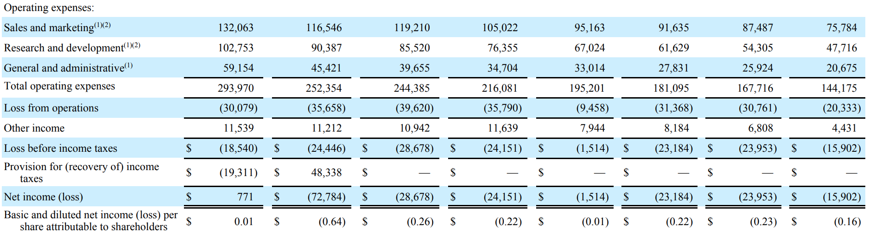
Breakdown of Revenue Continue...

Slide 80

Cash Flow: Operating (10-K)

Slide 81

Cash Flow: Investing & Financing (10-K)

Slide 82

Cash Flow: Operating (10-Q)

Slide 83

Cash Flow: Investing & Financing (10-Q)

Slide 84
Financial Statements Analysis

Slide 85

Total Revenue (million)

Slide 86

Gross Margin

Slide 87

Diluted EPS (million)

Slide 88

Return on Equity

Slide 89

Return on Asset

Slide 90

HOLD

Slide 91

Notes:
B2C

Slide 92

Stock Price

Slide 93

Statistics

Slide 94

5-Day Performance

Slide 95

1-M Performance

Slide 96

6-M Performance

Slide 97

1-Yr Performance

Slide 98

5-Y Performance

Slide 99

Wayfair Comparison to Dow Jones and S&P 500

Slide 100
Company Overview
An American e-commerce company that sells furniture and home-goods
Founded: August 2002 in Boston Massachusetts, US
Founders: Niraj Shah and Steve Conine
Headquarters: Boston, Massachusetts
IPO: October 2, 2014
Employees: 16,700 (as of Sept 30, 2020)

Slide 101

IPO

Slide 102

Brands

Slide 103

Company Strategy

Slide 104

Revenue Streams

Slide 105

Acquisitions
Buyster
Acquisition announced date: September 20, 2011
Buyster is a Sydney-based Australian online retail company aimed to offer great value products and excellent customer service, and make your shopping experience easier, quicker, and hassle free

Slide 106

Acquisitions
DwellStudio
Acquisition announced date: Aug 2, 2013
DwellStudio is a New York City-based design house and retailer focused on modern home and family furnishings.
Notes:
In August 2013, Wayfair acquired DwellStudio, a New York City-based design house and retailer focused on modern home and family furnishings.

Slide 107

Acquisitions
CustomMade
Acquisition announced date: May 21, 2015
CustomMade is an online marketplace connecting Buyers who want one-of-a-kind creations with professional and passionate Makers of those goods. Born in 1996 with the vision to help people find the unique gifts, objects and goods they cannot find through traditional retail channels.

Slide 108

Acquisitions
TrumpIt
Acquisition announced date: August 30, 2016
“Trumpit is conversations with PHOTOS! Trumpit is the only Augmented Reality app that allows you to REACT to photos your friends send YOU!”

Slide 109

Subsidiaries

Slide 110

Management

Slide 111

CEO, Co-Chairman, and Co-Founder
•Niraj Shah
•Co-founded the company with Steve Conine in 2002.
•CEO and co-founder of Simplify Mobile.
•Entrepreneur-in-Residence at Greylock Partners.
•COO and a member of the Board of iXL, CEO and co-founder of Spinners.
•Included in Fortune Magazine's 40 Under 40.
•Won the Ernst and Young's Entrepreneur of the Year award.
•Serves on the board of Massachusetts Competitive Partnership, the Greater Boston Chamber of Commerce, and the Federal Reserve Bank of Boston.
•Holds a B.S. in engineering from Cornell University.

Slide 112

Co-Chairman and Co-Founder
•Steve Conine
•Co-founder and co-chairman of Wayfair.
•Co-founded Spinners Incorporated.
•Chief operating officer for the London office of iXL.
•Founder, chief technology officer and board member of Simplify Mobile.
•Member of the Board of Directors at CarGurus.
•Holds a B.S. from Cornell University.

Slide 113

Chief Financial Officer
•Michael Fleisher
•Chief Financial Officer of Wayfair.
•Trustee and Vice Chair of the Chewonki Foundation.
•Vice Chairman, Strategy and Operations of Warner Music Group’s.
•Executive Vice President and Chief Financial Officer of WMG.
•Chairman and CEO of Gartner, Inc.
•On the board of Squarespace, Inc.
•As an associate at Bain Capital.
•Holds a bachelor's degree in economics from the Wharton School of Business.

Slide 114

Chief Global Supply Chain Officer
•Allan Lyall
•Global Vice President of Fulfillment at Wayfair.
•Customer Fulfilment Director of Tesco.
•Vice President of European Operations of Amazon,
•Senior operations logistics of Apple.
•Director of European Fulfilment for Apple Computers.

Slide 115

Chief Product and Marketing Officer
•Ed Macri
•Chief Product and Marketing Officer of Wayfair.
•Marketing positions at IBM-Emptoris.
•Holds a B.A. from Dartmouth College and M.B.A. from MIT Sloan School of Management

Slide 116

Interim Chief Technology Officer
•Jim Miller
•Member of board of directors of Wayfair.
•Interim Chief Technology Officer of Wayfair.
•Strategic Advisor of AREVO Inc.
•Chief Executive Officer of AREVO.
•Vice President of Worldwide Operations at Google Inc.
•Executive Vice President of Sanmina-SCI Corporation
•Holds B.S. from Purdue University, an M.S. from MIT and an MBA from the Sloan School of Management at MIT.

Slide 117

Chief Merchandising Officer
•Steve Oblak
•Chief Merchandising Officer of Wayfair.
•Member of the management team of River West Brands,
•Senior Director at FutureBrand Worldwide.
Holds B.A. from Hamilton College and an M.B.A. from Northwestern University.

Slide 118

Chief Operating Officer
•Thomas Netzer
•Chief Operating Officer of Wayfair.
•Partner at McKinsey.
•Holds PhD in business and a diploma in business administration from the University of Cologne.

Slide 119

VP of Lifestyle Brands and Wayfair Canada
•Paul Toms
•Vice President of Lifestyle Brands and Canada of Wayfair.
•General Manager of Joss & Main.
•Hold B.A. in Economics from Boston University.

Slide 120


Shareholder Ownership

Slide 121

Top Shareholders

Slide 122

Balance Sheet (10Q Part 1)

Slide 123

Balance Sheet (10Q Part 2)

Slide 124

Balance Sheet (10K Part 1)

Slide 125

Balance Sheet (10K Part 2)

Slide 126

Income Statement (10K)

Slide 127

Income Statement (10Q)

Slide 128

Cash Flow: Operating (10-K)

Slide 129

Cash Flow: Investing & Financing (10-K)

Slide 130

Cash Flow: Operating (10-Q)

Slide 131

Cash Flow: Investing & Financing (10-Q)

Slide 132
Recommendation:
HOLD

Slide 133


Slide 134
STOCK PERFORMANCE

Slide 135

KEY STATISTICS

Slide 136

FUNDAMENTALS

Slide 137

5-DAY PERFORMANCE

Slide 138

1-M PERFORMANCE

Slide 139

6-M PERFORMANCE

Slide 140

1-Y PERFORMANCE

Slide 141

5-Y PERFORMANCE

Slide 142

10-Y PERFORMANCE

Slide 143

20-Y PERFORMANCE

Slide 144
Company Overview
AMAZON.COM, INC. (NASDAQ: AMZN)
An American technology company with a focus on:
E-commerce
Cloud computing
Digital streaming
Artificial intelligence
Grocery stores

Slide 145
Company Overview
World’s biggest online retailer
Founded: July 5, 1994 in Bellevue, Washington, US
Founder: Jeff Bezos
Headquarters: Seattle, Washington and Crystal City, Arlington, Virginia
IPO: May 15, 1997
Employees: 1,125,300 people in 2020
Mission: To be Earth’s most customer-centric company

Slide 146


Slide 147
ACQUISITIONS

Slide 148


Slide 149




AMAZON’S EXPENSIVE ACQUISITIONS – TOP 5
Acquired on June 16, 2017 with $13.7 billion
Acquired on November 2, 2009 with $1.2 billion
Acquired on June 26, 2020 with $1.2 billion
Acquired on March 28, 2013 with $1.2 billion
Acquired on August 25, 2014 with $970 million

Slide 150

ZOOX ACQUISITION
…”Creating autonomous mobility from the ground up.”
Includes developing zero-emission vehicles for riders, not drivers.
Autonomous ride-hailing service, meant to revolutionize the taxi and ride-hailing industry.

Slide 151

OVERALL ANNUAL NET REVENUE
Note: Worldwide; 2004 to 2019
Further information regarding this statistic can be found on page 8.
Source(s): Amazon; ID 266282

Slide 152

OVERALL QUARTERLY NET REVENUE
Note: Worldwide; Q1 2007 to Q1 2020; consolidated net sales
Further information regarding this statistic can be found on page 8.
Source(s): Amazon; ID 273963

Slide 153

ANNUAL NET SALES BASED ON REGIONS
Annual net sales of Amazon in selected leading markets from 2014 to 2019 (in billion U.S. dollars)
Net sales of Amazon in leading markets 2014-2019
Note: Worldwide; 2014 to 2019; including AWS
Further information regarding this statistic can be found on page 8.
Source(s): Amazon; ID 672782
2

Slide 154

ANNUAL NET REVENUE BY SEGMENT
Annual net revenue of Amazon from 2006 to 2019, by segment (in billion U.S. dollars)
Net revenue of Amazon from 2006-2019, by segment
Note: Worldwide; 2006 to 2019
Further information regarding this statistic can be found on page 8.
Source(s): Amazon; ID 266289
2

Slide 155

GLOBAL NET REVENUE BY PRODUCT GROUP
Global net revenue of Amazon from 2014 to 2019, by product group (in billion U.S. dollars)
Global net revenue of Amazon 2014-2019, by product group
Note: Worldwide; 2014 to 2019
Further information regarding this statistic can be found on page 8.
Source(s): Amazon; ID 672747
4

Slide 156

Monthly Website Traffic

Slide 157

ANNUAL CASH FLOWS GENERATED

Slide 158


AMAZON’S REVENUE STREAMS
Online retail business
Third-party retail service
Amazon Prime
Amazon Web Service (AWS)
Others. E.g. Amazon Kindle

Slide 159

Online Retail
First-party Seller
a brand manufacturer that sells inventory directly to Amazon, who then sells it to the customer.
Second-party Seller
an Amazon supplier that is not the manufacturer of the product
Third-party sellers
uses Amazon as a marketplace to sell directly to consumers; Amazon has nothing to do with the production and distribution of the product.

Slide 160

Amazon sales as a percentage of online retail sales in the United States from 2012 to 2017
U.S. Amazon first-party and third-party e-commerce sales share 2012-2017
Note: United States; 2012-2017
Further information regarding this statistic can be found on page 8.
Source(s): Digital Commerce 360; US Department of Commerce; Internet Retailer; ID 917414
2

Slide 161

Distribution of active Amazon marketplace sellers worldwide in 2019, by country
Share of Amazon marketplace sellers worldwide 2019, by country
Note: Worldwide; 2019
Further information regarding this statistic can be found on page 8.
Source(s): Marketplace Pulse; ID 1086651
2

Slide 162

THIRD-PARTY SALES PERCENTAGE 2007-20
Percentage of paid units sold by third-party sellers on Amazon platform as of 1st quarter 2020
Third-party seller share of Amazon platform 2007-2020
Note: Worldwide; Q2 2007 to Q1 2020
Further information regarding this statistic can be found on page 8.
Source(s): Amazon; ID 259782
2

Slide 163

AMAZON PRIME
A paid subscription service
Worldwide subscribers: 150 million (4th quarter 2019)
Providing:
Same, one or two-day delivery
streaming music and video
Shopping benefit: e.g., Whole Foods Market
Prime Reading
Others

Slide 164

Number of Amazon Prime members in the United States as of December 2019 (in millions)
Number of U.S. Amazon Prime subscribers 2013-2019
Note: United States; December 2013 to December 2019
Further information regarding this statistic can be found on page 8.
Source(s): Consumer Intelligence Research Partners; Fortune; ID 546894
6

Slide 165

AMAZON PRIME GENERAL BENEFITS

Slide 166

AMAZON PRIME DELIVERY BENEFITS

Slide 167


Slide 168


Slide 169

Amazon Web Service (AWS)
Provide on-demand cloud computing platforms and APIS to individuals, companies, and governments, on a metered pay-as-you-go basis
Over 175 fully featured services from global data centers
Most popular:
Amazon Elastics Compute Clouds (EC2)
Amazon Simple Storage Service (Amazon S3)

Slide 170

Amazon Web Service (AWS)
Global market share of cloud infrastructure services from 2017 to 2020, by vendor
Cloud infrastructure services market share worldwide 2017-2020, by vendor
Share of cloud infrastructure services
Note: Worldwide; 2017 to 2020
Further information regarding this statistic can be found on page 8.
Source(s): Synergy Research Group; Statista estimates; ID 477277
4
Notes:
Amazon is losing market share to Rackspace and Microsoft

Slide 171

Annual revenue of Amazon Web Services from 2013 to 2019 (in million U.S. dollars)
Amazon Web Services: annual revenue 2013-2019
Note: Worldwide; 2013 to 2019
Further information regarding this statistic can be found on page 8.
Source(s): Amazon; ID 233725
2

Slide 172

Quarterly revenue of Amazon Web Services from 1st quarter 2014 to 1st quarter 2020 (in million U.S. dollars)
Amazon Web Services: quarterly revenue 2014-2020
Note: Worldwide; Q1 2014 to Q1 2020
Further information regarding this statistic can be found on page 8.
Source(s): Amazon; ID 250520
2

Slide 173
MANAGEMENT TEAM

Slide 174

AMAZON’S MANAGEMENT TEAM
Jeffrey P. Bezos
Chairman of the Board of Amazon since 1994
CEO (1996 – now)
President (1994-1999; 2000-now)
Founder of Amazon
Founder of Blue Origin
Owner of Nash Holdings
Top shareholders of Amazon
Divorce in 2019
MacKenzie (his ex-wife) received 25% of his stake in Amazon
Still the biggest shareholder (75,049,750 shares or 15.1% of outstanding shares)

Slide 175

AMAZON’S MANAGEMENT TEAM
Jeffrey M. Blackburn
Senior Vice President, Business Development (2006 – now)
Leave of absence (2020 - 2021)
Previous position: VP, Operations Integration
Top shareholders (0.014% of outstanding shares, worth $164 m)
Degree:
MBA from Stanford Graduate School of Business

Slide 176

AMAZON’S MANAGEMENT TEAM
Brian T. Olsavsky
Joined Amazon in April 2002
Vice President, Finance for Amazon’s North America retail business (2007 – 2010)
Vice President, Finance for the Global Consumer Business (2011 – 2015)
Senior Vice President (2015 – now)
CFO (2015 – now)
Owns 1,570 shares (0.0003% of Amazon)
Degree:
Bachelor of Science in Mechanical Engineering from Penn State
MBA in Finance from Carnegie Mellon University

Slide 177

AMAZON’S MANAGEMENT TEAM
Andrew R. Jassy
Founder of Amazon Web Services (Mar. 2006)
Senior Vice President of AWS (2006 – 2016)
CEO of Amazon Web Services (2016 – now)
Top shareholders of Amazon (0.02% of all outstanding share)
Degree:
Bachelor of Arts from Harvard University
MBA from Harvard Business School

Slide 178

AMAZON’S MANAGEMENT TEAM
Shelley L. Reynolds
Vice President of Finance (2006 – 2007)
Vice President, Worldwide Controller (2007 – now)
Principle Accounting Officer (2007 – now)
Owns 6,122 shares (0.0012% of Amazon)
Degree:
University of Washington Foster School of Business
Before joining Amazon:
Deloitte & Touche LLP (1998 – 2006)
Specialized in matters related to mergers & acquisitions
Served multiple publicly traded multi-national corporations from a broad range of industries.

Slide 179

AMAZON’S MANAGEMENT TEAM
Jeffrey A. Wilke
Joined in 1999
Senior Vice President, Worldwide Operations (2002 – 2006)
Senior Vice President, North America Retail (2007 – 2012)
Senior Vice President, Consumer Business (2012– 2016)
CEO Worldwide Consumer (2016 – now)
Owns 68,907 shares (0.014% of Amazon)
Degree:
MBA and MS in Chemical Engineering at MIT’s Leader for Global Operations program
BSE in Chemical Engineering, Summa Cum Laude, from Princeton University

Slide 180

AMAZON’S MANAGEMENT TEAM
David A. Zapolsky
Associate General Counsel (1999 – 2002)
Vice President and Associate General Counsel for Litigation and Regulatory matters (2002 – 2012)
Vice President, General Counsel, and Secretary (2012 – 2014)
Senior Vice President, General Counsel, and Secretary (2014 – now)
Owns 3,466 shares (0.00069% of Amazon)
Degree:
Undergraduate: Columbia University
Graduate: University of California

Slide 181
MANAGEMENT COMPENSATION
Two basic components:
A modest base salary
a minimum level of cash compensation
significantly less than those paid to senior leadership at similarly situated companies
Vary from $81,840 to $175,000
Stock-based components
Primary components
Periodic grants of time-vested restricted stock units subject to long-term vesting requirements.
Closely tie total compensation to long-term shareholder value
Amazon believes this approach works better for the company
Better than the approach that focus on specific performance measures.

Slide 182

MANAGEMENT COMPENSATION

Slide 183

OWNERSHIP OF SHARES
Total numbers shares of common stock outstanding: 497,856,129 (Feb 18, 2020)

Slide 184

OWNERSHIP BREAKDOWN
Notes:
15.1% of ownership is by the insiders
59.47% of ownership is by held by institutions
25.43% of ownership is held by the general public

Slide 185

TOP INSTITUTIONAL OWNERS

Slide 186


Slide 187

10-Q BALANCE SHEET (ASSETS)
Notes:
Sharp decrease in cash this quarter
- Looks like it may have been spent on PPE and marketable securities though
What are marketable securities??
-

Slide 188

10-Q BALANCE SHEET (LIABILITIES AND SHAREHOLDERS EQUITY)
Notes:
AP and long-term lease liabilities/debt jumped, likely bcus part of it was also spent on PPE and marketable securities
Nice jump in R/E

Slide 189

10-K BALANCE SHEET (ASSETS)
Notes:
They keep earning more cash
Large jump in marketable securities
Good PPE growth
Mention what the operating leases are on

Slide 190

10-K BALANCE SHEET (LIABILITIES AND SHAREHOLDERS EQUITY)

Slide 191

10-K CONSOLIDATED STATEMENT OF OPERATIONS
Notes:
Net product sale have healthy increase
Net service sales have giant increase (doubled in two years)
Net income and basic EPS has grown to a nice margin

Slide 192

10-Q CONSOLIDATED STATEMENT OF OPERATIONS

Slide 193

10-K CONSOLIDATED STATEMENT OF OPERATIONS

Slide 194

10-Q DECOMPOSITION OF SALES BY SEGMENTS

Slide 195

10-Q DECOMPOSITION OF SALES BY SERVICES
Notes:
Physical stores have seen a large decrease since the pandemic, and has not recovered at all from Q2 to Q3
- All other services have had healthy growth since Q2 2019 and the pandemic

Slide 196

10-K CONSOLIDATED STATEMENT OF CASH FLOWS

Slide 197

10-K CONSOLIDATED STATEMENTS OF CASH FLOWS
2017 2018 2019

Slide 198

10-K CONSOLIDATED STATEMENT OF CASH FLOWS
2017 2018 2019

Slide 199

10-Q CONSOLIDATED STATEMENT OF CASH FLOWS
Notes:
Large increase in cash from 3 months ended YOY, looks like they are stockpiling cash
Tripled net income YOY for three months ended
Large increase in spending for inventories
Large increase in AP

Slide 200

10-Q CONSOLIDATED STATEMENT OF CASH FLOWS
Three Months Ended Nine Months Ended Twelve Months Ended
September 30, September 30, September 30,
2019 2020 2019 2020 2019 2020

Slide 201

10-Q CONSOLIDATED STATEMENT OF CASH FLOWS
Three Months Ended Nine Months Ended Twelve Months Ended
September 30, September 30, September 30,
2019 2020 2019 2020 2019 2020
Notes:
Received a large loan most likely during pandemic time to help fund operations

Slide 202

RECOMMENDATION

