Slide 1

E-commerce

Slide 2




Order of Presenters
Xumeng Han
Chenxi He
Adrian Chua
Kaiyin Jiang

Slide 3





Agenda
Overview of the Industry
Amazon
Shopify
Etsy

Slide 4
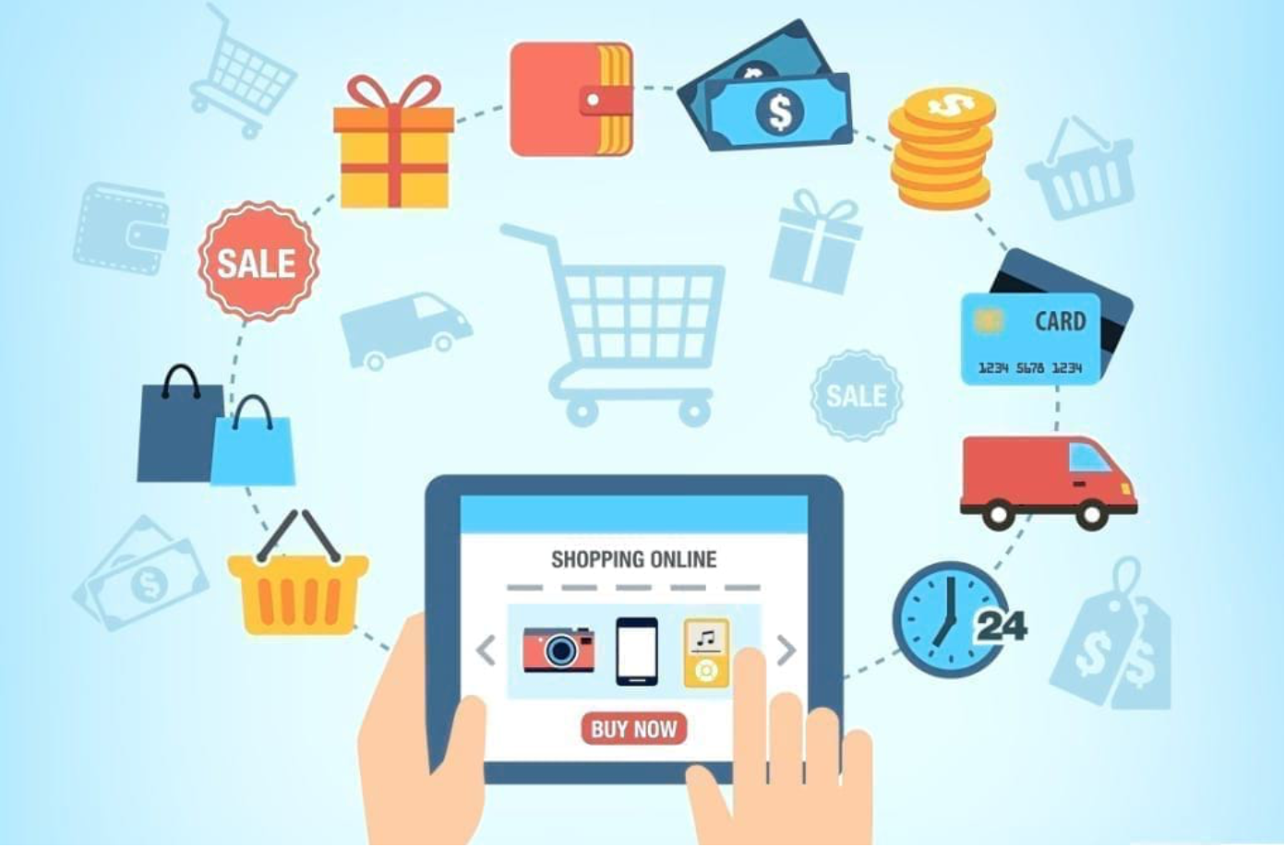
E-commerce Industry Overview

Slide 5

What is E-commerce?
Ecommerce (or electronic commerce) is the buying and selling of goods (or services) on the internet.
E-commerce was come up about 40 years ago.
E-commerce includes B2C (Business to Consumer); B2B; C2C; C2B; B2G (Business to Government); C2G

Slide 6
History of E-commerce Industry From 1969-1998
1969: CompuServe is founded. by electrical engineering students Dr. John R. Goltz and Jeffrey Wilkins, early CompuServe technology was built utilizing a dial-up connection.
1982: Boston Computer Exchange launches.it was the world’s first ecommerce company.
1994: Marc Andreessen and Jim Clark co-found Netscape Navigator as a web browser.
1998: Paypal came out as an e-commerce transfer tool.
1979: Michael Aldrich invents electronic shopping by connecting a modified TV to a transaction-processing computer via telephone line. This made it possible for closed information systems to be opened and shared by outside parties
1992: Charles M. Stack helped Book Stacks Unlimited becoming the first online book marketplace.
1995: Amazon was founded by Jeff Bezos as an online bookstore at the beginning .

Slide 7
History of E-commerce Industry From 1999-2014
2014: Applepay came out as a mobile digital payment method. In the same year, Jam.com Launches.This company competed with Costco and Sam’s Club
1999: Alibaba launches as an online supermarket. It became a significant B2B, B2C, C2C platform and impacted many business activities today.
2009: BigCommerce launches as an e-commerce storefront platform.
2004: Shopify launches as an online market.
2005: Amazon first used Amazon Prime as a membership to collect flat annual fee. And in the same year, Etsy launches as an e-commerce platform.
2000: Google Adwords came out as a way for e-commerce business to advertise their products towards people who using google search..
2011: Google wallet debuted as a digital peer to peer payment method based on mobile device. In the same year, sponsored stories came out by Facebook.

Slide 8
History of E-commerce Industry From 2017-Present
2022: Customer journeys and personalization? Artificial intelligence-enable shopping? Digital currencies?
2017: Instagram had expanded to additional ecommerce platforms, which allows users to purchase products.
2020: COVID-19 drived a surge on E-commerce. Transaction reached $82.5 billion.
2017: E-commerce created a new record $6.5 billion on Cyber Monday.

Slide 9
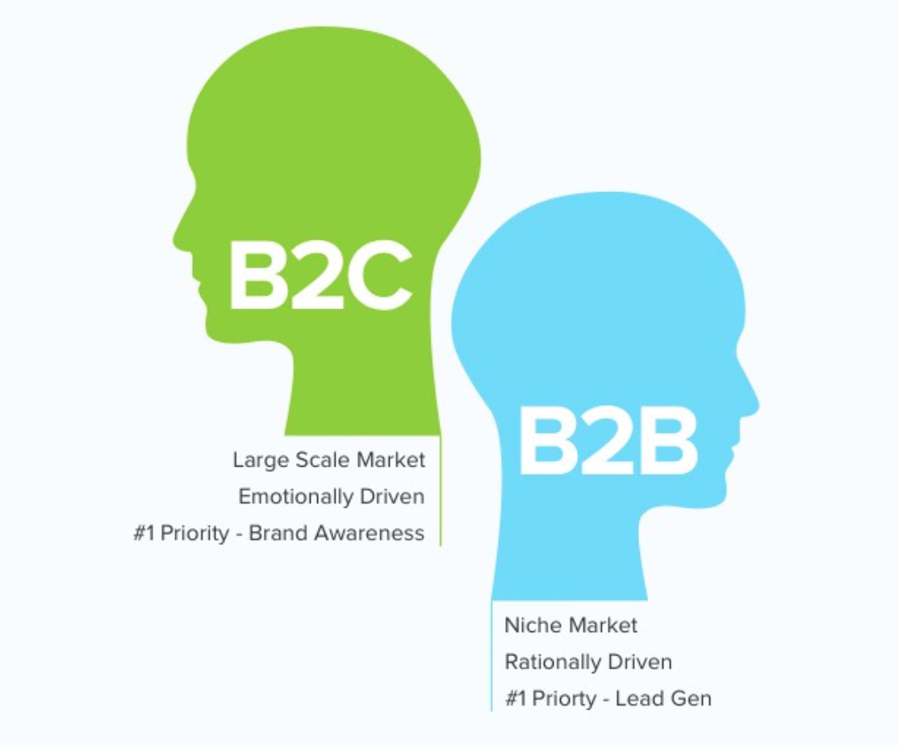
B2C
B2B
Amazon
Google
Facebook
Tencent
Walmart
Target
Alibaba
Priceline Group
eBay
Netflix
Amazon
Walmart
Alibaba
General Electric
IndiaMart
AutoGlobalTrade
eWorldTrade
Quill
Grainger
Mckesson

Slide 10
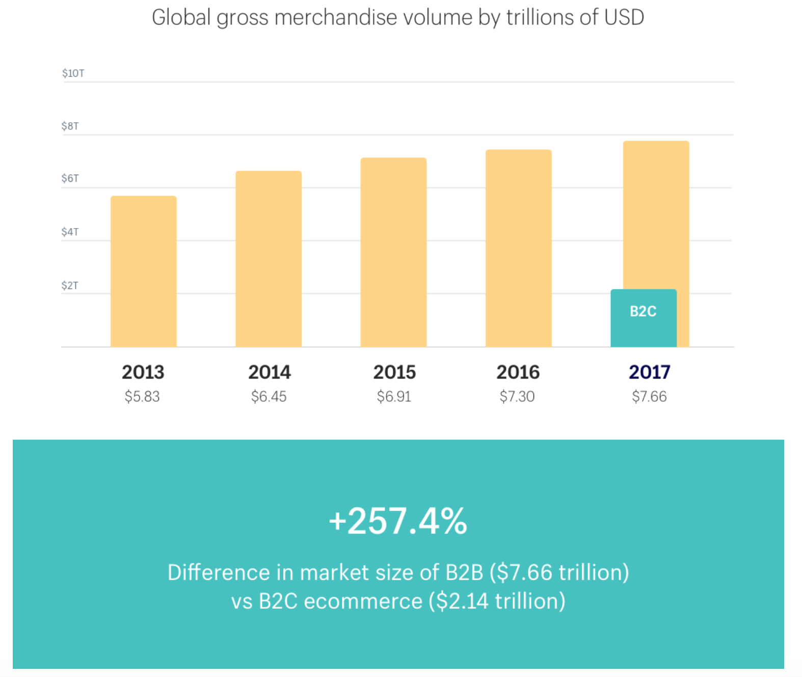

Slide 11
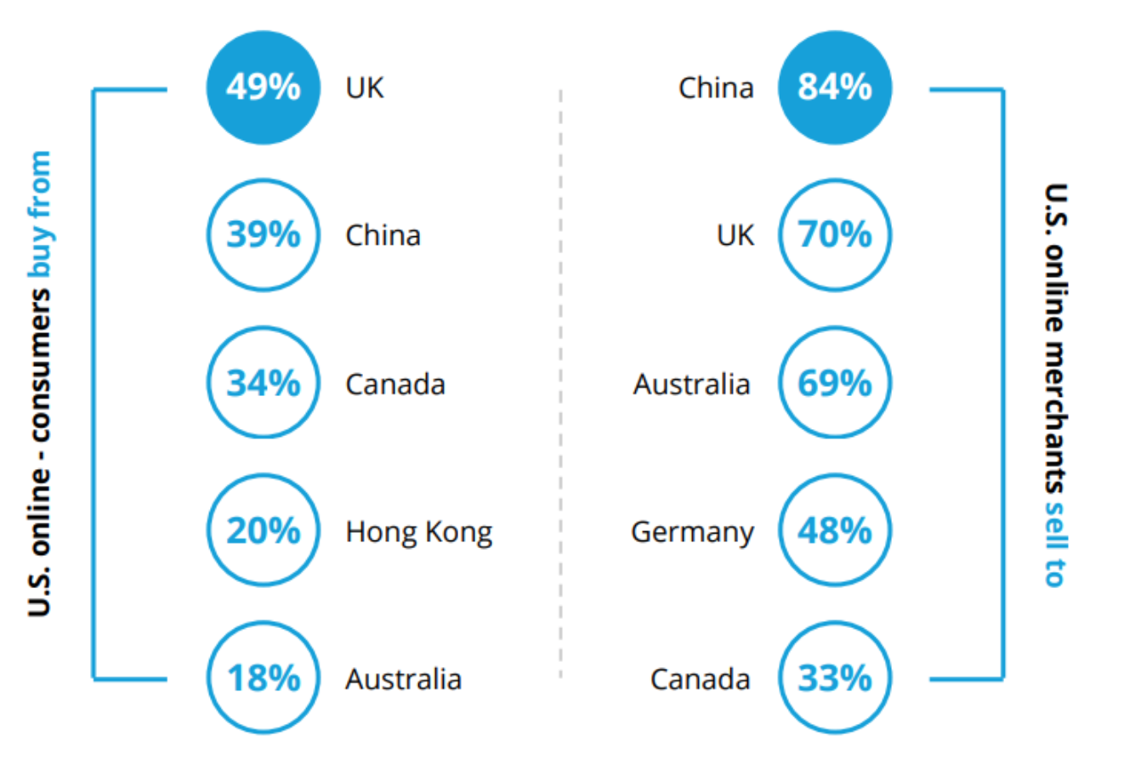
U.S. Online B2C Trade

Slide 12
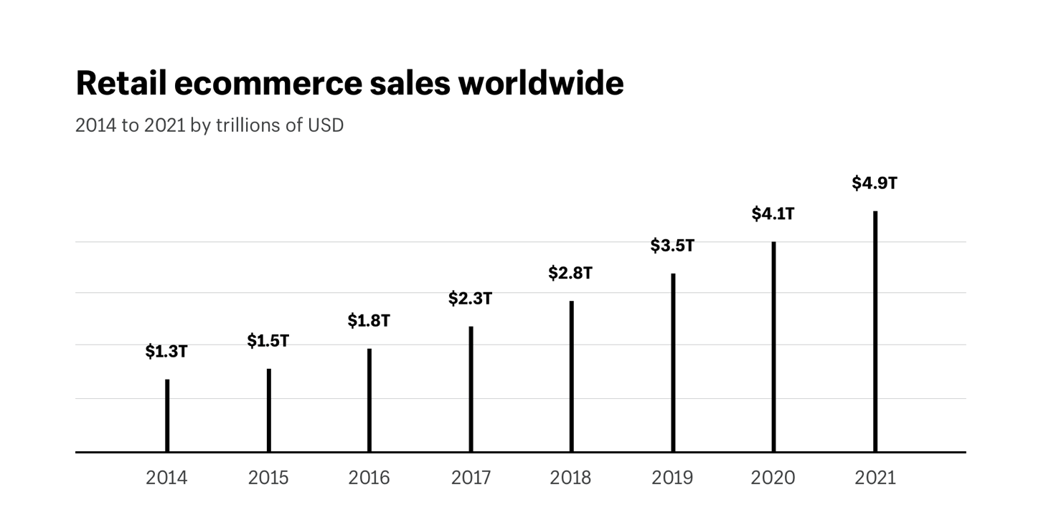
History

Slide 13
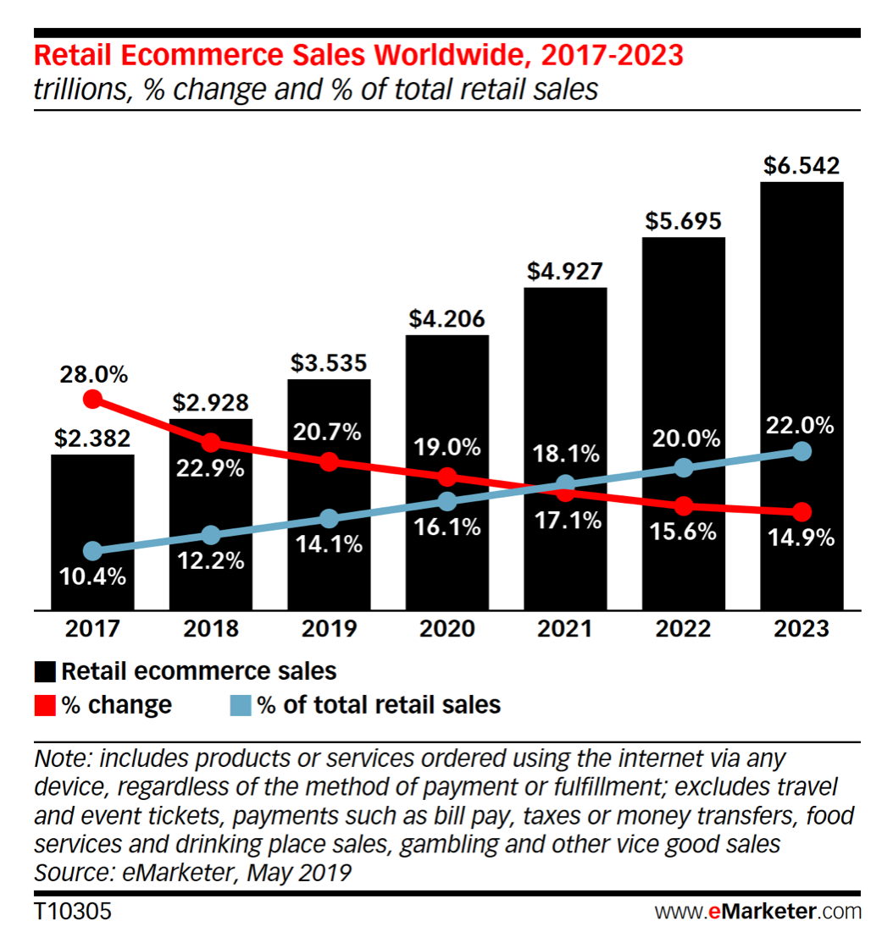

Slide 14
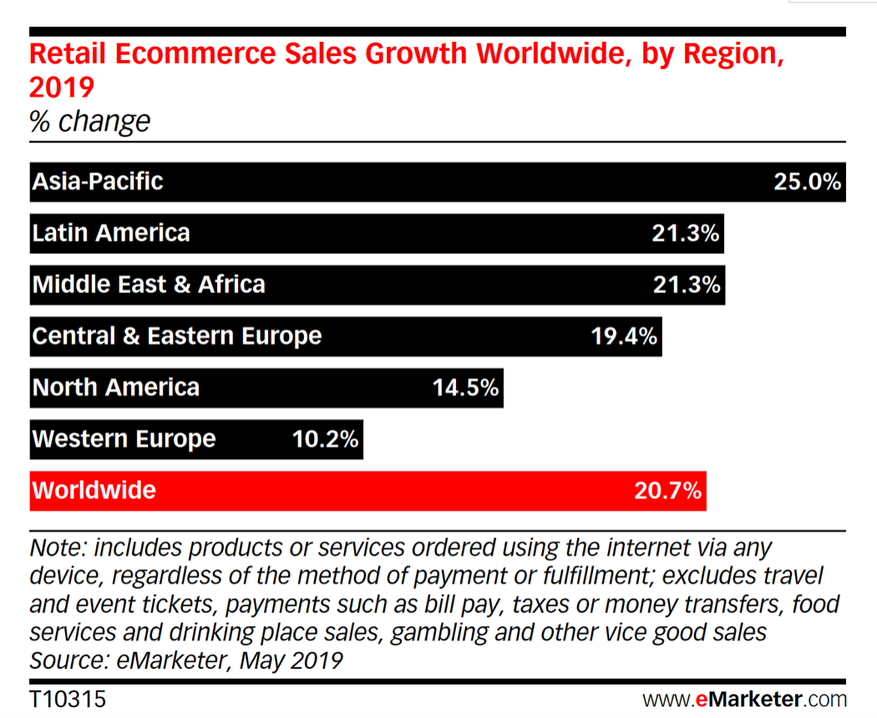

Slide 15
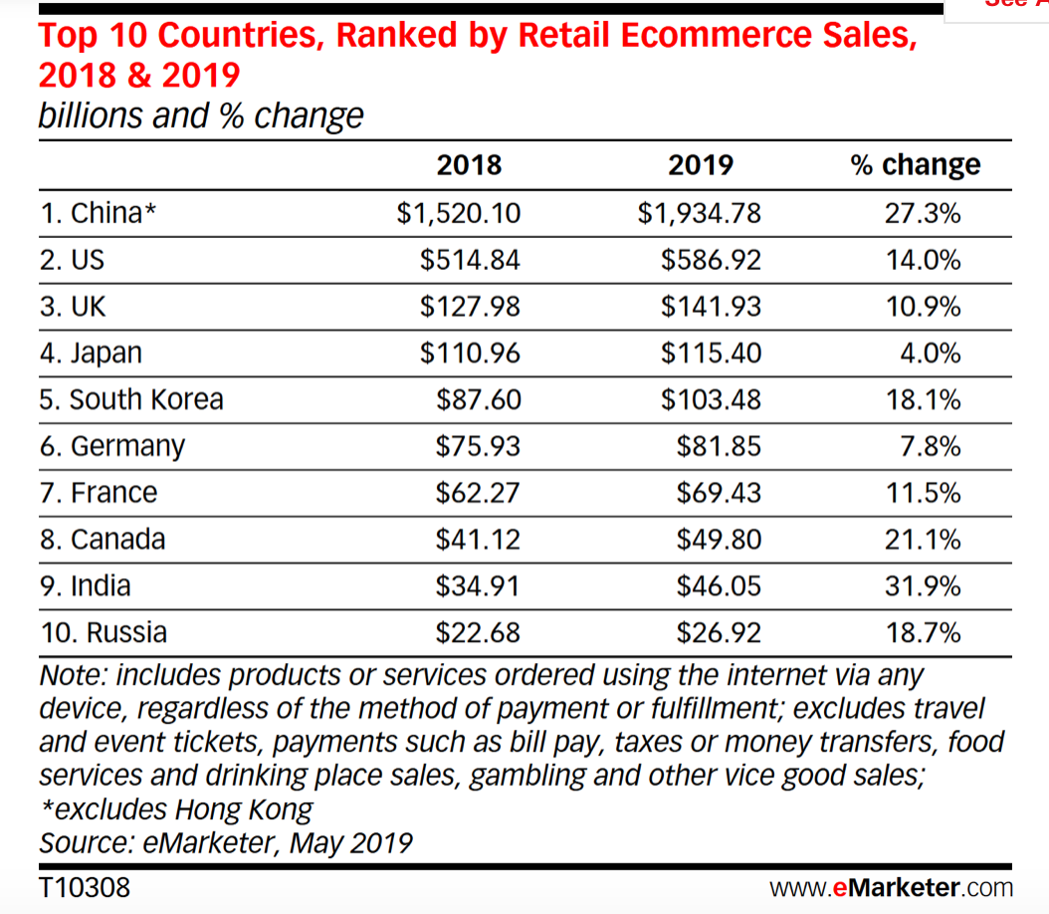

Slide 16
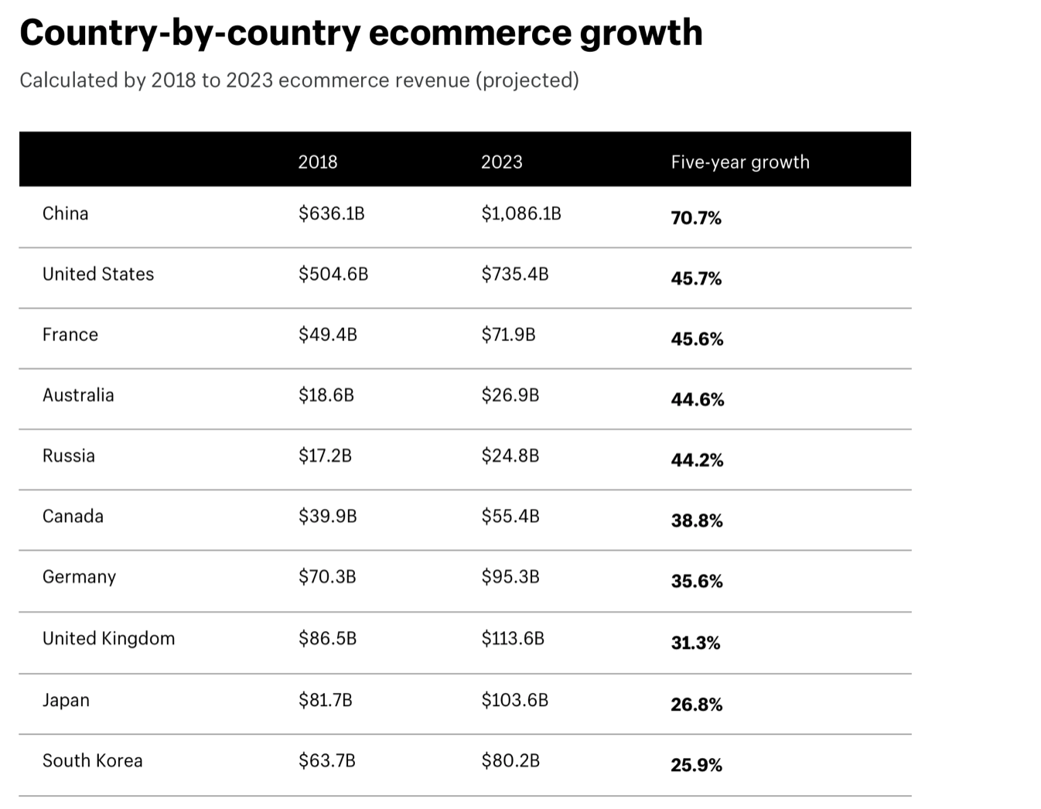

Slide 17
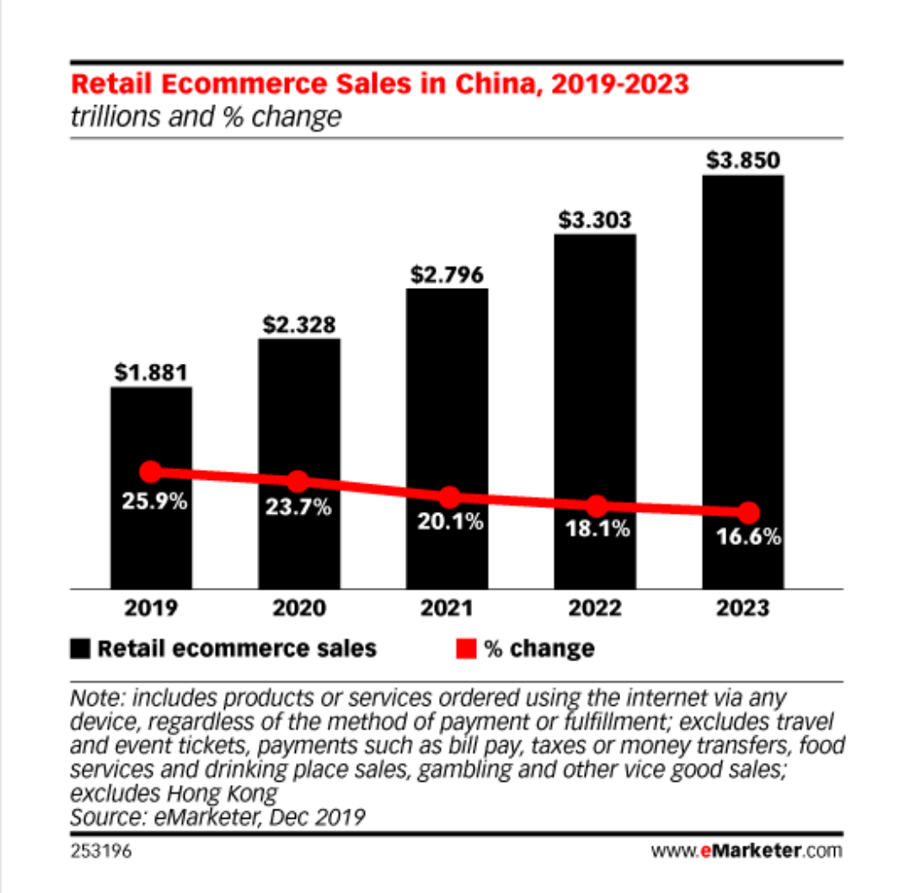

Slide 18
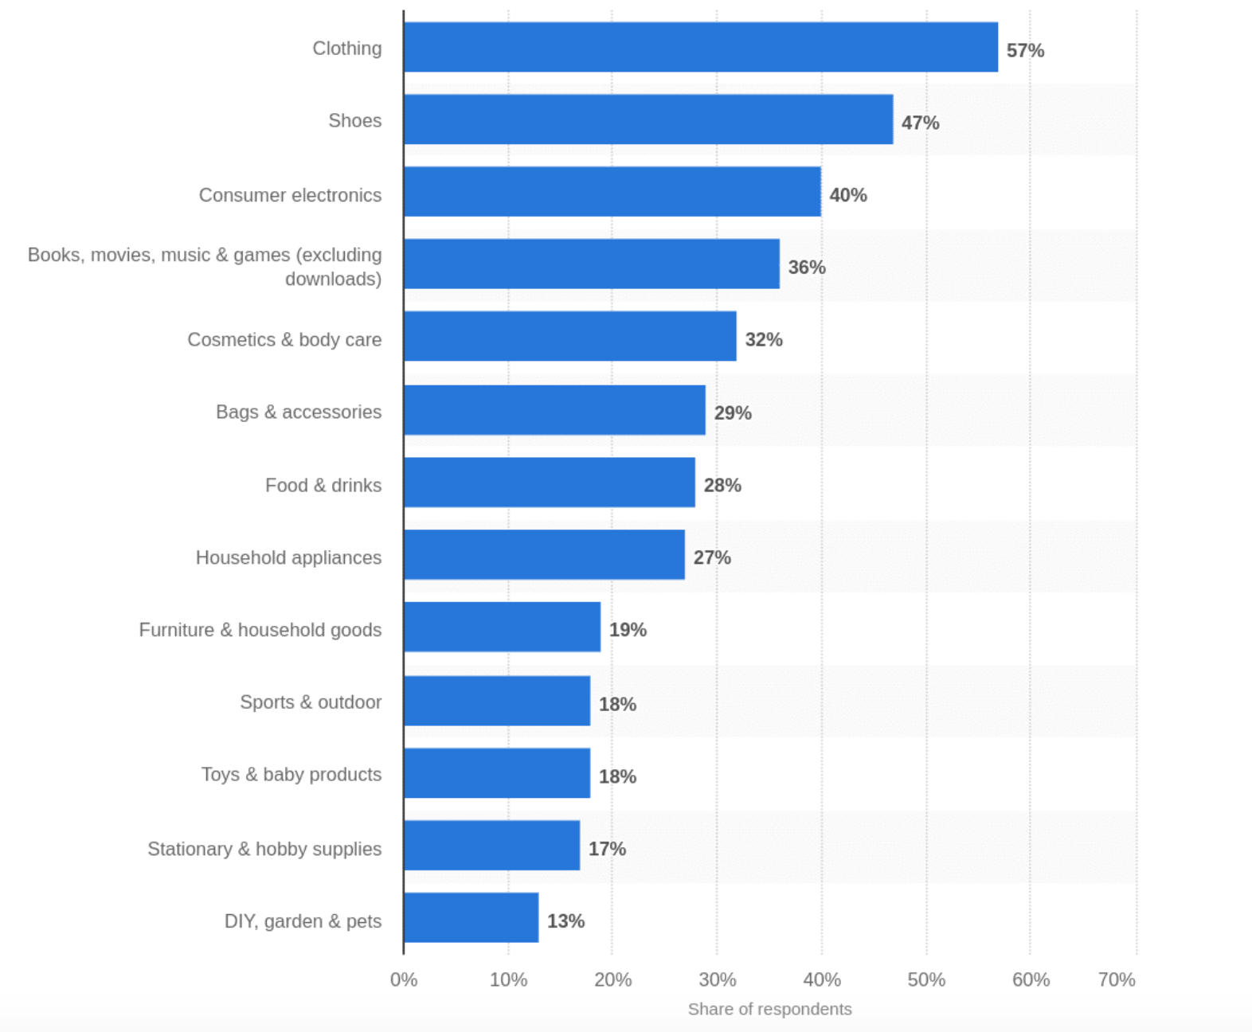
In 2019, the choices of online shoppers in U.S.

Slide 19
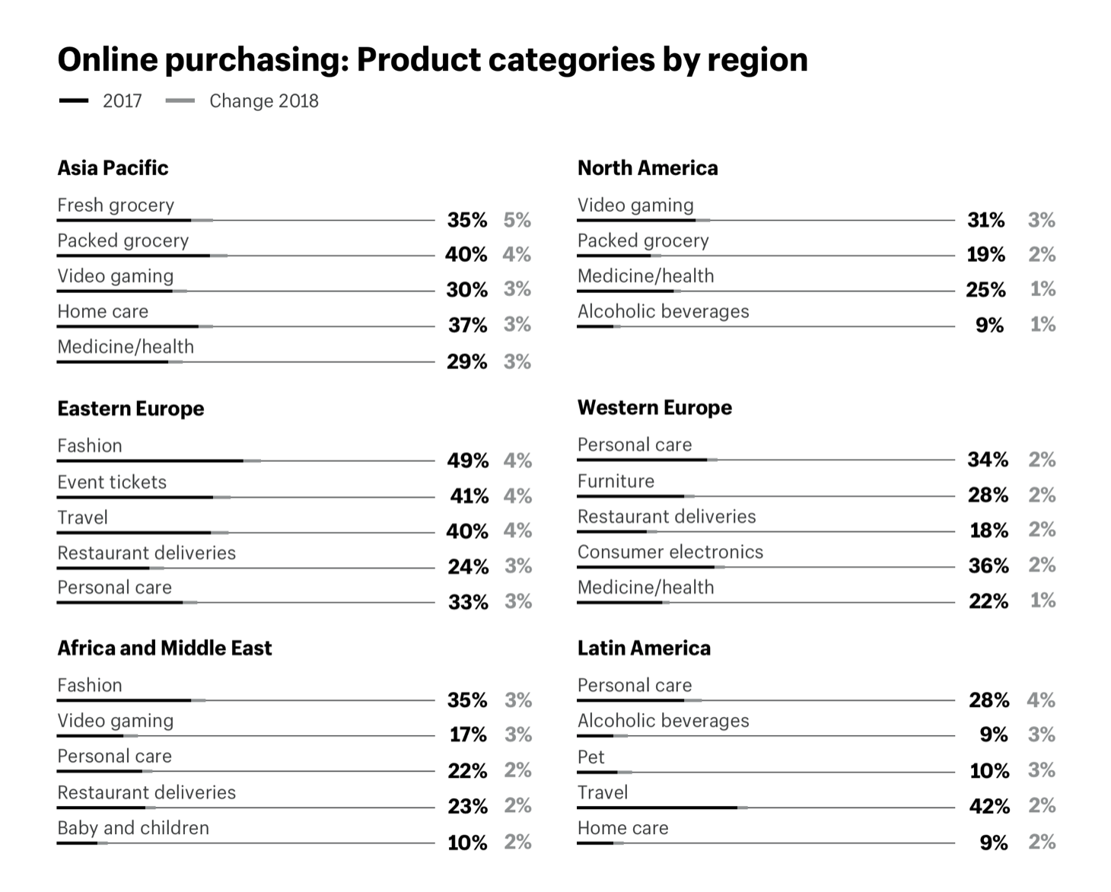

Slide 20
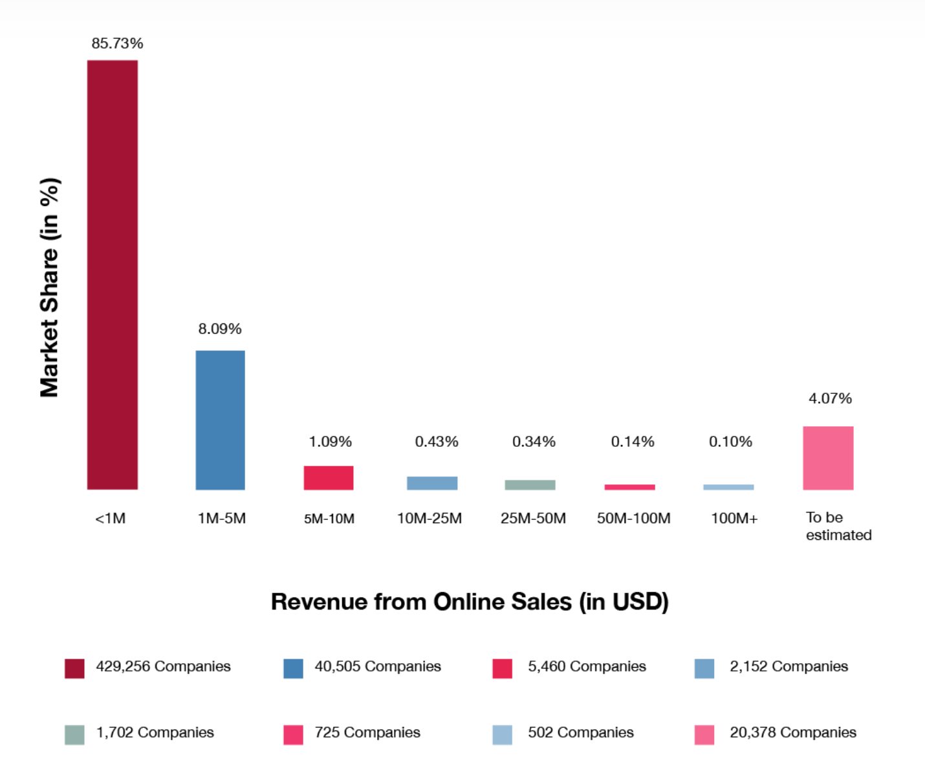

Slide 21
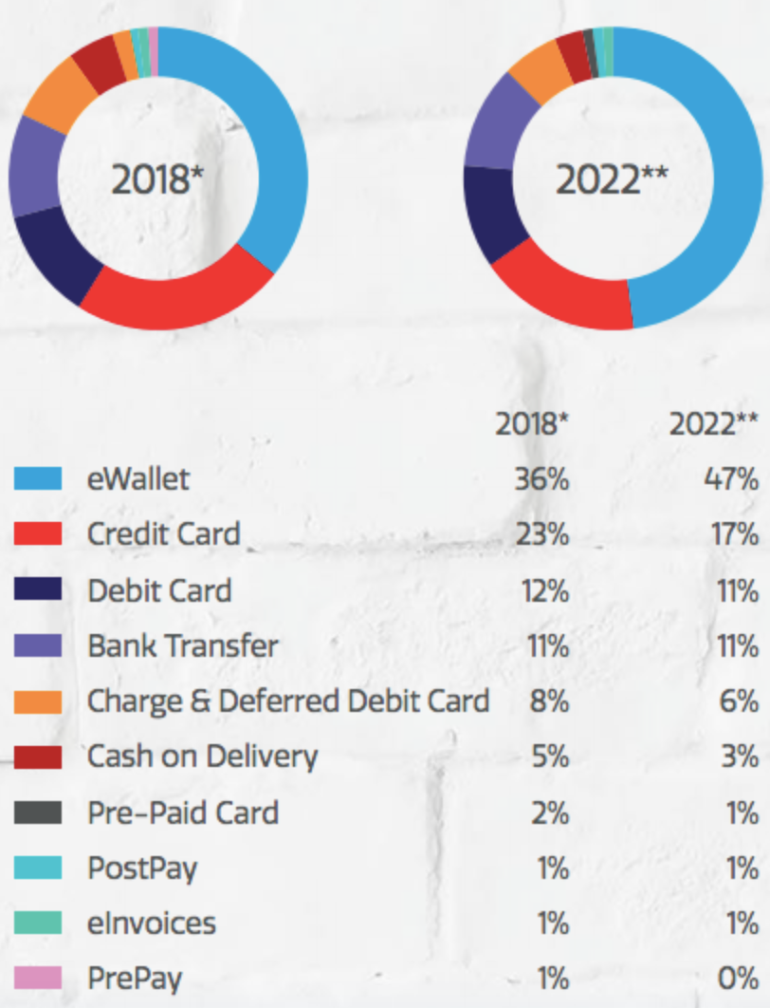

Slide 22
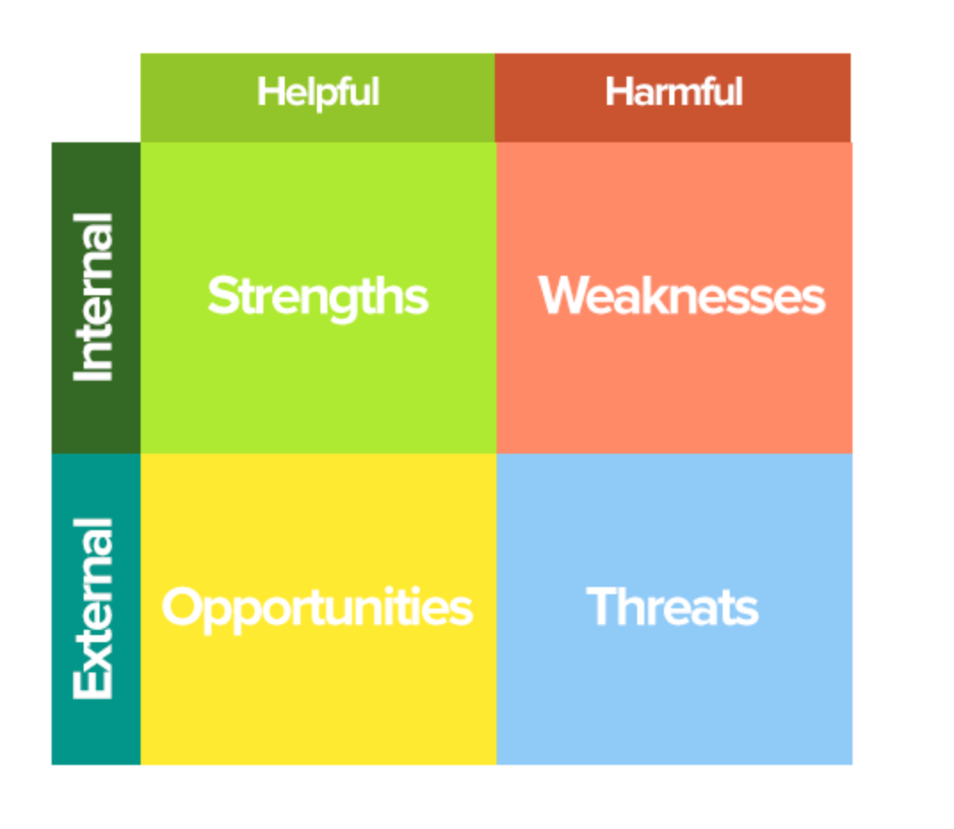

Slide 23
Strengthen
Ease and Accessibility
Lower Prices
Global Access
Easy Start-up

Slide 24
Weakness
Unfriendly to Elder Generation
Limitation to Products Identification
Limitation to Communication
Concerns on Environment

Slide 25
Opportunities
Growing Market
Social Net and Influencers

Slide 26
Threats
Competition
Fraud
Data concerns
Monopolies

Slide 27

Regulation
Tax
Payment Gateway
Trademarks, Patents and Copyright
Shipping Restriction
Age Restriction
License and Permits

Slide 28
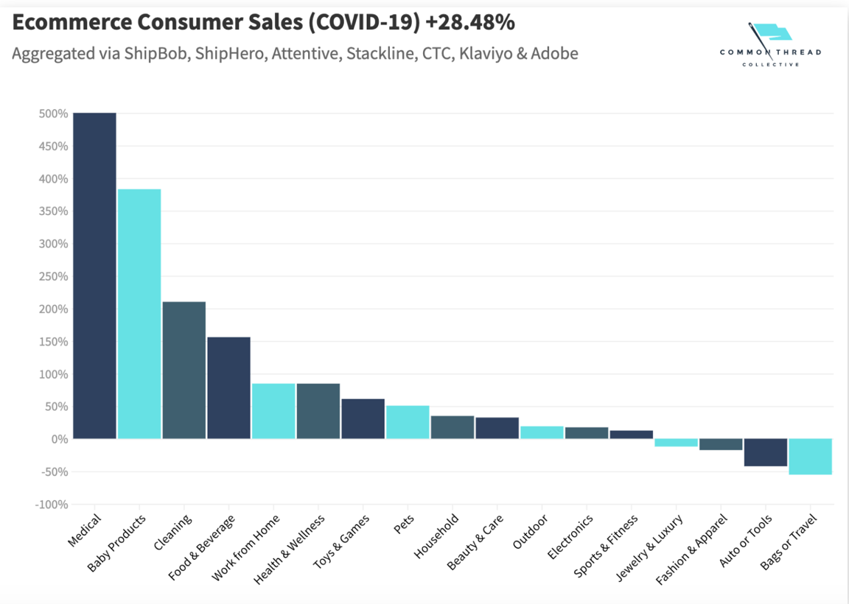
How COVID-19 Impacts E-commerce

Slide 29
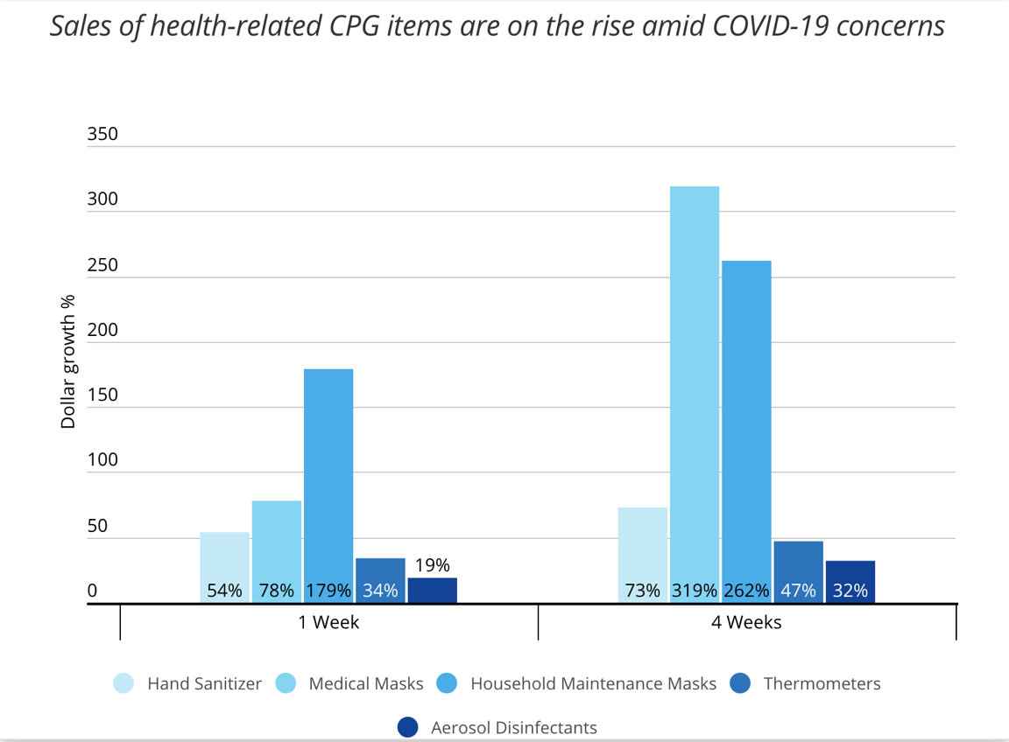

Slide 30
The Trend of E-commerce in the future
AR enhances the reality of online shopping.
There will be a growing volume of voice search.
AI helps shops learn about shoppers.
On-site personalization uses those insights to create individualized experiences.
Big data plays a big part in creating personalized experiences.
Chatbots improve the shopping experience.
Mobile shopping is still on the move.

Slide 31
The Trend of E-commerce in the future
More ways to pay.
Headless and API-driven ecommerce allow continued innovation.
Customers respond to video.
Subscriptions keep customers coming back.
Sustainability is becoming more important.
Businesses should optimize digital strategy for conversion.
B2B is growing…and changing.

Slide 32
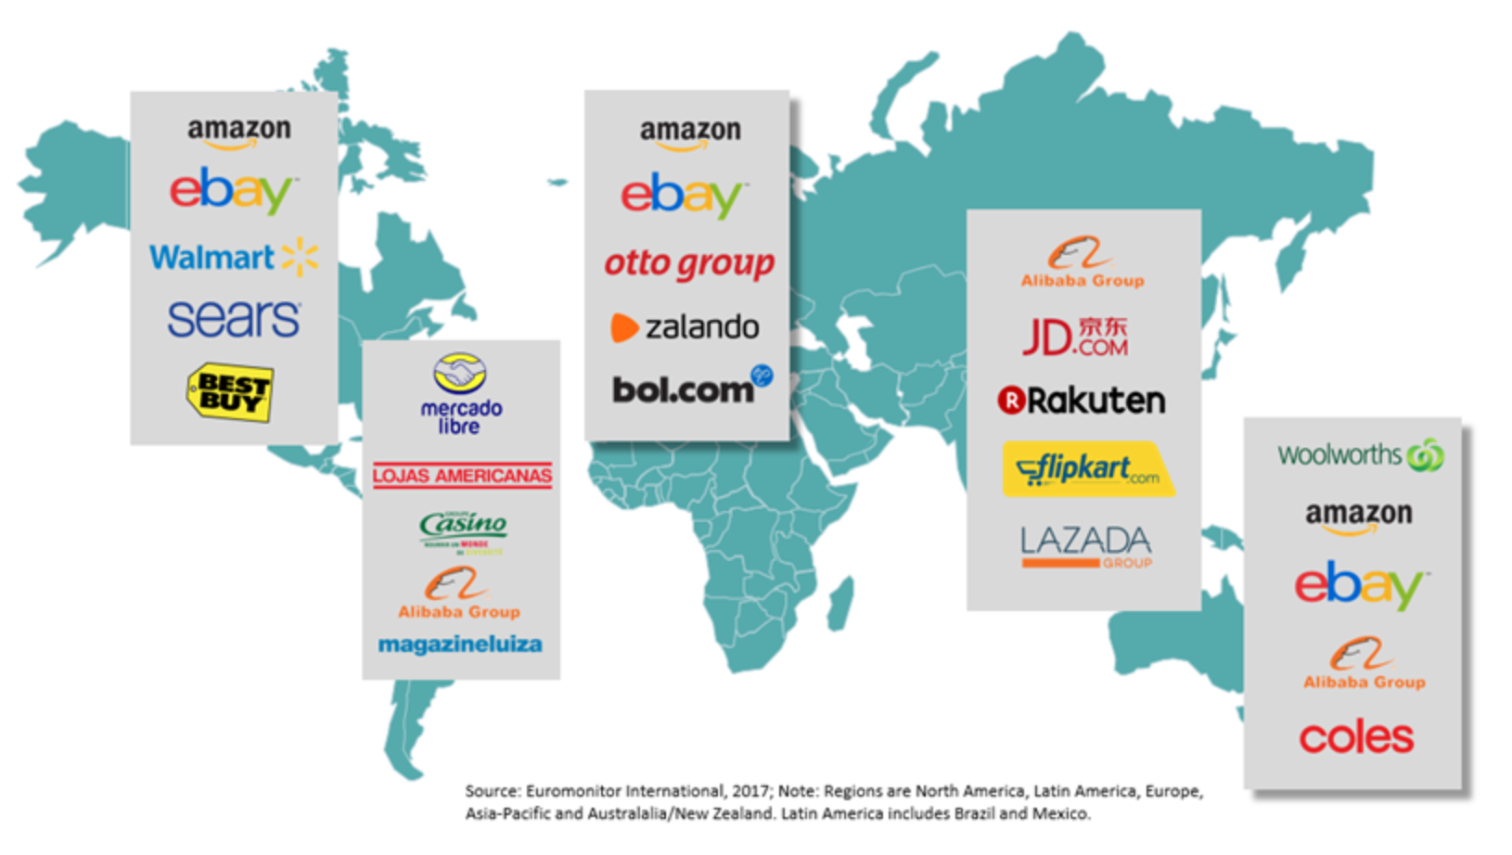

Slide 33


Slide 34

STOCK PERFORMANCE

Slide 35
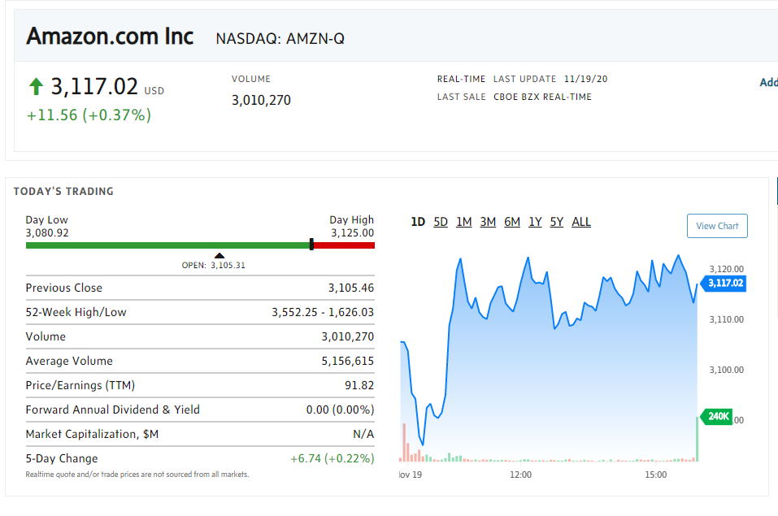
KEY STATISTIC

Slide 36
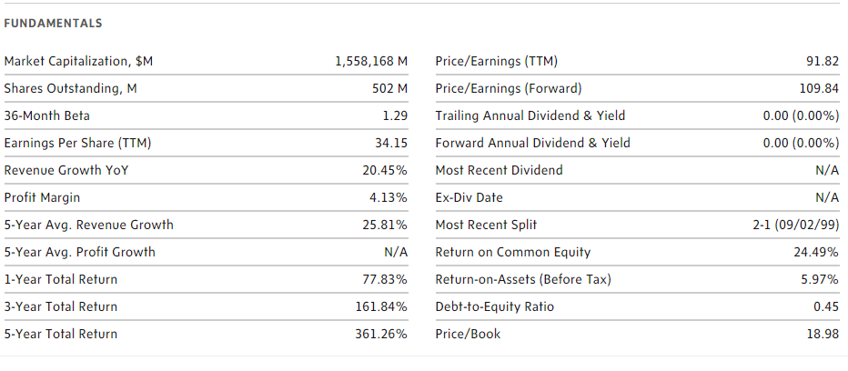
AMAZON FUNDAMENTALS

Slide 37
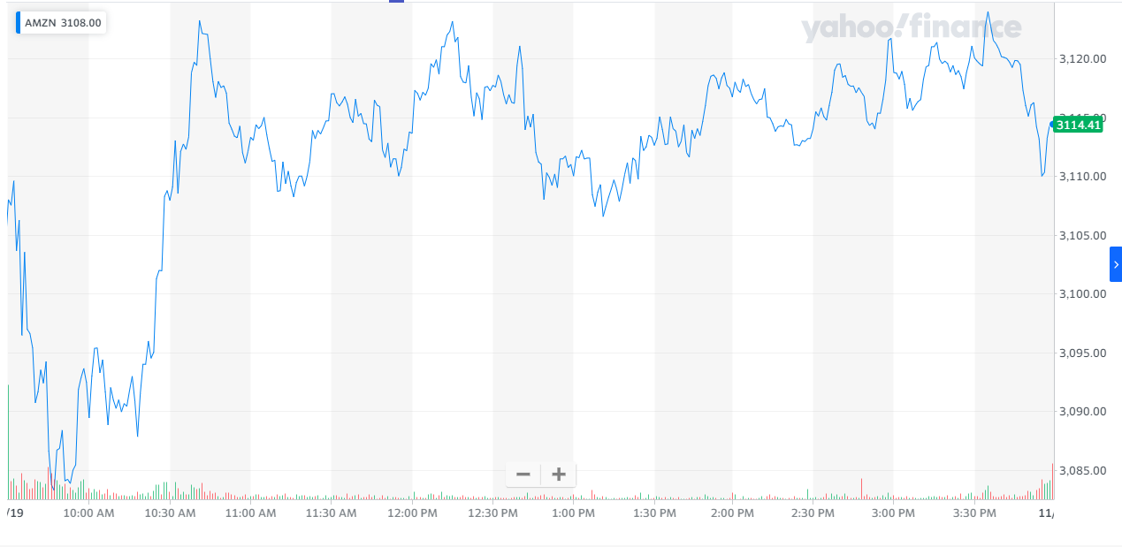
1-DAY PERFORMANCE

Slide 38
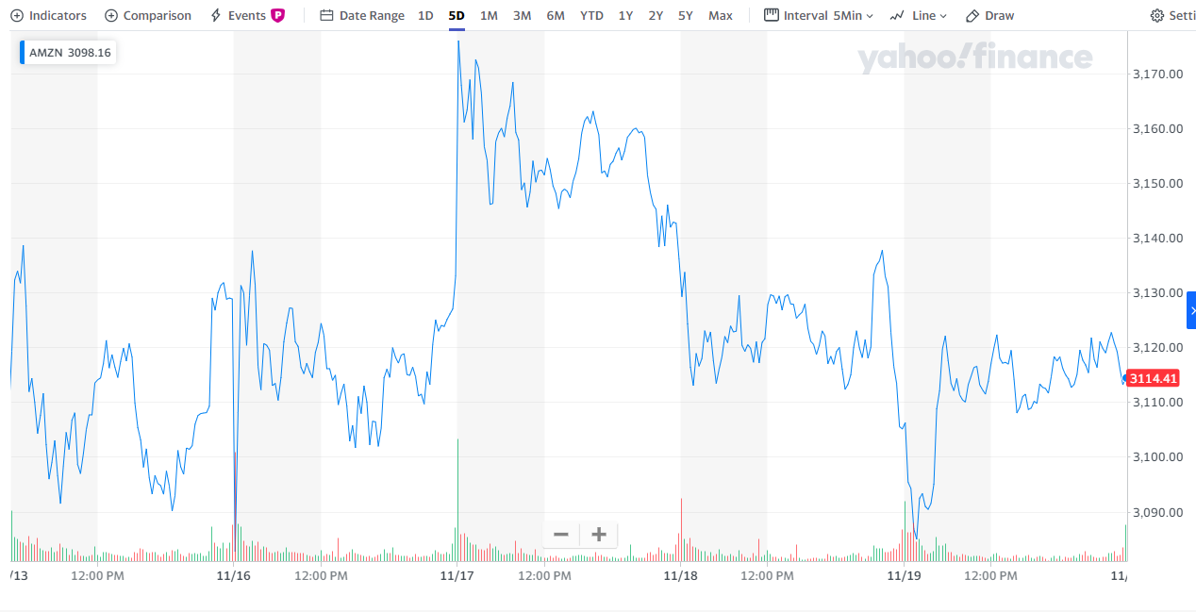
5-DAY PERFORMANCE

Slide 39
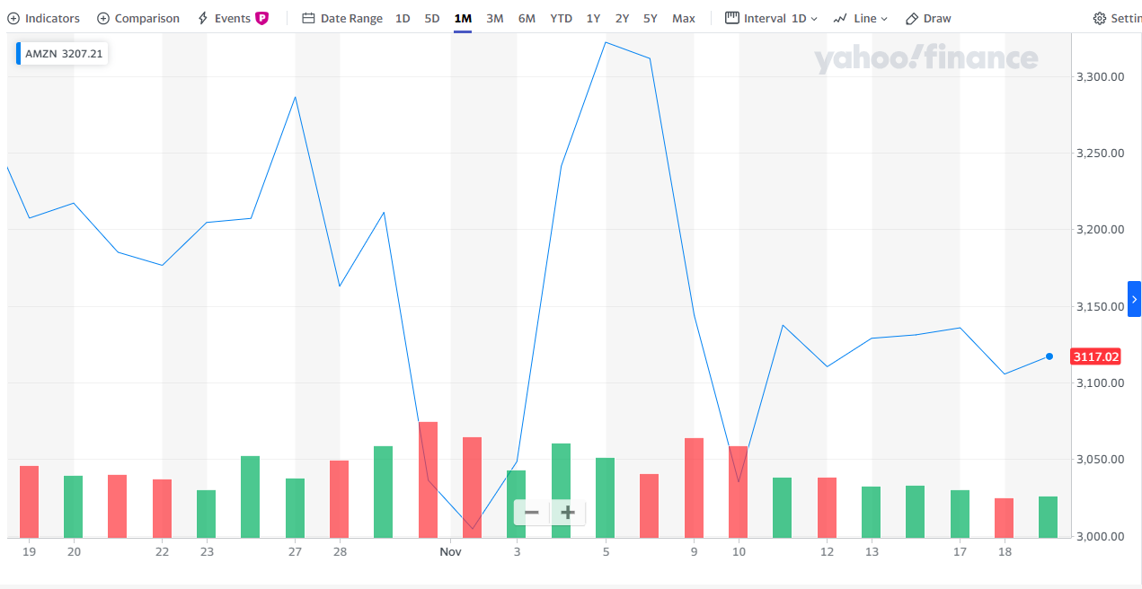
1-MONTH PERFORMANCE

Slide 40
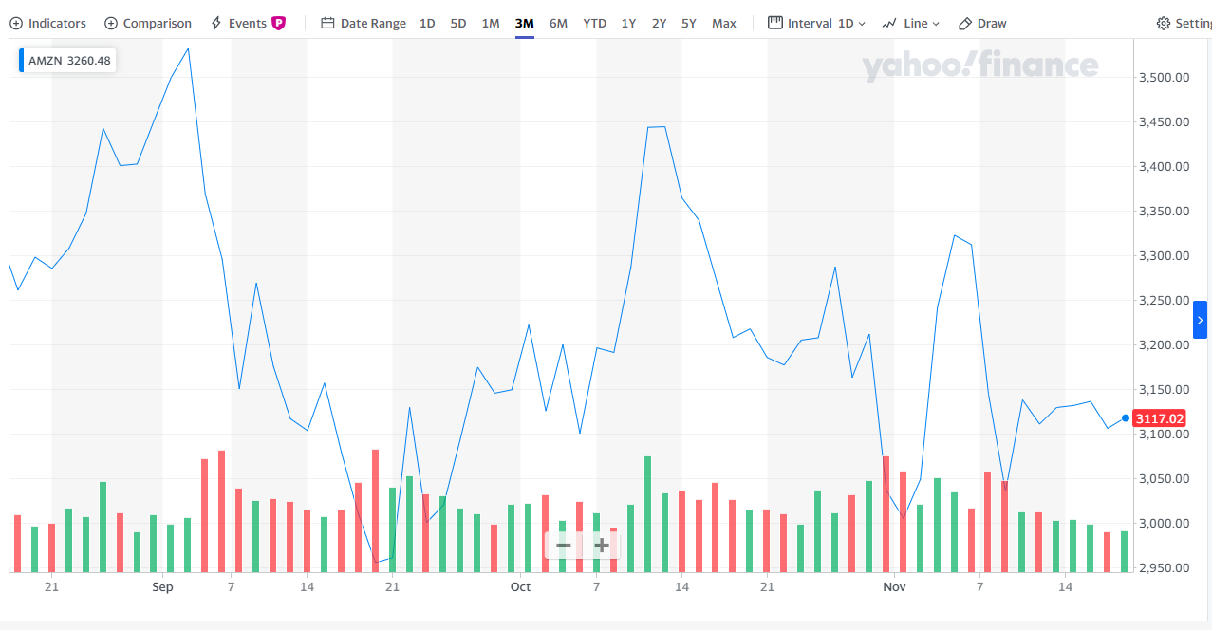
3-MONTH PERFORMANCE

Slide 41
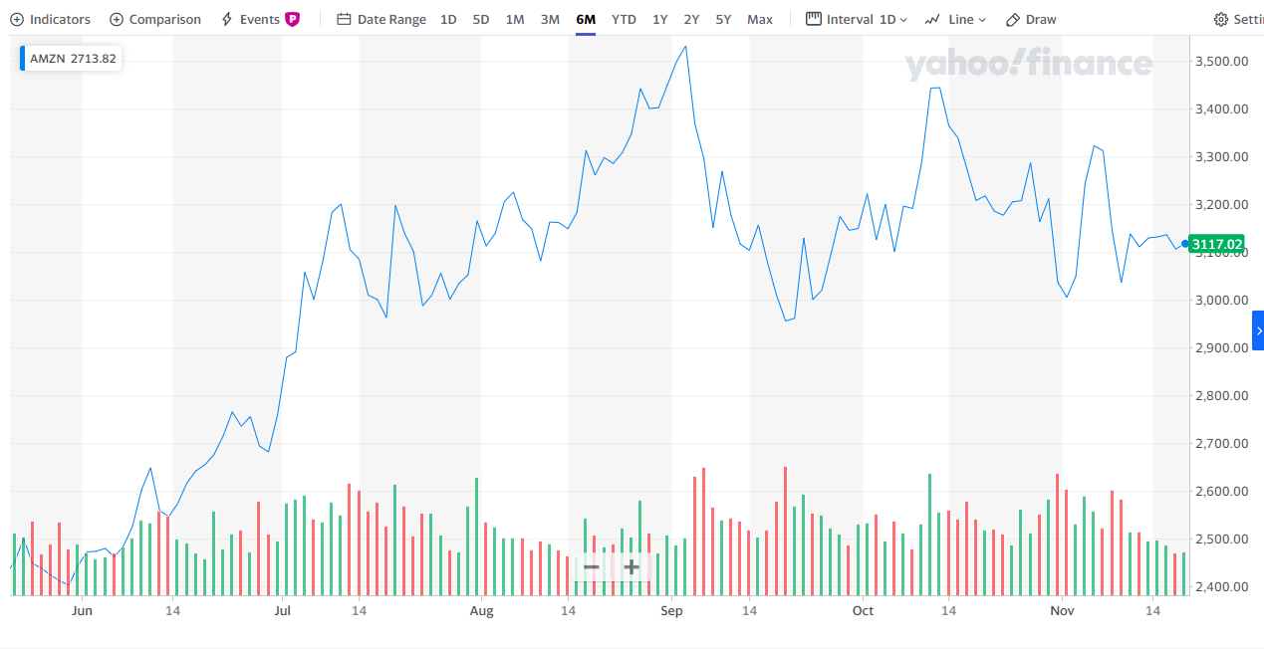
6-MONTH PERFORMANCE

Slide 42
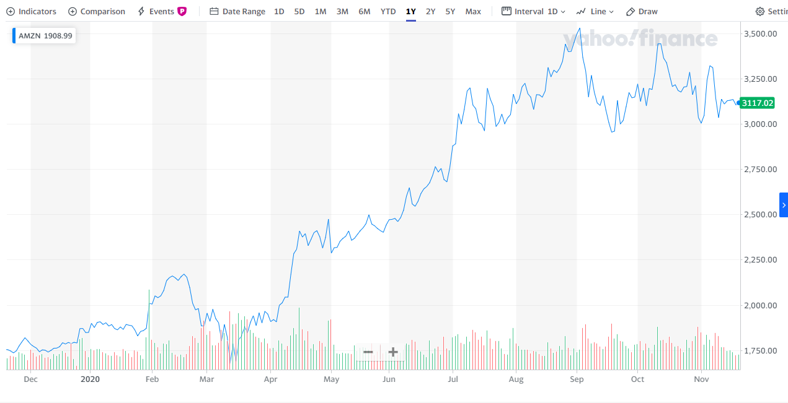
1-YEAR PERFORMANCE

Slide 43
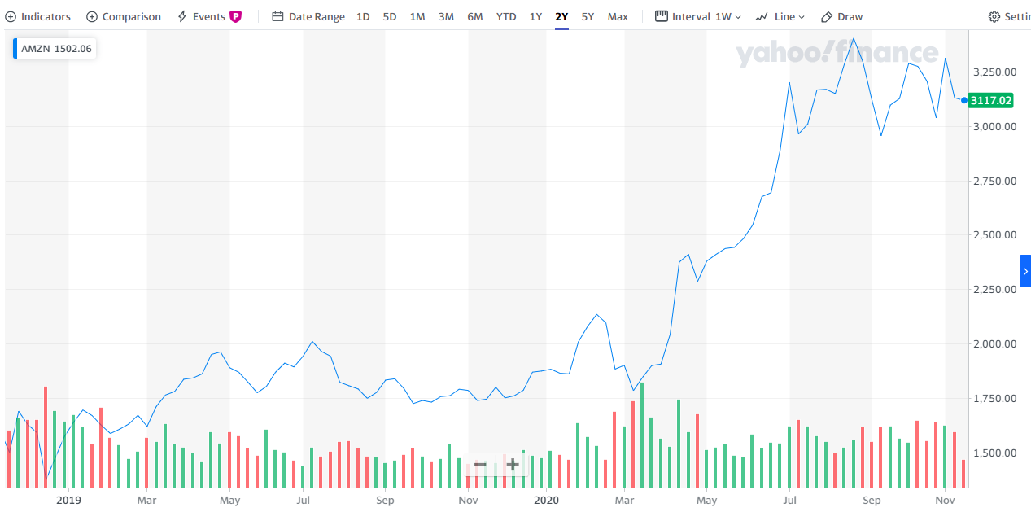
2-YEAR PERFORMANCE

Slide 44
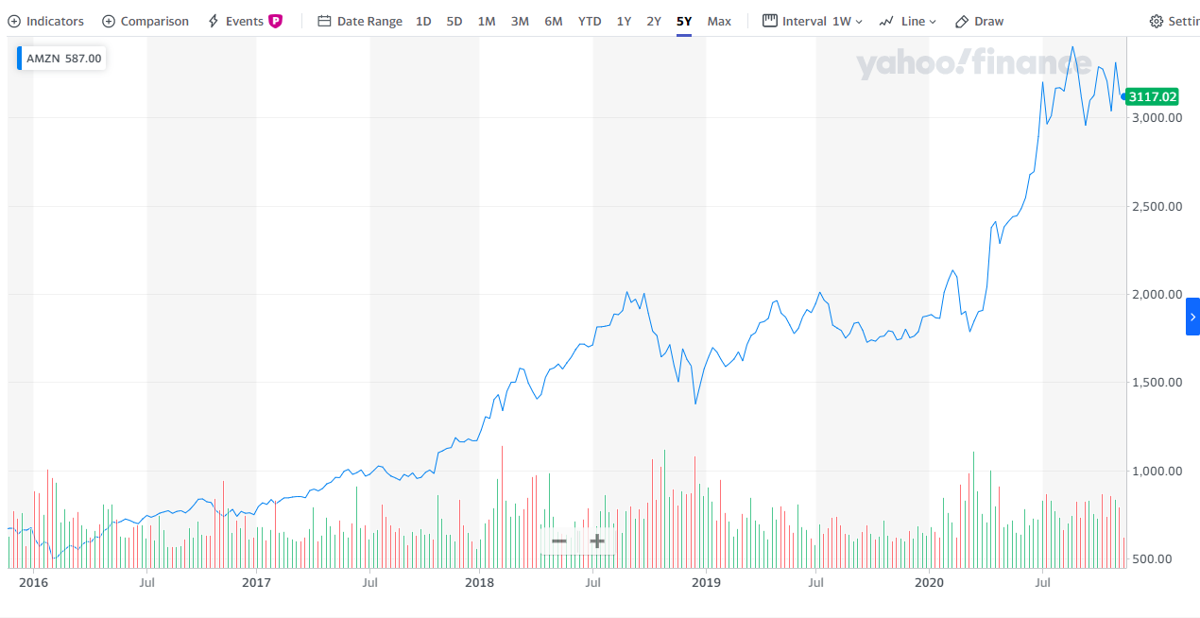
5-YEAR PERFORMANCE

Slide 45
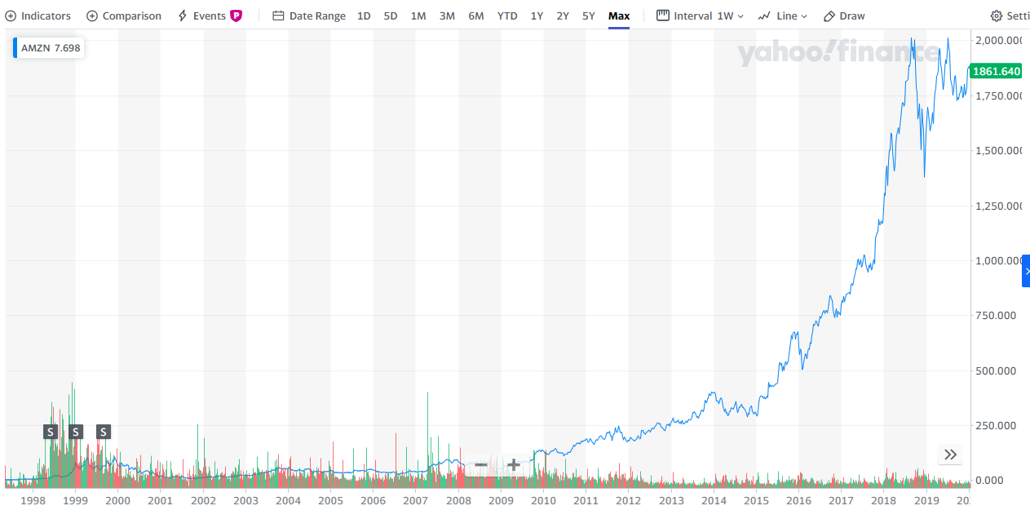
All-Time Chart

Slide 46


Slide 47
AMAZON’S OVERVIEW
International technology company
2020 Market Cap $1.564 Trillion USD
Focus on:
E-commerce
Cloud computing
Digital streaming
Artificial intelligence
Groceries

Slide 48

AMAZON’S OVERVIEW
Founder: Jeff Bezos
Founded in July 5, 1994
Employees (2020): 1,125,300
Headquarters:
Seattle, Washington
Crystal City, Arlington, Virginia

Slide 49

AMAZON’S OVERVIEW
IPO: $18 (May 15, 1997, Nasdaq)
If you invested $10,000 on that day and price
Well…. What are you doing here in this lesson go retire already!

Slide 50


Slide 51
AMAZON’S MANAGEMENT TEAM
Executive Officers:
Jeffrey P. Bezos
Jeffrey M. Blackburn
Andrew R. Jassy
Brian T. Olsavsky
Shelley L. Reynolds
Jeffrey A. Wilke
David A. Zapolsky

Slide 52
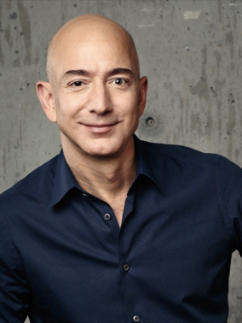
AMAZON’S MANAGEMENT TEAM
Jeffrey P. Bezos
Chairman of the Board of Amazon since 1994
CEO (1996 – now)
President (1994-1999; 2000-now)
Founder of Amazon
Founder of Blue Origin
Owner of Nash Holdings
Top shareholders of Amazon
Divorce in 2019
MacKenzie (his ex-wife) received 25% of his stake in Amazon
Still the biggest shareholders (holding 15.1% of outstanding shares)

Slide 53

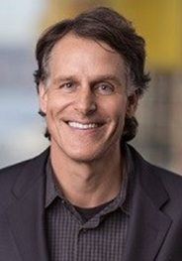
Jeffrey M. Blackburn
Senior Vice President, Business Development (2006 - present)
Leave of absence (2020-2021)
Previous position: VP, Operations Integration
Top Shareholder (0.014% outstanding shares, $164MM)
MBA from Stanford Graduate School of Business

Slide 54

AMAZON’S MANAGEMENT TEAM
Andrew R. Jassy
Founder of Amazon Web Services (Mar. 2006)
Senior Vice president of AWS (2006-2016)
CEO of Amazon Web Services (2016 – now)
Top shareholders of Amazon (0.02% of all outstanding share)
Degree:
Bachelor of Arts from Harvard University
MBA from Harvard Business School

Slide 55

AMAZON’S MANAGEMENT TEAM
Brian T. Olsavsky
Joined Amazon in April 2002
Vice President, Finance for Amazon’s North America retail business (2007 – 2010)
Vice President, Finance for the Global Consumer Business (2011 – 2015)
Senior Vice President (2015 – now)
CFO (2015 – now)
Degree:
Bachelor of Science in Mechanical Engineering from Penn State
MBA in Finance from Carnegie Mellon University

Slide 56
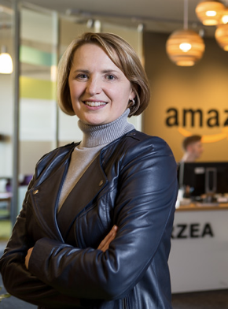
AMAZON’S MANAGEMENT TEAM
Shelley L. Reynolds
Vice President of Finance (2006 – 2007)
Vice President, Worldwide Controller (2007 – now)
Principle Accounting Officer (2007 – now)
Degree:
University of Washington Foster School of Business
Before joining Amazon:
Deloitte & Touche LLP (1998 – 2006)
Specialized in matters related to mergers & acquisitions
Served multiple publicly traded multi-national corporations from a broad range of industries.

Slide 57

AMAZON’S MANAGEMENT TEAM
Jeffrey A. Wilke
Join in 1999
Senior Vice President, Worldwide Operations (2002 – 2006)
Senior Vice President, North America Retail (2007 – 2012)
Senior Vice President, Consumer Business (2012– 2016)
CEO Worldwide Consumer (2016 – now)
Own 0.011% of outstanding shares
Degree:
MBA and MS in Chemical Engineering at MIT’s Leader for Global Operations program
BSE in Chemical Engineering, Summa Cum Laude, from Princeton University

Slide 58

AMAZON’S MANAGEMENT TEAM
David A. Zapolsky
Associate General Counsel (1999 – 2002)
Vice President and Associate General Counsel for Litigation and Regulatory matters (2002 – 2012)
Vice President, General Counsel, and Secretary (2012 – 2014)
Senior Vice President, General Counsel, and Secretary (2014 – now)
Own 0.0007% of outstanding shares (worth $9m)
Degree:
Undergraduate: Columbia University
Graduate: University of California

Slide 59
MANAGEMENT COMPENSATION
Two basic components:
A modest base salary
a minimum level of cash compensation
significantly less than those paid to senior leadership at similarly situated companies
Vary from $81,840 to $175,000
Stock-based components
Primary components
Periodic grants of time-vested restricted stock units subject to long-term vesting requirements.
closely tie total compensation to long-term shareholder value
Amazon believes this approach works better for the company
Better than the approach that focus on specific performance measures.

Slide 60
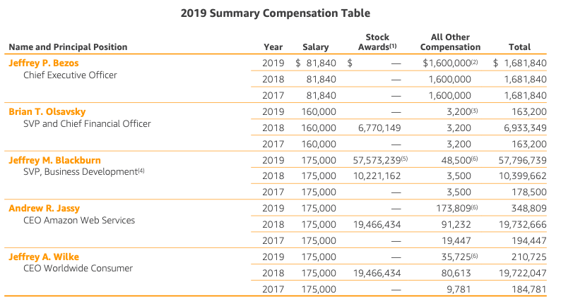
MANAGEMENT COMPENSATION

Slide 61
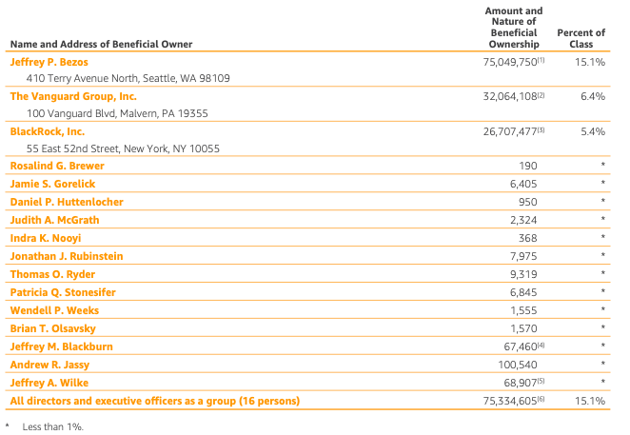
OWNERSHIP OF SHARES
Total numbers shares of common stock outstanding: 502M (Q3 2020)

Slide 62

ACQUSITION 101

Slide 63
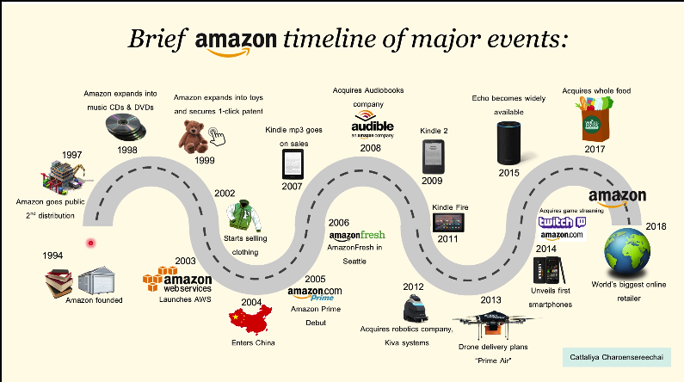

Slide 64
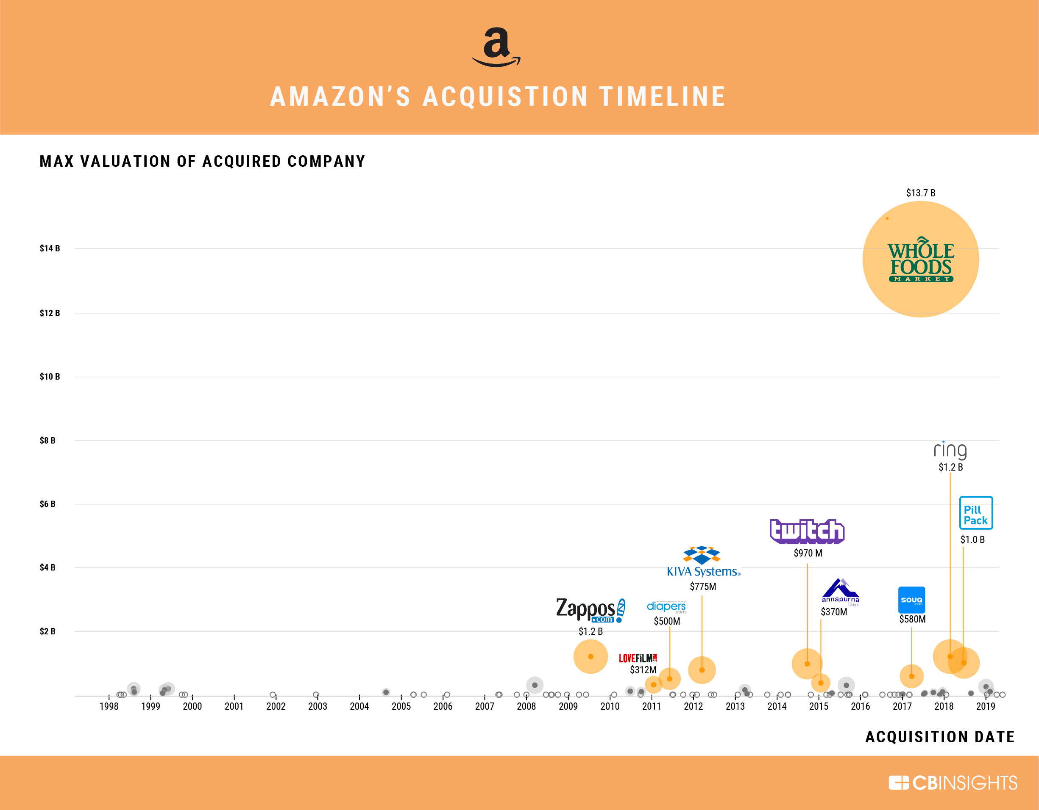

Slide 65




AMAZON’S EXPENSIVE ACQUISITIONS – TOP 5
Acquired on June 16, 2017 with $13.7 billion
Acquired on November 2, 2009 with $1.2 billion
Acquired on June 26, 2020 with $1.2 billion
Acquired on March 28, 2013 with $1.2 billion
Acquired on August 25, 2014 with $970 million

Slide 66
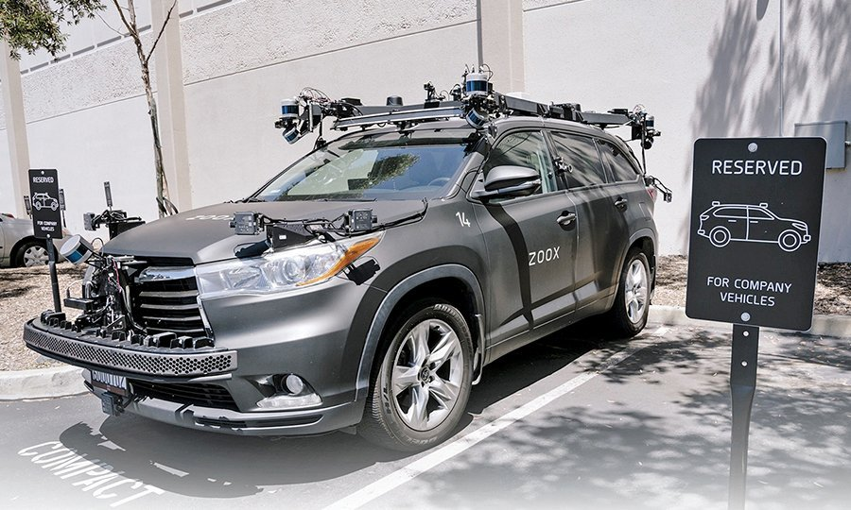
ZOOX ACQUISITION
Robo Taxi?
…”Creating autonomous mobility from the ground up.”
Includes developing zero-emission vehicles for riders, not drivers.
Autonomous ride-hailing service, meant to revolutionize the taxi and ride-hailing industry.

Slide 67
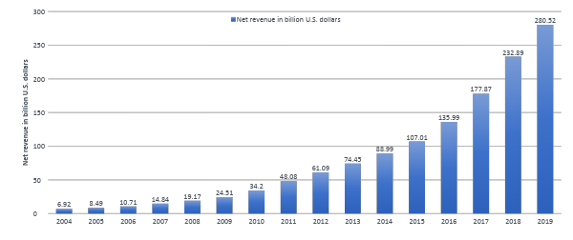
OVERALL ANNUAL NET REVENUE
Note: Worldwide; 2004 to 2019
Further information regarding this statistic can be found on page 8.
Source(s): Amazon; ID 266282

Slide 68
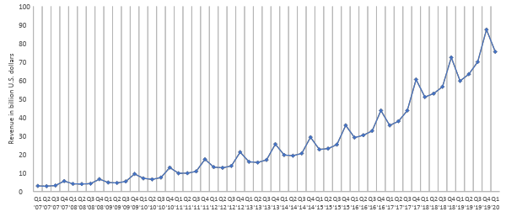
OVERALL QUARTERLY NET REVENUE
Note: Worldwide; Q1 2007 to Q1 2020; consolidated net sales
Further information regarding this statistic can be found on page 8.
Source(s): Amazon; ID 273963

Slide 69
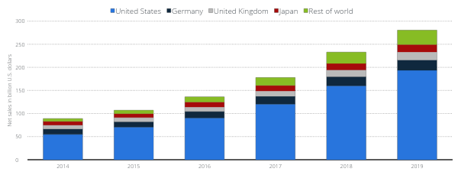
ANNUAL NET SALES BASED ON REGIONS
Annual net sales of Amazon in selected leading markets from 2014 to 2019 (in billion U.S. dollars)
Net sales of Amazon in leading markets 2014-2019
Note: Worldwide; 2014 to 2019; including AWS
Further information regarding this statistic can be found on page 8.
Source(s): Amazon; ID 672782
2

Slide 70
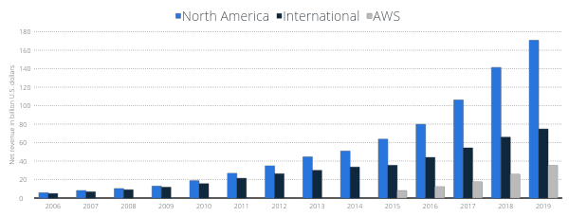
ANNUAL NET REVENUE BY SEGMENT
Annual net revenue of Amazon from 2006 to 2019, by segment (in billion U.S. dollars)
Net revenue of Amazon from 2006-2019, by segment
Note: Worldwide; 2006 to 2019
Further information regarding this statistic can be found on page 8.
Source(s): Amazon; ID 266289
2

Slide 71
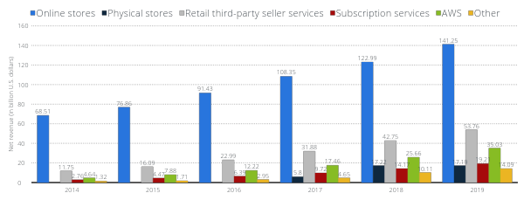
GLOBAL NET REVENUE BY PRODUCT GROUP
Global net revenue of Amazon from 2014 to 2019, by product group (in billion U.S. dollars)
Global net revenue of Amazon 2014-2019, by product group
Note: Worldwide; 2014 to 2019
Further information regarding this statistic can be found on page 8.
Source(s): Amazon; ID 672747
4

Slide 72
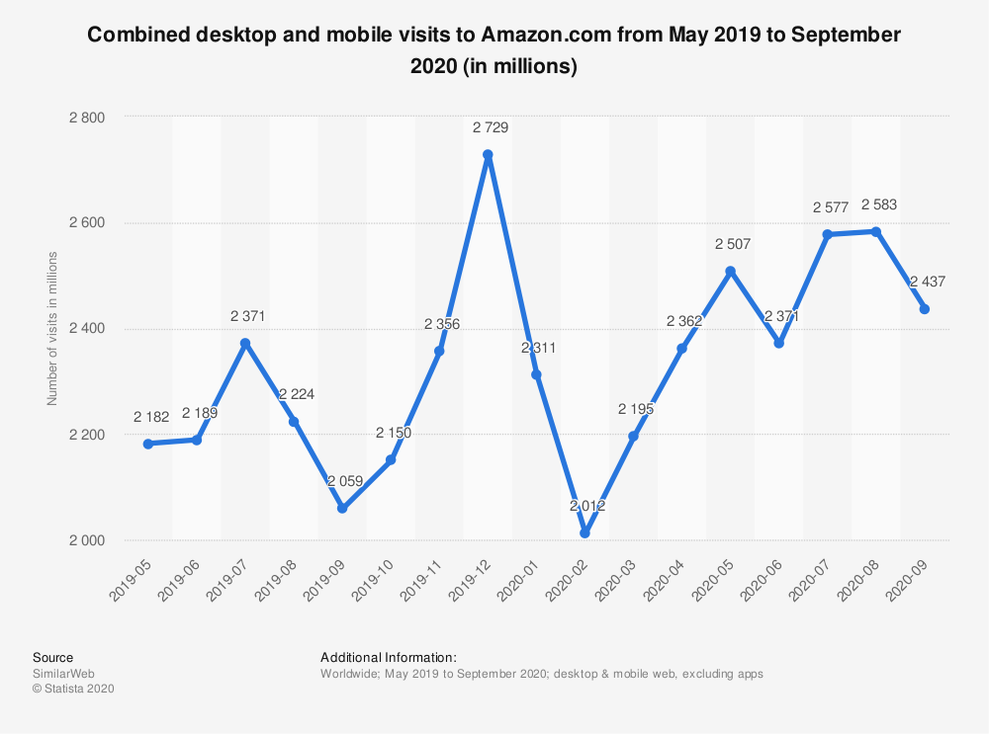
Monthly Website Traffic

Slide 73
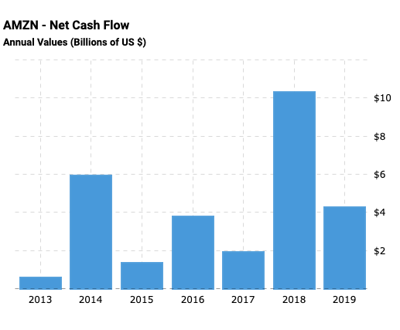
ANNUAL CASH FLOWS GENERATED

Slide 74
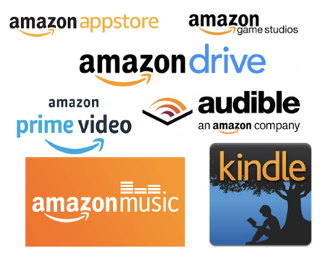
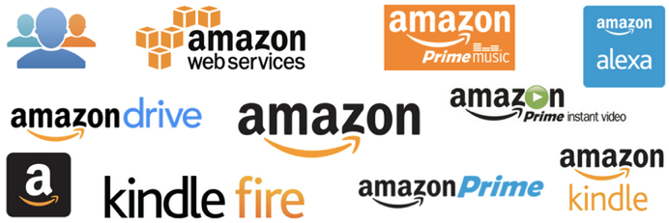
AMAZON’S REVENUE STREAMS
Online retail business
Third-party retail service
Amazon Prime
Amazon Web Service (AWS)
Others. E.g. Amazon Kindle

Slide 75

Online Retail
First-party Seller
a brand manufacturer that sells inventory directly to Amazon, who then sells it to the customer.
Second-party Seller
an Amazon supplier that is not the manufacturer of the product (Resellers)
Third-party sellers
uses Amazon as a marketplace to sell directly to consumers; Amazon has nothing to do with the production and distribution of the product.

Slide 76
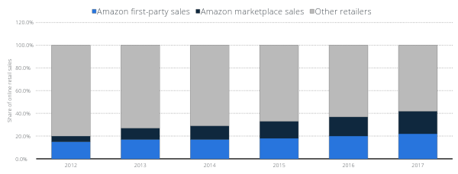
Amazon sales as a percentage of online retail sales in the United States from 2012 to 2017
U.S. Amazon first-party and third-party e-commerce sales share 2012-2017
Note: United States; 2012-2017
Further information regarding this statistic can be found on page 8.
Source(s): Digital Commerce 360; US Department of Commerce; Internet Retailer; ID 917414
2

Slide 77
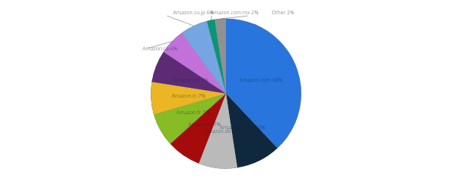
Distribution of active Amazon marketplace sellers worldwide in 2019, by country
Share of Amazon marketplace sellers worldwide 2019, by country
Note: Worldwide; 2019
Further information regarding this statistic can be found on page 8.
Source(s): Marketplace Pulse; ID 1086651
2

Slide 78
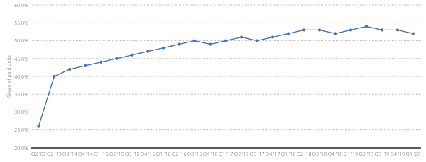
THIRD-PARTY SALES PERCENTAGE 2007-20
Percentage of paid units sold by third-party sellers on Amazon platform as of 1st quarter 2020
Third-party seller share of Amazon platform 2007-2020
Note: Worldwide; Q2 2007 to Q1 2020
Further information regarding this statistic can be found on page 8.
Source(s): Amazon; ID 259782
2

Slide 79

AMAZON PRIME
A paid subscription service
Worldwide subscribers: 150 million (4th quarter 2019)
Providing:
Same, one or two-day delivery
streaming music and video
Shopping benefit: e.g., Whole Foods Market Grocery discount, free delivery etc.
Prime Reading
Others

Slide 80
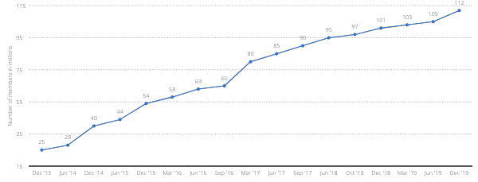
Number of Amazon Prime members in the United States as of December 2019 (in millions)
Number of U.S. Amazon Prime subscribers 2013-2019
Note: United States; December 2013 to December 2019
Further information regarding this statistic can be found on page 8.
Source(s): Consumer Intelligence Research Partners; Fortune; ID 546894
6

Slide 81

AMAZON PRIME GENERAL BENEFITS

Slide 82

AMAZON PRIME DELIVERY BENEFITS

Slide 83


Slide 84


Slide 85

Amazon Web Service (AWS)
Provide on-demand cloud computing platforms and APIS to individuals, companies, and governments, on a metered pay-as-you-go basis
Over 175 fully featured services from global data centers
Most popular:
Amazon Elastics Compute Clouds (EC2)
Amazon Simple Storage Service (Amazon S3)

Slide 86

Amazon Web Service (AWS)
Global market share of cloud infrastructure services from 2017 to 2020, by vendor
Cloud infrastructure services market share worldwide 2017-2020, by vendor
Share of cloud infrastructure services
Note: Worldwide; 2017 to 2020
Further information regarding this statistic can be found on page 8.
Source(s): Synergy Research Group; Statista estimates; ID 477277
4
Notes:
Amazon is losing market share to Rackspace and Microsoft

Slide 87

Annual revenue of Amazon Web Services from 2013 to 2019 (in million U.S. dollars)
Amazon Web Services: annual revenue 2013-2019
Note: Worldwide; 2013 to 2019
Further information regarding this statistic can be found on page 8.
Source(s): Amazon; ID 233725
2

Slide 88

Quarterly revenue of Amazon Web Services from 1st quarter 2014 to 1st quarter 2020 (in million U.S. dollars)
Amazon Web Services: quarterly revenue 2014-2020
Note: Worldwide; Q1 2014 to Q1 2020
Further information regarding this statistic can be found on page 8.
Source(s): Amazon; ID 250520
2

Slide 89


NO DIVDENDS
Focused on Revenue growth
Stock buybacks (few)
A company that never matures
Reinvests profits
DIVIDENDS

Slide 90

FINANCIAL STATEMENT

Slide 91

10-Q BALANCE SHEET (ASSETS)
Notes:
Sharp decrease in cash this quarter
- Looks like it may have been spent on PPE and marketable securities though
What are marketable securities??
-

Slide 92

10-Q BALANCE SHEET (LIABILITIES AND SHAREHOLDERS EQUITY)
Notes:
AP and long-term lease liabilities/debt jumped, likely bcus part of it was also spent on PPE and marketable securities
Nice jump in R/E

Slide 93

10-K BALANCE SHEET (ASSETS)
Notes:
They keep earning more cash
Large jump in marketable securities
Good PPE growth
Mention what the operating leases are on

Slide 94

10-K BALANCE SHEET (LIABILITIES AND SHAREHOLDERS EQUITY)

Slide 95

10-K CONSOLIDATED STATEMENT OF OPERATIONS
Notes:
Net product sale have healthy increase
Net service sales have giant increase (doubled in two years)
Net income and basic EPS has grown to a nice margin

Slide 96

10-Q CONSOLIDATED STATEMENT OF OPERATIONS

Slide 97

10-Q DECOMPOSITION OF SALES BY SEGMENTS

Slide 98

10-Q DECOMPOSITION OF SALES BY SERVICES
Notes:
Physical stores have seen a large decrease since the pandemic, and has not recovered at all from Q2 to Q3
- All other services have had healthy growth since Q2 2019 and the pandemic

Slide 99

10-K CONSOLIDATED STATEMENT OF OPERATIONS

Slide 100

10-K CONSOLIDATED STATEMENT OF CASH FLOWS

Slide 101

10-K CONSOLIDATED STATEMENTS OF CASH FLOWS
2017 2018 2019

Slide 102

10-K CONSOLIDATED STATEMENT OF CASH FLOWS
2017 2018 2019

Slide 103

10-Q CONSOLIDATED STATEMENT OF CASH FLOWS
Notes:
Large increase in cash from 3 months ended YOY, looks like they are stockpiling cash
Tripled net income YOY for three months ended
Large increase in spending for inventories
Large increase in AP

Slide 104

10-Q CONSOLIDATED STATEMENT OF CASH FLOWS
Three Months Ended Nine Months Ended Twelve Months Ended
September 30, September 30, September 30,
2019 2020 2019 2020 2019 2020

Slide 105

10-Q CONSOLIDATED STATEMENT OF CASH FLOWS
Three Months Ended Nine Months Ended Twelve Months Ended
September 30, September 30, September 30,
2019 2020 2019 2020 2019 2020
Notes:
Received a large loan most likely during pandemic time to help fund operations

Slide 106



Slide 107


Slide 108



Slide 109

Key Statistics

Slide 110

1 Day Chart

Slide 111

5 Day Chart

Slide 112

1 Month Chart

Slide 113

3 Month Chart

Slide 114

6 Month Chart

Slide 115

1 Year Chart

Slide 116

2 Year Chart

Slide 117

5 Year Chart

Slide 118

All Time Chart

Slide 119

2019 Price Per Month

Slide 120
Shopify Inc. (NYSE: SHOP) (TSX: SH)
Shopify is a leading global commerce company, providing trusted tools to start, grow, market and manage a retail business
Shopify is an e-commerce company that provides a cloud-based multi-channel commerce platform for businesses of all sizes
Founded in 2004
Headquarters: Ottawa, Ontario
Shopify went public on the NYSE and TSX on May 21, 2015 and trades under the ticker name “SHOP” on the NYSE and “SH” on the TSX
Mission: Make commerce better for everyone

Slide 121


Shopify at a Glance

Slide 122

A Global Perspective

Slide 123

A Global Perspective

Slide 124
Shopify History
2004
Tobi Lütke was a software engineer by trade but was burned out so he decided to pursue a passion and open an online store called Snowdevil where he would sell snowboards
Tobi built attempted to build his own platform because he was unsatisfied with e-commerce tools available.
He wanted a simple, user friendly tool but this did not exist then so he decided instead of using an off-the-shelf solution, he would build the online store infrastructure himself
2006
Tobi Lütke, Daniel Weinand and Scott launched Shopify as a set of tools merchants could use to build their own sites

Slide 125
Shopify History
2009
Shopify launched an API (Application Programming Interface) and an app store
Both were meant to help existing base of Shopify merchants and a new base of developers
Developers were now able to sell their apps and merchants could browse, buy and install apps
Merchants now had easy access and quick ways to customize and improve online store fronts
2010
Shopify released a free app giving merchants another way to manage online sales
Allowed sellers to monitor their online stores, look up customer information and fulfil orders from their phones
Shopify raised $7 million from a series A round of venture capital financing

Slide 126
Shopify History
2011
Shopify raised a Series B round where they raised $15 million from venture capital financing
2012
Shopify saw a 61% growth in new stores and over 2.2x revenue growth across stores
Shopify was a finalist
Profit magazine named Shopify “Canada’s Smartest Company”
Shopify was a finalist for Startup of the Year in the Canadian Startup award

Slide 127
Shopify History
2013
Shopify unveiled a major platform redesign that included over 60 new features
Added updates like refund management, better search functionality, easier to use admin features, and a live theme editor
Raised $100 million Series C round this year
Capital was used to transition from an e-commerce platform to a commerce platform
Shopify created an app ecosystem and developer community and turned themselves into an approachable authority on succeeding at e-commerce
Shopify Payments allowed merchants to accept credit cards without a third party payment gateway and Point of Sale (POS) system was launched

Slide 128
Shopify History
2014
Shopify platform now hosted around 120,000 online retailers, and it was listed as 3rd in Deloitte’s Fast 50 in Canada
Shopify earned $105 million, twice as much as it raised in the previous year
Shopify overhauled their app to accommodate offline sales
Rumors of a Shopify IPO started swirling
2015
Shopify’s initial public offering went public on the NYSE and TSX in May, raising more than $131 million
Shopify generated $45 million during the first quarter as a public offering, doubled from the year-ago quarter

Slide 129
Shopify History
2016
To merge personalized touch of offline commerce with convenience of e-commerce, Shopify introduced an integration with Facebook Messenger
2017
Shopify closed the gap between online and offline shopping with Shopify QR codes
These allowed shoppers to scan a code and directly give shoppers access to items in the merchant’s online store
Integration of Buzzfeed and eBay as a channel for merchants
Powers more than 500,000 business in approximately 175 countries
Integrates DHL Express and UPS as shipping partners

Slide 130
Shopify History
2018
Shopify launched an integration with Google Pay on Shopify stores accelerating checkout
Enhanced back office workflow efficiencies like multi-location inventory management, fraud protection among others
Launched Shopify AR making selling with Augmented Reality accessible for small businesses
Sold 2,600,000 Class A subordinate voting shares at a price to the public of $154.00 USD per share to strengthen its balance sheet to support further growth
2019
Acquired 6 River Systems, a leading provider of collaborative warehouse fulfillment solution to accelerate growth of Shopify Fulfillment Network while supporting 6 River Systems to continue building and selling their solutions for warehouses
Launched Sustainability Fund to invest at least $5 million to help reduce carbon footprint
Shopify sold 2,185,000 Class A subordinate voting shares at a price of $317.50 USD per share to strengthen its balance sheet to support growth initiatives

Slide 131

Shopify History

Slide 132
Two Main Revenue Streams
Subscription Solution
Recurring subscription component that accounted for 32% of revenue in Q3 of 2020
Merchant Solution
Merchant success-based component that accounted for 68% of revenue in Q3 of 2020

Slide 133
Revenue Streams: Subscription Solutions
Generate subscription solutions revenues principally through the sale of subscriptions to Shopify platform
Also generate associated solutions revenues from the sale of custom themes and apps and the registration of domain names

Slide 134
Revenue Streams: Subscription Solutions
Offer pricing plans designed to meet the needs of current and prospective merchants
Different services and pricing levels allows entrepreneurs to scale without leaving the Shopify platform
Subscription terms automatically renew unless notice of cancellation is provided in advance
Subscription fees are non-refundable
Notes:
Offering different service and pricing levels allows entrepreneurs to scale without leaving the Shopify platform: as a merchant upgrades to the higher-priced options, they receive more powerful tools. We believe this ability to retain merchants as they grow is an important factor for our success in serving the SMB market. While most merchants subscribe to our Basic and Shopify plans, the majority of our GMV comes from merchants subscribing to our Advanced and Shopify Plus plans. Merchant retention rates are also higher among merchants on higher-priced plans. Offered at a starting rate that is several times that of our Advanced plan, Shopify Plus solves for the complexity of merchants as they grow and scale globally, offering additional functionality, and support, including features like Shopify Flow and Launchpad for ecommerce automation, and dedicated account management where appropriate.

Slide 135

Revenue Streams: Subscription Solutions

Slide 136

Revenue Streams: Subscription Solutions

Slide 137

Revenue Streams: Subscription Solutions

Slide 138

Revenue Streams: Subscription Solutions

Slide 139
Revenue Streams: Merchant Solutions
Generate merchant solutions revenues from payment processing fees from Shopify Payments
Also generate merchant solutions revenue from transaction fees, Shopify Shipping, Fulfillment, Shopify Capital, referral fees, POS hardware and warehouse fulfillment solutions
Notes:
Shopify Payments is a fully integrated payment processing service that allows our merchants to accept and process payment cards online and offline, and is also designed to drive higher retention among merchant subscribers.
Transaction fees are typically charged based in part on a percentage of Gross Merchandise Volume ("GMV") processed on subscription plans where the merchant has not signed up for Shopify Payments.
Shopify Fulfillment Network for merchants looking to outsource fulfillment. Leveraging a partner network of fulfillment centers dispersed across the United States, Shopify Fulfillment Network is designed to help ensure merchants’ orders are delivered to buyers quickly and cost-effectively by leveraging Shopify’s scale with deep machine learning tools, including demand forecasting, smart inventory allocation across warehouses and intelligent order routing
Shopify Fulfillment Network partners leveraging 6 River Systems’ cloud-based software and collaborative mobile robots can increase the speed and reliability of their warehouse operations by empowering on-site associates with daily tasks, including inventory replenishment, picking, sorting, and packing.
Shopify Capital was launched in the United States to help eligible merchants secure financing and accelerate the growth of their business by providing access to simple, fast, and convenient working capital. We apply underwriting criteria prior to purchasing the eligible merchant's future receivables or making a loan to help ensure collectibility.
We also generate merchant solutions revenues in the form of referral fees from partners to whom we direct business and with whom we have an arrangement in place. Pursuant to terms of the agreements with our partners, these revenues can be recurring or non- recurring.

Slide 140
Revenue Streams: Merchant Solutions
Variety of merchant solutions to augment those provided through a subscription to address the broad array of functionality merchants require
Offering merchant solutions create additional value for merchants through a single centralized commerce platform and in turn, creates additional value for Shopify by increasing merchants’ use of the platform

Slide 141

Revenue Streams: Merchant Solutions

Slide 142

Revenue Streams: Merchant Solutions

Slide 143

Revenue Streams

Slide 144

Key Performance Indicators
Monthly Recurring Revenue (MRR)
Gross Merchandise Value (GMV)
Notes:
We use to evaluate our business, measure our performance, identify trends affecting our business, formulate financial projections and make strategic decisions include Monthly Recurring Revenue ("MRR") and Gross Merchandise Volume ("GMV").

Slide 145

Key Performance Indicators: MRR
Notes:
MRR at the end of each period by multiplying the number of merchants who have subscription plans with us at the period end date by the average monthly subscription plan fee, which excludes variable platform fees, in effect on the last day of that period, assuming they maintain their subscription plans the following month. MRR allows us to average our various pricing plans and billing periods into a single, consistent number that we can track over time. We also analyze the factors that make up MRR, specifically the number of paying merchants using our platform and changes in our average revenue earned from subscription plan fees per paying merchant. In addition, we use MRR to forecast monthly, quarterly and annual subscription plan revenue, which makes up the majority of our subscriptions solutions revenue. We had $74.4 million of MRR as at September 30, 2020 compared to $50.7 million as at September 30, 2019. Our MRR growth rate increased in the three months ended September 30, 2020, when compared to previous quarters. This increase was driven by shops that were created during the extended free trial period offered from March 21, 2020 to May 31, 2020 remaining on the platform and converting to paying merchants in the three months ended September 30, 2020

Slide 146

Key Performance Indicators: GMV
Notes:
GMV is the total dollar value of orders facilitated through our platform including certain apps and channels for which a revenue-sharing arrangement is in place in the period, net of refunds, and inclusive of shipping and handling, duty and value-added taxes. GMV does not represent revenue earned by us. However, the volume of GMV facilitated through our platform is an indicator of the success of our merchants and the strength of our platform. Our merchant solutions revenues are also directionally correlated with the level of GMV facilitated through our platform. For the three and nine months ended September 30, 2020, we facilitated GMV of $30.9 billion and $78.4 billion, respectively (2019 - $14.8 billion and $40.5 billion, respectively)

Slide 147

Additional Key Performance Indicator: Operating Leverage

Slide 148

Growth Strategy

Slide 149

Growth Strategy

Slide 150
Growth Strategy
Grow Base of Merchants
Grow Merchants’ Revenue
Continuous Innovation and Expansion of Shopify Platform
Notes:
We believe that we have a significant opportunity to increase the size of our current merchant base. As such we have a dedicated focus on product and brand marketing paired with global earned media efforts and ongoing content creation and distribution to continue growing this global base. Our continued investments in functionality to boost adoption of the Shopify platform by merchants around the world include the translation of the Shopify platform, which is now available in 20 languages, as well as the incorporation of local payment methods into Shopify Payments.
Our goals are closely aligned with the goals of our merchants. The more a merchant sells on our platform, the more revenue we generate as they process more transactions, upgrade plans, add new sales channels, ship more products, and use additional solutions. We intend to continue to improve our platform to help our merchants sell more and expect to continue to use initiatives such as our Shopify blogs, Shopify Academy, Shopify community forums, Shop Class programs, and Shopify space in Los Angeles to educate our merchant base on how they can be even more successful using our platform.
Our platform is built to support innovation and the rapid technology changes in commerce and we have consistently expanded the functionality of our platform over the last decade. We foresaw the rise of mobile and launched our Shopify Mobile application in 2010 and continued to improve mobile functionality of our merchants' stores. Other platform additions include Shopify Payments, in 2013, which eliminates the need for merchants to set up and maintain a direct relationship with a third-party payment gateway, gives merchants access to low credit card processing rates, and allows us to cross-sell additional solutions to our merchant base. We added Shopify Shipping in 2015, which allows merchants to print postage labels and ship products at discounted rates directly through Shopify; Shopify Capital in 2016, which offers growing merchants working capital directly through the Shopify platform; and Shopify Fulfillment Network in 2019, which provides merchants with a network of distributed fulfillment centres to help ensure timely deliveries and lower shipping costs, enabling merchants to put their brand and customer experience front and centre. We intend to continue expanding the capabilities of our platform so merchants can not only keep pace with the rapid changes in commerce, but be among the earliest adopters of commerce innovation.

Slide 151
Growth Strategy
Continue to Grow and Develop Shopify Ecosystem
Continue to Expand Referral Partner Program
Continue to Build for the Long-term
Notes:
We have a thriving third-party ecosystem that includes app developers, theme designers, and other partners that bolster the functionality of our platform. Our annual Unite conference demonstrates to partners the opportunities that exist to collaborate in building the future of commerce technology. This ecosystem has grown in part due to the platform’s functionality, which is highly extensible and can be expanded through our API. There are currently approximately 3,700 apps available in the Shopify App Store. We believe that growing our ecosystem makes the Shopify platform more attractive and stickier, which further expands our merchant base, and in turn drives additional growth of our ecosystem.
We have strong relationships with thousands of design and marketing agencies throughout the world. These agencies build merchant web and mobile shops on our platform. Approximately 24,500 active partners referred merchants to us in the past 12 months, and we refer work to them using our services marketplace. We intend to strengthen our existing relationships with referral partners and create new ones with the goal of expanding our overall merchant base.
We have a culture of iteration and experimentation with a focus on maximizing long- term value, and many of our investments are made with an eye toward what we believe merchants will require several years from now. Such longer-term initiatives include localizing the platform for international expansion, promoting our brand, expanding our existing services, introducing new solutions, and entering into strategic partnerships and acquisitions. Because we view commerce as a powerful vehicle for positive change, as part of our focus on the long term, in 2019 Shopify launched a five million dollar sustainability fund focused on funding the most promising and impactful technologies and projects for combating climate change.

Slide 152

Growth Strategy
Notes:
\

Slide 153

Growth Strategy

Slide 154


Acquisitions

Slide 155

Oberlo UAB
Completed acquisition of Oberlo UAB in April 2017
Oberlo UAB is a company that facilitates product sourcing and dropshipping
With Oberlo UAB, one can access a variety of products online from suppliers all over the world and add products of your choice to your own online store

Slide 156

Final Purchase Price (Oberlo UAB)
Notes:
The acquired technology, the Oberlo app, was valued at $11,590 and customer relationships were valued at $395 using a discounted cash flow methodology, and are being amortized over 3 and 2 years, respectively. Goodwill from the Oberlo acquisition is primarily attributable to the expected synergies that will result from integrating the Oberlo solution with the Company's platform, and the acquisition of an assembled workforce. None of the goodwill recognized is expected to be deductible for income tax purposes. The deferred tax liability relates to the taxable temporary difference on the acquired intangible assets.

Slide 157

Solutions Alveo Inc.
Completed acquisition of Solutions Alveo Inc. in June 2018
Montreal based company that developed an app that helps automate the return process of Shopify merchants

Slide 158

Tictail, Inc.
Completed acquisition of Tictail Inc. in November 2018
Tictail is a social shopping website for shoppers to discover emerging designers around the world
The platform was a DIY e-commerce tool focused on strong community integration, simplicity of use, and attractive, customizable design

Slide 159

Total Purchase Price (Tictail Inc.)

Slide 160
Helpful.com Inc.
Completed acquisition of Helpful.com, Inc. in January 2019
Toronto based company that builds enterprise mobile products through the use of artificial intelligence

Slide 161

Handshake Corp.
Completed acquisition of Handshake Corp. in May 2019
New York based company that provides business-to-business ecommerce solutions
Online trading platform for wholesale companies

Slide 162
Vinderbit Pty Ltd.
Completed acquisition of Vinderbit Pty Ltd. in June 2019
Australian based company that provides back-office inventory management software solutions
Application supplier

Slide 163

6 River Systems, Inc.
Completed acquisition of 6 River Systems in October 2019
6 River Systems provides collaborative warehouse fulfillment solutions
They are a flexible and scalable warehouse automation powered by collaborative robots and artificial intelligence
The solution engages associates and keeps them on task and boosts productivity by 2-3x
Tobi Lütke said “With 6 River Systems, we will bring technology and operational efficiencies to companies of all sizes around the world.”

Slide 164

Total Purchase Price (6 River Systems Inc.)
Notes:
The acquired technology was valued at $142,500 using a discounted cash flow methodology and customer relationships were valued at $7,600 using a cost approach, and are being amortized over 9 and 5 years, respectively. Goodwill from the 6RS acquisition is primarily attributable to the expected synergies that will result from integrating the 6RS collaborative robot technology with Shopify Fulfillment Network, and the acquisition of the assembled workforce. None of the goodwill recognized is expected to be deductible for income tax purposes. The deferred tax liability relates to the taxable temporary difference on the acquired intangible assets.

Slide 165

Old Way vs New Way

Slide 166

Partnerships

Slide 167
Shopify and Walmart Marketplace
Shopify becomes Walmart’s first-ever commerce platform partner helping businesses reach shoppers and grow sales
Enables Shopify merchants to get their products in front of high-intent, loyal Walmart buyers helping merchants expand their reach and drive sales
Notes:
First time Walmart has partnered with a commerce platform empowering small to medium-sized businesses to sell through its online marketplace
Merchants will be able to connect their shopify store to their walmart seller account, enabling them to quickly and easily sync their product catalog and create product listings on Walmart’s website
By end of 2020, 1200 merchants are expected to be able to sell through walmart’s website

Slide 168
Shopify and Walmart Marketplace
By activating the Walmart channel through Shopify, merchants will get access to the following:
Inventory and order management from within Shopify
Bulk editing marketplace listings
No additional monthly fees
Notes:
Shopify will automatically keep merchants’ products synced with Walmart.com, making it easy to track products, orders, inventory, and fulfillment right from within Shopify.
Shopify’s Walmart channel allows merchants to add and manage product information in bulk, all from one place, when connecting to Walmart.com. This saves merchants time and effort when listing many different products and product variants.
Unlike other marketplaces, Walmart Sellers don’t pay any fees to list their products on Walmart.com. They’ll only pay referral fees when they make sales.

Slide 169

Partnerships

Slide 170
Shopify and TikTok
Announced a partnership with TikTok in October 2020
First-of-its-kind commerce partnership bringing the world’s leading destination for short form video to Shopify’s more than one million merchants
TikTok channel allows merchants to create and connect their TikTok For Business account and deploy In-Feed shoppable video ads within Shopify
Notes:
TikTok is one of the world’s fastest growing entertainment platforms with over 100 million highly engaged users in the US alone. The TikTok channel means Shopify merchants—even those without a strong TikTok following of their own yet—can connect with these new audiences using content that feels authentic and genuine to the TikTok experience
Merchants can take advantage of TikTok’s global scale to reach new and highly engaged audiences.
Merchants select which product they would like to feature, and video ads are automatically generated that drive to their Shopify stores for checkout. Ready-made templates designed specifically for commerce mean merchants of any size can take advantage of the TikTok channel using their existing imagery or video.
Shopify and TikTok will also collaborate to test new commerce features over the coming months that will further empower merchants to expand their paid and organic reach in video and on profiles.
Mutually beneficial partnership where SMB merchants of Shopify can have a wider reach to new audiences and can help TikTok grow and expand their commerce capabilities globally

Slide 171
COVID-19
Continued focus on the health and well-being of employees, partners, service providers and communities
Accelerated products that will best serve Shopify merchants
Partnered with the Government of Canada to launch “Go Digital Canada” to support the digitization of businesses in Canada
Notes:
Through this partnership, small businesses across Canada could launch their business online through an extended 90-day free trial for all new standard plan sign-ups through March 31, 2021 and eligible merchants received a free Tap & Chip Reader and POS Pro for their retail stores
This initiative built on efforts earlier in the year to support our merchants in this difficult time, including offering an extended 90-day free trial for all new standard plan sign-ups from March 21, 2020 through May 31, 2020; availability of gift card capabilities to merchants on all plans; local in-store or curbside pick up and delivery for POS merchants; an increased funding commitment of $200 million above the March 31, 2020 level for the remainder of 2020 for Shopify Capital; an expansion of Shopify Capital to the United Kingdom and Canada; and the launch of the Express theme, as well as tipping capabilities, aimed at helping local restaurants and coffee shops and other merchants looking to connect with customers online.
Demand for Shopify Capital remained strong in Q3, with merchants receiving $252.1 million in funding across the U.S., the U.K. and Canada. Merchants' access to capital is even tougher as a result of COVID-19, which makes it even more important to continue lowering this barrier by making it quick and easy to access capital, so merchants can focus on growing their business.

Slide 172
Management Team
Toby Lütke, Founder and Chief Executive Officer
Harley Finklestein, President
Amy Shapero, Chief Financial Officer
Joe Frasca, Chief Legal Officer
Brittany Forsyth, Chief Talent Officer
Jean-Michel Lemieux, Chief Technology Officer
Toby Shannan, Chief Operating Officer

Slide 173

Tobi Lütke, Founder & Chief Executive Officer
In 2004, Tobi began building software to launch an online snowboard brand named Snowdevil
In 2006, Tobi and his founding team launched the Shopify platform
Served as Shopify CEO since 2008 and CTO from 2004 to 2008
Served as Chair of Digital Industries Table, an advisory board commissioned by the federal government to provide recommendations of how to turn Canada into a digital leader
Serves as a board member of Canada Learning Code, an organization working to give Canadians access to digital skills

Slide 174

Harley Finklestein, President
Currently serves as the president of Shopify
Served as Shopify’s Chief Platform Officer from 2010-2016
Served as Shopify Chief Operations Officer from 2016-2020
Serves on the Board of Directors of the CBC and an advisor to Felicis Ventures
Holds a Bachelor degree in Economics from Concordia University and a J.D/M.B.A joint degree in Law and Business from University of Ottawa

Slide 175

Amy Shapero, Chief Financial Officer
She joined Shopify in 2018
She was the CFO at Betterment, an online wealth-management service,
She was previously the CFO at Sailthru, a marketing solutions platform
She was previously Senior VP of Strategy, Corporate Development and Corporate Communications at DigitalGlobe
She began her career as a CPA at Ernst & Young followed by investment banking positions at Credit Suisse and Goldman Sachs
She holds an MBA from the University of Chicago Booth School of Business

Slide 176

Joe Frasca, Chief Legal Officer
He joined Shopify in 2014
Prior to his appointment at Shopify, he was Senior Corporate Counsel at EMC Corporation between 2008 and 2014
He also worked as an Associate at Skadden, Arps, Slate, Meagher & Flom LLP
He holds a J.D. from Boston University School of Law, a Masters of Law and Diplomacy from Tufts University and B.S. in Russian Language and Linguistics from Georgetown University

Slide 177

Brittany Forsyth, Chief Talent Officer
She has been in this role in Shopify since 2014
She has been with the company since 2010 and previously served as the Director of HR
She is actively involved with a number of HR organizations across North America
She obtained a Bachelor of Commerce degree at Carleton University

Slide 178

Jean-Michel Lemieux, Chief Technology Officer
He joined Shopify in 2015
Prior to joining Shopify, he served as the Vice President of Engineering at Atlassian
He also Served as the Chief Architect for Rational Team Concert, a division of IBM
He co-authored the book Eclipse Rich Client Platform
He has filed to U.S. patents on software configuration management
He holds a Bachelor’s degree in Computer Science from the University of Ottawa

Slide 179

Toby Shannan, Chief Operating Officer
He joined Shopify since 2010
He oversees Shopify’s global operations as well as its customer support and service strategy
Prior to joining Shopify, he co-founded and was acting CEO of Social Fabric, a personal genomics company
He was also the VP of Sales and Marketing at DNA Genotek from 2003 to 2007
He is a board member and trustee at the Santa Fe Institute and has been a member of the Institute's Applied Complexity Network (ACtioN) since 2017

Slide 180
Board of Directors
Tobi Lütke
Robert Ashe
Gail Goodman
Colleen Johnston
Jeremy Levine
John Phillips

Slide 181

Robert Ashe
He has served as a member of the Board of Directors since December 2014
He served as the CEO of Cognos Incorporated, a business intelligence and performance management software company from 2005 to 2008 before IBM acquired the company
He remained with IBM as a general manager of business analytics from 2008 to 2012
He currently serves on the Board of Directors of the MSCI Inc. (NYSE)
He holds a Bachelor of Commerce from the University of Ottawa and is a Fellow of the Institute of Chartered Accountants of Ontario

Slide 182

Gail Goodman
She has served as a member of the Directors since November 2016
She is currently the Chief Product Officer at Pepperlane
She previously served as President and CEO of Constant Contract, a software company providing small companies with online marketing tools
She currently serves on the Board of Directors of a number of private companies and nonprofits
She holds a B.A. from the University of Pennsylvania and an M.B.A. from The Tuck School of Business at Dartmouth College

Slide 183

Colleen Johnston
She has served as a member of Shopify Board of Directors since 2019
She is the former CFO of TD Bank where she spent 14 years
She also held senior leadership roles at Scotiabank over the course of 15 years
She currently serves on the Board of Directors of a number of private and non-profits
She holds a Bachelor of Business Administration from York University’s Schulich School of Business and is a Fellow of the Chartered Accountants of Ontario

Slide 184

Jeremy Levine
He has served as a member of the Shopify Board of Directors since 2011
Since January 2007, he has been a Partner at Bessemer Venture Partners, a venture capital firm he joined in 2001
He currently serves on the Board of Directors of Pinterest and on the Board of a number of privately held companies
He holds a B.S. degree in Computer Science from Duke University

Slide 185

John Phillips
He served as a member of Shopify Board of Directors since 2010
He worked with Klister Credit Corp., an investment and consulting company, and is currently its CEO
He had a career in the legal profession working in private practice at Blake, Cassels & Graydon LLP for 20 years and a general counsel at Clearnet Communications Inc.
He currently serves on the Board of Directors of a number of privately held companies
He received a B.A. from Trinity College, University of Toronto and an L.L.B/J.D. from the Faculty of Law University of Toronto

Slide 186

Ownership Summary

Slide 187

Institutional Holders

Slide 188

Mutual Fund Holders

Slide 189

2019 Management Team Compensation Table

Slide 190
Financial Statements

Slide 191

Balance Sheet (10-Q) - Assets

Slide 192

Balance Sheet (10-Q) - Liabilities and Equity

Slide 193

Balance Sheet (10-K) - Assets

Slide 194

Balance Sheet (10-K) - Liabilities and Equity

Slide 195

Statement of Operations (10-K)

Slide 196

Statement of Operations (10-Q)

Slide 197

Breakdown of Revenue

Slide 198

Breakdown of Revenue

Slide 199

Statement of Cash Flows (10-K) - Operating Activities

Slide 200

Statement of Cash Flows (10-K) - Investing and Financing Activities

Slide 201

Statement of Cash Flows (10-Q) - Operating Activities

Slide 202

Statement of Cash Flows (10-Q) - Investing and Financing Activities

Slide 203

Key Financial Ratios (Annual)

Slide 204


Recommendation
HOLD

Slide 205


Slide 206

Stock Overview

Slide 207

Key Statistics

Slide 208

1 Day Chart

Slide 209

5 Day Chart

Slide 210

1 Month Chart

Slide 211

3 Month Chart

Slide 212

6 Month Chart

Slide 213

1 Year Chart

Slide 214

3 Year Chart

Slide 215

5 Year Chart

Slide 216

All Time Chart

Slide 217
Etsy Inc. (Nasdaq: ETSY-Q)
Formed in June 18, 2005 in Brooklyn, New York, United States.
An E-commerce website focused on handmade or vintage items and craft supplies.
Mission: To enable people to make a living making things, and to reconnect makers with buyers.
Vision: to build a new economy and present a better choice: buy, sell, and live homemade.
Number of employees: 1240 (in 2019)
Revenue Streams: Marketplace Revenue, Seller Services, and other revenue includes fees received from third-party payment processors.
The first initial public offering (IPO) on Nasdaq Global Select Market under the symbol “ETSY” on April 16, 2015.
Etsy’s gross merchandise sales volume (GMV) was $4.7billion until December 2019.

Slide 218
Etsy History
2005
Etsy was founded in 2005 by Robert Kalin, Chris Maguire, and Haim Schoppik. They named the company “Etsy” because they wanted to start from scratch (without anything that already exists).
2007
In November, buyers spent $4.3 million purchasing 300,000 items for sale on Etsy, an increase of 43 percent from October 2007.

Slide 219
Etsy History
2008
A strike in eBay made Etsy more competitive in e-commerce market. In July, Rob Kalin ceded the position of CEO to Maria Thomas, and some longtime employees left Etsy.
2009
Users organized an “etsyday” promotion on Twitter that brought extra attention to the site.
As of May 2009, it had approximately 60 employees and sales of $10 to 13 million per month.
Etsy acquired Adtuitive Inc., a contextually-driven retail product ad platform.

Slide 220
Etsy History
2011
Etsy "introduced a Facebook-style social networking system called People Search...to help buyers and sellers connect with each other and become friends.
2012
In May 2012, Etsy raised $40 million in Series F funding, and announced the company had certificated as a B Corporation that has balanced purpose and profit. Etsy used the fund raised to expand in international markets.

Slide 221
Etsy History
2013
Etsy acquired Lascaux Co. which develops social networking applications for mobile devices.
Etsy permitted factory-made goods and dropped shipping. Etsy claimed the meaning of the word "handmade" should be redefined to encompass factory made.
Overall, the company’s sales grew from $895M to $1.34B in 2013.
2014
Etsy made two acquisitions - A Little Market (a French online marketplace) and Grand St. (a creative technology marketplace).

Slide 222
Etsy History
2015
Etsy went public on April 16, 2015 and sold $13.3 million shares.The company's valuation was $1.8 billion and raised $237 million in IPO proceeds.
Etsy launched Etsy Manufacturing, which was a marketplace that helped sellers find and connect directly with manufacturers to form partnerships.
2016
Etsy acquired AI startup company Blackbird Technologies that provide technology solutions.

Slide 223
Etsy History
2017
After experiencing a first-quarter loss in May 2017, Etsy replaced its chief executive and cut 8% of its workforce.
2019
In July, Etsy acquired music based marketplace Reverb for $275 million.
2020
In April, Etsy issues a call to all sellers on the site to start making face masks to combat COVID-19.

Slide 224
Important Acquisition
Adtuitive
Lascaux Co
A Little Markt
Grand St
Blackbird Technologies
Reverb

Slide 225

Adtuitive (2009)
Etsy has acquired New York-based advertising startup Adtuitive in 2009 for a disclosed amount.
The crafted coders from Adtuitive worked on Etsy’s key initiatives. They improved Etsy’s search algorithms and expanded Etsy’s Showcase advertising system.
Etsy's 2009 gross merchandise sales reached $130 million at the end of October -- up from $88 million over all of 2008 (and up from $26 million in 2007).

Slide 226
Lascaux Co (2013)
Etsy acquired Lascaux Co, which was the team behind Mixel, an iOS app for creating photo collages, for an undisclosed amount.
Mixel team turned their focus to Etsy’s mobile future rather than continue to work on Mixel.
Compared to 2012, Etsy’s mobile visits grew by 244 percent.

Slide 227

A Little Market (2014)
Etsy acquired A Little Market, a Paris-based online marketplace for handmade items, for an undisclosed amount.
Etsy has focused on international growth, capitalizing on the strongest economies in the world has been a top priority.
It added that its business in France is more than 90% import/export and that Little Market, where most goods are sold domestically, will complement its existing business.
The acquisition helped Etsy further expand its market to Europe.

Slide 228

Grand St (2014)
Etsy acquired Grand St, a creative technology marketplace offering a showcase for creative and small-batch technology, for an undisclosed amount.
Etsy’s acquisition had helped its buyers be more interested in unique and innovative goods, and also made it easier for independent makers and designers to bring ideas to market and find a global audience.

Slide 229

Blackbird Technologies (2016)
Etsy acquired Blackbird Technologies which provided machine learning and artificial intelligence, for $32.5 million.
The acquisition essentially helped Etsy improve its search and discovery to point shoppers to items better matched to their tastes, and kept them from abandoning their shopping carts, a common pain point for any e-commerce enterprise.
In the long term, Etsy looked to use some of Blackbird’s tech in other areas beyond search that would that strengthen our markets and seller services platform.

Slide 230

Reverb (2019)
Etsy acquired Reverb, a Chicago-based online music gear marketplace, for $275 million.
The two companies would share knowledge and best practices, and Etsy planned to leverage its marketplace expertise to help Reverb further scale and grow.
There is a trend that Etsy would expand its business to sell music instruments.

Slide 231

Core Geographies
Strong Q1 revenue: COVID-19 tailwinds.
Notes:
https://grizzle.com/etsy-q1-2020-earnings-covid19-tailwinds/

Slide 232
Core Geographies
Strong Q1 revenue: COVID-19 tailwinds.

Slide 233
Etsy Business Model

Slide 234


Slide 235
Etsy Business Model
Business models among Etsy, Amazon and Shopify are similar to each other.
Etsy chose a narrow domain of art, craft, handicraft and handmade items, while Amazon and Shopify have a more horizontal domain.

Slide 236
Technology

Slide 237
Revenue Streams
Listing fee: $0.20 USD for each item in one renewal period. Despite pattern-only items that don’t expire, every other item is automatically renewed every fourth months.
Commission: Etsy takes 5% transaction fee on the sale price once an item is sold. If the payment is made through Etsy Payment, there will be an extra 3.5% + $0.25 payment processing fee when an item is sold.
Advertisement Revenue: the sellers would have to pay to promote on the website.

Slide 238

Demographics of Sellers in Etsy

Slide 239

Demographics of Sellers in Etsy

Slide 240

Demographics of Buyers in Etsy

Slide 241

Demographics of Buyers in Etsy
In 2019, approximately 41.4% of active buyers were repeat buyers, a slight increase compared to 2018.
As of December 31, 2019 habitual buyers grew to 2.5 million, an increase of 22.9% compared to 2018.
Loyalty

Slide 242

Annual Revenue of Etsy Inc. (2012-2019 in million USD)

Slide 243

Annual Revenue of Etsy Inc. by Segment (2012-2019 in million USD)

Slide 244

Etsy Inc.'s revenue from 2013 Q1 to 2020 Q2 (in million U.S. dollars)

Slide 245

Worldwide gross merchandise sales (GMS) of Etsy from 2017 Q1 to 2020 Q2 (in million U.S. dollars)

Slide 246
Management Team

Slide 247

Josh Silverman (Chief Executive Officer)
Josh Silverman has been Etsy’s CEO since 2017. He is also a member of Etsy’s board of directors.
Two decades of leadership experience include growing consumer technology companies and scaling global marketplaces.
Previously served as President of Consumer Products and Services at American Express, CEO of Skype, and CEO of shopping.com, and he held various executive roles at eBay.
Education: MBA in Stanford University, BA in Brown University.

Slide 248

Rachel Glaser (Chief Financial Officer)
Being CFO from 2015, Rachel has brought more than 30 years of senior financial experience to Etsy.
Before joining Etsy, Rachel was CFO at Move, Inc. and helped lead a successful sale of the company to News Corporation.
Rachel has also held roles as Senior Vice President, Operations Finance at Yahoo! and at The Walt Disney Company, where she spent nearly 20 years in leadership positions in finance, operations, and technology teams.
Education: MBA in University of Southern California.

Slide 249

Mike Fisher (Chief Technology Officer)
Mike joined Etsy in 2017.
As Chief Technology Officer, Mike is responsible for setting Etsy’s technology strategy and helping to further scale the global platform.
Before joining Etsy, Mike was the co-founder and managing partner of the consulting firm AKF Partners.
Education: MBA, phD in Case Western Reserve University.

Slide 250

Ryan Scott (Chief Marketing Officer)
Since Ryan Scott became Etsy’s Chief Marketing Officer in 2019, he has brought two decades of marketing and e-commerce experience to Etsy.
He leads the company's digital marketing, advertising, communications, brand, market research and international growth initiatives, elevating Etsy to new shoppers around the world and deepening engagement within our existing community.
Education: MS in Columbia University.

Slide 251

Kruti Patel Goyal (Chief Product Officer)
Kruti Patel Goyal became Etsy’s Chief Product Officer in 2011, being responsible for leading our product development efforts globally, building exceptional shopping experiences, and enabling sellers to start, manage and scale their creative businesses.
She has held many integral roles at Etsy from managing our Seller Services platform globally and building our Business & Corporate Development function.
Education: MBA in Harvard Business School, BA in Stanford University.

Slide 252

Jill Simeone (Chief Legal Officer and Corporate Secretary)
Jill Simeone became the Chief Legal Officer and Corporate Secretary in 2017.
She has brought more than 15 years of experience in international strategic advising, compliance, and public company reporting. She oversees the Legal and Policy team.
Before joining Etsy, Jill served as Vice President, Senior Counsel and Assistant Secretary at American Express Global Business Travel. Jill also held General Counsel positions at KCAP and CEMEX.
Education: AB in Harvard University.

Slide 253

Raina Moskowitz (Chief Operations, Strategy and People Officer)
Raina Moskowitz became Etsy’s Chief Operations, Strategy and People Officer in 2018, to develop and enable Etsy’s strategy by delivering exceptional service and experiences for both employees and customers.
Before joining Etsy, Raina led US customer marketing at American Express, and held multiple leadership roles in product, strategy and marketing.
Education: Wharton School at the University of Pennsylvania.

Slide 254
Financial Statements

Slide 255

Balance Sheet: Asset - 10Q (In Thousands USD)
except share and per share amounts
Notes:
https://s22.q4cdn.com/941741262/files/doc_financials/2020/q3/ETSY-9.30.20-10Q.pdf

Slide 256

Balance Sheet: Liability and Equity - 10Q (In Thousands USD)

Slide 257

Balance Sheet: Asset - 10K (In Thousands USD)
except share and per share amounts
Notes:
https://s22.q4cdn.com/941741262/files/doc_financials/annual/2019/Etsy-Annual-Report.pdf

Slide 258

Balance Sheet: Liability and Equity - 10K
(In Thousands USD, except share and per share amounts)

Slide 259

Income Statement - 10K (In Thousands USD)
except share and per share amounts

Slide 260

Income Statement - 10Q (In Thousands USD)
(except share and per share amounts)

Slide 261

Cash Flow (Part 1) - 10K (In Thousands USD)

Slide 262

Cash Flow (Part 2) - 10K (In Thousands USD)

Slide 263

Cash Flow (Part 1) - 10Q (In Thousands USD)

Slide 264

Cash Flow (Part 2) - 10Q (In Thousands USD)

Slide 265
Decision: BUY

Slide 266
Thank you for listening!

