Slide 1

Real Estate Investment Trust

Slide 2
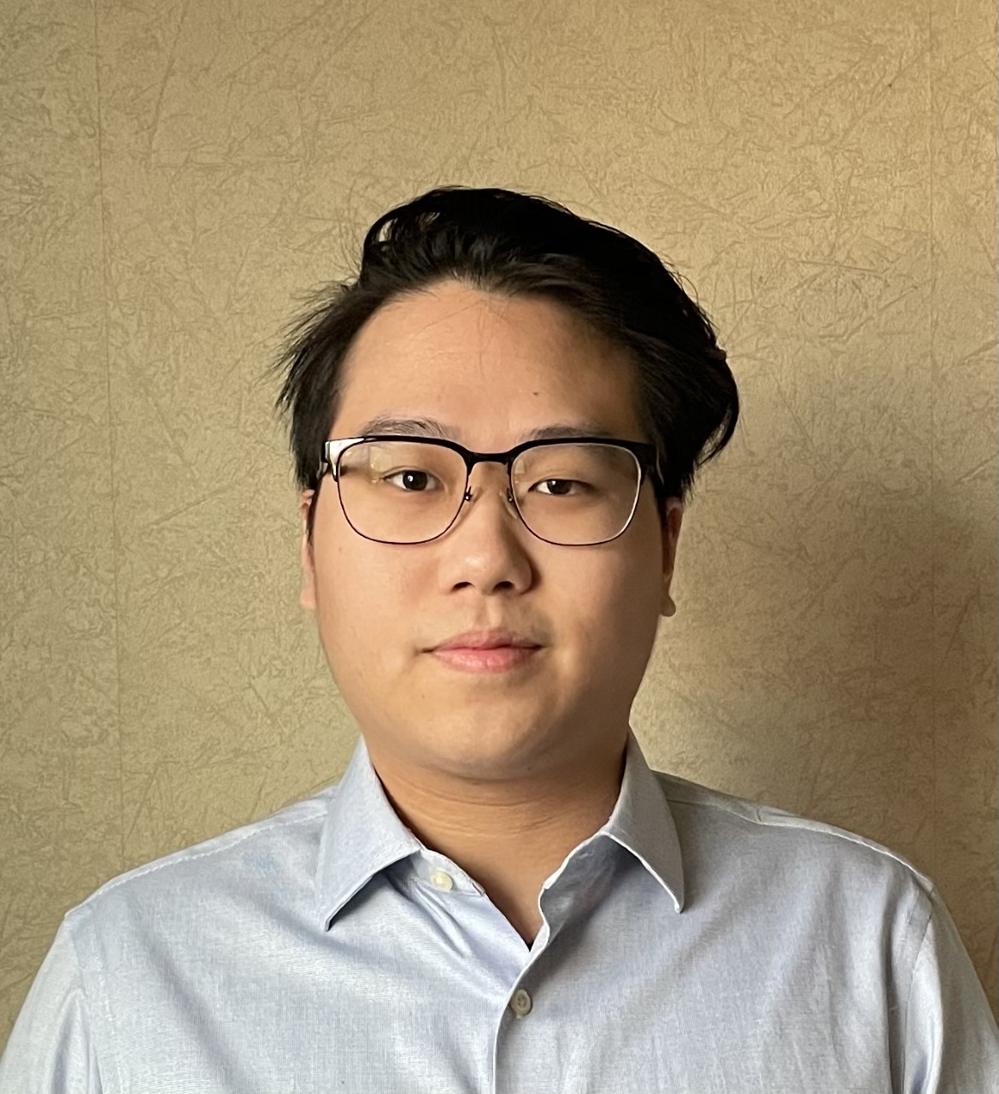

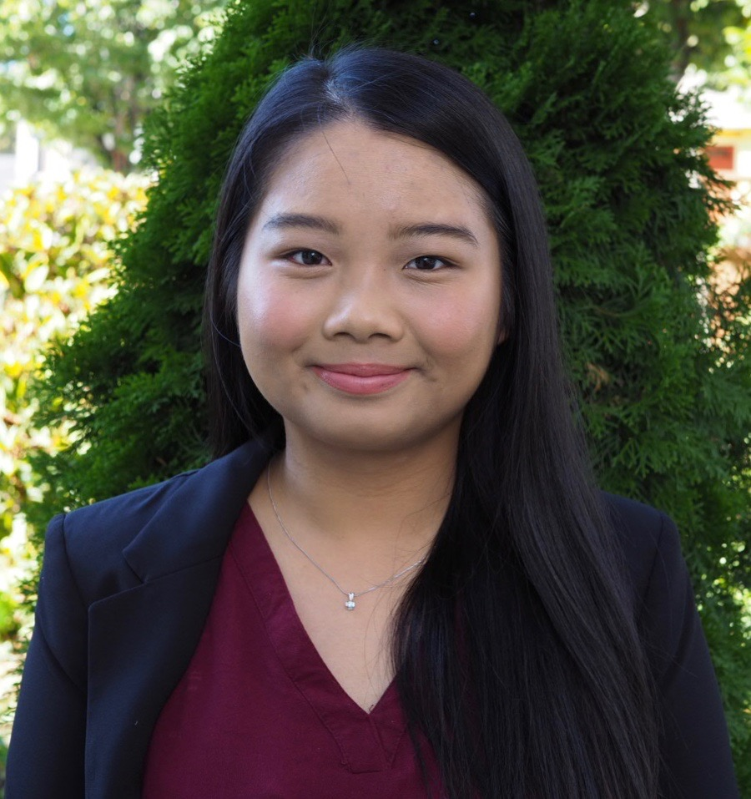
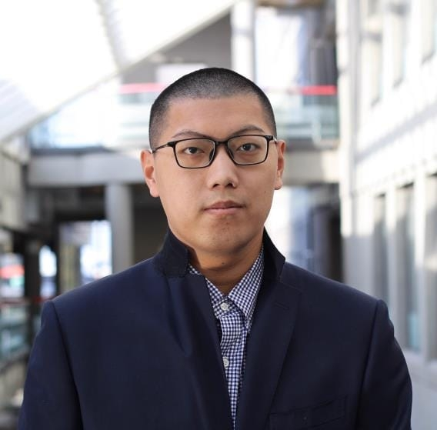
Presenters
Alan Lin
James Collins
name
Ziyu Kuang
Notes:
By presentor

Slide 3
SECTOR

Slide 4
REITs Timeline
1960
1965
1972
1976
1986
1991
REIT created by President Eisenhower signed Cigar Excise Tax Extension. The National Association of Real Estate Investment Funds incorporated on September 15
Continental Mortgage Investors becomes the first REIT, listed on NYSE.
NAREIT REIT Index debuts as the first REIT Index
President Ford signs first package of REIT Simplification amendments allowing REITs to be established as corporations in addition to business trusts
President Reagan signs Tax Reform Act which prevent taxpayers from using partnerships to shelter earnings from other sources and REITs to be internally advised and managed
NAREIT Adopts FFO
Notes:
https://www.reit.com/investing/reit-basics/reit-industry-timeline#57

Slide 5
REITs Timeline
1993
2000
2001
2009
2014
2016
First Canadian REIT, Real Fund, emerged
First Real Index Fund, iShares Dow Jones Real Estate Index Fund was formed
S&P added REITs to its indexes with launch of Global Real Estate Index
FTSE,NAREIT,& NPRA announced the addition of REITs & listed property companies in emerging markets to Global Real Estate Index
Paramount launched the largest REIT IPO to date for 2.3 billion USD
June 2016, equity market capitalization of publicly traded REITs passed $1 trillion for the first time

Slide 6
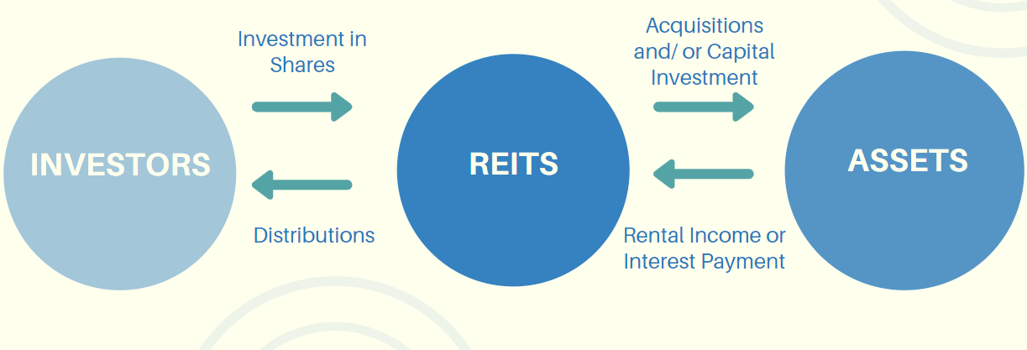
REITs Operation

Slide 7
Types of REITs
Equity
Mortgage
Hybird
Companies provide financing to income producing real estate by purchasing mortgages and MBS. Revenue from Net Interest Margin, Exposed to interest rate risk and credit risk.
Companies provide financing to income-producing real estate by purchasing mortgages and MBS. Revenue from Net Interest Margin. Exposed to interest rate risk and credit risk
Combination of Equity and Mortgage REITs. Companies own real estate and mortgages/MBS. Earn income both rental income and interest income.

Slide 8
Purchase of REITs
Publicly Traded
Non-Traded
Private
Traded on stock exchange like regular stock and registered with SEC. They are easy to buy and sell and have great liquidity.
Registered with SEC but do not trade on any public exchanges. They have private sponsors who market to investors. Relatively stable but illiquid compared to publicly-traded REITS
These are neither traded on stock exchanges or registered with SEC therefore not subject to same disclosure requirements as other types. Illiquid compared to other types

Slide 9
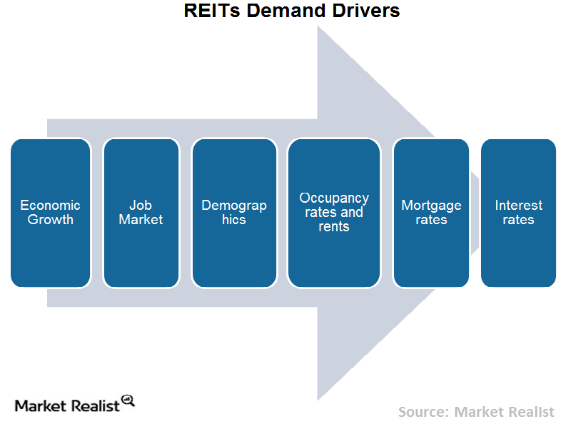
REITs Demand Drivers
Notes:
https://mr-uploads.s3.amazonaws.com/uploads/2015/08/Chart-16-Demand-drivers.png
Factors-drive-reit-earnings
https://marketrealist.com/2015/08/factors-drive-reit-earnings/

Slide 10
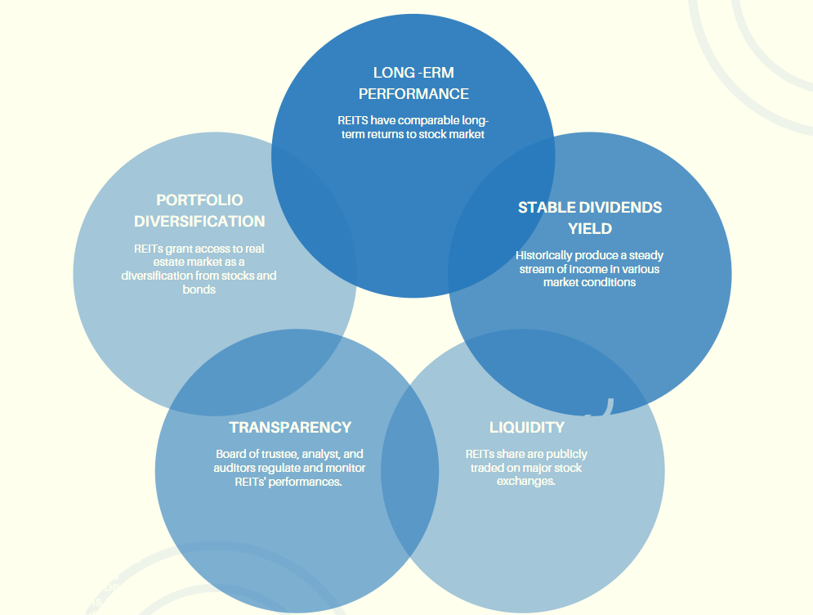
REITs Investment Advantages

Slide 11
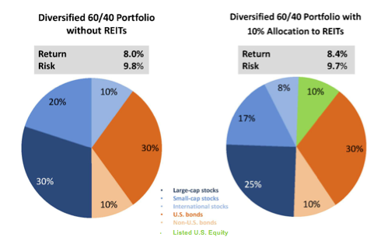
Investment Diversification
Notes:
https://www.fa-mag.com/news/diversification--reits-pack-the-most-punch-15196.html
• Reduces the impact of market volatility
• Reduces the time spent in monitoring the portfolio
• Helps seek advantage of different investment instruments
• Helps achieve long-term investment plans
• Helps avail of benefit of compounding of interest
• Helps keep the capital safe
• Lets you shuffle amongst investments
REITs historically:
Provide Low Correlation with Broader Market and Other Assets
Increase Return/Reduce Risk
Complete Asset Allocation

Slide 12
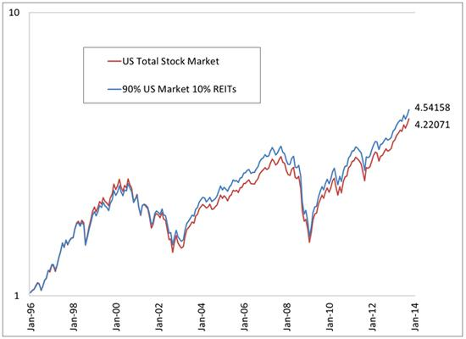
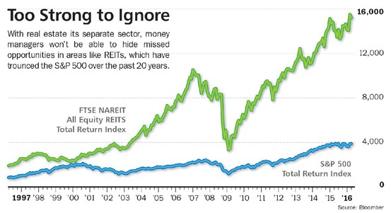
Investment Diversification

Slide 13
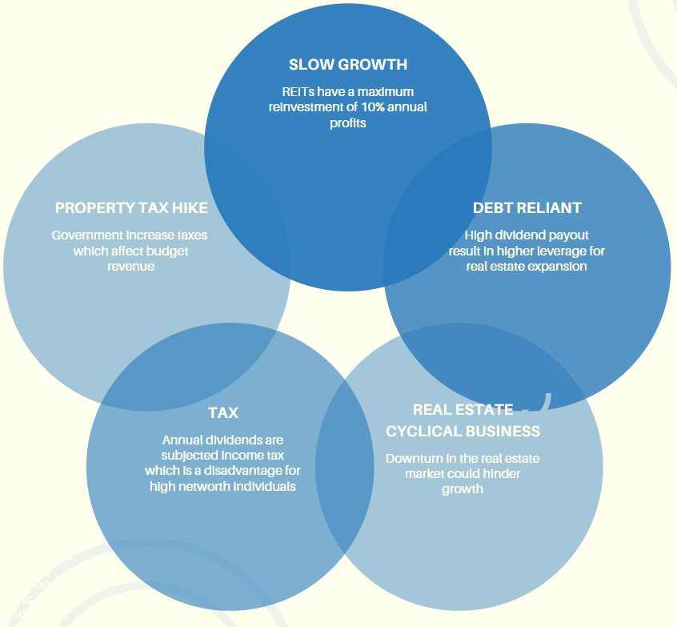
REITs Investment Risks

Slide 14
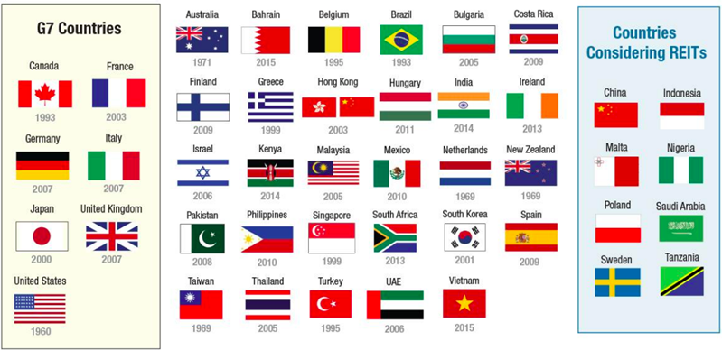
Globalization
Notes:
https://www.reit.com/investing/global-real-estate-investment
https://www.bloomberg.com/news/articles/2020-06-02/china-takes-first-steps-toward-launching-3-trillion-reit-market
China kicked off a REIT trial in late April that will initially focus around pooling capital to fund infrastructure projects like highways and airports. If successful, the program may be expanded to include traditional real estate, exposing individual investors to a market Goldman Sachs Group Inc. estimates could one day be worth as much as $3 trillion.

Slide 15
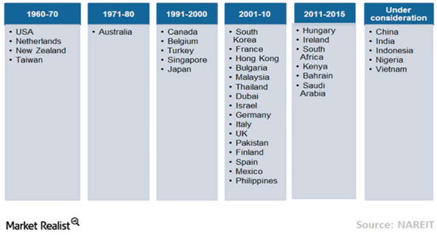
Global Evolution of REITs

Slide 16
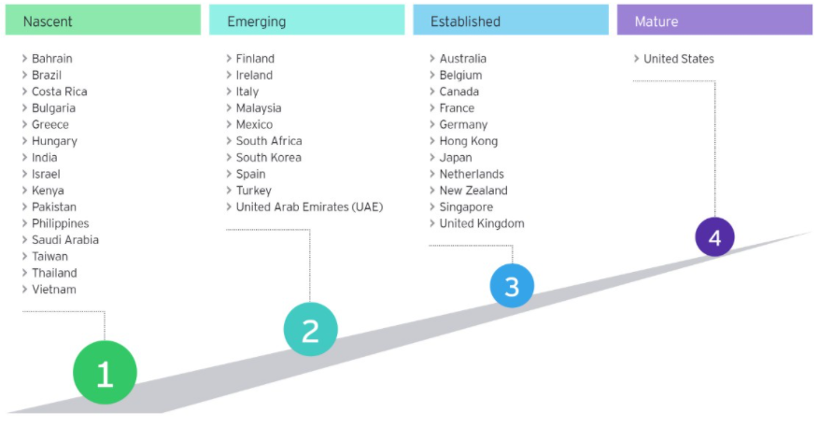
Stages of REIT Regime Maturity
Notes:
There are now 37 REIT markets with a total market cap of approximately US$1.7t.

Slide 17
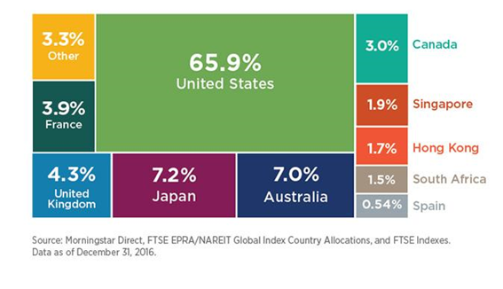
Global REITs Market Access
Notes:
https://www.ey.com/en_ca/real-estate-hospitality-construction/how-reit-regimes-are-doing-in-2018

Slide 18
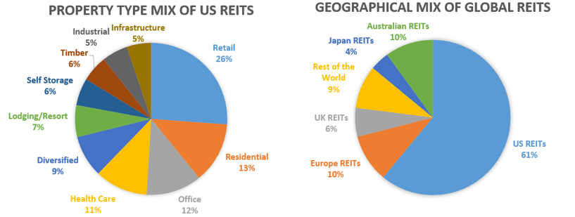
REITs Distribution
Notes:
https://static.seekingalpha.com/uploads/2017/3/25/47644028-14904281936211898_origin.png

Slide 19
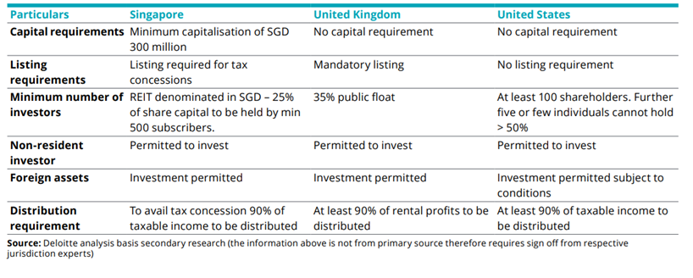
REITs Regulations Comparison

Slide 20
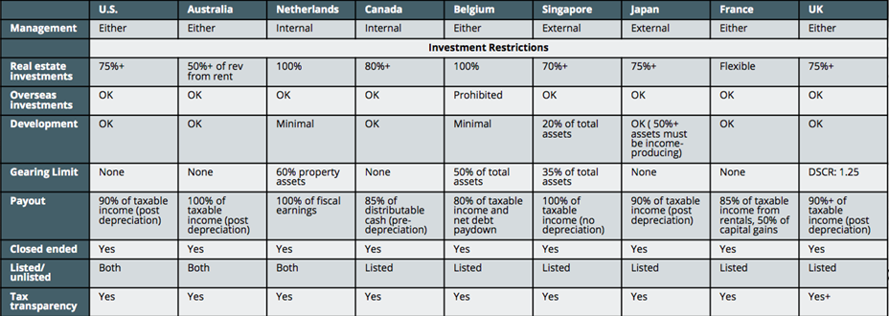
REITs Regulation Comparison

Slide 21
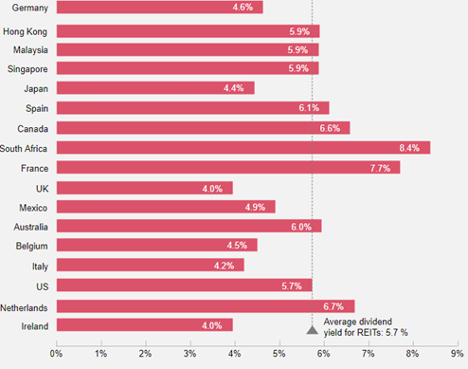
REITs Annual Average Dividend Yield

Slide 22
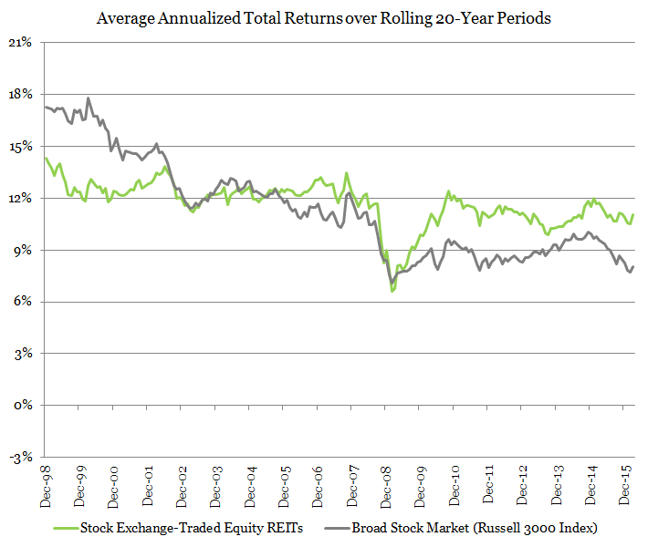
20-years REITs Returns compared to Market

Slide 23
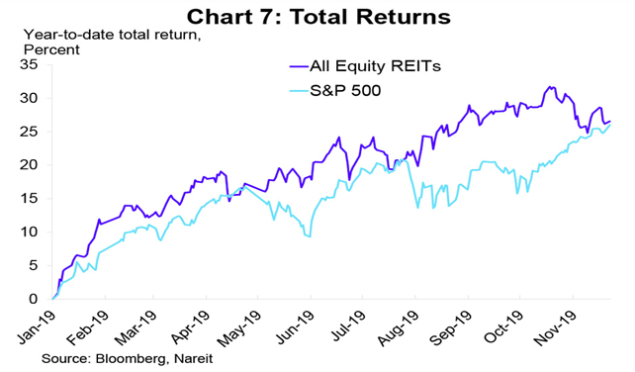
2019 REITs Performance compared to Market
Notes:
https://www.reit.com/data-research/research/nareit-research/2020-economy-real-estate-reit-outlook#:~:text=The%20outlook%20for%20REITs%20in,earnings%20in%20the%20year%20ahead.

Slide 24
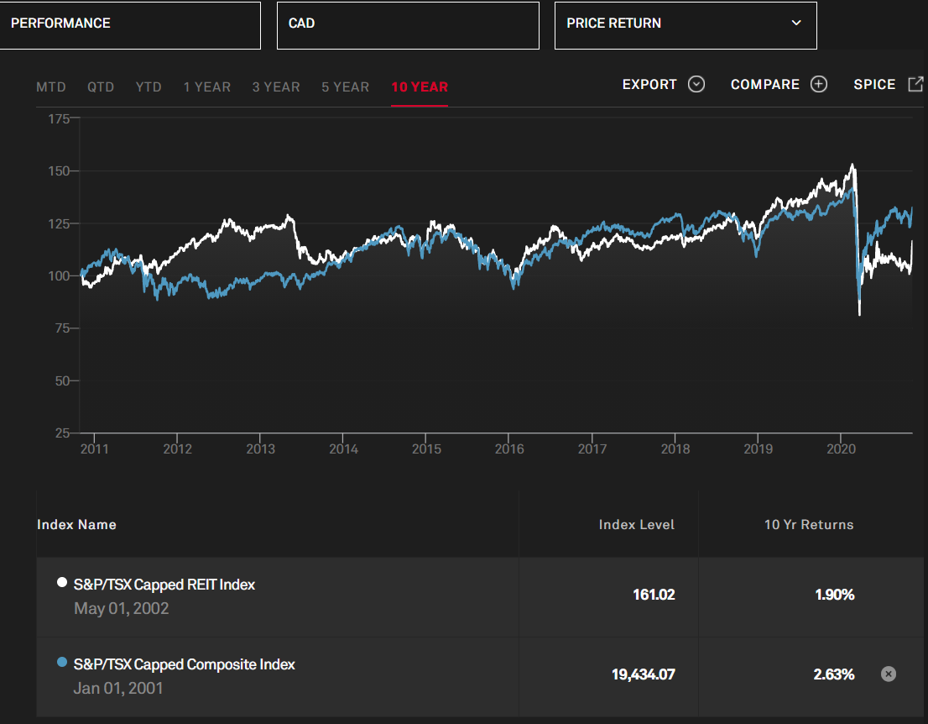
10-year Price Return compared to market
Notes:
https://www.spglobal.com/spdji/en/indices/equity/sp-tsx-capped-reit/#overview

Slide 25
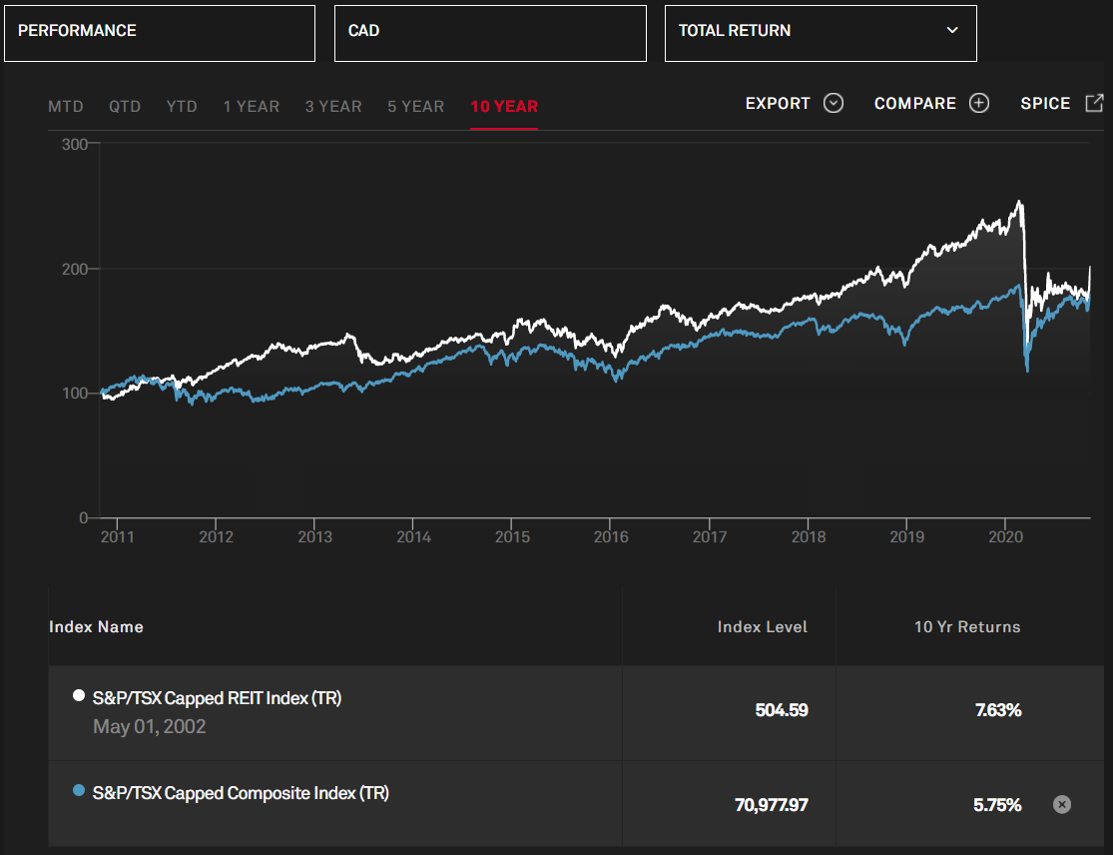
10-year Total Return compared to market

Slide 26
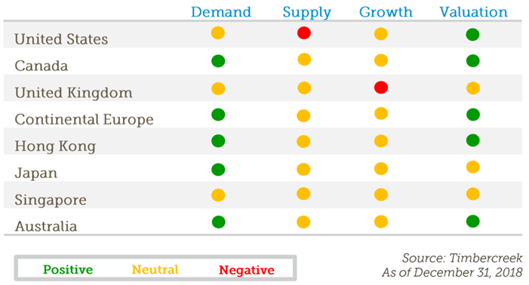
Market Outlook

Slide 27
Canada compared to US REITs

Slide 28
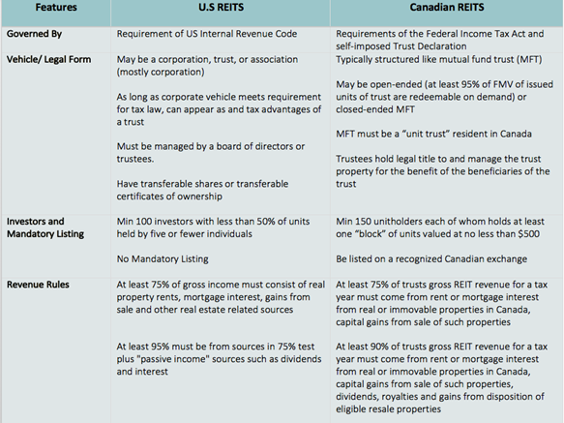
Rules and Regulations

Slide 29
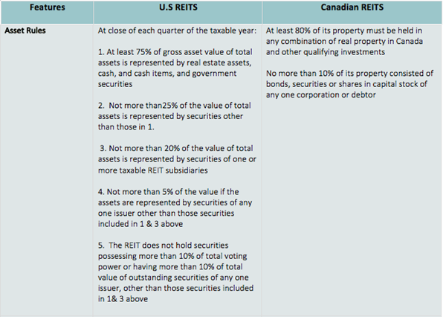
Rules and Regulations

Slide 30
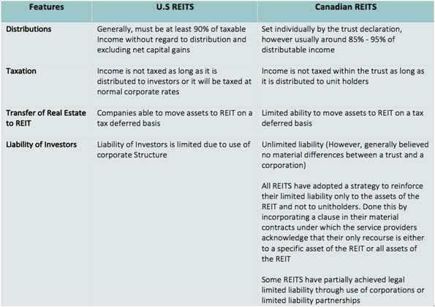
Rules and Regulations

Slide 31
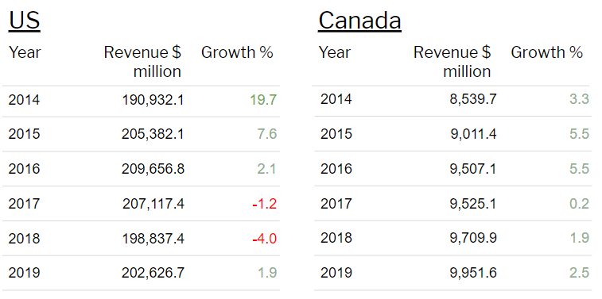
REITs Revenue US Canada

Slide 32
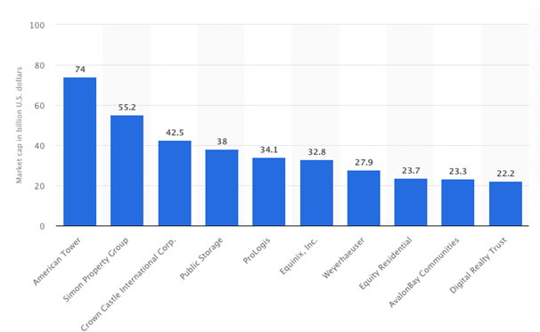
2019 Leading REITs by Market Cap

Slide 33
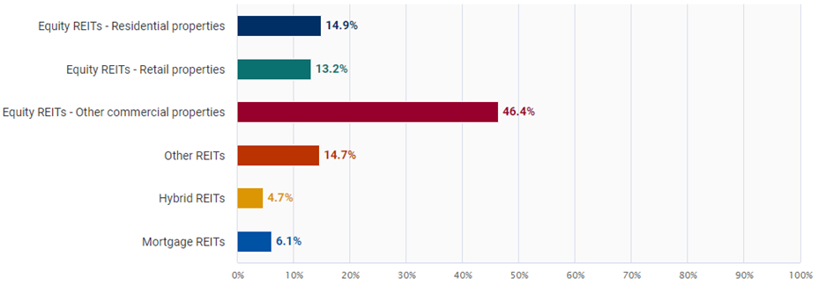
US REITs Segmentation

Slide 34
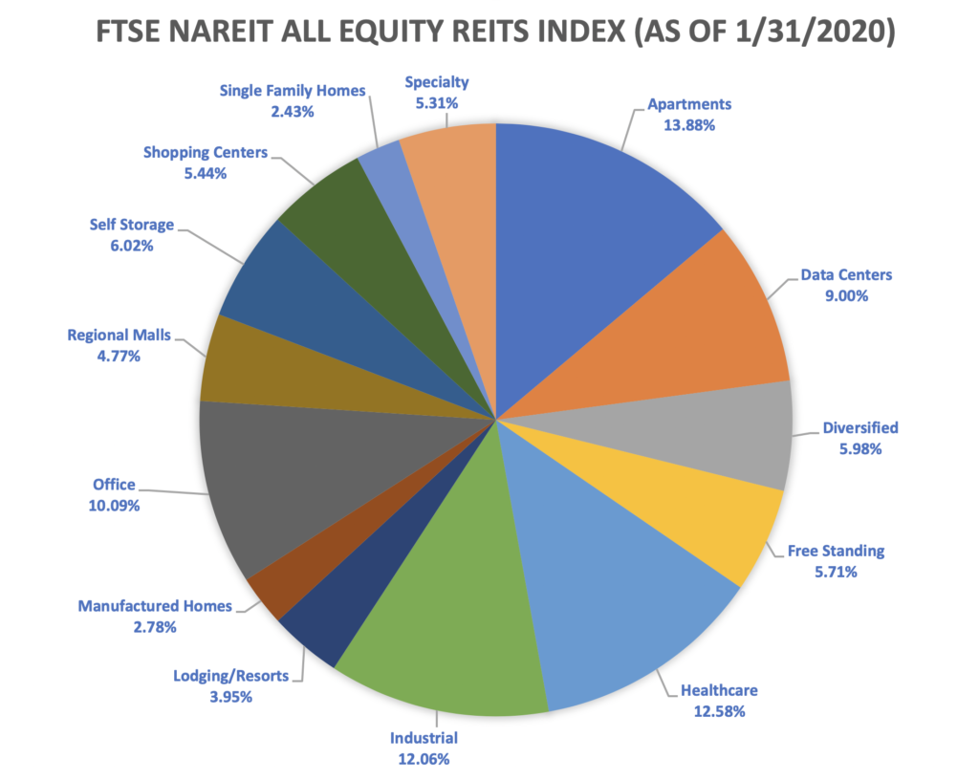
Equity REITs Sectors
Notes:
https://11r8i71smg9y1w70b64etqrh-wpengine.netdna-ssl.com/wp-content/uploads/2020/02/REITs-Chart-1-1024x817.png

Slide 35
Canadian REITs

Slide 36
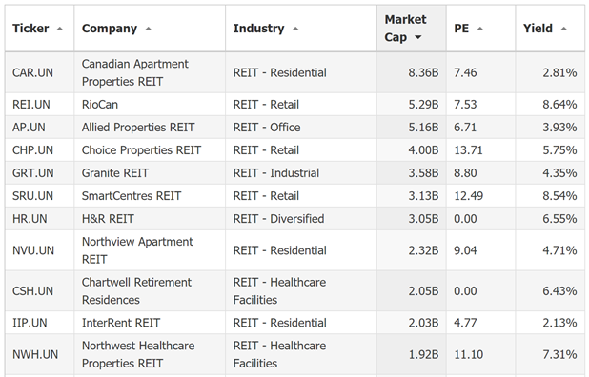
Canadian REITs Market Cap

Slide 37
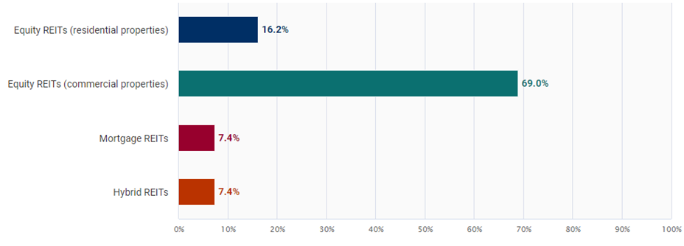
REITs Types Segmentations Canada

Slide 38
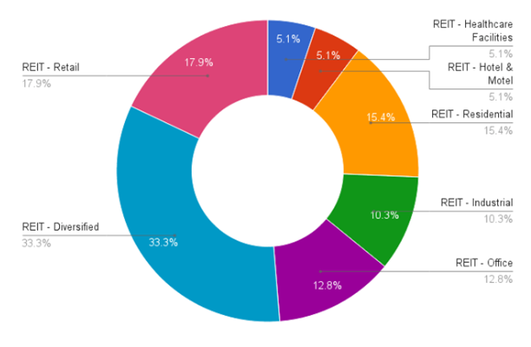
Canadian REITs Industry Sectors

Slide 39
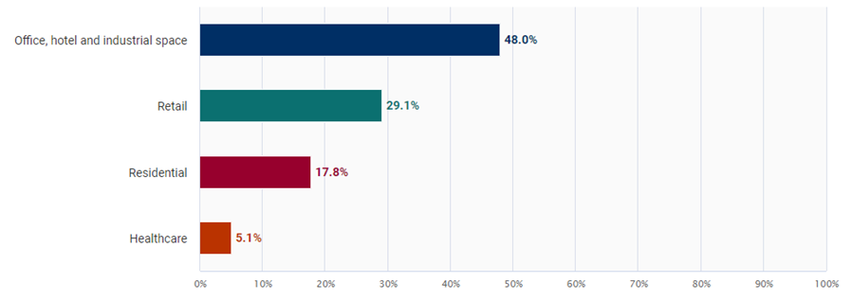
Canadian REITs Sector Majority

Slide 40
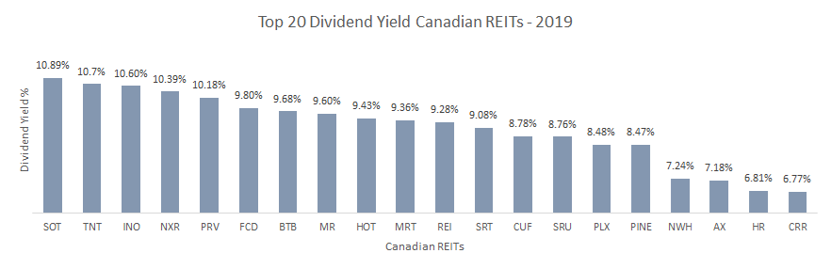
Top 20 Dividend Yield Canadian REITs
Notes:
https://www.canadastockchannel.com/reits-dividend-stocks/?a=&issuer=&symbol=&sortby=&reverse=&rpp=20&start=0

Slide 41
Key Valuation Metrics

Slide 42
Valuation Metrics
NAV
FFO
AFFO
Net Asset Value also known as liquidation value.
Assets are calculated at market value.
REITs trading price is close to NAV
Funds from operation measures the long term cash flow of the company
Adjusted funds from operations smoo

Slide 43
NAV Calculation
Fair Value of Properties Formula
Net Asset Value Formula
Net Operating Income/ Capitalization Rate
Capitalization Rate =
Required rate of return on real estate assets - Growth rate of NOI
+(Fair Value of Properties + Non Real Estate Assets + Non Income Producing Real Estate)
-Total Liabilities
= Net Asset Value
NAV/ (Total Share + Trust Units)
=NAV Per Share

Slide 44
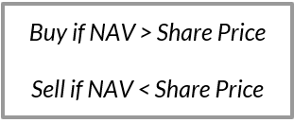
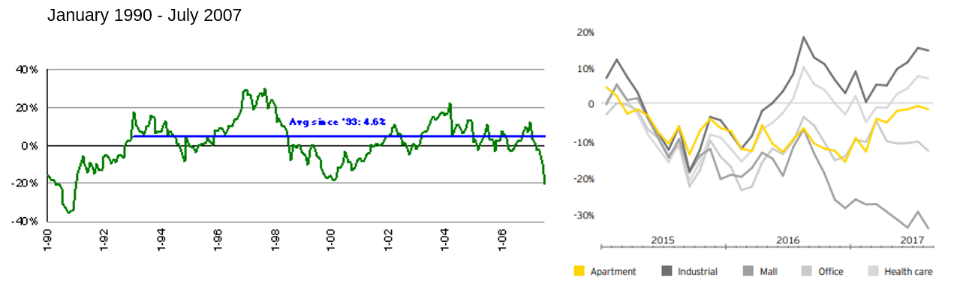
REITs Price Premiums vs. Green Street Nav

Slide 45
FFO Calculation
FFO Formula
Net Income
+(Depreciation expense + Amortization expense + Losses on sale of assets)
-(Gains on sale of assets + Interest income)

Slide 46
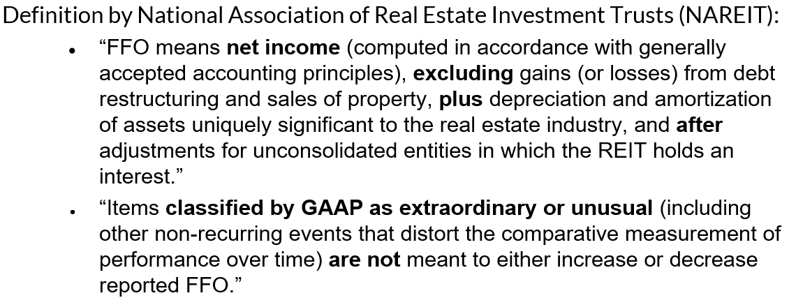
Measuring FFO

Slide 47
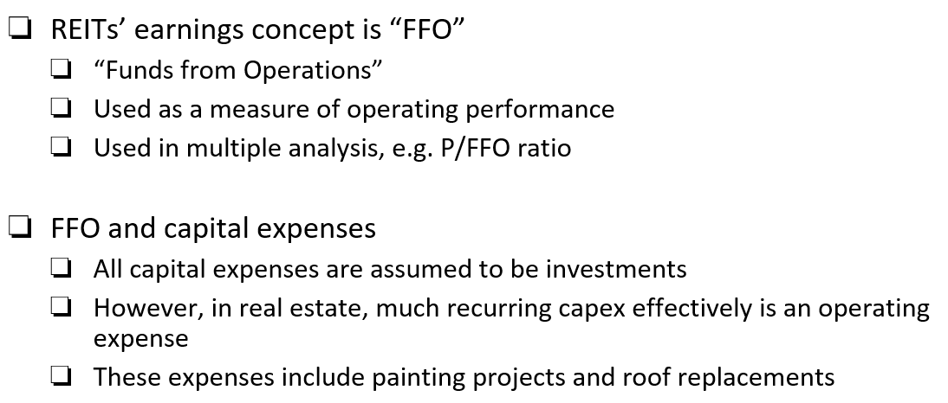
Measuring P/FFO

Slide 48
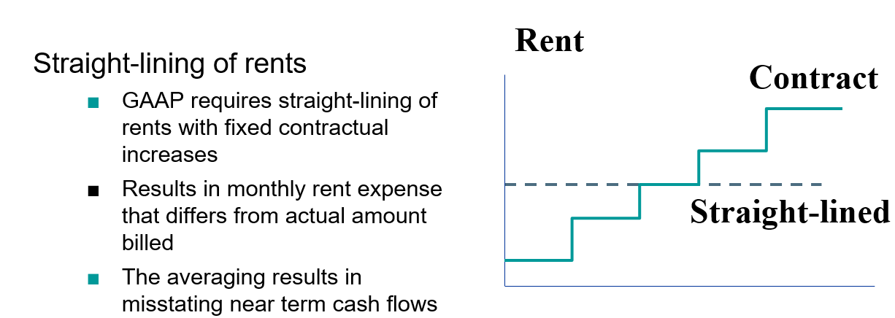
Measuring FFO

Slide 49
FFO Payout
Payout Strategy
To attract investors some REITs have high dividend payouts
Earnings do not pay corporate income tax
Trust Unit holders pay capital gains tax on dividends
Dividend reinvestment plans (DRIPs) automatically reinvest dividends into additional trust units
Accelerate compounding interest rate
dollar cost averaging during declining share prices

Slide 50
FFO Calculation
AFFO
Formula
Adjustments made to recurring CapEx to maintain the quality of the REIT’s underlying assets
Calculation makes adjustment to GAAP straight-lining of rent, leasing cost, and other material factors.
FFO
+Rent Increases
-Recurring Capital Expenditures
-Straight-lined rents
=Adjusted Funds From Operations

Slide 51
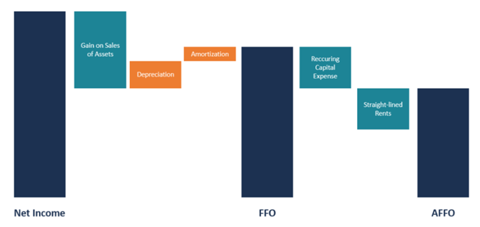
Measuring: P/AFFO

Slide 52
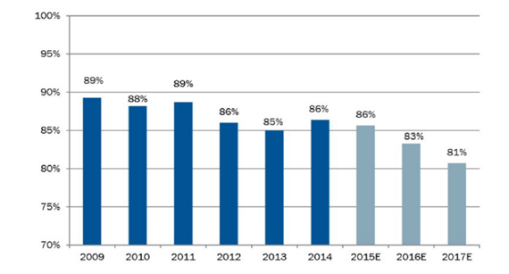
Weighted Average AFFO Payout Ratio

Slide 53
FFO and AFFO Comparison
FFO
AFFO
FFO is a standardized REITs earning reporting
More difficult to manipulate
AFFO is better measurement of earning as it normalizes recurring capital expenditure
Less defined

Slide 54
Effects of COVID-19 Q3

Slide 55
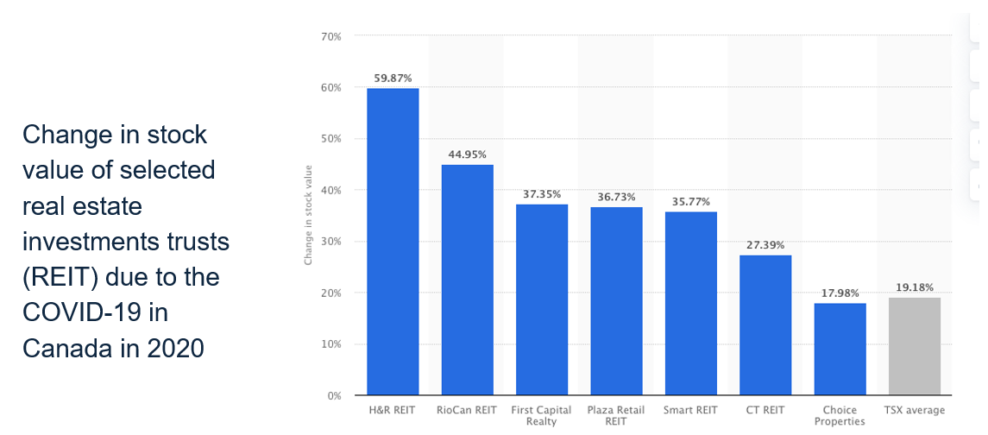
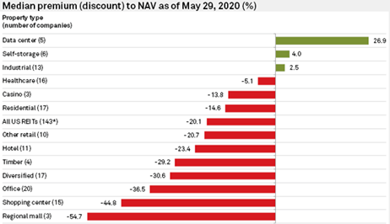
COVID-19 affect on Q2

Slide 56
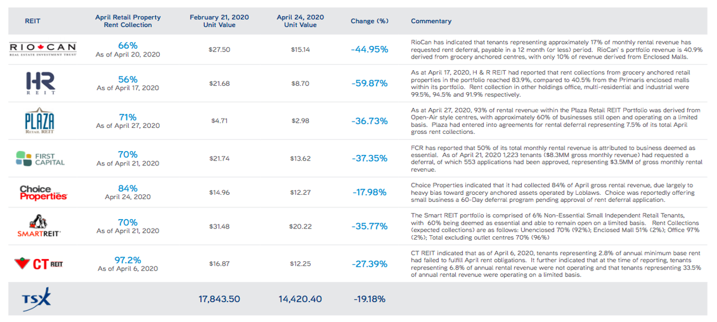
COVID-19 affect on Canadian REITs

Slide 57
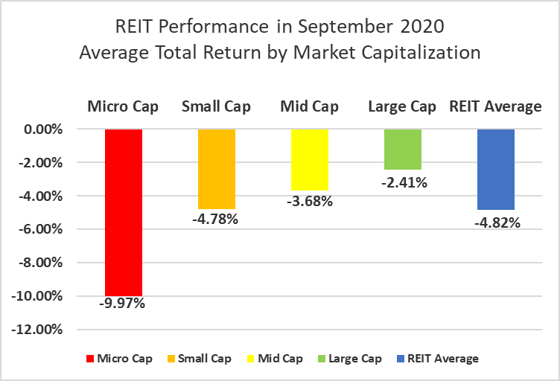
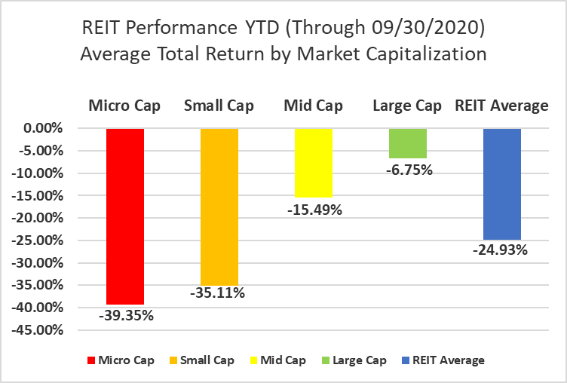
COVID-19 affect on Q3

Slide 58
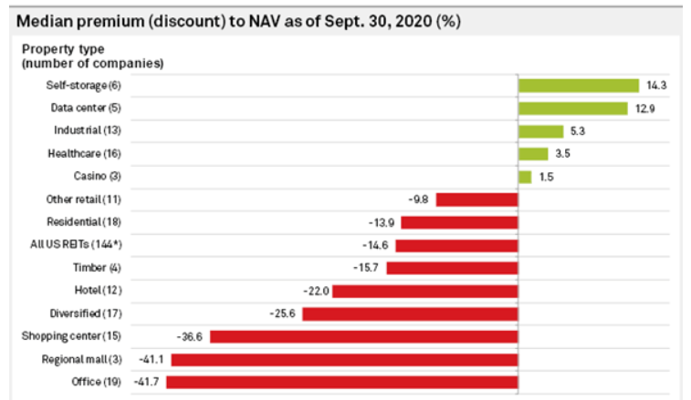
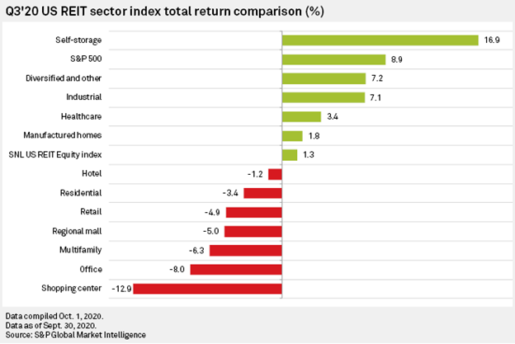
COVID-19 affect on Q3

Slide 59


Slide 60
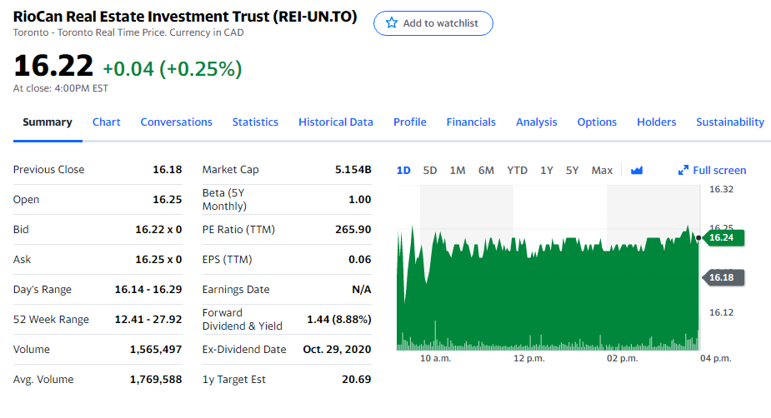
Stock Performance

Slide 61

Performance – 1 Year

Slide 62

Performance – 5 Year

Slide 63

Performance – Max

Slide 64

1 Year Comparison – S&P/TSX Capped REIT Index ETF

Slide 65

5 Year Comparison – S&P/TSX Capped REIT Index ETF

Slide 66

Max Comparison – S&P/TSX Capped REIT Index ETF

Slide 67
Company History
During the worst real estate recession since the Great Depression in 1992, Ed Sonshine saw an opportunity in the REITs business model seen initially in the USA and Australia.
In 1993, RioCan was founded; in 1994 was listed on the TSX.
From 1995 to 1999, RioCan made many significant acquisitions that doubled the size of the company.
In 1999, RioCan acquired RealFund, one of Canada’s other original REITs.
In 2015, RioCan entered into the residential real estate market due to the decreasing popularity in traditional brick and mortar retail. Development of residential buildings on commercial properties transforming them to mixed-use urban properties.
Currently the second largest REIT in Canada.

Slide 68
Company Overview
Total enterprise value of approximately $11.4 billion as of November 8th.
RioCan earns 50% of their revenue in the Greater Toronto Area (GTA) and 90% from Canada’s six major markets.
Diversified portfolio including many different commercial retailers as well as rental properties.
26-years of experience in creating value through acquisitions and development.
42m square feet in the development pipeline.
Upward trend in rent collection since Covid-19 with 96% committed occupancy over the duration of the pandemic.
77.7% of revenue comes from strong and stable tenants.

Slide 69

Company Commitment

Slide 70

Competitive Advantage

Slide 71
Strategy
RioCan continues to focus on the major markets in Canada, a strategy they have employed for over a decade.
Acquisitions and development in strategic locations in urban areas.
Development of mixed-use properties.
Properties located in high density areas that are heavily trafficked and/or located near public transportation.
Staggered development strategy includes staggering debt maturities.
The trust maintains low leverage by staggering maturities, limiting variable debt to reduce interest rate risk and refinancing risk, and using a mix of unsecured and secured debt.
Diverse tenant mix of strong national companies that are focused on necessity and/or service.

Slide 72

Strategy

Slide 73
Properties Profile

Slide 74


Property Profile
Notes:
Mixed-Use / Urban
Assets with more than one type of use (retail, office, residential mixed-use assets) located in major markets and non mixed-use assets located in high density urban areas. Examples of these properties include: Yonge Eglinton Centre and Yonge Sheppard Centre.
Grocery Anchored Centre
Assets with a grocery anchor tenant or sites adjacent to shadow grocery anchors (i). Examples of these properties include: Sage Hills Crossing and RioCan Scarborough Centre.
Open Air Centre
Assets with little or no enclosed component and do not have a grocery store anchor. Examples of these properties include: Grandview Corners and RioCan Colossus Centre.
Enclosed
Assets with large enclosed shopping and common areas. Examples of these properties include: Burlington Centre and Oakville Place.

Slide 75

Major Market Positioning

Slide 76

Major Market Positioning

Slide 77

Canadian Market

Slide 78
Tenant Profile
Notes:
***for subheaders we can either do 1 colour per person or one colour for the whole group

Slide 79

Tenant Profile

Slide 80

Tenant Profile

Slide 81

Tenant Profile

Slide 82
Property Projects

Slide 83
Acquisitions
In 2019 RioCan spent $822.67 million acquiring interest in income properties.
Ending interest was 100% for 13 properties
Remaining 2 properties RioCan acquired 50% interest
In 2020 RioCan made 4 acquisitions of income properties for $68.70 million.
All purchases took place in the first quarter
Ending interest was 100% for 2 properties and 50% ending interest in the remaining acquisitions
In 2019, RioCan spent $118.54 million on development properties.
In 2020, RioCan spent $34.04 million on development properties in the first quarter. No purchases were made in the second and third quarters.

Slide 84
Development Strategy
RioCan staggers development to ensure they can allocate the necessary resources to each project while reducing risk.
Strategic co-ownerships reduce the capital requirements and reduce risk.
Projects are not started until a third-party does market studies to ensure there is enough demand to provide the necessary risk-adjusted returns.
For income producing properties, RioCan strategically plans development. This ensures they can collect income until development begins, as well adjusting to the reduction in revenue associated with development on a income producing property.
Residential developments gives RioCan access to Canadian Mortgages and Housing Corporation that provides insured mortgages and lowers the cost of debt.

Slide 85

Development
Greenfield Development refers to projects on vacant land in typically suburban markets.
Urban Intensification refers to development projects on existing income producing properties typically increasing density or square footage on mixed-use projects.
Expansion and Redevelopment refers to repositioning through development of income producing properties .
Notes:
Pg 45

Slide 86

Development

Slide 87

Development

Slide 88

Development

Slide 89

Development

Slide 90

Development

Slide 91
Risks and Uncertainties

Slide 92
Risks and Uncertainties
General Risks
Changes in general economic and local market conditions
Changes in equity and credit markets
Fluctuations in interest costs
The attractiveness of the properties to tenants
Competition from other available space
The stability and creditworthiness of tenants
Various other factors
COVID Related Risks
Potentially increase the difficulty and cost of accessing capital
Tenants unable to open due to government restrictions
Impacts of closure or reduced volume on tenants impacting cash flow and/or long-term viability
Potentially impact RioCan’s current credit rating, total market return, and dividend yield
Restrictive measures may be re-implemented in preparation of a second wave of Covid-19

Slide 93


Adjustments in Operations for Covid-19
Diversified portfolio including many commercial retailers and increasing office and residential properties.
Actively reducing exposure in declining retail concepts while increasing exposure in more stable retail tenants.
Increase percentage of strong and stable tenants has led to a high retention ratio over the duration of the economic slowdown.
Remote workforce – all key functional areas operating uninterrupted.
Strong liquidity of approximately $803.4 million.
Postponed early stage projects while continuing development.
In line with the staggered development RioCan has always employed.

Slide 94
2020 Quarter 3 Results

Slide 95

Third Quarter 2020 Financial Highlights
Net income from operations attributable to Unitholders for the three months ended September 30, 2020 was $126.1 million compared to $135.3 million in the same period in 2019, representing a decrease of $9.2 million or 6.8%.
Excluding the $48 million of higher net fair value losses over the previous period and the $2.8 million in the unrealized fair value increase for marketable securities.

Slide 96
Third Quarter 2020 Financial Highlights
The decrease of $9.2 million was largely the net effect of:
$14.4 million due to the rent abatement for qualified tenants and bad debts as result of Covid-19.
$1.6 million decrease in NOI from property dispositions net of acquisitions
$1.1 million in higher deferred income tax expense
$1 million lower lease cancellation, property management and other fee income;
$4.9 million in lower transaction and other costs due to lower disposition activity and reversal of prior year transaction cost accrual
$1.7 million decrease in general and administration costs primarily from lower incentive compensation costs
$1.5 million increase in net operating income from lease-up of the trust first three residential rental towers, eCentral, Frontier and Brio, as they are being leased up.

Slide 97

Third Quarter 2020 Financial Highlights

Slide 98


Occupancy Percentage 2020 Q3

Slide 99


Third Quarter 2020 Financial Highlights

Slide 100
Management Team

Slide 101

Executive Bench

Slide 102

Ed Sonshine (CEO)
Founded RioCan in 1993 and has been CEO since, President until January 1, 2012
Converted Real Estate Mutual Fund Trust into one of Canada’s first REITs in late 1993
Law Degree from Osgoode Hall Law School, Bachelor of Arts from the University of Toronto
Holds board positions in 6 companies including RioCan, Cineplex, Mount Sinai Hospital (Toronto), and three investment companies
Canada’s Outstanding CEO of the Year in 2013
Retiring from the CEO position March 31st, 2021 but will take a position on the board as Lead Trustee to oversee the transition

Slide 103

Jonathan Gitlin(President and COO)
Joined RioCan in 2005 and worked up to the Chief Operating Officer position in March of 2019
Head of the Trusts investment team since 2007
Responsible for the six major market focus RioCan uses
Oversaw RioCan’s residential expansion and the creation of RioLiving
Will take the CEO position when Ed Sonsine retires on March 31st, 2021

Slide 104

Qi Tang (CFO)
Masters of Science in Accounting from the University of Saskatchewan
CPA, CA, CFA
Appointed as CFO on April 3rd, 2017
Five years of experience in the REIT industry before joining RioCan

Slide 105
Capital Structure

Slide 106

Capital Structure 2019

Slide 107

Capital Structure 2020 Q3

Slide 108

Capital Structure Metrics

Slide 109
Covenants
RioCan’s Declaration of Trust has limits on debt similar to the covenants for unsecured debentures.
Leverage limit of 60% of aggregate assets.
Maintenance of at least $1 billion in consolidated unitholders’ equity.
Interest coverage ratio of > 1.65
Series 1 debentures can be converted to mortgage debt at anytime at which point the covenants are eliminated.

Slide 110
Capital Expenditure on Income Properties

Slide 111

Capital Expenditures on Income Properties 2019

Slide 112

Capital Expenditures on Income Properties 2020 Q3

Slide 113
Financial statements

Slide 114

Fair Value Loss in 2020

Slide 115

Balance Sheet 2020 Q3

Slide 116

Balance Sheet 2019

Slide 117

Income Statement 2019

Slide 118

Income Statement 2020 Q3

Slide 119

Statement of Cash Flows 2019 (Operating)

Slide 120

Statement of Cash Flows 2019 (Investing)

Slide 121

Statement of Cash Flows 2019 (Financing)

Slide 122

Statements of Cash Flows 2020 Q3 (Operating)

Slide 123

Statements of Cash Flows 2020 Q3 (Investing)

Slide 124

Statements of Cash Flows 2020 Q3 (Financing)

Slide 125
Results of Operations
Net Operating Income (NOI)
Funds From Operations (FFO)
Adjusted Cash Flow from Operations (ACFO)
Distributions to Unitholders

Slide 126

Net Operating Income (NOI): 2019

Slide 127

Net Operating Income (NOI): 2020 Q3

Slide 128

Funds From Operations (FFO): 2019

Slide 129

Funds From Operations (FFO): 2020 Q3

Slide 130

Adjusted Cash Flow from Operations (ACFO): 2019

Slide 131

Adjusted Cash Flow from Operations (ACFO): 2020 Q3

Slide 132

Dividend Distribution 2020

Slide 133

Distributions to Unitholders

Slide 134


Slide 135


Slide 136

Stock Performance

Slide 137

Stock Performance - 1 Year

Slide 138

Stock Performance - 5 Years

Slide 139

Stock Performance - Max

Slide 140

1 Year Comparison - S&P/TSX Capped REIT Index ETF

Slide 141

5 Year Comparison – S&P/TSX Capped REIT Index ETF

Slide 142

Max Comparison – S&P/TSX Capped REIT Index ETF

Slide 143



Company Overview
Founded in 2003, listed on TSX in 2004
One of the largest diversified closed-end commercial real estate investment trusts in Canada
Portfolio consists of industrial, retail and office properties in Canada and U.S.
Objective: maximize total returns to shareholders, including a monthly cash distribution and long-term appreciation in value

Slide 144

Company Commitment (ESG)
Environmental Practices
Committed to minimizing carbon footprint and promoting use of energy efficient practices
At Dec. 2019, Artis had 17 properties with a LEED certification, 22 properties with a BOMA BEST certification and 18 properties with an Energy Star certification
Social Practices
Committed to fostering a diverse, inclusive and safe work environment.
Make contributions to local charities through fundraising activities
Focus on a positive culture in the workplace and strong community relationships
Governance Practices
Diversity policy: 20% female representation on the Board but will implement a minimum of 30% female representation by 2021 annual general meeting
Trustees appointed after 2018 may serve on the Board for a maximum of 10 years
Implemented a non-binding “say on pay” vote on an annual basis at the 2019 annual general meeting
Notes:
Leadership in Energy & Environmental Design (LEED): a green building tool that addresses the entire building lifecycle, recognizing best-in-class building strategies
Energy Star: a voluntary U.S. Environmental Protection Agency (EPA) program that certifies buildings in the U.S. for superior energy performance
Building Owners and Managers Association (BOMA) promotes energy efficiency and sustainability for new and existing buildings by assigning certification levels based on achievement of energy targets

Slide 145

Competitive Advantage

Slide 146
Strategy
Strategic Asset Ownership
Portfolio of office, retail, and industrial real estate is strategically and diversely located in primary and secondary markets in Canada and the U.S.
Continually analyzes performance of its assets and relevant economic fundamentals of its target markets to identify acquisition opportunities
Disciplined Growth
Strives to achieve maximum value from its portfolio by effectively managing assets, such as maintaining high occupancy levels
Prudent Financial Management
Has a long-term conservative approach to financial management
Minimize interest rate risk by using various sources of capital and staggering debt maturities
Ensures ample access to cash to reinvest in the portfolio, make acquisitions, and fund development projects

Slide 147
Value Creation Initiatives
New Initiatives were announced in November 2018
Focus: improve profile growth, strengthen balance sheet, and ensure long-term and sustainable growth
Repurchase units under NCIB
Has repurchased $194 million of common units and $86 million of preferred units
Optimize portfolio by narrowing company’s focus to fewer asset classes
Intended to sell between $800,000,000 to $1,000,000,000 of non-core assets over 3 years
Mainly sold office properties
Pursue high-yielding, accretive development projects in its target markets
Notes:
Normal-course issuer bid (NCIB): company repurchases shares to cancel them

Slide 148

Classification of Assets - Based on New Initiatives

Slide 149


Value Creation Initiatives
Spin-off of Canadian retail properties into a new REIT
Sandpiper Group
Group of activist institutional investors who own 5% of the trust
Demand replacement of 5 of the 7 board of trustee members with its suggested nominees
Opposes spin-off of retail property
Suggested to dispose of retail portfolio assets since Artis holds many retail assets in Alberta
Jetport Inc.
Holds 13.3% of Artis’ outstanding units (largest unitholder)
Supports Sandpiper Group’s value creation plan and intends to vote in favour of proposed nominees

Slide 150
Current Events

Slide 151

Effects of COVID-19
Tenant Support Program
Qualifying tenants have been allowed to defer a portion of their rent for April and May
As at Sept. 30, 2020, Artis granted $5.5 million rent deferral
Allowance for doubtful accounts of $2.2 million
The retail portfolio is expected to have the largest impact
Retail segment represents 18.7-19.2% of NOI
Lease fell from 90.8% to 87.9% over 2020
Over the three quarters of 2020, it collected 88.8%-96.5% of rent charges (excluding deferred rent) in each quarter

Slide 152
Effects of COVID-19
Rent collection
With a strong tenant base and limited exposure to the retail segment, Covid 19 is expected to have a low impact on rental revenue
Q1: 93.2% of rent, excluding deferred rent, was collected
Q2: 96.8% (93.1%, deferred rent included) of rental revenue collected
Q3: 98.4% (97.6%, deferred rent included) of rental revenue collected
Property
Property dispositions are expected to be unlikely (a decline in number of properties sold is evident in 2020 compared to 2019)
Ongoing and future development projects may be delayed for an unknown duration

Slide 153
Properties

Slide 154


Disposition

Slide 155

Projects Completed in 2020
Park 8Ninety IV (phase 4)
100,000 sq ft industrial build-to-suit development for a multi-national tenant
Location: Greater Houston Area, Texas
Leased commenced in July 2020
Linden Ridge Shopping Centre II
17,070 sq ft densification project
Location: Winnipeg, Manitoba
100% leased to two national tenant

Slide 156


Current Developments

Slide 157





Development Initiatives

Slide 158
Properties Profile

Slide 159

Asset Class Distribution

Slide 160

Real Estate Performance

Slide 161
Tenant Profile

Slide 162

Top 10 Tenants
Notes:
By percentage of gross revenue in Canadian and US dollars

Slide 163

Portfolio Map

Slide 164

Number of Locations in Each Province/State

Slide 165
2020 Quarter 3 Results

Slide 166

Portfolio by Asset Class - Canada

Slide 167

Portfolio by Asset Class - U.S

Slide 168

Occupancy

Slide 169

Proportionate Share Property NOI

Slide 170

Property NOI By Geographical Region

Slide 171
Management Team

Slide 172

Armin Martens
Position in Company
Founding President and CEO since 2005
Work experience
Has been actively involved in the construction, development, and management of commercial real estate for more than 30 years
Previous Director of Fortress Paper, Bank of Canada, and Canada’s Central Bank
Education
Bachelor of Science (civil engineering) from University of Manitoba
MBA from International Institute for Management Development

Slide 173

Jim Green
Position in company
CFO since inception
Work experience
Joined Marwest Group of Companies in 1981, served in various capacities with Marwest which includes role of CFO at Artis
Education
Bachelor of Science from University of Manitoba
Obtained CA from Institute of Chartered Accountants of Manitoba
Notes:
Marwest’s extensive experience in syndication led it to found Artis REIT in 2004

Slide 174

Kim Riley
Position in company
Executive Vice President - Investments & Developments since Feb. 2019
Former Senior Vice President - Acquisitions from Jan. 2017 - Feb. 2019
Joined company in 2005, holding various positions in accounting, valuation, and investments and developments
Work experience
14 years of experience in the commercial real estate industry
Education
Bachelor of Commerce from University of Manitoba
Obtained CPA and CMA

Slide 175

Frank Sherlock
Position in company
Executive Vice President - Property Management since Jan. 2015
Former Senior Vice President - Property Management
Work experience
Former vice president of Crown Property Management Inc
Former Vice President and General Manager of Trizec Hahn
Director of Real Estate Management of Oxford Properties Group
Education
Bachelor of Commerce from University of Calgary
Obtained Real Property Administrator (RPA) from BOMA and Certified Shopping Centre Manager (CSM) from International Council of Shopping Centres

Slide 176

Philip Martens
Position in company
Executive Vice President (U.S. Region) since March 2019
Former Senior Vice President - Asset Management (U.S. Region)
Work experience
Over 20 years in real estate transactions and related tax matters
Previously managed his own tax practice and various real estate opportunity funds focused on investments in Arizona
Education
MBA, Bachelor of Science in Accountancy, Bachelor of Arts in History

Slide 177
Capital Expenditure

Slide 178

Capital Expenditure 2019

Slide 179

Capital Expenditure 2019

Slide 180

Capital Expenditure 2020

Slide 181
Financial statements

Slide 182

Balance Sheet - 2020 Q3 - Assets
(In thousands of Canadian dollars)

Slide 183

Balance Sheet - 2020 Q3 - Liabilities and Unitholders’ Equity

Slide 184

Balance Sheet - 2019 - Assets

Slide 185

Balance Sheet - 2019 - Liabilities and Unitholders’ Equity

Slide 186

Income Statement - 2019

Slide 187

Income Statement - Continued

Slide 188

Income Statement - 2020 Q3

Slide 189

Cash Flow Statement - 2019 (Operating)

Slide 190

Cash Flow Statement - 2019 (Investing)

Slide 191

Cash Flow Statement - 2019 (Financing)

Slide 192

Cash Flow Statement - 2020 Q3 (Operating)

Slide 193

Cash Flow Statement - 2020 Q3 (Investing)

Slide 194

Cash Flow Statement - 2020 Q3 (Financing)

Slide 195

Net Operating Income - 2019

Slide 196

Funds From Operations - 2019

Slide 197

Adjusted Funds From Operations - 2019

Slide 198

FFO/AFFO - 2020

Slide 199

Distribution Period

Slide 200

Distributions to Unitholders

Slide 202


Slide 203

Stock Performance

Slide 204

Performance 1Y

Slide 205

Performance 5Y

Slide 206

Performance Max

Slide 207

1Y Comparison vs. REITS S&P/TSX

Slide 208

5Y Comparison vs. REITS S&P/TSX

Slide 209

Max Comparison vs. REITS S&P/TSX

Slide 210
Company History
Founded in 2002 and based in Toronto, Antario
Went public in Feb 28th, 2003 and publicly traded on Toronto Stock Exchange.
Fifth large REITS in Canada with steady growth rate.

Slide 211
Company Overview
Allied Properties focus on buying and leasing space in urban, light-industrial buildings that have been converted into modern office and retail space. (Products: Urban workplace and Urban data centre place)
About 60% of Allied Properties owned properties are in Toronto and Montreal. Rest of the properties are distribute in Vancouver, Edmonton, Calgary and Kitchener.
About 60% of its tenants operate in the telecom, information technology, business service, and professional sectors.
Vision: To make a continuous contribution to cities and culture that elevates and inspires the humanity in all of us

Slide 212
Company Commitments/ ESG
Before going public, AP began to focus on the adaptive re-use of older structures building over a century ago. They chose to recycling instead of re-building the property to minimize the impact on environment.
Preparing to release ESG(Environment, Social and Governance) report annually start from 2020.

Slide 213
Company Commitments/ ESG
Environment: Aim to reduce our environmental footprint at all stages of the real estate value chain, through acquisition, development, and ongoing operations.
Social: Aim to increase both employee and tenant satisfaction and support local vibrancy in the neighbourhoods that the company impact.
Governance: Aim to ensure their governance infrastructure supports equitable, transparent, and responsible business conduct.

Slide 214
STRATEGY
Intensifies the use of underutilized land
Strives to maintain high levels of occupancy and leased area
Allocate additional capital to accretive acquisitions

Slide 215
Current Events

Slide 216
COVID-19 Impact
Business continuity interruptions,
Disruptions of development activities (Lack of suppliers)
Unfavorable market conditions
Threats to the health and safety of employees
Unable to collect full rental fee
Negatively impact on market price of Allied Properties

Slide 217
Properties Profile

Slide 218

Properties Profile
13.9 million sq ft of Gross Leasable Area
located in 7 cities across Canada

Slide 219

Lease States

Slide 220
Property Projects

Slide 221

Properties Under Development

Slide 222

Recent Acquisitions (2020)
Notes:
(in thousands or millions?)

Slide 223
Properties

Slide 224

Properties in Vancouver

Slide 225

Properties in Toronto

Slide 226


Property Profile
Sun Tower, 128 West Pender, Vancouver BC
The Castle - 8 Pardee, Toronto ON

Slide 227


Lease Maturity
Notes:
Altering schedule to avoid a disproportionately large level of lease maturities in a given year

Slide 228

Data Centres
3 urban data centres in Toronto. Named 151, 250 and 905. Especially 151, they called the gateway to Canada for all major North American cities and numerous major international cities. .
All leased with long contracts.

Slide 229
Tenant Profile
Notes:
***for subheaders we can either do 1 colour per person or one colour for the whole group

Slide 230

Tenant Profile
User-mix on percentage of rental revenue

Slide 231

Tenant Profile
Percentage of rental revenue of top 10 users

Slide 232
2020 Quarter 3 Results

Slide 233

Third Quarter 2020 Financial Highlights

Slide 234


Slide 235


Slide 236
Management Team

Slide 237

Michael Emory
President and chief executive officer (CEO)
Bachelor degree in Arts and Master degree in Law
He was a partner at the law firm of Aird & Berlis LLP (cooperation and estate financial specialist)
Prior entering the real estate business in 1988
He is also a Director of Equitable Group Inc. and Equitable Bank.

Slide 238

Tom Burns
Executive Vice President and COO
Formerly senior vice president in DTZ Barnicke
30 year experience in commercial leasing, operation and development
Master of Business Administration specializing in real estate

Slide 239

Cecilia Williams
Executive Vice President and CFO (since 2015)
Graduate from University of Toronto
Worked as accountant at Arthur Andersen since 2001 before joining Allied
Senior financial and planning positions in Magna International, Canwest Broadcasting/ Shaw Media and Dream Unlimited

Slide 240

Hugh Clark
Executive Vice President, Development (since 2012)
Used to be licensed architect in both Ontario and Massachusetts before joining Allied
Graduate from University of Toronto and Harvard University
Responsible for overseeing value creation projects for Allied

Slide 241
Capital Structure

Slide 242

Capital Expenditure 2019

Slide 243

Capital expenditure 2020 Q3
Notes:
Page 50

Slide 244

Debt 2019

Slide 245


Slide 246
Financial statements

Slide 247

Balance Sheet 2019

Slide 248

Balance Sheet 2020

Slide 249

Income statement 2019

Slide 250

Income Statement Q3

Slide 251

Cash flow Statement
2019

Slide 252


Cash flow Statement
2019

Slide 253

Cash flow Statement
2019

Slide 254

Cash flow Statement
Q3

Slide 255



Cash flow Statement
Q3

Slide 256

Cash flow Statement
Q3

Slide 257

NOI 2019

Slide 258

NOI 3rd Quarter 2020

Slide 259

FFO 2019

Slide 260

FFO 2020 3rd Quarter

Slide 261

AFFO 2019

Slide 262

AFFO 3rd Quarter 2020

Slide 263

Dividend Distribution 2020

Slide 264

Distribution Payout Ratio

