Slide 1
Canadian
Oil and Gas Sector
Presented by:
Ka-Yiu Wong, 301448096
Aaron Cuming, 301328834
Kaiwen Liang; 301334910
Sam Hui: 301325995

Slide 2
Agenda
1) Oil and Gas Sector Overview
2) Company Analysis
I. ARC Resources Ltd.
II. Crescent Point Energy Corp.
III. Suncor Energy

Slide 3
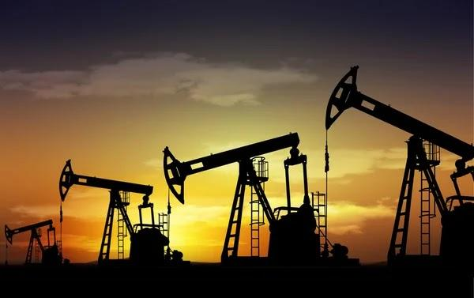
Definition of Crude Oil and Natural Gas
Crude Oil | Natural Gas
- Fossil Fuel (Formed when layers of decomposing plants and animals are subject to intense heat from the Earth, pressure from rocks and millions of years) | - Fossil Fuel
- a Mixture of Hydrocarbons | - a Mixture of Hydrocarbons
- exists in liquid phase in natural underground reservoirs | - exists in gas phase in natural underground reservoirs

Slide 4
Crude Oil Properties
Light/ Heavy: the Viscosity Status of the Oil
(The heavier it is, the higher viscosity and the harder to transport.)
Sweet/ Sour: the Sulfuric Content
(The sourer it is, the higher sulfuric content and further processing is required; otherwise, pipes and refineries would be damaged)

Slide 5
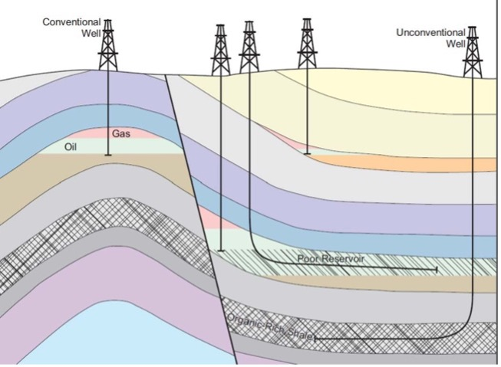
Crude Oil Categories
1) Conventional
Includes Crude Oil and Natural Gas
Faster and Cheaper to Develop
2) Unconventional
Includes Wider Variety of Sources
(e.g., Oil Sands, Extra Heavy Oil, Gas to Liquids)
Costly to Develop

Slide 6

Is Crude Oil a Scare Resource?
Support Side
Using proven reserves, there will be no more oil by 2068.
Against Side - Kern River Case
Discovered in 1899 with an Estimated Production Life of 50 years (1949)
Still producing today
Will have thousands of new wells to be drilled over the next 15 years
“Technology and Geologic Knowledge increased faster than Production; therefore,
increasing estimates of technically recoverable resources through time,”
Scott Lauermann, a spokesperson for the American Petroleum Institute

Slide 7
Resources and Reserves
Resources:
the amount of existing crude oil or natural gas
has associated reserves
Reserves:
the deposits that are known to exist with a reasonable level of certainty
the amount that can be extracted or converted to profit.
the size that can be estimated to a certain degree
With the improved tech or new found deposits, the amount of reserves increase

Slide 8
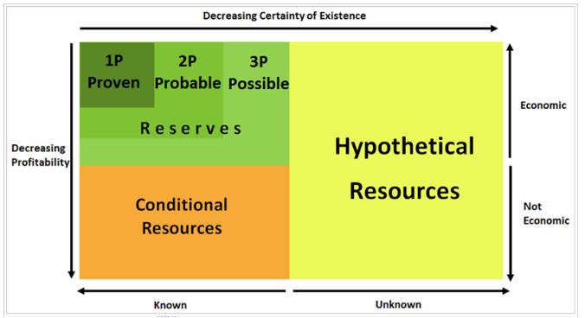
McKelvey Box – 3Ps of Reserves
Proven | Reserves | High probability of being economically viable.
Probable |  | Medium probability of being economically viable.
Possible |  | Low probability of being economically viable.
** Reserves may become Conditional Resources if Prices Drops.
Conditional | Resources | Uneconomic or unavailable
** If tech improved, it may become reserves.
Hypothetical | Resources | With Insufficient Understanding or Even No
** If being discovered, it could end up economic.

Slide 9
What do Oil and Gas Reserves mean to an Oil or Gas Company?
A company’s Reserves are its Economic Lifeblood
Thus, Reserves Statement can provide a view of:
(1) Un-depleted Assets of the company;
(2) the Potential for a company’s Future Growth; and
(3) the Profitability of the company
as Oil Company's Production Assets are Amortized on a unit of Depletion Basis.

Slide 10
What do Oil and Gas Reserves mean to an Oil or Gas Company?
A company’s Reserves are its Economic Lifeblood
Thus, Reserves Statement can provide a view of:
(1) Un-depleted Assets of the company;
(2) the Potential for a company’s Future Growth; and
(3) the Profitability of the company
as Oil Company's Production Assets are Amortized on a unit of Depletion Basis.

Slide 11
Organization of Petroleum Exporting Countries (OPEC)
OPEC was created in 1960 and currently has a total of 13 Member Countries.
In 2016, OPEC allied with other 10 top non-OPEC oil-exporting nations to form OPEC Plus.
Through OPEC Plus members' coordination of production, OPEC Plus becomess the single most influential supply-side in worldwide oil and energy markets.
over 50% of global oil supplies
about 90% of proven oil reserves
Functions: ensure the stability of oil prices in the international market without any major fluctuations

Slide 12
Canadian Oil and Gas Industry Characteristics
Capital-Intensive | High Barrier to Entry owing to the High Cost Tangible Cost: Cost for Purchasing and Maintaining drilling equipment (Account for roughly 20 to 40% of the total cost) Intangible Cost: expenses associated with (1) mud drilling; (2) employees; (3) chemicals; (4) supplies; (5) the fracking process and; (6) crews Account for roughly 60 to 80% of the total cost
Highly Skilled
Highly Regulated
Highly Competitive
Price Dependent
Essential R&D
Others

Slide 13
Canadian Oil and Gas Industry Characteristics
Capital-Intensive | Highly skilled and Labor Intensive High Demand on workers with expertise to operate drilling equipment The Lack of Job Security leads to High Turnover and High Vacancy Rate High Salary to Retain Experienced Workers and Attract New People Average annual salary per employee is about $410,000
Highly Skilled
Highly Regulated
Highly Competitive
Price Dependent
Essential R&D
Others

Slide 14
Canadian Oil and Gas Industry Characteristics
Capital-Intensive | Highly Regulated owing to Environment, Health and Safety Concerns The Federal, Provincial, State, Foreign and Local Laws and Regulations for controlling: The Discharge of Hazardous Wastes The Protection of the Environment The Prevention of Oil Spill ⇒ Significantly affect the operations and increase the risk exposure
Highly Skilled
Highly Regulated
Highly Competitive
Price Dependent
Essential R&D
Others

Slide 15
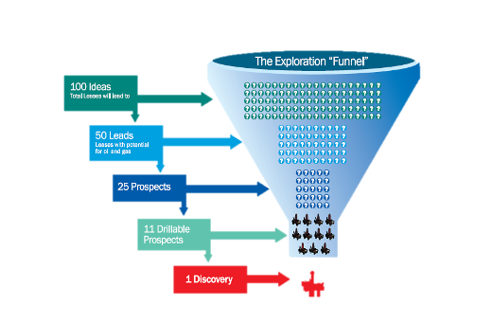
Canadian Oil and Gas Industry Characteristics
Capital-Intensive | A Few Powerful Participants High Barrier of Entry Being Dominated by Powerful Companies Industry Consolidation in the 90’s when Oil Prices Went Down
Highly Skilled
Highly Regulated
Highly Competitive
Price Dependent
Essential R&D
Others

Slide 16
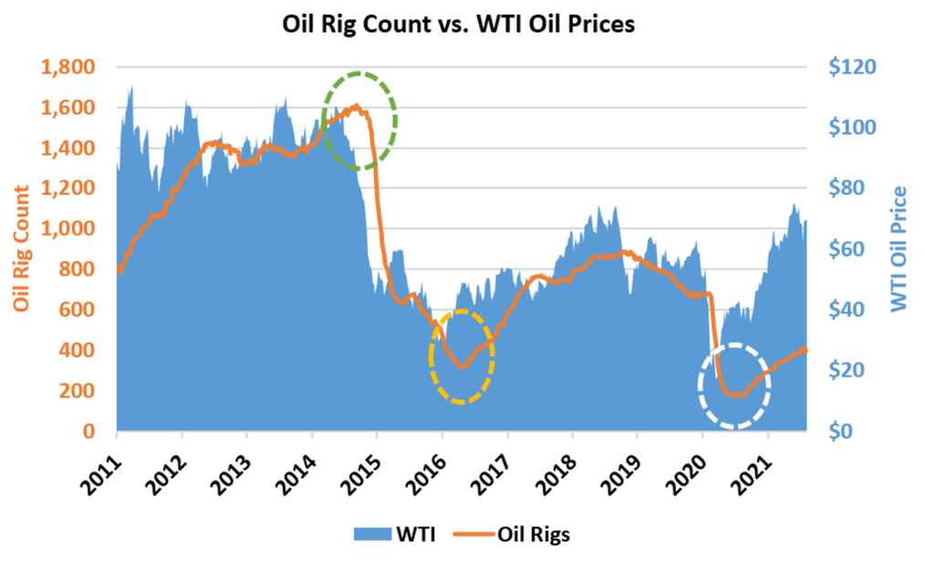
Canadian Oil and Gas Industry Characteristics
Capital-Intensive | Highly Dependent on the Price and Demand for petroleum Rig Count Plunged following Oil Price Drops Rig Count Surged following Oil Price Rises BUT before the drilling company sees any profit, it takes time to size up land, setup rigs, take out the oil, transport and refine it
Highly Skilled
Highly Regulated
Highly Competitive
Price Dependent
Essential R&D
Others

Slide 17
Canadian Oil and Gas Industry Characteristics
Capital-Intensive | (1) Technologies of Directional Drilling and Hydraulic Fracturing Accelerating Decline rates in worldwide Mature Reservoirs Maintain Existing Production Developing New Reservoirs that located in challenging geological locations Generating Future Production Gains (2) Technologies for Environmentally Safe Strict Environmental Regulations People are more Value-oriented
Highly Skilled
Highly Regulated
Highly Competitive
Price Dependent
Essential R&D
Others

Slide 18
Canadian Oil and Gas Industry Characteristics
Capital-Intensive | Profitability Being Significantly Affected by: (1) Type of Contract - determines the prospects for future revenue growth. (i) a Footage Contract; (ii) a day-work contract; or (iii) a turnkey contract (2) Length of Contracts (3) Location (for Contract Drillers) (i) Onshore rigs tend to remain domiciled within a particular region or country (ii) Offshore rigs are often relocated based on market demand (4) Natural calamities Hurricanes would destroy offshore drilling rigs and other equipment; and delay the delivery of services and materials to jobsites
Highly Skilled
Highly Regulated
Highly Competitive
Price Dependent
Essential R&D
Others

Slide 19
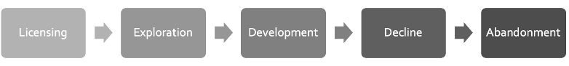
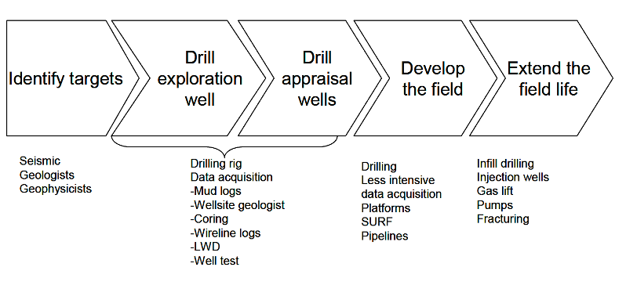
Life Cycle of a Hydrocarbon Basin
Life Cycle of an Oil Field

Slide 20
Exploration
(1) Analysis of Surface Features
- to get initial clues to the location of shallow hydrocarbon deposits
E.g., Analyzes Rock Formations, Faults, and Folds in the Earth's Crust
(2) Commissions Surveys from which Potential Reservoir Targets are Selected
E.g., Passive Seismic, Reflective Seismic, Magnetic and Gravity surveys
Chance of Success: < 20%

Slide 21
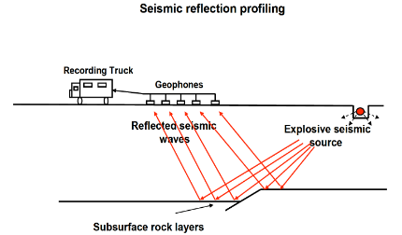
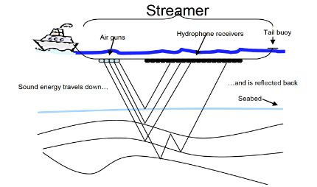
Exploration with Examples – Onshore and Offshore Seismic
Onshore Seismic Setup
Offshore Seismic Operations

Slide 22
Development
(1) Assessing Economic Feasibility of the Project
(2) Drilling (and injecting, if needed) all the Production Wells
(3) Building Infrastructure
E.g., Platforms, Pipelines, Processing Plants and Possibly Export Terminals
(4) Tendering the Front-end Engineering and Design of any Future Production Installation
⇒ Substantial Capex Outlays

Slide 23
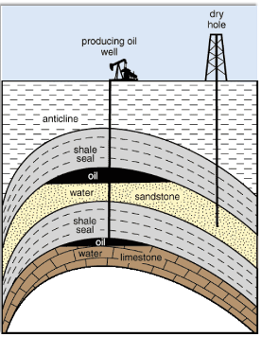
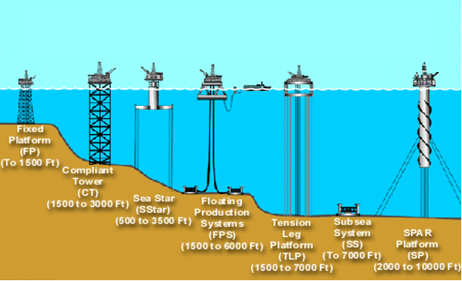
Conventional Oil and Gas Exploration and Production
Type of Rigs: Onshore and Offshore

Slide 24
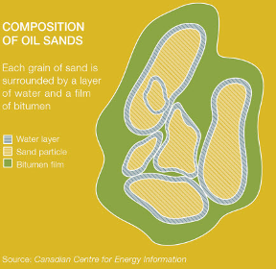
Unconventional Oil and Gas Exploration and Production
Extraction of Oil Sands
- Extremely Viscous and Heavy
- Mixture of Sand, Clay, various Minerals, Bitumen, and Water.
- Recover the Bitumen from other Substances
→ Upgrade it to Higher-end Products
Primary Methods of Recovery: (1) Surface mining & (2) In-situ
Surface mining: extract within 250 feet of the surface
In-Situ: extract without removing the soil above them

Slide 25
Surface Mining
1) Strip Mining
Removing layers of rock and dirt to reach a mineral deposit.
2) Open Pit Mining
Removing materials and rock through a large hole/pit.
3) Mountaintop Removal Mining
Removing the mountaintop through explosives to expose the resources underneath

Slide 26
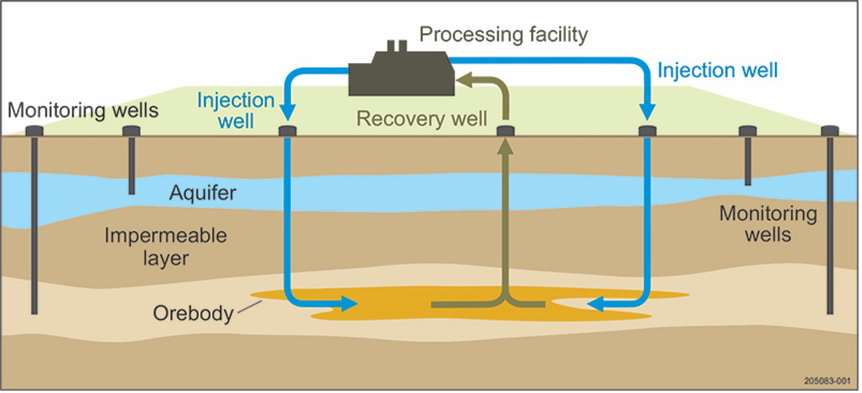
In-Situ Recovery Mining

Slide 27
Decline and Abandonment
Decline
Lower Volume
+ Higher Cost for enhancing production techniques
+ Higher Cost for maintaining aging infrastructure
--> Free Cash Flow Generation Diminishes
Option 1: Sale of Current Oil Field
Option 2: Maintenance of Current Oil Fields
Option 3: Investment in New Oil Field Projects
Option 4: Abandonment of Current Oil Field
Abandonment
when the Cost of Extracting Remaining Oil can not be justified by Commodity Prices
Cost including funds for Decommission and Clean-up Process
(Cost for $280 to 700 million)

Slide 28
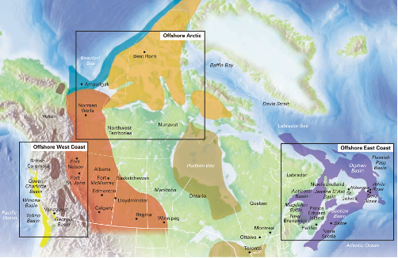
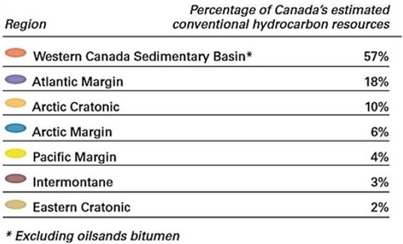
Canada’s Estimated Conventional Hydrocarbon Resources in 7 Hydrocarbon Regions
Source: Geological Survey of Canada (2014)

Slide 29
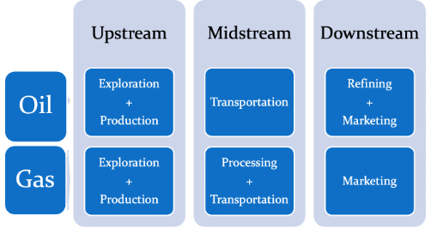
Value Chain of Oil and Gas

Slide 30
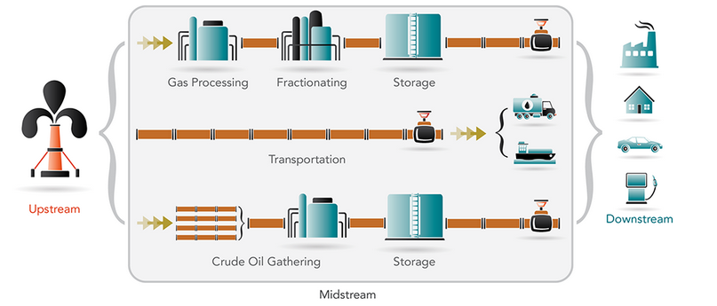
The Upstream and Midstream Value Chain of Oil and Gas

Slide 31
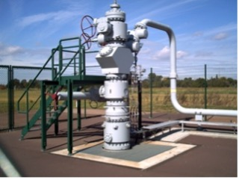
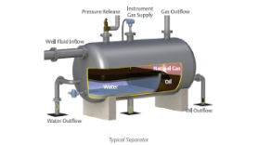
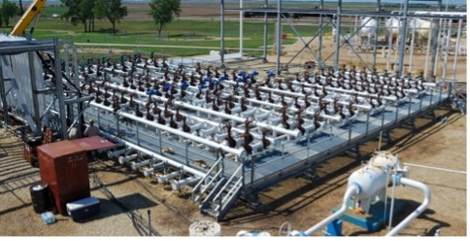
Upstream and Midstream Value Chain of Oil and Gas (Con’t)
(1) Wellheads
(3) Separation
(2) Manifolds and Gathering
(4) Metering, Storage and Export
(5) Utility system
Upstream sometimes,
mainly done by Midstream
Done by Upstream
Upstream sometimes,
mainly done by Midstream
Upstream sometimes,
mainly done by Midstream

Slide 32
(1) Wellheads
(1) usually sit on top of the oil or gas well leading down to the reservoir
(2) may also be an injection well to inject water or gas into the reservoir for maintaining pressure and levels to maximize production
Done by Upstream

Slide 33
Onshore:
The individual well streams are brought into the main production facilities through a network of gathering pipelines and manifold systems.
Offshore:
The dry completion wells on the main field center feed directly into the production manifolds system.
Outlying wellhead towers and subsea installations feed into the production risers through a multiphase pipelines system.
(2) Manifolds and Gathering
Upstream sometimes,
mainly done by Midstream

Slide 34
(3) Separation
Usually, the well produces a combination of gas, oil, and water, with various contaminants
A gravity separator is the most used for separating and processing the mixture
Upstream sometimes,
mainly done by Midstream

Slide 35
(4) Metering, Storage and Export
(5) Utility system
(4) Metering, Storage and Export
Meters are used to measure, monitor and manage the natural gas and oil exported from the production installation.
(5) Utility System
System provides services to the main process safety or residents, like electricity.
Upstream sometimes,
mainly done by Midstream

Slide 36
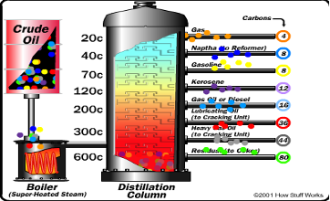
The Downstream Value Chain of Oil and Gas
Refining
A Process of Converting Crude Oil into Usable Products
through separate hundred types of hydrocarbons with different lengths of carbon chains in crude oil
Marketing
The Refinery Operations often include Product Distribution Terminals
for dispensing products to bulk customers E.g., Airports, Gasoline Stations, Ports and Industries.

Slide 37
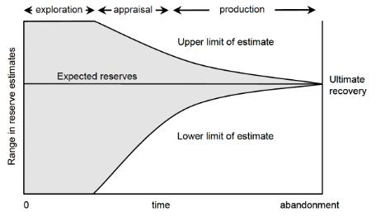
Assessing Risk and Reward
Typical Progression of Field Reserve Estimates Over Time
Reserve estimates are highly inaccurate during the late stage of the basin’s or field's life.

Slide 38
Probability of Geologic Success’ (Pg)
Chevron (1997) proposed a new risk assessment approach for estimating oil and gas reserves in economic quantities through four elements, called the” Probability of Geologic Success”,
Pg = P_source * P_reservoir * P_trap * P_dynamics
Where:
P_source = A ‘source rock’ is needed to generate the hydrocarbons
P_reservoir = A suitable ‘reservoir’ interval is needed to bear the hydrocarbons
P_trap = A ‘trap’ is needed to contain the hydrocarbons
P_dynamics = All three elements must occur within a ‘dynamic’ system where each can interact

Slide 39
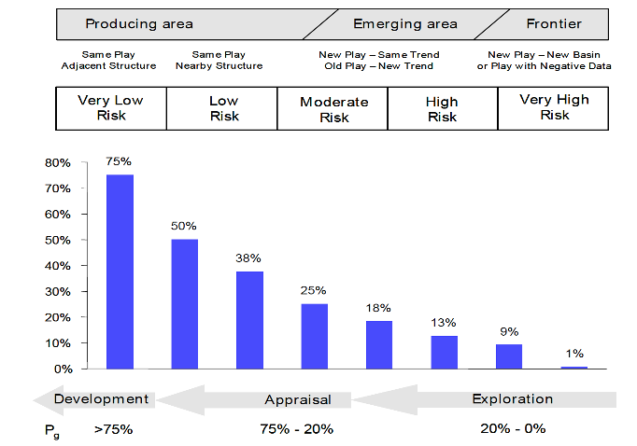
Geological Success within Differing Scenarios

Slide 40
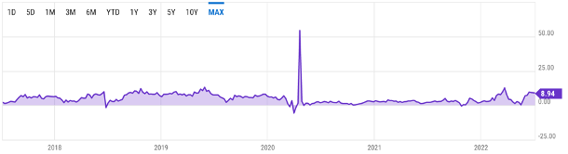
Benchmark Crude Oil Prices and Grades
Oil Price Benchmarks
Brent: pricing over 75% of the world's traded oil.
West Texas Intermediate (WTI): mainly pricing over Canada and the United State
The Brent WTI Spread is close, usually around $2 to 9 USD/bbl.
* Brent and WTI are used as indicative oil prices,
in most cases, crudes are traded at a discount or premium depending on their Viscosity Status (Light/
Heavy) and Sulphur Content (Sweet/ Sour)

Slide 41
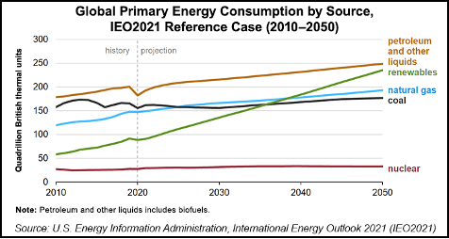
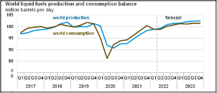
Global Energy Consumption and Production
Short Term (2022 to 2023)
Long Term (2020 to 2050)

Slide 42
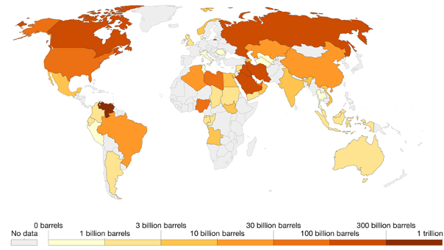
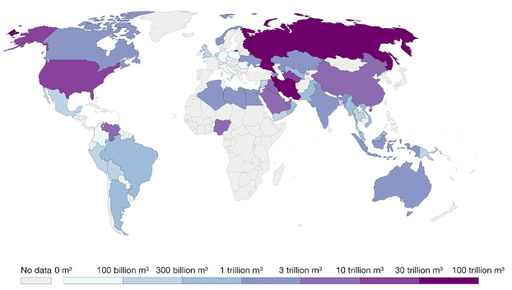
Proven Crude Oil and Natural Gas Reserves
Oil Reserves (2020)
Gas Reserves (2020)

Slide 43
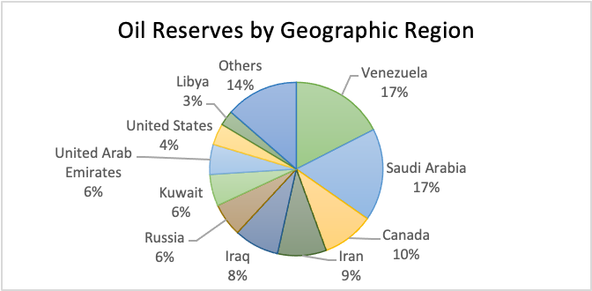
Crude Oil Reserves by Geographic Region

Slide 44
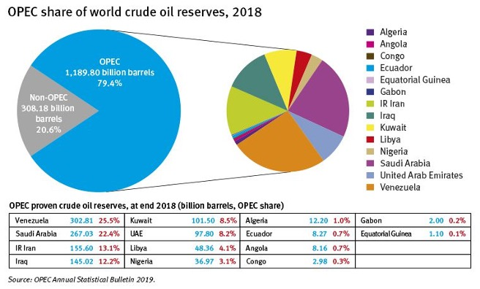
OPEC Share of World Crude Oil
OPEC accounts for
80% of Global Reserves and
50% of Oil Production
In 2018, its Proven Oil Reserves stand at 1.19 billion barrels.

Slide 45
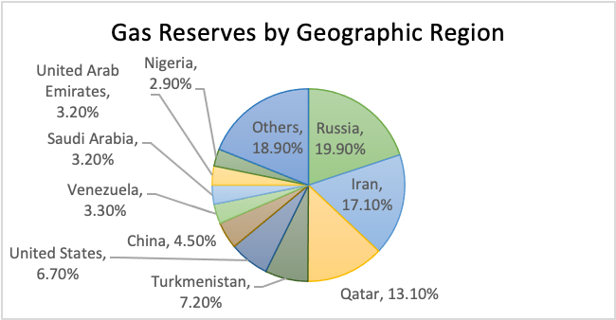
Gas Reserves by Geographic Region

Slide 46
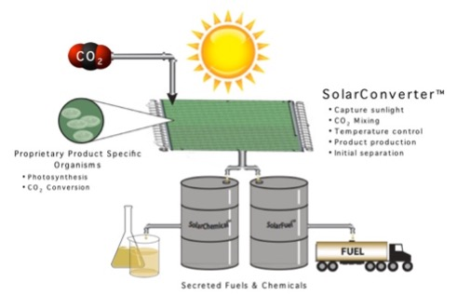
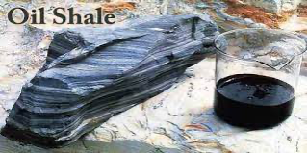
Oil and Gas’s Alternatives
Public and Scientific Attention Driven Factors:
(1) Increases in Oil Prices
(2) Need for Increased Energy Security
(3) Concern over Greenhouse Gas Emissions from Fossil Fuels
Alternative 1: Biofuel
Derived from Biomass
E.g., Solid Biomass, Liquid Fuels, Biogases and Sunlight
Alternative 2: Extract Oil and Gas through Alternative Techniques and Other Unconventional Fossil Fuels
E.g., Shale Oil from Oil Shale

Slide 47
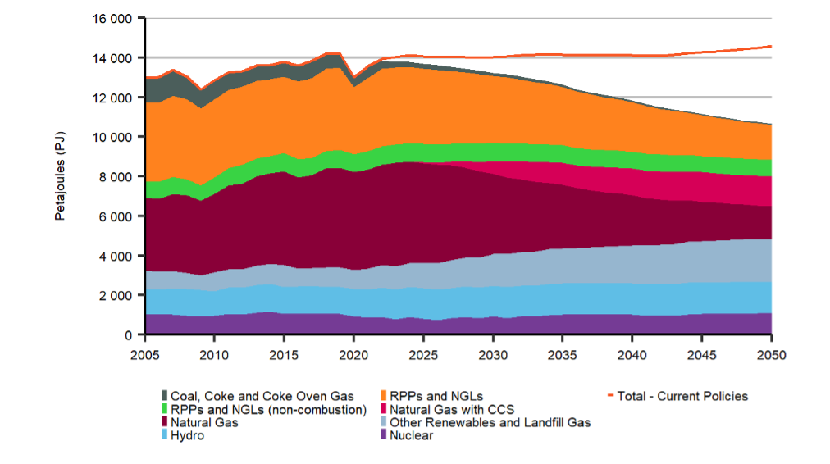
Canadian Outlook
Drilling | Primary Energy Demand by Fuel and Share of Total Demand Canada is recovering after the COVID pandemic and thus there will be a surge in energy needs. However, more renewable energy is expected to be used owing to the raised awareness of environmental protection and environmental concerns about using fossil fuels. Increases by 7.5% from 2021 to 2050 (Current Policies Scenario) falls by 21% from 2021 to 2050 (Evolving Policies Scenario – Reductions in Fossil Fuel Use)
Crude Oil Production (2021 to 2050)
Natural Gas Production (2021 to 2050)
Uncertainties

Slide 48
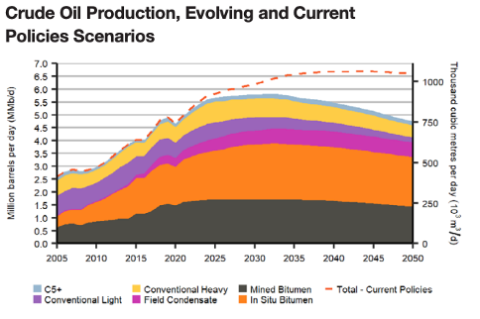
Canadian Outlook
Drilling | Canadian crude oil production recovered to pre-pandemic levels by late 2020. In both scenarios, production increases in the near term, but long-term trends differ significantly based on scenario assumptions E.g., Future Price Levels and Domestic Climate Policy
Crude Oil Production (2021 to 2050)
Natural Gas Production (2021 to 2050)
Uncertainties

Slide 49
Canadian Outlook
Drilling | Evolving Policies Scenario: Low Global Oil Prices and Steadily more Ambitious Climate Policies (1) Expected to Increase from 5.0 million barrels per day (MMb/d) in 2021 to 5.8 MMb/d in 2032, then fall to 4.8 MMb/d in 2050 (2) Brent Crude Oil Price is assumed to fall from an annual average of US$68 per barrel in 2021 to US$40 per barrel in 2050 The way to Maintain this Low Cost throughout the Projection Period (to 2050) is the Vast Majority of Oil Sands Production is from those Long-lived Oil Sands Facilities, with a Low Operating Cost, that are Producing Today Current Policies Scenario: High Global Oil Prices with High Global Oil Demand (1) Expected to Increase Rapidly to 5.8 MMb/d in 2041 (2) Brent Crude Oil Price is assumed to stay at US$70 per barrel
Crude Oil Production (2021 to 2050)
Natural Gas Production (2021 to 2050)
Uncertainties

Slide 50
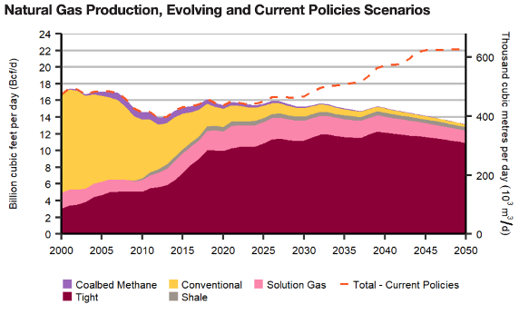
Canadian Outlook
Drilling | Evolving Policies Scenario Natural Gas Production Remains Near the Current Level through much of the next 20 years Current Policies Scenario Natural Gas Production is expected to Steadily Increase and Reach 22.2 Bcf/d in 2050 (a 40% increase from 2021 production levels)
Crude Oil Production (2021 to 2050)
Natural Gas Production (2021 to 2050)
Uncertainties

Slide 51
Canadian Outlook
Drilling | Future Oil and Gas Prices Potential Labour Shortages The Future Growth of U.S. Shale Gas Production and its Impact on North American Gas Prices Well Production Rates
Crude Oil Production (2021 to 2050)
Natural Gas Production (2021 to 2050)
Uncertainties

Slide 52
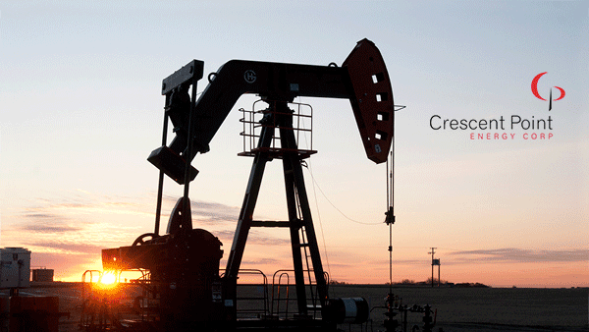
Crescent Point Energy

Slide 53
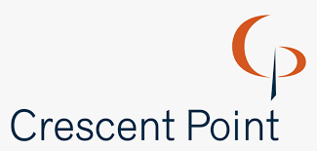
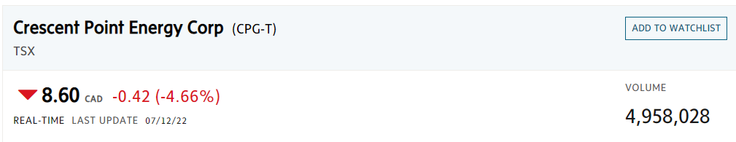
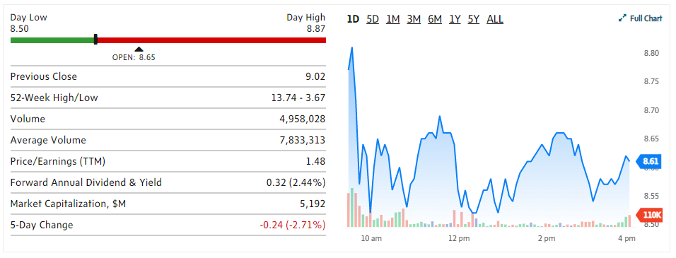

Slide 54
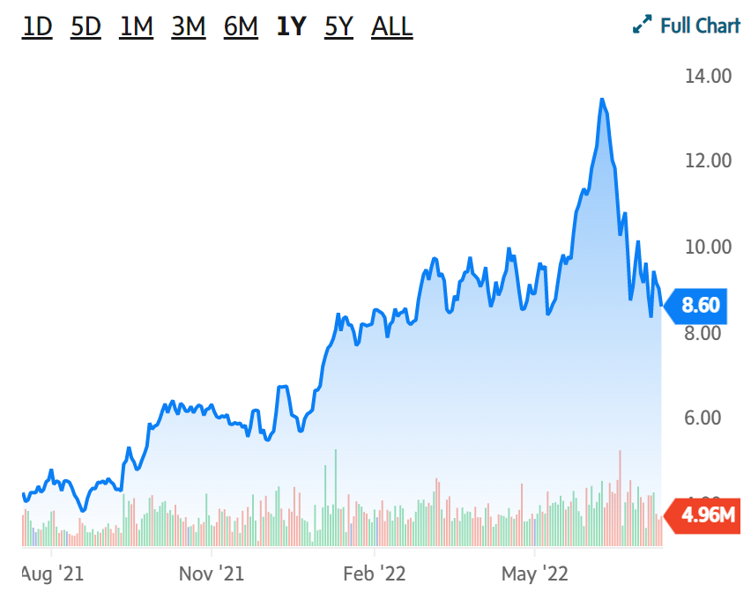
1 Year Stock Performance

Slide 55
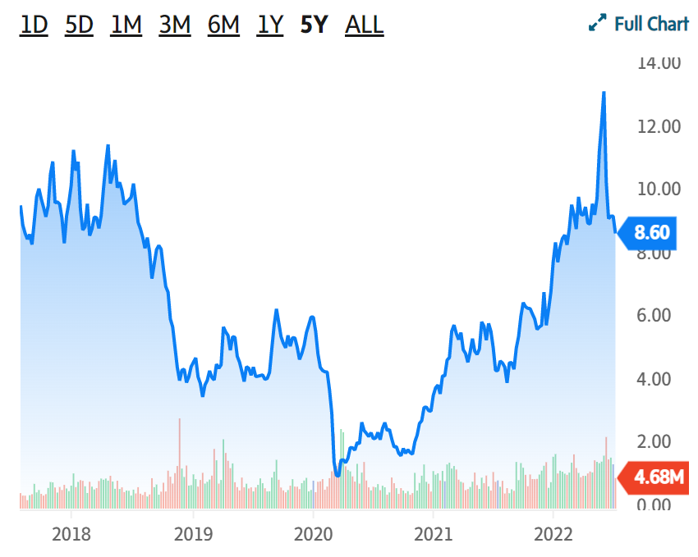
5 Year Stock Performance

Slide 56
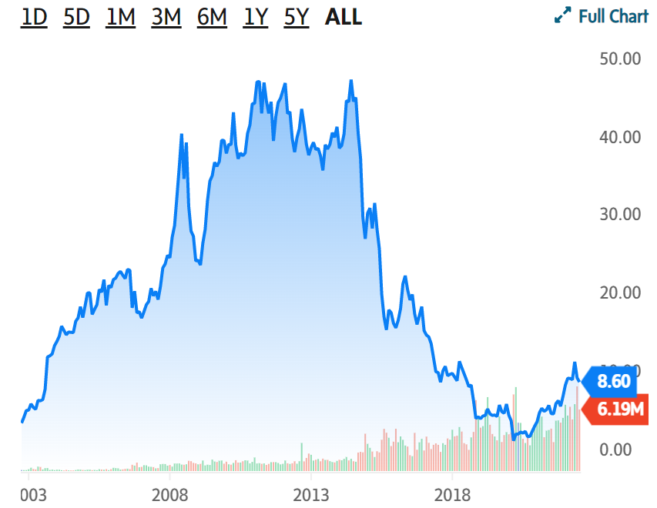
All Time Stock Performance

Slide 57

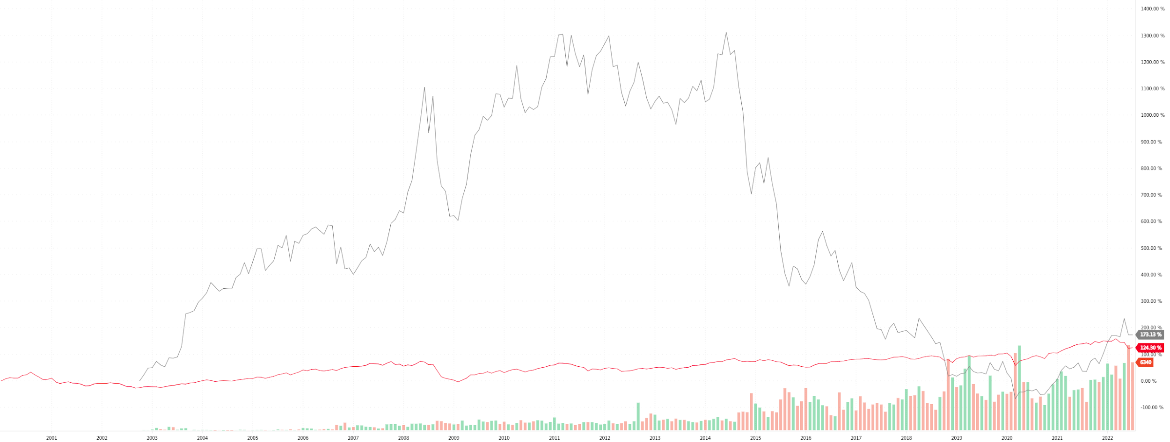
Relative Performance

Slide 58
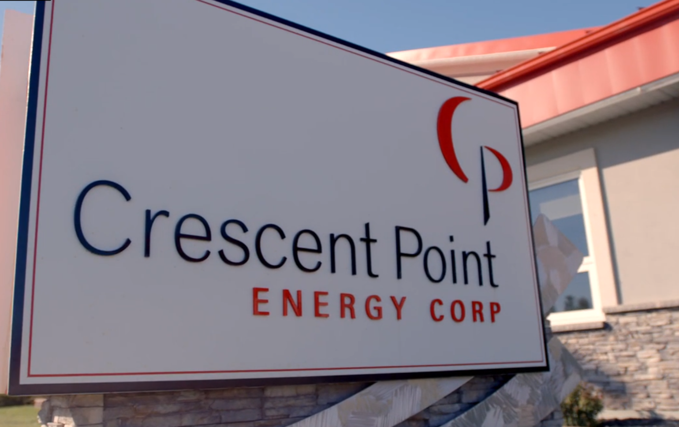
Company Overview

Slide 59

Company Background
An oil and gas exploration and development company based in Calgary, Alberta
Explores, develops, and produces light and medium crude oil, natural gas liquids, and natural gas reserves in Western Canada and the United States
Formed in 2001 as a junior oil exploration and production company

Slide 60

Company History
2001
2003
2005
Founded 2001
Converts to a trust after merging with Tappit Resources Ltd. and continues to acquire high-quality assets in western Canada
The Trust increases monthly distributions by 18 percent, from $0.17 to $0.20 per unit, announces a new core area in southwest Saskatchewan and increases production to 12,164 boe/d
Begins to trade on the Toronto Stock Exchange as a junior exploration and production company
Increases proved plus probable reserves by 42 percent, production by 70 percent and cash flow by 91 percent, all while maintaining excellent balance sheet strength
2001
2004

Slide 61
Company History
2006
2009
2011
2014
Completes more than 10 acquisitions during the year and executes a successful drilling program, increasing average daily production by 70 percent to 20,723 boe/d
Converts from an income trust to a dividend-paying corporation. Initial dividend is set at $0.23 per share
Begins expanded into the US (North Dakota). Open an office in Colarado
On January 22, 2014, Crescent Point shares opened for trading on the New York Stock Exchange
Largest acquisition, $628 million acquisition of Mission Oil & Gas Inc.
Acquisition of Lower Shaunavon assets from Penn West Energy Trust, as well as the corporate acquisitions of Ryland Oil Corp. and Shelter Bay Energy Inc.
Completes more than $3 billion in acquisitions, consolidating key resource plays and establishing the Uinta Basin as a new core area
2007
2010
2012

Slide 62
Company History
2015
2017
2021
Acquires Legacy Oil + Gas Inc. and Coral Hill Energy Ltd. Also lowers its cost structure and takes steps to eliminate freshwater usage in Saskatchewan.
Identifies new drilling locations in its core areas that increased its corporate productive capacity by approximately 70%
Announces Accretive Acquisition of Kaybob Duvernay Assets for $900 Million and Enhanced Free Cash Flow
Grows its drilling inventory by approximately 1,000 net locations, supported by its organic new play discovery program in the emerging Flat Lake and Uinta basin resource plays
Reports a $145.1 million loss in its latest quarter on a 73-per-cent decrease in revenues amid lower crude oil prices
Brings onstream its first fully operated five-well pad in the Kaybob Duvernay, well costs in the region have come in 20 per cent lower than anticipated, reported $121.6M Q4 profit
2016
2020
2022

Slide 63
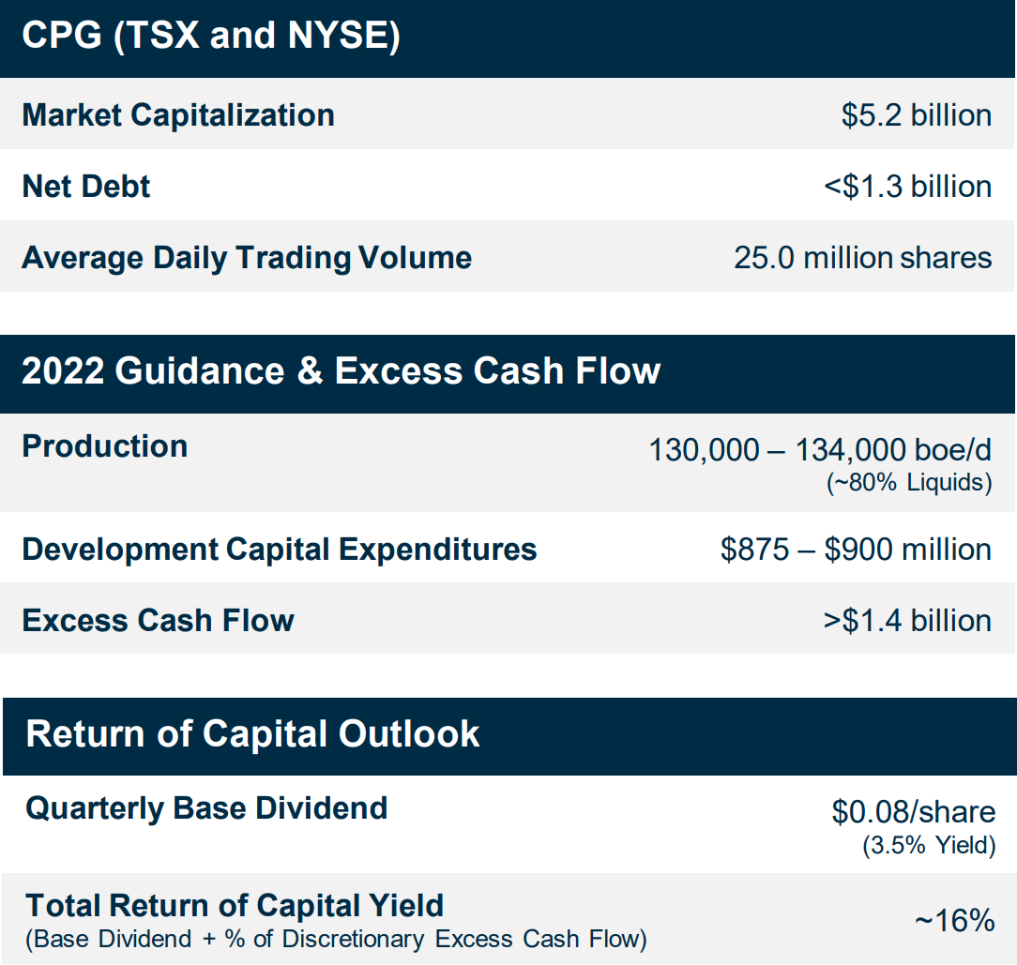
Corporate Structure

Slide 64
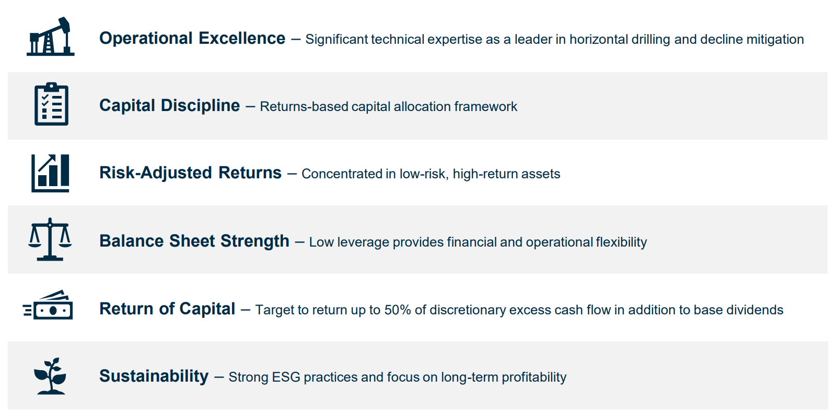
Company Strategy

Slide 65
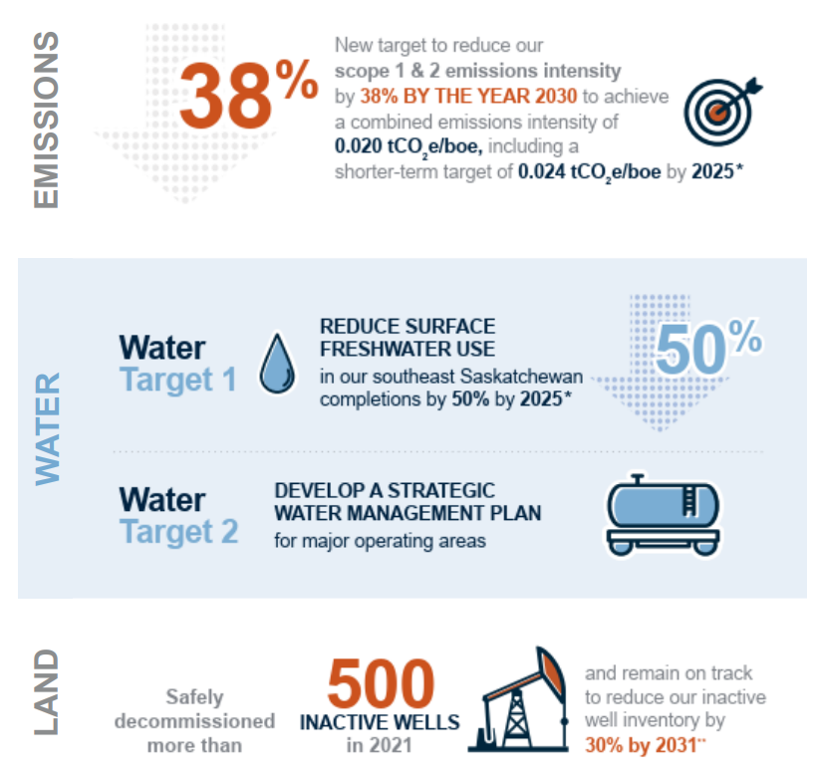
Corporate Responsibility

Slide 66
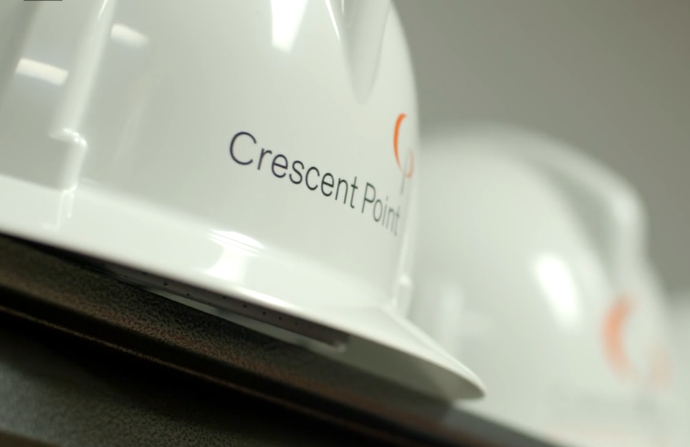
Management

Slide 67

Craig Bryksa
President, Chief Executive Officer and a Director of Crescent Point since September 2018
Was Vice President, Engineering West and has held a number of senior management roles with Crescent Point since joining the company in 2006
Rich experience as a professional engineer in the oil and gas industry
a Bachelor of Applied Science degree in Petroleum Engineering from the University of Regina

Slide 68
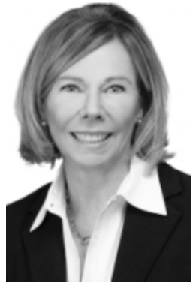
Barbara Munroe
Independent Chairman of the board
Appointed as board chair following Bob Heinemann's retirement in October 2019
More than 25 years of experience as a lawyer and executive in diverse industries
An experienced corporate director and currently serves as a director of Willow Biosciences Inc. and ENMAX Corporation.
Bachelor of Commerce, Finance degree and a Bachelor of Laws degree, both from the University of Calgary.

Slide 69




Directors
James E. Craddock
Bachelor of Science in Mechanical Engineering from Texas A&M University
John P. Dielwart
Bachelor of Science degree in Civil Engineering with Distinction from the University of Calgary
Ted Goldthorpe
Bachelor of Arts in Commerce from Queen's University
Mike Jackson
Bachelor of Science degree and a Master of Business Administration, both from Dalhousie University

Slide 70




Directors
Jennifer F. Koury
Bachelor of Commerce degree from the University of Alberta
Francois Langlois
Bachelor of Geological Engineering degree from Laval University
Myron M. Stadnyk
Bachelor of Science in Mechanical Engineering from the University of Saskatchewan
Mindy Wight
Bachelor of Commerce Degree from the University of Northern British Columbia

Slide 71


Officers
Ryan Gritzfeldt
Chief Operating Officer since 2018
Previously worked as VP, Marketing & Innovation and VP, Engineering and Business Development East for Crescent Point from 2010 until 2018
worked in the oil and gas industry since 1998
Bachelor of Applied Science degree in industrial systems engineering from the University of Regina
Ken Lamont
Chief Financial Officer since 2016
Previously worked as VP, Finance and Treasurer for Crescent Point
worked in the oil and gas industry since 2001
Chartered Professional Accountant and holds the ICD.D designation
Bachelor of Commerce degree (with distinction) from the University of Alberta

Slide 72


Officers
Mark Eade
SVP, General Counsel and Corporate Secretary
over 20 years of experience in corporate governance, securities and mergers and acquisitions law
Was a partner with Norton Rose Fulbright Canada LLP law firm from 2011 to 2015.
Bachelor of Commerce degree and a LL.B. degree from the University of Saskatchewan
Garret Holt
SVP, Corporate Development since 2019
over 30 years of experience in the oil and gas industry
Was an Executive Director in Energy Investment Banking with JPMorgan
Bachelor of Science from the University of Tulsa

Slide 73


Officers
Mike Blair
VP, Exploration and New Ventures since 2019
over 20 years of experience as a geologist
Previously worked as Director of southwest Saskatchewan and Alberta exploration and was also responsible for new company ventures
Bachelor of Science in Geology and Master of Science in Geology from the University of Regina
Rob Fiorentino
VP, Operations and EH&S since 2020
Joined the company in 2015 and has held various engineering roles in a management capacity
Bachelor degree in mechanical engineering with a minor in business from the University of Victoria

Slide 74


Officers
Justin Foraie
VP, Engineering and Marketing
Been with the company since 2009
Bachelor of Applied Science degree in Petroleum Systems Engineering from the University of Regina
Member of the Association of Professional Engineers and Geoscientists of Alberta and Saskatchewan
Shelly Witwer
VP, Business Development since 2019
Joined the company in 2007
significant experience in land and business development
Bachelor of Commerce degree and a Bachelor of Arts degree in Energy Economics from the University of Calgary

Slide 75

Asset Overview

Slide 76

Operating Areas
Central Alberta
Kaybob Duvernay
Providing significant low risk drilling inventory with attractive economics
North Dakota
Primarily located in Williams County focused on the development of the Bakken and Three Forks formations
Generates attractive netbacks given its high liquids-weighting and low operating expenses
SE Saskatchewan
Viewfield Bakken​
  largest and longest producing resource play
Flat Lake
  a multi-zone resource play
  an extension of the Three Forks play in North Dakota
SW Saskatchewan
Shaunavon​
  The Shaunavon waterflood and enhanced oil recovery programs are expected to provide additional benefits over the long-term

Slide 77


Slide 78


Slide 79


Slide 80


Slide 81

Crescent works primarily in Southeast Saskatchewan
Also have production going in Alberta and North Dakota

Slide 82

Drilling Activity

Slide 83

Production Estimates

Slide 84

Product Type Production Information

Slide 85

Property, Plant and Equipment

Slide 86

Netback
(Gross Profit per barrel)

Slide 87

Outlook for 2022

Slide 88

Value Drivers

Slide 89


Production Growth

Slide 90


Slide 91

Condensate Exposure

Slide 92

Increasing Shareholder Returns

Slide 93

Dividends
2009 - Changed from an income trust company to a dividend paying company
Initial dividend set for $.23 per share
409% increased dividend when comparing FY21 to FY 20

Slide 94

Dividends
In December 2021, Crescent Point declared a quarterly cash dividend of $0.045 per share to be paid on April 1, 2022
dividends declared to shareholders was reduced by $0.2 million due to common shares purchased and cancelled under the Normal Course Issuer Bid ("NCIB") during the first quarter of 2022

Slide 95

Differentiated Assets Base

Slide 96

Financial Statements

Slide 97

Balance Sheet Q1 2022 Assets

Slide 98

Balance Sheet Q1 2022 Liabilities & SE

Slide 99

Balance Sheet FY 2021 Assets

Slide 100

Balance Sheet FY 2021 Liabilities & SE

Slide 101

Income Statement
FY 2021

Slide 102

Income Statement Q1 2022

Slide 103

Cash Flow Statement FY 2021

Slide 104

Cash Flow Statement Q1 2022

Slide 105

Summary of Quarterly Results

Slide 106
Recommendation:
BUY

Slide 107


Slide 108

Stock price snapshot-Ticker: SU

Slide 109

1-year stock performance

Slide 110

5-year stock performance

Slide 111

All time stock performance

Slide 112

Company Overview

Slide 113
Company Overview
Globally competitive intergrated energy company
Suncor is headquartered in Calgary, Alberta, Canada, and they have a global team of over 30,000 people. Their operations include
  Oil sands development, production and upgrading
    the world’s largest producer of bitumen
  Petroleum refining in Canada and the US
  National Petro-Canada retail distribution network
    including the Electirc Highway network of fast-charing EV stations
Listed on both the TSX and NYSE (Ticker SU)

Slide 114
Company history
Founded in 1919 as Sun Company of Canada, subsidiary of Sun Oil (now Sunoco)
Government of Ontario purchased a 25% stake
1979
1993
1919
1981
Sun formed Suncor by merging its Canadian refining and retailing interets
The government of Ontario and Sun Oil divested
Notes:
Have more details from 1979 to 2003

Slide 115
Company history
Sun Oil also divested its interest; Suncor became independent
Sunoco Inc. changes company name to Suncor Energy Products Inc.
1979
2005
1995
2002
Sun formed Suncor by merging its Canadian refining and retailing interets
Acquired a scond refinert from Valero Energy
Notes:
Have more details from 1979 to 2003

Slide 116
Company history cont.
Acquired Petro-Canada and merged in 2009
Courted Canadian Oil sands. Reached owernship 49% of the Syncrude project
2013
Current
2009
2015
Moved its retail brand from Phillips 66 to shell in the US
Holds a majority stake in Syncrude with 58.74%
Notes:
Mergers

Slide 117

Corporate Structure

Slide 118

The Suncor advantage

Slide 119

GHG Emissions Objective - net zero by 2050

Slide 120

GHG Emissions Objective - net zero by 2050

Slide 121

Management

Slide 122

Management

Slide 123

Kris Smith
Interim President and Chief Executive Officer
Joined Suncor in the year 2000
Previously held positions in Suncor’s US downstream business
Bachelor fo arts with honours from the University of Alberta
Bacgelor of laws from Dalhouse University
Advanced Management Program at Harvard Business School

Slide 124

Alister Cowan
Chief Financial Officer
Joined Suncor in the year 2014
Priorly the CFO of Husky Energy, and led the finance function for other energy and utilites sector companies
Bachelor of Arts degree in Accounting and Finance from Heriot-Watt University
Chartered Accountant as a member of The Institute of Chartered Accountants of Scotland

Slide 125

Paul Gardner
Chief People Officer
Master’s degree in industrial relations from Queen’s Unveristy
Bachelor of public adminstration from Queen’s University

Slide 126

Bruno Francoeur
Executive Vice President
Was appointed EVP, Business & Operations Services in 2021
More than 30 years of industry experience, including over 10 years at Union Carbide and 6 years as vice president at the Montreal refinery
Bachelor of science in chemical engineering from the Unversity of Sherbrooke

Slide 127

Martha Hall Findlay
Chief Climate Officer
Leads Suncor’s efforts to address the nexus of climate and energy
Named a Canadian Climate Champion in 2021 by the British High Commission and the Canada Climate Law Initiative
Priroly was the President and CEO fo the Canada West Foundation, one of Canada’s most important public policy think tanks
Over 30 years of experience as a corporate lawyer, inteenational trade expertm senior executive and successful entrepreneur

Slide 128

Shelly Powell
Senior Vice President, E&P and In Situ
Was appointed senior VP in 2021
Began her Suncor carreer at the Sarnia Refinery in 1995 as Process Operator
Bachelor’s degree in chemical engineering from the University of Ottawa
Master of business adminstration from the University of Michigan
Master of Science degree in finance from the University of Michigan

Slide 129

Arlene Strom
Chief Sustainability Officer and General Counsel
Joined Suncor in the corporate legal group in 2023
Priorly practed corporate and securites law in Calgary
Bachelor of arts degree in business administration from Trinity Western University
Maser of arts degree in public policy and an LLB from the University of British Columbia

Slide 130

Peter Zebedee
Executive Vice President, Mining and Upgrading
Joined Suncor in 2022
25 years of experience as CEO of LNG Canada
Was Vice presidnet Canada Manufacturing and general manager Scorgord at Shell
Bachelor of applied science in geological engineering from the University of British Columbica

Slide 131

Asset Overview

Slide 132

Operations & Consumer Network

Slide 133


Slide 134


Slide 135


Slide 136


Slide 137

Value Drivers & Cost Structure

Slide 138


Slide 139


Slide 140


Slide 141


Slide 142


Slide 143


Slide 144


Slide 145


Slide 146


Slide 147

Financial Statements

Slide 148

2022 Q1 Balance Sheet
Notes:
B/S Q1

Slide 149

2021 Annual Balance Sheet
Notes:
B/S Q1

Slide 150

2022 Q1 Income Statement
Notes:
B/S Q1

Slide 151

2021 Annual Income Statement
Notes:
B/S Q1

Slide 152

2022 Q1 Cash Flow Statement
Notes:
B/S Q1

Slide 153

FY2021 Cash Flow Statement
Notes:
B/S Q1

Slide 154
Recommendation:
BUY

Slide 155

ARC Resources Ltd.

Slide 156


Stock price snapshot-Ticker: ARX

Slide 157

1-year stock performance

Slide 158

5-year stock performance

Slide 159

All-time stock performance

Slide 160

Company Overview

Slide 161
Company Background
Founded in 1996 as a conventional oil and gas company and began with the acquisition of 21 properties from Mobil Oil Canada.
Organized as an oil and gas royalty trust until 2011 when the company converted to a corporation structure.
Largest pure-play producer in Canada’s Montney Region. Business activities include the exploration, development and production of oil and natural gas reserves.
Canada’s largest condensate producer and third largest natural gas producer. Also one of Canada’s largest dividend paying companies.

Slide 162
Significant Mergers and Acquisitions
Acquired Starcor Energy Royalty Fund and Orion Energy Trust.
Acquired Storm Exploration Inc., adding the Parkland Montney field.
2003
2021
1999
2010
Purchased Star Oil and Gas ltd.
Combined with Seven Generations Energy Ltd.
Combination with Seven Generations Energy Ltd made ARC the largest pure-play producer in the Montney Region

Slide 163


Core Business Activities
Exploration, production and development of fossil fuels.
Pure play oil and gas producer.
  Pure play = company that only focuses on one line of business (non diversified).
Largest fossil fuel product is natural gas (61% of total production).
Main focus for capital expenditures is drilling and completions.
Production Profile
Cap Expenditures by Classification
Year ended December 31, 2021

Slide 164

Financial Strategy
ARC’s priority is to sustain production, invest in facility development and pay a base dividend at gas prices below current prices.
Profits above this are used for further dividends, debt repayment and stock buybacks.
Current Prices:
USD $98.56/bbl WTI
CDN $4.67/GJ AECO

Slide 165


Corporate Structure

Slide 166

Differentiation

Slide 167

Senior Leadership

Slide 168

Terry Anderson, B.SC.,P.ENG.
President and Chief Executive Officer
Joined ARC in the year 2000, appointed CEO in 2020.
More than 30 years experience working in the North American energy industry.
Played key role in ARC’s shift from a royalty trust to a corporation.
As CEO, led ARC’s business combination with Seven Generations Energy Ltd., which turned ARC into the largest pure play Montney producer in Canada.

Slide 169

Kris Bibby, B.COMM, CPA, CA
Senior Vice President and Chief Financial Officer
Joined ARC in the year 2014, appointed CFO in 2020.
Previously served as a CFO at a junior oil and gas company with international operations.
Recognized as the Best Investor Relations Officer in 2020 by IR Magazine Awards.

Slide 170

Armin Jahangiri, P.ENG.
Senior Vice President and Chief Operating Officer
Joined ARC in 2014, appointed COO in 2021.
More than 20 years of domestic and international experience in the energy industry.
Has held development, operations and production engineering positions with other major Canadian oil and gas producers.

Slide 171

Lara Conrad, P.ENG.
Senior Vice President and Chief Development Officer
Joined ARC in 2011, appointed CDO in 2021.
More than 20 years experience in the energy industry.
Named to the Global Female Influencer 275 list in 2020 by the Energy Council.

Slide 172

Asset Overview

Slide 173

What is the Montney Region?
Area of 130,000 Km² in British Columbia and Alberta.
One of the largest natural gas reserves in North America.
Potential to produce:
  449 trillion cubic feet of natural gas.
  14,521 million barrels of natural gas liquids.
  1,125 million barrels of oil.

Slide 174

ARC’s Asset Portfolio in the Montney Resource Play
ARC is the largest pure-play producer in the Montney.
More than 1 million net acres of total land position.
Large natural gas, liquids-rich gas and crude oil reserves.
Existing infrastructure with capacity of approximately 340,000 barrels of oil equivalent per day.

Slide 175

Approximately 1,500 million barrels of oil equivalent of proved and probable reserves.
Inventory of over 5,500 drilling locations.
Drilling Inventory & Total Reserves

Slide 176

Owned & Operated Northern Alberta Infrastructure
MMcf/day = million cubic feet per day
Mbbl/day = thousand barrels of oil per day

Slide 177

Owned & Operated Northeast BC Infrastructure
MMcf/day = million cubic feet per day

Slide 178

Value Drivers & Cost Structure

Slide 179

Value Drivers: Production Growth
By the end of 2021, production of crude oil increased by 235%, production of liquids increased by 188%, and production of natural gas increased by 65%.
Much of these increases were driven by the business combination with Seven Generations Energy Ltd, as well as expansions at the Sunrise facilities.

Slide 180

Value Drivers: Production Growth

Slide 181

Value Drivers: Gross Profit per Barrel

Slide 182

Value Drivers: Market Exposure

Slide 183

Value Drivers: LNG Supply

Slide 184

Value Drivers: Attachie Reserves
Attachie West Phase 1 is the leading development opportunity in ARC’s portfolio and has the potential to support more than a century of production at current rates.

Slide 185

Value Drivers: Attachie Reserves
Estimated net earnings of between $450 - $500 million/year once Kakwa plant has been completed.

Slide 186

Cost Structure: Montney Region
Western Canadian sedimentary basin, Montney region has some of the lowest forecasted break-even cost levels for new wells drilled between 2023 and 2025 in North America.

Slide 187

Cost Structure
ARC’s network of owned and operated infrastructure allows it to have a lower operating expense per boe than other Canadian firms.

Slide 188

Cost Structure: Innovation in Attachie
ARC has used innovation, optimization and technology to lower drilling costs and improve drilling efficiency when accessing their large Attachie reserves.

Slide 189

Financial Statements

Slide 190

2022 Q1 Balance Sheet

Slide 191

2021 Annual Balance Sheet

Slide 192




2021 Annual Balance Sheet-Note 8

Slide 193


2021 Annual Income Statement

Slide 194

2021 Annual Income Statement-Note 22

Slide 195

2021 Annual Income Statement-Note 10

Slide 196


2022 Q1 Income Statement

Slide 197

2021 Annual Statement of Cash Flows

Slide 198

2022 Q1 Statement of Cash Flows

Slide 199
Recommendation:
BUY

