Slide 1
Canadian Oil & Gas
Raza Chaudhry
Anson Wong
Anson Cheng
Deo Lao
Donna Wu

Slide 2
Agenda
Terminology
Industry Analysis
  Oil industry
  Gas industry
Company Analysis
  Suncor Energy
  Crescent Point Energy Corp.
  Imperial Oil Ltd.

Slide 3
Definition of Crude Oil & Natural Gas
Crude oil
  Fossil fuel; result of dead organisms decomposed underground.
  Become hydrocarbons that can be extracted as a liquid.
Natural gas
  Flammable gas consisted of hydrocarbons that occurs naturally underground.
  Also a fossil fuel.

Slide 4
Resource vs. Reserves
Resource refers to the amount of oil/natural gas that exists.
Resources have associated reserves.
When amount of reserves increase, due to improved tech or new found deposits.
Reserves are deposits that are known to exist with a reasonable level of certainty; you know its actually there.
  Amount that can be extracted or converted to profit.
  Size can be estimated to a certain degree.

Slide 5
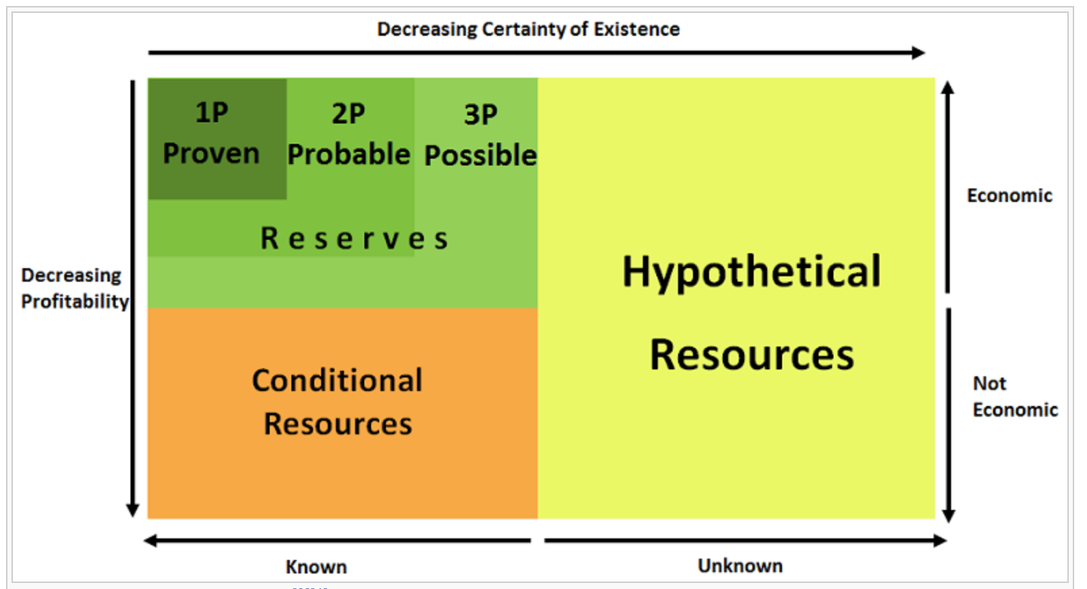
Resource vs. Reserves (cont.)
Notes:
McKelvey box
3Ps of reserves.
Proven resources have a high probability of being economically viable.
Probable contains proven reserves; medium probability.
Possible contains proven reserves; lowest of the 3.
Conditional resources are uneconomic or unavailable; may become reserves if technologies improve. However, reserves can also become conditional resources if prices of the item decreses.
Hypothetical resources are resources known about minimally or not at all; could end up economic when discovered.

Slide 6
Crude Oil Categories
Conventional
  Includes crude oil & natural gas.
  Easier and cheaper to produce than unconventional oil.
Unconventional
  Wider variety of sources (ie. Oil sands, extra heavy oil, gas to liquids, etc.)
  More costly to produce due to additional production costs to convert to synthetic crude oil.

Slide 7
Crude Oil Properties
Light/Heavy
  Compares the density of oils.
  Heavier oils are more difficult to transport.
  Heavier the oil, lower the API gravity; how heavy the oil is compared to water.
  Light if 28 degrees API or higher.
  Heavy if below 28 degrees API.
Sweet/Sour
  Refers to sulfur content in the oil.
  Sweet = lower content, sour = higher content.
  More sour oils require further processing to prevent damage on pipes and refineries.

Slide 8
Oil & Gas Value Chain
Upstream
Exploration
Production
Midstream
Transportation
Downstream
Refining
Processing
Marketing

Slide 9
Oil & Gas Exploration & Production
Conventional; drilling a hole into the earth with an oil rig to create an oil well.
Onshore; extraction from under land.
  Carbon tool drilling
  Horizontal drilling
  Hydraulic Fracturing (aka. Fracking)
Offshore; extraction from under the sea bed.
  Much more difficult due to remote and highly variable environments.
Notes:
Carbon tool drilling; of repeatedly dropping a heavy metal bit into the ground, eventually breaking through rock and punching a hole through to the desired depth.
Horizontal drilling; on the surface it resembles a vertical well, beneath the surface; the well inclines so that it runs parallel to the natural gas formation. Horizontal drilling is often used with shale gas wells.
Fracking; the process of injecting liquid at high pressure into subterranean rocks, boreholes, etc. so as to force open existing fissures and extract oil or gas.

Slide 10
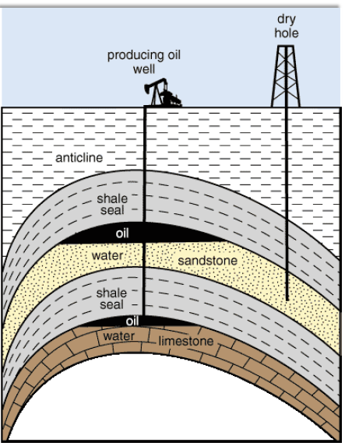
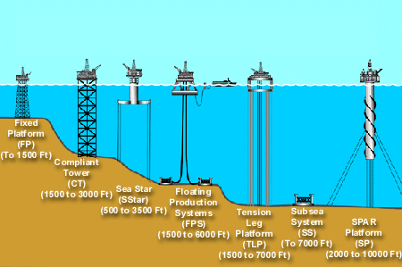
Onshore & Offshore

Slide 11
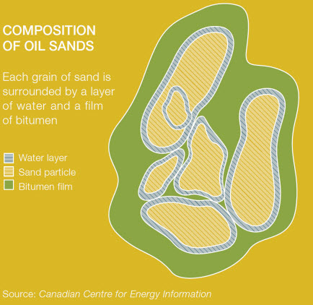
Oil & Gas Exploration & Production (cont.)
Unconventional; extraction of oil sands.
  Extremely viscous and heavy mixture in the earth comprised of sand, clay, various minerals, bitumen, and water.
  Separate/recover the bitumen from other substances and upgrade to higher end products.
Primary methods of recovery: Surface mining & In-situ
Surface mining; when bitumen is within 250 feet from the surface.
In-Situ; extract deeper deposits without removing the soil above it.
Notes:
Bitumen; black, viscous mixture of hydrocarbons similar and found in tar. Used for road surfacing.
The oil sands are located in three basins in the provinces of Alberta and Saskatchewan, Canada – Athabasca, Cold Lake and Peace River. To date, the Athabasca basin is where the majority of oil sands projects have been developed.

Slide 12
Surface Mining
Strip mining; removing layers of rock and dirt to reach a mineral deposit.
Open pit mining; removing materials and rock through a large hole/pit.
Mountaintop removal mining; explosives are used to remove the mountaintop to expose the resources underneath.

Slide 13
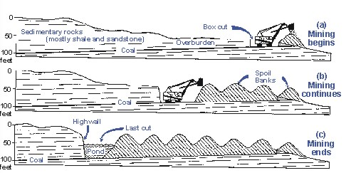
Strip Mining

Slide 14
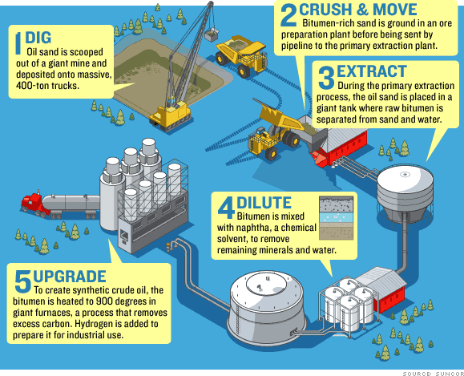
Open Pit Mining

Slide 15
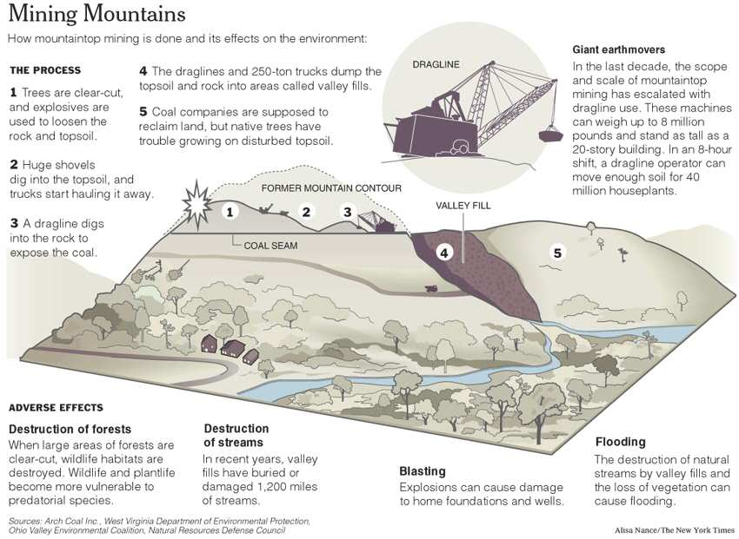
Mountaintop Removal Mining

Slide 16
In-Situ Recovery
Steam Assisted Gravity Drainage (SAGD)
Cyclic Steam Stimulation (CSS)
Vapor Extraction Process (VAPEX)
Toe-to-heel Air Injection (THAI)
Cold Heavy Oil Production with Sand (CHOPS)

Slide 17
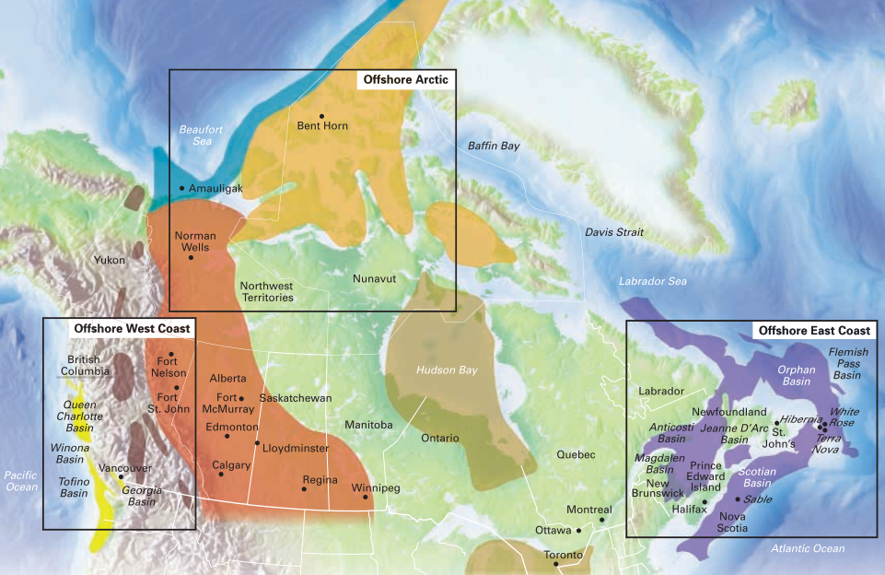
Canada’s 7 Hydrocarbon Regions

Slide 18
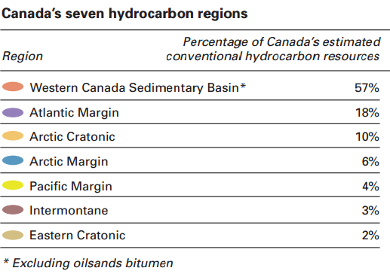
Canada’s 7 Hydrocarbon Regions

Slide 19
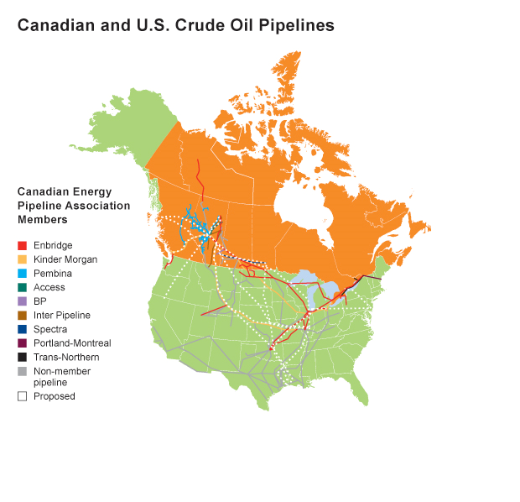
Oil & Gas Transportation
Transportation of oil through pipelines, rail, shipping, and trucking.
Different types of pipelines for different purposes:
  Gathering system field lines
  Transmission truck lines
  Distribution lines
Notes:
Gathering system field lines: move crude oil and natural gas from wells to processing facilities. After processing, feeder lines carry the hydrocarbons to the major, long distance transmission lines.
Transmission trunk lines: deliver product to small-diameter distribution pipelines, as well as industrial users, local distributors, refineries or connection pipelines to the United States.
Distribution lines: Local distribution companies (LDCs) use distribution lines to deliver natural gas to homes and businesses. Crude oil transmission lines also transport natural gas liquids (NGLs) and other refined petroleum products, while natural gas transmission lines only transport natural gas

Slide 20
Oil & Gas Refining & Marketing
Converting crude oil into finished products such as liquefied petroleum gas, gasoline, jet fuel, etc.
Crude oil is boiled, distilled, and goes through various subunits in the distillation unit depending on the intended finished product.
Distribute and sell the refined product and natural gas.

Slide 21
Macroeconomic Environment
Oil prices are determined by:
US interest rate – US federal reserve – FOMC
OPEC and Non OPEC Production
US Shale oil revolution

Slide 22
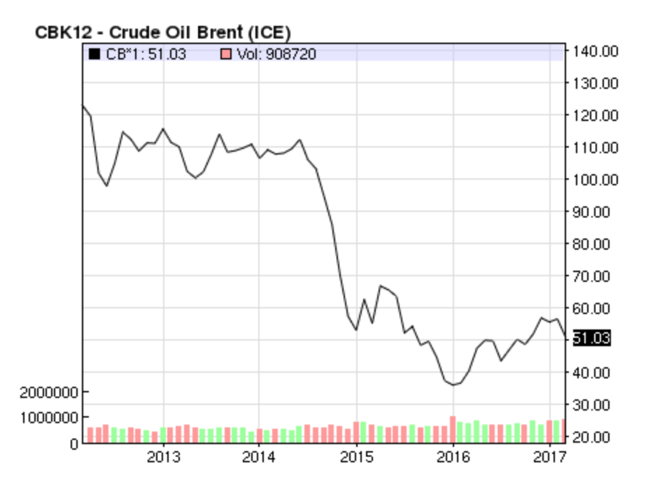
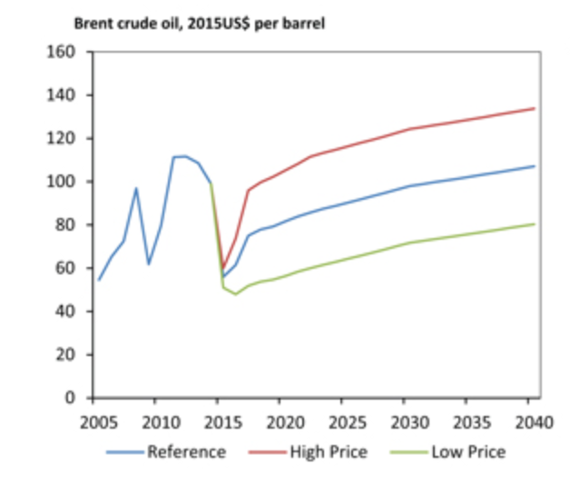
Global Oil Prices
Notes:
Brent crude oil prices to average $55/b in 2017 and $57/b in 2018.
General expected rise in crude oil prices in upcoming year, but have been generally volatile.
Brent Crude is a major trading classification of sweet light crude oil that serves as a major benchmark price for purchases of oil worldwide. This grade is described as light because of its relatively low density, and sweet because of its low sulfur content.
Higher the prices better the exports and worse off the importers.

Slide 23
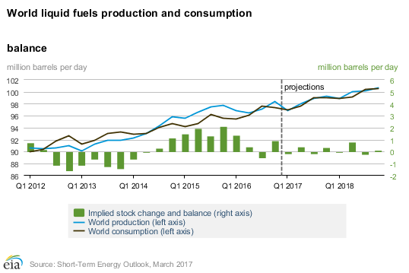
Global Oil Production & Consumption
Notes:
https://www.eia.gov/outlooks/steo/report/global_oil.cfm

Slide 24
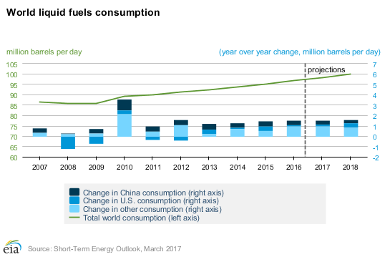
Global Oil Consumption Trend
Notes:
General projected increase in consumption.

Slide 25
Global Oil Consumption by Country
Notes:
2011 data
US Consumes a huge amount, but does not produce nearly as much.

Slide 26
Global Oil Production by Country
Notes:
2013 data
U.S. crude oil production averaged an estimated 8.9 million barrels per day (b/d) in 2016. U.S crude oil production is forecast to average 9.2 million b/d in 2017 and 9.7 million b/d in 2018.
Large focus in US, Russia, and Middle East (Saudi, UAE, Iraq, Iran)
Middle Eastern countries accounted for the highest dollar value worth of crude oil exports during 2015 with shipments valued at $325 billion or 41.3% of global crude oil exports. This compares with 18% for Europe, 9.9% for North America and 7.7% for Latin America.
(http://www.worldstopexports.com/worlds-top-oil-exports-country/)

Slide 27
Global Oil Exports (barrels/day)
Notes:
2006 data
Once again highlighting the middle east and Russia for their driving force in oil production and exports.

Slide 28
Global Oil Imports (barrels/day)
Notes:
2006 data.
US clearly consumes way more than they produce than anyone else.

Slide 29
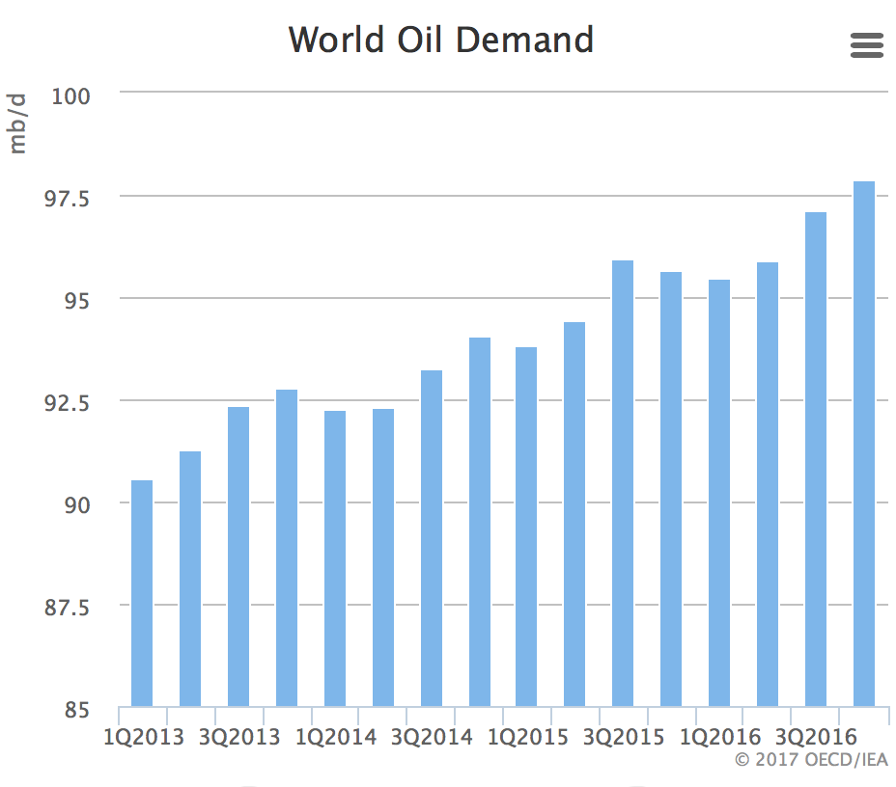
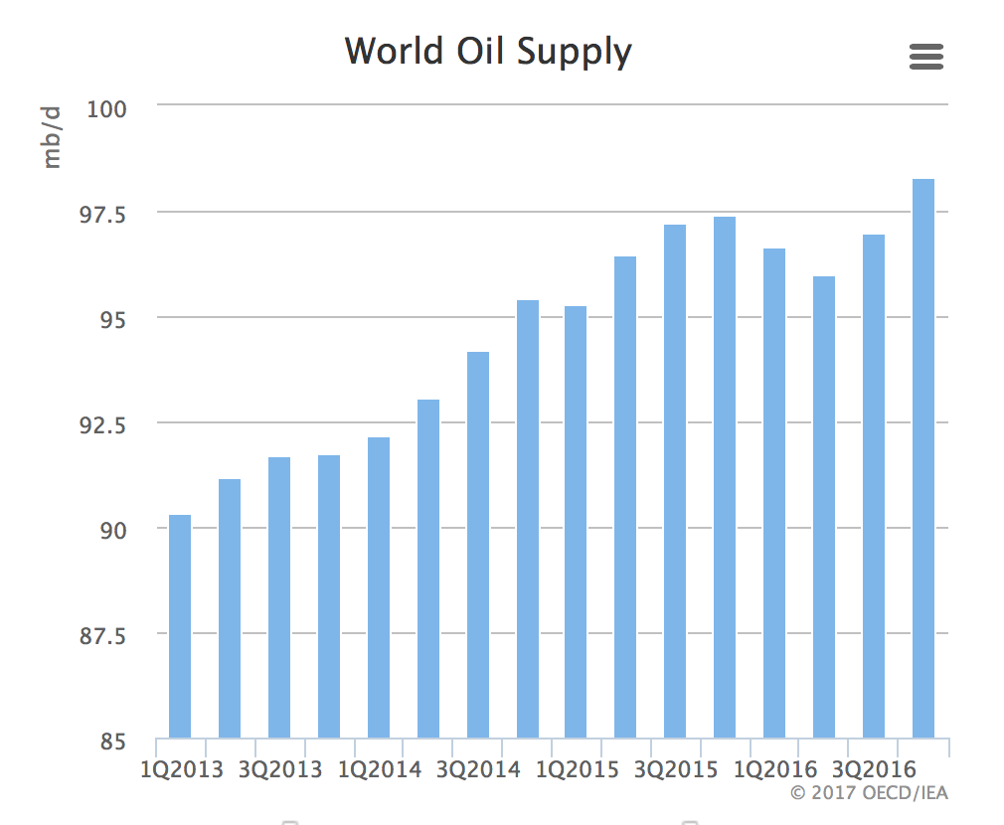
Global Oil Demand & Supply
Notes:
https://www.iea.org/oilmarketreport/omrpublic/
2017 data
General upward trends with demand supply generally following each other.
Having expanded by 1.6 mb/d in 2016, global oil product demand growth is expected to ease back to 1.4 mb/d in 2017. Early indicators of 1Q17 demand support this, with slowdowns seen in January in Japan, Germany, Korea and India.
Global oil supplies rose 260 kb/d in February as OPEC and non-OPEC producers pumped more. At 96.52 mb/d, world oil production stood 170 kb/d below a year ago. OPEC posted a year-on-year decline for the second month running. In 2017 non-OPEC output is set to rise 0.4 mb/d to 58.1 mb/d.

Slide 30
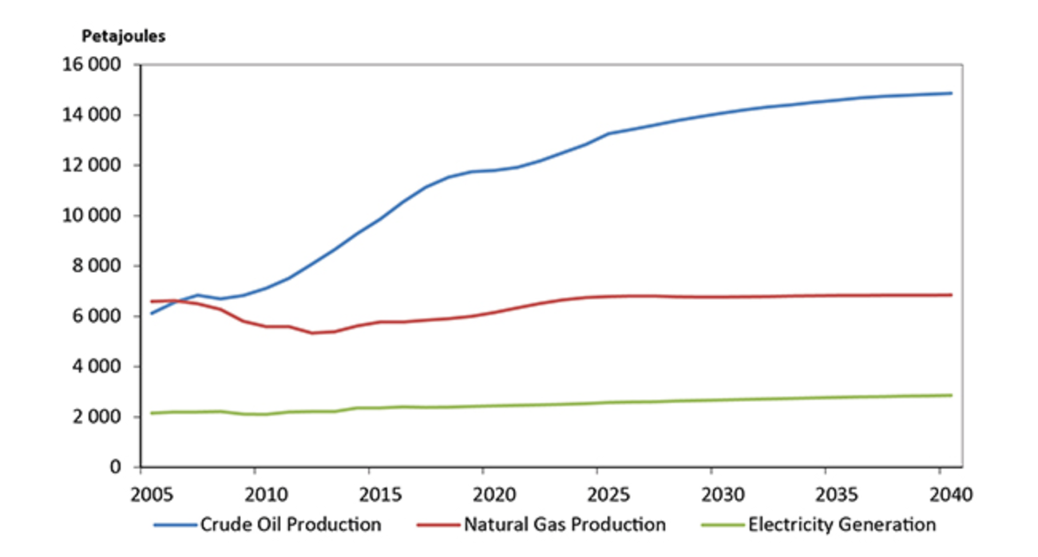
Canadian Oil & Gas Production + Takeaways
Notes:
Takeaway with general increase of oil but natural gas has plateaued.
Oil reserves have decreased from 4.1 billion barrels to 3.9 barrels from 2014 to 2015.
NG reserves have increased from 70.5 trillion cubic feet to 77 trillion cubic feet.
Natural gas exports is an important driver for natural gas production.
Total end-use energy in Canada is increasing less quickly than the past, so exports will be main driver for production.
Energy production grows faster than energy use.
http://www.capp.ca/publications-and-statistics/statistics/basic-statistics
https://www.neb-one.gc.ca/nrg/ntgrtd/ftr/2016/index-eng.html

Slide 31
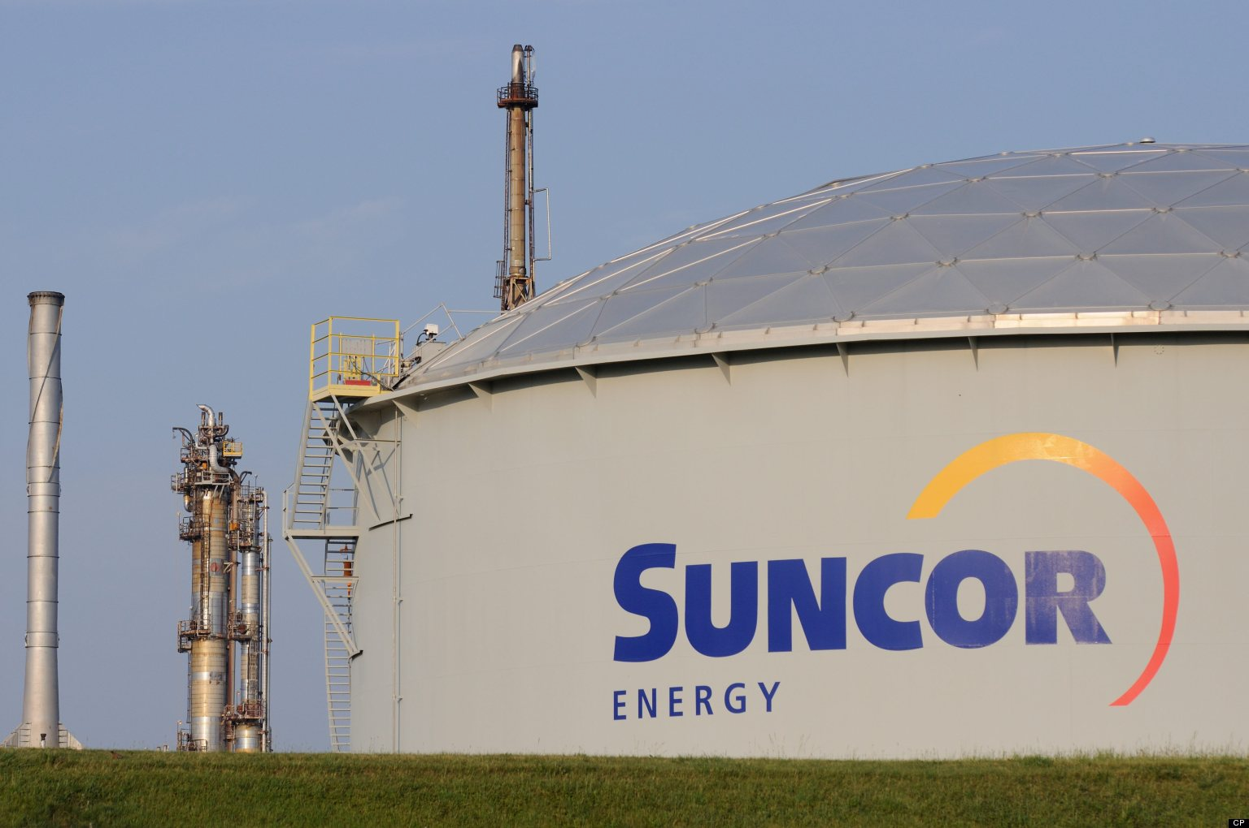

Slide 32
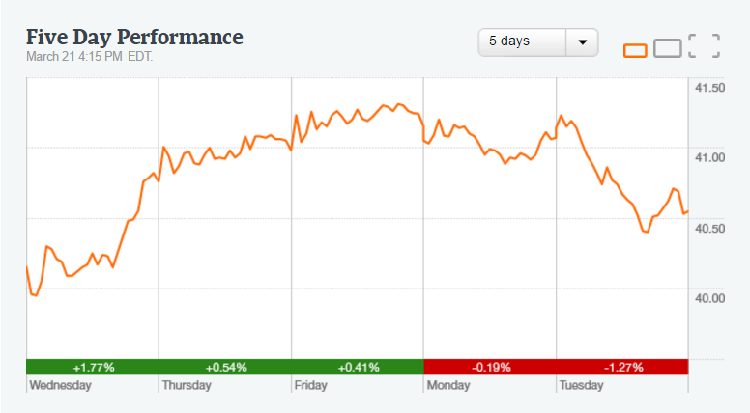
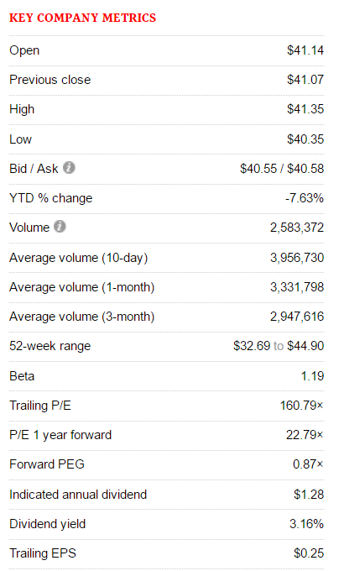

Slide 33

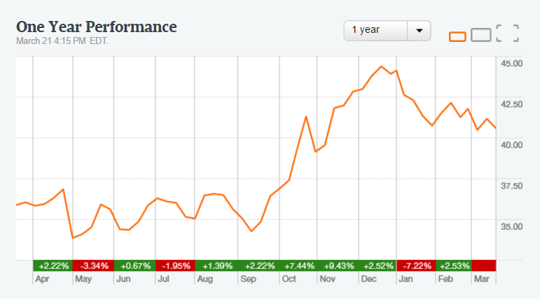
1 year stock performance

Slide 34
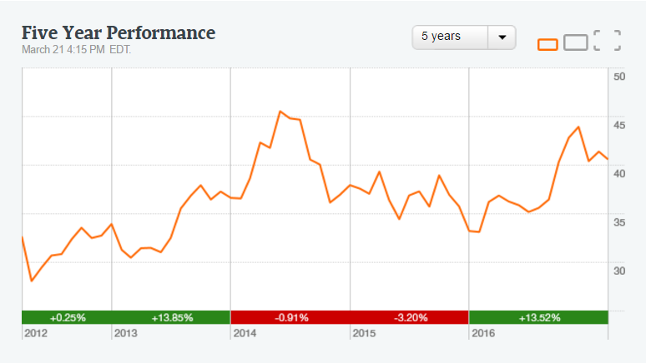
5 year stock performance

Slide 35
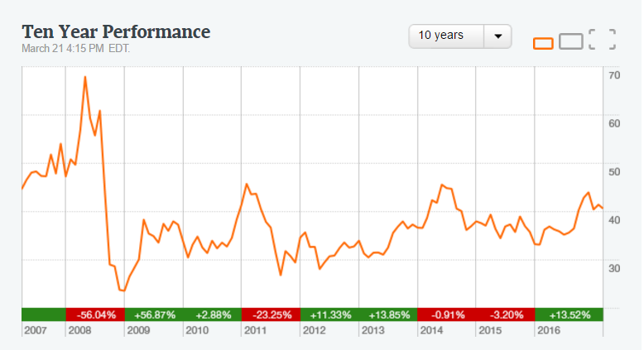
10 year stock performance

Slide 36
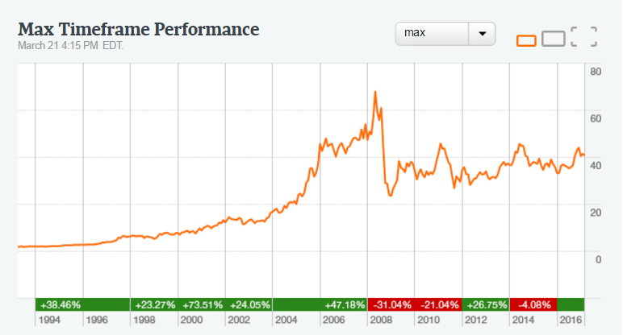
Max Timeframe Performance

Slide 37
Company History
In 1917, Sun Company Inc. opens in Canada supplying lubricating oils, kerosene and spirits to war plants in the Montreal area.
1919 founded in Montreal as Sun Company of Canada
In 1930, The first Sunoco service stations are opened in Toronto, Montreal, and Quebec City.
1950, Sun Company drills first Canadian producing well in New Norway, Alberta. Sun Company begins a three-year core-hole drilling program before acquiring Lease 86 – current site of Suncor's existing oil sands operation.
In 1953, Sun Company incorporates Great Canadian Oil Sands Limited (GCOS) and acquires leases and patents.
In 1967, Construction of the first commercial-scale oil sands processing facility is completed.

Slide 38
Company History
In 1979, Sun formed Suncor by merging its Canadian refining and retailing interests.
In 1983, Hennigar is killed in a plane crash north of Toronto. William R. Loar replaces him.
In 1991, Rick George becomes Suncor’s president and CEO.
In 1992, Suncor completes its initial public offering of stock.
In 1996, With 60 per cent of its assets in Alberta, Suncor moves its head office from Toronto to Calgary.
In 1997, Suncor celebrates the 30th anniversary of its oil sands operation and starts trading on the New York Stock Exchange.

Slide 39
Merge with Petro- Canada
On March 23, 2009, Suncor announced the acquisition of Petro-Canada.
The merger of Suncor and Petro-Canada becomes effective on August 1. It creates Canada’s largest energy company.
The merger increased Suncor’s asset base by $35.8 billion, including goodwill, and long-term debt by $4.4 billion

Slide 40
Business Segment
Oli Sand
Exploration and Production
Refining and Marketing
Corparate, Energy Trading and Eliminating

Slide 41
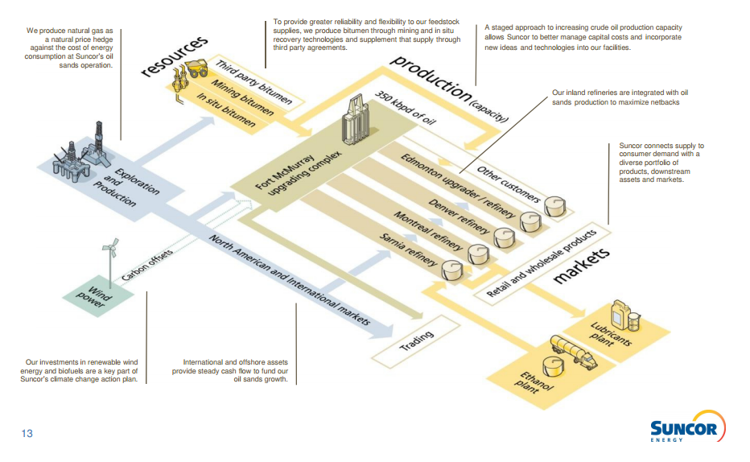

Slide 43
Oli Sands
Oil Sand Operation
  Suncor’s wholly owned and operated mining, extraction, upgrading, in situ and related logistics and storage assets in the Athabasca oil sands region.
Oil Sands Ventures
  Suncor’s 50.8% interest in the Fort Hills mining project
  53.74% working interest in the Syncrude oil sands mining and upgrading joint operation.
  The company’s interest in Syncrude increased from 12% as a result of the acquisition of COS, and the purchase of an additional 5% interest from Murphy during 2016.
  Suncor also holds a 36.75% interest in the idled Joslyn North mining prospect.

Slide 44
Oil Sands operations production was 374,800 bbls/d in 2016.

Slide 45
Exploration and Production
E&P Canada
  Suncor’s 37.675% working interest in Terra Nova.
  Non-operated interests in Hibernia (20% in the base project and 19.132% in the Hibernia Southern Extension Unit (HSEU))
  White Rose (27.5% in the base project and 26.125% in the extensions)
  The Hebron project (21.034%)
  Interests in several exploration licences offshore Newfoundland and Labrador and Nova Scotia
  Suncor’s working interests in unconventional natural gas properties in northeast B.C.

Slide 46
Exploration and Production
E&P International
  U.K. sector of the North Sea: Non-operated interests in Buzzard (29.89%), Golden Eagle Area Development (26.69%), the Rosebank future development project acquired in 2016 (30%)
  Southern part of the Norwegian North Sea : the Oda project (30%).
  Pursuant to Exploration and Production Sharing Agreements (EPSAs)
  Pursuant to a Production Sharing Contract (PSC), an interest in the Ebla gas development in Syria.

Slide 47
Financial Highlight
E&P Canada production increased to 52,900 boe/d from 47,000 boe/d in the prior year,

Slide 48
E&P Canada production averaged 52,900 boe/d in 2016, compared to 47,000 boe/d in 2015.

Slide 49
Refining and Marketing
Refining and Supply operations refine crude oil and intermediate feedstock into a broad range of petroleum and petrochemical products.
Marketing operations sell refined petroleum products to retail, commercial and industrial customers

Slide 51
Corporate, Energy Trading and Eliminating
The company's investments in renewable energy projects, results related to energy marketing, supply and trading activities, and other activities not directly attributable to any other operating segment.

Slide 53
Executive Profile

Slide 54
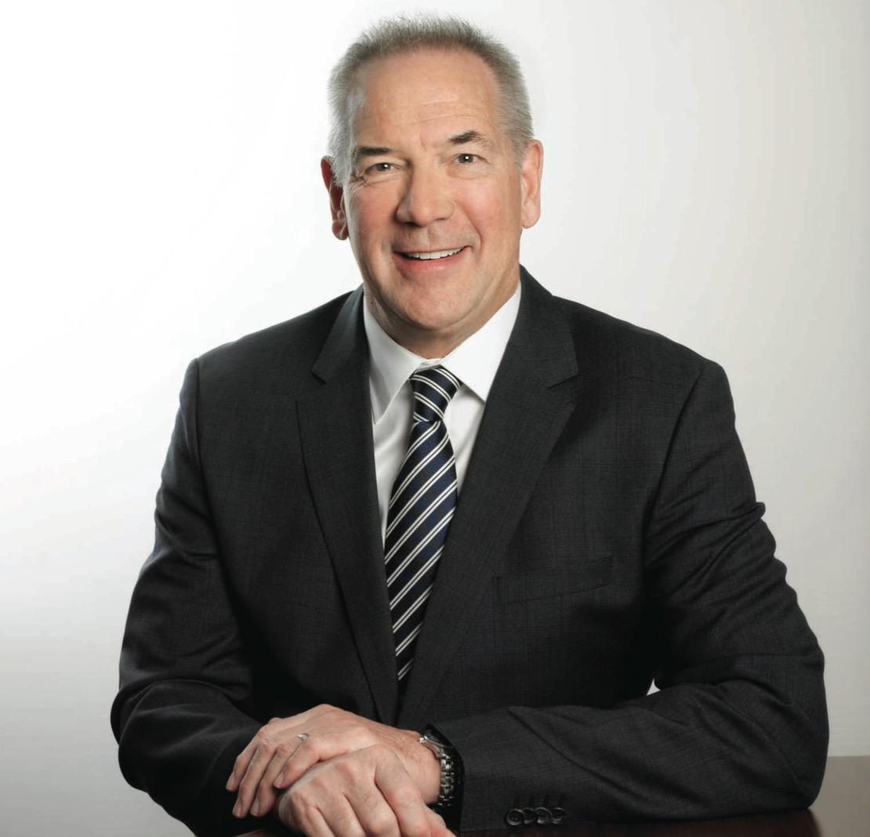
Steve Williams (President and CEO)
- Joined Suncor in May 2002
- B.Sc in chemical engineering at Exter University
- Graduate of the business economics program in Oxford and advanced management program in Harvard Business School
- More than 39 years of international energy industry experience
- Board member of Business Council of Canada
- Member of Institute of Directors
- One of 12 founding CEOs Canada’s Oil Sands Innovation Alliance
- Member of advisory board of Canada’s Ecofiscal Commission
- Vice-chair of Alberta Premier Advisory Committee
- In November 2015, he was chosen as the Canadian CEO of the Year by the Global & Mail

Slide 55
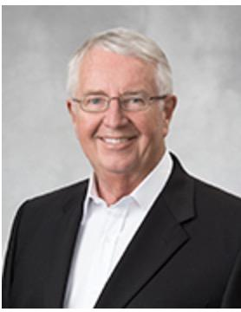
James Simpson (Chair, Board of Directors)
- Was elected in 2004
- Previously a director of Petro Canada
- Past President of Chevron Canada Resource
- B.Sc. and M.Sc. degree and graduated from a senior executive program at M.I.T Sloan School of Business
- Will retire on April 27, 2017

Slide 56
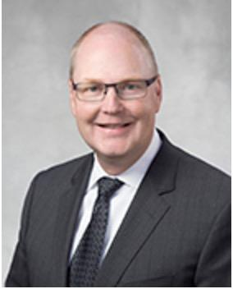
Eric Axford (VP, Business Service)
- Joined Suncor since 1996
- Previously Held senior policy position in Alberta government
- Represent Suncor as board member with CAPP, Energy Council of Canada
- B.A in economics in U of Calgary and M.A in business in U of Alberta
- Responsible for safety, health, environment and communication

Slide 57
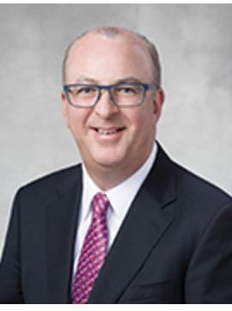
Alister Cowan (VP and CFO)
- Joined Suncor in 2014
- Was a CFO of Husky Energy
- B.A in Accounting and Finance from Heriot-Watt University in Edinburgh
Chartered Accountant

Slide 58
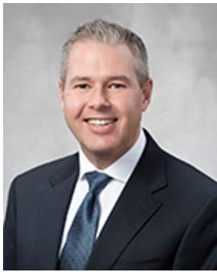
Paul Gardner (Senior VP, Human Resource)
- B.A. in public administration from Carleton University
- M.A. in industrial relations from Queen’s University
- Responsible for ensuring proper HR strategies and programs are in place to support Suncor’s base business, long-term growth strategies

Slide 59
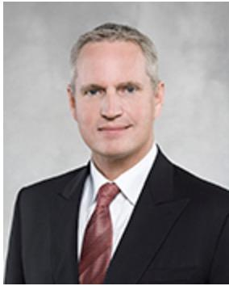
Mark Little (President, Upstream)
- Hold degrees in both computer science and applied petroleum engineering technology
- Leads Suncor's upstream organization including all Suncor’s operated and non-operated oil sands, in situ,conventional exploration and production worldwide and Syncrude Canada

Slide 60
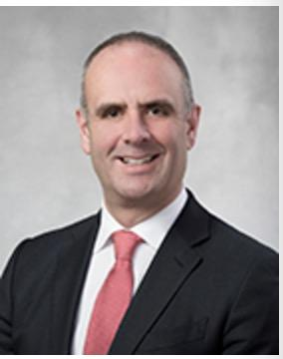
Mike MacSween(VP, Major Projects)
- Joined Suncor in 1996
- B.Sc. in chemical engineering from University of New Brunswick
- M.A of Business Administration of Queen’s University
- Leads engineering, procurement and construction for growth projects

Slide 61
Financial Statements

Slide 62
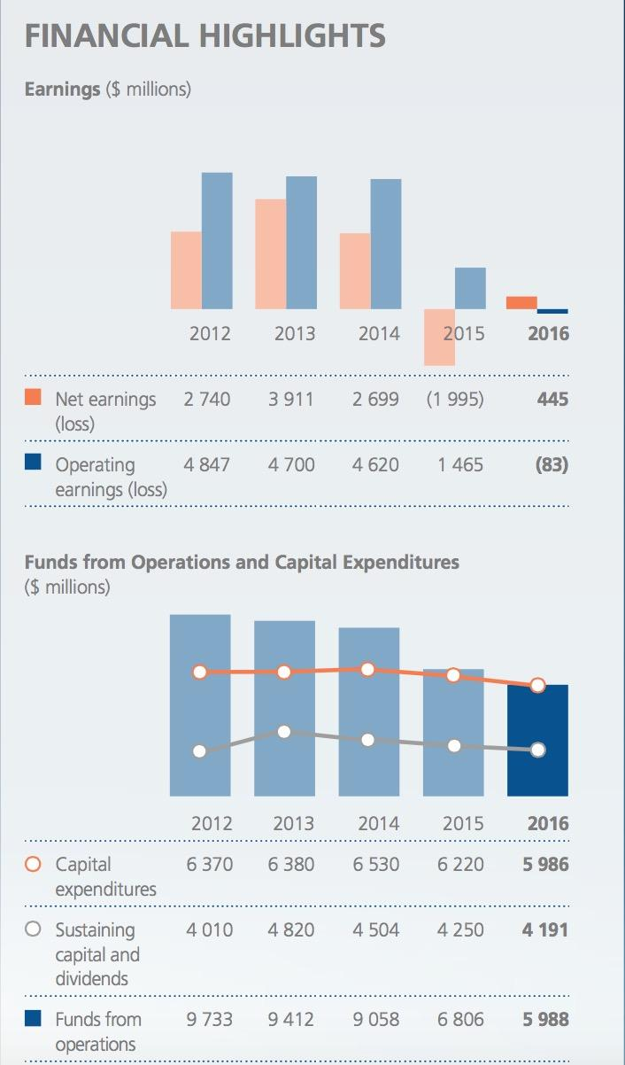
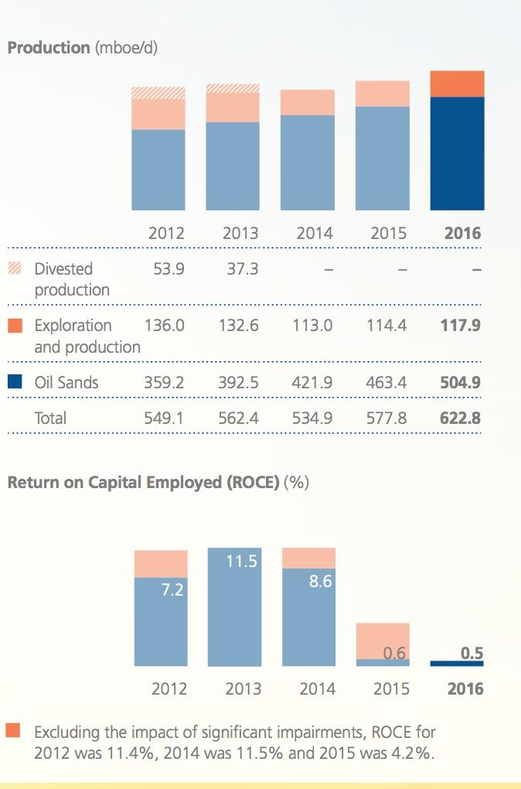

Slide 63
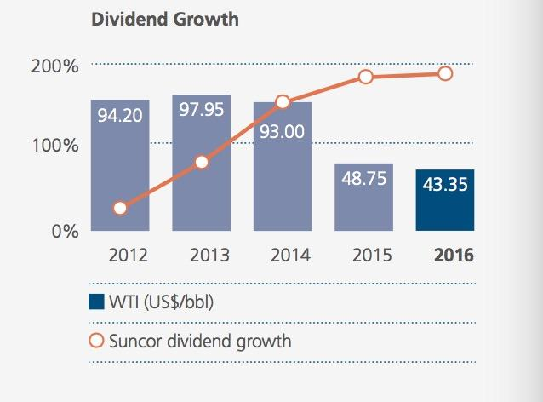

Slide 64
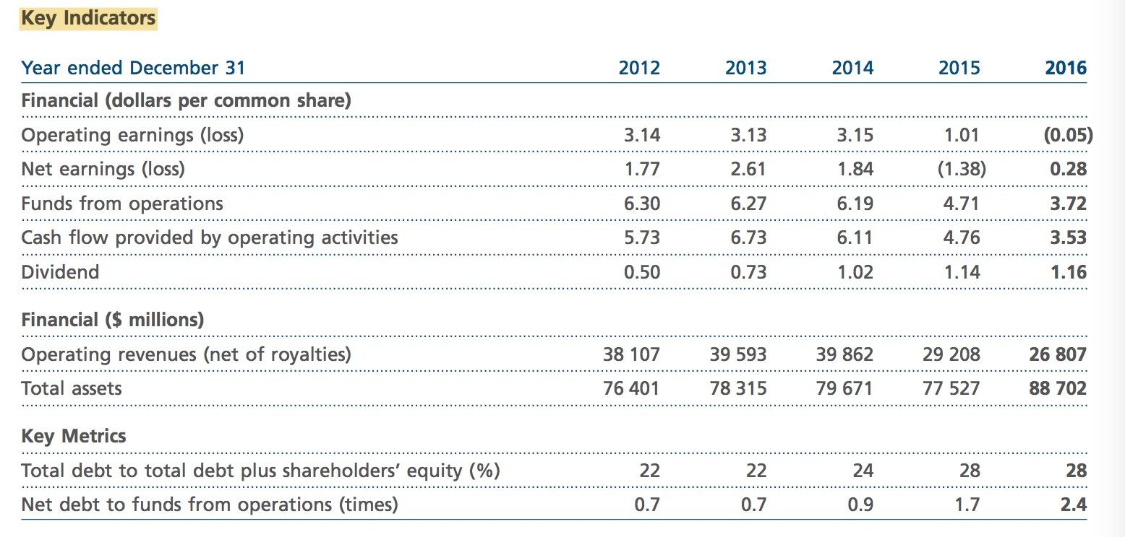

Slide 65
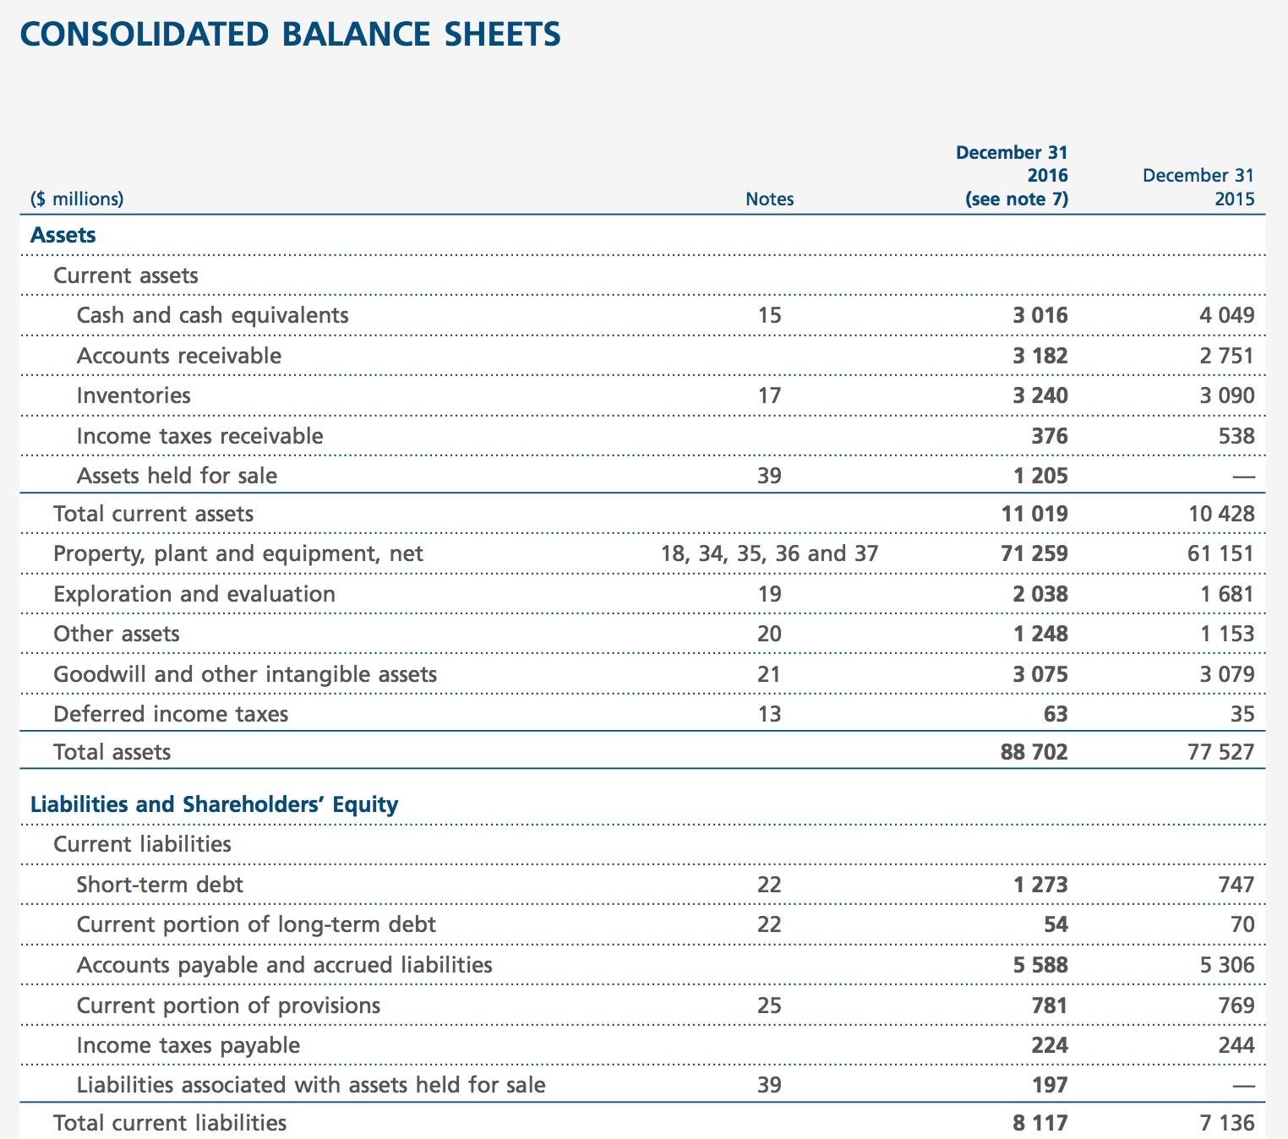

Slide 66
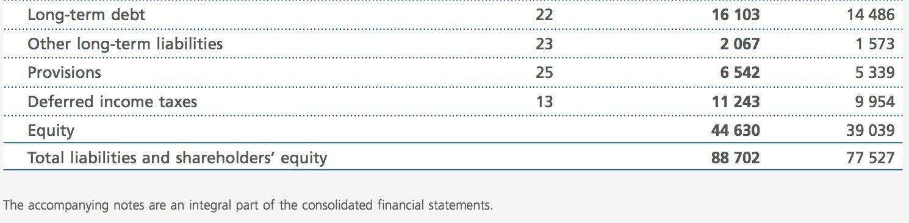

Slide 67
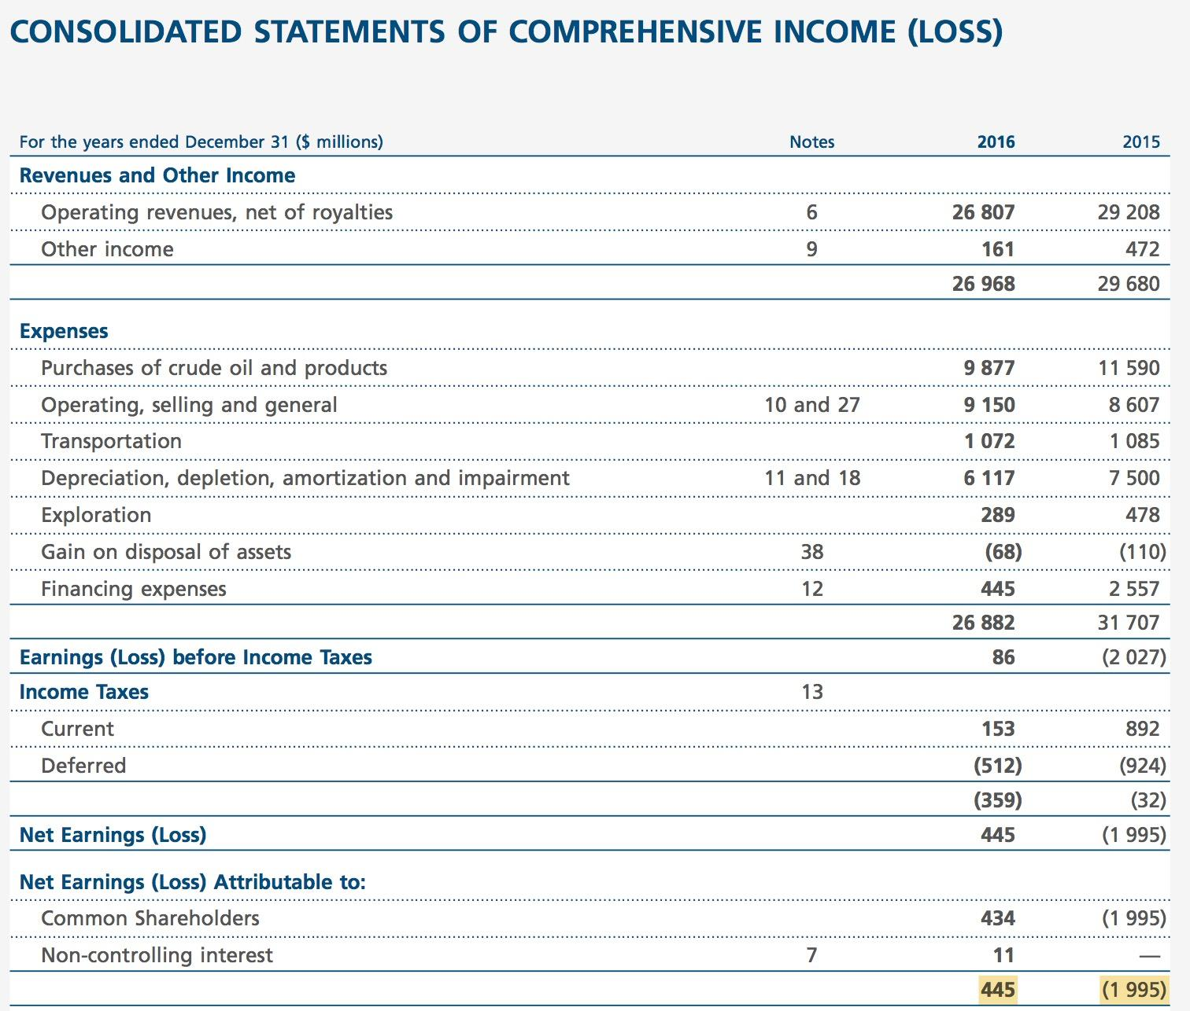

Slide 68
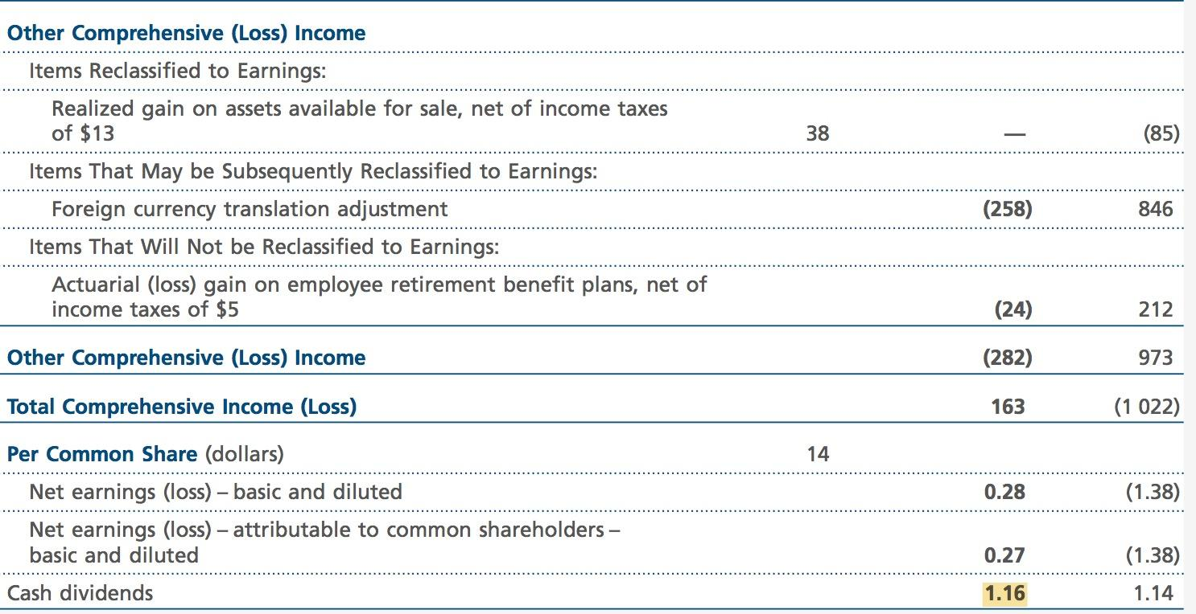

Slide 69
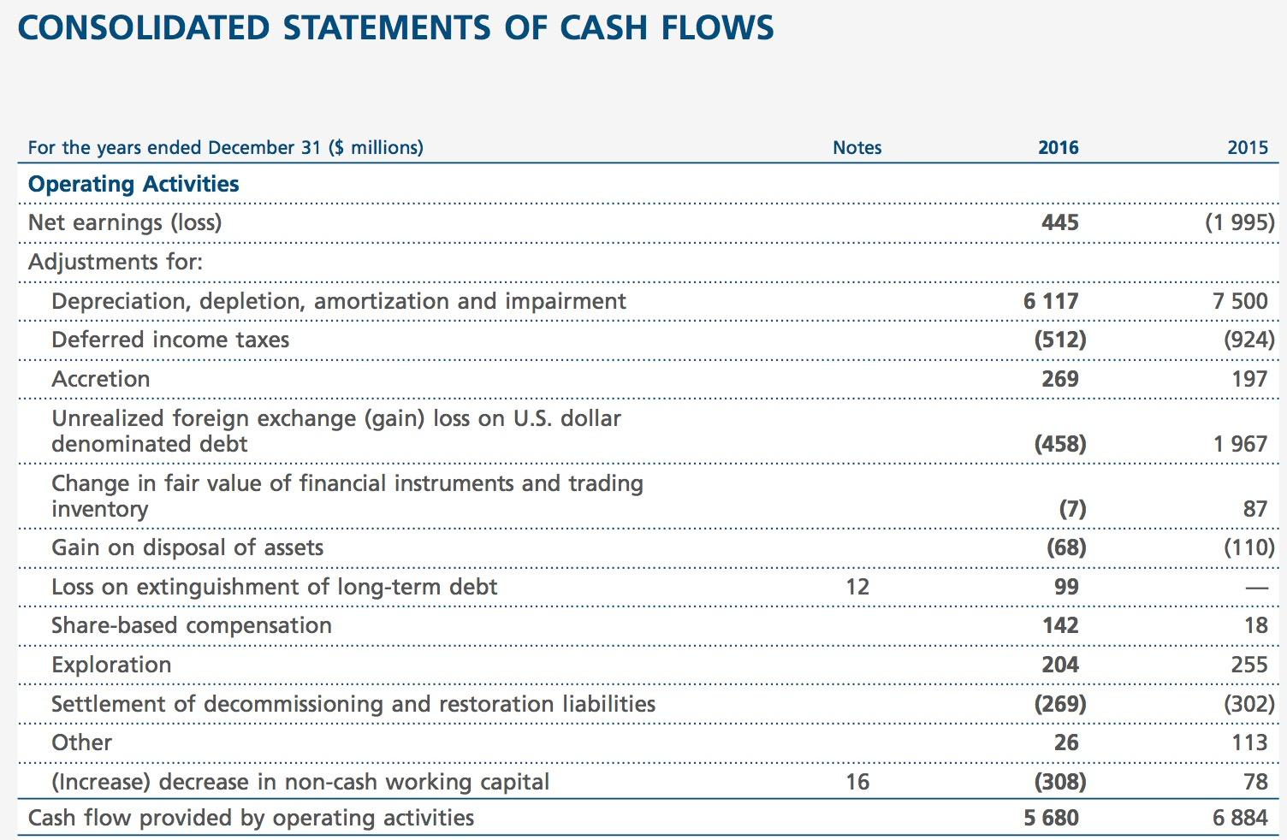

Slide 70
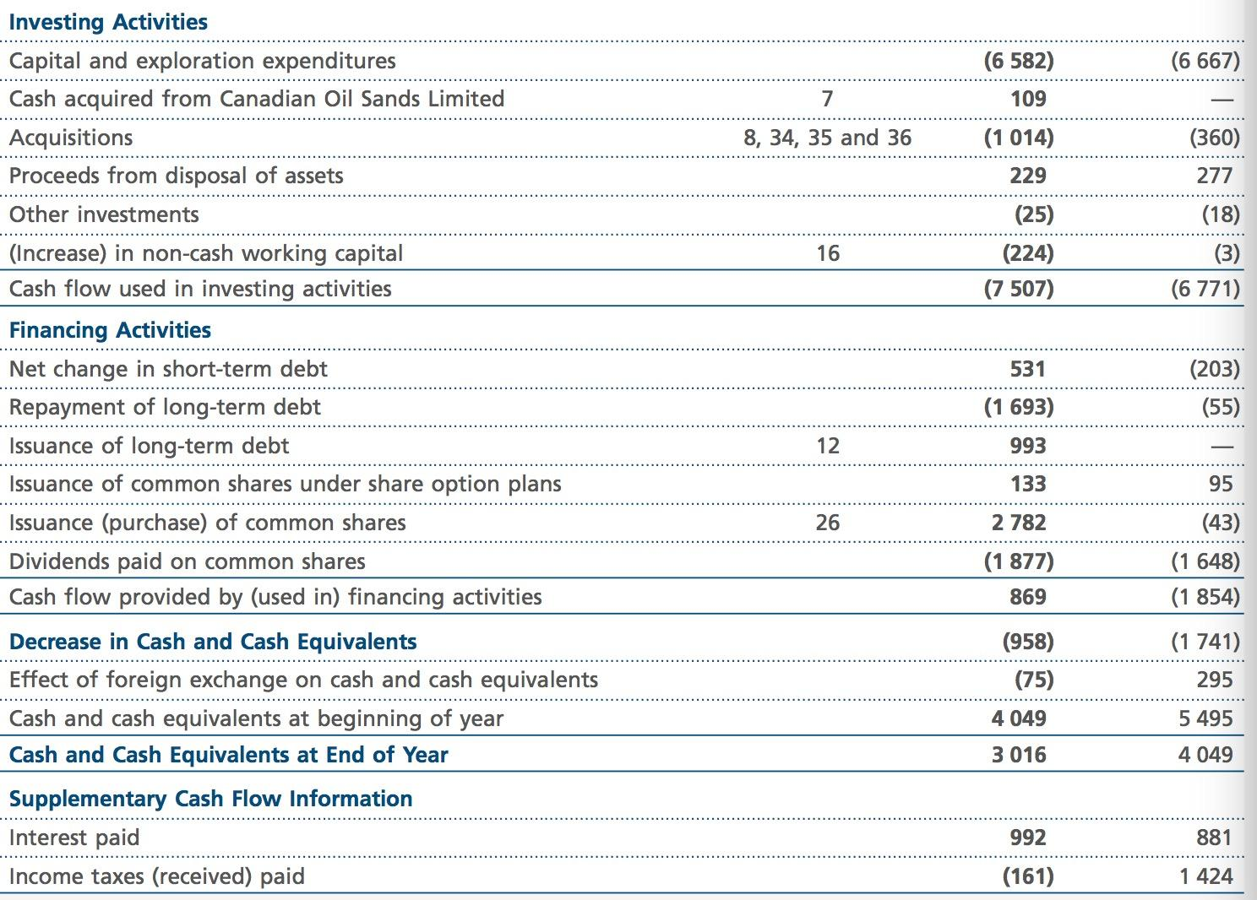

Slide 71
Recommendation
Hold

Slide 72
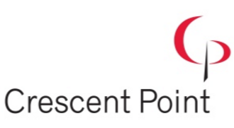
Crescent Point Energy

Slide 73
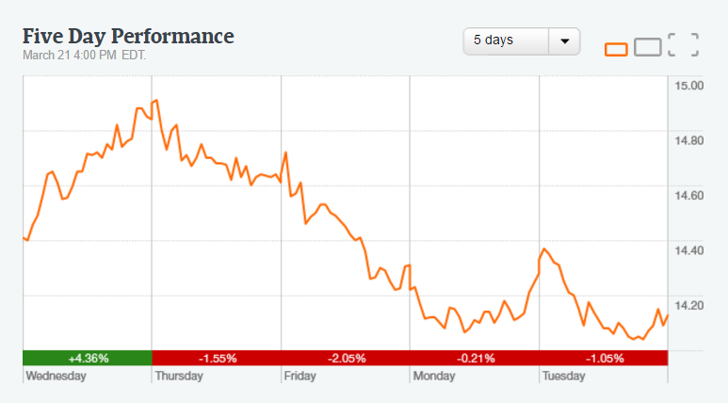
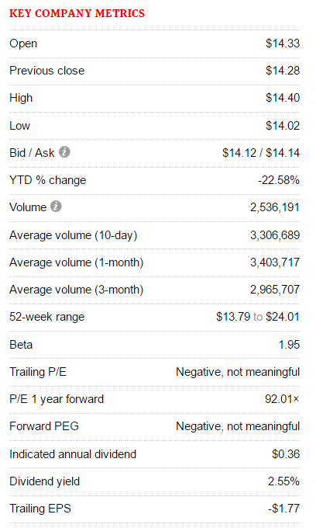

Slide 74

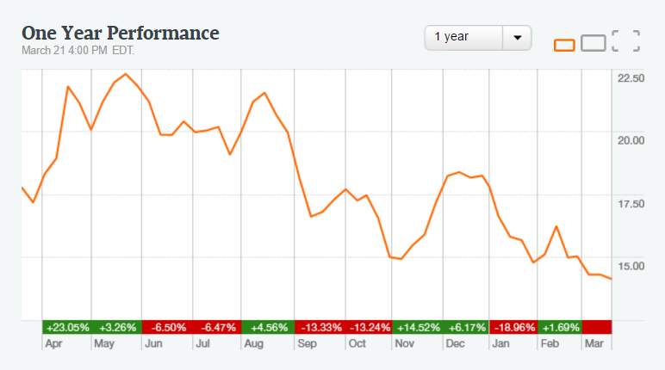
1 Year Moving Average

Slide 75
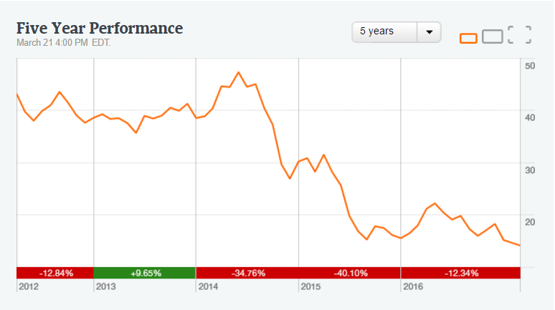
5 Year Moving Average

Slide 76
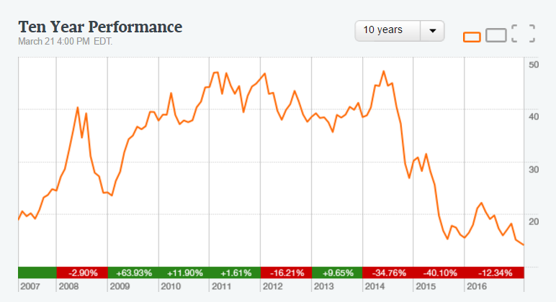
10 Year Moving Average

Slide 77
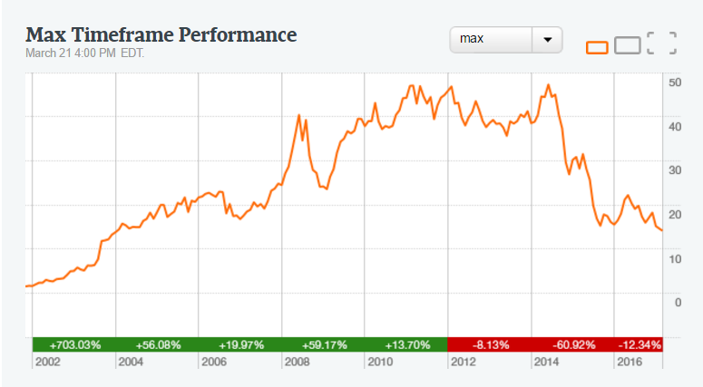
Max

Slide 78
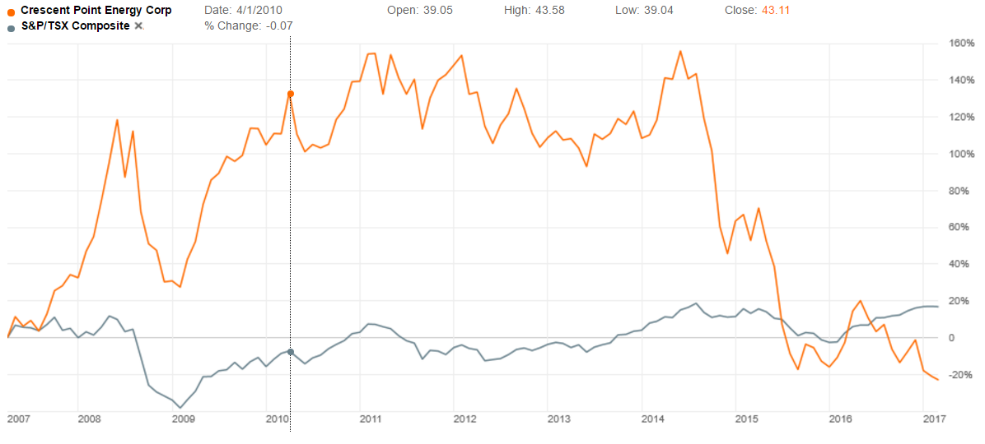
Relative Performance

Slide 79
Overview
Relatively new company (traded on the TSX 2001)
Works primarily in Oil and Gas wells
Based in Alberta, works mostly in Southern Saskatchewan
Expanding slowly into United Stated

Slide 80
History
Founded 2001
2001 - Crescent Point Energy begins to trade on the Toronto Stock Exchange as a junior exploration and production company
2002 - In its first full year, increases average daily production from 275 – 1,974 boe/d. Crescent shares begin trading on the TSX, after graduating from the TSX Venture Exchange
2003 - Converts to a trust after merging with Tappit Resources Ltd. and continues to acquire high-quality assets in western Canada
2004 - Increases proved plus probable reserves by 42 percent, production by 70 percent and cash flow by 91 percent, all while maintaining excellent balance sheet strength
2005 - The Trust increases monthly distributions by 18 percent, from $0.17 to $0.20 per unit, announces a new core area in southwest Saskatchewan and increases production to 12,164 boe/d

Slide 81
History
2006 - Completes more than 10 acquisitions during the year and executes a successful drilling program, increasing average daily production by 70 percent to 20,723 boe/d
2007 - Completes its largest acquisition, $628 million acquisition of Mission Oil & Gas Inc. The acquisition increases the Trust’s asset base to more than 2.5 billion boe OOIP and includes a controlling interest in the Viewfield Bakken resource play
2009 - In July, Crescent Point converts from an income trust to a dividend-paying corporation. Initial dividend is set at $0.23 per share
2010 - Acquisition of Lower Shaunavon assets from Penn West Energy Trust, as well as the corporate acquisitions of Ryland Oil Corp. and Shelter Bay Energy Inc.
2011 – Begin expanded into the US (North Dakota). Open an office in Colarado
2012 - Completes more than $3 billion in acquisitions, consolidating key resource plays and establishing the Uinta Basin as a new core area

Slide 82
History
2014 -On January 22, 2014, Crescent Point shares opened for trading on the New York Stock Exchange
2015 - Increases its high-quality asset base organically and by acquiring Legacy Oil + Gas Inc. and Coral Hill Energy Ltd. Also lowers its cost structure and takes steps to eliminate fresh water usage in Saskatchewan.
2016 - Grows its drilling inventory by approximately 1,000 net locations, supported by its organic new play discovery program in the emerging Flat Lake and Uinta basin resource plays

Slide 83
Health, Safety and Environment
Crescent works with the environment and people around them
Stress the importance of the protection of the environment
Contributed $63.5 million to the environment emission reduction fund
Contributed $47.3 million to reduction of greenhouse gas emissions and to meet/exceed provincial and federal targets
Spent 10.8 million on upgrading facilities in Saskatchewan
Notes:
As part of Crescent Point’s ongoing commitment to reduce greenhouse gas emissions, the Company contributed to a reclamation fund directed to environmental initiatives. To date, $65.3 million has been contributed to the environment emission reduction fund and $47.3 million has been expended to reduce greenhouse gas emissions and to meet and exceed provincial and federal targets. In 2016, the Company spent a total of $10.8 million, primarily on upgrading facilities in Saskatchewan. The upgrades have reduced emissions, which continue to meet or exceed provincial and federal emission regulations

Slide 84

Oil and Gas wells
Crescent works primarily in Oil and Gas wells in Saskatchewan
Expanding into Basin’s in Utah and Montana/North Dakota
Extract both natural gas and oil through the use of pumpjacks

Slide 85

Oil and Gas wells
Wells are borings (giant holes) in the Earth designed to bring oil to the surface
These wells also produce natural gas as well
Crescent works in both gas wells and oil wells

Slide 86

Drilling
Most exploration takes place in Canada (Saskatchewan)

Slide 87

Where does Crescent work?
Crescent works in primarily in Southwest Saskatchewan
They have production going in Williston Basin (borders Montana and North Dakota
Slowly working to produce in Utah (the Uinta Basin)

Slide 88

Production Estimates

Slide 89
Management

Slide 90

Directors - Scott Saxberg
President (since 2001), CEO and an acting director of Crescent
One of the founders of Crescent in 2001
Worked in Oil and Gas since 1992
Held various roles in companies such as Magin Energy Inc., Wascana Energy Inc., and Shelter Bay
Bachelor of Science degree in mechanical engineering from the University of Manitoba

Slide 91

Directors – Peter Bannister
Chairman of the Board and President of Destiny Energy Inc
Been on the Crescent board since 2003
Worked in Oil and Gas since 1982
Held various roles with companies such as Mission Oil and Gas Inc., StarPoint Energy Inc., and many others
Bachelor of Science degree in geology with a minor in economics

Slide 92




Directors
Rene Amirault
Laura A. Cillis
D. Hugh Gillard
Robert F. Heinemann

Slide 93




Directors
Mike Jackson
Barbara Monroe
Gerald A. Romanzin
Gergory G. Turnbull

Slide 94


Officers
Ken Lamont
C. Neil Smith
CFO
Held the role since January 2016
Previously worked as VP, Finance and Treasurer for Crescent Point
Worked in Oil and Gas since 2001
Bachelor of Commerce degree from the University of Alberta and is a CA
COO
Held the role since March 2013
Previously worked as VP, Engineering and Business Development
Worked with Crescent Point since 2003
Worked in Oil and Gas since 1986
Bachelor of Science degree in geological engineering (UBC) and a Master of Business Administration (Dean's List) from the Uni. of Calgary

Slide 95


Officers
Derek Christie
Tamara MacDonald
Senior VP, Exploration and Geosciences
Previously worked as VP, Exploration and Geosciences and VP, Geosciences
Worked with Crescent Point since 2007
Worked in Oil and Gas since 1991
Bachelor of Science degree in Geology from the University of Calgary
Senior VP, Corporate and Business Development
Held the role since January 2016
Previously worked as VP Land and Corporate Development (2004-2016)
Worked in Oil and Gas since 1992
Bachelor of Commerce degree, with a major in Petroleum Land Management, from the University of Calgary

Slide 96


Officers
Brad Borggard
Mark Eade
VP, Corporate Planning and Investor Relations
Held the role since February 2017
Previously worked as VP, Corporate Planning
Worked at Crescent Point since 2010
Bachelor of Commerce degree in finance from the University of Calgary, as well as the CFA designation.
VP, General Counsel and Corporate Secretary
Held the role since September 2015
Worked as corporate secretary since 2004
Bachelor of Commerce degree (with honours) and a LL.B. degree from the University of Saskatchewan

Slide 97


Officers
Ryan Gritzfedlt
Stephen Toews
VP, Marketing and Innovation
Held role since January 2016
Previously worked as VP, Engineering and Business Development East (2010-2015)
Also worked as Engineering Manager, Southeast Saskatchewan (2006-2009)
Bachelor of Applied Science degree in industrial systems engineering from the University of Regina
VP, Engineering and Operations
Held role January 2016
Previously worked as VP, Engineering and Business Development West (2010-2015)
Also worked as Engineering Manager (2005-2009)
Bachelor of Science degree in mechanical engineering from the University of Saskatchewan

Slide 98

Dividends
2009 - Changed from an income trust company to a dividend paying company
Initial dividend set for $.23 per share
Dividend decreased in 2016 compared to 2015, attributed to the reduction in dividends declared to shareholders to $.50 per share (2016) from $2.11 (2015)
Notes:
ividends decreased 74 percent in the year ended December 31, 2016 compared to 2015.
The decrease in dividends relates
primarily to the reduction in the dividends declared to shareholders to $0.50 per share in the year ended December 31, 2016 from
$2.1
1 per share in 2015

Slide 99


Dividends
2017
2016

Slide 100

Income Tax

Slide 101

Taxes
Horizon = Crescent had tax pools of approx. $12 billion (Dec 31/2016) to shelter future taxable income
Crescent Point does not expect to be taxable in the next 5 years
Notes:
Basically, the tax pools are losses they have occurred in the past, they will use these pools in the future if they are ever gonna be taxed. So they use the losses in the future so they don’t gotta pay tax

Slide 102

Property, Plant and Equipment

Slide 103
Goodwill
December 31, 2015, Crescent has goodwill of $251.9 million (according to Year End 2015 Balance Sheet)
December 31, 2016, Crescent has goodwill of $251.9 million (according to Year End 2016 Balance Sheet)
The goodwill balance is attributed to the corporate acquisitions from 2003-2012
Acquisitions include Ryland Oil (2010), Wil Stream Exploration (2012), Reliable Energy (2012), and Cutpick Energy (2012)
Notes:
The impairment test of goodwill at December 31, 2016 and December 31, 2015, determined based on fair value less costs of disposal, concluded that the estimated recoverable amount exceeded the carrying amount. As such, no goodwill impairment existed

Slide 104

Outlook for 2017
Expecting a 10% increase in production
Expecting more production in Uinta Basin and Williston Basin

Slide 105

Outlook for 2017
Notes:
Exit production (how much theyre gonna produce)
Q4 = how much debt they have compared to how much cash they are bringing in (2x more debt)

Slide 106
Financial Statements

Slide 107

Summary of Quarterly Results

Slide 108

Balance Sheet Year End 2016 (Assets)

Slide 109

Balance Sheet Year End 2016 (Liabilities + SE)

Slide 110

Income Statement Year End 2016

Slide 111

Shareholders Equity Year End 2016

Slide 112

Cash Flow Statement Year End 2016

Slide 113
Recommendation
Crescent is relatively cheap ($14.22)
Expanding into the US, working hard to produce in the Uinta Basin
Production is expected to increase in 2017
Oil prices have been shaky as of late (speculation of a “price war”)
OPEC and US shale fight, prices have been lowest since the OPEC cut deal last November
Crescent may have the financial flexibility to survive a dip in price

Slide 114
HOLD

Slide 115



Slide 116



Slide 117


1 year stock price

Slide 118

5 year stock price

Slide 119

10 years stock price

Slide 120

Max

Slide 121

1 year stock price vs. S&P TSX

Slide 122

10 years stock price vs. S&P TSX

Slide 123
Timeline (con’t)
1880
1985
Valves at Imperial‘s oil sands recovery operation in Cold Lake, Alta., where bitumen is produced from underground reservoirs.
Made Canada’s first Arctic oil discovery at Atkinson Point, N.W.T., 145 kilometres east of the mouth of the Mackenzie River
1970
1920
1947
16 refiners in southwestern Ontario were created The Imperial Oil Company, Limited.
Discovered oil in Norman Wells, N.W.T., on the Mackenzie River
Discovery of oil at Leduc marked the beginning of Western Canada's great oil development
Notes:
The story began in 1880, when 16 refiners in southwestern Ontario created The Imperial Oil Company, Limited.
In 1920, Norman Wells, N.W.T., on the Mackenzie River, where Imperial discovered oil in 1920.
In 1947, lmperial's discovery of oil at Leduc on February 13, 1947, marked the beginning of Western Canada's great oil development.
In 1970, Imperial’s oil rig at Atkinson Point, N.W.T., 145 kilometres east of the mouth of the Mackenzie River, where the company made Canada’s first Arctic oil discovery.
In 1985, Valves at Imperial‘s oil sands recovery operation in Cold Lake, Alta., where bitumen is produced from underground reservoirs. Commercial production at Cold Lake began in 1985 and now exceeds 140,000 barrels a day.

Slide 124
Timeline
1992
Funded a new mining development in Fort McMurray, Alta - Kearl oil sands project
2009
1999
2000
Large-scale equipment helps to mine the bitumen saturated sands at the Syncrude oil sands operation near Fort McMurray, Alta
Canada's ﬁrst offshore natural gas operation, the Sable offshore energy project, in Halifax, N.S.
An industry leader in recovering gas that would otherwise be burnt off or released to the atmosphere.
Notes:
In 1992, large-scale equipment helps to mine the bitumen saturated sands at the Syncrude oil sands operation near Fort McMurray, Alta. Imperial holds a 25 percent share in Syncrude.
In 1999, Canada's ﬁrst offshore natural gas operation, the Sable offshore energy project, goes into production in December 1999. Imperial has a nine-percent working interest in the venture that is located in relatively shallow water, about 250 kilometres southeast of Halifax, N.S.
In 2000, Imperial discovered modern technology at Norman Wells, which helps to recover gas produced with oil, reducing the need for flaring. Imperial is an industry leader in recovering gas that would otherwise be burnt off or released to the atmosphere.
In 2009, Imperial announces its decision to fund the first phase of the Kearl oil sands project, a new mining development northeast of Fort McMurray, Alta.
Today, Imperial operates from coast to coast and are best known for the familiar brand names: Esso and Mobil. It makes the products that drive modern transportation, power cities, lubricate industries and provide petrochemical building blocks for thousands of consumer goods.

Slide 125
Background Overview
Founded in 1880, when 16 refiners in southwestern Ontario created The Imperial Oil Company, Limited
  operates as Esso and Mobil brand name
Headquartered in Calgary, Canada
Canada's largest refiner and leading marketer of petroleum products
Three segments:
  Natural resources: Oil Sands, Natural Gas
  Petroleum
  Chemical
Notes:
Founded in 1880
Goal: do business in an economically, environmentally and socially responsible manner while delivering superior LT value
Canada's largest refiner and leading marketer of petroleum products such as fuels, lubricants, asphalts and specialty products.
Retail brands- Esso Mobil
LT commitment to research and technology – scientists at Calgary and Sarnia facilities conduct research and partner with academic experts and scientists at ExxonMobil

Slide 126

Background Overview
  69.9% hold by Exxon Mobil Corporation
  Imperial Oil and Exxon Mobil have agreed to operate their Western Canada production together as of April 1, 2005
  Traded in ASEX, TSE
  Symbol: IMO-T, IMO-A
Market cap : 34.73B (March 2017)
Share price: $40.97 (March 2017)

Slide 127
Strategy
Clarify, Simple and Focus
Deliver reliable and efficient product
Invest in R&D for long term future opportunities
Cost effective and efficient production
Environmental and social responsible

Slide 128
Strengths
Innovation and oil sands research
Opportunities
Future oil sands projects
Weaknesses
Earning sensitive to oil price
Low profit margin
Threats & Risks
High competitive
Environmental regulations
Notes:
Canada is one of the high-cost places in the world to find and produce oil and gas
Deep gas, natural gas from coal and developments offshore, in the oil sands and the North are large, complex and expensive and have long lead times before they turn a profit
Future oil sands projects at Aspen, Corner, Clyden and CL Grand Rapids
Research:
Liquid Addition to Steam for Enhancing Recovery (LASER) 2005
LASER involves adding a volume of light hydrocarbon liquids (a diluent) to injected steam. Adding solvent to the steam increases the amount of oil that can be produced per unit of injected steam, thereby reducing both water and GHG intensity per barrel of bitumen produced. (Cold Lake operations)
Solvent-Assisted Steam-Assisted Gravity Drainage (SA-SAGD)
heating the reservoir by continuous steam injection just like in SAGD, but enhanced by the addition of solvent. SA-SAGD is expected to increase bitumen production rates from each operating well pair and improve the steam-to-oil ratio, a measure of thermal efficiency.
Supporting oil sands research
Our new Calgary Research Centre is under construction and the oil sands research team will move from its current location at the University of Calgary to the state-of-the-art facility by early 2017, further enabling improvements and innovations for the industry.
Tighter environmental and security regulations
Kyoto Protocol

Slide 129
Business segments
Three business segments:
  Natural Resources (Upstream)
  Petroleum Products (Downstream)
  Chemicals
Notes:
The natural resource operation includes the exploration for and production of crude oil and natural gas.
The petroleum products operations consist of transporting, refining, blending, and the marketing of crude oil and refining products.
The chemical operations consist of the manufacturing and marketing of various petrochemicals.

Slide 130

Natural Resources
Conventional oil and gas
  Nine conventional oil and gas sites
  The Mackenzie gas project
Oil sands operation
  Cold Lake
  Kearl
  Syncrude
Notes:
Imperial has nine conventional oil and gas sites mainly in the Northwest Territories and Alberta. in 2004, Imperial carried out the Mackenzie gas project with other companies to further produce conventional oil and gas. And, there are three main projects that help Imperial sustain oil and gas production for oil sands operation: Cold lake, Syncrude and drilling lease at Kearl.

Slide 131


Slide 132

Cold Lake Oil Sands Operation

Slide 133

  Wholly owned oil sands operation since 1960’s
  North America’s largest in-situ operation, with production averaging about 150,000 barrels of bitumen per day
  Operates five plants in the area – Leming, Maskwa, Mahihkan, Mahkeses and Nabiye
  Further expansions project on Cold Lake
Notes:
Cold lake is Imperial’s wholly owned oil sands operation and has produced over 750 MB since 1960’s.
Cold Lake is North America’s largest in-situ operation, with production averaging about 150,000 barrels of bitumen per day in recent years.
The operation is the longest-running in-situ operation in Canada and the first to implement Imperial’s patented cyclic steam- stimulation recovery technology.
Cold Lake produced its billionth barrel of bitumen in 2009, the only in-situ operation in Canada to achieve this milestone.
Technology developments have increased bitumen recovery rates from about 20 percent in the mid- 1990s to more than 50 percent today. Over the same period, new technologies in water treatment and re-use have enabled Cold Lake operations to reduce fresh water requirements by more than 60 percent for every barrel of bitumen produced, and today more than 95 percent of Cold Lake’s water is recycled.
Our leases at Cold Lake cover about 780 square kilometres of oil sands and we operate five plants in the area – Leming, Maskwa, Mahihkan, Mahkeses and Nabiye.

Slide 134

Notes:
The operation is the longest-running in-situ operation in Canada and the first to implement Imperial’s patented cyclic steam- stimulation recovery technology.

Slide 135

In-situ Technology: Cyclic Steam Stimulation (CSS)

Slide 136

The Cold Lake Expansion
  located within the existing Cold Lake Lease Area
  Utilize solvent-assisted steam-assisted gravity drainage (SA-SAGD) to recover the bitumen
  Is expected to produce of about 50,000 barrels of bitumen per day
  Has an expected lifespan of up to 30 years.
Notes:
Building on the success of our Cold Lake operations, Imperial is proposing to develop an expansion that
will utilize solvent-assisted steam-assisted gravity
drainage (SA-SAGD) to recover the bitumen. The
proposed development, named the Cold Lake expansion project, will be located within the existing Cold Lake Lease Area
The Cold Lake expansion project is expected to have
eventual average annual production of about 50,000
barrels of bitumen per day. Based on the resource
characteristics and proposed recovery method, the
Cold Lake expansion project has an expected lifespan
of up to 30 years.
Another long-life, high-quality mining resource for Imperial is Syncrude, with a 25-percent ownership in this join venture. It produces 60,000 barrels a day for Imperial. You can find the list of co-venturers on the left graph while the right one shows the potential growth in synthetic oil produced by Syncrude.
The last cash cow for Imperial to make profit from oil sands is the drilling lease at Kearl. In 2004, Imperial established a mining project at North East of Fort McMurray, in Alberta, with 70% capital shares and the remaining 30% belongs to ExxonMobil Canada. The estimated cost for Kearl is between $4.5 and $6.5 billion, but this project would support production of 300,000 barrels a day for over 40 years.

Slide 137
Kearl Oil Sand
- One of Canada’s highest quality oil sands deposits and represents the next generation of oil sands mining
- Has an estimated 4.6 billion barrels of recoverable bitumen resource
- Located in north of Fort McMurray, AB
- Joint-venture with Exxon Mobil
Notes:
Kearl is one of Canada’s highest quality oil sands deposits and represents the next generation of oil sands mining. Technology innovation is at the heart of Kearl. We’ve developed new approaches that enhance environmental performance and reduce cost. For example, our use of Paraffinic Froth Treatment technology and the integration of energy-saving cogeneration means Kearl is able to produce blended bitumen with about the same life-cycle greenhouse gas emissions as many other crude oils refined in the United States. (Access the November 2012 IHS CERA report)
Kearl has an estimated 4.6 billion barrels of recoverable bitumen resource, which will help meet North America’s energy needs for the next 40 years. Production at Kearl’s initial development began in April 2013 while the start-up of the Kearl expansion in mid-2015 brought production capacity to 220,000 bpd.
Located 70 kilometres (43.5 miles) north of Fort McMurray, AB, Kearl is jointly owned by Imperial (71 percent) and ExxonMobil Canada (29 percent).

Slide 138

In-situ Production
SAGD: Steam Assisted Gravity Drainage
  Because of the rising prices of natural gas, crude producers are moving towards using bitumen or high sulphur fuels to generate steam
  80% of bitumen extraction relies on this method
Notes:
As depicted below, SAGD technology requires the horizontal drilling of two parallel wells through the oil-bearing formation. Steam generated from natural gas or other fuels is injected into the upper well creating a high-temperature chamber that serves to heat and loosen the thick crude oil; the heated thinner oil is then pumped to the surface via the second horizontal well.
In-situ production methods are used on bitumen deposits buried too deep for mining to be economical. These techniques include steam injection, solvent injection and firefloods in which oxygen is injected and part of the resource burned to provide heat.
In Situ
Includes various methods used to recover deeply buried bitumen deposits, including steam injection, solvent injection and firefloods
380,000 barrels per day → 700,000 barrels per day in 2010
More than 80% of the Oil Sands reserve require this method

Slide 139

In-situ Technology: Steam Assisted Gravity Drainage (SAGD)

Slide 140

Crude Oil - Syncrude
World's largest mineable oil sands operation.
Syncrude is the single largest crude oil producer in Canada
Imperial owns 25 percent of Syncrude Canada

Slide 141

Ownership of Syncrude

Slide 142
Syncrude
Mining and upgrading (crude oil) operation in the Athabasca oil-sands region near Fort McMurray
A major expansion underway at Syncrude is expected to increase Imperial's share of Syncrude production to 90,000 barrels a day by mid decade, and further expansion planned for 2010 and beyond could increase Imperial's share of production from Syncrude to as much as 140,000 barrels a day
Notes:
Imperial owns 25 percent of Syncrude Canada - a pioneer in oil sands mining. With high value production and improvement actions ongoing, Syncrude is a strategic asset in our company's portfolio.
Syncrude is a joint venture established to recover shallow deposits of oil sands using open-pit mining methods to extract bitumen and upgrade it to produce a high-quality, light (32 degree API), sweet, synthetic crude oil. Syncrude leases cover about 63,000 net acres.
Imperial's share of production in recent years has averaged about 60,000 - 70,000 bpd before royalties.

Slide 143



Mackenzie gas project
Onshore natural gas resource to North American markets
In the Mackenzie Valley of Canada's Northwest Territories
Total project investment is estimated at $7 billion
Co-venture with
Notes:
The Mackenzie Gas Project is a proposed 1220-kilometre natural gas pipeline system along the Mackenzie Valley of Canada's Northwest Territories to connect northern onshore gas fields with North American markets. The goal is to have natural gas moving through the pipeline by 2010. Imperial co-ventured with ConocoPhillips, Shell Canada, ExxonMobil Canada and the Aboriginal Pipeline Group. Total project investment is estimated at $7 billion.
Mackenzie Gas Project
This project would create the infrastructure to bring an estimated six trillion cubic feet (tcf) of onshore natural gas resource from the Northwest Territories to North American markets.
Imperial, as operator and on behalf of the Mackenzie gas project joint-venture participants, has applied to the regulator for a seven-year extension of the project’s regulatory approval, to 2022 from 2015. The regulator has advised that it will take additional time to consider the request and, as a result, has temporarily extended the terms to September 2016.

Slide 144

Opportunities

Slide 145

Petroleum Products & Services

Slide 146

Petroleum Products
Three refineries: Sarnia, Strathcona, and Nanticoke
Nation-wide distribution system with 30 primary terminals
Notes:
Except for the Sarnia refinery that processes Canadian crude oil, the other three process both foreign and Canadian crude oil. The Sarnia and Strathcona refineries also produce and package lubricant and specialty products. The company also purchases domestic crude oil at freely negotiated prices from a number of sources, under 30-day contracts. The foreign crude oil is purchased at competitive prices through Exxon Mobil. The company has spent $340 million of capital expenditures for its refineries in 2005 in order to increase efficiency and yield.
Imperial oil has a nation-wide distribution system with 30 primary terminals to move products from refineries to market by pipeline, tanker, rail, and road transport.

Slide 147


Slide 148


Slide 149



Petroleum Products
Asphalt
Base Stocks & Specialties
  Wax
  White oil
Lubricants
Chemicals
Notes:
We are one of the largest global suppliers of base stocks, wax, white oil and asphalt.
Asphalt
Base Stocks & Specialties Base stocks are used in the manufacture of finished lubricants and in other unique process oil applications.

Slide 150
Chemicals Segment
one of the largest chemical manufacturers and marketers based in Canada.
The largest market share in domestic solvents in Canada
The largest market share in North America for polyethylene used in rotational molding
  Chemical products: polyethylene and benzene
Notes:
Imperial has the largest market share in domestic solvents in Canada. It is also the largest market share in North America for polyethylene used in rotational molding. Among the various chemicals that Imperial produce, the main two products are polyethylene and benzene.
Petrochemicals are important ingredients in many everyday products like polyethylene resins, adhesives, sealants, paints, crop protection, and household and automotive products. They are also used in refining and industrial processes from metalworking to pharmaceutical manufacturing.
Chemical intermediates
Hydrocarbon and oxygenated fluids
Plasticizers
Polyethylene resins

Slide 151
Chemicals Segment Map

Slide 152

Esso Retail Stations
The largest producer and marketer of petroleum products in Canada
2005 A network of 1,978 Esso service stations across Canada three refineries in Canada
Distributed and marketed through over
  650 Esso convenience stores,
  400 sites with car washing facilities
  100 commercial facilities, and
  3 urban home heating operations
Notes:
Imperial is the largest producer and marketer of petroleum products in Canada. The petroleum market of Imperial can be traced back to 1916. Today, Imperial owns a network of 1978 ESSO service stations and four refineries across Canada.
Distribute through its ESSO stations (787)
650 convenience stores (ON THE RUN)

Slide 153

Management
Rich Kruger: Chairman, president and chief executive officer
In 1981, Mr. Kruger started his career with Exxon in Houston, Texas, and held various technical, supervisory, and management positions
In 1996, he became technical manager for Exxon's engineering activities in the former Soviet Union and in 1999 was appointed vice president, Africa Deep water, ExxonMobil Development Company
In 2008, he was appointed president of ExxonMobil Production Company and elected a vice president of Exxon Mobil Corporation
Education : Mechanical engineering degree from the University of Minnesota and a master's degree in business administration from the University of Houston
Notes:
Rich Kruger: Chairman, president and CEO effective March 1, 2013
Experiences:
In 1981, Mr. Kruger started his career with Exxon in Houston, Texas, and held various technical, supervisory, and management positions
In 1996, he became technical manager for Exxon's engineering activities in the former Soviet Union and in 1999 was appointed vice president, Africa Deepwater, ExxonMobil Development Company.
In 008, he was appointed president of ExxonMobil Production Company and elected a vice president of Exxon Mobil Corporation.
Degree: Mechanical engineeringdegree from the University of Minnesota and a master's degree in businessadministration from the University of Houston.

Slide 154

Management
John Whelan : Senior vice-president, upstream
Mr. Whelan started his career with Mobil Oil Canada in 1988 as a subsurface engineer in Drayton Valley, Alberta
In 2004, he assumed a role at ExxonMobil Production Company's headquarters in Houston, Texas as a planning and business analyst and became operations technical manager with ExxonMobil's US production affiliate in 2006
Mr. Whelan returned to Houston to assume ExxonMobil Production Company's planning and commercial manager role until joining Imperial in 2013
Education : a Bachelor of Engineering in Mechanical Engineering from Memorial University of Newfoundland
Notes:
John Whelan was appointed as senior vice-president, upstream, effective March 1, 2017.
A professional engineer, Mr. Whelan started his career with Mobil Oil Canada in 1988 as a subsurface engineer in Drayton Valley, Alberta.
In 1991, he moved to Stavanger, Norway and held a variety of roles related to the development of major offshore oil and gas projects.
Mr. Whelan returned to Canada in 1999 and progressed through various managerial assignments related to ExxonMobil Canada's east coast producing operations. In 2004, Mr. Whelan assumed a role at ExxonMobil Production Company's headquarters in Houston, Texas as a planning and business analyst.
The following year, he coordinated ExxonMobil Production Company's global business plan and
in 2006 he became operations technical manager with ExxonMobil's US production affiliate.
Two years later, Mr. Whelan moved to Stavanger, Norway to become operations manager for ExxonMobil's Norwegian affiliate. Following that assignment, Mr. Whelan returned to Houston to assume ExxonMobil Production Company's planning and commercial manager role until joining Imperial in 2013.
A native of St. John's, Newfoundland, Mr. Whelan earned a Bachelor of Engineering in Mechanical Engineering from Memorial University of Newfoundland.

Slide 155

Management
  Beverley Babcock : Senior vice-president, finance and administration and controller
Ms. Babcock worked as an assistant controller of financial reporting and treasury finance manager in West Africa
Coordinated ExxonMobil's communications to shareholders and analysts in the investment community as investor relations manager
Responsible for a global organization providing accounting, reporting and payroll services as vice-president, corporate financial services with Exxon Mobil Corporation
Education : a bachelor's degree from Queen's University and a master’s degree in Business Administration from McMaster University. She is also a member of the Canadian Institute of Chartered Accountants
Notes:
Beverley Babcock was appointed senior vice-president, finance and administration and controller, effective September 1, 2015.
Ms. Babcock is Canadian and holds a bachelor's degree from Queen's University and a master’s degree in Business Administration from McMaster University. She is also a member of the Canadian Institute of Chartered Accountants.
Ms. Babcock has held a variety of diverse assignments over the course of her career with Imperial in Canada and has had global assignments with Exxon Mobil Corporation in the United States and the United Kingdom, including assistant controller of financial reporting and treasury finance manager, where she was responsible for financing large scale projects in West Africa. She also coordinated ExxonMobil's communications to shareholders and analysts in the investment community as investor relations manager and most recently was responsible for a global organization providing accounting, reporting and payroll services as vice-president, corporate financial services with Exxon Mobil Corporation.

Slide 156

Management
Theresa Redburn: Senior vice-president, commercial and corporate development
In 1994, Ms. Redburn worked as the risk management manager
In 2000, she moved into the corporate group, assuming management roles in corporate planning and public affairs and became the manager of gas, power and NGL marketing
In 2009, she undertook global assignments with Exxon Mobil Corporation in Houston, as manager business analysis in gas marketing and then as the commercial manager in upstream ventures, both covering ExxonMobil’s global business interests
In 2014, she was appointed vice-president upstream commercial
Education: a bachelor of science degree from Queen’s University in Chemical Engineering
Notes:
Theresa Redburn was appointed senior vice-president, commercial and corporate development, effective January 1, 2017.
Ms. Redburn has worked for Imperial for over 30 years in a range of positions within the downstream, corporate and upstream segments of the business. Within the downstream, Ms. Redburn had various assignments, including refining operations and projects, and marketing roles in lubricants and specialties and retail. Ms. Redburn worked as the risk management manager in 1994 and moved into the role of Canada heating fuel manager a few years later. Ms. Redburn then moved into the corporate group in 2000, assuming management roles in corporate planning and public affairs. This was followed by a move into the upstream area of the business where she became the manager of gas, power and NGL marketing.
In 2009, Ms. Redburn undertook global assignments with Exxon Mobil Corporation in Houston, as manager business analysis in gas marketing and then as the commercial manager in upstream ventures, both covering ExxonMobil’s global business interests.
Ms. Redburn returned to Canada in 2014 and was appointed vice-president upstream commercial at Imperial.
Ms. Redburn is Canadian and holds a bachelor of science degree from Queen’s University in Chemical Engineering.

Slide 157

Management
Peter Dinnick: Vice-president and general counsel
In 2004, Mr Dinnick assigned to the law department of Mobil Producing Nigeria Unlimited
In 2007, he was the general counsel of Exxon Neftegas Limited (ENL), operator of the Sakhalin 1 Project, based in Russia and manager of the law function in Russia for ExxonMobil
In 2012, he was assistant general counsel, upstream, with Imperial Oil Limited
Education: graduated from University of Adelaide (South Australia) with a B.Sc. Honors Degree in Geology. He admitted to the Bar in South Australian and in the State of Victoria in 1991 and to the Alberta Bar in 2015
Notes:
Mr. Dinnick was appointed vice-president and general counsel effective January 1, 2017.
Mr. Dinnick graduated from University of Adelaide (South Australia) with a B.Sc. Honors Degree in Geology in 1985 and worked in the Australian mining industry (gold & nickel) with Western Mining Corporation before returning to law school in 1987. He was subsequently admitted to the Bar in South Australian in 1991 and worked in private practice until joining Esso Australia's law department in mid-1994 (also gaining admission to the Bar in the State of Victoria).
Mr. Dinnick undertook various assignments within Esso Australia's law department before being assigned to the law department of Mobil Producing Nigeria Unlimited in 2004, as the international contracts and projects manager. From July 2007 to May 2012, Mr. Dinnick was the general counsel of Exxon Neftegas Limited (ENL), operator of the Sakhalin 1 Project, based in Yuzhno-Sakhalinsk, Sakhalin Island (Far East Russia) and ExxonMobil Russia Inc. (Moscow) and manager of the law function in Russia for ExxonMobil. From May 2012 to December 2016, Mr. Dinnick was assistant general counsel, upstream, with Imperial Oil Limited and after completing NCA, articling and CPLED requirements, was admitted to the Alberta Bar in 2015.

Slide 158

Management
David Bailey: Treasurer
In 1999, Mr. Bailey joined Exxon Mobil Corporation’s treasurer’s department in 1999 as a financial analyst
In 2007, he served as an advisor in ExxonMobil’s investor relations department
In 2010, he became manager of the Dallas Treasury Center, where he directed short-term investments and borrowing, foreign exchange, and treasury share purchases for ExxonMobil’s affiliates across Canada, the U.S. and South America
Education: Computer science degree from Trinity University and a master’s degree in business administration from Harvard University.
Notes:
Mr. Bailey was appointed treasurer of Imperial Oil Limited on April 1, 2013.
A native of Fort Worth, Texas, Mr. Bailey holds a computer science degree from Trinity University and a master’s degree in business administration from Harvard University.
Mr. Bailey joined Exxon Mobil Corporation’s treasurer’s department in 1999 as a financial analyst and held several positions of increasing responsibility in cash management, capital markets, credit, and business services. During this time, he completed assignments in the U.S., Belgium, and the U.K. spanning corporate, upstream, and downstream activities.
In 2007, Mr. Bailey served as an advisor in ExxonMobil’s investor relations department communicating ExxonMobil’s core strategies and strengths to the investment community. In 2010, he became manager of the Dallas Treasury Center, where he directed a multi-billion-dollar portfolio of short-term investments and borrowing, foreign exchange, and treasury share purchases for ExxonMobil’s affiliates across Canada, the U.S., and South America.

Slide 159

Balance Sheet

Slide 160

Balance Sheet

Slide 161

Income statement

Slide 162

Income statement

Slide 163

Cash Flow

Slide 164

Cash Flow

Slide 165
Conclusion
Revenue, cash generated from operation decreases
ROA, ROE improve in current year
Stock price under perform when compare to S&P TSX
There maybe potential for in-situ projects and breakthrough technology
Hold

