Slide 1
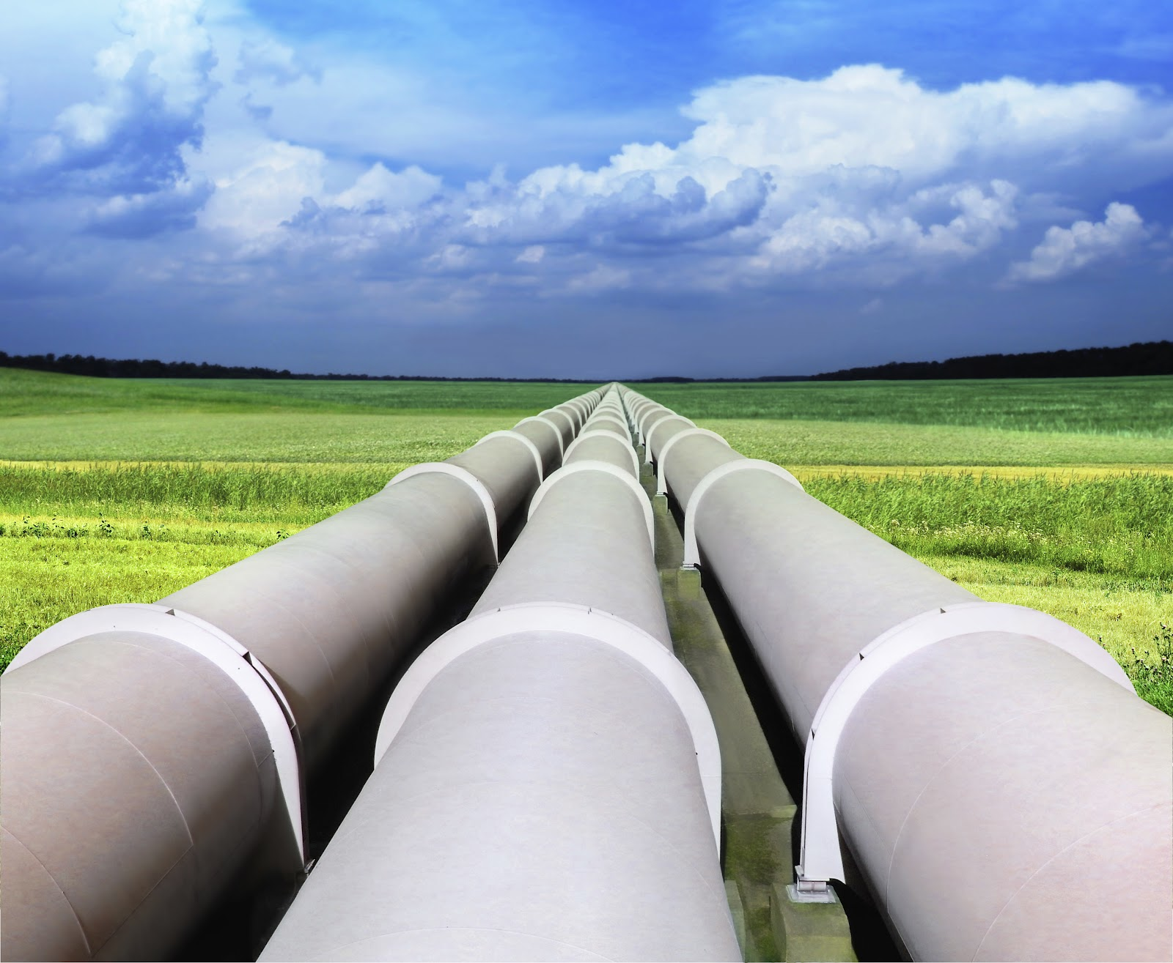
Canadian pipelines
Group 6
Gurse Sandhu
Katy Guo
Yue Gao
Kevin Wong

Slide 2
Agenda
Industrial and Stock Overview
Enbridge Inc.
Pembina Pipeline Corp.
Inter Pipeline Fund

Slide 3
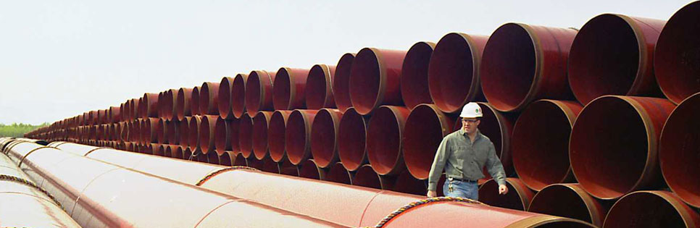
Why do Pipelines Exist?
Energy Highways: like road and highways, Canada’s transmission pipelines form a major transportation network.
More than 100,000 km of underground pipeline transport majority of Canada’s daily crude and natural gas production.

Slide 4
Pipeline Companies’ Role
In the role of gathering, transportation, processing, fractionation, storage and marketing services to the oil and gas industry.
Generally not engaged in exploration and production.
Earn fees for their service without taking ownership of the actual commodity

Slide 5
Industrial Overview
Supplied 94% of domestic demand
High Efficiency
  Produce 3 millions barrels every day, almost 0% of leakage
  Takes only 30 days from Alberta to Southern Ontario
Extracting, Transporting and Storing Variety of Fuels
    Crude Oil, Natural Gas, Petroleum
GDP Produced in 2012: $51.95 Billions
  Export: $83.5 Billions

Slide 6
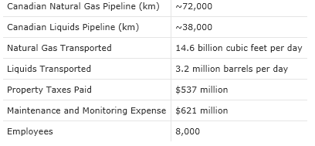
Canadian Pipeline Industry

Slide 7
Industrial Growth
2% every year from 2006-2012
Local industry’s turnover expands 17% from 2006, remains nearly double the size of the domestic market
2013-2018: forecasted growth of 19% in turnover of local service providers

Slide 8
Industrial News
The Canadian market for transport via pipelines reached a total size of C$4.4 billion in 2012, up 11% on 2006.
The market did not suffer severely during the economic downturn, as the main customers were enterprises related to the oil and gas industry.
The value of services provided to Canadian companies by foreign pipeline operators reached C$362 million, or 8% of the market, in 2012 – an increase of 6% from 2006.

Slide 9
Important Fact
97% of companies are small and micro-sized (employing fewer than 100 people), 3% of industry players generate 55% of total revenue. The companies are also concentrated around the major gas and oil basins in Canada, in the regions of Alberta, Saskatchewan and Ontario.

Slide 10
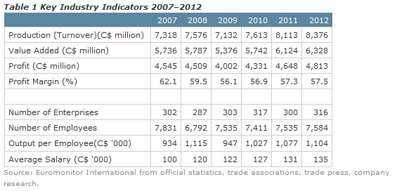
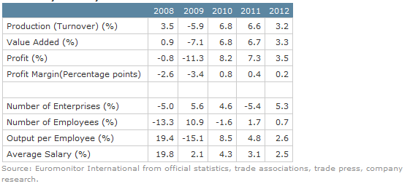
Industry Performance
Industry is growing Steadily in terms of turnover, size.
Profit margin has decreased

Slide 11
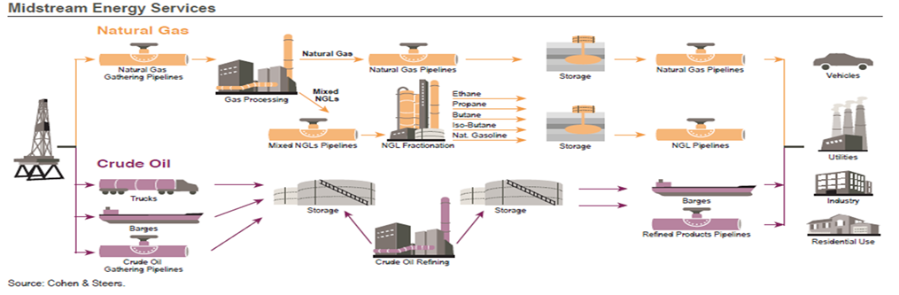
Industry Structure
Upstream | Midstream | Downstream
Exploration and Production | Transportation and Gathering | Refining and Retailing

Slide 12
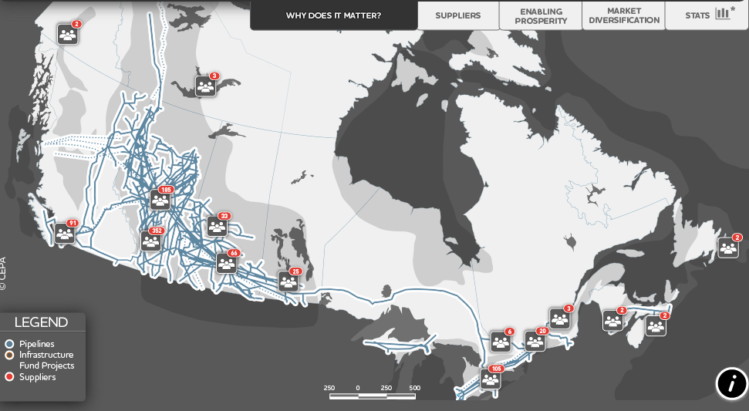
Overall Canadian Pipeline Map

Slide 13
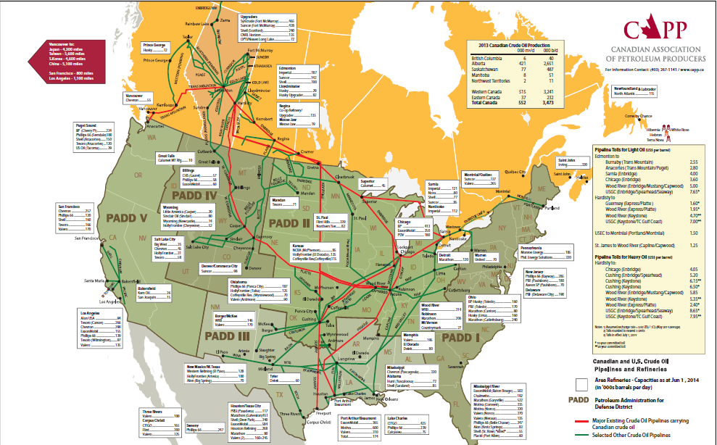
Canadian-North American
Pipeline Map

Slide 14
Types of Pipelines – By Products
Liquids Pipelines
  Crude Oil, Liquefied Natural Gas
  Refined petroleum products
Natural Gas Pipelines
  Directly to households/Businesses
  Ethane, Methane, Propane etc.
  Small diameter

Slide 15
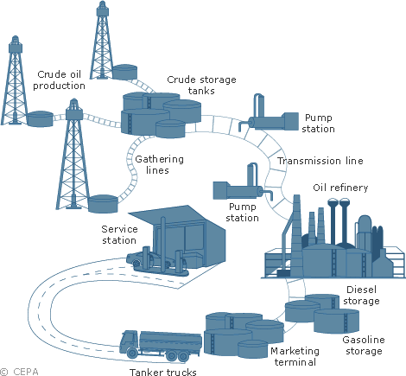
Liquid Fuel Delivery Network
Field → Refinery → Distribution
Extract → Transfer (Pump & Transmission Line) → Breakdown

Slide 16
Fractionation
Essential process in distillation of liquid mixtures.
Separate the mixture into its component parts or fractions based on the differences in volatilities.
Commonly utilized to recover the natural gas liquids (NGL)
Recovered NGL is processed through a fractionation train consisting of three distillation towers in series: deethanizer, depropanizer, and debutanizer.
Purified gas is then pipelined to the end user market.

Slide 17
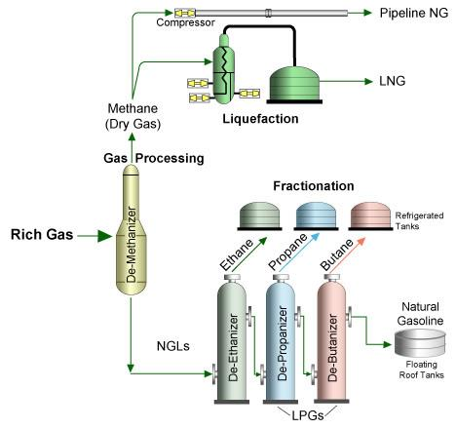
Fractionation Process

Slide 18
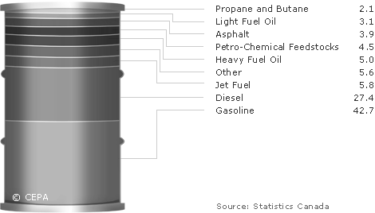
Liquid Fuel Refining

Slide 19
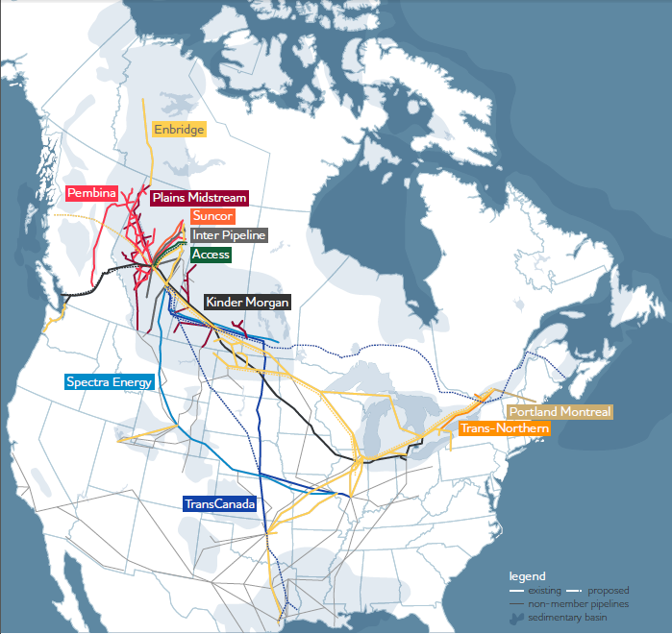
Canadian Liquid Pipeline Map

Slide 20
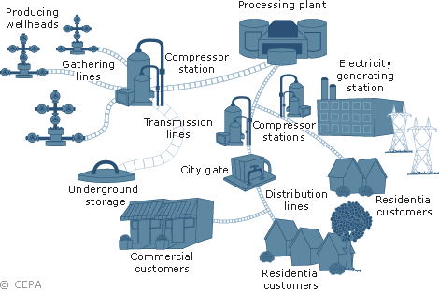
Natural Gas Delivery Network
Extract → filter → compressed → transfer (pressure) → Depressurize

Slide 21
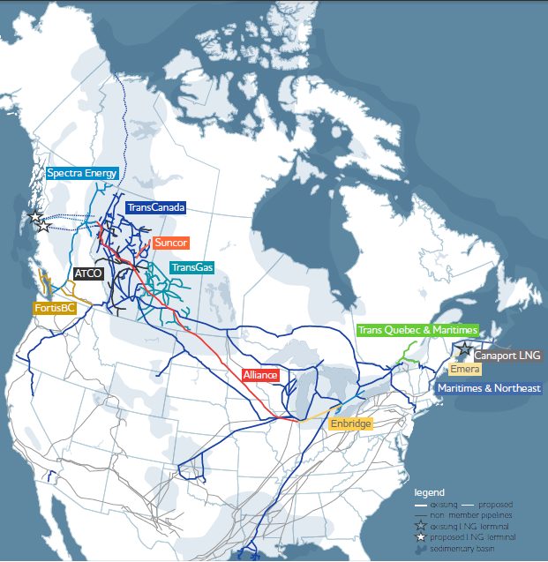
Canadian Natural Gas Pipeline Map

Slide 22
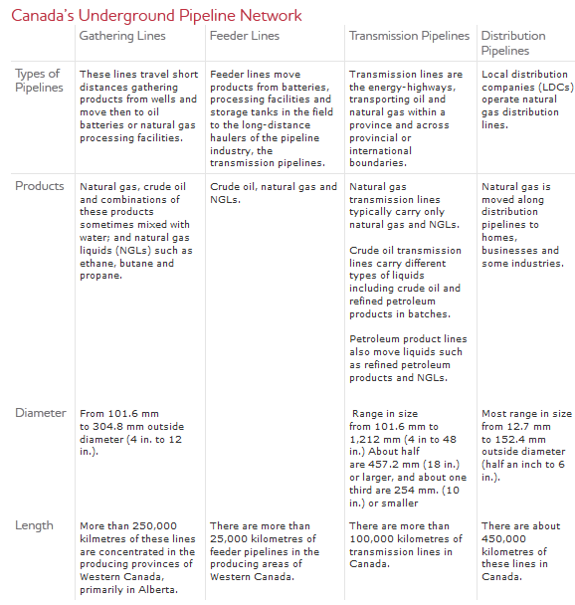
Types of Pipeline – Overall

Slide 23
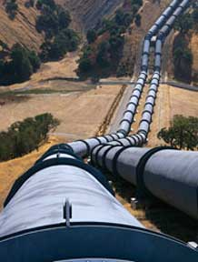
Pipeline Systems
Gathering system
  Most gathering systems located in the west of Canada
The trunk pipelines
  Mostly locate near population center in the East of Canada
Distribution system
  Equally divided between eastern and western Canada

Slide 24
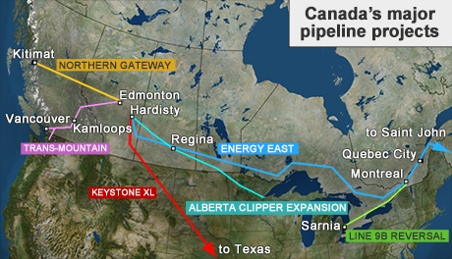
Proposed Canadian Pipeline
6 of 14 proposed projects
  Enbridge’s Northern Gateway to the B.C. coast.
  Enbridge’s Alberta Clipper Expansion to the U.S.
  Enbridge’s Line 9B Reversal in Ontario.
  Kinder-Morgan’s Trans Mountain doubled line from Alberta to B.C.
  TransCanada’s Keystone XL to the U.S. Gulf Coast.
  TransCanada Energy East to Eastern Canada.

Slide 25

Pipeline – How?
Pre-Construction
  Surveying and staking
  Preparing the right-of-way
  Digging the trench
  Stringing the pipe
Construction
  Bending and joining the pipe
  Coating the pipeline
  Positioning the pipeline
  Installing valves and fittings
  Backfilling the trench
Post Construction
  Pressure Testing
  Final clean-up

Slide 26

Pipeline - Aspects
Determination of physical aspects
  Distance
  expected volumes
  type and range of products
External Factors
  Environmental sensitive areas
  Proximity to communities
  Climate
  Geology

Slide 27

Alternatives for Transporting Fuel
Trucks
  Good for short distance
  Small Load
Cargo Ships
  Across Continents
  Risky
Trains

Slide 28
Crude Oil by Rail
The absence of adequate capacity in Western Canada, rail transport is expected to continue to rise due to the protracted regulatory processes for new pipelines and other uncertainties.
There can be long-term viability with this mode of transportation as there are also a number of benefits associated with this mode of transportation.

Slide 29
Benefits of Rail Transportation
Speed to market: Unit train averages 28km/hr. Getting oil to the refinery quickly means producers are paid sooner and refiners receive feedstock sooner.
Optionality/Flexibility: Already existing rail tracks in place to reach East Coast, West Coast, Gulf Coast markets in the U.S.
Diluent: Less or no diluent is required when transporting bitumen in rail tank cars, representing a significant cost savings in diluent costs.

Slide 30
Benefits of Rail Transportation
Scalability: Producers have the flexibility to adjust the volumes being shipped with manifest trains. Manifest trains are individual cars of small groups of cars . New loop tracks uploading facilities are being standardized and are typically built to accommodate 120 cars.
Product integrity: Commodity isolation in separate rail tank cars results in no loss at quality at destination. The crude oil loaded is not mixed with other grades of crude during transportation
Low capital requirement: Typical costs to build unit train terminals ranges between $30 million- $50 million with a capital payout of 5 years or less.

Slide 31
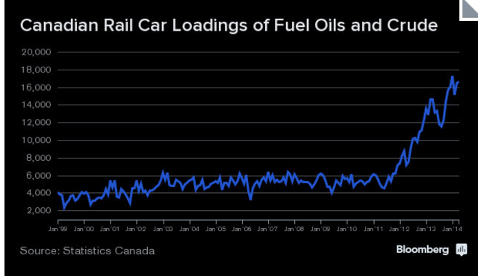

Slide 32
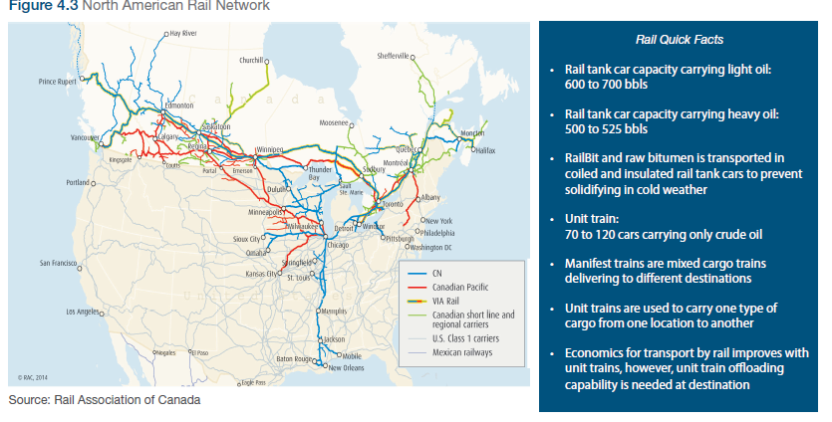

Slide 33
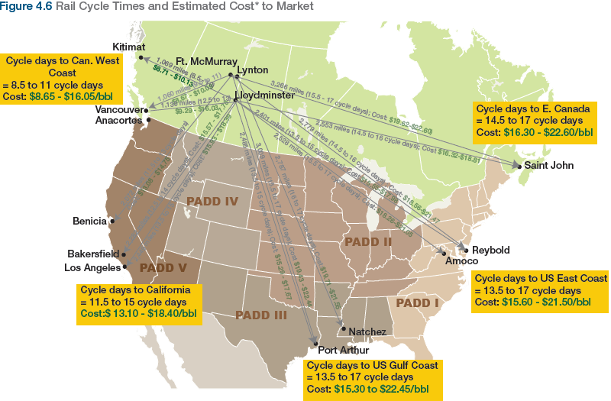
Pipeline cost: price ranges from $7-$10 per barrel.

Slide 34
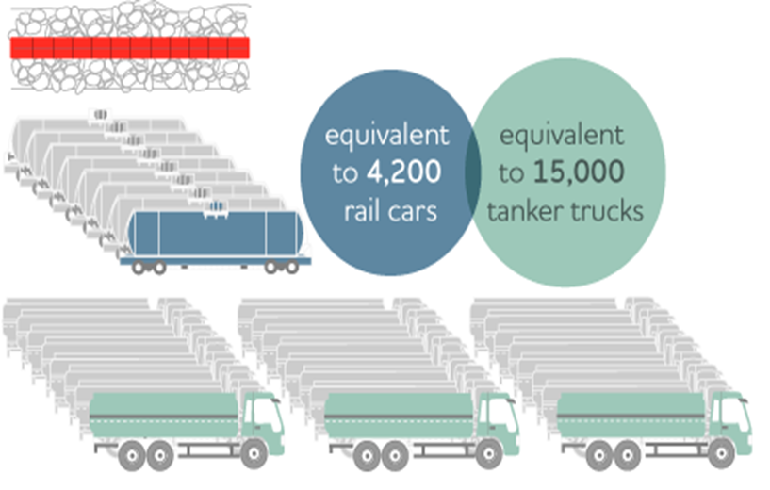
Advantage of Pipeline
Safe
Efficient
Low Pollution
Low Variable Cost
Mass Transporting
Large Scale

Slide 35
Disadvantage of Pipelines
High Initial Cost
Possible Environmental Unfriendly
Strongly Regulated by the Government and Other Green Organizations
Low Flexibility

Slide 36
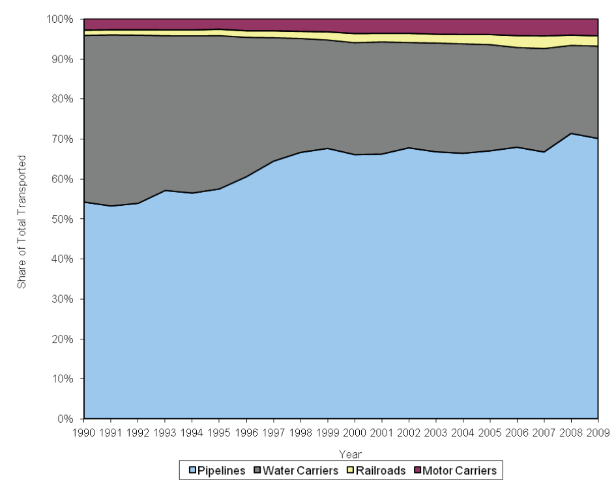
Pipeline VS Others

Slide 37


Regulators and Legislation
Canada: National Energy Board (NEB)
USA: Federal Energy Regulatory Commission (FERC)
Pipeline and Hazardous Materials Safety Administration (PHMSA)

Slide 38



Pipeline Organizations
Canadian Energy Pipeline Association (CEPA)
Canadian Association of Petroleum Producers (CAPP)
Association of Oil Pipe Lines (AOPL)

Slide 39
Canadian Energy Pipeline Association (CEPA)
Non-profit Organization
Represents Canada’s pipeline companies operating more than 130,000 km of pipeline in Canada and the United States.
1.2 billion barrels and 5.1 trillion cubic feet of natural gas each year
Transport 97 % of Canada’s daily oil and gas
Notes:
to enhance the operating excellence, business environment and recognized responsibility of the Canadian energy transmission pipeline industry through leadership and credible engagement between member companies, governments, the public and stakeholders.

Slide 40
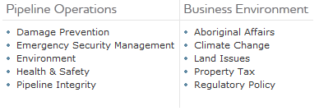
CEPA’s Vision
Notes:
Employee Safety: training, risk management and mitigation
Land Management: short and long-term impacts to land
Land Use and Access: rights, land access, sites/routes, landowner relations
Pipeline Integrity: system reliability, design and monitoring, risk management and mitigation
Air Emissions: releases from transmission systems and ambient air quality
Economic Benefits: local business and employment, community investment, taxes paid, contribution to national and regional economies
Damage Prevention: all interference causing damage to pipelines
Climate Change: emissions, adaptation and product impact
Aboriginal Relations: legal and constitutional rights, agreements, and economic development
Emergency Management: preparedness, response and reclamation
Water Impacts: watershed disruption, water crossings, and water quality
Workforce: attraction, recruitment, retention and competency
Wildlife: habitat disruption, impacts to species and mitigation
Noise: noise impacts of operations

Slide 41
Industry Outlook
According to the NEB's, additional capacity is soon needed to accommodate growing supply and provide greater market flexibility.
Proposed pipelines and expansion are increasing
Development of new pipelines is critical to open new markets for Canadian oil and gas
New energy supply needs to be connected to existing pipeline system
The industry must continue to make huge investment in pipelines to provide cost competitive infrastructure

Slide 42
Market Access
For the Canadian pipeline industry to continue to strive, it needs access to new and existing markets
Canada is the number one supplier of oil and natural gas to the U.S. and must remain so
  Canada is the ideal energy partner for the U.S:
    business friendly, politically stable and has abundant source of energy
    strong, transparent regulation
    CEPA members safety track records is second to none
  Access to Asian pacific market is a key strategic outlet

Slide 43
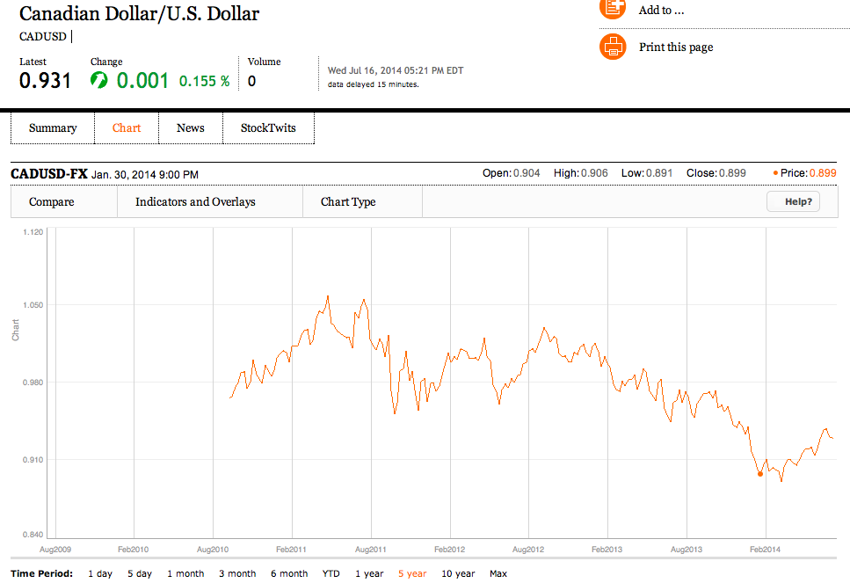
US Dollar /Canadian Dollar, 5 yrs.

Slide 44
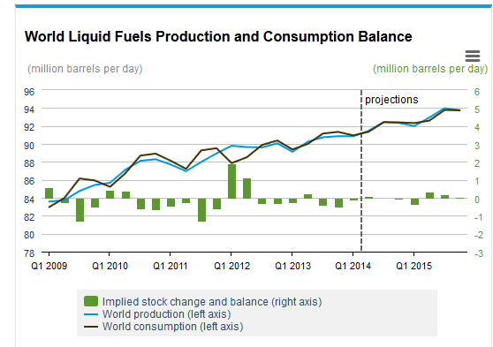
Global Liquid Fuels Productions and Consumption

Slide 45
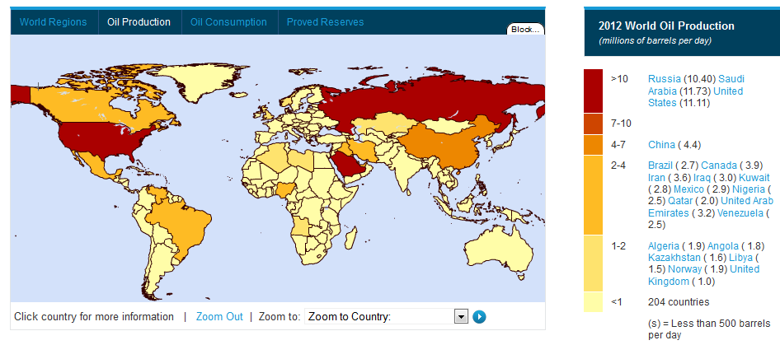
World Oil Production by region

Slide 46
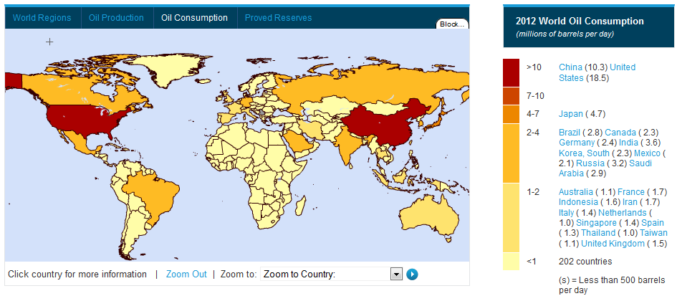
World Oil Consumption by Region

Slide 47
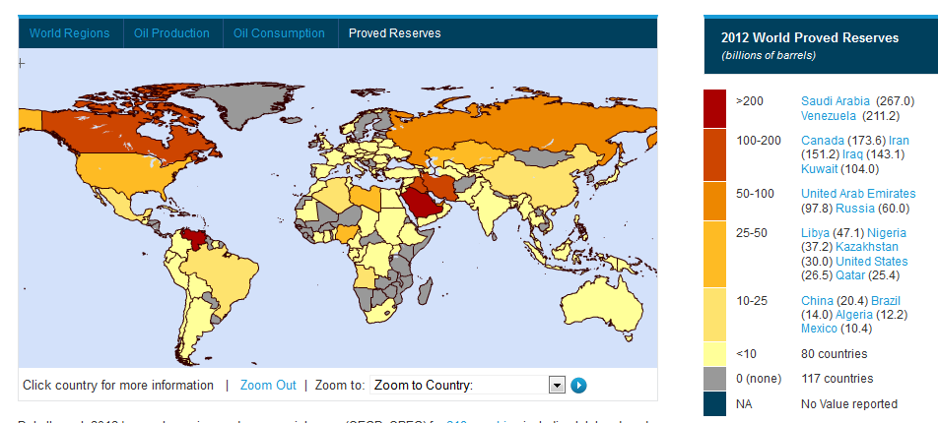
World Oil Reserve by Region

Slide 48
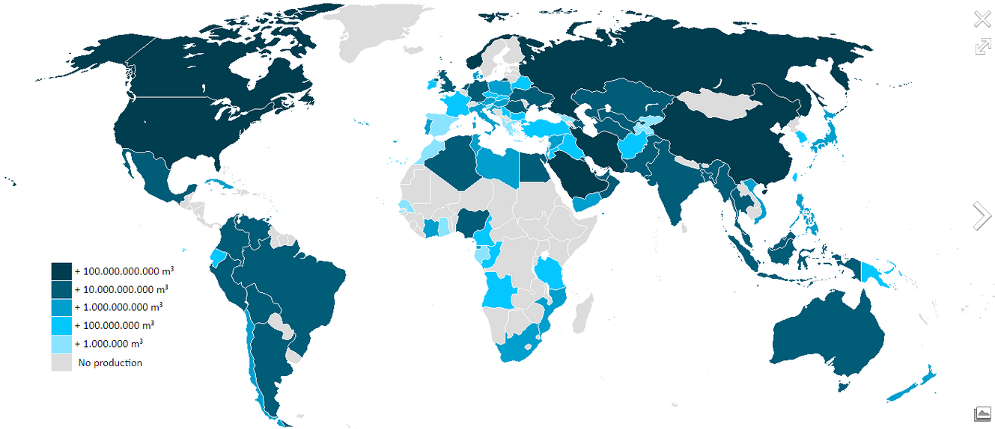
World Natural Gas Production by Region

Slide 49
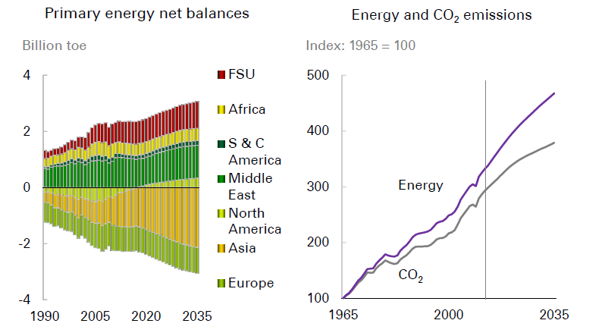
Energy net balances

Slide 50
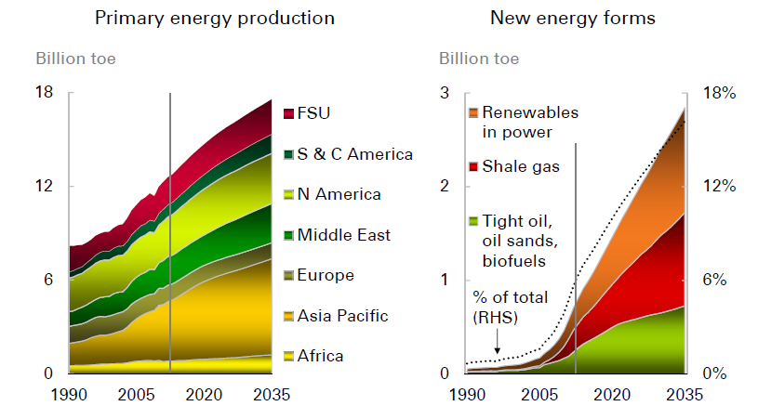
Future Energy Trend

Slide 51
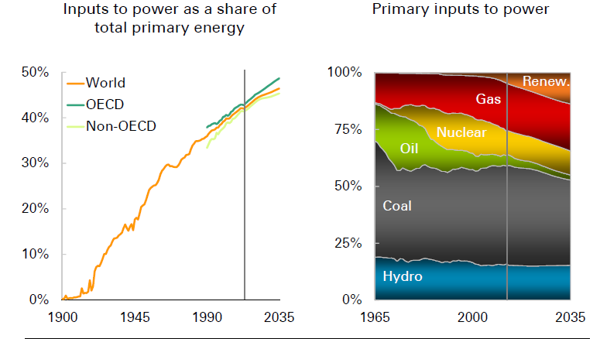
The Coming Trend: Renewable Energy is Definitely a Big Threat

Slide 52
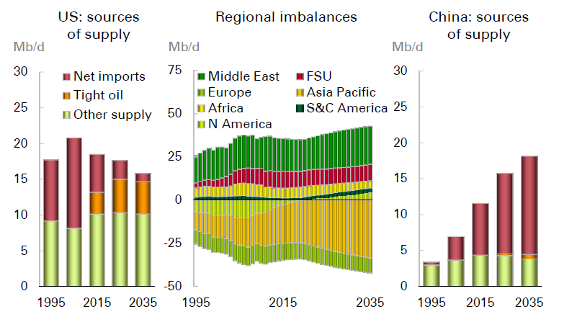
The Coming Oil Trend: China demands more

Slide 53
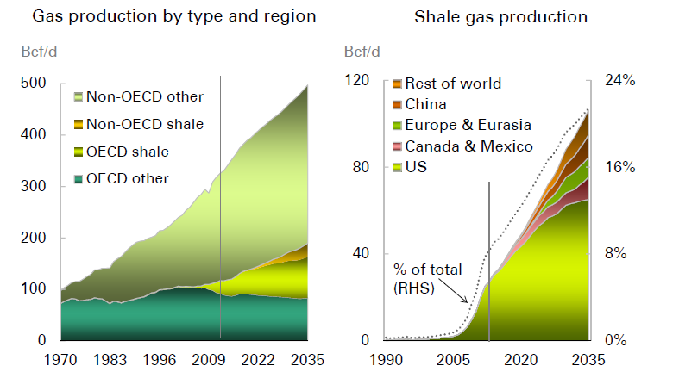
Gas Production by type and region

Slide 54
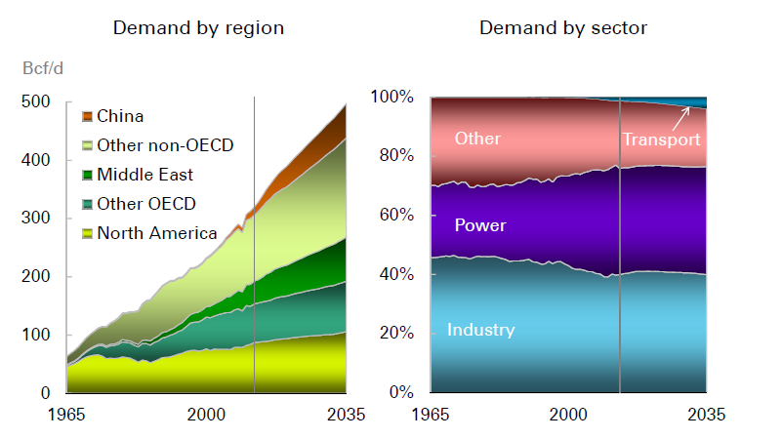
Gas Demand by Region and Sector

Slide 55
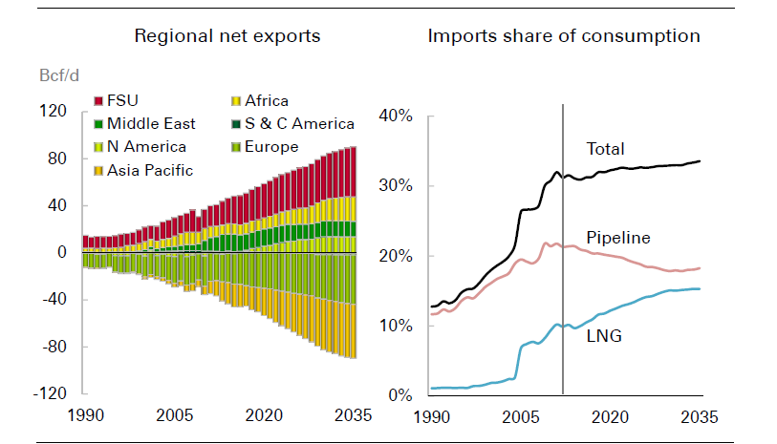
Net Gas Export

Slide 56
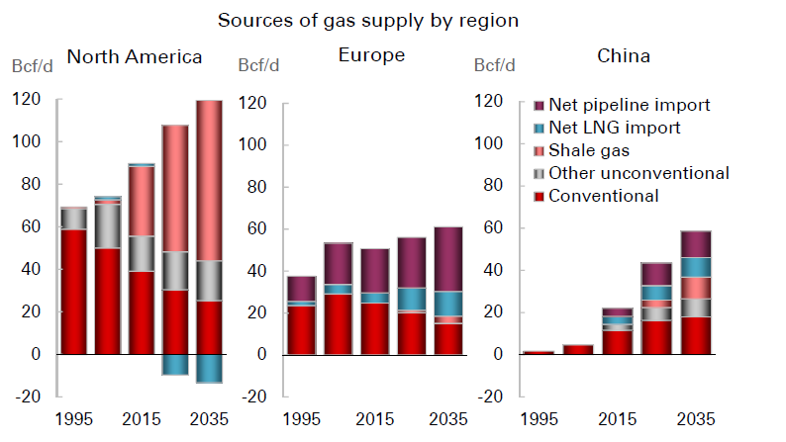
Sources of Gas by Region

Slide 57

Potential Benefits of Investing in Energy Infrastructure Companies
Growth and Income
Stable Cash Flows
Inflation Hedge (growing distributions faster than inflation)
Tax Advantaged Yields

Slide 58
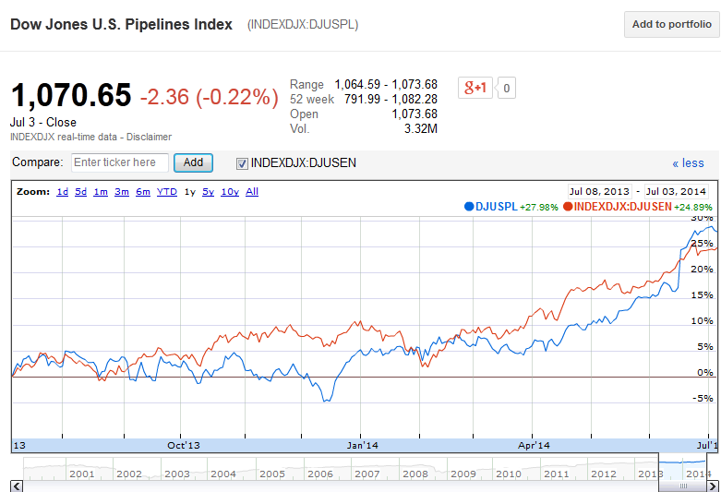
Dow Jones U.S. Pipeline Index VS Dow Jones Oil & Gas Index (1 year)

Slide 59
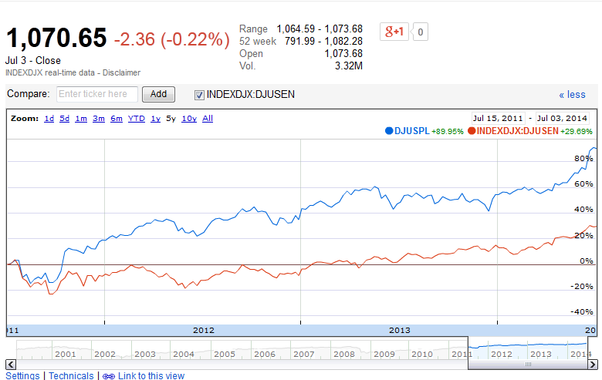
Dow Jones U.S. Pipeline Index VS Dow Jones Oil & Gas Index (3 year)

Slide 60
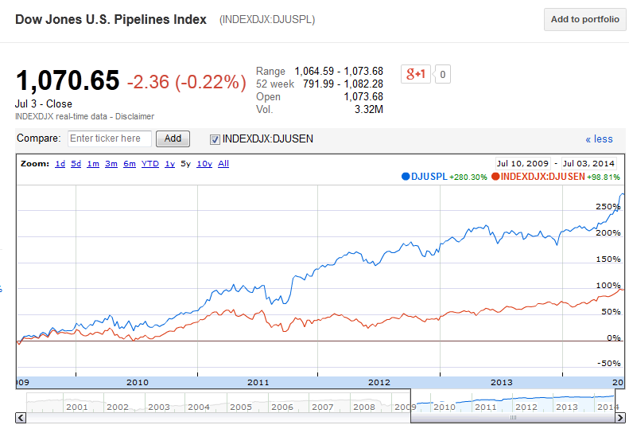
Dow Jones U.S. Pipeline Index VS Dow Jones Oil & Gas Index (5 year)

Slide 61
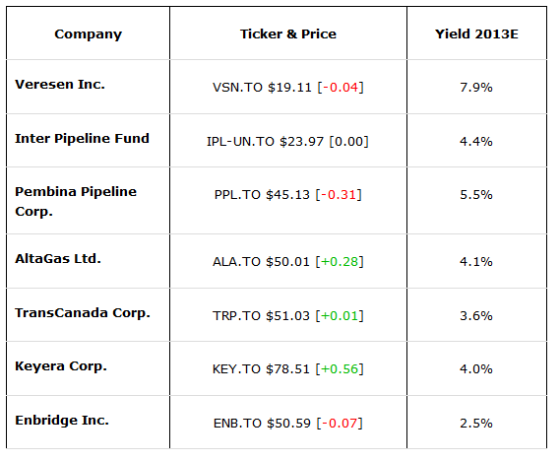
Major Stock Performance Overview

Slide 62
Specific Business Risk Factors
Supply/Demand
  Strongly depends on the lease's technology and remaining supply
  Seasonality
  Counterparty risk
Capital Intensity
  Cost overruns and weak financial metric during growth stage
  Large multi-year growth project vs. smaller shorter construction periods
  Huge Investment

Slide 63
Specific Business Risk Factors
Competitive Environment
  Alternative energy sources (Renewable)
  Global competition
Regulator/Contractual
  Jurisdiction
  Allowed ROE and capital structure defined by regulatory bodies
  Long-term contracts
  Flexibility of regulatory framework
Social Responsibilities
  Environment
  Politics
Others (Exchange Rate, Warfare etc.)

Slide 65
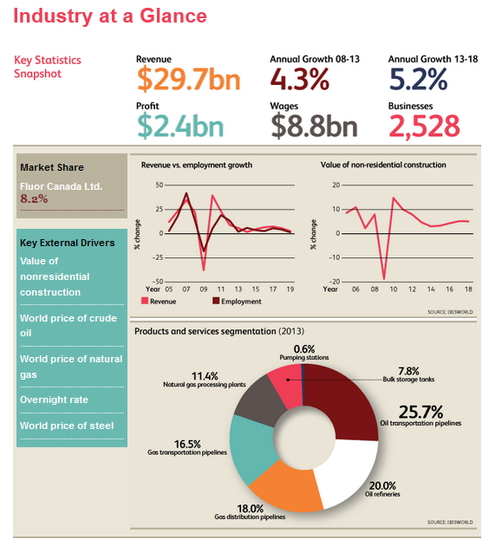

Slide 78
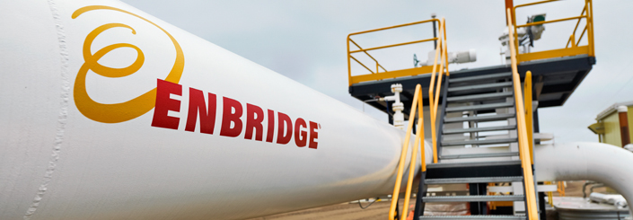
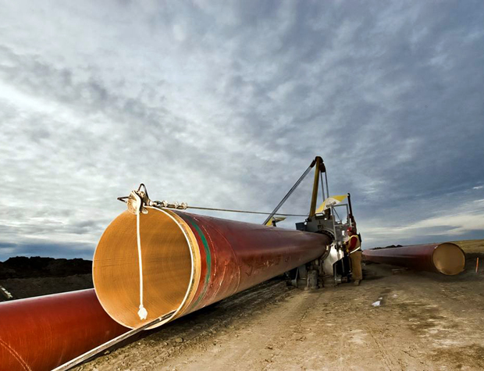
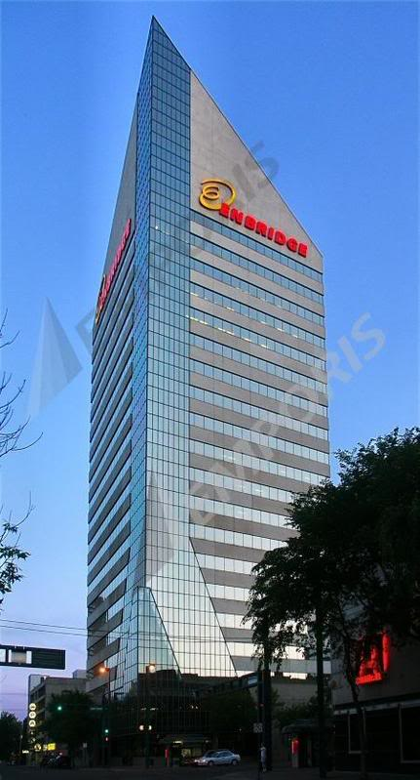

Slide 79
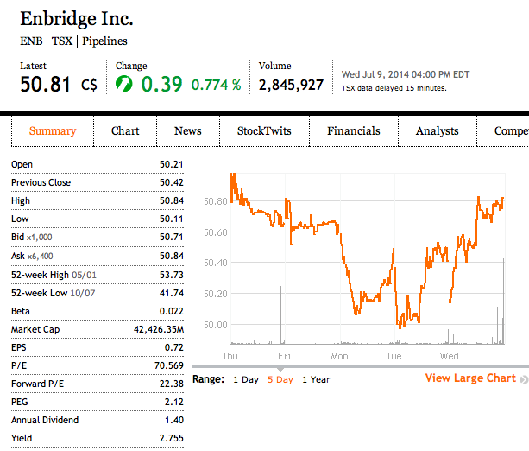

Slide 80
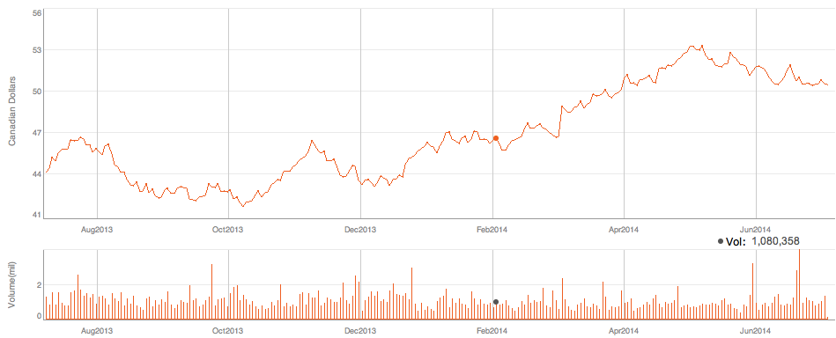
ENB – 1 Year

Slide 81
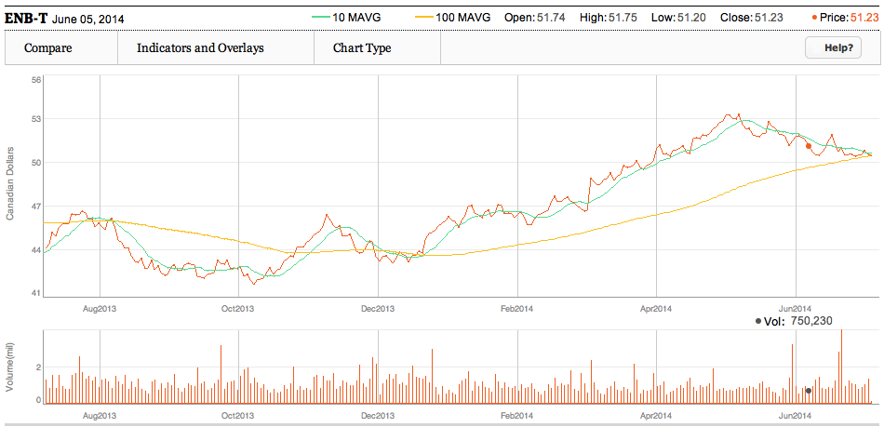
ENB – 1 Year MA (10 and 100)
Notes:
The longer moving average sets the tone for the bigger trend and the shorter moving average is used to generate the signals.

Slide 82
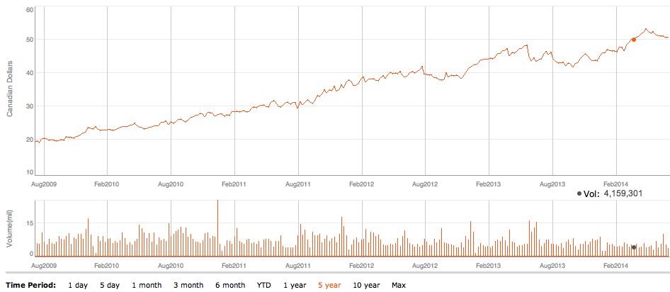
ENB – 5 Year

Slide 83
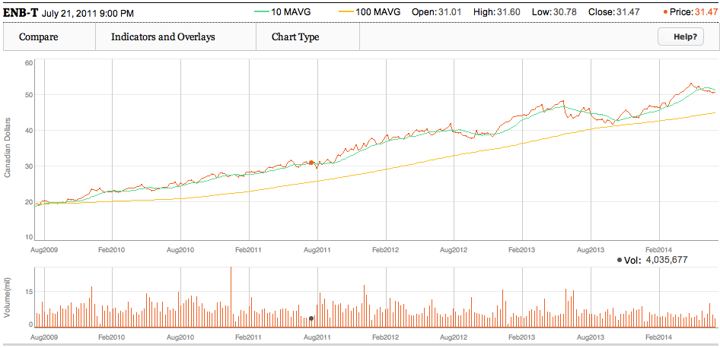
ENB – 5 Year MA (10 and 100)

Slide 84

ENB – 10 Year

Slide 85

ENB – 10 Year MA (10 and 100)

Slide 86


Slide 87

Enbridge’s compound annual growth rate (CAGR) vs. S&P/TSX Composite Index

Slide 88




Slide 89

Visible growth
As of March 2014, Enbridge had an enterprise-wide total of $30 billion of commercially secured growth investments
All investments are expected to come into service by 2017 – the largest capital program in the company’s history
Largely focused on organic growth and small to medium-sized acquisitions that enhance strategic position, rather than large-scale, transformational transactions

Slide 90
Company Overview

Slide 91
Company Profile
Major energy delivery based in Calgary, Alberta, Canada, focusing on transport and distribution of crude oil, natural gas, and other liquids
The largest natural gas distributor in Canada and a major oil pipeline operator in North America
Initially incorporated by Imperial Oil as Interprovincial Pipe Line Ltd. (IPL) in 1949
More than 11,000 employees, mostly in Canada and the United States
Notes:
http://en.wikipedia.org/wiki/Enbridge
owns and operates Canada’s largest natural gas distribution company and provides distribution services in Ontario, Quebec, New Brunswick and New York State.

Slide 92

65-year History
On April 30, 1949, Interprovincial Pipe Line Company was officially incorporate; IPL’s mainline system continued to expand and grow through the 1950s and 1960s
1980s: IPL completed its Norman Wells pipeline; acquired Toronto-based Home Oil and relocated corporate offices to and changed its name to Interhome Energy Inc.
1990s: IPL Energy acquired Consumers’ Gas, became Enbridge and built the Athabasca Pipeline; was awarded the exclusive franchise to develop and operate a natural gas distribution network for the province of New Brunswick.
2000s: Enbridge expanded its international interests
in Spain and Colombia; shares were first listed on the New York Stock Exchange; invested in the SunBridge wind power project in Saskatchewan;
completed the acquisition of Houston’s Midcoast Energy
Resources and acquired Shell Gas Transmission

Slide 93



Slide 94




Investing in Renewable Energy
The largest solar energy generator and the second-largest wind energy generator in Canada
Notes:
Enbridge is the largest solar energy generator and the second-largest wind energy generator in Canada.

Slide 95
Investing in Energy Innovation
In 2013:
  Temporal Power Ltd., a developer and manufacturer of electrical energy storage systems
  On-RampWireless Inc., a developer of wireless solutions
  Smart Pipe Company Inc., the developer of a high-pressure, self-monitoring internal pipeline replacement system
Pipeline Integrity + Leak Detection
  real-time leak detection technologies; ultra-high-sensitivity gas-leak monitoring systems; advanced aerial leak-detection technologies; gas-sensing technology for use on aboveground storage tanks; and leak-response technologies
Finding Solutions for Energy Storage
  Store electricity from renewable energy
  Hydrogenics Corporation; Temporal Power
Notes:
Temporal Power Ltd., a developer and manufacturer of electrical energy storage systems (please see story on facing page).
On-RampWireless Inc., a developer of wireless solutions that enable us to better connect with and monitor assets, such as transmission pipelines, in a more economical and reliable manner than conventional wireless technologies currently allow.
Smart Pipe Company Inc., the developer of a high-pressure, self-monitoring internal pipeline replacement system, which features an embedded fibre optic inspection system that allows the pipeline operator to continually monitor and instantly detect and locate possible leaks, abnormal temperature changes, third-party impacts or ground movement.
In 2013, Enbridge also invested
$5 million in Temporal Power, developer
of an innovative flywheel technology. As Canada’s top producer of solar
power and second largest generator
of wind power, with large renewable
energy projects in the U.S. as well,
Enbridge is investing in technologies
that support large-scale energy storage.
In 2012, Enbridge invested $5 million
in Hydrogenics Corporation, whose
water electrolysis technology can
convert surplus renewable energy into
ultra-clean-burning hydrogen gas.

Slide 96

Strategy
Priority #1 – Safety and Operational Reliability
A leak on Line 37 pipeline in northern Alberta
Published first Operational Reliability Review
Safety & Reliability Committee of the Board
Priority #2 – Executing our Capital Program
$41 billion enterprise-wide growth program
Added more than $10 billion to our funding sources in 2013
Priority #3 – Extend and Diversify Growth
Focus remains on liquids pipelines
Bring new platforms including power generation, electricity transmission, international and energy services

Slide 97
Current Business Operations
Gas Distribution
Gas Pipelines, Processing and Energy Services
Sponsored Investments
Liquids Pipelines
Corporate
The largest transporter of crude oil in Canada with 2.2 million barrels per day of oil and liquids.
Canada's largest natural gas distribution utility
The largest solar energy generator and the second-largest wind energy generator in Canada
20.6% ownership interest in EEP,L.P., 66.7% investment in the U.S. segment of the Alberta Clipper Project, 67.3% economic interest
in Enbridge Income Fund
Ownership of 38.9% of Noverco’s common shares and investment
in preferred shares

Slide 98


Slide 99

Liquids Pipelines
  Company’s near-term focus
Consists of common carrier and contract crude oil, natural gas liquids (NGL) and refined products pipelines and terminals in Canada and the United States
6 major liquids pipeline systems
  Canadian Mainline
  Regional Oil Sands System
  Southern Lights Pipeline
  Seaway Pipeline
  Spearhead Pipeline
  Feeder Pipelines

Slide 100

Liquids Pipelines - Canadian Mainline
Six adjacent pipelines with a combined design operating capacity of approximately 2.5 million bpd
Transports various grades of crude oil and diluted bitumen from western Canada to the Midwest region of the United States and eastern Canada
Two crude oil pipelines and one refined products pipeline located in eastern Canada

Slide 101


Liquids Pipelines - Regional Oil Sands System
Notes:
Two long haul pipelines
The Athabasca Pipeline
The Waupisoo Pipeline
Two large terminals
The Athabasca Terminal located north of Fort McMurray, Alberta
Cheecham Terminal, located 45 miles south of Fort McMurray where the Waupisoo Pipeline initiates
Wood Buffalo Pipeline, Woodland

Slide 102

Liquids Pipelines - Spearhead Pipeline
Delivers crude oil from the Flanagan, Illinois delivery point of the Lakehead System to Cushing, Oklahoma
Both the initial committed shippers and expansion shippers were required to enter into 10-year shipping commitments at negotiated rates that were offered during the open season process.
Notes:
Volumes significantly
increased over 2011 due to higher commodity price
differentials which increased demand at Cushing, Oklahoma
in anticipation of additional capacity on the Seaway Pipeline
for further transportation to the Gulf Coast.

Slide 103
Other Liquids Pipelines
Southern Lights Pipeline
  180,000 bpd, 20-inch diameter
  Transporting diluent from Chicago, Illinois to Edmonton, Alberta
  Tariff revenues under long-term contracts with committed shippers
Seaway Pipeline
  Acquired a 50% interest in the 1,078-kilometre (670-mile) Seaway Pipeline
  Filed a brief with the FERC asking for expedited ruling by the FERC on the committed rates
Feeder Pipelines And Other
  85% interest in Olympic Pipe Line Company, the largest refined products pipeline in the State of Washington

Slide 104


Slide 105

Gas Distribution
Natural gas distribution utility operations in Quebec and New Brunswick
The most significant being EGNB, which owns the natural gas distribution franchise in the province of New Brunswick
Rates and Tariffs Regulatory Matters
Risks
  weather, economic conditions, pricing of competitive energy sources and growth in the number of customers

Slide 106


Slide 107

Gas Pipelines, Processing and Energy Services
42.7% interest in Aux Sable US and a 50% interest in Aux Sable Canada
Energy Services provides energy supply and marketing services to North American refiners, producers and other Customers
Alliance Pipeline US consists of ~3,000 km of integrated, high-pressure natural gas transmission pipeline and ~860 km of lateral pipelines and related infrastructure
Vector Pipeline provides operating services to and holds a 60% joint venture interest in Vector

Slide 108


Gas Pipelines, Processing and Energy Services
Notes:
Offshore is comprised of 13 active natural gas gathering and
FERC-regulated transmission pipelines and one active oil
pipeline with a capacity of 60,000bpd, in five major corridors
in the Gulf of Mexico, extending to Deepwater developments.
These pipelines include almost 2,600 kilometres (1,600
miles) of underwater pipe and onshore facilities with total
capacity of approximately 7.3 bcf/d. Offshore currently moves
approximately 45%of offshore deepwater gas production
through its systems in the Gulf of Mexico.

Slide 109


Slide 110
Sponsored Investments
EEP:
  EEP owns and operates crude oil and liquid petroleum transportation and storage assets and natural gas and NGL gathering, treating, processing, transportation and marketing assets in the United States; Average ownership interest in EEP during 2013 was 21.1%; Enbridge holds a US$1.2 billion investment in EEP preferred units
EELP:
  Enbridge funded 66.7% of the EELP (Enbridge Energy, Limited Partnership) equity requirements

Slide 111

Sponsored Investments
Enbridge Income Fund (EIF)
- three core businesses:
  Renewable and alternative power generation (Green Power);
  Crude oil and liquids pipeline transportation and storage (Liquids Transportation and Storage);
  50% interest in Alliance Pipeline Canada

Slide 112


Slide 113

Crude Oil Release
July 27, 2012, Line 14 of EEP’s Lakehead System, 1,700 barrels of oil release (US$10 million loss)
July 26, 2010, Line 6B of EEP’s Lakehead System, 20,000 barrels of crude oil leak (US$1,122 million loss)
On September 9, 2010, Line 6A of EEP’s Lakehead System, 9,000 barrels of crude oil release (US$48 million loss)
……

Slide 114





Slide 115
Corporate
Investments in green energy projects, business development activities as well as investing and financing activities
Noverco
  Enbridge owns an equity interest in Noverco through ownership of 38.9% of its common shares and an investment in preferred shares
  Noverco is a holding company that owns ~71% of Gaz Metro Limited Partnership(Gaz Metro) in Quebec and the state of Vermont
  A significant portion of earning is from dividends on Noverco’s preferred share investments
Other Corporate
  new business development activities, general corporate investments and financing costs not allocated to the business segments
  Other corporate costs include dividends on preference

Slide 116


Slide 117
Enbridge's Commercially Secured Growth Projects 2013 – 2017 ($36 billion)
Eastern Access $2.7 Billion
Light Oil Market Access 6.3 Billion
Western Gulf Coast Access $5.2 Billion
Power Generation + Transmission $1.5 Billion
Line 3 Replacement + Other Mainline $9.0 Billion
Regional Expansions $7.0 Billion
Gas Pipeline + Processing $2.5 Billion
Enbridge Gas Distribution $1.7 Billion
Notes:
Light Oil Market Access
$6.3 Billion¹
We're expanding access to markets for growing volumes of North Dakota and western Canada light oil to premium refinery markets in Ontario, Quebec and the U.S. Midwest, helping to ensure that consumers in these regions are served with gasoline, diesel and other products refined from reliable supplies of North American crude oil.
Eastern Access
$2.7 Billion¹
We're establishing a path for western Canadian and Bakken crude oil to access refineries in eastern Canada, as well as the Midwest and eastern U.S.
Western Gulf Coast Access
$5.2 Billion²
We're connecting Canadian heavy oil supply to the vast refinery complex along the western Gulf Coast near Houston.
Regional Expansions
$7.0 Billion³
We're expanding our regional infrastructure in key producing regions, including Alberta where we're well positioned to tie-in new oil sands developments to mainline pipelines and increase capacity for current customers.
Line 3 Replacement + Other Mainline
$9.0 Billion
We're replacing all segments of Line 3 of our mainline between Hardisty, Alberta and Superior, Wisconsin with new pipe using the latest available high-strength steel and coating technology. Targeted for completion in 2017, the Line 3 Replacement Program is the largest project in the Company's history.
Gas Pipeline + Processing
$2.5 Billion
We're expanding our offshore pipeline infrastructure in the Gulf of Mexico; and we're growing our network of onshore natural gas gathering, treating, processing and transmission facilities to support the large unconventional gas plays in both Canada and the United States.
Enbridge Gas Distribution
$1.7 Billion
Enbridge Gas Distribution is upgrading and expanding its system in the Greater Toronto Area (GTA) to meet growing demand for natural gas from residential, commercial and industrial customers.
Power Generation + Transmission
$1.5 Billion⁴
Our first power transmission project went into service in 2013; and with new wind projects under development in Alberta and Texas, we're further solidifying our position as a leading renewable energy generator in North America
¹ Including associated Mainline expansions
² Including associated Mainline expansions; excluding Seaway Pipeline acquisition cost of $1.2 billion in 2012
³ 2013 – 2017; includes Norlite (diluent) Pipeline System
⁴ Includes $1.1 billion for four wind power projects (Massif du Sud, Saint-Robert-Bellarmin and Lac Alfred in Quebec; Blackspring Ridge in Alberta, and Keechi in Texas) and US$0.4 billion for the Montana-Alberta Tie Line

Slide 118
Enbridge’s Northern Gateway
>$300 billion in additional GDP over 30 years.
  $6.5billion, from Edmonton to Kitimat
  Westbound: 525,000 barrels/day
  Eastbound:193,000 barrels/day

Slide 119
Enbridge’s Alberta Clipper Expansion
450,000 barrels/day → 570,000 barrels/day
Canadian portion: 1,078 km
Install new pumps in 8 facilities
4 new mainline pumps and an electrical substation at the Metiskow Station
Additional metering terminal and booster pump at the Hardisty Terminal

Slide 120
Enbridge’s Line 9B Reversal
639-kilometre section of Line 9 from North Westover, Ont., to Montreal
Current capacity: Approximately 240,000 barrels/day
Critical step in ensuring the future of Quebec’s refining and petrochemical industries

Slide 121
Value Creation Formula
Industry-Leading Growth
  $36 billion in growth projects that are commercially secured and planned to be in service by 2017
  Additional inventory of $5 billion in projects that are still in development, giving a record $41-billion growth plan through 2017
A Reliable Business Model
  Commercial model favors organic growth
  Financial risk management strategy
  State-of-the-art project management approach ensures the capital program is delivered on time and on budget
Significant Dividend Income
  Pay out 60% to 70% of adjusted earnings as dividends
Notes:
financial risk management strategy is focused on Mitigating exposure to interest rate variability, foreign exchange, and commodity prices through a comprehensive hedging program; maintaining our credit ratings; diversifying our funding sources; and providing liquidity through substantial standby bank credit capacity that stood at $17.6 billion at year end

Slide 122

Management Team

Slide 123

Position: President and Chief Executive Officer
Date of Appointment: October 1, 2012
Past Experience:
Member of the Enbridge Inc. Board of Directors.
President, Gas Pipelines, Green Energy & International
More than 30 years experience in the energy business including the upstream oil and gas exploration, development and pipelines businesses.
Joined Enbridge in 1995
Held positions including Executive Vice President, Major Projects & Green Energy, and as President, Enbridge Gas Distribution; Senior Vice President, Corporate Planning and Development; and Vice President, Financial Services and Treasurer for Enbridge's U.S.-based master limited partnership.

Slide 124


Position: President, Enbridge Gas Distribution
Date of Appointment: Oct. 1, 2013
Past Experience:
More than 25 years of experience working in a number of operating roles within Enbridge, most recently as Senior Vice President, Operations within Gas Distribution
Other roles included Vice-President of Planning and Opportunity Development. He is active in the Mackenzie Health Foundation community group.
Qualifications:
A registered professional engineer in Ontario
Graduated from Queen’s University, in Kingston, Ont., with a degree in Chemical Engineering
Master of Business Administration degree from the University of Toronto.

Slide 125


Position: President, Gas Pipelines and Processing
Date of Appointment: Jan. 30, 2014
Past Experience:
Joined Enbridge from Southwest Energy, where he served as Senior Vice President, Midstream
senior leadership positions with CenterPoint Energy, Spectra Energy and Duke Energy.
Chairman of the Board of the Interstate Natural Gas Association of America (INGAA).
Dean’s Advisory Board at the University of Houston’s Bauer School of Business
Chairman of the board of directors of Theatre Under the Stars.
Qualifications:
Bachelor of Science (B.Sc.) degree in mechanical engineering from the University of Kentucky, as well as a Masters of Business Administration (MBA) degree from the University of Houston.

Slide 126


Position: President, Liquids Pipelines
Date of Appointment: March 1, 2014
Past Experience:
Chief Commercial Officer for Liquids Pipelines
President, Gas Distribution, providing overall leadership to Enbridge Gas Distribution
28 years dedicated to energy marketing and business development activities
Senior Vice President, Investor Relations & Enterprise Risk; Senior Vice President, Business Development; Vice President, Upstream Development for Enbridge Pipelines Inc.; and Vice President, Gas Services for Enbridge Inc.
Qualifications:
Bachelor of Commerce degree from the University of Saskatchewan

Slide 127


Position: Strategic Advisor, Office of the President and CEO
Date of Appointment: March 1, 2014
Past Experience:
President, Liquids Pipelines and Major Projects
Over 34 years of experience with Enbridge, including more than two decades in the liquids pipelines business
President of Enbridge Pipelines Inc. and Enbridge Energy Partners, L.P. from 1997 to 2000
Group Vice President, Corporate Planning and Development from 2001 to 2003, Group Vice President and Chief Financial Officer from 2003 to 2006
Executive Vice President, Chief Financial Officer and Corporate Development from 2006 to 2008
President of Liquids Pipelines until January 2012, at which time the Major Projects business unit was added to his portfolio.

Slide 128


Position: Chief Operating Officer
Date of Appointment: May 2013
Past Experience:
Joined Enbridge in 1987 as part of the Engineering group
senior management positions in Sarnia and Edmonton in Operations, Shipper Services, and IT
Senior Vice President, Development and Services, based in Calgary
President Gas Pipelines located in Houston, Texas with responsibilities for Gas Gathering and Processing, as well as on-shore and off-shore gas pipelines.
2008 Campaign Chair for the United Way Alberta Capital Region and Vice Chair of its Board of Directors
President of the Board of the Alberta Chamber of Resources and sits on the Board of the Canadian Energy Pipeline Association.
Qualifications:
Graduated from the University of Alberta with a Bachelor of Science in Physics.

Slide 129
Financial
Performance

Slide 130

Annual Balance Sheet

Slide 131

Annual Balance Sheet

Slide 132

Quarterly Balance Sheet
Notes:
ACCOUNTS RECEIVABLE AND OTHER
Pursuant to a Receivables Purchase Agreement (the Receivables Agreement) executed in 2013, certain
trade and accrued receivables (the Receivables) have been sold by certain Enbridge Energy Partners,
L.P. (EEP) subsidiaries to an Enbridge wholly-owned special purpose entity (SPE). The Receivables
owned by the SPE are not available to Enbridge except through its 100% ownership in such SPE. The
Receivables Agreement provides for purchases to occur on a monthly basis through to December 2016,
provided accumulated purchases net of collections do not exceed US$450 million at any one point. The
value of trade and accrued receivables outstanding owned by the SPE totaled US$433 million ($479
million) and US$380 million ($404 million) as at March 31, 2014 and December 31, 2013, respectively.

Slide 133

Quarterly Balance Sheet
Notes:
ACCOUNTS RECEIVABLE AND OTHER
Pursuant to a Receivables Purchase Agreement (the Receivables Agreement) executed in 2013, certain
trade and accrued receivables (the Receivables) have been sold by certain Enbridge Energy Partners,
L.P. (EEP) subsidiaries to an Enbridge wholly-owned special purpose entity (SPE). The Receivables
owned by the SPE are not available to Enbridge except through its 100% ownership in such SPE. The
Receivables Agreement provides for purchases to occur on a monthly basis through to December 2016,
provided accumulated purchases net of collections do not exceed US$450 million at any one point. The
value of trade and accrued receivables outstanding owned by the SPE totaled US$433 million ($479
million) and US$380 million ($404 million) as at March 31, 2014 and December 31, 2013, respectively.

Slide 134

Quarterly Income Statement

Slide 135

Quarterly Income Statement

Slide 136

Annual Income Statement

Slide 137

Annual Income Statement

Slide 138

Annual Cash Flows

Slide 139

Annual Cash Flows

Slide 140

Quarterly Cash Flows

Slide 141

Quarterly Cash Flows

Slide 142

Recommendation
Hold

Slide 143



Slide 144

PPL – 5 Day

Slide 145

1 Year Historical Price

Slide 146

PPL – 1 Year MA (10 and 100)

Slide 147

5 year Historical Price

Slide 148

10 Year Historical Price

Slide 149

Common Share （2014）

Slide 150
PPL Dividend History
Total 2011 Dividends: $1.560/share
Total 2012 Dividends: $1.605/share
Total 2013 Dividends: $1.645/share

Slide 151

PPL Dividends & EPS

Slide 152

Strong Financial Performance

Slide 153

Financial & Operating Overview (2014 Q1)

Slide 154

Annual Financial & Operating Overview

Slide 155

Company Overview

Slide 156
Pembina Pipeline (PPL)
History
Founded as energy industry at 1954
Headquarters located at Calgary, Canada
Leading transportation and midstream service provider that has been serving North America's energy industry for 60 years.
Transports conventional and synthetic crude oil and natural gas liquids produced in western Canada; oil sands and heavy oil pipelines; gas gathering and processing facilities
Oil and natural gas liquids infrastructure and logistics business
Joined TSX in 1997

Slide 157
Acquisition of Provident Energy Limited
Pembina entered an agreement with Provident on Jan 16, 2012 to acquire all of the issued and outstanding common shares of Provident to create an integrated company that will be a leading player in the North American energy infrastructure sector
After Acquisition, dividend rate increased by 3.8%. ($0.13 – $0.135)
The acquisition closed as of April 2, 2012.

Slide 158
Benefits of acquisition
Scale and Scope
Complete Value Chain
Key Growth Areas
Expanded Footprint
Strong Leadership Team
Substantial Growth Opportunities
Strong Synergies
Superior Financial Platform
Notes:
Scale and Scope: A substantially larger, and more diversified portfolio of businesses across the energy infrastructure value chain;
Complete Value Chain: A highly integrated suite of services being offered to customers through the combination of Pembina's liquids transportation, gas services, and midstream and marketing segments and Provident's capabilities in NGL extraction, fractionation, storage, transportation and logistics permitting both a diversification of business and strengthening the value proposition for its shareholders and customers;
Key Growth Areas: Extensive energy infrastructure businesses located in key growth regions including: Montney, Duvernay, Alberta Deep Basin, Pelican Lake heavy oil, Athabasca oil sands, Cardium, Swan Hills, Bakken, Marcellus and Utica;
Expanded Footprint: Greater access to NGL barrels as well as increased capability to store, process and market barrels across key North America hubs including Edmonton, Sarnia and Mont Belvieu. The pro forma company will have operations in key market areas for NGL and crude oil in close proximity to pipelines, rail and truck facilities, storage, fractionation, petrochemical and refining customers;
Strong Leadership Team: An experienced management team with a strong focus on being a responsible, reliable operator and a trusted member of the community;
Substantial Growth Opportunities: A larger entity capable of pursuing more complex growth projects at an accelerated pace including an aggregate capital program of approximately $700 million of announced spending in 2012 (Pembina: $550 million, Provident: $150 million). Major near-term projects include:
Saturn and Resthaven liquids extraction facilities;
Peace NGL pipeline expansion;
Redwater liquids storage development;
Redwater fractionator capacity expansion;
Strong Synergies: The combined entities will generate substantial synergies:
The ability to leverage technical, commercial and operational skills from both Pembina and Provident over the combined asset base, achieving cost savings and operating efficiencies;
Synergies that will be realized by more fully connecting, integrating and utilizing the current and future asset bases of both companies;
Corporate cost synergies through the consolidation of head offices, the decrease of Provident debt service costs, and the elimination of costs associated with Provident's public company costs;
Capital efficiencies through the allocation of capital expenditures to the highest return projects.
Superior Financial Platform: The pro forma company will generate a diversified stable cash flow stream and enjoy a very strong balance sheet with pro forma 2011 senior debt to EBITDA of approximately 2.4x.
Due to the continued success of producers drilling for liquids rich natural gas and the increase in field liquids extraction, the amount of NGL being produced in the Western Canadian Sedimentary Basin has increased significantly. To meet the growing need of producers in the region, Pembina expects that on closing of the proposed transaction, it will begin development of a new 65,000 bpd fractionator at Provident's Redwater site, which is anticipated to be in-service by mid 2014 pending continued customer support and subject to required regulatory and environmental approvals.

Slide 159
General Services
1. Conventional and natural gas liquids transportation
2. Oil sands pipelines
3. Crude oil hubs, terminals and storage
4. Gas gathering and processing
5. NGL fractionation and logistics

Slide 160
Current business operations
Conventional pipeline
Oil sands & heavy oil
Midstream
Gas services

Slide 161

Conventional Pipeline

Slide 162
Conventional Pipeline
Started in 1954 and has expanded this business to meet the growing needs of producers in Alberta and British Columbia
PPL owns and operates 8200 km of conventional pipeline which transport approximately half of Alberta's conventional crude oil production.
About 30% of the natural gas liquids is produced in western Canada and virtually all of the conventional oil and condensate produced in BC.

Slide 163

Conventional Pipeline (2014 Q1)

Slide 164

Conventional Pipeline

Slide 165

Oil sands & Heavy oil

Slide 166
Oil sands & Heavy oil
Pembina plays an important and growing role in supporting Alberta’s oil sands industry, transporting synthetic crude oil from the Syncrude Canada Ltd. and Canadian Natural Resources Ltd. oil sands operations near Fort McMurray to markets near Edmonton.
Services oil sands producers operating southwest of Fort McMurray and heavy oil producers in the Peace River/Seal region of Alberta by providing both diluent and diluted bitumen pipeline transportation.
Has approximately 1,650 km of oil sands pipelines with about 30 percent of the total take-away capacity from the Athabasca oil sands region.

Slide 167

Oil Sands & Heavy Oil (2014 Q1)

Slide 168

Oil Sands & Heavy Oil

Slide 169

Midstream

Slide 170
Midstream
Crude oil segment
  “legacy” midstream operation (e.g. Pembina Nexus Terminal - PNT)
The NGL segment ( two large operating systems)
  Redwater West
  Empress East

Slide 171

Midstream (2014 Q1)

Slide 172

Midstream

Slide 173

Gas Services

Slide 174
Gas Services
Gas Services provides gas gathering, compression, and both shallow and deep cut processing services for its customers, primarily on a fee-for-service basis under long-term contracts.
Strategically positioned in active and emerging (Natural Gas Liquid) NGL-rich plays in the Western Canada Sedimentary Basin (WCSB) and integrated with Pembina's other businesses.

Slide 175

Gas Services (2014 Q1)

Slide 176

Gas Services

Slide 177

Operating results Q1-2014

Slide 178

Pembina’s fully integrated services

Slide 179
Pembina’s business strategy
General Strategy:
  provide highly competitive and reliable returns to investors through monthly dividends on their common shares while also enhancing the long-term value of their securities

Slide 180
Generating Value
Generating Value:
1. cost-effective, reliable services
2. Diversification
3. safe and environmentally responsible
4. prudent financial management

Slide 181

PPL Growth Projects

Slide 182

Phase III Expansion
PPL has reached binding commercial agreements to proceed with constructing approximately $2 billion in pipeline expansions on Dec. 16, 2013 (the "Phase III Expansion")
The 540 km Phase III Expansion will follow and expand upon certain segments of the Company's existing pipeline systems from Taylor, British Columbia southeast to Edmonton, Alberta to fulfill capacity needs for Pembina's customers, with priority being placed on areas where debottlenecking is essential.

Slide 183
Musreau II Gas Plant
Musreau II, along with associated natural gas liquids (NGL) and gas gathering pipelines near its existing Musreau facility (part of the Company's Cutbank Complex) in west central Alberta.
Expected to cost approximately $110 million and is underpinned by long-term contracts with area producers for 100 percent of the facility's capacity.
Pembina expects Musreau II to be in-service in the first quarter of 2015.

Slide 184
Cornerstone Oil Sands Pipeline Project
Consists of two 320 km pipelines + related infrastructure to service KOSP’s upstream developments in northeast Alberta.
Two parallel pipelines for blended bitumen product and diluent supply, pump stations, and terminal facilities near Conklin and the Edmonton area including diluents connectivity at Pembina’s Nexus terminal.
Estimated capital cost for the project is $850 million.
Pembina expects to begin pipeline and terminal construction activities in Q4 2015 and construction of terminal facilities in Q2 2016, with system start-up expected to take place in mid-2017.

Slide 185
Redwater Fractionator and Storage (RFS) Project
Expanded Storage/ RFS III
  Pembina announced that it has entered into long-term cost-of-service agreements with NOVA Chemicals Corporation for NOVA’s use of an underground storage cavern, along with associated infrastructure, currently in development at Pembina's Redwater fractionation and storage site.
  The cavern will provide approximately 500,000 barrels of storage, with an expected on-stream date in mid-to-late 2015. Pembina expects the total capital cost of the cavern and associated infrastructure to be approximately $40 million.
RFS II
  With RFS II, Pembina will essentially be twinning the Company's existing 73,000 barrel per day ethane-plus fractionator in Redwater to address a portion of the anticipated shortfall in fractionation capacity within the Fort Saskatchewan, Alberta area.
  Subject to regulatory and environmental approvals, Pembina expects RFS II, which is 97% contracted, to be in-service late in the fourth quarter of 2015 at an estimated cost of $415 million.

Slide 186
Peace and Northern Expansions
Phase II
  Expand its natural gas liquids (NGL) and crude oil and condensate throughput capacity on its Peace and Northern Pipeline Systems by an additional 108,000 barrels per day (bpd)
  These expansions are expected to accommodate increased volumes associated with higher customer demand due to strong drilling results and increased field liquids extraction by area producers.
  Expansion plans include increasing capacity on Pembina's Peace Pipeline System by 55,000 bpd by late-2014 and its Northern NGL System by 53,000 bpd by mid-2015
Phase I
  Pembina has completed its Phase I NGL Expansion, which expanded NGL capacity by 52,000 bpd on the Peace and Northern Pipelines, bringing total capacity on this system to 167,000 bpd. The Company has also completed its Phase I low vapour pressure expansion on its Peace Pipeline, which increased crude oil and condensate capacity by 40,000 bpd, bringing total capacity on this system to 195,000 bpd

Slide 187
Saturn Enhanced Liquids Extraction Facilities
Saturn II
  PPL entered into agreements with a third-party producer to proceed with Saturn II at a capital cost of approximately $170 million. (March 5,2013)
  Saturn II is expected to extract approximately 13,000 bpd of NGL which will be transported on the same pipeline lateral Pembina is currently constructing for Saturn I.
Saturn I
  Completed and commissioned its 200 million cubic feet per day (mmcf/d), Saturn natural gas liquids (NGL) extraction facility (the Saturn Facility) and associated pipelines and infrastructure. The facility, which has the capacity to extract up to 13,500 barrels per day (bpd) of NGL, was fully operational as of late-October 2013.

Slide 188
Resthaven Enhanced Liquids Extraction Facilities
Pembina is participating in a project to develop an enhanced liquids extraction facility, the Resthaven Facility, by modifying and expanding an existing shallow cut gas plant.
Project plans also include the construction of a 44 km, 6 inch natural gas liquids (NGL) pipeline to transport the products from the Resthaven Facility to Pembina's Peace Pipeline, which delivers product into Edmonton, Alberta.
Pembina estimates that the Resthaven Facility, associated NGL pipeline and storage will cost approximately $240 million and expects the new facilities to be in-service in the third quarter of 2014

Slide 189

management Team

Slide 190

management Team
Michael Dilger
  Director, President & CEO
  Appointment Date: January 2014
  Past experience:
    Mick served as Pembina's Chief Operating Officer ("COO") since November 2008 and as the Company's President & COO since February 2012. Mick also served as Pembina's Vice President, Business Development between 2005 and 2008.
    Senior executive in Nova Corporation and TransCanada Pipeline Ltd.
    Director of Trilogy Energy
  Expertise:
    Corporate and strategic development
    Acquisition and divestitures
    Finance and business develop
  Qualifications
    Bachelor of Commerce Degree from the University of Calgary
    Chartered accountant since 1989

Slide 191

management Team
Peter Robertson
  Senior Vice President & CFO
  Appointment Date: September 2013
  Past experience:
    Vice President, Finance & Chief Financial Officer in January 2000
    Peter served as Controller from 1991 to 2000 and Manager of Accounting for Peace Pipe Line
    He also held a series of increasingly responsible finance-related positions with several oil and gas and utility businesses
  Qualification:
    chartered accountant since 1975
    a member of the Scottish and Alberta Institutes

Slide 192

management Team
Paul Murphy
  Senior Vice President
  Appointment date: September 2013
  Paul joined Pembina in February 2011 as Vice President, Conventional Pipelines. Paul oversaw Pembina's crude oil and natural gas liquids pipelines and related facilities throughout Alberta and British Columbia
  Responsibility: oversees the safe, reliable and responsible operation of Pembina’s:
    Conventional Pipelines Business Unit (CBU),
    Oil Sands & Heavy Oil Business Unit (OBU)
    a portion of the Midstream Business Unit (MBU).
  Related experiences:
    nearly 30 years of related experience in hydrocarbon exploration, processing, NGL extraction and transportation

Slide 193

management Team
Stuart Taylor
  Held the role of Vice President, Gas Services, a position he held since joining Pembina in 2009.
  Oversaw the business unit through a period of dramatic growth, and helped establish it as one of Pembina’s core businesses.
  Oversaw the planning and construction of three gas plants and multiple enhanced-recovery projects, which have served to increase Pembina’s gas liquids throughput by more than 50% since 2009.
  Professional geologist
  more than 25 years of experience in the oil and gas industry
    geologic, strategic planning and business development skills in various capacities while at Westcoast Energy Inc., NOVA Corporation, TransCanada PipeLines Ltd.
  Qualification:
    Bachelor of Science Degree in Geology and a minor in Geophysics (The University of Calgary)

Slide 194

management Team
Claudia D’Orazio
  Vice President
  Pembina’s VP of Risk and Treasurer from April 2012 to September 2013, and Corporate Controller from 2006 to 2012.
  Before joining the Company, Claudia spent more than 12 years with the Royal Bank of Canada (RBC) in a number of positions in Montreal, Toronto and Calgary.
  Past Experiences:
    Sales and Market Manger in the Personal Commercial Banking
    Senior Manager
    Business Unit Controller
  Qualification
    Bachelor of Commerce in Accounting and MIS at McGill University
    Chartered Accountancy

Slide 195

management Team
Debbie Sulkers
  Debbie joined Pembina in June 2011 as Vice President, Corporate Services.
  Sulkers leads the Human Resources, Office Services and Communications and Public Affairs teams in aligning human resource strategies with Pembina's business strategy, and in implementing critical initiatives that support the company's continued business activities, culture and values.
  Sulkers will lead strategic planning to best support Pembina's growth in leadership and organizational development, performance and talent management, employee relations, recruitment and succession planning.
  Debbie came to Pembina with over 30 years of varied experience in human resources, which includes 12 years of executive responsibility.

Slide 196

management Team
Harold (Harry) K. Anderson
  Vice President
    Legal and Land, Regulatory and Aboriginal Relations departments, as well as Environment
  Qualification
    Bachelor of Law degree (The University of Calgary)

Slide 197

management Team
Scott Burrows
  Vice President
    financial analyses of current and future business opportunities
    evaluating various financing alternatives
    oversees Pembina’s Investor Relations and related marketing initiatives
  Past Experiences:
    Pembina Manager, Corporate Development of Pembina (November 2010 – January 2012)
    Senior Manager, Corporate Development and Planning of Pembina (January 2012 – March 2013 )
    Vice President, Corporate Development and Investor Relations (March 2013 – Present )
  Qualification
    Bachelor of Commerce (UBC)
    CFA charterholder

Slide 198

Financial Performance

Slide 199

Quarterly Financial Information (2012 – 2014)

Slide 200
Market Risk Management Program
Commodity Price Risk
Foreign Exchange Risk
Interest Rate Risk

Slide 201

Annual Balance Sheet (A & L Parts)

Slide 202

Annual Balance Sheet (E Part)

Slide 203

Balance Sheet 2014 Q1 (Assets)

Slide 204

Balance Sheet 2014 Q1 (L+SE)

Slide 205

Income statement-q1

Slide 206

Annual Income Statement

Slide 207

Annual Cash Flow Statement

Slide 208

Cash Flow Statement (2014 Q1)

Slide 209

PPL EBITDA (2014 Q1)

Slide 210

PPL Annual EBITDA

Slide 211
Why invest in PPL?
1. Profitable, high-quality company
2. Plenty of future growth catalysts
3. Solid dividend yield

Slide 212
Recommendation
BUY

Slide 213


Notes:
Inter Pipeline is one of Canada’s leading energy infrastructure businesses and ranks among the top 100 companies listed on the Toronto Stock Exchange. It’s in the business of transporting, processing and storing petroleum and petrochemical products. Every day Inter pipeline handles the equivalent of 1.8 million barrels of energy commodities through operations in Canada and Western Europe. It’s petroleum pipeline systems in Canada spans 6,400 kilometres in length and it transports over 1 million barrels per day. Our NGL extraction facilities have the capacity to process 6.2 billion cubic feet of natural gas per day and we are the largest supplier of feedstocks to the Canadian petrochemical industry. In Europe, its the 4th largest independent bulk liquid storage business with a total capacity of 19 million barrels.

Slide 214

IPL.UN – 5 day
Notes:
(4) On June 1, 2013, Inter Pipeline completed several internal transactions related to the restructuring of its limited partnership structure to a corporate form by indirectly purchasing Pipeline Management Inc. (General Partner), for initial consideration of $170 million, plus closing adjustments of $8.6 million, and a future second instalment of up to $170 million. Please refer to the TRANSACTIONS WITH RELATED PARTIES section
Didn’t effect the stock price

Slide 215

IPL.UN – YTD

Slide 216

IPL.UN – 1 Year

Slide 217

IPL.UN – 1 Year Moving Average
10&100

Slide 218

IPL.UN – 5 Year

Slide 219

IPL.UN – 1997-Present

Slide 220


Slide 221

Notes:
IPL generated record results for last year. Funds from operations increased 8.9% from $433.9 million in 2012 to $472.6 million in 2013. There was strong performance in both the oil sands transportation and conventional oil pipelines business segments. Funds from operations in the oil sands transportation business increased 19.3% or $35.6 million to a new record of $219.7 million, primarily due to the contribution from the Polaris pipeline system, which entered commercial service in the third quarter of 2012.
The conventional oil pipelines business also generated record FFO* of $174.9 million, an increase of 14.0% or $21.5 million over 2012. This increase is largely due to higher volumes on the Mid-Saskatchewan and Central Alberta pipeline systems, as well as the midstream marketing activities. NGL extraction business’ operating results were impacted by lower propane-plus and ethane volumes at the Cochrane extraction facility which was the primary driver for a decrease in FFO* of $23.9 million to $170.7 million in 2013.
The bulk liquid storage business experienced lower utilization and storage rates resulting in decreased FFO* of $7.0 million. Corporate costs were $12.5 million or 7.0% lower than 2012, largely due to the elimination of management and incentive fees due to the successful Corporate Conversion. Inter Pipeline’s strong financial results produced a positive payout ratio* of 73.6% for the year ended December 31, 2013.
Inter Pipeline recorded a net loss of $47.0 million for the year ended December 31, 2013, compared to net income of $317.0 million in 2012. This is primarily due to the one-time non-cash General Partner internalization expense of $348.6 million in the second quarter of 2013 and an unfavourable change in the mark-to-market adjustment of derivative financial instruments, partially offset by higher operating results discussed above.
In 2013, total dividends to shareholders were $338.2 million, an increase of 18.6% or $53.0 million from $285.2 million in 2012. The higher dividends are primarily due to two increases in monthly dividends announced in 2013 totaling $0.18 per common share on an annualized basis. Inter Pipeline’s new annualized dividend following the June and September 2013 increases is $1.29 per common share. In addition, the overall number of common shares outstanding increased largely due to Inter Pipeline’s equity offering in October 2013, a successful Corporate Conversion in September 2013, as well as strong shareholder participation in Inter Pipeline’s dividend reinvestment plan.
There consolidated debt increased $833.2 million from $3,127.6 million at December 31, 2012 to $3,960.8 million at December 31, 2013. During this period, Inter Pipeline funded capital expenditures of approximately $1.8 billion. In October 2013, Inter Pipeline completed an equity offering for gross proceeds of $345 million, the net proceeds of which were used to pay down a portion of the amount drawn under Inter Pipeline’s $1.25 billion senior unsecured revolving credit facility (syndicated credit facility). Inter Pipeline’s total recourse debt to capitalization* ratio at December 31, 2013 was 52.8%. This ratio is higher than otherwise would be as a result of charging the one-time, non-cash internalization cost of $348.6 million to earnings in the second quarter. This non-cash expense concurrently decreased shareholders’ equity which reduced Inter Pipeline’s capitalization by $348.6 million. On September 3, 2013, Inter Pipeline announced the completion of the Corporate Conversion, resulting in, among other things, a General Partner internalization liability of $178.6 million being converted to common shares of Inter Pipeline. The remaining General Partner internalization liability of $170 million was settled with convertible common shares which will be exchanged for common shares, and will be credited to equity upon revenue commencement for two identified oil sands projects prior to 2017. Management anticipates this will occur in early 2015, at which time the remaining impact to equity of charging the internalization value to earnings will be reversed, and the related negative impact on Inter Pipeline’s total recourse debt to capitalization* level will be eliminated. At December 31, 2013, Inter Pipeline’s total debt to total capitalization ratio* was 65.3%, which includes non-recourse debt of $1,612.2 million held within Inter Pipeline’s Corridor corporate entity, consistent with 65.3% at December 31, 2012. Inter Pipeline’s total debt to total capitalization* and total recourse debt to capitalization* ratios at December 31, 2013 would have been 63.6% and 50.8%, respectively assuming the remaining $170 million convertible common shares were converted to common shares of Inter Pipeline.

Slide 222


Slide 223


Slide 224


Slide 225

1st Quarter Highlights

Slide 226

Cash Distribution Growth
Notes:
the declaration of a cash dividend of $0.1075 per share for April 2014.

Slide 227

5 Year Growth Summary

Slide 228
OVERVIEW OF INTER PIPELINE

Slide 229
Company Overview
Created in 1997
Major in petroleum transportation, storage and natural gas liquids (NGL) extraction business in Calgary
Operates diversified energy infrastructure assets in Western Canada, the United Kingdom, Ireland and Germany
Koch Pipelines Canada LP is Inter Pipeline’s predecessor
Canada’s leading energy infrastructure businesses and ranks among the top 100 companies listed on the Toronto Stock Exchange
Handles the equivalent of 1.8 million barrels of energy commodities through operations in Canada and Western Europe
Generates long-term, predictable cash flows

Slide 230


Slide 231


Slide 232
STRATEGY
Acquire and develop long-life, high-quality energy infrastructure assets that generate sustainable and predictable cash flow
Support stable and increasing returns to unit holders
Notes:
Inter Pipeline Ltd. is an energy infrastructure business that
provides shareholders with a stable source of monthly cash
dividends. With four business segments operating in western Canada and
western Europe, our diversified asset portfolio generates long-term and
predictable cash flows.

Slide 233
Business Type
Publicly traded limited partnership under the laws of the Province of Alberta on October 9, 1997
What is limited partnership?
Limited partner: has a share of ownership but who takes NO part in managing the partnership : NOT liable for any amount greater than their original investment in the partnership
General partner: takes part in the daily operations of the
  partnership
personally responsible for the liabilities of the partnership

Slide 234
Corporate conversion
in June 2013, inter Pipeline purchased all outstanding shares of Pipeline Assets Corp., the former owner of the general Partner.
This transaction eliminated all future management, acquisition, divestiture and incentive fees payable to an external manager and set the stage for its planned conversion to a corporation.
In the past, for income tax purposes only Canadian residents were permitted to own inter Pipeline’s Class A limited partnership units. As a corporation, inter Pipeline can now attract equity capital from US and international investors.
Notes:
Increase liquidity

Slide 235

Corporate structure

Slide 236

Current business operations
Notes:
Our oil sands pipelines transport approximately 35% of oil sands volumes produced in Canada, while our conventional oil pipeline business transports approximately 15% of western Canadian crude oil volumes. Our NGL extraction business is one of the largest in North America and processes roughly 40% of the natural gas that is exported from the Province of Alberta. Our bulk liquid storage assets handle more than 100 different products and have a combined storage capacity of 19 million barrels. The acquisition and development of long life infrastructure assets has made Inter Pipeline one of the fastest growing businesses in Canada

Slide 237


Slide 238

Notes:
throughputs are specialized agreements that set forth a product or service, use and duration of use. For example, an oil company might secure the use of an oil pipeline for a year by entering into a throughput contact with the pipeline holder
Total pipeline throughput volumes averaged 1,028,800 barrels per day (b/d)
Volumes transported on Inter Pipeline's conventional oil gathering pipelines reached the highest quarterly average in the past six years

Slide 239


Slide 240


Slide 241


Slide 242

Notes:
Throughput volumes were 7 percent lower than in the comparable quarter of 2013 due to the inclement weather and the impact of maintenance activities and steam injection cycles at certain producer-operated facilities. The Cold Lake, Corridor and Polaris pipeline systems transported 473,700 b/d, 319,000 b/d, and 32,200 b/d, respectively.
Funds from operations for the quarter totaled $63.4 million, an increase of $12.6 million, or 25 percent, over the prior year. Higher results were primarily due to a full quarter of operations for the Polaris pipeline system, which entered service in March 2013.
The Cold Lake and Polaris pipeline systems are currently being expanded under a $2.9** billion development program that is anchored by long-term contracts with the FCCL Partnership, a business venture between Cenovus Energy and ConocoPhillips. Under these contracts, Inter Pipeline will provide 850,000 b/d of bitumen blend and diluent capacity for the Foster Creek, Christina Lake and Narrows Lake projects through the installation of approximately 840 kilometres of new pipeline and associated facilities. New capacity is expected to enter commercial service in phases beginning in mid-2014, and generate up to $330 million in long-term annual EBITDA once fully in service. In the first quarter, construction activities continued according to plan, with approximately 90 percent of new pipeline now installed and facility work advancing on schedule.

Slide 243


Slide 244


Slide 245


Slide 246


Slide 247

Notes:
The conventional oil gathering segment has benefited from the success of horizontal drilling and completion technologies in the Viking and other light oil plays. Funds from operations totaled $46 million for the three month period, an increase of 14 percent over first quarter 2013 results. Gains were driven by increased throughput levels, higher tolls, and strong results from Inter Pipeline's midstream marketing business. Average revenue per barrel was similar to the first quarter of 2013 at $2.91.
Throughput volumes across Inter Pipeline's conventional oil gathering systems increased by 10 percent over first quarter 2013 levels, driven by increased drilling activity in certain service areas. The Bow River, Central Alberta, and Mid-Saskatchewan systems transported 203,900 b/d in the first quarter compared to a first quarter 2013 average of 185,300 b/d. This represents the highest quarterly throughput level experienced on our conventional oil gathering systems in the past six years. Inter Pipeline is also advancing a $70 million capital program to accommodate growing demand for conventional oil transportation services. Our current investment program is the largest in the history of Inter Pipeline's conventional oil transportation business segment.

Slide 248


Slide 249

Notes:
Some market participants view fractionation spreads (also called “frac spreads”) as one indication of the profitability of some natural gas processing companies. Frac spreads depend on natural gas liquids (NGLs) and natural gas prices, and they increase when NGL prices increase relative to natural gas prices.

Slide 250

Notes:
Inter Pipeline's NGL extraction business generated strong results in the first quarter, with funds from operations totaling $48.5 million. This represents a gain of 13 percent over the $43 million generated in the first quarter of 2013. Increased results were primarily tied to higher propane-plus and ethane product pricing at the Cochrane NGL extraction facility. Natural gas throughput levels and NGL production volumes in the current quarter were similar to first quarter 2013 amounts. Extraction facilities at Cochrane and Empress processed a combined 2.8 billion cubic feet per day (bcf/d) in the quarter, with ethane and propane-plus production averaging 109,200 b/d.
In the first quarter of 2014, frac-spread pricing on propane-plus sales at the Cochrane facility averaged US$0.94 per US gallon, up from the US$0.88 per US gallon realized in the first quarter of last year.

Slide 251


Slide 252

Bulk liquid storage Terminals

Slide 253

Notes:
Financial results in the bulk liquid storage business increased compared to the first quarter of 2013. Favorable foreign exchange rates and various one-time revenues from our UK subsidiary, Simon Storage, more than offset the impact of lower tank utilization rates at certain terminals. For the quarter, funds from operations totaled $21.6 million, a gain of $1.2 million over first quarter 2013 results.
Demand for bulk liquid storage at the Gulfhavn terminal in our Danish subsidiary continues to be adversely impacted by the absence of contango price relationships in the futures markets for certain petroleum products. Overall, the utilization rate for our Danish storage business dropped to 69% compared to 85% in the first quarter of 2013. Simon Storage's performance remained solid, with utilization rates flat at 91%.

Slide 254

Cash Flow by Business Segment - 2013

Slide 255
Risks
Market Risks
exposure to changes in commodity prices (e.g. frac-spread, power price), foreign currencies and interest rates
Management: commodity price swap agreements, foreign currency exchange contracts, power price hedges and heat rate and interest rate swap agreements
Credit Risks
exposure relates primarily to customers and financial counterparties holding cash and derivative financial instruments, with a maximum exposure equal to the carrying amount of these instruments
Management: credit approval and monitoring procedures
Notes:
Inter Pipeline generally relies on committed credit facilities and cash flow from its
operations to fund capital requirements. At June 30, 2012, Inter Pipeline had access to committed
credit facilities totaling $2.3 billion, of which approximately $822.1 million remains unutilized, and
demand facilities totaling $45 million of which $44.8 million remains unutilized.
http://www.interpipeline.com/files/pdf/investor-relations/2014/Q1%202014%20MDA%20and%20Financials.pdf

Slide 256
Business Expansion
  Plan to invest approximately $2.1 billion in new transportation infrastructure
  Expand and integrate the Cold Lake and Polaris pipeline systems and connect to new production sites in the Cold Lake region.
  Provide transportation service to the Foster Creek, Christina Lake and Narrows Lake oil sands projects
  Infrastructure to support bitumen production growth and diluent demand at FCCL’s
Notes:
Organic growth

Slide 257
Polaris System Expansion
Estimated $1 billion in Capital costs associated with the Polaris expansion program
Major new 30-inch diameter pipeline will be constructed from the Edmonton area to the Christina Lake oil sands project.
340 km new-build project, 100 km of smaller diameter pipelines will be constructed to provide connections to the Foster Creek and Narrows Lake oil sands projects including several diluent receipt points at the Edmonton market hub
Planned system configuration capacity will increase from 120,000 b/d to 820,000 b/d

Slide 258
Cold lake Expansion
2 new pump stations will be added at the Foster Creek production site and a new pipeline connection will be built to the Narrows Lake oil sands development.
Existing Foster Creek extension will be twinned with new 36-inch diameter pipeline and Cold Lake mainline from La Corey to Hardisty will be twinned with a new 42-inch diameter pipeline.
400 km (approx.) of new pipeline will be added to the Cold Lake system
Mainline capacity will increase from approximately 650,000 b/d to 1.2 million b/d.
Capital costs associated with the Cold Lake expansion program are currently estimated at $1.1 billion.

Slide 259
Capital expenditure
97% of total expenditures for 2014 will come from organic growth projects
Expansion of oil pipeline systems in 2014 with a $1.3 billion capital expenditure program of which $1.2 billion will support development of oil sands transportation for new pipeline and facility construction projects

Slide 260
Capital expenditure
Conventional Oil Pipeline: Approximately $70 million will be spent in 2014 to enhance oil handling and transportation facilities
Conventional oil gathering systems continue to benefit from increased drilling activity and the application of new well completion technologies. This is creating a need for new investments in battery connection projects and pipeline capacity expansions.
Oil Sand Transportation: Continuing to advance its major integrated expansion program that commenced in 2013 on the Cold Lake and Polaris pipeline

Slide 261
Capital expenditure
Bulk Liquid Storage:
Will spend approximately $10 million on organic growth capital projects in 2014 where majority of capital will be invested at terminals in the United Kingdom and Germany operated by Inter Pipeline’s wholly owned subsidiary Simon Storage
NGL Extraction Business:
Will spend approximately $10 million in 2014 on several projects to further improve the recovery of ethane and propane-plus products extracted at Inter Pipeline’s Cochrane and Empress straddle plants

Slide 262


Slide 263
Management

Slide 264


Management
Position: President & Chief Executive Officer
Date of Appointment: Jan 1, 2014
Past Experience:
Joined Koch Pipelines Canada LP ( Inter Pipeline’s predecessor) in 1997
Vice President of Operations at IPL
Vice President, Corporate Development at IPL
Senior Vice President, Corporate Development at IPL
Chief Operating Officer at IPL
Engineer, Sherritt International Corporation
Qualifications:
Bachelor of Mechanical Engineering from the University of Alberta, Class of 1992
Masters in Engineering Management from University of Alberta in 1993
Holds a professional engineering designation and is a member of APEGA

Slide 265


Management
Position: Independent Director and Chairman of the Board
Date of Appointment: January 1, 2014
Age: 67
Past Experience:
Senior Partner in the Business Law Group of McCarthy Tetreault LLP
Director on the National Board of the Institute of Corporate Directors
Chair of the National Board of the Institute of Corporate Directors (Calgary Chapter)
Lecturer in the Director Education Program at the Haskayne School of Business at the University of Calgary
Chair of the Board of Governors of Mount Royal University
Governor of the Glenbow Museum

Slide 266


Management
Position: Chief Financial Officer
Date of Appointment: March 1, 2014
Past Experience:
CFO, Athabasca Oil Corporation
Senior Vice President, Finance & Chief Financial Officer at Provident Energy Ltd.
Executive Vice President & Chief Financial Officer, Zargon Energy Trust
Chief Risk Officer, Encana Corporation
CFO, PanCanadian Energy Services
Qualifications:
Bachelor of Commerce, Accounting at University of Saskatchewan (1978-1982)
Institute of Chartered Accountants, 1985

Slide 267


Management
Position: Executive Vice Chairman
Date of Appointment: January 1, 2014
Past Experience:
Previous President and CEO if Inter Pipeline since 1997
Vice President of Transportation, Koch Petroleum Canada
President of Koch Canada Ltd.
Director of South Saskatchewan Pipeline Company
Qualifications:
Bachelor of Science Degree from Arizona State University
MBA, University of Calgary

Slide 268


Management
Position: Senior Vice President, Operations
Date of Appointment: January 1, 2014
Past Experience:
Vice President, Operations at Inter Pipeline
General Manager, Major Projects and Engineering at Inter Pipeline
Operations and engineering management positions with Gibson Energy and Koch Pipeline
Qualifications:
Bachelor of Chemical Engineering from the University of Alberta in 1992
Professional engineering designation
Member of APEGA and APEGS
Notes:
he was responsible for various growth related projects; most notably the $1.8 billion expansion of the Corridor pipeline system

Slide 269
FINANCIAL

Slide 270

Annual Balance Sheet for Year-End Dec 31, 2013
Notes:
• Incurred record growth capital expenditures* of $1.7 billion during the year
• Announced a $45 million expansion of the Polaris pipeline system to accommodate additional diluent deliveries to
Imperial Oil’s Kearl oil sands project
Issued $500 million of senior medium-term notes (MTN) at an attractive interest rate of 3.448%

Slide 271

1st Quarter- 2014 Balance Sheet
Notes:
Incurred growth capital expenditures of $519 million, primarily related to Inter Pipeline’s $2.9 billion expansion program on the Cold Lake and Polaris systems
• Issued $301 million of new capital in a highly successful public equity offering

Slide 272

Quarterly Income Statement for March 31, 2014
Notes:
Generated funds from operations*(FFO) of $132 million, a 20 percent increase over first quarter 2013
• Generated net income of $90 million, a gain of $17 million over first quarter 2013 results

Slide 273

Annual Income Statement for Year-End Dec 31, 2013
Notes:
Generated funds from operations* (FFO) of $473 million, a new annual record
Normalized net income of $302 million after excluding one-time non-cash internalization costs of $349 million

Slide 274


Annual Cash Flow Statement for Year-End Dec 31, 2013

Slide 275

Quarterly Cash Flow Statement for Mar 31, 2014

Slide 276


Slide 277


Slide 278


Slide 279


Slide 280


Slide 281

Recommendation
BUY

