Slide 1

Canadian Telecommunications
Kendal Allemekinders | Graham Marsh | Josh Reyes | Joey Yan

Slide 2



Agenda
Industry Overview
Rogers - RCI.TO
Bell - BCE.TO
Telus - T.TO

Slide 3
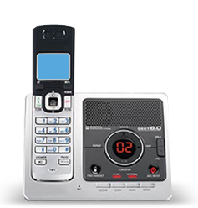
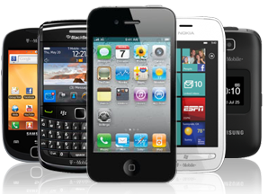

x
Telecommunications
Telecommunications refers to the exchange of information by electronic and electrical means over a significant distance.
A complete telecommunication arrangement is made up of two or more stations equipped with transmitter and receiver devices.
Telecommunications devices include telephones, telegraph, radio, microwave communication arrangements, fiber optics, satellites and the Internet.
Industry Overview

Slide 4
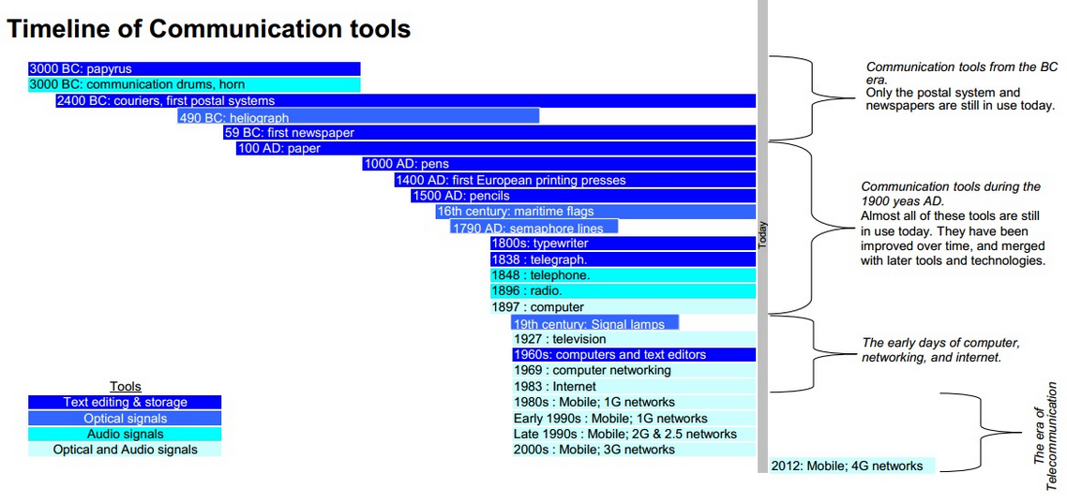
History of Telecommunications
Sources: Khourdajie, A. (2008), Marketing for the Wireless World
Industry Overview

Slide 5
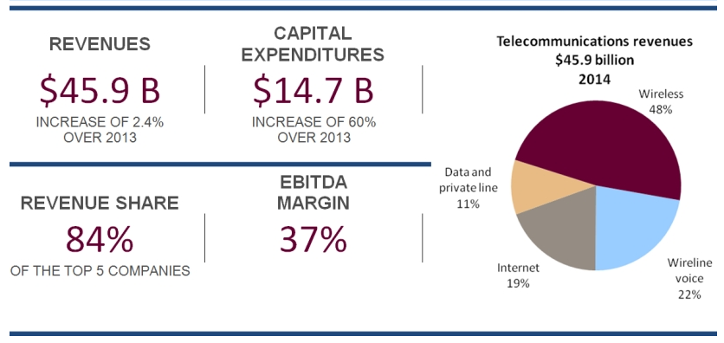
Telecommunications Sector Overview (2014)
Source: CRTC data collection
Industry Overview

Slide 6
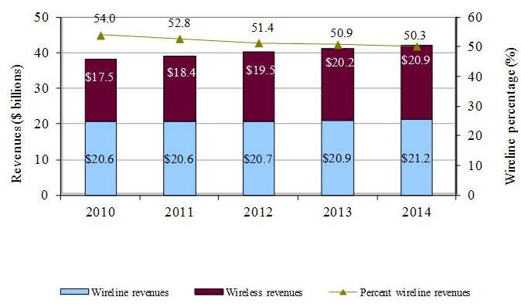
Telecommunications Revenue & Growth
Source: CRTC data collection
Industry Overview

Slide 7
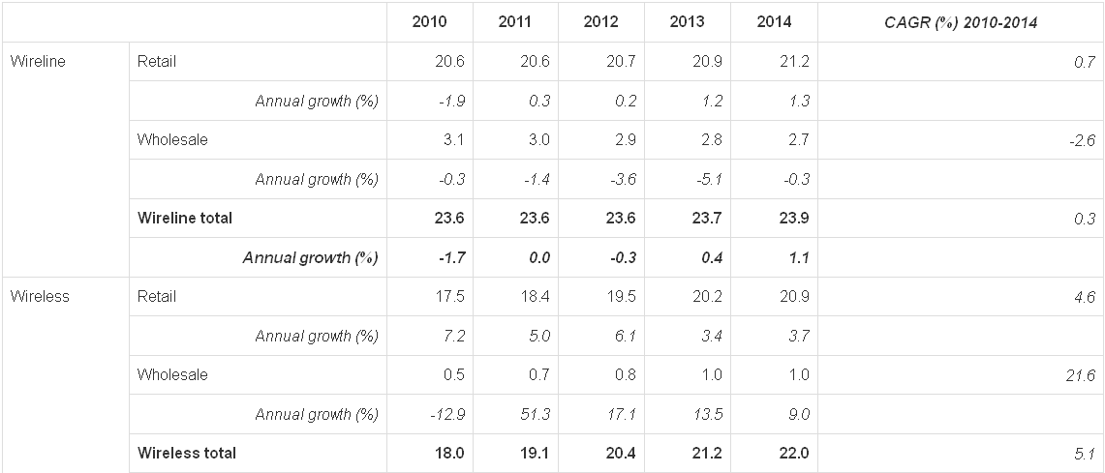
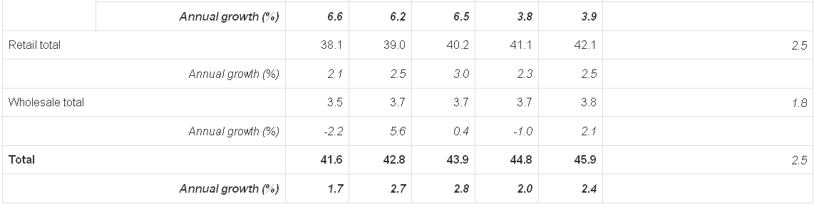
Wireline and Wireless Growth
($ Billions)
Source: CRTC data collection
Industry Overview

Slide 8
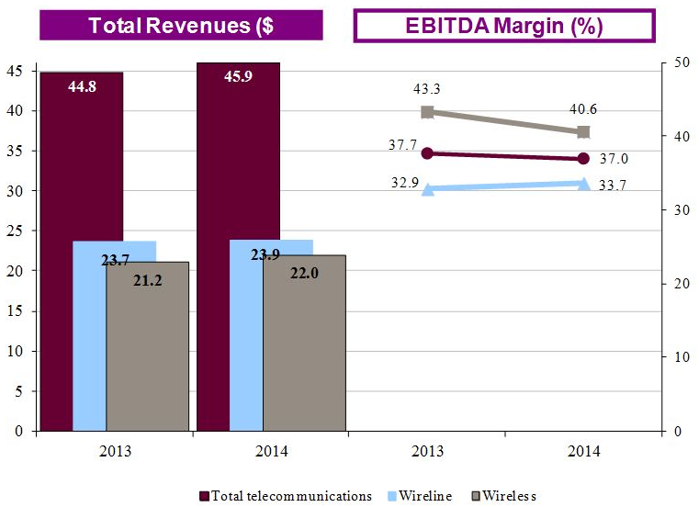
Wireless vs. Wireline
Source: CRTC data collection
Industry Overview

Slide 9
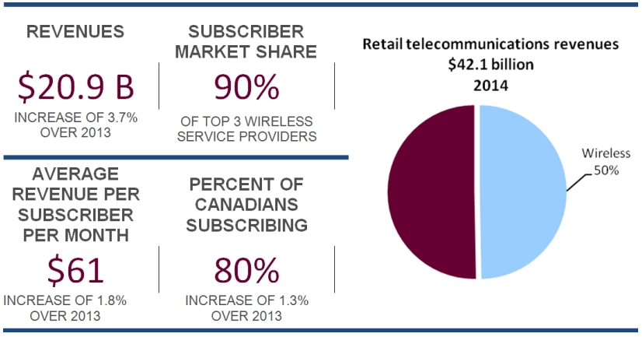
Wireless Retail Sector (2014)
Source: CRTC data collection
Industry Overview

Slide 10
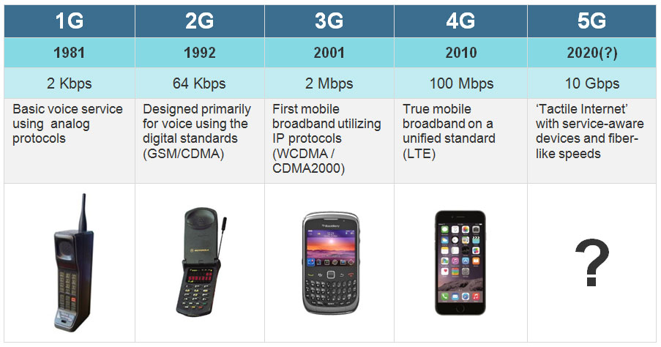
Industry Overview

Slide 11
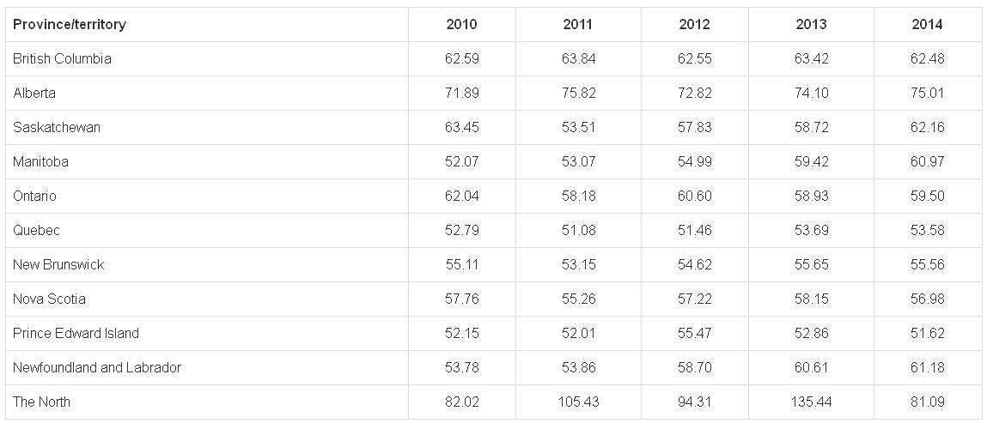
Wireless Subscribers by Province
Source: CRTC data collection
Industry Overview

Slide 12
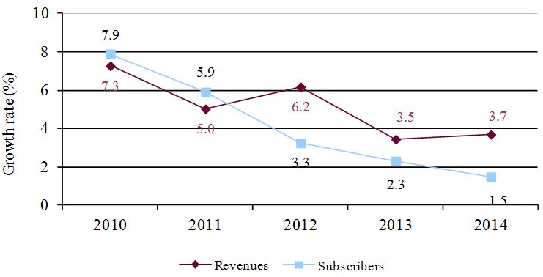
Wireless Revenue and Subscriber Growth Rates
Source: CRTC data collection
Industry Overview

Slide 13
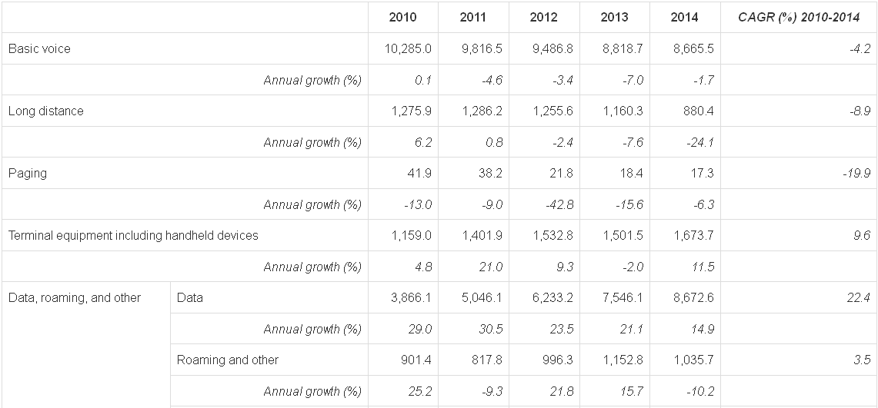
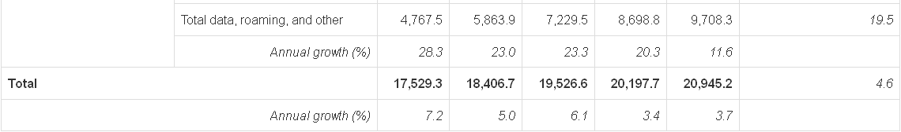
Wireless Revenue Components
($ Millions)
Source: CRTC data collection
Industry Overview

Slide 14
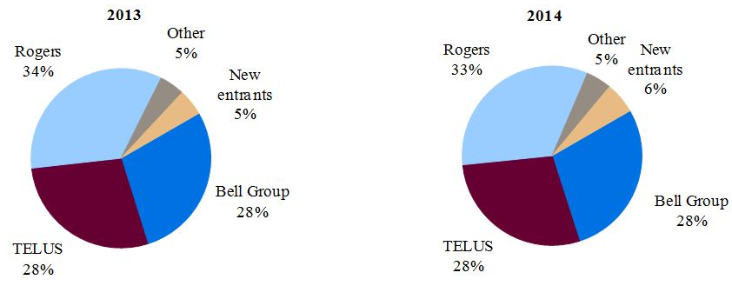
TSPs’ Wireless Subscriber Market Share
TSP: Telecommunication Service Provider
Source: CRTC data collection
Industry Overview

Slide 15
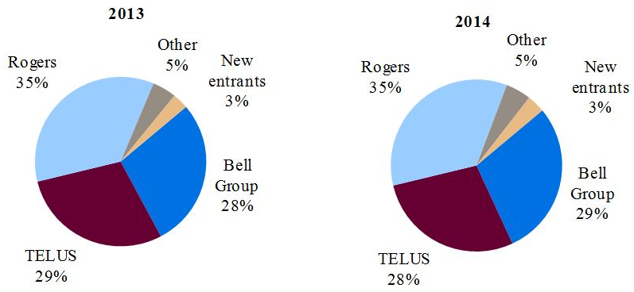
TSPs’ Wireless Revenue Market Share
Source: CRTC data collection
Industry Overview

Slide 16
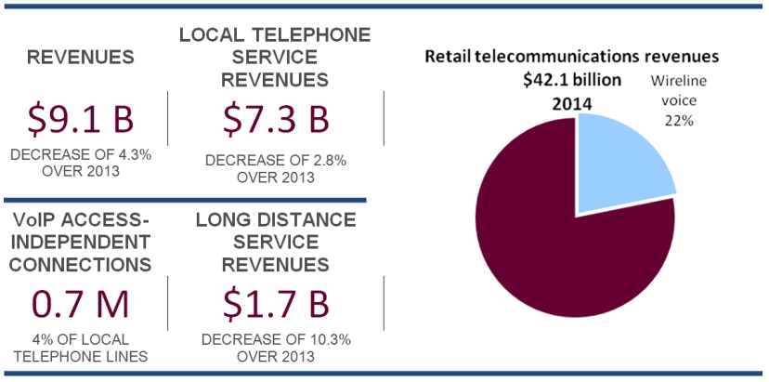
Wireline Voice Retail Sector (2014)
Source: CRTC data collection
Industry Overview

Slide 17
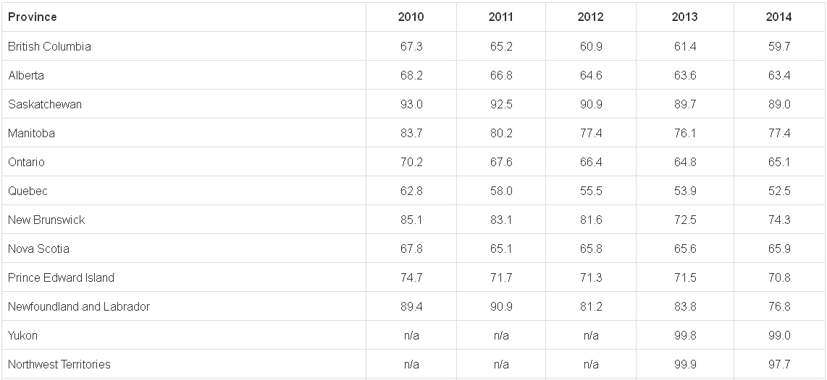
Incumbent TSP Provincial Retail Local Market Share %
Source: CRTC data collection
Industry Overview

Slide 18
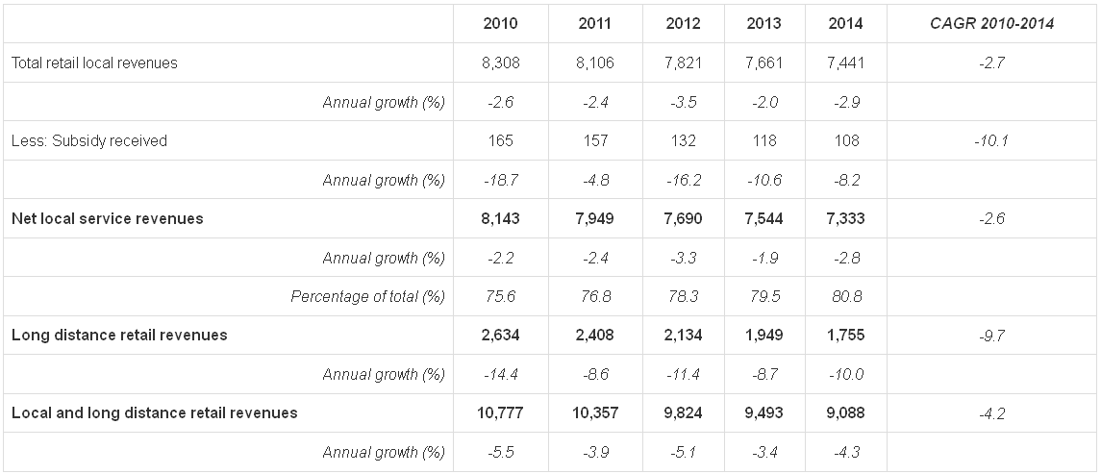
Wireline Local & Long Distance Retail Revenues
($ Millions)
Source: CRTC data collection
Industry Overview

Slide 19
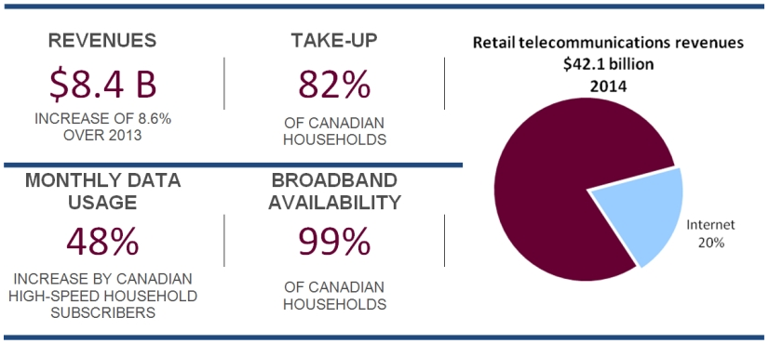
Internet and Broadband Retail Sector (2014)
Source: CRTC data collection
Industry Overview

Slide 20
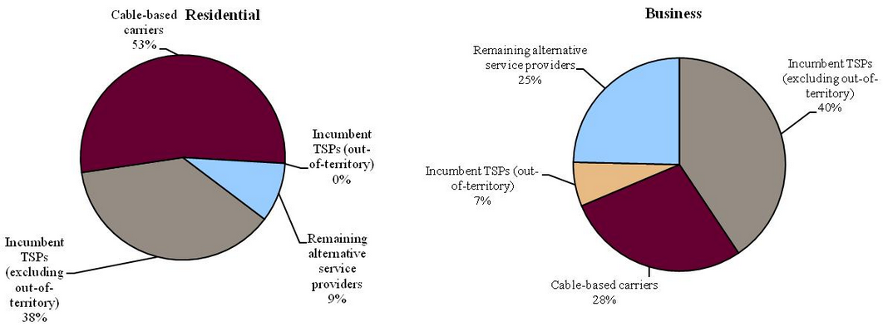
Internet Access Service Revenue Shares (2014)
Source: CRTC data collection
Industry Overview

Slide 21
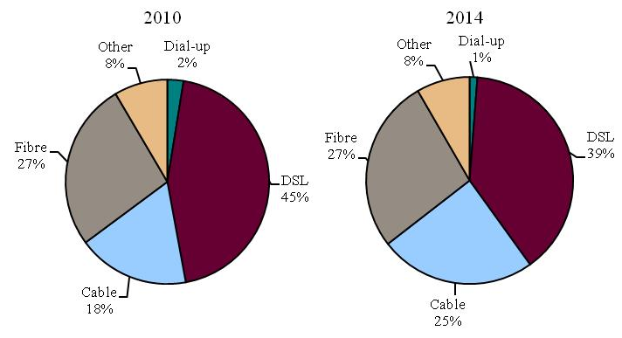
Business Internet Access Service Revenue
Source: CRTC data collection
Industry Overview

Slide 22
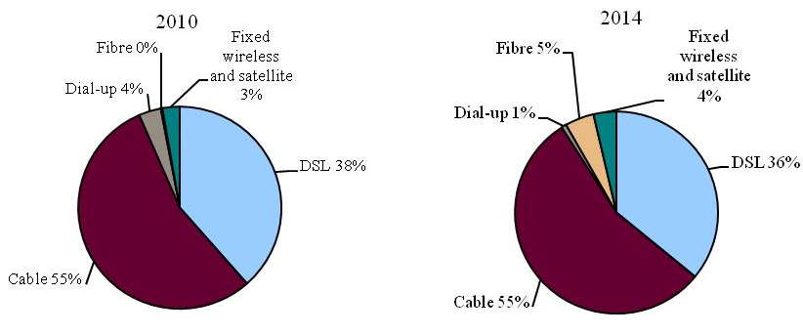
Residential Internet Access Service Subscriptions
Source: CRTC data collection
Industry Overview

Slide 23
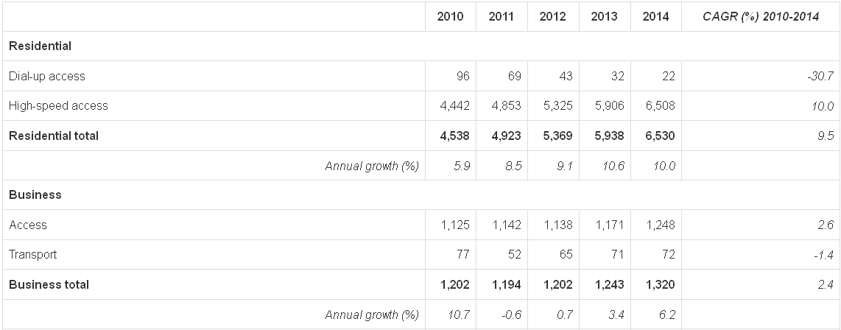
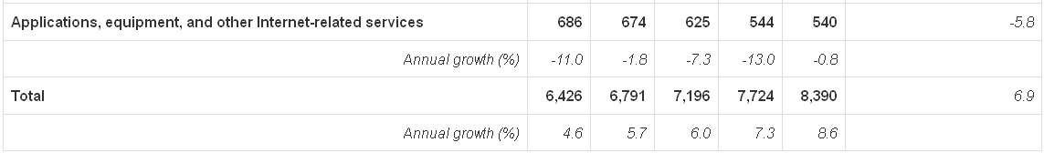
Retail Internet Service Revenues
($ Millions)
Source: CRTC data collection
Industry Overview

Slide 24
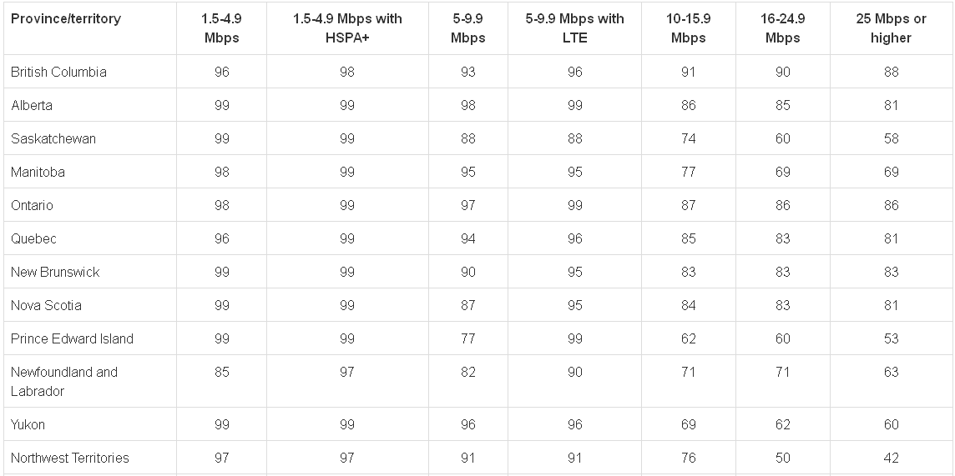
Broadband Availability % of Households (2014)
Source: CRTC data collection
Industry Overview

Slide 25
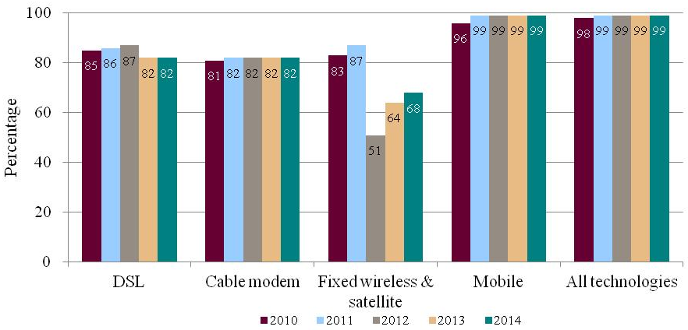
Broadband Availability % of Households
Source: CRTC data collection
Industry Overview

Slide 26
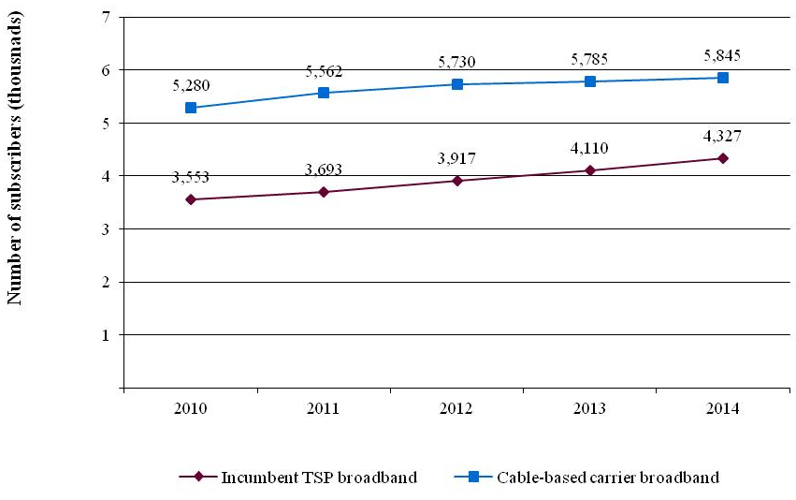
Broadband Subscriptions
Source: CRTC data collection
Industry Overview

Slide 27
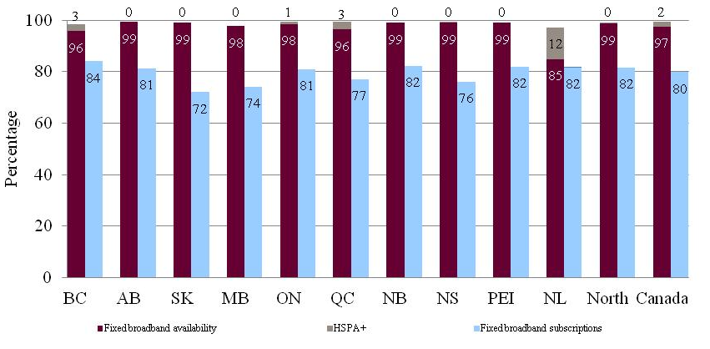
Broadband Availability vs. Broadband Subscriptions
Source: CRTC data collection
Industry Overview

Slide 28
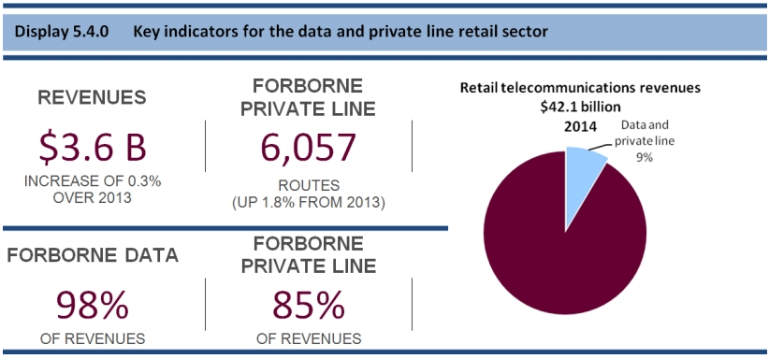
Detail & Private Line Sector (2014)
Source: CRTC data collection
Industry Overview

Slide 29
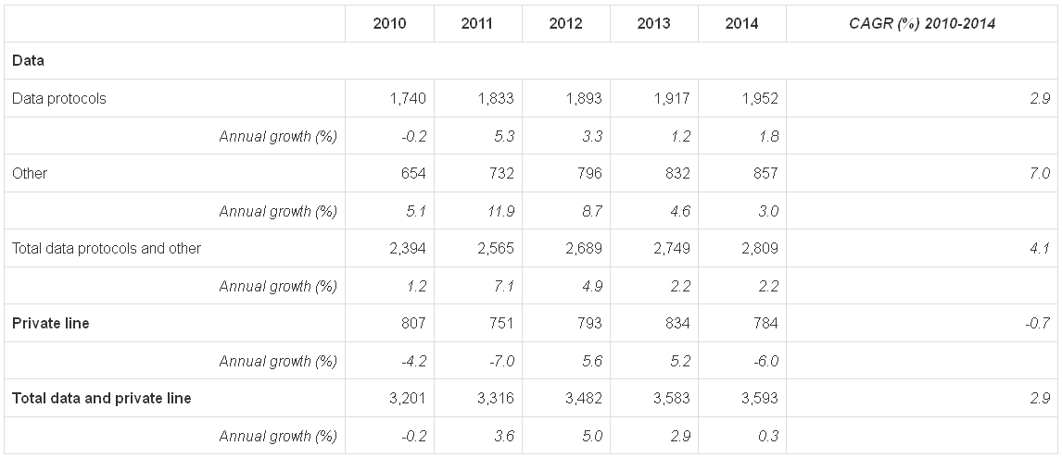
Data & Private Line Revenue Growth
($ Millions)
Source: CRTC data collection
Industry Overview

Slide 30
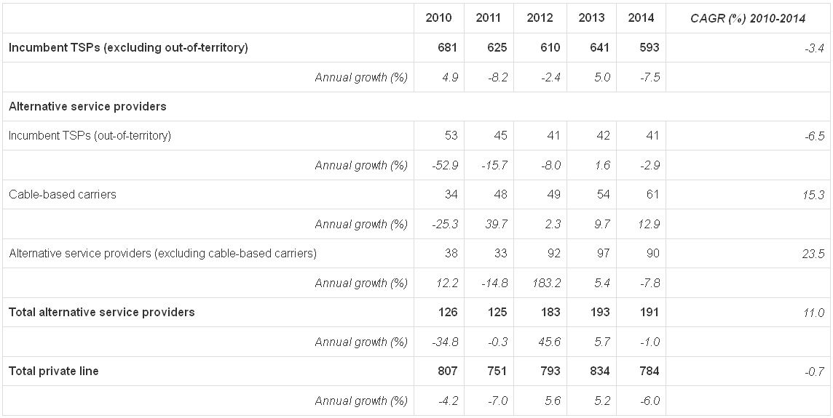
Private Line Retail Revenues by Service Provider
($ Millions)
Source: CRTC data collection
Industry Overview

Slide 31
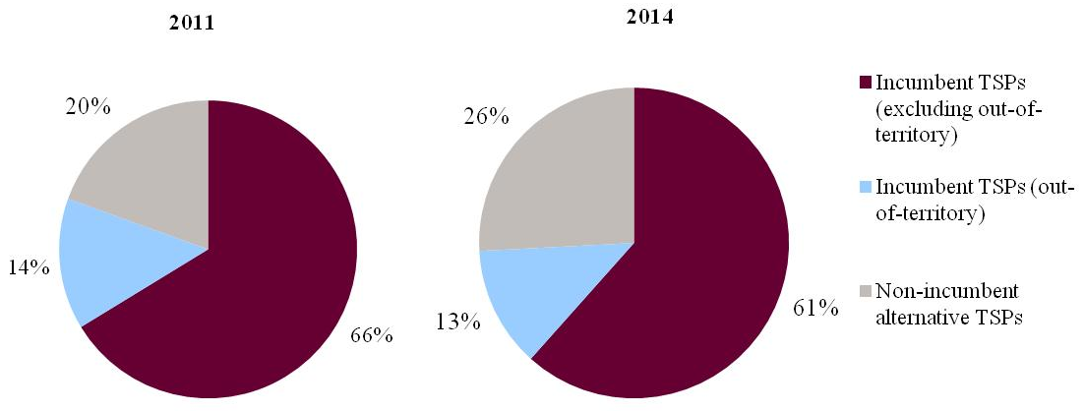
Retail Data and Private Line Revenue Market Share %
Source: CRTC data collection
Industry Overview

Slide 32
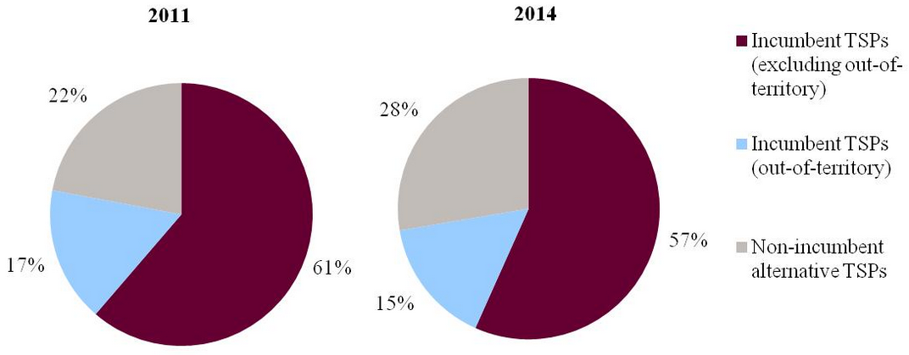
Retail Data Service Revenue Market Share %
Source: CRTC data collection
Industry Overview

Slide 33
Spectrum
Radio waves are a form of electromagnetic radiation which, like visible light or infrared, make up a portion of the entire spectrum.
Depending on their frequency (measured in hertz), radio waves can pass through solid objects and travel long distances. This makes them useful for mobile communications, broadcasting and many other wireless applications.
The radio frequency spectrum ranges from very low frequency radio waves at around 10kHz (30 kilometers wavelength) up to 100GHz (3 millimeters wavelength).
The radio spectrum is divided into frequency bands reserved for a single use or a range of compatible uses.
Within each band, individual transmitters often use separate frequencies, or channels, so they do not interfere with each other.
Source: GSMA
Industry Overview

Slide 34
Spectrum
For mobile phone call, a caller’s voice is converted by the handset into digital data, transmitted via radio to the network operator’s nearest tower or base station, transferred to another base station serving the recipient’s location, and then transmitted again to the recipient’s phone, which converts the signal back into audio through the earpiece.
There are a number of standards for mobile phones and base stations, such as GSM, WCDMA and LTE, which use different methods for coding and decoding, and ensure that users can only receive voice calls and data that are intended for them.
Because there are so many competing uses for wireless communication, strict rules are necessary to prevent one type of transmission from interfering with the next. And because spectrum is limited — there are only so many frequency bands
  Governments must oversee appropriate licensing of this valuable resource to facilitate use in all bands.
Governments spend a considerable amount of time allocating particular frequencies for particular services, so that one service does not interfere with another. These allocations are agreed internationally, so that interference across borders, as well as between services, is minimized.
Source: GSMA
Industry Overview

Slide 35
Spectrum Auction Process Overview
The Government of Canada holds spectrum auctions to sell radio frequencies to private users and telecommunication service providers.
A spectrum auction will generally take place according to the following steps:
  Public Consultation
  Comment Period
  Reply Comment Period
  Development Final Policy
  Amendments, Supplements and Clarification Questions
  Submission of Applicants
  Publication of List of Qualified Bidders
  Auction Opens
  Auction Closes
  Issuance of Licenses
  Unsold Licenses
Industry Overview

Slide 36
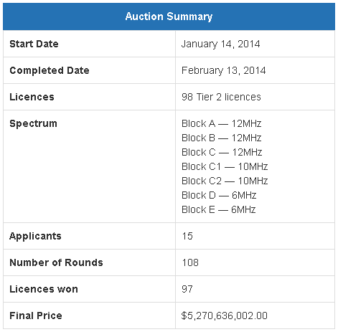
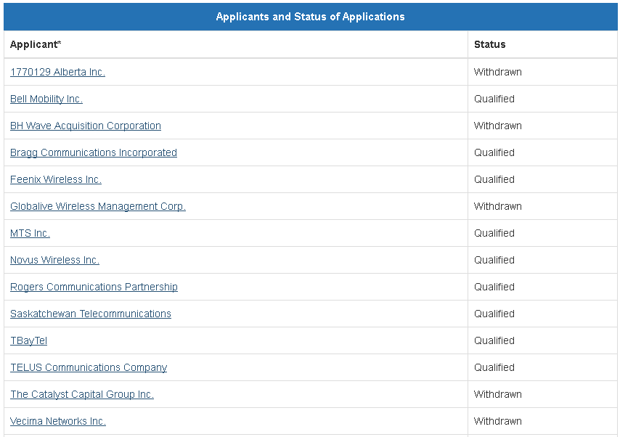
Spectrum Auction 700 MHz
Industry Overview

Slide 37
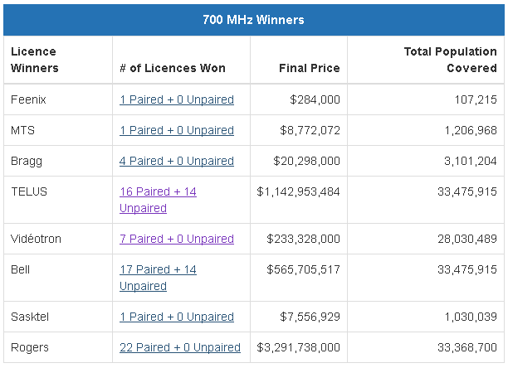
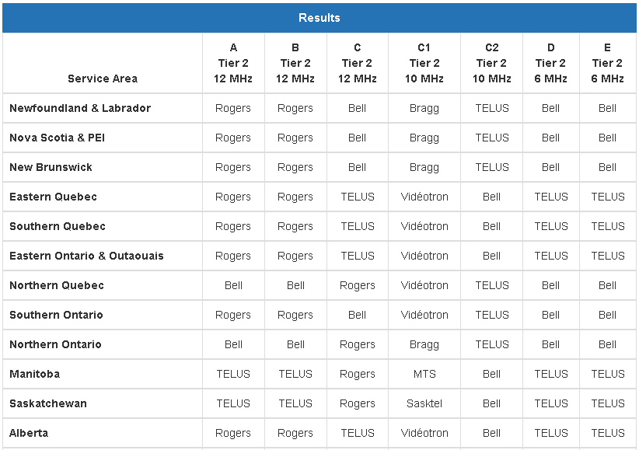

Spectrum Auction 700 MHz
Industry Overview

Slide 38
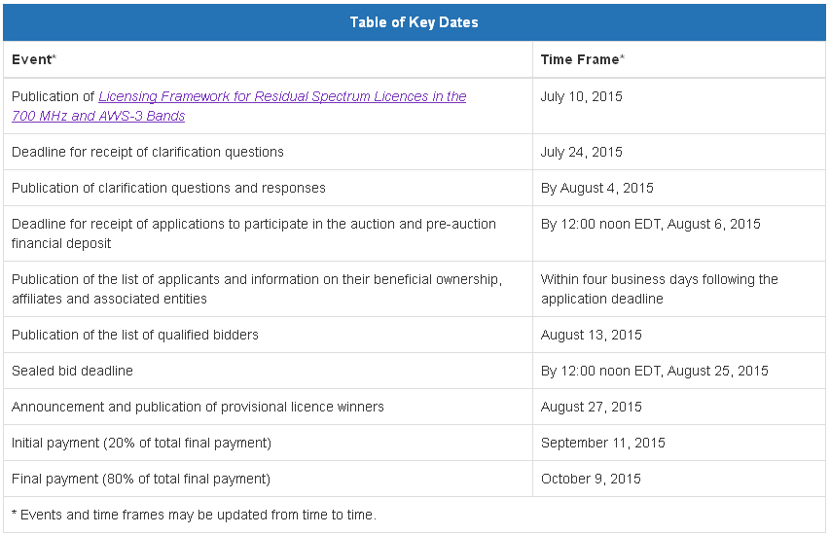
Spectrum Auction 700 MHz & AWS-3
Industry Overview

Slide 39
Spectrum Auction 700 MHz & AWS-3
Licences in the 700 MHz and AWS-3 bands were auctioned using Tier 2 service areas (a total of 14 service areas). These included block C1 in the 700 MHz band and block GHI in the AWS-3 band. Tier 2- 14 covers the areas of Yukon, the Northwest Territories and Nunavut as a single service area.
The 700 MHz auction included a spectrum cap of two paired blocks, applicable to all licensees, and a cap of one prime paired block (blocks B, C, C1, and C2) applicable to large wireless service providers.
The 700 MHz caps that apply to the 700 MHz spectrum licensed in the 2014 auction will be in place for a period of five years from the date of license issuance, and thus remain in effect for existing licensees.
  Industry Canada still considers the spectrum caps to be an appropriate mechanism for managing the availability of 700 MHz spectrum. Maintaining the cap will provide the opportunity for all interested service providers to acquire licenses in the North.
Industry Overview

Slide 40
Spectrum Auction 700 MHz & AWS-3
The licensee must comply with the spectrum aggregation limits.
A limit of two paired spectrum blocks in the 700 MHz band within blocks A, B, C, C1 and C2 is applicable to all licensees.
A limit of one paired spectrum block within blocks B, C, C1 and C2 is applicable to all licensees which are large wireless service providers. Large wireless service providers are defined as companies with 10% or more of the national wireless subscriber market share, or 20% or more of the wireless subscriber market share in the province of the relevant license area.
Industry Overview

Slide 41
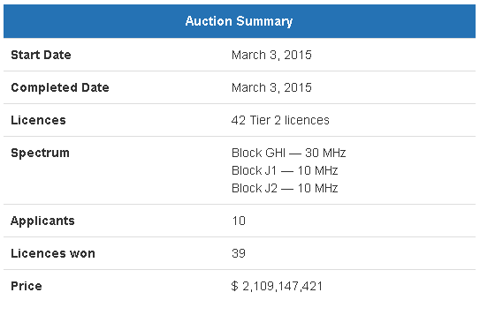
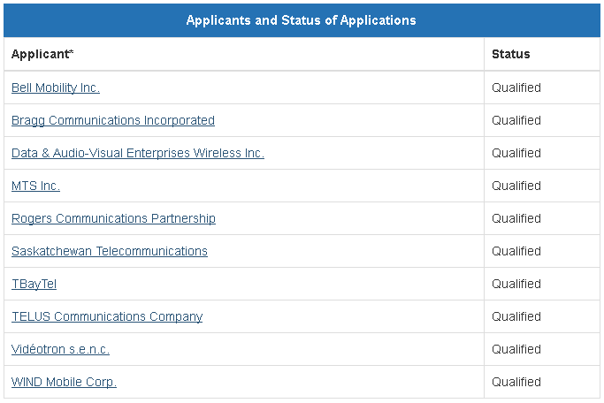
Spectrum Auction AWS-3
Industry Overview

Slide 42
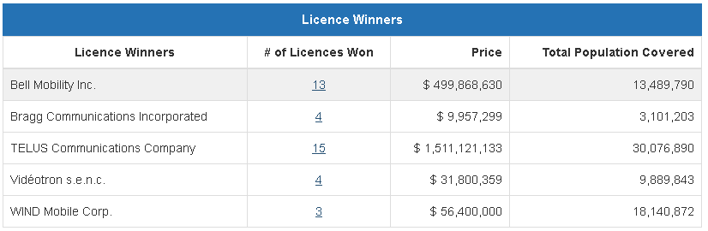
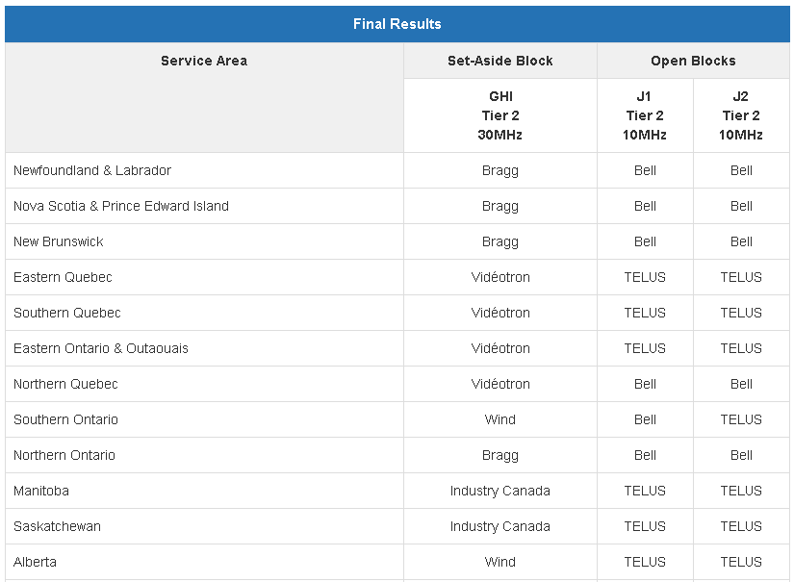
Spectrum Auction AWS-3
Industry Overview

Slide 43
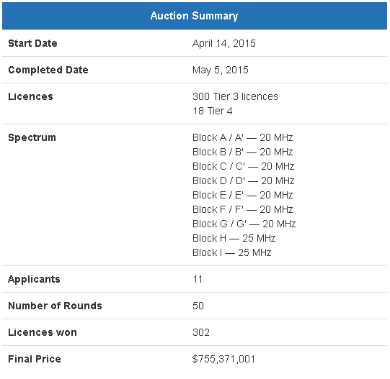
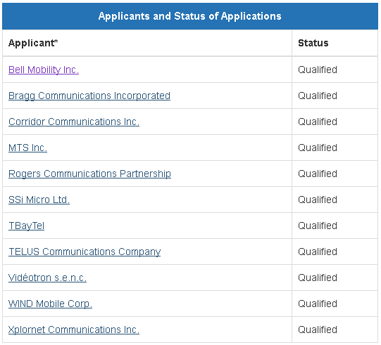
Spectrum Auction 2500-2690 MHz
Industry Overview

Slide 44
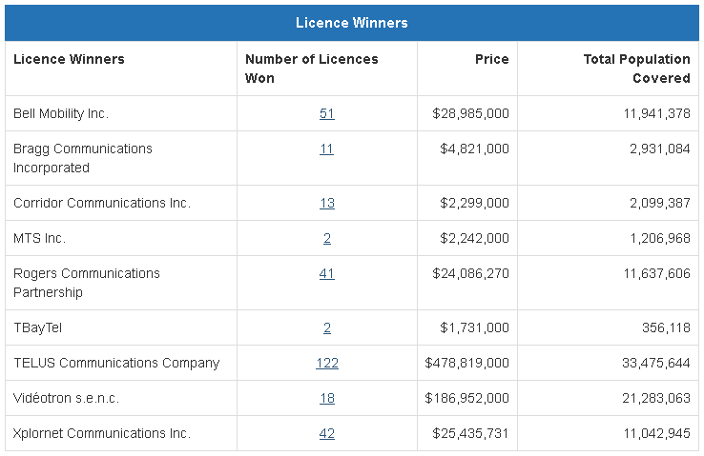
Spectrum Auction 2500-2690 MHz
Industry Overview

Slide 45
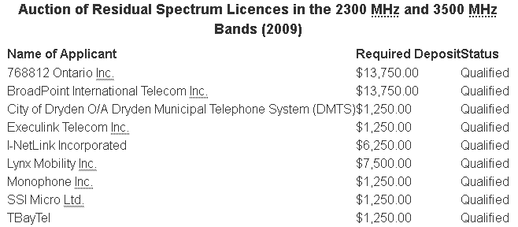
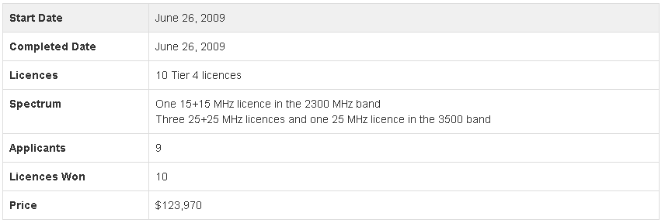
Spectrum Auction 2300 & 3500 MHz
Industry Overview

Slide 46
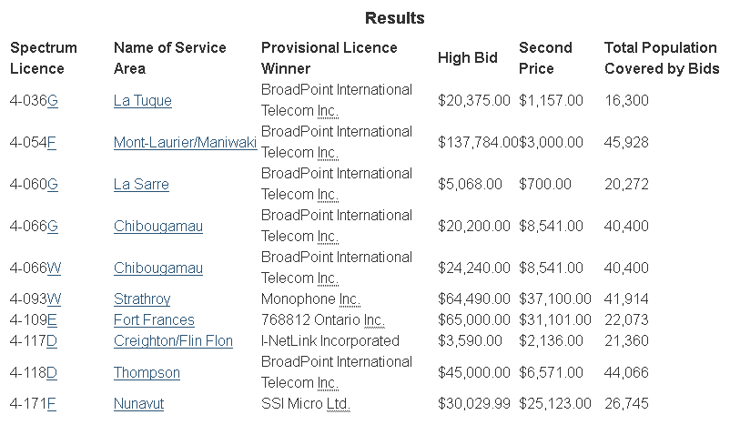
Spectrum Auction 2300 & 3500 MHz
Industry Overview

Slide 47
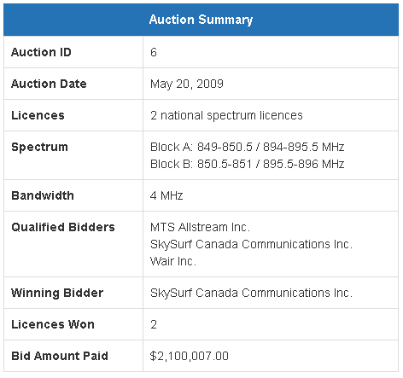

Spectrum Auction Air-Ground 849-851 MHz & 894-896 MHz
Industry Overview

Slide 48
Spectrum Auction Air-Ground 849-851 MHz & 894-896 MHz
All Bids Received
Spectrum Licence
 | A | B | A+B
MTS Allstream Inc. | $1,900,007.00 | $0.00 | $2,100,007.00
SkySurf Canada Communications Inc. | $0.00 | $0.00 | $5,135,678.29
Results
Provisional Licence Winner for A+B Licences | High Bid | Second Price | Total Populations Covered by Bids | Name of Service Area
SkySurf Canada Communications Inc. | $5,135,678.29 | $2,100,007.00 | 30,007,094 | Canada
Industry Overview

Slide 49



Spectrum Auction AWS-1
Industry Overview

Slide 50

Spectrum Auction AWS-1
Industry Overview

Slide 51


Spectrum Auction PCS – 2 GHz
Industry Overview

Slide 52

Spectrum Auction PCS – 2 GHz
Industry Overview

Slide 53


Spectrum Auction Broadband Wireless Access 24 & 38 GHz
Industry Overview

Slide 54

Spectrum Auction Broadband Wireless Access 24 & 38 GHz
Industry Overview

Slide 55


Slide 56




Source: The Globe and Mail
Overview
Management
Operations
Financials
Recommendation

Slide 57
History
1962 – Ted Rogers founded Rogers Radio Broadcasting Limited and bought CHFI-FM which quickly became a popular radio station
1967 – Rogers cable started and expanded past 12 channels in 1972
1985 – Rogers Cantel Inc. founded (now called Rogers Wireless) and signaled beginning of expansion into mobile phone market
1994 – Launches $3.1 billion takeover of Maclean Hunter to create Rogers Media
2000 – Acquires Toronto Blue Jays
2001 – Acquires Sportsnet and launches HDTV
Overview
Management
Operations
Financials
Recommendation

Slide 58
History
2004 – Buys back AT&T interest in Rogers Wireless for $1.8 billion and purchases Microcell for $1.6 billion
2007 – Acquires 5 CityTV television stations
2008 – Rogers Wireless launches Apple’s iPhone, and takeover of Aurora Cable
2009 – Rogers and Shaw agreed to divide the country in half in a lawsuit regarding cable service, with Rogers in the East
2011 – First to launch LTE network
2014 – Won beachfront 700 MHz spectrum
2015 – Acquired Mobilicity and Atlantic Inc.
Overview
Management
Operations
Financials
Recommendation

Slide 59

1 Year Performance with 50/200 MA
Source: TMX Money
Overview
Management
Operations
Financials
Recommendation

Slide 60

1 Year Performance Comparison
Source: TMX Money
Overview
Management
Operations
Financials
Recommendation

Slide 61

5 Year Performance with 50/200 MA
Source: TMX Money
Overview
Management
Operations
Financials
Recommendation

Slide 62

5 Year Performance Comparison
Source: TMX Money
Overview
Management
Operations
Financials
Recommendation

Slide 63

10 Year Performance with 50/200 MA
Source: TMX Money
Overview
Management
Operations
Financials
Recommendation

Slide 64

10 Year Performance Comparison
Source: TMX Money
Overview
Management
Operations
Financials
Recommendation

Slide 65

Max Performance
Source: Globe and Mail
Overview
Management
Operations
Financials
Recommendation

Slide 66

Common Shares Outstanding
Source: Rogers 2015 Annual Reports
Overview
Management
Operations
Financials
Recommendation

Slide 67

Share Features
Source: Rogers 2015 Annual Reports
Overview
Management
Operations
Financials
Recommendation

Slide 68

Dividends
Source: Rogers 2015 Annual Reports
Overview
Management
Operations
Financials
Recommendation

Slide 69

Dilution
Source: Rogers 2015 Annual Reports
Overview
Management
Operations
Financials
Recommendation
Notes:
Options with tandem stock appreciation rights or cash payment alternatives are accounted for as cash-settled awards. As these awards can be exchanged for common shares of the Company, they are considered potentially dilutive and are included in the calculation of the Company’s diluted net earnings per share if they have a dilutive impact in the period.

Slide 70
Management

Slide 71


Control
Source: Rogers 2015 Annual Reports
Overview
Management
Operations
Financials
Recommendation

Slide 72
Board of Directors
Alan Douglas Horn – Chairman
Vice President, Finance and Chief Financial Officer at Rogers from 1996 to 2006
President and Chief Operating Officer at Rogers from 1990-1996
Became Chairman of the Board in 2006
Member of the Advisory Committee of the Rogers Control Trust
Chartered Professional Accountant and Chartered Accountant Designations
Received his Bachelors of Science in Mathematics from the University of Aberdeen, Scotland
Source: Rogers Corporate Website
Overview
Management
Operations
Financials
Recommendation

Slide 73
Board of Directors
Charles Sirois – Lead Director
Current position since 2014
Chair of CIBC Board
Bachelors of Finance from Universite de Sherbrooke, Maser of Finance from Universite Laval
Founding partner of Tandem Expansion Fund
Previous senior positions at BCE and Teleglobe
Founder and senior positions at Microcell Telecommunications and Telesystem International Wireless
Source: Rogers Corporate Website
Overview
Management
Operations
Financials
Recommendation

Slide 74
Board of Directors
Charles Wiliam David Birchall – Vice Chairman Barrick Gold Corp.
Chairman of Barrick International Banking Corp
Vice Chairman of TrizeHahn Corp. 1996 – 2001
Fellow of the Institute of CA of England and Wales
Bonnie Brooks – Vice Chairman Hudson’s Bay Company
Current position since 2014
Director of Empire Company Ltd, Riocan Real Estate Investment Trust, and Abercrombie & Fitch Co.
MBA University of Western Ontario
LLD from University of Guelph, DCL from St. Mary’s University
Source: Rogers Corporate Website
Overview
Management
Operations
Financials
Recommendation

Slide 75
Board of Directors
Stephen Burch – Company Director
Chairman of Board of the University of Maryland Medical System
Various positions at Comcast Cable Communications 1987 - 2005
JD from Gonzaga University
John Henry Clappison – Company Director
Director of Rogers Bank since 2013
Director of SunLife Financial Inc. and Cameco Corp
CPA, CA, Fellow of the CPA of Ontario
Managing Partner of PwC 1990 – 2005
Source: Rogers Corporate Website
Overview
Management
Operations
Financials
Recommendation

Slide 76
Board of Directors
Guy Laurence – President, CEO
Joined Rogers in 2013
Previous CEO of Vodafone UK
Senior leadership positions at MGM Studios, United Cinemas, and Chrysalis Records
Philip Lind – Vice Chairman
Joined Rogers as Programming Chief in 1969
BA in Political Science from UBC, MA in Political Science from University of Rochester
Director of Central Canadian Public TV Association and the US Cable Centre
Source: Rogers Corporate Website
Overview
Management
Operations
Financials
Recommendation

Slide 77
Board of Directors
Isabelle Marcoux – Chair of the Board Transcontinental Inc.
Chair since 2012
Bachelor in Political Science, Economics, and Civil Law from McGill
Lawyer at McCarthy Tertault LLP
John MacDonald – Company Director
Previous executive positions at AT&T, MTS Allstream, Bell, and Leitech Technology Corp
B.Sc in Engineerint from Dalhousie, BA in Engineering from University of Nova Scotia
Source: Rogers Corporate Website
Overview
Management
Operations
Financials
Recommendation

Slide 78
Board of Directors
The Honourable David Peterson
Chairman of Cassels Brock & Blackwell LLP
Director of Franco-Nevada Corp and VersaPay Corp
Former Premier of Ontario, appointed QC in 1980
BA University of Western Ontario, LLB University of Toronto
Edward Rogers – Deputy Chairman
Representative controlling shareholder of Rogers Communications
Launched wireless data in Rogers in 1997
Various former positions within Rogers
Source: Rogers Corporate Website
Overview
Management
Operations
Financials
Recommendation

Slide 79
Board of Directors
Loretta Rogers – Company Director
Advisor of RCT
President of Canadian Lyford Cay Foundation
BA from Univesity of Miami
Martha Rogers – Dr. of Naturopathic Medicine
Advisor of RCT
BA from University of Western Ontario
Doctor of Naturopathic Medicine from the Canadian College of Naturopathic Medicine
Source: Rogers Corporate Website
Overview
Management
Operations
Financials
Recommendation

Slide 80
Board of Directors
Melinda Rogers – Founder, Rogers Ventures, and Vice Chair of Rogers Control Trust
Advisory Council of the Rotman School of Business
Director of Next Issue Magazine
BA from University of Western Ontario, MBA from Rotman School of Business
Source: Rogers Corporate Website
Overview
Management
Operations
Financials
Recommendation

Slide 81

Senior Leadership
Guy Laurence – President and Chief Executive Officer
Joined Rogers in 2013 as President and CEO
More than 30 years of global experience in telecommunications, media, and television
Previous CEO of Vodafone UK 2008 – 2013
Senior roles & CEO of Vodafone Netherlands 2000 – 2008
Senior leadership positions at MGM Studios, United Cinemas, and Chrysalis Records
Salary = $1,200,000
Total Compensation = $8,340,000
Source: Rogers Corporate Website
Overview
Management
Operations
Financials
Recommendation

Slide 82

Senior Leadership
Tony Staffieri – Chief Financial Officer
Joined Rogers in April 2012
Began his career with PricewaterhouseCoopers
Bachelor of Business Administration degree from the Schulich School of Business
Fellow Charted Accountant and Fellow Chartered Professional Accountant designations
Worked at Bell as Senior VP Finance
Salary = $675,000
Total Compensation = $2,700,000
Source: Rogers Corporate Website
Overview
Management
Operations
Financials
Recommendation

Slide 83

Senior Leadership
Bob Berner – Chief Technology Officer
Joined Cantel (later Rogers) in 1985 and helped launch and operate the company’s wireless network
After holding numerous positions within Rogers, became Chief Technology Officer in 2005
Professional engineer with 35 years’ experience in the telecommunications industry
Bachelor of Applied Science degree in Engineering from University of Toronto
Source: Rogers Corporate Website
Overview
Management
Operations
Financials
Recommendation

Slide 84

Senior Leadership
Frank Boulben – Chief Strategy Officer
Over 20 years of wireless and Internet experience in various executive positions (Vodafone, Orange, Vivendi, Blackberry)
Joined Rogers as Chief Strategy Officer in May 2014
Graduatd from Ecole Polytechnique and Ecole Nationale des Ponts et Chausees with a major in Network Economy and Management
Source: Rogers Corporate Website
Overview
Management
Operations
Financials
Recommendation

Slide 85

Senior Leadership
Rick Brace – President, Media Business Unit
Joined Rogers in August 2015 as President, Media Business Unit
More than 40 years of experience in the media industry
Worked with Bell Media in senior leadership roles for 13 years
Bachelors degree in Radio and Television from Ryerson University
Source: Rogers Corporate Website
Overview
Management
Operations
Financials
Recommendation

Slide 86

Senior Leadership
Jacob Glick – Chief Corporate Affairs Officer
Joined Rogers in November 2014 as current position
Previously held same position at Google
Also served as General Counsel, Director of Policy Development and Corporate Secretary, Canadian Internet Registration Authority (CIRA), and as a litigator with McCarthy Tetrault
Attended University of Toronto for Bachelors of Arts in Political Science, and for his law degree (LLB)
Source: Rogers Corporate Website
Overview
Management
Operations
Financials
Recommendation

Slide 87
Operations

Slide 88

Rogers 3.0
Source: Rogers 2015 Annual Reports
Overview
Management
Operations
Financials
Recommendation

Slide 89


Rogers 3.0
Source: Rogers 2015 Annual Reports
Overview
Management
Operations
Financials
Recommendation
Notes:
Rogers 3.0 is their plan to re-accelerate revenue growth and increase cash flow and shareholder returns

Slide 90

Rogers 3.0
Source: Rogers 2015 Annual Reports
Overview
Management
Operations
Financials
Recommendation

Slide 91



Organization Structure
Source: Rogers 2015 Annual Reports
Overview
Management
Operations
Financials
Recommendation

Slide 92
Wireless
Rogers is Canada’s largest provider of wireless communications services
9.9 million subscribers between Rogers, Fido, Chatr, and Mobilicity brands
34% subscriber share and 34% revenue share of Canadian wireless market
Reached 93% of the Canadian population on LTE network alone
Supported by voice and data roaming agreements in more than 200 countries
Source: Rogers 2015 Annual Reports
Overview
Management
Operations
Financials
Recommendation

Slide 93

Wireless Coverage
Source: Rogers Corporate Website
Overview
Management
Operations
Financials
Recommendation

Slide 94

Wireless – Spectrum
Source: Rogers 2015 Annual Reports
Overview
Management
Operations
Financials
Recommendation
Notes:
Current spectrum holdings

Slide 95

Wireless – Spectrum
Source: Rogers 2015 Annual Reports
Overview
Management
Operations
Financials
Recommendation
Notes:
Access through network sharing agreements

Slide 96

Wireless – Spectrum
Source: Rogers 2015 Annual Reports
Overview
Management
Operations
Financials
Recommendation
Notes:
Option arrangement to buy additional spectrum

Slide 97


Wireless
Source: Rogers 2015 Annual Reports
Overview
Management
Operations
Financials
Recommendation

Slide 98


Wireless
Source: Rogers 2015 Annual Reports
Overview
Management
Operations
Financials
Recommendation

Slide 99




Wireless Metrics
Source: Rogers 2015 Annual Reports
Overview
Management
Operations
Financials
Recommendation

Slide 100
Cable
2.0 million high-speed Internet subscribers
1.9 million television subscribers (31% market share)
1.1 million phone subscribers
Rated fastest Internet service by PCMag.com
Source: Rogers 2015 Annual Reports; Rogers Corporate Website
Overview
Management
Operations
Financials
Recommendation

Slide 101

Cable
Source: Rogers Corporate Website
Overview
Management
Operations
Financials
Recommendation

Slide 102


Cable
Source: Rogers 2015 Annual Reports
Overview
Management
Operations
Financials
Recommendation

Slide 103


Cable Subscribers
Source: Rogers 2015 Annual Reports
Overview
Management
Operations
Financials
Recommendation

Slide 104




Cable Metrics
Source: Rogers 2015 Annual Reports
Overview
Management
Operations
Financials
Recommendation

Slide 105
Business Solutions
Sells to small, medium, and large enterprises and governments
Sells to other carriers on a wholesale basis
8,500 on-net fibre connected buildings
Overview
Management
Operations
Financials
Recommendation

Slide 106

Business Solutions
Overview
Management
Operations
Financials
Recommendation

Slide 107


Business Solutions
Source: Rogers 2015 Annual Reports
Overview
Management
Operations
Financials
Recommendation
Notes:
Next generation: generated by the provision of high- speed, high-reliability data and voice communications, provided on Rogers’ advanced IP, Ethernet, and cloud platforms, and mainly through Rogers’ extensive communications network and data centre infrastructure.
Legacy: generated mainly by circuit-switched local and long distance voice services and legacy data services, provided over TDM and prior generation data platforms, with client access often delivered using leased third-party network elements and tariffed ILEC services.

Slide 108


Business Solutions Metrics
Source: Rogers 2015 Annual Reports
Overview
Management
Operations
Financials
Recommendation

Slide 109
Media
Owns Toronto Blue Jays Baseball Club, the Rogers Centre, the Grand Slam of Curling
37.5% ownership of Maple Leaf Sports & Entertainment (owner of Toronto Maple Leafs, Toronto Raptors, and Toronto FC)
Owns digital media properties Texture by Next Issue and 50% ownership of Shomi
Television assets include seven Sportsnet channels, seven City stations, five OMNI Television multilingual channnels, FX, FXX, OLN, and G4
Owns 51 Canadian radio stations, publishes more than 25 consumer and business magazines, and owns The Shopping Channel
Source: Rogers Corporate Website
Overview
Management
Operations
Financials
Recommendation

Slide 110


Media
Source: Rogers 2015 Annual Reports
Overview
Management
Operations
Financials
Recommendation

Slide 111


Media
Source: Rogers 2015 Annual Reports
Overview
Management
Operations
Financials
Recommendation

Slide 112
Financials

Slide 113

Financial Highlights
Source: Rogers 2015 Annual Reports
Overview
Management
Operations
Financials
Recommendation

Slide 114

Key Performance Indicators
Source: Rogers 2015 Annual Reports
Overview
Management
Operations
Financials
Recommendation

Slide 115

Segment
Financials
Source: Rogers 2015 Annual Reports
Overview
Management
Operations
Financials
Recommendation

Slide 116

Balance Sheet – Assets
Source: Rogers 2015 Annual Reports
Overview
Management
Operations
Financials
Recommendation

Slide 117

Balance Sheet – Liabilities & Shareholders Equity
Source: Rogers 2015 Annual Reports
Overview
Management
Operations
Financials
Recommendation

Slide 118

Intangible Assets
Source: Rogers 2015 Annual Reports
Overview
Management
Operations
Financials
Recommendation

Slide 119

Income Statement
Source: Rogers 2015 Annual Reports
Overview
Management
Operations
Financials
Recommendation

Slide 120

Income Statement - Continued
Source: Rogers 2015 Annual Reports
Overview
Management
Operations
Financials
Recommendation

Slide 121

Cash Flow from Operations
Source: Rogers 2015 Annual Reports
Overview
Management
Operations
Financials
Recommendation

Slide 122

Cash Flow from Investing
Source: Rogers 2015 Annual Reports
Overview
Management
Operations
Financials
Recommendation

Slide 123

Cash Flow from Financing
Source: Rogers 2015 Annual Reports
Overview
Management
Operations
Financials
Recommendation

Slide 124
Change in Cash Flow
Source: Rogers 2015 Annual Reports
Overview
Management
Operations
Financials
Recommendation

Slide 125

Changes in Shareholders’ Equity
Source: Rogers 2015 Annual Reports
Overview
Management
Operations
Financials
Recommendation

Slide 126

Long-Term Debt
Source: Rogers 2015 Annual Reports
Overview
Management
Operations
Financials
Recommendation

Slide 127

Long-Term Debt Issued
Source: Rogers 2015 Annual Reports
Overview
Management
Operations
Financials
Recommendation

Slide 128
Recommendation

Slide 129
HOLD
Overview
Management
Operations
Financials
Recommendation

Slide 131





Source: The Globe and Mail
Overview
Management
Operations
Financials
Recommendation

Slide 132
History
Canada’s largest communications company, founded in 1880 by Charles Fleetford Sise
Offers a full range of communications and content service, which include fibre-based IPTV and high-speed Internet services, 4G LTE wireless, home phone and business network and communications services, data hosting, cloud computing , television, radio, out of home digital to residential, business, and government customers.
Headquarters are in Montreal, Quebec
Overview
Management
Operations
Financials
Recommendation

Slide 133

1 Year Performance with 50/200 MA
Source: TMX Money
Overview
Management
Operations
Financials
Recommendation

Slide 134

1 Year Performance Comparison
Source: TMX Money
Overview
Management
Operations
Financials
Recommendation

Slide 135

5 Year Performance with 50/200 MA
Source: TMX Money
Overview
Management
Operations
Financials
Recommendation

Slide 136

5 Year Performance Comparison
Source: TMX Money
Overview
Management
Operations
Financials
Recommendation

Slide 137

10 Year Performance with 50/200 MA
Source: TMX Money
Overview
Management
Operations
Financials
Recommendation

Slide 138

10 Year Performance Comparison
Source: TMX Money
Overview
Management
Operations
Financials
Recommendation

Slide 139

Max Performance
Source: Globe and Mail
Overview
Management
Operations
Financials
Recommendation

Slide 140

Common Shares Outstanding
Overview
Management
Operations
Financials
Recommendation

Slide 141

Common Shares Outstanding
Overview
Management
Operations
Financials
Recommendation

Slide 142

Dividends Paid 5 Year
Overview
Management
Operations
Financials
Recommendation

Slide 143
Management

Slide 144
Ownership
Institutional Shares increased from 2014 to 2015 by 0.84% to 42.97%
Owner of Institutional Holdings | Number of Shares | Amount in Canadian Dollars
Royal Bank of Canada | 67,549,177 | 2,942,442,150
Bank of Montreal | 32,160,036 | 1,400,891,168
TD Asset Management Inc. | 18,375,040 | 800,416,742
CIBC World Markets Inc. | 15,120,619 | 658,654,164
Wellington Management Group LLP | 12,209,495 | 531,845,602
Overview
Management
Operations
Financials
Recommendation

Slide 145

Executive Team
George Cope
President & CEO
BCE Inc. and Bell Canada
Served in public-company chief executive roles in the industry for more than 25 years
Previous CEO of Telus Mobility and Clearnet Communications
Under Mr. Cope’s leadership, Bell announced the Bell Let’s Talk initiative in 2010, the largest-ever corporate commitment to Canadian mental health
Education:
Western University - Honours Business Administration (HBA) degree
Awarded the Queen’s Diamond Jubilee Medal for his work on Bell Let’s Talk
Appointed as a Member of the Order of Canada in 2014.
Mr. Cope serves as a Director of Bank of Montreal and of BCE and Bell Canada.
Overview
Management
Operations
Financials
Recommendation

Slide 146

Executive Team Continued
Mirko Bibic
Chief Legal & Regulatory Officer and Executive VP, Corporate Development (since 2012)
Bell and BCE Inc
Joined Bell as Senior VP, Regulatory in 2004
Promoted to Senior VP, Regulatory & Government Affairs in 2008
Assumed additional responsibilities as Executive Vice President, Corporate Development in 2015.
Prior to joining Bell:
Managing partner of the Ottawa office of Stikeman Elliott LLP
Education:
University of Toronto – LL.B
Called to the Ontario bar in 1994.
Overview
Management
Operations
Financials
Recommendation

Slide 147

Executive Team Continued
Glen Leblanc
Executive VP and Chief Financial Officer (since 2015 Q2)
Bell and BCE Inc
Hired in Q2 of 2015 to replace Siim Vanaselja
Worked as Executive Vice-President and Chief Financial Officer of Bell Aliant Inc. from 2006 up to December 2014
Prior to joining Bell:
Managing partner of the Ottawa office of Stikeman Elliott LLP
Education:
St. Mary’s University – Bachelor of Commerce
CMA and FCMA designations from the Society of Certified Management Accountants of Nova Scotia
Overview
Management
Operations
Financials
Recommendation

Slide 148

Executive Team Continued
Charles Brown
President
The Source
Appointed Executive VP, Strategic Initiatives for Bell in early 2009
In May 2009, Mr. Brown was appointed to oversee Bell’s acquisition of The Source
Promoted to President of The Source in 2011
Serves on the boards of Axia NetMedia, Northwestel and the McMichael Canadian art collection
Education:
University of Toronto - B.A.
Master of Business Administration from the Richard Ivey School of Business at the University of Western Ontario.
Overview
Management
Operations
Financials
Recommendation

Slide 149

Executive Team Continued
Wade Oosterman
Group President
Bell Canada and BCE
Oversees Bell’s national wireless and wireline consumer business units and Bell Media
Bell’s Chief Brand Officer.
Previously worked at Clearnet Communications and Telus Mobility
Executive VP of Sales and Marketing at Clearnet
Education:
Master of Business Administration degree from Western University
Overview
Management
Operations
Financials
Recommendation

Slide 150

Executive Team Continued
Stephen Howe
Executive VP & Chief Technology Officer
Was Senior VP and Chief Technology Officer for Bell Mobility where he led the rollout of Bell's world-leading HSPA+ wireless network
Prior to Joining Bell:
Executive VP of technology at Telus and Clearnet
Education:
McMaster University - Engineering in Engineering Physics
Cornell University - Master of Business Administration
Overview
Management
Operations
Financials
Recommendation

Slide 151

Executive Team Continued
Mary Ann Turcke
President
Bell Media
Oversees all of the company’s national operations including TV, radio, digital and out of home
Was Group President, Media Sales, Local TV and Radio for Bell Media.
Joined Bell in 2005 as VP, Customer Experience and Operations for Small and Medium Business
Promoted to Executive VP of Field Operations in 2008
Member of the Women’s Executive Network Hall of Fame
Named 2015 Woman of the Year by Women in Communications and Technology
Education:
Bachelor of Civil Engineering from Queen’s University
Master of Engineering from the University of Toronto
Master of Business Administration from Queen’s
Overview
Management
Operations
Financials
Recommendation

Slide 152

Executive Team Continued
Michael Cole
Executive VP & Chief Information Officer
Bell Canada
Was SVP, Bell Canada Operations, Mass Markets
Joined Bell Canada in 1991 after graduating
Named to Canada’s Top 40 Under 40 in 2009
Education:
Master of Business Administration degree from the University of Toronto’s Rotman School of Business
Overview
Management
Operations
Financials
Recommendation

Slide 153

Executive Team Continued
Rizwan Jamal
President & Residential Services
Responsible for all consumer wireline services
Was Chief Marketing Officer (CMO) for BRS in 2014
Joined Bell in 2010 as VP, Client Experience
Promoted to Senior VP of Sales, Marketing and Product Development for BRS
Education:
Master of Business Administration degree from Queen’s University
Bachelor of Applied Science in Systems Design Engineering from the University of Waterloo
Overview
Management
Operations
Financials
Recommendation

Slide 154

Executive Team Continued
Blaik Kirby
President of Bell Mobility
Responsible for Bell’s national wireless operations
Formerly Chief Marketing Officer (CMO) for Bell’s wireless business unit
Joined Bell in 2005 as VP of Corporate Strategy for BCE and led Bell’s 100 Day Plan as part of the company’s strategic transformation in 2008
Served as Senior VP of Marketing and Sales for Mobility before his appointment as CMO in 2014
Originally worked as a repair technician for Bell Canada in 1986
Education:
Masters of Business Administration from the Ivey School of Business at Western University
Master of Engineering from the University of Toronto
Bachelor of Engineering Science from Western
Overview
Management
Operations
Financials
Recommendation

Slide 155

Executive Team Continued
Bernard le Duc
Executive Vice President & Corporate Services
Oversees Human Resources, Communications, Corporate Security, Procurement and Real Estate for BCE and Bell
Joined Bell in 2001
Has led the Bell Let’s Talk mental health strategy in the workplace
Prior to Joining Bell:
Worked at Bombardier Transportation, Booz Allen & Hamilton Managing Consulting, and The Dow Chemical Company
Education:
Master of Engineering (Chemical Engineering) from the University of London’s Imperial College
MBA from INSEAD in Fontainebleau, France
Overview
Management
Operations
Financials
Recommendation

Slide 156

Executive Team Continued
Tom Little
President of Bell Business Markets
Appointed President of Bell Business Markets in 2011
Joined Bell in 2009
Received the Ernst & Young Entrepreneur of the Year award, Ontario Region in 2005
Education:
Chartered Accountant
Dean’s Honour List graduate of the Richard Ivey School of Business at the University of Western Ontario
Overview
Management
Operations
Financials
Recommendation

Slide 157

Executive Team Continued
Martine Turcotte
Vice Chair, Québec
Responsible for driving the company’s business, government and community investment initiatives across Québec
Was the first woman to be named Chief Legal Officer of Bell and the youngest to join the ranks of the executive team in 1999
Others:
Member of the Board of Governors of McGill University and Montréal en Lumière
Member of the boards of directors of Empire / Sobeys and CIBC
Vice-Chair of the Board of trade of Metropolitan Montreal
Chair of Théâtre Espace Go Inc.
Overview
Management
Operations
Financials
Recommendation

Slide 158

Executive Team Continued
John Watson
Executive Vice President
Customer Experience
Responsible for all residential and wireless customer service across Bell
Joined Bell in 2010 as Senior VP, Operations for Bell Mobility
Prior to Joining Bell:
President of Consumer Solutions at Telus
Education:
Master of Business Administration degree from York University.
Overview
Management
Operations
Financials
Recommendation

Slide 159
Executive Team Salaries
Executive | Total Compensation
George Cope | 11,092,836.00
Wade Oosterman | 3,939422.00
Thomas Little | 2,673,086.00
Overview
Management
Operations
Financials
Recommendation

Slide 160

Operations

Slide 161

Business Strategies
Overview
Management
Operations
Financials
Recommendation

Slide 162
Revenue Breakdown
Overview
Management
Operations
Financials
Recommendation

Slide 163
Bell Wireless
Provides integrated digital wireless voice and data communications products and services to customers across Canada
Includes the results of operations of Bell Mobility Inc. (Bell Mobility) and wireless-related product sales from The Source (Bell) Electronics Inc. (The Source)
Overview
Management
Operations
Financials
Recommendation

Slide 164
Bell Wireless
Overview
Management
Operations
Financials
Recommendation

Slide 165
Bell Wireless
Overview
Management
Operations
Financials
Recommendation

Slide 166
Bell Wireless
Overview
Management
Operations
Financials
Recommendation

Slide 167

Bell Wireless
4G LTE Advanced
LTE (Lined is Future)
4G HSPA+ (Lined is Future)
Extended
Overview
Management
Operations
Financials
Recommendation

Slide 168
Bell Wireline
Provides data, local telephone, long distance and other communications services to customers primarily in the urban areas of Ontario and Québec. Also offer local exchange carrier (CLEC) services in Alberta and British Columbia.
Includes the wholesale business, which provides data, local telephone, long distance and other services to resellers and other carriers, and the wireline operations of NorthwesTel Inc. (NorthwesTel), which provides telecommunications services in Northern Territories
Includes wireline-related product sales from wholly-owned subsidiary, national consumer electronics retailer The Source
Overview
Management
Operations
Financials
Recommendation

Slide 169
Bell Wireline
Overview
Management
Operations
Financials
Recommendation

Slide 170
Bell Wireline
Overview
Management
Operations
Financials
Recommendation

Slide 171
Bell Media
Canada’s premier multimedia company with leading assets in TV, radio, OOH advertising and digital media
• Revenues are derived primarily from advertising and subscriber fees
• Conventional TV revenue is derived from advertising
• Specialty TV revenue is generated from subscription fees and advertising
• Pay TV revenue is received from subscription fees
• Radio revenue is generated from advertising aired over our stations
• OOH revenues are generated from advertising
Overview
Management
Operations
Financials
Recommendation

Slide 172





Subsidiaries and Investments
Bell Wireless | Bell Wireline | Bell Media | Bell Aliant | Other Investment
Overview
Management
Operations
Financials
Recommendation

Slide 173
Bell Media
Overview
Management
Operations
Financials
Recommendation

Slide 174
Bell Media
Overview
Management
Operations
Financials
Recommendation

Slide 175

Financials

Slide 176
Financials
Overview
Management
Operations
Financials
Recommendation

Slide 177
Financials
Overview
Management
Operations
Financials
Recommendation

Slide 178
Financials
Overview
Management
Operations
Financials
Recommendation

Slide 179
Financials
Overview
Management
Operations
Financials
Recommendation

Slide 180
Financials
Overview
Management
Operations
Financials
Recommendation

Slide 181
Financials
Overview
Management
Operations
Financials
Recommendation

Slide 182
Financials
Overview
Management
Operations
Financials
Recommendation

Slide 183
Financials
Overview
Management
Operations
Financials
Recommendation

Slide 184

Recommendation

Slide 185
HOLD
Overview
Management
Operations
Financials
Recommendation

Slide 186


Slide 187





Source: The Globe and Mail
Overview
Management
Operations
Financials
Recommendation

Slide 188
Strategic Intent
“To unleash the power of the Internet to deliver the best solutions to Canadians at home, in the workplace and on the move.”
Overview
Management
Operations
Financials
Recommendation

Slide 189
History
1990
TELUS Corporation established, following the reorganization of the Alberta Government Telephones Commission. Marked the largest initial public offering in Canadian history up to this time, raising $896 million.
1991
The Province of Alberta sold its remaining ownership interest in TELUS for $870 million
1995
TELUS acquired ED TEL from the City of Edmonton for $467 million
Overview
Management
Operations
Financials
Recommendation

Slide 190
History
1996
The TELUS "master brand" introduced, bringing products and companies under one unified identity. The ED TEL and AGT brands are retired.
1997
TELUS given approval by the CRTC to commence multimedia service trials in Edmonton and Calgary
2005
TELUS integrates into one operating structure. TELUS Communications and TELUS Mobility.
Overview
Management
Operations
Financials
Recommendation

Slide 191
History
2009
TELUS launches 3G+ wireless network.
2011
2012
TELUS launches 4G LTE wireless network
TELUS launches 4G+ wireless network
Overview
Management
Operations
Financials
Recommendation

Slide 192
In 2015…
TELUS had the lowest number of complaints among national wireless carriers in Canada to the Complaints for Telecommunications Services (CCTS)
Leading postpaid customer churn rate on a national basis.
Acquired ($1.1 billion) AWS-3 wireless spectrum licences which are expected to deploy into the existing network within the next three years, once international standards for the spectrum frequencies are established and associated equipment is available.
Overview
Management
Operations
Financials
Recommendation

Slide 193
Acquisitions
2000 - CAG-TAMS Inc. (Bill-Integration)
2000 – Clearnet (Wireless)
2001 - Northwest Digital (NWD) Systems Inc.
2001 - Columbus Group. (Data Network Integration)
2001 - QuebecTel
2001 - PSINet
2001 - Daedalian Solutions Inc.
2001 - Arqana Technologies Inc. (IT Infrastructure)
2004 - ADCOM, Inc. (Video Conferencing)
2006 - Assurent Secure Technologies. (IT Security)
2007 - Emergis (Electronic Health Care Solutions)
2009 - Black’s Photography
Overview
Management
Operations
Financials
Recommendation

Slide 194
Acquisitions 2015
March 2015, completed acquisition of Medesync, a certified electronic medical records (EMR) product that will bring a bilingual web-based interface to our EMR portfolio in Quebec.
Medesync uses the latest cloud-based and mobile technologies to provide physicians with access to EMRs from any computer or mobile device.
Medesync’s EMR technology features a number of tools for managing and accessing all aspects of a clinic’s operations, including cheduling, prescribing, billing and electronic lab results.
Overview
Management
Operations
Financials
Recommendation

Slide 195

Closure of Black’s Photography
In June 2015, announced the closure of the remaining 59 Black’s Photography retail stores across Canada by August 2015. Technological innovations have changed the way Canadians take and share photographs, with fewer of them using retail photo outlets.
Overview
Management
Operations
Financials
Recommendation

Slide 196

Coverage (4G HSPA & LTE)
At the end of 2015, 4G LTE network covered 96% of Canada’s population, up from more than 89% of the
population at the end of 2014
Overview
Management
Operations
Financials
Recommendation

Slide 197

1 Year Performance with 50/200 MA
Source: TMX Money
Overview
Management
Operations
Financials
Recommendation

Slide 198

1 Year Performance Comparison
Source: TMX Money
Overview
Management
Operations
Financials
Recommendation

Slide 199

5 Year Performance with 50/200 MA
Source: TMX Money
Overview
Management
Operations
Financials
Recommendation

Slide 200

5 Year Performance Comparison
Source: TMX Money
Overview
Management
Operations
Financials
Recommendation

Slide 201

10 Year Performance with 50/200 MA
Source: TMX Money
Overview
Management
Operations
Financials
Recommendation

Slide 202

10 Year Performance Comparison
Source: TMX Money
Overview
Management
Operations
Financials
Recommendation

Slide 203

Max Performance
Source: Globe and Mail
Overview
Management
Operations
Financials
Recommendation

Slide 204

5 year Dividend Chart
Source: YCharts
Overview
Management
Operations
Financials
Recommendation

Slide 205

Shares Ownership
Overview
Management
Operations
Financials
Recommendation

Slide 206
Shares Outstanding
Returned approximately $628 million to our shareholders in 2015 under normal course issuer bid (NCIB) program.
Overview
Management
Operations
Financials
Recommendation

Slide 207

Dividend Growth
Overview
Management
Operations
Financials
Recommendation

Slide 208
Earnings Per Share
Overview
Management
Operations
Financials
Recommendation

Slide 209
Management

Slide 210

Darren Entwistle – President & CEO
Joined in 2000 as President and CEO
May 2014 - August 2015 served as Executive Chair before resuming previous role
Bachelor of Economics – Concordia University
MBA Finance – McGill
Network Engineering Diploma – University of Toronto
Previously, CCO & Director of IP Services – Cable and Wireless Communication
Total Compensation: $9,277,252
Overview
Management
Operations
Financials
Recommendation

Slide 211
Why CEO Switch?
Joe Natale’s reluctance to relocate to the Vancouver headquarters or another city in Western Canada was the reason for his departure.
“There’s a risk that any incoming CEO is going to feel overshadowed or at least bottlenecked by having the previous CEO there, especially when it’s someone with as large a personality as Darren Entwistle” - Matt Fullbrook, Clarkson Centre for Business Ethics
“If we consider the facts though, we are comfortable saying it was certainly not an operating performance issue that prompted the move. Natale has been in a senior operating role with this company since 2003 and the company has maintained the highest growth profiles for an incumbent globally with many of the best operating metrics in the industry.” - Greg MacDonald, Macquarie Capital Markets Canada Ltd.
Overview
Management
Operations
Financials
Recommendation

Slide 212

Josh Blair - Executive Vice President, TELUS Health and TELUS International and President, Business Solutions West
Also serves as Chief Corporate Officer
20-year career at TELUS, has led diverse teams throughout the organization, including Human Resources and Community Investment.
Bachelor Electrical Engineering – U.Victoria
Executive MBA – Queen’s School of Business
Previously worked with BC Tel, in several areas, including engineering and information technology. He also ran a startup firm that had been incubated within Telus.
Total Compensation: $ 3,813,540
Overview
Management
Operations
Financials
Recommendation

Slide 213

Dave Fuller - Executive Vice-President and President, TELUS Consumer and Small Business Solutions
Joined TELUS in 2004, most recently serving as Chief Marketing Officer
Previously, spent over five years as Senior Vice-President of Business Solutions Marketing
Bachelor of Engineering – Queen’s University
MBA – York University
Spent over 15 years in the consulting industry
Overview
Management
Operations
Financials
Recommendation

Slide 214

John Gossling - Executive Vice-President and Chief Financial Officer
Joined TELUS executive team in 2012
Previously, 3 years as CFO of CTVglobemedia, 8 years as part of Rogers Communications leadership team
Bachelor of Mathematics – U. of Waterloo
Chartered Accountant – Ontario
Spent over 15 years in the consulting industry
Total Compensation: $ 2,292,584
Overview
Management
Operations
Financials
Recommendation

Slide 215

Monique Mercier - Executive Vice-President, Corporate Affairs, Chief Legal Officer and Corporate Secretary, TELUS
Trusted advisor to the TELUS executive leadership team and Board of Directors.
U. Montreal Law School
Masters in Politics – Oxford University
Overview
Management
Operations
Financials
Recommendation

Slide 216

Erros Spadotto - Executive Vice-President, Technology Strategy
Joined Telus in 2000, served as executive vice president and chief technology officer of TELUS Mobility
Bachelor of Electrical Engineering – U.Windsor
MBA – Western University
Previously, the executive positions of chief technology officer and chief information officer at Clearnet
Total Compensation: $3,081,634
Overview
Management
Operations
Financials
Recommendation

Slide 217

François Gratton - Executive Vice-President and President, Business Solutions East and TELUS Québec
Joined Telus in 2008, from acquisition of Emergis where he was executive vice president, health delivery solutions.
Bachelor of Law – U. Montreal
MBA – Harvard Business School
Previously, President, TELUS Quebec and Atlantic Canada
Overview
Management
Operations
Financials
Recommendation

Slide 218

Sandy McIntosh - Executive Vice-president, People & Culture and Chief Human Resources Officer
Joined Telus in 2008, from acquisition of Emergis where he was executive vice president, health delivery solutions.
Bachelor Public Administration – Carelton U.
MBA – Queen’s University
Master’s Industrial Relations – Queen’s University
With her leadership, TELUS has been named as one of Canada’s 10 Most Admired Corporate Cultures three times
Overview
Management
Operations
Financials
Recommendation

Slide 219

Tony Geheran - Executive Vice-President and President Broadband Networks
Spent 5 years as Senior Vice-President of Customer Solutions Delivery
Mechanical and Electrical Engineering – Royal Navy UK
Marketing – Cranfield School of Management
Certificate in Business Admin. Open University
Previously, a Director with Cable & Wireless Communications
Overview
Management
Operations
Financials
Recommendation

Slide 220

Phil Bates - Executive Vice-president, Operations and Application Development
Joined Telus in 2003, where he led the team that provides network and IT system implementation and customer service for TELUS’ largest business and government clients
Bachelor in Electrical Engineering – Rochester IT
MBA – University of Rochester
Master’s Systems Engineering and Architecture
(University of South Carolina)
Previously worked with Sprint Canada, MCI Communications and a number of other organizations.
Overview
Management
Operations
Financials
Recommendation

Slide 221

R.H. (Dick) Auchinleck - Chair
Became chair on August 10, 2015. Served as a director since 2003
Also Lead Director of ConocoPhillips (Oil & Gas)
Bachelor of Chemical Engineering - UBC
Previously employed by Gulf Canada Resources Ltd.
Overview
Management
Operations
Financials
Recommendation

Slide 222
Operations

Slide 223

Strategy
Overview
Management
Operations
Financials
Recommendation

Slide 224

Overview
Management
Operations
Financials
Recommendation

Slide 225

Wireless
Overview
Management
Operations
Financials
Recommendation

Slide 226
Wireline
Voice
Internet
TELUS TV
IP networks and applications
Conferencing and collaboration
Business process outsourcing solutions
Hosting, managed IT, security and cloud-based services
Healthcare
Overview
Management
Operations
Financials
Recommendation

Slide 227
Spectrum Results 2015 +700mhz (2014)
August 25 - Residual Spectrum Licenses in the 700 MHz and AWS-3 Bands
April 14 - Spectrum Licenses for Broadband Radio Service (BRS) — 2500 MHz Band
March 3 - Spectrum Licences for Advanced Wireless Services - (AWS-3)
700 MHz Auction (2014)
Overview
Management
Operations
Financials
Recommendation

Slide 228

Wireless Indicators
Overview
Management
Operations
Financials
Recommendation

Slide 229

Wireless
Average monthly postpaid subscriber churn rate was 0.94% in 2015, as compared to 0.93% in 2014. The modest increase was mainly due to competitive intensity as two-year and three-year customer contracts began expiring concurrently in June 2015, as well as the effects of the economic slowdown, and our focused marketing efforts on higher-value loading
COA per gross subscriber addition was $418 in 2015, an increase of $33 from 2014, mainly due to an increase in per-unit subsidy cost
Overview
Management
Operations
Financials
Recommendation

Slide 230


Wireless Segmented
Overview
Management
Operations
Financials
Recommendation

Slide 231

Wireline Indicators
Overview
Management
Operations
Financials
Recommendation

Slide 232

Wireline (Revenue & EBITDA)
Overview
Management
Operations
Financials
Recommendation

Slide 233


Wireline Segmented
Overview
Management
Operations
Financials
Recommendation

Slide 234
Financials

Slide 235

Financial Highlights
Overview
Management
Operations
Financials
Recommendation

Slide 236

Balance Sheet (Assets)
Overview
Management
Operations
Financials
Recommendation

Slide 237

Balance Sheet (Liabilities and Equity)
Overview
Management
Operations
Financials
Recommendation

Slide 238

Changes in Shareholder’s Equity
Overview
Management
Operations
Financials
Recommendation

Slide 239

Intangible Assets
Overview
Management
Operations
Financials
Recommendation

Slide 240

Intangible Assets (Accumulated Amortization)
Overview
Management
Operations
Financials
Recommendation

Slide 241


Income Statement
Overview
Management
Operations
Financials
Recommendation

Slide 242

Segment Information
Overview
Management
Operations
Financials
Recommendation

Slide 243


Cash Flow Statement (cont)
2015 2014
Overview
Management
Operations
Financials
Recommendation

Slide 244


Comprehensive Income
Overview
Management
Operations
Financials
Recommendation

Slide 245


Cash Flow Statement
Overview
Management
Operations
Financials
Recommendation

Slide 246

Long-Term Debt
Overview
Management
Operations
Financials
Recommendation

Slide 247

Long-Term Debt
Overview
Management
Operations
Financials
Recommendation

Slide 248
Recommendation

Slide 249
BUY
Overview
Management
Operations
Financials
Recommendation
Notes:
Good Long-Term Management
Outstanding Labor & Personnel Relations
Increasing Dividend
Buying Back Shares
Leading Churn Rate and ARPU

