Slide 1
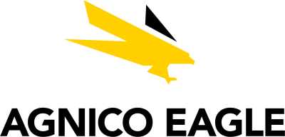


Canadian Materials – AEM, ABX, K
Discussion Materials | BUS 417 | Group 5 | July 24, 2025
Chetan Janjua, Michael Kmetiuk, Ruben Gonzalez, Sukhbir Dhaliwal

Slide 2
Table of Contents
Sector Commentary – Precious Metals & Mining
Agnico Eagle Mines (TSX:AEM)
Barrick Mining Corporation (TSX:ABX)
Kinross Gold (TSX:K)

Slide 3
Sector Commentary – Precious Metals & Mining

Slide 4
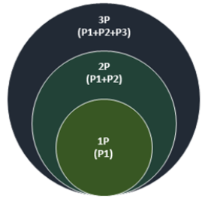
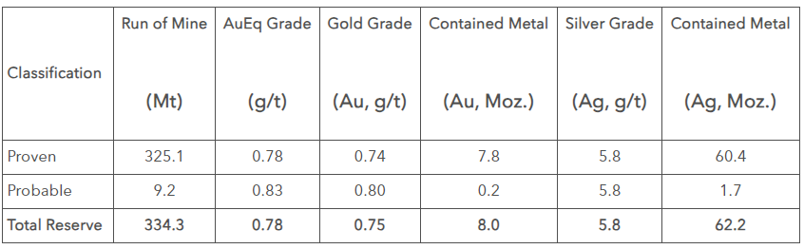
Mineral Resource Classification
Mineral Resources
Minerals and materials that are potentially extractable on a profitable basis under present economic conditions. Resources include deposits that may become reserves in the future
Mineral Reserves
Represent the economically viable portion of the mineral resources that have been proven through exploration, feasibility studies, and assessments to be extractable with degree of certainty past a given threshold under current economic conditions
Example of R&R Table

Slide 5
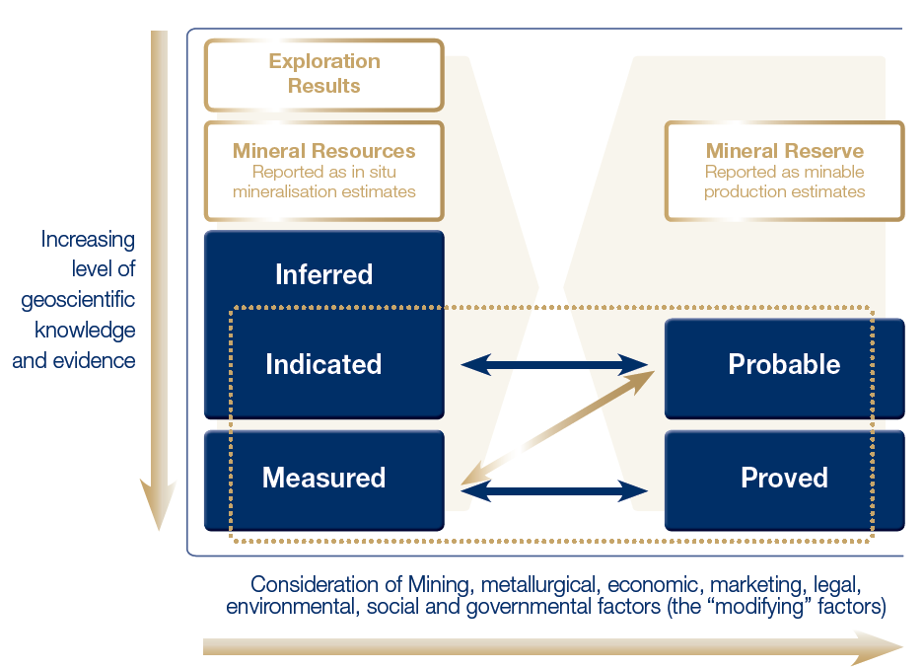
Mineral Resource Classification
Mining History & Industry Overview

Slide 6
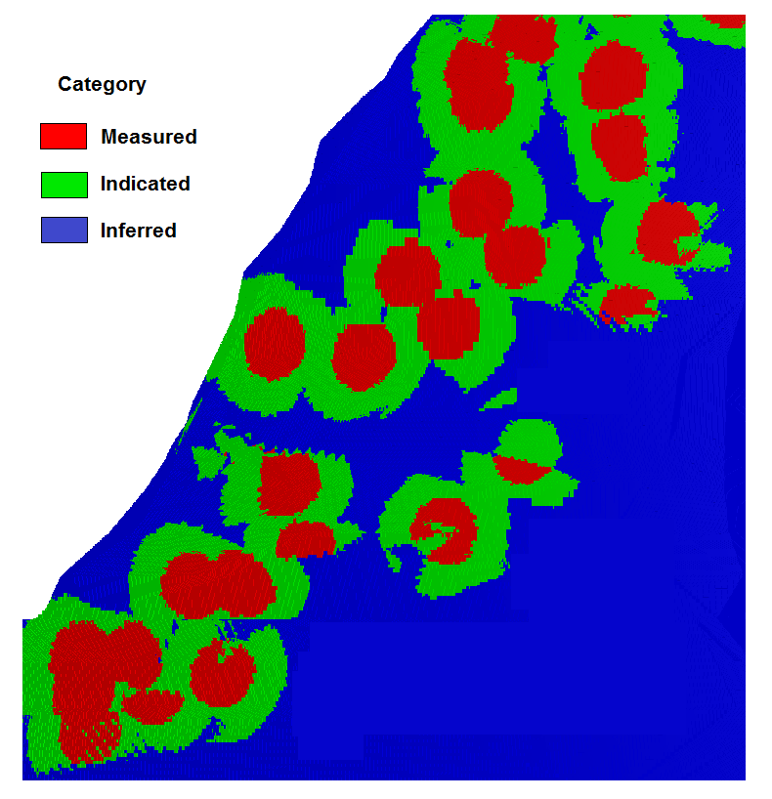
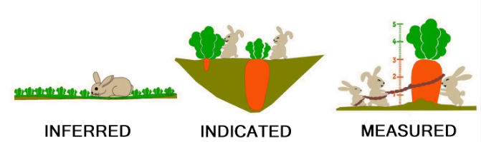
Mineral Resources
Inferred
Estimates of mineralization based on geological evidence and sampling; lack data to be classified as reserves
Represent lower level of confidence compared to measures and indicated and used in early-stage exploration where data can be insufficient for higher classifications

Slide 7
Mineral Resources
Indicated
Estimated quantities of mineralization within a deposit which are supported by geological evidence and sampling; less certain than proven reserves
Represent higher level of confidence relative to inferred resources and are expected to be economically feasible and extractable under current economic conditions

Slide 8
Mineral Resources
Measured
Highest level of confidence in mineral resources estimation within the mining industry and represents the minerals or materials in a deposit that have been thoroughly samples and analyzed
Measured resources are associated with precise geological information given their quality and quantity and are used in developing mine plans and feasibility studies

Slide 9
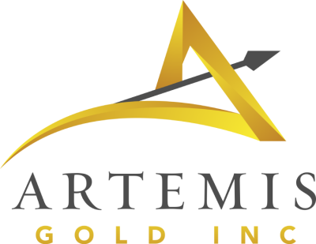
















Mineral Resources
Sector classifications
Resource stage is typical for single-asset juniors that are drilling and could be pre-feasibility
Intermediate and senior/large senior miners may have some development projects that are in the resource stage
Juniors | Intermediates | Seniors | Large Seniors
Miners will report Measured & Indicated and Inferred Resources for assets that have passed that stage

Slide 10
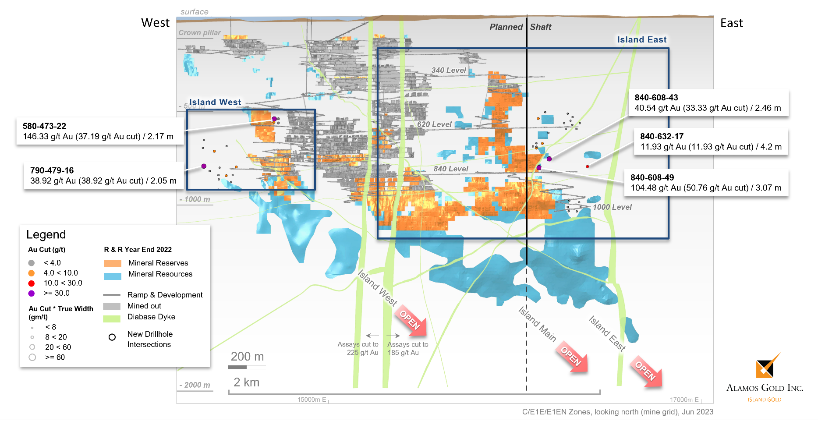
Mineral Reserves
Probable
Estimated mineral deposits that are likely to be economically extractable with a higher degree of confidence than mineral resources
Determined through geological data, feasibility studies, economic assessments

Slide 11
Mineral Reserves
Proven
Minerals deposits with the highest level of confidence given their quantity and quality and are supported by thorough mineral exploration, geological data, and economic viability assessments
Proven reserves are economically feasible for extraction with a high degree of certainty

Slide 12
Mineral Reserves
Sector classifications
Reserve stage is typical for some juniors and all intermediates/seniors/large seniors: any assets post-feasibility study stage
Common valuation multiple is Enterprise Value⁽¹⁾/2P Reserves
Juniors | Intermediates | Seniors | Large Seniors
Miners will report Proven & Probable (2P) Reserves for assets that have passed that stage

Slide 13


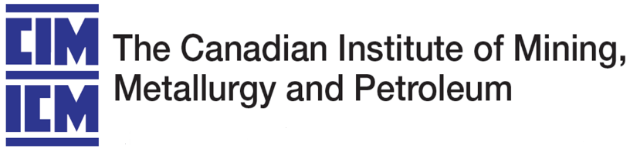
NI 43-101
National Instrument (NI) 43-101
Ensures accuracy, transparency, and consistency of reporting standards for resources and reserves for Canadian stock exchanges
Requires reports to be prepared under the supervision of qualified personal who company with the standards and are accountable for the accuracy of the information
Outlines details on property description, sampling methods, data verification, resource and reserve estimates, and other aspects used for decision-making
NI 43-101 reports have gained global recognition and are used a benchmark for reporting standards beyond Canadian jurisdiction

Slide 14
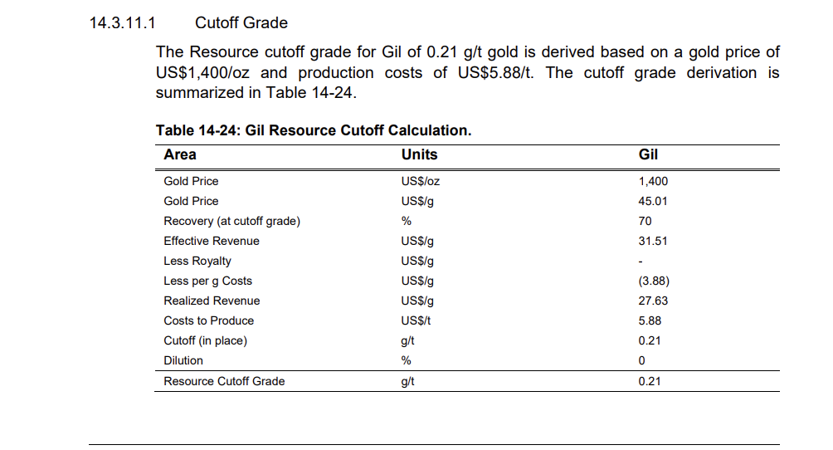
NI 43-101 Example: Kinross Gold
Example: Kinross Gold

Slide 15
Materials GICS Sector Subclassifications
Materials
Metals & Mining
Diversified Materials
Precious Metals
Forestry
Paper Products
Diversified Chemicals
Base Metals
Other Commodities
Gold
Silver
PGMs
Copper
Iron
Nickel
Zinc
Thermal Coal
Potash
Other
Metallurgic Coal
Agricultural products

Slide 16
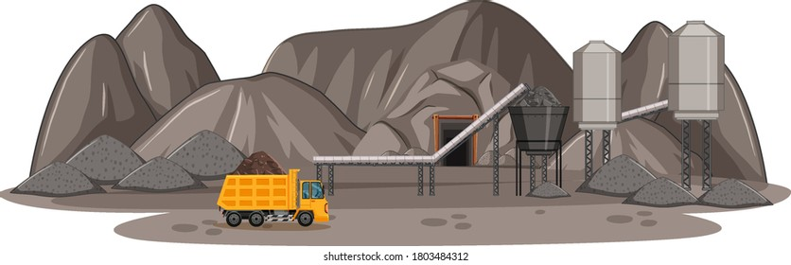

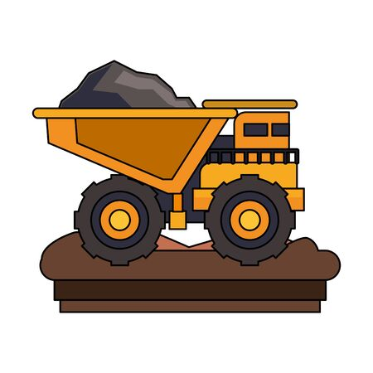


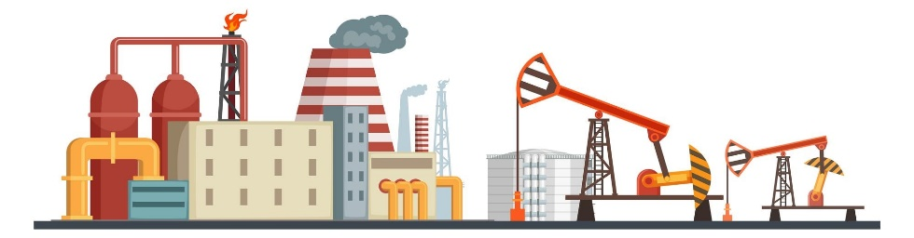
Producing Mining Companies

Slide 17



Royalty and Streaming Mining Companies
Royalty Agreement
Streaming Agreement
Investment
% of Revenue from Production
Investment
Buy % at a discounted Price
Notes:
s

Slide 18
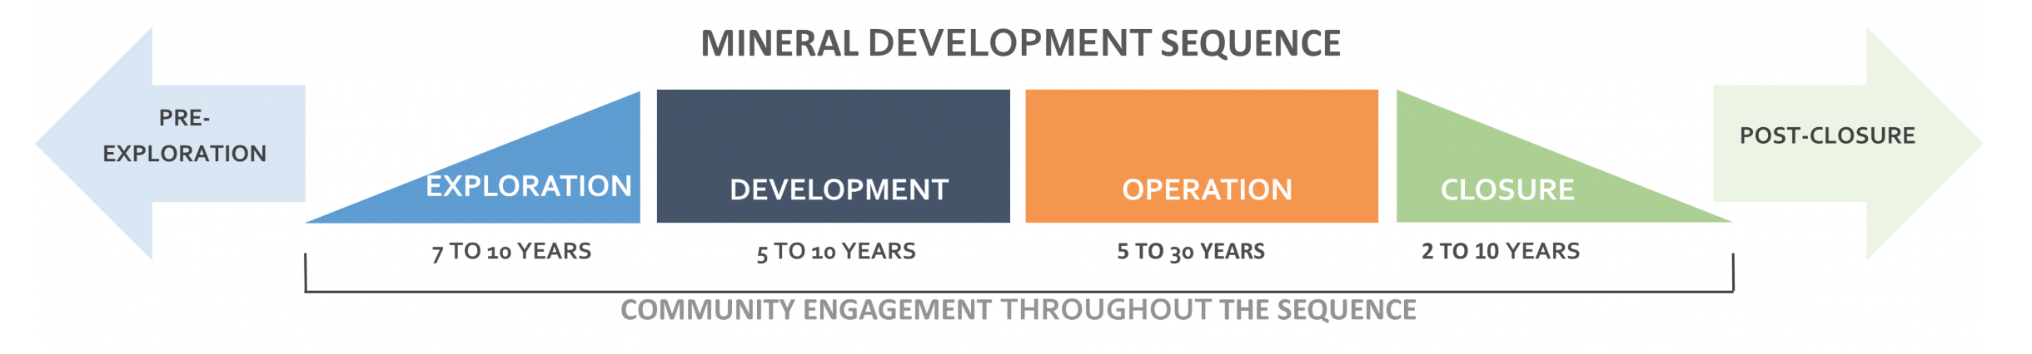
Development, Operation, and Closure of Mines
Finding an ore body and developing it into a mine is a long, costly and complex process that can take many years.
During exploration and development, companies make considerable efforts to find mineral deposits, evaluate them and determine the feasibility of a potential mine.
Once a mine is in production, it faces ongoing operational expenses and changing commodity prices. A mine closes when the metal or mineral is exhausted, demand diminishes or production is no longer profitable. At this point, the mine will be decommissioned and the environment in the area restored.

Slide 19
Key Distinctions for Gold Mining
Ore:
  A naturally occurring rock or mineral that contains a valuable substance in concentrations economically viable for extraction
  Composed of various minerals with the target metal, often with impurities
  For example, gold ore is a rock with economically feasible concentrations of gold
  Key processes for extracting ore are mining, milling, and concentrating
Grade
  Concentration of gold in the rock (ore)
  Amount of gold per tonne of ore mined (g/t)
Production
  Tonnes of ore mined * grades (variable) * conversion * recovery % = production
  How much a gold a company produces and sells over a given time period (quarter/annual publications)
  Reported in Troy Ounces (1oz = 31.1g)
  Main revenue driver for mining companies given constant commodity price
  Mining companies give production ranges (low-end/high-end) of what they think they will produce from given assets and cumulatively
Doré:
  A bar composed of a mixture of precious metals, typically containing gold and silver. Produced during mining and refining processes or from scrap gold.
  Average gold content ranging from 50-75%.
  Requires further refinement before being used as raw material for gold items. Not classified as ore or bullion, but metal bars with high gold content.
  Extremely malleable and need to be alloyed for items like jewelry. After refining, the alloy can be reversed to its pure state.
  Can be assayed for gold content and traded similarly to bullion bars. Market is small, limited to specialist dealers, refiners, and mints.
  Lack of specific standards; weight can vary (up to 25kg), and purity levels differ between refiners.
  Insufficient purity for investment gold

Slide 20
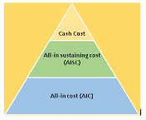
Key Distinctions for Gold Mining
All-in Sustaining Costs (AISC):
  Measures the total cost to produce one ounce of gold, including direct mining, sustaining capital, royalties, and overhead
  Excludes non-sustaining capital, greenfield exploration, and financing costs, offering a more complete cost picture than basic cash costs
  AISC helps investors compare miners' profitability and efficiency by showing sustainable margins at current gold prices
Cash cost
All-in Sustaining Cost
(AISC)
All-in Cost
(AIC)

Slide 21
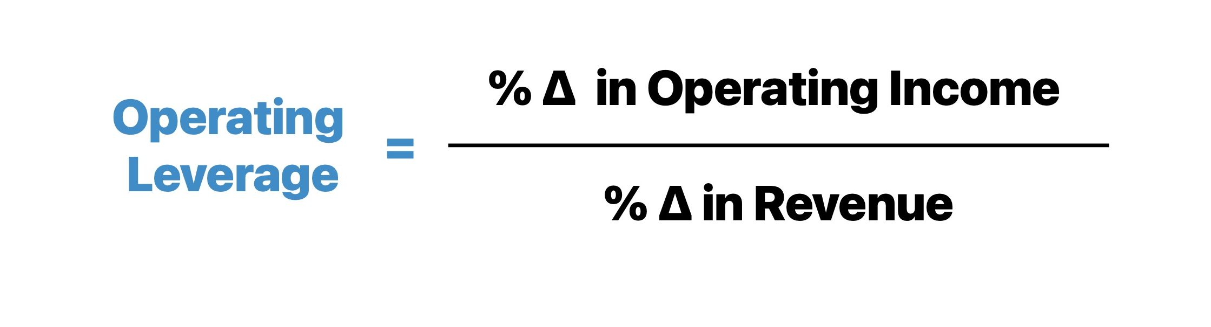
Operating Leverage
How much do earnings change based on a changes in the gold price?
Lower-cost producers have less operating leverage and are thus less sensitive to changes in the price of gold
  Low-cost producers will rise less when gold goes up and fall less when gold goes down
Dividend payments are typically low and inconsistent
Profitability is low and volatile – analysts look more at operating cash flow
Rising gold prices = want higher operating leverage = higher cost miners = higher AISC
Declining gold prices = want lower operating leverage = lower cost miners = lower AISC

Slide 22
Overview of Gold Mining Companies
Definition of Junior and Senior Companies:
  Junior: Primarily in exploration, occasional project advancement (largest number of companies in Canada)
  Intermediate: Have a a few (about 1-5) mines in production, focus on exploration and M&A.
  Senior: Have at least multiple mines in production, conduct exploration and M&A (lowest number of companies in Canada)
Capital Requirements:
  Junior: Raise equity for exploration.
  Intermediate: Raising equity/debt, M&A.
  Senior: Revenues from production finance exploration, M&A.
Juniors | Intermediates | Seniors | Large Seniors

Slide 23
How Do Mining Companies Grow?
Mergers & Acquisitions:
Mining industry is “eat or be eaten” sector where smaller companies frequently get consolidated into larger miners
Recent transactions include:
  Royal Gold’s acquisition of Sandstorm Gold ($3.5bn)
  Equinox Gold’s acquisition of Calibre Mining ($2.6bn)
  Teck Resources’ sale of coal mines to Glencore ($6.9bn)
  Lundin Mining’s acquisition of Filo Mining ($4.5bn)
Existing mine/development with infrastructure = brownfield asset (most common in M&A)
1
Exploration:
Spend heavy capex on drilling, exploration, and feasibility costs to determine economic potential of deposit(s), and building the mine yourself
Greenfield projects include building the infrastructure and mine from the ground-up, at the risk of not getting approval, or spending money to realize the mine is not profitable
A strong pipeline of greenfield projects indicates high reinvestment into future growth by replacing depleting reserves with new ones
Upside potential of assets being more profitable than previously thought
2

Slide 24
Development, Operation, and Closure of Mines
Junior companies are mostly involved in the exploration phase but can occasionally advance a project toward production. There are many junior companies in Canada, up to 7 times more than senior companies.
    Exploration and mining activities require increasing amounts of investment capital as they progress toward production. Junior companies raise equity capital to finance exploration of mineral resources.
Intermediate companies are those that have at least 1 mine in production and they often conduct exploration as well. There are fewer than 100 such companies in Canada. Intermediate companies have revenues from production that can finance exploration.
Senior/Large Senior companies usually have multiple mines in production and they often conduct exploration as well. There are fewer than 10 such companies in Canada. Senior companies have revenues from production that can finance exploration. Seniors also take part in M&A and are usually the buyers of junior miners’ assets (or the entire company)

Slide 25
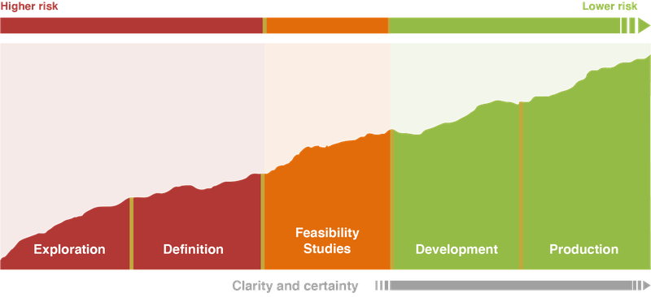
Exploration
Exploration involves major effort to determine the location, size and shape of mineral deposits. In planning exploration, companies decide which metals or minerals they are searching for and set objectives and strategies for exploration.
Companies use various survey methods to search a wide geographic area for “anomalies,” which are findings that may indicate a mineral deposit in the underlying bedrock. They narrow down the search on the ground. Through experimental drilling and excavation (prospecting), they determine whether the mineral is present, its exact location and characteristics.
This is followed by a step to verify anomalies and “showings,” which are outcroppings or indications just below the surface containing the target metal or mineral. If verification is successful, the company has discovered a mineral deposit. Then it delimits the deposit; that is, it determines the shape and boundaries of the deposit and identifies sections of the deposit with different grades of the mineral.

Slide 26
Technical Assessments & Feasibility Studies
Preliminary Economic Assessment (PEA) - Conducted in early stages to assess potential viability of project; includes preliminary analysis of geological, engineering economic aspects
Pre-feasibility Study (PFS) - More detailed assessment analyzing mining methods, metallurgy, infrastructure, and economics to assess project feasibility
Feasibility Study (FS) - Report that evaluates technical and economic aspects including mine design, production schedule, financial analysis, environmental impact assessments, and market studies
Bankable Feasibility Study (BFS) - Upgraded version of the feasibility study required by financial institutions for funding purposes

Slide 27
Production
Once a mine has been classified as “feasible” and has been approved by governments or other local agencies, operating miners will begin constructing the mine, including the mill, worker housing, connecting railways, access roads, etc.
Once the required infrastructure for operating the mine has been built, companies will begin drilling and excavating and aiming for first resource/first ore
Once first ore has been found and accessed, the miner will then process it into the final product, where “first pour” is announced
After operations ramp up, then miners will begin “commercial production”, where they begin operating the mine for its projected lifespan based on initial estimates and technical reports

Slide 28
Mine Complex Development
Larger mining companies are generally in charge of mine development
The mine itself needs to be built by uncovering the deposit, preparing the area, and sinking the shafts.
A processing plant needs to be constructed and infrastructure such as roads or rail may need to be built to transport large quantities of the metal or mineral for further processing and sale.
Mines are either:
Surface mines
  Employed when mineral resources are at or near Earth's surface
  Types of surface mining for gold miners:
    Open Pit Mining
    Placer Mining
Underground Mines
  Employed when mineral resources are below earth’s surface and inaccessible by surface mining
  Types of underground mining:
    Cut and fill
    Long Hole Stope Mining

Slide 29
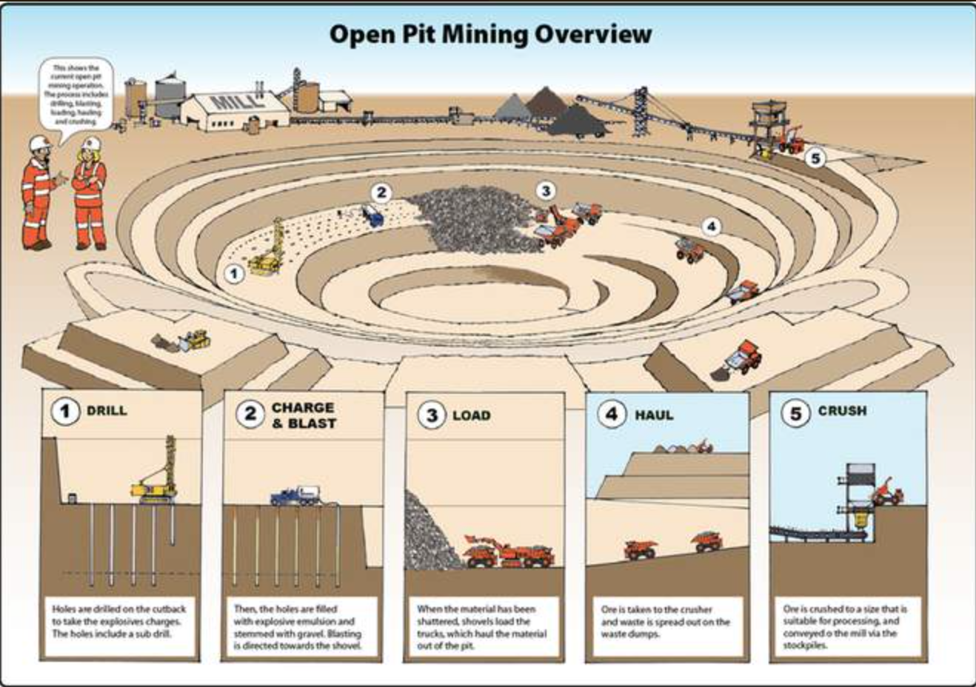
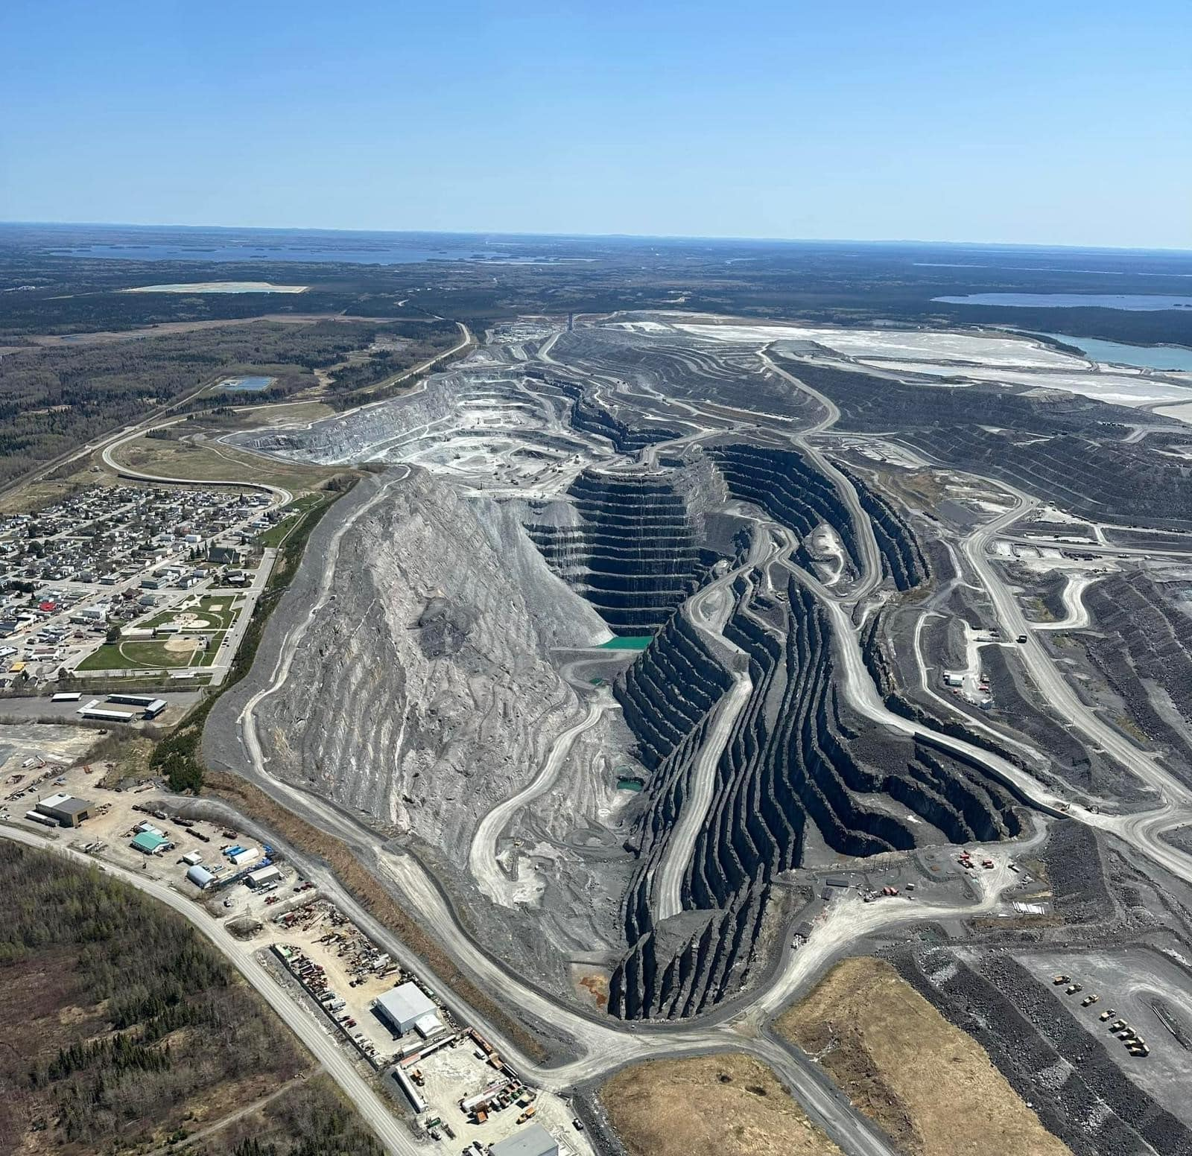
Open Pit Mining
Used for large, near-surface mineral deposits
Common for large base metal deposits
Mining progresses from the surface downward, forming a pit with stepped walls
Common for both precious and base metals, most prevalent in Canada

Slide 30
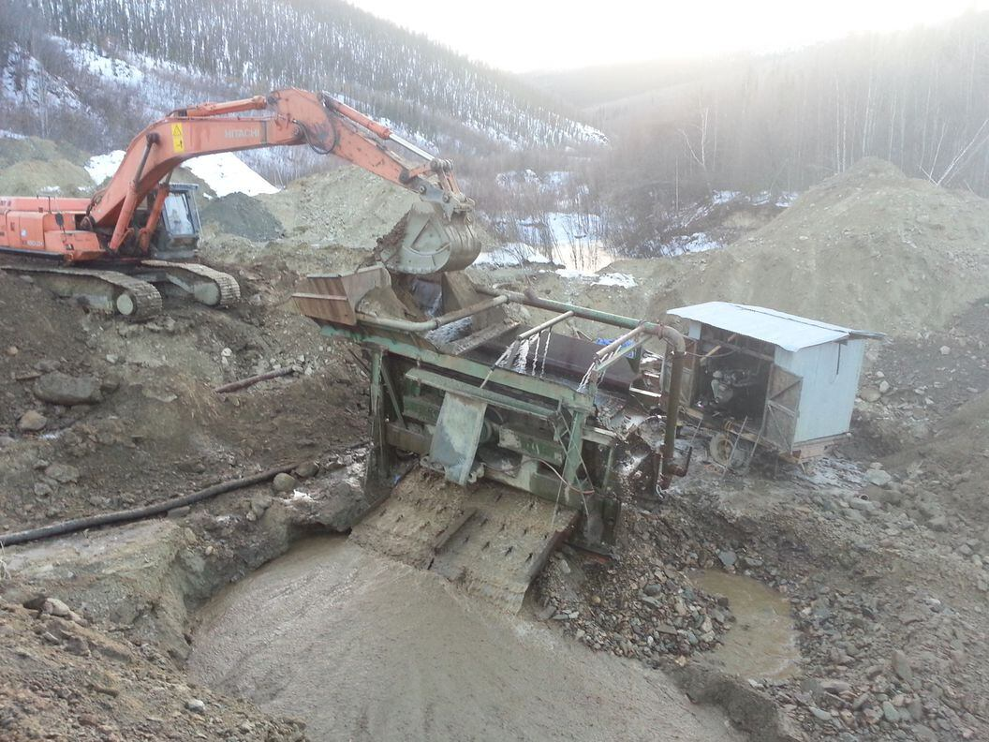
Placer Mining
Uses water to concentrate gold and heavy minerals from sand and gravel
In its most basic form, it is equivalent to gold panning
Excavation with heavy machinery, hauling to wash plant
Sorting, sluicing, and separating gold from tailings
Some variations include dredging from pond/lake or vacuuming sediment from the sea floor

Slide 31
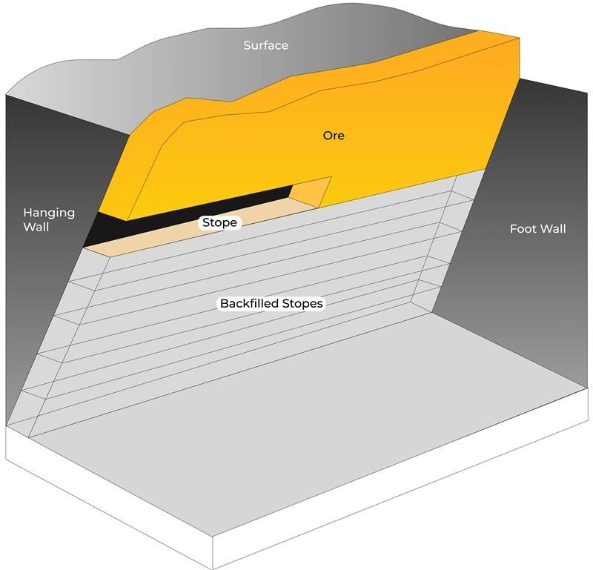
Cut and Fill Mining
Used for narrow, vein-like deposits or irregular deposits
Horizontal slices are mined, followed by replacing the space with a filler before proceeding to next slice
  Best for unstable rock conditions for safety

Slide 32
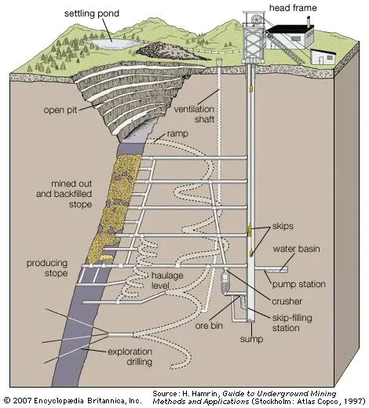
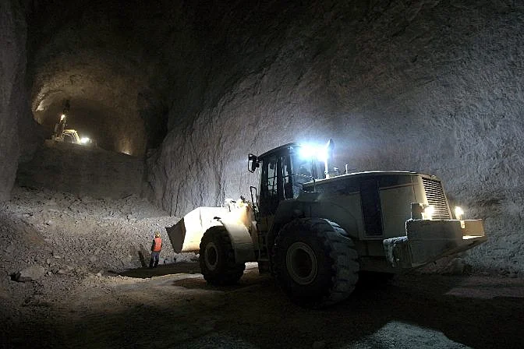
Long Hole Stope Mining
Used for near-surface mineral deposits that are not accessible/profitable through open pits
Usually used for regular ore bodies with long blast holes between levels, where blasts make ore fall
  Used by major players like AEM in LaRonde, Canadian Malartic Complex mines

Slide 33
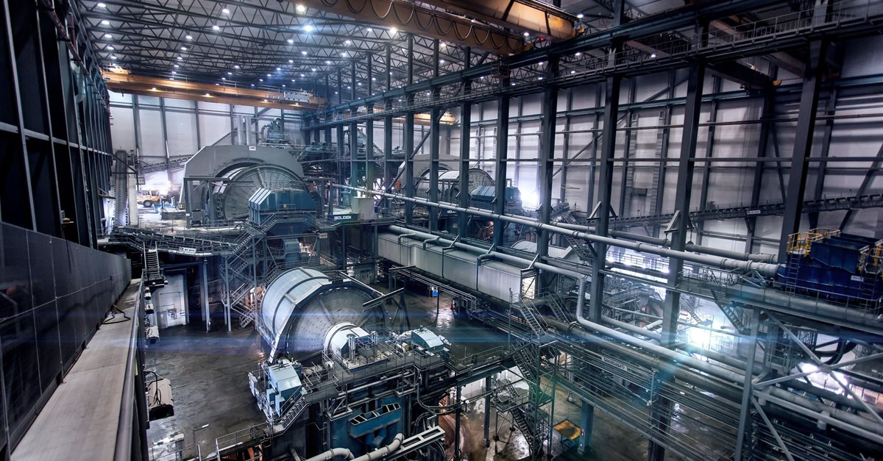
Crushing & Grinding
Crushing and Grinding is the reduction of large ore chunks to small sand-sized particles.
It is an essential but costly step in mineral processing
Liberation Size is the size required to separate minerals from waste rock.
Ore passes through crushers and grinding mills for size reduction
There are various methods for collecting minerals after liberation that leave waste rock behind.

Slide 34
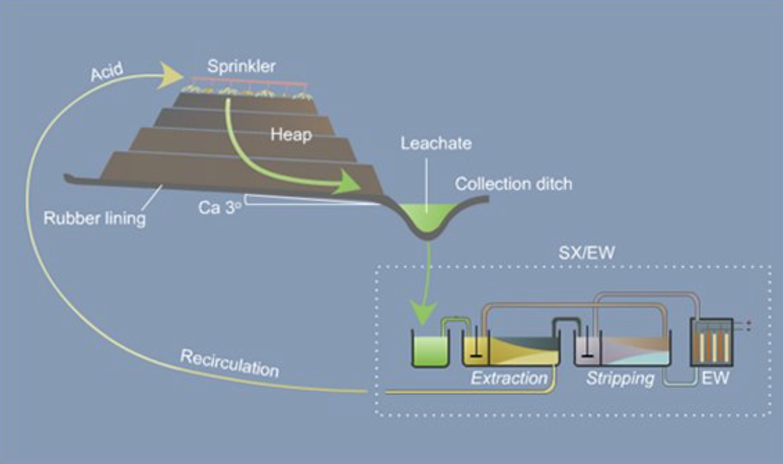
Heap Leaching & SX-EW
Heap Leaching is a recovery method for metals such as gold, copper, or uranium from oxide ores. Crushed ore is stacked on a lined pad and sprayed with leaching solution. Mineral-rich leach solution is then collected and processed at an SX-EW plant
SX-EW stands for Solvent Extraction Electrowinning:
  First step (SX): Metal is extracted from the leach solution using solvents
  Second step (EW): Pure metal is recovered from solvent solution through electrolysis
In Situ Leach is similar to heap leaching, but used for underground oxide deposits.
  Leaching solution is introduced through boreholes after which metal is recovered by SX-EW

Slide 35
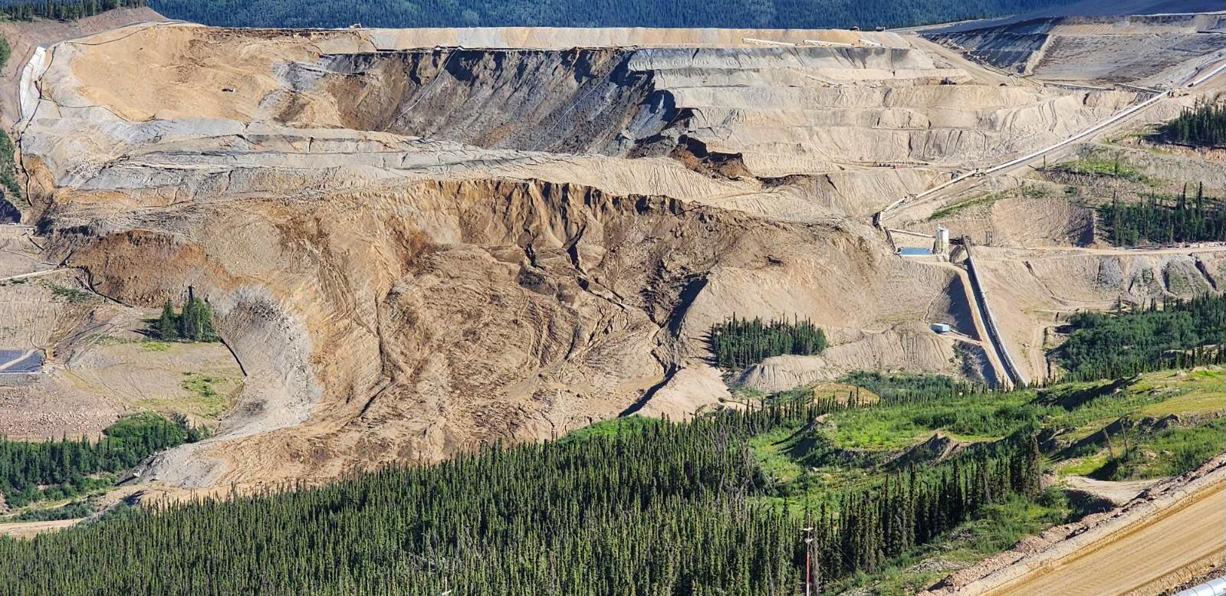
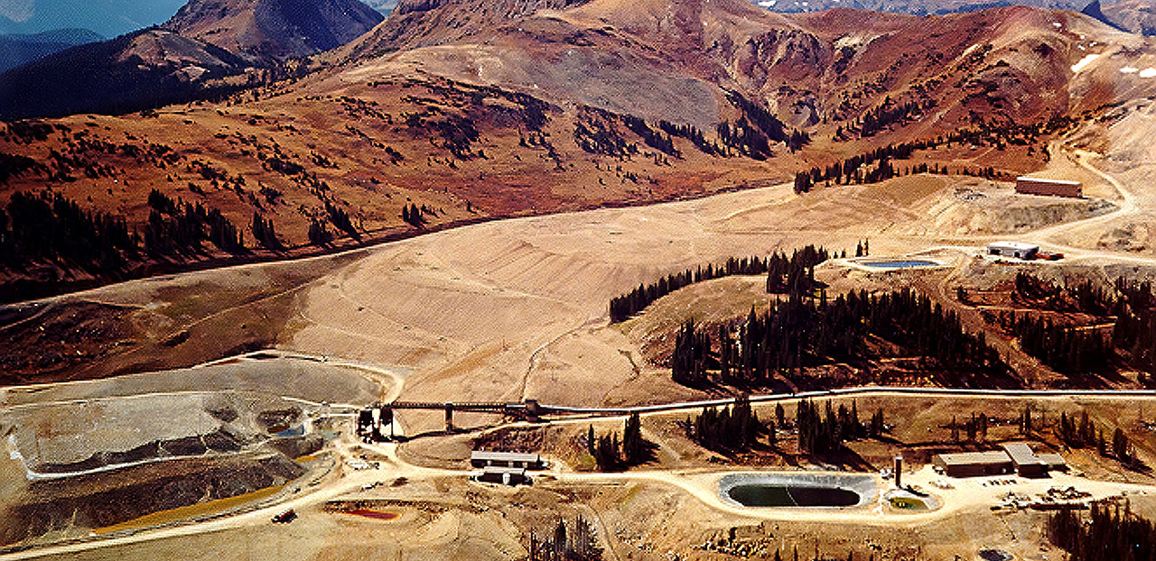
Importance of Clean Business – Eagle & Summitville
Victoria Gold – 2024 Heap Leach Failure
Summitville Mine – 1991 Heap Leach Failure
Large heap leach landslide on June 24, 2024 in Yukon, CA
Unstable land caused ore stockpile to collapse and send toxic tailings into nearby ecosystem, damaging rivers and wildlife with cyanide
Victoria Gold filed for bankruptcy shortly after, CEO fired
Local sources say the mine should have never received permission to operate under that environmental standard
Operations to reduce cyanide contamination in Yukon rivers is ongoing, with upset Indigenous communities
PwC given receivership of mine, looking to sell, Agnico Eagle Mines seen as potential buyer given special situation
Large heap leach landslide in 1991 given high snowmelt and rainfall causing leach pad to overflow
Low grades extracted through cyanide solutions and acid mine drainage (AMD)
Poorly lined leach pads caused an overflow of cyanide, copper, cadmium into local rivers and communities
Galactic Resources filed for bankruptcy shortly after the disaster

Slide 36
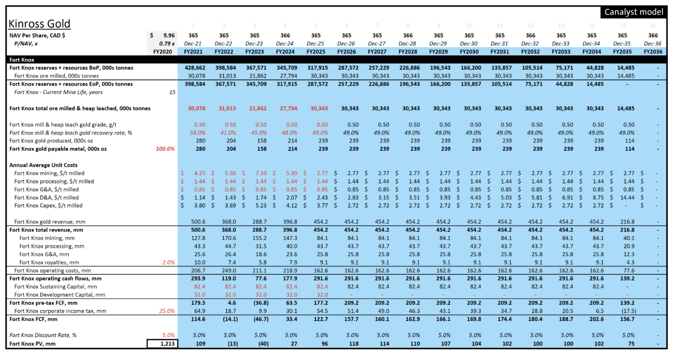





Gold Miner Valuation Method (Net Asset Value/Sum of the Parts)

Slide 37
Gold Miner Valuation Multiples¹
R&S names trade above operating peers on a P/NAV and P/CFPS basis
P/NAV
P/CFPS
EV/Reserves
R&S
25
Median
75
Senior
25
Median
75
Intermediate
25
Median
75
Junior
25
Median
75
Source(s): Bloomberg
As of February 20, 2025

Slide 38
Jurisdictional Risk – Investment Attractiveness Scores
Mining is all about stability of cash flows
Better

Slide 39
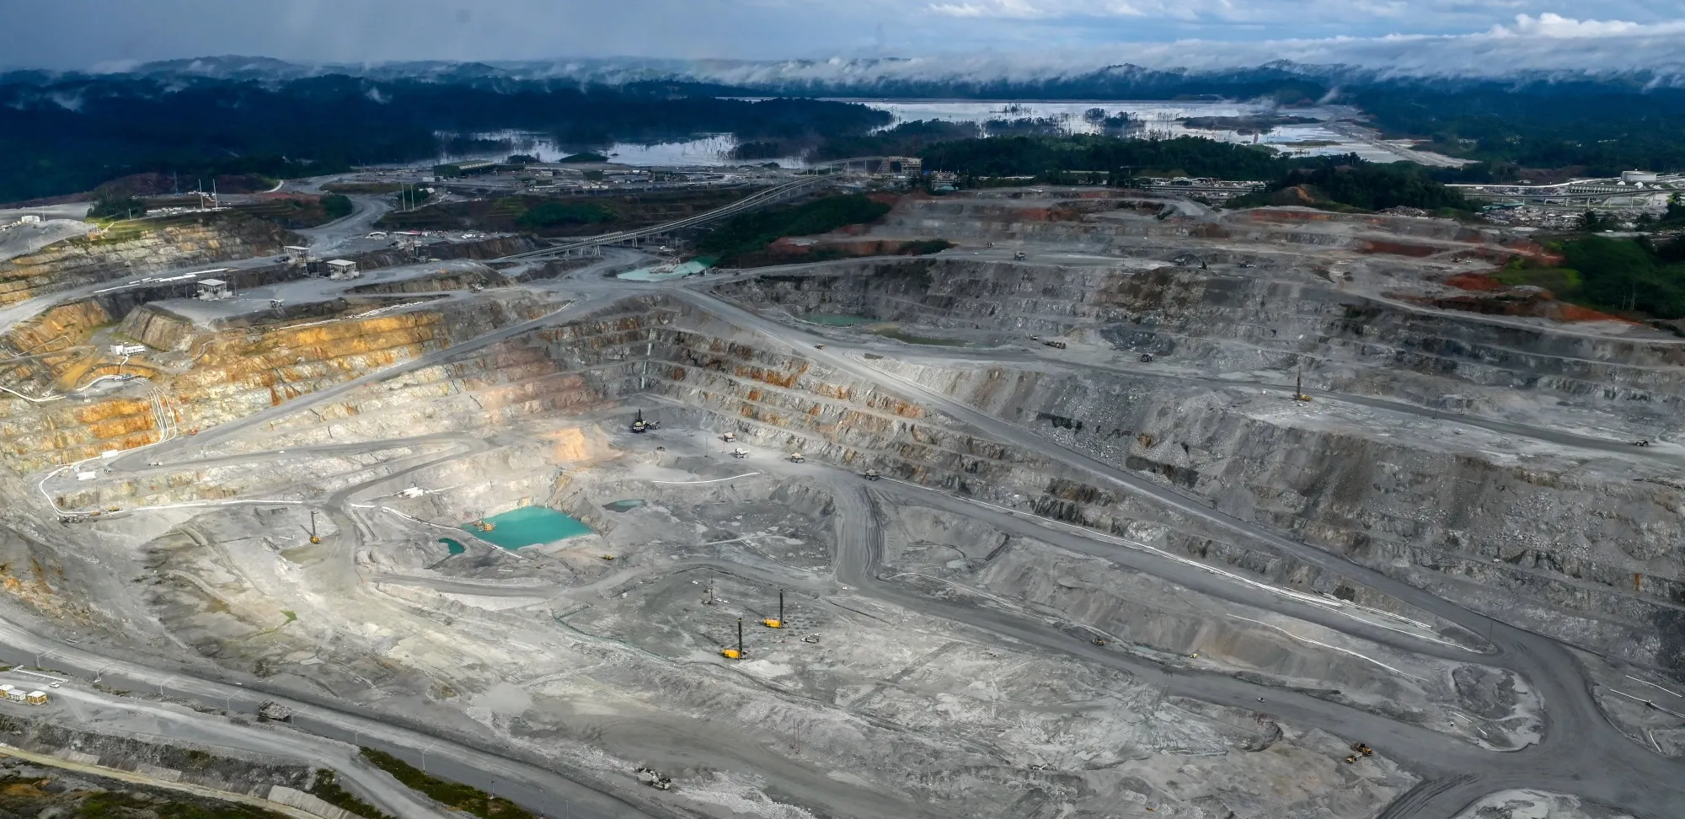
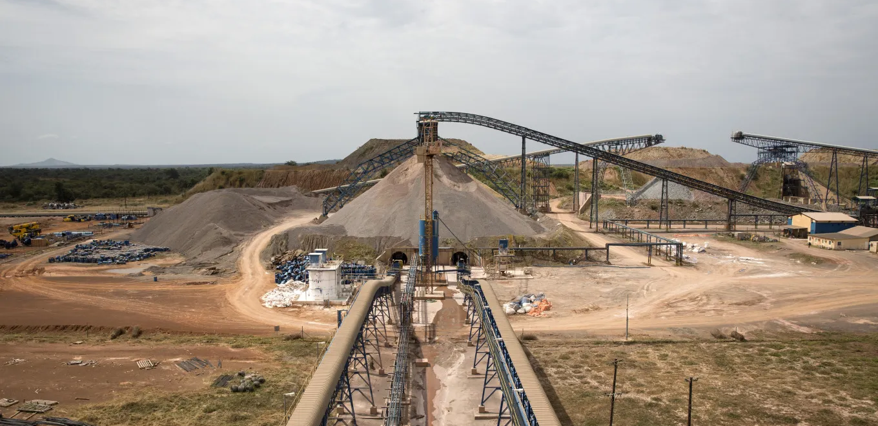
Mining and Geopolitics – Panama & Mali
Cobre Panama Shutdown – First Quantum (FM)
Loulo-Gounkoto Shutdown – Barrick Mining
$10bn NPV copper mine in Panamanian jungle shut down in 2023 after being deemed “unconstitutional” by Panamanian Supreme Court
  Disputes and protests over environmental concerns, resource nationalism over FM getting “too good of a deal”
  FM and royalty & streaming partner Franco-Nevada (FNV) both saw significant distrust from investors following announcement and asset impairment on balance sheets
Accounted for 40% of FM’s revenue, and about 22% of FNV’s NAV at time of closure
FM initiated international arbitration against Panama which it has now dropped following cooperation with Panamanian president
Increasing sentiment for reopening of mine – stockpiled concentrate to be shipped, about $300m of copper sitting idle
$[]NPV gold/copper mine in Malian desert shut down in 2025 after dispute with coup government
New Malian 2023 mining code caused tensions between Barrick and government, and eventually led to a shutdown
Malian government claimed it was owed higher royalties and taxes that Barrick fought against, went to Supreme Court
Arrest warrant for CEO Mark Bristow and other key Barrick miners went live in Mali, some employees detained in late 2024
Malian government proceeded by sending a vehicles and helicopters to seize over three tonnes of gold ($200m+) to prevent Barrick from selling it
Barrick spending $15m per month on maintenance, foregone revenue of $1.24bn per year

Slide 40
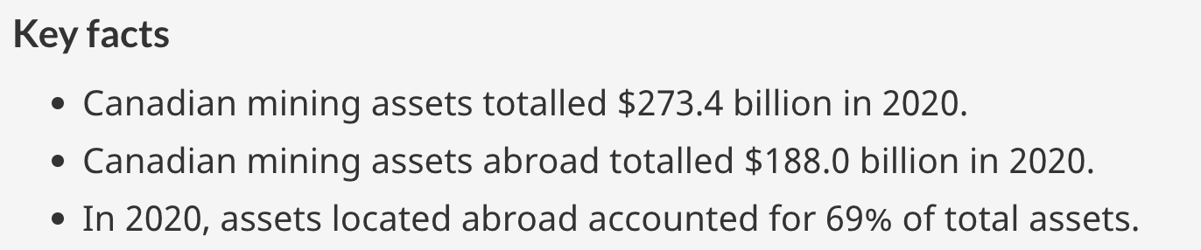
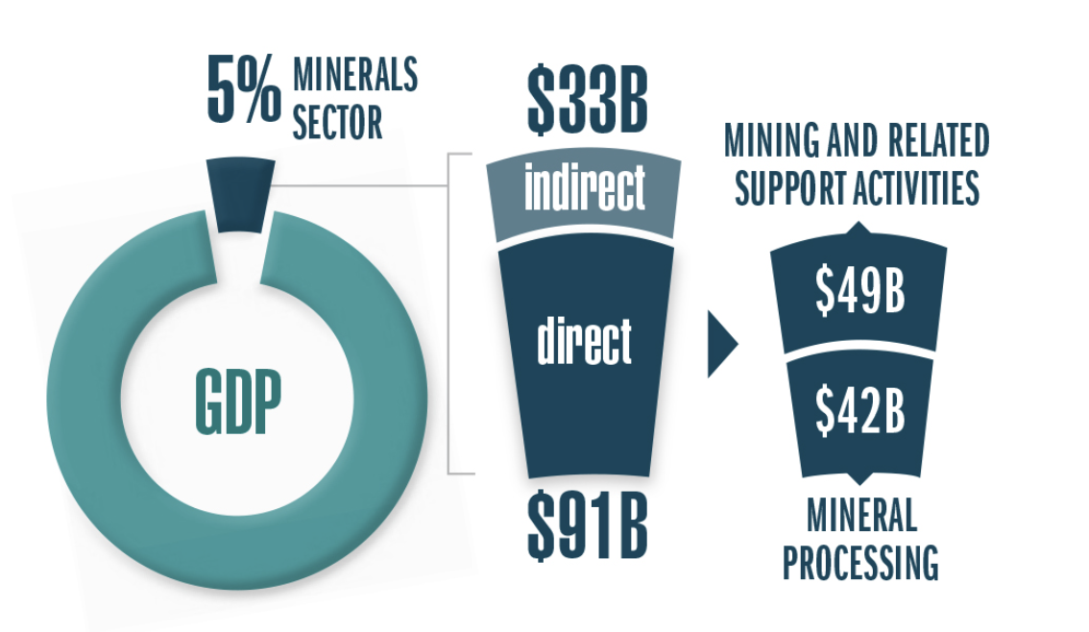
Mining in the Canadian Economy
Mining History & Industry Overview
Mineral production reach a value of $55.5 bn in 2021

Slide 41
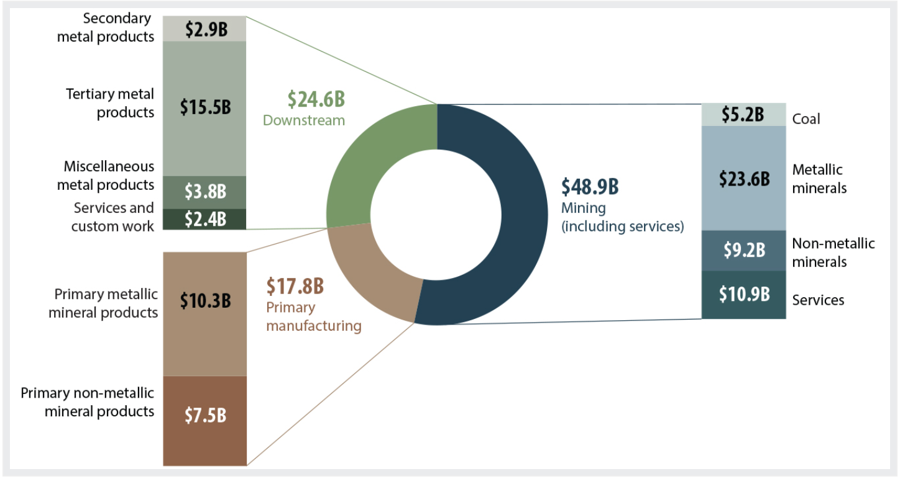
Nominal GDP in the Minerals Sector
Mining History & Industry Overview
Minerals sector nominal gross domestic product by subsector and product group

Slide 42
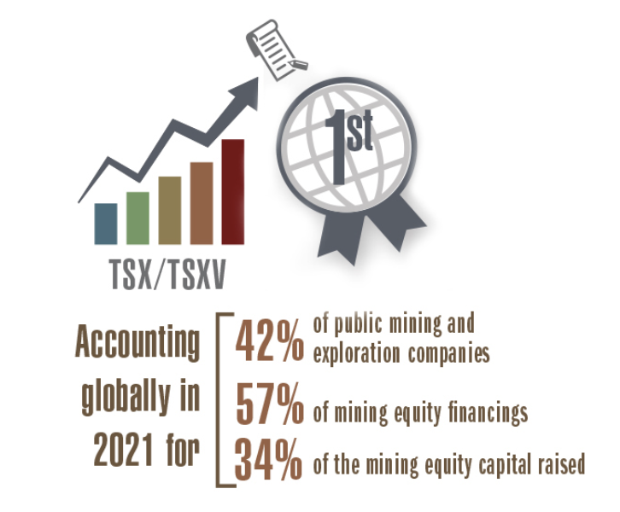
Mining’s Contribution to Canadian Finance
Materials as % of S&P/TSX Capped Composite (XIC)
(TSX) and TSX Venture Exchange (TSXV) are the world's primary listing venues for mining and mineral exploration companies
More than 1,170 issuers in 2021, accounting for 42% of global listings.
In Vancouver, miners are the largest clients of investment banks (Scotia, BMO, National, TD, RBC, CIBC)

Slide 43
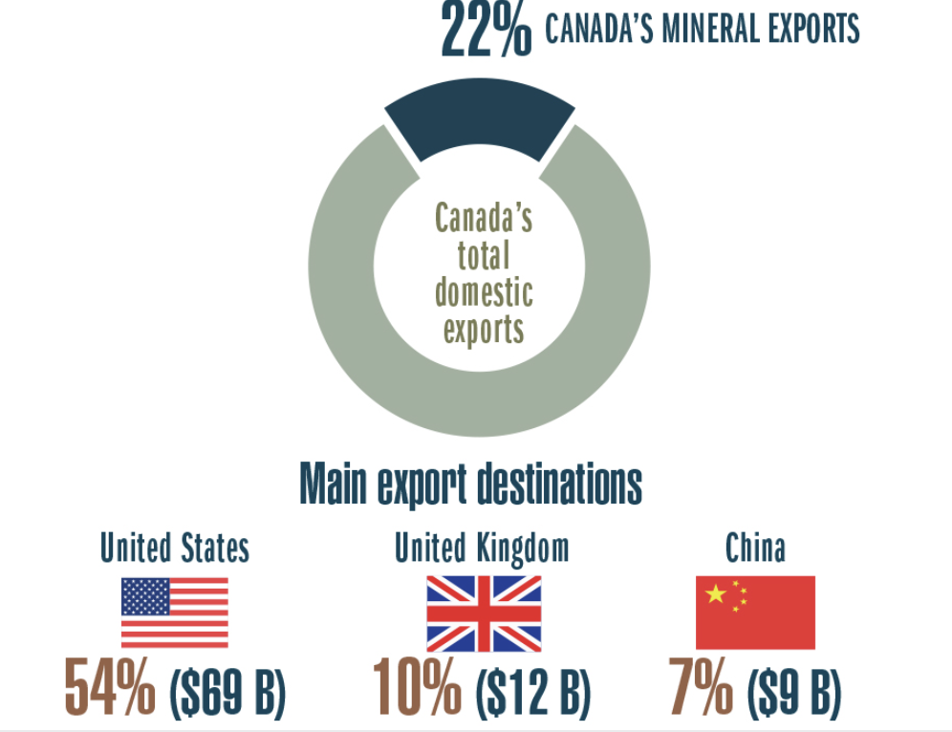
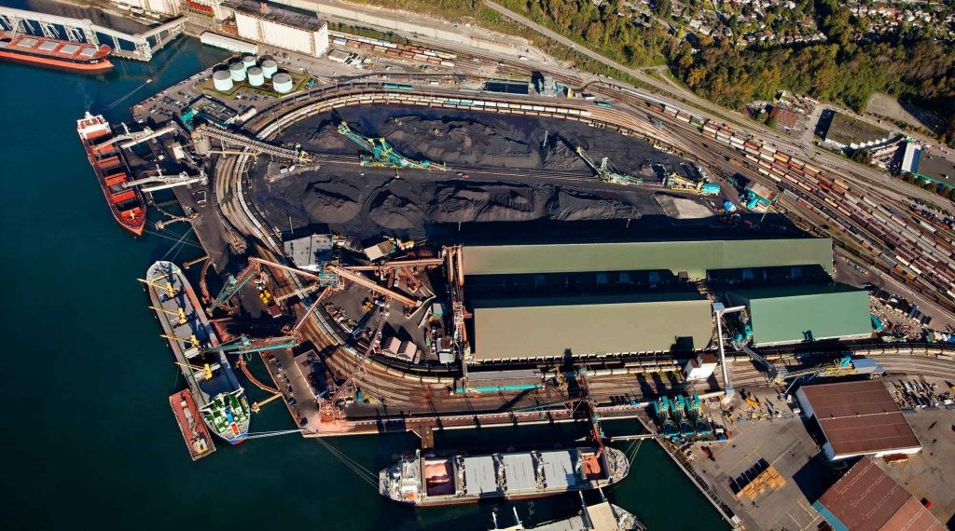
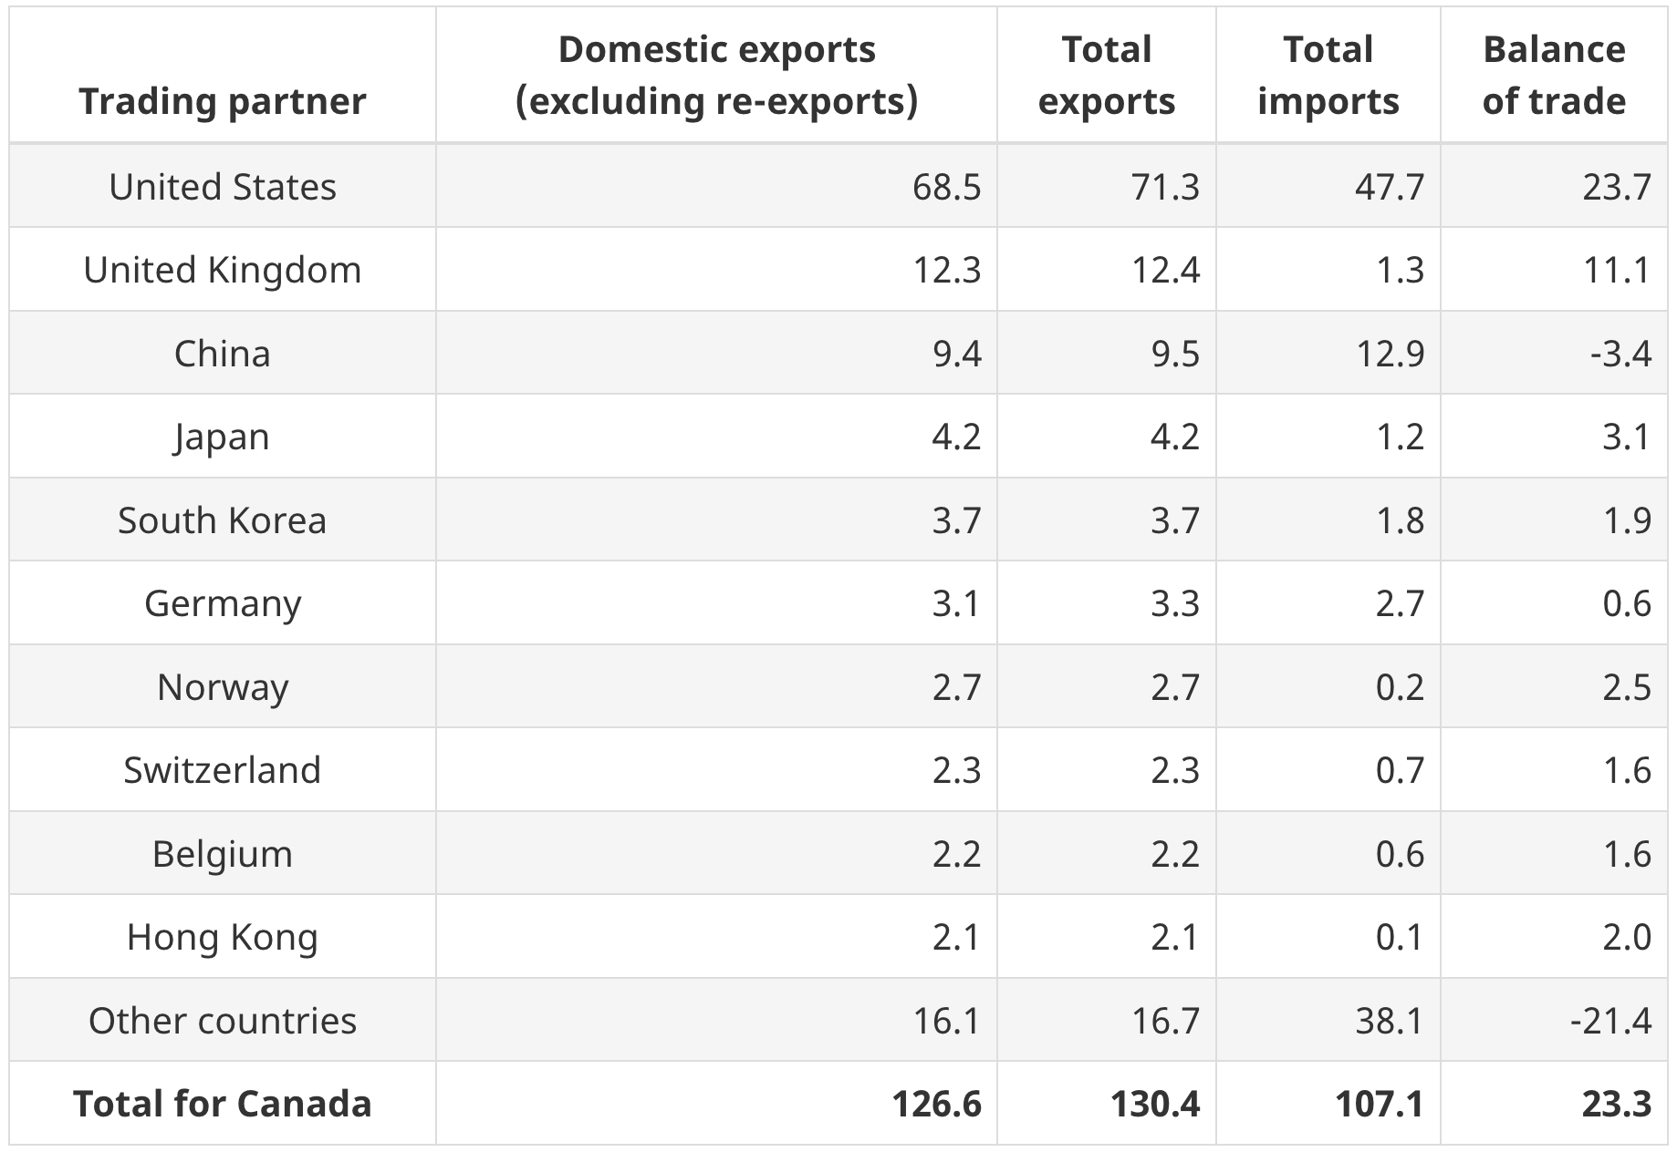
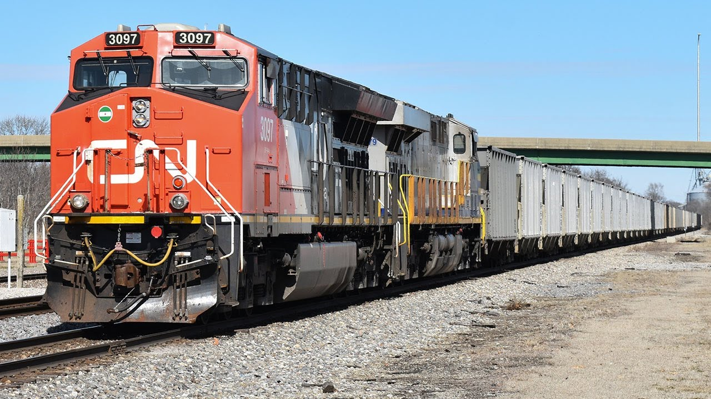
Contribution to Canadian Trade
Valued at $126.6 billion in 2021, domestic mineral exports accounted for 22% of Canada's total merchandise exports
Canadian Mineral Exports
Vancouver’s Presence – North Shore Terminals
Trading Partner Overview
Connection With Other Major Sector - Industrials

Slide 44
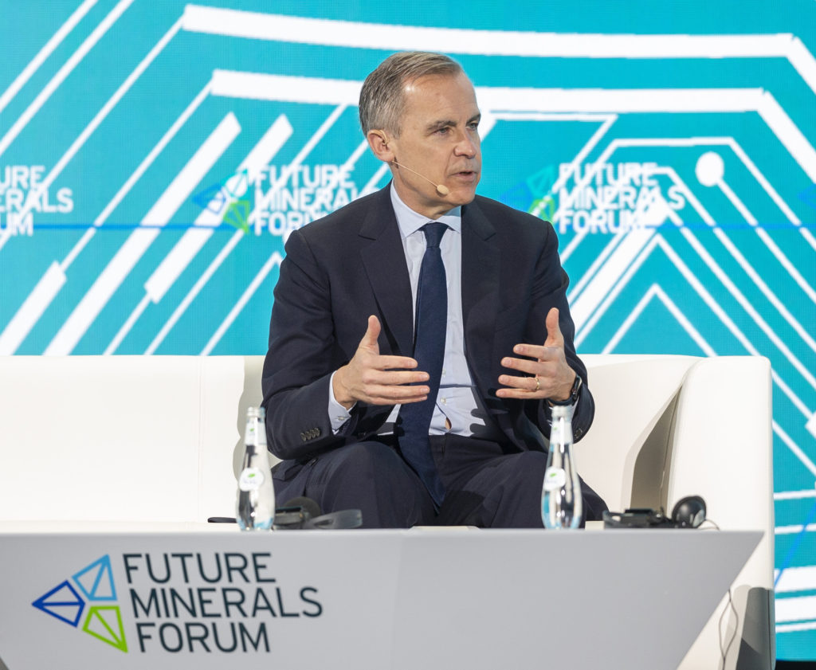
Mining in Canadian Politics
New government is focusing on fast-tracking approvals under “one project, one review” mandate
Canada’s potential as a resource economy will be magnified by eliminating lengthy and bureaucratic review processes for permitting and approving new mines
Remains extremely considerate of Indigenous participation and consent
Make Canada “the global supplier of choice for critical minerals”

Slide 45
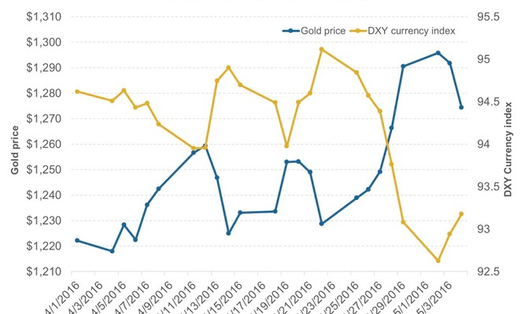
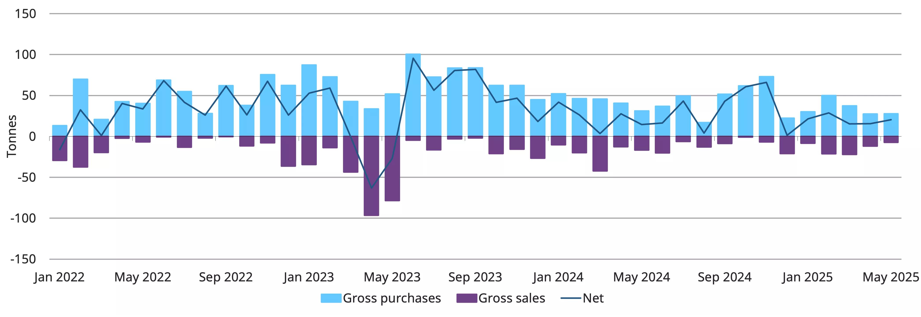
Gold Price Drivers
Declining Interest Rates
Weakening USD vs Gold Price
Central Bank Purchasing

Slide 46
Precious Metals & Mining Sector Drivers
Sector Investment Decision-Making
Gold outlook is positive amongst macroeconomic uncertainty and investors are seeking safe haven:
  US trade policies, tariffs
  Declining yields and interest rates
  Slowing global growth
  Geopolitical tension
  Weakening USD
  High uncertainty index
Buy Characteristics
Hold characteristics
Sell characteristics
Leverage to the gold price through higher AISC
Quality mining jurisdictions
High production and reserve growth
Low or non-dividend paying
Mediocre mining jurisdictions
Mediocre growth
Poor employee health & safety
High carbon intensity
Risky jurisdictions
Low or non-dividend paying
Low or no growth

Slide 47
Agnico Eagle Mines (TSX & NYSE:AEM)

Slide 48
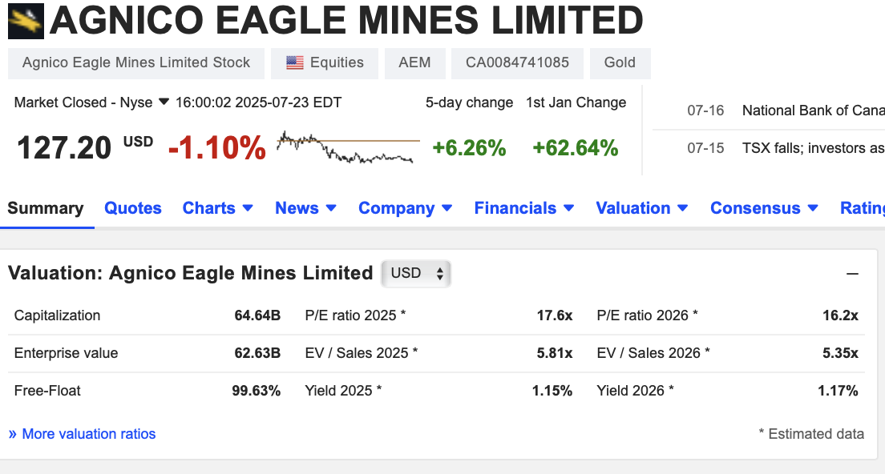
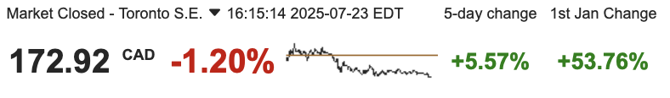
Agnico Eagle Mines (AEM)

Slide 49
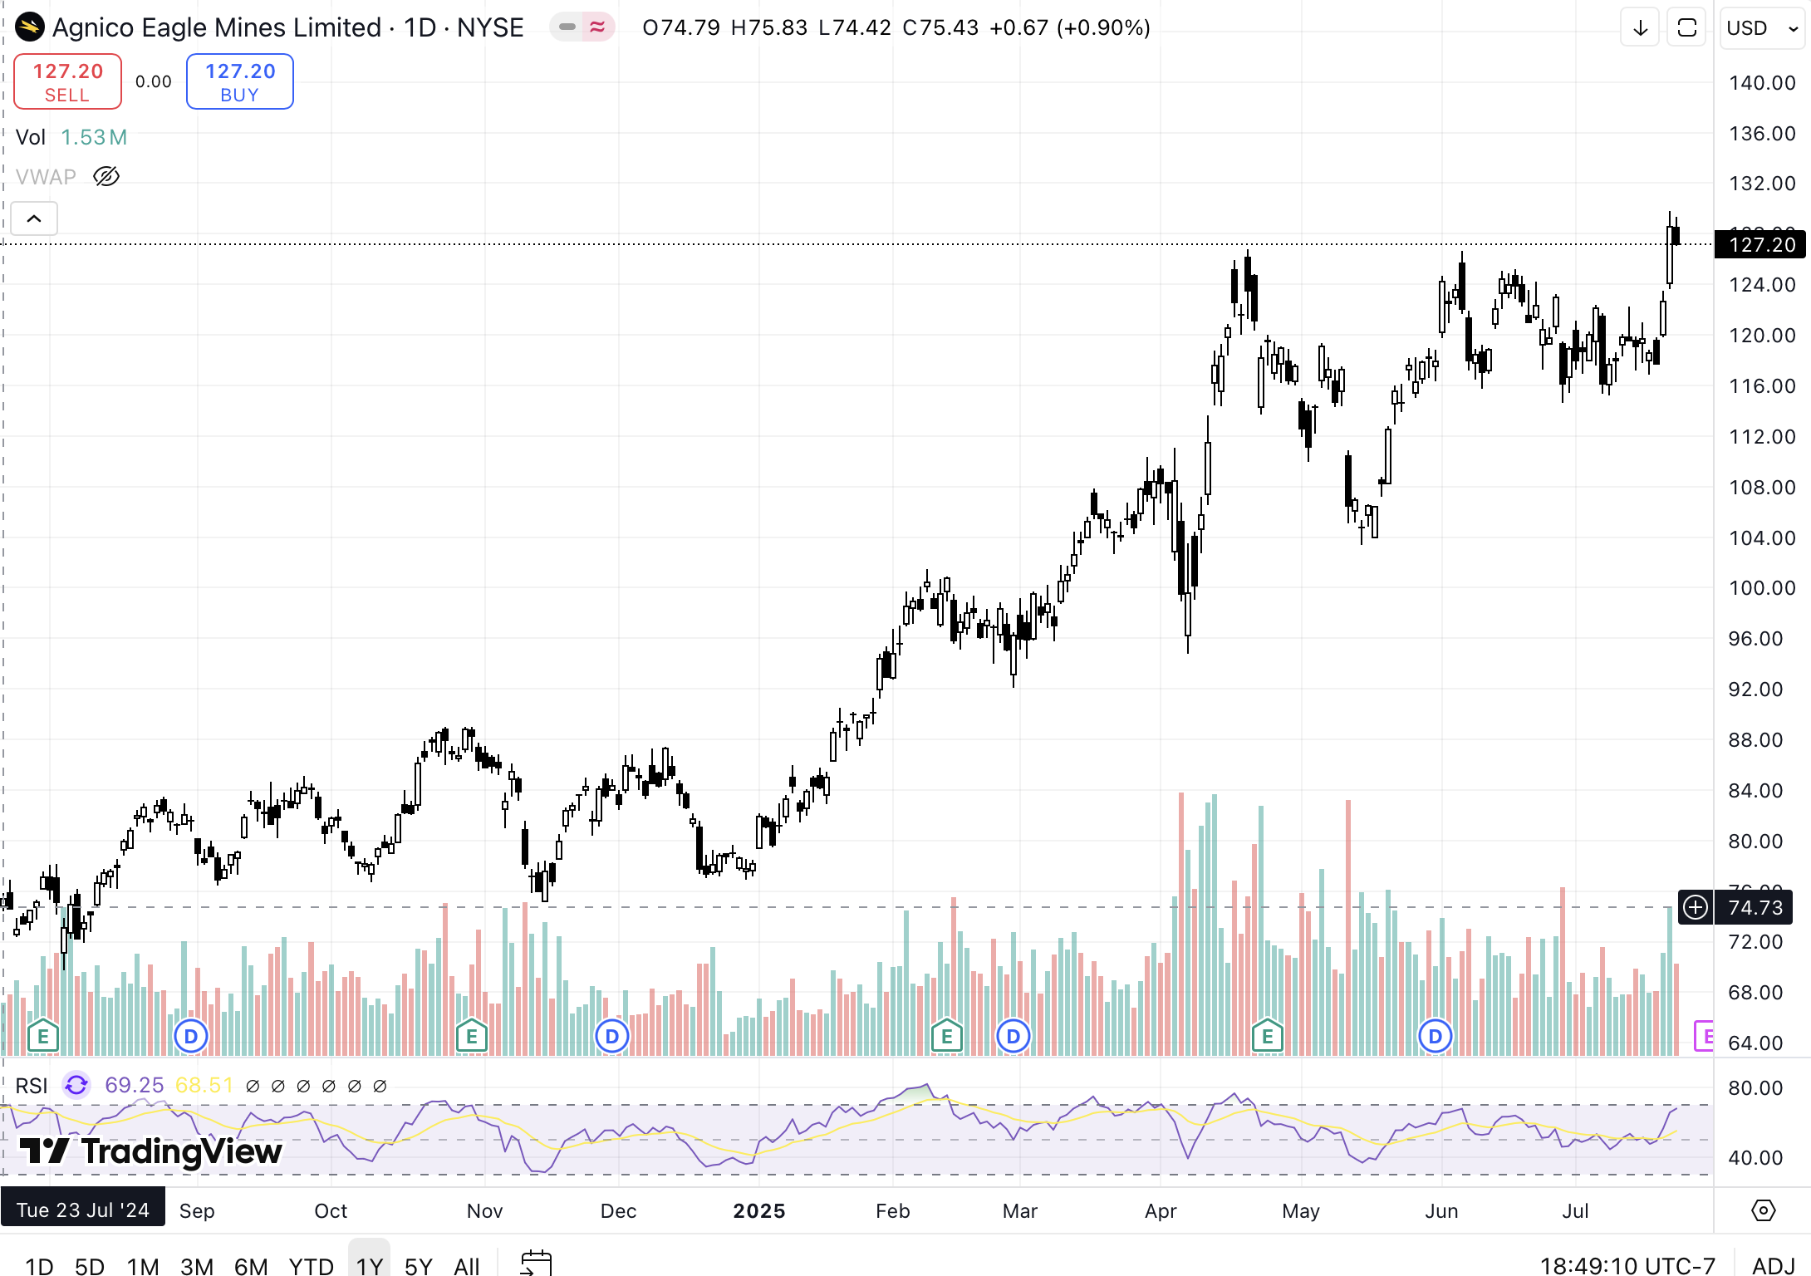
1 Year Price Performance

Slide 50
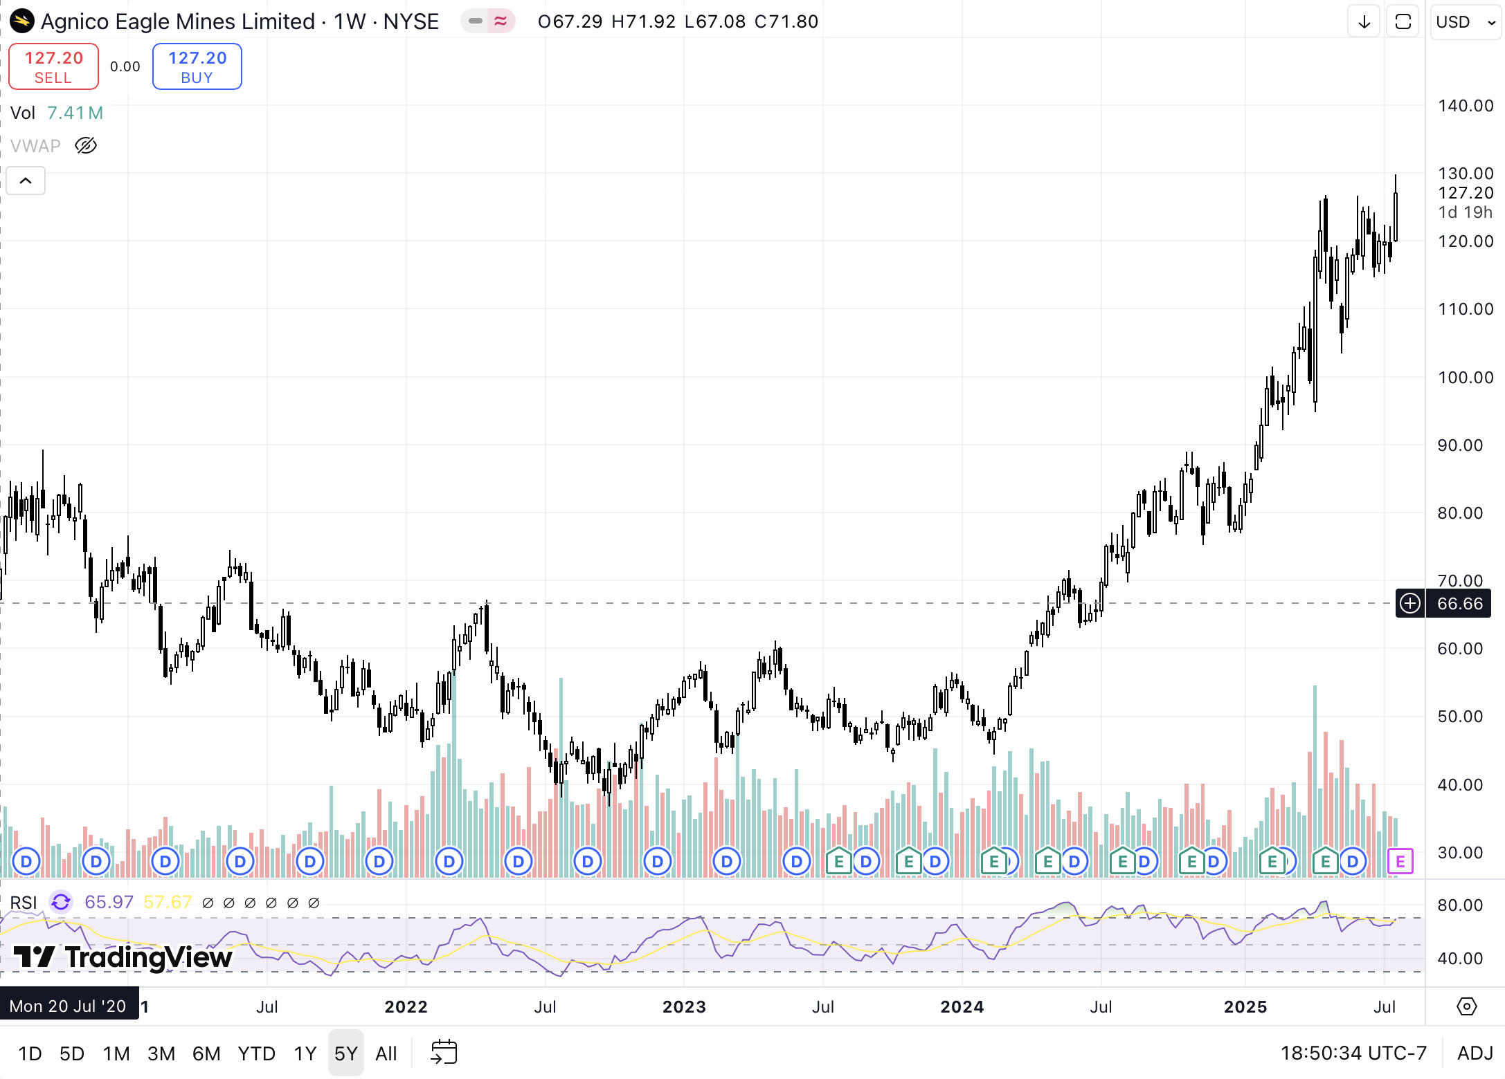
5 Year Price Performance

Slide 51
1 Year Price Performance Vs TSX Composite Index and Gold

Slide 52
1 Year Price Performance Vs ABX & K

Slide 53
5 Year Price Performance Vs TSX Composite Index and Gold

Slide 54
5 Year Price Performance Vs ABX & K

Slide 55
10 Year Price Performance Vs TSX Composite Index and Gold

Slide 56
10 Year Price Performance Vs ABX & K

Slide 57
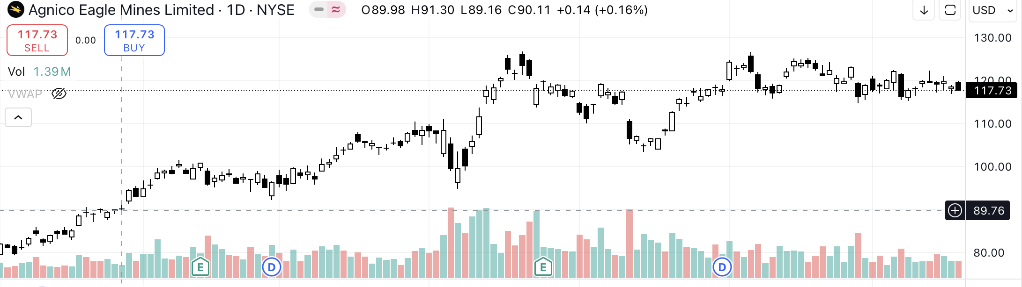
YTD Price Performance
Commentary
Q1 2025 Highlights
26% increase y/y in net earnings (USD 1.53/share)
32% increase in operating cash flow (USD 594M, compared to Q1 2024)
USD 154M returned to shareholders via dividends and share buybacks
Gold production for Q1 at 873.8koz, positioning the company on track to meet 2025 production guidance of 3.3–3.5Moz
Production weighted ~80% to Canadian operations, underscoring jurisdictional stability
Developments
Continued development of Odyssey underground project at Canadian Malartic and Upper Beaver project in Ontario
Record 54.3Moz gold reserves reported as of Dec 31, 2024
Strategic focus remains exclusively on gold, with no diversification into base metals
No major geopolitical risks due to operations concentrated in stable, mining-friendly jurisdictions

Slide 58
Company Overview & Key Statistics
Company Overview
Key Statistics
Founded in 1957 in Cobalt, Ontario
Agnico Eagle Mines Ltd. (TSX/NYSE: AEM) is a senior gold producer focused exclusively on gold production, exploration, and mine development.
Operations span Canada, Australia, Finland, and Mexico, with approximately 80% of gold production from Canadian mines.
In 2024, Agnico produced 3.49 million ounces of gold (873.8koz in Q1 2025), making it one of the world’s largest pure gold producers.
Key assets include Detour Lake, Canadian Malartic, LaRonde, Meliadine, Fosterville, and Kittila.
Key developments:
Record 54.3Moz in gold reserves as of 2024.
Development of Odyssey, Upper Beaver, and Wasamac projects.
Growth strategy focused on expanding Canadian production.
52 Week Range | $69.72 – $126.76
Volume | 1,872,917
Market Cap | 59.17B
Beta (5Y Monthly) | 0.49
PE Ratio (TTM) | 25.03
EPS (TTM) | 4.70
Forward Dividend Yield | 1.36%
1-Year Return | 68.63%
3-Year Return | 230%
5-Year Return | 85.97%
5-Year Revenue Growth | 232%
5-Year Earnings Growth | 300%

Slide 59
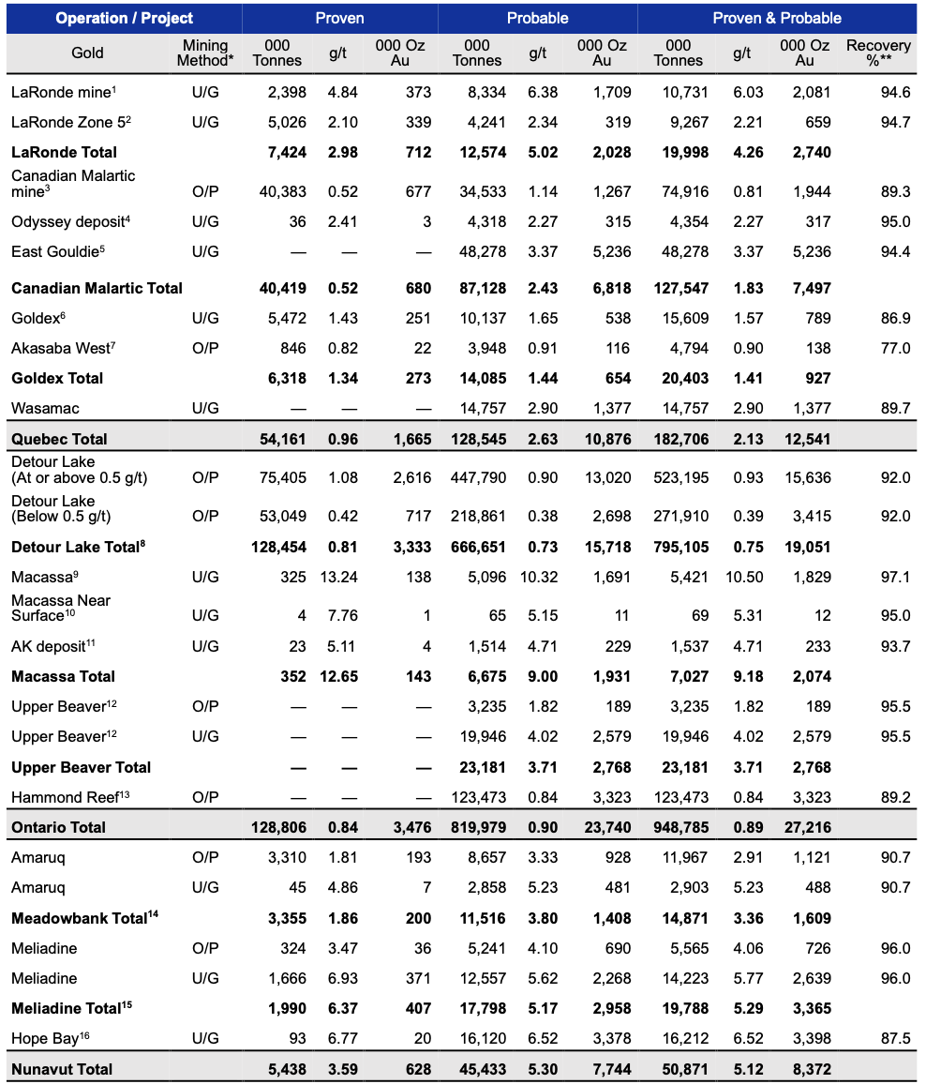
Proven & Probable Mineral Resources - Gold
Gold

Slide 60
Proven & Probable Mineral Resources - Gold
Gold

Slide 61
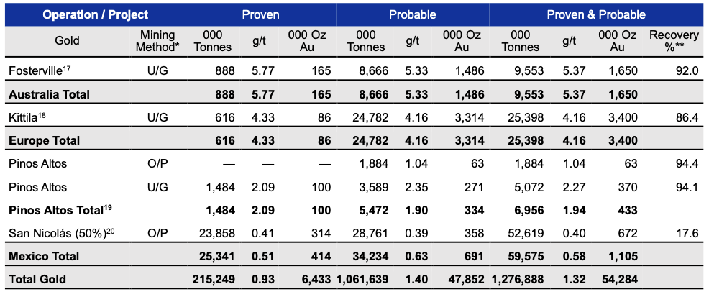
Proven & Probable Mineral Resources - Gold
Gold

Slide 62
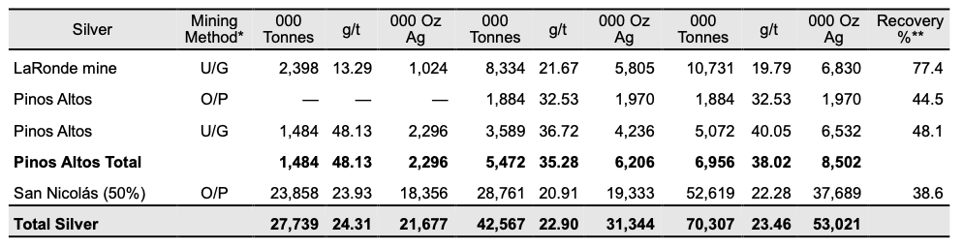
Proven & Probable Mineral Resources – Silver

Slide 63
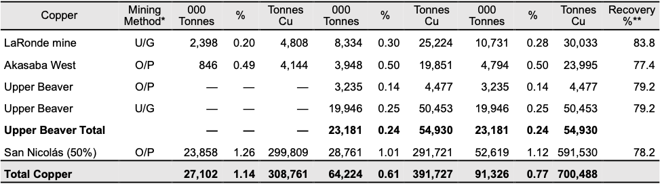
Proven & Probable Mineral Resources – Copper

Slide 64

Proven & Probable Mineral Resources - Zinc

Slide 65

Asset Map

Slide 66

Agnico Eagle Mining Operations and Production (Gold Ounces)

Slide 67
Canada Operations: Detour Lake Mine
Asset Overview
Key Statistics
  100% owned and operated by Agnico Eagle
  Located in northeastern Ontario, Canada
  One of the largest open-pit gold mines in North America
  Infrastructure includes large open pit, processing plant, and tailings facilities
  Core to Agnico’s Canada-focused growth strategy
  Focus on pit expansion and mill optimization to sustain low costs and extend production life
  Investor Highlight:
  Agnico’s largest, lowest-cost operation with a mine life to 2052, driving long-term free cash flow and supporting dividends from a stable jurisdiction.
Mine life
2052
2025 gold production estimate (oz)
750,000
2024 gold production (oz)
705,798
Production cost of sales 2025E ($/oz)
$940
2P Reserves (oz)
16,342,000

Slide 68
Canada Operations: Canadian Malartic Complex
Asset Overview
Key Statistics
  Joint venture (Agnico 50%, operator)
  Located in Malartic, Quebec, Canada
  Large open-pit mine transitioning to Odyssey underground development
  Key Quebec hub within Agnico’s regional strategy
  Odyssey project will extend mine life to 2039 and lower costs over time
  Uses existing mill and infrastructure, reducing development capital needs
  Investor Highlight:
  A cornerstone transitioning asset – current cash flow contributor evolving into a low-cost, long-life underground mine, securing future production stability.
Mine life
2039
2025 gold production estimate (oz)
530,000
2024 gold production (oz)
493,524
Production cost of sales 2025E ($/oz)
$1,150
2P Reserves (oz)
3,899,000

Slide 69
Canada Operations: LaRonde Complex
Asset Overview
Key Statistics
  Located in Abitibi region, Quebec
  Agnico’s longest-running mine (since 1988) and a leader in deep underground mining
  Produces gold with silver, zinc, and copper by-products, lowering effective costs
  Strong operational track record with over 35 years of production
  Active exploration supports life extension beyond 2035
Investor Highlight:
Reliable cash flow producer with diversification benefits (by-products) and established infrastructure, sustaining Agnico’s Quebec production base.
Mine life
2035
2025 gold production estimate (oz)
300,000
2024 gold production (oz)
314,189
Production cost of sales 2025E ($/oz)
$1,190
2P Reserves (oz)
3,218,000

Slide 70
Canada Operations: LaRonde Zone 5 (LZ5)
Asset Overview
Key Statistics
Satellite underground mine located near the main LaRonde Complex
Shares infrastructure with LaRonde, enhancing operational efficiency
Operates as a standalone ore source but integrated within the LaRonde processing network
Supports overall production flexibility and mine life extension at LaRonde Complex
Focused on consistent, low-to-medium scale underground production
Mine life
2035
2025 gold production estimate (oz)
105,000
2024 gold production (oz)
98,519
Production cost of sales 2025E ($/oz)
$1,150
2P Reserves (oz)
1,054,000

Slide 71
Finland Operations: Kittila Mine
Asset Overview
Key Statistics
Located in Lapland, northern Finland
Agnico Eagle’s only European asset and Europe’s largest primary gold producer
Underground mining operation with on-site processing plant
Focused on continuous underground expansion and mill optimization
Strategic foothold for Agnico Eagle in a stable jurisdiction with long mine life potential
Mine life
2035
2025 gold production estimate (oz)
235,000
2024 gold production (oz)
219,244
Production cost of sales 2025E ($/oz)
$1,040
2P Reserves (oz)
4,038,000

Slide 72
Australia Operations: Fosterville Mine
Asset Overview
Key Statistics
Located in Victoria, Australia
High-grade underground gold mine acquired through the Kirkland Lake Gold merger
Historically known for exceptionally high-grade zones (Swan Zone)
Currently focused on steady underground production and exploration to extend mine life
Represents Agnico Eagle’s key Australian platform for long-term growth
Mine life
2030
2025 gold production estimate (oz)
285,000
2024 gold production (oz)
275,859
Production cost of sales 2025E ($/oz)
$1,100
2P Reserves (oz)
1,759,000

Slide 73
Canada Operations: Meliadine Mine
Asset Overview
Key Statistics
Located near Rankin Inlet, Nunavut, Canada
Agnico Eagle’s second-largest Canadian gold operation
Underground and open-pit mining operation with on-site milling
Key driver of Agnico’s Arctic growth strategy
Focus on underground expansion and ongoing reserve development to sustain long-term production
Operates in a remote but mining-friendly jurisdiction with established infrastructure
Mine life
2033
2025 gold production estimate (oz)
340,000
2024 gold production (oz)
320,500
Production cost of sales 2025E ($/oz)
$1,200
2P Reserves (oz)
4,887,000

Slide 74
Canada Developments: Hope Bay Project
Asset Overview
Key Statistics
Located in the Kitikmeot region of Nunavut, Canada
Acquired from TMAC Resources in 2021
Currently in development and exploration phase – no commercial production yet
Significant land package with multiple deposits along an 80 km greenstone belt
Long-term strategic asset aimed at establishing a major gold district
Focused on exploration drilling, reserve definition, and project development planning
Mine life
2045 (estimated)
2025 gold production estimate (oz)
N/A (development)
2024 gold production (oz)
N/A (development)
Production cost of sales 2025E ($/oz)
N/A (development)
2P Reserves (oz)
3,355,000

Slide 75
Jurisdictional Risk
Concentration of NAV in safest jurisdictions among peers
Investment Attractiveness Score - By Asset
Net Asset Value (NAV) Breakdown

Slide 76











All-in Sustaining Costs (AISC)
Cheapest senior gold producer
Vs Peers
Cash Costs ($US/oz)

Slide 77

Agnico Eagle Mining Explorations

Slide 78

Growth – Project Pipeline
Growth assets form robust project pipeline to replace depleting reserves at Canadian Malartic and Detour Lake in safe jurisdictions
Exploration Stage, Estimated: N/A
Exploration Stage, Estimated: N/A
Advanced Exploration Stage, Estimated: N/A
Permitting Stage Estimated: 2026
Advanced Exploration Stage, Estimated: N/A

Slide 79





Precedent Transactions
Buyer | Target | Mine(s) | Purchase Price | Date
 |  | Marban Alliance | $185mm CAD (all cash) | Feb 2025
 |  | San Nicolas | $580mm CAD | Jun 2023
 |  | Canadian Malartic | $6.5bn CAD (all stock) | Mar 2023
 |  | Detour Lake Macassa Fosterville | $13.5bn CAD (all stock) | Feb 2022
 |  | Hope Bay | $460mm CAD (all cash) | Feb 2021

Slide 80

Capital Allocation Strategy

Slide 81


2025 Guidance & Outlook
Key Guidance Numbers

Slide 82

Forward Guidance & Outlook

Slide 83

Forward Guidance & Outlook

Slide 84


Ownership Structure
Top 10 Largest Shareholders
Ownership Structure
Holder | Common Stock Equivalent Held | % Ownership | Market Value (CAD in mm)
Fidelity Management & Research Co. LLC | 20,803,673 | 4.136 % | 2 474 M $
Van Eck Associates Corp. | 20,025,391 | 3.982 % | 2 382 M $
Vanguard Fiduciary Trust Co. | 19,803,469 | 3.938 % | 2 355 M $
Fidelity Investments Canada ULC | 16,797,353 | 3.34 % | 1 998 M $
Royal Trust Corp. of Canada | 15,783,807 | 3.138 % | 1 877 M $
Capital Research & Management Co. | 15,755,012 | 3.133 % | 1 874 M
MFS Investment Management Canada Ltd. | 13,441,198 | 2.673 % | 1 599 M $
DWS Investment Management Americas, Inc. | 11,924,543 | 2.371 % | 1 418 M $
BMO Bank NA | 9,519,907 | 1.893 % | 1 132 M $
Merrill Lynch International | 9,045,046 | 1.798 % | 1 076 M $

Slide 85

Insider Trading Activity
Commentary
CEO, Chair and Senior Executives actively sold large share blocks in 2024 and 2025.
Last buy transaction was in Jan 2024 done by the CEO at 70 USD per share!

Slide 86

Dividends

Slide 87

Company Executives

Slide 88


Company Executives
Background
Ammar Al-Joundi – President & CEO of Agnico Eagle Mines Ltd. since Feb 2022
Joined Agnico Eagle in 2010 as CFO, promoted to President in 2015
Previously served as CFO of Barrick Gold Corporation, overseeing global finance and strategy
Early career in structured finance at Citibank Canada
Holds a Mechanical Engineering degree (University of Toronto) and an MBA (Western University)
Over 25 years of experience in mining, finance, and capital markets
Leads Agnico’s Canadian-focused growth strategy and major gold reserve expansion

Slide 89


Company Executives
Background
Dominique Girard – Executive Vice President, Chief Operating Officer – Nunavut, Quebec & Europe
Leads Operations and Project Development teams across Agnico’s Nunavut, Quebec, and European assets
Joined Agnico Eagle in 2000 as a Metallurgist at the LaRonde mine
Held key roles:
Mill Superintendent at Kittilä mine (Finland)
General Manager at Meadowbank mine (Nunavut)
Corporate Director, Business Strategy Group
Vice President, Technical Services
VP, Nunavut (2015–2020)
SVP, Operations – Canada & Europe (2020–2022)
Holds a B.Sc. in Mineral Processing Engineering from Laval University (P.Eng.)
Member of the Ordre des ingénieurs du Québec (OIQ)
Over 20 years of operational leadership in mining operations and project development

Slide 90


Company Executives
Background
Guy Gosselin – Executive Vice President, Exploration, Agnico Eagle Mines Ltd.
Leads Agnico’s global exploration team across all operating regions
Joined Agnico in earlier roles including:
  Chief Geologist at LaRonde Division
  Exploration Manager for Eastern Canada
  Vice President – Exploration
  SVP, Exploration (2019–2022)
Holds an M.Sc. in Geology from Université du Québec à Chicoutimi (M.Sc.A., P.Eng.)
Professional member of OIQ (Quebec Order of Engineers) and OGQ (Order of Geologists of Quebec)
Over 20 years of experience in mineral exploration and resource development

Slide 91


Company Directors

Slide 92

Company Financials: 10-Q Consolidated Balance Sheet

Slide 93
Company Financials: 10-Q Consolidated Balance Sheet

Slide 94
Company Financials: 10-Q Consolidated Balance Sheet

Slide 95

Company Financials (2024 Annual): Consolidated Balance Sheet

Slide 96
Company Financials (2024 Annual): Consolidated Balance Sheet

Slide 97
Company Financials (2024 Annual): Consolidated Balance Sheet

Slide 98

Company Financials (2024 Annual): Consolidated Income Statement

Slide 99

Company Financials: 2025 Q1 Consolidated Income Statement

Slide 100

Company Financials (2024 Annual): Consolidated Cash Flows

Slide 101
Company Financials (2024 Annual): Consolidated Cash Flows

Slide 102

Company Financials: 2025 Q1 Consolidated Cash Flows

Slide 103
Company Financials: 2025 Q1 Consolidated Cash Flows

Slide 104

Sustainable Competitive Advantage (Moat)

Slide 105
Rating: BUY
Investment Thesis
Price/Book Value
Low-risk mining jurisdictions with long-term geologic potential and geopolitical stability
Disciplined capital allocation and shareholder returns driven by sustainable and high-quality assets
Low-cost, high-quality portfolio of assets with synergistic economies of scale with unique partnerships
Consistent dividend payment over 41-year span
Sustainable source of competitive advantage:
Low-cost, profitable, long-lifespan tier 1 mines in extremely safe, mining-friendly jurisdictions
Having the resources to operate mines and restructure operations to boost profitability and consolidate through cash generation

Slide 106
Barrick Mining Corporation (TSX:ABX)

Slide 107

1D Performance Snapshot

Slide 108

1-Year Price Chart

Slide 109

5-Year Price Chart

Slide 110

10-Year Price Chart

Slide 111
1 Year Price Performance Vs TSX Composite Index and Gold

Slide 112
1 Year Price Performance Vs ABX & K

Slide 113
5 Year Price Performance Vs TSX Composite Index and Gold

Slide 114
5 Year Price Performance Vs ABX & K

Slide 115
10 Year Price Performance Vs TSX Composite Index and Gold

Slide 116
10 Year Price Performance Vs ABX & K

Slide 117
Company Overview & Key Statistics
Company Overview
Key Statistics
Founded by Peter Munk in 1983 in Toronto, Canada
Barrick Mining Corporation (FKA Barrick Gold Corporation) is a large senior gold and copper company engaged in production, exploration, and mine development
Primary production is gold, but significant copper production is achieved through its Zaldivar and Jabal Sayid joint ventures in addition to its Lumwana mine
Operations span across 18 countries and five continents
  (Q1) 60% attributable gold production (758koz) in NA
  80% attributable copper production (44kt) in Africa and Middle East
Barrick's 2024 group production
  Gold production – 3.91Moz (758koz in Q1 2025)
  Copper production – 195kt (44kt in Q1 2025)
(2024) The business is organized into sixteen mine sites, with eight individually owned gold mines and one individually owned copper mine
Key developments
  Agreement to sell 50% stake in the Donlin Gold Project (Alaska) for $1bn
  Restructuring of the business to build on its copper production (aimed at growing the company’s production volumes)
52 Week Range ($) | 21.73 - 29.88
Volume | 3,147,089
Market Cap ($m) | 50,862
Beta (5Y Monthly) | 0.33
PE Ratio (TTM) | 16.33
EPS (TTM) | 1.32
Forward Dividend Yield | 1.84%
1-Year Return | 14.80%
3-Year Return | 46.58%
5-Year Return | (23.59%)
5-Year Revenue Growth | 5.87%
5-Year Earnings Growth | (11.60%)

Slide 118

YTD Price Performance
Commentary
Q1 2025 Highlights
  61% increase y/y in net earnings ($0.27/share)
  59% increase in operating cash flow (compared to Q12024)
  $143m in share buybacks and a $0.10/share quarterly dividend
Asset Performance: Gold production for Q1 is at the top end of 700-750koz
  Positioning the company on track to achieve year end production targets
Developments
  Advancements in deal with Discovery Silver to purchase the Hemlo gold mine in Ontario, Canada
    Sale aimed at capturing high gold prices and rising interest by smaller firms in NA to acquire mining operations
  Geopolitical conflict in Mali: Barrick shuttered in April due to the government alleging non-payment of taxes & ownership conflicts
    Loulo-Gounkoto gold complex under state control
    Barrick's gold exports blocked, and assets seized by the government

Slide 119

Barrick Production (Sample)
North America

Slide 120

Barrick Production (Sample)
Latin America & Asia Pacific

Slide 121



Barrick Production (Sample)
Africa & Middle East

Slide 122

Proven & Probable Mineral Resources (Gold)
Africa & Midde East

Slide 123


Proven & Probable Mineral Resources (Gold)
Latin America & Asia Pacific

Slide 124

Proven & Probable Mineral Resources (Gold)
North America

Slide 125

Proven & Probable Mineral Resources (Copper)

Slide 126

Proven & Probable Mineral Resources (Silver)

Slide 127

Mineral Reserves (Gold)
Africa & Middle East

Slide 128


Mineral Reserves (Gold)
Latin America & Asia Pacific

Slide 129

Mineral Reserves (Gold)
North America

Slide 130

Mineral Reserves (Copper)

Slide 131

Barrick Asset Map
NA, Latin America & Asia Pacific, Africa & ME

Slide 132

Nevada Operations: Cortez
Asset Overview
Key Statistics
Joint venture with Newmont (38.5% ownership) and JV operator Barrick (61.5%) through Nevada Gold Mines (NGM)
Complex consists of multiple open pit mines, underground mines, and processing facilities
  Incl. Oxide mill and heap leach pads
Goldrush
  ventilation shaft enables increased mining rates (alongside two underground primary fans) with another planned
  Exp. Long-life underground mine with projected annual production of 400,000+ ounces per annum (100% basis) by 2028
Fourmile
  100% owned by Barrick
  3-yr feasibility study beginning in 2025
  192% increase in resources and 137% growth in inferred resources (as per mineral resource estimate)
  Grade improving by 35% (as per mineral resource estimate)
Mine life
2030
2025 gold production estimate (oz)
420,000 – 470,000
2024 gold production (oz)
444,000
Production cost of sales 2025E ($/oz)
1,420 – 1,520
2P Reserves (oz)
8,290,000

Slide 133

Nevada Operations: Carlin
Asset Overview
Key Statistics
Joint venture with Newmont (38.5% ownership) and JV operator Barrick (61.5%) through Nevada Gold Mines (NGM)
Gold mine located in Eureka and Elko Counties
  46 km west of Elko, Nevada
Complex is a mature mineral district with gold extraction occurring since 1925 with consistent exploitation occurring since 1965
Complex consists of multiple open pit mines, underground mines, and processing facilities
  Incl. Two roasters, an autoclave, and heap leach pads
Reserve additions made at Leeville (attributed to Miramar), Gold Quarry, and Exodus
Increases in resources at Leeville and Pete Bajo
Final phase of Gold Quarry roaster expansion complete
  Exp. to deliver an increase of 20% in throughput
Mine life
2037
2025 gold production estimate (oz)
700,000 – 785,000
2024 gold production (oz)
775,000
Production cost of sales 2025E ($/oz)
1,470 – 1,570
2P Reserves (oz)
9,520,000

Slide 134

Nevada Operations: Phoenix
Asset Overview
Key Statistics
The Phoenix complex is located in Elko, Nevada and is a tri-metal operation
  Gold, copper, & silver
Owned by Nevada Gold Mines (joint venture) with Barrick owning 61.5% and Newmont owning 38.5%
Mine includes a flotation mill, carbon-in-leach plant, copper leach pad, and solvent extraction-electrowinning plant
Increased throughput due to planned maintenance
  Gold production in Q4 2024 34% higher than Q3 2024
Growth driven by the addition of Reona layback to reserves
  Tailings Storage Facility Cell 1 design updated (displacing lower grade material)
Growth opportunities in copper production and high-grade gold + copper
  Porphyry potential around Copper Canyon stock
Mine life
2032
2025 gold production estimate (oz)
85,000 – 105,000
2024 gold production (oz)
127,000
Production cost of sales 2025E ($/oz)
2,070 – 2,170
2P Reserves (oz)
1,910,000

Slide 135

Nevada Operations: Turquoise Ridge
Asset Overview
Key Statistics
Joint venture with Newmont (38.5% ownership) and JV operator Barrick (61.5%) through Nevada Gold Mines (NGM)
Gold mining operation located in Humboldt County, 64 km northeast of Winnemucca, Nevada
Complex has supported sporadic mining of minerals since 1883
Complex consists of multiple open pit and underground mines
Mine features an autoclave, oxide mill, and heap leach pads
Value attributed to high-grade underground mine
Barrick invested in a third shaft: additional ventilation and shorter haulage distances
Growth in open pit mining operations (replacement of cut 40 for cut 55 in reserves)
Production up 19% y/y
Processing cost per tonne declined 40% y/y
Mine life
2032
2025 gold production estimate (oz)
310,000 – 345,000
2024 gold production (oz)
304,000
Production cost of sales 2025E ($/oz)
1,370 – 1,470
2P Reserves (oz)
8,900,000

Slide 136

Ontario Operations: Hemlo
Asset Overview
Key Statistics
Located north of Lake Superior, 35 km east of Marathon, Ontario
Mine in production since 1985 with production of 21 million oz of gold by December 2016
Operates as an underground mine with ongoing advancements in studies and permits for restart of larger-scale open pit mining
  Golden Giant and David Bell mines closed
Skilled workforce in neighboring towns of Marathon, Manitouwadge, White River, etc.
William's mine contains a 10,000 tpd carbon-in-pulp gold mill with electrowinning and refining capacity
Mine life
2026
2025 gold production estimate (oz)
140,000 – 160,000
2024 gold production (oz)
143,000
Production cost of sales 2025E ($/oz)
1,500 – 1,600
2P Reserves (oz)
1,636,000

Slide 137
Pakistan Operations: Reko Diq
Asset Overview
Key Statistics
Barrick owns 50% of the copper-gold mine with remaining ownership by three SOEs (25%) and the Government of Balochistan (15%)
Mine is located in the Chagai district of Balochistan, near the Afghanistan and Iran borders
Mine faces challenges related to sustaining adequate living conditions
  Locale has a sparse population
  Lack of infrastructure including education, healthcare, and clean water
Reconstitution completed in December 2022, with the aim of creating a long-life copper-gold mine
  Targeting production of 240kt pa copper and 300koz pa gold (Phase 1) and 400kt pa copper and 500koz pa gold (Phase 2)
Expected plant commissioning date
2028
Probable copper tonnes (Mt)
1,500
Probable copper grade (%)
0.48
Probable contained copper (Mt)
7.3
Mine life
2064

Slide 138
Chile Operations: Norte Abierto
Asset Overview
Key Statistics
Ownership is structured through a 50/50 joint venture with Newmont
Located in the Chile by the Maricunga Volcanic Belt
One of the world's largest undeveloped gold-copper deposits
Currently in the pre-feasibility stage (2A) with the scope of mine development, power, water treatment, camp, etc.
Mine includes a porphyry copper-gold deposit and minor epithermal gold deposits
  55% gold and 45% copper
Mine life
21 years
Proven gold tonnes (Mt)
110
Proven gold grade (g/t)
0.65
Proven contained gold (oz)
2,400,000
2P Reserves (oz)
11,600,000

Slide 139

Papua New Guinea Operations: Porgera
Asset Overview
Key Statistics
Located in the Enga Province of the Western Highlands of PNG
Joint venture operation through Porgera Joint Venture with Barrick (owning 95%) and Mineral Resources Enga (owning 5%)
Gold operations consist of an open pit and underground mine located in Papua, New Guinea
Local resources to support mine operations have grown significantly since inception
  Local population increase from 3-5,000 to 30-50,000
  Reduction of mortality rates through infrastructure improvements including a hospital
Gold production 62% higher q/q: driven by ramp up in operations
Mine life
2043
2025 gold production estimate (oz)
70,000 – 95,000
2024 gold production (oz)
46,000
Production cost of sales 2025E ($/oz)
1,510 – 1,610
2P Reserves (oz)
1,450,000

Slide 140
Argentina Operations: Veladero
Asset Overview
Key Statistics
Mine is located in the San Juan Province of Argentina
Ownership is through a 50/50 joint venture in Minera Argentina Gold SRL with Shandong Gold
Operations consist of a large open-pit heap leach gold and silver mine
  Mine also consists of a two-stage crushing and extraction process using valley-fill heap leaching and Merrill-Crowe recovery
Production began in 2005
Mine life
2027
2025 gold production estimate (oz)
190,000 – 220,000
2024 gold production (oz)
252,000
Production cost of sales 2025E ($/oz)
1,390 – 1,490
2P Reserves (oz)
1,610,000

Slide 141

D.R. Congo Operations: Kibali
Asset Overview
Key Statistics
Kibali is located in the Haut Uélé Province of the DRC
Production at Kibali is for gold doré bars
Ownership structured as a joint venture through Kibali Goldmines SA with Barrick (45%), Anglogold Shanti (45%), and SOKIMO (10%)
  Barrick serving as the operator at Kibali for exploration and mining
Project consists of multiple mineral deposits
  Underground mine at Karagba-Chauffeur-Durba (KCD)
  Open pit mines at KCD, Sessenge, Aerodrome, and Gorumbwa
Mine life
2034
2025 gold production estimate (oz)
310,000 – 340,000
2024 gold production (oz)
309,000
Production cost of sales 2025E ($/oz)
1,280 – 1,380
2P Reserves (oz)
4,600,000

Slide 142

Saudi Arabia Operations: Jabal Sayid
Asset Overview
Key Statistics
Copper operation located in Jeddah, Saudi Arabia
Ownership through a 50/50 joint venture with Ma'aden
Commercial production began in July 2016
Lode 1 growth project
  New orebody located 1 km from existing lode
  Design includes a processing plant upgrade, underground capital development, ventilation, and infrastructure upgrades to paste plant and underground mining infrastructure
Mine life
2032
2025 copper production estimate (kt)
25-35
2024 copper production (kt)
32
Production cost of sales 2025E ($/lb)
2.00-2.30
2P Reserves (oz)
158,000

Slide 143

Mali Operations: Loulo-Gounkoto
Asset Overview
Key Statistics
Complex consists of Loulo and Gounkoto (distinct mining permits)
  Loulo: complex comprises two underground mines (Yalea and Gara) and a processing plant producing gold doré bars
  Gounkoto: operations include an underground and open-pit mine
Mines are located in western Mali near the Senegal border
Ownership structured through joint ventures: Société des Mines de Loulo SA and Société des Mines de Gounkoto owning Loulo and Gounkoto respectively
  Barrick has 80% ownership, and the State of Mali has 20%
  Barrick is the operator for both operations
Mine life
2034
2025 gold production estimate (oz)
N/A (projection not included due to gov shutdown)
2024 gold production (oz)
578.000
Production cost of sales 2025E ($/oz)
N/A (projection not included due to gov shutdown)
2P Reserves (oz)
7,300,000

Slide 144
Ivory Coast Operations: Tongon
Asset Overview
Key Statistics
Tongon is a gold mine located within the Nielle mining permit area
  55 km south of Mali border
Ownership structured through a joint venture through Société des Mines de Tongon SA
  Barrick owning 89.7%, with the remaining 10% owned by the State of Côte d’Ivoire and 0.3% by Ivorian investors
Mine life
2026
2025 gold production estimate (oz)
110,000 – 140,000
2024 gold production (oz)
148,000
Production cost of sales 2025E ($/oz)
1,790 – 1,890
2P Reserves (oz)
610,000

Slide 145

Tanzania Operations: Bulyanhulu
Asset Overview
Key Statistics
Located in the Kahama district of Shinyanga (NW Tanzania)
  55 km south of Lake Victoria
Bulyanhulu is a narrow-vein gold mine with gold, silver, and copper mineralization due to steeply-dipping veins
Commercial production began in 2001
Conversion drilling successfully replaced the reserves in 2024
Upper West Box Cut completed with improved decline development rate to 180m/mth and total advance of 436m
  on track for first ore by end 2025
Mine life
2033
2025 gold production estimate (oz)
150,000 – 180,000
2024 gold production (oz)
168,000
Production cost of sales 2025E ($/oz)
1,470 – 1,570
2P Reserves (oz)
3,740,000

Slide 146

Tanzania Operations: North Mara
Asset Overview
Key Statistics
Ownership structured through a joint venture between Barrick and the Tanzanian government through North Mara Gold Mine Ltc.
  Majority owned by Barrick with the Tanzanian government owning 16%
  Economic benefits shared 50/50
North Mara is a gold mine located in NW Tanzania in the Tarime district
The mine contains an open pit and underground mine
  Extracting from the Gokona and Nyabirama deposits
The processing plant has a capacity of 8,000 tonnes per day
Commerical production began in 2002
Mine life
2038
2025 gold production estimate (oz)
230,000 – 260,000
2024 gold production (oz)
265,000
Production cost of sales 2025E ($/oz)
1,370 – 1,470
2P Reserves (oz)
2,880,000

Slide 147

Dominican Republic Operations: Pueblo Viejo
Asset Overview
Key Statistics
Ownership structured through a joint venture in the Pueblo Viejo Dominicana Corp. between Barrick (60%) and Newmont (40%)
Located 100 km northwest of Santo Domingo in the Dominican Republic
Pueblo Viejo is a precious metal deposit containing an open pit gold mine
Commercial production began in 2013 and full design capacity was achieved in 2014
Gold production target of 800koz for 2026 (100% basis)
Mine life
2041
2025 gold production estimate (oz)
370,000 – 410,000
2024 gold production (oz)
352,000
Production cost of sales 2025E ($/oz)
1,540 – 1,640
2P Reserves (oz)
12,300,000

Slide 148
Jurisdictional Risk
Highest jurisdictional risk among peers despite Nevada Gold Mines exposure
Investment Attractiveness Score - By Asset
Net Asset Value (NAV) Breakdown

Slide 149
All-in Sustaining Costs (AISC)
Second-priciest among large senior gold producers
Vs Peers

Slide 150


Growth – Project Pipeline
Construction Stage Estimated: 2026
Pre-Feasibility Stage Estimated: TBD
Feasibility Study Stage Estimated: 2028
Feasibility Study Stage Estimated: N/A
Construction Stage Estimated: 2028
Construction Stage Estimated: N/A
Construction Stage Estimated: N/A

Slide 151







Precedent Transactions
Rare and spaced out
Buyer | Target | Mine(s) | Purchase Price | Date
 |  | Rackla Connaught | $35.99mm (all stock) | Feb 2023
 |  | Reko Diq | $1.14bn (all stock) | Dec 2022
 |  | Sabodala-Massawa | $3.19bn (all stock) | Nov 2020
 |  | Massawa | $554mm (25% cash, 75% stock) | Dec 2019
 |  | Loulo-Gounkoto Tongon Kibali | $8.43bn (all stock) | Sep 2018

Slide 152



2025E Forward Guidance & Outlook

Slide 153


1Q25 MD&A
MD&A Commentary
Select Financials
Gold revenues in Q1 '25 decreased 17% compared to Q4 '24
  Lower sales volumes offset by higher gold prices
Gold prices volatile due to economic & geopolitical headwinds
  Trade disputes
  Decline in trade-weighted USD
Q1 '25 attributable gold production decreased by 30% compared to Q4 '24
  (primary) attributed to suspension of Loulo-Gounkoto operations by Mali gov
  (secondary) lower production at Carlin due to planned shutdown
17% increase in Q1 '25 copper revenues compared to Q4 '24
  Higher realized copper price
  Copper prices impacted by Chinese demand forecasts
Q1 '25 attributable copper production lower than Q4 '24 by 20k tonnes
  Lower grades processed & lower throughput at Lumwana

Slide 154


Ownership Structure
Top 10 Largest Shareholders
Ownership Structure
Holder | Common Stock Equivalent Held | % Ownership | Market Value (CAD in mm)
Wellington Management Group LLP | 77,989,866 | 4.536 | 2,272.7
Capital Research and Management Company | 74,240,884 | 4.318 | 2,163.4
The Vanguard Group, Inc. | 68,861,295 | 4.005 | 2,006.7
Van Eck Associated Corp. | 67,797,266 | 3.943 | 1,975.7
Arrowstreet Capital LP | 53,425,008 | 3.107 | 1,556.9
First Eagle Investment Management LLC | 45,617,874 | 2.653 | 1,329.3
RBC Global Asset Management Inc. | 19,980,930 | 1.162 | 582.3
BMO Asset Management Corp. | 19,558,071 | 1.137 | 569.9
TD Asset Management Inc. | 17,950,892 | 1.044 | 523.1
CIBC Asset Management | 16,259,610 | 0.946 | 473.8

Slide 155

Insider Trading Activity
(LTM) Top 10 Open Market Transactions by Value
Ownership Structure
Holder | Transaction Type | Transacted Shares | Transaction Value (CAD)
Bristow, Dennis Mark (President & CEO) | Acquisition | 230,872 | 5,696,567
Coleman, Christopher Lewis (Former Independent Director) | Disposition | (121,334) | (3,473,291)
Grobler, Riaan | Disposition | (121,874) | (3,221,639)
Hill B.Eng, Mark F. (COO Latin America & Asia Pacific) | Acquisition | 86,085 | 2,112,417
Shuttleworth, Graham Patrick (Senior EVP & CFO) | Acquisition | 83,365 | 2,056,959
Keener, Christine (COO NA) | Acquisition | 80,049 | 1,969,969
Steele, John (Exec. Metallurgy, Engineering & Capital Projects | Acquisition | 54,477 | 1,344,173
Bock, Sebastian (COO Africa & ME) | Acquisition | 52,365 | 1,292,061
Thomas, Kevin J. (Senior EVP Strategic Matters) | Acquisition | 50,528 | 1,232,105
Rich, Darian Kevin (HR Exec) | Acquisition | 40,378 | 996,292
Commentary
Strong buy-in from key executives
  CEO & CFO
  COOs of operating regions
83+% of LTM open market transactions by insiders are acquisitions
  ~16% dispositions

Slide 156

Company Executives
Key Executives

Slide 157

Company Executives
Background
Position as CEO held since August 11, 1995
  Position on Interantional Advisory Board held since 2022
  Position as President held since January 1, 2019
Has been the Director and Non-Executive Chairman at Midway Resources International since November 2005
Serves as the Chairman of Nevada Gold Mines LLC, Gounkoto S.A, KibaliSarl, Tongon S.A., and Morila S.A
Serves as the President of Mali's advisory council
Pre-merger: Joined Randgold & Exploration in 1992, responsible for exploration and new business activities
  Later assuming the role of Director at Randgold Resources
Education
  Ph.D. in Geology from Natal University and the University of KwaZulu-Natal
  Fellow of the Geological Society of South Africa

Slide 158


Company Executives
Compensation (FY 2023 USD)

Slide 159

Company Executives

Slide 160

Company Executives
Background
Joined Barrick in 2019, responsible for engineering, metallurgy, and capital projects in Africa and the Middle East
Position held since April 2024
20-year professional career specializing in operational, technical, and leadership roles
  Underground mining, open cast operations, and processing facilities
Education
  M.E. from HBS
  Executive program at HBS

Slide 161



Company Executives
Background
Position held since July 2022
Group GM of Finance at Randgold Resources Ltd since February 25, 2016
  Prior role as the Group Corporate Finance Manager
Prior professional experience
  Joined Randgold in 2008 as the Senior VP and CFO (Africa & ME) for Randgold
    Later assuming responsibility for Africa & the ME in July 2022
Education
  Chartered Accountant
  Executive program at HBS
Compensation (FY 2023 USD)

Slide 162

Company Executives
Background
Position held since January 1, 2019
Served as Barrick's CIO from September 12, 2016 through December 31, 2018
  Also held the role of VP of Evaluations and VP of Mining Capital Projects
Prior professional experience as the Partner and Head of Mining and Evaluations at Waterton Global Resource Management
Several years of experience in the mining industry
  Senior positions at BHP Billiton, AngloGold Ashanti, Placer Dome, and WMC Ltd
Formerly the Director of Midas Gold Corporation from May 22, 2018 until January 31, 2019
Education
  B.eng in Mining Engineering
  Graduate Diploma in Mineral Economics

Slide 163


Company Executives
Compensation (FY 2023 USD)

Slide 164

Company Executives
Background
Position held since February 7, 2022
Professional experience expands across finance, strategy, commercial roles, and operations
Serves as the North American COO for Nevada Gold Mines LLC
Was formerly the VP of Europe and North America for Alcoa
  Prior professional role was as a CPA for PWC
Education
  BSC in Accounting from Grove City College
  MBA from Carnegie Mellon University

Slide 165

Company Executives

Slide 166

Company Financials: 10-Q Balance Sheet (Assets)

Slide 167

Company Financials: 10-Q Balance Sheet (Liabilities & SE)

Slide 168

Company Financials: 10-K Balance Sheet (Assets)

Slide 169

Company Financials: 10-K Balance Sheet (Liabilities & SE)

Slide 170

Company Financials: 10-K Income Statement

Slide 171

Company Financials: 10-Q Income Statement

Slide 172

Company Financials: 10-K Cash Flows (Operating Activities)

Slide 173

Company Financials: 10-K Cash Flows (Investing & Financing Activities)

Slide 174

Company Financials: 10-Q Cash Flows (Operating Activities)

Slide 175

Company Financials: 10-Q Cash Flows (Investing & Financing Activities)

Slide 176
Rating: HOLD
Investment Thesis
Price/Book Value
Exposed to significant geopolitical and jurisdictional risk despite concentration of NAV in Nevada Gold Mines
Situation in Mali presents an undervaluation relative to peers given increases in gold price YTD
Valuation is not justified given mediocre jurisdictions, growth in-line with peers
Executive compensation significantly above street/comparables which can be reallocated into de-risking current projects
Lower margins compared to AEM
Source of sustainable competitive advantage:
Operating high-reserve mines in riskier jurisdictions and de-risking through partial ownership, higher risk = higher reward

Slide 177
Kinross Gold (TSX:K)

Slide 178


1D Performance Snapshot

Slide 179
1-Year Price Chart

Slide 180
5-Year Price Chart

Slide 181
10-Year Price Chart

Slide 182
1 Year Price Performance Vs TSX Composite Index and Gold

Slide 183
1 Year Price Performance Vs ABX & K

Slide 184
5 Year Price Performance Vs TSX Composite Index and Gold

Slide 185
5 Year Price Performance Vs ABX & K

Slide 186
10 Year Price Performance Vs TSX Composite Index and Gold

Slide 187
10 Year Price Performance Vs ABX & K

Slide 188
Gold Price vs Real Yields (10-Yr UST)
Key themes of rising gold prices include central bank purchases and ETF flows
Correlation after Russia’s invasion of Ukraine = 0.51
Correlation before invasion = -0.90

Slide 189
Company Overview & Key Statistics
Company Overview
Key Statistics
Kinross Gold is a Canadian based gold producer and is a senior gold miner
The company produced nearly 2.1mm ounces of gold in 2024
Kinross operates in the Americas and West Africa after selling its low-cost Russian operations in 2022 as a response to Russia’s invasion of Ukraine
Production is spilt roughly with 70% in the Americas and 30% in West Africa
The company has a portfolio of 6 producing mines
More than half of Kinross’s operations are in higher risk jurisdictions
Its Paracatu mine in Brazil and Tasiast mine in Mauritania represent ~ 55% of the 2.1 million gold equivalent ounces sold by the company in 2024
In 2022, the company purchased the Great Bear project in Canada
52 Week Range ($) | 11.11 - 22.02
Volume | 3,476,960
Market Cap | 26.106B
Beta (5Y Monthly) | 0.76
PE Ratio (TTM) | 15.88
EPS (TTM) | 1.34
Forward Dividend Yield | 0.77%
1-Year Return | 66.90%
3-Year Return | 403.33%
5-Year Return | 87.08%
5-Year Revenue Growth | 8.04%
5-Year Earnings Growth | 6.20%

Slide 190

Property, Plant, & Equipment by Geographic Region ($mm USD)
Operations in Mauritania are the most capital intensive with the region representing ~29% of PP&E

Slide 191

Proven & Probable Mineral Resources (Gold)

Slide 192

Proven & Probable Mineral Resources (Sliver)

Slide 193


Kinross Asset Map and Production (Gold Ounces)
Gold Production

Slide 194

Brazil Operations: Paracatu
Asset Overview
Key Statistics
The Paracatu mine is 100% owned and operated by Kinross
The mine is in the northwestern portion of the Minas Gerais State in Brazil
The Paracatu mine includes an open pit mine, two process plants, two tailings facilities areas, and related surface infrastructure and support infrastructure
Largest gold mine in Brazil and it is one of the largest gold mining operations in the world
Attractive cost structure
Strong track record of good operating performance with seven years of more than 500koz of production
Mine life
2032
2025 gold production estimate (oz)
585,000
2024 gold production (oz)
528,574
Production cost of sales 2025E ($/oz)
$1,025
2P Reserves (oz)
4,887,000

Slide 195

Mauritania Operations: Tasiast
Asset Overview
Key Statistics
The Tasiast mine is owned and operated by TMLSA which is a wholly owned subsidiary of Kinross
The Tasiast Lands are in northwestern Mauritania. It is roughly 300 kilometres north of the capital Nouakchott
A royalty of 3% of the selling price resulting from the final ore processing stage in Mauritania is paid to the Mauritania government
The mine has an attractive low-cost structure
Open pit mine
Mine life
2033
2025 gold production estimate (oz)
500,000
2024 gold production (oz)
622,394
Production cost of sales 2025E ($/oz)
$860
2P Reserves (oz)
4,705,000

Slide 196

Chile Operations: La Coipa
Asset Overview
Key Statistics
The La Coipa mine is located approximately 1,000 kilometers north of Santiago
Kinross acquired 50% of the La Coipa mine in January 2003 and would later acquire the remaining 50% from Goldcorp in December 2007 after an asset swap transaction
No royalties are paid on gold and sliver produced from the La Coipa mines
La Coipa’s estimated mineral reserve is approximately 642,000 oz of gold and 15,890k oz of silver
2P reserves sliver (oz)
15,890,000
2025 gold production estimate (oz)
230,000
2024 gold production (oz)
246,131
Production cost of sales 2025E ($/oz)
$1,060
2P reserves gold (oz)
642,000

Slide 197

Chile Operations: Lobo-Marte
Asset Overview
Key Statistics
The Lobo-Marte project is owned by MDO which is a Chilean company that is 100% owned by Kinross
The Lobo-Marte project currently comprises two open-pit minable gold ore deposits
The deposits are located approximately seven kilometers apart, in the Atacama Region of Northern Chile
The mine has the potential to be a long-life and low-cost asset
The mine has significant mineral reserves and annual gold production is estimated to be ~300,000oz
The company will provide a project update in 2026
Probable reserves gold (oz)
6,733,000
Strip ratio
2.0
Estimated annual gold production (oz)
300,000
Average grade processed
1.3 g/t
Average recovery rate Au
70%

Slide 198

United States Operations: Fort Knox
Asset Overview
Key Statistics
The Fort Knox property is located in Fairbanks North Star Borough, Alaska
The property includes an open pit mine, mill, tailings facility, heap leach facilities and the Gil Sourdough satellite mine
For this asset, the State claims a 3% production royalty, based on net income and recovery of initial capital investment
Current production life on the asset is expected to extend to 2030
Strong gold production growth in 2024 relative to 2023
Near term production growth expected through contribution from Manh Choh
Mine life
2030
Fort Knox 2P reserves (oz)
1,276,000
2024 gold production (oz)
334,519
Attributable production cost of sales 2024 ($/oz)
$1,233
Manh Choh 2P reserves (oz)
558,000

Slide 199

United States Operations: Round Mountain
Asset Overview
Key Statistics
The Round Mountain mine is located roughly 90 kilometers north of Tonopah in Nye County, Nevada
Production at the mine is subject to a sliding scale royalty – 4% at gold price at or below $1,200oz and 7.15% at a gold price of $1400 or higher
There is also a net proceeds tax of 5% payable to the state of Nevada on the gross proceeds from the sale of minerals
The mine is operated using open-pit mining methods
There is potential for additional production through high-productivity and low-cost underground operations (higher margins)
2023 gold production (oz)
235,690
2P reserves (oz)
1,883,000
2024 gold production (oz)
215,387
Attributable production cost of sales 2024 ($/oz)
$1,527
Grade
0.8 g/t

Slide 200

United States Operations: Bald Mountain
Asset Overview
Key Statistics
Kinross acquired Bald Mountain mine from Barrik on January 11, 2016
The mining district is located at the southern end of Ruby Mountains in east-central Nevada
Both fixed and sliding scale royalties exist on this mine and are topped-out at gold prices above $1,000oz
Royalties range from 1-9% of gross sales
This mine is also subject to the 5% Nevada Net Proceeds Tax
The Bald Mountain operation is an open-pit operation with various mines contributing to production. The largest deposits are Saga & LBM
The company announced approval for phase 1 mining at the Redbird pit which is expected to produce 175,000oz of gold, extending production until 2028
2023 gold production (oz)
157,749
2P reserves (oz)
1,173,000
2024 gold production (oz)
181,047
Production cost of sales 2024 ($/oz)
$1,205
Grade
0.7 g/t

Slide 201
Jurisdictional Risk
Moderate jurisdictional risk as North American assets deplete
Investment Attractiveness Score - By Asset
Net Asset Value (NAV) Breakdown

Slide 202
All-in Sustaining Costs (AISC)
Second-cheapest among large senior gold producers
Vs Peers

Slide 203


Growth Catalyst: Great Bear Project
Key Highlights
Key Project Statistics
Stable operating jurisdiction located 24km southeast from the town of Red Lake, Ontario
Host to several already existing mining operations
Significant regional infrastructure already in place (Highway 105 & exiting provincial transmission power line and access to Enbridge natural gas pipeline)
Project expected to produce 518koz per year at an all-in sustaining cost of $800 for the first 8 years
Expected Gold Production

Slide 204

Growth Catalyst: Great Bear Project (Path to Production)
Production expected to start in 2029

Slide 205






Precedent Transactions
Buyer | Target | Mine(s) | Purchase Price | Date
 |  | Russian Assets | $440mm CAD (all cash) | Apr 2022
 |  | Chirano | $304mm CAD (75% cash, 25% stock) | Aug 2022
 |  | Great Bear | $1.7bn CAD (80% cash, 20% stock) | Feb 2022
 |  | Chulbatkan | $371mm CAD (all cash) | Jul 2019
 |  | Cerro Cesale Quebrada Seca | $374mm CAD (all cash) | June 2017

Slide 206


Strong Leverage to Gold
Kinross has more sensitivity to gold prices than industry peers, thus benefiting from record gold prices
The company is also more sensitive to market movements than GDX (a gold miner ETF)

Slide 207

Capital Allocation Strategy

Slide 208

2025E Capital Expenditure Guidance
Capital expenditures expected to be higher as the company reinvests back into operations

Slide 209


2025 Guidance & Outlook
Key Guidance Numbers
Production & Cost Guidance

Slide 210

Forward Guidance & Outlook
Kinross expects gold production to flat-line during a time of record high gold prices

Slide 211


1Q25 MD&A – Select Commentary & Financials
MD&A Commentary
Select Financials
Metal sales increased 38% to $1,497.5mm
Main driver behind revenue growth was a 38% increase in the average realized price of gold ($2,857oz)
Production cost of sales were $1,043oz a 6% increase relative to last year
Higher costs were due to lower production in Mauritania (lowest cost operation) and higher production at Fort Knox
Higher royalty charges also increased production costs due to higher gold prices
FCF increased by 155% relative to last year driven by higher gold prices and lower capital spending

Slide 212

1Q25 MD&A – Operating Income by Segment
Paracatu mine delivered strong growth driven by increased production and lower production costs

Slide 213

Ownership Structure
Top 10 Largest Shareholders
Ownership Structure
Holder | Common Stock Equivalent Held | % Ownership | Market Value (CAD in mm)
BlackRock, Inc. (NYSE:BLK) | 153,874,462 | 12.543 | 3,293.0
Van Eck Associates Corporation | 108,369,041 | 8.833 | 2,319.2
The Vanguard Group, Inc. | 47,926,769 | 3.907 | 1,025.7
Boston Partners Global Investors, Inc. | 47,526,913 | 3.874 | 1,017.1
Arrowstreet Capital, Limited Partnership | 39,791,835 | 3.244 | 851.6
Renaissance Technologies LLC | 32,451,794 | 2.645 | 694.5
Norges Bank Investment Management | 30,264,839 | 2.467 | 647.7
RBC Global Asset Management Inc. | 26,031,129 | 2.122 | 557.1
Mackenzie Financial Corporation | 13,377,661 | 1.09 | 286.3
Fidelity International Ltd | 13,052,763 | 1.064 | 279.3

Slide 214

Company Executives
Key Executives

Slide 215

Company Executives
J. Paul Rollinson Chief Executive Officer
Background
Appointed to board and as Chief Executive Officer on August 1, 2012
Joined Kinross in 2008 as an Executive Vice-President, New Investments
Was also appointed as Executive Vice-President of Corporate Development in 2009
Prior to joining Kinross, he spent 17 years in investment banking. His final position was Deputy Head of Investment Banking.
During his time in Scotia, he was responsible for the mining, power/utilities, forestry, and industrials sectors
Prior to joining Scotia, he worked at Deutsche Bank AG, where the last position he held was Managing Director/Head of Americas for the mining group.
Has a bachelor degree in Geology from Laurentian University and a Master of Engineering in Mining from McGill University

Slide 216

Company Executives
Geoffrey P. Gold President
Background
Appointed as President in March 2024
Joined Kinross in 2006 as a Senior Vice-President and Chief Legal Officer
Was later appointed as Executive Vice-President and Chief Legal Officer in 2008
Has held various executive positions in the company before becoming President (corporate development and HR)
Has more than 30 years of mining experience
He has also previously served as Vice-President, Assistant Secretary and Associate General Counsel for Placer Dome (2001 to 2006)
Holds a bachelors degree in Law and Commerce from the University of British Columbia

Slide 217

Company Executives
Andrea S. Freeborough Executive Vice-President and Chief Financial Officer
Background
Appointed as CFO in 2019
First joined the company in 2009 as Vice-President, Corporate Controller
Prior to becoming CFO, she also held positions as Vice-President, Finance in 2013, and Vice-President, Investor Relations and Corporate Development in 2017
Prior to joining Kinross, she worked at KPMG (1998 to 2009)
Is a CPA and holds a Bachelor of Business Administration from Wilfrid Laurier University

Slide 218

Company Executives
Ryan Latinovich Executive Vice-President, Corporate Development
Background
Appointed as Executive Vice President, Corporate Development in February 2025
Has 19+ years of capital markets experience at RBC with his most recent position being Global Head of Mining & Metals, Global Investment Banking
Prior to joining RBC, Ryan served as a Captain in the Canadian Armed Forces
He is a CPA and CFA
Additionally, he holds an MBA from Queen’s University, a Masters in International Politics and Economics from the Norman Paterson School of International Affairs, and a bachelors in Business from the Royal Military College of Canada

Slide 219

Company Executives
Claude Schimper Executive Vice-President, and Chief Operating Officer
Background
Appointed as Executive Vice-President and Chief Operating Officer in 2022
Joined Kinross in 2010 as Vice-President and General Manager
In 2014 he was promoted to Regional Vice-President, Russia where he provided leadership and oversight on mines and projects
In 2021 he promoted a senior leadership position as Executive Vice-President, Russia and West Africa Operations
Holds a diploma in metalliferous mining from Technikon Witwatersrand in Johannesburg, South Africa
Has more than 30 years of mining experience

Slide 220

Company Executives
William D. Dunford Senior Vice-President, Technical Services
Background
Appointed as Senior Vice-President, Technical Services in 2023
Joined Kinross more than 16 years ago
Has previously held technical and operational roles in the company
His most recent role was Vice-President, Mining Operations where he oversaw Kinross’ corporate mine planning, business planning, and maintenance
He also has corporate development experience in the company and has investment banking experience where he was previously the Director of Global Mining Investment Banking at CIBC
William holds a bachelors degree in mining engineering and economics both from Queen’s University

Slide 221

Company Executives
Kathleen Grandy Senior Vice-President, Human Resources
Background
Appointed as Senior Vice-President, Human Resources in 2021
Joined Kinross in 2008 and held senior positions in the legal department
Transitioned into the human resources department in 2020 as Vice President, Human Resources
Holds a bachelors degree in psychology and a Juris Doctor both from the University of Toronto

Slide 222

Company Executives
Ben Little Senior Vice-President, External Affairs
Background
Appointed as Senior Vice-President, External Affairs in 2024
Oversees all external affairs activity for Kinross
Has 25 years of experience in mining, legal, and political sectors with experience managing complex developments in complex jurisdictions
Prior to joining Kinross, Ben was Senior Vice-President, Corporate Affairs, Health, Safety & Security, and People at IAMGOLD
Ben holds a bachelors degree in political studies from Queen’s University, a masters degree in international relations from the University of Oxford, and a Juris Doctor from the University of Toronto

Slide 223

Company Executives
David Shaver Senior Vice-President, Investor Relations and Communications
Background
Appointed as Senior Vice-President, Investor Relations and Communications in 2025
Joined Kinross in 2021 as Senior Vice-President, Corporate Development
Oversaw the acquisition of Great Bear Resources as well as the divestures of the Chirano and Russian assets in 2022
Has 20+ years of investment banking experience in the global metals and mining sector with his most recent position being Managing Director, Investment Banking, Global Mining and Metals at CIBC Capital Markets
Holds an MBA from Queen’s University and a Bachelors of Arts from Western University

Slide 224

Company Financials: 1Q25 Balance Sheet (Assets)
Unaudited and expressed in $mm of USD

Slide 225

Company Financials: 1Q25 Balance Sheet (Liabilities and SE)
Unaudited and expressed in $mm of USD

Slide 226

Company Financials: 2024 Balance Sheet (Assets)
Figures expressed in $mm of USD

Slide 227

Company Financials: 2024 Balance Sheet (Liabilities and SE)
Figures expressed in $mm of USD

Slide 228

Company Financials: 2024 Statement of Income
Figures expressed in $mm of USD, except per share amounts

Slide 229

Company Financials: 1Q25 Statement of Income
Unaudited, expressed in $mm of USD, except per share amounts

Slide 230

Company Financials: 2024 Statement of Cash Flows
Cash flows from operating activities ($mm USD)

Slide 231

Company Financials: 2024 Statement of Cash Flows
Cash flows from investing and financing activities ($mm USD)

Slide 232

Company Financials: 1Q25 Statement of Cash Flows
Cash flows from operating activities ($mm USD)

Slide 233

Company Financials: 1Q25 Statement of Cash Flows
Cash flows from investing and financing activities ($mm USD)

Slide 234
Rating: SELL
Premium valuation despite jurisdictional risk and expected flat-lining in production
Investment Thesis
Price/Book Value
Despite increased production in the US after acquiring assets from Barrick, most of the production occurs in higher risk jurisdictions (Paracatu & Tasiast)
Kinross also operates higher cost mines compared to peers and most of its lower cost mines are subject to more jurisdictional risk
Kinross is more exposed to fluctuations in gold prices due to where it sits in the cost curve relative to industry peers
Additionally, both the Paracatu and Tasiast mines have remaining lives of less than a decade
Kinross is also exposed to risks related to changes in government taxes and royalties
The company also currently trades at a premium relative to its historical P/Book

