Slide 1
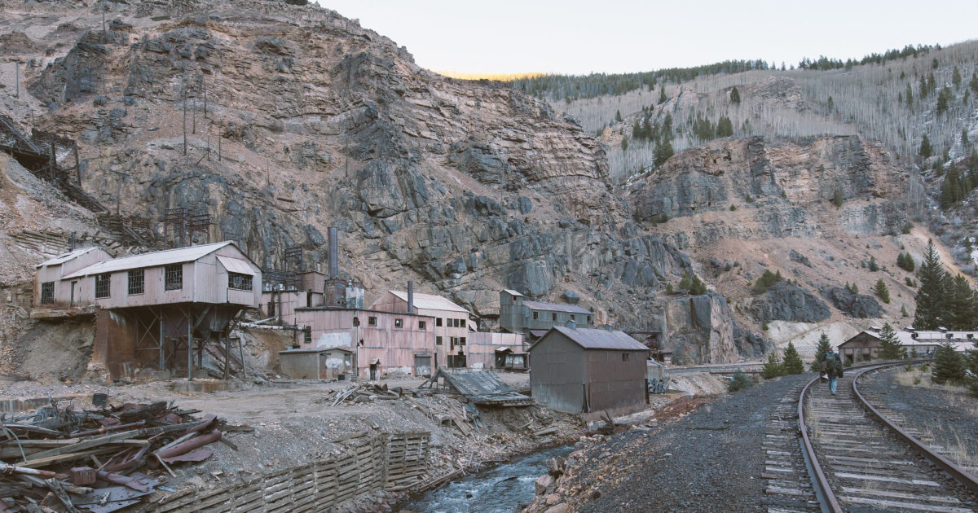
Canadian Metals & Mining
November 17th, 2023
Halfdan Kelly, Rameez Arshad, Daniel Szpakowski, Yuling Dai, Jaskern Athwal

Slide 2
Table of Contents
Mining History & Industry Overview
Commodity Markets
Gold: Agnico Eagle Mine
Uranium: NexGen Energy
Diversified: Teck Resources
Buy/Sell Recommendation

Slide 3
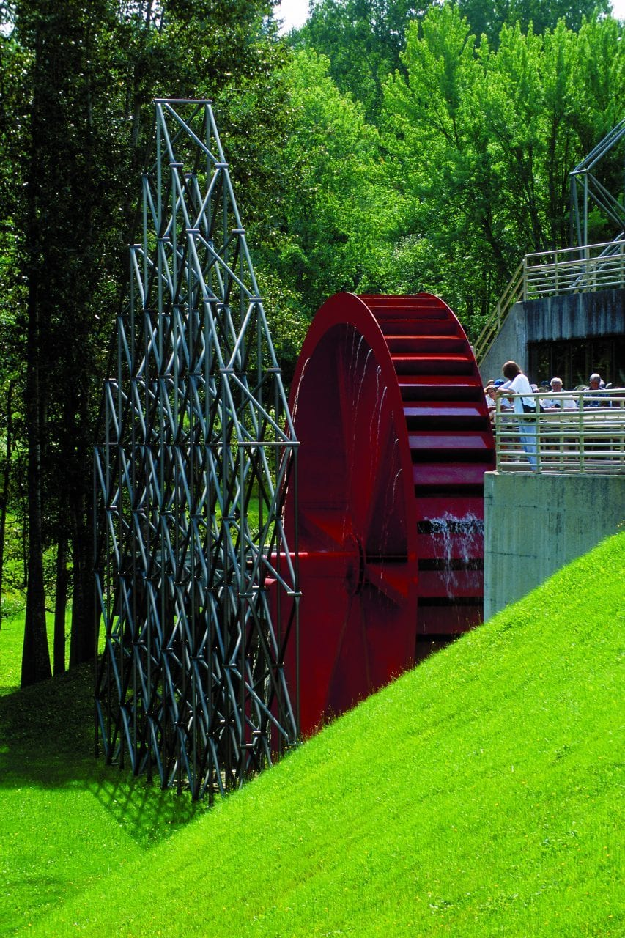
History of Canadian Mining
Mining History & Industry Overview
Coal was first discovered in 1672 on Cape Breton Island in Nova Scotia by French Settlers
An iron mine near Trois-Rivières in Quebec opened in 1738 and is considered the first industrial-scale mining operation in Canadian history
In 1848 the first industrial-scale mining of an element other than iron commenced in Bruce Mines, Ontario where copper was extracted
Prior to the 1880’s almost all significant mineral deposits in Canada were discovered by accident
In 1859 was discovered in BC’s Cariboo Region which kickstarted gold and mineral prospecting nationwide
In these early days many prospectors were financed by local business people, in some cases by individual business people, and sometimes by “syndicates” of several people in return for an interest in any discoveries made by the prospectors.
Small companies, were formed to explore for discoveries and hopefully to develop mines on deposits found. They obtained the needed funding by selling company shares to the public.
In the 1920s and 1930s, many mining companies formed their own exploration departments, employing their own geologists and prospectors.
Metal prices were low during the Great Depression of the 1930s, and, as a result, exploration for non-precious metals was severely reduced
In 1934, the United States increased the gold price from US$20.67 to US$35.00 per troy ounce (31.103 grams), leading to a major increase in gold exploration, gold mine development and gold production in Canada.
In 1939, war soon brought exploration to a halt, except exploration for strategic minerals not normally available from sources in North America, such as chromite, manganese, tin and tungsten. At most mines, work to replace the ore mined by new reserves either ceased or was cut to an absolute minimum.
Early industrial fabrications at Les Forges du Saint-Maurice, Canada’s first iron mine that operated from 1738-1883 (courtesy Salut Canada)
Postwar Canada saw an increase in detection for uranium deposits thanks to the invention of the Geiger counter
Important uranium deposits were soon discovered at Beaverlodge Lake, Saskatchewan

Slide 4
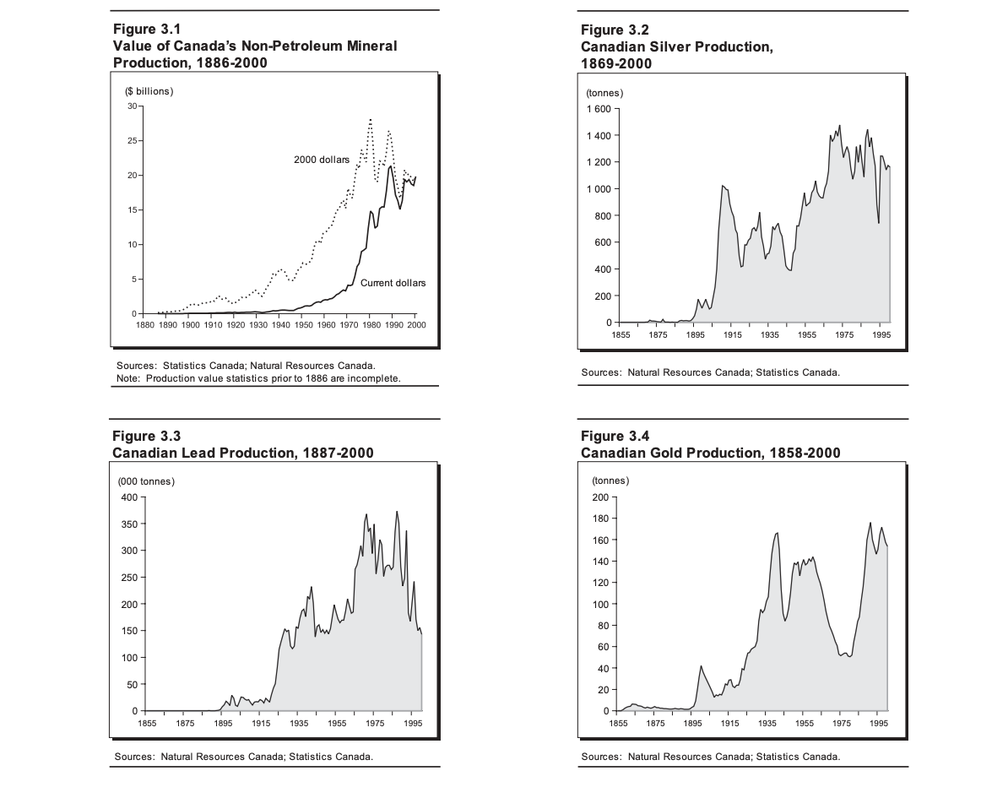
Early History of Mining in Canada
Mining History & Industry Overview

Slide 5
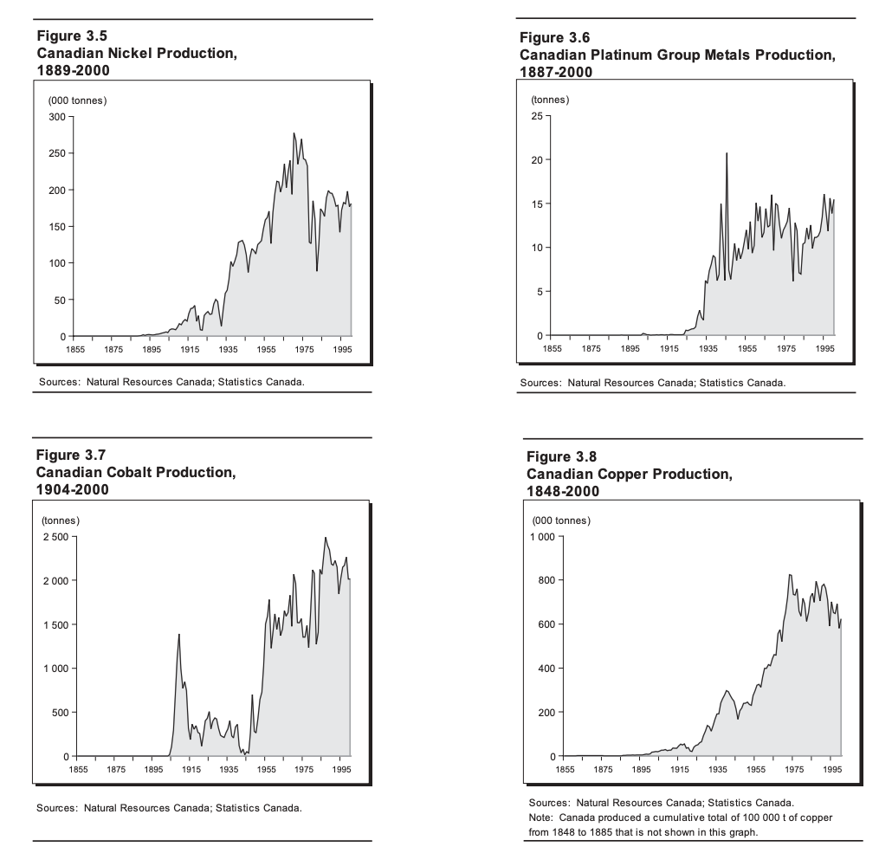
Early History of Mining in Canada
Mining History & Industry Overview

Slide 6
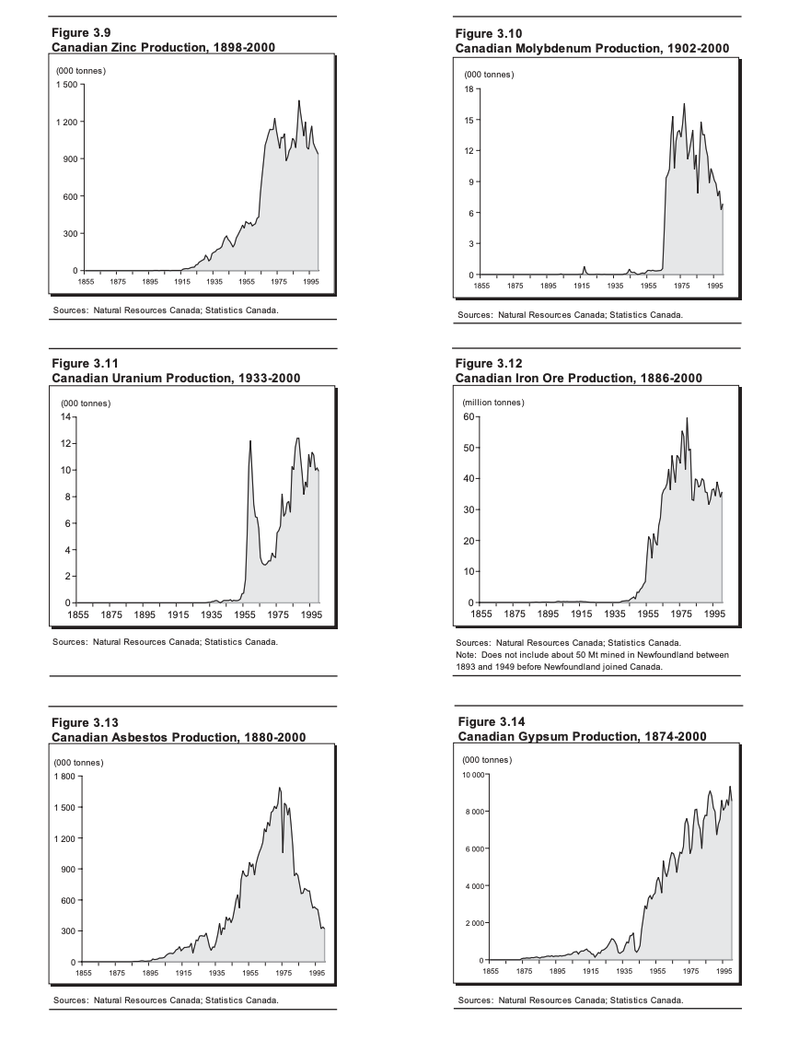
Early History of Mining in Canada
Mining History & Industry Overview

Slide 7
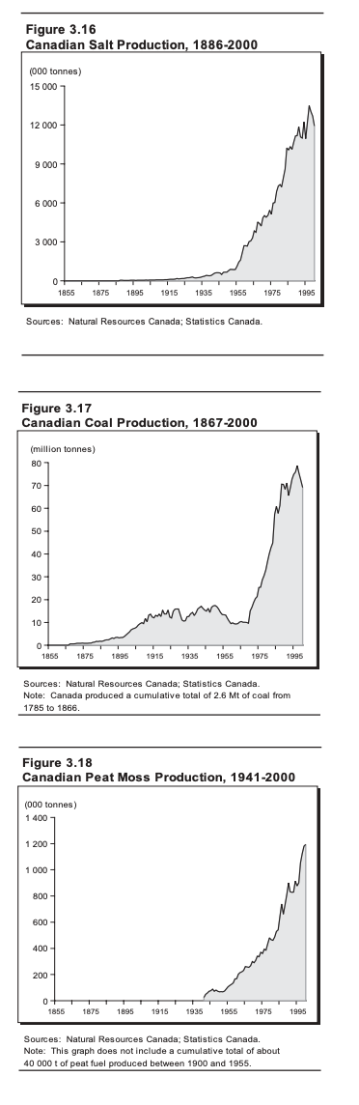
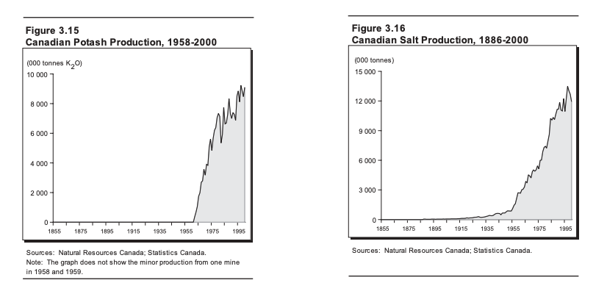
Early History of Mining in Canada
Mining History & Industry Overview

Slide 8
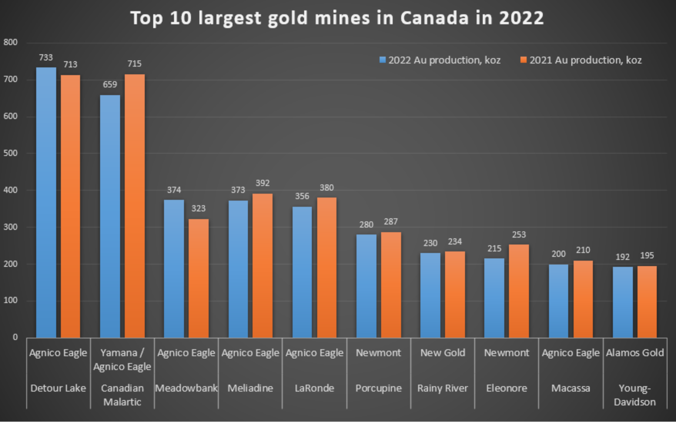
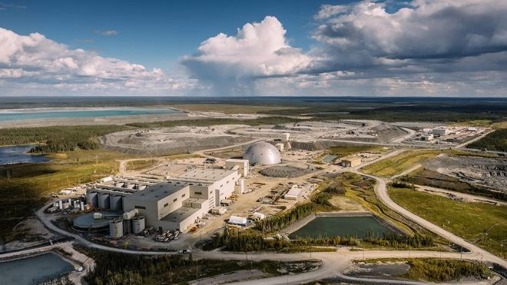
Biggest Gold mines in Canada by Output
Mining History & Industry Overview
Detour Lake Mine - Northern Ontario

Slide 9
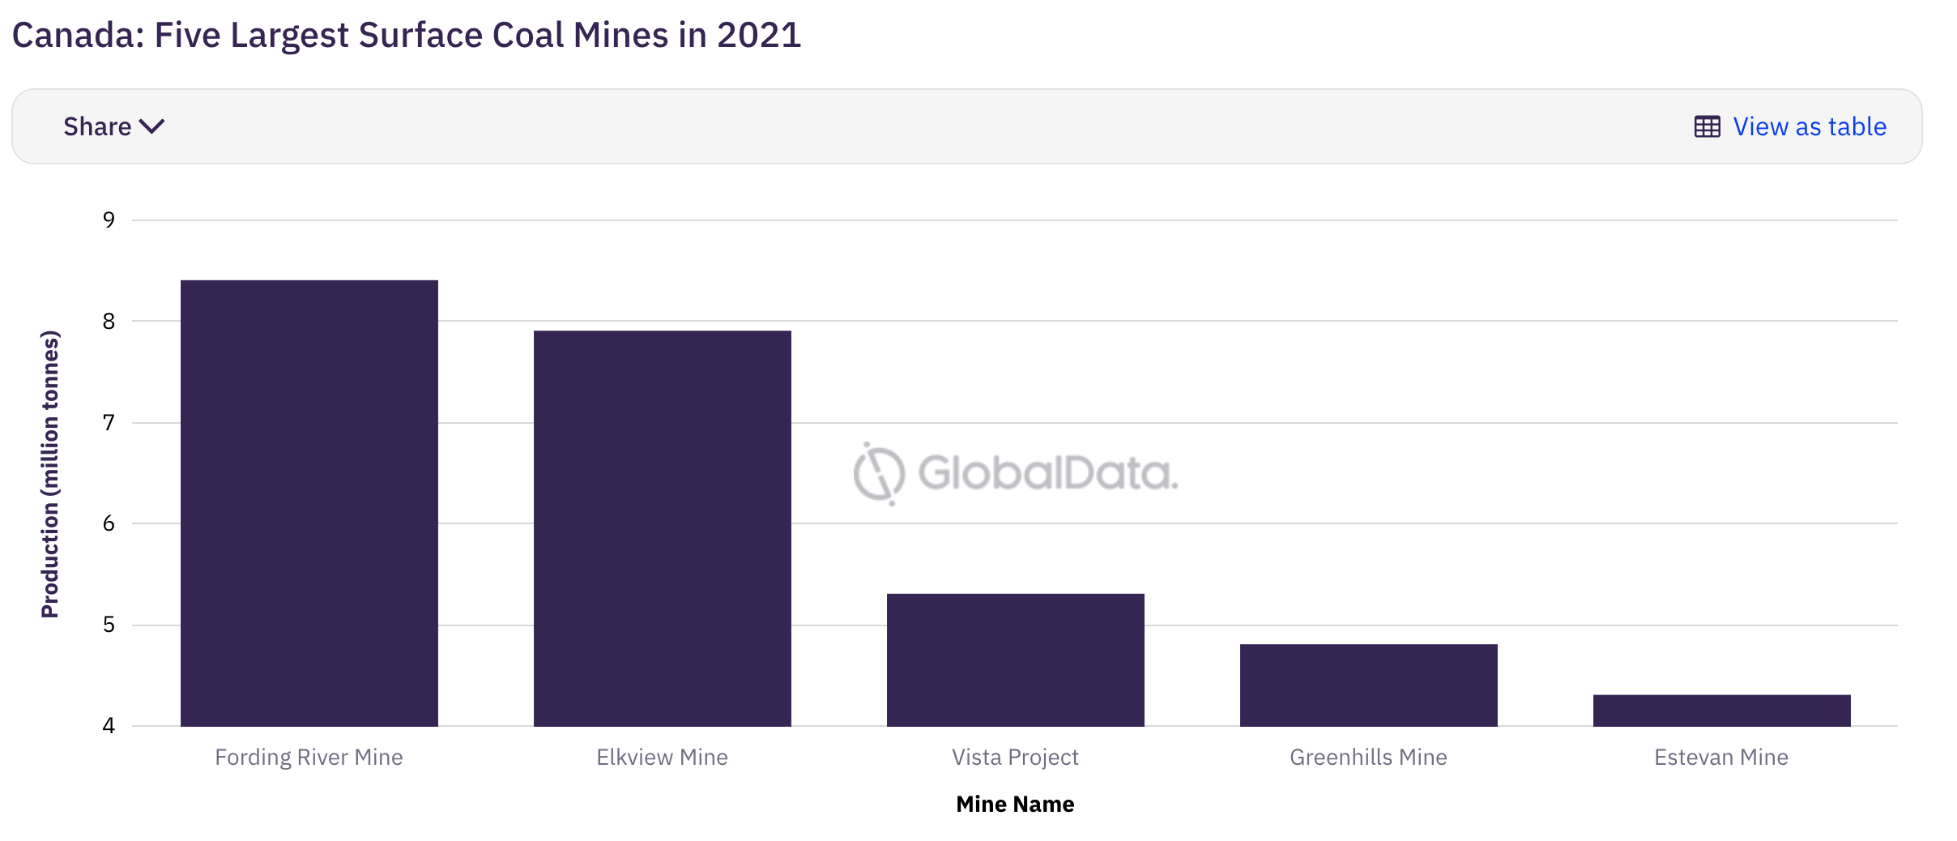
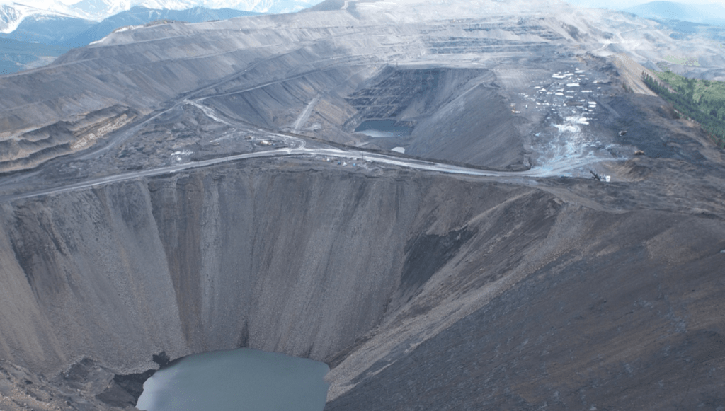
Biggest Coal Mines in Canada by Output
Mining History & Industry Overview
Fording River Mine - Elkford, BC

Slide 10
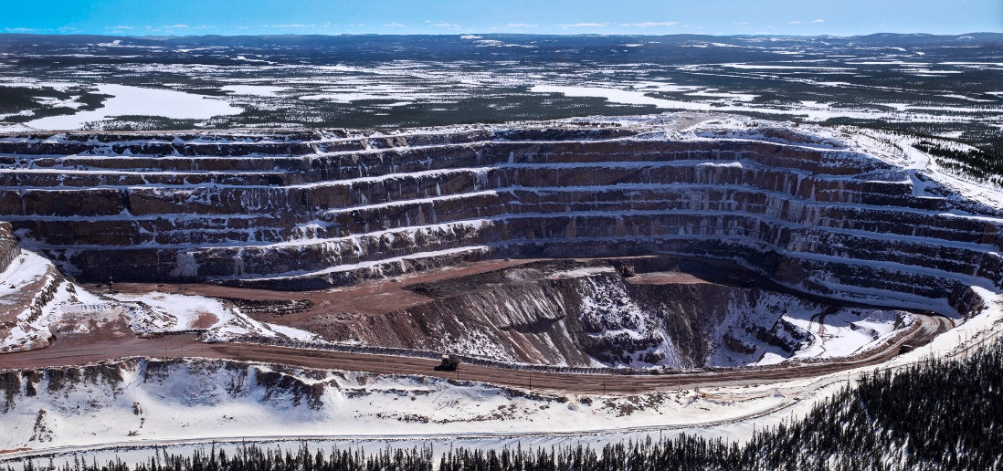
Biggest Iron Ore Mines in Canada by Output
Mining History & Industry Overview
1. Mont Wright Mine - 23.29 million tonnes in 2022
2. Carol Lake Mine -16.38 million tonnes in 2022
3. Bloom Lake Mine - 7.96 million tonnes of iron ore in 2022
4. Scully Mine - 5.4 million tonnes of iron ore in 2022
5. Mary River Project - 4.5 million tonnes of iron ore in 2022
Mont Wright Mine, Quebec

Slide 11
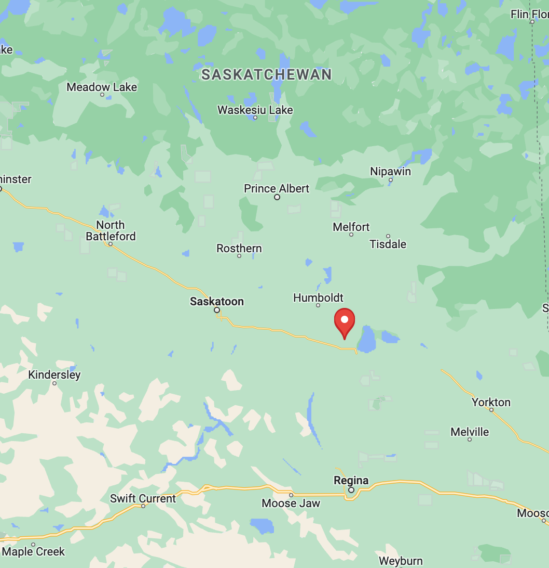
Potash
Mining History & Industry Overview
Canada has the world’s largest potash reserves (1.1bn tonnes)
BHP Jansen site in Saskatchewan (140km east of Saskatoon) will become the biggest potash mine in the world at its completion in 2026 with an estimated annual output of 8.5 million tonnes

Slide 12
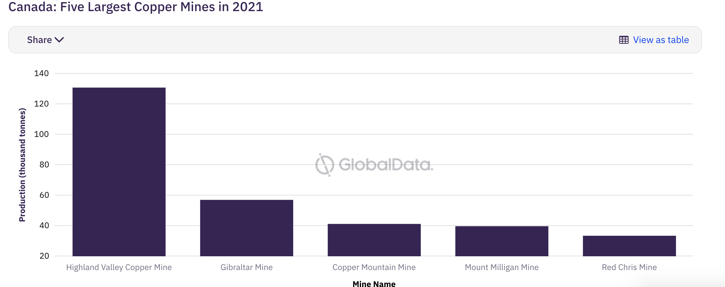
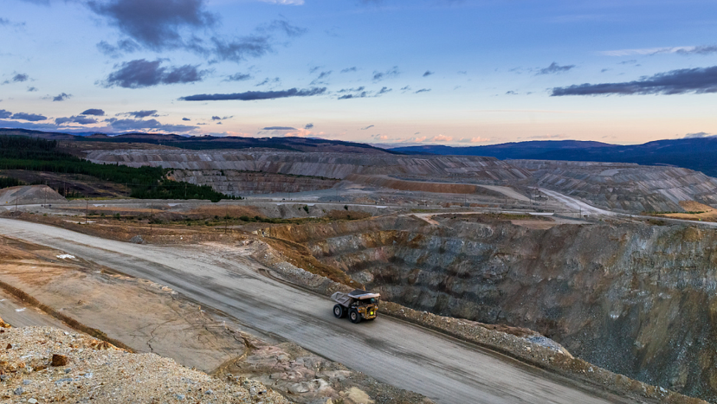
Biggest Copper Mines in Canada by Output
Mining History & Industry Overview
Highland Valley Copper Mine – Logan Lake, BC

Slide 13
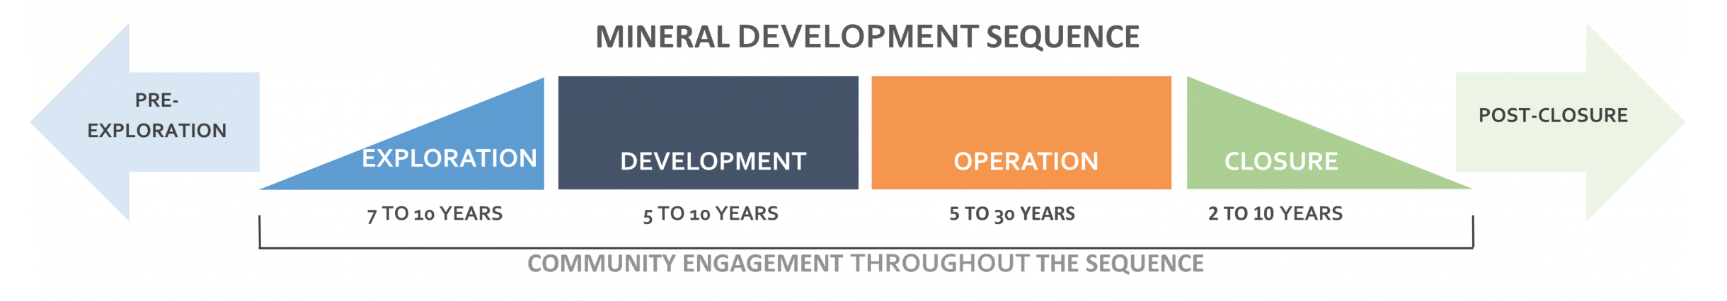
Development, Operation, and Closure of Mines
Mining History & Industry Overview
Finding an ore body and developing it into a mine is a long, costly and complex process that can take many years.
During exploration and development, companies make considerable efforts to find mineral deposits, evaluate them and determine the feasibility of a potential mine.
Once a mine is in production, it faces ongoing operational expenses and changing commodity prices. A mine closes when the metal or mineral is exhausted, demand diminishes or production is no longer profitable. At this point, the mine will be decommissioned and the environment in the area restored.

Slide 14
Overview of Mineral Exploration Companies
Mining History & Industry Overview
Definition of Junior and Senior Companies:
  Junior: Primarily in exploration, occasional project advancement.
  Senior: Have at least 1 mine in production, conduct exploration.
Number of Companies in Canada:
  Junior: Up to 7 times more than senior companies.
  Senior: Fewer than 200 in Canada.
Capital Requirements:
  Junior: Raise equity for exploration.
  Senior: Revenues from production finance exploration.

Slide 15
Exploration
Mining History & Industry Overview
Exploration involves major effort to determine the location, size and shape of mineral deposits. In planning exploration, companies decide which metals or minerals they are searching for and set objectives and strategies for exploration.
Companies use various survey methods to search a wide geographic area for “anomalies,” which are findings that may indicate a mineral deposit in the underlying bedrock. They narrow down the search on the ground. Through experimental drilling and excavation (prospecting), they determine whether the mineral is present, its exact location and characteristics.
This is followed by a step to verify anomalies and “showings,” which are outcroppings or indications just below the surface containing the target metal or mineral. If verification is successful, the company has discovered a mineral deposit. Then it delimits the deposit; that is, it determines the shape and boundaries of the deposit and identifies sections of the deposit with different grades of the mineral.

Slide 16
Mine Complex Development
Mining History & Industry Overview
“Senior” mining companies are generally in charge of mine development
The mine itself needs to be built by uncovering the deposit, preparing the area, and sinking the shafts.
A processing plant needs to be constructed and infrastructure such as roads or rail may need to be built to transport large quantities of the metal or mineral for further processing and sale.
Mines are either:
  “Open pit,” meaning a large hole on the surface
  “Underground,” consisting of a series of shafts beneath the surface, or a combination of the two

Slide 17
Development, Operation, and Closure of Mines
Mining History & Industry Overview
Companies involved in mineral exploration and mining are referred to as “junior” or “senior.”
Junior companies are mostly involved in the exploration phase but can occasionally advance a project toward production. There are many junior companies in Canada, up to 7 times more than senior companies.
Exploration and mining activities require increasing amounts of investment capital as they progress toward production. Junior companies raise equity capital to finance exploration of mineral resources.
Senior companies are those that have at least 1 mine in production and they often conduct exploration as well. There are fewer than 200 such companies in Canada. Senior companies have revenues from production that can finance exploration.

Slide 18
Key Distinctions for Gold Mining
Mining History & Industry Overview
Ore:
  A naturally occurring rock or mineral that contains a valuable substance in concentrations economically viable for extraction
  Composed of various minerals with the target metal, often with impurities
  For example, gold ore is a rock with economically feasible concentrations of gold
  Key processes for extracting ore are mining, milling, and concentrating
Doré:
  A bar composed of a mixture of precious metals, typically containing gold and silver. Produced during mining and refining processes or from scrap gold.
  Average gold content ranging from 50-75%.
  Requires further refinement before being used as raw material for gold items. Not classified as ore or bullion, but metal bars with high gold content.
  Extremely malleable and need to be alloyed for items like jewelry. After refining, the alloy can be reversed to its pure state.
  Can be assayed for gold content and traded similarly to bullion bars. Market is small, limited to specialist dealers, refiners, and mints.
  Lack of specific standards; weight can vary (up to 25kg), and purity levels differ between refiners.
  Insufficient purity for investment gold

Slide 19
Surface Mining
Mining History & Industry Overview
Surface mining methods are employed when mineral resources are at or near Earth's surface
Various techniques are used, such as open pit, strip mining, quarrying, placer mining, and evaporation ponds
Types of Surface Mining:
  Open Pit Mining
  Quarrying
  Strip Mining
  Placer Mining

Slide 20
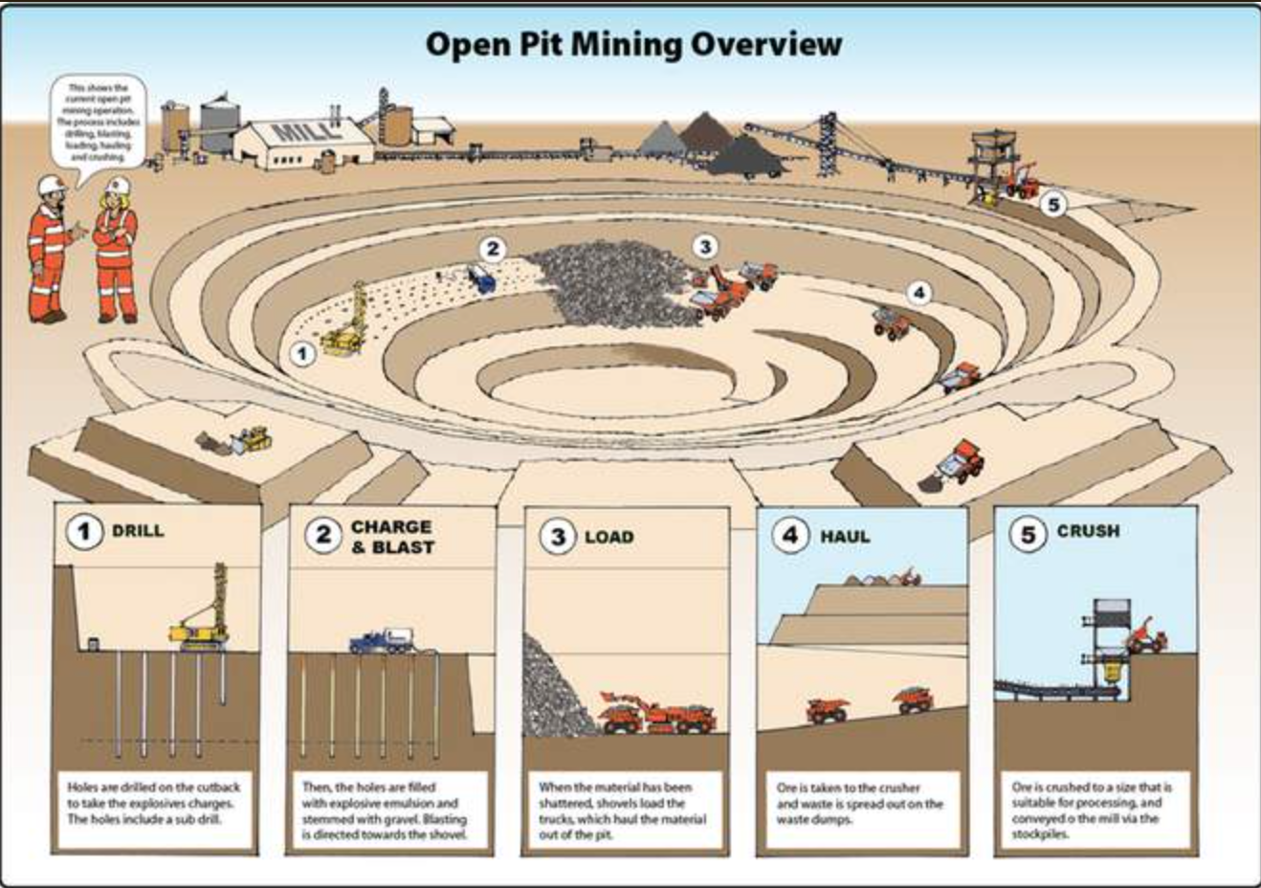
Open Pit Mining
Mining History & Industry Overview
Used for large, near-surface mineral deposits
Common for large base metal deposits
Mining progresses from the surface downward, forming a pit with stepped walls
Common for base metals, most prevalent in BC

Slide 21
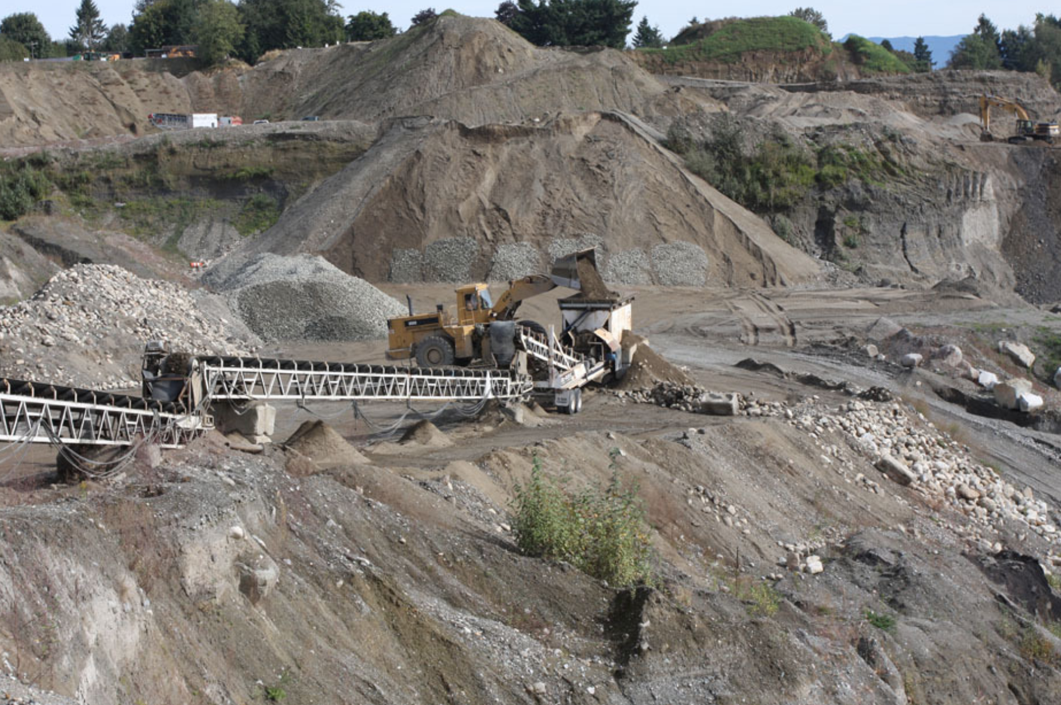
Quarrying
Mining History & Industry Overview
Surface mining without complex processing
Extracts sand, gravel, crushed stone, industrial minerals, and dimension stone
Sediment extraction without blasting
Material sorted by size in processing plants
Used for various industrial minerals and construction materials

Slide 22
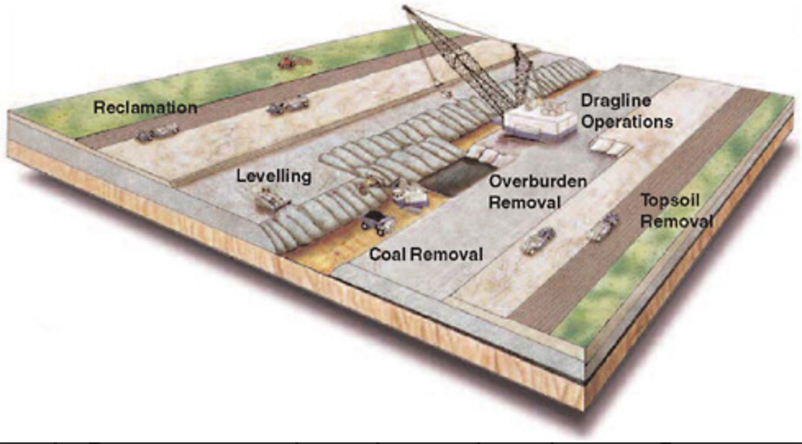
Strip Mining
Mining History & Industry Overview
Extracts coal layers near the surface.
Soil stripped before mining, stockpiled for reclamation.
Dragline or bucket wheel excavator removes sedimentary rock to expose coal.
Waste rock dumped behind the coal seam.
Revegetation or preparation for agriculture after mining.

Slide 23
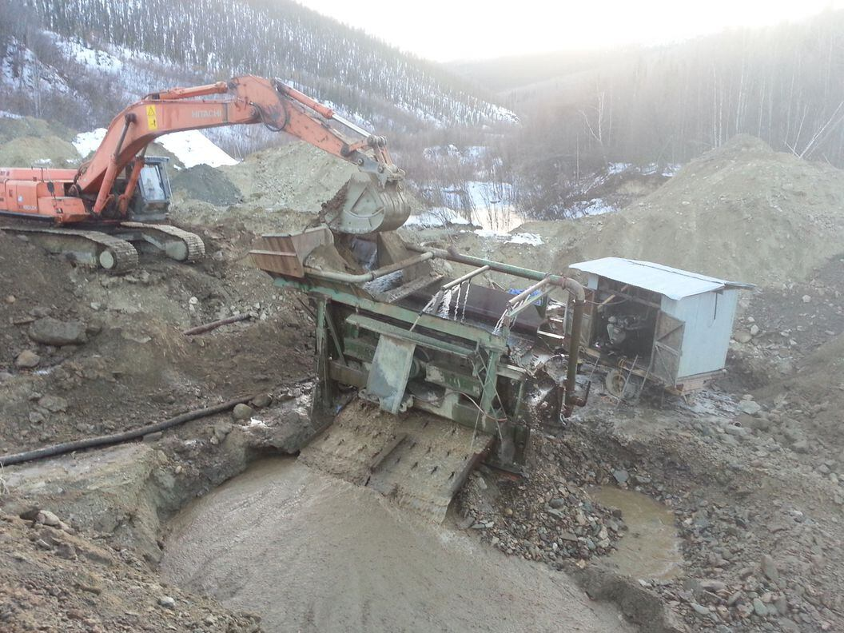
Placer Mining
Mining History & Industry Overview
Uses water to concentrate gold and heavy minerals from sand and gravel
In its most basic form, it is equivalent to gold panning
Excavation with heavy machinery, hauling to wash plant
Sorting, sluicing, and separating gold from tailings
Some variations include dredging from pond/lake or vacuuming sediment from the sea floor

Slide 24
Crushing & Grinding
Mining History & Industry Overview
Crushing and Grinding is the reduction of large ore chunks to small sand-sized particles.
It is an essential but costly step in mineral processing
Liberation Size is the size required to separate minerals from waste rock.
Ore passes through crushers and grinding mills for size reduction
There are various methods for collecting minerals after liberation that leave waste rock behind.

Slide 25
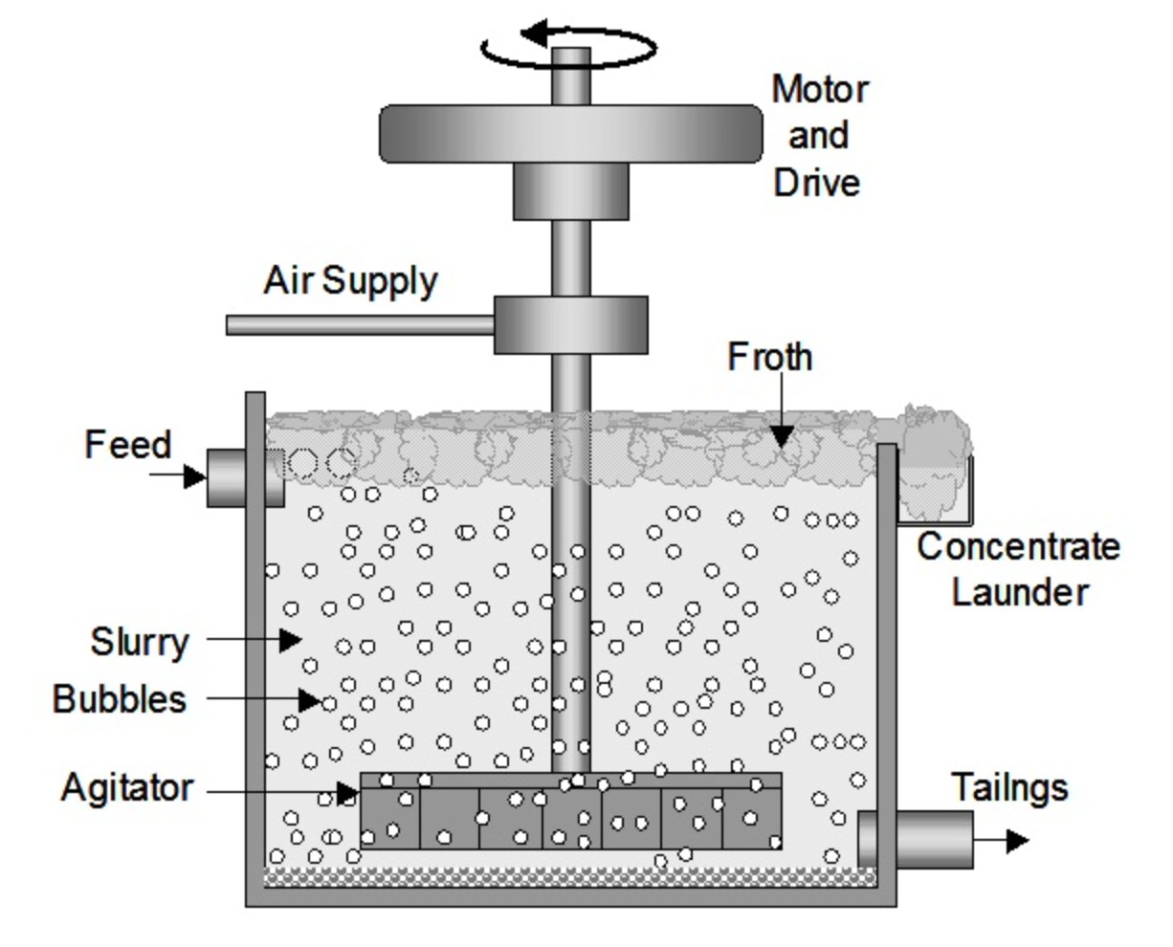
Froth Flotation & Smelting
Mining History & Industry Overview
Froth Flotation is used for recovering base metals (such copper, zinc, or molybdenum) from sulfide ores
Chemical frothers and collectors create bubbles to separate minerals from tailings
The froth collected and processed to remove water which results in mineral concentrate
Smelting is a metallurgical process that produces pure metal from mineral concentrate
  Involves melting concentrate in a furnace with flux and oxygen
The end result is the separation of matte (desired metal) from slag (unwanted portion)
An example of a final product could be blister copper which is approximately 90% pure, which is then further refined by being subjected to electrorefining.
Electrorefining is the further purification of metals (e.g., copper) from blister copper. The metal undergoes electrolysis in a sulfuric acid solution to achieve 99.99% purity

Slide 26
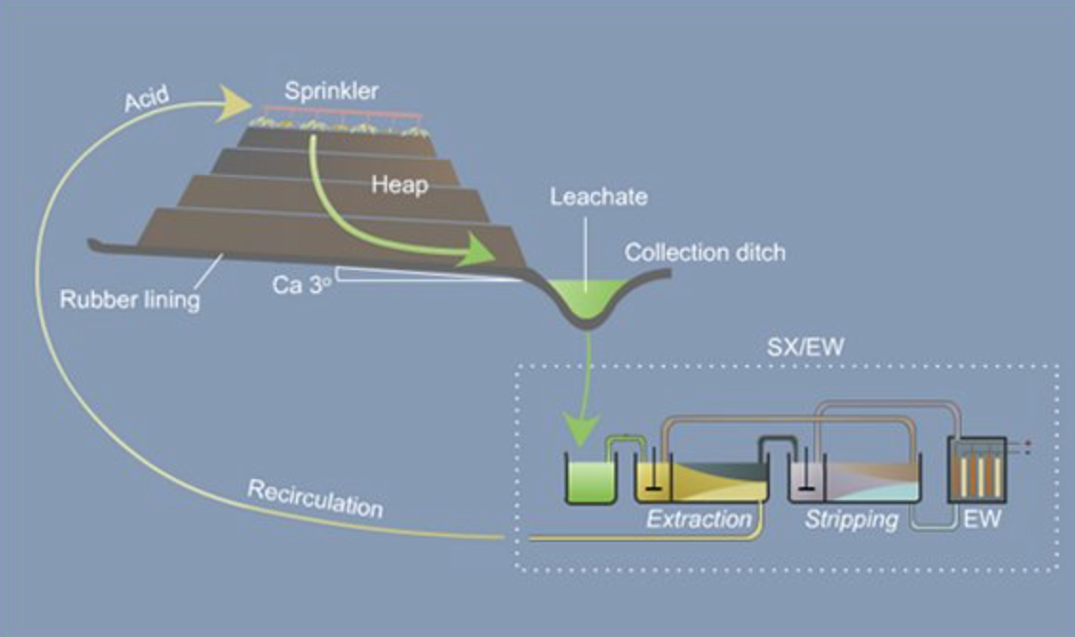
Heap Leaching & SX-EW
Mining History & Industry Overview
Heap Leaching is a recovery method for metals such as gold, copper, or uranium from oxide ores. Crushed ore is stacked on a lined pad and sprayed with leaching solution. Mineral-rich leach solution is then collected and processed at an SX-EW plant
SX-EW stands for Solvent Extraction Electrowinning:
  First step (SX): Metal is extracted from the leach solution using solvents
  Second step (EW): Pure metal is recovered from solvent solution through electrolysis
In Situ Leach is similar to heap leaching, but used for underground oxide deposits.
  Leaching solution is introduced through boreholes after which metal is recovered by SX-EW

Slide 27
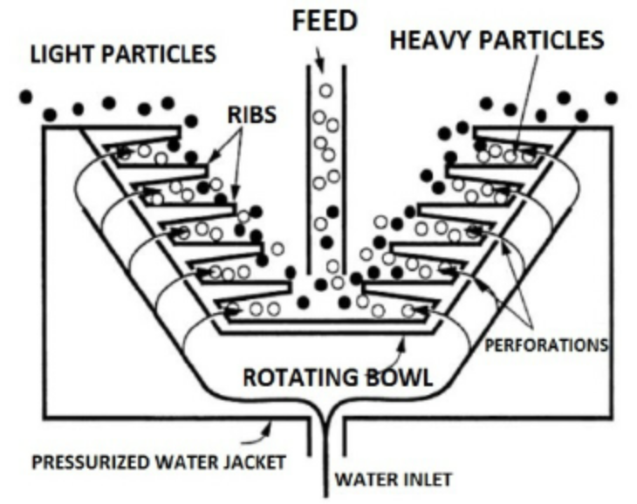
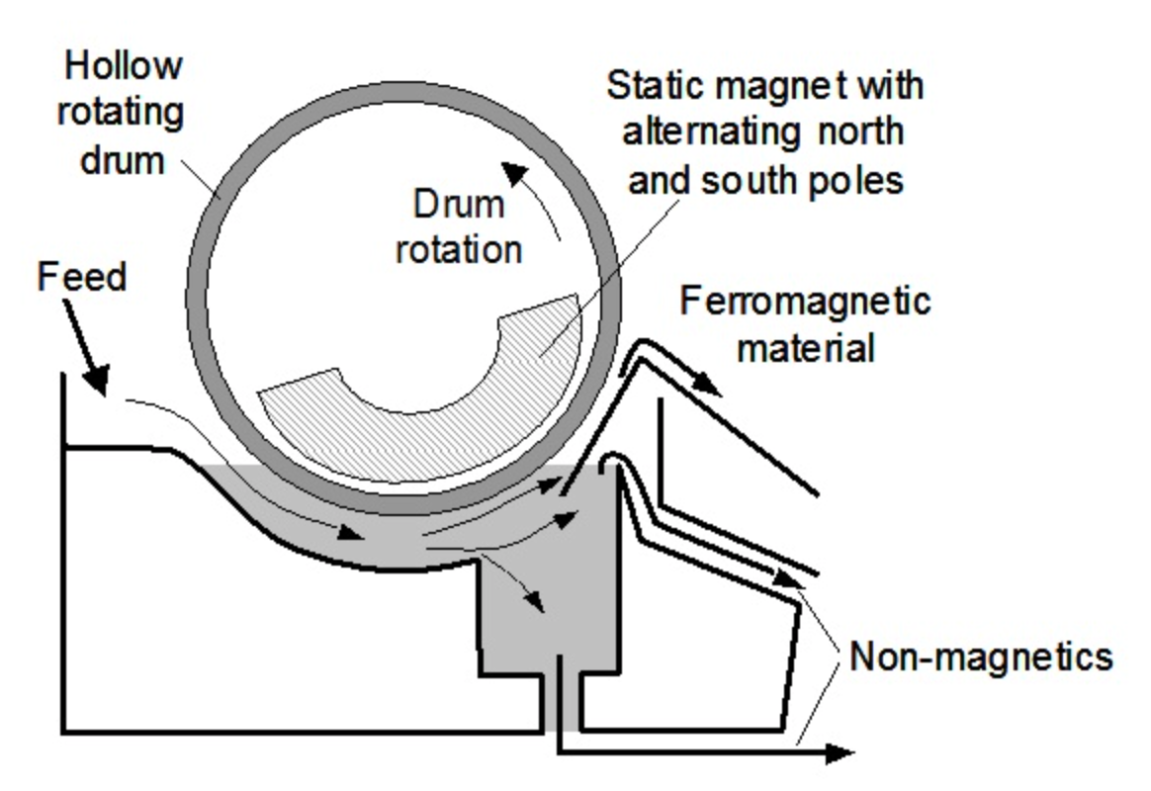
Gravity & Magnetic Separation
Mining History & Industry Overview
Gravity Separation is a method to separate high specific gravity metals from low specific gravity rocks. It is done by concentrating gold in moving water and collecting placer platinum
An example of a machine that does this is Knelson Separator, a portable device that concentrates gold by spinning mineral slurry
  Lighter waste rock grains spin off, heavy gold collects at the bottom
Applications:
Gravity separation is also used in coal processing to separate lighter coal from sedimentary rock
Magnetic Separation is a method used to recover magnetic minerals from non-magnetic waste rock
  Useful in iron deposits with iron oxide occurring with silicate minerals
Pulverized iron ore passes by rotating magnets where Magnetic mineral grains stick to the magnet and non-magnetic waste rock passes through
  Used in placer gold mining to separate specific gravity magnetic minerals
For example, magnetite sand from copper mine tailings in BC is extracted through magnetic separation

Slide 28
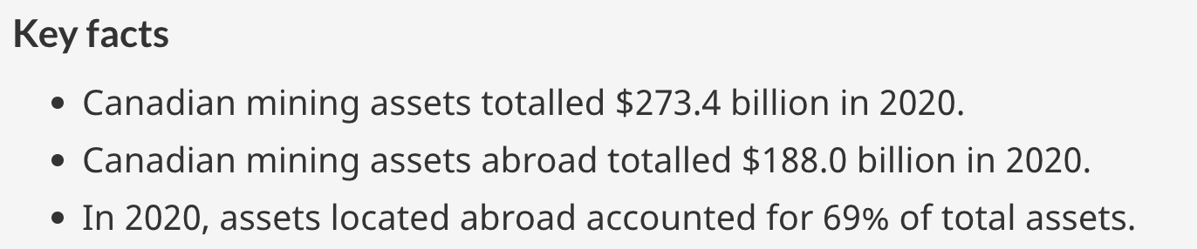
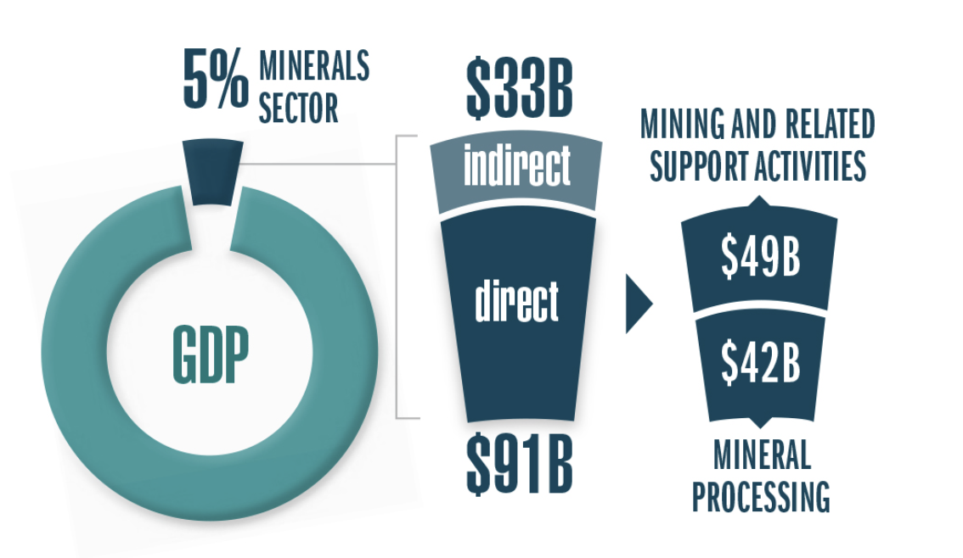
Mining in the Canadian Economy
Mining History & Industry Overview
Mineral production reach a value of $55.5 bn in 2021

Slide 29
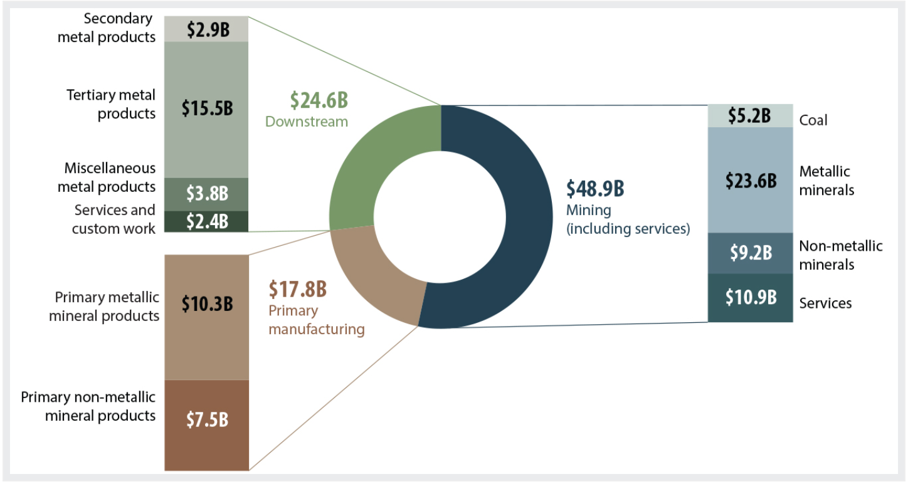
Nominal GDP in the Minerals Sector
Mining History & Industry Overview
Minerals sector nominal gross domestic product by subsector and product group

Slide 30
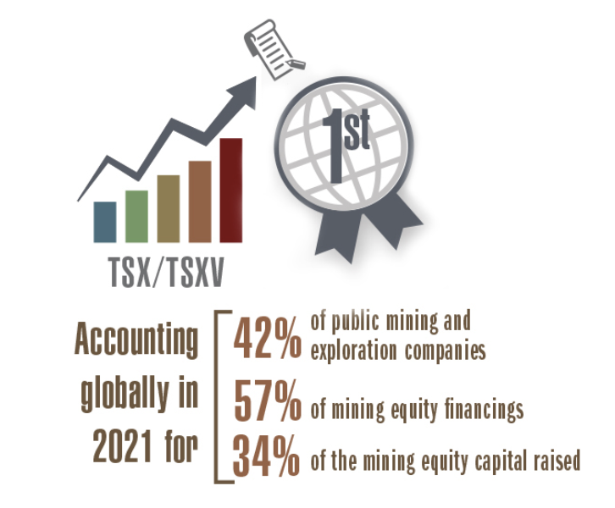
Mining’s Contribution to Canadian Finance
Mining History & Industry Overview
(TSX) and TSX Venture Exchange (TSXV) are the world's primary listing venues for mining and mineral exploration companies
More than 1,170 issuers in 2021, accounting for 42% of global listings.

Slide 31
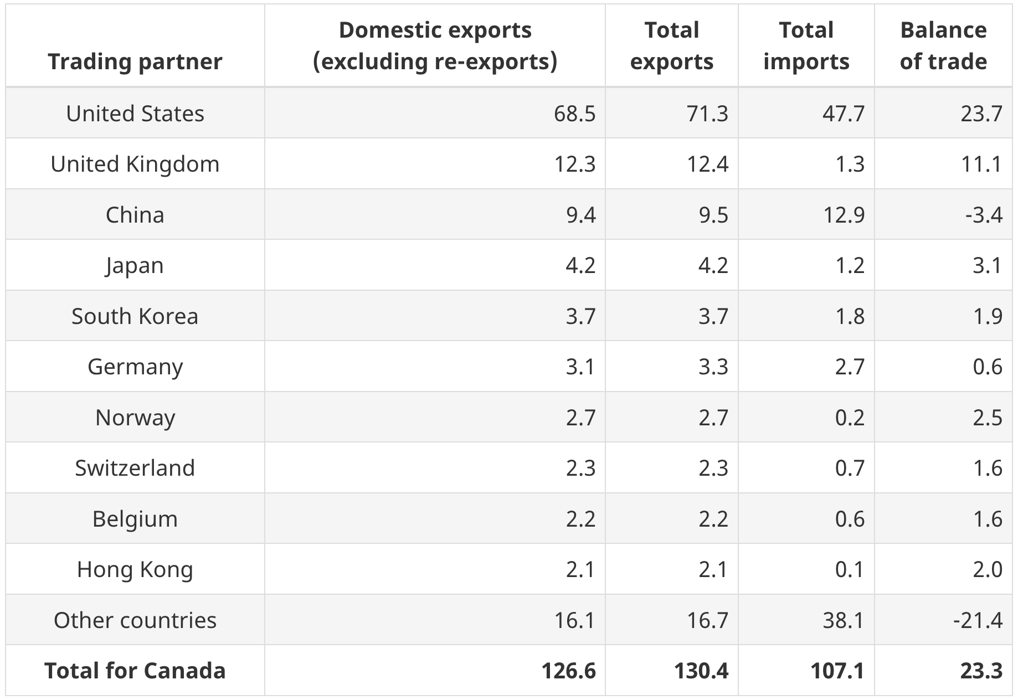
Contribution to Canadian Trade
Mining History & Industry Overview
Canadian mineral trade by partner ($bn)

Slide 32
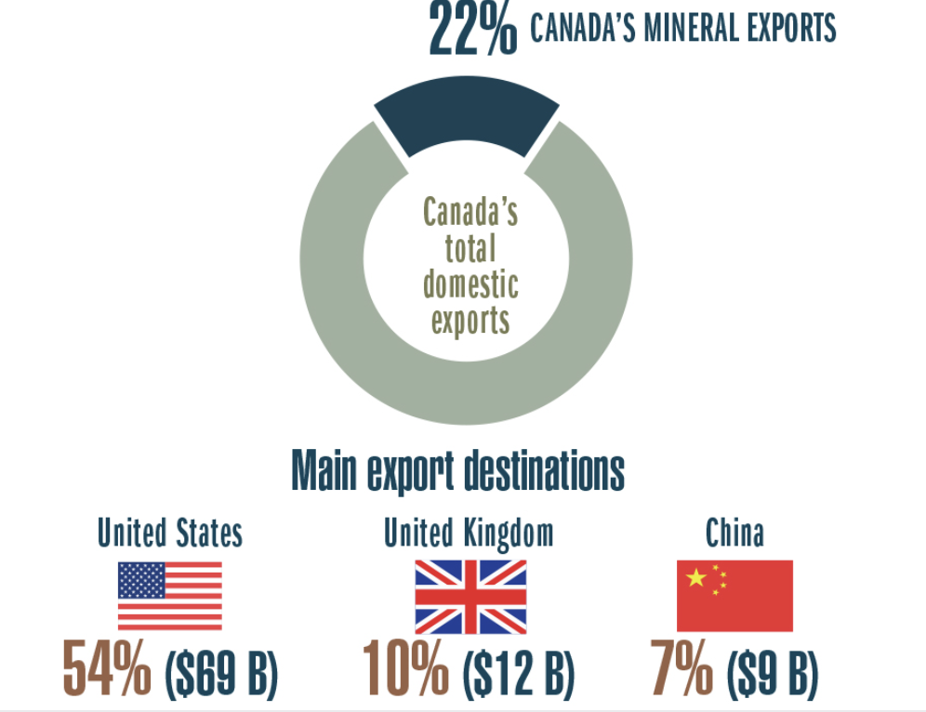
Exports
Mining History & Industry Overview
Valued at $126.6 billion in 2021, domestic mineral exports accounted for 22% of Canada's total merchandise exports.

Slide 33
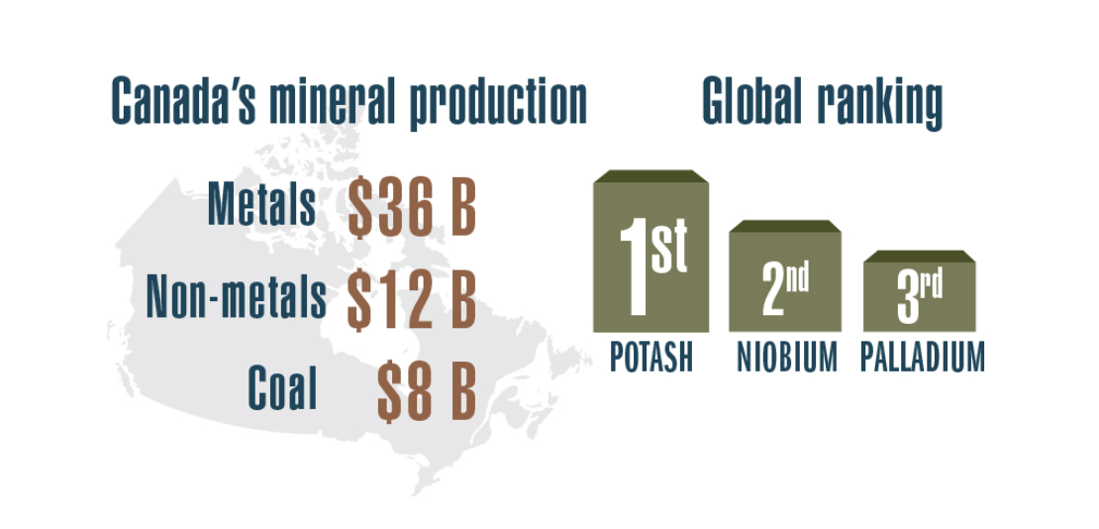
Canadian Mineral Commodities
Mining History & Industry Overview

Slide 34
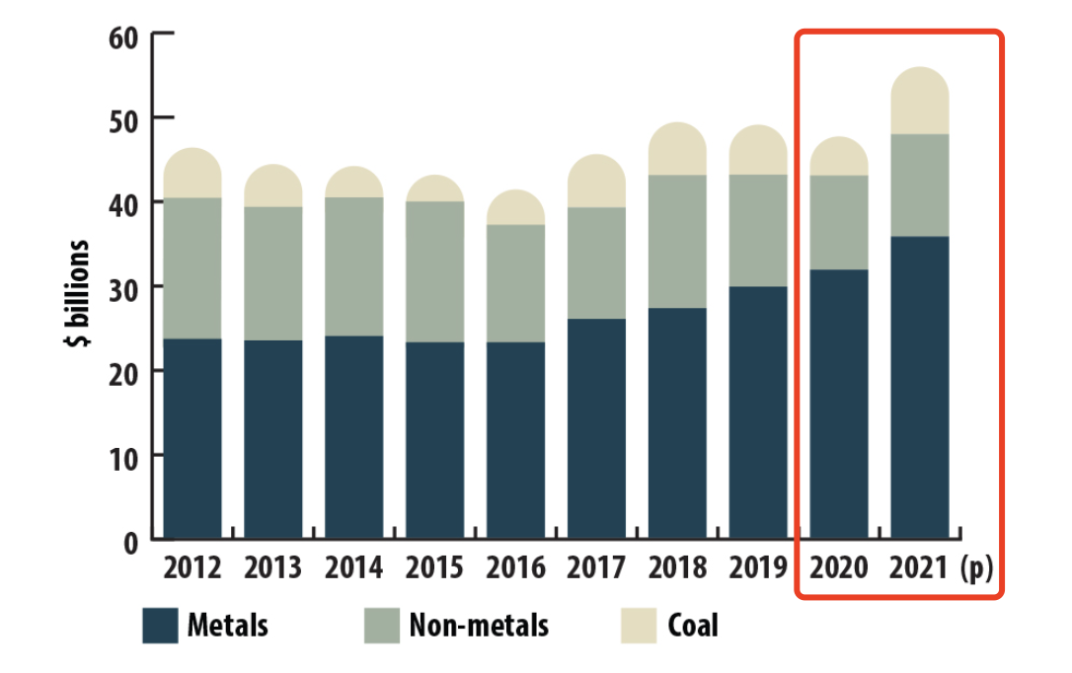
Canadian Mineral Commodities
Mining History & Industry Overview
The 2021 value of Canadian mineral production was $55.5 billion, 20% higher than the 2020 value of $46.4 billion.
Metals’ value of production increased by 13% from the previous year.
Non-metals and coal went up by 10% and 101%, respectively.

Slide 35
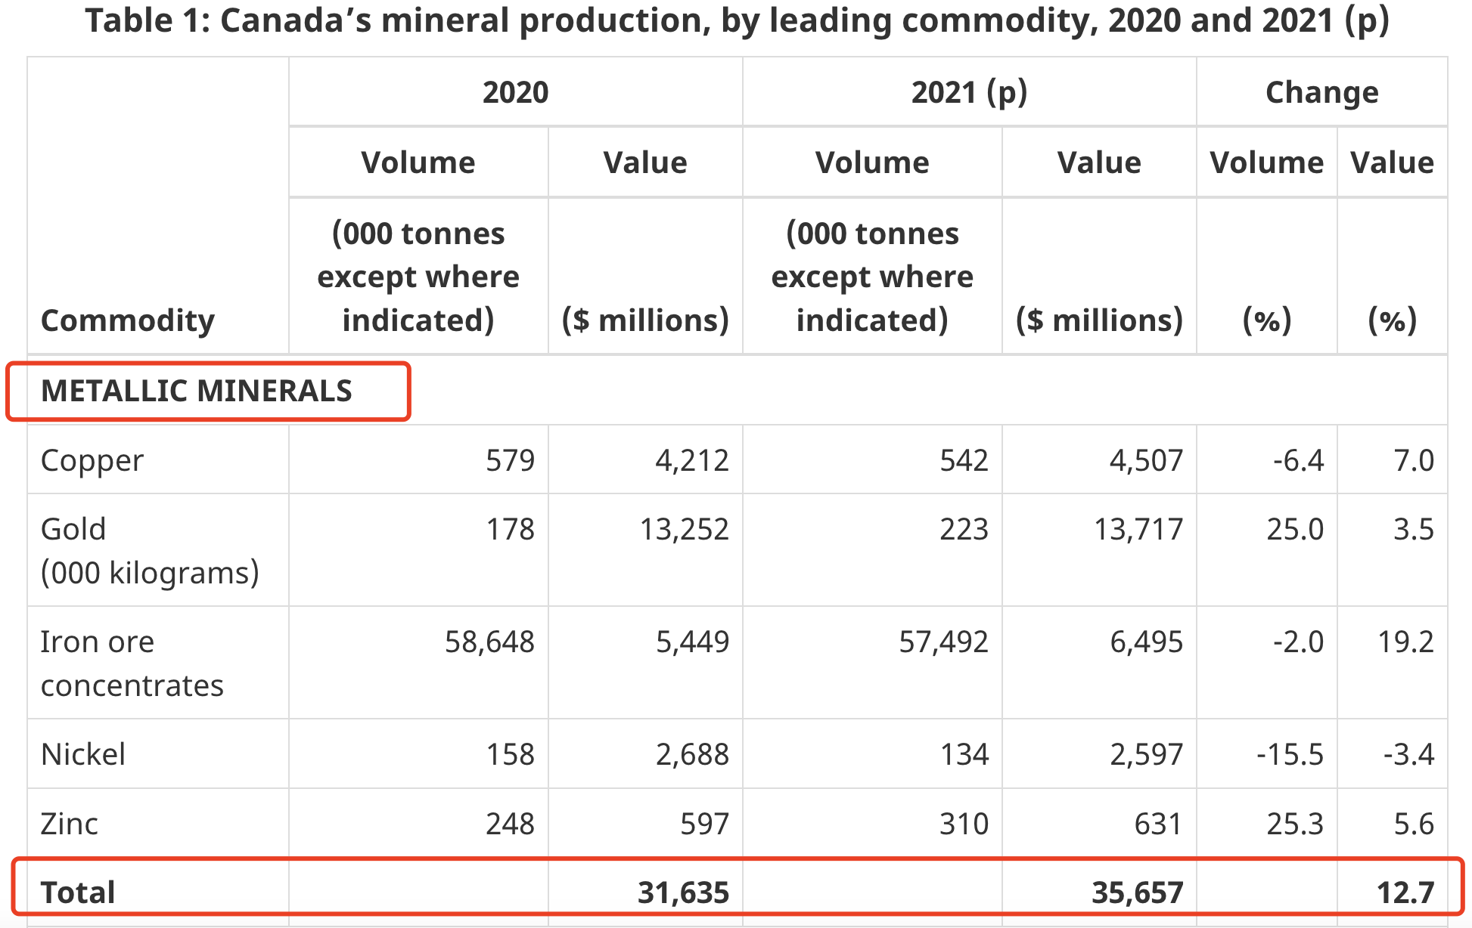
Canadian Commodities: Metals
Mining History & Industry Overview
In 2021, the volume of slightly more than half of the metals shipped by Canadian mines decreased
The value of production increased by 13% to $35.7 billion due to higher prices.

Slide 36
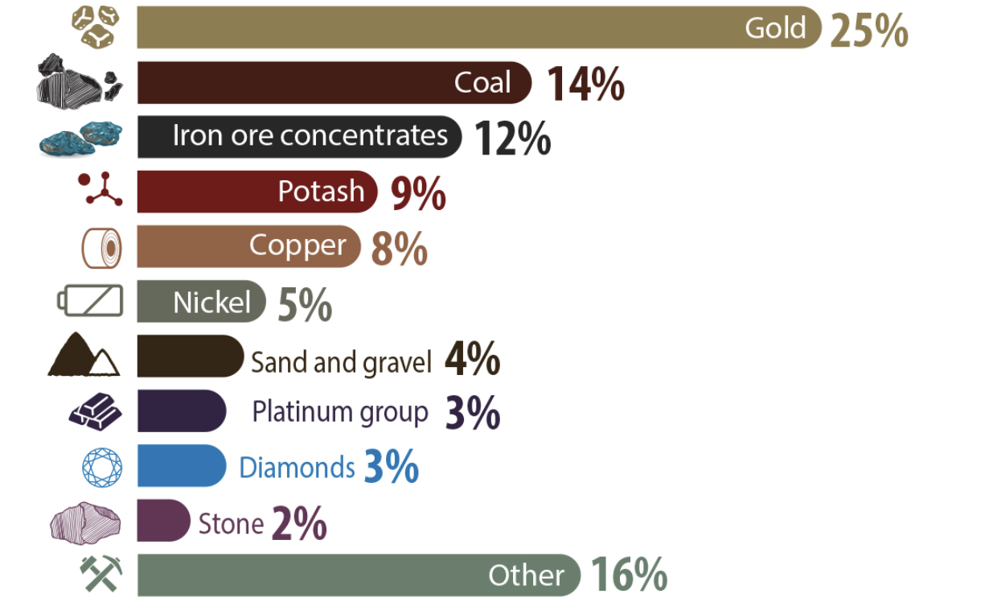
Commodities Production
Mining History & Industry Overview
Canada's top five mineral products by value for 2021 were gold, coal, iron ore concentrates, potash, and copper.
Their combined value was $37.5 billion.

Slide 37
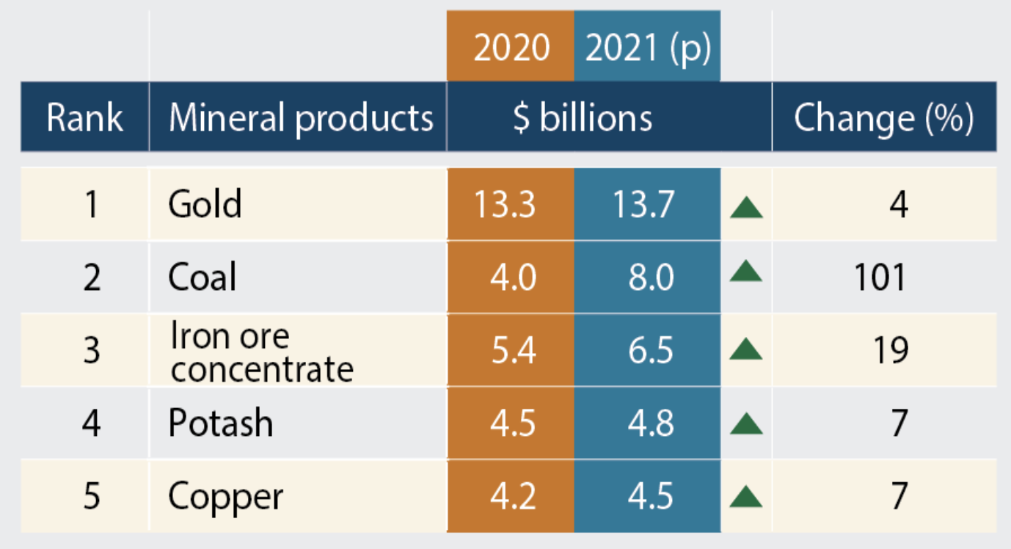
Commodities Value
Mining History & Industry Overview
Canada’s top five mineral products by value

Slide 38
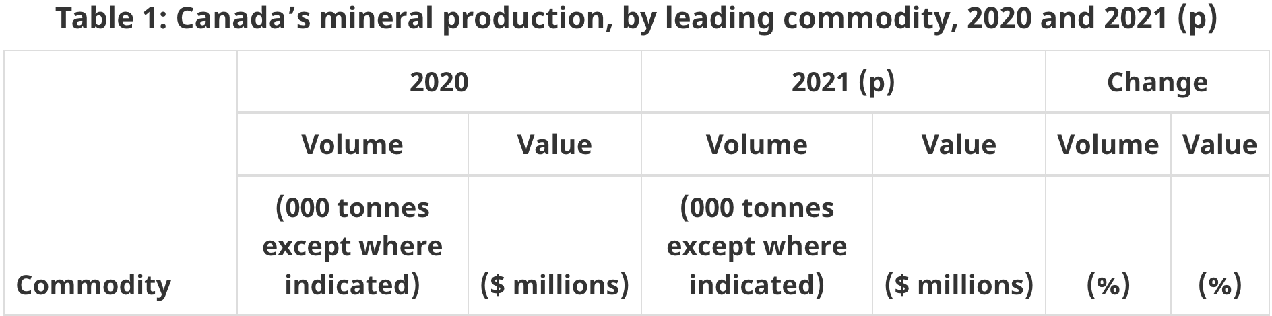
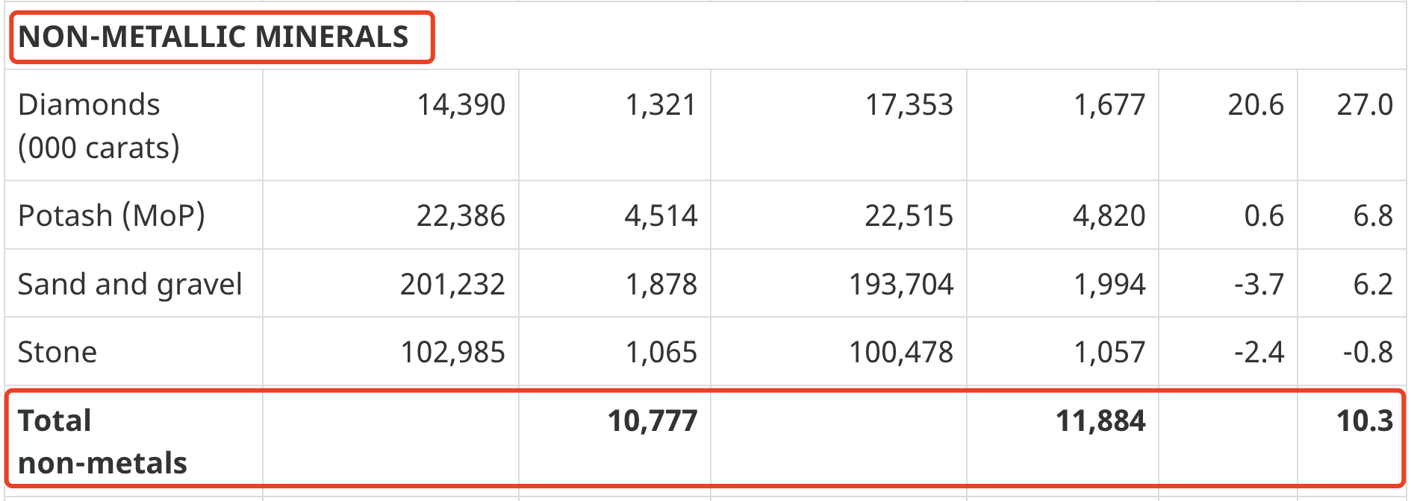
Canadian Commodities: Non-metals
Mining History & Industry Overview
The value of non-metallic mineral production reached $11.9 billion in 2021, a 10% increase compared to 2020.

Slide 39
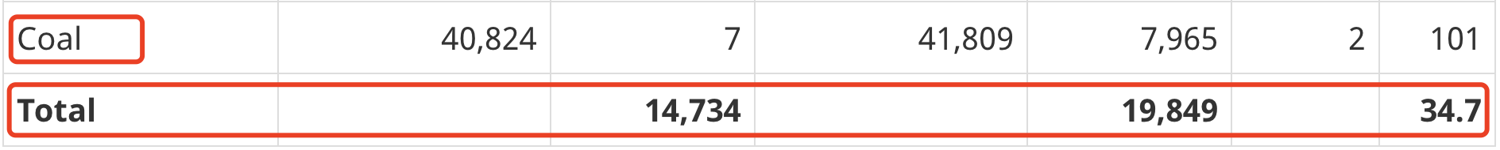
Commodities in Canada: Coal
Mining History & Industry Overview
In 2021, Canadian mines produced 42 million tonnes of coal, a slight increase of 2% compared to the previous year.

Slide 40
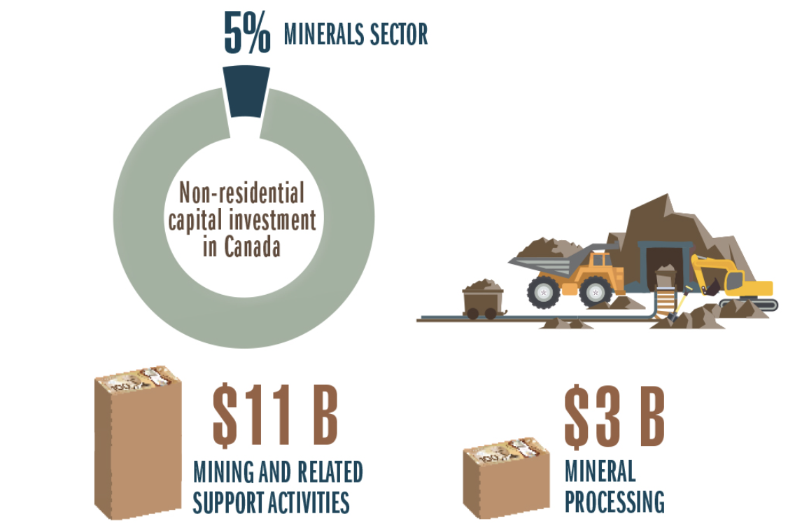
Mineral Sector Investments
Mining History & Industry Overview
In 2021, the minerals sector invested $14.4 billion in new capital construction and in machinery and equipment, accounting for 5% of the Canadian total.

Slide 41
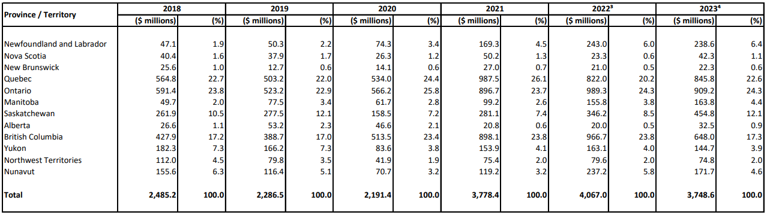
Preliminary Estimates of Exploration Spending
Mining History & Industry Overview
Elevated exploration spend continues through 2023

Slide 42
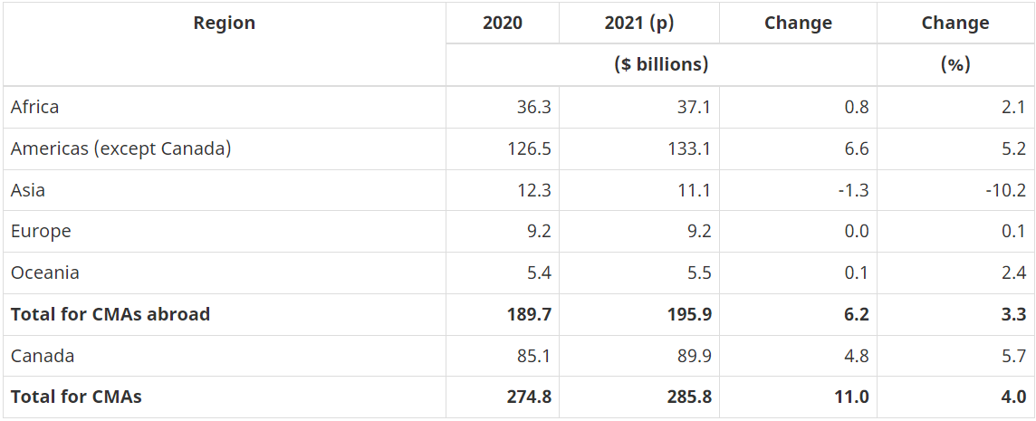
Value of Canadian Mining Companies by Region
Mining History & Industry Overview

Slide 43
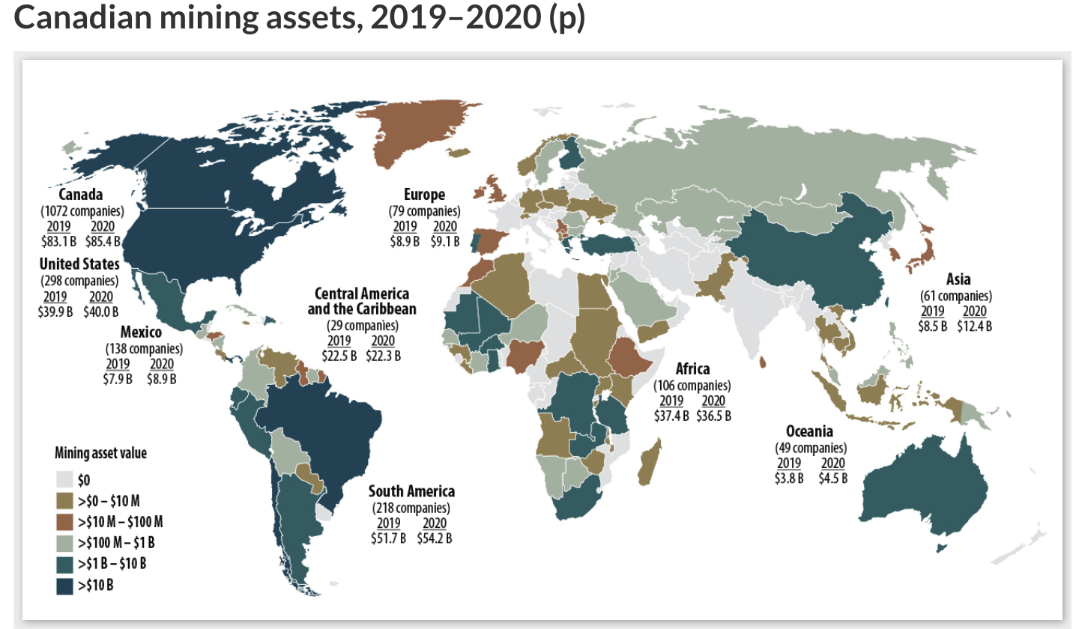
Canada’s Presence Abroad
Mining History & Industry Overview

Slide 44
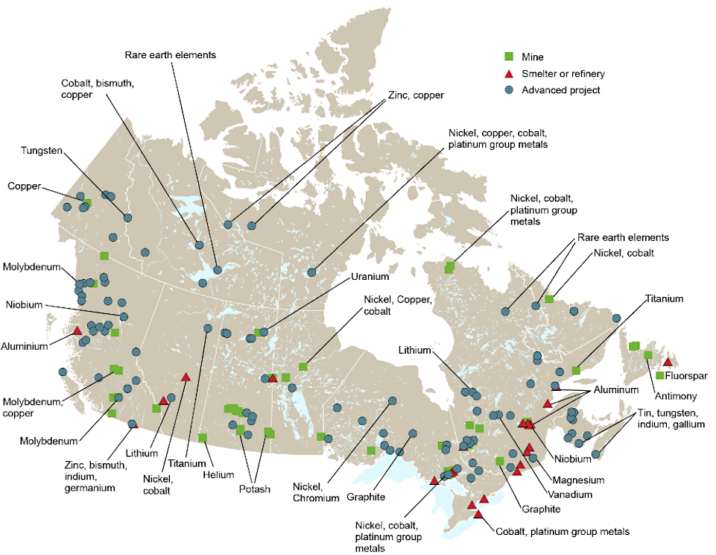
Mineral Deposits in Canada
Mining History & Industry Overview
Notes:
Ghana – Largest producer in Africa
Peru – Largest producer in South America
s

Slide 45
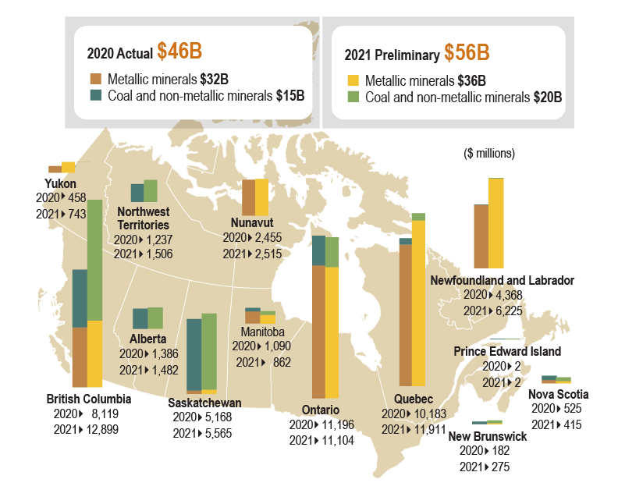
Value of Mineral Deposits in Canada
Mining History & Industry Overview
Notes:
Ghana – Largest producer in Africa
Peru – Largest producer in South America
s

Slide 46
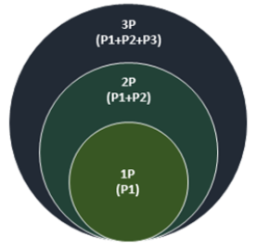
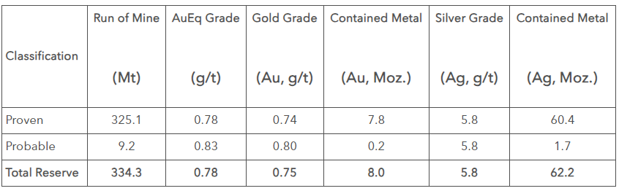
Mineral Resource Classification
Mining History & Industry Overview
Mineral Resources
Minerals and materials that are potentially extractable on a profitable basis under present economic conditions. Resources include deposits that may become reserves in the future
Mineral Reserves
Represent the economically viable portion of the mineral resources that have been proven through exploration, feasibility studies, and assessments to be extractable with degree of certainty past a given threshold under current economic conditions
Example of R&R Table

Slide 47
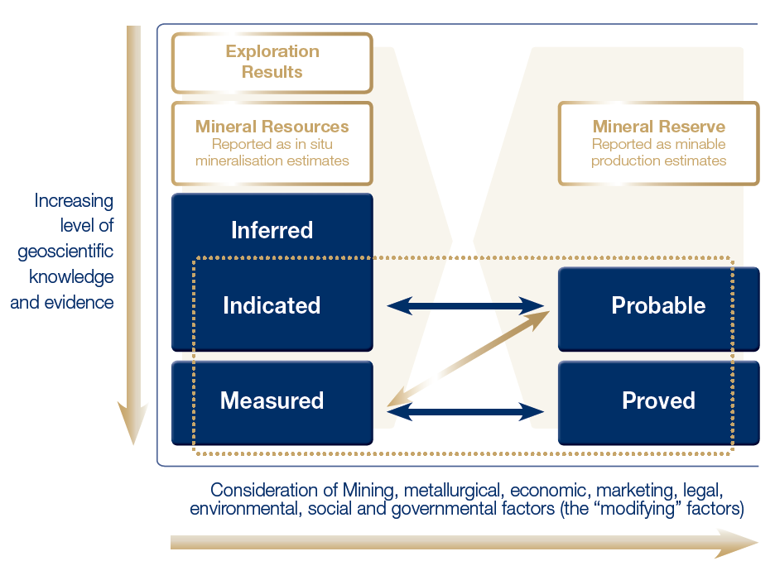
Mineral Resource Classification
Mining History & Industry Overview

Slide 48
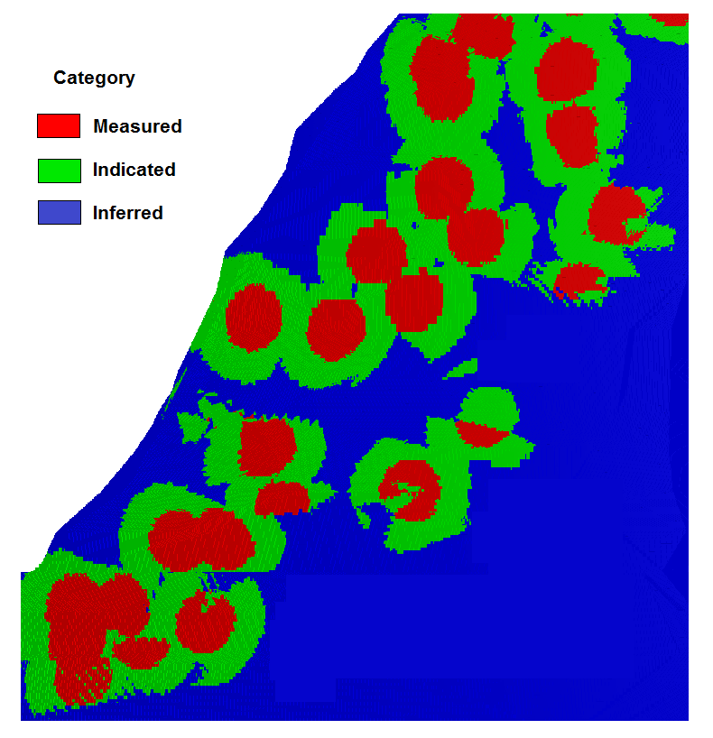

Mineral Resources
Mining History & Industry Overview
Inferred
Estimates of mineralization based on geological evidence and sampling; lack data to be classified as reserves
Represent lower level of confidence compared to measures and indicated and used in early-stage exploration where data can be insufficient for higher classifications

Slide 49
Mineral Resources
Mining History & Industry Overview
Indicated
Estimated quantities of mineralization within a deposit which are supported by geological evidence and sampling; less certain than proven reserves
Represent higher level of confidence relative to inferred resources and are expected to be economically feasible and extractable under current economic conditions

Slide 50
Mineral Resources
Mining History & Industry Overview
Measured
Highest level of confidence in mineral resources estimation within the mining industry and represents the minerals or materials in a deposit that have been thoroughly samples and analyzed
Measured resources are associated with precise geological information given their quality and quantity and are used in developing mine plans and feasibility studies

Slide 51
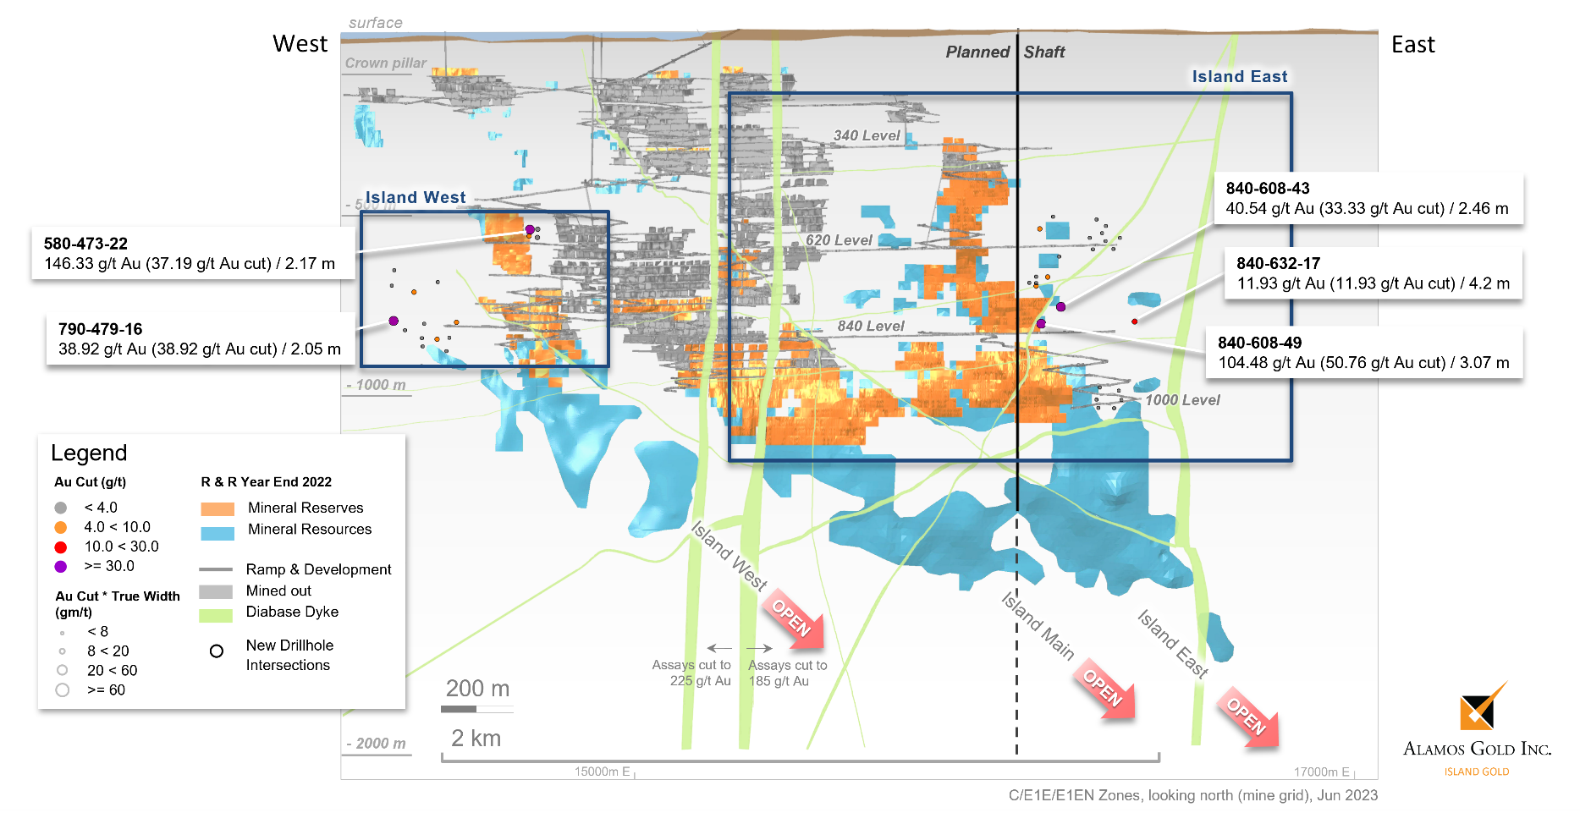
Mineral Reserves
Mining History & Industry Overview
Probable
Estimated mineral deposits that are likely to be economically extractable with a higher degree of confidence than mineral resources
Determined through geological data, feasibility studies, economic assessments

Slide 52
Mineral Reserves
Mining History & Industry Overview
Proven
Minerals deposits with the highest level of confidence given their quantity and quality and are supported by thorough mineral exploration, geological data, and economic viability assessments
Proven reserves are economically feasible for extraction with a high degree of certainty

Slide 53
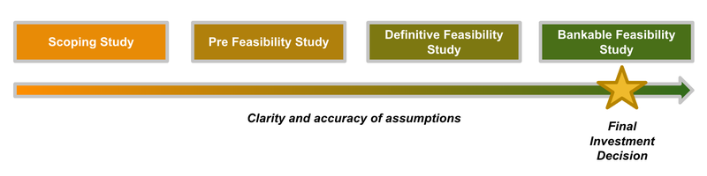
Technical Assessments & Feasibility Studies
Mining History & Industry Overview
Preliminary Economic Assessment (PEA)
  Conducted in early stages to assess potential viability of project; includes preliminary analysis of geological, engineering economic aspects
Pre-feasibility Study (PFS)
  More detailed assessment analyzing mining methods, metallurgy, infrastructure, and economics to assess project feasibility
Feasibility Study (FS)
  Report that evaluates technical and economic aspects including mine design, production schedule, financial analysis, environmental impact assessments, and market studies
Bankable Feasibility Study (BFS)
  Upgraded version of the feasibility study required by financial institutions for funding purposes

Slide 54



NI 43-101
Mining History & Industry Overview
National Instrument (NI) 43-101
Ensures accuracy, transparency, and consistency of reporting standards for resources and reserves for Canadian stock exchanges
Requires reports to be prepared under the supervision of qualified personal who company with the standards and are accountable for the accuracy of the information
Outlines details on property description, sampling methods, data verification, resource and reserve estimates, and other aspects used for decision-making
NI 43-101 reports have gained global recognition and are used a benchmark for reporting standards beyond Canadian jurisdiction

Slide 55


NI 43-101 Example: Artemis Gold
Mining History & Industry Overview

Slide 56






Producing Mining Companies
Mining History & Industry Overview

Slide 57



Royalty and Streaming Mining Companies
Mining History & Industry Overview
Royalty Agreement
Streaming Agreement
Investment
% of Revenue from Production
Investment
Buy % at a discounted Price
Notes:
s

Slide 58






Royalty and Streaming Mining Companies
Mining History & Industry Overview
Capturing Upside
Reducing Risk
Most royalties and streams last as long as the mine is operational, so the holder will get benefit of increased production and increased lifespan
Royalty and streaming companies are not exposed to the potential risks of capital cost overruns and operating cost pressure, which are borne by mining companies
Royalty and streaming companies can generate revenue much faster than mining companies, as they can invest in an already producing or developing project
This avoids the long exploration and development timeline many miners face to first production
Most mining companies are regionally focused, royalty and streaming companies are able to invest in a globally diverse portfolio
Escaping jurisdictional risk and taking advantage of global opportunities
Royalty and streaming companies are more versatile compared to miners in changing market conditions
Investing in low-cost opportunities during market downturns
Reaping the reward during market upswings
Royalty and streaming companies often have dividend policies, rewarding investors consistently
Notes:
s

Slide 59
Valuation Spreads
Mining History & Industry Overview
Valuation gap between Intermediates and Seniors has persisted given ongoing investor risk aversion

Slide 60

Mining M&A Market & Trends
Mining History & Industry Overview

Slide 61
Industry Risks
Mining History & Industry Overview
Commodity Price Volatility:
The metals and mining industry is highly sensitive to fluctuations in commodity prices. Prices of metals such as gold, copper, nickel, and others can be influenced by global economic conditions, geopolitical events, and supply-demand dynamics.
Operational Risks:
Mining operations are inherently risky due to factors such as geological uncertainties, equipment failures, and accidents. Ensuring the safety of workers and the efficient operation of mines is a constant challenge.
Regulatory and Permitting Risks:
The mining industry is subject to various regulations related to environmental impact, safety, and land use. Changes in regulations or difficulties in obtaining permits can impact project timelines and costs.

Slide 62
Industry Risks (cont’d)
Mining History & Industry Overview
Environmental and Social Risks:
Increased awareness and scrutiny of the environmental and social impacts of mining operations have led to greater regulatory and public pressure. Companies may face challenges related to community relations, environmental stewardship, and compliance with sustainability standards.
Infrastructure and Transportation Challenges:
In remote or undeveloped mining regions, inadequate infrastructure and transportation can pose challenges. Lack of proper roads, ports, and energy infrastructure can increase operational costs and hinder the efficient movement of goods.
Capital Intensity:
Mining projects often require significant upfront capital investments. If commodity prices fall or operational issues arise, companies may face challenges in servicing debt or attracting further investment.

Slide 63
Industry Risks (cont’d)
Mining History & Industry Overview
Technological Changes:
Advances in technology can impact the efficiency and competitiveness of mining operations. Companies that fail to adopt new technologies may face challenges in maintaining cost-effectiveness.
Political and Geopolitical Risks:
The industry is exposed to political and geopolitical risks, especially in regions with unstable political environments. Changes in government policies, taxation, or geopolitical tensions can impact mining operations.
Project Development and Execution Risks:
Mining projects often involve significant capital investments and long lead times. Delays or cost overruns in project development can negatively impact the financial performance of mining companies.
Social License to Operate:
Mining companies need community support to operate successfully. Social and community opposition to mining activities, concerns about environmental impact, or disputes with indigenous communities can pose risks to a company's social license to operate.

Slide 64
Commodity Markets: Gold

Slide 65
Gold Index vs. Canadian Equities
Commodity Markets: Gold
Gold has largely outperformed Canadian equities over the last 5-years

Slide 66
Gold Spot Price Performance
Commodity Markets: Gold
Gold prices have rallied over the last 5-years on inflationary pressures, geopolitical tensions, and economic uncertainty
Source(s): S&P Capital IQ

Slide 67

Gold Price vs. Treasury Yields (UST 10Y)
Commodity Markets: Gold
Yields are a driving factor of gold prices; gold is negatively correlated to yields

Slide 68

Supply and Demand Statistics
Commodity Markets: Gold

Slide 69

Gold ETF Flows by Region
Commodity Markets: Gold

Slide 70

Gold Reserves (US$ mm) of the Top 30 Countries
Commodity Markets: Gold

Slide 71


Global Gold Production
Commodity Markets: Gold
Canada accounts for 7% of global production
331 t
193 t
187 t
332 t
981 t
545 t
315 t
Notes:
Ghana – Largest producer in Africa
Peru – Largest producer in South America
s

Slide 72

Canadian Gold Production by Region
Commodity Markets: Gold
BC hosts the largest gold reserves, but has low grades; Ontario accounts for three-quarters of Canada’s gold production

Slide 73

Canadian Gold R&R by Region
Commodity Markets: Gold

Slide 74

Estimated Canadian Gold Production
Commodity Markets: Gold

Slide 75
Production Costs
Commodity Markets: Gold
Production costs rose in 2022
Cost Drivers
Gold Producer Operating Costs
Costs are expected to remain high for precious metals, creating potential for margin compression if gold and silver prices soften
Various producers lifted cost guidance in 2022 citing inflationary pressures; only 30% producers met their original cost guidance
Unlike other business, gold miners are unable to pass higher costs on to consumers, resulting in margin compression/erosion
Gold Producer Operating Costs by Inputs
Gold Mine Costs (2021-2023E)

Slide 76

Canadian Gold Mines vs. Global Average All-in Sustaining Costs (AISCs)
Commodity Markets: Gold

Slide 77
Gold Market Commentary
Commodity Markets: Gold
Gold prices remain elevated in 2023 on the back of persistent inflationary pressures
Rates have been stabilizing and monetary policy is easing pointing to future rate cuts
  As a non-yielding assets, gold prices tend to perform well in a softer rates environment
Economic uncertainty and pending fears of a recission continue to support high gold prices
  U.S. bank failures (SVB, Signature Bank); Credit Suisse
On going geopolitical tensions have spurred investors to seek investments in safe-haven assets
  Israel and Palestine war
  Russia and Ukraine war
  U.S.-China tensions
Recovering demand across key gold markets
  China and the ramp-up following the COVID-19 lockdowns continues
  Central Bank buying increases on the backdrop of diversification and de-dollarization

Slide 78
Commodity Markets: Uranium

Slide 79
Uranium: Introduction
Commodity Markets: Uranium
Uranium is a naturally occurring radioactive element, used primarily as fuel in nuclear power plants to generate electricity
  Canada is the second largest producer of uranium in the world, accounting for 13% of global production in 2022
Uranium is used almost entirely as a fuel for generating electricity in nuclear power plants
  Over 99% of all uranium mined is used for energy generation, with less than 1% going towards medical or military uses
  Nuclear power is greenhouse gas free and accounted for 15% of Canada’s electricity generation in 2022
Uranium is governed by non-proliferation agreements which dictate that uranium must be used for peaceful purposes
  The Nuclear Non-Proliferation Treaty is a key international agreement aimed at preventing the proliferation of nuclear weaponry

Slide 80


Uranium: Uses and Price Trends
Commodity Markets: Uranium
Uranium Usage in Energy
Uranium 1 YR Price Chart

Slide 81

Canadian Uranium Production
Commodity Markets: Uranium

Slide 82

Canadian Uranium Mining and Processing Project Map
Commodity Markets: Uranium

Slide 83




Top Canadian Uranium Mines
Commodity Markets: Uranium
Cigar Lake Mine
McArthur River Mine
Rabbit Lake Mine
Key Lake Mine

Slide 84

Global Uranium Production (2022)
Commodity Markets: Uranium

Slide 85




Top Global Uranium Mines
Commodity Markets: Uranium
Olympic Dam Mine (Australia)
Kazatomprom Mines (Kazakhstan)
Rossing Uranium Mine (Namibia)
Husab Mine (Namibia)

Slide 86

Leading Uranium Producers (2022)
Commodity Markets: Uranium

Slide 87

Global Uranium Reserves by Country (2021)
Commodity Markets: Uranium

Slide 88


CANDU Reactors
Commodity Markets: Uranium
CANDU (Canada Deuterium Uranium) reactors are a type of pressurized heavy water reactor (PHWR)
  They use heavy water (deuterium oxide) as a moderator and coolant, allowing the use of natural uranium as fuel without the need for enrichment
The CANDU reactor technology was developed in Canada by Atomic Energy of Canada Limited (AECL) in the late 1950s and early 1960s, making Canada one of the pioneers in the development of pressurized heavy water reactor technology
CANDU reactors have the flexibility to use various fuel types, including natural uranium, recycled uranium from spent nuclear fuel, or mixed oxide (MOX) fuel
  This flexibility reduces dependence on enriched uranium and enhances the efficient use of nuclear fuel resources
One notable feature of CANDU reactors is their capability for online refueling. This means they can refuel while the reactor is still operating, allowing for continuous electricity generation without the need for prolonged shutdowns

Slide 89

CANDU Nuclear Reactor Diagram
Commodity Markets: Uranium

Slide 90

Government of Canada Map of Nuclear Reactors
Commodity Markets: Uranium

Slide 91

World Locations of CANDU Reactors
Commodity Markets: Uranium

Slide 92

Nuclear Power Generation by Country
Commodity Markets: Uranium

Slide 93
Commodity Markets: Diversified Materials

Slide 94
Copper: Introduction
Commodity Markets: Diversified Materials
Copper is a soft, mallable, and ductile metal that has a variety of industrial applications
  The metal is often used in the construction, electronics, transportation, clean energy, and telecommunications industries
Copper is particularly useful for its conductive properties of electricity and heat, and as a result it is often used in electrical wiring
  Copper is often a key component in circuit boards and other electrical parts
Copper is 100% recyclable and 80% of the copper mined is still in use today
  Copper recycling is a major supply source and copper is regarded as a relatively environmentally friendly material

Slide 95


Copper: Global Uses and Price Trends
Commodity Markets: Diversified Materials
Global Copper Uses (2020)
Copper 1 YR Price Chart

Slide 96

Canadian Copper Production (2021)
Commodity Markets: Diversified Materials

Slide 97

Canadian Copper Mining Project Map
Commodity Markets: Diversified Materials
Heavy concentration on the west coast, Quebec, and Ontario

Slide 98




Top Canadian Copper Mines
Commodity Markets: Diversified Materials
British Columbia dominates the copper market in Canada
Highland Valley Copper Mine (British Columbia)
Copper Mountain Mine (British Columbia)
Red Chris Mine (British Columbia)
Mount Polley Mine (British Columbia)

Slide 99


2014 Mount Polley Mine Disaster
Commodity Markets: Diversified Materials
25 billion litres of contaminated materials spilled
On August 4th, 2014, a four-square kilometre sized tailings pond full of toxic copper and gold mining waste breached, spilling an estimated 25 billion litres of contaminated materials into Polley Lake, Hazeltine Creek and Quesnel Lake
  These lakes were source of drinking water and major spawning grounds for sockeye salmon
Following the Mount Polley mine disaster, a local state of emergency was declared for the Cariboo Regional District over drinking water contamination concerns

Slide 100

Global Copper Production (2012-2021)
Commodity Markets: Diversified Materials

Slide 101


Global Copper Production continued
Commodity Markets: Diversified Materials
Leading copper mines worldwide (2022)
Copper production by country (2022)

Slide 102




Top Global Copper Mines
Commodity Markets: Diversified Materials
Heavy presence in Chile
Escondida Copper Mine (Chile)
Grasberg Copper Mine (Indonesia)
Collahuasi Copper Mine (Chile)
Morenci Copper Mine (United States)

Slide 103

Leading global copper producers (2022)
Commodity Markets: Diversified Materials
By production output

Slide 104

Global copper reserves (2021)
Commodity Markets: Diversified Materials

Slide 105
Coal: Introduction
Commodity Markets: Diversified Materials
Coal has historically been a major global energy source, used for energy generation, steel production, and various industrial processes
  Coal has been a cornerstone of many economies due to its affordability and abundance
The coal industry faces market challenges due to changing energy trends, environmental regulations, and societal pressures to transition to cleaner energy sources
  Many coal mining companies are diversifying their portfolios or investing in cleaner technologies like carbon capture and storage (CCS) to adapt to the changing landscape and reduce their environmental footprint
Steelmaking and metallurgical coal are interchangeable terms used to refer to a specific high-quality type of coal used in the steelmaking process
  This coal undergoes a process called "coking" where volatile matter is removed from the coal, resulting in high carbon content

Slide 106


Steelmaking Coal: Global Uses and Price Trends
Commodity Markets: Diversified Materials
Global Coal Uses (2020)
Coal 1 YR Price Chart

Slide 107

Canadian Coal Production
Commodity Markets: Diversified Materials

Slide 108

Canadian Coal Production by Province (2021)
Commodity Markets: Diversified Materials

Slide 109

Canadian Coal Mining Project Map
Commodity Markets: Diversified Materials
Heavy focus in Alberta and Saskatchewan

Slide 110




Top Canadian Coal Mines
Commodity Markets: Diversified Materials
Heavy concentration in Western Canada
Elk Valley Coal Mine (British Columbia)
Cardinal River Mine (Alberta)
Cumberland Mine (British Columbia)
Brule Mine (British Columbia)

Slide 111

Global Coal Production
Commodity Markets: Diversified Materials

Slide 112


Global Coal Production continued
Commodity Markets: Diversified Materials
Major global coal deposits
Coal production by country (2021)

Slide 113




Top Global Coal Mines
Commodity Markets: Diversified Materials
North Antelope Rochelle Mine (United States)
Haerwusu Coal Mine (China)
Cerrejón Mine (Colombia)
Peaks Downs Mine (Australia)

Slide 114

Global Coal Reserves (2020)
Commodity Markets: Diversified Materials

Slide 115
Agnico Eagle Mines

Slide 116



Company Overview
Agnico Eagle Mines
Agnico Eagle is the 3rd largest global gold producer with operating mines in Canada, Australia, Finland and Mexico
The company has exposure to low-risk jurisdictions and assets with strong geological growth potential
Agnico finished 2022 with gold production of 3.1 million ounces of payable gold with an AISC of just over $1,100 an ounce
Completed its merger with Kirkland Lake Gold in 2022; now has gold mineral reserves of 48.7 million
Ticker: AEM
Share Price: $67.06
Key Metrics & Fundamentals

Slide 117

Key Ratios
Agnico Eagle Mines

Slide 118
Historical EV / EBITDA
Agnico Eagle Mines

Slide 119
Year-to-date Price Chart
Agnico Eagle Mines

Slide 120
1-year Price Chart
Agnico Eagle Mines

Slide 121
5-year Price Chart
Agnico Eagle Mines

Slide 122
Max Price Chart
Agnico Eagle Mines

Slide 123
AEM vs. S&P/TSX (5-year)
Agnico Eagle Mines

Slide 124
AEM vs. (XGD) Gold Index (5-year)
Agnico Eagle Mines

Slide 125
AEM vs. MSCI World Index (5-year)
Agnico Eagle Mines

Slide 126
Dividend Overview
Agnico Eagle Mines
A steady and increasing dividend
Dividends Per Share (US$)
Dividend Yield

Slide 127
Repurchasing of Shares ($US mm)
Agnico Eagle Mines
Returning value to shareholders

Slide 128
Investment Thesis & Highlights
Agnico Eagle Mines
Expected gold production of 3.2 - 3.4 million ounces of gold per year through 2024
With costs expected to decline as synergies are realized, Agnico expects ASICs to be between $1,140 and $1,190 in 2022
Production growth and low costs post merger are driving significant free cash flow generation
On a valuation basis, Agnico trades at a slight premium to its peers; however, when compared to peers of similar asset quality and size, such as Newmont Corporation, Agnico trades at a discount
The company has room for significant expansion given considerable growth in their core assets
Agnico has positioned themselves strongly in the gold space with a well-diversified asset portfolio
Assets such as Detour Lake, Fosterville, and LaRonde offer low-cost production with high contribution to revenues
Expansions and exploration at various minesite notably Macassa, Canadian Malartic, and Detour Lake continue to be future drivers for the name, offering attractive opportunities to create value through low-risk growth
On the back of high global volatility and commodity pressure following COVID-19, geopolitical tensions, and strong future growth drivers, Agnico has positive outlook ensuring the company’s success moving forward

Slide 129
Catalysts & Growth Drivers
Agnico Eagle Mines
Closing of San Nicolas stake acquisition (1H23)
Realization of optimalization benefits from the AEM-KL merger (2022+)
Malartic Odyssey shaft sinking initial underground production (Q423); project cost revaluation due to cost inflation (Q323); 3.5ktpd target (2024); steady UG (2029)
Kittila shaft project commissioning (Q423); final decision on environmental and water permit appeal (late 2023)
Detour Lake assessment for 28Mtpa throughput/+1Moz production post 2025 (2023)
Macassa shaft sinking completion and commissioning (Q423); potential production from AK (2024)
LaRonde Zone LR11-3 full production (2H23)
Kirkland Lake Upper Beaver technical study and potential conceptual open-pit evaluation (2023+)
Hope Bay updated economic study including Madrid and Boston deposits (2023+)
Pinos Altos Cubiro deposit initial production and increased flexibility (2H23)
Meliadine Phase 2 expansion to 6,000 tpd (mid-2024) and 6,250 tpd (2026)

Slide 130



Company Timeline
Agnico Eagle Mines
Track record of value creation

Slide 131

Asset Map
Agnico Eagle Mines

Slide 132

Resources & Reserves
Agnico Eagle Mines
Gold mineral reserves increase 9% to record levels; measured and indicated resources increase 12% despite successful conversion of 6.0 Moz to mineral reserves

Slide 133
Net Asset Value by Asset
Agnico Eagle Mines
Canadian Malartic overtakes Detour Lake as the company's largest asset following its acquisition of Yamana Gold

Slide 134


Operations: Canadian Malartic (Odyssey)
Agnico Eagle Mines
Asset Overview
25 km west of Val-d’Or in northwestern Quebec
Second-largest operating gold mine in Canada
The acquisition by Agnico Eagle of Yamana Gold's Canadian assets on March 31, 2023, resulted in the Company owning 100% of the Canadian Malartic Complex
Produced 329,396 oz Au and 245,000 oz Ag in 2022 (representative of Agnico’s 50% share)
Key Facts

Slide 135

Operations: Detour Lake
Agnico Eagle Mines
Asset Overview
The Detour Lake operation is located in northeastern Ontario, approximately 300 km northeast of Timmins
Detour Lake emerged in 2022 as the largest gold producing mine in Canada with the country’s largest gold reserves at 20.7 million ounces and substantial growth potential
Mine life has been extended by 10 years to 2052
Expected gold production of 690,000 oz per year in 2023 rising to 740,000 oz per year in 2025
Key Facts

Slide 136


Operations: Fosterville
Agnico Eagle Mines
Asset Overview
As the largest gold producer in the state of Victoria, Australia
Located 20 km from the city of Bendigo and 130 km north of the city of Melbourne
Fosterville mine is a high-grade, low-cost underground gold mine
Fosterville mine features highly-profitable gold production, as well as extensive in-mine and district-scale exploration potential
Key Facts

Slide 137


Operations: Goldex
Agnico Eagle Mines
Asset Overview
The Goldex mine is in the Abitibi region of northwestern Quebec and northern Ontario
Goldex is the easternmost part of the chain of operations and properties that Agnico Eagle owns
Underground mining and processing in the mill started in September 2013
Commercial production was achieved in October 2013
Key Facts

Slide 138


Operations: Kittila
Agnico Eagle Mines
Asset Overview
The Kittila mine in northern Finland is the largest primary gold producer in Europe
Located in Northern Finland
Kittila achieved commercial production on May 1, 2009
Was Agnico Eagle’s first mine outside of Canada
Since open-pit mining was completed in 2012, Kittila has been an underground-only operation
Key Facts

Slide 139


Operations: La India
Agnico Eagle Mines
Asset Overview
La India mine is located approximately 200 km east of Hermosillo in Sonora, Mexico
La India achieved commercial production on February 1, 2014
Pinos Altos mine is approximately 70 km southeast of La India
Operating synergies between the two operations
Key Facts

Slide 140


Operations: LaRonde Complex
Agnico Eagle Mines
Asset Overview
Located in the Abitibi region of northwestern Quebec
LaRonde mine achieved commercial production in 1988
Gold production in 2023 and 2024 is forecasted at 275,000 oz and 280,000 ox, respectively; increasing to 310,000 ounces in 2025 and reaching a run-rate of 325,000 oz per year in 2026
Mine life of the LaRonde mine is 2036
Key Facts

Slide 141


Operations: Macassa
Agnico Eagle Mines
Asset Overview
The Macassa mine, located in the Town of Kirkland Lake, Ontario
One of the highest gold grade mines in the world
Located in an area with well-developed infrastructure, including a provincial highway, a railway system and a private airport
Macassa ore is processed on-site at the Macassa mill
Key Facts

Slide 142


Operations: Meadowbank Complex
Agnico Eagle Mines
Asset Overview
The Meadowbank open-pit gold mine in the Kivalliq District of Nunavut
Agnico Eagle’s first Low Arctic mine with mining operations continuing until 2019
The Meadowbank gold mine achieved commercial production in March 2010 and produced its three millionth ounce of gold in 2018
Extended the life of the Meadowbank Complex to at least 2026 by supplying a new source of ore to the existing Meadowbank mill
Key Facts

Slide 143


Operations: Meliadine
Agnico Eagle Mines
Asset Overview
The Meliadine mine in the Kivalliq District of Nunavut
Agnico Eagle’s second mine in Canada’s Low Arctic
Opened nine years after the Meadowbank mine
Meliadine includes seven gold deposits, six of which are part of the current mine plan
Commercial production began at Meliadine in May 2019
Key Facts

Slide 144


Operations: Pinos Altos
Agnico Eagle Mines
Asset Overview
Pinos Altos is in the mountainous region of northern Mexico
Pinos Altos lies in the Sierra Madre gold belt
It is an underground mining operation containing reserves of gold and silver
In 2023, most of the ore at Pinos Altos will be produced from underground deposits
At the advanced Cubiro underground project at Pinos Altos, initial production is expected in the second half of 2024
Key Facts

Slide 145

2023 Guidance & 2024+ Outlook
Agnico Eagle Mines
2023 Outlook:
Payable gold production is forecasted to be between 3.24 to 3.44 million ounces in 2023
2024+ Outlook:
Payable gold production is forecasted to be between 3.35 to 3.55 million ounces in 2024 and between 3.40 and 3.60 million ounces in 2025

Slide 146



Portfolio Optimization
Agnico Eagle Mines

Slide 147


Forward-looking Strategy
Agnico Eagle Mines

Slide 148

Forward-looking Strategy (cont’d)
Agnico Eagle Mines

Slide 149



Ownership Analysis
Agnico Eagle Mines
Active managers have built a large stake in AEM showcasing the trust the company holds amongst the investor and money manager community

Slide 150


Debt & Capitalization
Agnico Eagle Mines

Slide 151

Management Team
Agnico Eagle Mines
Appointed President and Chief Executive Officer (CEO) of Agnico Eagle Mines Limited in February 2022
Education:
Professional Engineer with a degree in Mechanical Engineering (graduating with distinction), University of Toronto
MBA (graduating with honors), University of Western Ontario
Experience:
Was President of Agnico Eagle from 2015 to 2022
Served as the Agnico Eagle’s Senior Vice-President and Chief Financial Officer
Over 20 years of experience in finance and business strategy, and has extensive experience in mining, capital markets and banking
Served as the Chief Financial Officer of Barrick Gold Corporation, as Barrick’s Senior Executive Vice President and as its Executive Vice President
Held various senior financial roles including Senior Vice President of Capital Allocation and Business Strategy, Senior Vice President of Finance, Executive Director and Chief Financial Officer of Barrick South America and Vice President, Structured Finance at Citibank, Canada
Ammar Al-Joundi, MBA
President and Chief Executive Officer

Slide 152

Management Team
Agnico Eagle Mines
Education:
Bachelor of Commerce degree from the University of Toronto
Experience:
Joined Agnico Eagle Mines Limited in 1985 as Comptroller, later becoming Chief Financial Officer (1990 to 1998) and eventually serving as CEO from 1998 to 2022
Previously worked as a staff accountant at Clarkson Gordon (Ernst & Young)
Recognitions/Accomplishments:
Instrumental in Agnico Eagle's transformation from a small, single-mine gold producer to a multi-mine international gold mining company.
Recognized as The Northern Miner’s Mining Person of the Year in 2007 and 2017 and received the Globe and Mail ROB Magazine's Global Visionary of the Year CEO in 2020
Featured in The Best-Performing CEOs in the World list in the Harvard Business Review in 2010, 2016, and 2017
Honored as a Fellow by the Chartered Professional Accountants of Ontario and awarded an honorary Doctor of Laws degree from St. Francis Xavier University
Sean Boyd, FCPA, FCA
Executive Chairman

Slide 153

Management Team
Agnico Eagle Mines
Education:
Graduated with an Engineering degree in mineral processing (P.Eng. - Laval University).
Member of the OIQ (Quebec Order of Engineers)
Experience:
Held positions including Senior Vice President, Operations - Canada and Europe (2020 - 2022) and Vice President, Nunavut (2015 - 2020)
Joined the company as a Metallurgist in 2000 at the LaRonde mine and progressed through strategic roles such as Mill Superintendent at the Kittilä mine (Finland), General Manager at the Meadowbank mine, Corporate Director with the Business Strategy Group, and Vice President Technical Services
Recognitions/Accomplishments:
Demonstrated a progressive career within the company, assuming roles of increasing responsibility from a Metallurgist to Vice President position
Leadership in various strategic capacities across different mines and regions, indicating a diverse and extensive operational and project management background
Dominique Girard, B.Sc., P.Eng.
Executive Vice President, Chief Operating Officer – NVT, QC, EU

Slide 154

Management Team
Agnico Eagle Mines
Education:
M.Sc. from Université du Québec de Chicoutimi
Professional Engineer and a member of the Order of Engineers (OIQ - Quebec) and the Order of Geologists (OGQ - Quebec)
Experience:
Executive Vice President, Exploration, overseeing global exploration teams across multiple continents
Senior Vice President, Exploration from 2019 to 2022
Previous roles include Vice President - Exploration, Exploration Manager for Eastern-Canada, Chief Geologist at the LaRonde Division, and Exploration Geologist
Guy Gosselin, M.Sc. A., P.Eng.
Executive Vice President, Exploration

Slide 155

Management Team
Agnico Eagle Mines
Education:
Bachelor of Science in Mining Engineering from Queen’s University
Licensed Professional Engineer (Quebec)
Experience:
Previously served as Senior Vice President (SVP) - Sustainability, People and Culture, SVP of Sustainability, and Vice President - Corporate Development at Agnico Eagle, holding various roles since joining in 2004
Held key positions including General Manager at multiple mines, Corporate Director – Mining, Senior Corporate Director, and Vice President, Project Development
Recognitions/Accomplishments:
Instrumental in various leadership roles at Agnico Eagle, contributing to operational efficiency, sustainability, and cultural alignment
Carol Plummer, B.Sc., P.Eng.
Executive Vice President, Operational Excellence

Slide 156

Management Team
Agnico Eagle Mines
Education:
Bachelor of Administrative and Commercial Studies from the University of Western Ontario
Certified Public Accountant in the United States (Illinois)
Experience:
Executive Vice President, Finance, and Chief Financial Officer since May 2023
Over 20 years of progressive experience in the mining industry
Previous roles include Chief Financial Officer at Alamos Gold since 2011, Controller and Corporate Secretary for a Central American-based gold producer, and a career start at PwC
Recognitions/Accomplishments:
Named a CPA Ontario Fellow and recognized with its highest distinction in 2022
Served on various boards including the Canada Advisory Board for FM Global, World Gold Council, NOMAD Royalty Company (Chair of Audit Committee), and Canadian Feed the Children
Received the Best Investor Relations by a CFO Award at the Canadian IR Magazine Awards in 2016 and 2017
Jamie Porter, FCPA, FCA, CPA
Executive Vice President, Finance & Chief Financial Officer

Slide 157

Management Team
Agnico Eagle Mines
Education:
Graduate in mining technology with a specialization in ore processing from College de l'Abitibi Témiscamingue
Experience:
Held roles including Senior Vice President for Corporate Development, Business Strategy, and Technical Services from 2020 to 2022, and Senior Vice President for Business Strategy and Technical Services from 2014 to 2019
Brings over 25 years of experience in the mining industry, spanning roles in Technical Services, Project Development, Metallurgy, Marketing, as well as operational roles like Mill Superintendent and Metallurgist
Recognitions/Accomplishments:
Involved in various expansion projects as a Project Manager
Holds the position of Chair at the Canada Mining Innovation Council (CMIC), indicating a leadership role in driving innovation and technological advancements within the mining sector
Jean Robitaille
Executive Vice President, Chief Strategy & Technology Officer

Slide 158

Management Team
Agnico Eagle Mines
Education:
Bachelor of Applied Sciences in Mineral Engineering from the University of Toronto
Executive MBA from the Kellogg-Schulich School of Management
Experience:
Previously held roles as Chief Operating Officer (2021 - 2022), Senior Vice President of Technical Services and Innovation (2020 - 2021), and Vice President of Technical Services (2019 - 2020) at Kirkland Lake Gold
Past positions include Vice President of Technical Services at Tahoe Resources Inc. and various operational and technical roles at Lake Shore Gold Corp
Professional Engineer with over 20 years of experience in operational and technical roles within the mining industry
Currently chairs the Board of Directors of the Ontario Mining Association
Natasha Vaz, P.Eng.
Executive Vice President, Chief Operating Officer – ON, AUS, MEX

Slide 159

Management Team
Agnico Eagle Mines
Experience:
Progressed through executive roles within the company, including Senior Vice President, Legal, General Counsel, Corporate Secretary, and Vice President, Legal & Corporate Secretary
Previously served as in-house counsel for a Canadian-based international manufacturing company and worked as a corporate securities lawyer at a prominent Toronto law firm
Recognitions/Accomplishments:
Provides strategic legal advice to the company and the Board of Directors
Leads teams in Legal, Indigenous, Community & Government Relations, and Communications at Agnico Eagle
Held progressively responsible executive positions within the company, showcasing an evolving leadership role
Prior experience in both corporate law and as in-house counsel, contributing to a diverse legal skill set
Chris Vollmershausen
Executive Vice President, Legal, General Counsel & Corporate Secretary

Slide 160

Management Team
Agnico Eagle Mines
Education:
Degree in Chemical Engineering from Middle East Technical University
Experience:
Vice President, Sustainability & Regulatory Affairs, with previous experience as Vice President, Environment at Kirkland Lake Gold from 2017 to 2022
Over 20 years of comprehensive experience in the mining sector, spanning research, consulting, engineering, and business development
Recognitions/Accomplishments:
Recipient of the Central District Distinguished Service Award and the Sustainable Development Award from CIM
Active committee member in various organizations, including the Canadian Institute of Mining and the Ontario Mining Association
Appointed as the mining representative for the Canadian Sustainability Standards Board, contributing efforts to align ESG reporting
Mohammed Ali
Vice President, Sustainability & Regulatory Affairs

Slide 161

Management Team
Agnico Eagle Mines
Experience:
Vice President, Health, Safety, Social Affairs, and People at Agnico Eagle
  Overseeing Health & Safety, Human Resources, Indigenous, Community & Government Relations, and Communications teams
Progressed through various roles at Agnico Eagle since 2001, including positions at Meadowbank and LaRonde Complex mines, involvement in Abitibi (Quebec) region operations, and as part of the management team for the Kittilä mine (Finland)
Held roles including Vice President, People & Social Affairs; Senior Corporate Director, Communications, Social, and Public Affairs; Director, Nunavut Shared Services; Strategic Optimization Superintendent - Nunavut; and Human Resources Manager - Nunavut
Jason Allaire
Vice President, Health, Safety, Social Affairs and People

Slide 162

Management Team
Agnico Eagle Mines
Education:
Bachelor of Commerce with a minor in Economics from the University of Toronto
Member of the Chartered Professional Accountants of Ontario (CPA, CA)
Certified Public Accountant (CPA) in Illinois, USA
Experience:
Joined Agnico Eagle in 2004 and held progressively senior roles, including Corporate Director, Controller, and Manager of Corporate Reporting
  Led and contributed to various core financial departments, including Internal Audit, Financial Planning and Analysis, Financial Systems, and Treasury
Previously worked at Ernst & Young LLP in audit and tax positions
Mathew Cook
Vice President, Finance

Slide 163

Management Team
Agnico Eagle Mines
Education:
Graduated from the University of Western Ontario
Holds the designation of Chartered Professional Accountant (CPA, CMA)
Experience:
Previously Corporate Director, Treasurer, contributing to the growth of Agnico Eagle's treasury and financial risk management strategies
Held the role of Mine Controller at the Meadowbank Mine since joining in 2007
Has nearly 20 years of experience in treasury, corporate finance, financial reporting and planning, and operations finance
Possesses 15 years of experience specifically within the mining industry
Held finance positions in leading diamond mining and global consumer packaged goods companies before joining Agnico Eagle
Ben Lam, CPA, CMA
Vice President, Treasury

Slide 164

Management Team
Agnico Eagle Mines
Education:
Bachelor of Commerce (Honours) degree from Queen’s University
Chartered Professional Accountant (CPA, CA)
CFA Charter holder
ICD.D designation from the Institute of Corporate Directors
Experience:
Joined Agnico Eagle in 2019 as Senior Director, Corporate Development, later becoming Vice President, Corporate Development
Previously held progressively senior roles in Investment Banking with TD Securities, specializing in M&A and financings within the global resources sector
Started his professional career as a staff accountant at Ernst & Young
Peter Netupsky, CA, CPA, CFA
Vice President, Corporate Development

Slide 165
Agnico Eagle Mines: Q2 2023 Earnings Results
Agnico Eagle Mines
Lower sales offset by lower costs
Commentary
Earnings Table
Modestly lower revenues were contrasted by modestly lower AISCs generating considerable free cash flow of US$298mm, beating street consensus of US$279mm
Despite increased production, gold sales were not as robust (853koz)
AEM still possesses debt of US$1.5bn after using US$312mm+ of their cash balance to repay capital providers; no share repurchases in 2Q23
Despite the lukewarm performance, Agnico shares are down 5.8% since earnings in July; negative sentiment regarding gold prices and year-over-year increases in capex from exploration are key drivers for the downward pressure on the stock
Diversified NAV and our expectations for gold prices do not suggest a sell rating
Measure | Actual | Consensus | Variance
Financial Summary
Earnings Per Share (US$) | $0.65 | $0.55 | 18.2%
Revenues ($US mm) | $1,718 | $1,744 | (1.5%)
EBITDA ($US mm) | $864 | $854 | 1.2%
Operating Activities
Equity Gold Production (koz) | 873 | 856 | 2.0%
AISC (US$/oz) | $1,150 | $1,158 | (0.7%)
Management’s Forward Guidance
P/NAV Comparison
San Nicolas feasibility study targeted for 1H24, following the EIA’s completion guided for 3Q23; the 50/50 venture with Teck will expose AEM to copper-zinc resources
Odyssey achieved initial production; Detour undergoing a mining scenario study targeted for 1H24 and has a new ore sorting pilot test is underway for about 1.5mt of low-grade ore
Detour set another quarterly record for throughput; however, annualized throughput is expected to come in at 27mtpa below guided 28mtpa
Canadian Malartic and LaRonde drove upward pressure on production which was partially offset by lower output at Kittila and Meadowbank
Notes:
ja

Slide 166

Operational Performance
Agnico Eagle Mines

Slide 167

Expense Breakdown
Agnico Eagle Mines
Total production costs per ounce of gold produced decreased to $843 in 2022 compared with $861 in 2021 and $838 in 2020

Slide 168

Asset Specific Financials
Agnico Eagle Mines
Now 100% owned

Slide 169

Balance Sheet – Q3 2023
Agnico Eagle Mines

Slide 170
Balance Sheet – Q3 2023 (cont’d)
Agnico Eagle Mines

Slide 171

Balance Sheet – FY2022
Agnico Eagle Mines

Slide 172
Balance Sheet – FY2022 (cont’d)
Agnico Eagle Mines

Slide 173

Consolidated Statements of Income – FY2022
Agnico Eagle Mines

Slide 174

Consolidated Statements of Income – Q3 2023
Agnico Eagle Mines

Slide 175

Consolidated Statements of Comprehensive Income – FY2022
Agnico Eagle Mines

Slide 176

Consolidated Statements of Comprehensive Income – Q3 2023
Agnico Eagle Mines

Slide 177

Cash Flow Statement – FY2022
Agnico Eagle Mines

Slide 178
Cash Flow Statement – FY2022 (cont’d)
Agnico Eagle Mines

Slide 179

Cash Flow Statement – Q3 2023
Agnico Eagle Mines

Slide 180
Cash Flow Statement – Q3 2023 (cont’d)
Agnico Eagle Mines

Slide 181


Conclusion
Agnico Eagle Mines
Recommendation: BUY
Agnico Eagle is primed for growth compared to industry peers
Recent M&A is expected to result is significant corporate, profit, and cost synergies
  Increased presence in the Abitibi Gold Belt
  100% owners of the Canadian Malartic Mine
Offers a diverse portfolio of industry leading assets in a world-renowned mining jurisdictions such as Canada, Australia, and Finland
Attractive production profile paired with lost cost mines position competitively on the industry cost curve

Slide 182
NexGen Energy

Slide 183



Company Overview
NexGen energy
Involved in uranium exploration and development
Main asset: Rook 1 – located in Athabasca Basin, Saskatchewan
Measured and indicated mineral resources total 3,754 kt grading 3.10% U308 containing 256.7M lbs supporting initial 10.7-year mine-life
Rook 1 forecasted industry low AISC of $10.69/lb
Achieved market cap of $4.3B on single asset
Ticker: NXE
Share Price: $8.49
Key Metrics & Fundamentals

Slide 184
Year-to-date Price Chart
NexGen energy

Slide 185
1-year Price Chart
NexGen energy

Slide 186
5-year Price Chart
NexGen energy

Slide 187
Max Price Chart
NexGen energy

Slide 188
NXE vs. S&P/TSX (5-year)
NexGen energy

Slide 189
NXE vs. Uranium Spot Price
NexGen energy

Slide 190
NXE vs. MSCI World Index (5-year)
NexGen energy

Slide 191
Investment Thesis & Highlights
NexGen energy
Rising Demand
Climate change, energy security, and energy affordability have led to a significant increase in demand and new investments in nuclear energy
  Increasing demand due to capacity increases and small modular reactors (16% nuclear plant growth this decade)
Demand is ~190 mm lbs/year of U₃O₈
70% of demand from Organization for Economic Co-operation and Development (OECD) countries
  NexGen is only selling to nations allied for energy security with net zero targets
Approximately 240 mm lbs deficit by 2040
  Current Nuclear Capacity: 391GW
  Estimates Nuclear Capacity (2040): 931GW
Requirements of doubling uranium production to sustain current prices and will need to triple by 2050 to meet the growing demand

Slide 192
Investment Thesis & Highlights (cont’d)
NexGen energy
Regulatory
Regulatory policies are mandating shift towards green energy
  EU Net Zero Industry Act, U.S. ADVANCE Act, U.K. Great British Nuclear Act, China 5-year Plan, Japanese Green Transformation Act
Supply Deficits
Lacking reinvestment in Uranium mining projects due to regulatory inhibitors and social issues
Strategic reserves and mine depletion
Bottlenecks in fuel services, highly concentrated supply chains, and trade challenges
U₃O₈ supply ~130 mml lbs/year – structural deficit ~60 mm lbs/year
Producers fully contacted for 4+ years, limiting access to supply
Uranium supply will need to triple by 2050 to meet the growing demand

Slide 193


Uranium Supply & Demand Deficit
NexGen energy

Slide 194

Athabasca Basin Map
NexGen energy

Slide 195

Rook 1 Project: Asset Map
NexGen energy

Slide 196

Rook 1 Project: Facility Map
NexGen energy
Asset Map

Slide 197

Rook 1 Project: Overview
NexGen energy
The largest single-source deposit of high-grade, low-cost uranium in the world
Located in the uranium-rich Athabasca Basin in Saskatchewan, one of the world’s top mining jurisdictions
  Saskatchewan is a mining-friendly province that approaches resource development sensibly and sustainable
  Ranked #3 in the 2022 Best Practices Mineral Potential Index by the Fraser Institute
Optimal geotechnical setting and high grades result in ASIC of $10.69/lb U₃O₈

Slide 198


Rook 1 Project: R&R Summary
NexGen energy
M&I: 256,000,000 lbs U₃O₈ @3.10% | MI&I: 337,400,000 lbs U₃O₈ (contained)
Over 60% of M&I lbs at 17% grades, or 170x the average

Slide 199

Rook 1 Project: Progress Assessment
NexGen energy
Last week, NexGen announced the receipt of Provincial Environmental Assessment Approval for the Rook I Project
With the Provincial EA now in place, NXE is the first company in 20 years to receive approval for a uranium project in Saskatchewan
The company expects to submit the final federal EIS in early-2024 and to receive Canadian Nuclear Safety Commission approval by mid-2024
With permitting ahead of schedule, NexGen management expect construction approval to come through in 2025 and begin development in 2026, earmarking first production in 2028

Slide 200

Rook 1 Project: Economics Analysis
NexGen energy

Slide 201

Rook 1 Project: Economics Analysis
NexGen energy
Highly cash generative in all pricing environments
The average incentive price is estimates near ~$100/lb globally

Slide 202

Rook 1 Project: Cost Compatibility
NexGen energy
Arrow is the largest and most cost-effective project of its peers

Slide 203

Rook 1 Project: Production Profile
NexGen energy

Slide 204


Portfolio Development: Expansion of Rook 1
NexGen energy
The 190,000-hectare land package offers significant opportunities for additional discovery, with prospects spanning several decades
2023 exploration program entails ~22,500 meters of drilling, targeting multiple deposits within the land package (R7, Gartner, Gambit, and Morrow)

Slide 205


Forward-looking Strategy: Plan to Become a Top 10 Mining Company
NexGen energy

Slide 206



Ownership Analysis
NexGen energy
Active managers have built a large stake in NXE showcasing the trust the company holds amongst the investor and money manager community

Slide 207

Debt & Capitalization
NexGen energy

Slide 208

Management
NexGen energy
Bio and Experience
Director, Founder and CEO of NexGen Energy
  As of 2013
Previously Head of Corp. Dev. for Accord Nuclear Resource Management
CFA chart holder (Australia)
20 years experiencing in the mining industry
  Specialization in mine financing
  Experience in uranium assets on five continents
Chair and Director of ISOEnergy LTD.
  TSXV: ISO
  NexGen has 50.1% Stake
Leigh R. Curyer
CEO and Director

Slide 209

Management
NexGen energy
Bio and Experience
CCO of NexGen Energy
  As of Jan 2023
  Entered company as Corp. Dev. manager in 2014
15 years experiencing in the mining industry
  Capital market background, specialization in natural resources
Played integral role in capital raise of $550M
BCom from UBC
Travis G. McPherson
Chief Commercial Officer

Slide 210

Management
NexGen energy
Bio and Experience
CFO of NexGen Energy
  Previously VP Finance
  Holds CPA, CA
Previously from Mathanex Corp and Alterra Corp
  Background in audit
15 years experiencing in energy and mining industry
BCom from UVic
Ben Salter
Chief Financial Officer

Slide 211

Management
NexGen energy
Bio and Experience
SVP at NexGen Energy
  Mining engineer by trade
30 years experiencing in energy and mining industry
10 years experience in mining consulting
BSc in Mining Engineering from Queen’s
Kevin Small
SVP, Engineering and Ops

Slide 212

Balance Sheet – Q3 2023
NexGen energy

Slide 213

Balance Sheet – FY2022
NexGen energy

Slide 214

Income Statement – FY2022
NexGen energy

Slide 215

Income Statement – Q3 2023
NexGen energy

Slide 216

Statement of Cash Flows – FY2022
NexGen energy

Slide 217

Statement of Cash Flows – Q3 2023
NexGen energy

Slide 218

Recommendation
NexGen energy
Buy
The federal approvals is a significant valuation catalyst likely triggering a re-rating as development commences next year, further derisking Rook I
NXE is sufficiently funded through the start of construction with having received non-binding expressions of interest totaling over US$1B in available debt for the project
Stands to benefit from rising uranium prices while also receiving a premium due to lower geopolitical risks

Slide 219
Teck Resources

Slide 220


Company Overview
Teck Resources
A Vancouver based mining giant
Teck Resources is Canada’s largest diversified mining company
  Teck has a diversified portfolio of resources including copper, zinc, and steelmaking coal and produced 1.19M tonnes in 2022
Teck engages in exploring for, acquiring, developing, and producing natural resource projects
  Teck has mines across North and South America, and Europe
Teck generated 17.3B in revenues in 2022 and $3.3B in net income
Teck Resources Ltd.
TSX:TECK
$50.15 per share (as at 14/11/2023)

Slide 221


Teck Resources YTD Price & Volume Chart
Teck Resources

Slide 222


Teck Resources 1YR Price & Volume Chart
Teck Resources

Slide 223


Teck Resources 5YR Price & Volume Chart
Teck Resources

Slide 224


Teck Resources Max Price & Volume Chart
Teck Resources

Slide 225


Teck Resources 1YR Performance Against the Market
Teck Resources

Slide 226


Dividend Analysis
Teck Resources
Historical Dividends per Share Trends
Historical Dividend Yield Trends

Slide 227

Teck Resources Share Repurchase Trends
Teck Resources

Slide 228


Sale of Steelmaking Coal Business to Glencore
Teck Resources
Teck Resources Ltd. has agreed to sell its steelmaking coal business in a series of deals that value the operations at $9 billion US
  Swiss commodities giant Glencore will acquire a majority ownership
  Nippon Steel Corp. will acquire a 20 per cent stake in exchange for its interest in one of Teck's coal operations and $1.7 billion US in cash
  POSCO will swap its interest in a pair of Teck's coal operations for a three per cent stake
Teck has been weighing the future of its steelmaking coal business since it became apparent its plan to spin off the operations into a separate company did not have the required shareholder support
The deal follows an unsuccessful hostile takeover bid by Glencore for all of Teck earlier this year
  Teck’s board rejected Glencore's original offer, but the company continued its pursuit of the coal business
Glencore's initial pursuit for the entirety of Teck sparked sentiments of economic nationalism
  B.C. Premier David Eby spoke out against the proposed deal and federal Conservative Leader Pierre Poilievre urged the government to block any acquisition of Teck by Glencore
  The Keevil family also initially spoke out against the buyout

Slide 229

Teck Resources Asset Map
Teck Resources

Slide 230

Canadian Operations - Elkview
Teck Resources
Steelmaking Coal
Located near Sparwood, British Columbia
Teck ownership: 95%
  Remaining 5% held by Nippon Steel and POSCO
Elkview is 1 of 4 steelmaking coal operations
  Proven and possible reserves expected to last another 39 years

Slide 231

Canadian Operations – Fording River
Teck Resources
Steelmaking Coal
Located near Elkford, British Columbia
Teck ownership: 95%
  Remaining 5% held by Fording River Limited Partnership
Fording River is 1 of 4 steelmaking coal operations
  Proven and possible reserves expected to last another 42 years

Slide 232

Canadian Operations – Greenhills
Teck Resources
Steelmaking Coal
Located near Elkford, British Columbia
Teck ownership: 80%
  Remaining 20% held by POSCO Canada Limited and POSCO
Greenhills is 1 of 4 steelmaking coal operations
  Proven and possible reserves expected to last another 37 years

Slide 233

Canadian Operations – Line Creek
Teck Resources
Steelmaking Coal
Located near Sparwood, British Columbia
Teck ownership: 100%
Line Creek is 1 of 4 steelmaking coal operations
  Proven and possible reserves expected to last another 11 years
  Annual production capacities are approximately 4M tonnes of clean coal

Slide 234
Canadian Operations – Highland Valley Copper
Teck Resources
Copper
Located near Logan Lake, British Columbia
Teck ownership: 100%
Highland Valley Copper produces both copper and molybdenum
  Produced through autogenous and semi-autogenous grinding and flotation

Slide 235

Canadian Operations – Trail Operations
Teck Resources
Zinc and Lead Smelting and Refining
Located in the community of Trail, British Columbia
Teck ownership: 100%
The Trail Operations consist of a fully integrated smelting and refining complex.
  The complex includes a lead smelter, zinc plant, a precious metals refinery, and a variety of other facilities

Slide 236

United States Operations – Red Dog
Teck Resources
Zinc
Located in the Arctic Circle in Northwest Alaska
Red Dog was developed through an operating agreement between Teck and the land-owner NANA, owned by the Iñupiat people of northwest Alaska.
Red Dog is an open-pit truck-and-loader operation, using conventional drill and blast mining methods

Slide 237

Peruvian Operations – Antamina
Teck Resources
Copper and Zinc
Located in the Andes mountain range near Lima, Peru
Teck ownership: 22.5%
  BHP Plc owns 33.75%
  Glencore Plc owns 33.75%
  Mitsubishi Corp owns 10%
Antamina is a large-scale open pit, truck and shovel operation

Slide 238

Chilean Operations – Quebrada Blanca
Teck Resources
Copper
Located in the Tarapacá Region of northern Chile
Teck ownership: 60%
  Sumitomo Metal Mining and Sumitomo Corp collectively own 30%
  ENAMI, a Chilean state agency, owns 10%
The operation comprises an open pit mine area, concentrator plant and tailings facility, utilities and port facilities.

Slide 239

Chilean Operations – Carmen de Andacollo
Teck Resources
Copper and Gold
Located in the Coquimbo Region of central Chile
Teck ownership: 90%
  Empresa Nacional de Minería owns the remaining 10%
Carmen de Andacollo is an open pit mine, producing copper in concentrates from the hypogene portion of the orebody

Slide 240
Teck Resources Company Timeline
Teck Resources
A summary of the last 110 years
1913
Teck-Hughes Gold Mines Ltd. formed
1971
Teck merges with Area Mines, Leitch, Highland Bell, and Silverfields
1989-1992
Teck develops three new mines
2013
Teck Celebrates 100 years
2023
Teck sells steelmaking coal business to Glencore
1916
Teck-Hughes, Lamaque, and Canadian Devonian Petroleums merge to form Teck Corporation
1975-1986
Teck develops seven new mines
2007
Teck purchases Aur Resources
2015
Teck and Goldcorp combine Chilean projects

Slide 241
Teck Resources Forward-looking Strategy
Teck Resources
Growth in the copper business through prudent investments to grow the copper portfolio
  The Quebrada Blanca Phase 2 project is one of the largest undeveloped copper resources in the world and is currently being expanded as part of this copper growth strategy
  The sale of Teck’s steelmaking coal business allows management to refocus on the copper segment
Sustainability Strategy
  Through company filings, Teck has outlined various sustainability goals such as:
    Biodiversity, climate change, indigenous peoples and communities, health and safety, responsible production, tailings management, and water management
Cost Reduction Strategies Amidst a Contractionary Economic Environment
  The company remains highly focused on managing controllable operating expenditures
  Teck as well the broader economy continues to experience inflationary pressures in the cost of certain key supplies, including mining equipment, tires, labour and contractors

Slide 242
Key Risks to Teck Resources
Teck Resources
Exposure to Commodity Markets
  Commodity prices are a key driver of profit and cash flows
  On the supply side, key risks are the depleting nature of ore reserves, difficulties in finding new orebodies, the permitting processes and the availability of skilled resources to develop projects, as well as infrastructure constraints, political risk, and significant cost inflation
Weak Economic Growth and Export Markets
  Teck Resources is a major exporter of commodities, and weak economic growth in key export markets can limit the company's ability to sell its products
  Reduced demand from major consumer markets, such as China and other emerging economies, can significantly impact Teck's sales volumes and revenue streams
High Interest Rate Environment
  High interest rate environments lead to
    Increased borrowing costs
    Reduced ability to expand or invest
    Downwards pressure on profitability
Environmental and Regulatory Risk
  Teck Resources operates in a sector where environmental compliance, land reclamation, and community engagement are crucial
  Regulatory changes or environmental incidents can lead to increased operational costs or production disruptions

Slide 243
Teck Resources Share Structure Reorganization
Teck Resources
Teck Resources' Corporate Restructuring
  Completed a Canada Business Corporations Act plan, introducing a six-year sunset for multiple voting rights on Class A common shares (Dual Class Amendment)
Share Exchange Details
  Each Class A common share exchanged results in one new Class A common share and 0.67 of a Class B subordinate voting share
  New Class A shares auto-convert to Class B on May 12, 2029, retaining current terms
Shareholder Entitlements & Trading
  Class A common shareholders as of May 11, 2023, receive 0.67 of a Class B subordinate voting share per share by May 19, 2023 (Payment Date)
  Due bill trading till Payment Date ensures entitlement; trading without entitlement starts on May 23, 2023
Shareholder Actions & Fractional Shares
  No action needed from shareholders; retain existing Class A share certificates or DRS advice statements
  TSX Trust Company will sell and distribute fractional Class B shares, not issuing any, post-aggregation

Slide 244
Management Reorganization
Teck Resources
On July 26, 2022, Teck announced that Don Lindsay has informed them of his intention to retire as President and CEO of Teck effective as of September 30, 2022, following an outstanding 17 years.
  Teck’s Board has unanimously appointed Jonathan Price to succeed Don as Chief Executive Officer and Harry “Red” Conger as President and Chief Operating Officer, also effective September 30, 2022
  Harry Conger retired in October 2023, passing the title of President to Jonathan Price
Mr. Price, incoming Chief Executive Officer, is currently Teck’s Executive Vice President and Chief Financial Officer
  Mr. Price is an experienced executive with a proven track record spanning over 20 years in mining, capital markets, business development and finance
“We are reshaping our portfolio to have a bigger focus on copper and less on carbon and with that shift it is important…that the strategy is owned and led by the CEO who will be around, and I clearly wasn’t going to be the one” – Don Lindsay, Former CEO

Slide 245

Current Management
Teck Resources
President and Chief Executive Officer
Jonathan Price – President and CEO
  Appointed CEO November 1st, 2023
Extensive experience in the resources sector through a variety of finance, commercial, and business development roles across Europe, Asia, and Australia
Education
  Masters of Engineering – University of Oxford
  Masters of Business Administration – Cardiff University
FY 2022 Salary $2,441,144

Slide 246

Current Management
Teck Resources
Chief Commercial Officer
Ian Anderson – Chief Commercial Officer
  Appointed CCO in 2023
Brings 20 years of experience with Teck across numerous HR, logistics and operational functions, including General Manager for both Line Creek and Fording River operations and General Manager, Coal Logistics.
Education
  Bachelor of Arts – University of British Columbia
Salary unknown

Slide 247

Current Management
Teck Resources
Chair of the Board
Sheila Murray – Chair of the Board
  Appointed Chair in February 2020
Previously served as President of CI Financial Corp from 2016 to 2019, and prior to that had a 25-year career in securities law at Blake, Cassels & Graydon LLP
Education
  Bachelor of Law– Queens University
  Bachelor of Commerce – Queens University
FY 2022 Salary $371,624

Slide 248

Current Management
Teck Resources
Vice Chair of the Board
Norman Keevil III – Vice Chair of the Board
  Appointed Vice Chair in October 2018
Current President of Valence Water Inc, and was previously Chief Operating Officer at Sunpump Solar Inc and President of Poncho Wilcox Engineering
Education
  Bachelor of Mechanical Engineering – University of British Columbia
FY 2022 Salary $249,995

Slide 249

Other Notable Figures
Teck Resources
Former President and Chief Executive Officer
Don Lindsay – Former President and CEO
  Acted as CEO from 2005 to 2022
Seasoned leader in the global mining and resource sector with a background in Finance and Law
  Began his career in investment banking before transitioning to the mining industry
Education
  Masters of Business Administration – Harvard Business School
  Bachelor of Mining and Mineral Engineering – Queens University

Slide 250

Other Notable Figures
Teck Resources
Former President and Chief Operating Officer
Harry “Red” Conger – Former President and COO
  Acted as COO from 2020 to 2023
Mr. Conger had a career spanning several decades in the mining sector, holding various leadership positions at renowned mining companies such as Freeport-McMoRan before joining Teck Resources in 2020
Education
  Honorary Doctorate – Colorado School of Mines and the South Dakota School of Mines and Technology
  Bachelor of Science in Mining Engineering – Colorado School of Mines

Slide 251

Other Notable Figures
Teck Resources
Chairman Emeritus
Norman Keevil – Chairman Emeritus
  Worked with Teck Resources for 60 years
Dr. Keevil is a lifetime director of the Mining Association of Canada and was inducted into the Canadian Mining Hall of Fame in January 2004 and the Canadian Business Hall of Fame in 2012
Education
  Doctorate in Geophysics – University of California, Berkley
  Bachelor of Science, Applied Geology – University of Toronto
  Honorary Doctorate of Law – University of British Columbia

Slide 252

Teck Resources Q3 2023 Earnings
Teck Resources
Financial Metrics

Slide 253

Teck Resources Q3 2023 Earnings
Teck Resources
Management Guidance and Key Highlights
Key Highlights
Executing on copper growth strategy – Quebrada Blanca Phase 2 (QB2) is a long-life, low-cost operation with major expansion potential
2023 annual copper production guidance decreased to 320,000 to 365,000 tonnes from 330,000 to 375,000 tonnes, driven by a localized geotechnical event at Highland Valley Copper that occurred in August
  2023 annual copper production guidance for QB2 is unchanged from previously disclosed guidance of 80,000 to 100,000 tonnes

Slide 254

Financials - Balance Sheet
Teck Resources
Q3 2023

Slide 255

Financials - Balance Sheet
Teck Resources
FY 2022

Slide 256

Financials – Consolidated Statement of Income
Teck Resources
FY2022

Slide 257

Financials – Consolidated Statement of Income
Teck Resources
Q3 2023

Slide 258

Financials – Consolidated Statement of Comprehensive Income
Teck Resources
FY2022

Slide 259

Financials – Consolidated Statement of Comprehensive Income
Teck Resources
Q3 2023

Slide 260

Financials – Cash Flow Statement
Teck Resources
FY 2022

Slide 261

Financials – Cash Flow Statement
Teck Resources
Q3 2023

Slide 262
Investment Thesis & Highlights
Teck Resources
Teck Resources holds a top tier financial position bolstered by an industry leading and high-quality portfolio of diversified producing assets
  Teck has over 15 active operations and projects underway
The Quebrada Blanca Phase 2 project is one of the largest undeveloped copper resources in the world
  QB2 has an initial mine life of 27 years with significant potential for future growth
  Teck owns an indirect 60% interest in Compañía Minera Teck Quebrada Blanca SA ("QBSA"), the owner of QB2
Teck Resources has consistently maintained disciplined balance sheet management
  The company is taking a conservative approach to QB2 project financing, allowing them to reduce the impact of the high interest rate environment and maintaining Teck’s investment grade credit rating
Sale of Coal Business
  proceeds from the sale of the steelmaking coal business will improve its net leverage through debt reduction, the retention of additional cash on the balance sheet, and payment of transaction-related taxes, which are estimated to be about $750 million US
  This sale also allows Teck to refocus on other commodity resources like copper, and become more involved in the growing green energy transition while improving their ESG scoring and metrics

Slide 263
Recommendation
Teck Resources
Teck Resources Ltd.
TSX:TECK
$50.15 per share (as at 14/11/2023)
BUY

Slide 264


Buy/Sell Recommendations
Investment Recommendations
Buy
Hold
Sell
Notes:
Intertape Polymer – Private equity firm Clearlake Capital Group LP has signed a deal to buy Intertape Polymer Group Inc. for US$2.6 billion, including debt. Under the agreement that will see IPG become a privately held company, Clearlake will pay C$40, an 80% premium expected to close in Q3 2022.

Slide 265
Q&A

Slide 266
Appendix

Slide 267
Nickel: Introduction
Appendix
Nickel is a fundamental element in the production of stainless steel
  Nickel can enhance stainless steel’s resistance to corrosion and high temperatures
  Roughly 70-80% of global nickel mined is used in the creation of stainless steel
Nickel is gaining traction as part of the Electric Vehicle revolution
  Nickel is a critical component in the batteries used in EVs, specifically in the cathodes of lithium-ion batteries
Nickel and nickel alloys have diverse industrial applications
  Nickel plays a crucial role in various industrial applications in the aerospace and defense, electronics, and chemical industries due to its unique properties

Slide 268


Nickel: Global Uses and Price Trends
Appendix
Nickel Global Uses (2021)
Nickel 1 YR Price Chart

Slide 269

Canadian Nickel Production (2012-2021)
Appendix

Slide 270

Global Nickel Production (2012-2021)
Appendix

Slide 271


Global Nickel Production continued
Appendix
Leading nickel mines worldwide (2022)
Nickel production by country (2022)

Slide 272

Global Nickel Reserves (2021)
Appendix

Slide 273
Cobalt: Introduction
Appendix
Cobalt is a crucial component in the production of lithium-ion batteries
  Cobalt, along with copper and nickel are used extensively in the batteries of electric vehicles
Cobalt can be used to make superalloys
  Cobalt is a crucial element in the production of superalloys known for their exceptional strength and resistance to extreme temperatures and corrosion
Cobalt mining has global supply and ethical concerns
  The majority of world’s cobalt comes from the Democratic Republic of Congo, which comes with intensive concerns regarding ethical mining practices and environmental impact

Slide 274


Cobalt: Global Uses and Price Trends
Appendix
Cobalt Global Uses (2022)
Cobalt 1 YR Price Chart

Slide 275

Canadian Cobalt Production (2013-2022)
Appendix

Slide 276

Global Cobalt Production (2010-2022)
Appendix

Slide 277


Global Cobalt Production continued
Appendix
Leading cobalt mines worldwide (2022)
Cobalt production by country (2022)

Slide 278

Global Cobalt Reserves (2022)
Appendix

Slide 279
Top 4 global copper mines
Appendix
Heavy presence in Chile
Escondida Copper Mine (Chile)
Grasberg Copper Mine (Indonesia)
Collahuasi Copper Mine (Chile)
Morenci Copper Mine (United States)

Slide 280
Leading global copper producers (2022)
Appendix
By production output

