Slide 1

Canadian REITs
Presented by:
  Suki Yang
  Derrik Chen
  Lin Dou
  Michael Zhang

Slide 2



Agenda
Overview
REITs

Slide 3

What is a REIT?
Real Estate Investment Trust (REIT)
Public/private, open-end/closed-end unit trust
Invest primarily in income-producing real estate assets or MBS
Investors buy units of the trust
like they would buy shares
of a corporation

Slide 4
REIT Structure
Trustee
Acts on behalf of Unitholders
Trustee Fees
Unitholder
Invest in a REIT
REIT
Ownership
Properties
Distributions
Property Income
Management Services
Management Fees
Management Company

Slide 5


Market Size
142 REITs listed on major exchanges
34 REITs (26 on TSX, 4 on TSX-V, 4 private)
Market cap over $271 billion
Market cap about $29 billion
Since 1960
Since 1993

Slide 6
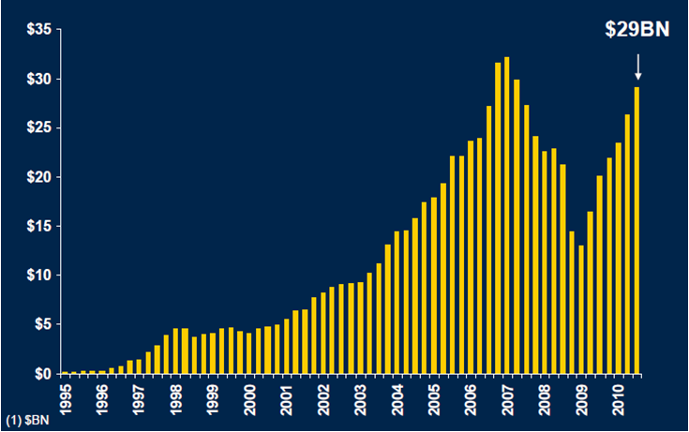
Canadian REIT Market Cap Growth Since 1995
Source: RBC Capital Markets, Real Estate Group, 2010

Slide 7
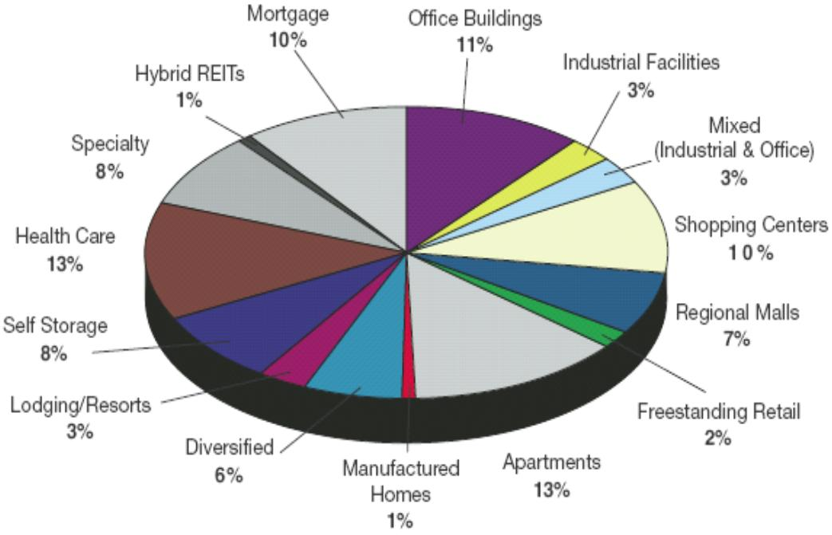
U.S. REITs
Source: NAREIT, as of February 28, 2009

Slide 8
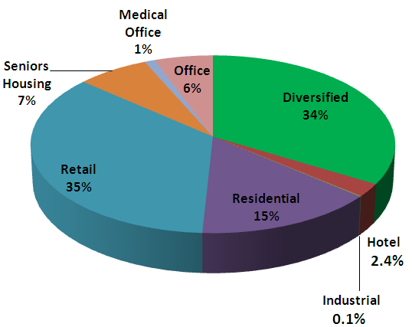
Canadian REITs
Source: De Grandpre Chait LLP, REIT Report, as of November 5, 2010

Slide 9
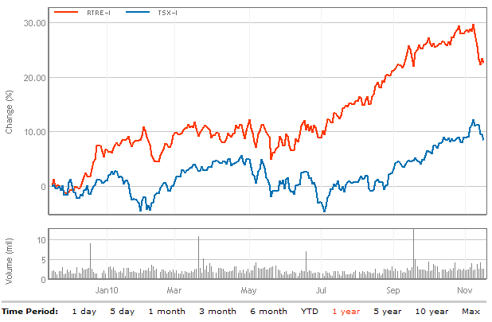
S&P/TSX Capped REIT vs. S&P/TSX Composite (1 yr)

Slide 10
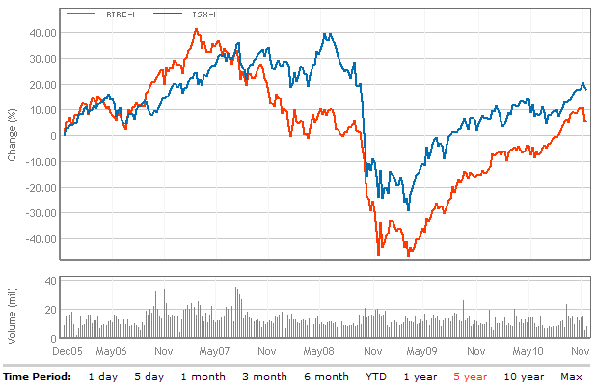
S&P/TSX Capped REIT vs. S&P/TSX Composite (5 yr)

Slide 11
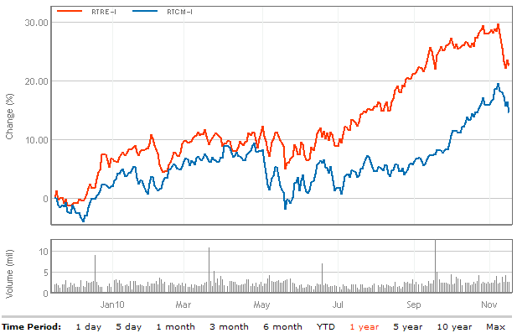
S&P/TSX Capped REIT vs. S&P/TSX Income Trust (1 yr)

Slide 12
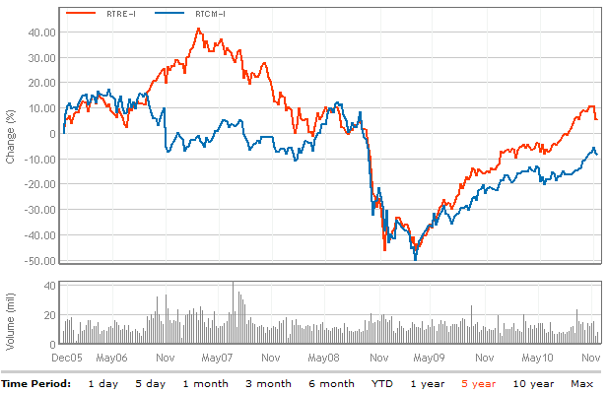
S&P/TSX Capped REIT vs. S&P/TSX Income Trust (5 yr)

Slide 13
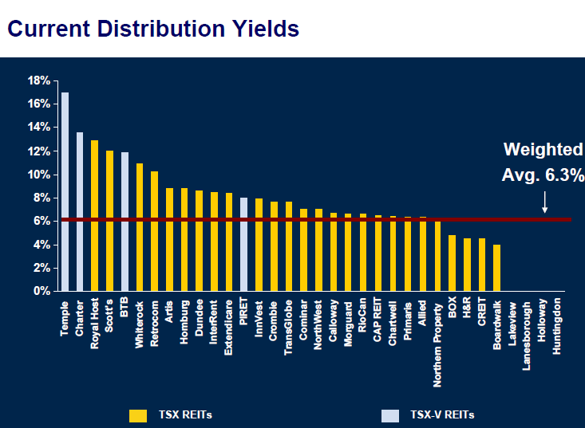
Source: RBC Capital Markets, Real Estate Group, 2010

Slide 14
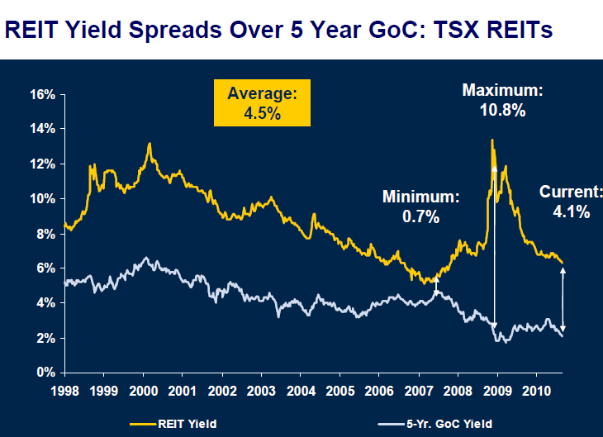
Source: RBC Capital Markets, Real Estate Group, 2010

Slide 15
Benefits of REITs
High yield, stable distributions
Capital appreciation potential
Tax advantage (no tax at entity level)
Diversification
Stable market performance

Slide 16
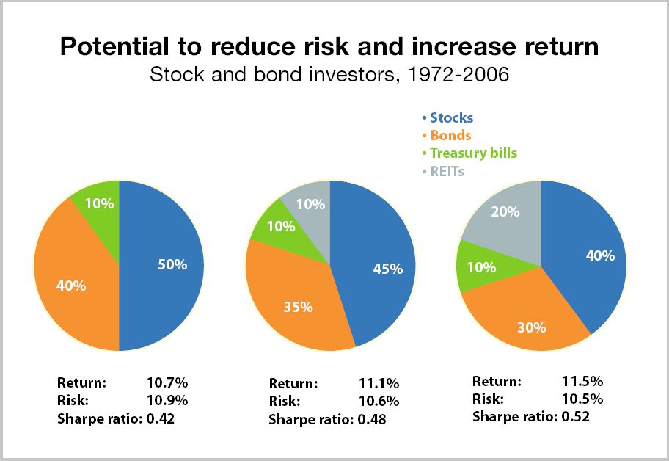
Diversification

Slide 17
Legality Requirements
Minimum of 150 unitholders, and are listed on a recognized Canadian Exchange
No more than 50% of the shares can be held by five or fewer individuals
At least 80% of its property must be real property in Canada, and other qualifying investments
At least 95% of its income must be derived from the disposition of or income earned from qualifying investments
No more than 10% of its property should consist of bonds, securities or shares in the capital stock of any one corporation or debtor

Slide 18
Tax Fairness Plan
New tax rules announced in October 2006
Applicable to Canadian publicly traded income trusts (or publicly-traded partnerships)
Effective from 2007 for trusts that begin to be publicly-traded after October 2006, but will only apply beginning from 2011 for existing trusts

Slide 19
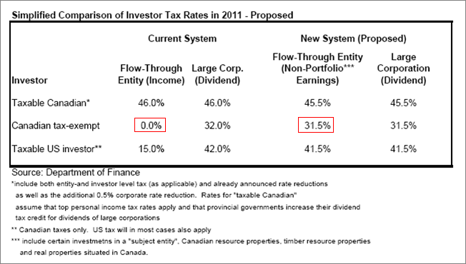

Slide 20
Tax Exemption for Canadian REITs If…
At no time in the year hold any non-portfolio property other than real properties situated in Canada
Have as not less than 95% of its income for the year from properties
Have as not less than 75% of its income for the year that is attributable to rents from, mortgages on, or gains from the disposition of real properties situated in Canada
Hold throughout the year real properties situated in Canada, cash, and debt or other obligations of Governments in Canada with a total fair market value that is not less than 75% of its equity value

Slide 21
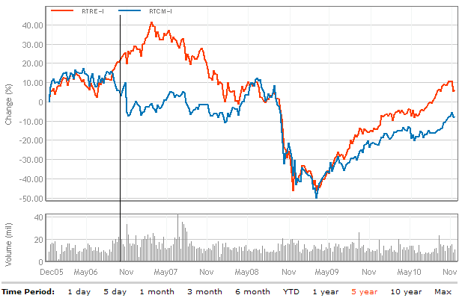
October 6, 2006: S&P/TSX Capped REIT vs. S&P/TSX Income Trust

Slide 22
Implications
Many income trusts will convert to corporations by 2011 or cut their distributions to account for the corporate taxes
Most existing REITs will not be affected provided that they meet the new requirements
REITs will be more preferable than income trust
Some REITs will convert to corporations or restructure themselves to qualify for the tax exemptions

Slide 23
Factors to Consider
Management Expertise
Net Asset Value per Share
Portfolio Diversification
Access to funding
Low Leverage
Earnings available for distribution
  FFO, AFFO, and FCF
Cash Distribution to Unitholders
  FFO or AFFO Payout Ratio

Slide 24
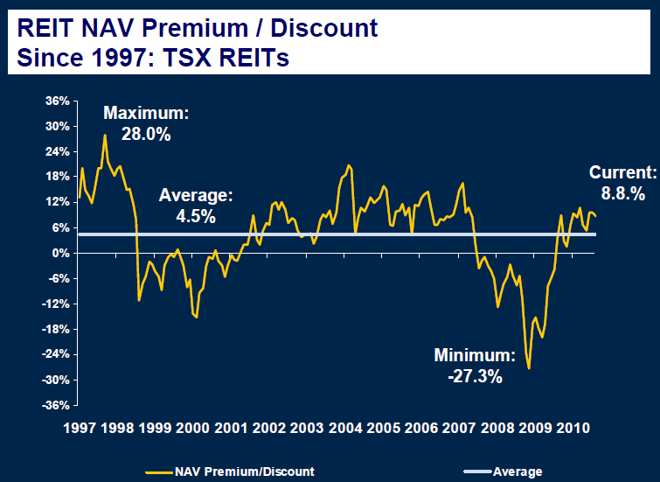
Source: RBC Capital Markets, Real Estate Group, 2010

Slide 25
Operating Performance Indicators
 | GAAP | Non-GAAP
 | Net Income (NI) | Funds from Operation (FFO) | Adjusted Funds from Operation (AFFO)
Calculation | Revenues – Expenses (including depreciation of real estates) | NI + Depreciation of real estate – Gains/losses from sales of properties | FFO – Ongoing capex – Tenant improvements – Other adjustments
Advantages | Easily comparable across the REIT industry | Adjust the limitations of GAAP NI | Adjust the limitations of FFO
Limitations | Historical cost based depreciation of properties may be a misleading indicator of REITs’ profitability because real estate assets tend to appreciate | Does not represent amounts available for capital requirements, debt service obligations, commitments or uncertainties | Can vary dramatically year-over-year depending upon the lease expiry profile that exists in any one period

Slide 26
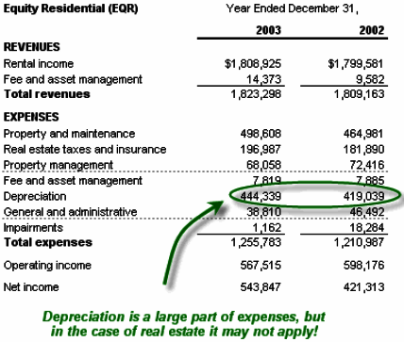
Operating Performance: GAAP NI

Slide 27
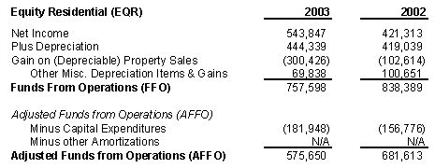
Operating Performance: FFO and AFFO

Slide 28
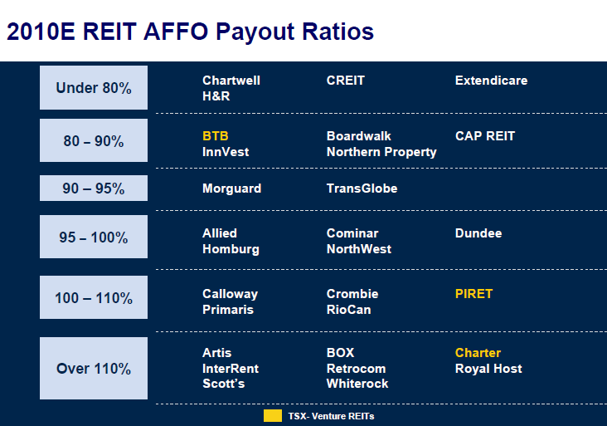
Source: RBC Capital Markets, Real Estate Group, 2010

Slide 29


Slide 30
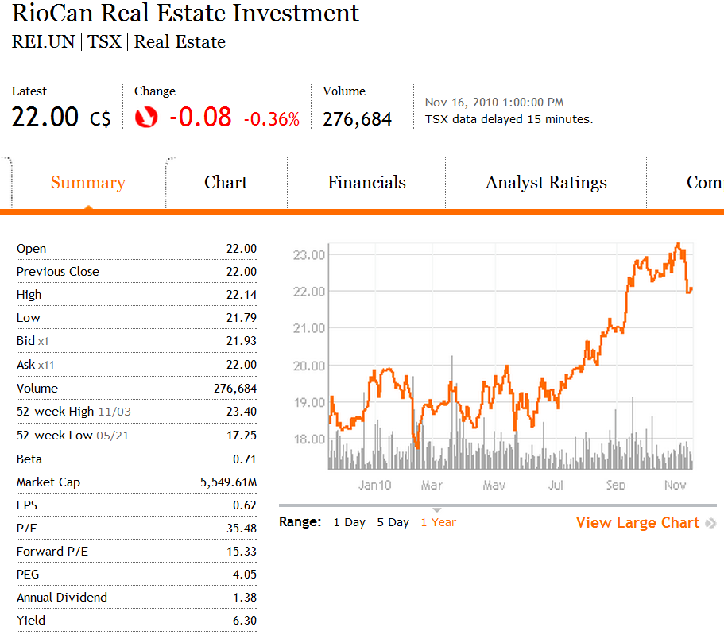
Stock Price Overview

Slide 31
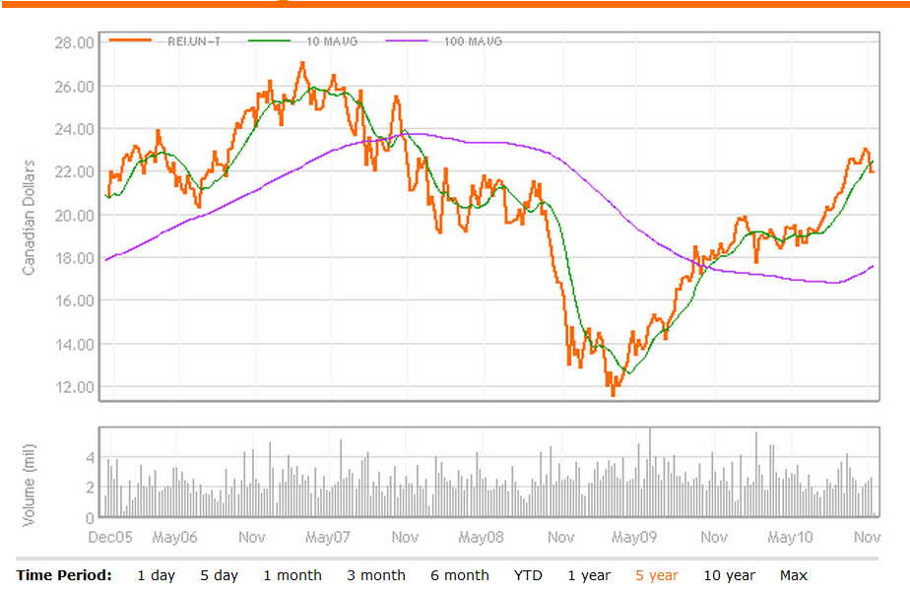
Charts & 5yr Moving Average at 10, 100

Slide 32
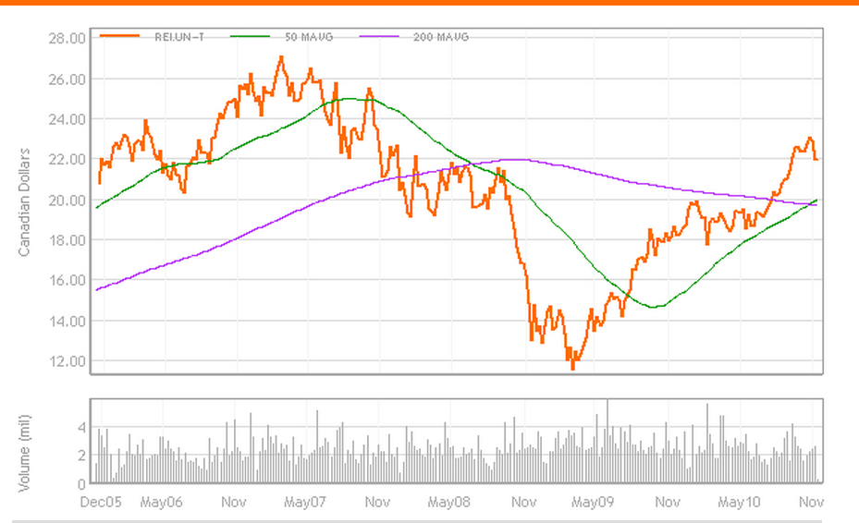
Charts & 5 yr Moving Average at 50, 200

Slide 33
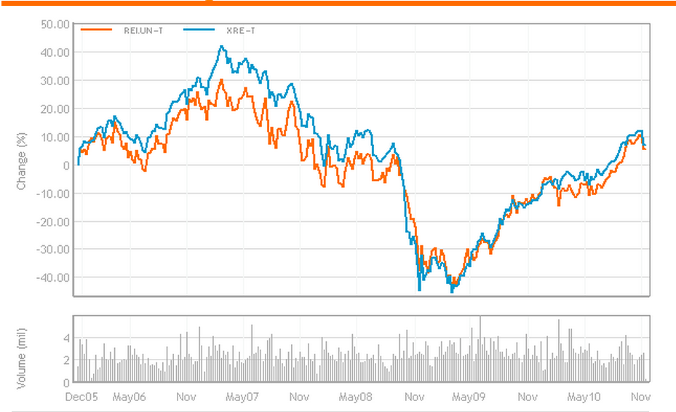
RIOCAN VS iShare (XRE-T, ETF) 5 yr

Slide 34
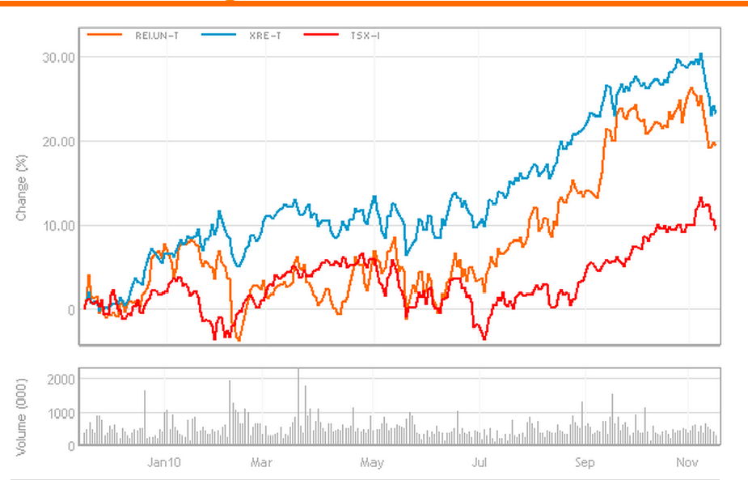
RIO VS iShare, TSX (XRE-T, ETF) 1 yr

Slide 35
Overview of RIO
  RIO is Canada’s largest REIT focused on retail real estate
  Total area of aggregated ownership of shopping center is over 60 million sq.ft.
  11 properties currently under Development
  Diversified tenant base
  Trust’s purpose is to deliver to its unitholders stable and reliable cash distributions that increase over the long term
  Most volatile sector for REITS to be in (Compared with Senior home and apartments)

Slide 36
Specified Investment Flow-Through (SIFT – REITS Examption)
To benefit from this exception (i.e. to be a REIT) for a given taxation year, a trust must:
At no time in the year hold any non-portfolio property other than real properties situated in Canada;
Have as not less than 95% of its income for the year income from properties (whether in Canada or abroad, and including dividends, interest, rents, etc. and taxable capital gains from dispositions of real properties);
Have as not less than 75% of its income for the year income that is directly or indirectly attributable to rents from, mortgages on, or gains from the disposition of, real properties situated in Canada; and
Hold throughout the year real properties situated in Canada, cash, and debt or other obligations of Governments in Canada (including Crown corporations, etc.) with a total fair market value that is not less than 75% of its equity value.

Slide 37
Qualification as REIT
Because of RioCan’s recent expansion in the U.S. and its associated investment income, it may be disqualified as REITS
Current 3 and 9 months ended Sept 30, 2010 revenue derived from non-compliant activities is $3.4 and $18.9 million.
Proportion in terms of total revenue is 3.9% and 7.5% respectively
7.5% YTD exceeded the limit for REITS exemption, therefore, restructure is needed.

Slide 38
Current Qualification Plan
Restructure of current mezzanine financing with development partners to RioCan subsidiaries
Sale of non-compliant assets to third parties
Sale of non-compliant assets to RioCan Management Inc.
Continuous training for staffs to ensure compliance with the REIT Exemption

Slide 39
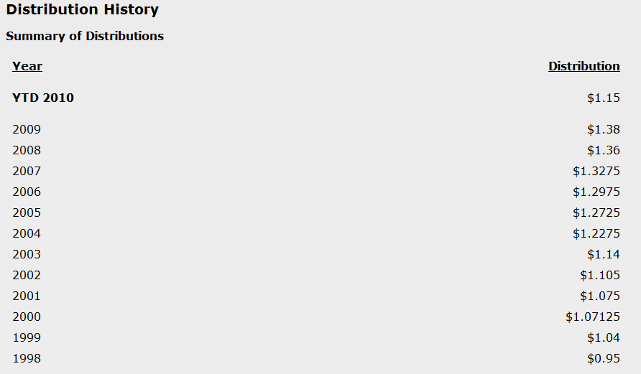
Income Dist. to Unitholders

Slide 40
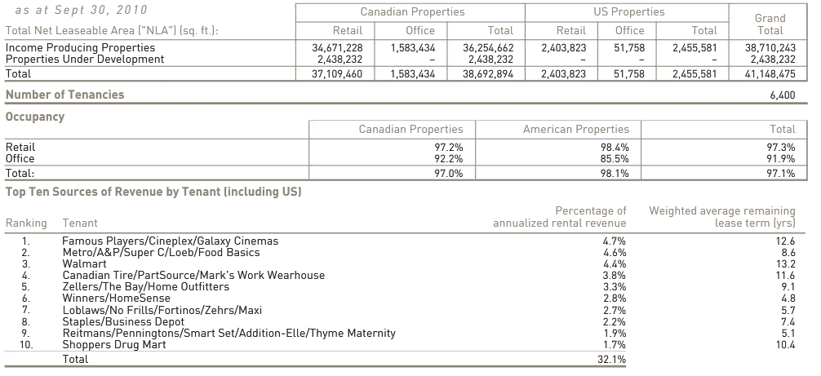
RIO FACTS

Slide 41
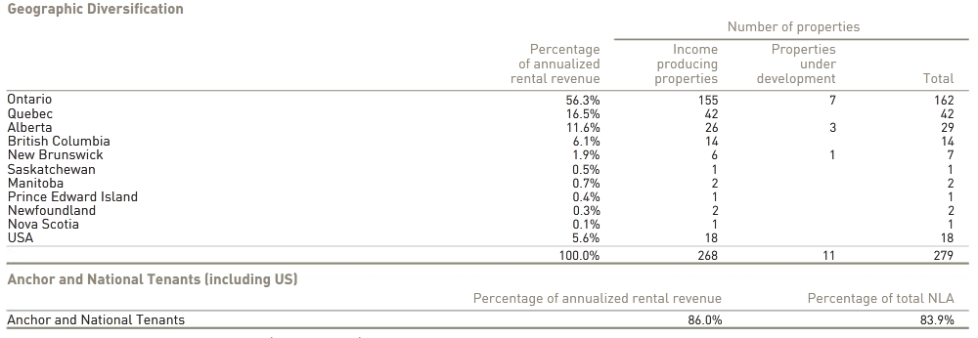
Geographic Diversification

Slide 42
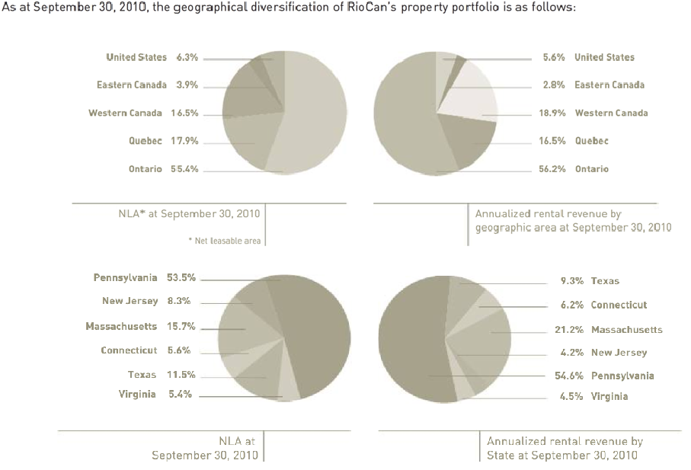
Lease Expiries

Slide 43
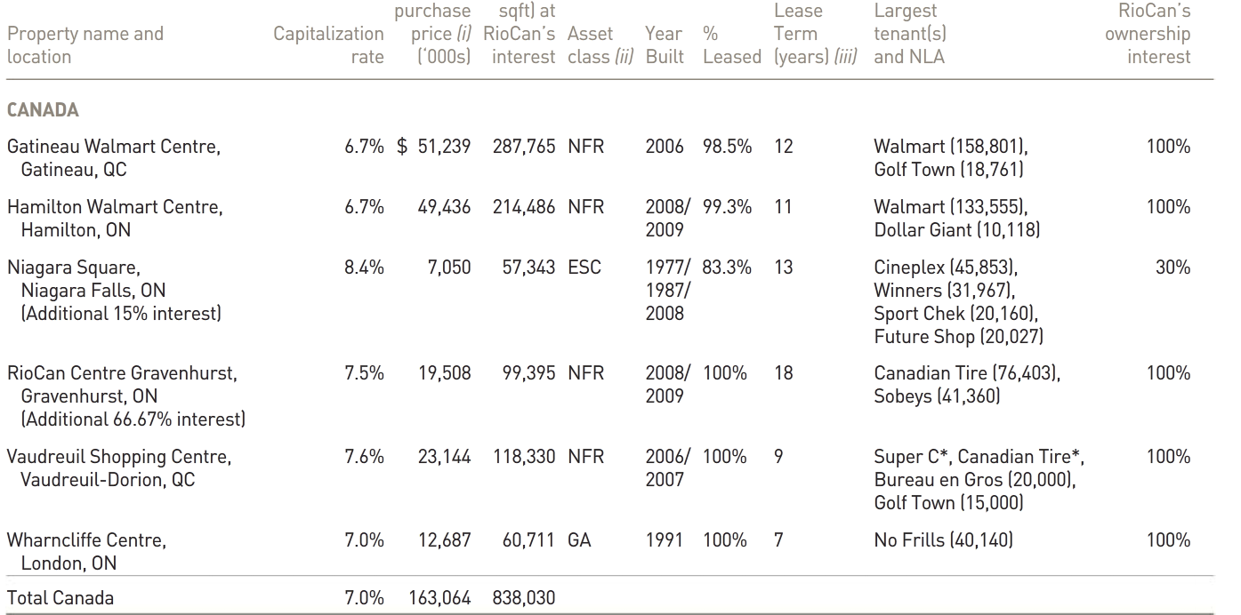
Recent Expansion in Canada

Slide 44
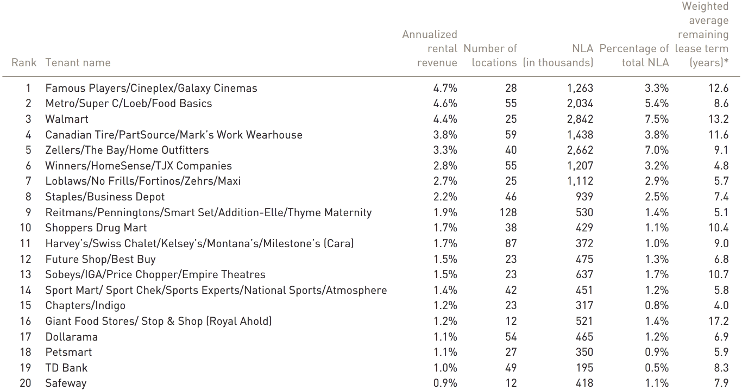
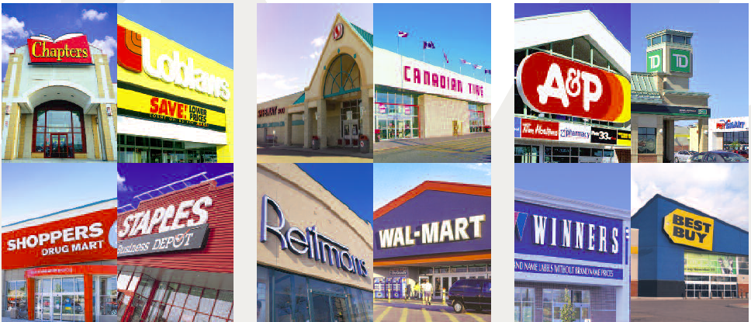
Top 20 Anchors in Canada

Slide 45
Recent U.S Expansions
Advance in U.S market due to the lowered real estate prices
Cedar: 80% Interest (Massachusetts, Pennsylvania, and Connecticut)
Inland Western: 80% interest for usd $123.3 million and assume $68.2m property level debt with average interest rate of 5.6% and average term 6 years.
(Dallas – Fort Worth, Houston, and Austin

Slide 46
Recent U.S Expansions(cont’d)
Kimco Realty – 31.7% Acquired Las Palmas Market Place in El Paso for $26.4695 million. Palmas MP is 638,000 square foot with average price of $10 per square foot for 7 years.

Slide 47
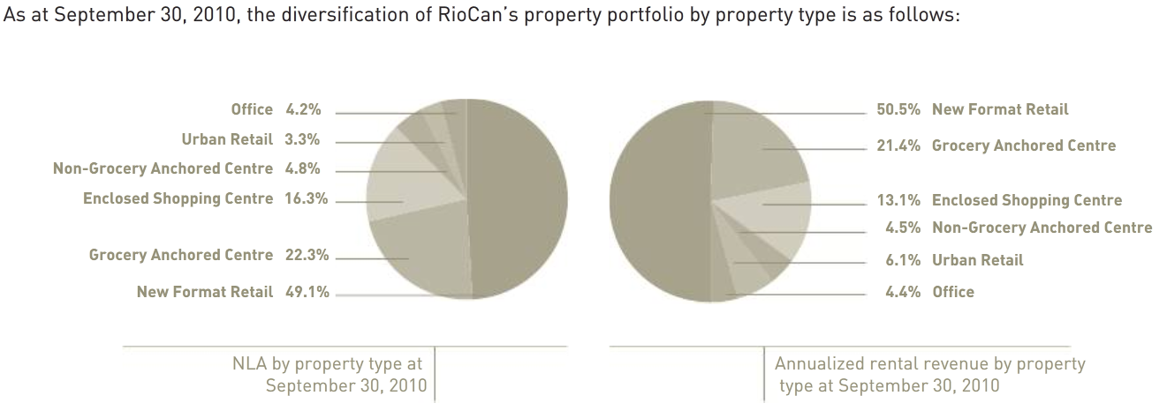

Slide 48
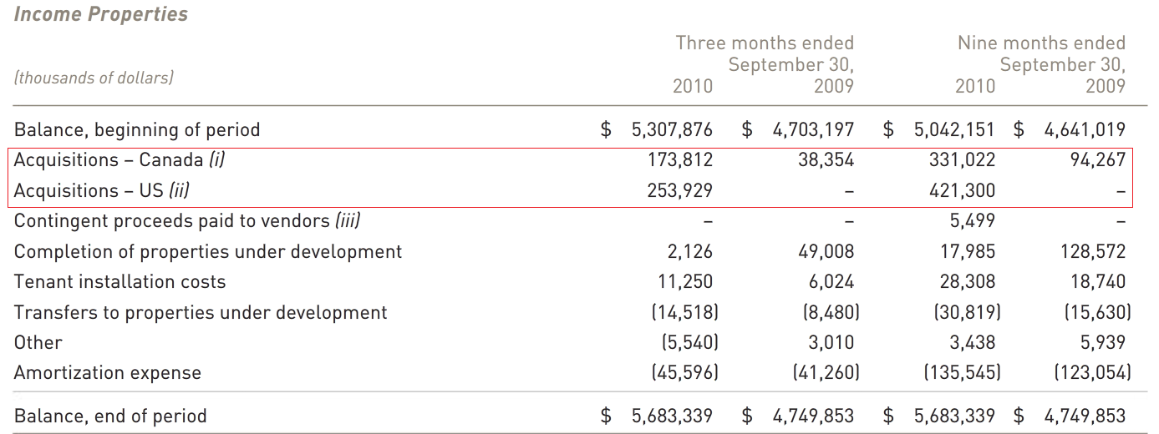
Summery of Income Ppty

Slide 49
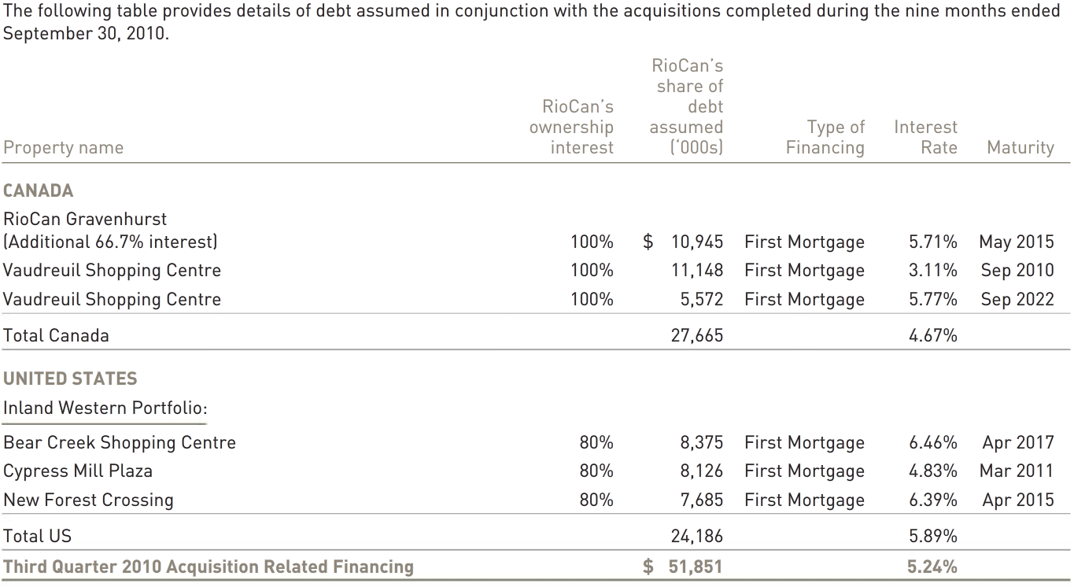
Related Financing on Ppty

Slide 50
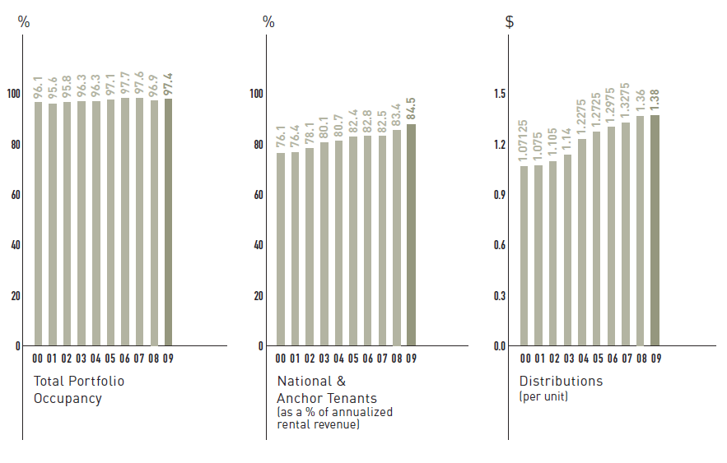
Occupancy Rates

Slide 51
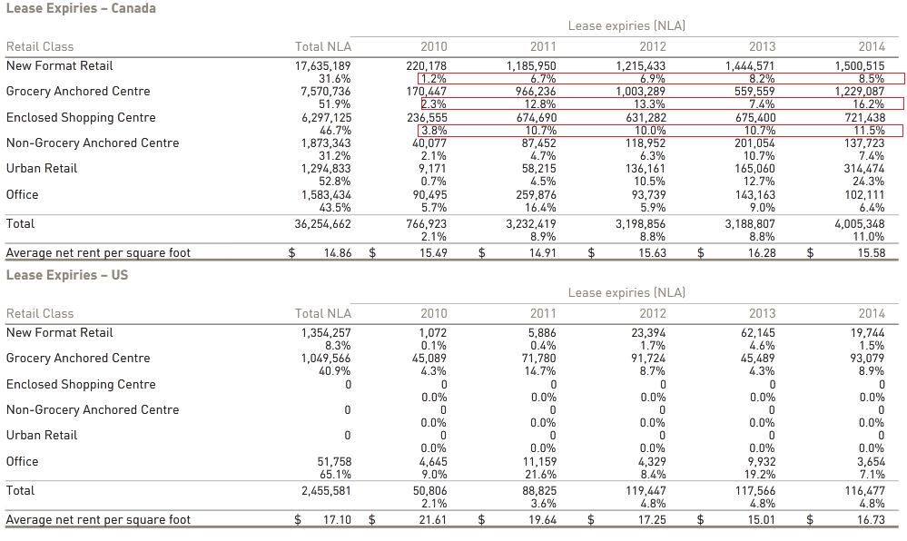
Lease Expiries
Notes:
It is important to keep steady rate of expiring leases to avoid constant cash flow and distribution. The industry average suggested by Deloitte is around 15 to 20% which we can see that RIO is doing a fairly good job here.

Slide 52
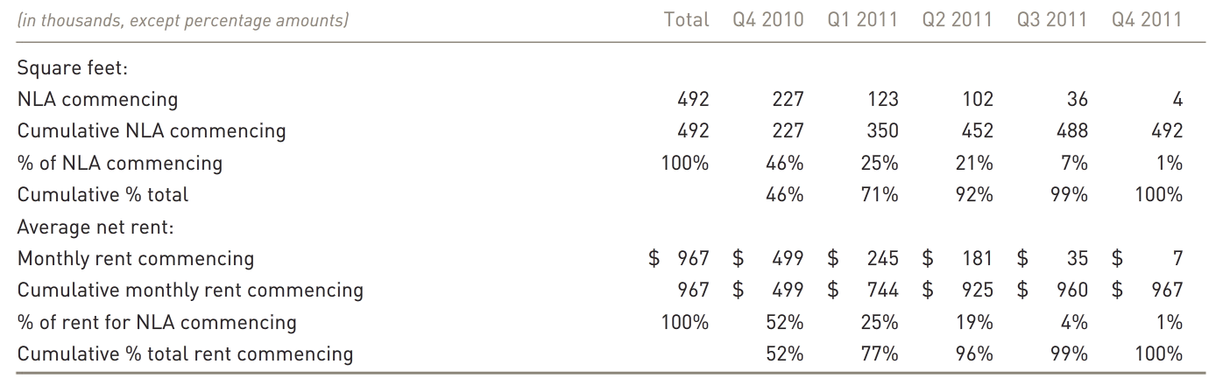
Leasing Activities
During 2009, RioCan retained 92.1% (2008 – 85.8%) of renewing tenants at an average renewal rental rate increase of 7.2% or $1.04 per square feet (2008 – $1.56).

Slide 53
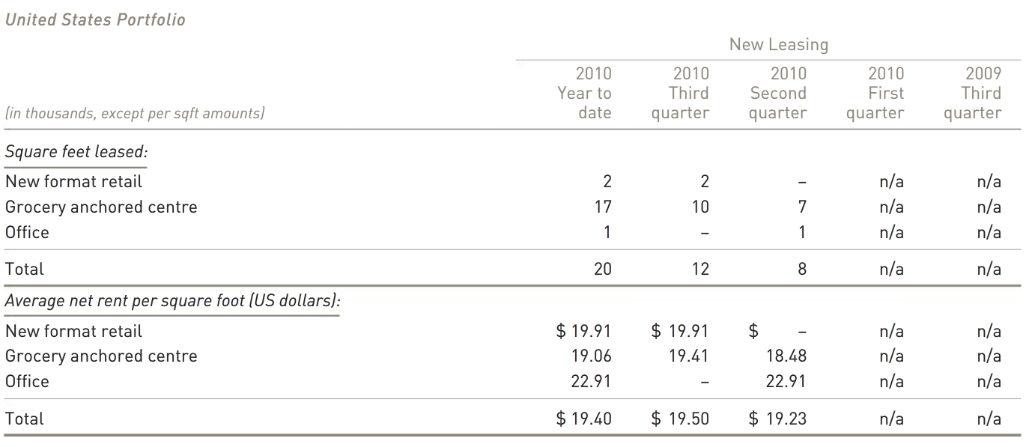
Summary of U.S Lease Breakdown

Slide 54
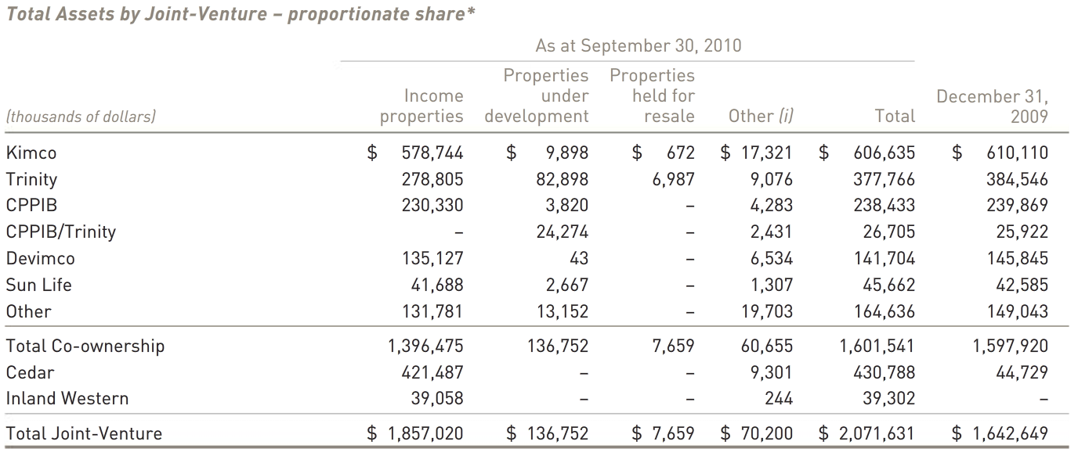
Joint Ventures Summary

Slide 55
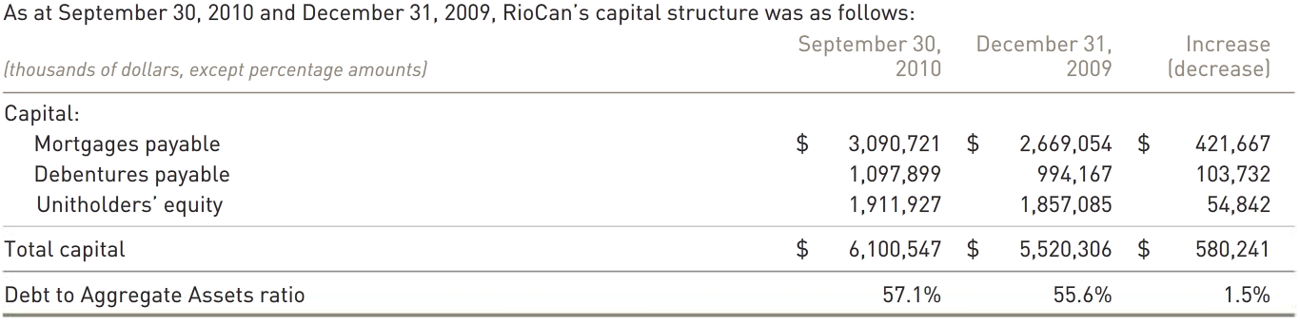
Capital Structure & Financing Acitivies
Rio’s leverage ratio limit is 60% (Covenants)
Rio’s current debt rating is BBB by S&P

Slide 56
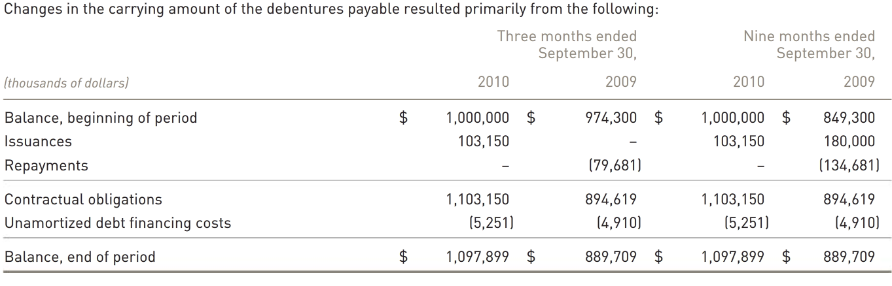
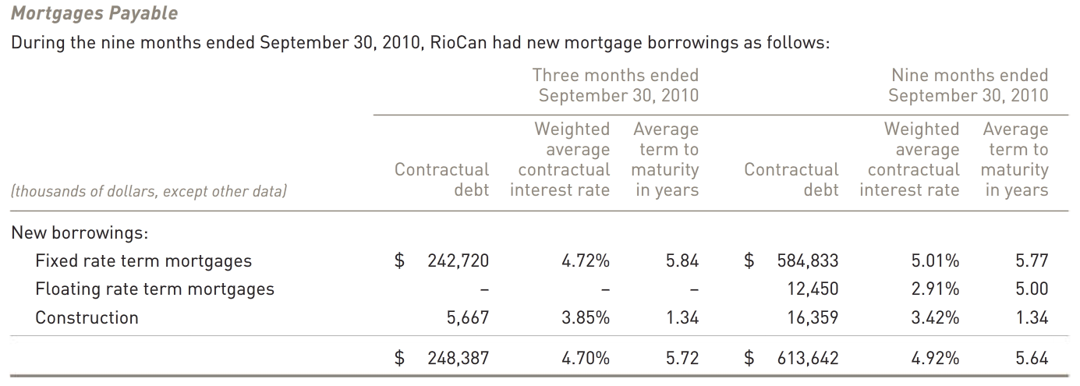

Slide 57
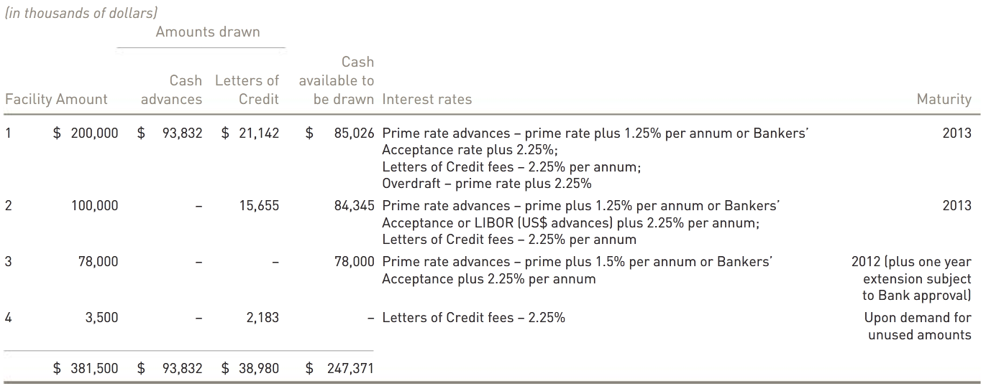
Capital Structure & Financing (Cont’d)
Note: Most Secured by Income Properties

Slide 58
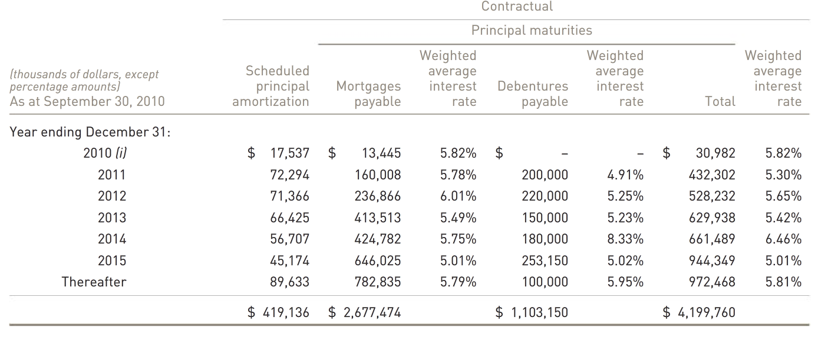
Capital Structure & Financing (Cont’d)

Slide 59
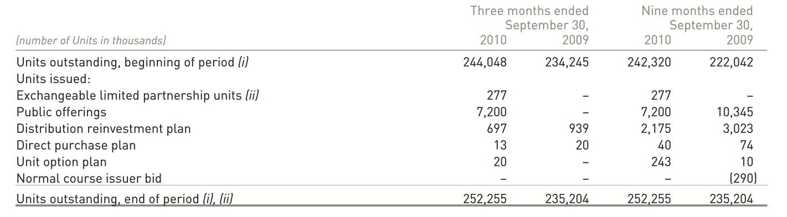
Unit Holders Summary
Notes:
Dilution

Slide 60
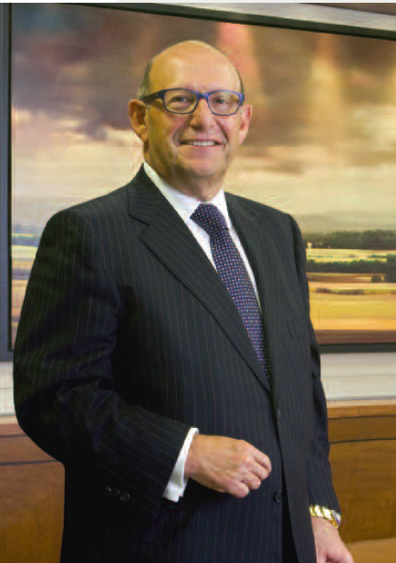
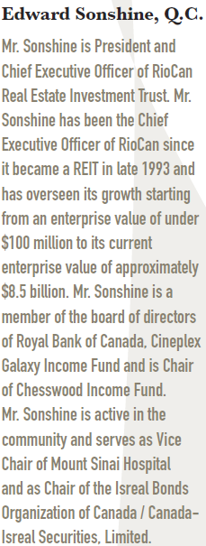
CEO

Slide 61
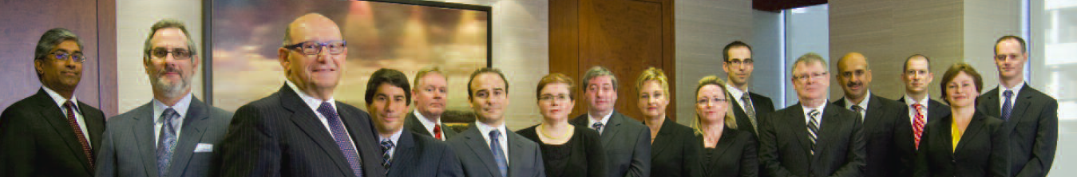
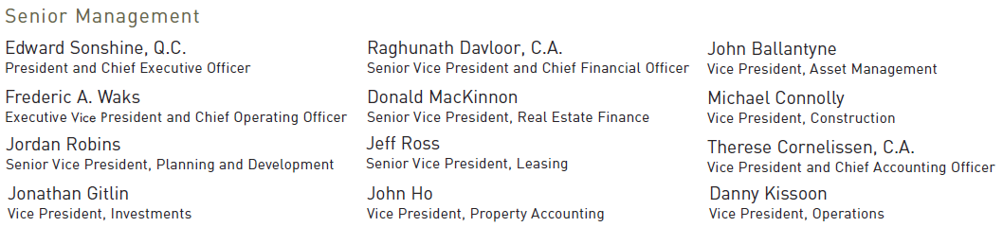

Senior Managements

Slide 62
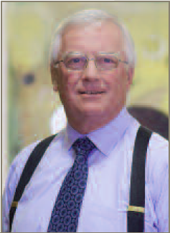
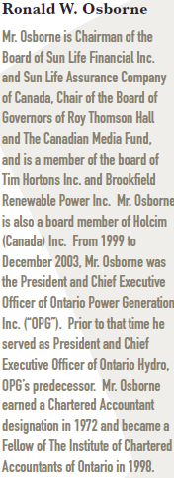
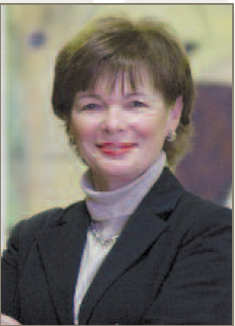
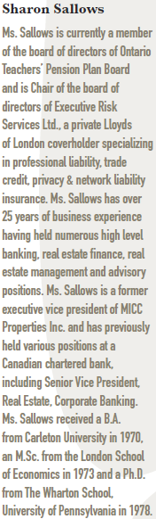
Broad of Trustees

Slide 63





Broad of Trustees

Slide 64




Broad of Trustees

Slide 65




Broad of Trustees

Slide 66


Balance Sheet
Consolidated Balance Sheet (Quarterly)

Slide 67

Consolidated Balance Sheet (Annual)

Slide 68

Consolidated Statement of Earning (Annual)

Slide 69

Consolidated Statements of Earnings (Quarterly)

Slide 70


Statement of Cash Flow (Quarterly)

Slide 71


Statement of Cash Flow (Cont’d)

Slide 72

Consolidated Cash Flow (Annual)

Slide 73

Consolidated Cash Flow (Cont’d)

Slide 74

Funds From Operations (FF0 Quarterly)

Slide 75

Funds from Operation (FFO -Annual)

Slide 76

Recommendation
Buy/Strong Buy

Slide 77

Notes:
Calloway Real Estate Investment Trust operates as an open-ended mutual fund trust in Canada. It engages in the acquisition, ownership, development, management, and operation of retail centers. As of December 31, 2007, the company owned 131 shopping centers and 2 industrial buildings with total gross leaseable area of 20.2 million square feet. Calloway Real Estate Investment Trust was founded in 1945 and is based in Vaughan, Canada.

Slide 78

Snapshot of CALLOWAY REAL ESTATE INVESTM

Slide 79


Slide 80

1 year with SMA 50 and SMA 200

Slide 81

5 years with SMA 50 and SMA 200

Slide 82

1 year compared to S&P TSX Capped REIT
Notes:
Calloway has outperformed the S&P TSX Capped REIT in 1 year, and is about 10% above the TSX REIT in Sep

Slide 83

5 years compared to S&P TSX Capped REIT

Slide 84

10 years compared to S&P TSX Capped REIT

Slide 85
About Calloway
Company Overview
Recent News
Overall Performance
Management Team

Slide 86

Company Overview
Unincorporated open-end real estate investment trust
Founded in 1945
Highest Occupancy (over 99%)
Largest number of Wal-Marts in Canada (99 stores)
Average term to maturity of 7.5 years
Average remaining lease term of 9.9 years
Notes:
Largest owner, operator and manager of large open-air centers in Canada
-Focused on the ownership and development of high quality retail properties
Calloway's vision is to provide a value-oriented shopping experience to Canadian consumers

Slide 87

Company Overview

Slide 88
Recent News
Highlights of the quarter:
Issued $266 million in new Trust Units
Acquired two income properties for $129.9 million
Net income: increased by $3.7 million ($0.03 per unit) to $10.5 million ($0.10 per unit) compared to the same period in 2009
Funds from operations (FFO) (non-GAAP measure): increased by $4.1 million to $43.4 million compared to the same period in 2009
Invested $40.7 million to complete the development and lease up of 153,879 square feet
Portfolio occupancy rate increased to 99.2%
Negotiated renewals of 279,500 square feet with an average rent increase of 8.4%
Notes:
Calloway continued its growth through Developments and Earnouts in the third quarter of 2010. During the
quarter, it focused on managing the operation and development of existing properties and raising the capital
required for future growth of the business.
Highlights for the quarter include the following:
• Acquired two income properties for $129.9 million.
(During the third quarter, Calloway acquired 0.73 million square feet of retail space in two retail properties
from a joint venture between SmartCentres and Wal-Mart Canada Realty Inc. for $129.9 million.
These acquisitions allowed Calloway to have a presence in two new markets. )

Slide 89

Overall Performance

Slide 90
Portfolio Highlights
As at March 31, 2010
Portfolio Size | 23.0M sq. ft.
Total GLA in Wal-Mart Anchored Centers | 84.8%
Occupancy: | 99.0%
Average Remaining Lease Term: | 9.0 years
Net Rent per square foot: | $13.79 (2009 – $13.55)
Net Rent per square foot (excluding anchors): | $18.88 (2009 – $18.26)
Notes:
As at September 30, 2010, Calloway's $4.3 billion real estate portfolio included 24.2 million square feet of built gross leasable area and 5.1 million square feet of future developable area in 119 operating and 10 development properties.

Slide 91

Notes:
Main market is Canada
97% of properties are comprised of large open-air shopping centres.
• 97% of revenues are derived from long-term leases extending past 2009.
• Calloway portfolio has an average remaining lease term of 9.9 years, with an annual average of 4.4% of
total GLA rolling over the next 10 years. Excluding anchors, average remaining lease term is 6.2 years.

Slide 92

Revenue by Province
Notes:
Rentals from income properties account for 97.1% of revenues for the quarter ended September 30, 2010,
with 72.5% of the portfolio located in Ontario and Quebec, primarily in the Greater Toronto and Montreal
areas. The balance of the portfolio is located across Canada.

Slide 93


Portfolio Occupancy
Calloway has maintained high and industry-leading occupancy
Portfolio of high quality, newly developed assets with minimal capex requirements (average age of 8.0 years).
Notes:
• occupancy of 99.2 % - Highest occupancy amongst REITs.
• 65.8% of revenues is derived from top 25 tenants.

Slide 94


Major Tenants
Notes:
The five largest tenants are Wal-Mart, Canadian Tire, Best Buy/Future Shop, Winners, Reitmans, they account for about 40% of portfolio revenue.
• 76% of owned properties are anchored by Wal-Mart.
• Wal-Mart is an anchor tenant that does really well even in an economic downturn, as it attracts
middle-ground consumers looking for value.

Slide 95

Wal-Mart Relationship
Calloway is Wal-Mart Canada’s biggest landlord
Notes:
Calloway has a total of 74 Wal-Marts under lease, of which 34 are SuperCentres.
An additional three expansions are expected to be completed by the end of 2010.
• Calloway has the largest number of Wal-Marts (99 stores) in its portfolio of all Canadian REITs. (as mentioned before)
• Upon completion of all remaining developments, an estimated 21.1% of gross revenues would be
derived from Wal-Mart leases.

Slide 96

SmartCentres Alliance
• Relationship with SmartCentres
• Average area developed: 3,000,000 square feet
SmartCentres’ owner, Mitchell Goldhar, is Calloway’s largest
unitholder (24.4%)
• SmartCentres has a long-standing partnership with Wal-Mart
Notes:
• Relationship with the most active shopping
centre developer in Canada, SmartCentres,
provides Calloway with a pipeline of
scarce product.
• Average area developed by SmartCentres
annually is: 3,000,000 square feet.
• SmartCentres has a vested interest in Calloway’s
success, as its owner, Mitchell Goldhar, is Calloway’s largest unitholder (24.4%).
• SmartCentres has a long-standing partnership with Wal-Mart.

Slide 97

Lease Maturity

Slide 98

Development Pipeline

Slide 99

Development Pipeline
Notes:
• In-house development enhances Calloway’s revenues by capitalizing on the value created by rezoning and
development.
• 26 development projects representing 2.3 million square feet are in the pipeline.
• SmartCentres is developing approximately 3.4 million square feet of the pipeline on an “earnout” basis.
• “Earnouts” are a future commitment to acquire parcels, conditional on rent commencement.
• Developments are only commenced on pre-leasing.

Slide 100

Management Team

Slide 101

Management Team
Simon Nyilassy
President, Chief Executive Officer
Total Annual compensation
C$465,000 CAD
As of Fiscal Year 2009
Chartered Accountant
Bachelor of Science degree from the
University of Warwick (1976)
Executive Vice President Finance at
SmartCentres prior to joining Calloway
previously worked in Markborough Properties,
Dundee Realty, Bramalea Limited and CIBC
World Markets
24 years experience in the real estate business
Notes:
Simon Nyilassy is the President and Chief Executive Officer of Calloway REIT.
Prior to joining Calloway, Mr. Nyilassy was Executive Vice President Finance at SmartCentres. Mr. Nyilassy has 24 years experience in the real estate business, having previously worked in senior financial roles with a number of large public and private Canadian companies, including Markborough Properties, Dundee Realty, Bramalea Limited and CIBC World Markets.

Slide 102

Management Team
Bart Munn
Chief Financial Officer
Total Annual compensation
C$300,000 CAD
As of Fiscal Year 2009
Chartered Accountant
Bachelor of Commerce degree from Queen's University
Vice President and Chief Financial Officer of
Morguard Corporation (1999-2005)
Vice President and Chief Financial Officer of
Morguard Real Estate Investment Trust (1997-
1999)
Senior Vice President Finance & Administration
for Morguard Investments Limited (1991-2005)
Notes:
Chief Financial Officer of Calloway Real Estate Investment Trust since December 2005.
spent more than 20 years in the real estate industry, with extensive experience in accounting, treasury, capital markets and mergers and acquisitions.
- Vice President and Chief Financial Officer of Morguard Corporation, a publicly traded owner and manager of commercial and residential real estate, from 1999 to 2005.
Vice President and Chief Financial Officer of Morguard Real Estate Investment Trust from 1997 to 1999. -
Also held the position of Senior Vice President Finance & Administration for Morguard Investments Limited, a wholly owned subsidiary of Morguard Corporation, from 1991 until 2005. Mr. Munn is a Chartered Accountant.

Slide 103

Management Team
Rudy Gobin
Executive Vice President Asset Management
Total Annual compensation
C$262,500 CAD
As of Fiscal Year 2009
Chartered Accountant
Bachelor of Commerce degree from the
University of Toronto (1987)
previously Calloway's Executive Vice President
of Operations and Strategy Officer
Executive Vice President, Finance and
Operations of SmartCentres (2001-2006)
Chief Financial Officer of Nexacor Realty
Management (March 1998-May 2001)
Notes:
Executive Vice President Asset Management of Calloway Real Estate Investment Trust.
- Mr. Gobin was previously Calloway's Strategy Officer and prior to that, held the position of EVP, Operations.
Before joining Calloway, Mr. Gobin was the Executive Vice President, Finance and Operations of SmartCentres from 2001 to 2006.
Chief Financial Officer of Nexacor Realty Management (real estate subsidiary of Bell Canada) from March 1998 to May 2001.
Mr. Gobin is a Chartered Accountant and has a Bachelor of Commerce degree from the University of Toronto (1987).

Slide 104
Financial Performance

Slide 105

Notes:
Financial highlights

Slide 106

Balance Sheet- 4 Quarters
(Millions of C$)

Slide 107

Balance Sheet- 4 Years
(Millions of C$)

Slide 108

Income Statement- 4 Quarters
Notes:
Interest Expense
Changes to the interest rate environment have a direct impact on income stream investments, and are certainly always a concern.
Interest costs incurred during the third quarter of 2010 totalled $74.6 million, net of the $1.0 million
amortization of acquisition date fair value adjustments. Interest capitalized to properties under development
totalled $4.8 million, and the balance of $69.8 million was expensed.
The increase in interest expense of $33.5 million over the same quarter of 2009 is mainly the result of:
• Adjustment for revised payments remaining on $150 million Series C 10.25% senior unsecured
debentures resulted in interest expense of $31.6 million.
• The $100 million Series E 5.10% senior unsecured debentures issued on June 4, 2010 and the $60
million 5.75% convertible debentures issued on January 5, 2010 offset by the $46.5 million of the
Series A 4.51% senior unsecured debentures and the redemption of $3.5 million of 6.00%
Convertible Debentures, respectively, increased interest expense by $1.6 million in the quarter
ended September 30, 2010.
• Amortization of accretion on the $125 million 6.65% convertible debentures issued on May 2, 2008,
and amortization of accretion on the $60 million 5.75% convertible debenture issued on January 5,
2010, totalled $0.5 million.

Slide 109

Income Statement- 4 Years

Slide 110

Cash Flow- 4 Quarters

Slide 111

Cash Flow- 4 Years

Slide 112


Slide 113
Recommendations

Slide 114

Recommendations

Slide 115


Recommendations

Slide 116
BUY

Slide 117

H&R REIT
Financial Information and Analysis as of November 2010

Slide 118
HR Price Quote
Symbol HR.UN

Slide 119

One year chart with MA 50(green), MA 200(purple)

Slide 120

One year chart with MA 20(green), MA 100(purple)

Slide 121

HR.UN-T(orange) vs. iShare (XRE-T)(teal) 5 yr
% Change
Nov 08

Slide 122

HR.UN-T(orange) vs. iShare (XRE-T) 1 yr (teal)

Slide 123
H&R REIT’s Business Model
An open ended trust to:
  Provide unitholders with stable and growing cash distributions, generated by the revenue it derives from investments in income producing real estate properties
  Maximize unit value through ongoing active management of the REIT’s assets, acquisition of additional properties and the development and construction of projects which are pre-leased to creditworthy tenants

Slide 124
H&R’s Strategic Plan
Accumulate a diversified portfolio of properties in both Canada and the United States
Attract creditworthy tenants
Focus is on creditworthy long-term leases rather than a specific allocation target (portfolio diversification target)

Slide 125

Recent Developments

Slide 126
Recent announcements
11/11/2010
H&R REIT announced its financial results for the third quarter ended September 30, 2010.
9/14/2010
H&R Closes $125 Million Senior Unsecured Debenture Financing
H&R Real Estate Investment Trust ("H&R REIT") (TSX: HR.UN; HR.DB; HR.DB.B; HR.DB.C; HR.DB.D) announced today that it closed its previously announced offering of $125 million principal amount of 5.00% Series C Senior Debentures due December 1, 2018 (the ("Debentures").
9/7/2010
H&R REAL ESTATE INVESTMENT TRUST Announces Increase to Series C Senior Unsecured Debenture Financing
TORONTO, September 7, 2010 - H&R Real Estate Investment Trust ("H&R") (TSX: HR.UN; HR.DB; HR.DB.B; HR.DB.C; HR.DB.D) announced today that as a result of strong investor demand for its public offering of Series C senior unsecured debentures which was announced earlier today, the size of the offering has been increased by C$25 million, to C$125 million. These debentures will bear interest at the rate of 5.00% and will mature on December 1, 2018. The offering is being underwritten by a syndicate co-led by RBC Capital Markets TD Securities Inc. and CIBC World Markets.

Slide 127


Selected Financial Information from 2009 Annual Report

Slide 128

Dividend Payout

Slide 129

Current Distribution Policy
Plans to increase distributions on a quarterly basis by 25 basis points beginning in October 2010 to the end of Q2 2012 (Time at which Bow will be completed and generating net annual rent of $94M).
Will then review dividend distribution to evaluate use of the excess cash.
Management sees contracted rental escalations (rent step-ups), accretive acquistions and minimal pressure for rising interest rates a good sign for REITS performance in the coming year.

Slide 130
Internal Reorganization
Plan of Arrangement Oct 1st, 2008
Created H&R Finance Trust in Oct, 2008
“Stapled unit”
Traded under TSX as HR.UN
Is not traded independently
Purpose:
  More elegant method of raising capital (leveraged buyouts) without hurting the trust’s credit ratings
  Receives favorable US Tax Treatment

Slide 131
Unitholder gets 1 unit of sister trust H&R Finance Trust
  Finance Trust holds the debt from US subsidiary(s)
  H&R REIT Trust holds the Asset
Nov 30th 2009, REIT and Finance Trust completed the 2009 Reorganization to enable REIT to qualify for the REIT exemption under ITA (Canada)
  Redeemed the stapled units from H&R Portfolio Limited Partnership

Slide 132
Diversified Portfolio

Slide 133
BV of Properties by Location

Slide 134

Square feet of Properties by Location

Slide 135

Comparison of Rental income across the 3 different types of Properties

Slide 136

Occupancy Rates
Very high occupancy rates

Slide 137

2010 Acquisitions

Slide 138

Average age of Assets
Average age of assets 16.8 years

Slide 139


Recent Dispositions from Q3 2010 Report

Slide 140
Properties under Development
Project | Location | 2009 | 2008
The Bow | Calgary, Alberta | $ 719 173 | $ 402 031
Bell Canada Phase III | Mississauga ,Ontario | completed | $ 117 007
Heart Lake | Caledon Ontario | $ 39 809 | $ 38 471
Airport Road | Brampton, Ontario | $ 35 552 | $ 32 687
Total |  | $ 794 534 | $ 590 196

Slide 141

The Bow (H&R’s Centerpiece)

Slide 142
The Bow
Strategic Significance:
  Flagship Property
  Encana’s Corporate headquarters in Calgary
    Approximately 2 million SF, 58-story office tower
    Budged about $1.5 billion, with full completion and the lease commencement date expected by April 2012
  Pre-leased 100% by Encana in the next 25 years
    Will generate in excess of $94 million of NOI in the first leasing year
    Rent step-up .75% per year, 1.5% for parking income
  Interest rate swap used to lock effective interest on construction facility at 6.9%
    Resulted gain for $3 463 million

Slide 143

Bell Canada Phase III
Completed, transferred to income properties in 1st Qtr. of 2009
Started paying rent since Jan 1st 2009
A net increase of $21.8 million in property operating income at end of 2009

Slide 144
Bell Canada Phase III
Bell Canada is one of the 5 major clients
  PipeLines Limited, Telus Communications and Bell Mobility ( >5% rental income, A rating)
  Tenant inducement of $17.5 million

Slide 145
Airport Road, Heart Lake
2008 Acquisitions
Airport Road
  80% interest
  Located in Brampton Ontario
  72 acre development land purchase
  Projected expected to provide 1.6 million sq. feet for single tenant industrial distribution facilities.
Heart Lake
  Part of a planned community of Mayfield West
  Project expected to produce 1,750,000 sq.ft of industrial properties

Slide 146







Creditworthy Tenants
*Based on estimated annualized gross revenue, excluding the straight lining of contractual rental and discontinued operations

Slide 147
Income Properties Comparison by Country
Income Properties | 2009 | 2008
Canada | $ 3 823 522 | $ 3 758 837
United States | $ 1 095 868 | $ 1 348 189
Total | $ 4 919 390 | $ 5 107 026
Net operating income (2009) | Canada | USA | Total
Operating revenue | $ 507 205 | $ 104 708 | $ 611 913
Property operating costs | (177 351) | (18 264) | (195 615)
Interest | (125 294) | (72 421) | (197 715)
Depreciation and amortization | (91 625) | (37 018) | (128 643)
Net operating income | $112 935 | $(22 995) | $ 89 940

Slide 148
US Operations Losses
Bankruptcy proceedings from US clients,
Circuit City (1 078 000 sq.ft)
  Write down of $19.8 million (property)
Bruno’s Supermarkets LLC
  Write down of $6.7 M (property), $6.8 M (mortgage)
Boscov’s Department Stores (7 properties termination)
  Write down of $ 106.9 million

Slide 149
Mortgages Payable
Dramatic decrease in mortgages payable
Financed by debentures, both convertible and non-convertible
Some mortgage obligations released under Chapter 11 the United States Bankruptcy Code
  Did result in loss in value (write-downs) of the mortgages

Slide 150
Move to Debentures
Decrease in bank indebtedness
Increase in unsecured debentures
Able to secure financing for the Bow Project

Slide 151

Debenture Financing (purpose of the proceeds received)

Slide 152

Debenture Rates

Slide 153
Tax Risk
Currently qualified as a mutual fund trust for Canadian Income Tax Purposes
Currently does not meet the technical requirements for REIT exemption
SIFT rules requires certain distributions to no longer be deductible in computing taxable income
Plans to qualify for REIT exemption

Slide 154
Management Profile
Thomas J. Hofstedter President, CEO since (December 1996)
President and CEO of Finance Trust (October 2008)
Member of Board of Trustee since 1996
attended the University of Toronto
Chartered Accountant
Compensation: $ 1 534 760
Exercisable options MV: $ 12 940 800
Member of Realpac

Slide 155
Management Profile
Larry Froom CA, Chief Financial Officer (since 2006)
joined H&R in 1997
joined H&R Developments in 1997 as Controller
promoted to VP - Finance for the H&R Group in 2003
appointed VP - Finance for H&R REIT in January 2006
assumed CFO position in September 2006
member of Realpac
Compensation: $ 797 256

Slide 156
Management Profile
Nathan Uhr
  Vice-President, Acquisitions, since 1996
  Compensation: $ 400 198
  was H&R Developments' Director of Leasing and Property Management and held various other positions with H&R over 20 years before becoming Vice-President, Acquisitions of H&R REIT, at its inception, in December 1996
  member of BOMA and the Canadian Urban Institute

Slide 157
Financial Analysis
3rd Quarter 2010 Financial Statements
Dec 31st 2009 Annual Report

Slide 158

Q3 Income Statement 1of 2

Slide 159

Q3 Income Statement 2 of 2

Slide 160

Dec 31st 2009 Income Statement 1of 2

Slide 161

Dec 31st 2009 Income Statement 2 of 2

Slide 162

Q3 Balance Sheet
$343,597 increase
$4,063,728
$67,474 cash decrease
$257,257 increase
$138,122

Slide 163

Dec 31st 2009 Balance Sheet
$ 4 124 856
$204 338 increase
$333 035 decrease
$460 938 increase
$99 378 decrease
$5 936 decrease
$5 351 123
$5 442 074

Slide 164


Q3 Statement of Cash Flows
Result of properties under development and acquisitions
$61,059 decrease

Slide 165
Performance Ratios
Consolidated data (CAD)
 | 12/31/2009 | 12/31/2008 | 12/31/2007 | 12/31/2006 | 12/31/2005
 | 12 months | 12 months | 12 months | 12 months | 12 months
 | Local GAAP | Local GAAP | Local GAAP | Local GAAP | Local GAAP
 | AR | AR | AR | AR | AR
PROFITABILITY RATIOS
Return on Shareholder Funds (%) | 6.23 | 1.21 | 6.64 | 5.98 | 7.07
Return on capital employed (%) | 5.81 | 3.85 | 5.71 | 5.65 | 6.26
Return on total assets (%) | 1.68 | 0.35 | 1.91 | 1.79 | 2.19
Profit margin (%) | 14.31 | 3.11 | 16.68 | 15.40 | 17.61
Gross Margin (%) | 68.25 | 67.74 | n.a. | n.a. | n.a.
EBITDA Margin (%) | 68.25 | 71.69 | 68.22 | 68.61 | 67.86
EBIT Margin (%) | 45.23 | 42.01 | 47.54 | 48.56 | 49.79
Cash Flow / Turnover (%) | 38.21 | 42.36 | 20.30 | 35.60 | 36.20
OPERATIONAL RATIOS
Net Assets Turnover (x) | 0.12 | 0.12 | 0.12 | 0.12 | 0.13
Interest Cover (x) | 1.40 | 1.43 | 1.57 | 1.52 | 1.60
Collection period (days) | 4 | 4 | 4 | 5 | 4
Credit period (days) | 95 | 77 | 57 | 39 | 42
STRUCTURE RATIOS
Current ratio (x) | 0.84 | 0.95 | 0.60 | 0.91 | 0.76
Liquidity Ratio (x) | 0.84 | 0.95 | 0.60 | 0.91 | 0.76
Shareholders Liquidity Ratio (x) | 0.40 | 0.44 | 0.44 | 0.44 | 0.47
Solvency ratio (%) | 27.02 | 28.89 | 28.84 | 29.94 | 30.98

Slide 166



5 year financial performance
Income Statement
Balance Sheet
Statement of Cash Flows

Slide 167
Funds from Operations, Adjusted Funds from Operations
FFO, AFFO

Slide 168

Q3 2010 FFO and NFFO 1of 2
Notes:
P75

Slide 169

Q3 2010 FFO and NFFO 2 of 2

Slide 170

Q3 2010 AFFO

Slide 171

2009 Annual Report FFO

Slide 172

2009 Annual Report AFFO

Slide 173
Recommendation
Hold

