Slide 1
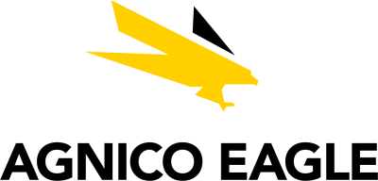


Canadian Materials – AEM, ABX, K
Discussion Materials | BUS 417 | Group 3 | November 7, 2025
Chris Cheung, Calvin Efendy, Alvin Wang, Kevin Zhou

Slide 2
Table of Contents
Sector Commentary – Precious Metals & Mining
Agnico Eagle Mines (TSX:AEM)
Barrick Mining Corporation (TSX:ABX)
Kinross Gold (TSX:K)

Slide 3
Sector Commentary – Precious Metals & Mining

Slide 4
Basic Materials Sector
Materials
Metals & Mining
Diversified Materials
Precious Metals
Forestry
Paper Products
Diversified Chemicals
Base Metals
Other Commodities
Gold
Silver
PGMs
Copper
Iron
Nickel
Zinc
Thermal Coal
Potash
Other
Metallurgic Coal
Agricultural products

Slide 5
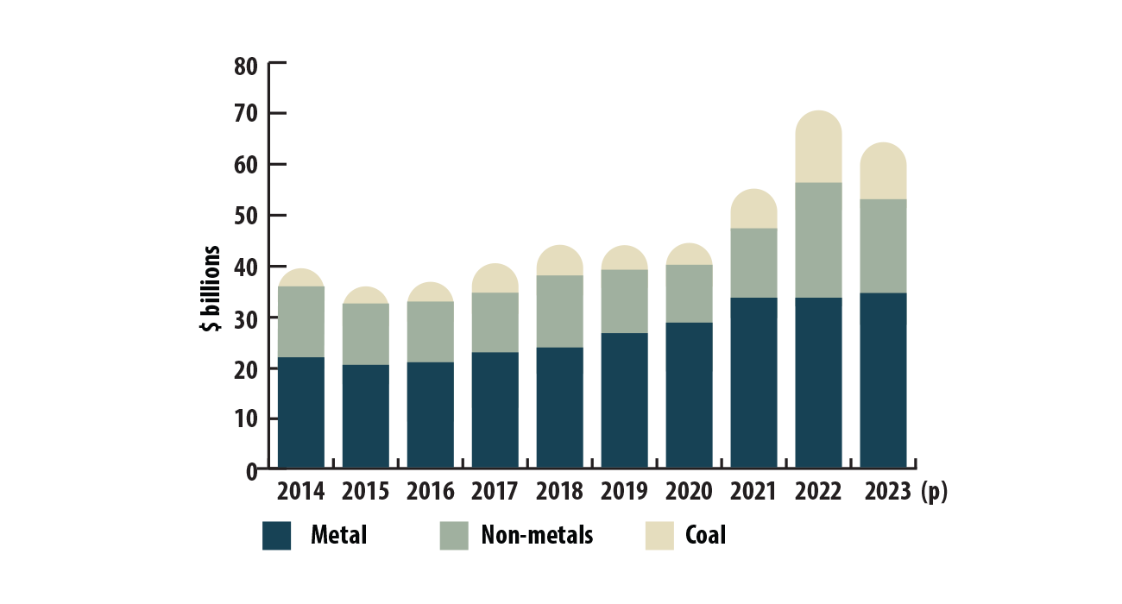
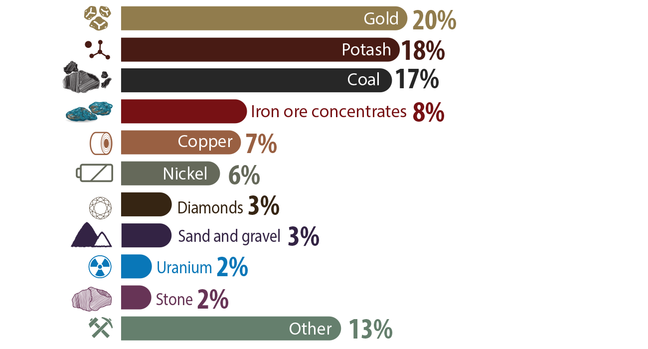
Canadian Mineral Industry Overview
Mineral production by commodity group, 2014-2023
Minerals and metals sector contribute 4% of Canada's total GDP in 2023
Gold is Canada's most valuable mined commodity, with a production value of $15.1 billion

Slide 6
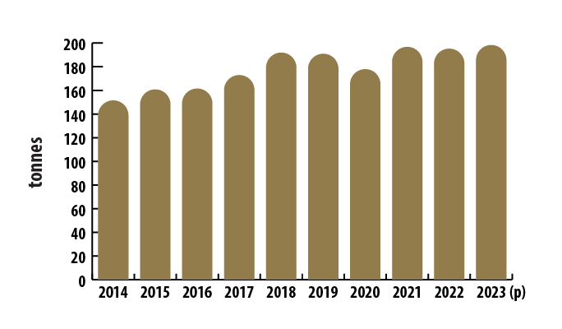
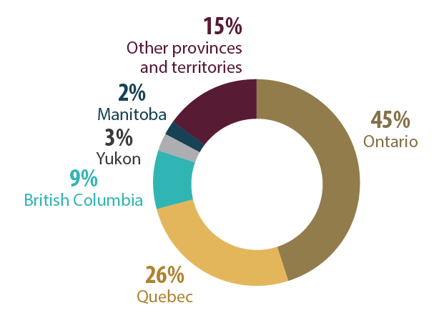
Canadian Mineral Industry Overview
Canadian Gold Production, 2014-2023
Canadian Gold Production, by region, 2023

Slide 7
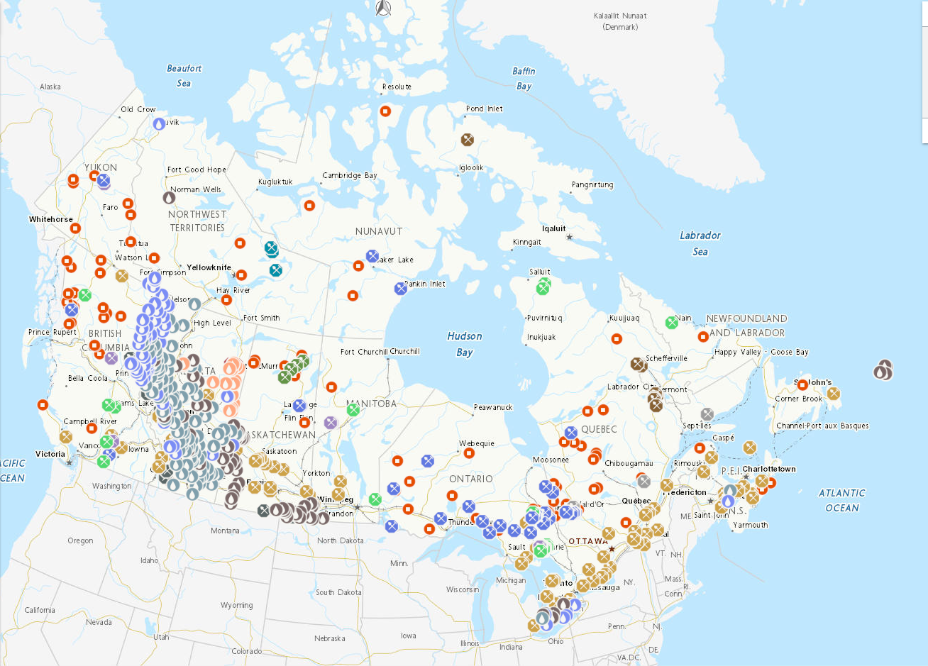

Slide 8
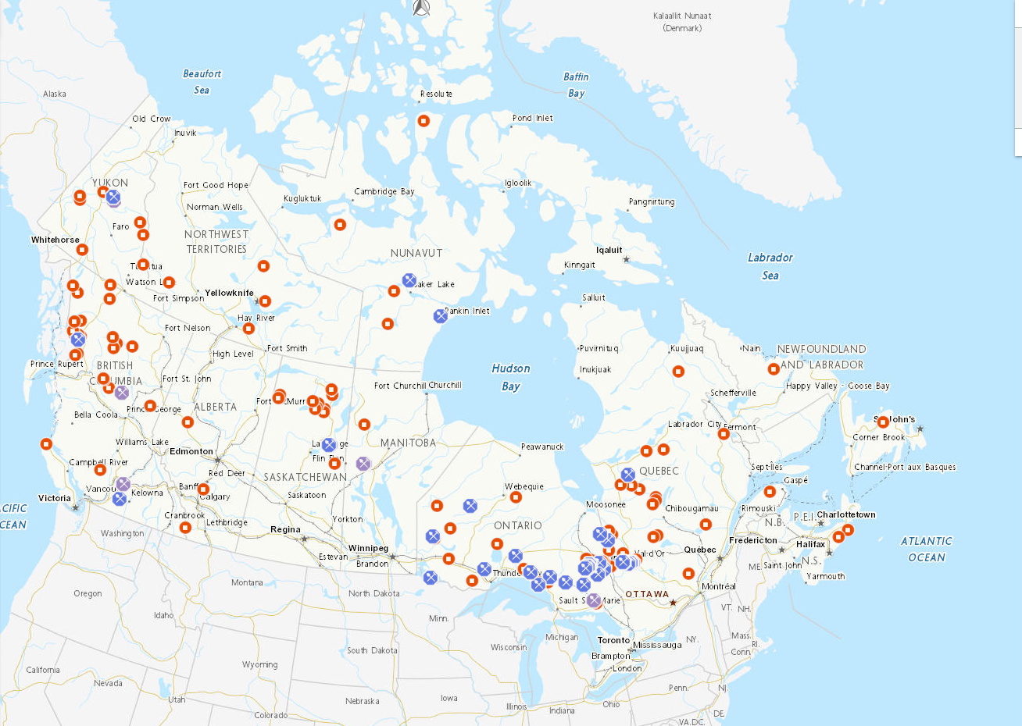

Slide 9

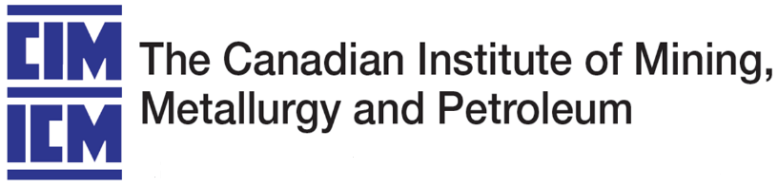

Mining Disclosure Standards
Canada has 13 provincial/territorial agencies that report to their provincial governments. They are an umbrella organization called Canadian Securities Administrators (CSA). They issue and enforce National Instrument such as:
  NI 43-101 < Disclosure standards for mineral projects
  NI 51-102 < Continuous Disclosure
  NI 52-109 < Certification of Disclosure
The Canadian Institute of Mining, Metallurgy and Petroleum (CIM) works alongside CSA to define the standards written in the national instruments.
Committee for Mineral Reserves International Reporting Standards (CRIRSCO) is an organization that consists of 15 countries. Its main purpose is to standardize exploration results, mineral resources and reserves, and bridge national reporting standards.

Slide 10
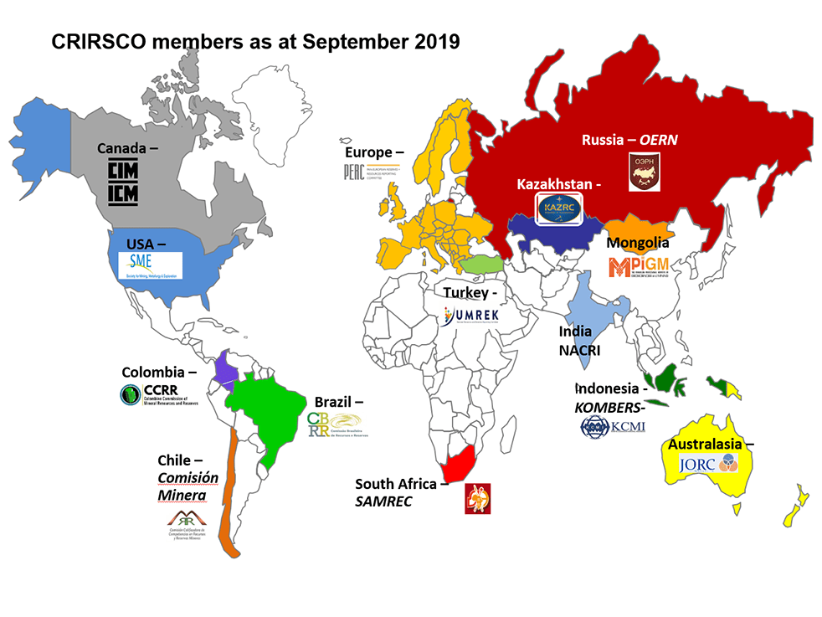
*Philippines' PMRC Committee join CRIRSCO as of 2023

Slide 11
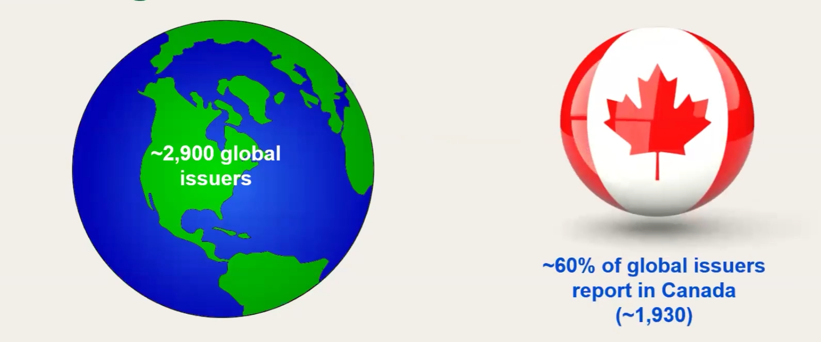
National Instrument (NI) 43-101
NI 43-101 is a part of Canadian Securities Law to prevent unfair, improper, or fraudulent practices. It foster fair & efficient capital markets. This is done by requiring issuers to proced, in specific filings, disclosure that is consistent, comparable, and decision-useful information.
It's the most common standard used worldwide.

Slide 12
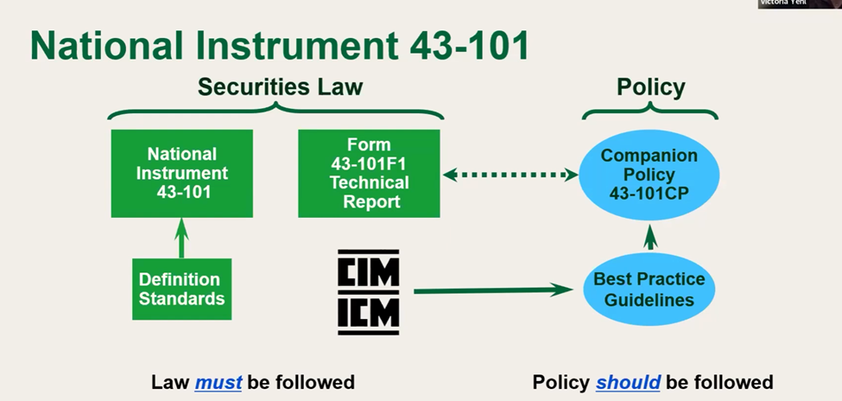
National Instrument (NI) 43-101

Slide 13
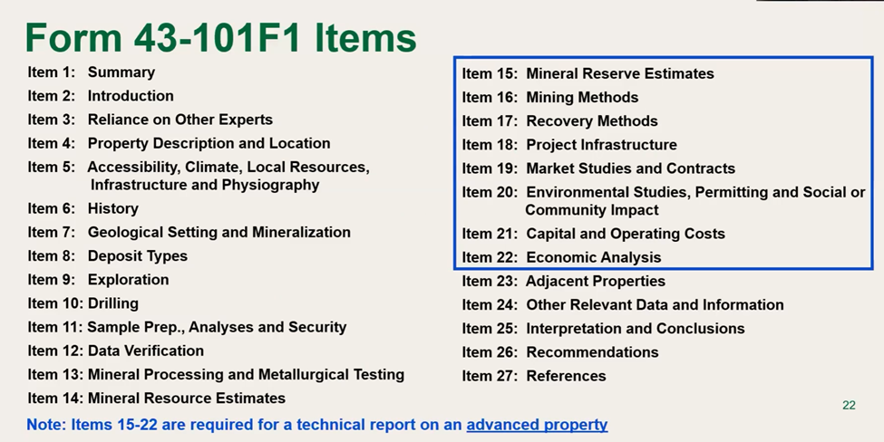
National Instrument (NI) 43-101
Important definitions in NI 43-101
  Reasonable assumptions & cutoff grades
  2014 CIM definition standards
  PEA, PFS, FS
  Social license issues
  Potential property-specific impacts are clearly identified

Slide 14
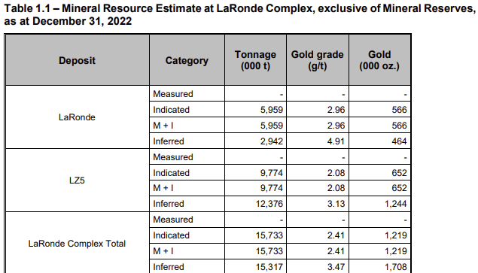
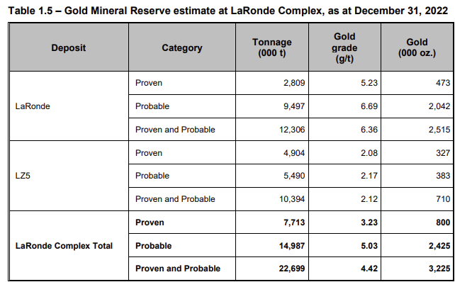

Slide 15
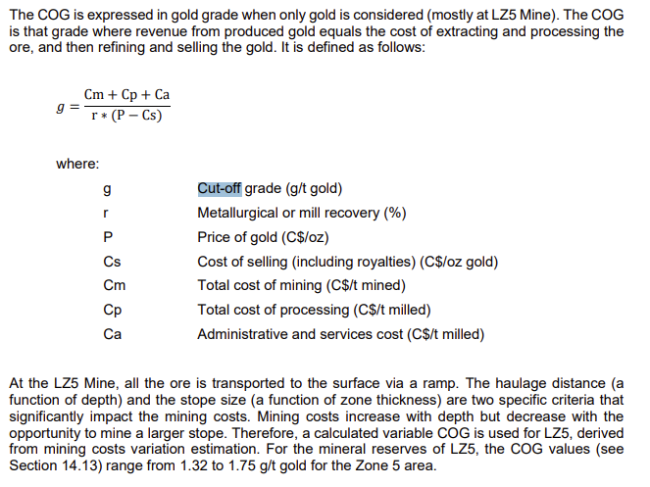

Slide 16
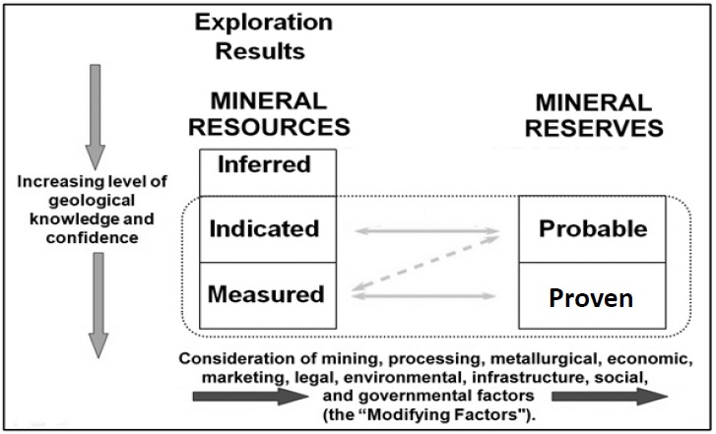
Mineral Resources and Reserves Classification

Slide 17
Mineral Resources
"A Mineral Resource is a concentration or occurrence of solid material of economic interest in or on the earth’s crust in such form, grade or quality and quantity that there are reasonable prospects for eventual economic extraction."(CIM, 2014)
Inferred
"An Inferred Mineral Resource is that part of a Mineral Resource for which quantity and grade or quality are estimated on the basis of limited geological evidence and sampling. Geological evidence is sufficient to imply but not verify geological and grade or quality continuity.
An Inferred Mineral Resource has a lower level of confidence than that applying to an Indicated Mineral Resource and must not be converted to a Mineral Reserve. It is reasonably expected that the majority of Inferred Mineral Resources could be upgraded to Indicated Mineral Resources with continued exploration." (CIM, 2014)
Indicated
"An Indicated Mineral Resource is that part of a Mineral Resource for which quantity, grade or quality, densities, shape and physical characteristics are estimated with sufficient confidence to allow the application of Modifying Factors in sufficient detail to support mine planning and evaluation of the economic viability of the deposit.
Geological evidence is derived from adequately detailed and reliable exploration, sampling and testing and is sufficient to assume geological and grade or quality continuity between points of observation.
An Indicated Mineral Resource has a lower level of confidence than that applying to a Measured Mineral Resource and may only be converted to a Probable Mineral Reserve." (CIM, 2014)
An Indicated Mineral Resource estimate is of sufficient quality to support a Pre-Feasibility Study which can serve as the basis for major development decisions.

Slide 18
Mineral Resources
Measured
"A Measured Mineral Resource is that part of a Mineral Resource for which quantity, grade or quality, densities, shape, and physical characteristics are estimated with confidence sufficient to allow the application of Modifying Factors to support detailed mine planning and final evaluation of the economic viability of the deposit.
Geological evidence is derived from detailed and reliable exploration, sampling and testing and is sufficient to confirm geological and grade or quality continuity between points of observation.
A Measured Mineral Resource has a higher level of confidence than that applying to either an Indicated Mineral Resource or an Inferred Mineral Resource. It may be converted to a Proven Mineral Reserve or to a Probable Mineral Reserve." (CIM, 2014)

Slide 19
Mineral Reserves
"A Mineral Reserve is the economically mineable part of a measured and/or Indicated Mineral Resource. It includes diluting materials and allowances for losses, which may occur when the material is mined or extracted and is defined by studies at pre-feasibility or feasibility level as appropriate that include application of Modifying Factors. Such studies demonstrate that, at the time of reporting, extraction could reasonably be justified.
The public disclosure of a Mineral Reserve must be demonstrated by a Pre-Feasibility Study or Feasibility Study." (CIM, 2014)
Probable
"A Probable Mineral Reserve is the economically mineable part of an indicated, and in some circumstances, a Measured Mineral Resource. The confidence in the Modifying Factors applying to a Probable Mineral Reserve is lower than that applying to a Proven Mineral Reserve.
Probable Mineral Reserve estimates must be demonstrated to be economic, at the time of reporting, by at least a Pre-Feasibility Study." (CIM, 2014)
Proven
"A Proven Mineral Reserve is the economically mineable part of a Measured Mineral Resource. A Proven Mineral Reserve implies a high degree of confidence in the Modifying Factors." (CIM, 2014)

Slide 20
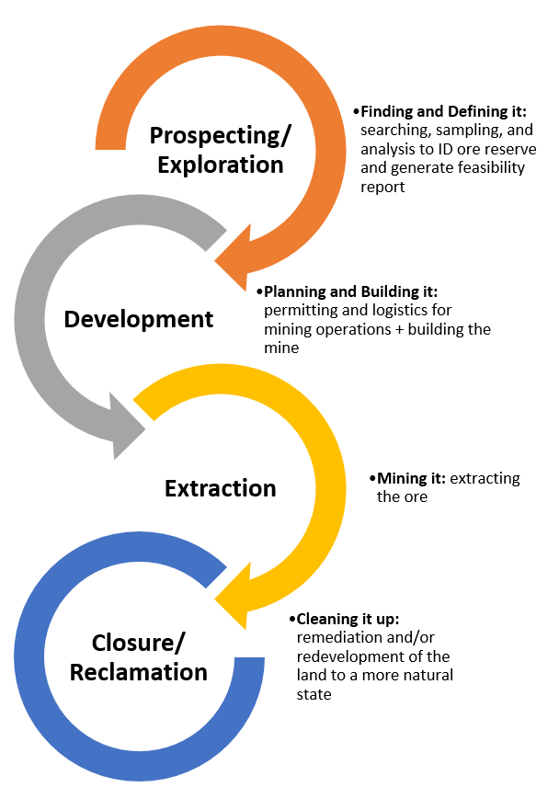
Mining Life Cycle

Slide 21
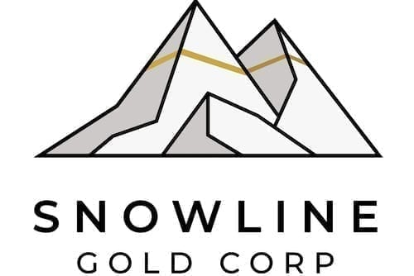


Mining Life Cycle
Exploration & Feasibility Phase
Locate and evaluate mineral anomalies
  Geochemical anomalies
  Geophysical anomalies
  Structural anomalies
Conduct sampling programs
Discovery drilling
Define and estimate mineral resources
Generate Scoping Study, Preliminary Economic Assessment
(PEA), and Feasibility Study < go or no-go decision

Slide 22
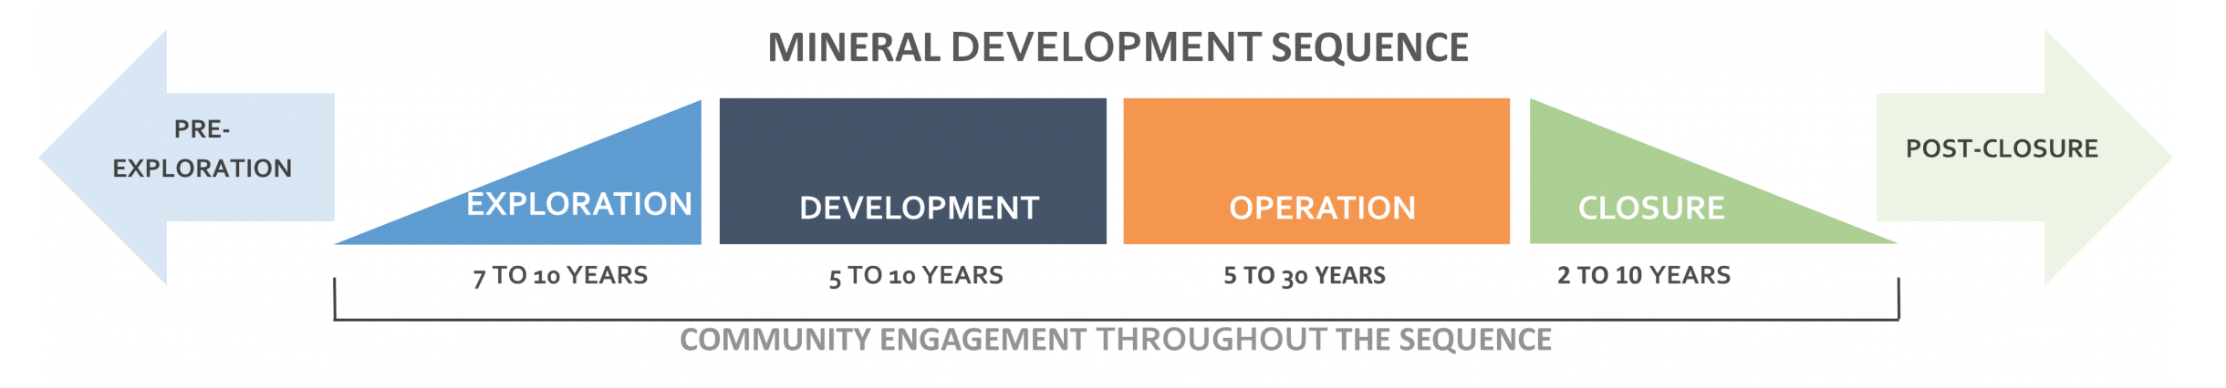
Planning & Construction Phase
If the project is feasible, then in the planning and construction phase, they will do the following: develop Mine plans, study environmental and social issues, issue permitting, generate bankable economic studies and started to build construction and infrastructure, pre-stripping.
Production/Operation Phase
After the planning & construction phase ended it will start production which includes Ore extraction, Crushing, Grinding, Concentrating, Metal Production, and Waste Management.
Closure Phase
Once all the ore has been extracted, the mine closure process begins, which can last for several years. The process includes clean-up, reclamation, and environmental monitoring.

Slide 23
Technical Reports
Technical reports evolve in accuracy, cost, and purpose as a project matures. In Canada jurisdiction, they follow NI 43-101 standard. Below are the technical reports that are produced in the mining life cycles:
Scoping Study (+- 10 years to production)
  A very rough estimate of the amount contained metal in the ground. No information of the economics of getting the metals off the ground
Preliminary Economic Assessment (PEA) (10-5 years to production)
  Early-stage estimate of economics of mining, processing and producing the minerals assets
Pre-Feasibility Study (PFS) (5-3 years to production)
  Detailed PEA, refine capital cost, operating estimates, and a more developed mine plans
Feasibility Study (FS) / Bankable Technical Report (3-1 years to production)
  Final go or no-go decision
Technical Updates (Production phase)
  Updated reserves and resource statement to indicate mineral inventory in the ground, cost estimates for extracting and producing from that asset

Slide 24
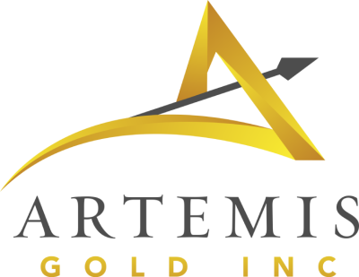
















Mineral Resources
Sector classifications
Resource stage is typical for single-asset juniors that are drilling and could be pre-feasibility
Intermediate and senior/large senior miners may have some development projects that are in the resource stage
Juniors | Intermediates | Seniors | Large Seniors
Miners will report Measured & Indicated and Inferred Resources for assets that have passed that stage

Slide 25
Mineral Reserves
Sector classifications
Reserve stage is typical for some juniors and all intermediates/seniors/large seniors: any assets post-feasibility study stage
Juniors | Intermediates | Seniors | Large Seniors
Miners will report Proven & Probable (2P) Reserves for assets that have passed that stage

Slide 26



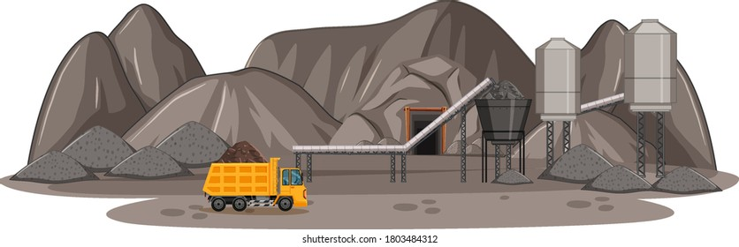
Royalty and Streaming Mining Companies
Royalty Agreement
Streaming Agreement
Investment
% of Revenue from Production
Investment
Take Interest, & Buy % at a discounted Price
Notes:
s

Slide 27
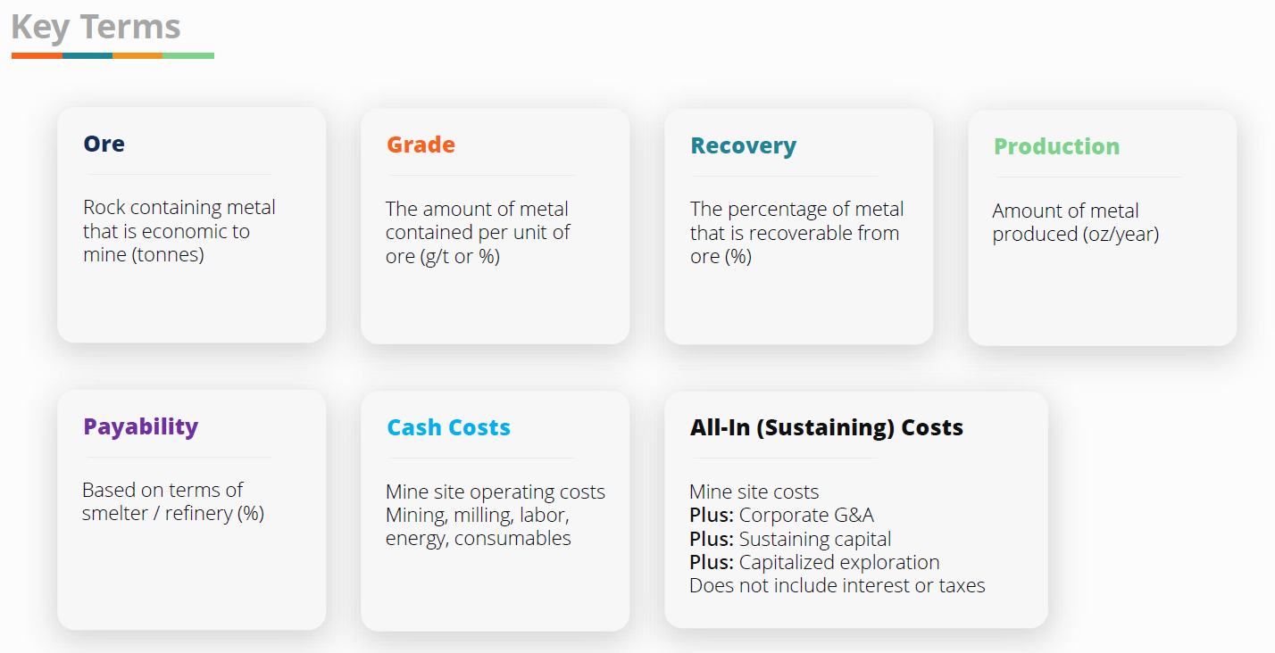

Slide 28
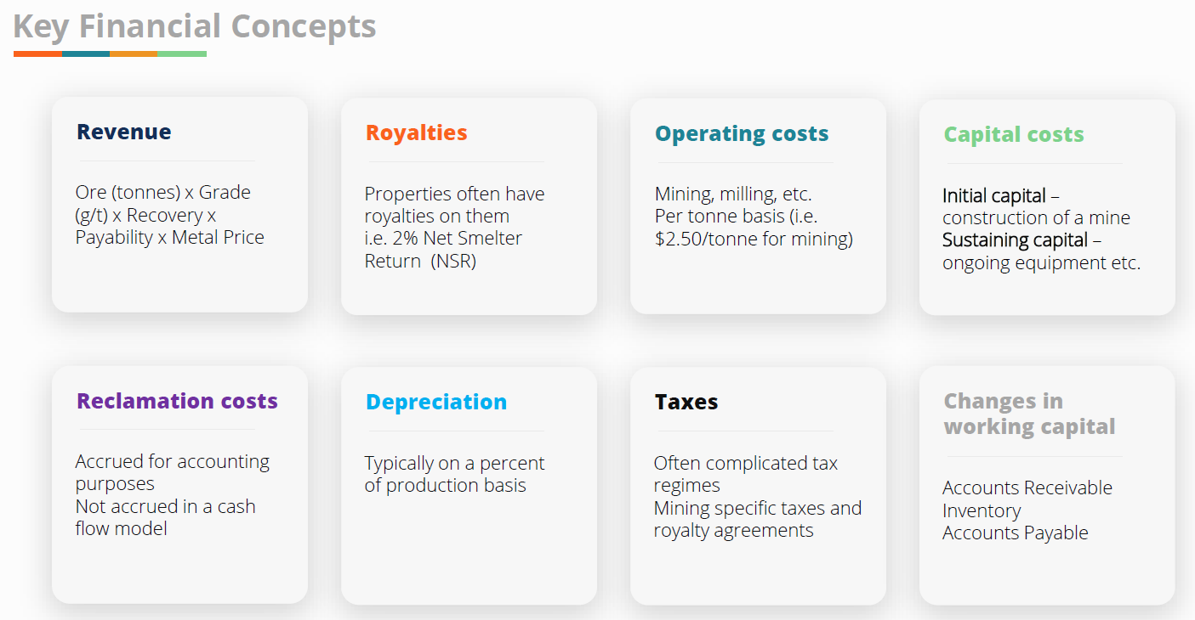

Slide 29
How Do Mining Companies Grow?
Mergers & Acquisitions:
Mining industry is “eat or be eaten” sector where smaller companies frequently get consolidated into larger miners
Recent transactions include:
  Royal Gold’s acquisition of Sandstorm Gold ($3.5bn)
  Fresnillo plc' acquisition of Probe Gold Corp ($780mm)
  Fuerte Metals' acquisiton of Coffee gold project from Newmont Corporation ($150mm)
  Teck Resources and Anglo American Merger ($53bn)
Exploration:
Spend heavy capex on drilling, exploration, and feasibility costs to determine economic potential of deposit(s), and building the mine yourself
Greenfield projects include building the infrastructure and mine from the ground-up, at the risk of not getting approval, or spending money to realize the mine is not profitable
A strong pipeline of greenfield projects indicates high reinvestment into future growth by replacing depleting reserves with new ones
Upside potential of assets being more profitable than previously thought

Slide 30
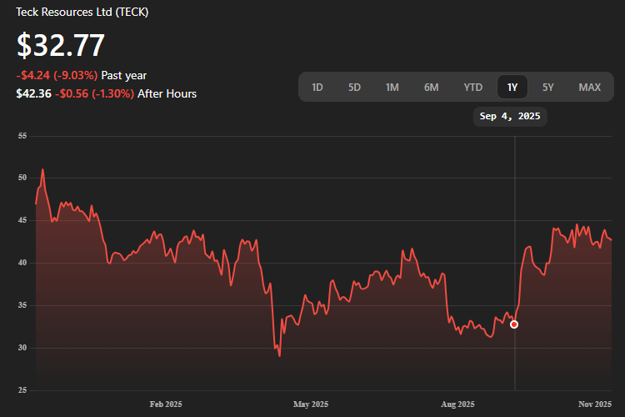

Slide 31
Mine Complex Development
Larger mining companies are generally in charge of mine development
The mine itself needs to be built by uncovering the deposit, preparing the area, and sinking the shafts.
A processing plant needs to be constructed and infrastructure such as roads or rail may need to be built to transport large quantities of the metal or mineral for further processing and sale.
Mines are either:
Surface mines
  Employed when mineral resources are at or near Earth's surface
  Types of surface mining for gold miners:
    Open Pit Mining
    Placer Mining
Underground Mines
  Employed when mineral resources are below earth’s surface and inaccessible by surface mining
  Types of underground mining:
    Cut and fill
    Long Hole Stope Mining

Slide 32
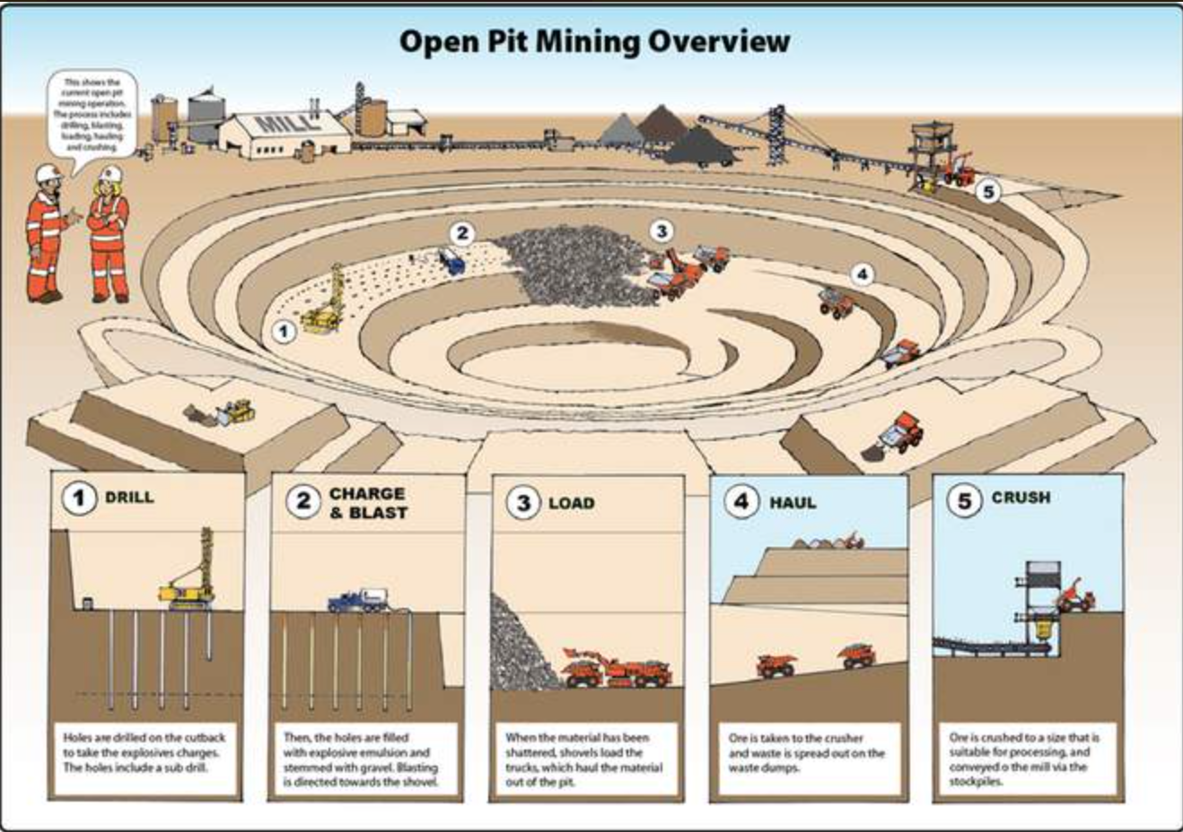
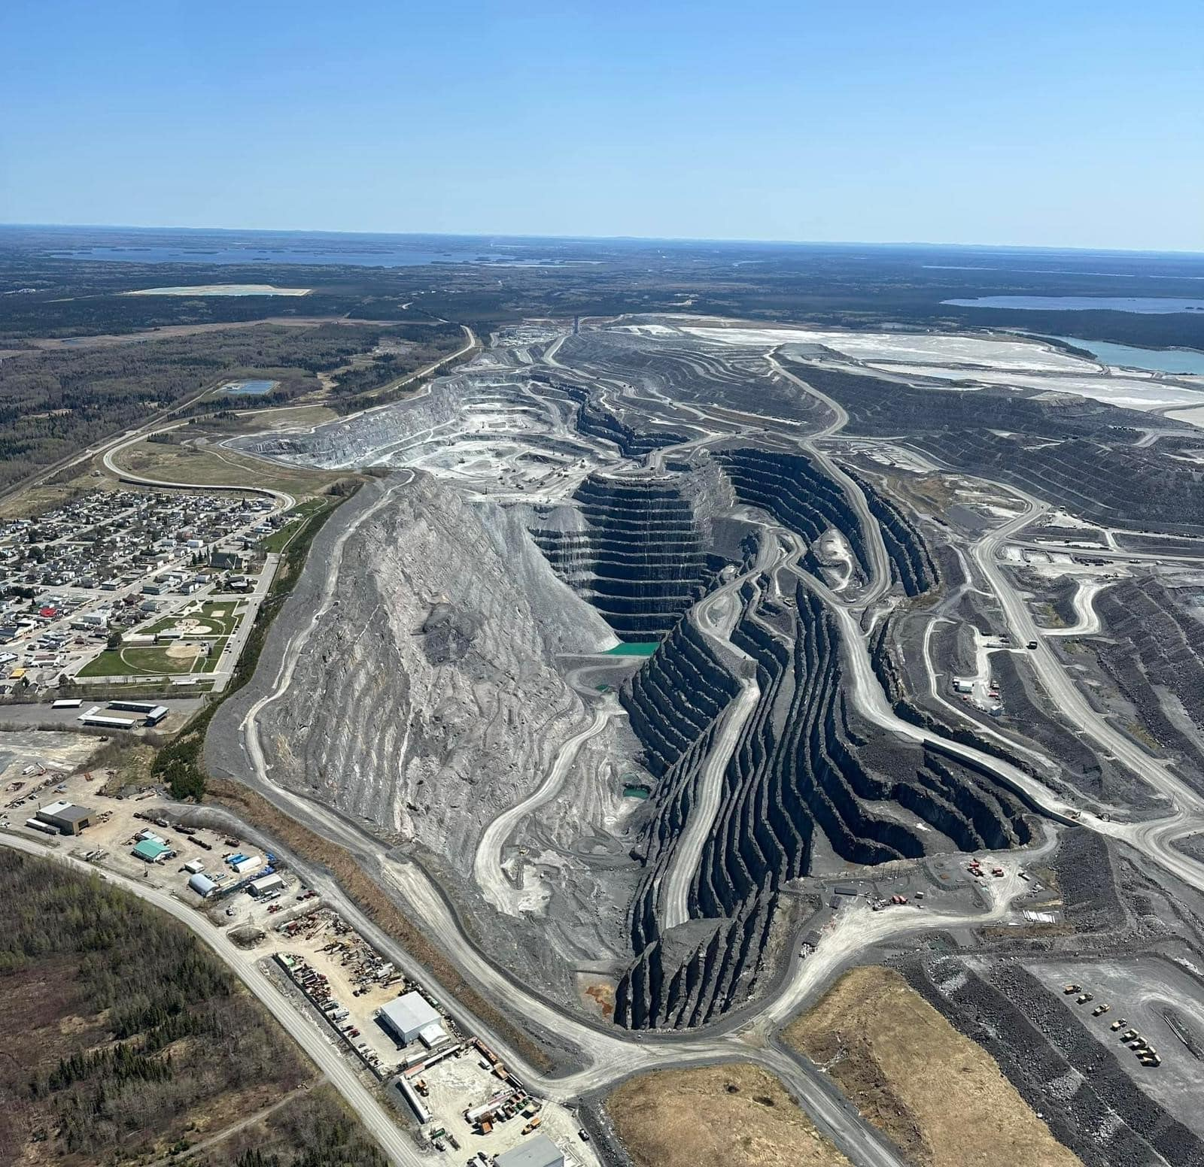
Open Pit Mining
Used for large, near-surface mineral deposits
Common for large base metal deposits
Mining progresses from the surface downward, forming a pit with stepped walls
Common for both precious and base metals, most prevalent in Canada

Slide 33
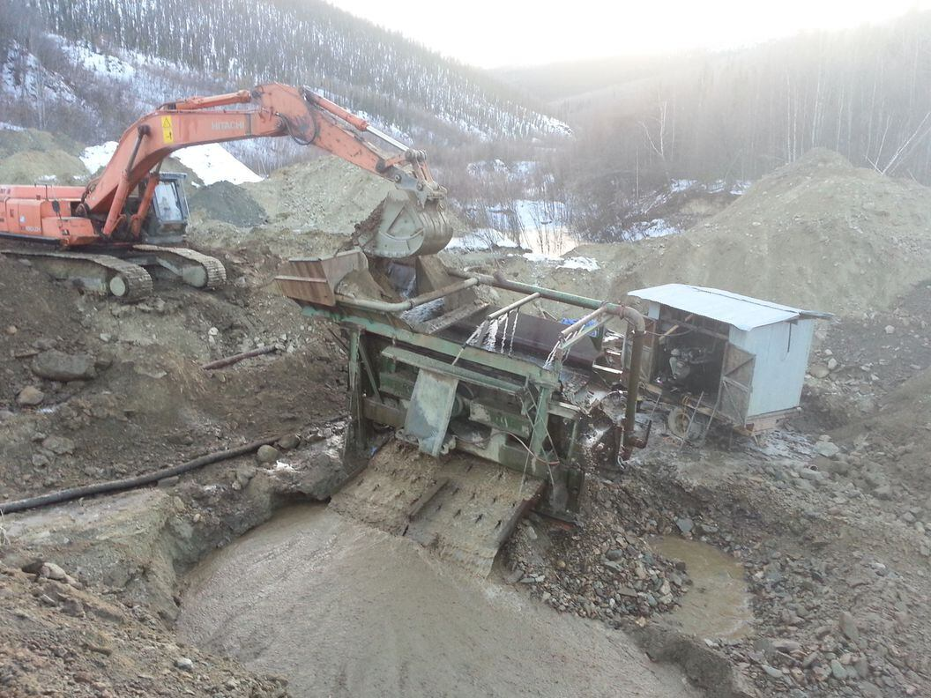
Placer Mining
Uses water to concentrate gold and heavy minerals from sand and gravel
In its most basic form, it is equivalent to gold panning
Excavation with heavy machinery, hauling to wash plant
Sorting, sluicing, and separating gold from tailings
Some variations include dredging from pond/lake or vacuuming sediment from the sea floor

Slide 34
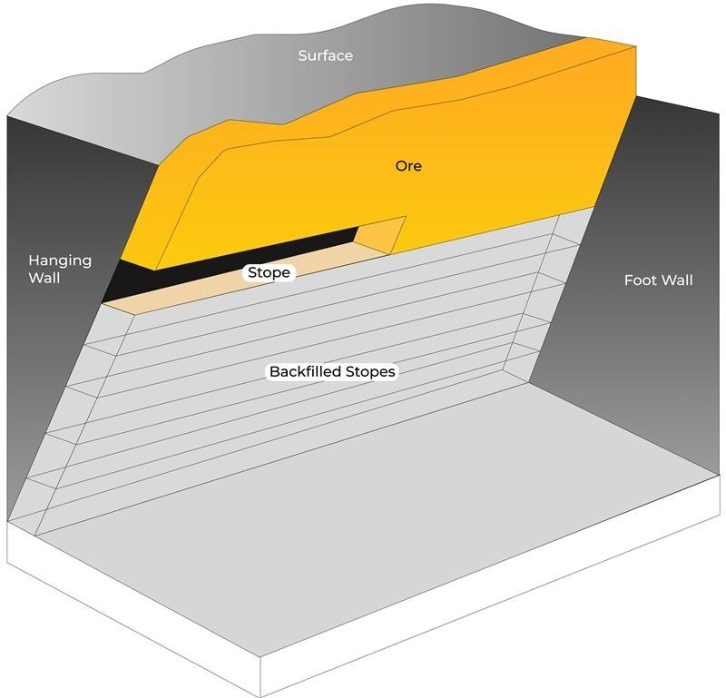
Cut and Fill Mining
Used for narrow, vein-like deposits or irregular deposits
Horizontal slices are mined, followed by replacing the space with a filler before proceeding to next slice
  Best for unstable rock conditions for safety

Slide 35
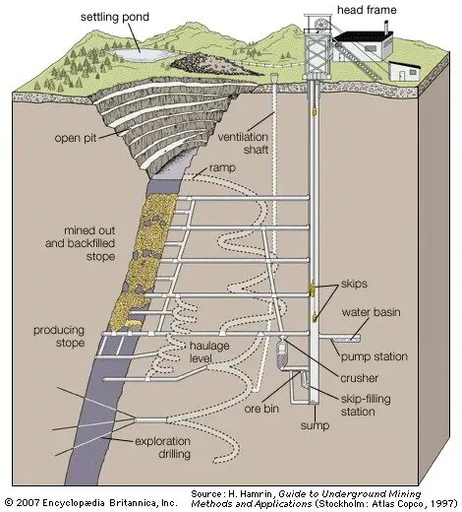
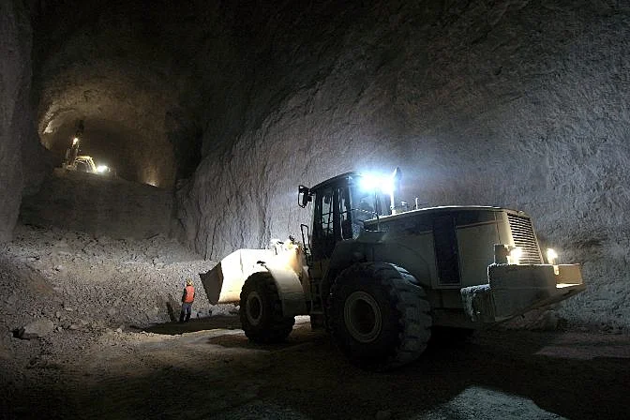
Long Hole Stope Mining
Used for near-surface mineral deposits that are not accessible/profitable through open pits
Usually used for regular ore bodies with long blast holes between levels, where blasts make ore fall
  Used by major players like AEM in LaRonde, Canadian Malartic Complex mines

Slide 36
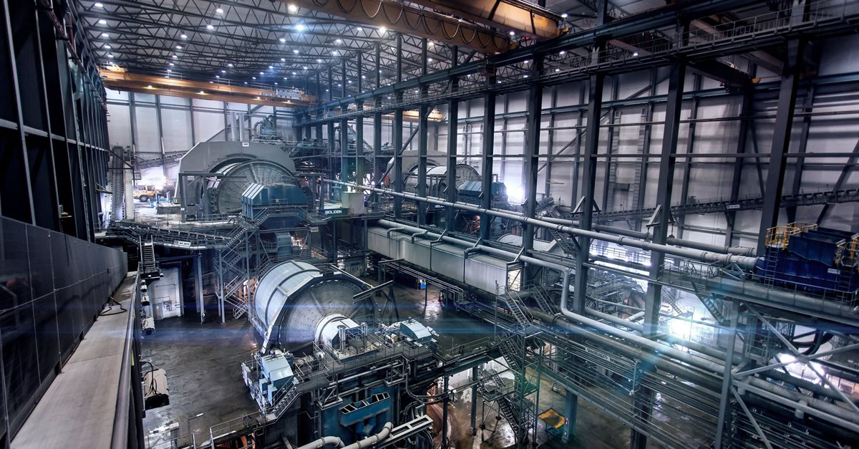
Crushing & Grinding
Crushing and Grinding is the reduction of large ore chunks to small sand-sized particles.
It is an essential but costly step in mineral processing
Liberation Size is the size required to separate minerals from waste rock.
Ore passes through crushers and grinding mills for size reduction
There are various methods for collecting minerals after liberation that leave waste rock behind.

Slide 37
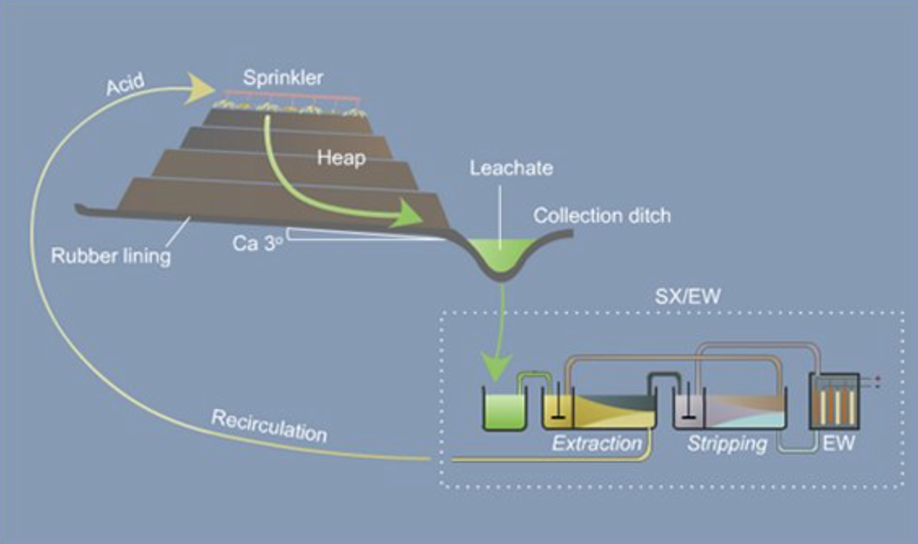
Heap Leaching & SX-EW
Heap Leaching is a recovery method for metals such as gold, copper, or uranium from oxide ores. Crushed ore is stacked on a lined pad and sprayed with leaching solution. Mineral-rich leach solution is then collected and processed at an SX-EW plant
SX-EW stands for Solvent Extraction Electrowinning:
  First step (SX): Metal is extracted from the leach solution using solvents
  Second step (EW): Pure metal is recovered from solvent solution through electrolysis
In Situ Leach is similar to heap leaching, but used for underground oxide deposits.
  Leaching solution is introduced through boreholes after which metal is recovered by SX-EW

Slide 38
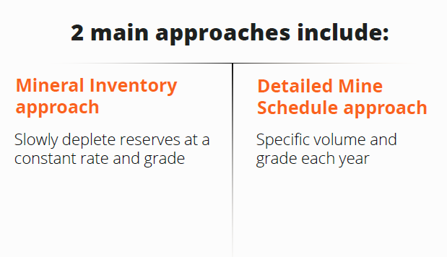
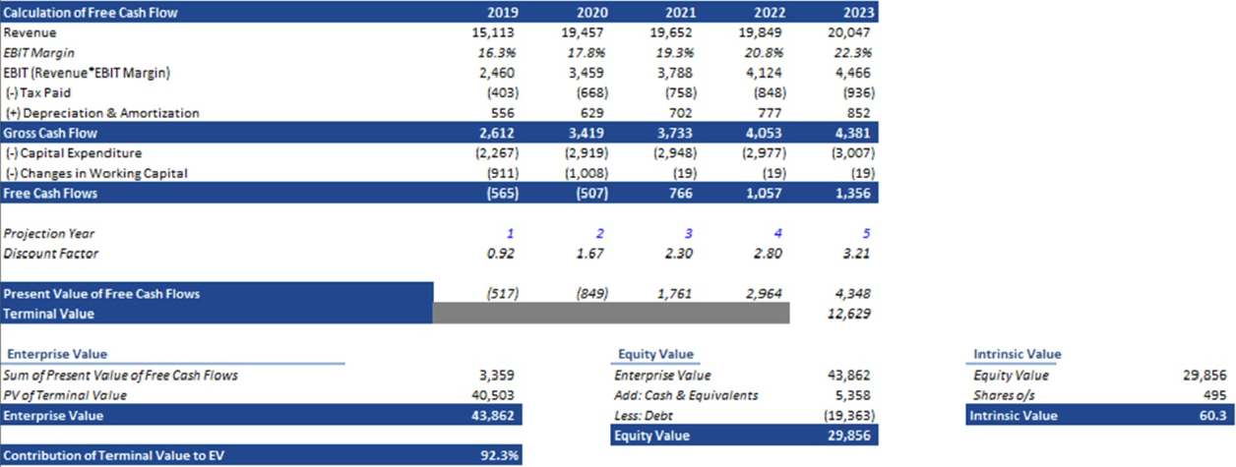
Gold Miner Valuation Method (DCF)

Slide 39
Gold Miner Valuation Multiples¹
R&S names trade above operating peers on a P/NAV and P/CFPS basis
P/NAV
P/CFPS
EV/Reserves
R&S
25
Median
75
Senior
25
Median
75
Intermediate
25
Median
75
Junior
25
Median
75
Source(s): Bloomberg
As of February 20, 2025

Slide 40
Jurisdictional Risk – Investment Attractiveness Scores
Mining is all about stability of cash flows
Better

Slide 41
Gold Byproducts
Tungsten, Silver
Arsenic trioxide, silver
Tungsten, Silver
Silver
Silver, Copper, Zinc, Lead
Copper, Silver
Copper, Silver
Antimony, Arsenic
Silver, Copper, Zinc
Silver, Copper, Zinc, Lead

Slide 42
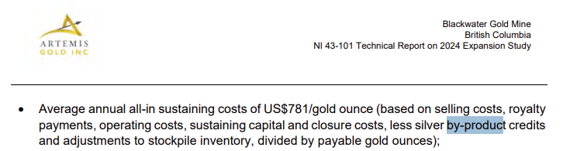
Byproduct Recovery
Precious or base metal byproducts recovery can reduce the mine cash cost.
In NI 43-101F1 reports, issuers will state "Byproduct Cash Cost" < how much does recovered byproducts reduce the net cost per oz of gold.
The mine can report a lower AISC by simply crediting its byproducts revenue.

Slide 43
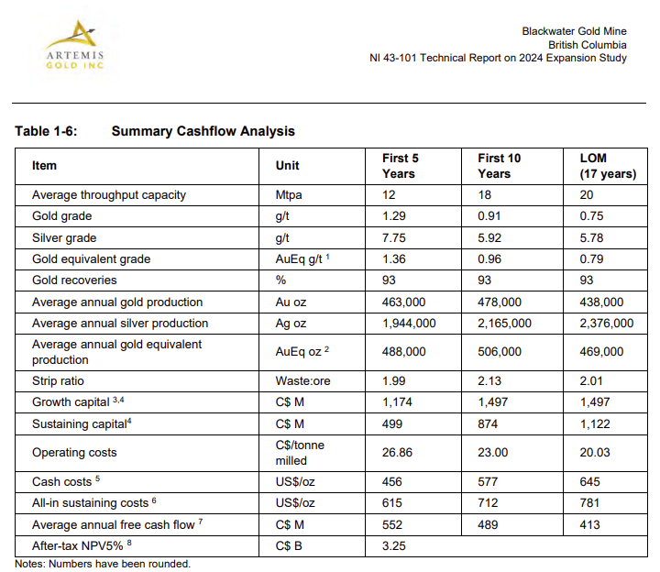

Slide 44
Toxic Byproducts
Arsenic is the most commonly present toxic waste in gold mining
When gold is liberated by roasting or bio-oxidation, arsenic is released as:
  Arsenic Trioxide dust (AS₂O₃) - Toxic, airborne
  Arsenate Precipitates
  Arsenic-bearing tailings or slags
The waste management involves:
  Converting Arsenic waste into a stable mineral form
  Containing those stable mineral (commonly using sealed underground chambers)
  Long-term monitoring
All-in lifetime cost for a large mine with arsenic byproducts can exceed $500 million up to $1 Billion if the site contains >200,000t of Arsenic Trioxide (i.e., Giant Mine at New West Territories < Approx. 237,000 tonnes of arsenic trioxide dust)
No profitable market for arsenic products

Slide 45
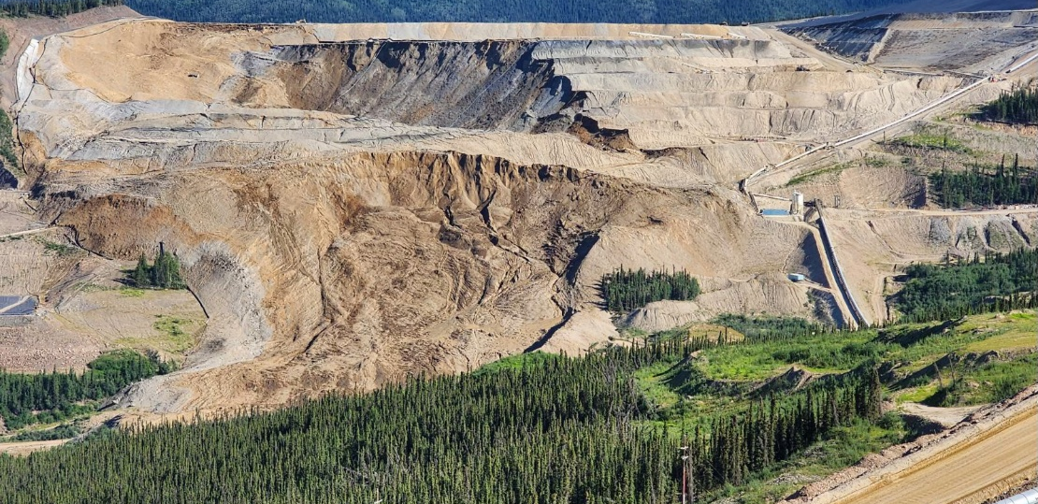
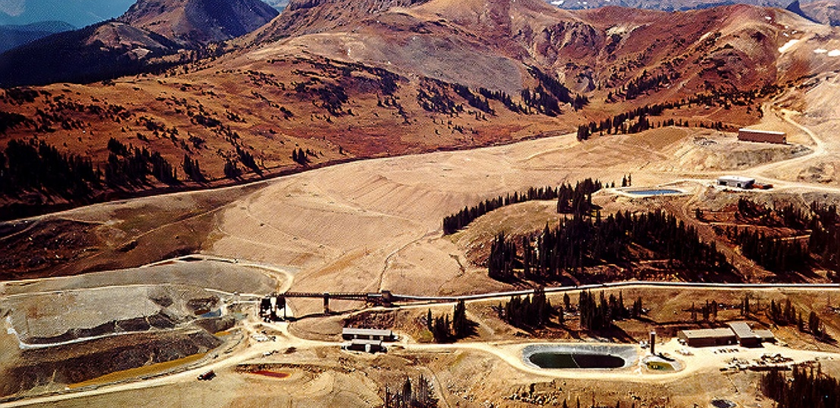
Importance of Clean Business – Eagle & Summitville
Victoria Gold – 2024 Heap Leach Failure
Summitville Mine – 1991 Heap Leach Failure
Large heap leach landslide on June 24, 2024 in Yukon, CA
Unstable land caused ore stockpile to collapse and send toxic tailings into nearby ecosystem, damaging rivers and wildlife with cyanide
Victoria Gold filed for bankruptcy shortly after, CEO fired
Local sources say the mine should have never received permission to operate under that environmental standard
Operations to reduce cyanide contamination in Yukon rivers is ongoing, with upset Indigenous communities
PwC given receivership of mine, looking to sell, Agnico Eagle Mines seen as potential buyer given special situation
Large heap leach landslide in 1991 given high snowmelt and rainfall causing leach pad to overflow
Low grades extracted through cyanide solutions and acid mine drainage (AMD)
Poorly lined leach pads caused an overflow of cyanide, copper, cadmium into local rivers and communities
Galactic Resources filed for bankruptcy shortly after the disaster

Slide 46
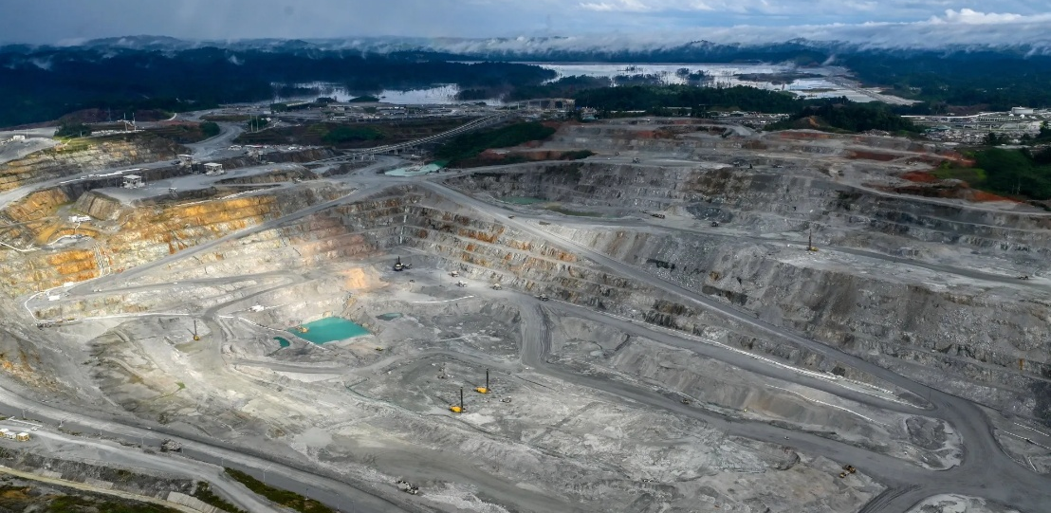
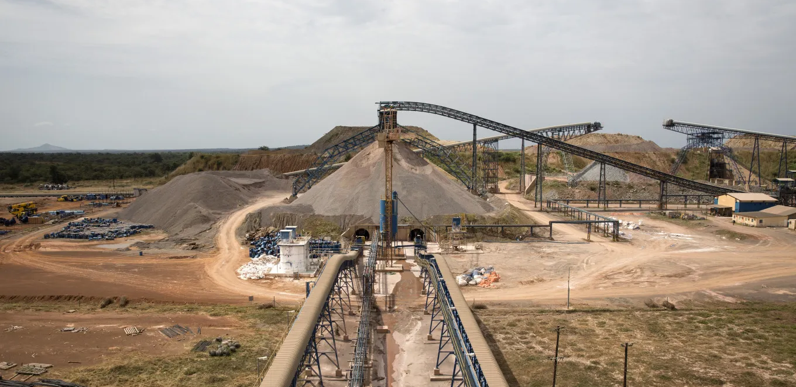
Mining and Geopolitics – Panama & Mali
Cobre Panama Shutdown – First Quantum (FM)
Loulo-Gounkoto Shutdown – Barrick Mining
$10bn NPV copper mine in Panamanian jungle shut down in 2023 after being deemed “unconstitutional” by Panamanian Supreme Court
  Disputes and protests over environmental concerns, resource nationalism over FM getting “too good of a deal”
  FM and royalty & streaming partner Franco-Nevada (FNV) both saw significant distrust from investors following announcement and asset impairment on balance sheets
Accounted for 40% of FM’s revenue, and about 22% of FNV’s NAV at time of closure
FM initiated international arbitration against Panama which it has now dropped following cooperation with Panamanian president
Increasing sentiment for reopening of mine – stockpiled concentrate to be shipped, about $300m of copper sitting idle
$[]NPV gold/copper mine in Malian desert shut down in 2025 after dispute with coup government
New Malian 2023 mining code caused tensions between Barrick and government, and eventually led to a shutdown
Malian government claimed it was owed higher royalties and taxes that Barrick fought against, went to Supreme Court
Arrest warrant for CEO Mark Bristow and other key Barrick miners went live in Mali, some employees detained in late 2024
Malian government proceeded by sending a vehicles and helicopters to seize over three tonnes of gold ($200m+) to prevent Barrick from selling it
Barrick spending $15m per month on maintenance, foregone revenue of $1.24bn per year

Slide 47
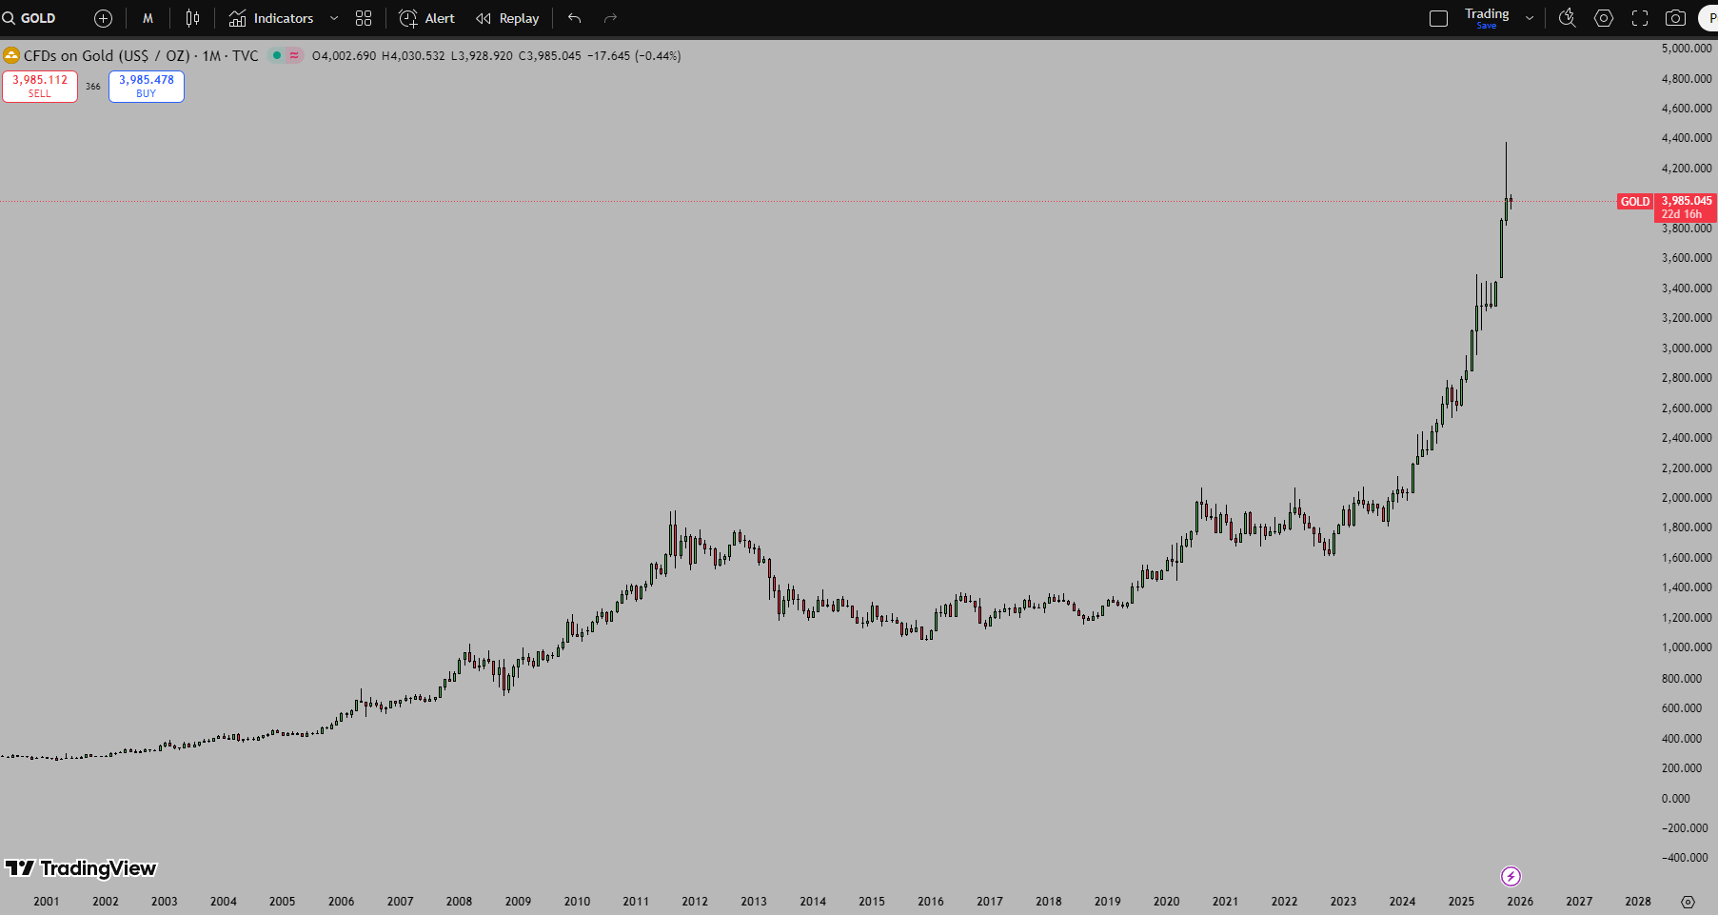

Slide 48
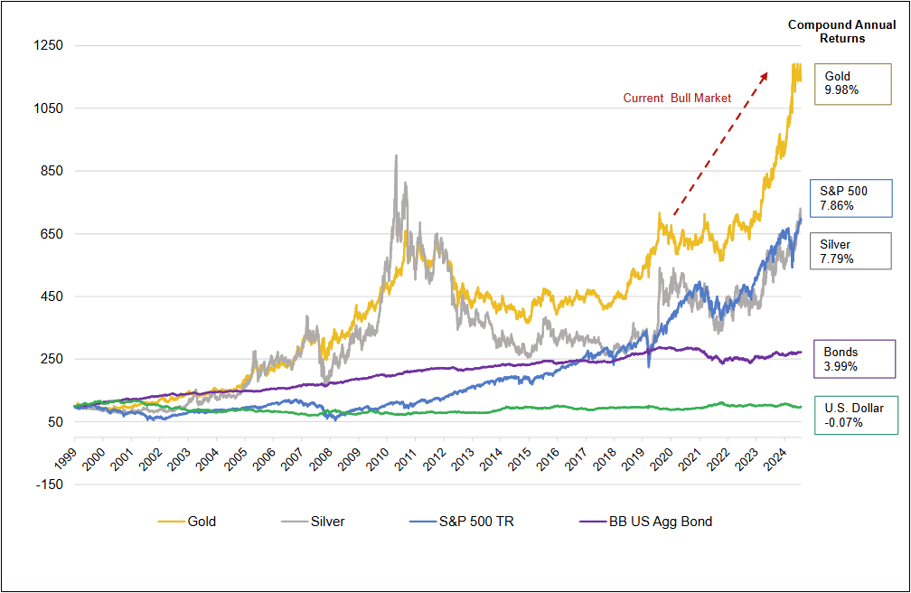

Slide 49
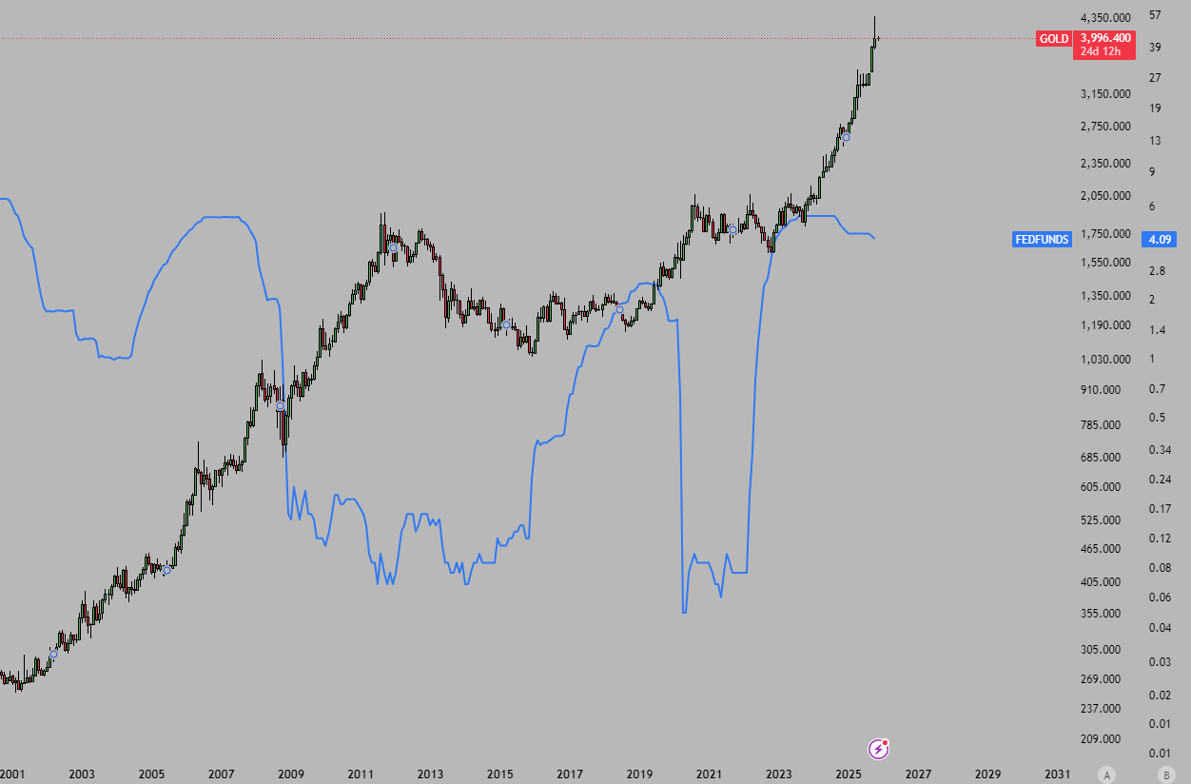
Real Interest Rates vs Gold Price

Slide 50
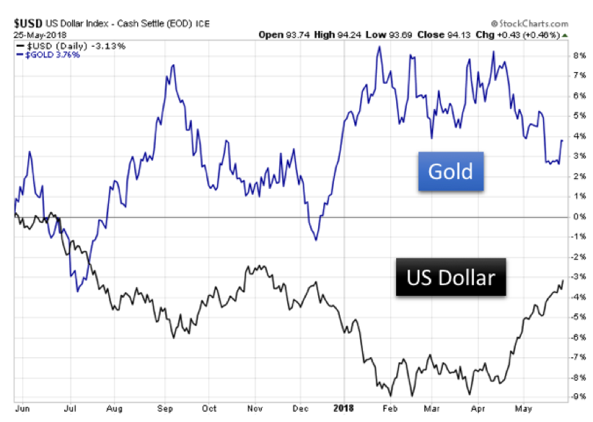
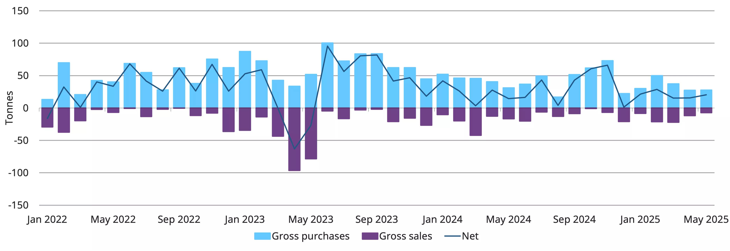
USD vs Gold Price & Central Bank Purchasing

Slide 51
Agnico Eagle Mines (TSX & NYSE: AEM)

Slide 52
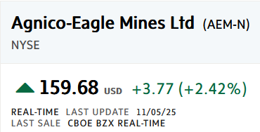
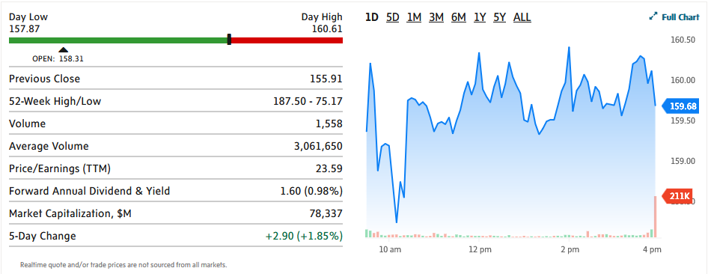
Agnico Eagle Mines (AEM) - NYSE

Slide 53
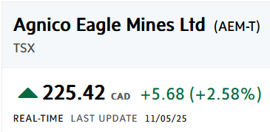
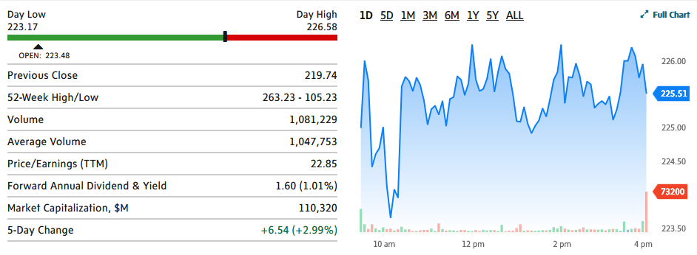
Agnico Eagle Mines (AEM) - TSX

Slide 54
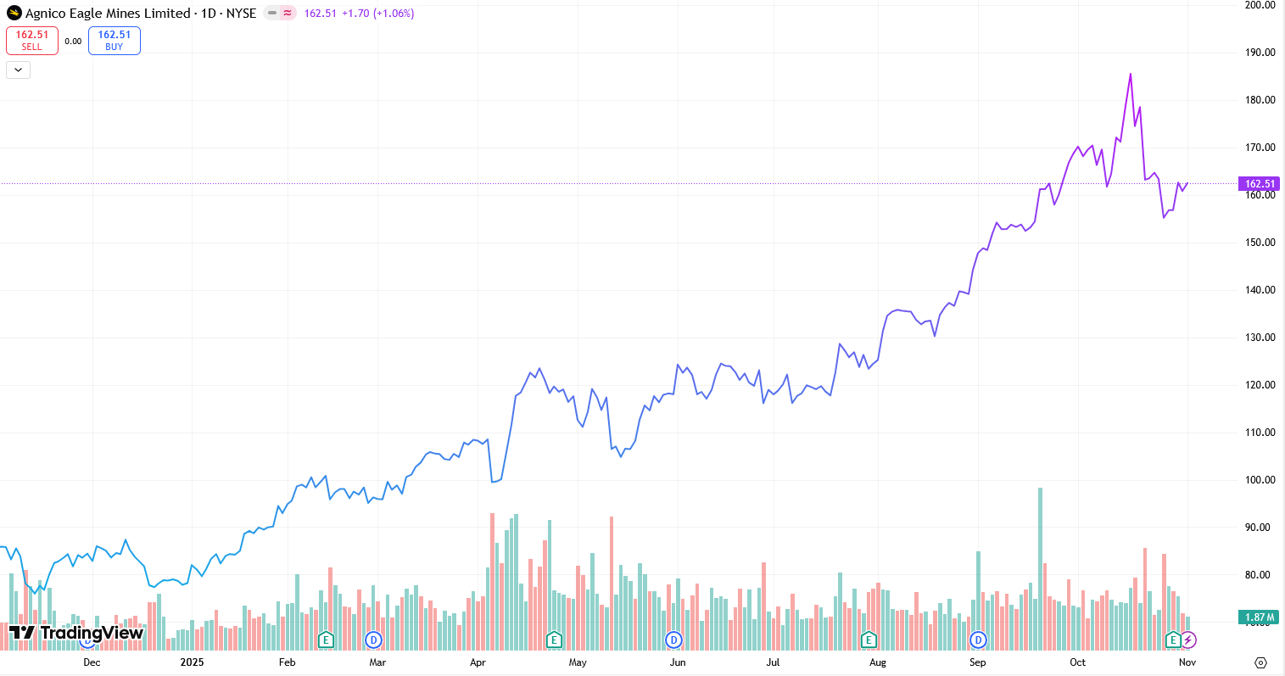
1 Year Price Performance

Slide 55

5 Year Price Performance

Slide 56

10 Year Price Performance

Slide 57

1 Year Price Performance Vs TSX Composite Index and Gold

Slide 58

1 Year Price Performance Vs ABX & K

Slide 59

5 Year Price Performance Vs TSX Composite Index and Gold

Slide 60

5 Year Price Performance Vs ABX & K

Slide 61

10 Year Price Performance Vs TSX Composite Index and Gold

Slide 62

10 Year Price Performance Vs ABX & K

Slide 63

YTD Price Performance
Q3 2025 Highlights
Record USD 3.1B in revenue with free cash flow of USD 1.2B
USD 350M returned to shareholders via dividends and share buybacks
Repaid USD 400M of debt, Moody’s upgrade from Baa1 to A3
Gold production for Q3 at 867k oz, achieving 77% of full-year guidance
Production weighted ~80% to Canadian operations, underscoring jurisdictional stability
Developments
Continued development of Odyssey and “fill-the-mill” opportunities, Detour underground, Hope Bayu, Upper Beaver, and San Nicolas
Record 54.3Moz gold reserves reported as of Dec 31, 2024
Strategic focus remains exclusively on gold, with no diversification into base metals
No major geopolitical risks due to operations concentrated in stable, mining-friendly jurisdictions

Slide 64
Company Overview & Key Statistics
Company Overview
Key Statistics
Founded in 1957 in Cobalt, Ontario
Agnico Eagle Mines Ltd. (TSX/NYSE: AEM) is a senior gold producer focused exclusively on gold production, exploration, and mine development.
Operations span Canada, Australia, Finland, and Mexico, with approximately 80% of gold production from Canadian mines.
In 2024, Agnico produced 3.49 million ounces of gold (873.8koz in Q1 2025), making it one of the world’s largest pure gold producers.
Key assets include Detour Lake, Canadian Malartic, LaRonde, Meliadine, Fosterville, and Kittila.
Key developments:
Record 54.3Moz in gold reserves as of 2024.
Development of Odyssey, Upper Beaver, and Wasamac projects.
Growth strategy focused on expanding Canadian production.
52 Week Range | $75.17 – $187.50
Volume | 2,344,818
Market Cap | 78.65B
Beta (5Y Monthly) | 0.45
PE Ratio (TTM) | 26.44
EPS (TTM) | 6.05
Forward Dividend Yield | 1.03%
1-Year Return | 87%
3-Year Return | 280%
5-Year Return | 98%

Slide 65

Proven & Probable Mineral Resources - Gold
Gold

Slide 66
Proven & Probable Mineral Resources - Gold
Gold

Slide 67

Proven & Probable Mineral Resources - Gold
Gold

Slide 68

Proven & Probable Mineral Resources – Silver

Slide 69

Proven & Probable Mineral Resources – Copper

Slide 70

Proven & Probable Mineral Resources - Zinc

Slide 71

Asset Map

Slide 72

Agnico Eagle Mining Operations and Production (Gold Ounces)

Slide 73
Canada Operations: Detour Lake Mine
Asset Overview
Key Statistics
  100% owned and operated by Agnico Eagle
  Located in northeastern Ontario, Canada
  One of the largest open-pit gold mines in North America
  Infrastructure includes large open pit, processing plant, and tailings facilities
  Core to Agnico’s Canada-focused growth strategy
  Focus on pit expansion and mill optimization to sustain low costs and extend production life
  Investor Highlight:
  Agnico’s largest, lowest-cost operation with a mine life to 2052, driving long-term free cash flow and supporting dividends from a stable jurisdiction.
Mine life
2052
2025 gold production guidance (oz)
720,000
2024 gold production (oz)
671,950
Production cost of sales 2025E ($/oz)
$775
2P Reserves (oz)
19,051,000

Slide 74
Canada Operations: Canadian Malartic Complex
Asset Overview
Key Statistics
  Joint venture (Agnico 50%, operator)
  Located in Malartic, Quebec, Canada
  Large open-pit mine will operate until 2029
  Currently transitioning to Odyssey underground development
  Key Quebec hub within Agnico’s regional strategy
  Odyssey project will extend mine life to 2039 and lower costs over time
  Uses existing mill and infrastructure, reducing development capital needs
  Investor Highlight:
  A cornerstone transitioning asset – current cash flow contributor evolving into a low-cost, long-life underground mine, securing future production stability.
Mine life
2042
2025 gold production guidance (oz)
590,000
2024 gold production (oz)
655,654
Production cost of sales 2025E ($/oz)
$995
2P Reserves (oz)
7,500,000

Slide 75
Canada Operations: LaRonde Complex
Asset Overview
Key Statistics
  Located in Abitibi region, Quebec
  Agnico’s longest-running mine (since 1988) and a leader in deep underground mining
  Produces gold with silver, zinc, and copper by-products, lowering effective costs
  Strong operational track record with over 35 years of production
  LaRonde Zone 5 underground satellite mine supports flexibility and efficiency for low-to-medium scale production
  Active exploration supports life extension beyond 2035
Investor Highlight:
Reliable cash flow producer with diversification benefits (by-products) and established infrastructure, sustaining Agnico’s Quebec production base.
Mine life
2034
2025 gold production guidance (oz)
310,000
2024 gold production (oz)
306,750
Production cost of sales 2025E ($/oz)
$978
2P Reserves (oz)
2,740,000

Slide 76
Finland Operations: Kittila Mine
Asset Overview
Key Statistics
Located in Lapland, northern Finland
Agnico Eagle’s only European asset and Europe’s largest primary gold producer
Underground mining operation with on-site processing plant
Focused on continuous underground expansion and mill optimization
Strategic foothold for Agnico Eagle in a stable jurisdiction with long mine life potential
Mine life
2036
2025 gold production guidance (oz)
230,000
2024 gold production (oz)
218,860
Production cost of sales 2025E ($/oz)
$1,020
2P Reserves (oz)
3,400,000

Slide 77
Australia Operations: Fosterville Mine
Asset Overview
Key Statistics
Located in Victoria, Australia
High-grade underground gold mine acquired through the Kirkland Lake Gold merger
Historically known for exceptionally high-grade zones (Swan Zone)
Currently focused on steady underground production and exploration to extend mine life
Represents Agnico Eagle’s key Australian platform for long-term growth
Mine life
2036
2025 gold production guidance (oz)
150,000
2024 gold production (oz)
225,203
Production cost of sales 2025E ($/oz)
$1,015
2P Reserves (oz)
1,650,000

Slide 78
Canada Operations: Meliadine Mine
Asset Overview
Key Statistics
Located near Rankin Inlet, Nunavut, Canada
Agnico Eagle’s second-largest Canadian gold operation
Underground and open-pit mining operation with on-site milling
Key driver of Agnico’s Arctic growth strategy
Focus on underground expansion and ongoing reserve development to sustain long-term production
Operates in a remote but mining-friendly jurisdiction with established infrastructure
Mine life
2032
2025 gold production guidance (oz)
385,000
2024 gold production (oz)
378,886
Production cost of sales 2025E ($/oz)
$936
2P Reserves (oz)
3,365,000

Slide 79
Canada Developments: Hope Bay Project
Asset Overview
Key Statistics
Located in the Kitikmeot region of Nunavut, Canada
Acquired from TMAC Resources in 2021
Currently in development and exploration phase – no commercial production yet
Significant land package with multiple deposits along an 80 km greenstone belt
Long-term strategic asset aimed at establishing a major gold district
Focused on exploration drilling, reserve definition, and project development planning
Mine life
2045 (estimated)
2025 gold production estimate (oz)
N/A (development)
2024 gold production (oz)
N/A (development)
Production cost of sales 2025E ($/oz)
N/A (development)
2P Reserves (oz)
3,365,000

Slide 80
Jurisdictional Risk
Concentration of NAV in safest jurisdictions among peers
Investment Attractiveness Score - By Asset
Net Asset Value (NAV) Breakdown

Slide 81

Q3 Production Costs and Margin

Slide 82

Agnico Eagle Mining Explorations

Slide 83

Growth – Project Pipeline
Growth assets form robust project pipeline to replace depleting reserves at Canadian Malartic and Detour Lake in safe jurisdictions
Exploration Stage, Estimated: N/A
Exploration Stage, Estimated: N/A
Advanced Exploration Stage, Estimated: N/A
Permitting Stage Estimated: 2026
Advanced Exploration Stage, Estimated: N/A

Slide 84





Precedent Transactions
Buyer | Target | Mine(s) | Purchase Price | Date
 |  | Marban Alliance | $185mm CAD (all cash) | Feb 2025
 |  | San Nicolas | $580mm CAD | Jun 2023
 |  | Canadian Malartic | $6.5bn CAD (all stock) | Mar 2023
 |  | Detour Lake Macassa Fosterville | $13.5bn CAD (all stock) | Feb 2022
 |  | Hope Bay | $460mm CAD (all cash) | Feb 2021

Slide 85

Capital Allocation Strategy

Slide 86


2025 Guidance & Outlook
Key Guidance Numbers

Slide 87

Forward Guidance & Outlook

Slide 88

Forward Guidance & Outlook

Slide 89


Ownership Structure
Top 10 Largest Shareholders
Ownership Structure
Holder | Common Stock Equivalent Held | % Ownership | Market Value (CAD, millions)
Vanguard Fiduciary Trust Co. | 20,417,906 | 4.06 % | 3 442
Van Eck Associates Corp. | 19,374,821 | 3.852 % | 3 266
Fidelity Management & Research Co. LLC | 17,806,350 | 3.54 % | 3 001
Capital Research & Management Co. (World Investors) | 17,302,836 | 3.44 % | 2 917
Fidelity Investments Canada ULC | 16,227,402 | 3.227 % | 2 735
Royal Trust Corp. of Canada | 15,725,019 | 3.127 % | 2 651
DWS Investment Management Americas, Inc. | 11,317,932 | 2.25 % | 1 908
MFS Investment Management Canada Ltd. | 11,109,908 | 2.209 % | 1 873
TD Waterhouse Private Investment Counsel, Inc. | 9,356,548 | 1.86 % | 1 577
BMO Bank NA (Investment Management) | 8,906,845 | 1.771 % | 1 501

Slide 90

Insider Trading Activity
Commentary
CEO, chair and senior executives actively sold large share blocks in 2024 and 2025.
Last buy transaction was on June 30 by 8 C-suites and senior executives.

Slide 91

Dividends

Slide 92


Company Directors

Slide 93

Company Executives

Slide 94


Company Executives
Background
Ammar Al-Joundi – President & CEO of Agnico Eagle Mines Ltd. since Feb 2022
Joined Agnico Eagle in 2010 as CFO, promoted to President in 2015
Previously served as CFO of Barrick Gold Corporation, overseeing global finance and strategy
Early career in structured finance at Citibank Canada
Holds a Mechanical Engineering degree (University of Toronto) and an MBA (Western University)
Over 25 years of experience in mining, finance, and capital markets
Leads Agnico’s Canadian-focused growth strategy and major gold reserve expansion

Slide 95


Company Executives
Background
Dominique Girard – Executive Vice President, Chief Operating Officer – Nunavut, Quebec & Europe
Leads Operations and Project Development teams across Agnico’s Nunavut, Quebec, and European assets
Joined Agnico Eagle in 2000 as a Metallurgist at the LaRonde mine
Held key roles:
Mill Superintendent at Kittilä mine (Finland)
General Manager at Meadowbank mine (Nunavut)
Corporate Director, Business Strategy Group
VP, Technical Services
VP, Nunavut (2015–2020)
SVP, Operations – Canada & Europe (2020–2022)
Holds a B.Sc. in Mineral Processing Engineering from Laval University (P.Eng.)
Member of the Ordre des ingénieurs du Québec (OIQ)
Over 20 years of operational leadership in mining operations and project development

Slide 96


Company Executives
Background
Guy Gosselin – Executive Vice President, Exploration, Agnico Eagle Mines Ltd.
Leads Agnico’s global exploration team across all operating regions
Joined Agnico Eagle in 2019, with earlier roles including:
  Chief Geologist at LaRonde Division
  Exploration Manager for Eastern Canada
  Vice President – Exploration
  SVP, Exploration (2019–2022)
Holds an M.Sc. in Geology from Université du Québec à Chicoutimi (M.Sc.A., P.Eng.)
Professional member of OIQ (Quebec Order of Engineers) and OGQ (Order of Geologists of Quebec)
Over 20 years of experience in mineral exploration and resource development

Slide 97


Company Executives
Background
Carol Plummer – Executive Vice President, Sustainability, People & Culture, Agnico Eagle Mines Ltd.
Joined Agnico Eagle in 2004 with earlier roles including:
  EVP – Operational Excellence (2022-2024)
  SVP – Sustainability (2020)
  VP – Corporate Development (2017-2019)
Holds an B.Sc. in Mining Engineering from Queen’s University
  (P.Eng. – Quebec)
Representative on the Mining Association of Canada’s Board of Director and currently resides as its chair

Slide 98


Company Executives
Background
Jamie Porter – Executive Vice President, Finance, and Chief Financial Officer, Agnico Eagle Mines Ltd.
Has over 25 years of experience in the mining industry, most recently as the CFO of Alamos Gold Inc.
Joined Agnico Eagle in 2023
Graduated with a Bachelor of Administrative and Commercial Studies from Western University
  A Chartered Professional Accountant (CPA) in Canada
  A Certified Public Accountant in the US (Illinois)

Slide 99


Company Executives
Background
Jean Robitaille– Executive Vice President, Chief Strategy & Technology Officer, Agnico Eagle Mines Ltd.
Has over 25 years of experience in the mining industry
Joined Agnico Eagle in 2014 with earlier roles including:
  SVP – Corporate Development, Business Strategy and Technical Services (2020-2022)
  SVP – Business Strategy and Technical Services (2014-2019)
A mining technology graduate (College de l’Abitibi Temiscamingue) with a specialty in ore processing
Currently serves as Chair of the Canada Mining Innovation Council (CMIC)

Slide 100


Company Executives
Background
Natasha Vaz – Executive Vice President, Chief Operating Officer, Ontario, Australia & Mexico, Agnico Eagle Mines Ltd.
Has over 20 years of operational and technical experience in the mining industry
Joined Agnico Eagle in 2022
Holds a Bachelor of Applied Sciences, Mineral Engineering from the University of Toronto and an Executive MBA from the Kellogg-Schulich School of Management
  A Professional Engineer
Currently sits on the Board of Directors of the Ontario Mining Association

Slide 101


Company Executives
Background
Chris Vollmershausen – Executive Vice President, Legal, General Counsel & Corporate Secretary, Agnico Eagle Mines Ltd.
Joined Agnico Eagle in 2014 with prior roles including
  SVP – Legal, General Counsel & Corporate Secretary (2021-2022)
  VP – Legal & Corporate Secretary (2018-2020)
  Corporate Legal Counsel (2014-2018)
Graduated from Western University with a Bachelor of Laws (LL.B.) and from Ivey Business School in Business Administration

Slide 102

Company Financials (Q3 10-Q): Consolidated Balance Sheet

Slide 103

Company Financials (Q3 10-Q): Consolidated Balance Sheet

Slide 104

Company Financials (Q3 10-Q): Consolidated Balance Sheet

Slide 105

Company Financials (2024 10-K): Consolidated Balance Sheet

Slide 106
Company Financials (2024 10-K): Consolidated Balance Sheet

Slide 107
Company Financials (2024 10-K): Consolidated Balance Sheet

Slide 108

Company Financials (2024 10-K): Consolidated Income Statement

Slide 109

Company Financials (Q3 10-Q): Consolidated Income Statement

Slide 110

Company Financials (2024 10-K): Consolidated Cash Flows

Slide 111
Company Financials (2024 10-K): Consolidated Cash Flows

Slide 112

Company Financials (Q3 10-Q): Consolidated Cash Flows

Slide 113

Company Financials (Q3 10-Q): Consolidated Cash Flows

Slide 114

Sustainable Competitive Advantage

Slide 115
Rating: Buy
Investment Thesis
Price/Book Value
Low-risk mining jurisdictions with long-term geologic potential and geopolitical stability
Disciplined capital allocation and shareholder returns driven by sustainable and high-quality assets
Low-cost, high-quality portfolio of assets with synergistic economies of scale with unique partnerships
Consistent dividend payment over 41-year span
Sustainable source of competitive advantage:
Low-cost, profitable, long-lifespan tier 1 mines in extremely safe, mining-friendly jurisdictions
Having the resources to operate mines and restructure operations to boost profitability and consolidate through cash generation

Slide 116
Barrick Mining Corporation (TSX:ABX)

Slide 117


1D Performance Snapshot

Slide 118


1D Performance Snapshot

Slide 119


1-Year Price Chart

Slide 120


5-Year Price Chart

Slide 121


10-Year Price Chart

Slide 122

1 Year Price Performance Vs TSX Composite Index and Gold

Slide 123

1 Year Price Performance Vs AEM & K

Slide 124

5 Year Price Performance Vs TSX Composite Index and Gold

Slide 125

5 Year Price Performance Vs ABX & K

Slide 126

10 Year Price Performance Vs TSX Composite Index and Gold

Slide 127

10 Year Price Performance Vs AEM & K

Slide 128
Company Overview & Key Statistics
Company Overview
Key Statistics
Founded by Peter Munk in 1983 in Toronto, Canada
Barrick Mining Corporation (FKA Barrick Gold Corporation) is a large senior gold and copper company engaged in production, exploration, and mine development
Primary production is gold, but significant copper production is achieved through its Zaldivar and Jabal Sayid joint ventures in addition to its Lumwana mine
Operations span across 18 countries and five continents
  (Q1) 60% attributable gold production (758koz) in NA
  80% attributable copper production (44kt) in Africa and Middle East
Barrick's 2024 group production
  Gold production – 3.91Moz (758koz in Q1 2025)
  Copper production – 195kt (44kt in Q1 2025)
(2024) The business is organized into sixteen mine sites, with eight individually owned gold mines and one individually owned copper mine
Key developments
  Agreement to sell 50% stake in the Donlin Gold Project (Alaska) for $1bn
  Restructuring of the business to build on its copper production (aimed at growing the company’s production volumes)
52 Week Range ($) | 21.73 - 51.09
Volume | 5,389,51
Market Cap ($m) | 78,936
Beta (5Y Monthly) | 0.53
PE Ratio (TTM) | 20.74
EPS (TTM) | 2.23
Forward Dividend Yield | 1.79%
1-Year Return | 71.09%
3-Year Return | 122.43%
5-Year Return | 29.25%
5-Year Revenue Growth | 15.4%
5-Year Earnings Growth | 36.7%

Slide 129

YTD Price Performance
Commentary
Q2 2025 Highlights
  Net earnings per share surged to $0.47, a 124% increase year-on-year and a 74% increase quarter-on-quarter.
  35% increase in operating cash flow (compared to Q1 2025)
  $268m in share buybacks and a $0.15/share quarterly dividend
Asset Performance: Q2 gold production 5% higher than Q1; in line with full year guidance
  Positioning the company on track to achieve year end production targets
Developments
  The sales processes for the Tongon and Hemlo mines are advancing
    Sale aimed at capturing high gold prices and rising interest by smaller firms in NA to acquire mining operations
  Geopolitical conflict in Mali: Bamako Commercial Court placed the Loulo-Gounkoto complex under provisional administration for a six-month period
    Barrick retains its 80% legal ownership but has deconsolidated the operations for reporting purposes.
    The company is continuing arbitration and remains committed to a constructive solution

Slide 130

Barrick Production (Sample)
North America

Slide 131

Barrick Production (Sample)
Latin America & Asia Pacific

Slide 132



Barrick Production (Sample)
Africa & Middle East

Slide 133

Proven & Probable Mineral Resources (Gold)
Africa & Midde East

Slide 134


Proven & Probable Mineral Resources (Gold)
Latin America & Asia Pacific

Slide 135

Proven & Probable Mineral Resources (Gold)
North America

Slide 136

Proven & Probable Mineral Resources (Copper)

Slide 137

Proven & Probable Mineral Resources (Silver)

Slide 138

Mineral Reserves (Gold)
Africa & Middle East

Slide 139


Mineral Reserves (Gold)
Latin America & Asia Pacific

Slide 140

Mineral Reserves (Gold)
North America

Slide 141

Mineral Reserves (Copper)

Slide 142

Barrick Asset Map
NA, Latin America & Asia Pacific, Africa & ME

Slide 143

Nevada Operations: Cortez
Asset Overview
Key Statistics
Joint venture with Newmont (38.5% ownership) and JV operator Barrick (61.5%) through Nevada Gold Mines (NGM)
Complex consists of multiple open pit mines, underground mines, and processing facilities
  Incl. Oxide mill and heap leach pads
Goldrush
  ventilation shaft enables increased mining rates (alongside two underground primary fans) with another planned
  Exp. Long-life underground mine with projected annual production of 400,000+ ounces per annum (100% basis) by 2028
Fourmile
  100% owned by Barrick
  3-yr feasibility study beginning in 2025
  192% increase in resources and 137% growth in inferred resources (as per mineral resource estimate)
  Grade improving by 35% (as per mineral resource estimate)
Mine life
2030
2025 gold production estimate (oz)
420,000 – 470,000
2024 gold production (oz)
444,000
Production cost of sales 2025E ($/oz)
1,420 – 1,520
2P Reserves (oz)
8,290,000

Slide 144

Nevada Operations: Carlin
Asset Overview
Key Statistics
Joint venture with Newmont (38.5% ownership) and JV operator Barrick (61.5%) through Nevada Gold Mines (NGM)
Gold mine located in Eureka and Elko Counties
  46 km west of Elko, Nevada
Complex is a mature mineral district with gold extraction occurring since 1925 with consistent exploitation occurring since 1965
Complex consists of multiple open pit mines, underground mines, and processing facilities
  Incl. Two roasters, an autoclave, and heap leach pads
Reserve additions made at Leeville (attributed to Miramar), Gold Quarry, and Exodus
Increases in resources at Leeville and Pete Bajo
Final phase of Gold Quarry roaster expansion complete
  Exp. to deliver an increase of 20% in throughput
Mine life
2037
2025 gold production estimate (oz)
700,000 – 785,000
2024 gold production (oz)
775,000
Production cost of sales 2025E ($/oz)
1,470 – 1,570
2P Reserves (oz)
9,520,000

Slide 145

Nevada Operations: Phoenix
Asset Overview
Key Statistics
The Phoenix complex is located in Elko, Nevada and is a tri-metal operation
  Gold, copper, & silver
Owned by Nevada Gold Mines (joint venture) with Barrick owning 61.5% and Newmont owning 38.5%
Mine includes a flotation mill, carbon-in-leach plant, copper leach pad, and solvent extraction-electrowinning plant
Increased throughput due to planned maintenance
  Gold production in Q4 2024 34% higher than Q3 2024
Growth driven by the addition of Reona layback to reserves
  Tailings Storage Facility Cell 1 design updated (displacing lower grade material)
Growth opportunities in copper production and high-grade gold + copper
  Porphyry potential around Copper Canyon stock
Mine life
2032
2025 gold production estimate (oz)
85,000 – 105,000
2024 gold production (oz)
127,000
Production cost of sales 2025E ($/oz)
2,070 – 2,170
2P Reserves (oz)
1,910,000

Slide 146

Nevada Operations: Turquoise Ridge
Asset Overview
Key Statistics
Joint venture with Newmont (38.5% ownership) and JV operator Barrick (61.5%) through Nevada Gold Mines (NGM)
Gold mining operation located in Humboldt County, 64 km northeast of Winnemucca, Nevada
Complex has supported sporadic mining of minerals since 1883
Complex consists of multiple open pit and underground mines
Mine features an autoclave, oxide mill, and heap leach pads
Value attributed to high-grade underground mine
Barrick invested in a third shaft: additional ventilation and shorter haulage distances
Growth in open pit mining operations (replacement of cut 40 for cut 55 in reserves)
Production up 19% y/y
Processing cost per tonne declined 40% y/y
Mine life
2032
2025 gold production estimate (oz)
310,000 – 345,000
2024 gold production (oz)
304,000
Production cost of sales 2025E ($/oz)
1,370 – 1,470
2P Reserves (oz)
8,900,000

Slide 147
Ontario Operations: Hemlo
Asset Overview
Key Statistics
Located north of Lake Superior, 35 km east of Marathon, Ontario
Mine in production since 1985 with production of 21 million oz of gold by December 2016
Operates as an underground mine with ongoing advancements in studies and permits for restart of larger-scale open pit mining
  Golden Giant and David Bell mines closed
Skilled workforce in neighboring towns of Marathon, Manitouwadge, White River, etc.
William's mine contains a 10,000 tpd carbon-in-pulp gold mill with electrowinning and refining capacity
To be sold to to Carcetti Capital Corp for $1.09 Billion
Mine life
2026
2025 gold production estimate (oz)
140,000 – 160,000
2024 gold production (oz)
143,000
Production cost of sales 2025E ($/oz)
1,500 – 1,600
2P Reserves (oz)
1,636,000

Slide 148
Pakistan Operations: Reko Diq
Asset Overview
Key Statistics
Barrick owns 50% of the copper-gold mine with remaining ownership by three SOEs (25%) and the Government of Balochistan (15%)
Mine is located in the Chagai district of Balochistan, near the Afghanistan and Iran borders
Mine faces challenges related to sustaining adequate living conditions
  Locale has a sparse population
  Lack of infrastructure including education, healthcare, and clean water
Reconstitution completed in December 2022, with the aim of creating a long-life copper-gold mine
  Targeting production of 240kt pa copper and 300koz pa gold (Phase 1) and 400kt pa copper and 500koz pa gold (Phase 2)
Expected plant commissioning date
2028
Probable copper tonnes (Mt)
1,500
Probable copper grade (%)
0.48
Probable contained copper (Mt)
7.3
Mine life
2064

Slide 149
Chile Operations: Norte Abierto
Asset Overview
Key Statistics
Ownership is structured through a 50/50 joint venture with Newmont
Located in the Chile by the Maricunga Volcanic Belt
One of the world's largest undeveloped gold-copper deposits
Currently in the pre-feasibility stage (2A) with the scope of mine development, power, water treatment, camp, etc.
Mine includes a porphyry copper-gold deposit and minor epithermal gold deposits
  55% gold and 45% copper
Mine life
21 years
Proven gold tonnes (Mt)
110
Proven gold grade (g/t)
0.65
Proven contained gold (oz)
2,400,000
2P Reserves (oz)
11,600,000

Slide 150
Papua New Guinea Operations: Porgera
Asset Overview
Key Statistics
Located in the Enga Province of the Western Highlands of PNG
Joint venture operation through Porgera Joint Venture with Barrick (owning 95%) and Mineral Resources Enga (owning 5%)
Gold operations consist of an open pit and underground mine located in Papua, New Guinea
Local resources to support mine operations have grown significantly since inception
  Local population increase from 3-5,000 to 30-50,000
  Reduction of mortality rates through infrastructure improvements including a hospital
Gold production 62% higher q/q: driven by ramp up in operations
Mine life
2043
2025 gold production estimate (oz)
70,000 – 95,000
2024 gold production (oz)
46,000
Production cost of sales 2025E ($/oz)
1,510 – 1,610
2P Reserves (oz)
1,450,000

Slide 151
Argentina Operations: Veladero
Asset Overview
Key Statistics
Mine is located in the San Juan Province of Argentina
Ownership is through a 50/50 joint venture in Minera Argentina Gold SRL with Shandong Gold
Operations consist of a large open-pit heap leach gold and silver mine
  Mine also consists of a two-stage crushing and extraction process using valley-fill heap leaching and Merrill-Crowe recovery
Production began in 2005
Mine life
2027
2025 gold production estimate (oz)
190,000 – 220,000
2024 gold production (oz)
252,000
Production cost of sales 2025E ($/oz)
1,390 – 1,490
2P Reserves (oz)
1,610,000

Slide 152

D.R. Congo Operations: Kibali
Asset Overview
Key Statistics
Kibali is located in the Haut Uélé Province of the DRC
Production at Kibali is for gold doré bars
Ownership structured as a joint venture through Kibali Goldmines SA with Barrick (45%), Anglogold Shanti (45%), and SOKIMO (10%)
  Barrick serving as the operator at Kibali for exploration and mining
Project consists of multiple mineral deposits
  Underground mine at Karagba-Chauffeur-Durba (KCD)
  Open pit mines at KCD, Sessenge, Aerodrome, and Gorumbwa
Mine life
2034
2025 gold production estimate (oz)
310,000 – 340,000
2024 gold production (oz)
309,000
Production cost of sales 2025E ($/oz)
1,280 – 1,380
2P Reserves (oz)
4,600,000

Slide 153

Saudi Arabia Operations: Jabal Sayid
Asset Overview
Key Statistics
Copper operation located in Jeddah, Saudi Arabia
Ownership through a 50/50 joint venture with Ma'aden
Commercial production began in July 2016
Lode 1 growth project
  New orebody located 1 km from existing lode
  Design includes a processing plant upgrade, underground capital development, ventilation, and infrastructure upgrades to paste plant and underground mining infrastructure
Mine life
2032
2025 copper production estimate (kt)
25-35
2024 copper production (kt)
32
Production cost of sales 2025E ($/lb)
2.00-2.30
2P Reserves (oz)
158,000

Slide 154

Mali Operations: Loulo-Gounkoto
Asset Overview
Key Statistics
Complex consists of Loulo and Gounkoto (distinct mining permits)
  Loulo: complex comprises two underground mines (Yalea and Gara) and a processing plant producing gold doré bars
  Gounkoto: operations include an underground and open-pit mine
Mines are located in western Mali near the Senegal border
Ownership structured through joint ventures: Société des Mines de Loulo SA and Société des Mines de Gounkoto owning Loulo and Gounkoto respectively
  Barrick has 80% ownership, and the State of Mali has 20%
  Barrick is the operator for both operations
Mine life
2034
2025 gold production estimate (oz)
N/A (projection not included due to gov shutdown)
2024 gold production (oz)
578.000
Production cost of sales 2025E ($/oz)
N/A (projection not included due to gov shutdown)
2P Reserves (oz)
7,300,000

Slide 155
Ivory Coast Operations: Tongon
Asset Overview
Key Statistics
Tongon is a gold mine located within the Nielle mining permit area
  55 km south of Mali border
Ownership structured through a joint venture through Société des Mines de Tongon SA
  Barrick owning 89.7%, with the remaining 10% owned by the State of Côte d’Ivoire and 0.3% by Ivorian investors
Mine life
2026
2025 gold production estimate (oz)
110,000 – 140,000
2024 gold production (oz)
148,000
Production cost of sales 2025E ($/oz)
1,790 – 1,890
2P Reserves (oz)
610,000

Slide 156

Tanzania Operations: Bulyanhulu
Asset Overview
Key Statistics
Located in the Kahama district of Shinyanga (NW Tanzania)
  55 km south of Lake Victoria
Bulyanhulu is a narrow-vein gold mine with gold, silver, and copper mineralization due to steeply-dipping veins
Commercial production began in 2001
Conversion drilling successfully replaced the reserves in 2024
Upper West Box Cut completed with improved decline development rate to 180m/mth and total advance of 436m
  on track for first ore by end 2025
Mine life
2033
2025 gold production estimate (oz)
150,000 – 180,000
2024 gold production (oz)
168,000
Production cost of sales 2025E ($/oz)
1,470 – 1,570
2P Reserves (oz)
3,740,000

Slide 157

Tanzania Operations: North Mara
Asset Overview
Key Statistics
Ownership structured through a joint venture between Barrick and the Tanzanian government through North Mara Gold Mine Ltc.
  Majority owned by Barrick with the Tanzanian government owning 16%
  Economic benefits shared 50/50
North Mara is a gold mine located in NW Tanzania in the Tarime district
The mine contains an open pit and underground mine
  Extracting from the Gokona and Nyabirama deposits
The processing plant has a capacity of 8,000 tonnes per day
Commerical production began in 2002
Mine life
2038
2025 gold production estimate (oz)
230,000 – 260,000
2024 gold production (oz)
265,000
Production cost of sales 2025E ($/oz)
1,370 – 1,470
2P Reserves (oz)
2,880,000

Slide 158

Dominican Republic Operations: Pueblo Viejo
Asset Overview
Key Statistics
Ownership structured through a joint venture in the Pueblo Viejo Dominicana Corp. between Barrick (60%) and Newmont (40%)
Located 100 km northwest of Santo Domingo in the Dominican Republic
Pueblo Viejo is a precious metal deposit containing an open pit gold mine
Commercial production began in 2013 and full design capacity was achieved in 2014
Gold production target of 800koz for 2026 (100% basis)
Mine life
2041
2025 gold production estimate (oz)
370,000 – 410,000
2024 gold production (oz)
352,000
Production cost of sales 2025E ($/oz)
1,540 – 1,640
2P Reserves (oz)
12,300,000

Slide 159
Jurisdictional Risk
Highest jurisdictional risk among peers despite Nevada Gold Mines exposure
Investment Attractiveness Score - By Asset
Net Asset Value (NAV) Breakdown

Slide 160










All-in Sustaining Costs (AISC)
Second-priciest among large senior gold producers
Vs Peers

Slide 161


Growth – Project Pipeline
Construction Stage Estimated: 2026
Pre-Feasibility Stage Estimated: TBD
Feasibility Study Stage Estimated: 2028
Feasibility Study Stage Estimated: N/A
Construction Stage Estimated: 2028
Construction Stage Estimated: N/A
Construction Stage Estimated: N/A

Slide 162







Precedent Transactions
Rare and spaced out
Buyer | Target | Mine(s) | Purchase Price | Date
 |  | Rackla Connaught | $35.99mm (all stock) | Feb 2023
 |  | Reko Diq | $1.14bn (all stock) | Dec 2022
 |  | Sabodala-Massawa | $3.19bn (all stock) | Nov 2020
 |  | Massawa | $554mm (25% cash, 75% stock) | Dec 2019
 |  | Loulo-Gounkoto Tongon Kibali | $8.43bn (all stock) | Sep 2018

Slide 163



2025E Forward Guidance & Outlook

Slide 164


2Q25 MD&A
MD&A Commentary
Select Financials
Gold revenues in Q2 '25 increased 19% compared to Q1 '25
  Lower sales volumes offset by higher gold prices
Gold prices volatile due to economic & geopolitical headwinds
  Trade disputes
  Decline in trade-weighted USD
Attributable gold production in Q2 2025 was 5% higher than Q1 2025
  (primary) attributed to suspension of Loulo-Gounkoto operations by Mali gov in Q1
  (secondary) lower production in Q1 in Carlin, Pueblo Viejo, and Kibali due to planned shutdown
11% increase in Q2 '25 copper revenues compared to Q4 '25
  Higher volume of sales
  Copper prices impacted by Chinese demand forecasts
Attributable copper production in Q2 '25 15% higher than Q1 '25 by 15k tonnes
  Higher throughput, grades and recovery at Lumwana

Slide 165


Ownership Structure
Top 10 Largest Shareholders
Ownership Structure
Holder | Common Stock Equivalent Held | % Ownership | Market Value (CAD in mm)
Capital Research and Management Company | 102,800,662 | 6.026 | 4,624.2
Wellington Management Group LLP | 73,253,147 | 4.294 | 3,296.1
The Vanguard Group, Inc. | 70,110,624 | 4.110 | 3.153.7
Van Eck Associated Corp. | 65,069,886 | 3.814 | 2,927.0
Arrowstreet Capital LP | 52,386,350 | 3.071 | 2,356.5
Blackrock, Inc | 48,589,968 | 2.848 | 2,185.7
First Eagle Investment Management LLC | 39,483,961 | 2.314 | 1,776.1
RBC Global Asset Management Inc. | 21,049,762 | 1.234 | 946.9
TD Asset Management Inc.. | 18,594,184 | 1.090 | 836.4
Dimensional Fund Advisors LP | 18,302,873 | 1.073 | 823.3

Slide 166

Insider Trading Activity
(LTM) Top 10 Open Market Transactions by Value
Ownership Structure
Holder | Transaction Type | Transacted Shares | Transaction Value (CAD)
Bristow, Dennis Mark (President & CEO) | Acquisition | 230,872 | 5,696,567
Coleman, Christopher Lewis (Former Independent Director) | Disposition | (121,334) | (3,473,291)
Grobler, Riaan | Disposition | (121,874) | (3,221,639)
Hill B.Eng, Mark F. (COO Latin America & Asia Pacific) | Acquisition | 86,085 | 2,112,417
Shuttleworth, Graham Patrick (Senior EVP & CFO) | Acquisition | 83,365 | 2,056,959
Keener, Christine (COO NA) | Acquisition | 80,049 | 1,969,969
Steele, John (Exec. Metallurgy, Engineering & Capital Projects | Acquisition | 54,477 | 1,344,173
Bock, Sebastian (COO Africa & ME) | Acquisition | 52,365 | 1,292,061
Thomas, Kevin J. (Senior EVP Strategic Matters) | Acquisition | 50,528 | 1,232,105
Rich, Darian Kevin (HR Exec) | Acquisition | 40,378 | 996,292
Commentary
Strong buy-in from key executives
  CEO & CFO
  COOs of operating regions
83+% of LTM open market transactions by insiders are acquisitions
  ~16% dispositions

Slide 167

Company Executives
Key Executives

Slide 168

Company Executives
Background
Appointed Group COO and Interim President and CEO in September 29, 2025
Served as Barrick's COO of Latin America and Asia Pacific from January 1, 2019 through September 29, 2025
Served as Barrick's CIO from September 12, 2016 through December 31, 2018
  Also held the role of VP of Evaluations and VP of Mining Capital Projects
Prior professional experience as the Partner and Head of Mining and Evaluations at Waterton Global Resource Management
Several years of experience in the mining industry
  Senior positions at BHP Billiton, AngloGold Ashanti, Placer Dome, and WMC Ltd
Formerly the Director of Midas Gold Corporation from May 22, 2018 until January 31, 2019
Education
  B.eng in Mining Engineering
  Graduate Diploma in Mineral Economics

Slide 169


Company Executives
Compensation (FY 2023 USD)

Slide 170



Company Executives
Background
Position held since July 2022
Group GM of Finance at Randgold Resources Ltd since February 25, 2016
  Prior role as the Group Corporate Finance Manager
Prior professional experience
  Joined Randgold in 2008 as the Senior VP and CFO (Africa & ME) for Randgold
    Later assuming responsibility for Africa & the ME in July 2022
Education
  Chartered Accountant
  Executive program at HBS
Compensation (FY 2023 USD)

Slide 171

Company Executives
Background
Position held since February 7, 2022
Professional experience expands across finance, strategy, commercial roles, and operations
Serves as the North American COO for Nevada Gold Mines LLC
Was formerly the VP of Europe and North America for Alcoa
  Prior professional role was as a CPA for PWC
Education
  BSC in Accounting from Grove City College
  MBA from Carnegie Mellon University

Slide 172



Company Executives
Background
Position held since January 1, 2019
Professional experience expands across finance, strategy and managing roles for mining companies
Serves as the Senior Vice-President, Chief Financial Officer
Prior Professional Experience
  Financial Director and Chief Financial Officer of Randgold Resources
  Managing director and head of metals and mining for the Americas in the global investment banking division of HSBC.
Education
  BCom in Accounting from University of Cape Town
  Chartered Accountant
Compensation (FY 2023 USD)

Slide 173



Company Executives

Slide 174


Company Financials: 10-Q Balance Sheet (Assets)

Slide 175

Company Financials: 10-Q Balance Sheet (Liabilities & SE)

Slide 176

Company Financials: 10-K Balance Sheet (Assets)

Slide 177

Company Financials: 10-K Balance Sheet (Liabilities & SE)

Slide 178

Company Financials: 10-K Income Statement

Slide 179

Company Financials: 10-Q Income Statement

Slide 180

Company Financials: 10-K Cash Flows (Operating Activities)

Slide 181

Company Financials: 10-K Cash Flows (Investing & Financing Activities)

Slide 182

Company Financials: 10-Q Cash Flows (Operating Activities)

Slide 183

Company Financials: 10-Q Cash Flows (Investing & Financing Activities)

Slide 184
Rating: HOLD
Investment Thesis
Price/Book Value
Exposed to significant geopolitical and jurisdictional risk despite concentration of NAV in Nevada Gold Mines
Situation in Mali presents an undervaluation relative to peers given increases in gold price YTD
Valuation is not justified given mediocre jurisdictions, growth in-line with peers
Executive compensation significantly above street/comparables which can be reallocated into de-risking current projects
Lower margins compared to AEM
Sudden departure of former CEO Dennis Mark Bristow
Source of sustainable competitive advantage:
Operating high-reserve mines in riskier jurisdictions and de-risking through partial ownership, higher risk = higher reward

Slide 185
Kinross Gold (TSX:K)

Slide 186


1D Performance Snapshot

Slide 187


1D Performance Snapshot

Slide 188

1-Year Price Chart

Slide 189

5-Year Price Chart

Slide 190

10-Year Price Chart

Slide 191

1 Year Price Performance Vs TSX Composite Index and Gold

Slide 192

1 Year Price Performance Vs ABX & AEM

Slide 193

5 Year Price Performance Vs TSX Composite Index and Gold

Slide 194

5 Year Price Performance Vs ABX & AEM

Slide 195

10 Year Price Performance Vs TSX Composite Index and Gold

Slide 196

10 Year Price Performance Vs ABX & AEM

Slide 197
Company Overview & Key Statistics
Company Overview
Key Statistics
Kinross Gold is a Canadian-based senior gold producer headquartered in Toronto
The company produced approximately 2.2 million gold-equivalent ounces in 2024
Kinross operates in the Americas and West Africa after selling its Russian assets in 2022
Production is split roughly 75 % in the Americas and 25 % in West Africa
The company has a portfolio of six producing mines: Paracatu (Brazil), Tasiast (Mauritania), La Coipa (Chile), Fort Knox (Alaska), Round Mountain (Nevada), and Bald Mountain (Nevada)
More than half of Kinross’s operations are in moderate- to higher-risk jurisdictions, primarily Mauritania, Brazil, and Chile
Paracatu and Tasiast remain the largest contributors, representing ~60% of total 2024 production.
In 2022, the company acquired the Great Bear Project in Ontario and continues to advance it toward initial production later this decade
Kinross generated record free cash flow of US $646 million in Q2 2025, supporting dividends and share buybacks
52 Week Range ($) | 12.79 - 39.09
Volume | 2,901,122
Market Cap | 38.843B
36-Month Beta | 1.04
PE Ratio (TTM) | 18.35
EPS (TTM) | 1.75
Forward Dividend Yield | 0.52%
1-Year Return | 121.39%
3-Year Return | 509.37%
5-Year Return | 179.81%
5-Year Revenue Growth | 8.04%
5-Year Earnings Growth | 6.20%

Slide 198
YTD Price Performance
Q2 2025 Highlights
Record revenue of USD 1.73 billion, up 42% year-over-year, driven by higher realized gold prices and stronger sales volumes
Free cash flow increased to USD 568 million, reflecting lower capital spending and higher margins
USD 150 million returned to shareholders through dividends and share buybacks in the first half of 2025
USD 400 million of debt repaid, further strengthening the balance sheet
Moody’s credit rating upgraded from Baa1 to A3, reflecting strong financial discipline
Operational Highlights
Gold production: 867 koz in Q2, bringing H1 2025 production to 1.38 Moz, keeping Kinross on track to meet full-year guidance of 2.0 Moz (± 5%)
All-in sustaining cost (AISC): USD 1,043/oz, up slightly due to higher royalties and inflationary pressures
Strong contributions from Tasiast (Mauritania) and Fort Knox (U.S.), partially offset by lower grades at La Coipa (Chile)
Capital expenditures: USD 568 million YTD, primarily focused on sustaining investments and the Great Bear Project in Ontario
Strategic and Development Updates
Continued progress on the Great Bear Project, advancing technical studies and permitting activities
54.3 Moz gold reserves maintained as of December 31, 2024, highlighting strong long-term mine life
Focus remains 100% on gold, with no exposure to base metals or high-risk jurisdictions
Operations remain concentrated in stable, mining-friendly regions — the Americas and West Africa

Slide 199

Property, Plant, & Equipment by Geographic Region ($mm USD)
Operations in Mauritania are the most capital intensive with the region representing ~29% of PP&E

Slide 200

Proven & Probable Mineral Resources (Gold)

Slide 201

Proven & Probable Mineral Resources (Sliver)

Slide 202


Kinross Asset Map and Production (Gold Ounces)
Gold Production

Slide 203

Mauritania Operations: Tasiast
Asset Overview
Key Statistics
The Tasiast mine is owned and operated by TMLSA, a wholly owned subsidiary of Kinross
Located ~300 km north of Nouakchott in northwestern Mauritania
A 3 % royalty on gross gold sales is paid to the Mauritanian government
Tasiast is one of Kinross’s largest, lowest-cost mines, with 2024 production of 622 koz and expected 2025 output of ~600 koz
Recent investment in the 24k Expansion has increased mill capacity to 24,000 t/d and improved operating efficiency
Mine life
2033
2025 gold production estimate (oz)
600,000
2024 gold production (oz)
622,394
Production cost of sales 2025E ($/oz)
$860
2P Reserves (oz)
4,705,000

Slide 204

Brazil Operations: Paracatu
Asset Overview
Key Statistics
The Paracatu mine is 100% owned and operated by Kinross
Located in the northwest of Minas Gerais State, Brazil
Includes two process plants, tailings facilities, and related infrastructure
Largest gold mine in Brazil and one of the world’s largest open-pit gold operations
Attractive cost structure and consistent performance, with eight consecutive years producing over 500 koz
Mine life
2032
2025 gold production estimate (oz)
585,000
2024 gold production (oz)
528,574
Production cost of sales 2025E ($/oz)
$1,025
2P Reserves (oz)
4,887,000

Slide 205

Chile Operations: La Coipa
Asset Overview
Key Statistics
The La Coipa mine is located in Chile’s Atacama Region, approximately 1,000 km north of Santiago
Kinross acquired 50 % of La Coipa in 2003 and the remaining 50 % from Goldcorp in 2007
No royalties are paid on gold and silver production
Estimated mineral reserves (Dec 31 2024): ~642 koz gold and 15.9 Moz silver
The mine continues to perform steadily following its 2022 restart and benefits from favorable recoveries
Mine life
2031
2025 gold production estimate (oz)
230,000
2024 gold production (oz)
246,131
Production cost of sales 2025E ($/oz)
$1,060
2P reserves gold (oz)
642,000

Slide 206

Chile Operations: Lobo-Marte
Asset Overview
Key Statistics
The Lobo-Marte project is owned by MDO, a 100 % Kinross subsidiary
It comprises two open-pit gold deposits located ~7 km apart in Chile’s Atacama Region
Probable reserves: 6.73 Moz gold @ 1.3 g/t
The project has the potential to be a large, long-life, low-cost open-pit mine producing ~300 koz per year.
Kinross continues to evaluate development timing and economics, with a project update expected in 2026
Probable reserves gold (oz)
6,733,000
Strip ratio
2.0
Estimated annual gold production (oz)
300,000
Average grade processed
1.3 g/t
Average recovery rate Au
70%

Slide 207

United States Operations: Fort Knox
Asset Overview
Key Statistics
The Fort Knox mine, located near Fairbanks in Alaska’s North Star Borough, is a long-life, open-pit gold operation owned and operated by Kinross
The site includes an open-pit mine, mill, heap-leach facilities, and the nearby Gil Sourdough satellite deposit, which extends the mine’s production profile
The State of Alaska receives a 3 % production royalty based on net income and recovery of initial capital
Mine life extends to 2030, supported by consistent performance and the integration of higher-grade ore from the Manh Choh project, which began ramp-up in 2025
Fort Knox produced 334 koz of gold in 2024, up from 291 koz in 2023, and continues to deliver steady results with a production cost of sales of US $1,233/oz
Near-term production growth and improved grade are expected as Manh Choh contributes ore to Fort Knox’s processing facilities
Mine life
2030
Fort Knox 2P reserves (oz)
1,276,000
2024 gold production (oz)
334,519
Attributable production cost of sales 2024 ($/oz)
$1,233
Manh Choh 2P reserves (oz)
558,000

Slide 208

United States Operations: Round Mountain
Asset Overview
Key Statistics
The Round Mountain mine, located 90 km north of Tonopah in Nevada’s Nye County, is a long-life open-pit operation owned and operated by Kinross
The mine is subject to a sliding royalty (4 % at ≤ US $1,200/oz and 7.15 % at ≥ US $1,400/oz) and a 5 % net proceeds tax to the State of Nevada
Round Mountain produced 215 koz in 2024, in line with plan, and is projected to deliver ~210–220 koz in 2025 at a cost of ~US $1,550 / oz.
The operation continues to evaluate underground mining options to access higher-grade zones and extend mine life
Consistent output and ongoing optimization support stable cash flow generation in Kinross’s U.S. portfolio
2023 gold production (oz)
235,690
2P reserves (oz)
1,883,000
2024 gold production (oz)
215,387
Attributable production cost of sales 2024 ($/oz)
$1,527
Grade
0.8 g/t

Slide 209

United States Operations: Bald Mountain
Asset Overview
Key Statistics
The Bald Mountain mine, located in Nevada’s Ruby Mountains district, is a large, open-pit gold operation acquired from Barrick Gold in 2016
The site includes multiple deposits, with Saga and LBM currently the largest producing areas
Mining is subject to both fixed and sliding-scale royalties (1–9 % of gross sales) and the 5 % Nevada Net Proceeds Tax
In 2024, Bald Mountain produced 181 koz of gold, up from 158 koz in 2023, reflecting stronger ore grades and improved recoveries
Kinross has approved Phase 1 mining at the Redbird pit, expected to produce ≈ 175 koz and extend mine life to 2028
2025 production is forecast to be around 180 koz at a cost of ~US $1 175 / oz, maintaining steady contribution from the U.S. portfolio
2023 gold production (oz)
157,749
2P reserves (oz)
1,173,000
2024 gold production (oz)
181,047
Production cost of sales 2024 ($/oz)
$1,205
Grade
0.7 g/t

Slide 210
Jurisdictional Risk
Moderate jurisdictional risk as North American assets deplete
Investment Attractiveness Score - By Asset
Net Asset Value (NAV) Breakdown

Slide 211
All-in Sustaining Costs (AISC)
Second-cheapest among large senior gold producers
Vs Peers

Slide 212


Growth Catalyst: Great Bear Project
Key Highlights
Key Project Statistics
Stable operating jurisdiction located 24km southeast from the town of Red Lake, Ontario
Host to several already existing mining operations
Significant regional infrastructure already in place (Highway 105 & exiting provincial transmission power line and access to Enbridge natural gas pipeline)
Project expected to produce 518koz per year at an all-in sustaining cost of $800 for the first 8 years
Expected Gold Production

Slide 213

Growth Catalyst: Great Bear Project (Path to Production)
Production expected to start in 2029

Slide 214







Precedent Transactions
Buyer | Target | Mine(s) | Purchase Price | Date
 |  | Units in Aurion (~9.99% ownership) | $743k CAD (885,000 units @ C$0.84 each) | Sept 2025
 |  | Russian Assets | $440mm CAD (all cash) | Apr 2022
 |  | Chirano | $304mm CAD (75% cash, 25% stock) | Aug 2022
 |  | Great Bear | $1.7bn CAD (80% cash, 20% stock) | Feb 2022
 |  | Chulbatkan | $371mm CAD (all cash) | Jul 2019
 |  | Cerro Cesale Quebrada Seca | $374mm CAD (all cash) | June 2017

Slide 215


Strong Leverage to Gold
Kinross remains one of the most gold-focused producers, with over 95% of total revenue derived from gold
The company continues to show high sensitivity to gold price movements, with one of the highest betas to both gold and the GDX

Slide 216

Capital Allocation Strategy

Slide 217

2025E Capital Expenditure Guidance
Capital expenditures expected to be higher as the company reinvests back into operations

Slide 218


2025 Guidance & Outlook
Key Guidance Numbers
Production & Cost Guidance

Slide 219

Forward Guidance & Outlook
Kinross expects gold production to flat-line during a time of record high gold prices

Slide 220


MD&A – Select Commentary & Financials
MD&A Commentary
Select Financials
Metal sales increased 42% year-over-year to $1.73B, driven by higher gold prices and stronger production from key assets
Average realized gold price rose 40% to $3,285/oz, compared with $2,342/oz in Q2 2024
Production cost of sales was $1,043/oz, up 6% from last year, primarily due to higher input costs and increased royalty payments
Fort Knox and Paracatu reported higher output, partially offset by lower production at Tasiast due to scheduled mill maintenance
Free cash flow (FCF) grew 155% year-over-year, supported by higher margins and reduced capital expenditure
Operating earnings and margins strengthened significantly due to higher realized prices and disciplined cost control across the portfolio.

Slide 221

MD&A – Operating Income by Segment

Slide 222


Ownership Structure
Top 5 Largest Shareholders
Ownership Structure
Holder | Common Stock Equivalent Held | % Ownership | Market Value (CAD in mm)
Van Eck Associates Corporation | 100,135,287 | 8.22 | 3,248.7
BlackRock, Inc. (NYSE:BLK) | 65,808,274 | 5.40 | 2,135.1
The Vanguard Group, Inc. | 49,184,947 | 4.04 | 1,595.7
Boston Partners Global Investors, Inc. | 44,412,847 | 3.64 | 1,440.9
Arrowstreet Capital, Limited Partnership | 39,791,835 | 3.27 | 1,291.0

Slide 223

Company Executives
Key Executives

Slide 224

Company Executives
J. Paul Rollinson Chief Executive Officer
Background
Appointed CEO and joined the Board of Directors in August 2012
Joined Kinross in 2008 as EVP, New Investments
Has led Kinross through over a decade of operational excellence and one of the best safety records in the gold industry
Previously spent 17 years in investment banking, specializing in the mining sector
Holds a B.Sc. (Honours) in Geology from Laurentian University and an M.Eng. in Mining from McGill University

Slide 225

Company Executives
Geoffrey P. Gold President
Background
Appointed President in January 2024
Oversees Kinross’s growth initiatives in Canada and Chile and leads global Legal and Government Relations functions
Joined Kinross in 2006; former EVP & Chief Legal Officer
Over 30 years of mining industry experience, including 10+ years at Placer Dome and prior private legal practice in Vancouver
Holds LL.B. and B.Com. (Honours) from the University of British Columbia; called to the Bar in 1990

Slide 226

Company Executives
Andrea S. Freeborough Executive Vice-President and Chief Financial Officer
Background
Appointed CFO in May 2019 and EVP in October 2021
Leads Kinross’s Finance, IT, and Investor Relations functions
Joined Kinross in 2009 after 11 years at KPMG in Toronto, London (UK), and New York
Named one of the “100 Global Inspirational Women in Mining” in 2016
Holds a BBA from Wilfrid Laurier University and is a CPA, CA

Slide 227

Company Executives
Ryan Latinovich Executive Vice-President, Corporate Development
Background
Appointed EVP, Corporate Development in February 2025
Oversees Kinross’s M&A and strategic partnerships
Former Global Head of Mining & Metals, Investment Banking at RBC
Served as a Captain in the Canadian Armed Forces with tours in Yugoslavia and Afghanistan
Holds CMA, CPA, CFA designations, an MBA (Queen’s), an M.A. (Norman Paterson School), and a B.A. (Royal Military College)

Slide 228

Company Executives
Claude Schimper Executive Vice-President, and Chief Operating Officer
Background
Appointed Chief Operating Officer in July 2022
Oversees Kinross’s global mining operations, ensuring safe and efficient delivery of production objectives
Joined Kinross in 2010 and has held senior operational roles, including leadership of the Russia and West Africa regions
Former Vice-President & General Manager of the Kupol Mine and later led Kinross’s Russian operations (2014–2022)
Brings over 30 years of mining experience, previously serving as COO of Balkan Resources and in key roles at Placer Dome and AngloGold Ashanti
Holds a South African National Higher Diploma in Metalliferous Mining from Technikon Witwatersrand (Johannesburg, South Africa)

Slide 229

Company Executives
William D. Dunford Senior Vice-President, Technical Services
Background
Appointed Senior Vice-President, Technical Services in September 2023
Leads Kinross’s Technical Services, Strategic Business Planning, and Business Performance Management teams
Joined Kinross over 16 years ago, holding progressively senior technical and operational roles, including VP & General Manager of Kupol before its 2022 sale
Previously served as VP, Mining Operations, overseeing Mine Planning, Geotechnical, Maintenance, and Continuous Improvement functions
Earlier in his career, worked in Corporate Development at Kinross and as Director, Global Mining Investment Banking at CIBC
Holds a B.Sc. in Mining Engineering and a B.A. in Economics from Queen’s University

Slide 230

Company Executives
Kathleen Grandy Senior Vice-President, Human Resources
Background
Appointed Senior Vice-President, Human Resources in April 2021
Leads Kinross’s global HR strategy, focusing on talent development, leadership effectiveness, and employee engagement
Also oversees Office Services and co-leads the ESG function with the SVP, External Affairs
Joined Kinross in 2008, holding progressively senior roles in Legal, including VP, Legal, Compliance & Corporate Secretary, before transitioning to HR in 2020
Began her career practicing corporate and securities law at Davies Ward Phillips & Vineberg LLP
Holds a B.Sc. in Psychology and a Juris Doctor from the University of Toronto

Slide 231

Company Executives
David Shaver Senior Vice-President, Investor Relations and Communications
Background
Appointed Senior Vice-President, Investor Relations and Communications in February 2025
Joined Kinross in 2021 as SVP, Corporate Development, overseeing the acquisition of Great Bear Resources and the divestitures of Chirano and Russian assets in 2022
Leads Kinross’s Investor Relations and Communications functions, focusing on expanding investor outreach and managing corporate communications strategy
Brings over 20 years of investment banking experience in the global mining and metals sector, most recently as Managing Director, Investment Banking, Global Mining & Metals at CIBC Capital Markets
Holds an MBA from Queen’s University and an Honours B.A. from the University of Western Ontario

Slide 232

Company Financials: Q3 10-Q Balance Sheet (Assets)
Unaudited and expressed in $mm of USD

Slide 233

Company Financials: Q3 10-Q Balance Sheet (Liabilities and SE)
Unaudited and expressed in $mm of USD

Slide 234

Company Financials: 2024 10-K Balance Sheet (Assets)
Figures expressed in $mm of USD

Slide 235

Company Financials: 2024 10-K Balance Sheet (Liabilities and SE)
Figures expressed in $mm of USD

Slide 236

Company Financials: 2024 10-K Statement of Income
Figures expressed in $mm of USD, except per share amounts

Slide 237

Company Financials: Q3 10-Q Statement of Income
Unaudited, expressed in $mm of USD, except per share amounts

Slide 238

Company Financials: 2024 10-K Statement of Cash Flows
Cash flows from operating activities ($mm USD)

Slide 239

Company Financials: 2024 10-K Statement of Cash Flows
Cash flows from investing and financing activities ($mm USD)

Slide 240

Company Financials: Q3 10-Q Statement of Cash Flows
Cash flows from operating activities ($mm USD)

Slide 241

Company Financials: Q3 10-Q Statement of Cash Flows
Cash flows from investing and financing activities ($mm USD)

Slide 242
Rating: HOLD
Premium valuation despite jurisdictional risk and expected flat-lining in production
Investment Thesis
Price/Book Value
Kinross remains financially disciplined, with record Q2 free cash flow of $646.6 million and growing liquidity of $2.8 billion
Stable 2.0 Moz production guidance (2025–2027) indicates strong operational consistency but limited near-term growth
High exposure to Brazil (Paracatu) and Mauritania (Tasiast) continues to elevate jurisdictional risk
All-in sustaining cost (AISC) at $1,493/oz limits margin expansion despite strong gold prices
The Great Bear Project offers long-term growth potential in a low-risk jurisdiction (Ontario)
Kinross trades near its five-year peak Price/Book ratio (~2.5×), suggesting fair valuation

