Slide 1
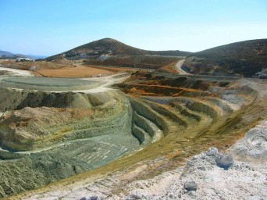

Canadian Minerals and Mining
BUS 417: Security Analysis
March 30, 2011
Sanjeev Gill, Justin Isaacs, Bryan Smyth, Phillip Kunz
Simon Fraser University
Undergraduate School of Business Administration

Slide 2
AGENDA
Industry Overview
Commodities
          Uranium
          Coal
          Zinc
          Copper
          Gold

Slide 3
Companies
  Teck Resources
  Goldcorp
  Cameco

Slide 6
Who determines the reserves
Assessments must be made by a qualified person
Reserve Definitions
Inferred to proven

Slide 7
Terms
Inferred Mineral Resource
Mineral Resource for which quantity and grade or quality can be estimated on the basis of
    geological evidence and limited sampling and reasonably assumed, but not verified, geological and grade continuity.
    The estimate is based on limited information and sampling gathered through appropriate techniques from locations such as outcrops, trenches, pits, workings and drill holes.

Slide 8
Indicated Mineral Resource
Mineral Resource for which quantity, grade or quality, densities, shape and physical characteristics, can be estimated with a level of confidence
    Sufficient to allow the appropriate application of technical and economic parameters
    To support mine planning and evaluation of the economic viability of the deposit.
    The estimate is based on detailed and reliable exploration and testing information gathered through appropriate techniques from locations such as outcrops, trenches, pits, workings and drill holes that are spaced closely enough for geological and grade continuity to be reasonably assumed.

Slide 9
Measured Mineral Resource
Estimated with confidence sufficient to allow technical and economic parameters
To support production planning and evaluation of the economic viability of the deposit.
    The estimate is based on detailed and reliable exploration drill holes that are spaced closely enough to confirm both geological and grade continuity.

Slide 10
A Mineral Reserve is the economically mineable part of a Measured or Indicated Mineral Resource demonstrated by at least a Preliminary Feasibility Study.
A Mineral Reserve includes diluting materials and allowances for losses that may occur when the material is mined.

Slide 11
Probable Mineral Reserve
The economically mineable part of an Indicated or Measured Mineral Resource
    demonstrated by at least a Preliminary Feasibility Study.
    This Study must include adequate information on mining, processing, metallurgical, economic, and other relevant factors that demonstrate, at the time of reporting, that economic extraction can be justified.

Slide 12
Proven Mineral Reserve
Economically mineable part of a Measured Mineral Resource
    Highest level of confidence that economic extraction is justified.

Slide 13
Industry Overview
Capitol Requirements
Consolidation Trends
Growing Commodity Prices

Slide 14
Cumulative financing of mining operations world-wide
(4 yrs)

Slide 15
EXPLORATION AND DEPOSIT APPRAISAL EXPENDITURES,1 BY PROVINCE AND TERRITORY, 2006-2011
Province / Territory | 2006 |  | 2007 |  | 2008 |  | 2009 |  | 2010a |  | 2011b
 | ($ millions) | (%) | ($ millions) | (%) | ($ millions) | (%) | ($ millions) | (%) | ($ millions) | (%) | ($ millions) | (%)
Newfoundland and Labrador | 100.8 | 5.3 | 148.0 | 5.2 | 146.7 | 4.5 | 54.9 | 2.8 | 109.3 | 4.2 | 126.8 | 4.0
Nova Scotia | 11.0 | 0.6 | 23.5 | 0.8 | 21.4 | 0.7 | 9.0 | 0.5 | 16.9 | 0.6 | 19.4 | 0.6
New Brunswick | 13.4 | 0.7 | 35.8 | 1.3 | 32.7 | 1.0 | 8.1 | 0.4 | 19.3 | 0.7 | 25.0 | 0.8
Quebec | 295.1 | 15.4 | 476.4 | 16.8 | 526.1 | 16.0 | 379.3 | 19.5 | 482.6 | 18.4 | 559.7 | 17.6
Ontario | 346.5 | 18.1 | 571.7 | 20.2 | 799.3 | 24.4 | 536.2 | 27.6 | 801.0 | 30.5 | 938.7 | 29.4
Manitoba | 52.9 | 2.8 | 102.6 | 3.6 | 152.1 | 4.6 | 97.8 | 5.0 | 79.3 | 3.0 | 76.8 | 2.4
Saskatchewan | 235.6 | 12.3 | 314.0 | 11.1 | 430.7 | 13.1 | 311.0 | 16.0 | 262.9 | 10.0 | 271.5 | 8.5
Alberta | 18.7 | 1.0 | 11.8 | 0.4 | 20.8 | 0.6 | 8.3 | 0.4 | 14.3 | 0.5 | 14.4 | 0.5
British Columbia | 344.2 | 18.0 | 470.6 | 16.6 | 435.4 | 13.3 | 217.1 | 11.2 | 341.3 | 13.0 | 493.7 | 15.5
Yukon Territory | 106.4 | 5.6 | 144.7 | 5.1 | 134.0 | 4.1 | 90.9 | 4.7 | 149.6 | 5.7 | 256.3 | 8.0
Northwest Territories | 176.2 | 9.2 | 193.7 | 6.8 | 147.7 | 4.5 | 44.1 | 2.3 | 84.7 | 3.2 | 83.0 | 2.6
Nunavut | 210.6 | 11.0 | 338.0 | 11.9 | 432.6 | 13.2 | 187.6 | 9.6 | 263.8 | 10.1 | 322.8 | 10.1
Total | 1,911.5 | 100.0 | 2,830.8 | 100.0 | 3,279.5 | 100.0 | 1,944.4 | 100.0 | 2,625.0 | 100.0 | 3,188.0 | 100.0

Slide 16
EXPLORATION PLUS DEPOSIT APPRAISAL EXPENDITURES,1 BY PROVINCE AND TERRITORY, BY MINERAL COMMODITY SOUGHT, 2010p
Province/Territory | Base Metals | Precious Metals | Uranium | Diamonds | Others2 | Total
 | ($ M)
Newfoundland and Labrador | 45.0 | 14.4 | 3.2 | - | 46.7 | 109.3
Nova Scotia | 1.5 | 10.0 | - | - | 5.4 | 16.9
New Brunswick | 11.0 | 4.9 | 0.1 | - | 3.3 | 19.3
Quebec | 89.6 | 243.1 | 39.8 | 17.8 | 92.3 | 482.6
Ontario | 118.6 | 624.1 | 0.8 | 27.6 | 29.9 | 801.0
Manitoba | 52.7 | 24.4 | - | … | 2.1 | 79.3
Saskatchewan | 0.9 | 9.4 | 104.8 | 14.2 | 133.7 | 262.9
Alberta | 0.3 | 0.3 | … | 1.3 | 12.4 | 14.3
British Columbia | 107.7 | 164.1 | - | 0.1 | 69.4 | 341.3
Yukon | 41.9 | 100.1 | … | - | 7.6 | 149.6
Northwest Territories | 12.6 | 31.8 | 0.1 | 23.8 | 16.4 | 84.7
Nunavut | 18.6 | 138.4 | 32.6 | 26.6 | 47.6 | 263.8
Total | 500.4 | 1,365.0 | 181.4 | 111.3 | 466.9 | 2,625.0

Slide 17
EXPLORATION PLUS DEPOSIT APPRAISAL EXPENDITURES,1 BY PROVINCE AND TERRITORY, BY MINERAL COMMODITY SOUGHT, 2011si
Province/Territory | Base Metals | Precious Metals | Uranium | Diamonds | Others2 | Total
 | ($ M)
Newfoundland and Labrador | 38.8 | 20.2 | 28.2 | - | 39.5 | 126.8
Nova Scotia | 3.0 | 9.7 | - | - | 6.7 | 19.4
New Brunswick | 13.0 | 6.7 | … | - | 5.3 | 25.0
Quebec | 109.4 | 274.9 | 27.0 | 19.5 | 129.0 | 559.7
Ontario | 160.8 | 705.4 | 1.9 | 13.3 | 57.3 | 938.7
Manitoba | 48.7 | 24.5 | 0.5 | … | 3.0 | 76.8
Saskatchewan | 6.5 | 10.6 | 115.4 | 6.8 | 132.1 | 271.5
Alberta | 1.0 | 0.7 | - | - | 12.7 | 14.4
British Columbia | 130.4 | 261.1 | - | 0.2 | 102.1 | 493.7
Yukon | 111.3 | 141.9 | - | - | 3.1 | 256.3
Northwest Territories | 11.3 | 23.8 | … | 22.2 | 25.7 | 83.0
Nunavut | 52.3 | 154.4 | 36.3 | 28.1 | 51.7 | 322.8
Total | 686.4 | 1,633.9 | 209.4 | 90.0 | 568.3 | 3,188.0

Slide 18
TOTAL MINERAL RESOURCE DEVELOPMENT INVESTMENTS, 2010 PRELIMINARY ESTIMATES AND 2011 SPENDING INTENTIONS
Expenditure Category | Exploration and Deposit Appraisal |  | Mine Complex Development |  | Grand Total
 | 2010a | 2011b | 2010a | 2011b | 2010a | 2011b
 | ($ 000)
Field Work Feasibility Studies, Environment and Land Access Costs | 2,624,970 | 3,188,043 | 1,968,502 | 2,247,033 | 4,593,472 | 5,435,076
On-Mine-Site | 211,574 | 327,732 | 1,968,502 | 2,247,033 | 2,180,076 | 2,574,765
Off-Mine-Site | 2,413,396 | 2,860,311 | n.a. | n.a. | 2,413,396 | 2,860,311
Capital Asset Expenditures
Non-Residential Construction | 376,175 | 1,105,061 | 3,651,907 | 4,409,207 | 4,028,081 | 5,514,268
Machinery and Equipment | 79,129 | 142,365 | 2,653,700 | 3,455,644 | 2,732,829 | 3,598,009
Subtotal | 455,304 | 1,247,426 | 6,305,607 | 7,864,851 | 6,760,911 | 9,112,277
Grand Total | 3,080,274 | 4,435,469 | 8,274,109 | 10,111,884 | 11,354,383 | 14,547,353

Slide 19
TOTAL MINERAL RESOURCE DEVELOPMENT INVESTMENTS, 2008-2009
Expenditure Category | Exploration and Deposit Appraisal |  | Mine Complex Development |  | Grand Total
 | 2008 | 2009 | 2008 | 2009 | 2008 | 2009
 | ($ 000)
Field work and overhead1 | 2,886,435 | 1,671,577 | 1,520,013 | 1,638,510 | 4,406,449 | 3,310,087
Engineering, economic and feasibility studies | 273,796 | 181,426 | 84,687 | 112,644 | 358,484 | 294,070
Environment | 105,680 | 80,632 | 88,874 | 90,625 | 194,554 | 171,257
Land Access | 13,568 | 10,735 | 19,845 | 18,330 | 33,413 | 29,065
Subtotal | 3,279,479 | 1,944,370 | 1,713,420 | 1,860,109 | 4,992,899 | 3,804,480
On-Mine-Site | 262,940 | 204,632 | 1,713,420 | 1,860,109 | 1,976,359 | 2,064,741
Off-Mine-Site | 3,016,539 | 1,739,738 | n.a. | n.a. | 3,016,539 | 1,739,738
Capital expenditures on fixed assets2 | 470,520 | 205,663 | 5,486,308 | 4,255,455 | 5,956,827 | 4,461,118
Repair and maintenance2 | 11,992 | 21,156 | 1,708,173 | 1,962,675 | 1,720,165 | 1,983,831
Subtotal | 482,512 | 226,819 | 7,194,481 | 6,218,130 | 7,676,992 | 6,444,949
Grand Total | 3,761,991 | 2,171,189 | 8,907,900 | 8,078,240 | 12,669,891 | 10,249,429

Slide 20
EXPLORATION PLUS DEPOSIT APPRAISAL EXPENDITURES,¹ BY PROVINCE AND TERRITORY, BY MINERAL COMMODITY SOUGHT, 2008
Province/Territory | Base Metals | Precious Metals | Uranium | Diamonds | Others² | Total
 | ($ millions)
Newfoundland and Labrador | 48.0 | 12.9 | 58.1 | - | 27.7 | 146.7
Nova Scotia | 8.3 | 7.6 | - | - | 5.5 | 21.4
New Brunswick | 13.2 | 9.4 | 2.9 | - | 7.2 | 32.7
Quebec | 122.4 | 263.3 | 87.3 | 12.8 | 40.3 | 526.1
Ontario | 257.0 | 444.6 | 16.9 | 19.0 | 61.8 | 799.3
Manitoba | 110.6 | 29.8 | … | 0.7 | 11.0 | 152.1
Saskatchewan | 10.7 | 20.7 | 189.5 | 53.7 | 156.1 | 430.7
Alberta | 0.5 | - | 3.8 | 8.0 | 8.5 | 20.8
British Columbia | 167.4 | 146.4 | 0.7 | 0.5 | 120.5 | 435.4
Yukon | 45.5 | 70.8 | 2.7 | - | 14.9 | 134.0
Northwest Territories | 17.0 | 19.3 | 3.6 | 93.1 | 14.7 | 147.7
Nunavut | 41.5 | 136.8 | 43.3 | 33.9 | 177.0 | 432.6
Total | 842.1 | 1 161.4 | 409.0 | 221.6 | 645.2 | 3 279.5

Slide 21
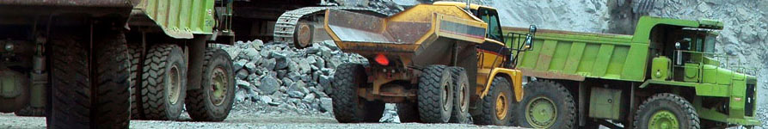
Capitol Expenditures Comparative

Slide 23
Consolidation Trend

Slide 25
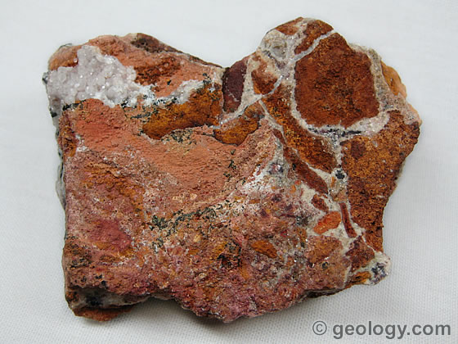
Copper

Slide 26
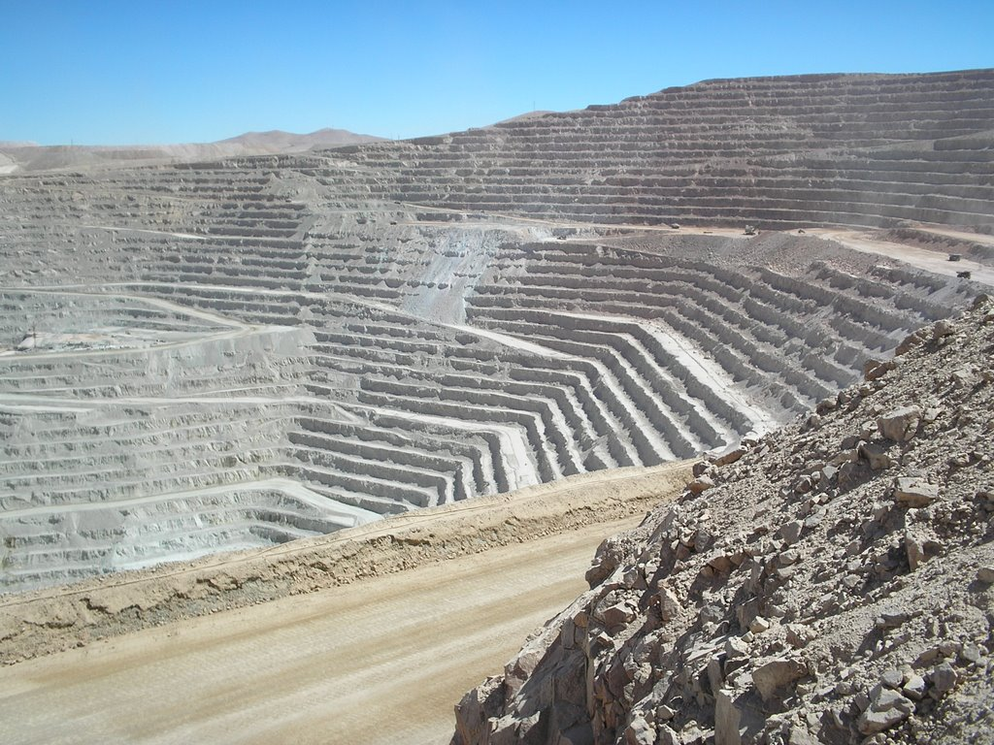
Escondida mine- worlds largest producing copper mine (BHP)

Slide 27
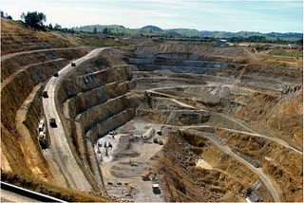
Mountain Top Removal

Slide 28
Copper Facts
The concentration of copper in ores average 0.6%
95% of all copper ever mined and smelted has been extracted since 1900
The total amount of copper on Earth is vast (around 10¹⁴ tons just in the top kilometer of Earth's crust, or about 5 million years worth at the current rate of extraction)
Various estimates of existing copper reserves available for mining vary from 25 years to 60 years

Slide 29
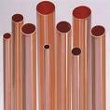
Copper Uses
About 98% of all copper is used as the metal
It is widely used in piping for water supplies
Copper is 100% recyclable
80% of the copper ever mined is still in use today

Slide 30
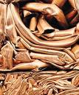
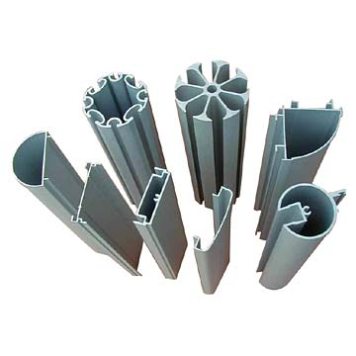
Natural Copper Price Caps

Slide 31
Copper Substitution

Slide 32
Copper VS Aluminum

Slide 34
Copper Substitution

Slide 35
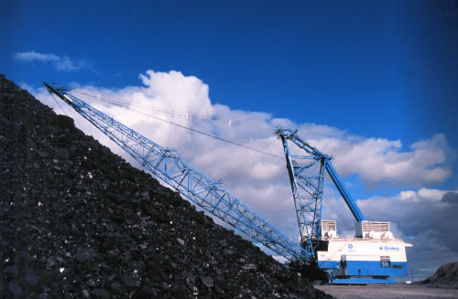
COAL

Slide 36

Coal Grades
The highest rank, anthracite. It is found almost exclusively in remote regions of northern British Columbia and the Yukon. Anthracite is not being mined in Canada at present.
Bituminous coal, is found in Alberta, British Columbia and the Maritimes. Bituminous coal can be metallurgical -- used to make coke for the steel industry -- or thermal, used to generate electricity. In 2002, bituminous coal accounted for 29.7 million tonnes (Mt) or approximately 45% of Canada's total coal production.
Sub-bituminous coal is softer than bituminous and contains more moisture, making it less economic to transport long distances. Alberta is the only province where sub-bituminous coal is mined.
Lignite is a soft, brown or black coal only the Saskatchewan deposits are currently being mined and production is used to generate approximately 70% the province's electricity.

Slide 38
Coal Facts
Coal is the world's most abundant fossil fuel
There is more stored energy in Canadian coal than all the country's oil, natural gas, and oil sands combined.
Coal provides over 23% of global primary energy needs
Canadian coal is exported to 21 countries on five continents with an annual value of approximately $2 billion.
Canada ranks tenth in the world in total coal reserves with 4 billion tonnes of bituminous coal.

Slide 39
Coal Uses
Coal has many important uses, but most significantly in electricity generation, steel and cement manufacture, and industrial process heating.
Almost 70% of total global steel production is dependent on coal.

Slide 40
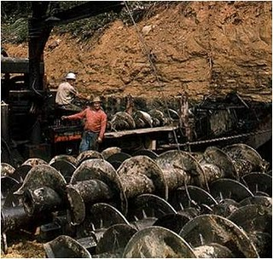
Typical Coal Mine

Slide 41
Technology Advancements In Underground mining
High Wall Mining/Continuous Mining

Slide 43
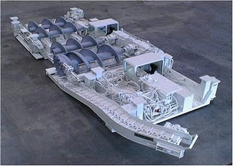
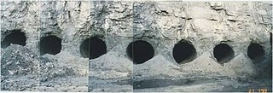
Auger Machine and Resulting Holes

Slide 44
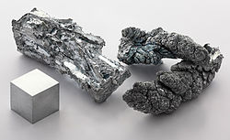
ZINC

Slide 45
Zinc Facts
The element is normally found in association with other base metals such as copper and lead in ores
Identified world zinc resources total about 1.9 billion tonnes
Total reserve base of 500 million tonnes has been identified
Nearly 200 million tonnes were economically viable in 2008
At the current rate of consumption, these reserves are estimated to be depleted sometime between 2027 and 2055
Commercially pure zinc is known as Special High Grade, often abbreviated SHG, and is 99.995% pure

Slide 46
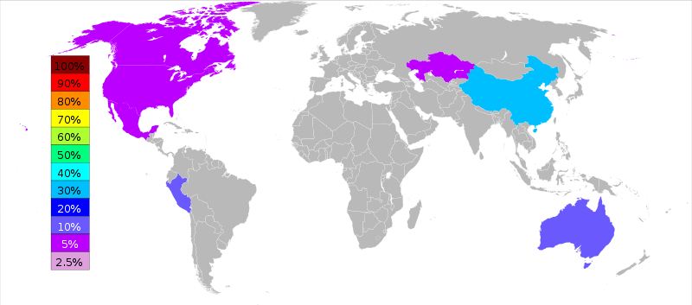
Zinc Deposits

Slide 47
Zinc Uses
Brass, which is an alloy of copper and zinc, has been used since at least the 10th century BC
Applications of zinc include:
    Galvanizing (59%)
    Die-casting (16%)
    Brass and bronze(10%)
    Rolled zinc (6.5%)
    Chemicals (6.0%)
    Miscellaneous (2.5%)

Slide 48
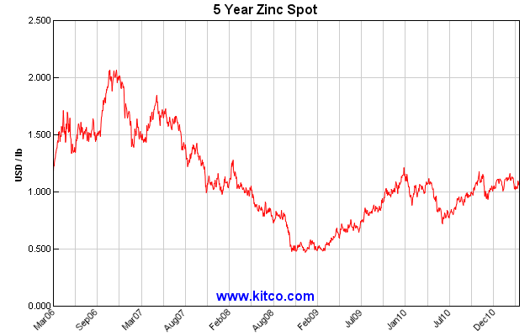

Slide 49
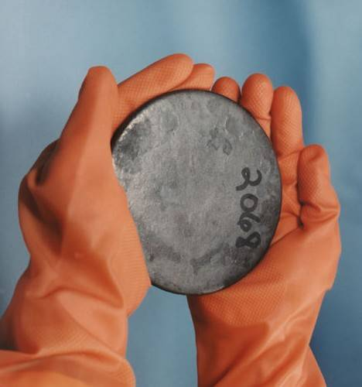
Uranium

Slide 50
Uranium Facts
The mining methods employed are
    conventional underground (UG)
    open cast (OC) (62 %),
    In situ Leaching(ISL, 29 %)
    by-product (10 %).
Uranium must be enriched for Use
The enrichment market is an oligopoly, with four principal companies
    Techsnabexport/Rosatom (38%),
    USEC Inc. (22%)
    Eurodif/Areva SA (21%)
    Urenco Group (14%)
Controlling approximately 95% of the global uranium enrichment capacity.

Slide 51
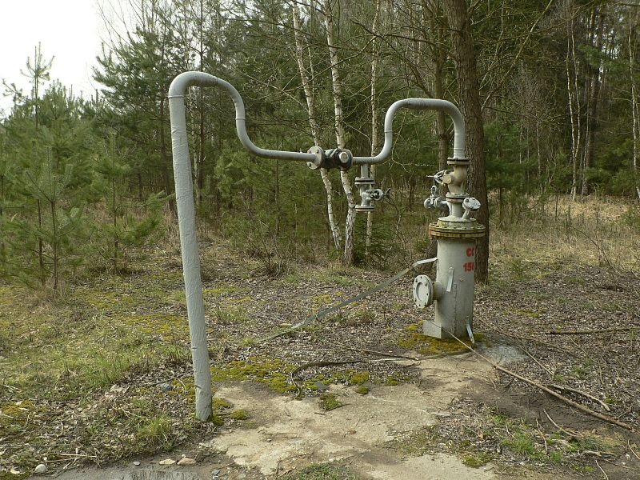
In-situ leaching- solution mining
Boreholes drilled into a deposit.
Explosive or hydraulic fracturing may be used to create open pathways
Leaching solution is pumped into the deposit where it makes contact with the ore
The solution bearing the dissolved ore content is then pumped to the surface and processed.
Allows the extraction of metals and salts from an Ore body without the need for conventional mining involving drill-and-blast, open-cut or underground mining

Slide 52
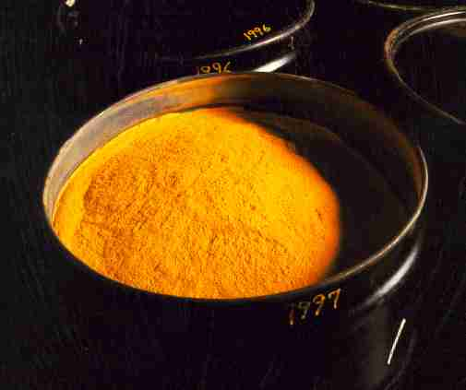
Uranium Enrichment Facilities
Location of Enrichment Facility | Enrichment Process | Capacity (1000kg SWU/annum)
Russia | Centrifuge | 20,000
France | Diffusion | 10,800
United States | Diffusion | 8,000
Germany-Netherlands-UK | Centrifuge | 5,850
China | Mostly Centrifuge | 1,300
Japan | Centrifuge | 900

Slide 53
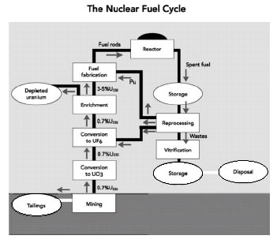
Uses Of Uranium = Nuclear Power Production

Slide 54
Canadian Uranium Mines

Slide 55
Mine | Operator | tonnes U | tonnes U3O8 | Average ore grade^{d} | Category
Rabbit Lake | Cameco | 9800 | 11,600 | 0.76% | proven & probable reserves
McClean Lake | Areva | 1031 | 1216 | 0.53% | proven reserves
 |  | 4115 | 4853 | 2.14% | measured + indicated
McArthur River | Cameco | 67,400 | 79,500 | 17.29% | proven reserves
 |  | 61,900 | 73,000 | 13.49% | probable reserves
 |  | 6500 | 7680 | 7.09% | measured + indicated
 |  | 57,800 | 68,200 | 13.46% | inferred resources
Cigar Lake | Cameco | 80,500 | 95,000 | 17.04% | proven & probable reserves
 |  | 455 | 540 | 2.27% | indicated resources
 |  | 51,500 | 60,680 | 12.61% | inferred resources
Midwest | Areva | 16,340 | 18,900 | 3.84% | measured + indicated
Dawn Lake | Cameco | 5,000 | 5,860 | 1.69% | indicated resources
Millennium | Cameco | 19,590 | 23,100 | 4.55% | indicated resources
 |  | 3,900 | 4,600 | 2.12% | inferred resources
Phoenix | Cameco | 13,700 | 16,200 | 17.98% | indicated resources
Tamarack | Cameco | 6900 | 8100 | 4.42% | indicated resources
Kiggavik | Areva | 49,153 | 57,966 | 0.22% | inferred resources
Michelin | Aurora | 26,000 | 30,600 | 0.11% | measured + indicated
 |  | 13,670 | 16,100 | 0.12% | inferred resources
Jacques Lake | Aurora | 4000 | 4700 | 0.08% | measured + indicated
Wheeler River | Denison | 15,180 | 17,900 | 17.5% | inferred resources

Slide 56
Average Uranium Price

Slide 57
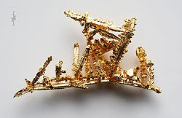
Gold

Slide 58
Gold Facts
The native metal occurs as nuggets or grains in rocks, in veins and in alluvial deposits
It is mined in shafts or historically by panning through silt
It is chemically stable and conducts electricity

Slide 59
Gold Uses
Gold is used to make jewellery and other art items- 50%
Electronic applications represent a significant amount of the United States’ annual gold consumption- 10%
Dentistry and a variety of other applications.
Held in reserves- 40%

Slide 60
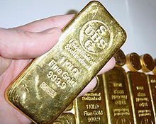
Gold price has been increasing dramatically

Slide 61
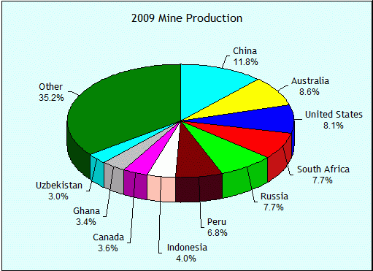
World Gold Production

Slide 62
World Gold Output
2009 2572mt
2008 2356mt
2007 2444mt

Slide 63

Teck Resources Ltd

Slide 64

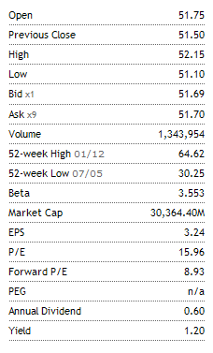
Stock Summary

Slide 65
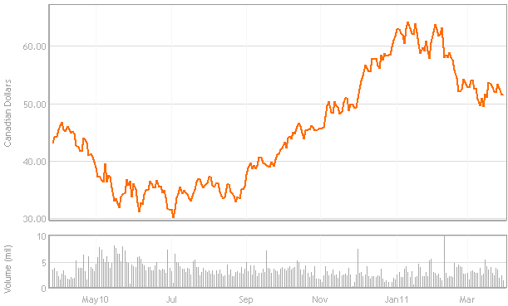
1 Year Price Movement

Slide 66
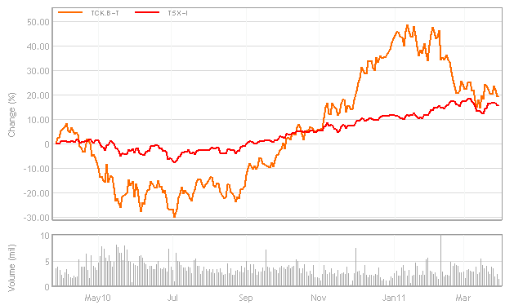
1 year vs. S&P/TSX Composite

Slide 67
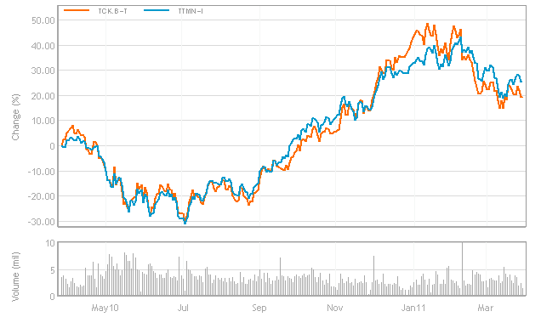
1 Year vs. TTMN-1

Slide 68
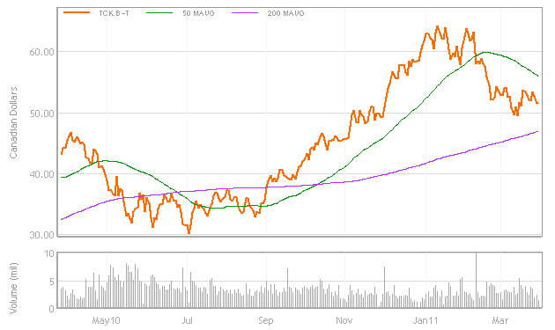
1 Year Technical Analysis

Slide 69
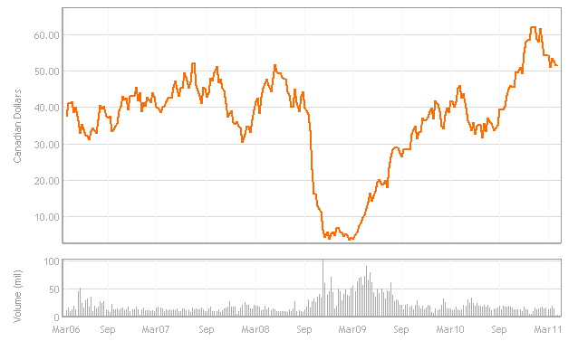
5 Year Price Movement

Slide 70
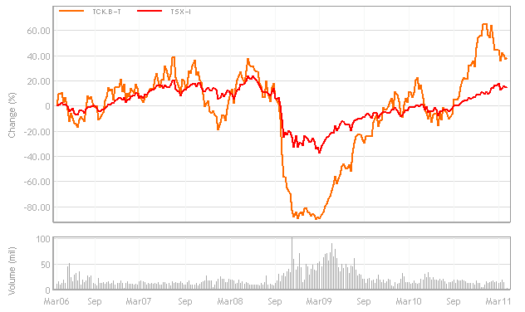
5 year vs. S&P/TSX Composite

Slide 71
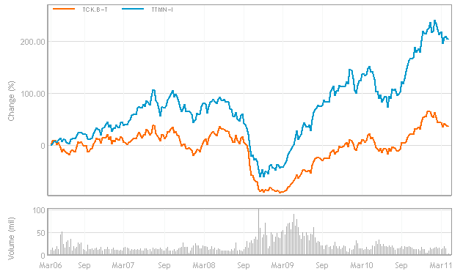
5 Year vs. TTMN-1

Slide 72
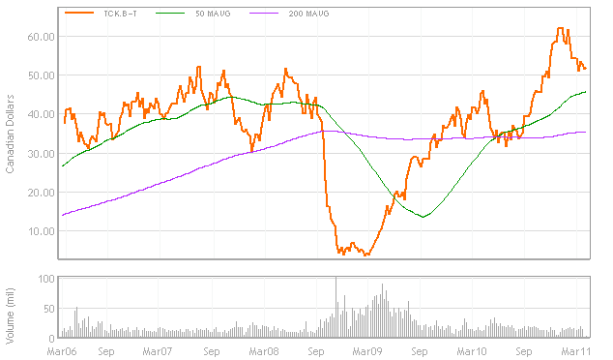
5 Year Technical Analysis

Slide 73
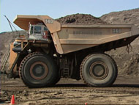
Teck Snapshot
Company History
Operations and Interests
Recent Transactions
Management

Slide 74
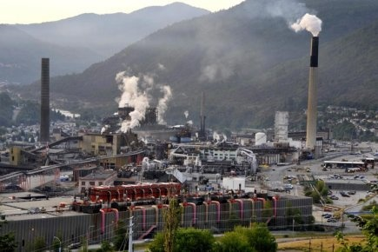
Company History

Slide 75
Company History
Cominco began operations in 1906 as The Consolidated Mining and Smelting Company of Canada (the name changed to Cominco in 1966).
Teck began in 1913 as Teck-Hughes Goldmine Ltd to develop a gold discovery at Kirkland Lake
Associations between the two began in 1986, and Teck acquired 100% of Cominco in July 2001.
Teck Cominco changed the company name to Teck Resources Ltd. in April 2009.

Slide 76
Operations
Headquartered in Vancouver, Teck is Canada’s largest diversified mining company
Has operations in copper, metallurgical coal, zinc, and energy
Committed to environmental and social responsibility
Also a significant participant in Canadian Oil Sands drilling

Slide 77
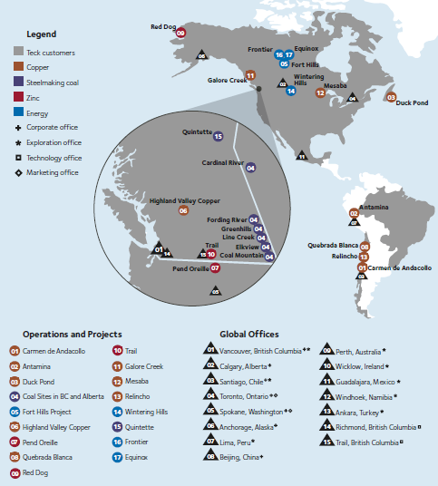
Operations and Interests

Slide 78
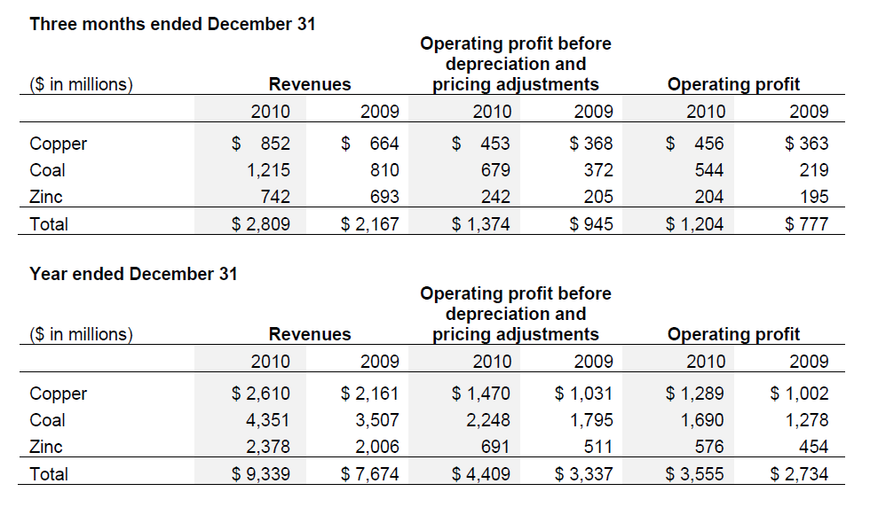
Operations and Interests

Slide 79
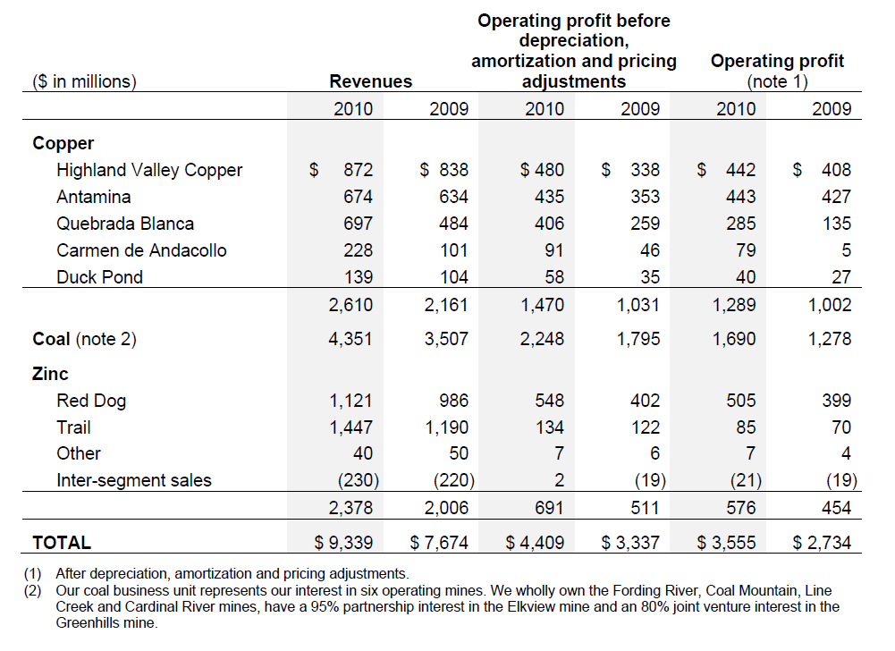
Operations and Interests Cont’d

Slide 80
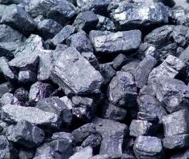
Metallurgical Coal

Slide 81
Metallurgical Coal
Coal accounts for 49% of operating profits, and each mine has an average life of 25 years
World’s 2nd largest exporter of seaborne steelmaking coal
Importing Markets:
  Asia (Japan, Korea, Taiwan and China), Europe and South America
Wholly own:
  Coal Mountain, Cardinal River, Fording River and Line Creek
Partially own:
  Elkview Mine (95%), Greenhills Mine (88%)
Entered into 10 year contract with CP to transport coal from mine sites to west coast for shipping.

Slide 82
Metallurgical Coal Operations
Cardinal River
  Owned by Luscar and CONSOL (prior to 2003); each retains a 2.5% royalty on coal mined from Chevrolet Creek pit
  Coal mined at Cardinal River is primarily steelmaking coal, although some thermal coal is also produced
  Annual production capacity is 2.0 million tonnes of clean coal annualy
  Expected to have a mine life of 26 years (at 2010 production rates)
Coal Mountain
  Of the 3,836 hectares that comprise the site, 1,016 are currently, or scheduled to be mined
  Produces both steelmaking and thermal coal
  Annual Production capacity is 2.7 tonnes of clean coal annually
  Expected to have a mine life of 9 years (at 2010 production rates)
The Elkview Mine
  Teck has a 95% partnership . The remaining 5% is held equally by Nippon Steel Corporation and POSCO, a Korean steel producer, each of which acquired a 2.5% interest in 2005 for US$25 million.
  The site is 27,054 hectares of coal lands, while 3,599 hectares have been mined or are scheduled for mining.
  Produces primarily high quality steelmaking coal, and a small amount of thermal coal.
  Annual production capacity is approximately 5.6 milllion tonnes of clean coal.
  Expected to have a mine life of 41 years (at 2010 production rates)

Slide 83
Metallurgical Coal Operation Cont’d
Fording River Mine
  Comprised of 20,304 hectares of coal lands, 4,263 hectares have been mined or are scheduled for mining.
  Primarily steelmaking coal, with a small amount of thermal coal.
  Annual production is 8.7 million tonnes of clean coal.
  Estimated mine life is 33 years (at 2010 production rates).
Greenhills Mine
  Comprised of 11,806 hectares of coal lands, 2,265 hectares have been mined or are scheduled for mining.
  Teck has an 80% interest in the joint venture while POSCAN (POSCO Canada Limited) has a 20% interest.
  Primarily steelmaking coal, small amount of thermal coal.
  Annual production is 4.5 million tonnes of clean coal.
  Expected mine life if 18 years (at 2010 production rates).

Slide 84
Metallurgical Coal Operations Cont’d
Line Creek Mine
  Supplies steelmaking and thermal coal to a variety of international and domestic customers.
  Comprised of 8,183 hectares of coal lands, 2,267 hectares are currently being mined or are scheduled for mining.
  Annual production is 2.9 million tonnes of clean coal.
  Expected mine life of 15 years (at 2010 production rates).
Quintette Project
  (100% Teck)
  Previously operated for nearly 18 years (until 2000).
  If re-started, could produce approximately 3.0 million tonnes of stelmaking coal annually.
  Feasibility study results are expected to be completed by mid 2011.
  Assuming positive results, the mine could be in production by 2013.

Slide 85
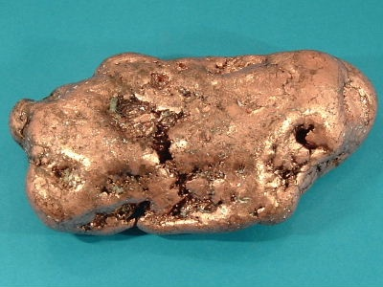
Copper

Slide 86
Copper
Can produce 370,000 tonnes of copper annually from their mines:
  Chile (Quebrada Blanca, and Carmen de Andacollo); Peru (Antamina); Canada (Highland Valley Copper, and Duck Pond)
Looking to expand copper operations:
  Current mines (Quebrada Blanca phase 2); new mines (Relincho, and Galore Creek); prospective projects (Canada, Chile, Mexico, US, Namibia, Turkey, Peru, and Australia)
70% of Teck copper is sold to the Asia-Pacific region

Slide 87
Copper Operations
Highland Valley Copper
  Located in south central British Columbia.
  Produces copper and molybdenum concentrates.
  “New life of mine plan” recently developed, which has extended the mine life to 2025.
  Teck has a 97.5% interest.
  Open pit operation; processing plant uses autogenous and semi-autogenous grinding and flotation to produce metal in concentrate from the ore.
  Concentrates transported to a port in Vancouver for export overseas.
  Majority of concentrates are sold under long-term sales contracts to smelters in several countries.
Antamina Mine
  Located in the Andes mountain range, north of Lima, Peru.
  Teck has a 22.5 % interest; other partners are BHP Billiton (33.75%), Xstrata plc (33.75%) and Mitsubishi Corporation (10%).
  Open pit, truck/shovel operation.
  A 302 kilometre-long slurry concentrate pipeline transports copper and zinc concentrates to the port for shipment to smelters and refineries world-wide.
  Entered into long-term copper and zinc concentrate off-take agreements with major smelting and refining companies.
  Expansion project of milling and flotation capacity began in January 2010. Increases in copper and zinc production are expected to start in 2012.

Slide 88
Copper Operations Cont’d
Quebrada Blanca Mine
  Located in northern Chile.
  Teck owns a 76.5% interest; other interests owned by Inversiones Mineras S.A., 13.5%, and Empresa Nacional de Minera, 10%.
  Open pit operation.
  Copper is trucked to Iquique for shipment to purchasers.
Quebrada Blanca Phase 2 (development project)
  Aims to increase Quebrada Blanca’s copper production by 100%, and extend production life by more than 30 years.
  Includes the construction of a new concentrating plant, a tailings facility and new pumping and piping installations for transporting concentrate to the loading port.
  Full feasibility study began in early 2011, to be completed by early 2012. (If positive, production from the concentrator could commence in 2016).

Slide 89
Copper Operations Cont’d
Carmen de Andacollo
  Located in central Chile.
  Teck owns a 90% interest in the mine; the remaining interest is held by Empresa Nacional de Minera.
  In 2010, Camen de Andacollo sold an interest in future gold production to Royal Gold, Inc. equivalent to 75% of payable gold produced until cumulative production reaches 910,000 ounces of gold, and 50% thereafter.
  Open pit mine, produces copper in concentrates from the hypogene portion of the orebody.
  Mine’s life recently extended by approximately 20 years (achievement of commercial production at its new copper concentrator).
Duck Pond
  Located in central Newfoundland. Achieved commercial production in April 2007.
  A copper and zinc mine.
  Uses underground mining methods, will transition to open pit mining towards the end of mine life.

Slide 90
Copper Operations Cont’d
Relincho Project
  Located in central Chile.
  Teck acquired full ownership in 2008.
  Consists of 3.2 million tonnes of contained copper in indicated resource.
  Prefeasibility study began 2nd quarter of 2010, to be completed in 3rd quarter of 2011.
Galore Creek Project
  L ocated in north western British Columbia.
  50/50 partnership was formed with NovaGold Resources Inc. (Aug 2007) to develop the Galore Creek deposit.
  Development activites suspended in Nov 2007(due to escalating cost estimates and a longer-than-anticipated construction schedule).
  2008, studies re-evaluated and optimized the project by defining a more realistic and lower risk development alternative (alternative plant site and tailings locations).
  Prefeasibility study underway, to be completed 2nd quarter of 2011.

Slide 91
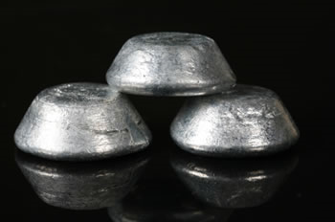
Zinc

Slide 92
Zinc
Accounts for 18% of operating profits
Can produce 650,000 tonnes of Zinc (in concentrates), or 290,000 tonnes (refined)
Own large mines in Alaska (Red Dog Mine), and Northern Peru (Antamina mine)
Metallurgical factory in Trail BC:
  “One of the world’s largest and highest margin fully-integrated zinc and lead smelting and refining operations”, that uses power from the Waneta hydro-electric dam

Slide 93
Zinc Operations
Trail Operations
  Located in British Columbia.
  Produces refined zinc and lead, a variety of precious and specialty metals, chemicals and fertilizer products.
  Waneta Dam provides clean and renewable power to the metallurgical operations.
  Surplus power is sold to customers in British Columbia and the United States.
  Two-thirds of the Waneta dam provides Trail Operations with reliable low-cost power.
  Remaining one-third belongs to BC Hydro.
Red Dog Operations
  Located in northwest Alaska, U.S.A.
  Properties are leased from, and were developed under an agreement with the NANA Regional Corporation, Inc. ("NANA"), a native Alaskan development corporation.
  Open-pit truck-and-loader operation, using conventional drill and blast mining methods.
  Concentrates are shipped to our metallurgical facilities at Trail, British Columbia and to customers in Asia and Europe.
Pend Oreille Mine
  Located in northeastern Washington State, USA.
  Zinc and lead concentrates delivered to Teck’s Trail smelter, in British Columbia, Canada.
  Operations suspended in February 2009; the mine placed on care and maintenance.

Slide 94
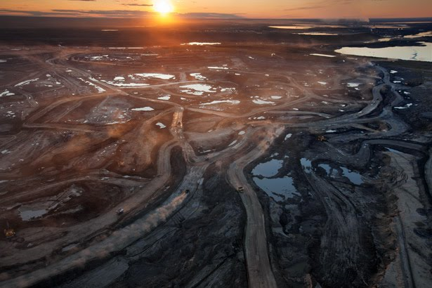
Energy

Slide 95
Energy
Energy business consists of interests in:
  Fort Hills oil sands (20%); Frontier and Equinox projects (both at 50%). (All properties located in Athabasca region of Alberta Canada)
With energy, Teck strives to:
  Improve oil sand extraction and processing practices
  Make positive contributions to water management, reclamation and air emissions

Slide 96
Energy Operations
Fort Hills Oil Sands Project
  Located 90 kilometres north of Fort McMurray in northern Alberta.
  Teck owns a 20% interest in the Fort Hills Energy Limited Partnership
  39.2% held by Total E&P Canada Ltd. and 40.8% held by Suncor Energy.
Fronteir and Equinox projects
  Equinox project consists of 2,860 hectares of oil sands leases.
  Frontier project consists of 26,100 hectares of oil sands leases.
  Engineering studies have started on the Frontier project, Including the option of developing Equinox as a satellite operation.

Slide 97
Recent Transactions
April 22nd, 2010: Teck resumes dividend payments (40 cents per share)
May 25th 2010: Files preliminary short form base debt shelf prospectus for sale of $6 billion US in debt securities
Aug 3rd 2010: Cash tender offer for $600 million of 9.75% senior secured noted (due 2014), and 10.25% senior secured (due 2016). Text
Aug 3rd 2010: Announces issue of $300 million worth of 3.85% notes (due 2017), and $450 million of 6.00% notes (due 2040).
Sep 8th 2010: Cash tender offer to purchase $1 billion of 10.750% secured notes (due 2019).

Slide 98
Recent Transactions Cont’d
Sept 8th 2010: Announce issue of $500 million of 4.500% notes (due 2021), and $200 million of 6.00% notes (due 2040).
Oct 6th 2010: Teck and CP enter 10 year agreement to transport steelmaking coal from five southeast BC mines to a Vancouver port.
Nov 17th 2010: Announce a 50% in the annual dividend rate.
Feb 24th 2011: Announce odd lot selling program, enabling Class A Common Shares and Class B Subordinate Voting Shares to sell without brokerage costs.
Mar 4th 2010: Teck enters agreement with Westshore to ship steelmaking coal from BC and Alberta mines from 2012 to 2016.

Slide 99
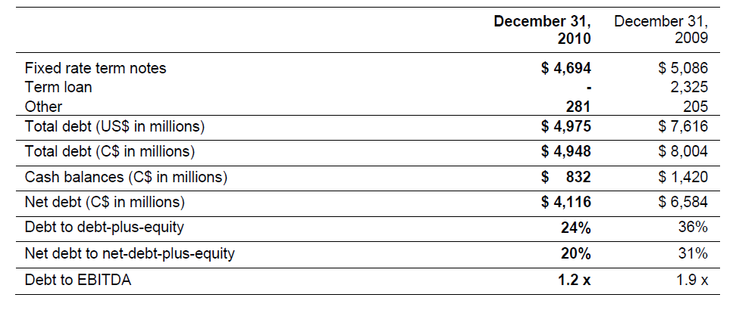
Change in Debt

Slide 100
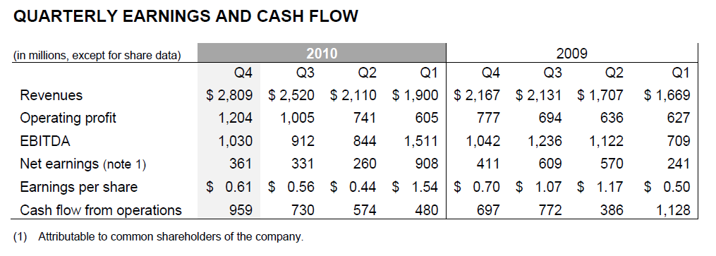
Operations

Slide 101
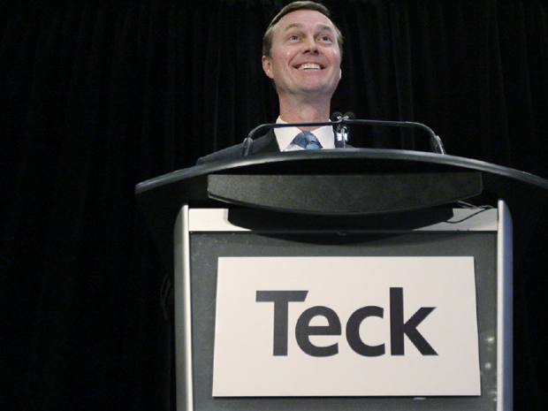
Management

Slide 102

Norman B. Keevil
Non-executive Chairman of the Board
Director Since: 1963
Background
  University of Toronto (B.A. Sc.)
  University of California, Berkeley (Ph. D.)
  University of British Columbia (Honourary LL.D); P.Eng (Ontario)
Vice-President Exploration at Teck Corporation from 1962 to 1968
Executive Vice-President from 1968 to 1981.
President and Chief Executive Officer from 1981 to 2001
Currently serves as Chairman of the Board for Teck Resources Ltd
He is a Lifetime Director of the Mining Association of Canada

Slide 103

Donald R. Lindsay
President and Chief Executive officer
Director Since: 2005
Background
  Queens University (B.Sc., Mining Engineering, Honours)
  Harvard Business School (M.B.A.)
Employed by CIBC World Markets Inc. (investment banking) from 1985 to 2004
  President of CIBC World Markets Inc.
  Head of Investment and Corporate Banking
  Head of the Asia Pacific Region.
Joined Teck Cominco Limited as President in January 2005,
Appointed Director in February, 2005 and Chief Executive Officer in April, 2005
He is a Director of Fording (GP) ULC.

Slide 104

Financial Analysis

Slide 105
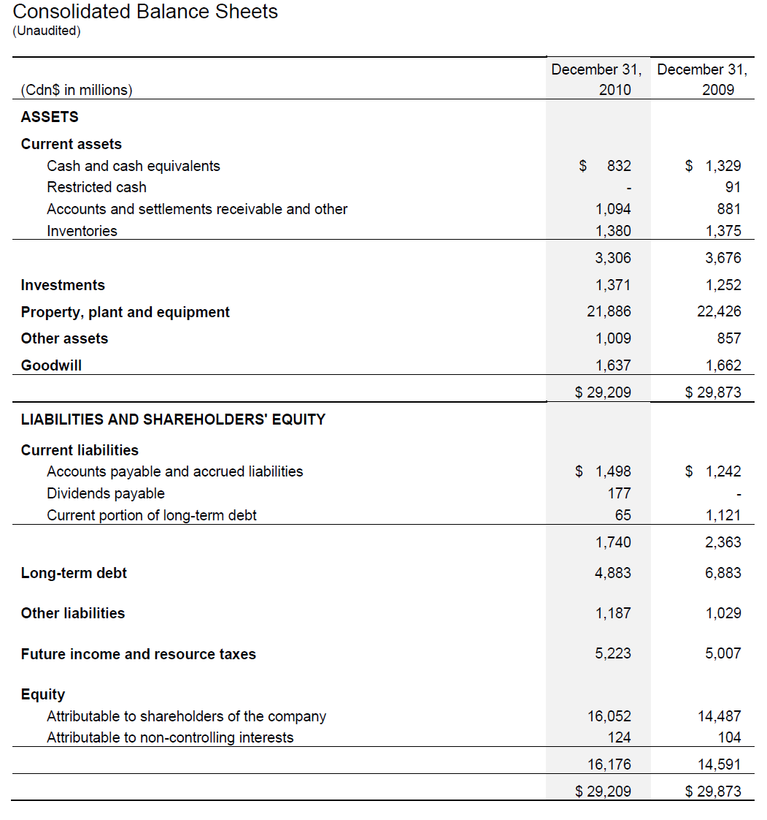
2010 Q4 Balance Sheet

Slide 106
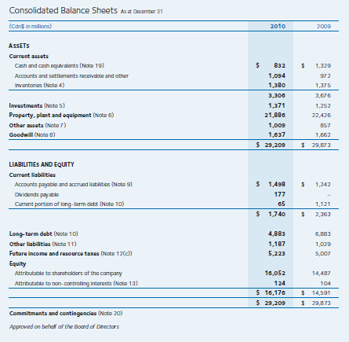
Annual Balance Sheet
Notes:
The drop in cash is largely due to a decrease in the amount of short term securities held.
Change in other assets due to increase in future income resource tax assets (the carry forward of previous years operating losses) and derivitives held (an increase in 2011)
Long term debt has decreased as Teck has been aggressively paying down LT debt.

Slide 107
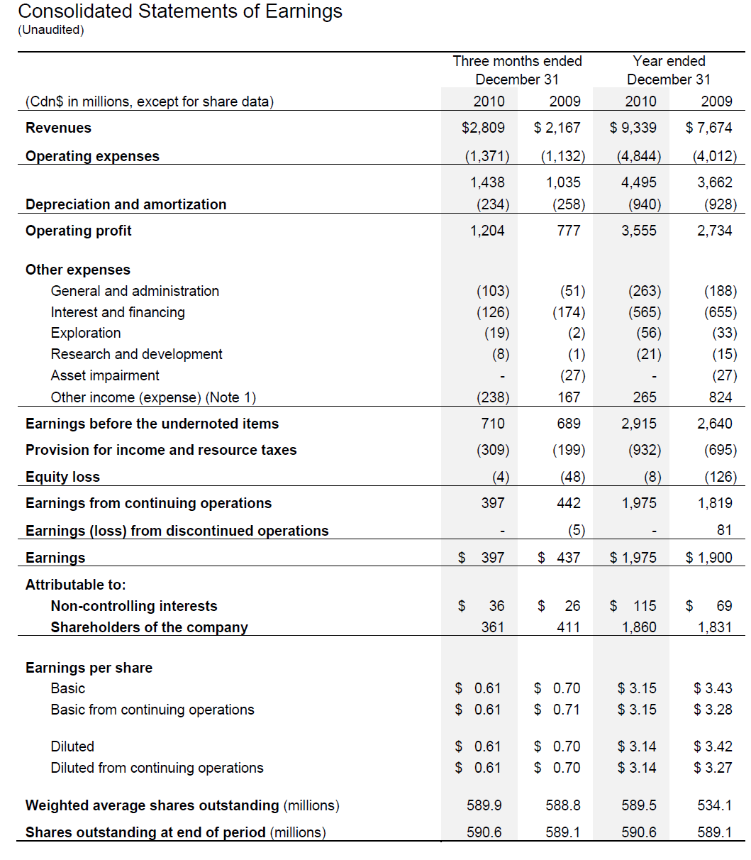
2010 Q4 Income Statement

Slide 108
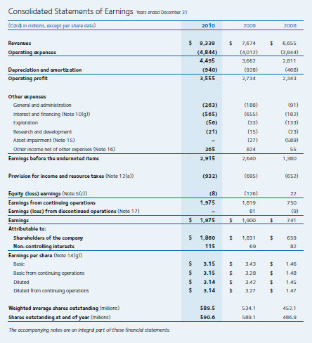
Annual Income Statement
Notes:
Interest and financing expense is a result of issuing lower yield debt.
EPS decrease partially a result of the dilutive effect of dilutive shares (options). Retirement of Boyd Payne; VP Coal

Slide 109
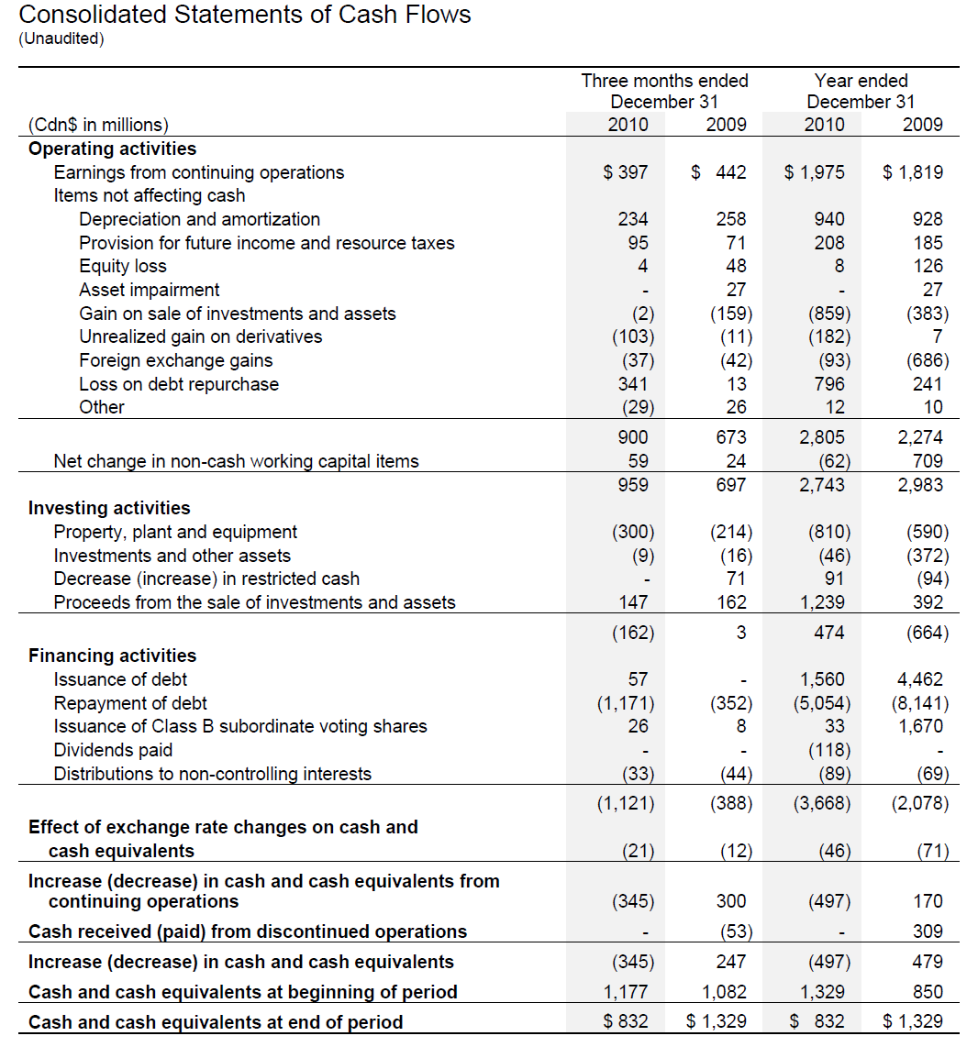
2010 Q4 Cash Flow Statement

Slide 110
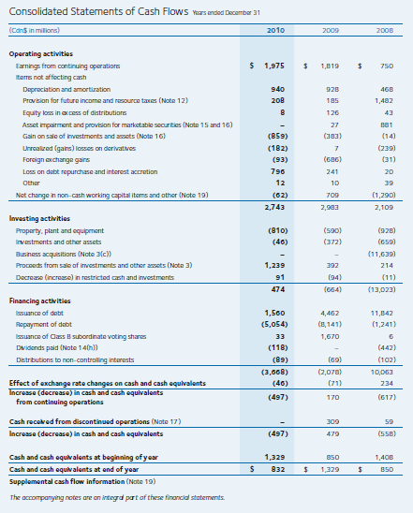
Annual Cash Flow Statement
Notes:
Note 16: gain on sale of investments and assets, comprised of both sales and refinancing of debt. Sale of Andacollo Gold Royalty; 1/3 interest in the Waneta dam to BC Hydro; 60% interest in Agi Dagi and Kirazli gold projects.
Declared dividends of 0.20 and 0.30 cents per share in 2nd and 4th quarters of 2010.

Slide 111
Recommendation
Buy!
Notes:
Strong Management team.
Responsible financial transactions (re-financing debt)

Slide 112
GOLDCORP

Slide 113
Stock Analysis

Slide 114
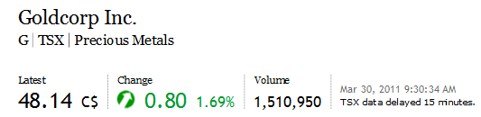



Stock Profile

Slide 115

1 Year Stock Price

Slide 116

1 Year vs. S&P/TSX Composite

Slide 117

1 Year vs. S&P/TSX Metals & Mining Index

Slide 118

1 Year Moving Average Technical Analysis

Slide 119

1 Year vs. Gold

Slide 120

5 Year Stock Price

Slide 121

5 Year vs. S&P/TSX Composite

Slide 122

5 Year vs. S&P/TSX Metals & Mining Index

Slide 123

5 Year Moving Average Technical Analysis

Slide 124

5 Year vs. Gold

Slide 125

Return Over 10-year Period

Slide 126
“The Story”

Slide 127
Overview
Vancouver based precious metals producer : gold & by-products (silver, copper, lead, zinc)
One of the world’s lowest cost and fastest growing multi-million ounce gold producers
Operations throughout the Americas: Canada, USA, Mexico, Guatemala, Argentina
70% of reserves in low political risk NAFTA countries
Strong pipeline of acquisitions: Quebec, Argentina, Chile, Dominican Republic
Does not hedge gold production
Has paid monthly dividends to shareholders since 2003
Zero net debt position with an undrawn credit facility of $1.5 Billion
Increased gold production to 2.52 million in 2010 from 2.42 million ounces in 2009 – 7th year of consecutive growth

Slide 128
History
Began in 1989 when Robert McEwen bought control of two mining companies
In 1990, he hired new management and changed the board of directors for both companies
In 1994, four mining companies merged to create Goldcorp Inc.
Transformed Goldcorp from a collection of small companies into a mining powerhouse
Overcame many challenges: bid to extract the gold he believed all along was at Red Lake, lawsuits, family feud, debilitating strike, and a death threat.

Slide 129
Recent Acquisition History
2006 Eleonore gold project from Virginia Gold Mines
2006 Placer Dome assets from Barrick Gold for $1.6 bil
2006 Glamis Gold, creating one of the world’s largest gold companies
2008 Disposed of Silver Wheaton for $1.57 bil
2008 Gold Eagle Mines (adjacent to Red Lake mine)
2010 70% interest in El Morro project
2010 Andean Resources for $3.4 bil

Slide 130
Firm Strategy
Dividends = Provide shareholders with superior returns from high quality assets
Minimize Risk = diversification and low political risk
Growth = Acquisitions and development of projects

Slide 131


Operations & Projects

Slide 132


Revenue Composition & Production

Slide 133


General Cost Structure and Margins
78%
70%
65%
77%
95%

Slide 134

Reserves

Slide 135
Red Lake Operation
Goldcorp invested $7 million in exploration costs in 1995 and found a high-grade gold mineralization
Canada’s largest gold mine
One of the world’s richest mines and lowest cost producer
In 2010 produced 703,000 oz at a cost of $297/oz
$32 million exploration investment in 2010

Slide 136
Pueblo Viejo
Located in the Dominican Republic
One of the largest gold assets in the world with a projected mine life of more than 25 years
Partnership with Barrick Gold Corporation
23.7 million ounce proven and probable gold reserve
Goldcorp’s interest represents 9.5 million ounces
Project is advancing on schedule with first gold expected in the fourth quarter of 2011
Goldcorp's 40% share of estimated annual gold production in its first five years is 415,000-450,000 ounces at a total cash cost of $250-$275 per ounce.

Slide 137

Management
Charles Jeannes, CEO & President
Appointed in 2008
Previously Executive Vice President
Former Executive Vice President from Glamis Gold
Broad experience in mining transactions, public and private financing, international regulation
B.A. from the University of Nevada and Law degree from the University of Arizona

Slide 138

Management
Lindsay Hall, Executive Vice President & CFO
Appointed in 2006
Previously Vice-President, Finance for Westcoast Energy
Chartered Accountant with extensive experience in senior financial positions in the energy industry
B.A. in Economics and a Bachelor of Commerce from the University of Manitoba

Slide 139
Analysis of Financial Statements

Slide 140

Balance Sheet

Slide 141
Balance Sheet

Slide 142

Income Statement

Slide 143

Income Statement

Slide 144

Cash Flow Statement

Slide 145
Forecasting Relevant Payoffs
Value driver: a factor that has a significant impact on the level and change of the security value.
  Profitability: gold prices & cost of production
  Growth: acquisitions, extraction efficiency, and development of projects
Forecast: gold prices maintain or increase short-to-medium term

Slide 146
Highlights
Growth Leader
Strategic Acquisitions (“acquisitions rampage!”)
Low Cost Producer with Strong Cash Margins
Strong Gold Prices
Market Sentiment Towards Commodities
Low Political Risk
Outstanding Balance Sheet
Strong Revenue Growth
Continued Investments in Operations
Low P/E Ratio
Steady Dividend Growth and Payout

Slide 147
Recommendation
BUY

Slide 148


Cameco

Slide 149

Market Profile

Slide 150
Agenda
Chart Analysis
History
Overview
Current Issues
Management
Financial Statement Analysis

Slide 151

Chart Analysis

Slide 152

1 Year return

Slide 153

1 Year vs TSX

Slide 154

5 Year vs TSX

Slide 155

5 Year vs TTMN

Slide 156

5 Year vs Spot Price of Uranium

Slide 157

50 and 200

Slide 158

50 and 100

Slide 159

10 and 20

Slide 160
History
Created by the merger of two Crown corporations-Saskatchewan Mining Development Corporation and Eldorado Nuclear Limited in 1998
In 1991 completes its IPO and shares begin trading on the Toronto and Montreal exchanges
In 1996 shares begin trading on the NYSE and forms a subsidiary named Cameco Gold to conduct the company’s gold business
Period of expansion as CCO moved into USA, Kyrgyzstan, and Central Asia in 1997-1998
McArthur River mine in Saskatchewan achieves full production and becomes the worlds 3rd largest high-grade uranium mine in 2000
2000-2002 expands into the energy sector, acquiring stakes in Bruce Power, an Ontario based nuclear power company

Slide 161
History (continued)
2004 begins construction on mines in Inkai, Kazakhstan and Cigar Lake, Saskatchewan, and creates consolidates gold operations into Centerra Gold
2008 expands into Western Australia, and signs memorandums of intent to further exploration and production in Kazatomprom, the national uranium producer of Kazakhstan
In 2009, Cameco announces they opened an office in India to help serve sales functions

Slide 162
Overview
One of the world’s largest uranium producers, accounting for 16% of the world’s production in 2009
Have controlling interest in the world’s high-grade reserves with ore grades up to 100 times the world average
Relative low-cost operation
Approximately 480 million pounds of proven and probable reserves
Business segments in Uranium Production, Fuel Services, Electricity, and Exploration

Slide 163
Overview
Uranium Production
Operating properties to mine Uranium in Canada (Saskatchewan), USA (Wyoming and Nebraska), Kazakhstan
Development projects: Cigar Lake, Saskatchewan
Expansion Projects: Kazakhstan, Saskatchewan
Fuel Services (conversion and enrichment services)
Ontario and United Kingdom
Exploration Projects
United States, Mongolia, Kazakhstan, Saskatchewan, Australia, South America
Electricity
Own 31.6% stake in Bruce Power Limited Partnership which operates four nuclear reactors in South Ontario
Generate 15% of Ontario’s electricity

Slide 164

Global Presence

Slide 165
Acquisitions and dispositions
Sold shares in Centerra Gold Inc., Cameco’s gold segment, $872 million (2009)
transferred $260 million to Kyrgyzaltyn to compensate Kyrgyz Republic for their stake in Centerra
After tax gain to CCO was $374million
Acquisition in 2008 for $346 million to acquire a 70% interest of mine in Western Australia
Adds potential for low-cost and diversifies the production by geography and deposit type

Slide 166


2009 Source of Revenue

Slide 167

Contract Structure

Slide 168

Current Issues
World Demand for Uranium increasing at 3% per year

Slide 169

Outlook

Slide 170
Current Issues (continued)
McArthur Lake, Saskatchewan
Owns 70%: World’s largest, high grade uranium mine
Ore grades at McArthur are 19.5%, 100x world’s average
Problems with the mine extends to significant groundwater and weak rock formations
Solution: Ground Freezing and Raisebore Mining have been successful so far
Key Lake, Saskatchewan
Owns 70%: World’s largest uranium mill in the world
Refines raw ore into sellable “yellow cake”

Slide 171
Current Issues (continued)
Cigar Lake
World’s second largest high grade deposit, with grades that are 100x world average (Avg Grade 17.3%)
209.3 “proven” and “probable” million pounds
50% owner (Areva, 37%)
Mine construction began in 2005 but with setbacks, mid-2013
Use available refinery capacity located in Saskatchewan

Slide 172
Management

Slide 173

Gerald Grandey, CEO
Appointed CEO on January 1, 2003
Appointed President and elected as a director on CCO board May, 2000
Joined Cameco in 1993 and promoted to senior VP 1997
Former chair of the World Nuclear Association
Law degree from Northwestern and BA in geophysical engineering
Retires July 1, 2011

Slide 174

Tim S. Gitzel, President and COO
Appointed President May 14, 2010
Appointed Senior VP and COO January 9, 2007
Extensive experience in the uranium industry from working for 16 in senior roles in various uranium related firms
Practiced as a lawyer in Saskatchewan
Will take over as CEO July 1, 2011

Slide 175

O. Kim Goheen, Senior Vice-President and CFO
Appointed senior vice-president and chief financial officer August 1, 2004
Joined Cameco in February 1997 as treasurer and was appointed vice-president in May 1999
Prior to joining Cameco, he was employed with Calgary-based IPL Energy Inc. (Enbridge) in a variety of financial capacities
Received a Bachelor of Commerce from the University of British Columbia in 1977 and a Master of Business Administration from the University of Western Ontario in 1979. He is also a Certified Management Accountant

Slide 176
Financial Analysis

Slide 177

2010 Annual Balance Sheet
Notes:
Big increase in short term investment: Purchased money market instruments with terms to maturity between three and 12 months.

Slide 178

2010 Annual Income Statement
Notes:
Almost doubled exploration expenditure. Big increase in R+D as well.

Slide 179

2010 Quarterly Income Statement

Slide 180

2010 Annual Statement of Cash Flows

Slide 181

2010 Quarterly Statement of Cash Flows

Slide 182

Another Issue…

Slide 183

Fallout from Fukushima

Slide 184

Previous Problems with Nuclear Power
Notes:
Three mile island 1976, Chernobyl 1986

Slide 185

Room for Growth

Slide 186

Recommendation: BUY!

